Slide 1
Condition and Health Assessment Value
                Wei Hu
                NASA HQ/SETMO
                September, 2022
                Presentation at 2022 NSF LRO Research Infrastructure Workshop

Slide 2
Summary
  NASA Space Environments Testing Management Office (SETMO)
  https://www.nasa.gov/offices/setmo
  Mission
  Contents
  Capability Components Condition and Health Assessments
  Approach overview
  Assessment Goals and Values
  Assessment Lessons Learned and Observations
  Future work

Slide 3
Vision
A portfolio of testing capabilities optimized to align with NASA’s evolving mission
Mission
Leadership and management for a portfolio of testing capabilities that provide NASA missions with essential and critical services

Slide 4
SETMO Overview
Provides leadership, oversight, and management of NASA’s shared capability assets
Ensures availability and readiness
Supports NASA and national mission needs
Prioritizes investment and centralized management
Enables strategic investment decisions to replace, modify, or demolish assets based on need

Slide 5
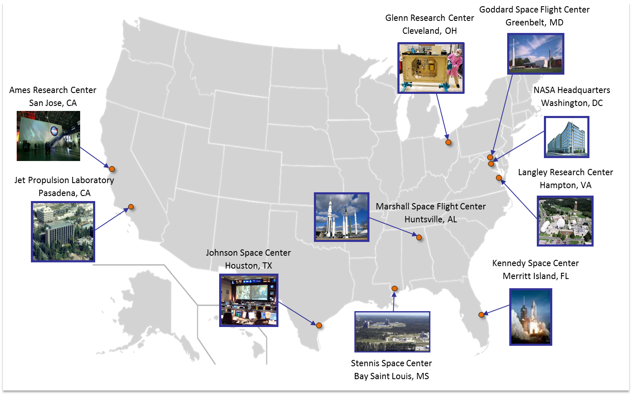
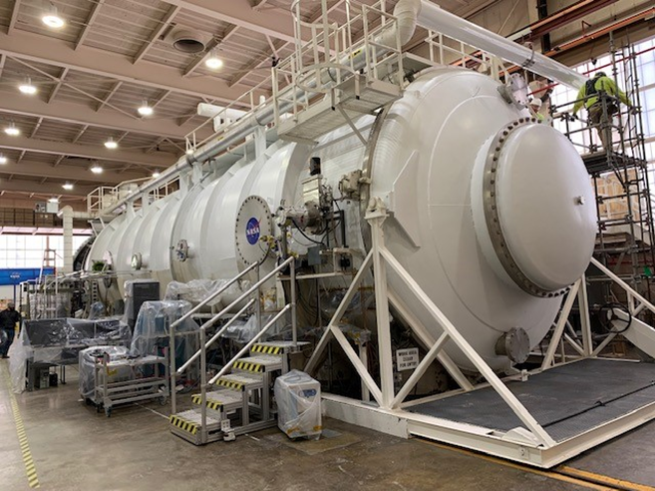
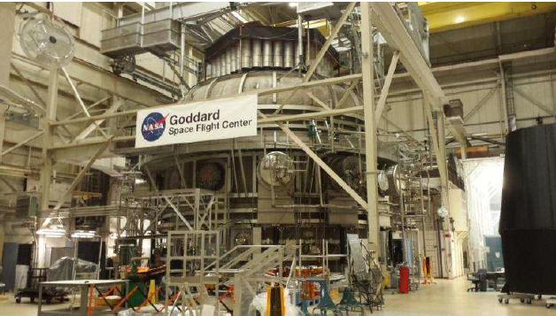
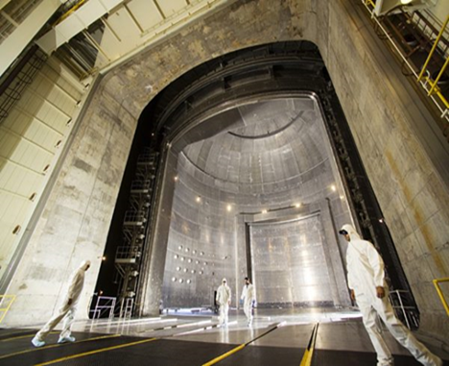
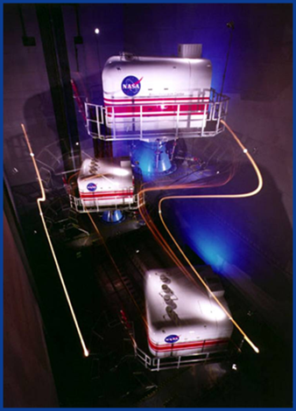
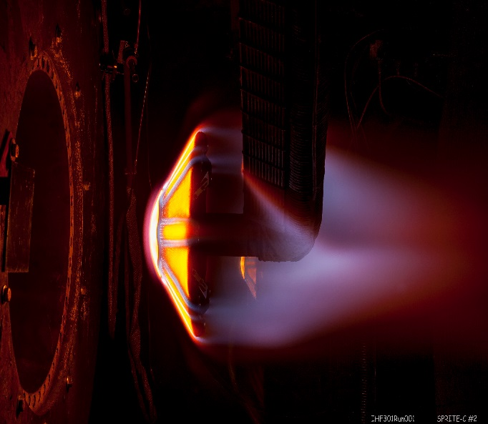
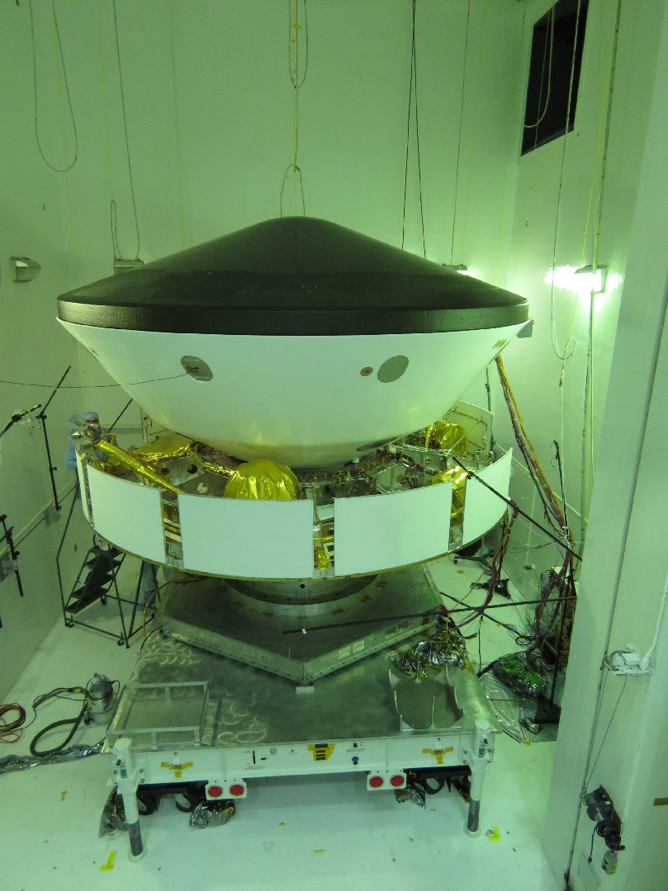
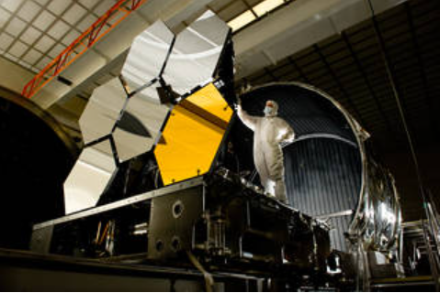
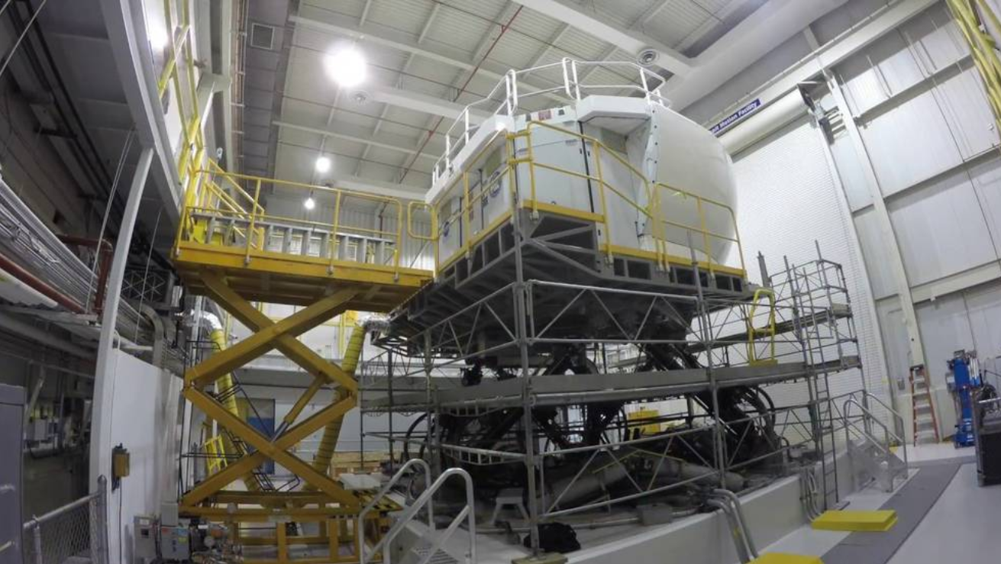
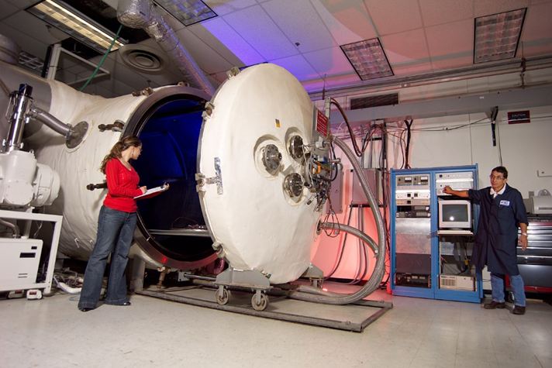
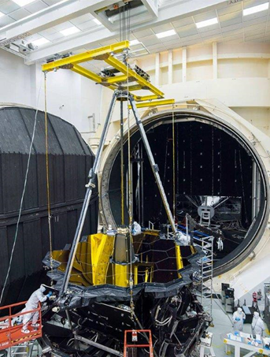
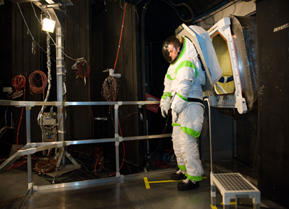
Armstrong Test Facility
NASA Headquarters
Armstrong Flight Research Center
Wallops Flight Facility
White Sands Test Facility
Stennis Space Center
Kennedy Space Center

Slide 6
Technical Capabilities Managed by SETMO
High Enthalpy Arc jet facilities study how high temperatures and vehicle velocities affect rockets and spacecraft as they exit and enter atmospheres on Earth and other planetary bodies in the solar system
Flight Simulation Fixed and motion research simulators model flight handling and control characteristics to aid in the development and design of improvements to current and next-generation aircraft and spacecraft
Space Environments Large-scale and other uniquely purposed chambers replicate extreme environments to certify performance of spacecraft, structures, components and instrumentation
External Radiation Research laboratories evaluate human and machine protections against high-energy radiation

Slide 7
NASA SETMO Condition and Health Assessment Approach Overview
Review the current conditions and health of our capability components
Identify maintenance and repair needs (areas of focus)
Review current operation processes and identify opportunities to optimize
Review the operational workforce and identify skill mix issues
Perform an estimated re-build/replacement value

Slide 8
Assessment Performance Goals
Un-biased independent review and opinions from outside experts
“Fresh set of eyes” in reviewing the capability components
Obtain periodic baseline and trending data
Identify items or issues that may have been missed when too “immersed in the day-to-day operation
Identify potential areas for optimization
Identify investment needs and areas of focus
Gather information for cost-risk trades
Provide opportunity for other capability components to send observers to visit other sites and learn different operational techniques

Slide 9
Assessment Performance Values and Examples
Any critical safety issues identified were worked immediately
Assessment identified LN2 dewars (15,000 gals) that were failing, and the capability component were unable to obtain funding. With the assessment report, we were able to work with the Center and agreed on cost sharing to replaced the dewars
Capability component was identified in 2009/2010 as no potential future need at the conclusion of JWST mirror calibrations campaign there in 2012/2013. The assessment provided costs to rebuild and minimum workforce sustainment requirements which helped to advocate for resources needed to bridge gaps during low utilizations

Slide 10
Lessons Learned and Observations
Many of the NASA SETMO capability components are under-utilized
  Some are designed to investigate the effects of a unique environmental exposure and not adaptable for other use
  Some are reluctant to bring “outside” work that could jeopardize unique attributes or capability or availability
Each NASA site have common test equipment, however, most have tailored their collection of test assets to accommodate specific product lines

Slide 11
Future work
Currently, assessments are at 5 to 6 year cycle
  Find the right cadence
Increase insights into system level health
Better estimates of resources required to maintain a capability components
Improve/incorporate risk-based approach to investments
Opportunities to optimize operations, increase utilization, and reduce costs
Evaluate opportunities to reduce un-needed capability components

Slide 12
Questions ?

