Slide 1

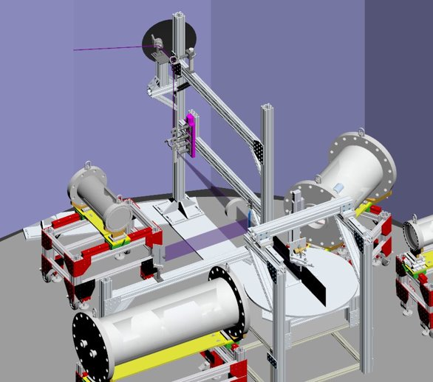
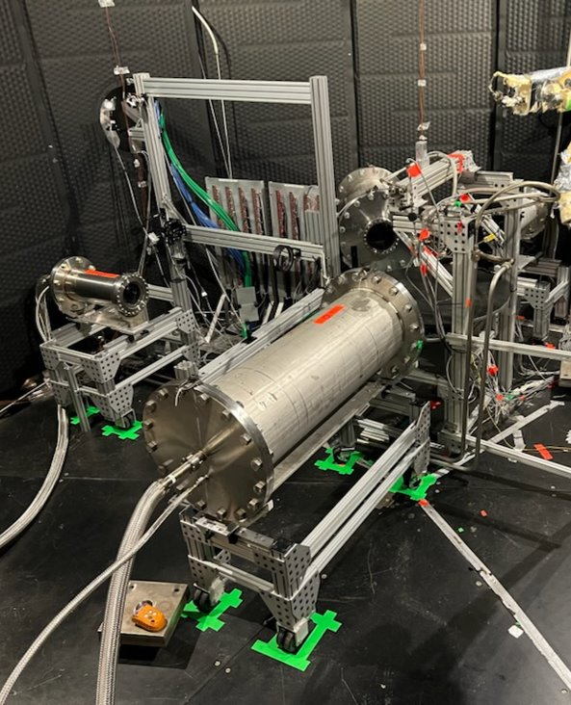
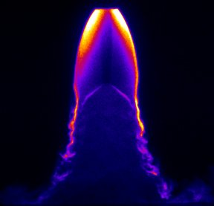
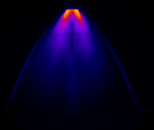
Plume-Surface Interaction at NASA Marshall
Planar Laser Induced Fluorescence (PLIF) with seeded nitric oxide was performed at NASA Marshall Space Flight Center in a 20-ft vacuum chamber.
Plume structure measurements were made within relevant lunar and Martian environments at a variety of flow conditions.
The test is part of the STMD/ESDMD Plume Surface Interaction project, led by Dr. Ashley Korzun (LARC-D205).
The test effort lasted 13 weeks (May – July) and involved thorough planning, preparation, and lab testing over many months prior to integration at the facility.
Olivia Tyrrell (NIA Associate Research Engineer, LARC-D304) completed camera view and CAD visualizations throughout the pre-test planning and spent six weeks in Huntsville during the test effort, assisting Drs. Neil Rodrigues and Paul Danehy (LARC-D304) with setup, test operation, and data collection.
This data provides the first laser-based flow measurements obtained at the test facility.
The resulting flow visualizations will provide highly valuable, novel information about plume flow physics in relevant future lunar and Martian landing environments.
CAD visualization of experimental setup inside 20-ft. vacuum chamber.
Actual experimental setup inside 20-ft. chamber.
Single PLIF image collected at high Reynolds number in Martian-like pressure environment.
Sequence of PLIF images collected at high Reynolds number, ultra-low pressure and varying nozzle height.

