Slide 1
Environmental testing contamination sensitive instruments and optics in non-cleanliness-controlled facilities
SPIE OPTICS + PHOTONICS 2022
21-25 August 2022
Craig Jones
KBR

Slide 2
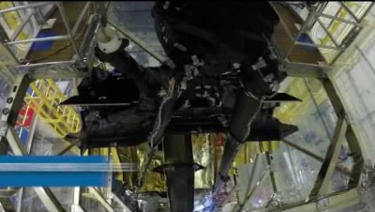
Credit: NASA Goddard Space Flight Center

Slide 3
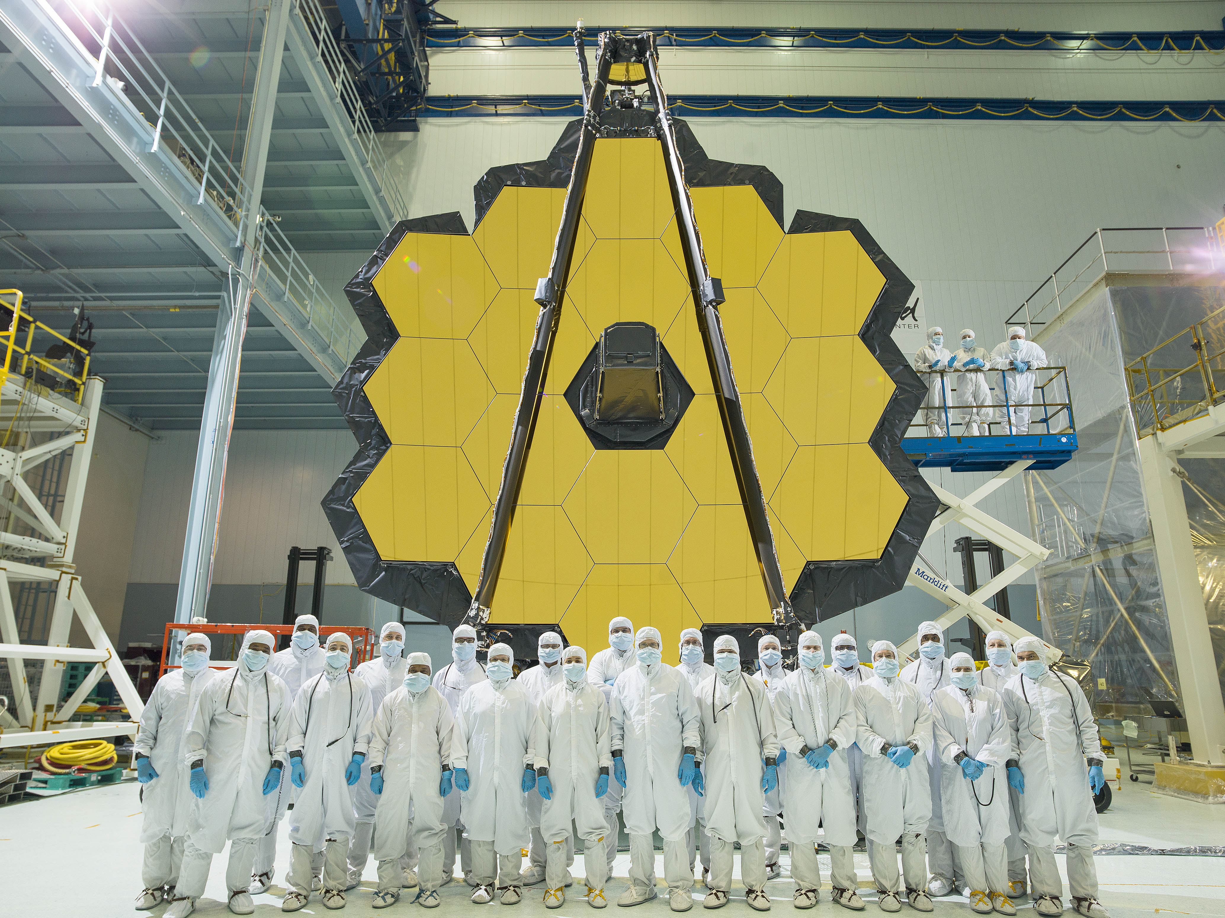
Co- Authors
Eve Wooldridge
NASA
Alan Abeel
NASA
Colette Lepage
Peraton

Slide 4
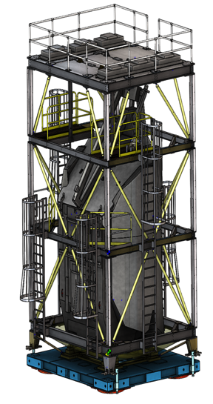
OTIS Tent
The purpose for this enclosure was to keep contamination control requirements intact during environmental testing at Goddard Space Flight center.
Our core design team for this enclosure included Contamination, Mechanical, and structural analysis engineers.
Included in the design are three levels. On levels two and three allow clean entry access into enclosure.
Enclosure dimensions are 17.90’W X 15.58’L X 30.81’H

Slide 5
Construction of the OTIS enclosure consisted of:
Five bolted on ladders, removable for acoustic and vibration testing
Six 2’ X 4’ HEPA filter modules in the celling.
Handrailing on top for lifting operations and HEPA filter installation.
Two platforms on level 3 for access to lifting points and contamination sample placement for OTIS.
Two small platforms on level 2 for access to lifting points and contamination sample placement for OTIS.

Slide 6
Enclosure material used for protection of OTIS
Cleanroom approved polyurethane material for the most outer layer
Dunshield bagging material
Melinex for clear visibility during lifting operations

Slide 7
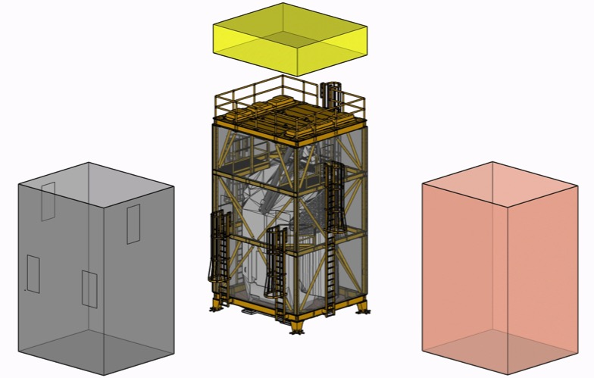
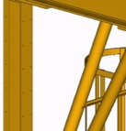
Enclosure material used for protection of OTIS
Yarmulke Bagging
HEPA/charcoal
filters
Bagging Layer Stack up
Melinex
(3)
Tent
Frame
Dunshield
(2)
Poly
(1)
Dunshield & Melinex
Layer Bagging
Poly Layer Bagging
Melinex Windows

Slide 8
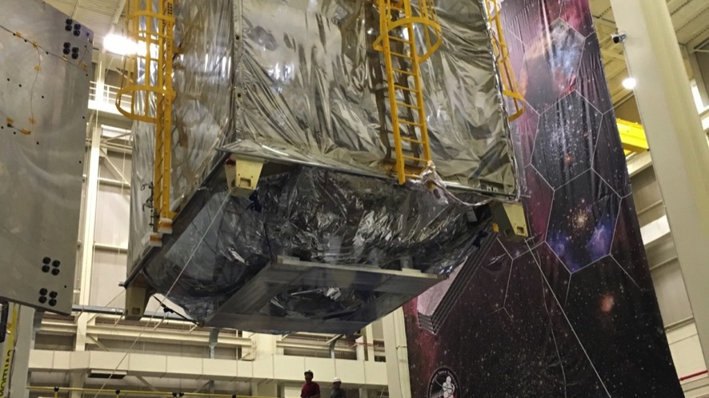
Credit: Chris Gunn photo/image
Diaper

Slide 9
Contamination monitoring and sampling

Slide 10
HEPA filter evaluation process
Checking for leaks, physical damage of the HEPA filter itself.
Checking to see if the HEPA filter seated properly in place.
Checking particle counts using an “in specification” calibrated particle counter.
Checking the velocity of the clean air from the HEPA filter units.

Slide 11
OTIS enclosure air velocity data
Measurement Location | Air velocity (ft/min)
Filter #1 west | 128
Filter #1 center | 170
Filter #1a | 41
Filter #2 west | 87
Filter #2 center | 101
Filter #2a | 37
Filter #3 west | 83
Filter #3 center | 54
Filter #4 west | 120
Filter #4 center | 325
Filter #4a | 25
Filter #5 west | 80
Filter #5 center | 260
Filter #5a | 29
Filter #6 west | 101
Filter #6 center | 45
+V1
Filter #3
Filter #6
No access to filter #3 and #6 from this point
Filter #2a
Filter #5a
BEAM
-V2
Spike
Filter #2
Filter #5
Filter #1a
Filter #4a
BEAM
Filter #1
Filter #4

Slide 12
Leak test: Air particle counts
OTIS enclosure air particle count data
All air particle counts are better than Class 500.
An unrepairable spike on Filter #2 remained, however, the particle counts were lower compared to the first leak check, and the spike is on the edge behind the mirrors – therefore acceptable.
The spike that appeared on Filter #6 during the first leak check is no longer apparent.
Overall, counts were consistently lower compared to the last leak check.
Particle Count Location | 0.3 µm/ft³ | 0.5 µm/ft³ | 1 µm/ft³ | 5 µm/ft³
Filter #4 near cross beam | 95 | 22 | 9 | 0
Filter #4 | 20 | 3 | 0 | 0
Filter #4 near cross beam | 102 | 37 | 13 | 0
Filter #4 A | 289 | 126 | 63 | 0
Filter #5 | 22 | 6 | 3 | 0
Filter #5 | 1039 | 60 | 16 | 0
Filter #5 near cross beam | 195 | 8 | 0 | 0
Filter #5A | 99 | 15 | 5 | 0
Filter #6 | 41 | 1 | 1 | 0
Platform door opened | 90 | 12 | 4 | 0
Platform door closed but cracked slightly open at bottom | 146 | 21 | 8 | 0
Middle of tent on platform | 74 | 13 | 6 | 0
Middle of tent on platform | 72 | 13 | 2 | 0
Middle of tent on platform | 81 | 8 | 3 | 0
Base of tent at air outlet +V2 side | 76 | 4 | 1 | 1
Base of tent at air outlet +V2 side | 103 | 7 | 0 | 0
Base of tent at air outlet -V1 side | 78 | 2 | 0 | 0
Base of tent at air outlet -V2 side | 93 | 4 | 1 | 0
Base of tent at air outlet +V1 side | 46 | 3 | 1 | 0
Particle Count Location | 0.3 µm/ft³ | 0.5 µm/ft³ | 1 µm/ft³ | 5 µm/ft³
Filter #1 | 45 | 21 | 9 | 1
Filter #1 near cross beam | 69 | 19 | 5 | 0
Filter #1a | 167 | 54 | 19 | 0
Filter #2 | 78 | 6 | 0 | 0
Filter #2 SPIKE | 1893 | 135 | 25 | 0
Filter #2 SPIKE | 3609 | 247 | 45 | 0
Filter #2 SPIKE | 4464 | 380 | 85 | 0
Filter #2 near cross beam | 50 | 3 | 1 | 1
Platform door opened | 104 | 22 | 6 | 0
Platform door closed but cracked slightly open at bottom | 453 | 51 | 16 | 1
Middle of tent on platform | 127 | 38 | 18 | 1
Middle of tent on platform | 75 | 12 | 5 | 0
Middle of tent on platform | 59 | 7 | 2 | 0
Filter #3 only half | 8 | 1 | 0 | 0

Slide 13
Acoustic Dry Run #1

Slide 14
Diagram of sample locations
Placement - Just before tent is installed over OTIS
Removal - Just after tent is removed from OTIS
  Gel-paks for particulate fallout
    Level 3 platforms, 1 Gel-paks each
    Level 2 platforms, 1 Gel-paks each
    Ledges, 8 Gel-pak on mirror sides
  Foils for molecular accumulation
Level 3 Platforms
Level 2 Platforms
Ledges
Ledges

Slide 15
Particle fallout: #1 acoustic testing
All samples contained Al and Al anodized particles.
Second test set up after ceiling and sources of metallic particulate covered.
Acoustic Budget Fallout

Slide 16
Acoustic Dry Run #2

Slide 17
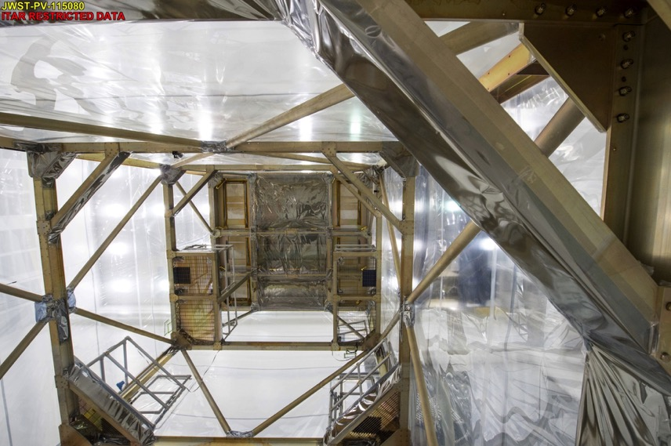
HEPA filters re-tested, metal connections & ceilings covered
ddddddddddddd
Credit: Chris Gunn photo/image
Tent Filters
Metal connections covered

Slide 18
Particle fallout: 2nd acoustic testing
Much better. Counts are good and no metallic particulate observed.
Tent is good to go!
Acoustic Budget Fallout

Slide 19
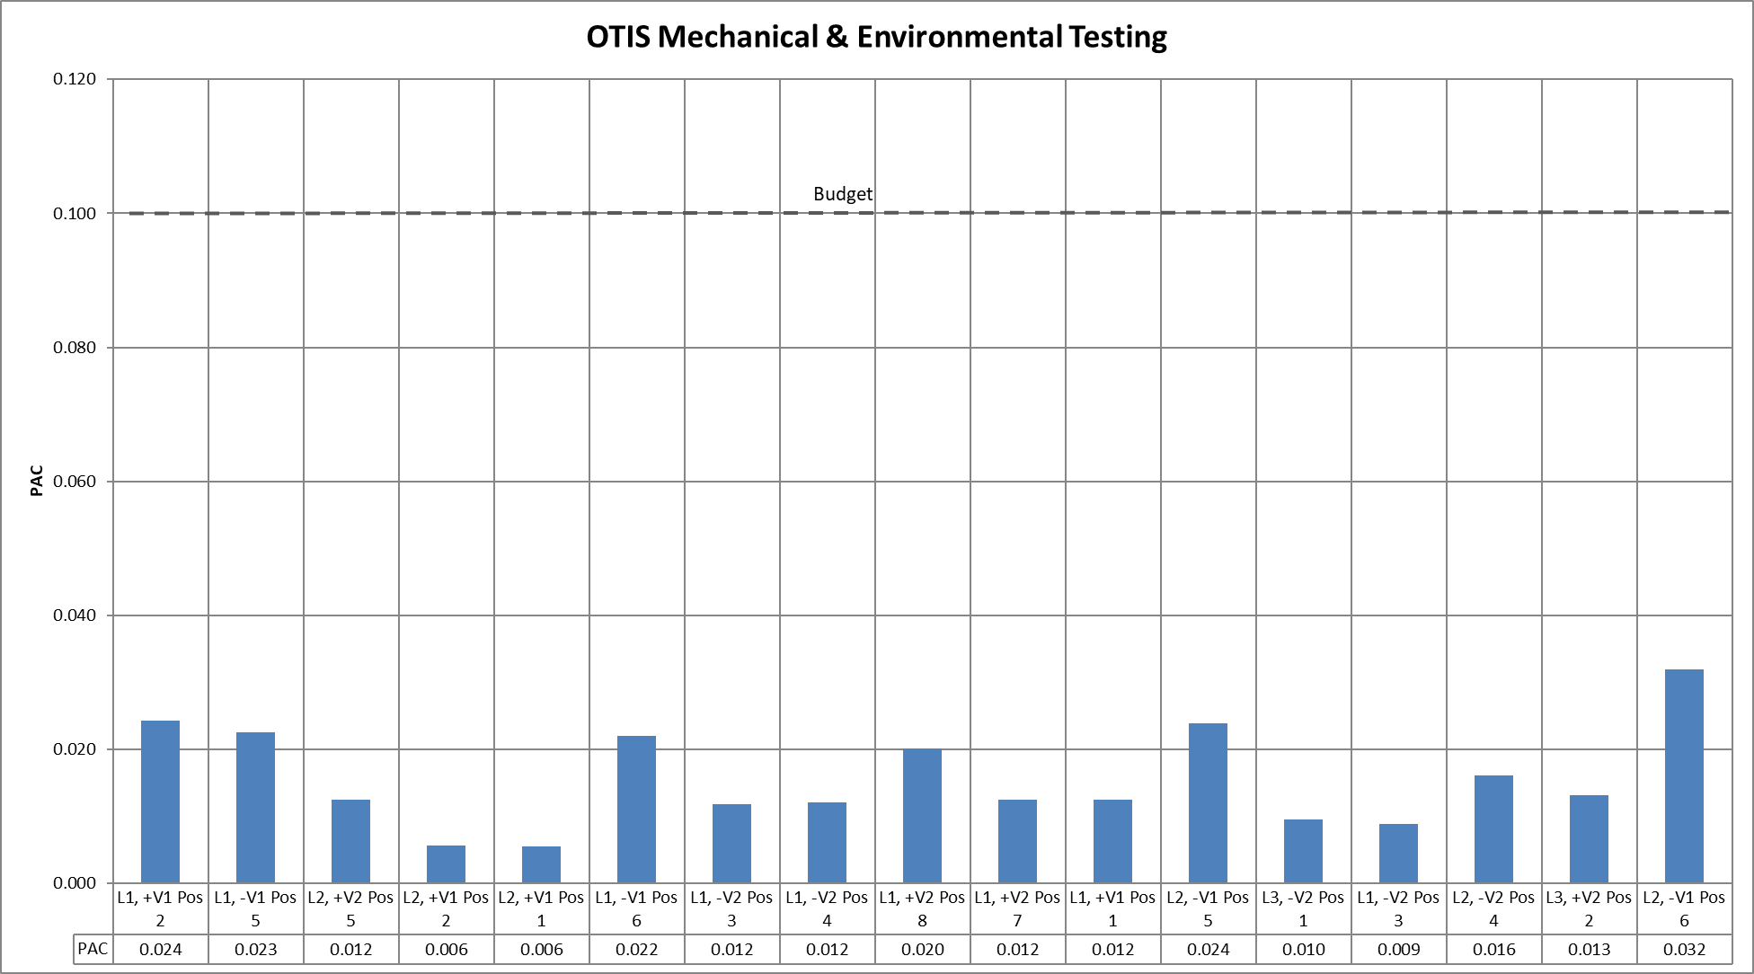
Fallout Budget after all Testing

Slide 20
Lessons learned
Be prepared for worst case scenarios:
A plan of 2 weeks turn into over 3 months.
Dry Run Test #2 data enabled the CC team to confidently respond that the OTIS would be well-protected against contamination for a longer period.
Final results confirmed this in the 2nd acoustic test, and proved to be priceless.
Walk through each process step to account for every detail:
For example, scrutinizing the process showed Dunshield and Melinex were the optimum films, but the outer polyethylene layer was needed to keep the Dunshield layer clean to re-enter the cleanroom for acoustic reconfiguration.
After testing, the enclosure was again moved into the cleanroom. At that point, the Dunshield layer was removed.

Slide 21
Summary
The extensive planning and testing put into the OTIS clean tent enclosure, with excellent collaboration between the OTIS mechanical and contamination control groups, were well-rewarded with the exceptional particulate contamination results.
Average particle fallout accumulation of 0.016 PAC, and none of the individual wafers showed a deposition greater than 32% of the allocation despite the extended time inside of the enclosure.

Slide 22
Credit: Chris Gunn photo/image

Slide 23
Acknowledgements
Darian Robbins, Christopher Gunn, Carol Jones, Sandra Irish, Kenny Harris, Eric Johnson, Daniel Alvarado, Frank Jenkins, Diane Schuster, Sierra Lobo CC technician team, JWST Mechanical technician team, Kristin McKittrick, Christopher Hoffman

