Slide 1
Necessity for professionally trained CC technicians to support the James Webb Space Telescope integration, testing and launch campaign
Raymond LeVesque, presenter
KBR, Inc.
Edwin Goldman
Prime Science and Technology,
Baltimore, MD, 21201
Eve M. Wooldridge,
NASA Goddard Space Flight Center, Greenbelt, MD, 20771
Colette D. Lepage, Azuka J. Harbor
Peraton, Greenbelt, MD, 20770
Kelly Henderson-Nelson, Jason E. Durner
KBR, Inc., Fulton, MD, 20759

Slide 2
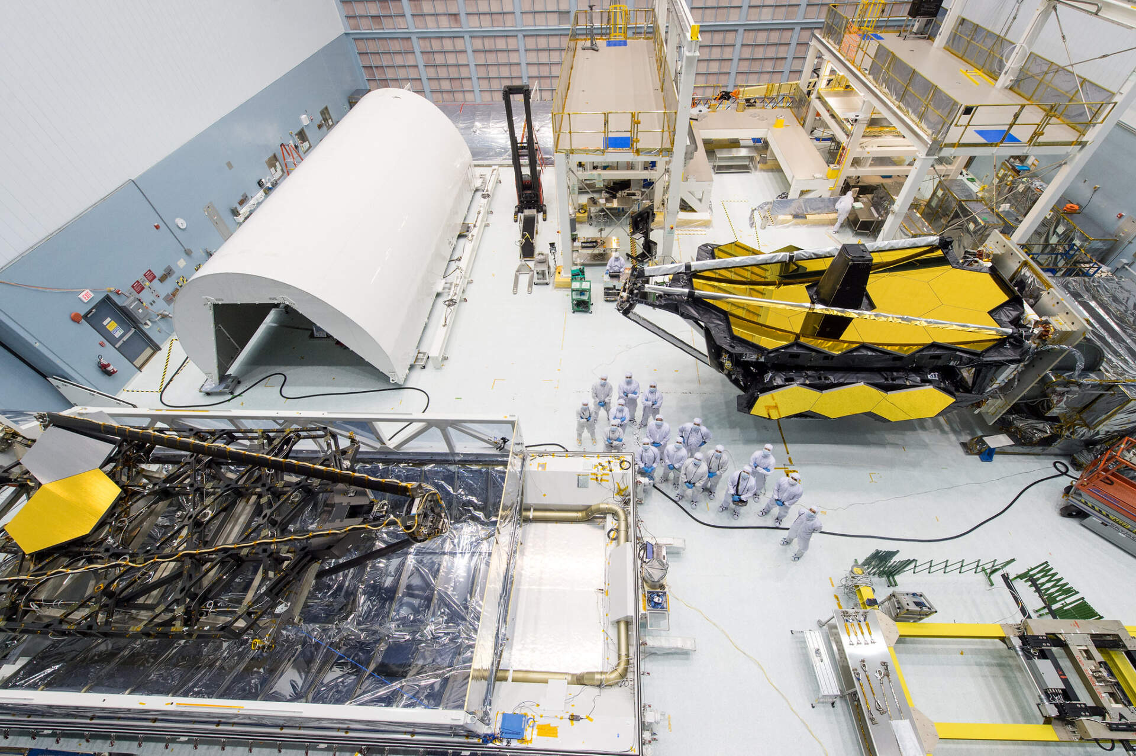
Introduction
Webb’s Contamination Challenges
The usual issues & more
Very low End-Of-Life (EOL) particulate and molecular limits
Specialized facilities scattered all over the planet
A long, arduous Integration & Test (I&T) campaign over 15+ years
(Credit: NASA/GSFC)
ESA/NASA/Don Pettit

Slide 3
Industry Standard Approach
Janitorial staff daily maintenance is key to good cleanroom operations
Vacuum and mop floors (avoiding hardware)
Empty trash cans
Pull dirty tacky mats
Clean return air registers
This allows discipline specialists to focus on their work, not the cleanroom
Electrical I&T focuses on routing their cables, not whether the floor is dirty
Mechanical I&T is less worried about using dirty tools
Metrology can install their delicate mirrors and optics without concern that they will be at risk from the cleanroom environment
Good outcomes arise from a team tasked to maintain facility cleanliness

Slide 4
Simple questions yielded complex answers
What Happens When . . .
Electrical I&T needs to route SpaceWire, a delicate specialized cable?
Ground Support Equipment (GSE) arrives dripping with cutting fluid, metal cuttings, grease and peeling paint?
Mechanical I&T needs to chase the threads on a mounting hole in a flight structure?
Metrology brings in delicate, expensive laser trackers and mirrors that are visibly dusty?
Delicate, one-of-a-kind flight hardware needs to be inspected and cleaned?

Slide 5
A Cleanroom versus what lives there
Janitorial service staff are integral to a well-functioning cleanroom
Keep the facility in good operational condition
Generally, janitorial staff lack training for sensitive hardware work
Safe handling of specialized hardware, like SpaceWire cables
Electrostatic Discharge (ESD) protocols
Hands on cleaning knowledge for flight parts, laser trackers & so on
Webb bridged this gap with specially trained, dedicated contamination control technicians (CCTs)

Slide 6
Specialized CC Technicians
Goddard Space Flight Center (GSFC) has a cadre of specially trained CCTs supporting programs in many cleanrooms on Center
While Webb hardware was at GSFC it used these specialized CCTs
When Webb left GSFC, some CCTs traveled with it; others were hired & carefully trained at each location along its journey to launch
Careful hiring and On-the-Job training were key to building effective CCT Teams for this sensitive observatory
“Familiarity breeds Respect” - Knowledge of the Project
Invests crew members in mission success
Equips them to better tackle what arises
Enables them to be flexible and collaborate in solving problems

Slide 7
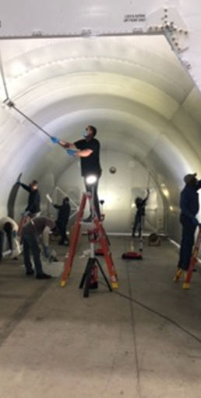
Benefits of Specialized CCTs
Cleaning of the Webb transporter
Dedicated Webb CCTs traveled to OH from AZ, TX, CA and MD
This familiar, cohesive team made quick work of a huge task
Quickly knew how to collaborate and resolve new, unexpected situations
Understood how this would interact with the precious cargo that it would carry to the South American launch site
Managed logistics for cleaning supplies
(Credit: NASA/GSFC)

Slide 8
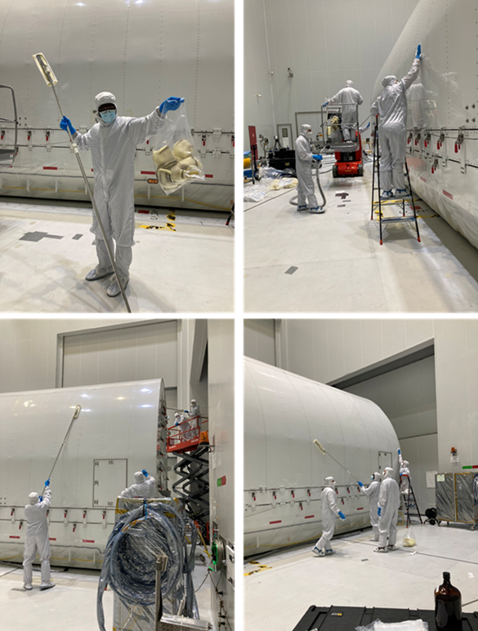
Benefits of Specialized CCTs, continued
Consistency, Efficiency
Webb CCTs cleaned Transporter for entry to Webb cleanroom
Webb CCTs cleaned Transporter for entry to launch site cleanroom
Risk Reduction
Webb CCTs knew peculiar sensitivities of the Observatory
CCTs and CC engineers (CCEs) worked as a cohesive team to surface, discuss and resolve contamination issues
(Credits: NASA/GSFC)

Slide 9
The CCT training program
First Day on the Job
Walkdown of the Webb cleanroom
Cleanroom training specific to the facility
High-level training of Webb’s mission and its unique systems
After some time working on the Floor
Second review of Webb’s mission
Particles: Light scattering and throughput loss
Molecular: Altering absorptance, reflectance, emittance
Thermal impacts, emphasizing hot and cold sides of Observatory
Need to minimize heat transfer

Slide 10
Most training was On-the-Job
Various hardware & equipment entered/exited cleanroom each day
Each piece arriving at CCT workstation was unique, incompatible with a “one size fits all” cleaning approach
As effective as On-the-Job training proved to be, CCEs supplemented it with training packets on various subjects, including
Cleanroom garment gowning
Cleaning
Inspection
Hardware triaging techniques
Cleanroom design and operation
Types and sources of contamination
Identifying metal coatings

Slide 11
Identifying metal coatings
Problematic
Zinc
Galvanized
Cadmium
Black oxide
Tin
Cleaning cautions
Dry film lube
Acceptable
Stainless steel
Aluminum
Conversion Ctg.
Anodize
(Credit: NASA/GSFC)

Slide 12
Growing knowledge & capabilities
Solvent selection expedited cleaning operations, reduced problems
Flight hardware often arrived with cleaning guidance
GSE was a mixed bag, leaning on CCT, CCE experience
Painted, other coated surfaces
Multilayer Insulation, Tapes, Films
Webb CCEs, Lead CCTs learned their team’s strengths and provided options for new duties playing to these natural talents
Enhanced the team’s capabilities
Reduced some of the inherent tedium in the CCT role
Prepared CCTs to better handle new situations, which were many as Webb made its way to launch

Slide 13
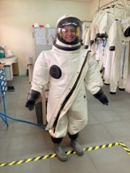
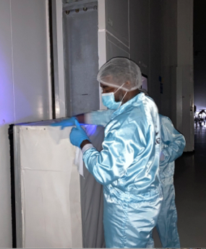
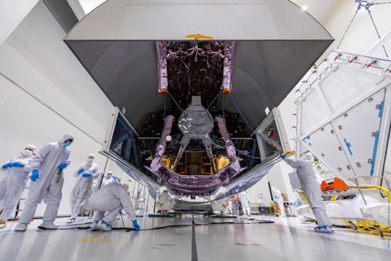
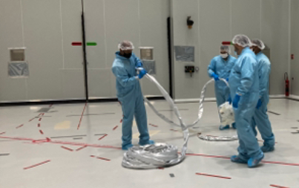
Expanded Capabilities
CCTs were identified as being well suited to key added duties
Image Analysis and Ellipsometry
Hardware management and logistics/tracking
Simultaneously supporting multiple I&T facilities
Adapting Launch site laundry facilities
SCAPE suit cleaning
(Credit: ESA/CNES/Arianespace/Optique Vidéo du CSG)
(Photo credits: BBC, ESA/CNES/Arianespace/Optique video du CSG)

Slide 14
Concluding Remarks
Webb repeatedly showed the benefits of specially trained CCTs
CCTs aligned with CC protocols, req’ts & hardware sensitivities
Fostered positive attitudes toward CC, earned trust & collaborated with other I&T disciplines
Achieved an order of magnitude reduction in cleanroom fallout
Augmented capabilities of many Webb partners
15+ years: The temperament, training & work ethic of Webb’s CCTs advanced work with ingenuity & integrity, ensuring every item on or near Webb was clean, providing additional margin on-orbit
The CCTs created a cooperative relationship with the I&T process that was an invaluable part of Webb’s spectacular success

Slide 15
Acknowledgments
The authors gratefully acknowledge support from NASA Contract NNG15CR64C and
NASA-GSFC Contamination Control Management
Eve Wooldridge, Randy Hedgeland, and Tina Montt de Garcia
NASA-GSFC OTIS Management
Lee Feinberg, Mark Voyton, Juli Lander

Slide 16
Thank you…
(Credit: NASA/GSFC)

