Slide 1




Wildfire Risk Support via Satellite-Derived Vegetation Health and Land Surface Model Soil Moisture
Jonathan L. Case*^{1,2}, Kevin K. Fuell^{2,3}, and Christopher R. Hain^{2,4}
¹ENSCO, Inc., ²Short-Term Prediction Research and Transition (SPoRT) Center
³University of Alabama – Huntsville
⁴NASA Marshall Space Flight Center
(Background: California’s 2021 Dixie Wildfire smoke plume during first author’s vacation)
21 August 2022
National Weather Association Annual Meeting 2022
Broadcaster Workshop

Slide 2
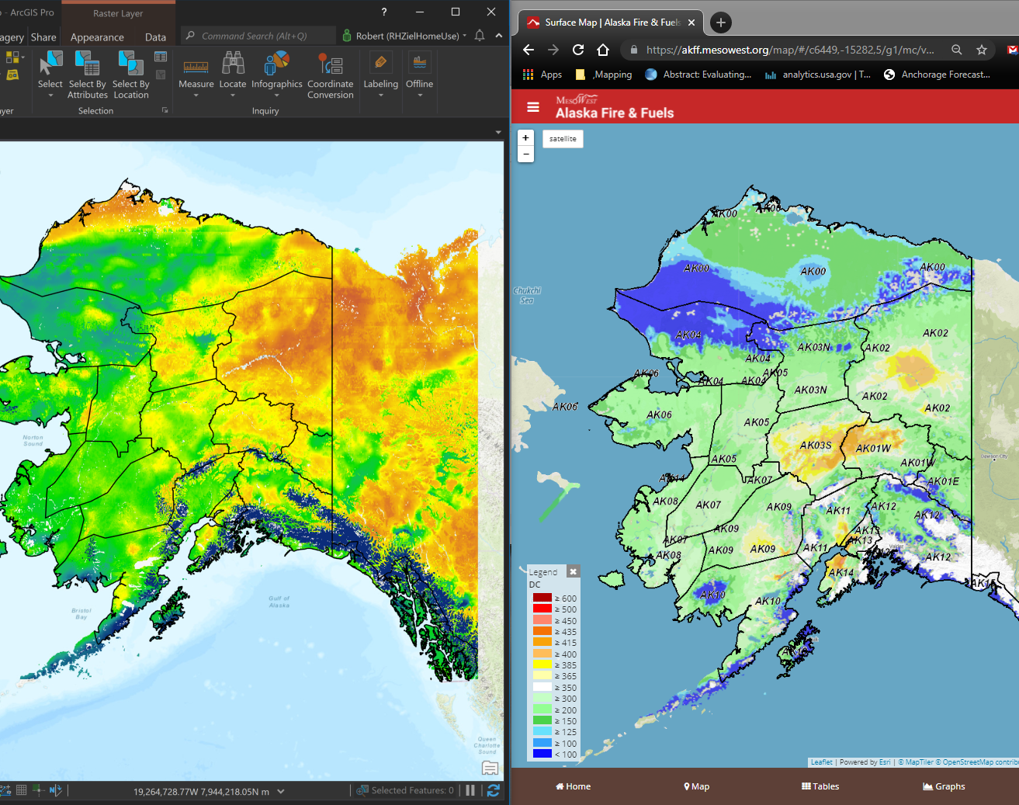
Wildfire Methods
SPoRT LIS 10-40 cm Relative Soil Moisture
Drought Code used in FWI System
Environmental Conditions Favoring Wildfire
Atmospheric conditions + sufficient supply of dry fuels (live and dead).
Wildfire Ratings and Indices
National Fire Danger Rating System (NFDRS) takes in account the weather, fuel type, live and dead fuel moisture models, and several indices.
Canadian Fire Weather Index (FWI) relies on weather to force various indices; used in AK & some northern states.
Note: The weather information is the primary input to the ratings and indices to indirectly determine fuel moisture and vegetation health
New Tools: NASA Land Information System (LIS) and Evaporative Stress Index (ESI) provide a direct estimate of surface and sub-surface moisture to impact dead/live fuel moisture and vegetation health.
LIS includes dynamic factors like infiltration rate to soil, retention of water, runoff, solar angle and insolation, etc.
Similar structure between LIS sub-surface soil moisture and the wildfire Drought Code

Slide 3
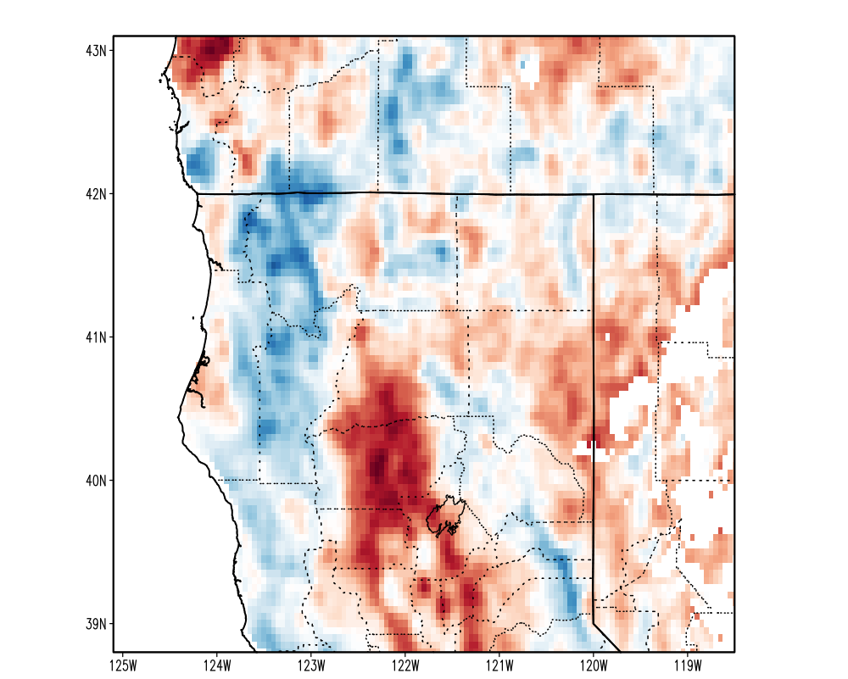
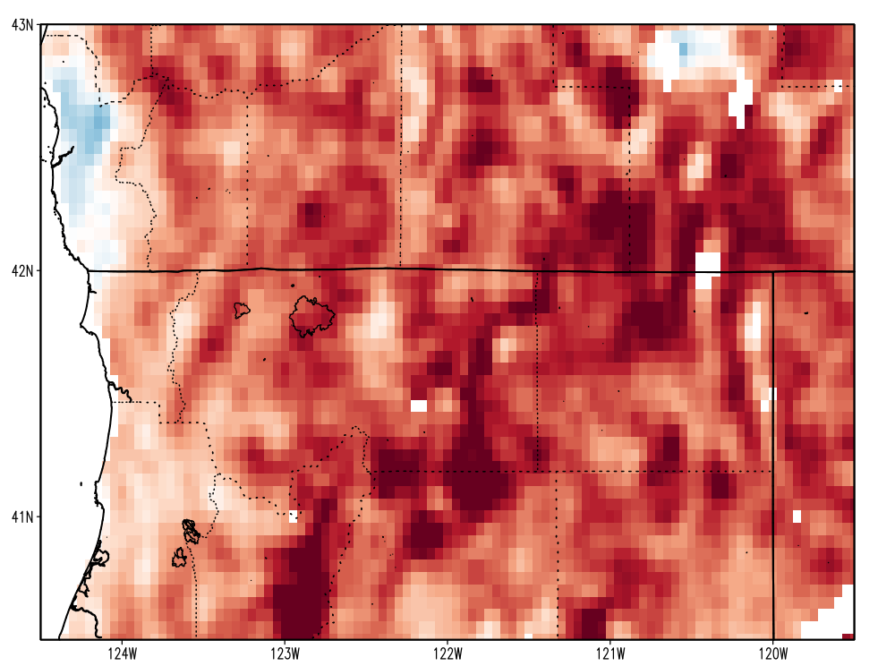
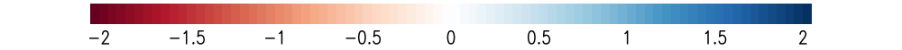
Evaporative Stress Index (ESI) to Monitor Vegetation Health
ESI represents temporal anomaly in ratio of actual ET to potential ET
Current surface moisture state is deduced directly from satellite Land Surface Temperatures (LST), which can detect stress before deterioration of vegetation cover
ESI may better represent “live fuel load” than remote sensing techniques such as NDVI, which focuses on how “green” or “brown” vegetation is
Stressed vegetation may be susceptible to rapid fire growth before “brownness” is observed in NDVI
Camp Fire; 8 Nov 2018
McKinney Fire; 28 Jul 2022
Four-week ESI change standardized anomalies for the (left) Camp Fire on 8 Nov 2018; and (right) McKinney Fire on 28 July 2022.

Slide 4
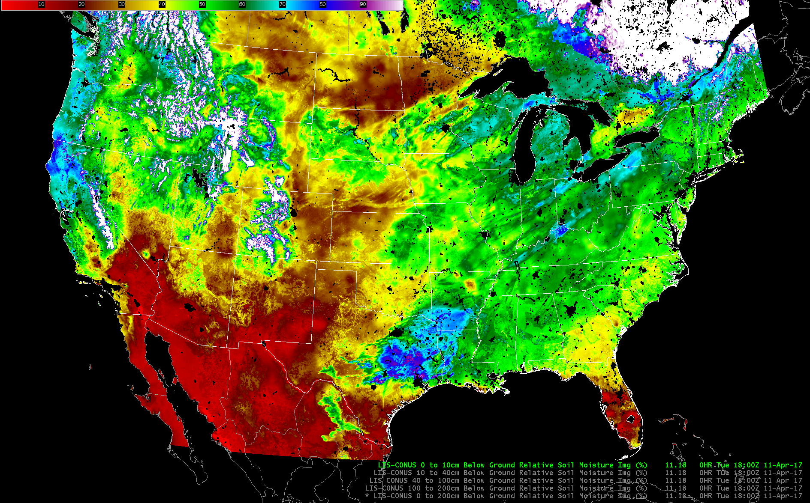
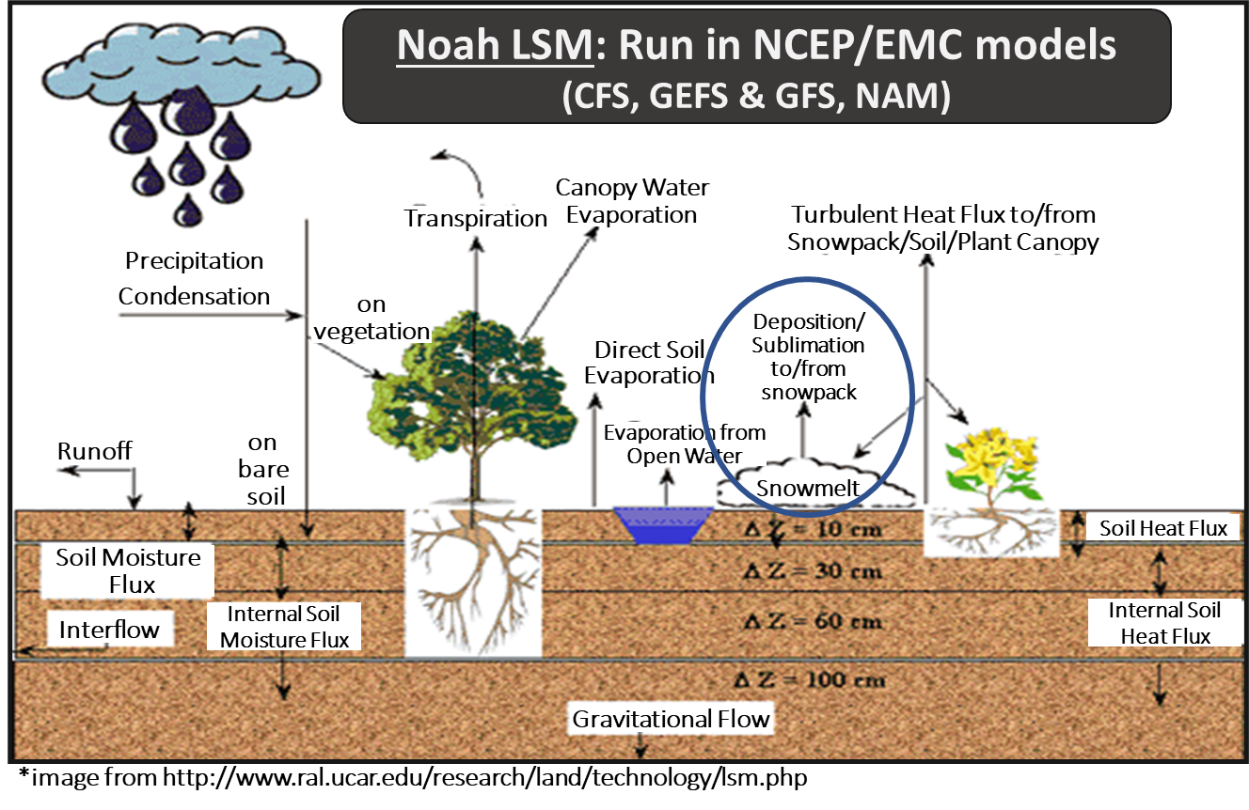
SPoRT-Land Information System (SPoRT-LIS)
Near real-time configuration of the NASA Land Information System (LIS)
Covers the full CONUS at ~3-km resolution (right image)
Hourly 0.125° NLDAS-2 analyses from climatology run to t – 4 days, based on ~4 day latency of NLDAS-2 analyses in real-time
Global Data Assimilation System (GDAS) short-term forecasts + NCEP/NSSL Multi-Radar Multi-Sensor (MRMS) from t – 4 days to t₀
Daily 1981-2013 soil moisture climatology and percentiles (bonus slide)
Incorporates daily real-time, global 4-km resolution VIIRS Green Vegetation Fraction (GVF)
Data available via web portal for [WRF model] initialization, geotiffs for GIS applications, web graphics for various zooms, and AWIPS II display
(Climatology)

Slide 5
Antecedent Soil Moisture and Wildfire
Challenging problem!
Soil moisture deficits tend to be present over widespread areas
Vast majority of wildfires are human-caused; difficult to anticipate from antecedent soils
SPoRT-LIS data suggest combination of shallow and deep soil moisture deficits coincide with elevated wildfire threat
SPoRT currently mining large database of lightning-initiated wildfires to develop relationships to land surface variables

Slide 6
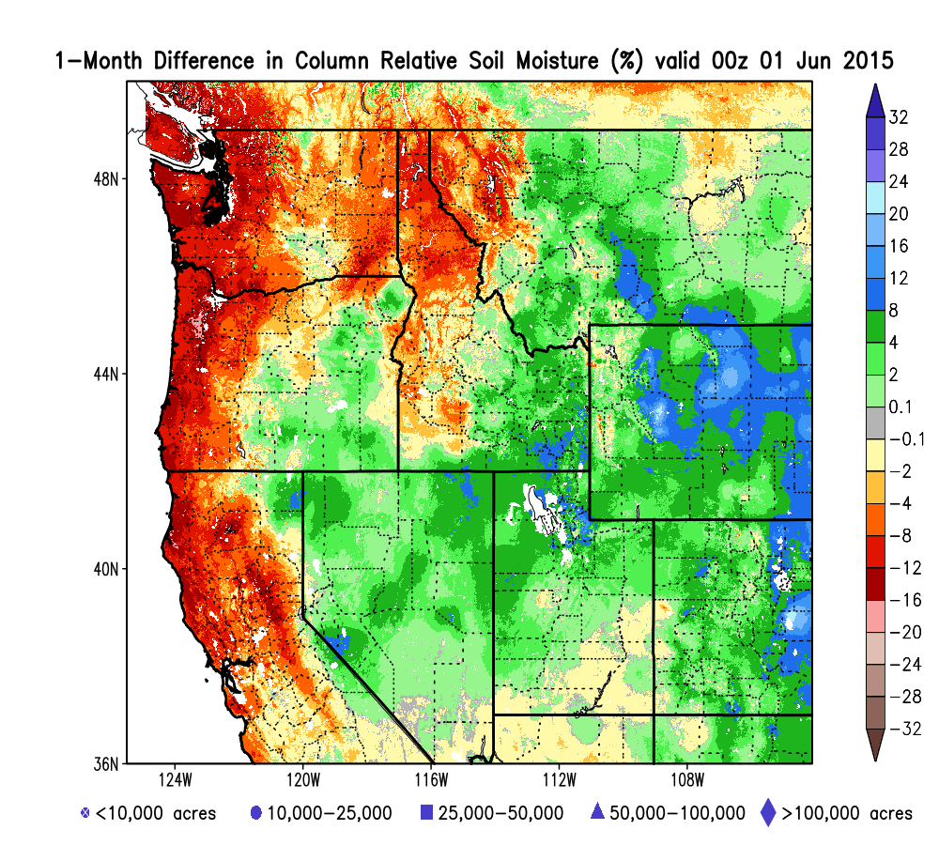
Antecedent Soil Moisture and Wildfire
Challenging problem!
Soil moisture deficits tend to be present over widespread areas
Vast majority of wildfires are human-caused; difficult to anticipate from antecedent soils
SPoRT-LIS data suggest combination of shallow and deep soil moisture deficits coincide with elevated wildfire threat
SPoRT currently mining large database of lightning-initiated wildfires to develop relationships to land surface variables
(right) seasonal animation of 1-month soil moisture changes associated with wildfires
Notes:
Cannot anticipate triggers or fire start locations!

Slide 7
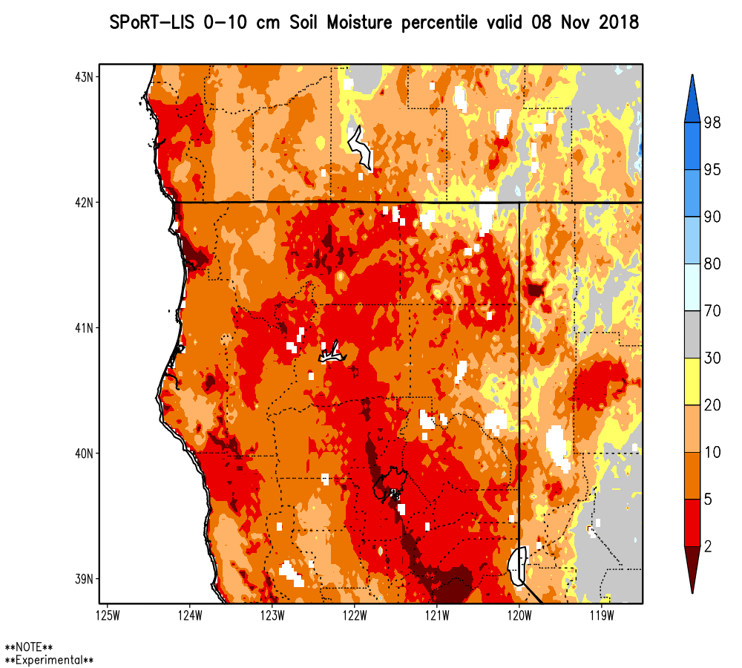
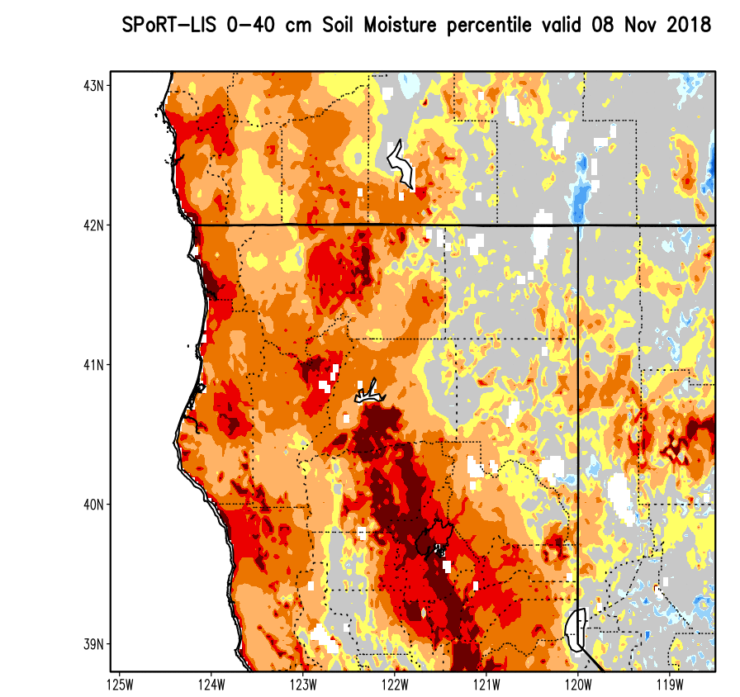
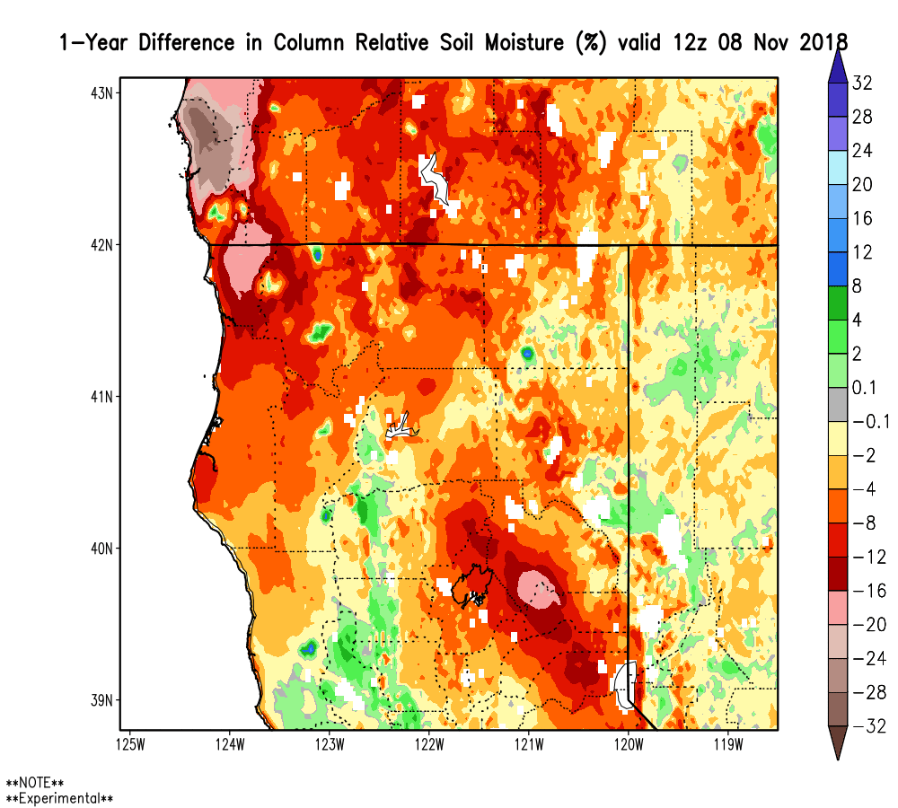
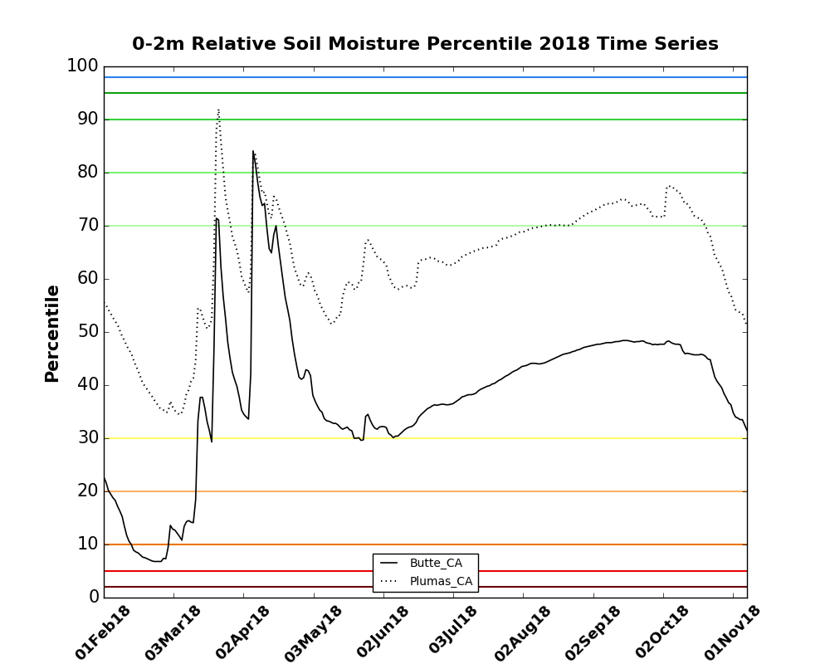
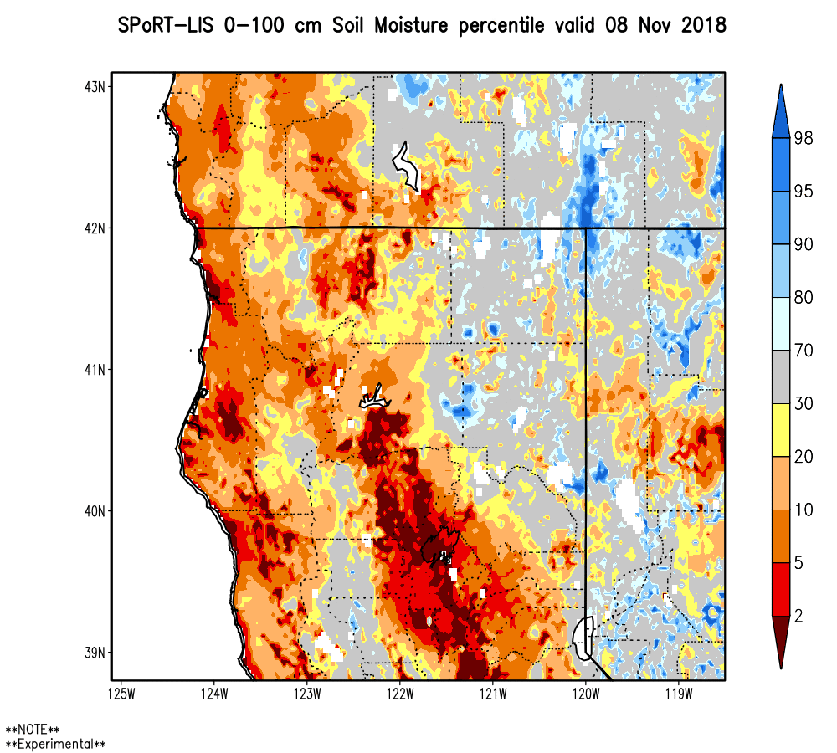
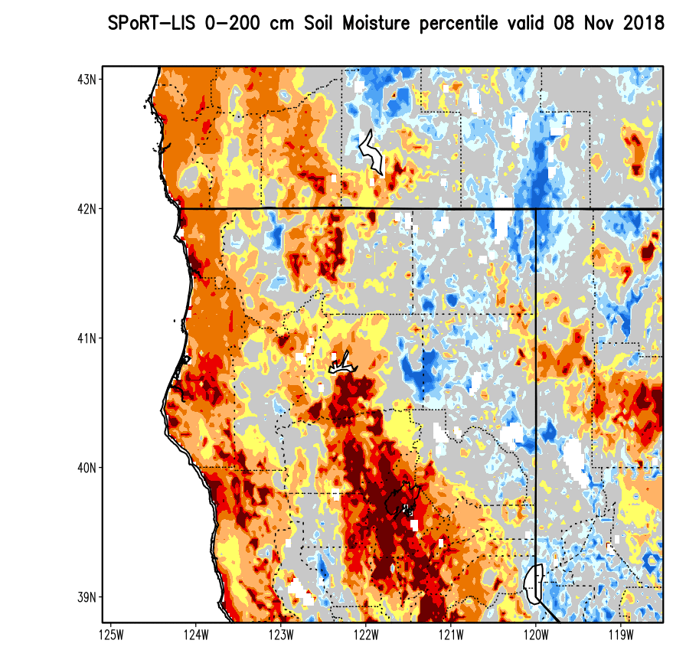
Antecedent Soil Moisture: Camp, CA Wildfire (Nov 2018)
0-10 cm
0-40 cm
Coincident dry anomalies of shallow and deep soil moisture
Substantial drying year-over-year
Bottom Line: Atypical levels of soil dryness in both shallow and deep layers
0-100 cm
0-200 cm

Slide 8
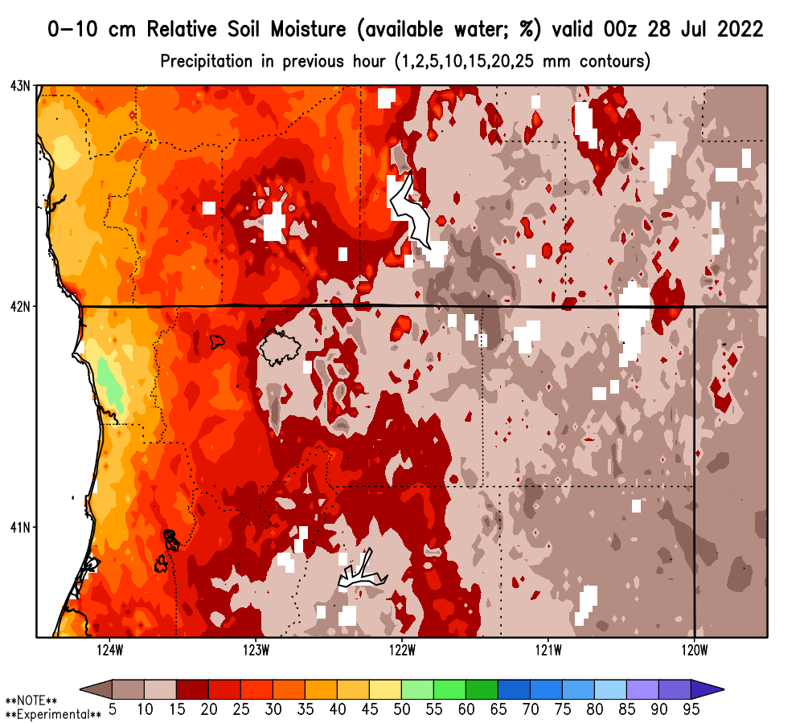
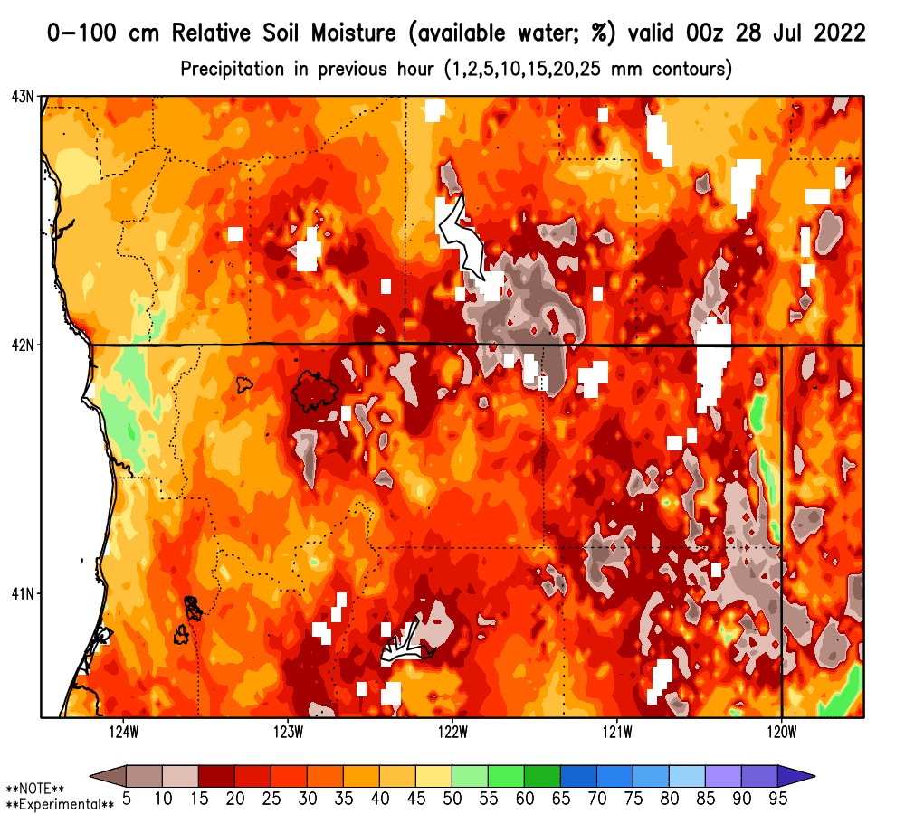
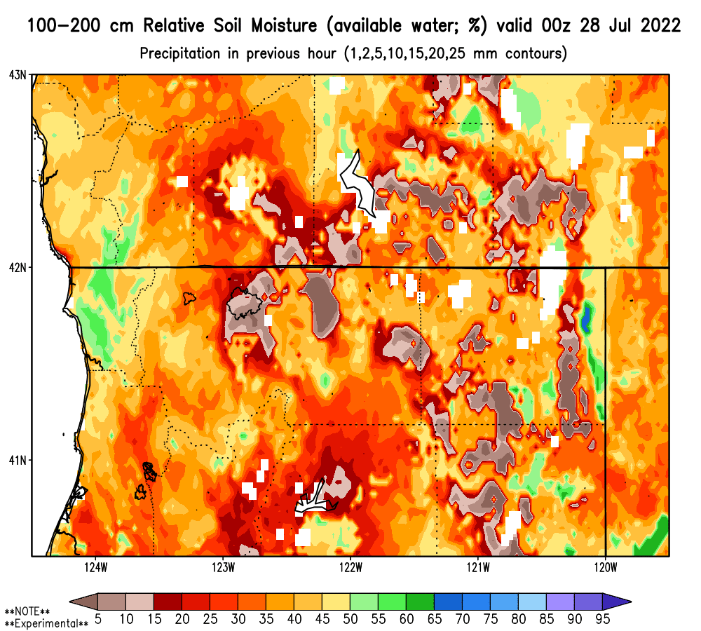
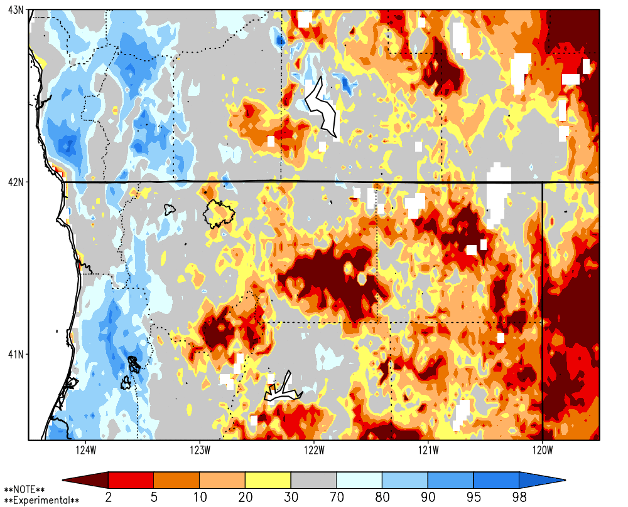
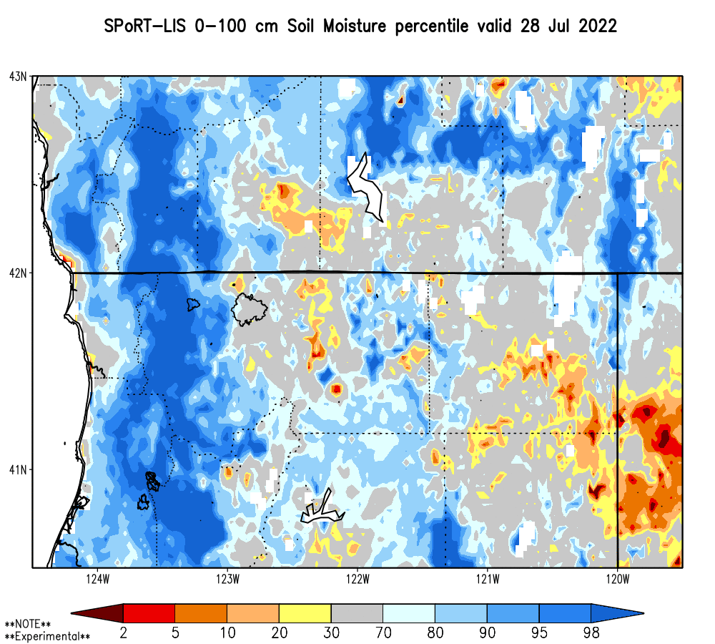
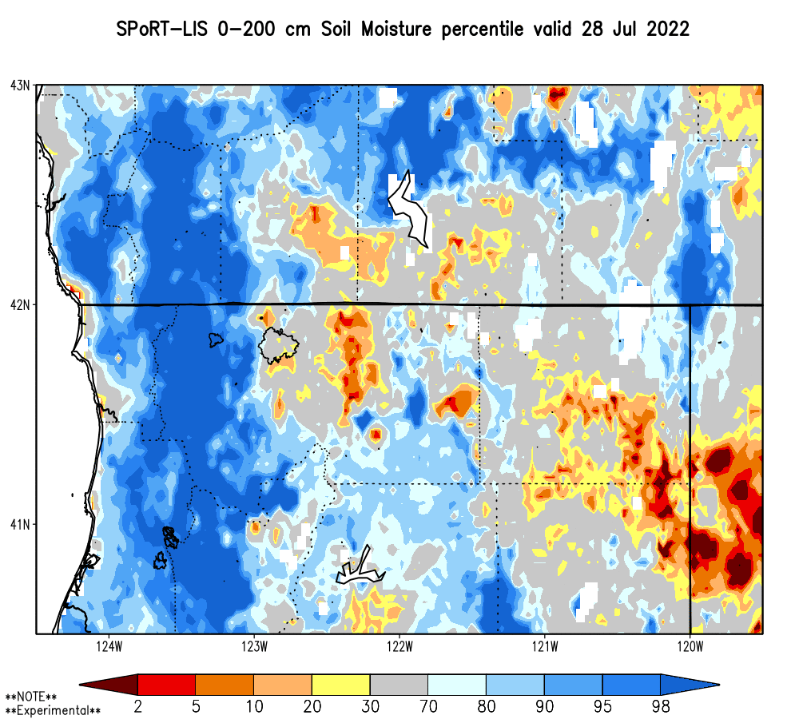
Antecedent Soil Moisture: McKinney, CA Wildfire (2022)
Relative
Soil Moisture (% saturation)
Locally dry soils in vicinity of wildfire initiation
Median to slightly drier than climo soil moisture
Bottom Line: Relatively typical levels of soil dryness; BUT locally drier, esp. in deeper soil layers.
Shallow Soil Moisture (0-10 cm)
Top One Meter Soil Moisture
Deep Soil Moisture
Soil Moisture Percentiles

Slide 9
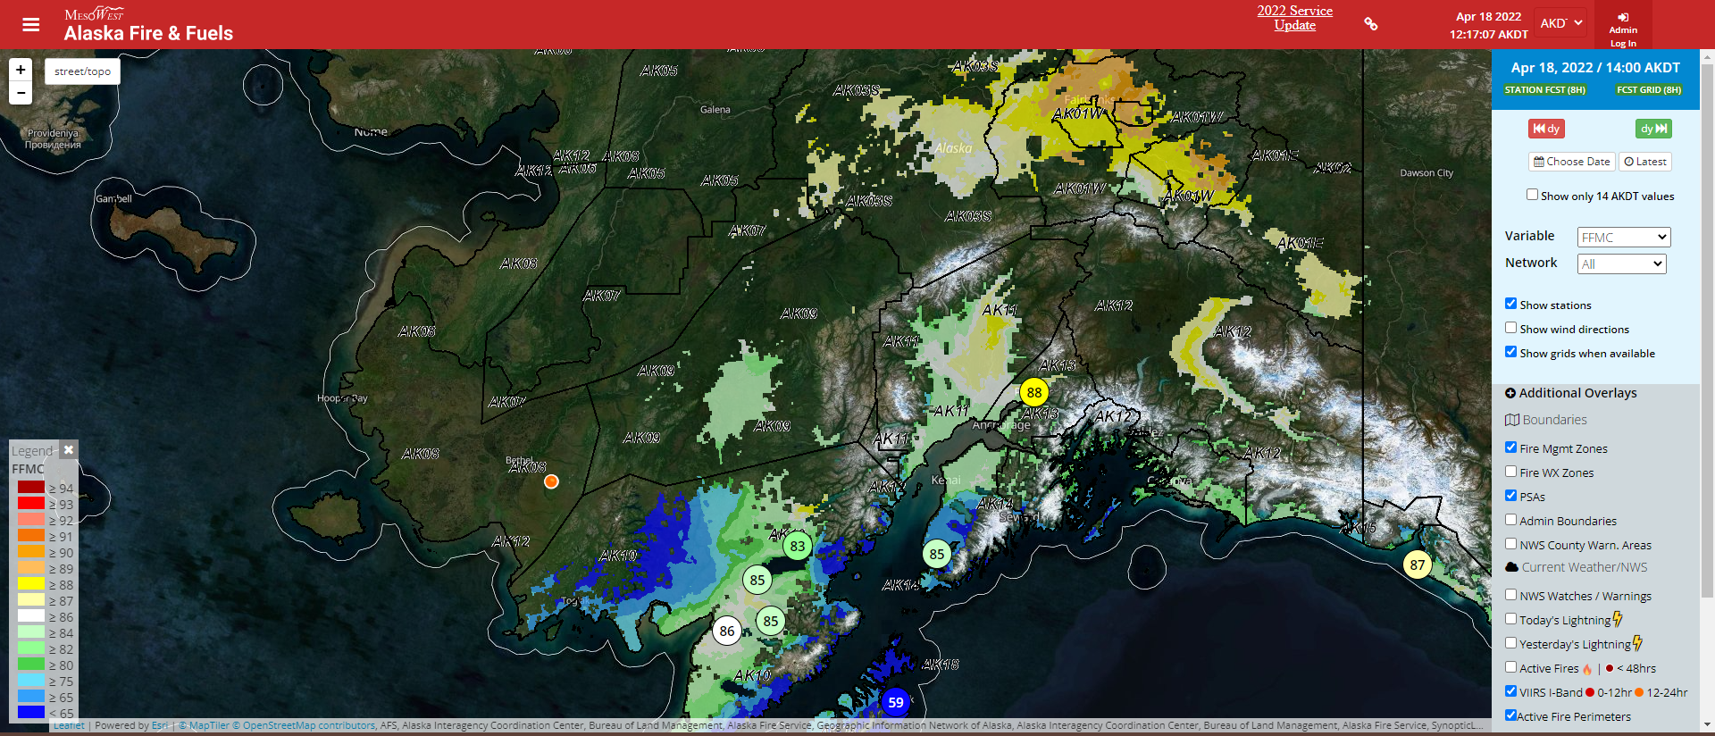
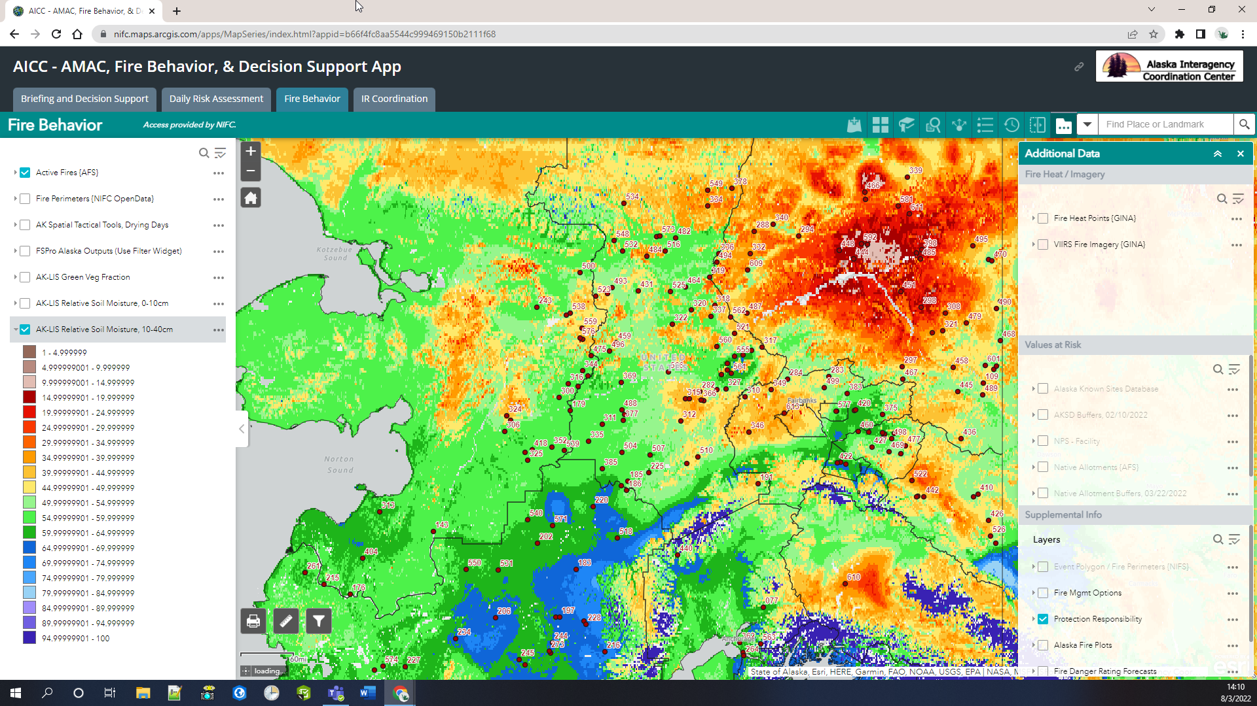
Impact & Access
False “snow - free” areas based on LIS - AK output
Early Season Application:
LIS snow cover, instead of climatology, was implemented by user in 2022 to start gridded Fine Fuel Moisture Code (FFMC) wildfire index.
Fire Fuel Analyst:
“I have used these outputs in a number of briefings to incoming teams, Multi-Agency Coordination Group, and other managers in conjunction with ‘traditional indices’ to describe the fire situation.”
Wildfire Program Mgr:
“Being informed by the NASA LIS-AK output reduces observational flights which cost money, are weather dependent, and carry risk to those participating.”
LIS soil moisture within GIS-based interface of AICC via REST Services as layer with other wildfire information (past fires shown)

Slide 10
Bonus Slides

Slide 11
Summary, Future, and Acknowledgements
SPoRT-LIS and ESI provide antecedent soil and vegetation stress conditions that can inform stakeholders on areas of enhanced wildfire threats
Ongoing applied research to examine land surface conditions favoring lightning-initiated wildfires
Future: Extending SPoRT-LIS into forecast, ensemble, and S2S realm
Two-week forecast soil moisture percentiles currently being generated
Data mining / machine learning models
NASA/SPoRT web: https://weather.msfc.nasa.gov/sport/
Twitter: @NASA_SPoRT Facebook: NASA.SPoRT
Acknowledgements: This research is funded by Dr. Tsengdar Lee of NASA HQ
Notes:
GACC: geographic area coordination center
My poster presentation is during the Monday session 4-6pm in the 18th Conference on Artificial and Computational Intelligence and its Applications to Environmental Science.
Poster #186. Title: Exploring the Use of Machine Learning to Develop a Predictive Model for Future Fire Seasons.

Slide 12
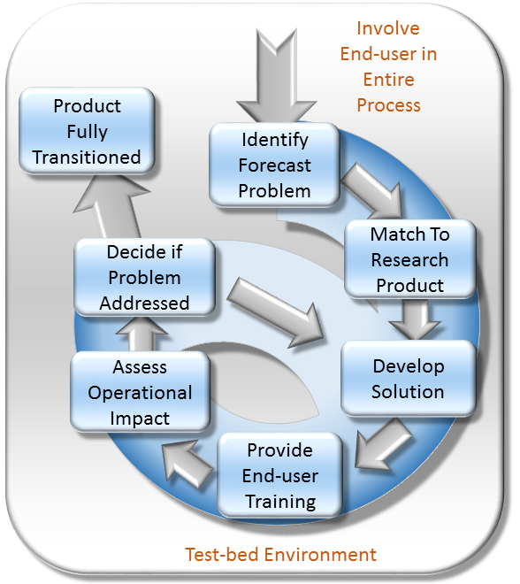

What is SPoRT?
Short-Term Prediction Research and Transition (SPoRT) Center
Our main purpose is to transition experimental [NASA] datasets and products to operational end users
Identify operational challenge
Determine how NASA data and products can aid in the decision-making process.

Slide 13
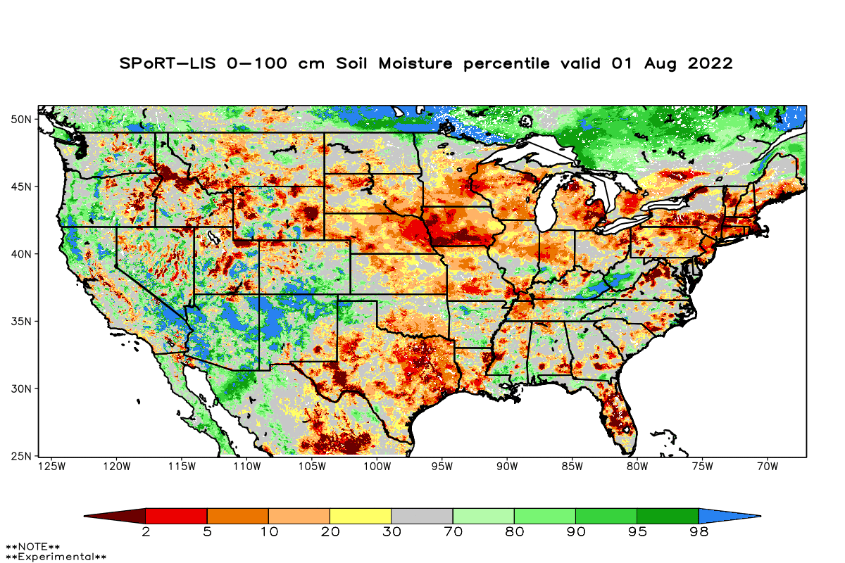
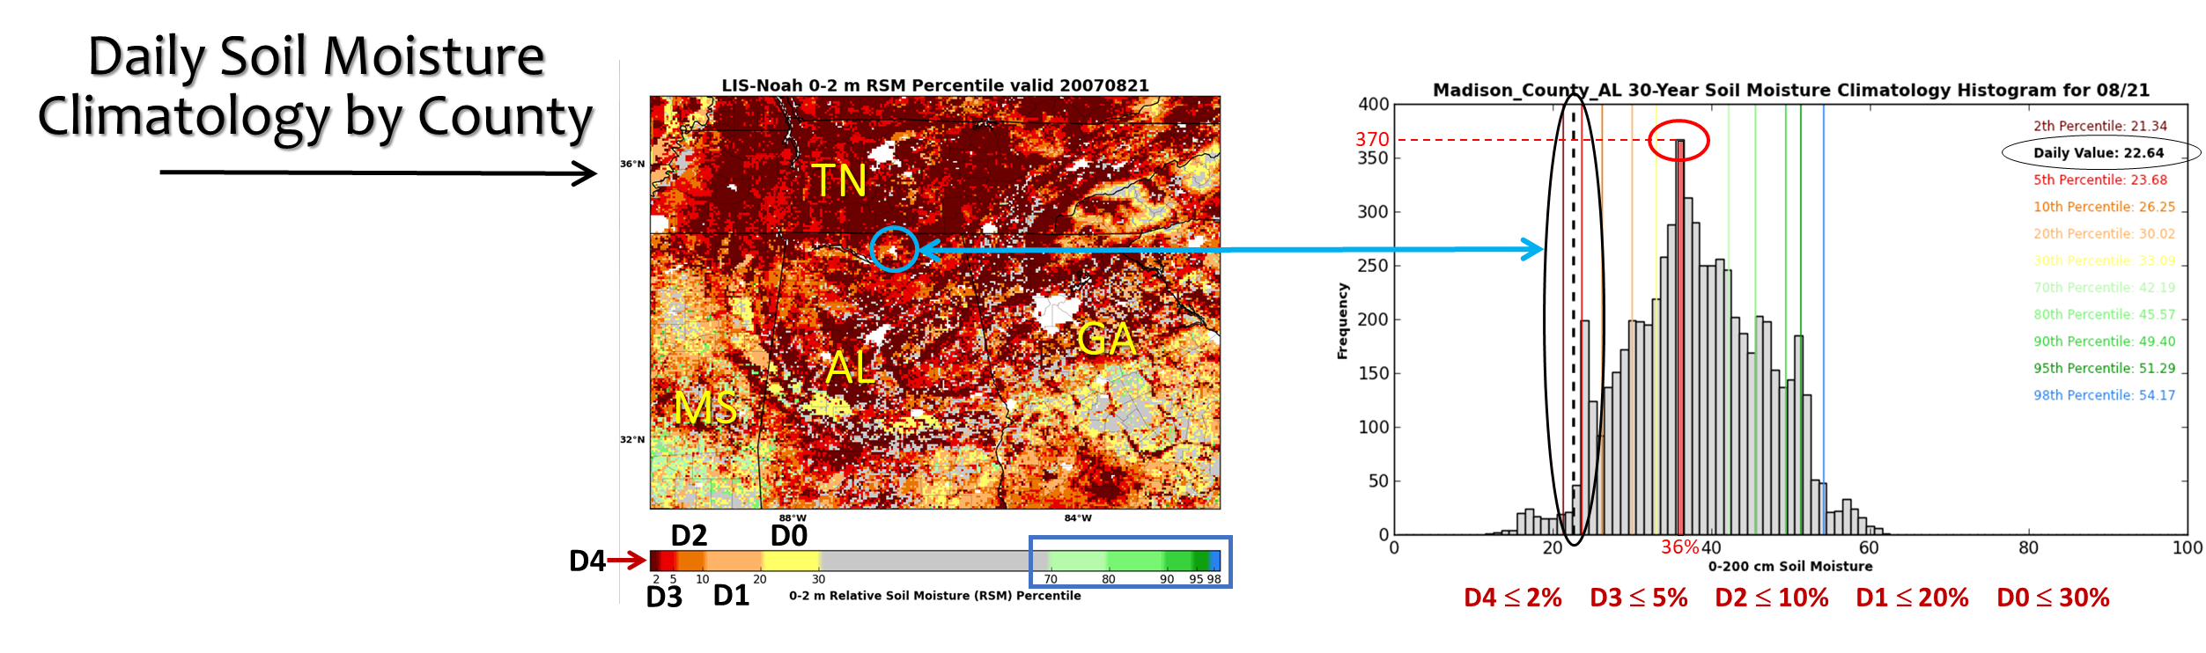
SPoRT-LIS Soil Moisture Climatology and Percentiles
Daily 1981-2013 soil moisture climatologies
0-2 m total column climatology for every CONUS county
Cumulative layers at every grid point (0-10cm, 0-40cm, 0-1m, 0-2m); 1-week moving centered window
All LIS grid points values grouped together in each county to form ~10⁶ unique daily climatologies
0-100 cm gridded soil moisture percentile

Slide 14
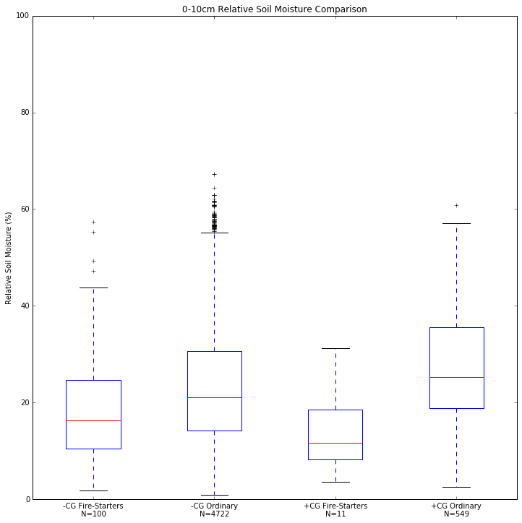
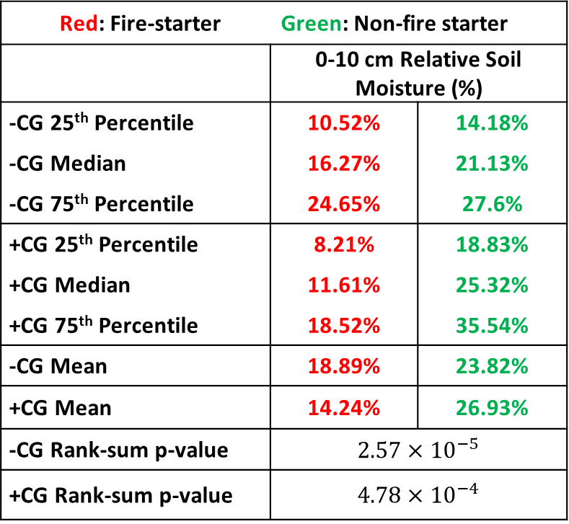
Antecedent Soil Moisture: 87 Ltg-Initiated Wildfires Days: 2008-15
Red: Fire-starter Green: Non-fire starter
 | 0-10 cm Relative Soil Moisture (%)
-CG 25th Percentile | 10.52% | 14.18%
-CG Median | 16.27% | 21.13%
-CG 75th Percentile | 24.65% | 27.6%
+CG 25th Percentile | 8.21% | 18.83%
+CG Median | 11.61% | 25.32%
+CG 75th Percentile | 18.52% | 35.54%
-CG Mean | 18.89% | 23.82%
+CG Mean | 14.24% | 26.93%
-CG Rank-sum p-value | $$2.57×{10}^{−5}$$
+CG Rank-sum p-value | $$4.78×{10}^{−4}$$
Boxplot shows significant difference between distributions of suspected fire-starters and ordinary strikes of both polarities
P-values < 0.05 indicate separation of distributions are most prevalent with the +CG flashes
Suspected fire-starters primarily in areas of lower relative soil moisture

Slide 15
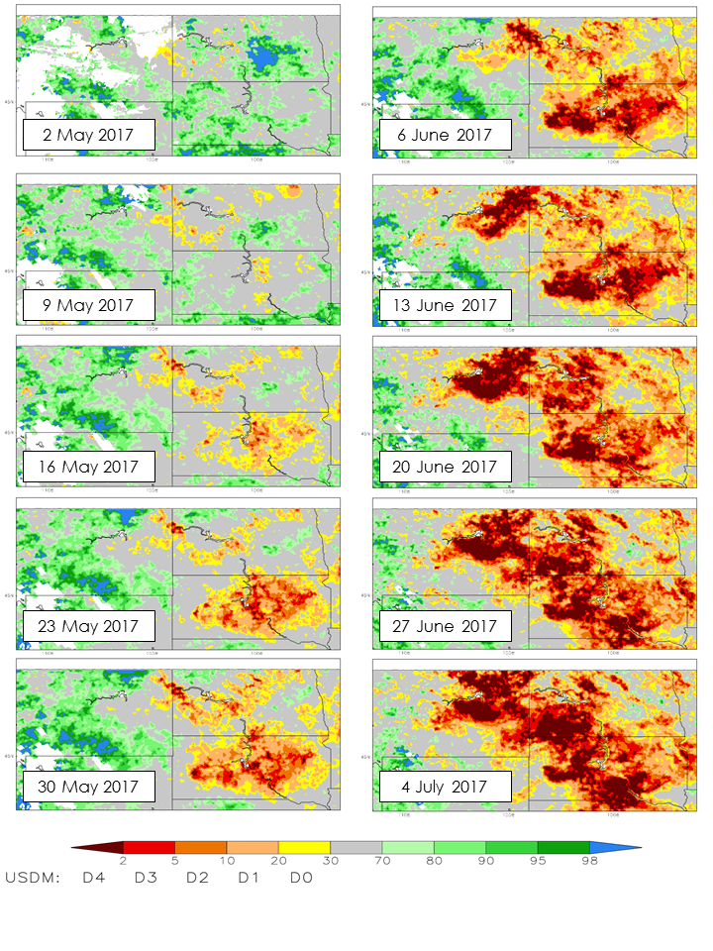
Development of a Multi-Scale Remote-Sensing Based Framework for Mapping Drought over North America Christopher Hain (U. of Maryland)
ESI Example: North Central US Flash Drought of 2017
Flash drought are rapid onset events typically driven by:
precipitation deficits,
high temperature anomalies;
strong winds;
Anomalous incoming solar radiation.
ESI provides early warning of the onset of vegetation stress.
Provides information physically related to “actual” stress.

Slide 16
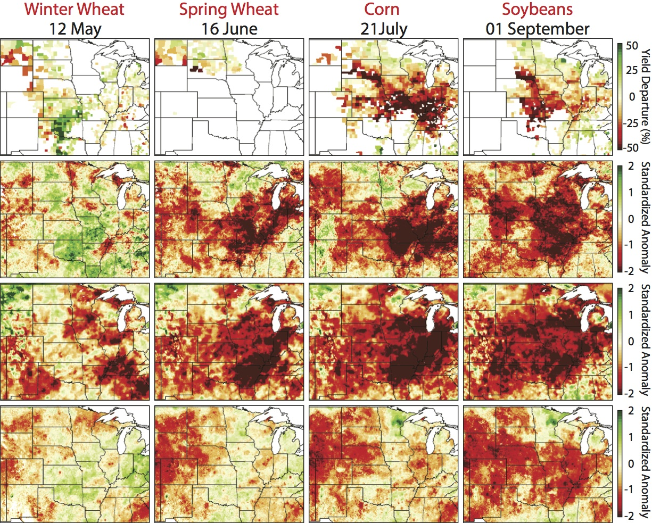
ESI: Early Warning Metrics for Onset of Vegetation Stress
Winter
Wheat
Spring
Wheat
Corn
Soybeans
Strong relationship between wheat yield and the ESI and VegDRI during critical crop stages
NLDAS has strong (weak) relationship to corn/soybeans (wheat) yield
ESI had strongest correlation to the wheat, corn, and soybean yield departures
CROP
YIELD
ESI
4WK
NLDAS TC
4WK
VEGDRI

Slide 17
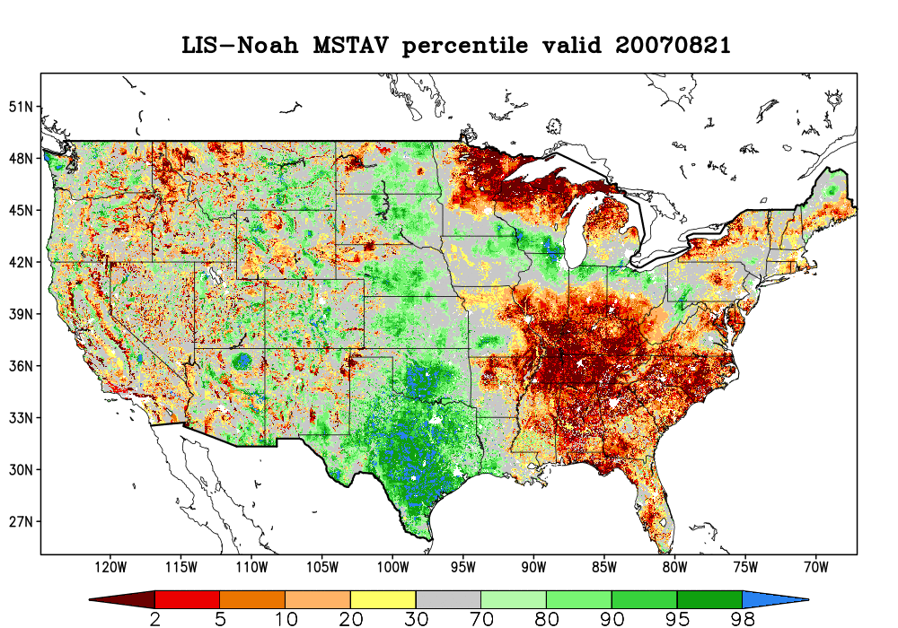
SPoRT-LIS Proxy Drought Validation
SPoRT-LIS 0-2 m soil moisture percentile valid 21 Aug 2007
SGP
NWUS
SEUS
Evaluated SPoRT-LIS 0-2m, county-based soil moisture percentile proxy drought category from 2006-2016 over three sub-regions shown above.

Slide 18
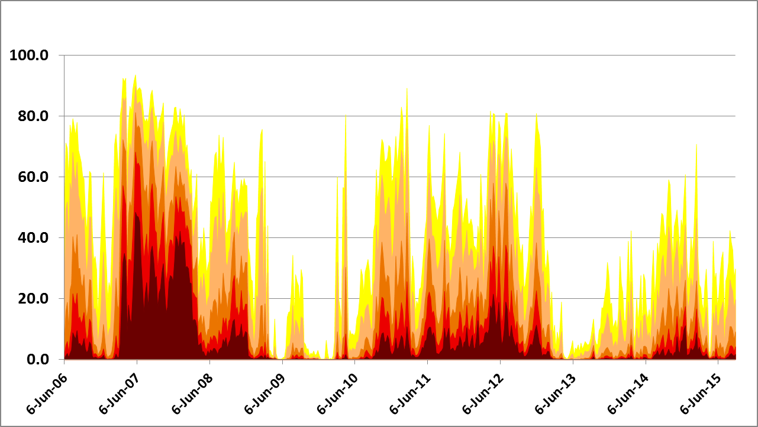
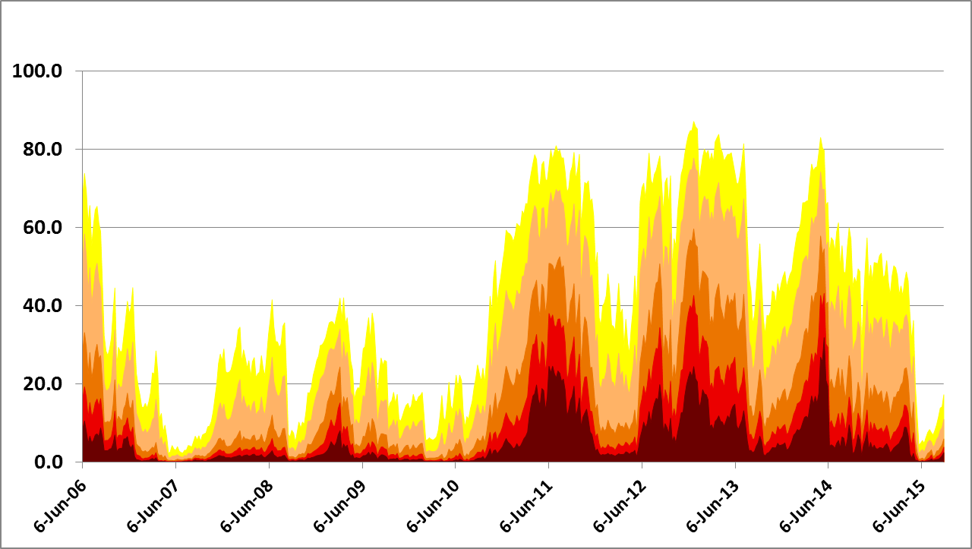
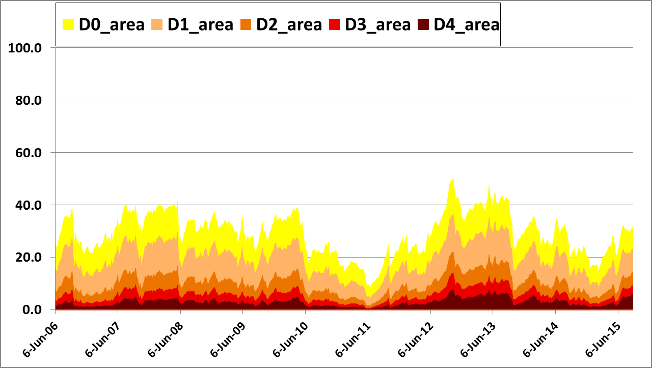
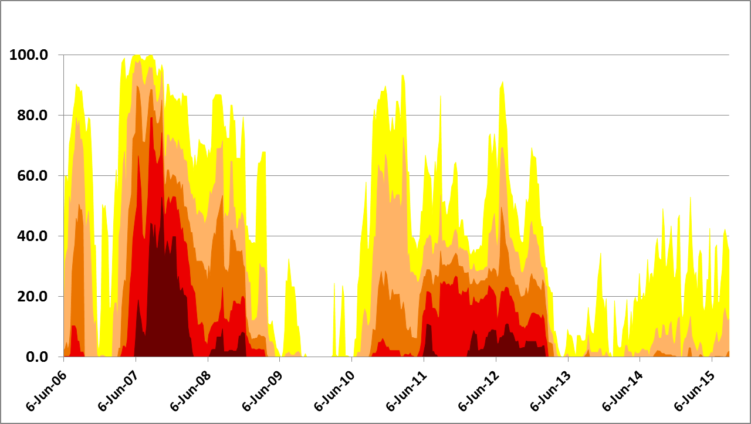
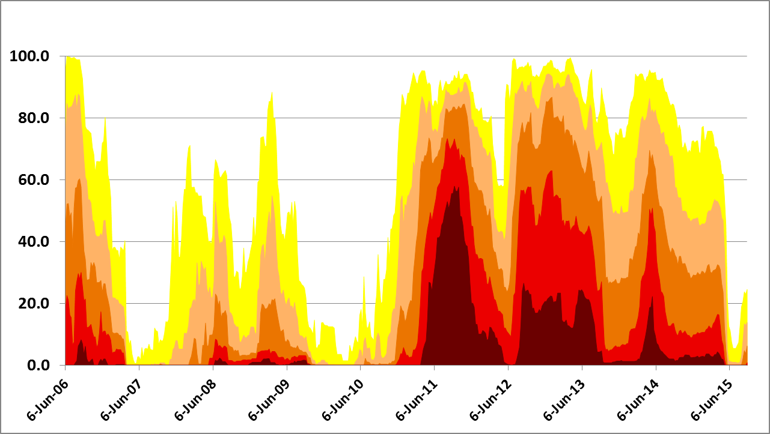
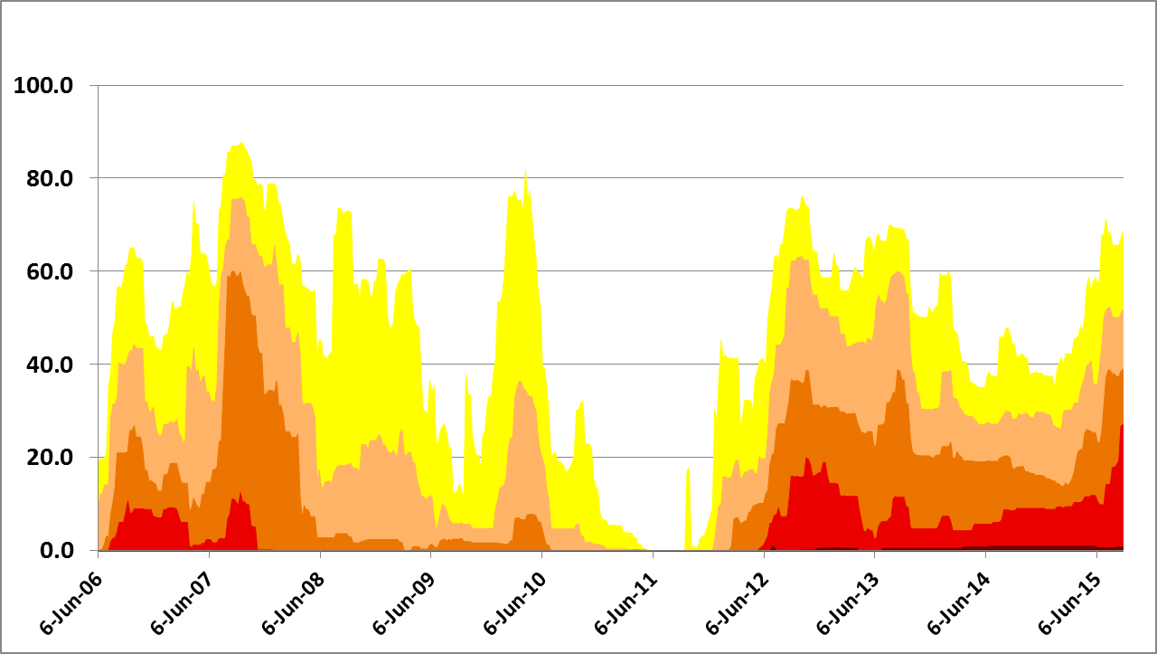
SPoRT-LIS Proxy Drought Validation
LIS
SEUS
LIS
SGP
LIS
NWUS
SPoRT-LIS 0-2 m soil moisture percentile valid 21 Aug 2007
SGP
USDM
SEUS
USDM
SGP
USDM
NWUS
NWUS
SEUS
SPoRT-LIS 0-2m soil moisture percentile proxy drought category verification. Time series of SPoRT-LIS areal coverage proxy drought categories [top row] versus USDM areal coverage of drought categories from 2006-2016.

Slide 19
SPoRT-LIS Proxy Drought Validation
SPoRT-LIS 0-2 m soil moisture percentile valid 21 Aug 2007
Difference in mean area (SPoRT-LIS minus USDM)
Bias | D0 | D1 | D2 | D3 | D4
SEUS | -4.1 | 2.1 | 0.2 | 0.7 | 2.4
SGP | -19.8 | -14.0 | -12.5 | -6.6 | -1.2
NWUS | -17.4 | -8.6 | -4.5 | 1.4 | 2.6
SGP
NWUS
Correlation | D0 | D1 | D2 | D3 | D4
SEUS | 0.89 | 0.87 | 0.85 | 0.83 | 0.72
SGP | 0.90 | 0.90 | 0.88 | 0.83 | 0.70
NWUS | 0.77 | 0.68 | 0.53 | 0.38 | 0.12
SEUS
SPoRT-LIS 0-2m soil moisture percentile proxy drought category verification. (Above-Left) Select CONUS verification regions; (Above-Right) Bias and Correlation statistics from 2006-2016.

Slide 20
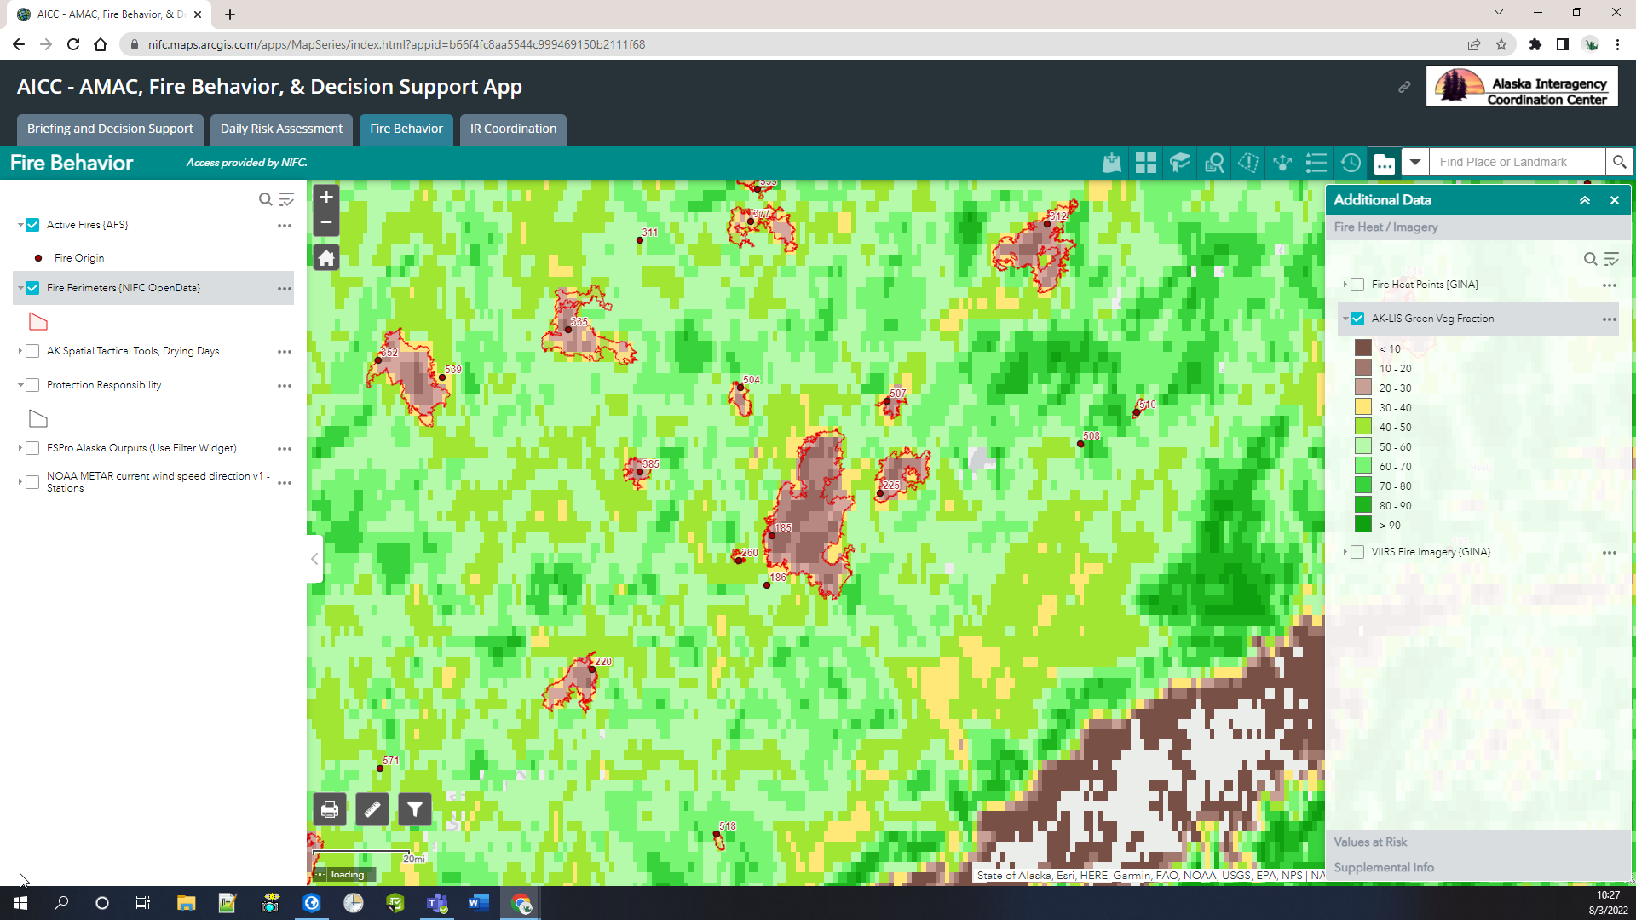
Impact & Access: Input Veg over Burn Scars

