Slide 1
LISA Telescope
Flight Design
J. Livasª, R. Keski-Kuhaª
For the LISA Telescope Team
ªNASA-GSFC, 8800 Greenbelt Rd, Greenbelt, MD-20771, USA;
Mirror Technology Days
November 15-17, 2022

Slide 2
US Telescope Team
C. Austinª, R. Bousquetª, K. Boyce ª, A. Davis ª, R. DeRosa ª, P. Fulda ^{b}, J. Gleason ^{b}, E. Grobª, T. Hadjimichaelª, H. Hollis^{b}, J. Howard ª, J. Ivanov ª, C. Jonesª, J. Kelly ª, R. Keski-Kuha ª, J. Leonª, J. Livas ª, G. Mathews ª, G. Mueller ^{b}, J. Sanjuan Munoz ^{b}, J. Papaª, S. Sankar ª, L. Seals ª, D. Tanner^{b}, Ada Uminska ^{b}, Andrew Weaver ª, Alexander Weaver ^{b}
ª NASA-GSFC, 8800 Greenbelt Rd, Greenbelt, MD-20771, USA
^{b} University of Florida, Gainesville, FL, 32611, USA
Development Partner: L3Harris Corporation, Rochester, NY

Slide 3
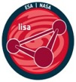
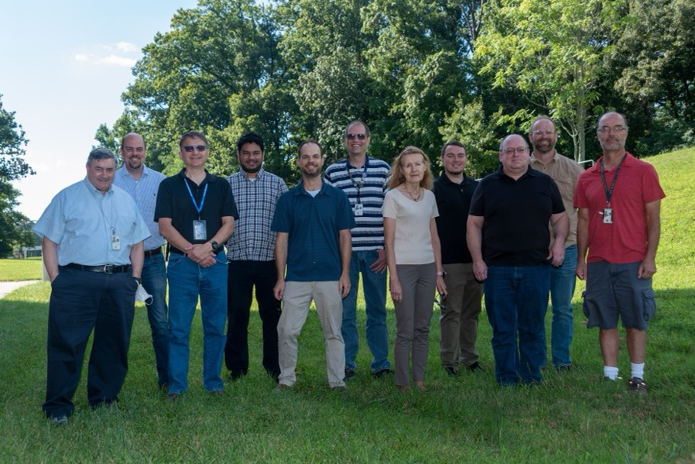
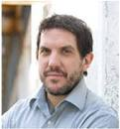
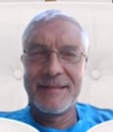
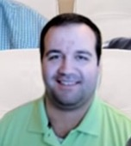
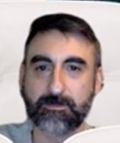



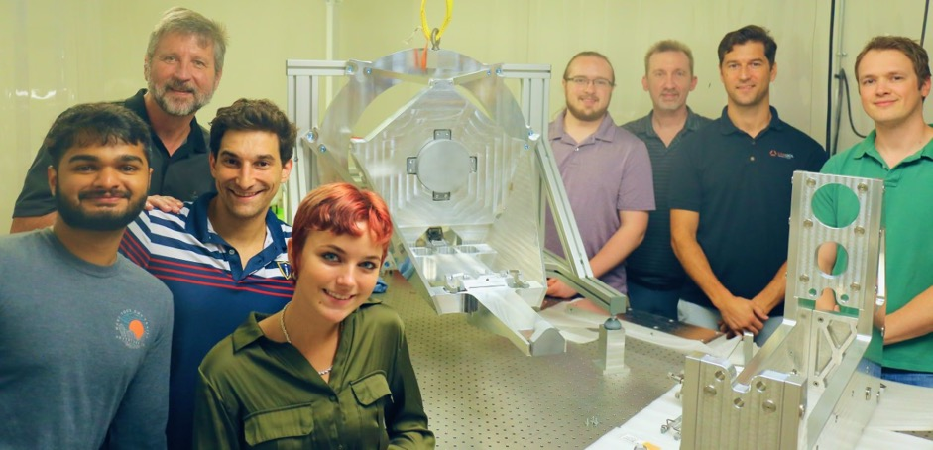
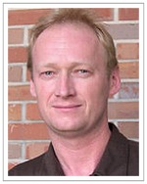
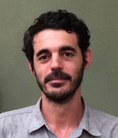
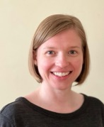
NASA LISA Telescope Team
Theo Hadjimichael Eric Grob Jon Papa Ryan DeRosa
Terra Hardwick Gary Matthews Len Seals
University of Florida LISA Telescope Team
Team members (l to r): Jeff Livas, Tim Johnson, John Leon, Shannon Sankar, Andrew Weaver, Kevin Boyce, Ritva Keski-Kuha, Joe Ivanov, Robert Bousquet, Corey Austin, Joe Howard
Not pictured:
Angel Davis
Craig Jones
Jason Kelly
Henock Legesse
Michael Lopez
Mark Wilson
Joshua Lutter
David Tanner
Guido Mueller Jose SanJuan Ada Uminska
Team members (l to r): Don George, Hal Hollis, Alex Weaver, Laura Roberts, Kylan Jersey, Joe Gleason, Paul Fulda, Paul Edwards

Slide 4
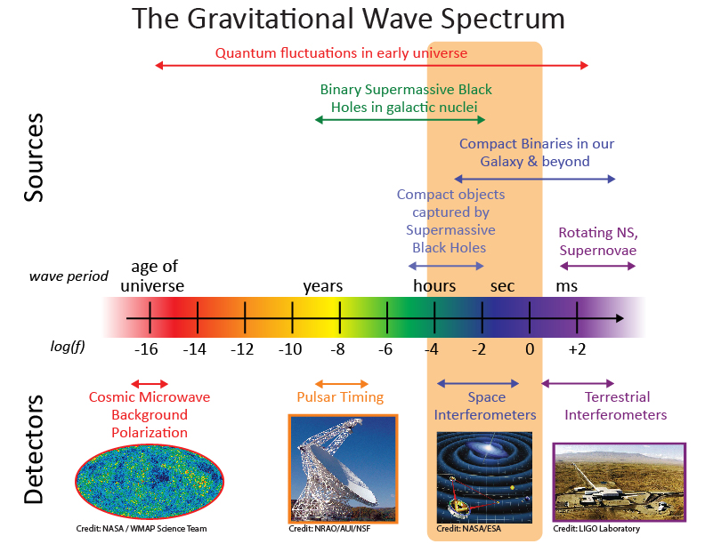
LISA Science Context
Why is LISA important?
Space-based measurement of gravitational waves (GW) is complementary to ground-based GW observatories
Rich array of sources both long-lived and transient
Observations with electromagnetic counterparts (ground and space) offer more complete understanding of the astrophysics
Sources are very high energy and therefore an important part of the Universe’s origin and evolution

Slide 5
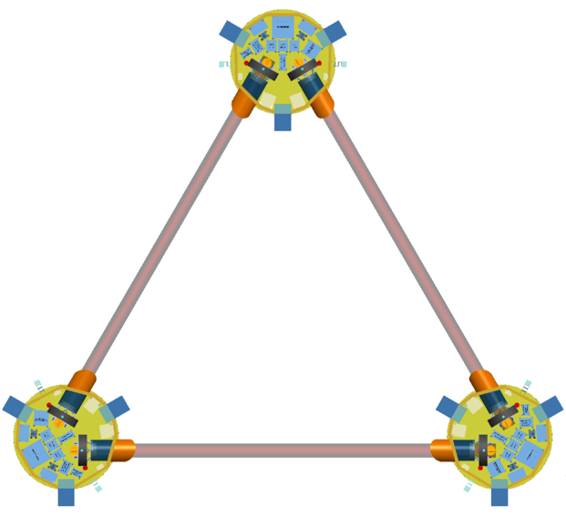
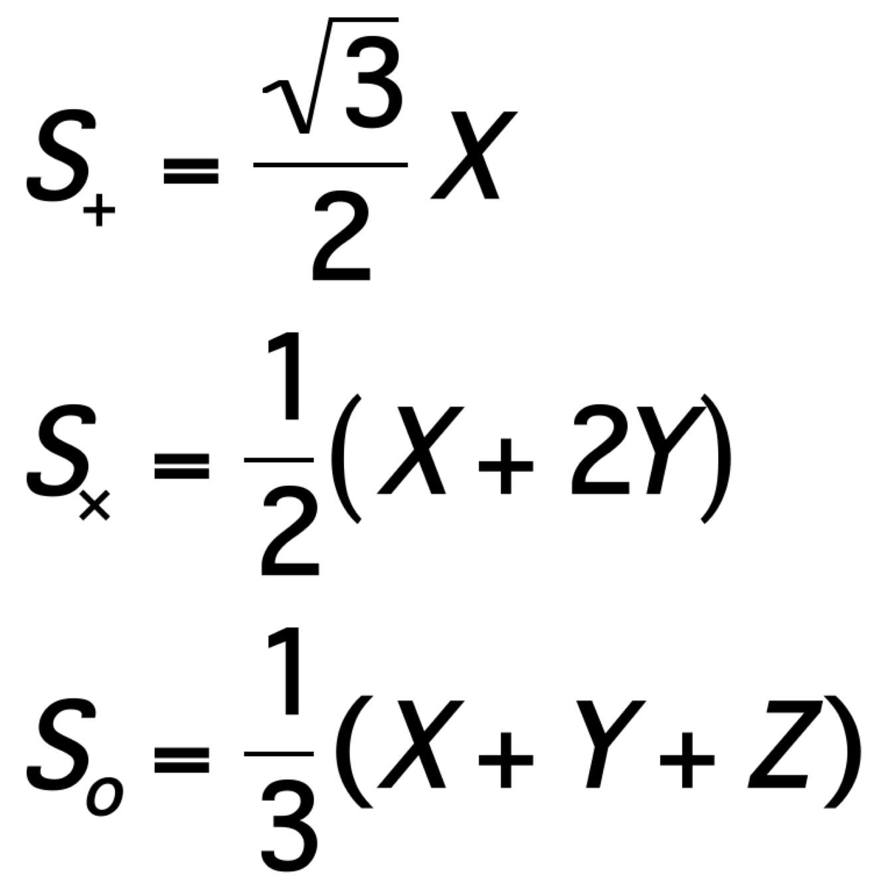
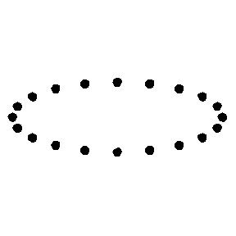
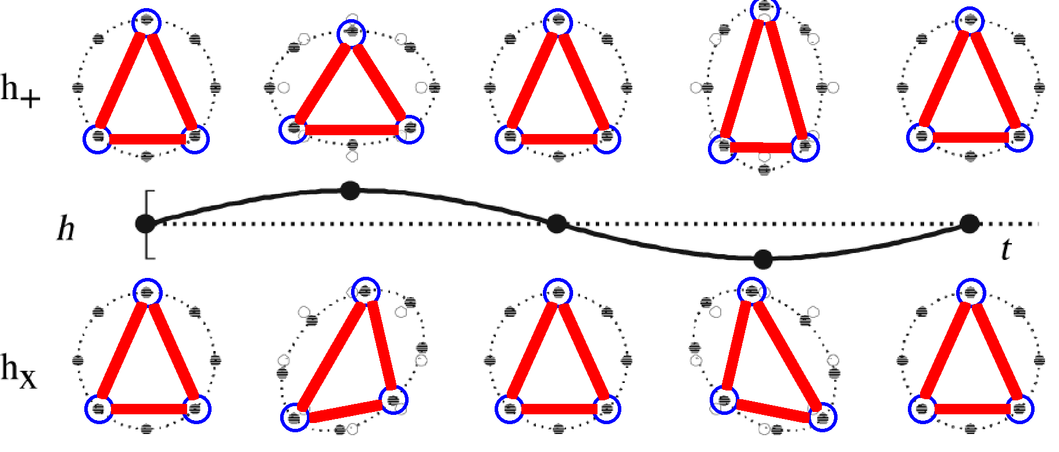
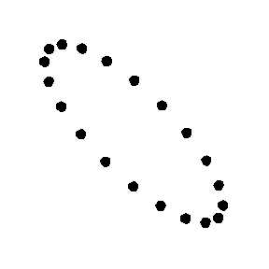
LISA Mission Summary
Mission Design
Three satellites in an equilateral triangle formation with arm lengths of ~2.5 million km.
Any two arms of this triangle represent a Michelson-type interferometer.
Gravitational waves deform space-time and can be detected as a change in the length of the interferometer arms (~ 10 pm/Hz^{1/2}).
Baseline 4 year lifetime + 6 years goal
    Limited by communications bandwidth
LISA Layout
Z
GW polarization
2.5 million km
+
X
“plus”
“cross”
“sagnac”
X
Y
Constellation Response
Heliocentric orbit
plus
2.5 X 10⁶ km
cross
sagnac: No GW response. Allows noise measurement.
Constellation Triangle rotates once per year as it orbits
Notes:
The Sagnac mode is not sensitive to gravitational waves and is analgous to blocking the aperture for an optical telescope making images of the sky. It allows a measurement of the noise floor.

Slide 6
LISA Mission Timeline
Date | Milestones
October 2013 | The “Gravitational Universe” selected as the science theme for the 3rd ESA flagship mission (L3)
June 2016 | LISA Pathfinder reports Sub-Femto-g test mass acceleration performance
October 2016 | Call for L3 mission proposals
June 2017 | Selection of LISA as L3 with a nominal 2034 launch
May 2018 | (ESA) Phase A kick-off
2018-2021 | LISA mission Phase A
Oct 2020 – Oct 2021 | Phase A Extension
<end 2021 | Formulation Review and Phase A end
>2023 | Mission Phase B
End 2023 | Mission Adoption
Adoption | Mission Implementation (Phase B2/C/D)
~2035 | Nominal Launch
Launch | Science operations (4 years (6 under consideration) baseline)
We are here
Need to show EDU TRL-6 before adoption

Slide 7
Requirements Review

Slide 8
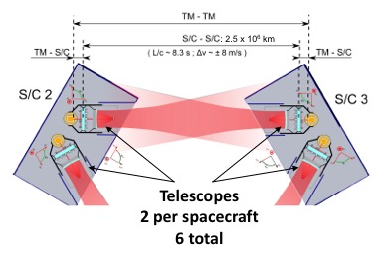
Telescope Functional Description
Efficiently deliver power on-axis between spacecraft (2.5 million km)
Simultaneous transmit and receive (TX/RX)
Afocal beam expander
  300 mm diameter large beam
  2.24 mm diameter on bench
  134X magnification
TM-TM
S/C - S/C: 2.5 x 10⁶ km
TM-S/C
L/c ~ 8.3 s, ∆υ ~ +/- 8 m/s
TM-S/C
Application is PRECISION LENGTH MEASUREMENT, not image formation
  Keep optical pathlength stable to ~ 1 pm/√Hz over the measurement bandwidth
  Minimize phase noise from coherent transmitter backscattered light
  Minimize tilt to length (TTL) coupling
Notes:
The LISA Telescope is designed to enable a precision length measurement between two widely space test masses. The measurement budget between pairs of proof masses is roughly 10 pm/√Hz.
There are two telescopes in series with the measurement, so their optical pathlength must be stable to ~ 1 pm/√Hz over the measurement band.

Slide 9
Key Telescope Optical Specifications
Specification | Value | Units | Comments
Wavelength | 1064 | nm | nominal system operating wavelength
Conjugates | Afocal |  | Telescope is an afocal transceiver, i.e. object and image at infinity. Specifications generally assume ”receive” mode, where the entrance pupil is the “large” pupil in inertial space
Field of Regard for Acquisition | +/- 225 | µrad | Circular field of view
Field of view for Science | +/- 20 | µrad | Circular field of view
Wave-front error | < 40 | nm | wavelength/30 with bipods
Large Pupil diameter | 300+/- 1 | mm | Large pupil is associated with M1, inertial space
Small pupil diameter | 2.24 +/- 0.0075 | mm | Small pupil is located at the system stop on the optical bench
Base ray deviation from optical axis (large pupil) | < 10 | µrad | The “base ray” is the center-field center-pupil ray. Boresight error associated with the large pupil
Base ray deviation from optical axis (small pupil) | < 1.3 | mrad | Interface requirement with the optical bench
Tilt-to-length (TTL) | < 0.6 | pm/nrad | “as built” over the science FOV

Slide 10
Key Telescope Challenges/design drivers
Dimensional Stability
  Low CTE material and thermal stability at the 1 x 10⁻⁵ K/√Hz level, using thermal baffles fixed to the spacecraft that act as a passive thermal filter
  Spacecraft is stable at the 1 x 10⁻³ K/√Hz level.
Minimize Coherent backscattered light
  Adopt an unobstructed optical design and plan the design to accommodate contamination
  Low scatter coatings and dimensionally stable structure so scattered light phase is stable
  Keep spacing between the telescope and optical bench stable
Minimize Tilt-to-length (TTL) coupling
  Careful design to minimize pathlength differences with field angle (dOPL vs Field)
  Careful alignment of measurement axes (bench to bench and bench to GRS) such that spacecraft jitter does not couple to the length measurement (movable aperture stops help optimize any residual during integration)
  Wavefront errors projected into the far-field will also couple TX angular jitter into an apparent length signal (keep wavefront error low: WFE < 40 nm RMS = λ/30 at 1064 nm)
Notes:
Key challenges and design drivers for the telescope.

Slide 11
Key Telescope Interfaces
Optical
  Small pupil/external stop on the optical bench
  Virtual large pupil located at the center of mass of the test mass
  optimize pupil imaging between the stop and the large pupil to minimize TTL coupling in the telescope itself
Mechanical
  3 pairs of bipod flexure interfaces to the MOSA Support Structure (MSS)
  Adequate mechanical clearance with the optical bench
  Designed for a fundamental mode of 115 Hz to accommodate worst case launch loads
Thermal
  Nested set of thermal baffles mounted to the spacecraft to filter thermal fluctuations to an acceptable level
  Sized to accommodate MOSA articulation
  Baffle to shield the optical bench
  Notional conduction paths through the bipod interface and from a cable harness to the optical bench
Notes:
Key challenges and design drivers for the telescope.

Slide 12
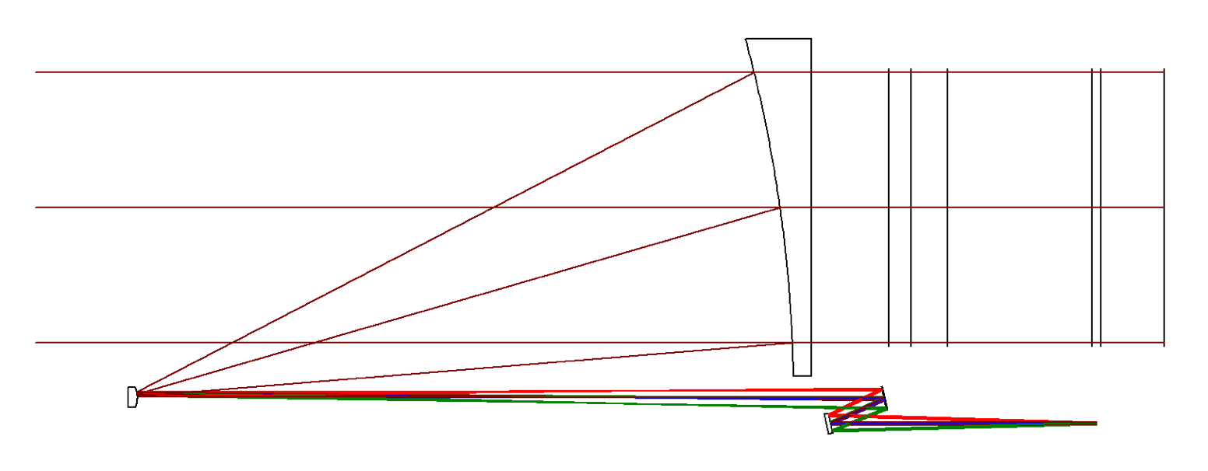
Design Update for Flight (1/2)
Simulations at the University of Florida uncovered a geometrical Tilt-to-Length (TTL) coupling of relative angular motion between the bench and the telescope converted to pathlength by the offset between the large and small beams axes.
Not a ”new” noise, but has not been included in the noise budget explicitly to date
For the (TEL-OB interface):
  the effect is proportional to the sine of the tilt angle
For the OB-Test mass:
  the effect is proportional to the cosine of the tilt angle
Optical Bench
M1
Test Mass
L_{OB-TM}
Measurement axis is test mass to test mass between spacecraft
Beam folded onto bench
M2
Small Pupil /stop
L_{offset}
Moveable Optical Subassembly (MOSA) geometry

Slide 13
Design Update for Flight (2/2)
Size of the effect:
  OB-Tel distance:
    δL = L_{offset} x δφ_{OB-TEL}
    L_{offset} = 240 mm
    If we require δp < 1 pm/√Hz
    Then δφ_{OB-TEL} < 4.1 prad/√Hz
  OB-TM distance:
    δL = L_{OB-TM} x (1- cos(δφ_{OB-TEL}))
    L_{OB-TM} = 240 mm
    Using δφ_{OB-TEL} = 4.1 prad/√Hz
    Gives δp = 2 x 10⁻²⁴ m/√Hz
    = 2 x 10⁻¹² pm/√Hz
Example: OB tilts
Optical Bench
M1
δφ_{OB-TEL}
L_{OB-TM}
Test Mass
L_{offset}
Beam folded onto bench
M2
Small Pupil /stop
δφ_{OB/TEL}
δL_{OB-TEL}= L_{offset} x sin(δφ_{OB-TEL})
≈ L_{offset} x δφ_{OB-TEL}
δL_{OB-TM}= L_{OB-TM} x (1-cos(δφ_{OB-TEL}))
≈ (1/2) L_{OB-TM} x δφ²_{OB-TEL}
An on-axis interface has much lower TTL.

Slide 14
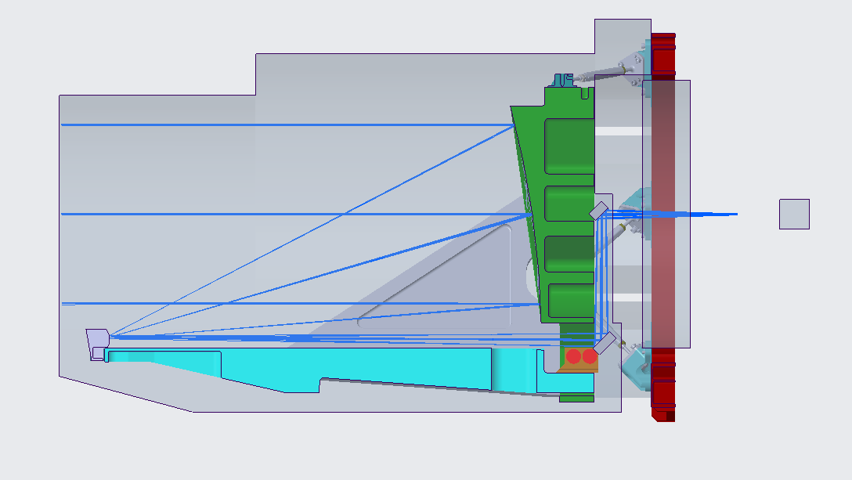
On-axis Interface Design: 4-mirror, 2 freeforms
EDU Design
New Design Summary
M1
M1 unchanged from EDU
M2 very slightly stronger (25.8 → 25.75 mm radius of curvature)
M3, M4 XY-polynomials similar to the EDU M3 design
Pros:
  No change to the MOSA: matches existing interfaces
  Compatible with the OB keep out zones
Cons:
  M2 alignment tolerance is tight
  No flat (helps make alignment adjustments orthogonal)
M3
M2
M4
New Design Overlaid on current EDU design for comparison
New 4-mirror Design
OB keep-out zone
M1
M1
Optical Bench
M4
M4
Test Mass
Small pupil: routed on the bench to the position of the stop
M2
M3
M3
M2
Existing MOSA Mechanical Envelope (no change)
15

Slide 15
Requirements Concerns
Design for manufacturing: not usually explicitly written down
  Need ~ 10 units
  Robust design for fabrication and alignment
    Good yields
    Tolerances that are well within the state of the art
    Simplify shapes to be machined
  Will mitigate schedule risk
Current design has tight tolerances for M2 alignment
Look at alternate designs to possibly relax these tolerances

Slide 16
Options on the table
Total mirrors | Four Mirror | Five Mirror | Six Mirror
Two powered mirrors | PPFF | PPFFF | PPFFFF
Three powered mirrors | PPPF PPFP | PPPFF PPFPF | PPPFFF PPFPFF
Four Powered Mirrors | PPPP | PPPPF PPPFP PPFPP | PPPPFF PPPFPF PPPFFP PPFPFP PPFFPP
Five Powered Mirrors |  | PPPPP | PPPPPF PPPPFP PPPFPP PPFPPP
Six Powered Mirrors |  |  | PPPPPP
Possible options are shown
  P = powered
  F = flat
Not all options make sense or will be studied
  Goal #1 is to relax M2 alignment tolerances
  Goal #2 is to simplify alignment/assembly of the entire telescope
Circled options will be examined first
Current design
Might consider if it makes mirror fabrication easier
No current plans to study

Slide 17
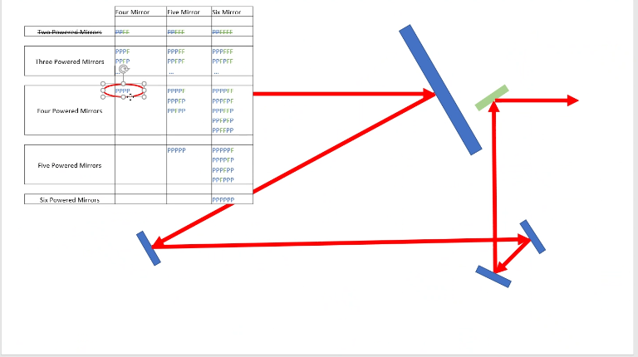
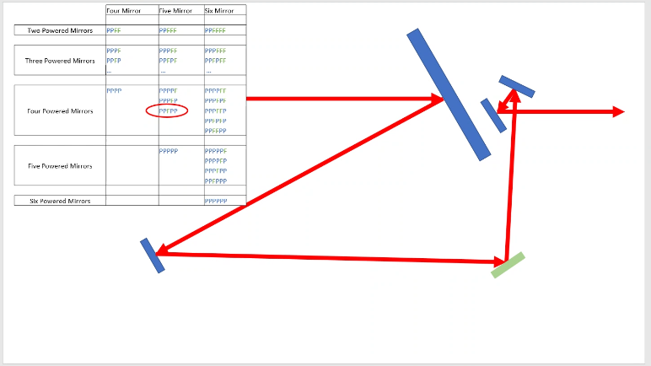
Example Configurations
Two possible 5-mirror options
Total mirrors | Four Mirror | Five Mirror | Six Mirror
Two powered mirrors | PPFF | PPFFF | PPFFFF
Three powered mirrors | PPPF PPFP | PPPFF PPFPF | PPPFFF PPFPFF
Four Powered Mirrors | PPPP | PPPPF PPPFP PPFPP | PPPPFF PPPFPF PPPFFP PPFPFP PPFFPP
Five Powered Mirrors |  | PPPPP | PPPPPF PPPPFP PPPFPP PPFPPP
Six Powered Mirrors |  |  | PPPPPP
Total mirrors | Four Mirror | Five Mirror | Six Mirror
Two powered mirrors | PPFF | PPFFF | PPFFFF
Three powered mirrors | PPPF PPFP | PPPFF PPFPF | PPPFFF PPFPFF
Four Powered Mirrors | PPPP | PPPPF PPPFP PPFPP | PPPPFF PPPFPF PPPFFP PPFPFP PPFFPP
Five Powered Mirrors |  | PPPPP | PPPPPF PPPPFP PPPFPP PPFPPP
Six Powered Mirrors |  |  | PPPPPP
May make alignment easier if it decouples pointing and ”power”
May be better for scattered light
May allow relaxed tolerances on M2 placement
Reduces angle of incidence on powered mirrors

Slide 18
Summary
Proposed 4 powered mirror design meets key requirements
    Excellent dimensional stability
    Extremely low coherent backscattered light
    Low “Intrinsic” tilt-to-length coupling
    Can accommodate dynamic stop placement during alignment
Alignment requirements are tight, but possible
Mechanical design with all-glass construction meets stiffness requirements
Identified an interface coupling that requires modifying the flight design
Other flight requirements still to be identified as part of Phase B
No change to the EDU program

