Slide 1
Artemis 1 Recovery and Post-Flight Evaluations
Jeremy Vander Kam, Orion TPS Liaison for Artemis 1 Recovery
Aug, 2022

Slide 2
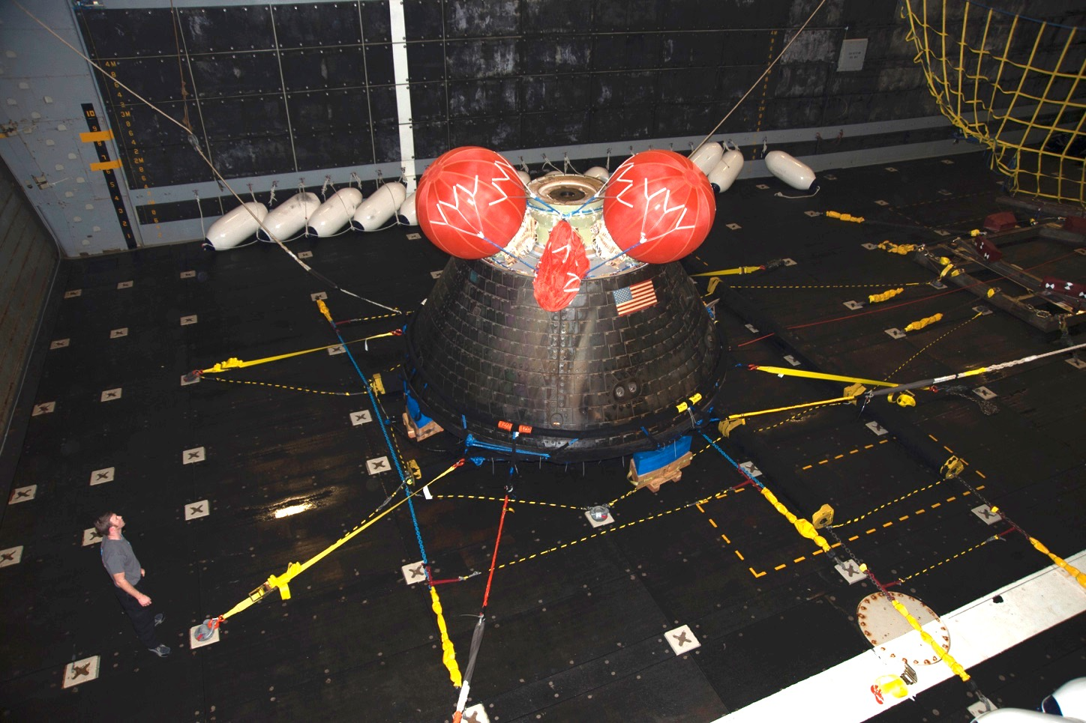
Four Parts to this Story
Orion Background
The EFT-1 Manufacturing Experience
The EFT-1 Flight Test and Post Flight Analysis
Moving Forward to Artemis Missions

Slide 3
The Orion Program and Ames’ Role
Orion started in 2006 as the Multi-Purpose Crew Vehicle (MPCV)
The TPS Advanced Development Project (ADP) ran from 2006 to 2009
  Purpose: Get started early on a large-scale ablative Heat Shield, technology that NASA had not pursued since the Apollo Program
  The ADP was based at Ames
The Orion contract was awarded in 2009 to Lockheed Martin
EFT-1 Flight Test flown in Dec 2014
Ames continues to provide arc jet testing, thermal and structural analysis, material development, and technical leadership

Slide 4
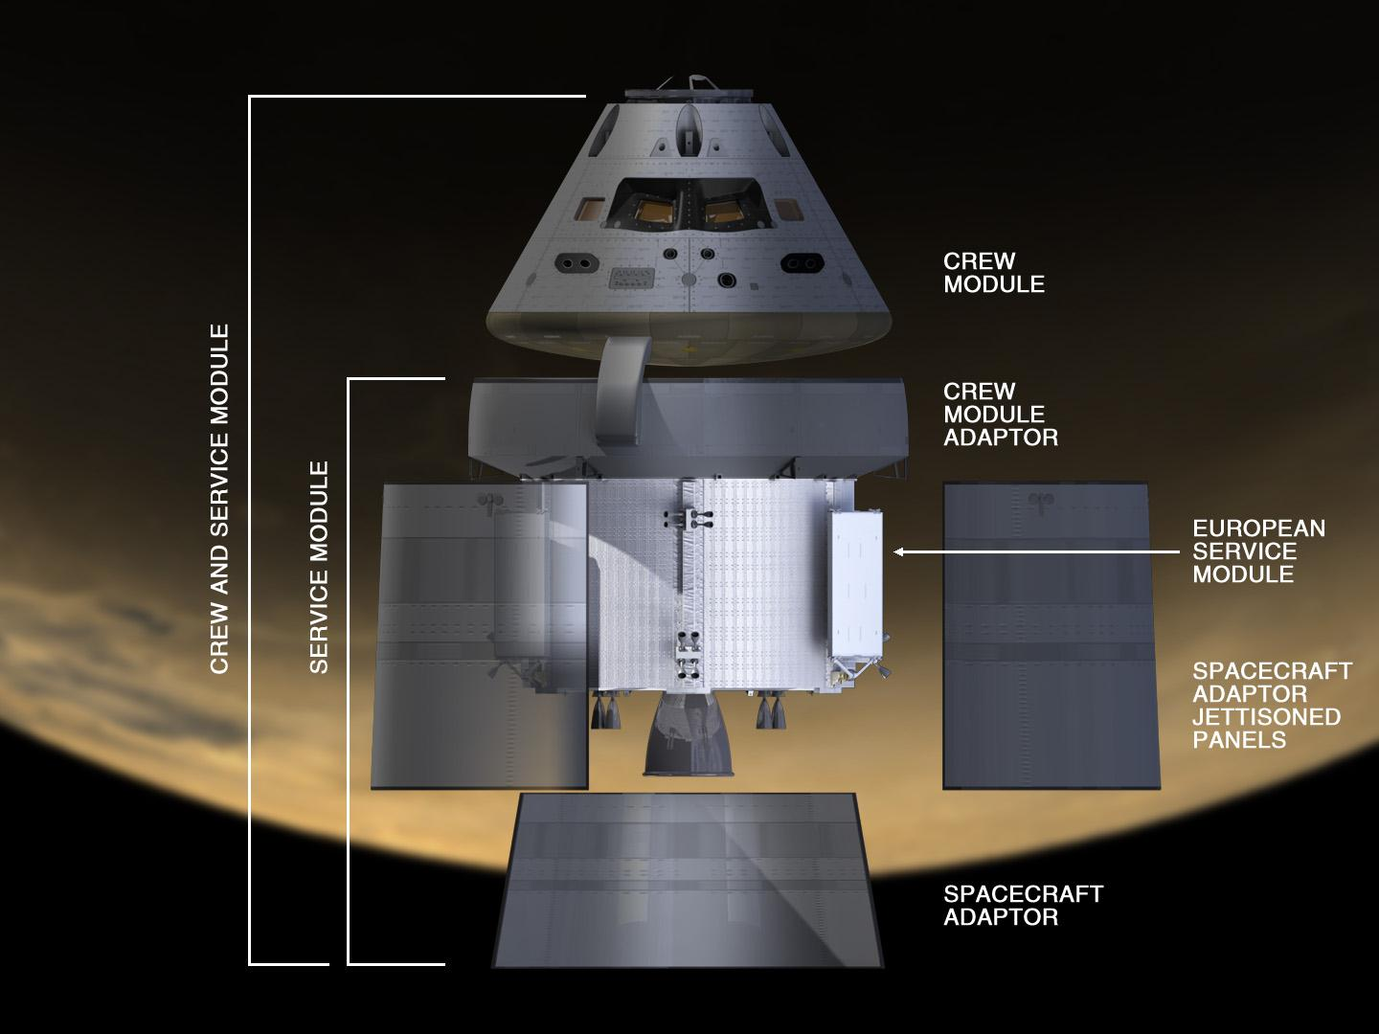
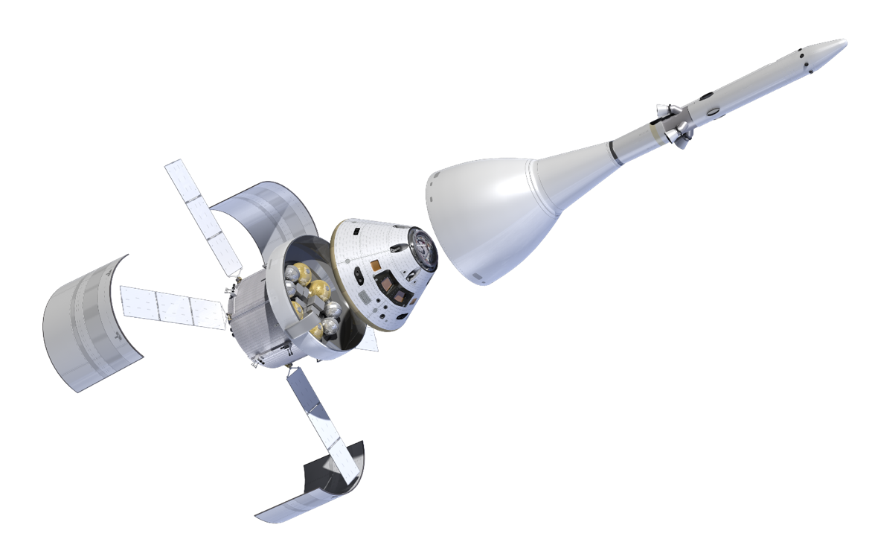
The Orion Spacecraft
Launch Abort
System
The Heat Shield
Crew Module
Service Module
On-Orbit Configuration

Slide 5
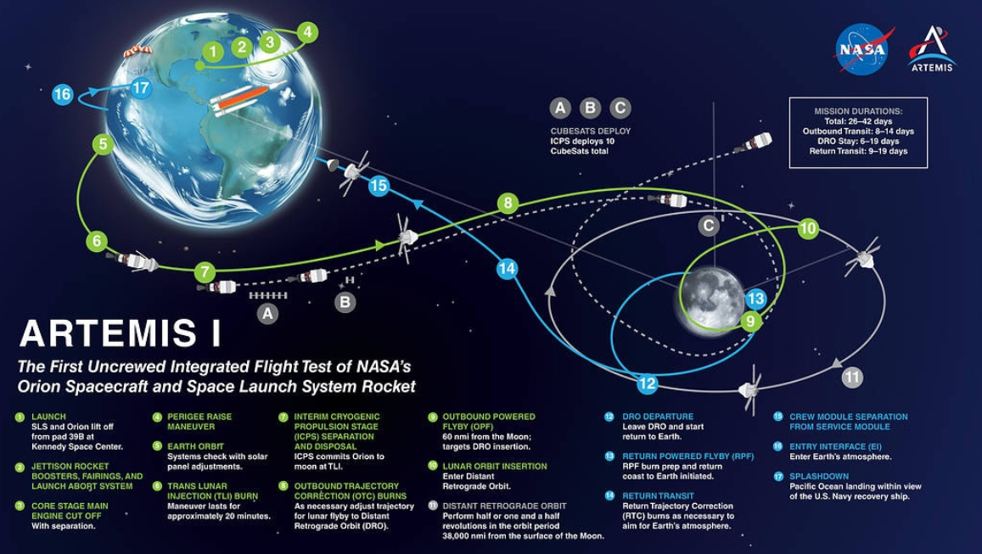
Artemis 1 Mission Profile
Artemis 1: Un-crewed Distant Retrograde Orbit (DRO) test, late Summer 2022
  Demonstrate TPS at entry velocities of ~ 11 km/s (EFT-1 was 8.9 km/s)
  25,000 mph instead of 20,000 mph
Artemis 1

Slide 6
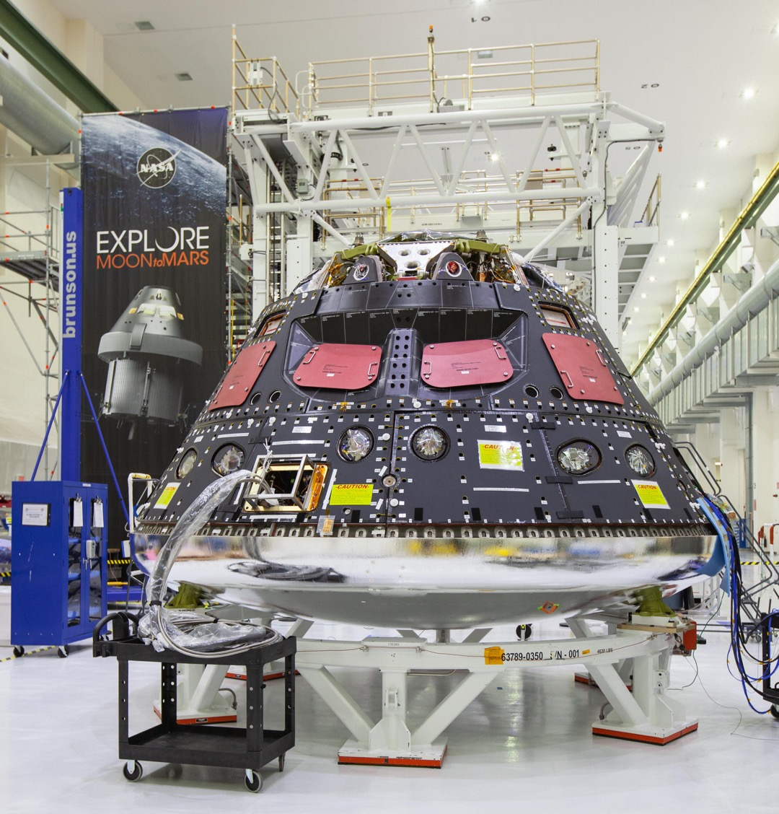
Artemis 1 Crew Module and Heat Shield

Slide 7
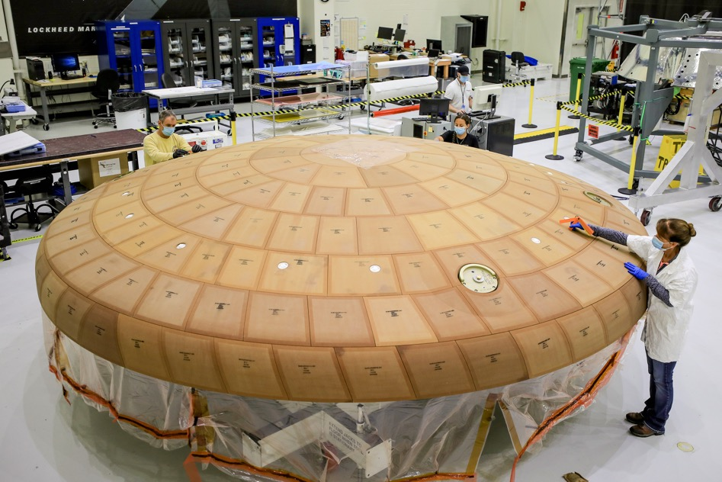
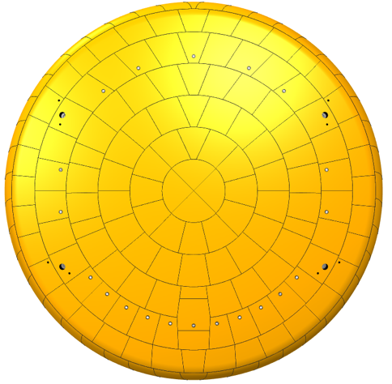
The Artemis 1 Heat Shield
186 Avcoat™ blocks bonded to the carrier structure
Seams filled with adhesive

Slide 8
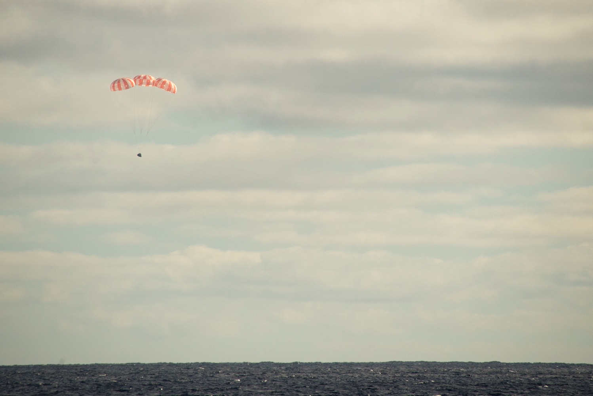
Orion on Descent

Slide 9
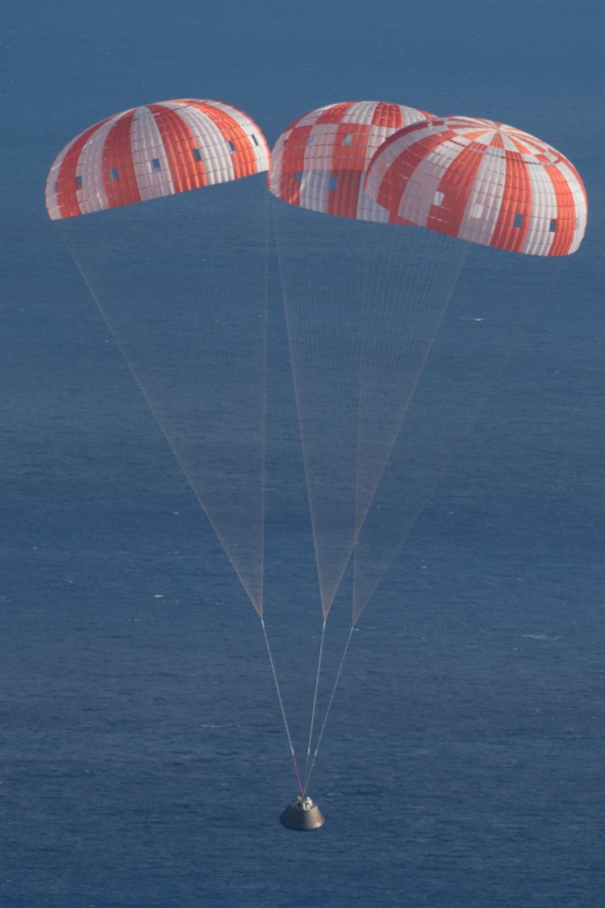

Slide 10
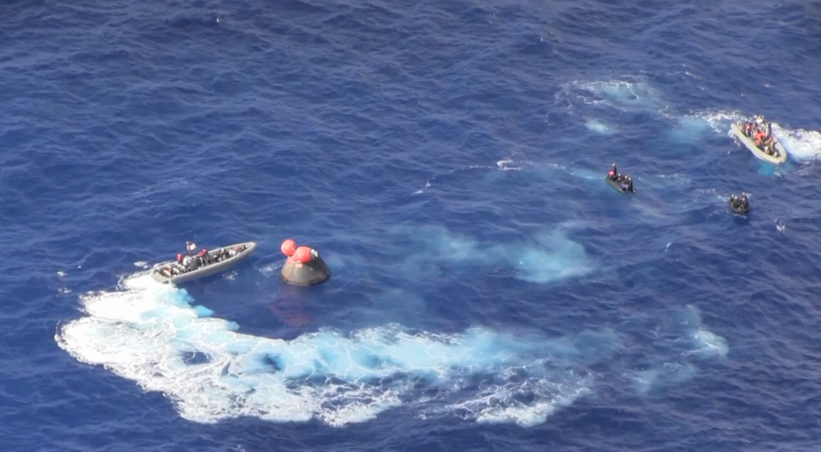
Small Boats Approach, Assess Safety, and Hook Up Lines

Slide 11
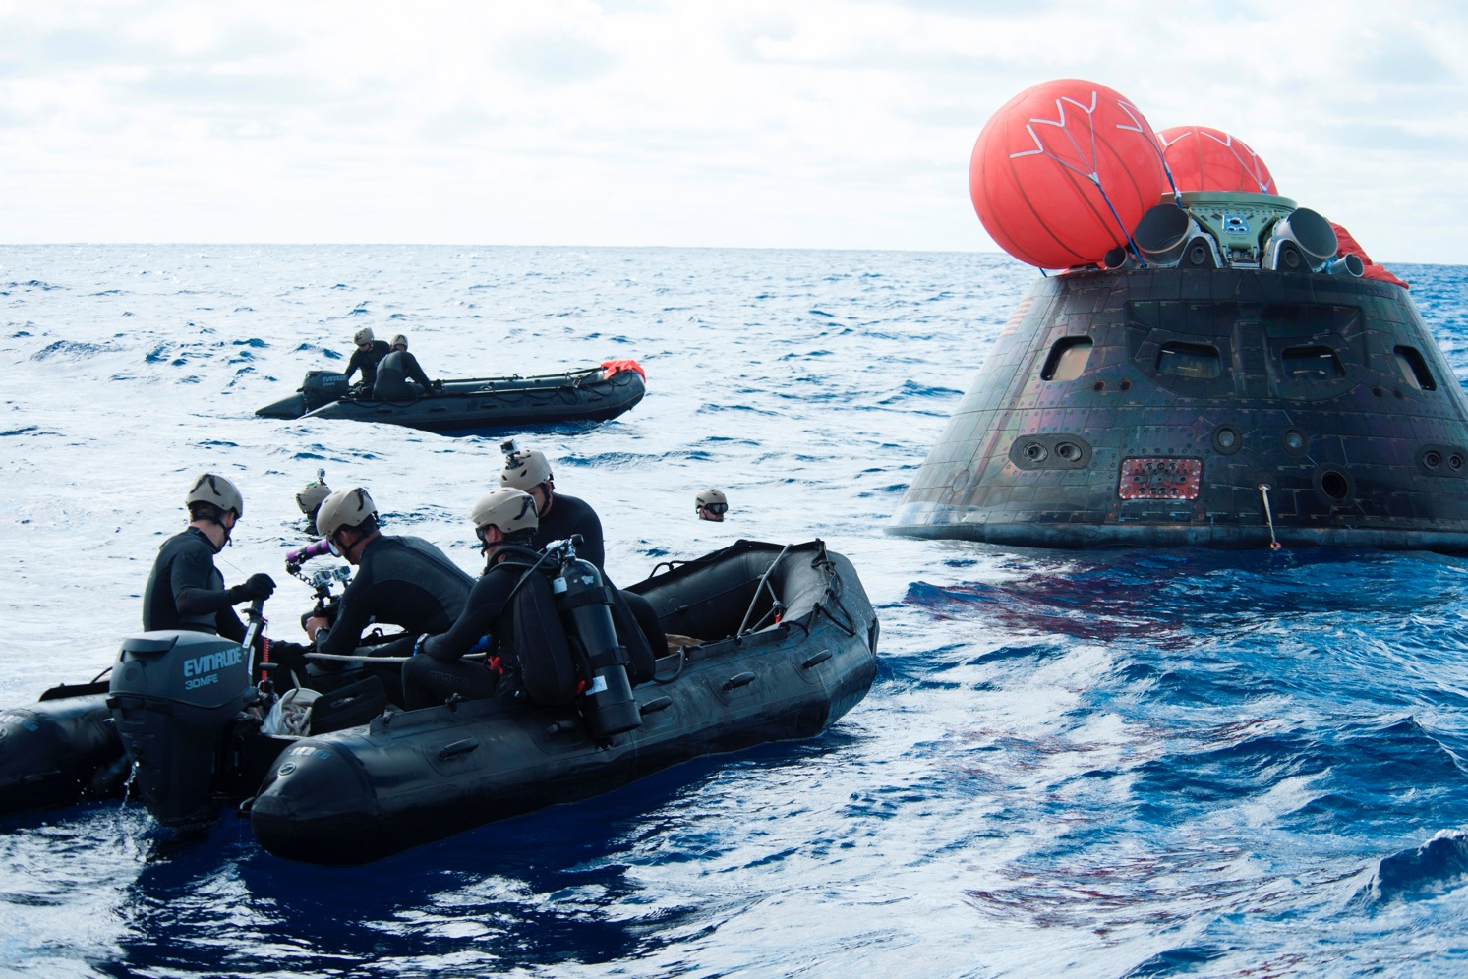
Recovery by US Navy MDS Units

Slide 12
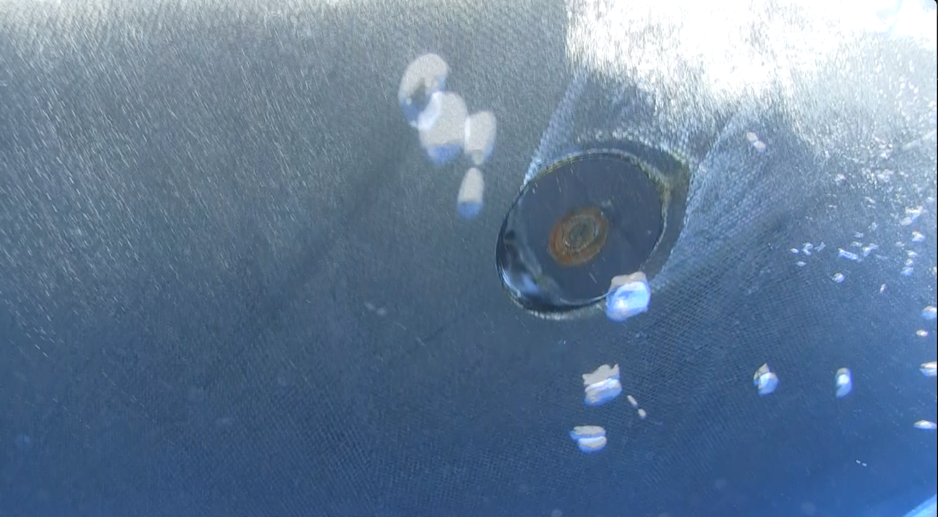
Underwater Imagery is Taken

Slide 13
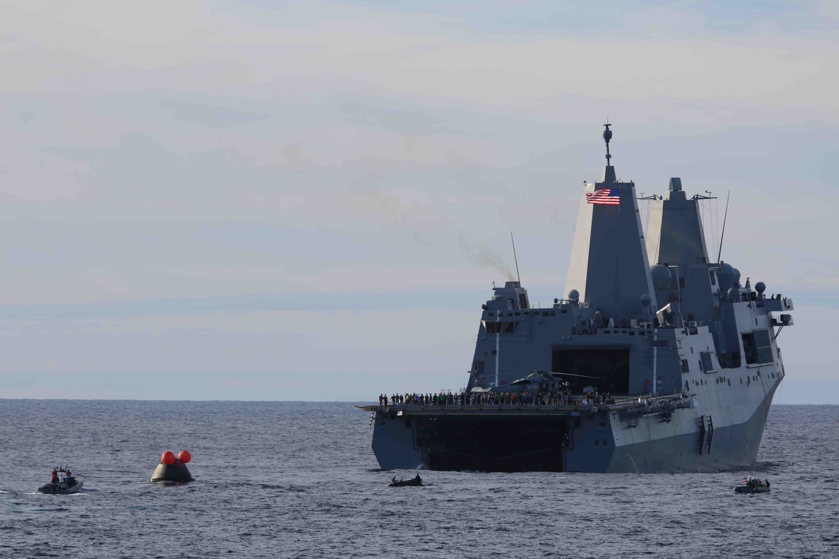
Orion is Winched Towards the LPD Ship

Slide 14
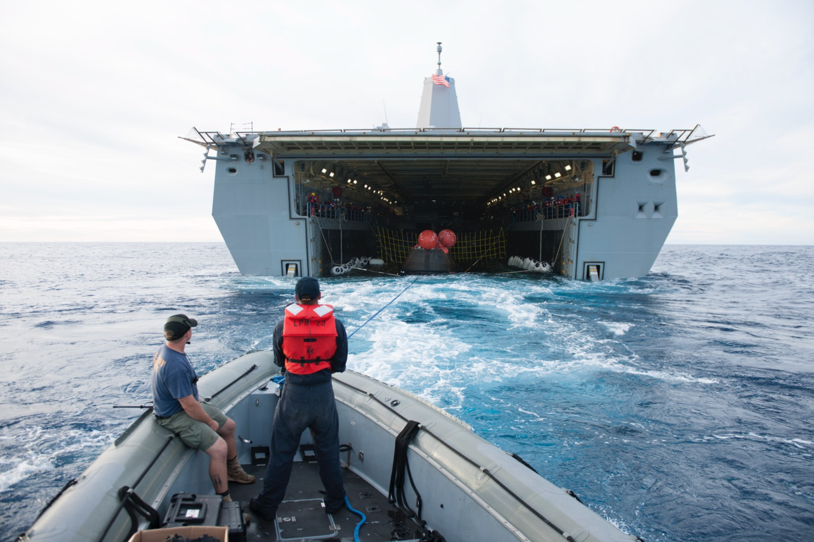
Orion is Floated into the Flooded Well Deck

Slide 15
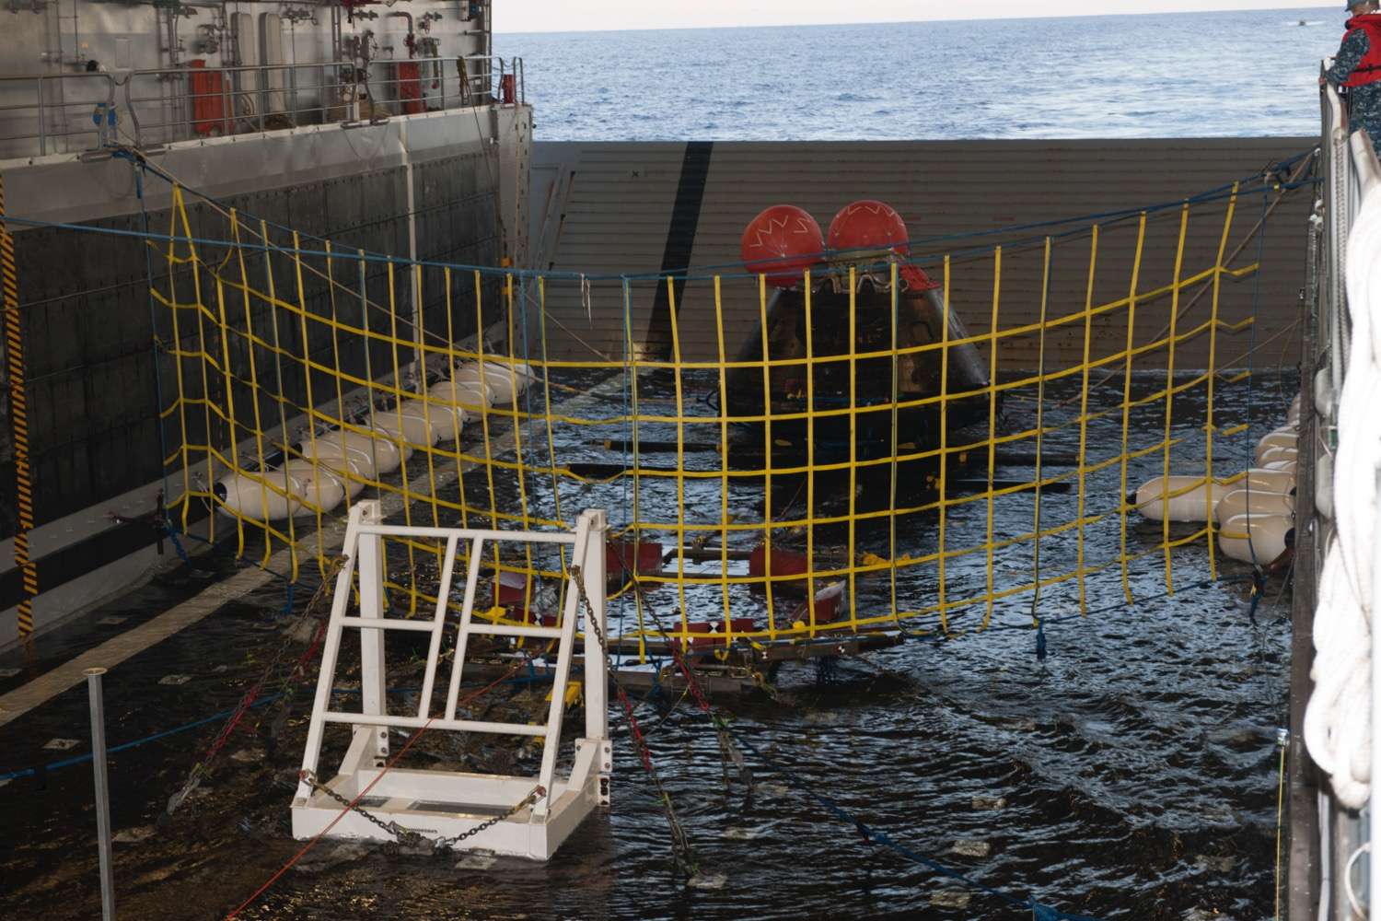
Orion Guided Over a Recovery Cradle and the Well Deck is Drained

Slide 16
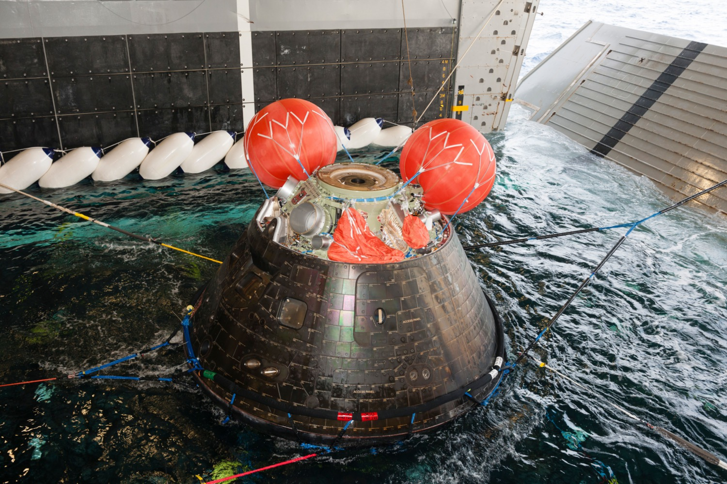
Orion over the Recovery Cradle

Slide 17
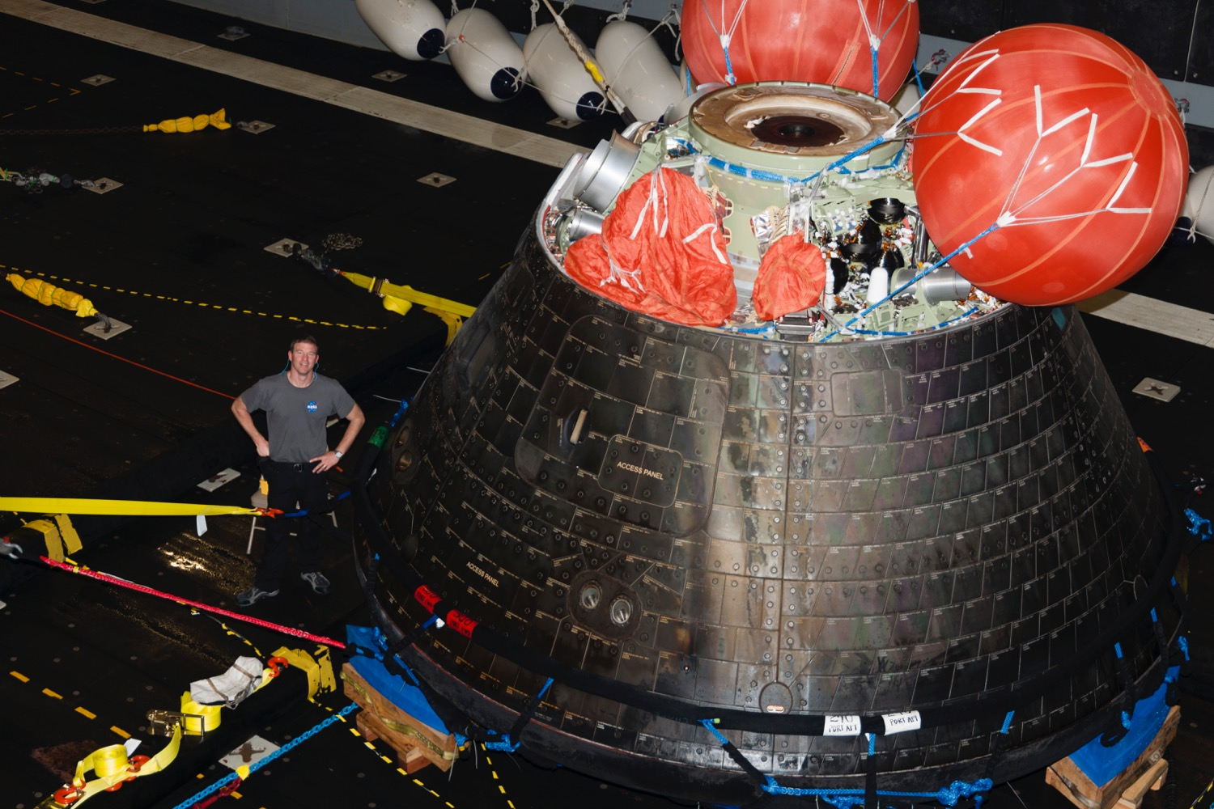
Initial Inspections and Photos Taken in the Well Deck

Slide 18
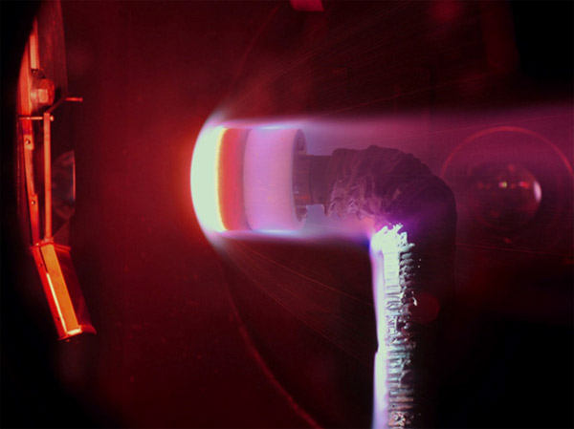
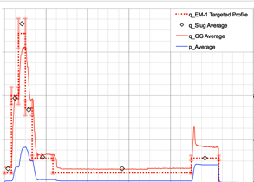
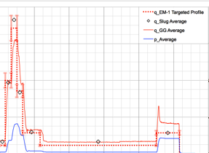
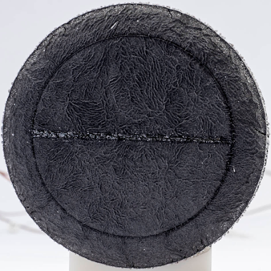
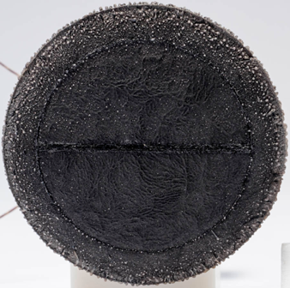
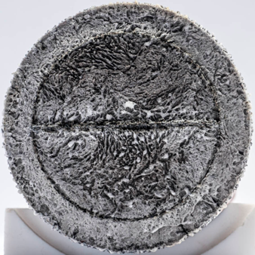
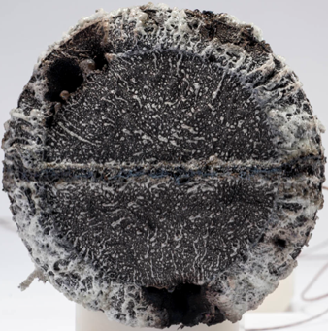
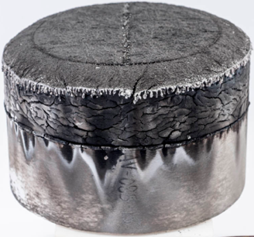
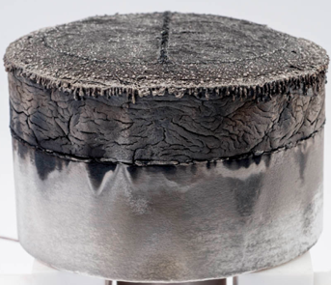
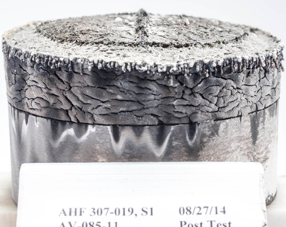
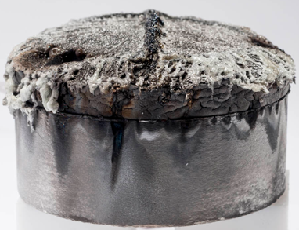
Artemis 1 Test Objective: Evaluate Seam “Fencing”
Seam adhesive can “grow” during the entry trajectory

Slide 19
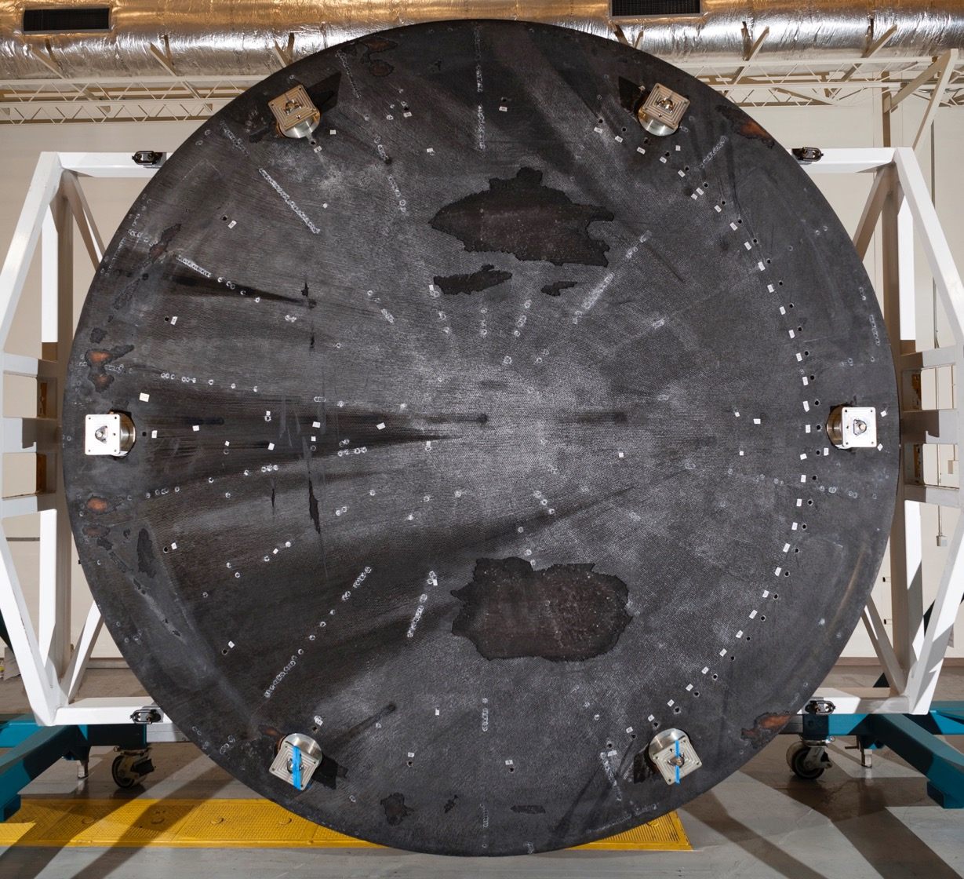
EFT-1 Post Flight
EFT-1 Heat Shield
Post-Flight Heat Shield
Transition Wakes
Stagnation Point – Off-center for a Lifting Entry
Recovery Damage
Manufacturing Repair Plugs

Slide 20
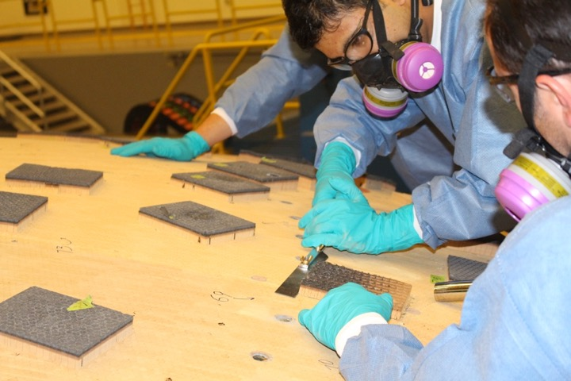
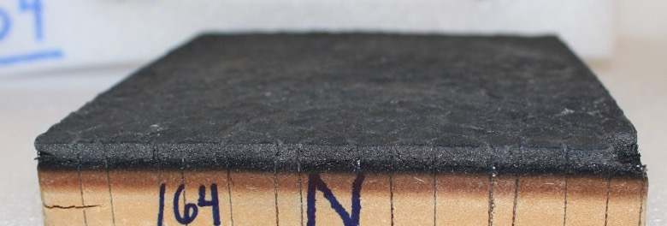
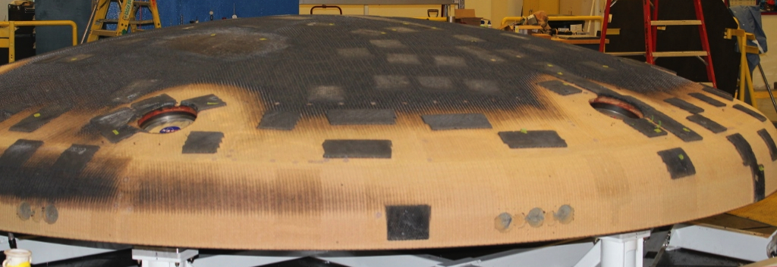
Post-Flight Evaluation
Progressive Machining Operations
~ 60 samples
> 200 Recession Measurements
Thermal, Material, and Mechanical Testing across the country

Slide 21
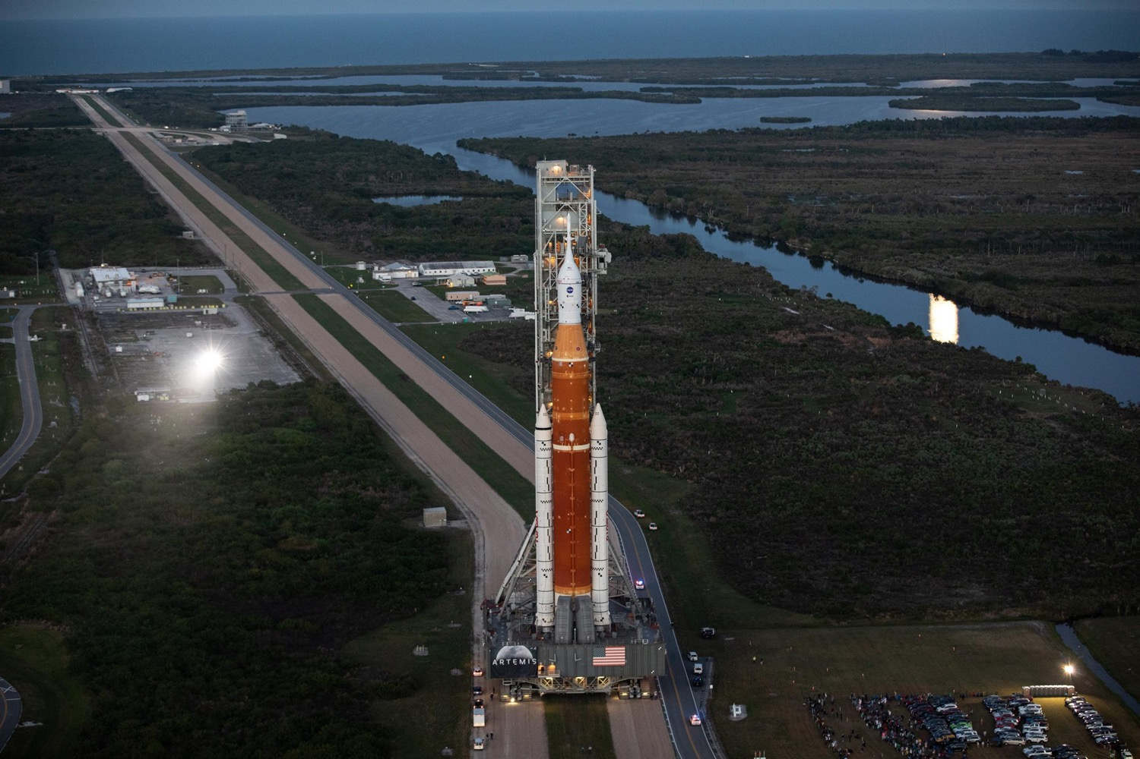
Artemis 1: Summer 2022

