Slide 1
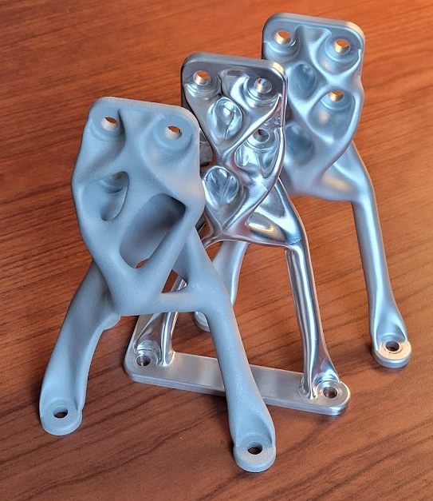
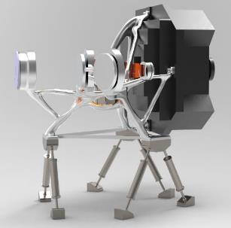
Generative Design and Digital Manufacturing:
Using AI and Robots to build spaceflight structures
Ryan McClelland
Research Engineer
Instrument Systems and Technology Division (ISTD, 550)
NASA Goddard Space Flight Center (GSFC)
8/24/2022
“Research is what I'm doing when I don’t know what I’m doing.”
-Wernher von Braun

Slide 2
Context
FY22/FY23 Internal Research and Development (IRAD) funding awarded
  Goal: create and infuse a broadly applicable process to rapidly develop lightweight spaceflight structures
    Using commercial software tools adapted for GSFC applications
  Method: build and test parts for diverse GSFC applications
  Status: developed process, demonstrated via test, infused into projects, publicized by presentations, follow-on IRAD submitted
Goals of this presentation
  Share what I have learned about Generative Design and Digital Manufacturing
    Part of the “Industry 4.0” revolution in Computer Aided Design/Analysis/Manufacturing
  Enable more projects to reduce development time/cost for structures by 5x-10x while improving the performance (mass/stiffness/strength) by 2x-4x.
    75%-50% of instrument mass is structure
    Get feedback on opportunities to further infuse, publicize, and advance this technology
“If I had nine hours to chop down a tree, I’d spend the first six sharpening my axe.”
– Abraham Lincoln

Slide 3
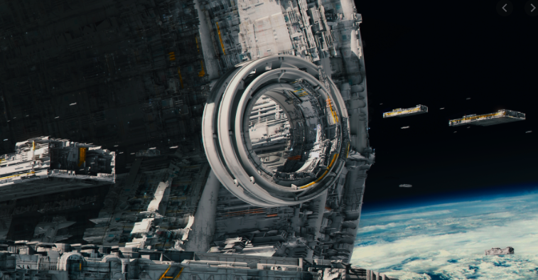
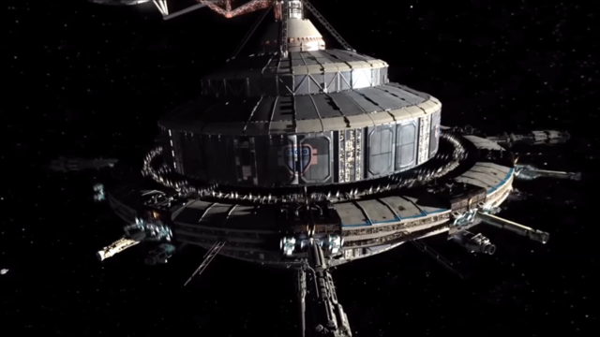
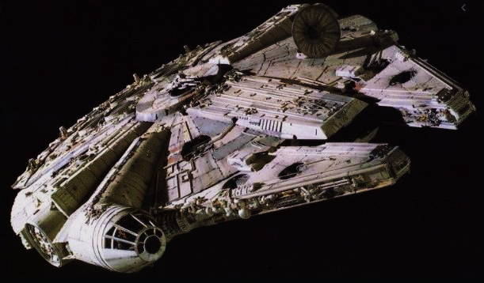
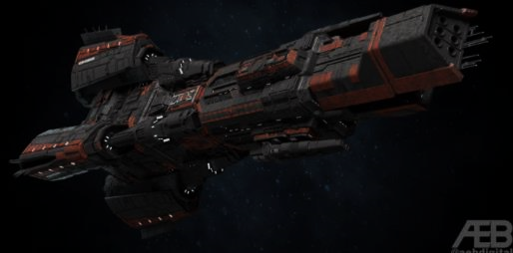
Inspiration
“AI is one of the most important things humanity is working on. It is more profound than, I dunno, electricity or fire,”
-Sundar Pichai (Google CEO)
Image source: https://www.artstation.com/artwork/Z5lYJm
Image source: https://expanse.fandom.com/wiki/Tycho_Station?file=Tycho-stn-3.png
Image source: https://en.wikipedia.org/wiki/Millennium_Falcon
We aren’t going to get there with current development methods
  ~$250K per kg
We need new tools to lower the cost of development
  How can AI be applied to spaceflight structure development?
Image source: https://mobile.twitter.com/aebdigital/status/1079504882393116674

Slide 4
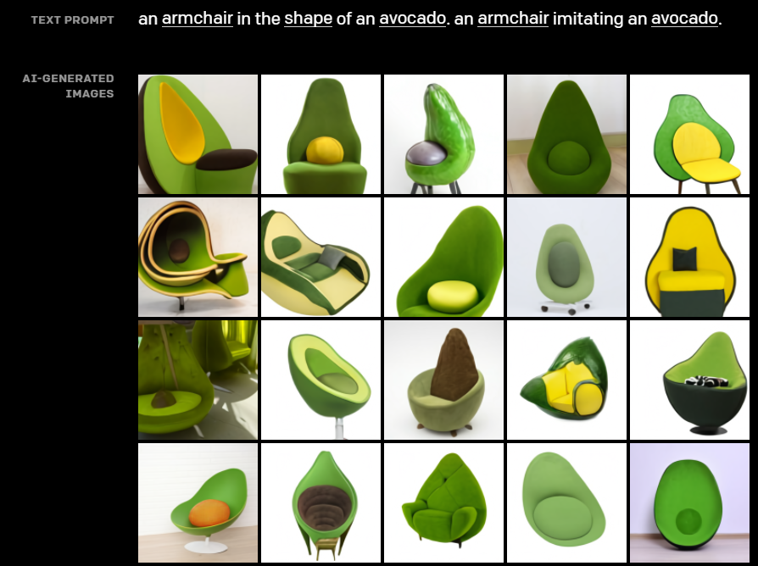
Generative Design
AI that generates multiple design outputs based on constraints
  Human designer collaborates to get ideal design
Applications
  Visual art
  Music
  Architecture
  Structural design
  Etc.?
    Mechanisms?
    Optical design?
    Circuit design?
    Mission architecture?

Slide 5
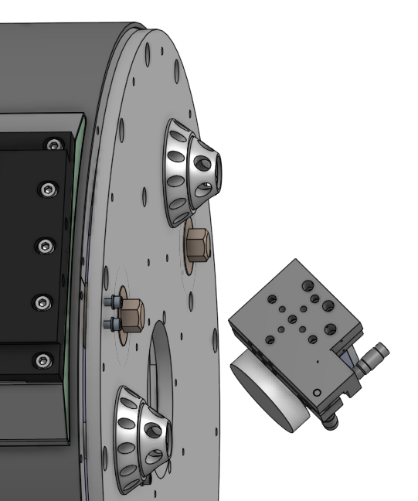
Application Example: EXCITE Tip/Tilt Bracket
Goal: Mount Tip/Tilt mirror assembly to the back of the Telescope (PI: Peter Nagler)
Interfaces: Bolt pattern on Tip/Tilt stage and bolt pattern on Telescope. Avoid Tip/Tilt assembly volume and optical path.
Loads: 10g vertical (x) 3g lateral(y and z) applied to Tip/tilt stage center of gravity (1.35 kg mass)
Modes: >100 Hz per standard practices and to avoid cryo-cooler excitation
Bracket mass target: 0.2 kg
Tip/Tilt assembly
Telescope

Slide 6
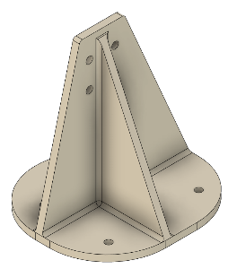
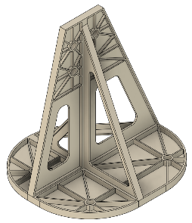
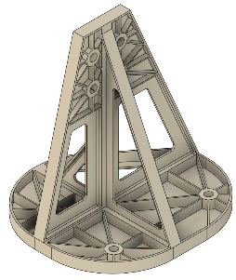
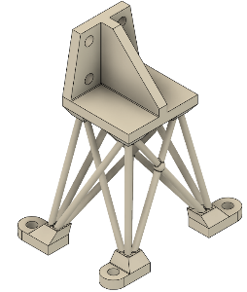
Application Example: Human Design
Design problem given to senior design engineer – Drew Jones
Finite Element Analysis (FEA) done my me
  Design improved with iteration
No manufacturable design meets the mass target
Elapsed time: 2 days
Designer / Iteration | Drew 1 | Drew 2 | Drew 3 | Drew 4
Design (Aluminum)
Mass (kg) | 0.59 | 0.18 | 0.27 | 0.18
1st Mode (Hz) | 137 | 37 | 65 | 108
Stiffness/mass (Hz/kg) | 232 | 205 | 240 | 600
Max Stress (MPa) | 26.3 | 189 | 103 | 60.7
Manufacturing | CNC | CNC Difficult to machine hog-outs – no quote | CNC Difficult to machine hog-outs – no quote | Not machinable/ printable– no quote

Slide 7
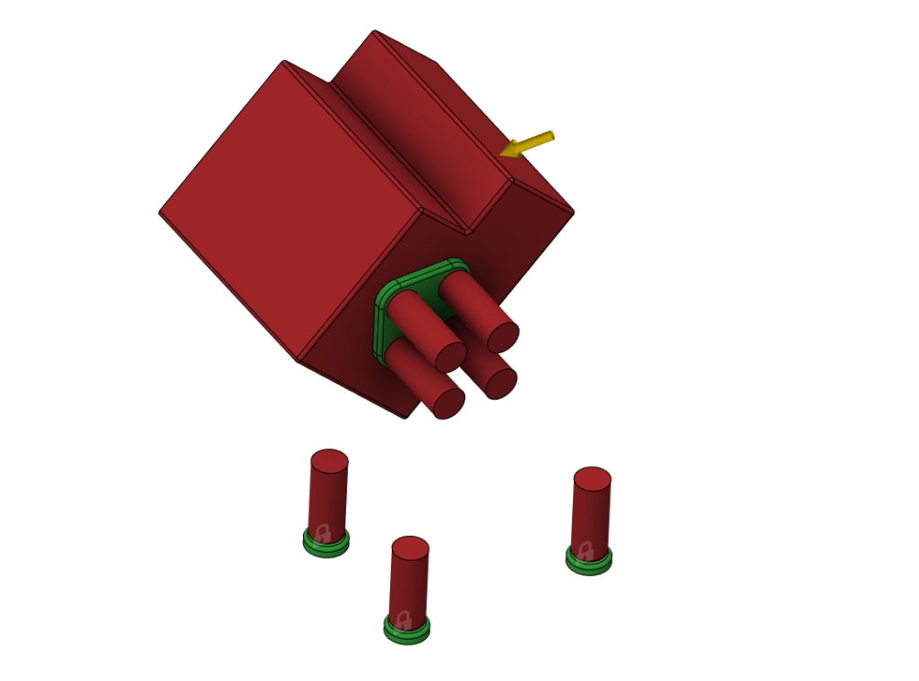
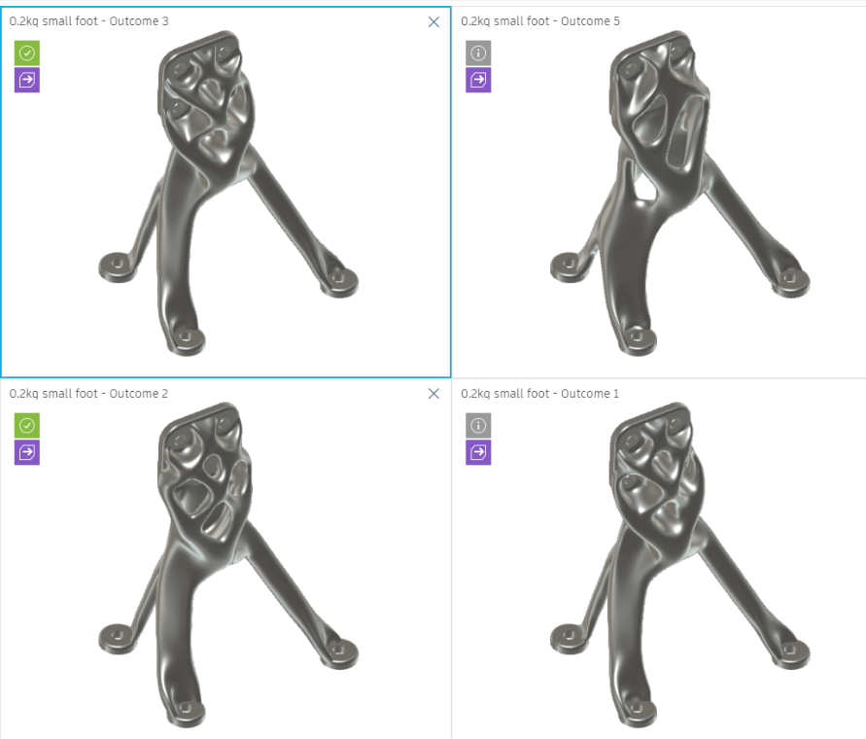
Generative Design: AI finding the ideal arrangement of atoms
Obstacles (red)
Load
Preserves (green)
Constraints
Inputs
Outputs

Slide 8
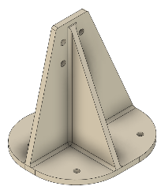
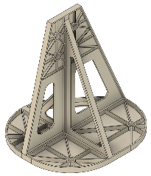

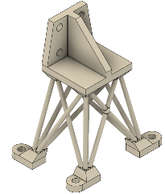
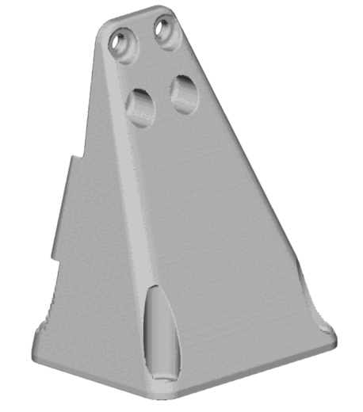
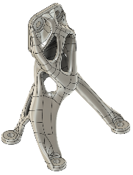
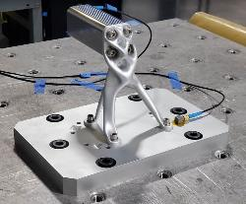
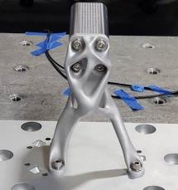
Application Example: AI Design
Design/analysis/DfM ~2hrs
Designer / Iteration | Drew/Ryan 1 | Drew/Ryan 2 | Drew/Ryan 3 | Drew/Ryan 4 | Generative 31 CNC | Generative 31 AM
Design (Aluminum)
Mass (kg) | 0.59 | 0.18 | 0.27 | 0.18 | 0.2 | 0.2
1st Mode (Hz) | 137 | 37 | 65 | 108 | 147 | 177
Stiffness/mass (Hz/kg) | 232 | 205 | 240 | 600 | 735 ~3x better | 885 ~3.5x better
Max Stress (MPa) | 26.3 | 189 | 103 | 60.7 | 14.8 >4x better | 11.2 >5x better
Manufacturing | CNC | CNC Difficult to machine hog-outs | CNC Difficult to machine hog-outs | Not machinable/ printable | $1000 3 days | $2000 3 weeks
Results verified by test

Slide 9
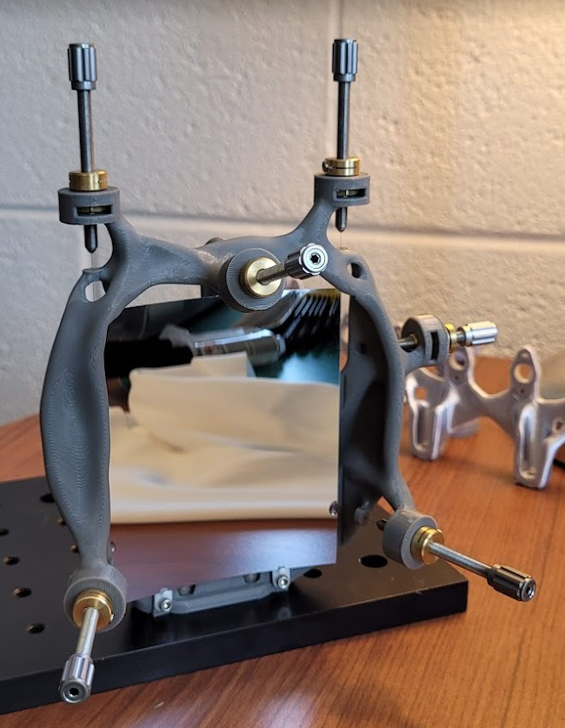
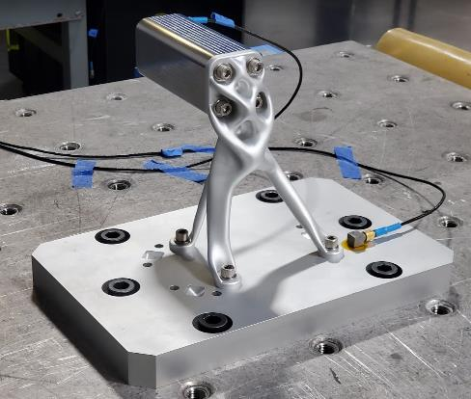
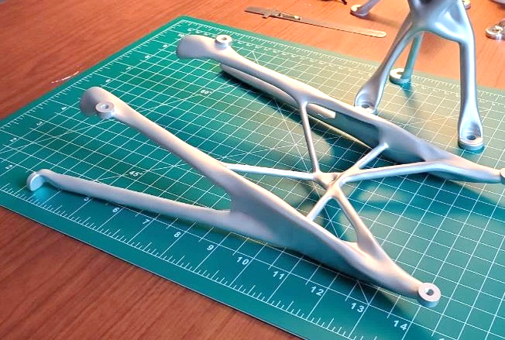
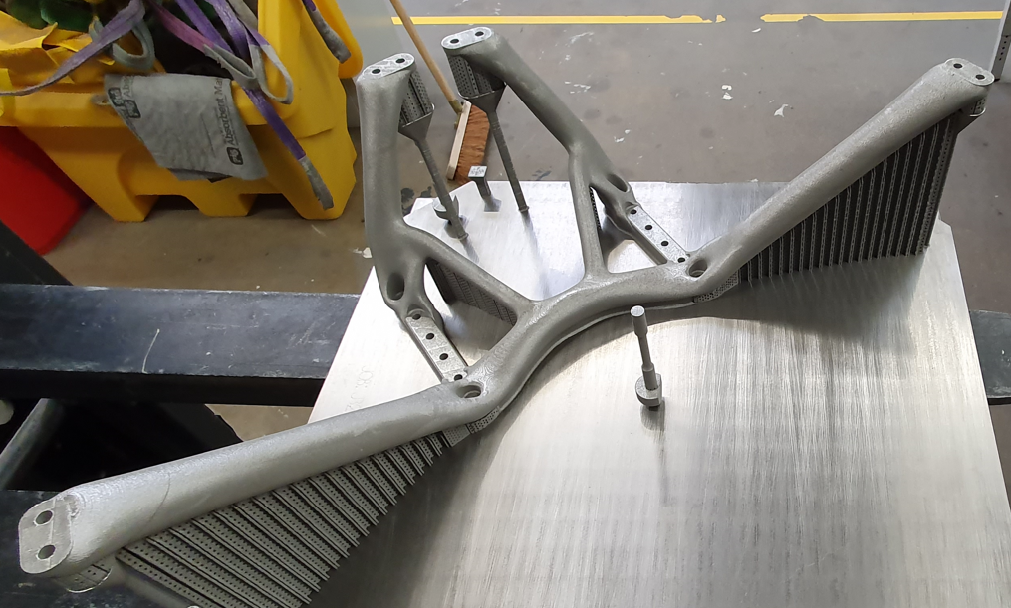
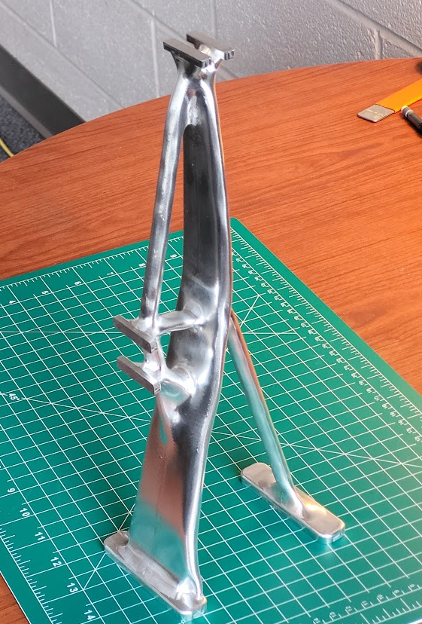
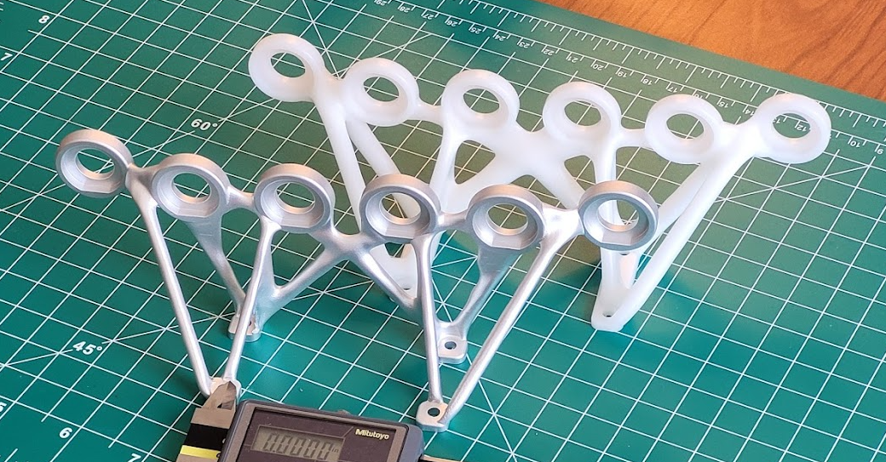
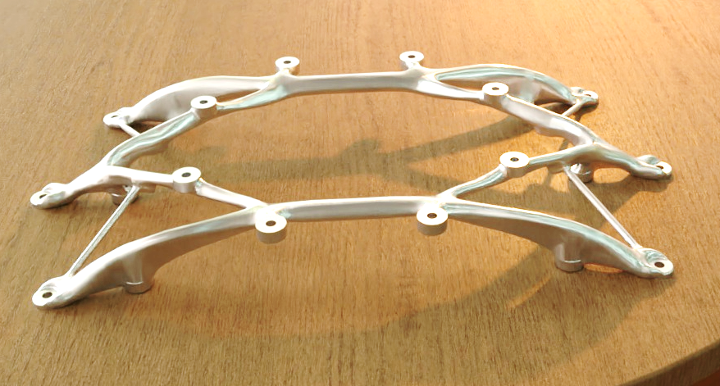
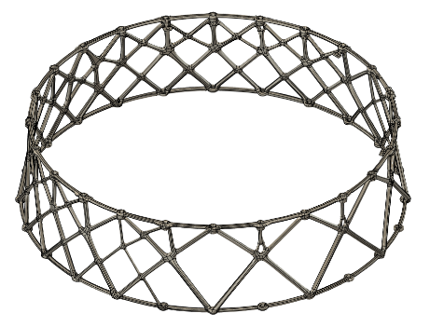
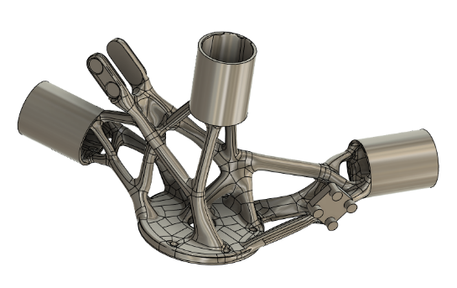
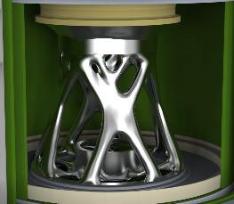
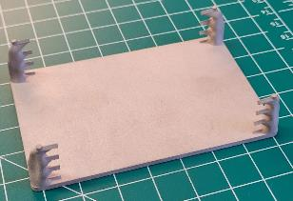
Application examples
“The trick to having good ideas is not to sit around in glorious isolation and try to think big thoughts. The trick is to get more parts on the table.”
- Steven Johnson
EXCITE: Radiator mount
EXCITE: Detector mount
NGXO: Mirror mount
EXCITE: Tip/Tilt mount
MSR-CCRS: Diode Mount
STAR-X Detector bench
ALICE: Optical Bench
HERMES: MAG Stanchion
NGXO: Mirror rack
DraMS: Carousel base
RST: OBA node
ALTIRS: Mirror mount

Slide 10
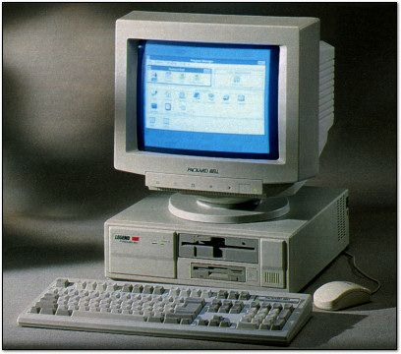

How is this possible?
Generative Design and Digital Manufacturing leverage the massive advances in Information Technology
  Pro/Engineer (e.g., Creo) released 1987
  NASTRAN released 1968
  Computing power has increased >10,000x since 1990!
    Enables a step-change in Computer Aided Engineering (CAE) capability
    Cloud computing allows practically unlimited compute for FEA
Generative Design can be considered an abstraction layer on top of:
  Computer Aided Design (CAD)
  Finite Element Analysis (FEA) i.e., simulation
  Design for Manufacturing (DfM)
Image source: https://www.vintagecomputing.com/index.php/archives/772/retro-scan-of-the-week-computer
Image source: https://elements.envato.com/cloud-computing-datacenter-server-room-servers-rac-62XTEN5
Generative Design
CAD
Top Op
DfM
Enable more science per dollar by reducing the development time/cost and increasing the performance of spaceflight structures.
FEA

Slide 11
Generative Design: Paradigm Shift
Current GSFC Process
Design requirements and goals
Designer creates CAD model
Analyst checks against requirements
Designer generates drawing
Machinist evaluates drawing
Fabrication
Inspection
Qualification
Flight
Months-Years
Generative Design Process
Design requirements and goals
AI Generates Designs; checks requirements and fabrication
Digital Manufacturing
Inspection
Qualification
Flight
Engineer focuses on requirements
Hours-Days
Demonstrated: Requirements known to parts in-hand in <2 weeks. 2x-4x lighter.

Slide 12
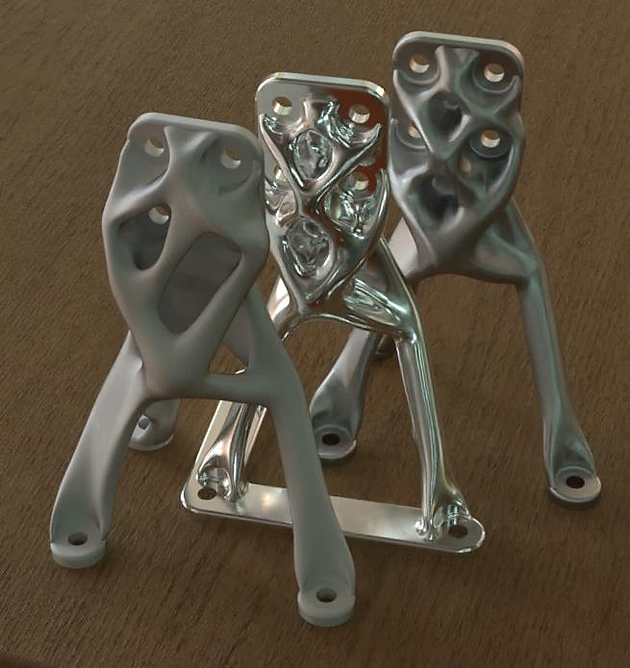
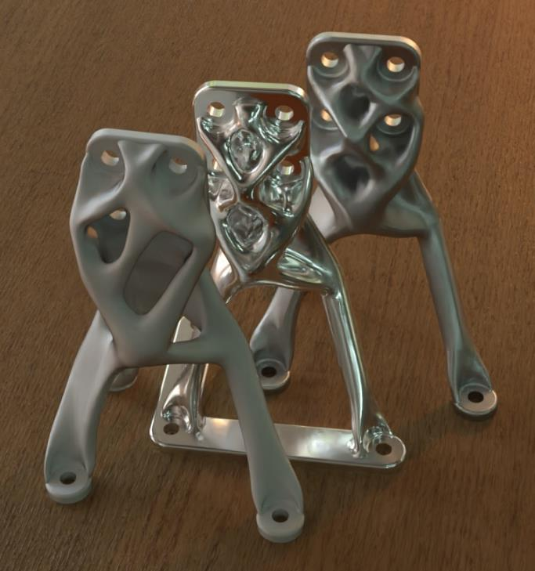
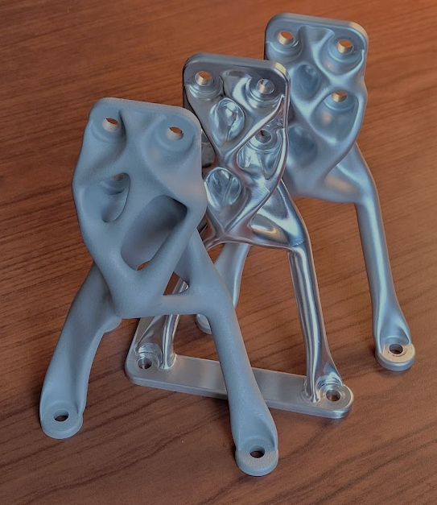

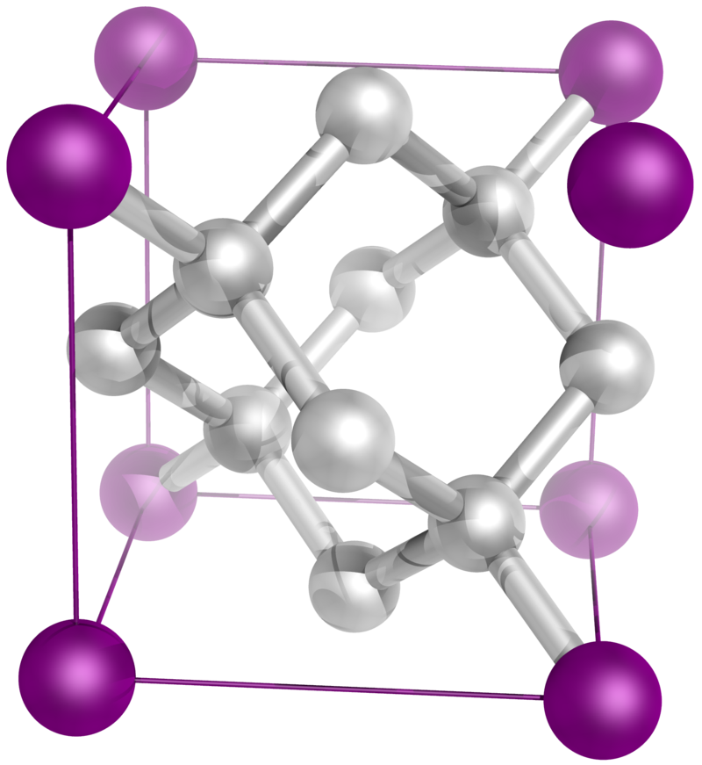
Digital Manufacturing: Robots turning bits to atoms
Bits
Atoms

Slide 13
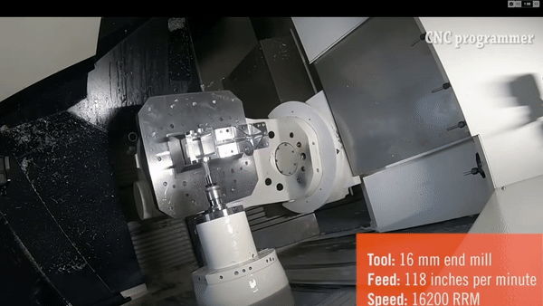
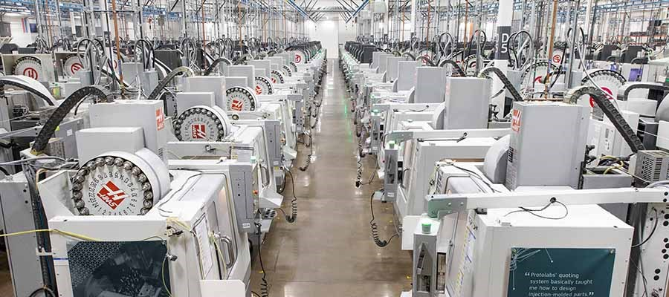
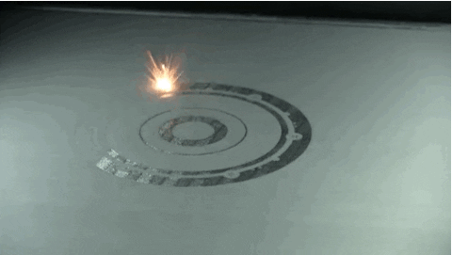
Digital Manufacturing
Robot: a machine capable of carrying out a complex series of actions automatically, especially one programmable by a computer
Manufacturing processes that can make parts from CAD files with minimal human intervention
  Software creates machine code (e.g., gcode) from CAD
  Robot runs the code and makes the part
Digital Manufacturing ≠ Additive Manufacturing
Automated CNC
  Computer Aided Manufacturing (CAM) creates gcode from CAD with some human input
  Exception: Protolabs – automated machine shop
    500+ HaaS CNC machines and no machinists
Additive Manufacturing (AM, 3D printing)
  Great at generating gcode from CAD
    AM often needs to be iterated: validation developing
  Allows more design freedom: better performance
  More “runway” for future improvements: bone-like structures
Image source: https://www.protolabs.com/services/cnc-machining/
Image source: https://www.youtube.com/watch?v=Byj1ON4x4vY
Image source: https://www.ge.com/news/reports/these-engineers-3d-printed-a-mini-jet-engine-then

Slide 14
TRL and Risk
There is no additional risk in Generative Design compared to human designs
  Generative Designs have higher margins due to better stress distribution
  Generative Design uses known and predictable algorithms
  Humans use unknown and unpredictable algorithms
    Give 10 different designers the same requirements, get 10 different designs
  Current design validation techniques can be used: e.g., NASTRAN/FEMAP
  Fewer mistakes from stove-piping of design, analysis, and manufacturing
    Common failure mode – game of telephone
  NASA requirements and standards can be encoded into Generative Design
    E.g. bolt edge distance, tool clearance, factor of safety, loads and modes
There is no additional risk in Digital Manufacturing compared to traditional techniques
  Current verification techniques can be applied: e.g., inspection and test
  NASA-STD-6030 defines requirements for flying AM parts
    11 AM parts on Perseverance Rover (JPL)
  Early optimized design encourages early prototypes to reduce risk: hardware rich

Slide 15
Next Steps
FY22 IRAD
  Continue to design/build/test applications, infuse into projects, and publicize
FY23 IRAD/CIF
  Continue to infuse and publicize FY22 advancements
  Extend game-changing benefits to the full diversity of GSFC applications, focusing on strategic priorities (e.g. Large Space Telescopes)
    Large truss structures
    Composite structures
    Bionic (bone-like) structures
    Flexure systems
    Robotically assembled/serviced structures
    Lightweight optics
Long term
  Look for other opportunities to advance Digital Engineering technologies that reduce mission development cost

Slide 16
Acknowledgments
550 REP Program (Diep Nguyen, Renee Reynolds, Pete Maymon, Patricia Cuchillas, etc)
Cross-cutting IRAD (Mike Johnson, Heather Bradshaw)
IRAD SME Consultants: Nathan Smith 541, Babak Farrokh 542, Steve Kenyon 543, David Steinfeld 545, Andrew Glendening 373
Academic and industrial collaborators: Penn State (Tim Simpson), Autodesk (Mike Smell), 3D Systems (Dustin Crouse), Protolabs (Dan Snetselaar), ZeroHour (Jesse Sherwood)
NGXO, OGRE, STAR-X (Will Zhang)
EXCITE (Peter Nagler)
MSR (Eric Waltman, John Troll)
ALICE (Luke Oman, Aaron Comis)
DraMS (Pete Barfknecht)
HERMES (Kevin Dahya)
ALTIRS (Matt Kowalewski)
RST (Michael Szedlmayer)
SQRLI (Mark Stephen)
XRF (Keith Gendreau)

