Slide 1



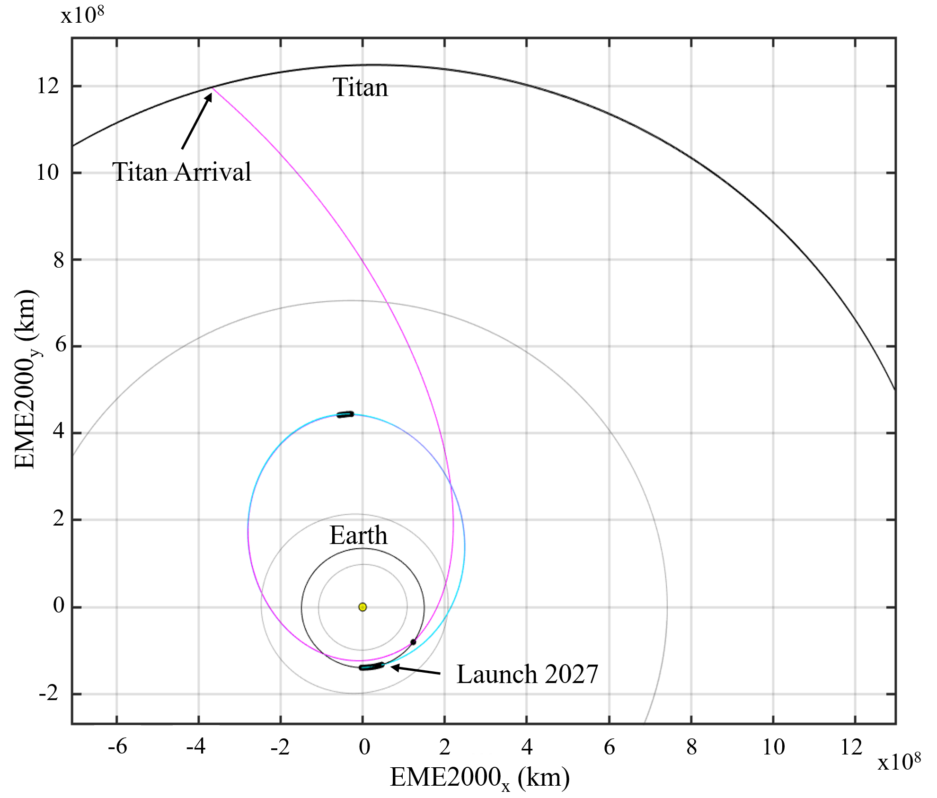
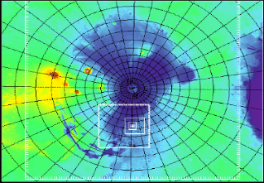

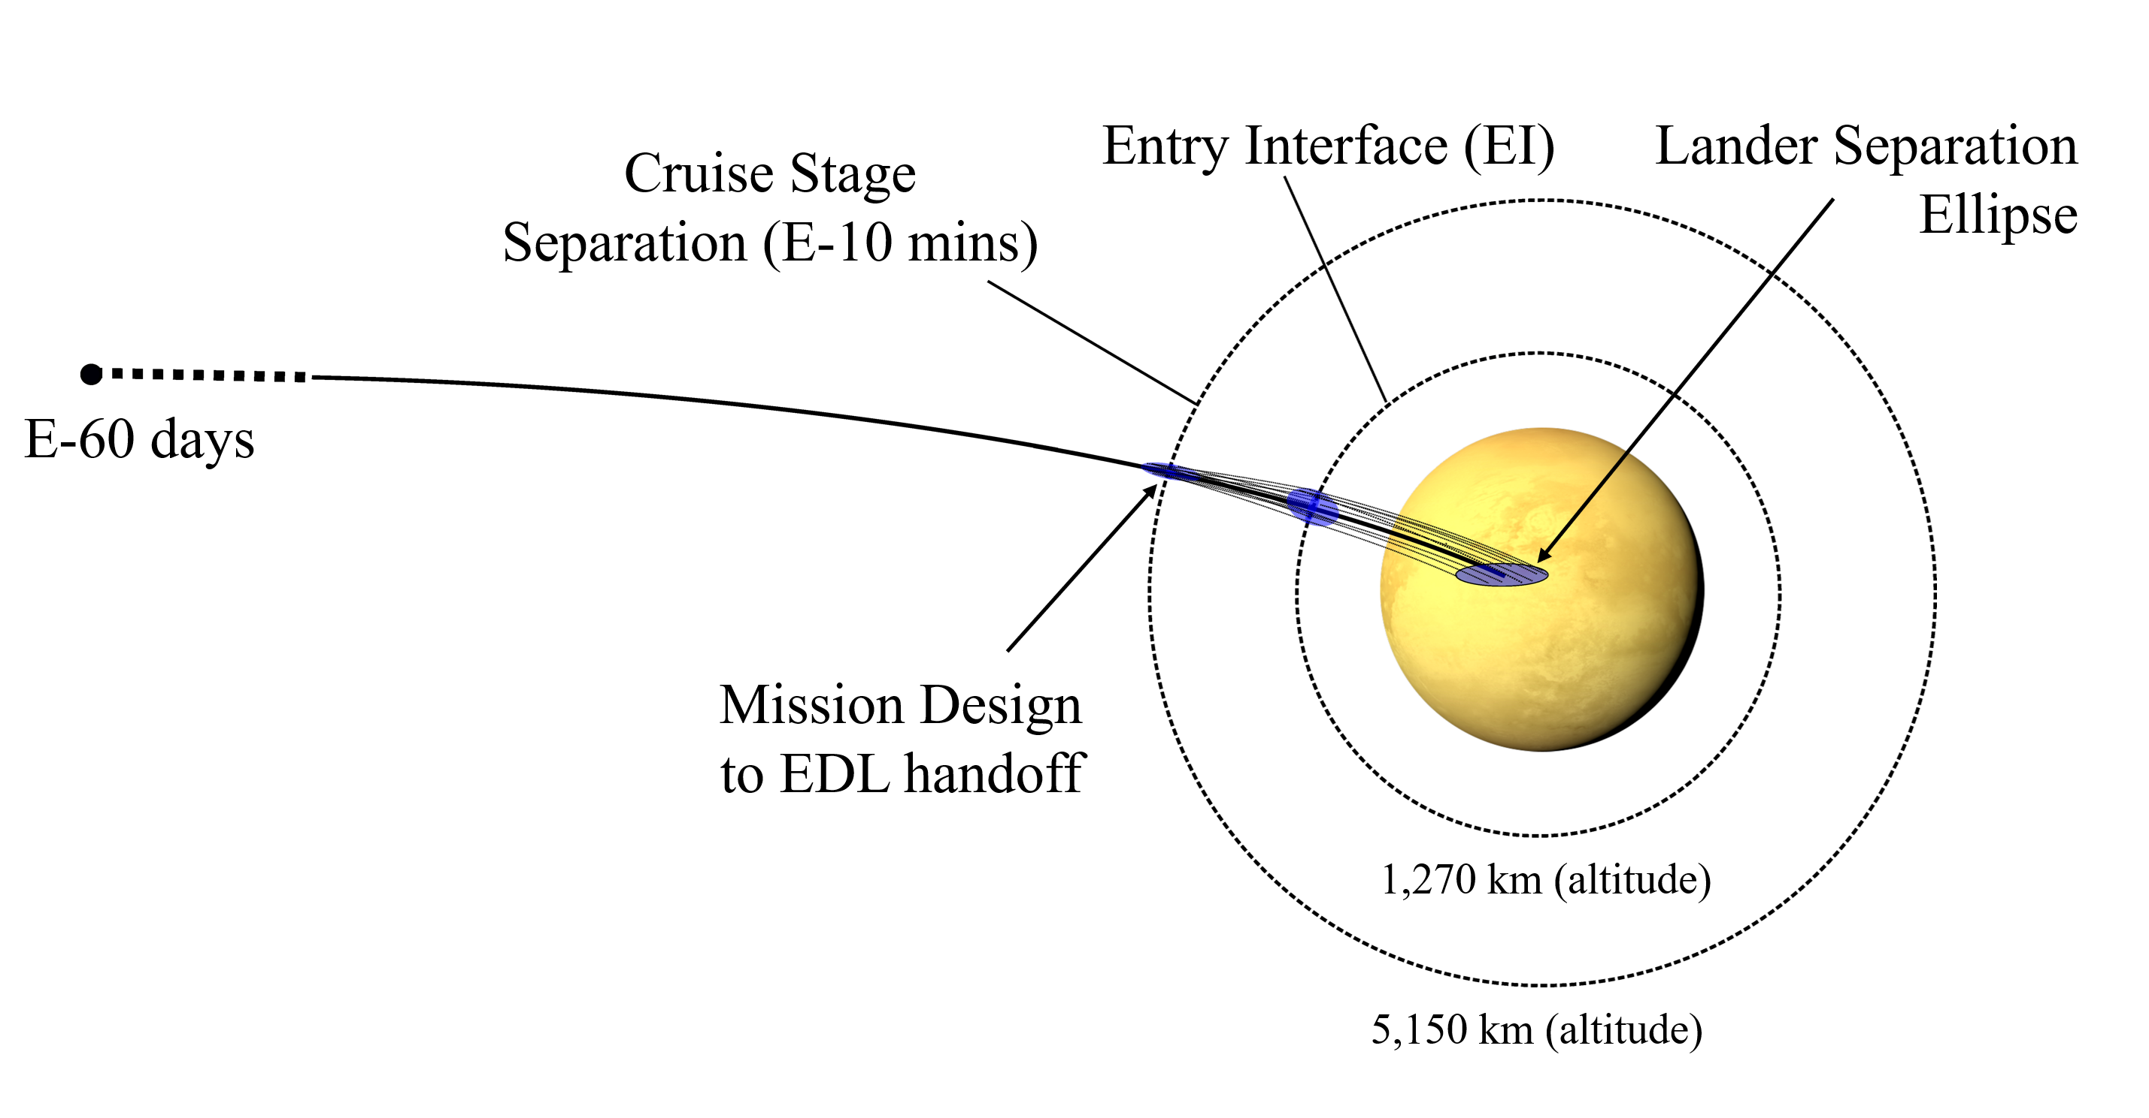
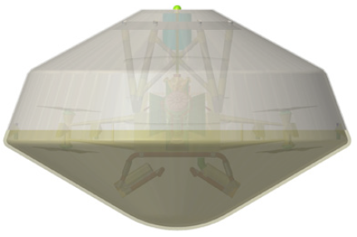
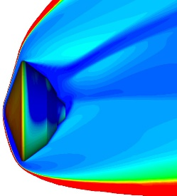
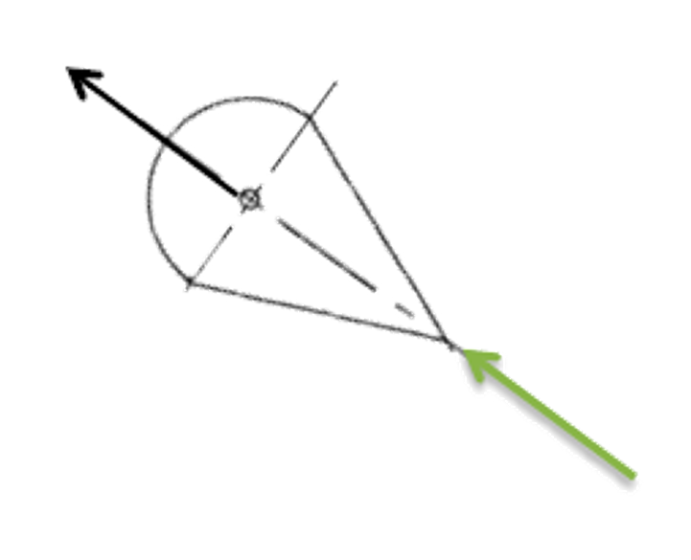
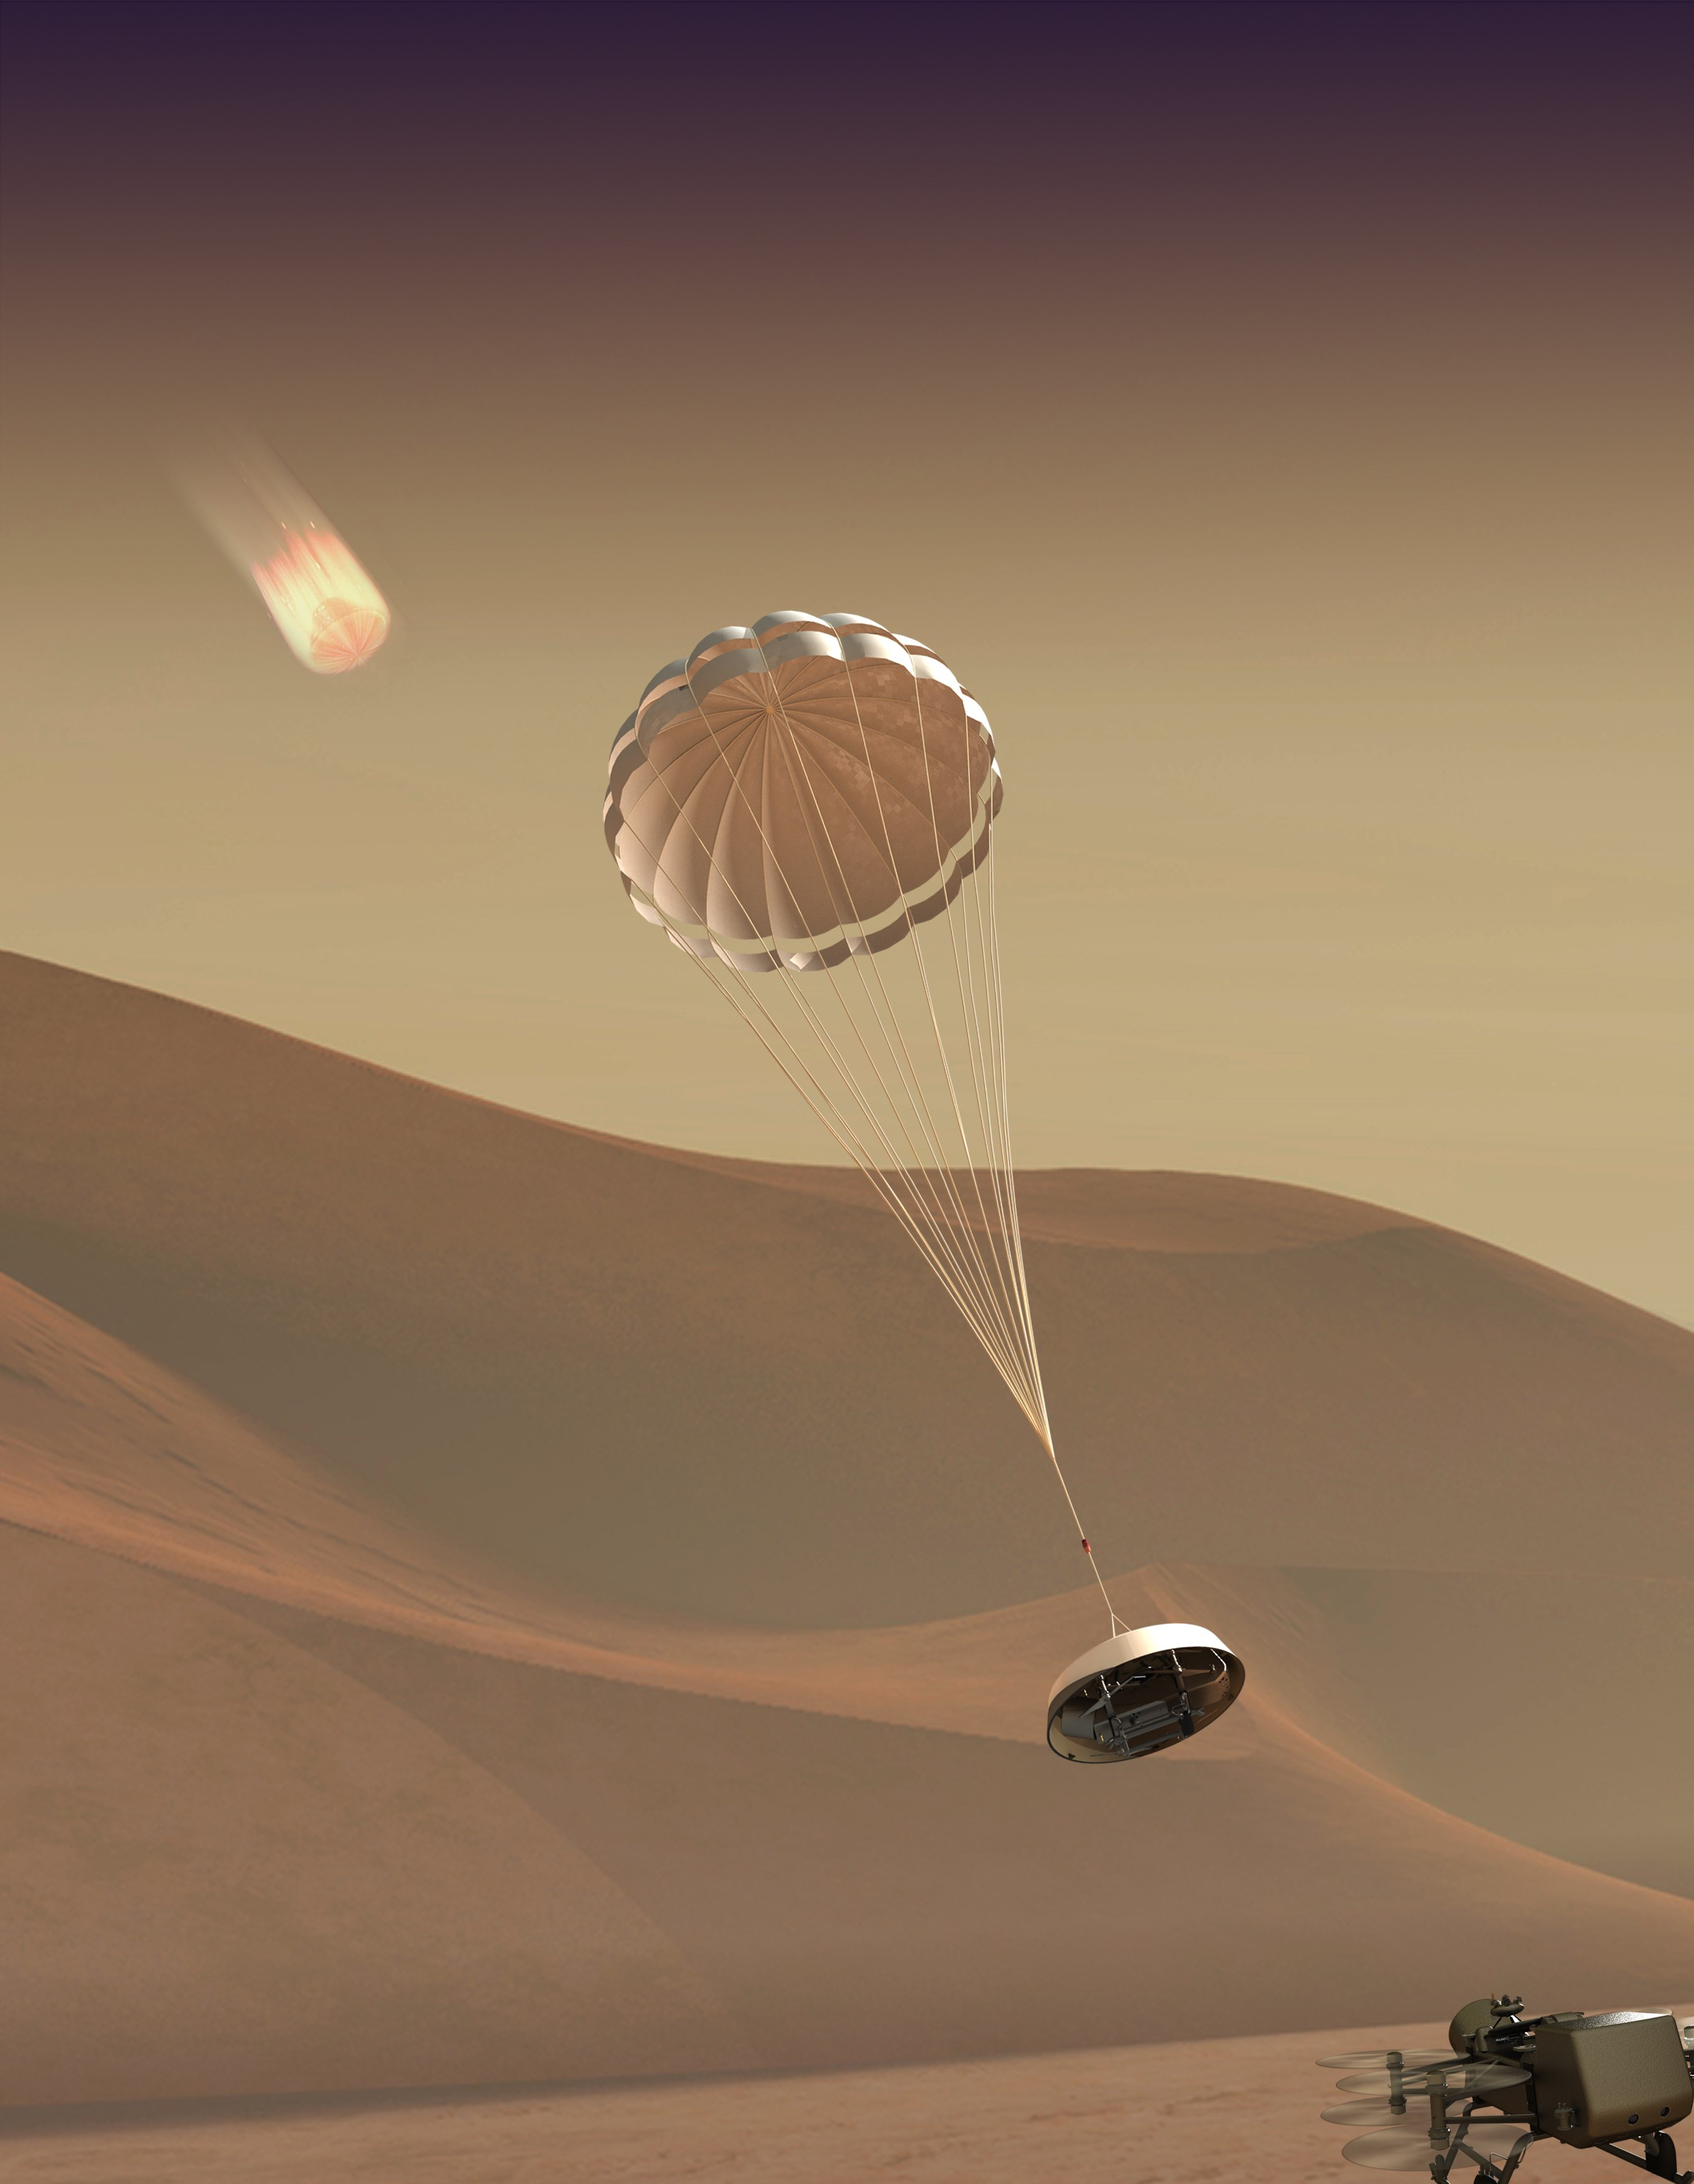
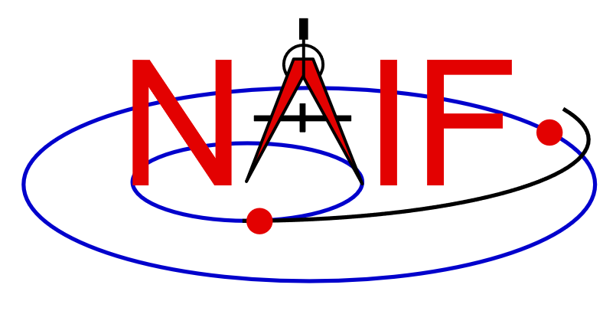
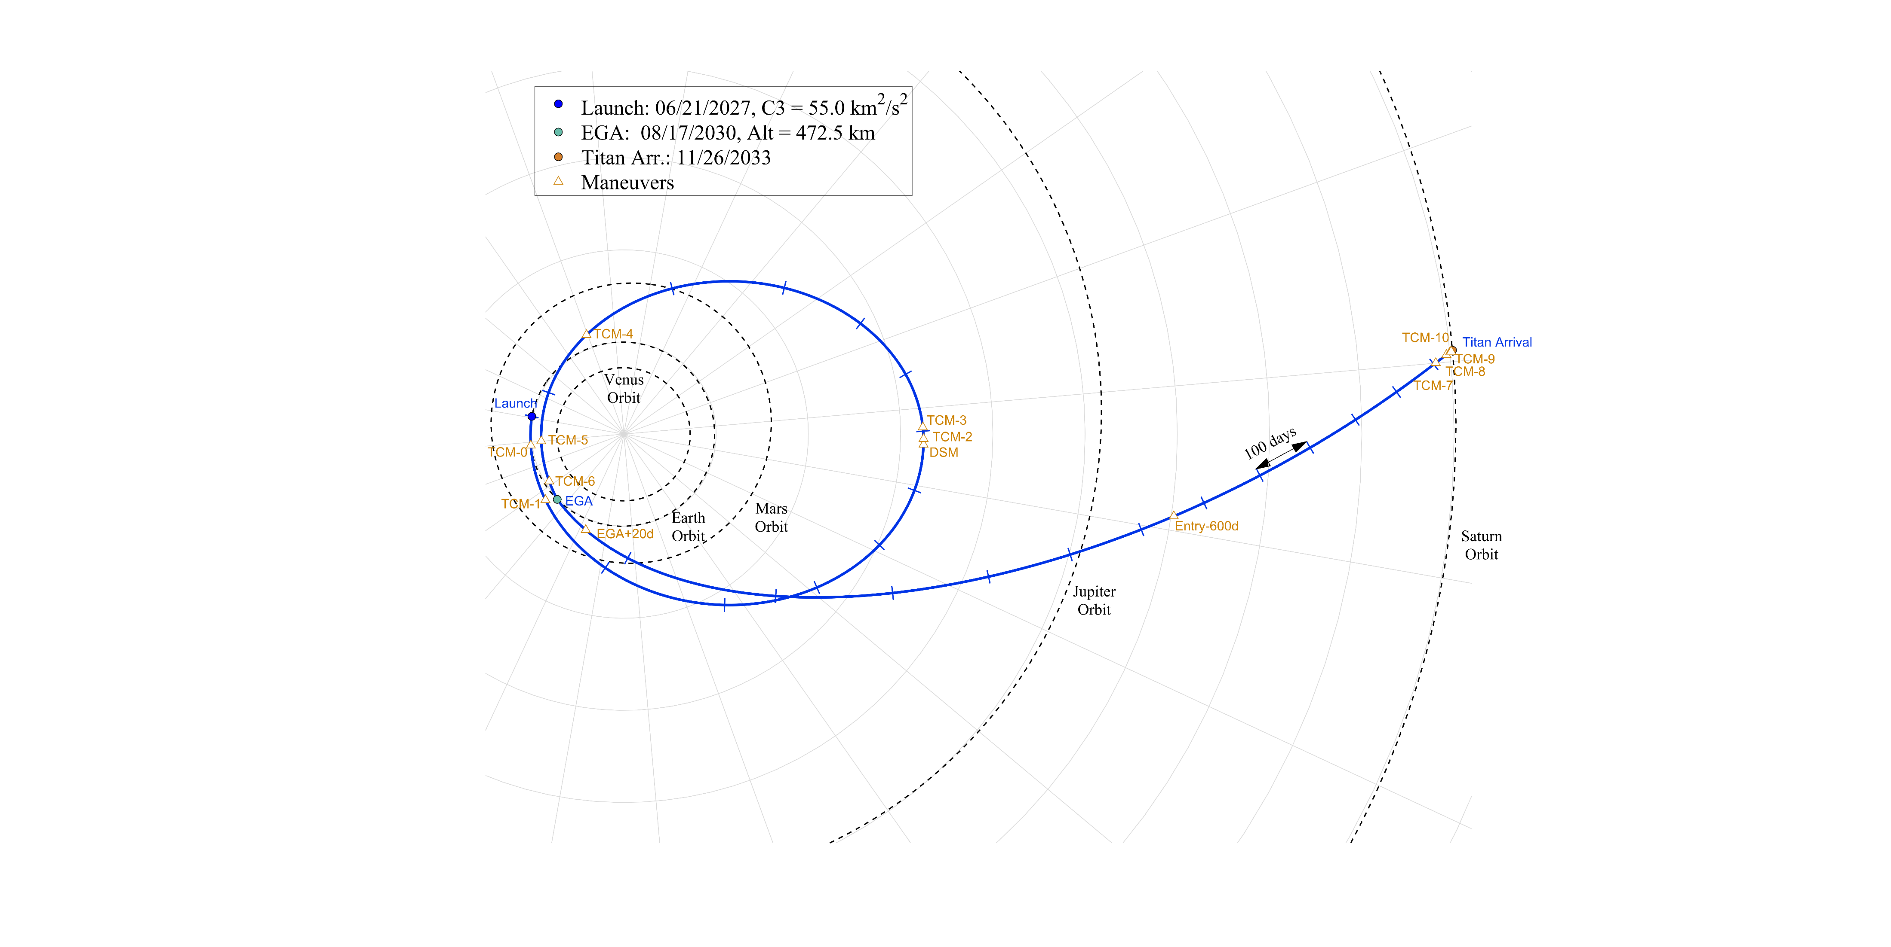
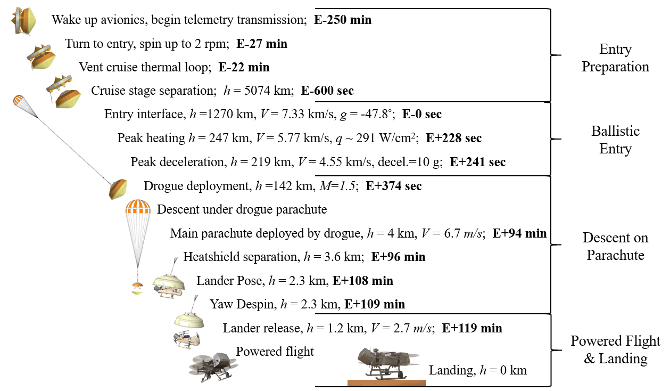
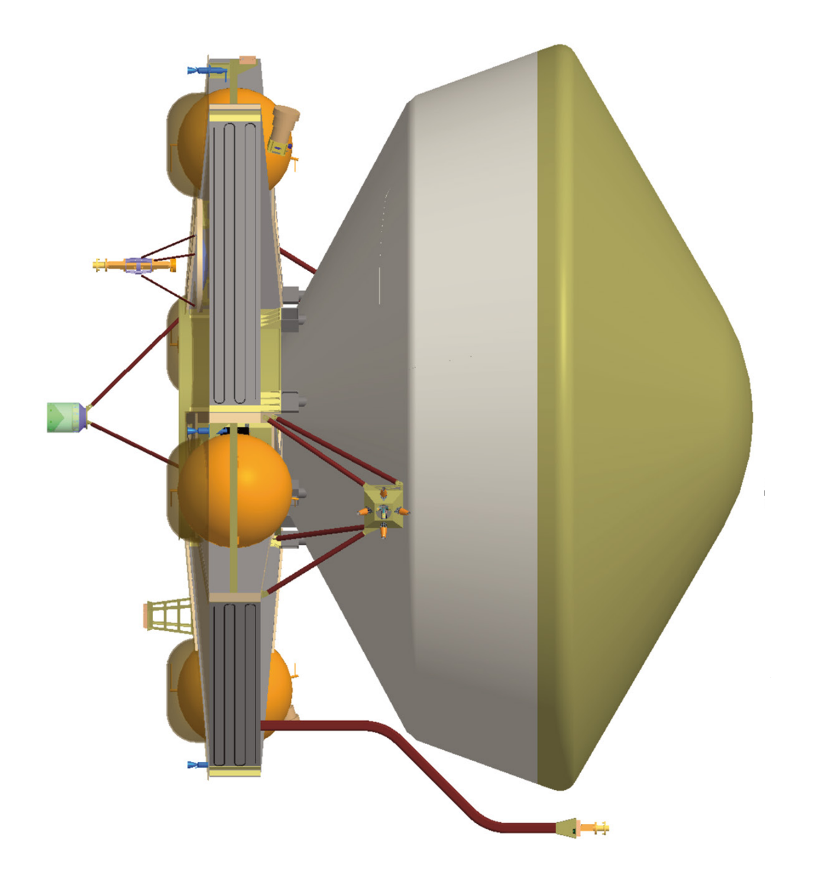
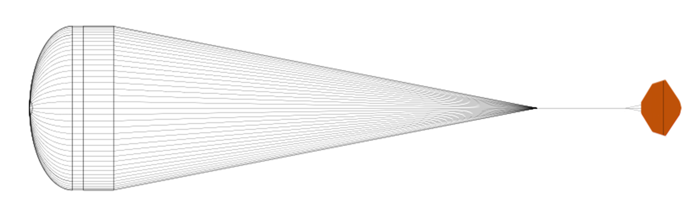
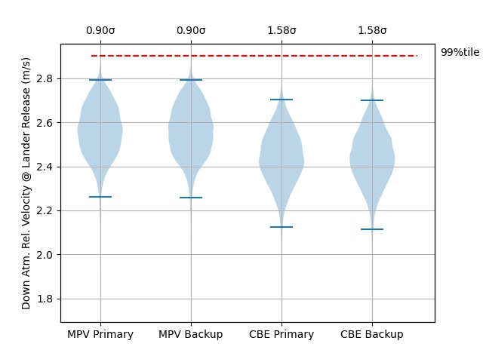
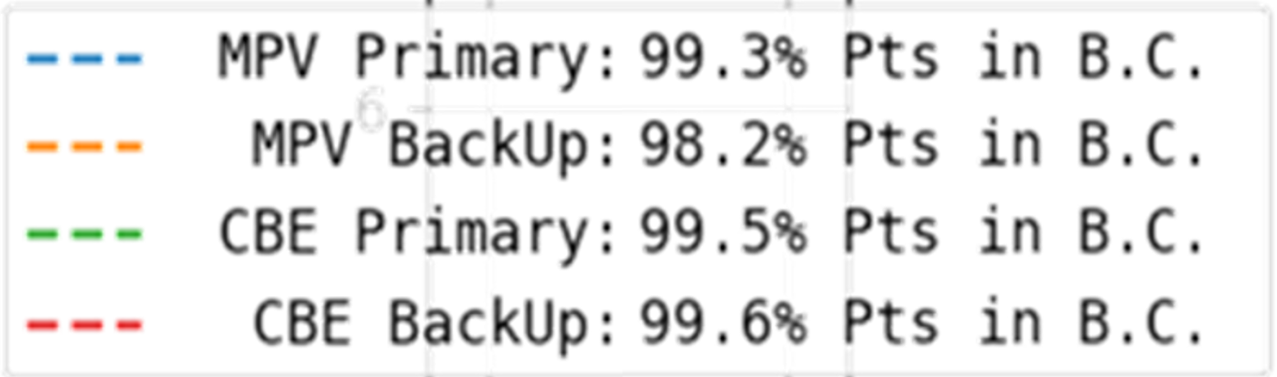
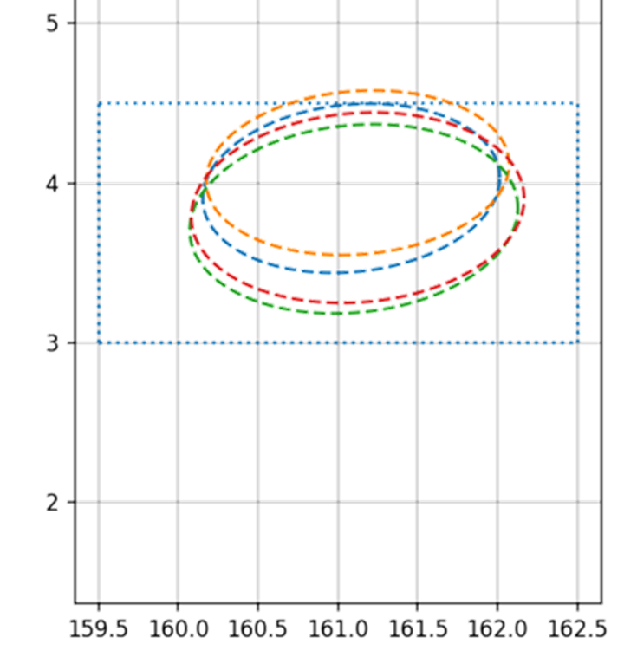
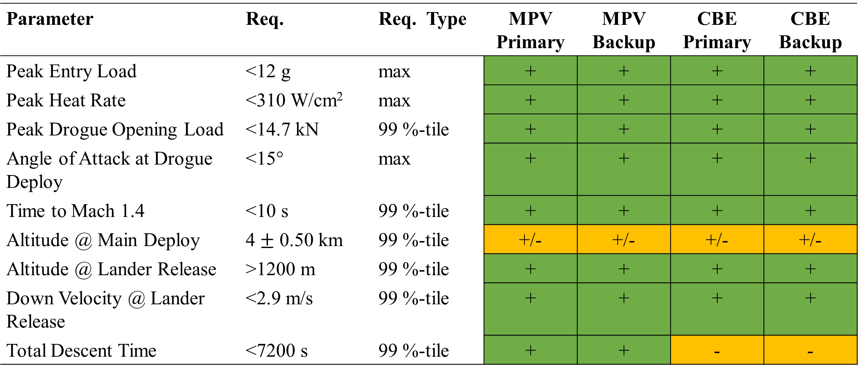
Dragonfly Entry and Descent Flight Mechanics Modeling and Analysis
R. Winski¹, A. Pensado¹
¹AMA Inc at NASA Langley Research Center
Abstract ID: 64
Mission Design
Introduction
Dragonfly is a New Frontiers Program mission that will deliver a rotorcraft lander to Saturn’s moon, Titan [1]. The focus of this work is to analyze the trajectory from cruise stage separation until lander separation. This analysis is done by the NASA Langley (LaRC) EDL team using Program to Optimize Trajectories II (POST2)[2]. This poster provides an overview of the current design and the robustness of the overall entry sequence as assessed using a Monte Carlo uncertainty analysis. This mission is led by Johns Hopkins Applied Physics Laboratory (APL), presented here is the design and analysis as of the Dragonfly EDL Assembly Preliminary Design Review (PDR).
Dragonfly has two launch opportunities: the primary launch window in 2027 and the back up opportunity in 2028. Both opportunities utilize an Earth gravity assist (EGA) with various trajectory correction maneuvers (TCM). The entire mission trajectory is designed to target a specific lander separation site. The APL mission design, as shown in Fig 2, is a collective effort to generate an end-to-end trajectory solution between APL, NASA LaRC, and JPL. The hand off between the simulations is defined as 10s prior to cruise separation.
Modeling and Simulation
The integrated trajectory is simulated and analyzed using POST2. Models are provided by interdisciplinary teams from APL, Jet Propulsion Laboratory (JPL), NASA Ames, NASA LaRC, Lockheed, and University of Central Florida (UCF). Fig 1 shows an overview of the models and the corresponding model owners.
During the design analysis cycle, the models are incorporated and combined in POST2, which enables overall trajectory performance assessment. The integrated trajectory is provided to model developers to support the subsystem design process. These models will be refined as the design matures during Phase C and as hardware is built.
Atmosphere (APL)
Gravity (JPL)
Mass
Properties
(Lockheed)
Aerothermodynamics
(Ames)
POST2
Aerodynamics (LaRC/UCF)
Fig 2. 2027 Launch Opportunity
Parachutes
(LaRC)
Subsystem models are brought together and integrated into trajectory simulation
Fig 3. Transition from mission cruise to EDL phase
SPICE
(NAIF JPL)
Concept of Operations
The POST2 simulation begins 10s prior to cruise stage separation. The entry vehicle is separated from the cruise stage using a spring mechanism and is designed to eliminate far-field recontact risk. After entry interface, the vehicle undergoes peak heating and deceleration. Then the drogue parachute deploys during a 5s window after reaching a sensed acceleration, using a smart trigger to minimize the angle of attack. This is to ensure the entry vehicle does not become unstable and that the drogue parachute opening loads are within requirements. The vehicle continues until the drogue lines are cut and the main parachute is deployed. The heatshield is deployed 120s after the main parachute is deployed. The lander is lowered into a pose condition after main parachute deployment. At 1200m and a down velocity of 2.7m/s, the lander is released. The simulation continues to track all vehicles to their respective touchdowns.
IMU (APL)
Initial States
(APL)
Fig 1. Overview of the models incorporated for the integrated performance simulation
Vehicle and Parachute Design
The entry vehicle design, a 4.5m 60° half-angle sphere cone, is based on the Genesis Sample Return Capsule (GSRC), was modified to meet requirements for lander geometry and mission heating.
This work modified the aerodatabase from GSRC. The GSRC free molecular and hypersonic data was modified using computational fluid dynamics (CFD) analysis. The low-speed database was modified using data collected from the Langley 12’ low speed wind tunnel. Additionally, further improvements will be made incorporating data collected from the Langley Transonic Dynamic Tunnel (TDT) and future CFD analysis.
The EDL vehicle uses a 5.4m Disk Gap Band (DBG) drogue parachute and 16.55m DBG main parachute that are modelled as separate, six-degree-of-freedom rigid bodies. The drogue parachute is mortar deployed. The deployment, inflation, and opening loads are defined by the models provided by the parachute design team.
Fig 4. Notional entry vehicle geometry [1]
Fig 6. The concept of operations of the entry vehicle from prior to entry interface to touchdown
Baseline Analysis
The baseline analysis consists of Monte Carlo results for primary and back up launch opportunities as well as the maximum possible value (MPV) and the current best estimate (CBE) mass properties. Fig 7 shows an example of the Monte Carlo results for 10,000 cases with the 1%-tile and the 99%-tile shown. The requirement is shown in red along with the margins shown on top. The current status of the trajectory performance is summarized in Table 2. The main parachute is sized for the MPV which leads to a high descent times for the CBE scenario. The altitude at main deploy is currently being refined as the triggers and uncertainties are better understood.
Fig 5. Generic geometry of the drogue and main parachute
Lander Separation Analysis
The EDL trajectory targets a lander separation point. The requirement indicates 95% of the lander separation points shall be in the landing box, where the landing box is defined by the project requirements for the lander. The separation box is defined by lander flight requirements to the science target, available radar data, and probabilities of rough terrain. The footprint ellipse is generated from the combined uncertainties from the initial states, and the uncertainties of the EDL trajectory. The current results show all baseline cases meet the 95% lander separation target in Fig 8.
Fig 7. Baseline results for the velocity at lander separation
Latitude (deg)
Table 2. Current Status of Requirements prior to PDR
Parameter | Req. | Req. Type | MPV Primary | MPV Backup | CBE Primary | CBE Backup
Peak Entry Load | <12 g | max | + | + | + | +
Peak Heat Rate | <310 W/cm² | max | + | + | + | +
Peak Drogue Opening Load | <14.7 kN | 99 %-tile | + | + | + | +
Angle of Attack at Drogue Deploy | <15° | max | + | + | + | +
Time to Mach 1.4 | <10 s | 99 %-tile | + | + | + | +
Altitude @ Main Deploy | 4 $±$ 0.50 km | 99 %-tile | +/- | +/- | +/- | +/-
Altitude @ Lander Release | >1200 m | 99 %-tile | + | + | + | +
Down Velocity @ Lander Release | <2.9 m/s | 99 %-tile | + | + | + | +
Total Descent Time | <7200 s | 99 %-tile | + | + | - | -
Longitude (deg)
Fig 8. Baseline results for the lander separation footprint
References
[1] Ralph et. al. Dragonfly: A Rotorcraft Concept for Scientific Exploration at Titan (2018)
[2] Program to Optimize Trajectories II https://www.nasa.gov/post2

