Slide 1
A New, Efficient, and Consistent Method for Generating Climate Data Record from Operational Hyperspectral Sounder Instruments on AQUA, S-NPP and NOAA 20
Xu Liu
W. Wu, L. Lei, X. Xiong, and Q. Yang et al.
  NASA Langley Research Center, Hampton, VA
  Thanks to L. Strow et al. and NASA SIPS for providing the CHIRP data
Acknowledgement for computer facilities:
Langley K-cluster, NASA supercomputer, NASA Sounder SIPS

Slide 2
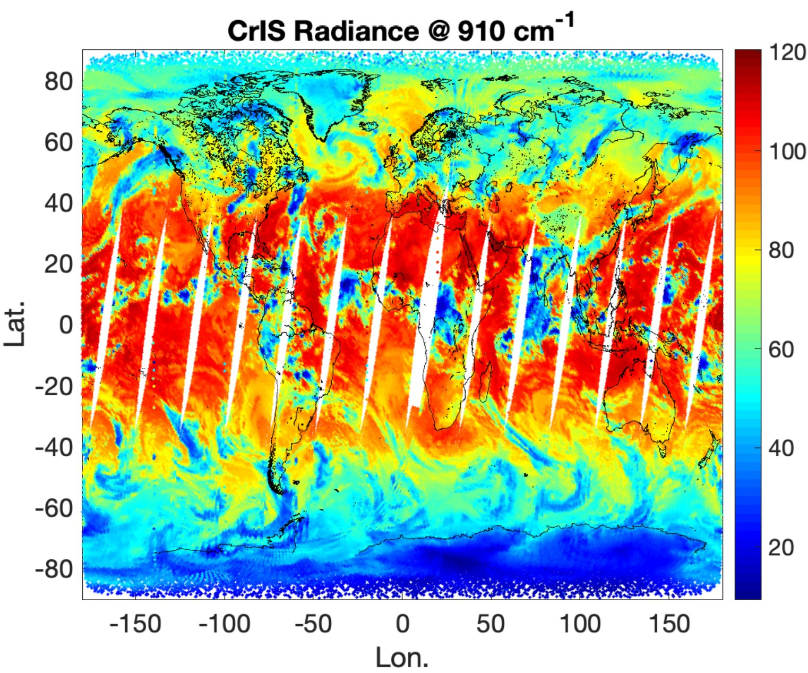
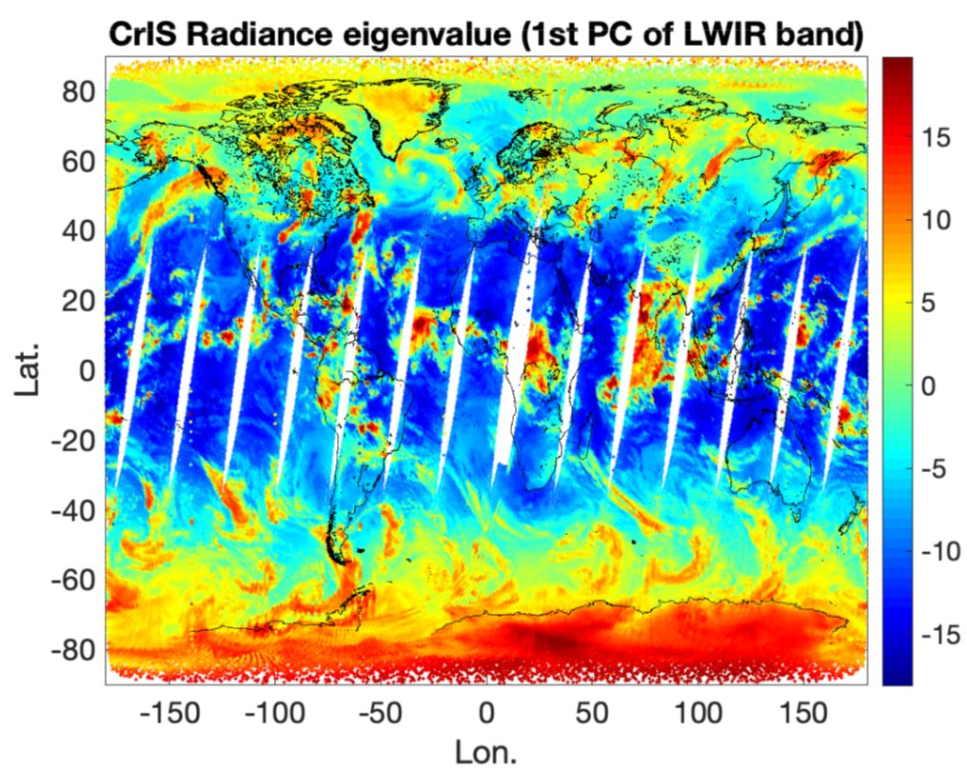
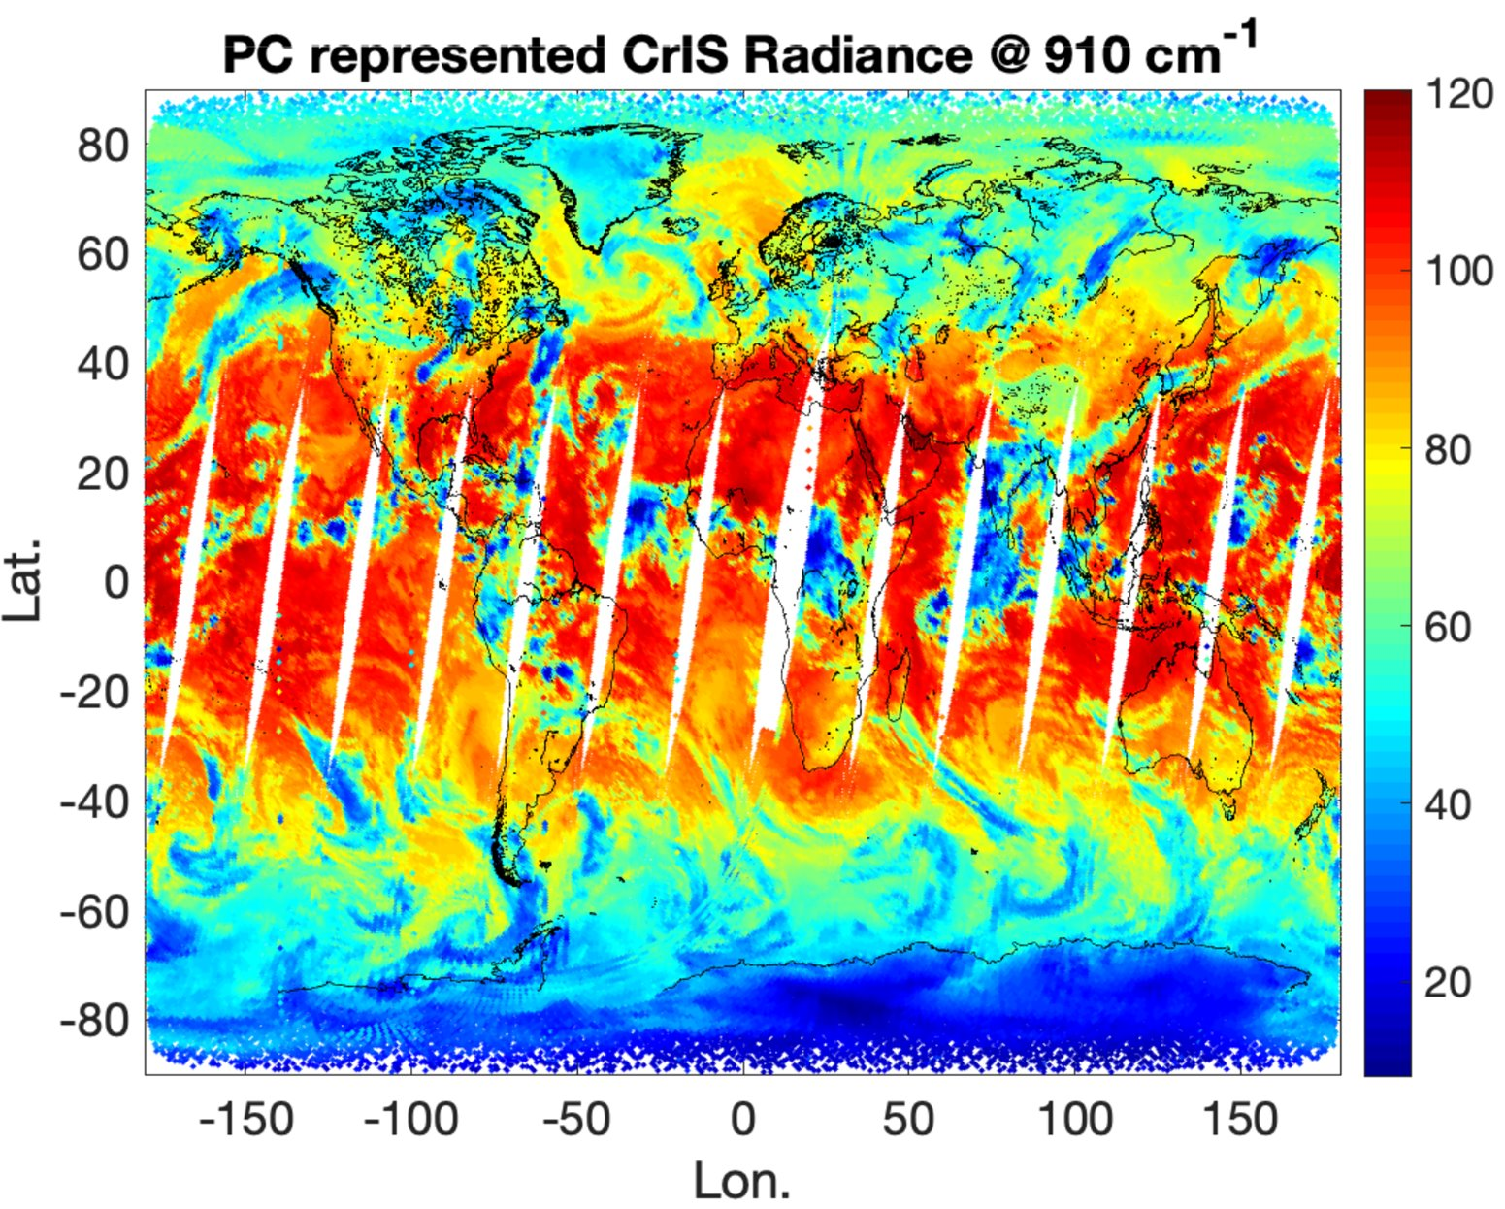
Introduction
Modern hyperspectral satellite remote sensors provide wealth of information on
  Atmospheric properties such as temperature, water vapor and trace gas vertical profiles
  Cloud and aerosol properties
  Surface properties (temperature, emissivity, reflectivity …)
Fast and accurate forward models are needed to invert hyperspectral data
  Hundreds to thousands of spectral channels with millions of observations each day
  Line-by-line (LBL) radiative transfer model (RTM) is too slow (needs millions of LBL RT calculations to account for atmospheric gas spectral contributions)
  Traditional channel-based forward models are also too slow (at least one RT calculations needed for each channel
Principal Component Analysis (PCA) converts hyperspectral data into super-channels
  Principal Components (PCs) capture the spectral correlations (remove redundant info)
  Super channels capture the information content of the original channel spectrum
  Super-channel number << than the original channel numbers

Slide 3
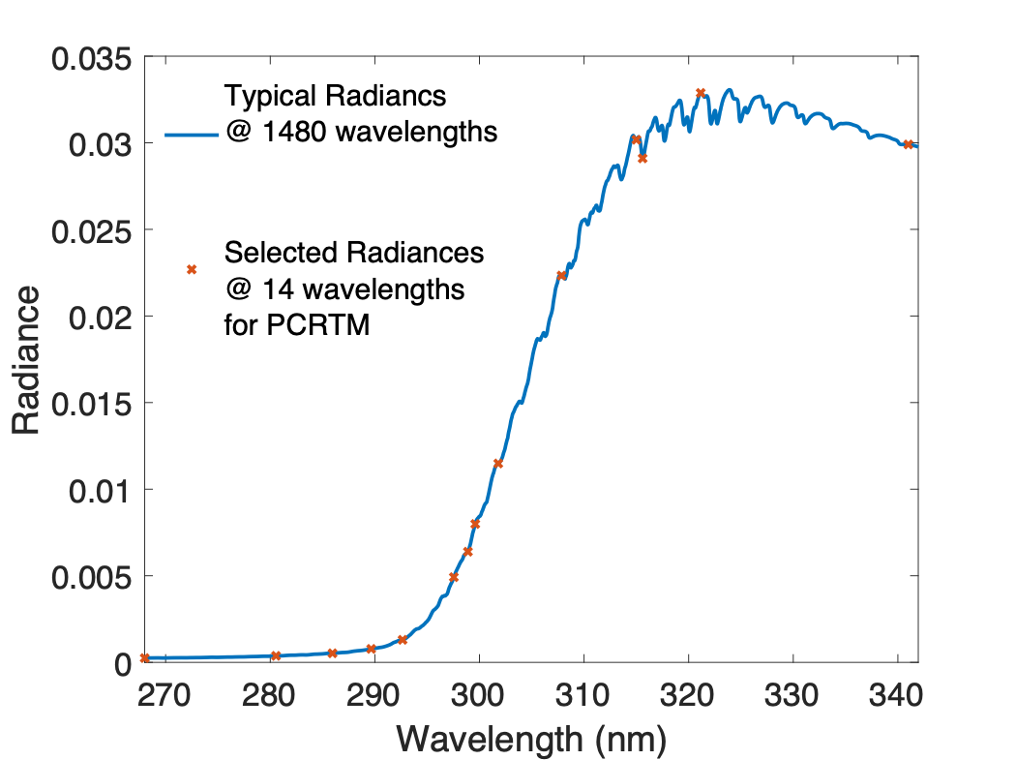
Principal Component Based Radiative Transfer Model (PCRTM)
PCRTM was specifically for hyperspectral remote sensors
  Number of RT calculations are << number of spectral channels
    Orders of magnitude faster than LBL RTMs
  RT calculations done monochromatically
    Physical-based RTM and accurate relative to LBL RTMs
  Provides analytical Jacobian needed for satellite data inversions
Multiple scattering clouds and aerosols included
Wide range of spectral coverage
  Thermal: 50-3000 cm⁻¹
  Solar: 200 nm – 2500 nm
  Suitable for AIRS, CrIS, IASI, PREFIRE, IRS, IASI-NG, NAST-I, S-HIS, CLARREO, CPF, SBG, TEMPO, OMI, SCIAMACHY …
Fast:
  Milliseconds to fraction of seconds in IR
  3-4 orders of magnitude faster than LBL in solar
Accurate relative to LBL:
  Thermal: Bias error < 0.002 K RMS error < 0.03 K
  Solar: bias error < 0.001%, RMS error ~0.05%

Slide 4
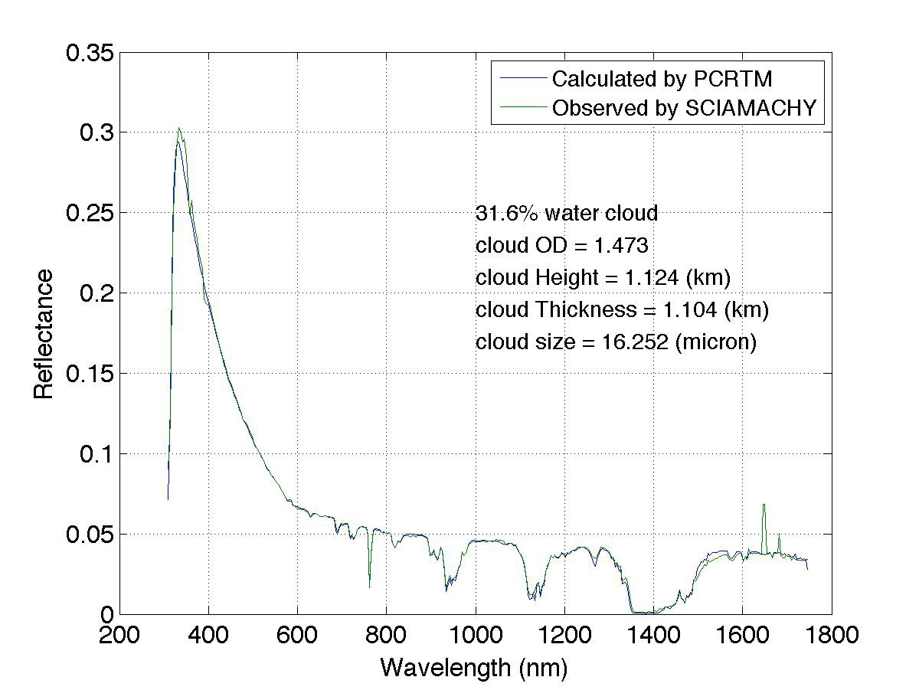
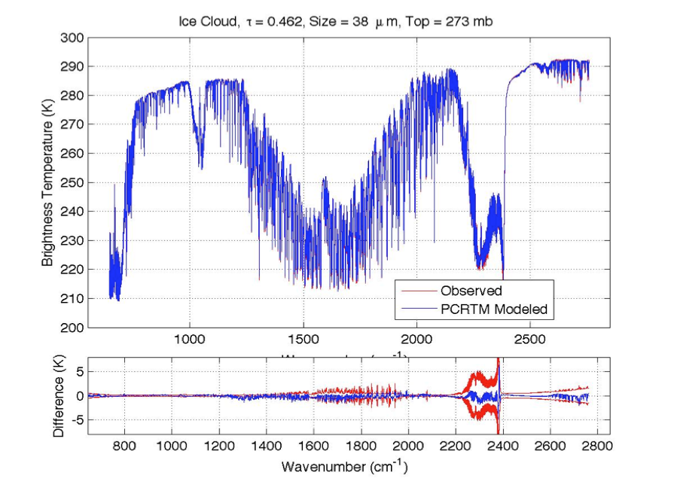
PCRTM Calculated Radiance Spectra Agree Well With Satellite Observations
PCRTM Simulated Reflectance @646 nm using MODIS L2 data
MODIS L1 Observed
Reflectance @646 nm
SCIAMACHY
IASI
CrIS
AIRS
MODIS L2 + CPF simulator @646nm

Slide 5
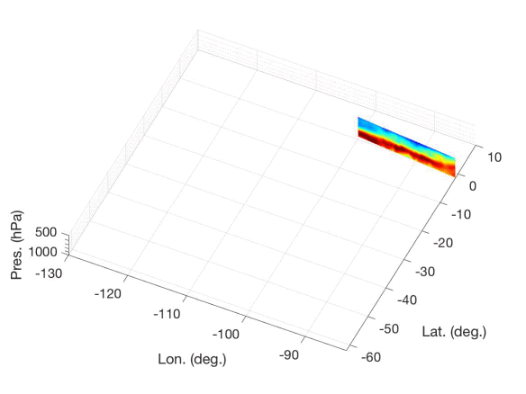
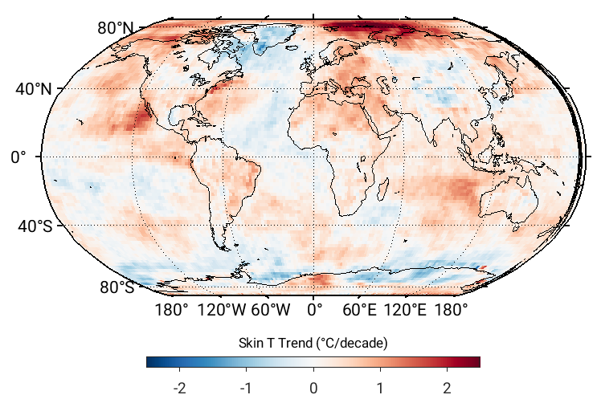
Two PCRTM-based Inversion Algorithms
L2 products: Single Field-of-view Sounder Atmospheric Product (SiFSAP)
  3-times higher spatial resolution
  Uses all spectral channel
  All sky algorithm-retrieves cloud explicitly
  Retrieve temperature, clouds, trace gases, and surface properties simultaneously
L3 Products: Climate Fingerprinting Sounder Products (ClimFiSP)
  Works on spatiotemporally averaged radiance spectra
  High quality climate product from multiple satellite data fusion
    Use consistent radiative kernels
    Ensure radiometric closures
Both products will be available at NASA GES DISC for public access
The PCRTM based algorithm can be easily extended to solar spectral region
Example of SiFSAP H₂O product
Example of ClimFiSP derived global surface temperature trend

Slide 6
Description of the ClimFiSP Algorithm
Issues with traditional L1-L2-L3 climate products
  L2 algorithm inconsistency for different satellite sensors
  Lack of radiance closure (e.g cloud-clearing method)
  L1-L2-L3 algorithm is computational demanding
ClimFiSP is designed to address the above-mentioned deficiencies
  Works on gridded L1 products directly using consistent radiative kernels
  Provides radiometric closure
  All parameters including clouds retrieved simultaneously
  More than 5 orders of magnitude faster than traditional L1-L2-L3 method
  Quick re-generation of climate products when instrument is re-calibrated or L1 algorithm is improved
  Can be used to diagnose radiance differences due to different sensors
Provide radiative kernels needed for climate studies
  Climate model validations using satellite data
  Climate model diagnosis/improvements

Slide 7
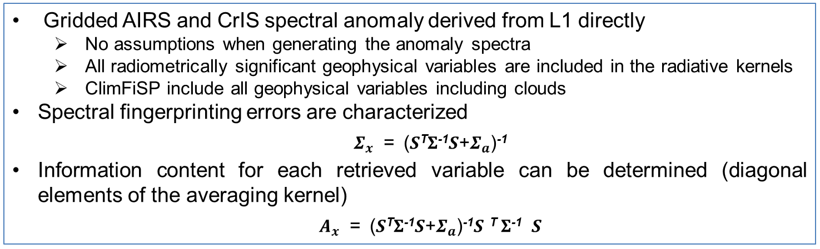
Radiometric Closure for ClimFiSP
Gridded AIRS and CrIS spectral anomaly derived from L1 directly
  No assumptions when generating the anomaly spectra
  All radiometrically significant geophysical variables are included in the radiative kernels
  ClimFiSP include all geophysical variables including clouds
Spectral fingerprinting errors are characterized
  $Σ_{x}$ = (𝑺^{T}𝚺⁻¹𝑺+$Σ_{a}$)⁻¹
Information content for each retrieved variable can be determined (diagonal elements of the averaging kernel)
  $A_{x}$ = (𝑺^{T}𝚺⁻¹𝑺+$Σ_{a}$)⁻¹𝑺 ^{T} 𝚺⁻¹ 𝑺
Examples of CrIS Spectral Anomaly
Closure for CrIS Gridded Spectral Anomaly

Slide 8
Example of AIRS and CrIS ClimFiSP product
ClimFiSP enables of the fusion of AIRS and CrIS data into a consistent temperature anomalies at different atmospheric pressure levels
ClimFiSP and AIRS L3 temperature anomalies from 2003 to 2018 show general agreement
Wu et. al. (2020) "Radiometrically Consistent Climate Fingerprinting Using CrIS and AIRS Hyperspectral Observations" Remote Sensing. https://doi.org/10.3390/rs12081291

Slide 9
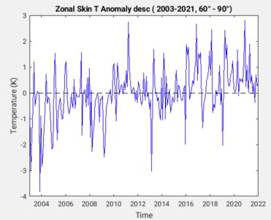
Applying the ClimFiSP Algorithm to CHIRP
CHIRP - Climate Hyperspectral Infrared Radiance Product
  Bias-corrected radiance (L1) time series for Aqua/AIRS, SNPP/CrIS, and JPSS/CrIS
  Generated by Larrabee Strow et al (2021)
  Available at NASA Sounder SIPS and DACC
We have applied the ClimFiSP algorithm to CHIRP data from 2003-2021
  Obtained climate time series for:
    atmospheric temperature, water vapor, O3, and other trace gas vertical profiles
    cloud optical depth, cloud height, and cloud particle size
    surface skin temperature, and surface emissivity
Example of ClimFiSP derived global surface temperature time series for 60-90º latitude
Example of ClimFiSP derived global surface temperature trend

Slide 10
Summary and Path Forward
PCRTM is a fast and accurate RTM addressing hyperspectral data analysis challenges
  Uses full hyperspectral information
  Physically-based with a few hundred RT calculations
  Includes multiple scattering clouds
  PCRTM handles polarization in solar spectral region
PCRTM-based ClimFiSP a new, efficient, and consistent method for generating climate data records from satellite IR sounders
  Eliminates/minimizes the inconsistency due to L2 algorithm differences in traditional L1-L2-L3 approach
  Radiometric closure (avoids CC errors, fits all parameters simultaneous including clouds)
  Consistent long-term climate data records (T, Q, trace gases, cloud, surface T and emis) from multiple satellite IR hyperspectral sounders
  Orders of magnitude faster than traditional approach (easy to reprocess once new improved L1 data are available)
Both ClimFiSP and SiFSAP data products will be available at NASA DAAC soon

