Slide 1
High Enthalpy Testing
Ernest Fretter
Thermophysics Facilities Branch
Brett A. Cruden*
Aerothermodynamics Branch
Entry Systems and Technology Division
NASA Ames Research Center, Silicon Valley
* AMA Contract No NNA15BB15C

Slide 2
Arc Jets
Ernest Fretter
NASA Ames Research Center
IPPW Short Course
Aug. 7, 2022

Slide 3
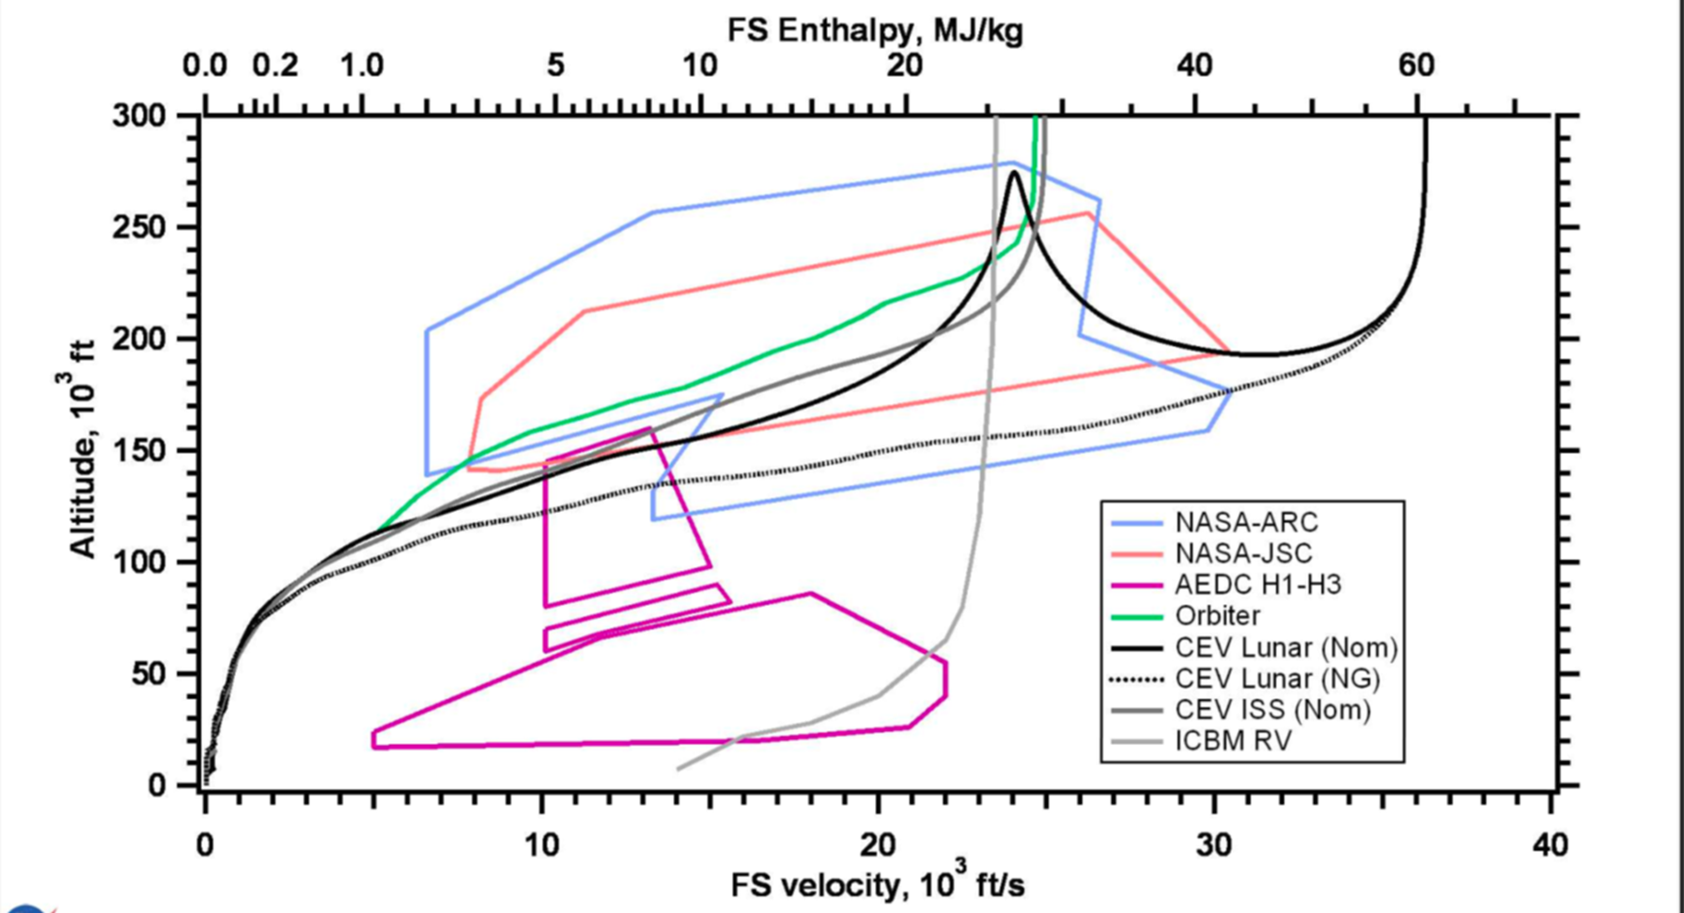
What is High Enthalpy?
General range from 1 to 100 MJ/kg at pressures from .01 to >100 bar
Depends on mission. Low for supersonic low altitude flight to highs for Mars Sample Return
MSR

Slide 4

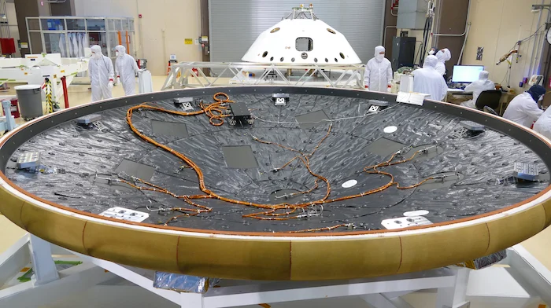
Ideal testing at High Enthalpy

Slide 5
For TPS, What are the Test Objectives
  Comparative screening of candidate materials
  Evaluating performance over a range of conditions
  Develop data base for modeling
  Validating performance of material interfaces (gaps, steps, A to B, etc.)

Slide 6
Techniques for Producing High Enthalpy Flows
Radiation (lasers, solar)
Furnaces & Combustion
Ballistic ranges (Low Enthalpy Testing topic)
Arc heaters
Shock tubes

Slide 7
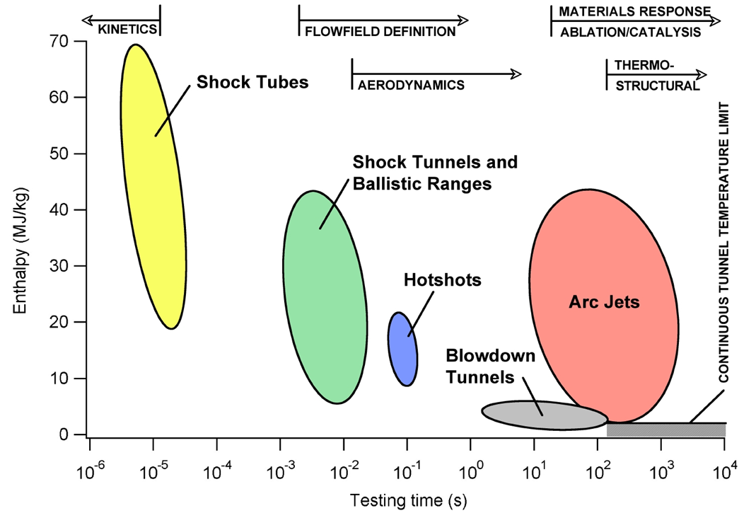
Range of Interest for High Enthalpy Tests

Slide 8
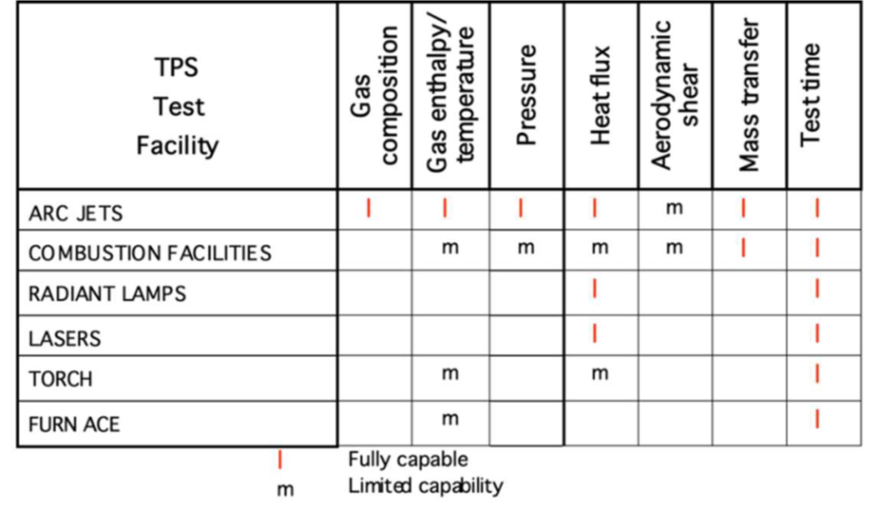
Why NASA ARC uses Arc Jets

Slide 9
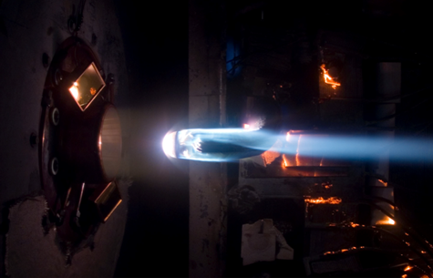
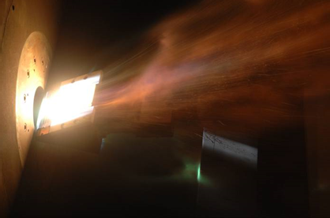
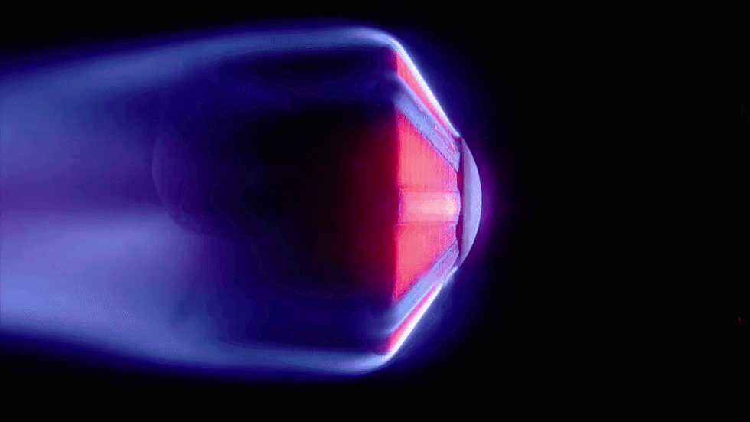
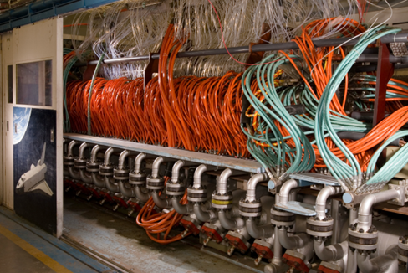
How do Arc Jets Work
An arc jet produces an electrically heated, high speed gas flow onto a test article – matching key parameters of hypersonic entry from space into an atmosphere

Slide 10
Standard arc jet process
Under vacuum, add argon gas; connect a hi-voltage D.C. source across electrodes to breakdown argon; and we have a flow of electrons inside the arc jet tube.
Air flow collides with electrons in this “lightning bolt”, dissociating air at high temperatures (> 9000º F)
Expand dissociated air out a nozzle to hypersonic conditions and into a chamber at altitude conditions matching peak heating
When conditions are correct, insert test sample and see what happens!

Slide 11
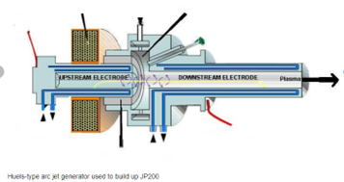
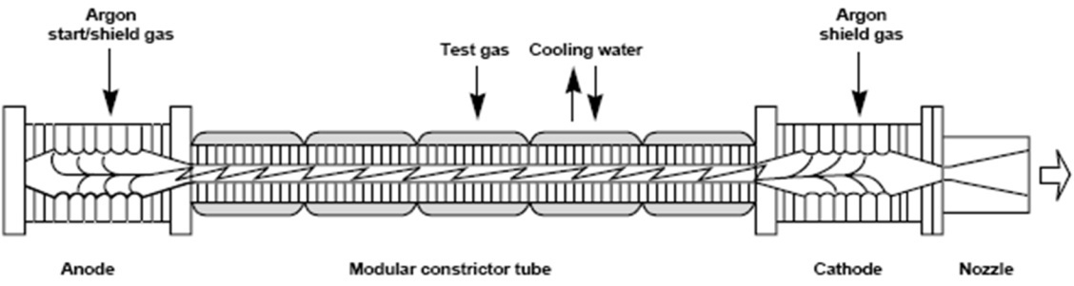
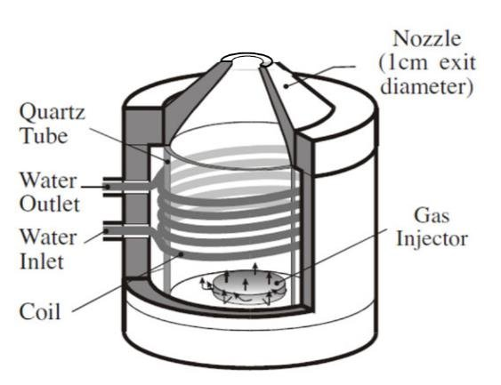
Principle Types of Arc Jets
Huels or Linde (free length)
  high P
  H<20 MJ/kg
Segmented Constrictor (fixed length)
  low to high P
  H < 50 MJ/kg
Inductively Coupled Plasma devices
  P <= 1 bar
  H < 80 MJ/kg

Slide 12
NASA Ames Arc Jet Complex
Facility Characteristics
High power, 5 operational arc jets ((1) x 10 MW, (3) x 20 MW, (1) x 60 MW)
Large test articles (up to 60 x 60 cm flat panel, 30.5 cm diameter stagnation)
Continuous high enthalpy flows (2 - 40 MJ/kg in air)
Combined heating with laser radiant source
Spectroscopic and LIF flow diagnostics available
Test times from seconds to over one hour
Laminar and turbulent flows
Instrumentation: pyrometers, IR camera, photogrammetric recession, HD video, scanning radiometer, LIF

Slide 13
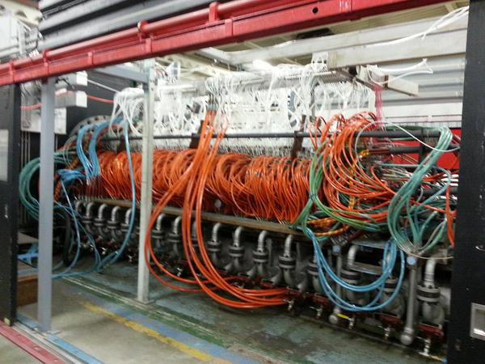
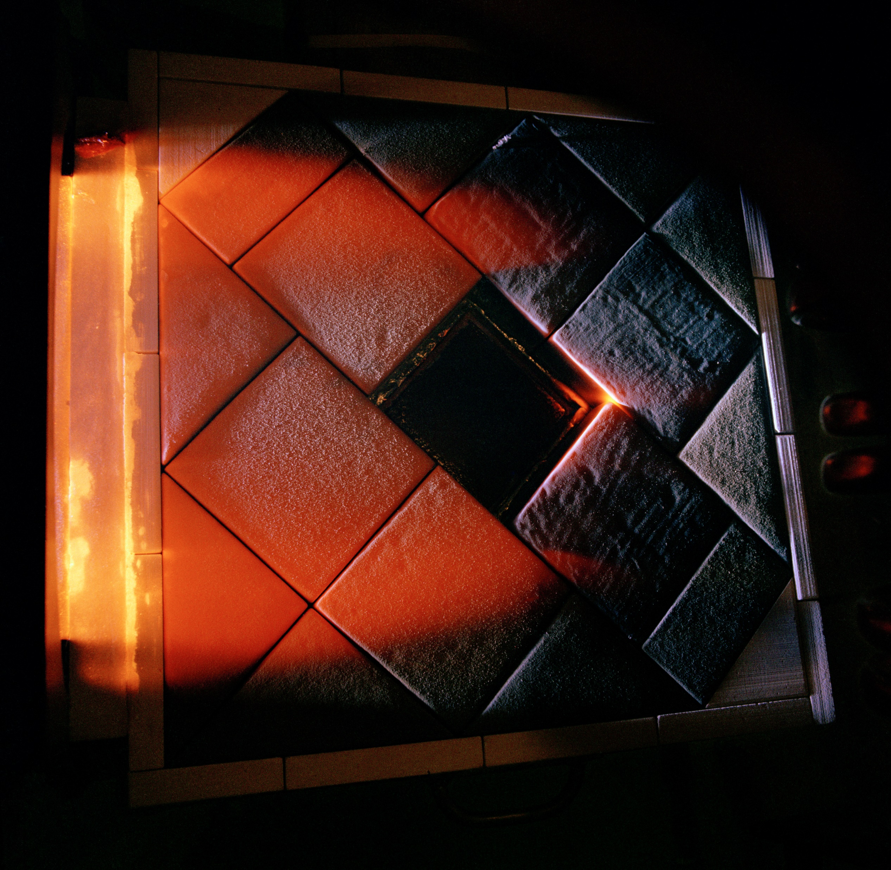
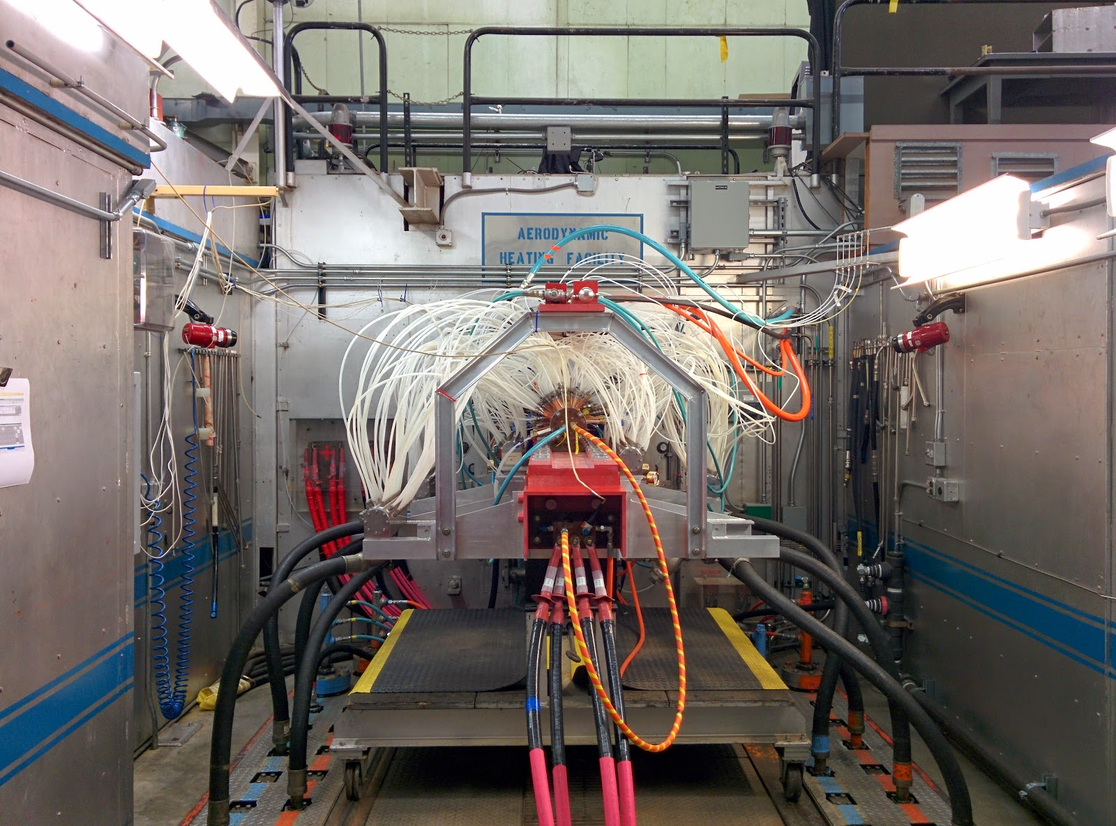
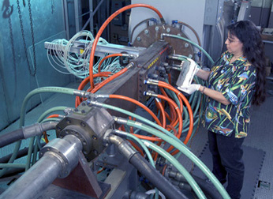
Ames Arc Jet Complex
Interaction Heating Facility (IHF) – 60 MW
Aerodynamic Heating Facility (AHF) (10 & 20 MW)
Panel Test Facility (PTF) – 20 MW
Turbulent Flow Duct (TFD) - ~15 MW

Slide 14
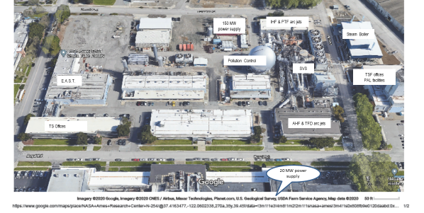
NASA Ames Arc Jet Complex Neighborhood

Slide 15
IHF now New and Improved with Combined Heating Capability
Combine IHF convective arc with 4 fiber optic IPG lasers of 50 kW each
λ= 1070nm ytterbium lasers
Produces 6x6” and 17 x 17” flat top and Gaussian distribution
Calibration plates, burn plates, 30 kW Ophir power meter

Slide 16
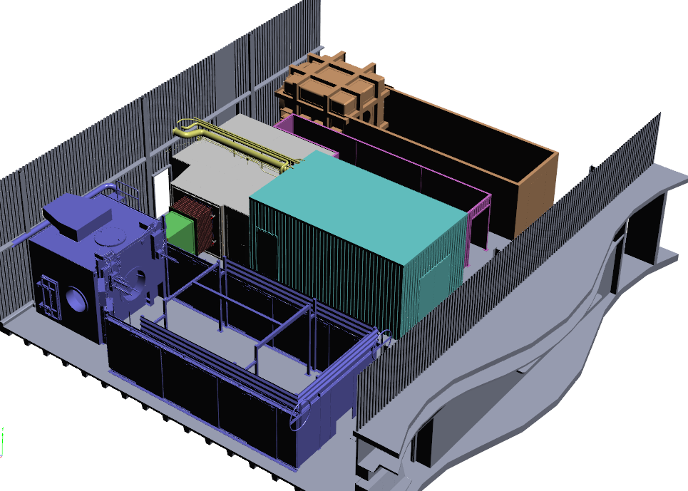
LEAF-Lite
Arc Jet Complex Combined Heating Layout
Laser Enhanced Arc-jet Facility (LEAF-Lite)
Interaction Heating Facility
LEAF-Lite allows for combined radiative and convective testing
LEAF-Lite Optics Enclosure (OE)
Beam Path Enclosure
North
Control Room
IHF Test Box
Convective Flow

Slide 17
Other Arc Heaters Worldwide
Facility | Location | Power Ranking (MW)
NASA ARC | USA | 60
NASA LaRC HYMETS |  | 0.5
AEDC |  | 70
Boeing LCAT |  | 6
Univ of Texas Austin |  | 1 .6
JAXA | Japan | 1
Chonbuk Nat’l Univ. | South Korea | 0.4 to 2.4
CIRA (SCIROCCO & Ghibli) | Italy | 70 & 2
ESA – Airbus | France | 6 - 20
DLR (L2K & L3K) | Germany | 5
IRS (PWK 1, 2, 4) |  | 6
Technion | Israel | 5
TsAGI | Russia | 10
Tsniimash |  | 50
CARDC | China | 20
CASC/BIA |  | Unk
VSSC | India | >0.25

Slide 18
ICP Arc Facilities
Country | Institution | Facility | Power (kW) | Max Enthalpy (MJ/kg)
USA | U. Vermont | ICP Torch | 30 | 50
 | U of Texas Austin | ICP Torch | 50 | -
 | UI Urbana Champagne | ICP Torch | 80 | 30
Russia | IPM | IPG 3&4 | 100 - 750 | 50
China | CARDC | FD-31A | 1000 | 60
Japan | JAXA | ICP WT | 110 | 20
Germany | IRS | PWK 1,2,4 | 100 – 600 | 150
 |  | PWK-3 | 375 | 80
 |  | IPG6-B | 20 | -
France | CORIA | IPT-1 | 100 | 17
 | C. Supelec | ICP Torch | 50 | -
 | Airbus | Plasmatron | 150 | -
Belgium | VKI | Minitorch | 15 | -
 |  | Plasmatron | 1200 | 80

Slide 19
Future Challenges
Higher enthalpy (Mars, comets, and asteroid returns)
Larger sample sizes, animated samples
Unusual gas mixes (gas giants, Venus, etc.)
The ability to use arc jets for validation would enhance their value significantly
Two approaches: improved in-situ diagnostics (instrumentation), improved modeling of arc column (simulation)
Will CFD replace the arc jets?

Slide 20
Shock tubes and Tunnels
Brett A. Cruden
AMA Inc at NASA Ames Research Center
IPPW Short Course
Aug. 7, 2022

Slide 21
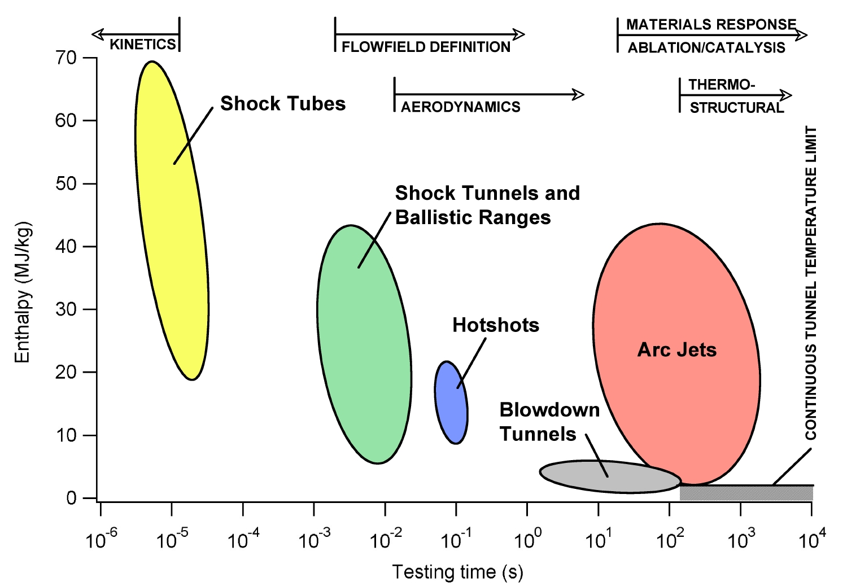
Ground test facility types and uses
Kinetics and
Radiation
AEROHEATING
AND LOADS

Slide 22
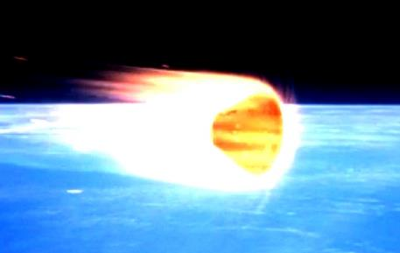
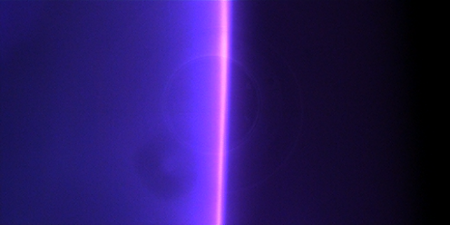
Shock Tube Similarity
Both Stagnation streamline and shock tubes are 1-D flows:
The equilibrium and non-equilibrium of the flow (on the stagnation line) is a function only of ρ∞ and v_{s}
This 1D flow has similarity to a shock tube in terms of
  Chemical Kinetics
  (Volumetric) Radiance
The shock tube does not capture the time and length scales of flight
Shock frame of reference
h = h₀+ v_{s}²/2
T=T_{s}
ρ = ρ_{s}
v=v_{s}
= ρ∞
T= T∞
h = h₀
Shock Tube
v=v_{s}
= ρ∞
T= T∞
h = h₀
h = h₀+ v_{s}²/2
T=T_{s}
ρ = ρ_{s}
22
Notes:
Note on radiation importance, relative magnitude and backshell

Slide 23

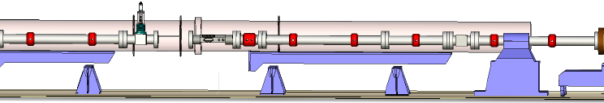
Electric Arc Shock Wave Generation
1292 cc
Driver Filled at
Higher pressure
(100 psi He)
Driven Section Filled with Test Gas
(0.01-2.0 Torr)
Compressed and
Dissociated Driven Gas
Capacitor Bank
Delivers
0.2-1 MA
For 10-100 μs
Grounded
Diaphragm Breaks
Pin charged
up to 10-25 kV (typical)
40 kV (Max)
Through 1.3 mF (1.2 MJ)
Capacitor Bank
Shock
Front
Diaphragm Maintains
Pressure Differential
Wire is pulled in
Contact
Front
23

Slide 24
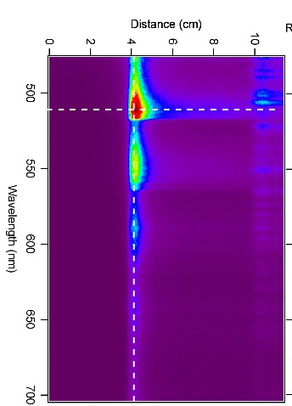
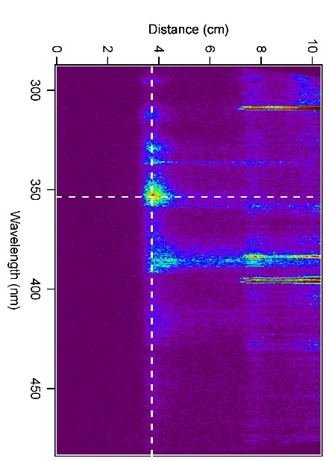
Shock Wave Generation
Compressed and
Dissociated Driven Gas
Shock
Front
Contact
Front
Emission
Transient
Pressure
Transient
24

Slide 25
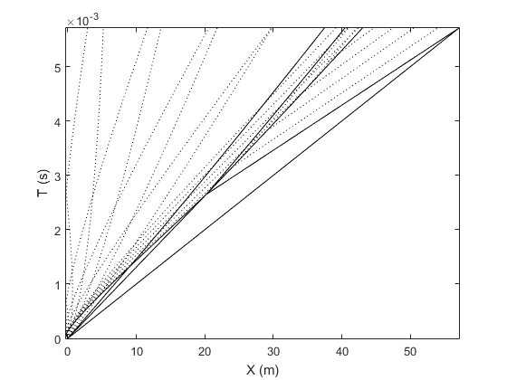
The Shock x-t diagram
Expansion Head
(Reflected)
Expansion Head
(Transmitted)
Expansion Head
(Reflected)
Expansion Tail
Shock Wave
Contact Front
Expansion Head
Shock tubes are often characterized in terms of an x-t diagram
The slope of the shock wave is the inverse of its velocity
The contact front separates test gas from driver gas
  The test gas is the region between the shock wave and contact front
Expansion waves will reflect off of the wall and other waves

Slide 26
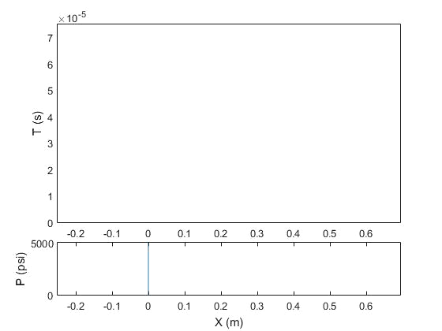
Shock x-t and P vs. x Animation
Driver Gas
Freestream Gas
Initial wave formation
  Shock, contact and expansion tail moves forward
  Expansion head moves backward
  Pressure drops from head to tail
Shocked Gas
Expansion Fan
Expansion Head
Shock Wave

Slide 27
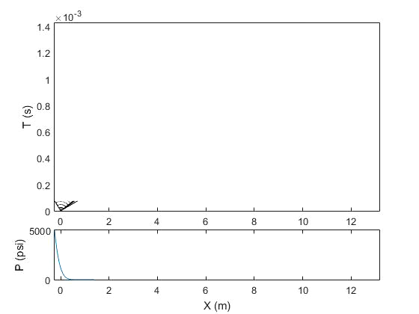
Shock x-t and P vs. x Animation
Driver Gas
Shocked Gas
Freestream Gas
Expansion head reflects off end wall
All waves move forward
Pressure is constant behind shock and contact front until expansion
Region between shock and contact (i.e. test time) grows as waves travel
Expansion Fan
Shock Wave

Slide 28
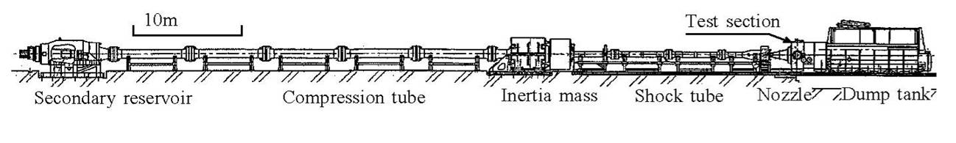
Shock Tunnels (Reflected)
High Pressure
(N₂)
Test Cabin
Driver Gas (He)
Test Gas (Air)
Piston
Diaphragm
(Steel)
Diaphragm
(Mylar)
Test Article
Bow Shock
A shock tunnel is a shock tube with a test cabin at the end of it
Two types of shock tunnels: expansion and reflected
Primary use of shock tunnels is to study aeroheating on test articles in relevant environments
Similarity variables: H, pL (binary scaling)
Notes:
28

Slide 29
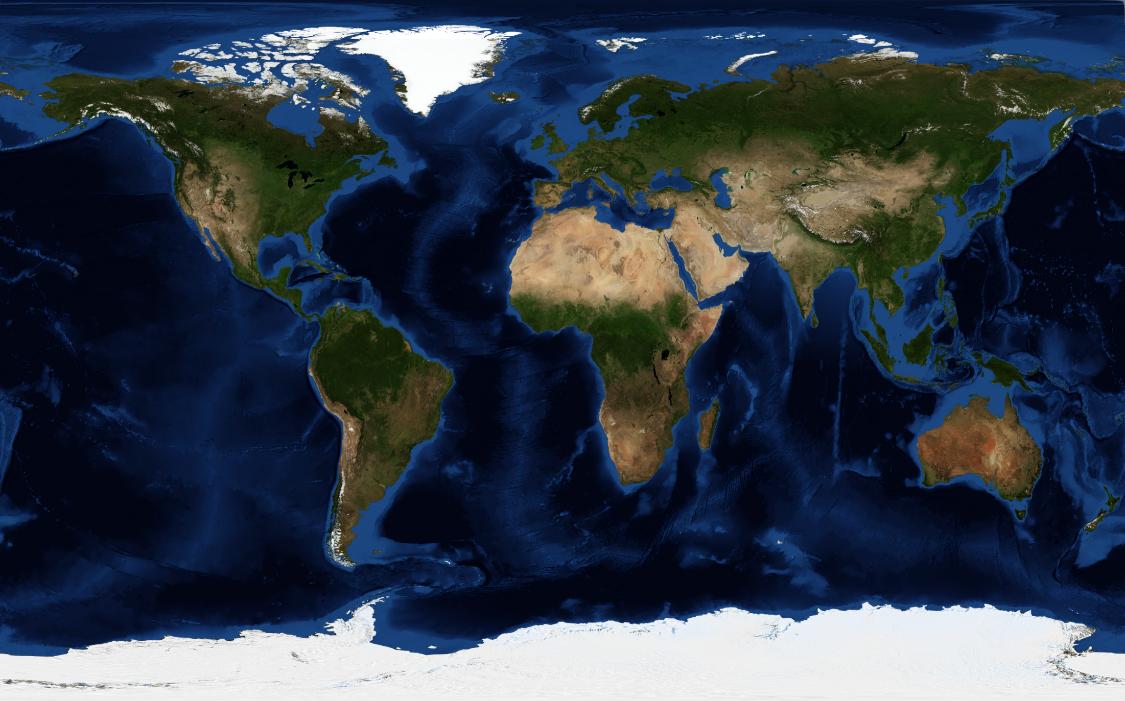





Shock Tube Facilities around the World*
T6
HEG
HAST
HELM
LENS
HIEST,
HEK-X
EAST
JF-12
HET
T5
ESTHER
HVST
X2, X3
* Not exhaustive

Slide 30
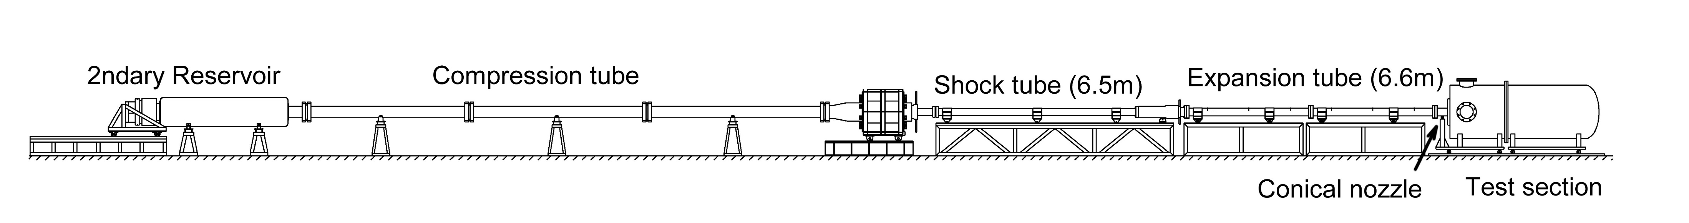
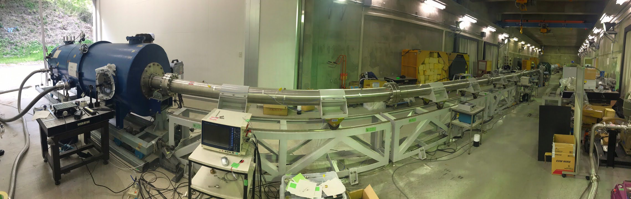
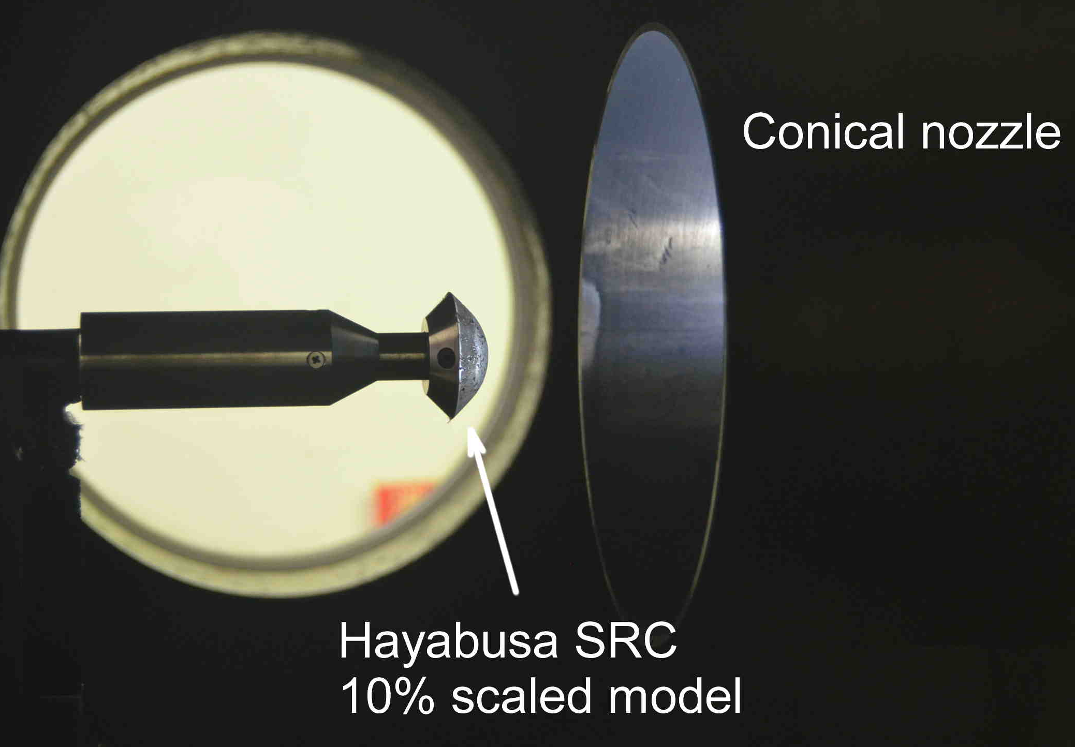
Super orbital expansion tube HEK-X
Free-piston driven expansion tube (Exit diameter of the conical nozzle is 200mm)
Over-driving operation: Up to 12km/s (H₀=70MJ/kg) or higher. P₀=130MPa. Test time 100-400 μsec.
Short turn-round time: 4 or 5 shots a day
Credit: Dr. Hideyuki Tanno, JAXA
Notes:
それでは実験の内容、主に設備と計測器の説明と実験の概要(流れですね)について説明します。

Slide 31
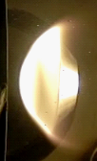
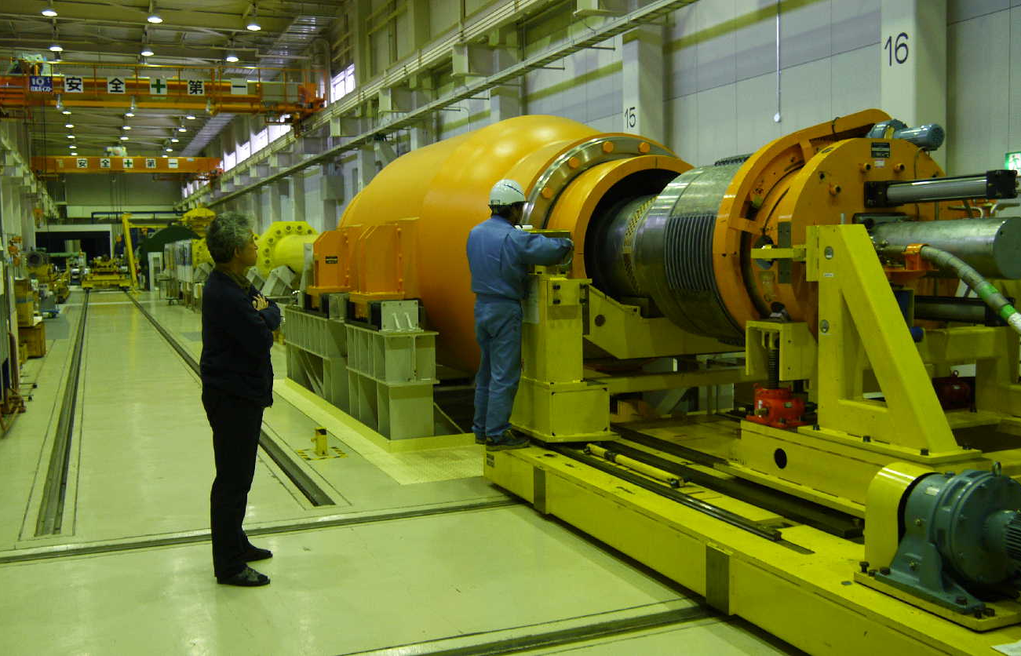
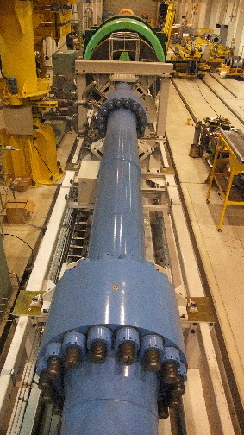
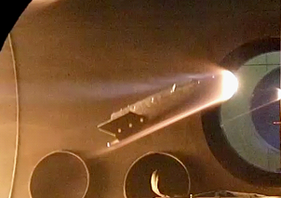
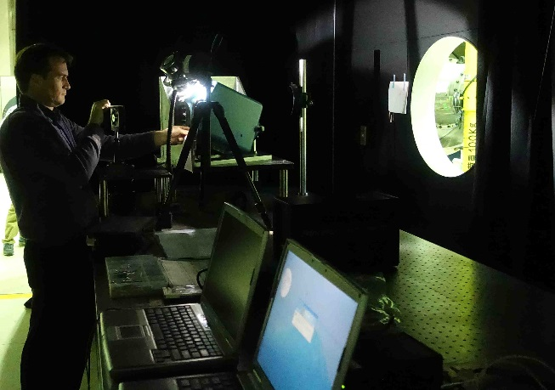
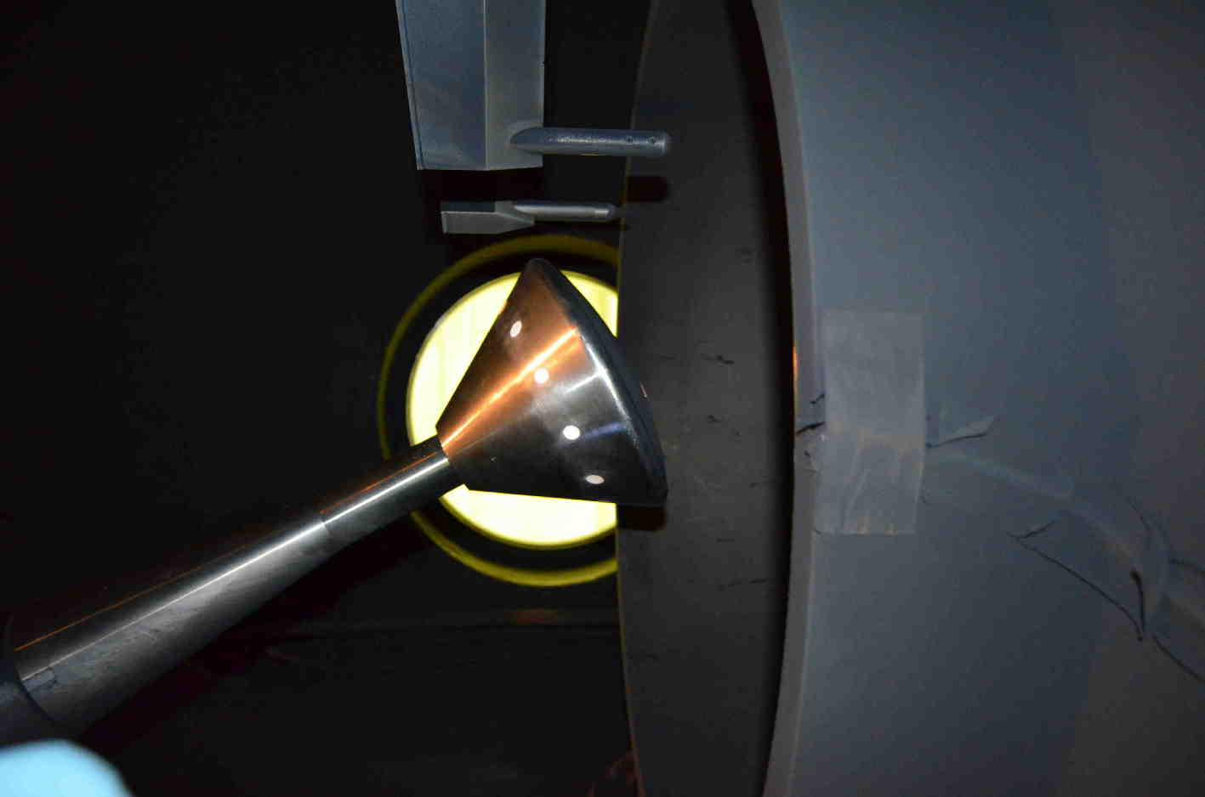
Free-piston shock tunnel HIEST
Compression tube : 42m, φ600mm
Shock tube : 17m,φ180mm
Piston : 220 ~ 780kg
Nozzle
  Conical : throat φ24~50mm exit φ1200mm
  Contoured : throat φ50mm exit φ800mm
90m
Maximum stagnation enthalpy 25MJ/kg (V=8km/s)
Maximum stagnation pressure 150MPa
Test time 2~15ms
Credit: Dr. Hideyuki Tanno, JAXA
Notes:
それでは実験の内容、主に設備と計測器の説明と実験の概要(流れですね)について説明します。

Slide 32
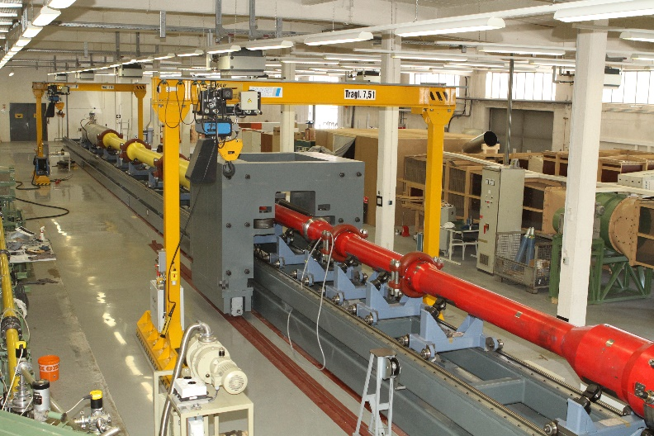
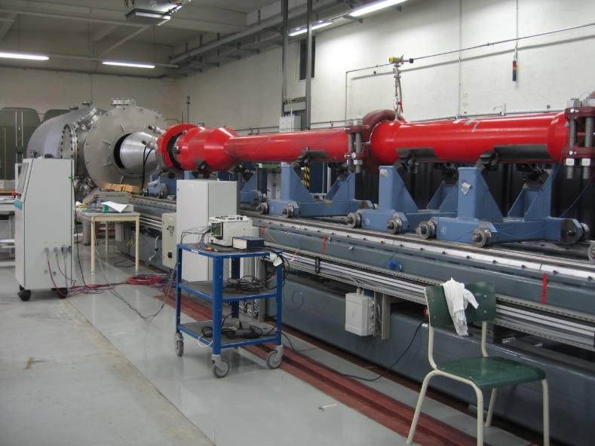
Experimental Simulation
Piston driven shock-tunnel HELM
Medium size
(Driver 21m, shock-tube 8-11m, nozzle diameter 0,7m)
Enthalpy range max. 20-25MJ/kg
Pressure sufficient for ρL, to generate turbulent flow conditions (max. 150-200 MPa)
Provides similarity in ρL=const. (binary scaling), velocity, gas, total enthalpy,
Re-number, compressibility effects
Recent research: Measurements of BL instability with ALTPs and of reservoir condition using LITA
Credit: Prof. Christian Mundt

Slide 33
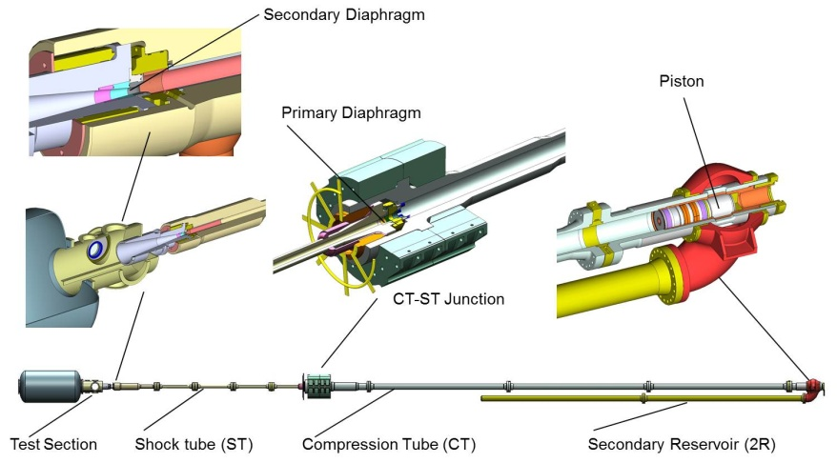
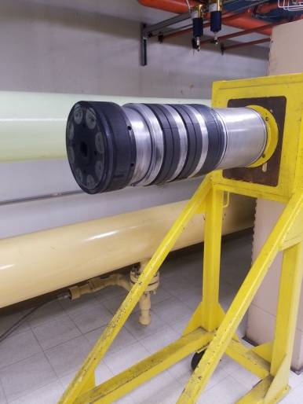
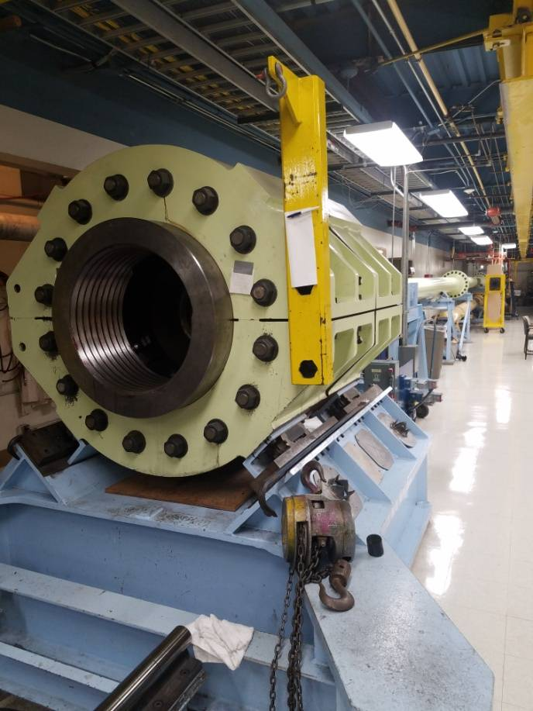
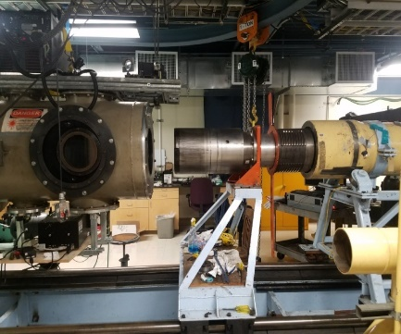

Caltech Hypervelocity Facilities
T5 Free Piston Reflected Shock Tunnel
Mach number 6
Re/m to 8 million
h_{o} to 22 MJ/kg
1-2 ms test time
Hypervelocity Expansion Tube (HET)
Mach number 3.0 to 7.4
Re/m 0.4 million (Mach 7) - 5 million (Mach 4)
h_{o} 2 to 9 MJ/kg
Thermochemically “clean” freestream
Both facilities recently characterized in collaboration
with RK Hanson (Stanford) via TDLAS T_{r}, T_{v}, U∞, ρ_{NO} measurements
(AFOSR FA9550-19-1-0219)
New facility planned: 17” Expansion Tube
Larger (150ft, 17” diam.) version of HET, Detonation-driven
Diagnostics: UV Emission Spectroscopy; MWIR Radiation; 1MHz schlieren; Focused Laser Differential Interferometry (FLDI); Surface heat flux, pressure; PSP
Credit: Prof. Joanna Austin

Slide 34
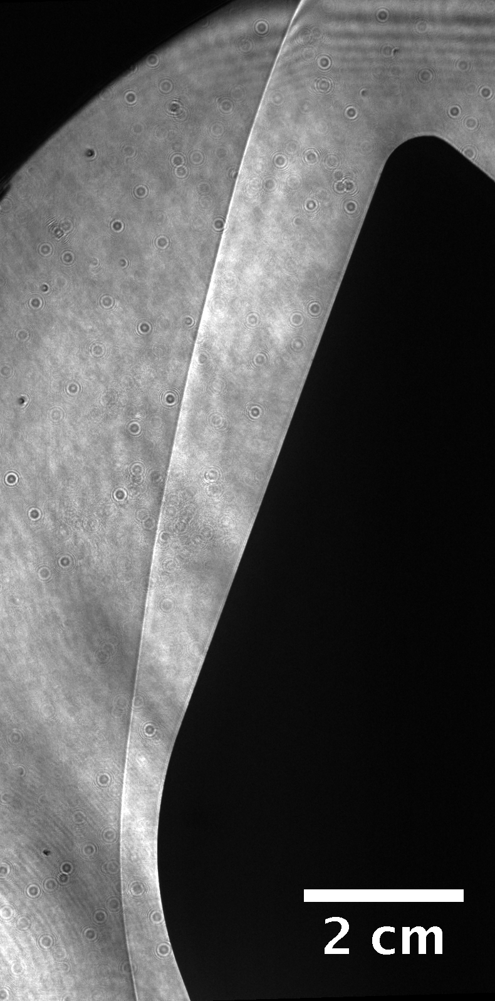
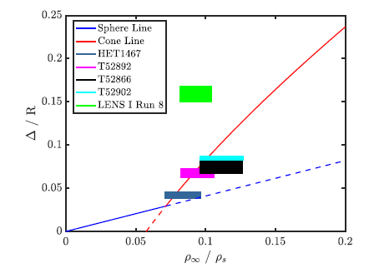
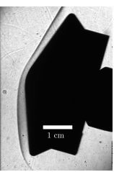
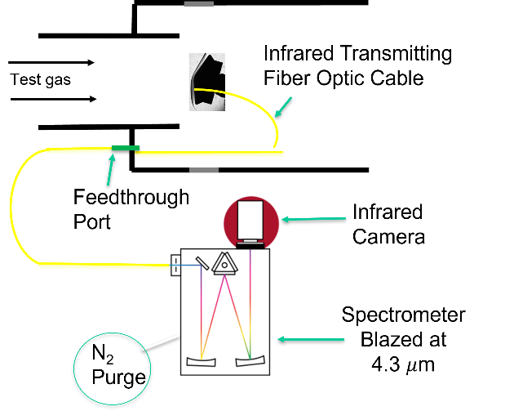
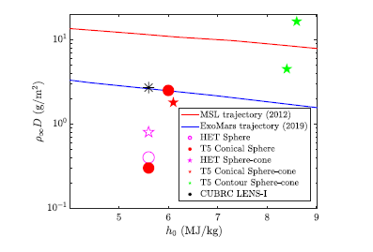
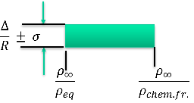
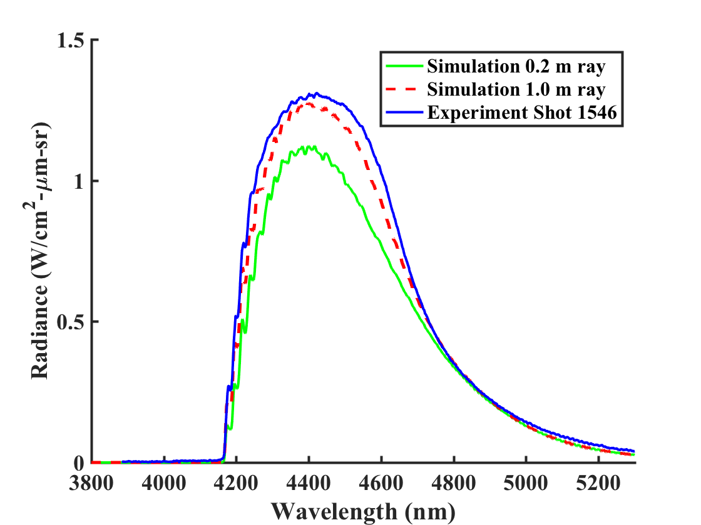


Hypervelocity Spherically-Blunted Cone Flows in Mars Entry Ground Testing
Sphere-cone
T52892 & HET1459
Comparison with cone/sphere behavior theory from Hornung, Martinez Schramm, Hannemann JFM 2019
HET fore measurements
T5 aft measurements
Leibowitz and Austin, AIAA J., 2022.
Supported in part by the NASA Space Technology Research Fellowships NNX14AM59H and NASA awards NNX14AO97A and NNX16AO55G. Collaborations with NASA Ames & Langley gratefully acknowledged.
Credit: Prof. Joanna Austin

Slide 35

Shock Tubes, in Perspective
HET
EAST
CUBRC LENS XX
CAS JF-12
JAXA HIEST
Dump tank
Shock tube
Detonation Driver
Test section

Slide 36


Electric Arc Shock Tube (EAST)
The Electric Arc Shock Tube (EAST) is capable of simulating high speed flows relevant to entry problems
Two shock tubes are available:
  4” Aluminum Tube – most heavily used, velocities up to 46 km/s
  24” Stainless Steel Tube – presently under refurb, intended for Low Density Studies
4” Tube
Blue
VUV
Test Section
Driver
7.5 m
Test section
23.5 m
24” Tube
Red
IR
Expansion Section
Primary Instrumentation: 4 spectrometers measure full radiative spectrum of shock layer
36

Slide 37








Radiance Obtained in Different Spectral Regions
Deep VUV
VUV
UV
UV/Vis
Visible
NIR
NIR
MWIR
37

Slide 38
EAST operating envelope and Recent Tests
Lunar return (Air)
Venus entry (CO₂/N₂)
Mars entry (CO₂/N₂)
Titan aerocapture (CH₄/N₂)
Mars return (Air)
Mars aerocapture (CO₂/N₂)
Uranus/Saturn
Probes (H₂/He)
38

Slide 39
EAST operating envelope and Recent Tests
Pioneer
Galileo
Hayabusa
Viking
Huygens
Chelyabinsk
Uranus Decadal
Saturn Decadal
MSL
Shuttle
Mars Return
Orion Lunar
39

Slide 40

EAST Upgrades: Low Density Shock Tube
Low Density Shock Tube (LDST) – 21.38” diameter (54.3 cm)
  Test time scaling (PD²) – 5x increase in diameter enables ~25x reduction in P
  Longer test times better for off-stagnation cases, thicker shocks with slower kinetics
  Investigation of Facility Artifacts
Expansion Cone
  Flows in expansion to simulate backshell heating
  mechanisms

Slide 41

Voitenko shock tube (1969)
High-explosive, shaped-charge driver – record 88 km/s shock speed
Destroys itself with each run

Slide 42

Conclusions – Shock Tubes
Shock tubes may be used to create flight-similar hypersonic flows
  Similarity in Radiation, Reaction Kinetics
Shock tunnels are generally used to quantify surface heating magnitudes and phenomena
  Binary scaling and enthalpy are similarity variables
Around a dozen shock tubes around the world may be used for quantifying hypersonic flow environments
  There are many more shock tubes that are used for, e.g. combustion studies
Most planetary entry environments have been replicated in the EAST facility (shock tube) with some other shock tubes providing comparable data
Questions about High Enthalpy Facilities at ARC?
https://www.nasa.gov/centers/ames/thermophysics-facilities-home
42

