Slide 1
Visualizing Corridors in Terminal Airspace using Trajectory Clustering
Carlos Paradis, Data Scientist, KBR Wyle Services, LCC
Dr. Misty Davies, Project Manager, NASA Ames Research Center

Slide 2
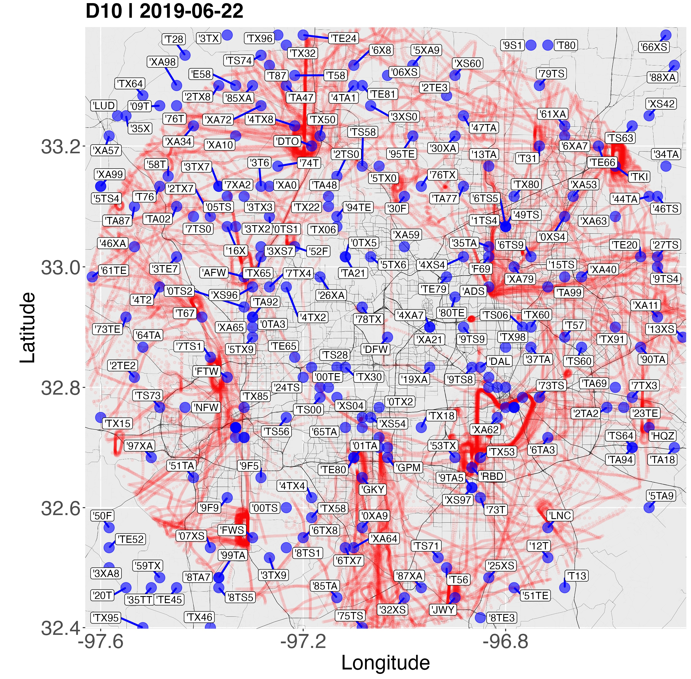
Leveraging existing UAM traffic at DFW-TRACON, June 22, 2019
Small airspace vehicles operate in urban areas today
We can study them as an early proxy for future UAM traffic
Indeed, corridor patterns emerge when observing current traffic by overlaying track points (red)
Sense making can be augmented using other metadata, such as sites surrounding emerging corridors (blue)

Slide 3
Leveraging existing UAM traffic at DFW-TRACON, June 22, 2019
While we can see corridors, we are not representing them mathematically to systematically answer questions such as:
  Which flights participate in the “heart shaped” corridor?
  What are the closest sites to a given corridor?
  Do flights fly the entirety of the corridor or only segments?
  How many flights flew a given corridor in a day?
In this work, we provide a framework to mathematically represent corridors for further sense making

Slide 4
Datasets and Assumptions
We used data from both Sherlock Data Warehousing (track points), and FAA sites in this work.
For each flight, we assume track points belong to a small manned aircraft if the specified flight plan origin and destination is unknown
We used June 22, 2019 for the scope of this work to emphasize spatial features and exploration over temporal analysis (future work).
I.e. A total of 593 trajectories were used in this study

Slide 5
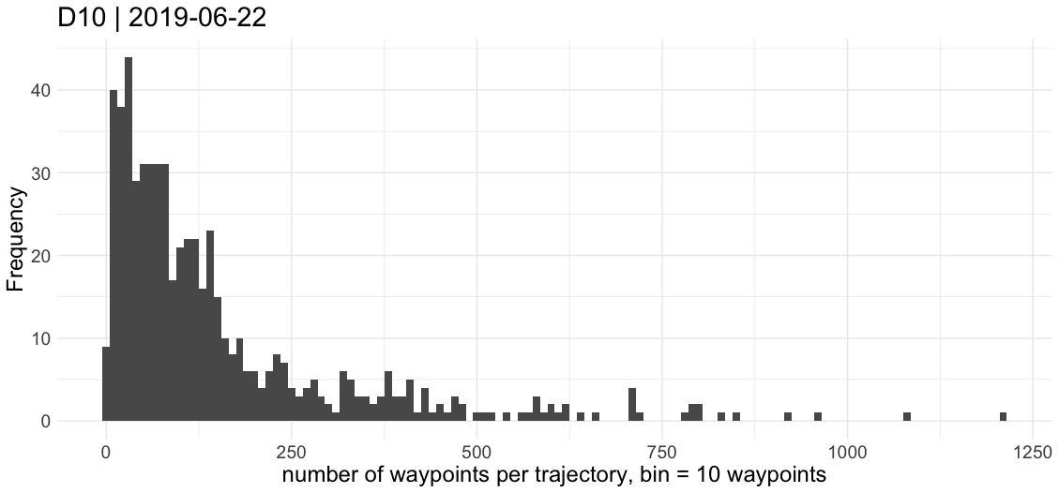
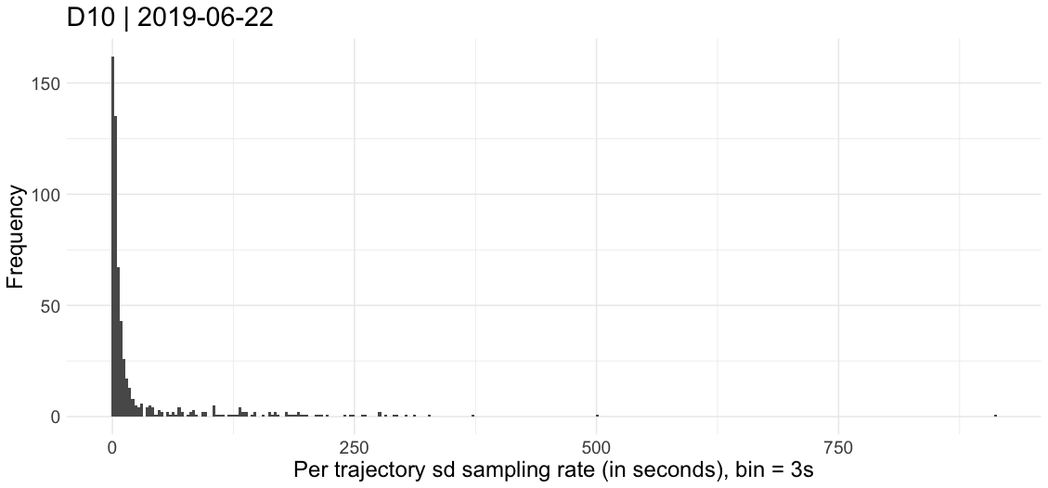
Datasets and Assumptions
Notes:
Reiterate we wish to represent trajectories mathematically to ask sense-making questions about them to make decisions
To mathematically group trajectories, we have to make them of the same size (same number of track points) so they can be grouped
Looking at the plot to the left, we can see 50 is a good upper bound, it includes the bulk of trajectories. For lower bound, we eliminated trajectories below 50 to avoid point interpolation.
Future work can explore different interpolation schemes and compare how they affect cluster formation. We just wanted to infer existing corridors conservatively.
The plot to the right is about the Sampling Rate of each trajectory. A high bar skewed to the left just means most of our trajectories had a consistent sampling rate, which means less pre-processing represent them as trajectories. Intuitively you could say a trajectory with high SD would be full of ”holes” (since a point would be at t=1, then other at t=3, then now suddenly at t=10, etc.

Slide 6
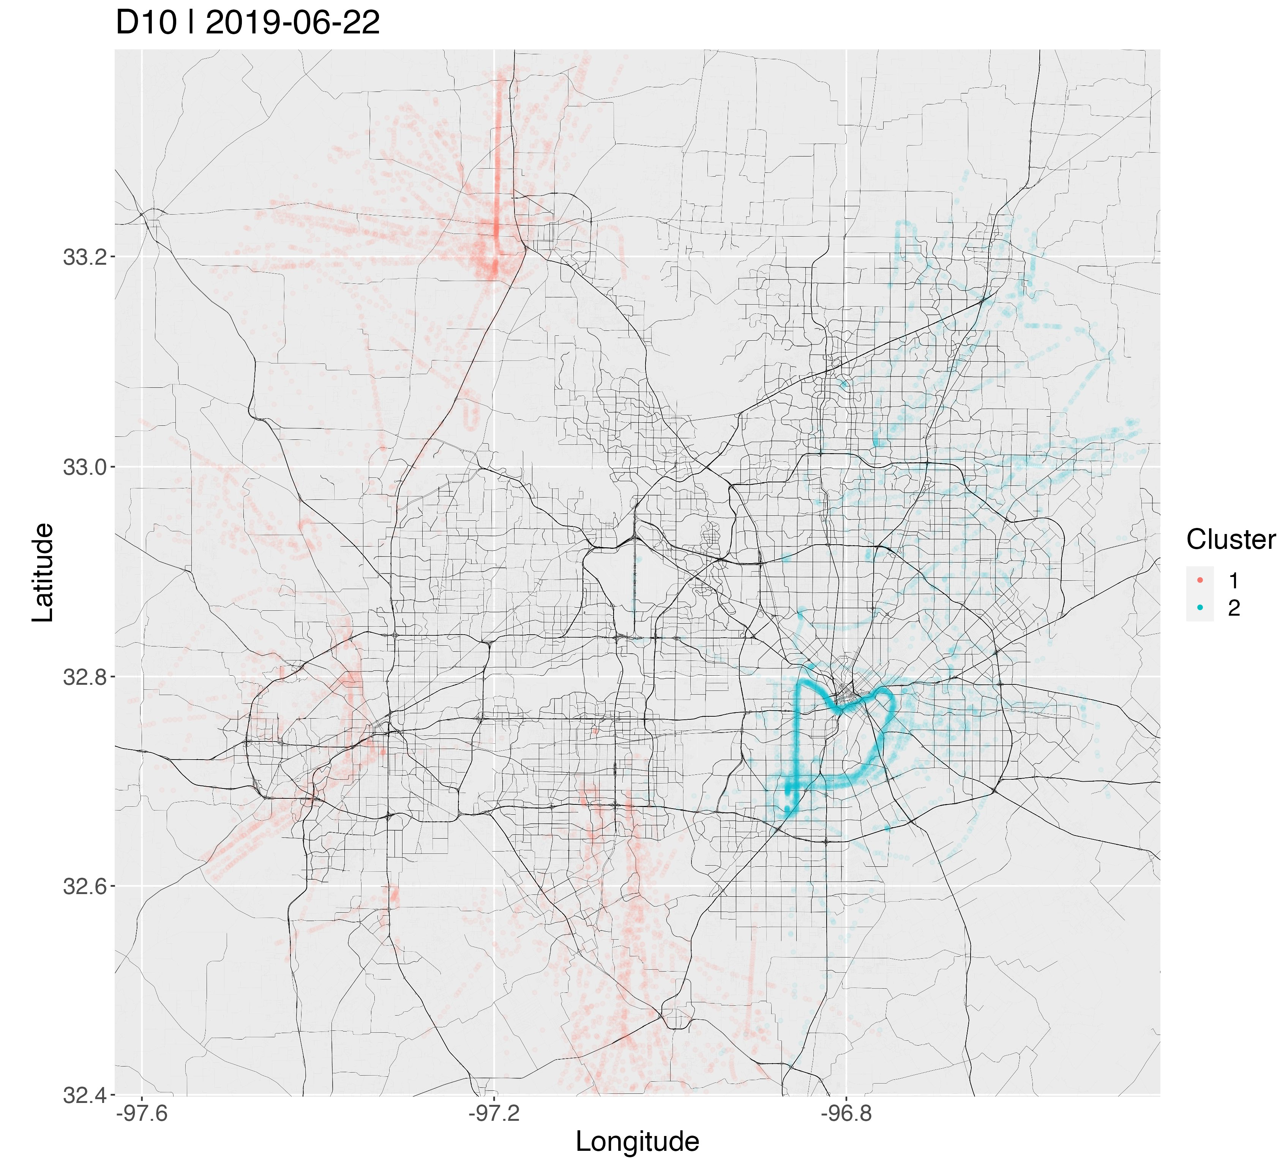
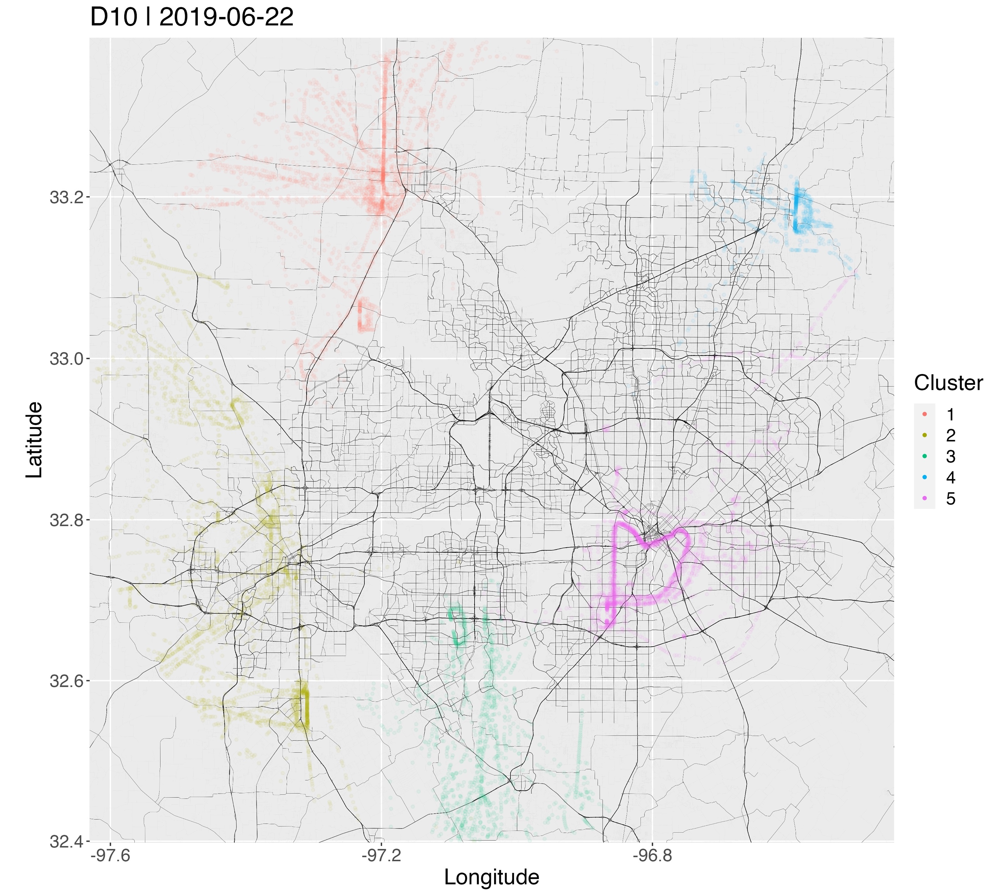
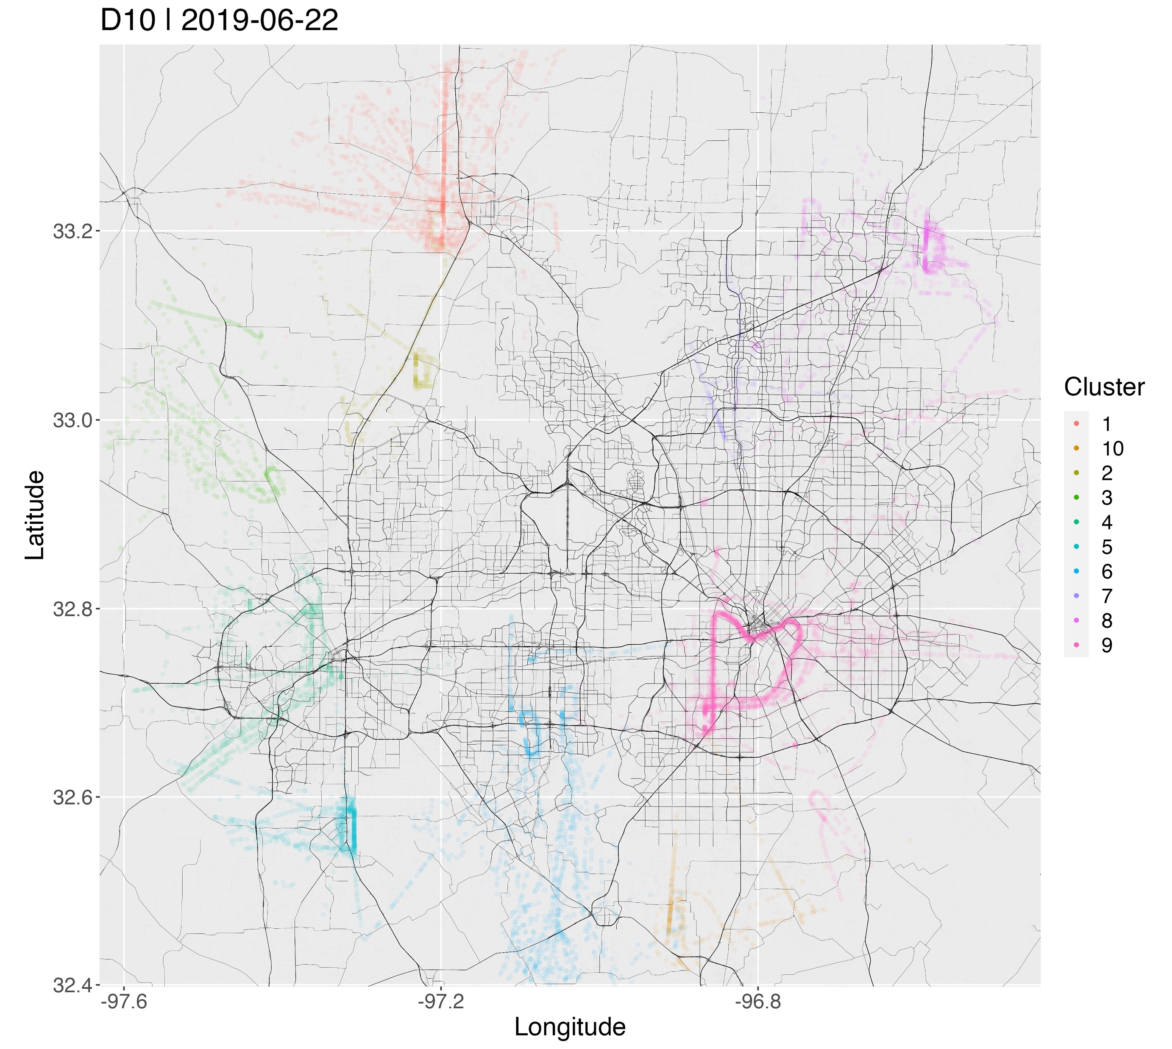
Method – Clustering trajectories with HDBSCAN
Min Pts = 35
Min Pts = 10
Min Pts = 5
Notes:
Once we establish a trajectory of n = 50, we can now compare each flight trajectory for similarity. Ideally, a computer program should identify corridors similarly to what we perceived. Above, the clusters are colored according to what the computer identified. We are now *mathematically* representing them, to them plot. Contrary to our very first slide, where we just plot track points.
We can now say which flights are associated to what corridor, which allows us to ask questions about them and study their properties.
This slides shows we experimented different parameters for HDBSCAN on MinPts. That is, the minimum number of points (trajectories here, not track points!) the algorithm should consider to be a cluster. This is a value we experiment and see how the algorithm reacts. The image shows visually three parameters we chose based on cut-off points in another plot in the paper (not include in these slides, but it is a N. Cluster vs Min Pts line plot).
Ultimately, we chose to proceed the paper with Min Pts = 5, as it allowed for more detail on different clusters.
We can also see that the clusters are consistent, hierarchically speaking as the parameters varied: The heart shape is still there. So, the results are promising!

Slide 7
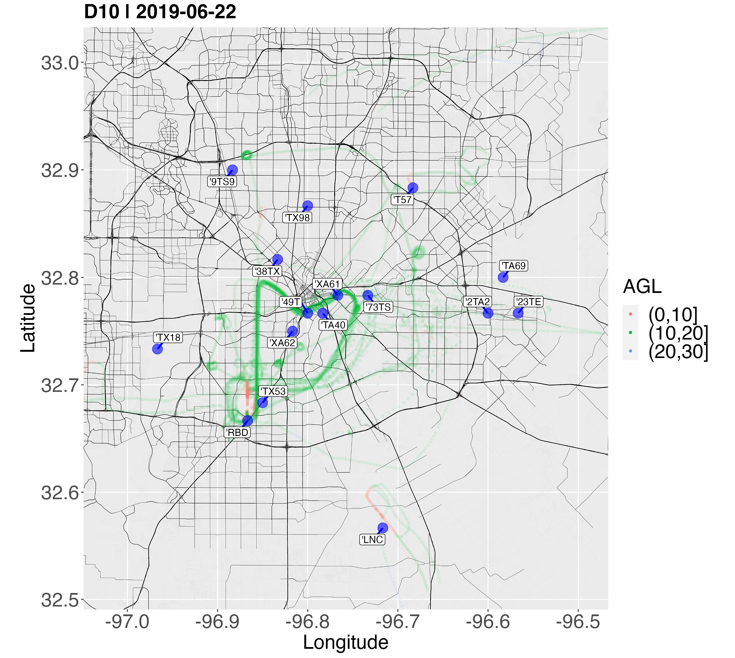
Leveraging existing UAM traffic at DFW-TRACON, June 22, 2019
Notes:
Since we can say a trajectory belongs to a corridor mathematically, by transitivity we can say a track point is assigned to a corridor.
We then create a heuristic to keep only sites of a corridor on display to reduce cluter: To each track point of a corridor, we can identify the closest site to each, below a given AGL and speed threshold
The image above shows that (TODO: Needs to replace with current paper image, I’m locked out of the internal overleaf)
With less clutter, we can now add the site IDs so other companion information can be displayed)

Slide 8
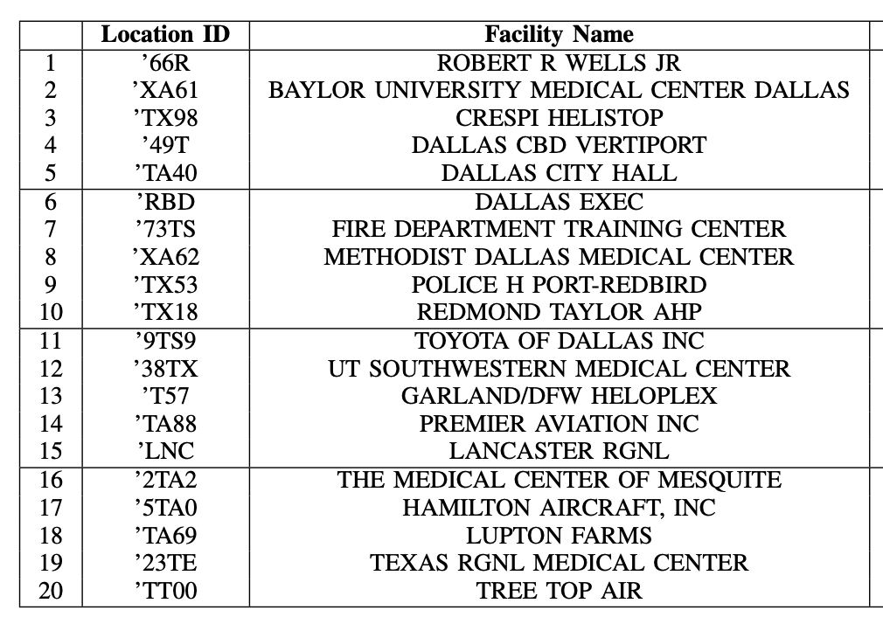
Dynamic Trajectory Recreation of a Corridor with Trace
Notes:
- The following shows the Heart shape corridor besides a table with the associated IDs. More information is available in the full table.

Slide 9
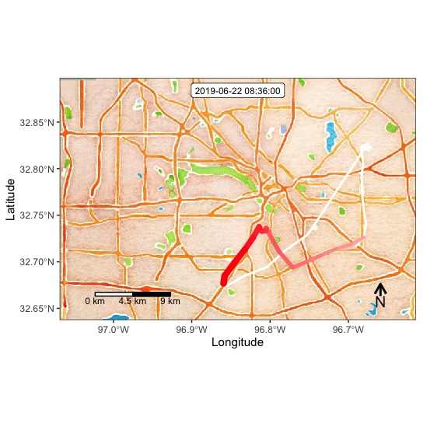
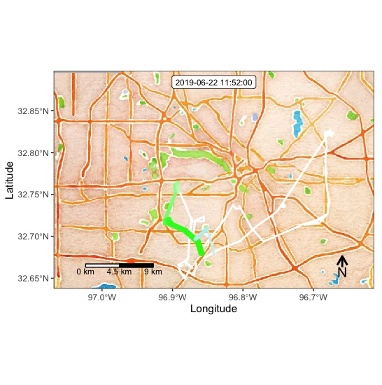
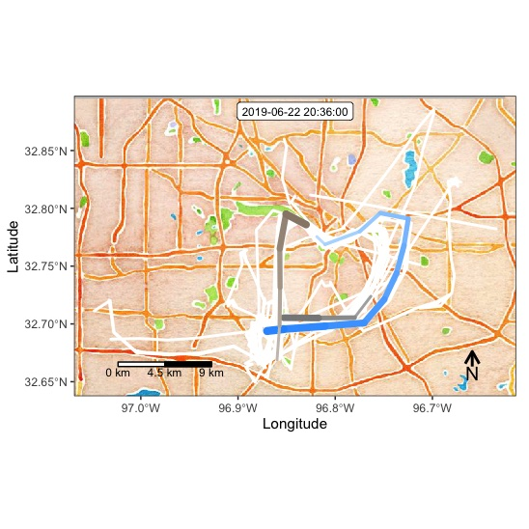
Dynamic Trajectory Recreation of a Corridor with Trace
First Trajectory
First Trajectory Trace + Second Trajectory
Remaining two trajectories + All traces

Slide 10
Conclusions & Future work
- We created a framework for UAM visualization from emerging data that can enable automated detection of present-day corridors
- Future work will leverage this data for simulations in order to devise UAM safety metrics
Notes:
The takeaway is a method to visualize and sense making of corridors. Since we only looked a single day, we can’t draw conclusive results of the corridors per se, but it sets the foundation for:
Different pre-processing techniques affecting the results of clusters
Different sizes of trajectory representations, or methods that do not require such assumption
Different features, beyond latitude and longitude (e.g. altitude, or ground speed of trajectory) in the comparisons of trajectories
Temporal analysis (e.g. early results suggested the absence of the heart shape on weekends), influence of whether, etc
Different Sites
Derive airspace metrics for complexity
Trajectory Tubes for corridor degree of separation
Etc

