Slide 1
Space Technology Mission Directorate
Game Changing Development Program
Presenter: Robert Maddock | Moderator: Chi Nguyen | FY22 SCALPSS 1.1 Annual Review Presentation | 09.16.22
Name/Email POC: Robert Maddock / robert.w.maddock@nasa.gov

Slide 2

Project Overview
Stereo CAmera for Lunar Plume-Surface Studies (SCALPSS) 1.1
Motivation:
  The behavior of dust and blast ejecta is Category “D” of the Lunar Strategic Knowledge Gap Theme III, “Understand how to live and work on the lunar surface.”
  The size and shape of the crater or craters formed at the point of landing will affect the risk to the landing vehicle, the science to be achieved there, and potentially the surface operations that can be conducted.
Technology Product Capability: Stereo imaging of plume surface interactions through CLPS lunar landing with high altitude stereo imaging prior to interactions onset. Data to be used to validate computational models needed for lander design nearby asset safety.
Technical Capabilities:
  stereo photogrammetry in lunar environment
Partners: NASA LaRC (project mgmt., hardware development, AI&T, payload delivery), NASA MSFC (camera / lens selection and performance, PSI CFD modeling), NASA JSC (camera calibration, MLI), Firefly Aerospace (CLPS lander provider)
Launch: January 2024
1

Slide 3

Team Members / Project Org Slide
SCALPSS 1.1 Project Management
Project Support
Systems Engineering
Assembly, Integration & Test
Science and Operations
Safety and Mission Assurance
Flight Hardware
Electronics
Thermal
Structures
Mechanical
Science and Data Analysis
(MSFC)
Configuration and Photogrammetry
Camera System (MSFC)
MLI
(JSC)
Contamination Control
Software
PI: Michelle Munk
PM: Rob Maddock
PPC: Stephanie Hamrick / Dave Lehotay
Schedule: Cyndy McPherson
CM: Heidi Connolley
Technical Lead: Chi Nguyen
K C Johnson
Richard Rawls
Larry Cowen (QA)
Miko Przemyslaw
Manish Mehta
Mike Manginelli
Ray Lueg
Bill Witherow
Mike Manginelli
Alex Scammell
Shawn McLeod
Adam Ben Shabat
Alan Sturgis
Nick Vitullo
Cory Wilson (flight)
Matt Rodgers (ground)
Paul Danehy
Olivia Tyrrell
Tim Fahringer
Molly Harwood
Notes:
If you have submitted a Project Plan, you could utilize the Organizational Chart found in section 8.3 – Management Structure

Slide 4

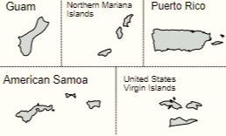

Collaborations & Partnerships
NASA
Commercial Lunar Payload Services (HQ/SMD)
Space Technology Mission Directorate (HQ)
Jet Propulsion Laboratory
Johnson Space Center
Langley Research Center
Marshall Space Flight Center
Industry/Academia
Alysium-Tech GmbH (Nuremburg, Germany)
Parraid, LLC
Protocase (Nova Scotia, Canada)
Protolabs
Teledyne FLIR
Public/Private Partnerships
Firefly Aerospace
Notes:
Infusion: An investment reaches a conclusion where a technology is handed off for use by a mission or other need. Infusions can be made to other NASA Mission Directorates, other Government Agencies, Commercial Entities, or International Partner.
Transition: An investment reaches a conclusion where a technology is handed off for further development. Transitions can be made to other STMD programs, other NASA Mission Directorates, academic institution, other Government Agencies, Commercial Entities, or International Partner.

Slide 5
Project Goals & Project Objectives
Technology Goals
Goal #1 | Develop and deliver flight payload for study of Plume-Surface Interactions near the lunar equator.
Goal #2 | Provide flight data for validation / anchoring of PSI modeling development.
Project Objectives
Objective #1 | Demonstrate the capture of landing site morphology, prior to, during, and following plume surface interactions (PSI)
Objective #2 | Demonstrate ability to detect onset of PSI
Objective #3 | Demonstrate ability to detect altitude at which ground obscuration occurs
Objective #4 | Demonstrate possible methods for determining ejecta sheet structure

Slide 6
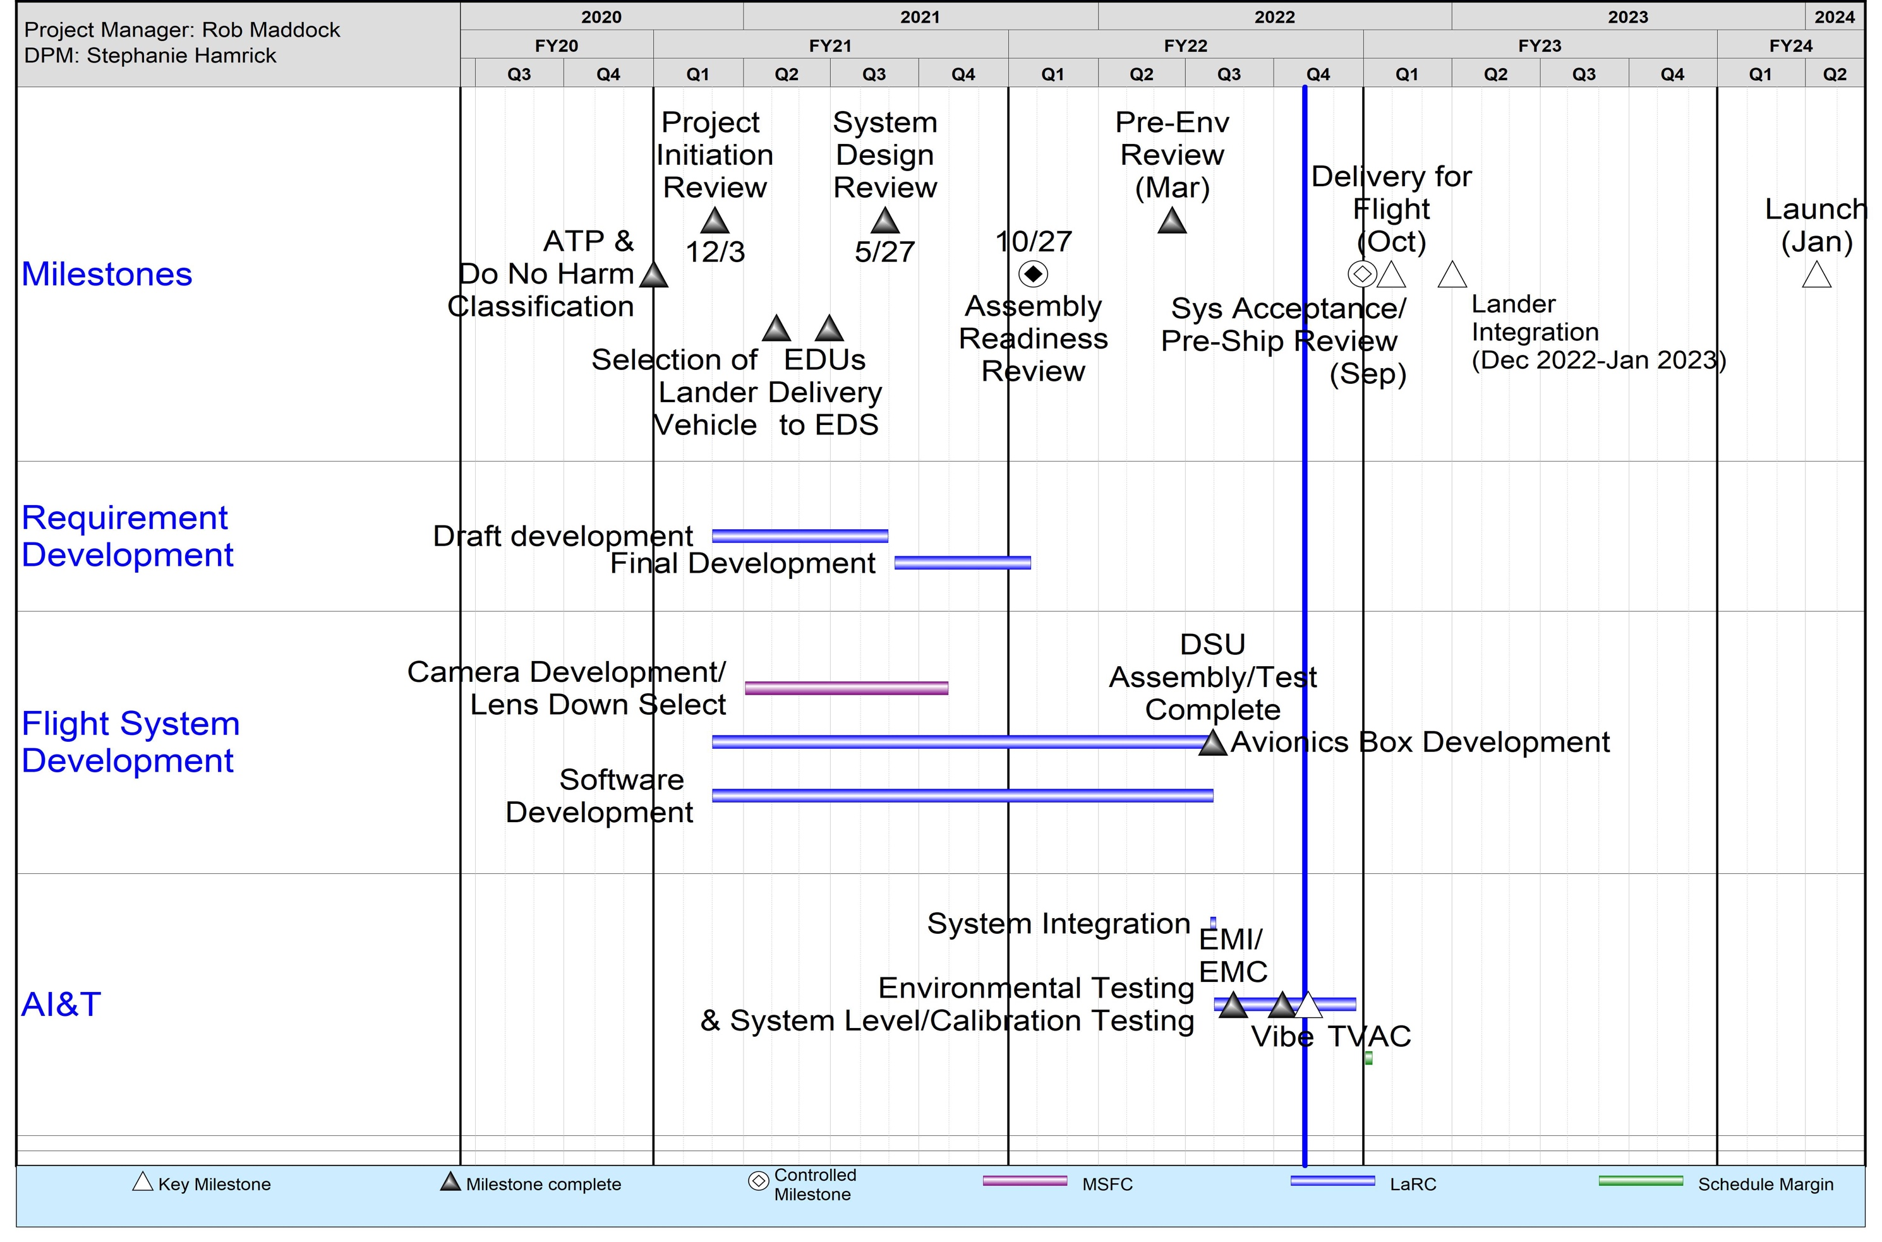
SCALPSS 1.1
Project Schedule
Re-flight of previously developed payload (TRL 8)
Notes:
Chart purpose: show TRL/SRL/MRL advancement over the project lifecycle schedule. Show TRL advancements as whole integer increases. Show how Key and Controlled milestones align with TRL advancement.
TRL/SRL/MRL may not advance at each milestone. Often several milestones are required to produce a step increase in TRL/SRL/MRL.
There can be one, or more, of these charts per project as needed.
For projects with fewer technical elements, the TRL/SRL/MRL data can be combined on one chart.
For more complex projects, the TRL/SRL/MRL progression can separated into multiple charts by project technical area.
Show TRL, SRL, and MRL data for each technical element on the same chart.
Delete TRL/SRL/MRL axis-labels that do not apply – e.g., remove SRL/MRL for projects/technical areas where SRL and MRL do not apply.

Slide 7
Accomplishments
Successfully completed System Design Review.
Coordinated pre-flight predictions using CFD modeling of PSI / erosion.
Procured and fabricated all required flight and GSE hardware.
Supported lander Payload Integration Planning Review.
Completed DSU (component level) thermal characterization testing.
Developed and provided science data collection ConOps to host lander.
Completed camera lens selection and lander configuration for flight.
Successfully completed Assembly Readiness Review with Independent Review Team.
Provided inputs and approval to first release of host lander ICD.
Completed lens focal length characterization testing at the MSFC Flat Floor Facility.
Completed assembly of all flight hardware (DSU and camera mount assemblies).
Delivered flight hardware (DSU) to EDS Project.
Delivered payload simulator to host lander.
Successfully completed Pre-Environmental Review with an independent Engineering Review Board
Completed all environmental testing (EMI/EMC, vibration and TVAC).

Slide 8
Project Assessment Summary
Project Name | Performance |  |  |  | Comments
 | C | S | T | P
Mid Year |  |  |  |  | Technical – Lander provider was late in the delivery of information needed to close out design (e.g., thermal model) Cost – Sufficient funding was provided during CRs with no schedule impacts Schedule – Cabling procurement lead time was much longer than anticipated Programmatic – Tracking possible conflicts between 1.0 lander integration and 1.1 environmental testing
Annual |  |  |  |  | Technical – All environmental testing is complete; hardware functions as expected Cost – Full FY22 BA received (with minimal FY22-23 swap required). Schedule – On schedule for 31 October hardware delivery (with some schedule margin still available) Programmatic – With additional 1.0 launch slip, now tracking possible conflicts between 1.0 flight and 1.1 lander integration and testing

Slide 9
Plans Forward and Transition / Infusion Plan
  As NASA and commercial companies prepare to land larger payloads (growing to human scale) on the Moon (and eventually Mars) they will employ increased landing engine thrust resulting in plume interactions with the surface becoming more extensive on missions that will at the same time require higher reliability than their predecessors. It is critically important to understand the effects of PSI on the landing site, on the landing vehicle itself, and on any nearby assets (including historical sites).
  Several years of Small Business Innovative Research (SBIR) and other small, low-TRL investments have taken advantage of recent computational advances, resulting in a starting tool set that can be applied to future missions.
  SCALPSS 1.1 is a “re-flight” of the SCALPSS payload on a second CLPS lander (Firefly Aerospace Blue Ghost) with modifications to collect additional and improved PSI data.
  Both SCALPSS payloads rely heavily on the flight proven design of the Mars 2020 EDLCam system and COTS hardware.
  Delivery of the SCALPSS 1.1 payload is planned for NLT 31 October 2022 with launch in January 2024.
  SCALPSS 1.0 and 1.1 data will feed directly into validation and anchoring of PSI computational and engineering models needed for the design of future landers.
  Lessons learned will be leveraged in the development of SCALPSS 2.0 as well as the entire CLPS PSI Mini-Suite payload (planned for delivery in ~April 2026).
  The project is also exploring opportunities to fly spare SCALPSS 1.1 hardware on other lunar (and Mars) missions, including in support of risk mitigation activities for HLS.
Notes:
Infusion: An investment reaches a conclusion where a technology is handed off for use by a mission or other need. Infusions can be made to other NASA Mission Directorates, other Government Agencies, Commercial Entities, or International Partner.
Transition: An investment reaches a conclusion where a technology is handed off for further development. Transitions can be made to other STMD programs, other NASA Mission Directorates, academic institution, other Government Agencies, Commercial Entities, or International Partner.

Slide 10
Education/Public Outreach
EPO Involvement
EPO Calendar Outlook (High Priorities):
6 Month Look-Ahead
Feature article for NASA.gov on environmental test campaign | TBD
SCALPSS included in AIAA SciTech PSI Overview presentation (01/06/22).
SCALPSS hardware displayed and discussed during a LaRC visit by Senator Nelson, Commander Melroy, members of Congress and the press (2/24/22).
Provided SCALPSS / PSI overview and challenges to students and families attending the Tabb Middle School Science Expo (04/13/22).
Notes:
Summary of the EPO activities (papers, conferences, outreach events) participated in over the last 6 months and the forward outlook for 6 months

Slide 11
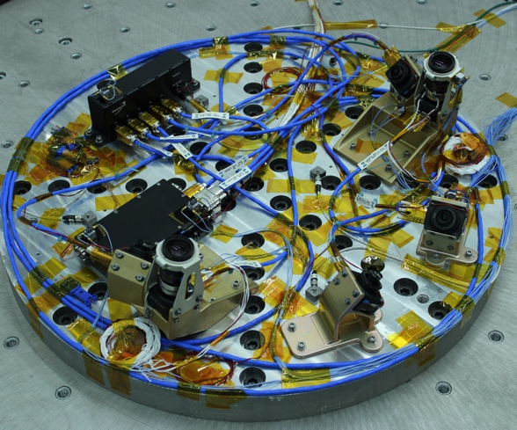
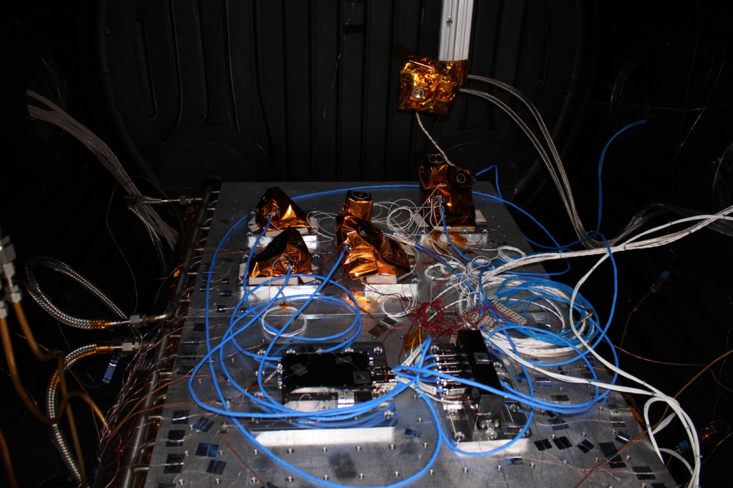
Summary
Key accomplishments for the year:
  Successfully completed the Assembly Readiness Review with Independent Review Team.
  Provided inputs and approval to first release of host lander ICD.
  Completed assembly of all flight hardware.
  Delivered flight hardware to EDS project and payload simulator to host lander.
  Successfully completed the Pre-Environmental Review with an independent Engineering Review Board.
  Completed all environmental testing.
(a)
(b)
SCALPSS 1.1 (CLPS 19D) hardware in (a) vibration testing and (b) thermal vacuum (TVAC) testing (June-August 2022)
Summary of the TechMat Capability End State for the Scope of the Project:
  SCALPSS 1.1 is a “re-flight” of the SCALPSS payload on a second CLPS lander (Firefly Aerospace Blue Ghost) with modifications to collect additional and improved PSI data.
  Delivery of the SCALPSS 1.1 payload is planned for NLT 31 October 2022 with launch in January 2024.
  Together, SCALPSS and SCALPSS 1.1 will provide critical flight data for the validation of PSI modeling by:
    demonstrating the capture of landing site morphology, prior to, during, and following PSI
    demonstrating ability to detect onset of PSI
    demonstrating ability to detect altitude at which ground obscuration occurs
    demonstrating possible methods for determining ejecta sheet structure

