Slide 1
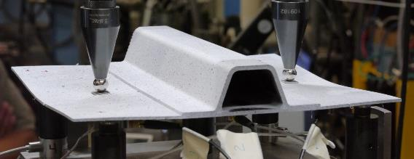

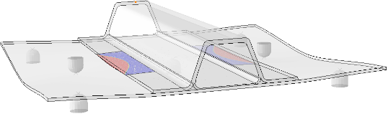
Predicting Skin/Stiffener Separation under Cyclic Loads
Experimental
Carlos G Dávila
Durability, Damage Tolerance
and Reliability Branch
NASA Langley Research Center
Hampton, VA
Simulation
ONERA Invited Talk
Centre de Châtillon, Paris, FR
September 15, 2022

Slide 2
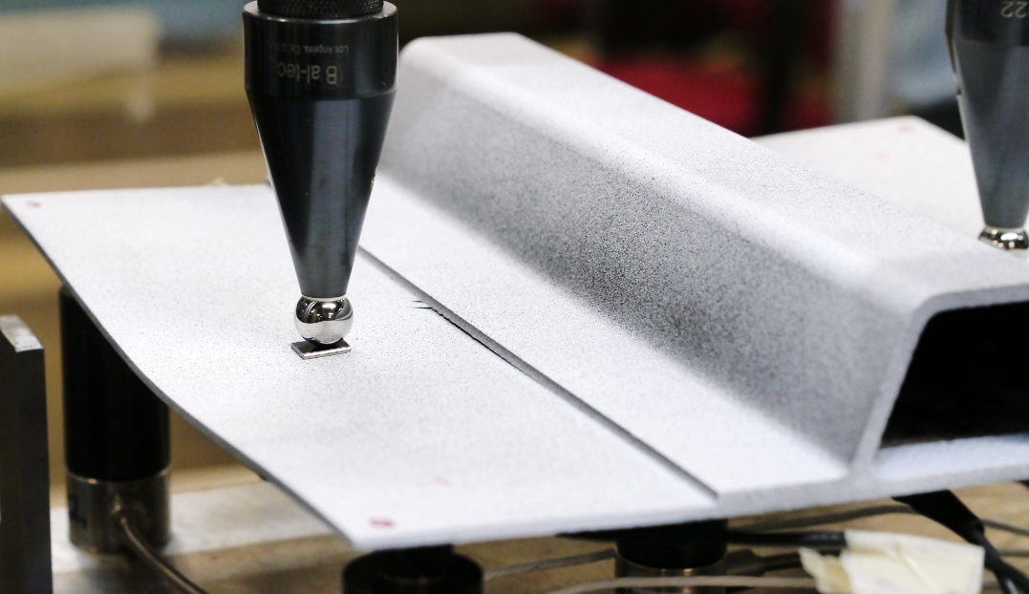
Fatigue: Skin/Stiffener Separation

Slide 3
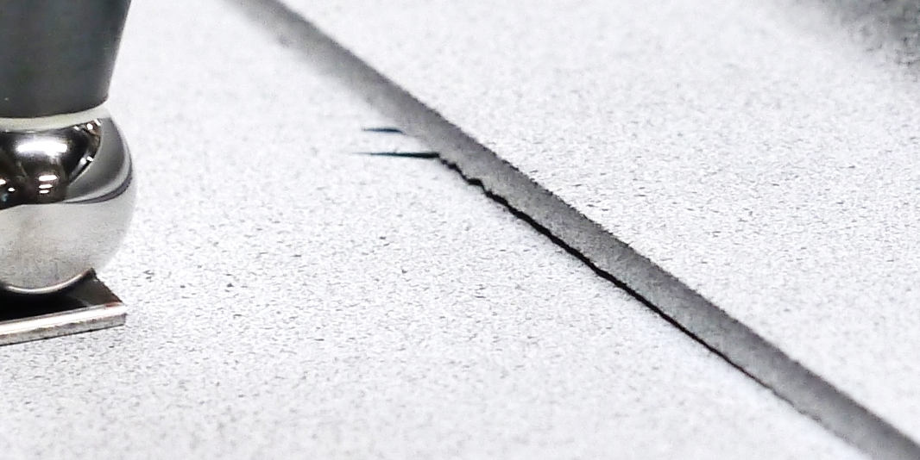
Fatigue: Skin/Stiffener Separation
How to model the initiation and propagation of skin/stiffener separation under cyclic loads?

Slide 4
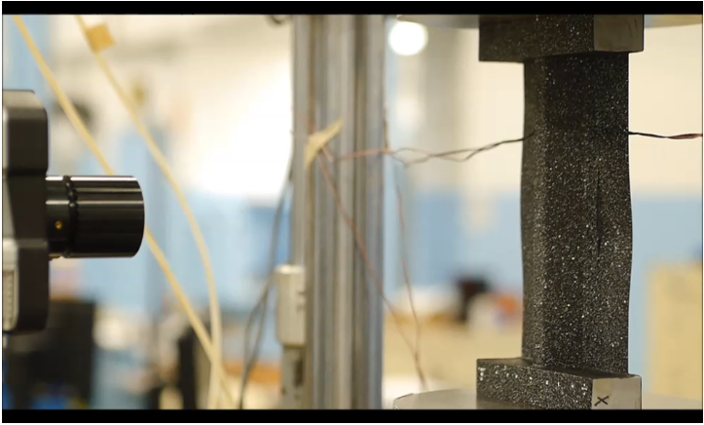
Fatigue Testing – Single Stringer Compression Specimen

Slide 5
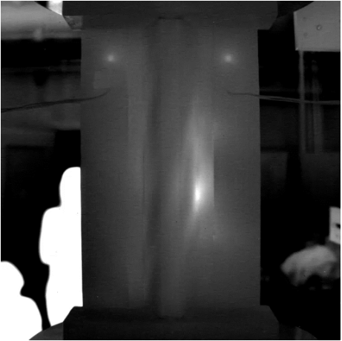
Fatigue - Thermography

Slide 6
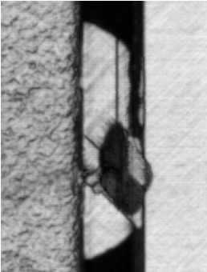
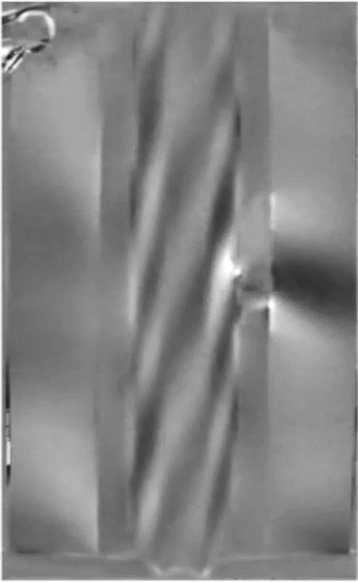
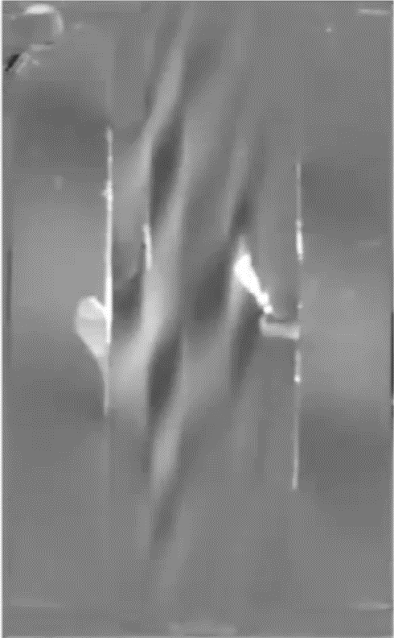
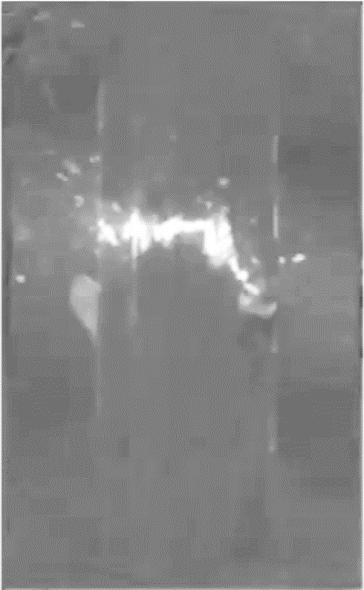
Collapse Sequence
Infrared camera
58 mm
Flange debonding and tunneling
Stringer crippling
A
B
C
Delamination inside skin

Slide 7
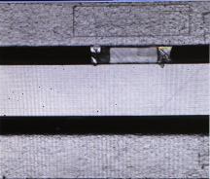
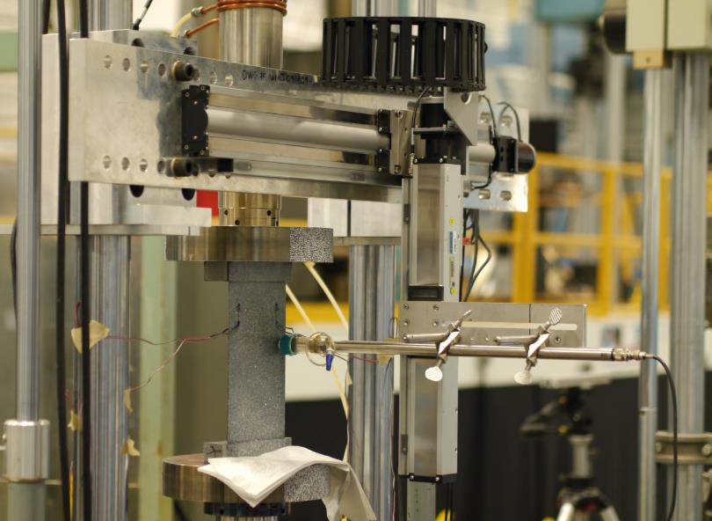
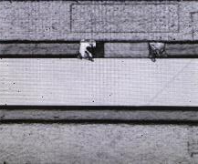
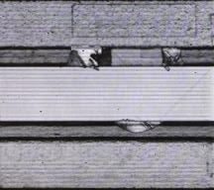
In-situ Ultrasonic Scanner (UT)
40 mm
Implanted defect
68 mm
1000 cycles
Cycles
72 mm
2000 cycles
Single stringer compression specimen (back)
87 mm
UT probe
6750 cycles

Slide 8
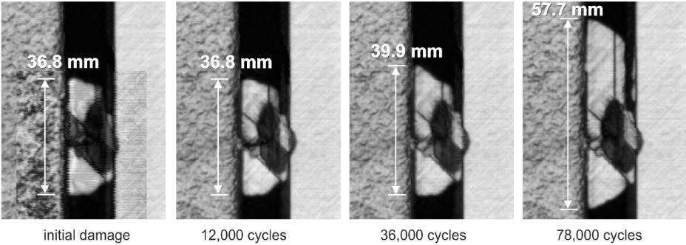
Fatigue Damage Propagation
Typical fatigue propagation of indentation damage
Collapse at 78,135 cycles

Slide 9
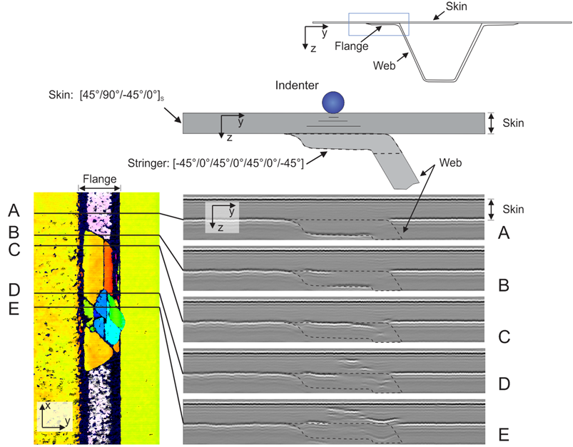
Morphology of Indentation Damage with Fatigue
A. Cross-section
Skin
Flange
B. Detail of indentation zone
Indenter
Web
Skin
C. Analysis of UT data
Web
Flange
Skin

Slide 10


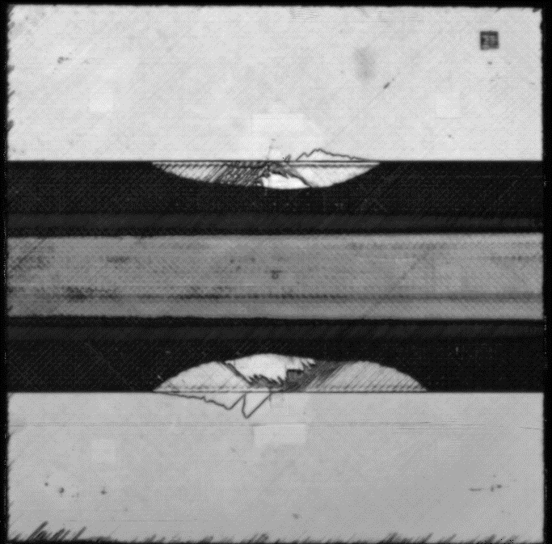
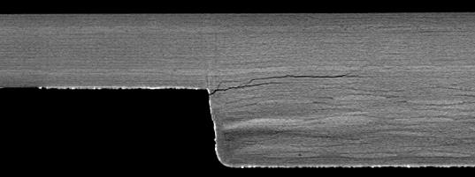
Separation - Nondestructive Evaluation (NDE)
Ultrasonic C-scanning (UT)
Delaminations
X-Ray Computed Tomography (CT)
Flange
Delaminations
Skin

Slide 11
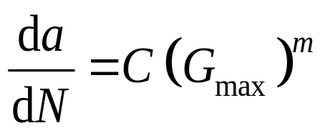
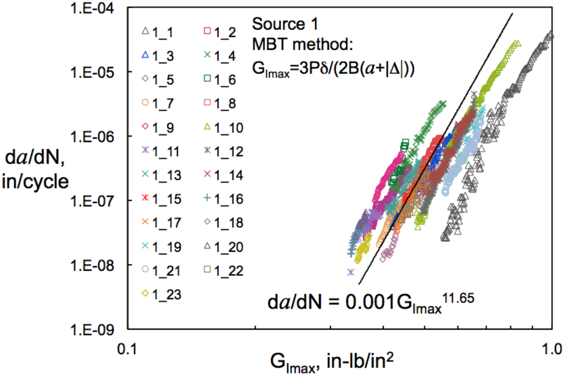
Fatigue Propagation Rate Using the Paris Law
Paris data does not apply to crack initiation.
Characterization tests take a long time and expensive to conduct.
Tests must be conducted at different stress ratios R and mode mixities B.
Resistance curves induce multiple Paris laws (R-curve effect).
Implementation or Paris law into a cohesive law is difficult.
Paris Law:
Murri, NASA/TM–2013-217966

Slide 12
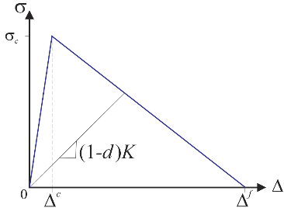
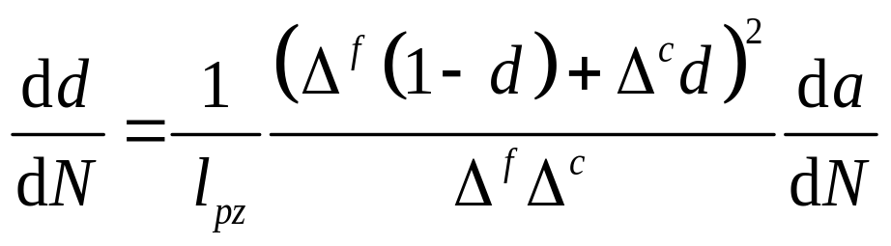
Turon Fatigue Cohesive Model (2006)
Paris Law
Turon Fatigue Damage Law
(Composites A, 2006)
However:
Both G_{max} and l_{pz} are “non-local” quantities, i.e, require data at other integration points
Issues with Paris Law

Slide 13
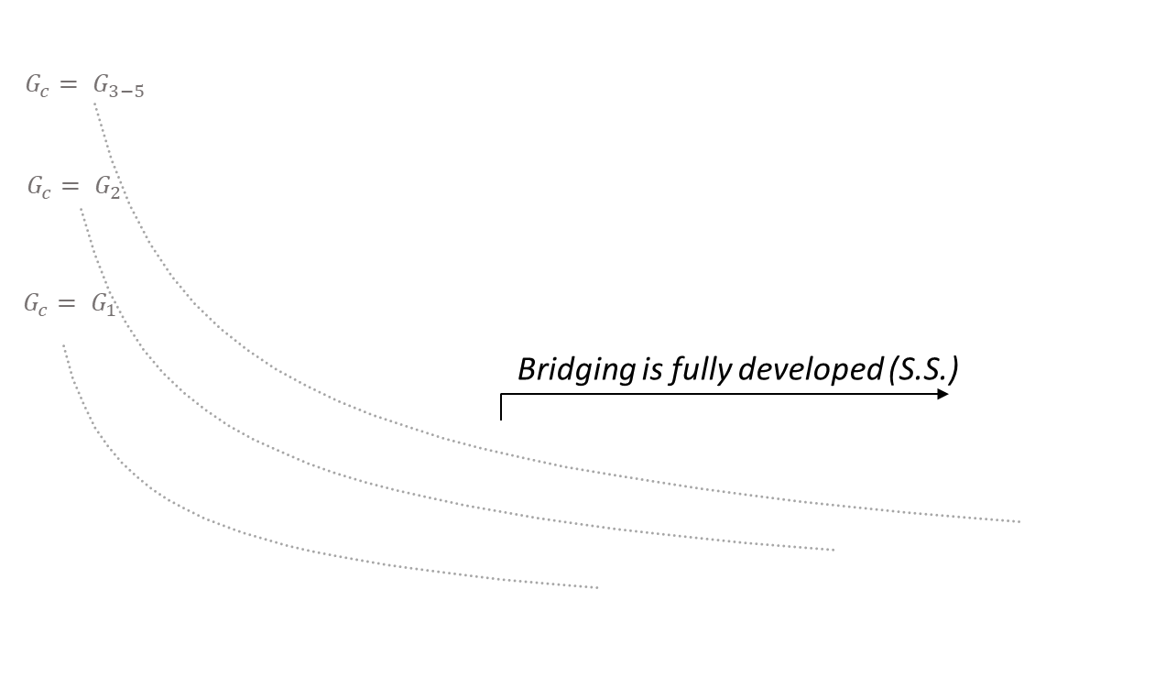
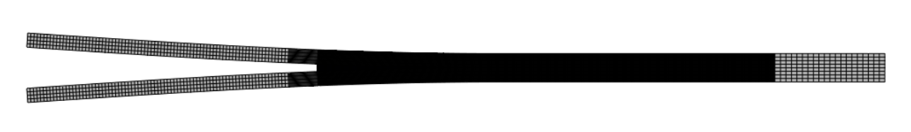
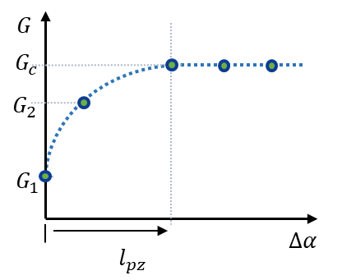
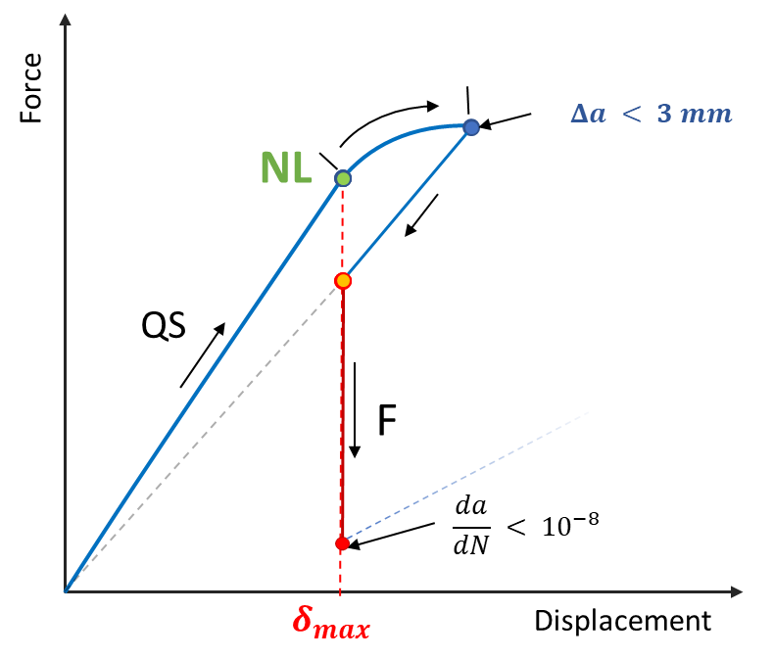
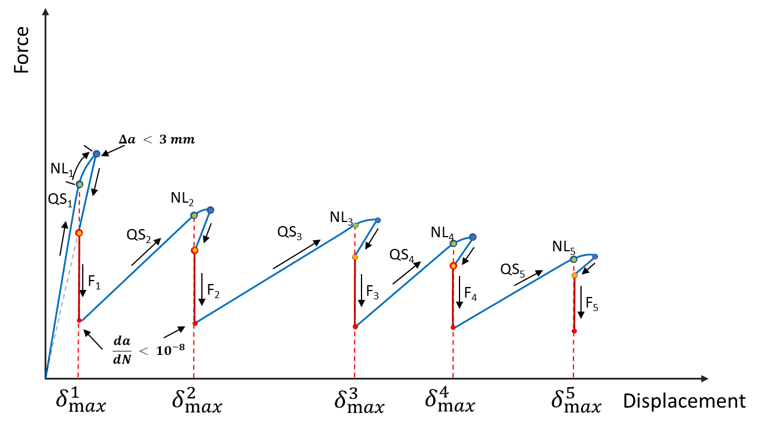
What effect does an R-curve have on fatigue?
Yao, L., Composites Part A, 2014
Loading Cycle: Quasi-static Fatigue
δ, F
QS
QS: Quasi-static
NL: 1st point of nonlinearity

Slide 14
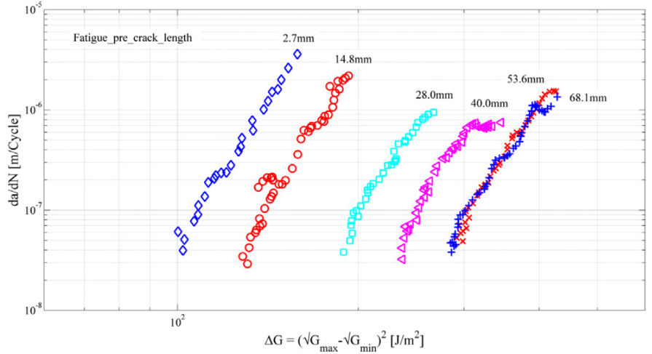
R-Curve In Fatigue
Yao, L., Composites Part A, 2014

Slide 15
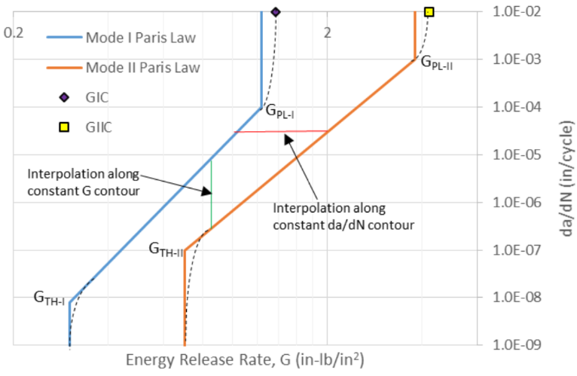
Characterization of Paris Law
Paris law data must be interpolated for mode mixity and stress ratio
Deobald et. al, NASA/TM–2017

Slide 16
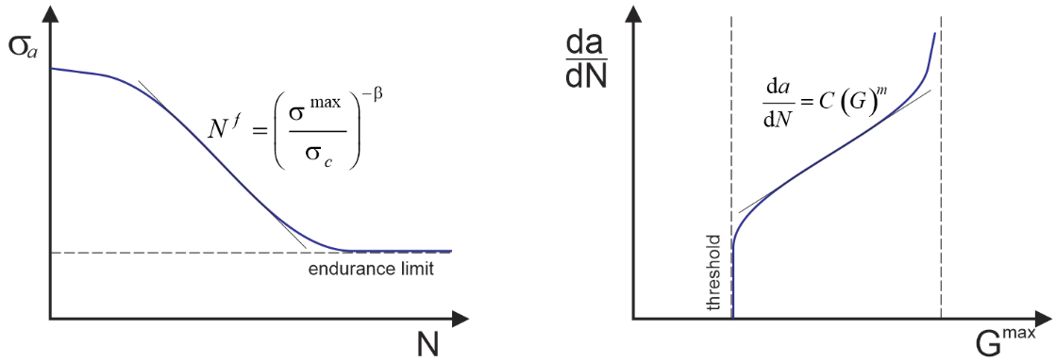
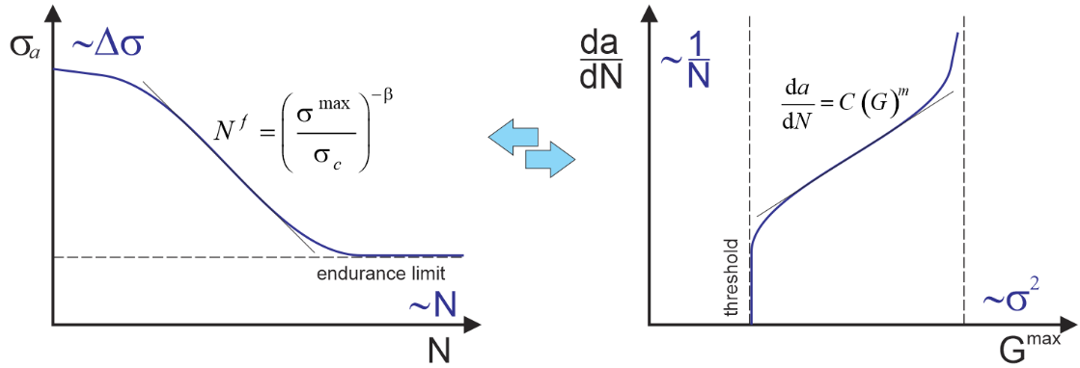
Fatigue: S-N or Paris Law?
S-N Curve
Paris Law
Allegri, 2013
S-N Curve and Paris law are related:
β = 2m
Can we develop a cohesive model based on S-N that can also predict crack propagation?

Slide 17
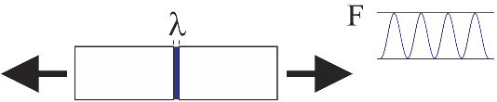
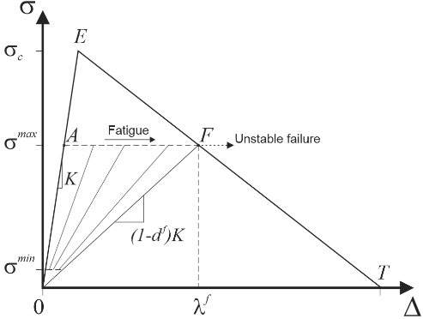
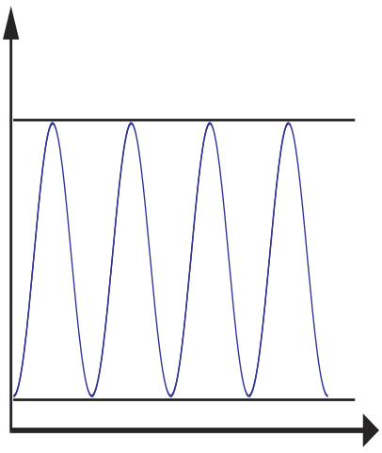
S-N Cohesive Fatigue Damage Model
Consider case of bar subjected to cyclic load
Assume cohesive law is envelope of fatigue damage
F
What damage law?
Time

Slide 18
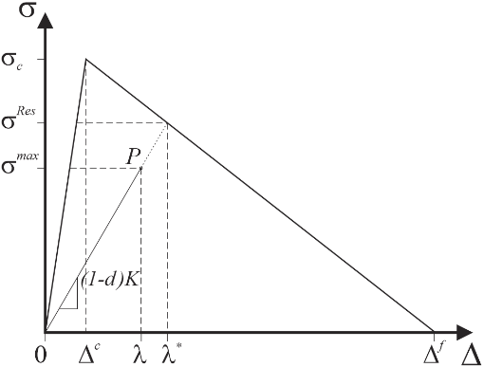
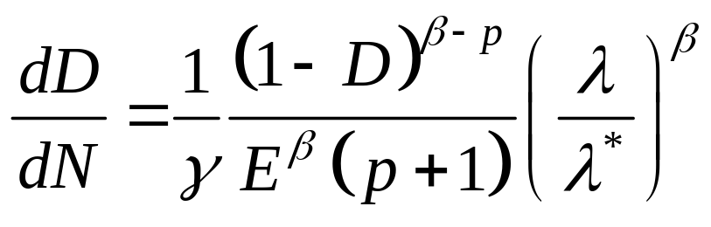
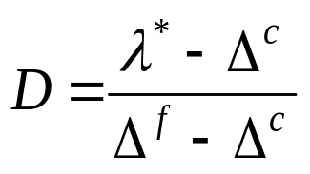
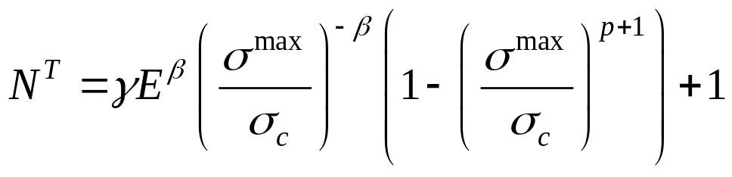
CF20 Cohesive Fatigue Damage Model
Consider damage accumulation function at point P:
A
B
CF20, Dávila et al. NASA/TP–2020-220584
Number of cycles to failure obtained by integrating dN from A to B:
≈ 1
S-N curve

Slide 19
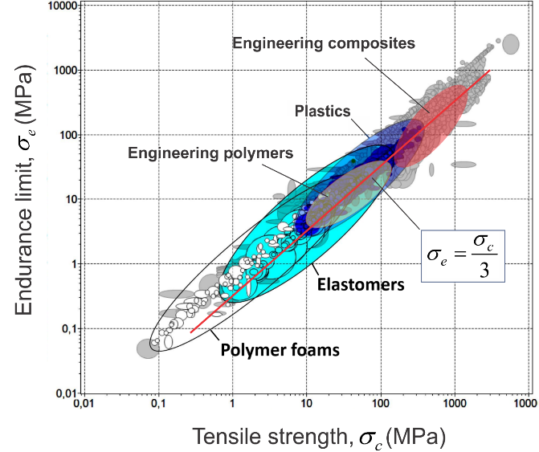
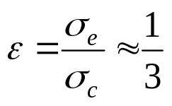
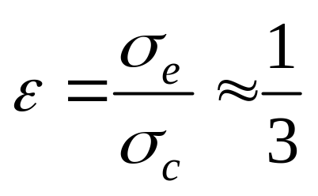
Endurance limit vs. tensile strength (R = -1)
Rotating beam fatigue testing
Motor
-
+
Specimen
For R = -1
N. Fleck, 1994
Notes:
Fleck, N. A., Kang, K. J., and Ashby, M. F., "Overview No. 112: The Cyclic Properties of Engineering Materials," Acta Metallurgica et Materialia, Vol. 42, No. 2, 1994

Slide 20
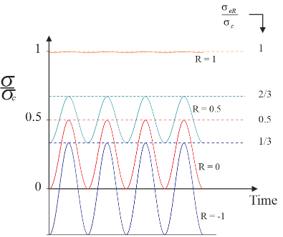
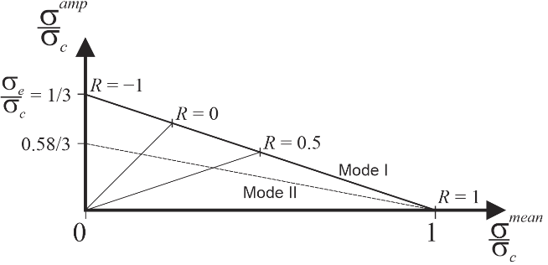
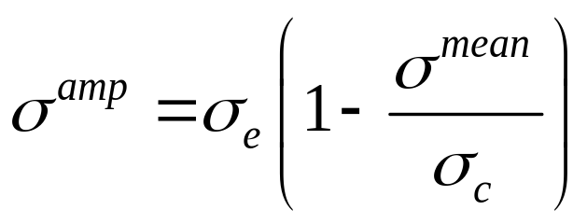
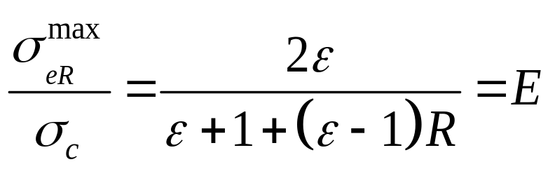
Goodman Diagram (GD)
The GD is design tool that represents the locus of stress states corresponding to a runout stress or a given number of cycles to failure
R = σ ^{min}/σ ^{max}
ε
0.58∗ε

Slide 21
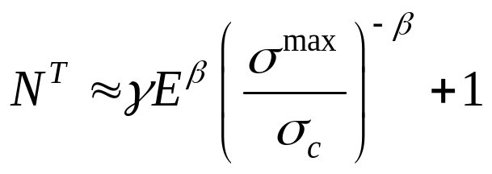
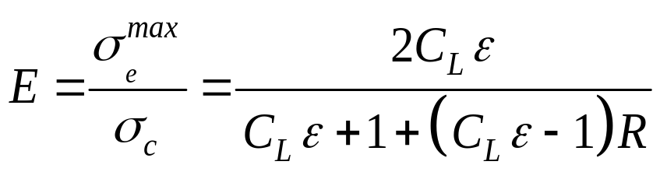
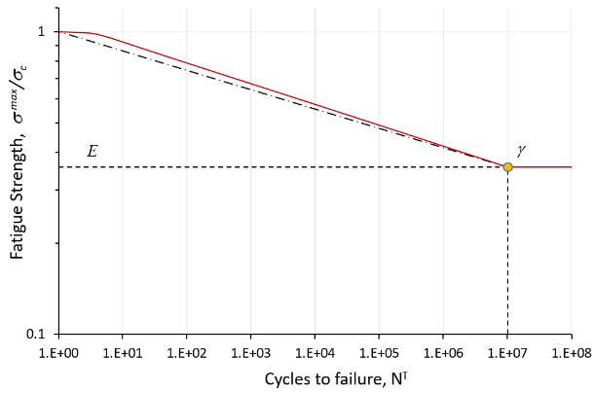
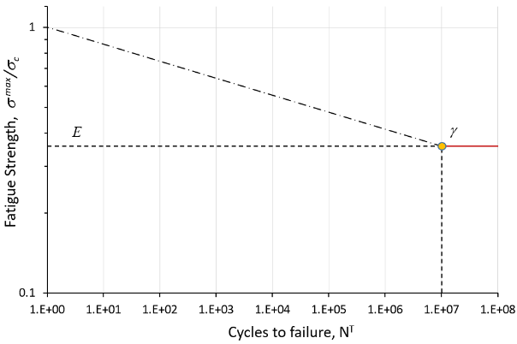

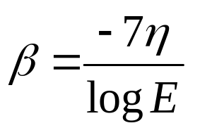
Determination of Damage Model Parameters
Endurance (Goodman diagram)
Endurance @ R=-1
Mixed-mode factor
Stress ratio
η = 0.95
η = 1
Mode mix
Brittleness
Fatigue model entirely defined by parameters η, ε, and p
Affects slope of S-N and Paris law
Affects pre-factor “C” of Paris law

Slide 22

Determination of Damage Model Parameters
Effect of the model parameters η, ε and p on: a) S-N diagram; b) crack propagation curve

Slide 23







Palmgren-Miner (P-M) Rule
Does the CF20 fatigue model satisfy the P-M rule?
$$\sum_{i=1}^{k}{\frac{n_{i}}{N_{fi}}=1}$$
$$σ_{i_max}$$
Recalling that the rate of damage in CF20 is:
,
$$N_{fi}$$
It is easy to show that for any sequence of cycles $n_{i}$ and $σ_{i_max}$,
$$\sum_{i=1}^{k}{\frac{n_{i}}{N_{fi}}=}$$
Yes, the P-M rule is satisfied, i.e., no fatigue history effect on subsequent damage

Slide 24












Implementation into a UMAT Subroutine
Fatigue damage
Fatigue parameters
QS mixed-mode parameters
(Turon)
Relative displacement jump
Quasi-static tearing damage
Calculate incremental fatigue damage
Update damage
Yes
Fatigue Enabled?
No
Update damage with fatigue
Loss of constitutive stiffness
Update damage

Slide 25




Analysis of Double Cantilever Beam Specimen (DCB)
Applied load remains constant
Detail of propagation zone

Slide 26

Propagation Rates for DCB Specimen
Analyses of DCB were conducted with 4 different applied loads (displacement control)
Test: Murri, NASA/TM–2013-217966
R = 0.1

Slide 27




R-Curve Effect on DCB Specimen
R-curve
Test: Murri, NASA/TM–2013-217966
Quasi-static response of DCB using superposition of bridging laws

Slide 28

Delamination Propagation Rates for DCB with R-Curve
Predicted delamination growth rates in a DCB specimen for several values of applied displacement (red) and applied force (green).
R = 0.1

Slide 29

Delamination Propagation Rates for DCB with R-Curve
Predicted delamination growth rates in a DCB specimen for several values of applied displacement (red) and applied force (green).
R = 0.1

Slide 30


R-Curve Effects with Superposition
DCB
DCB R = 0.1
R-curve
Analysis parameters:
η = 0.95, ε = 0.2, p = β
Test: Murri, NASA/TM–2013-217966
R-curve is captured by superposing two layers of elements with bilinear cohesive laws.

Slide 31


Effect of Stress Ratio R on Propagation Rates
(Allegri, 2013)
Analysis parameters:
η = 0.95, ε = 0.2, p = β

Slide 32


Mixed Mode Fatigue – Prediction of MMB Test
MMB 50% R = 0.1
Test conducted under force control.
R = 0.1
Analysis parameters:
η = 0.95, ε = 0.2, p = β

Slide 33



Three Point Bend (3PB) Doubler Specimen
Skin (tape laminate)
0°
z
x
y
Doubler (fabric)
Skin/doubler separation

Slide 34

Simplified Shell Model of 3PB Doubler Specimen
Skin (3 layers of elements)
Continuum Shell Model
Cohesive
Doubler (2 layers)
Empirical cohesive properties capture the effects of all damage mechanisms
s
Interface law w/ bridge
Interface law – nominal tape/tape
Bridge
d

Slide 35





Simplified Shell Model of 3PB Doubler Specimen
Test
Shell Model
Before peak load (symmetric)
After peak load (unsymmetric)
Analysis
Peak load
Propagation
Initiation
Propagation
Initiation
 | Base | Bridge
GI_{c} = | 0.45 | 0.60 | N/mm
GII_{c} = | 1.1 | 4.50 | N/mm
σ_{c} = | 105 | 3.5 | MPa
τ_{c} = | 97 | 10. | MPa
K_{I} = | 5E+05 | 1.8E+04 | N/mm³
K_{sh} = | 1.6E+05 | 3.0E+04 | N/mm³
BK = | 2.07 | 3
Predicted
Test
Computed (Turon’s constraints)

Slide 36


3PB Fatigue – Experimental Results

Slide 37


Delamination length in 3PB Doubler
3PB Doubler R = 0.1
Analysis parameters:
η = 0.95, ε = 0.2, p = β

Slide 38

Delamination length in 3PB Doubler
3PB Doubler R = 0.4
Analysis parameters:
η = 0.95, ε = 0.2, p = β

Slide 39

General Loading Conditions
Stress ratio
R=σ_{min}/σ_{max}
Force ratio
R_{L}=F_{min}/F_{max}
Assume R = R_{L}
Is this assumption always valid?

Slide 40



General Loading Conditions
Postbuckled stiffened panel Negative load ratios Unsynchronized loads
Constant pressure
Cyclic force
Geometric nonlinearity induces non-proportional stresses in structure.
R varies throughout structure.
Load reversal causes crack closure.
Mode mixity changes during cycle.
R is undefined.
Orientation of interfacial tractions change during cycle.
R is undefined

Slide 41



General Loading Conditions
Simplified Cyclic Loading Cycle Jump Analysis Min-Max Analysis
Valid if R = R_{L}
Can be used with cycle count techniques for spectrum loading.
Applies to all loads except possibly spectrum loading or block loading.
Valid if Min and Max are readily identifiable.
Can be used with cycle count techniques for spectrum loading.

Slide 42




General Loading Conditions
Min-Max Technique
Max Load Model
Twin Models
Share damage state
Min Load Model
Raimondo, AIAA J., 2020
Calculate Stress ratio
R=σ_{min}/σ_{max}

Slide 43
Concluding Remarks
Fatigue Cohesive Constitutive Model:
  Based on S-N curve rather than Paris law.
  Relies on relationship between S-N and Paris.
  Simplified loading procedure keeps load constant during analysis.
  Fatigue model parameters obtained from DCB test data.
  Same fatigue parameters were used in all analyses (η = 0.95, ε = 0.2, p = β ).
  Very simple to implement on top of a UMAT of a bilinear cohesive law
R-Curve Effects Modeled Using Cohesive Superposition
  R-curve represents effect of blunting, delving, bridging, and migrations.
  Shift in Paris lines is predicted.
Skin/Stiffener Separation: 3PB Doubler Test
  Specimen is initially pristine.
  Interface characterized by quasi-static R-curve.

