Slide 1


Mean Flow Effects on
Hypersonic Boundary-Layer Stability Analysis using LASTRAC
Xiaowen Wang
National Institute of Aerospace, Hampton, VA, 23666
Chau-Lyan Chang and Fei Li
NASA Langley Research Center, Hampton, VA, 23681
TFAWS Aerothermal Paper Session
Presented By
Xiaowen Wang
Thermal & Fluids Analysis Workshop
TFAWS 2022
September 6th-9th, 2022
Virtual Conference

Slide 2
Introduction to LASTRAC code
The Langley Stability and Transition Analysis Code (LASTRAC) is a publicly released code (US-person only) for boundary-layer transition analysis, developed by Dr. Chau-Lyan Chang (NASA/TM-2004-213233).
For hypersonic flows such as those over an atmospheric reentry vehicle, chemical reactions take place and nonequilibrium effects become important.
LASTRAC is now capable of analyzing linear instabilities (LST & Linear PSE) in chemical and thermal nonequilibrium flows. This new capability has been validated against known results that have led to several publications.

Slide 3
Overall Objectives
Complete the implementation of high enthalpy/nonequilibrium capabilities in LASTRAC with emphasis on finite amplitude perturbations (Nonlinear PSE).
Test and validate the resulting software by analyzing hypersonic boundary-layer transition in benchmark cases, available experimental configurations, and realistic atmospheric/reentry conditions.
  A systematic investigation on mean flow effects from different CFD solvers with different thermochemical models (VULCAN-CFD, ShockFIT, and LAURA).
  Effect of thermochemical models on the stability analysis using LASTRAC.

Slide 4
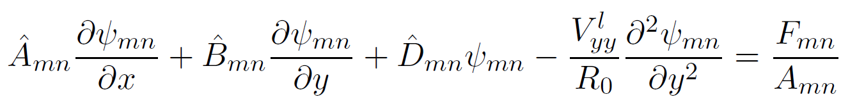

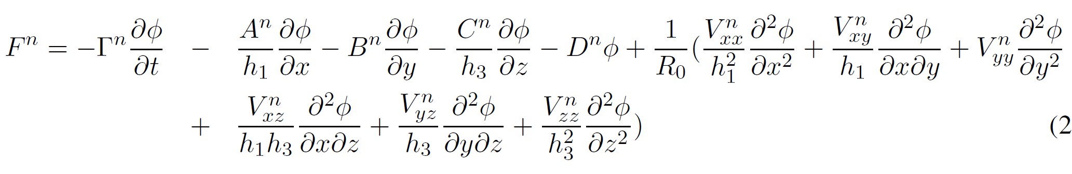
Governing Equations of the LASTRAC code
The nonlinear parabolized stability equations for the Fourier mode (m,n):
  Shape function:
  Streamwise curvature and transverse curvature may be included in the computation
  The left-hand side of the equation contains only linear coefficient matrices
  Nonlinear forcing term:
The equations are simplified for LST and Linear PSE.

Slide 5
Introduction to Mean Flow Solvers
VULCAN-CFD is a cell-centered finite volume solver to enable the simulation of turbulent reacting and nonreacting flows at conditions ranging from subsonic to hypersonic speeds. It can handle either structured multiblock meshes, or fully unstructured meshes.
ShockFIT solver is a high-order finite difference shock-fitting solver, where the shock is treated as a boundary of the computational domain. It can handle structured meshes.
LAURA uses an upwind-biased, point-implicit relaxation algorithm to obtain the numerical solution for 3-D, viscous, hypersonic flows in chemical and thermal nonequilibrium. It is a structured, multiblock, aerothermodynamic simulation code.

Slide 6
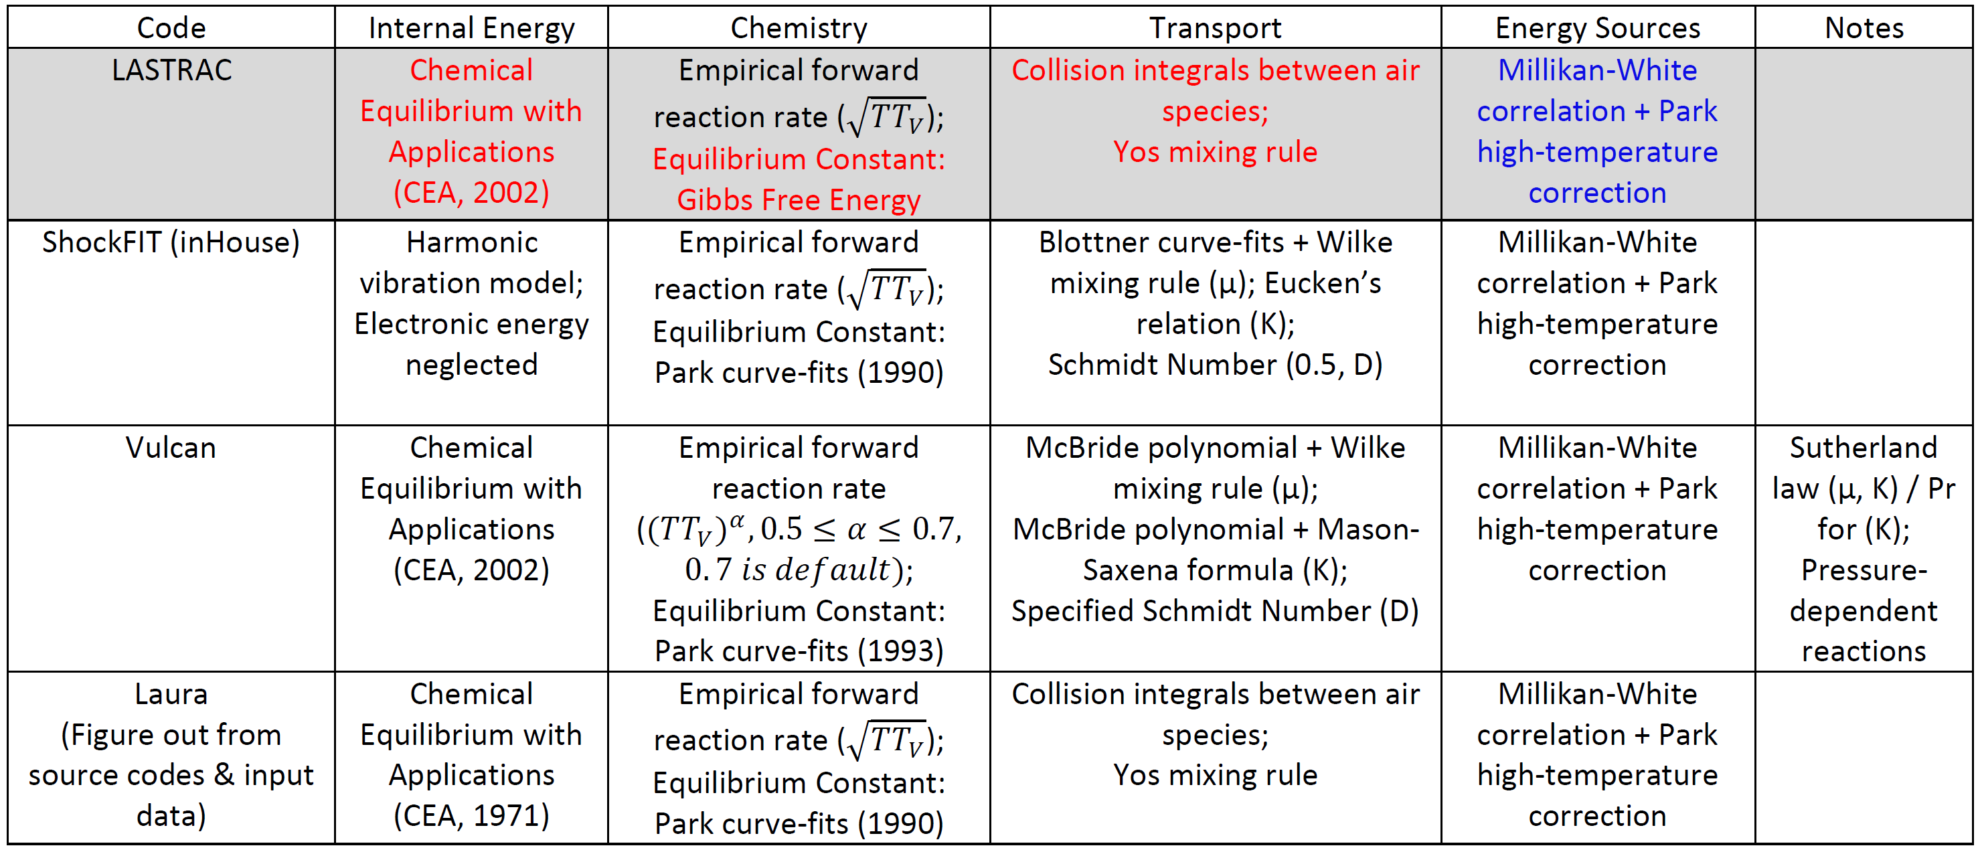
Thermochemical Models of Various Solvers
* Thanks to Robert Baurle & Kyle Thompson

Slide 7
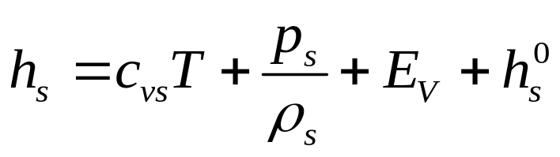
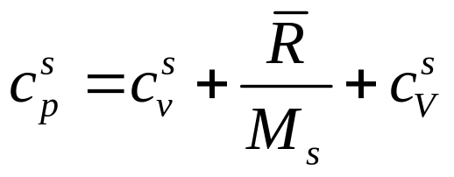
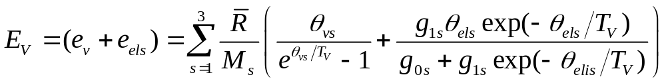
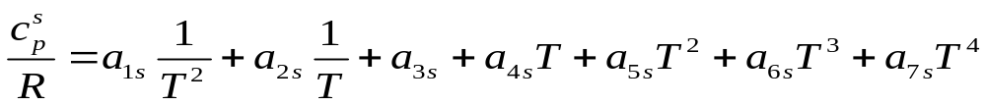
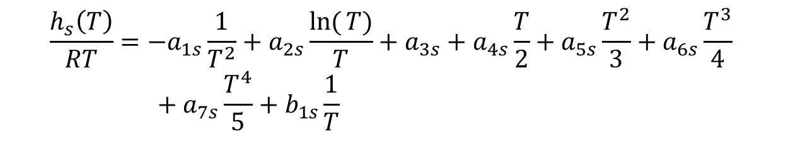
Model for Internal Energy
Definition of total enthalpy and specific heat
Vibration energy
$$\frac{h_{s}\left(T\right)}{RT}=−a_{1s}\frac{1}{T^{2}}+a_{2s}\frac{\ln{(}T)}{T}+a_{3s}+a_{4s}\frac{T}{2}+a_{5s}\frac{T^{2}}{3}+a_{6s}\frac{T^{3}}{4} \\ \begin{matrix}\begin{matrix} & \end{matrix} & & \end{matrix}+a_{7s}\frac{T^{4}}{5}+b_{1s}\frac{1}{T}$$
Definition of total enthalpy and specific heat
McBride et al., NASA/TP-2002-211556

Slide 8
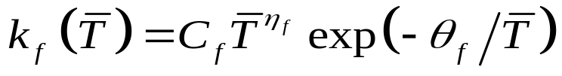

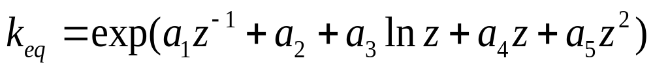
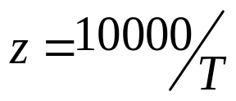
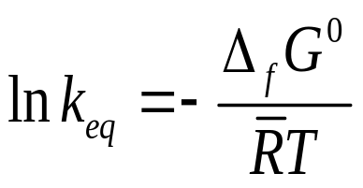
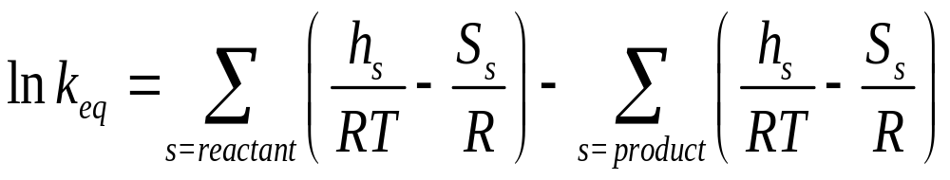
Model for Reaction Rates
Forward reaction rate
Backward reaction rate
Equilibrium constant
Equilibrium constant defined by free Gibbs energy
In the calculation of the forward reaction rate, the effective temperature $\overline{T}$ is a function of T and T_{v} for dissociation reactions whereas it is T for exchange reactions.

Slide 9

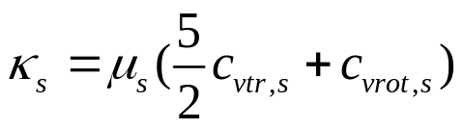

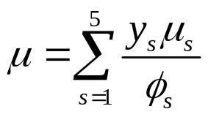
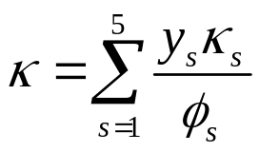
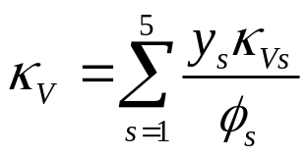
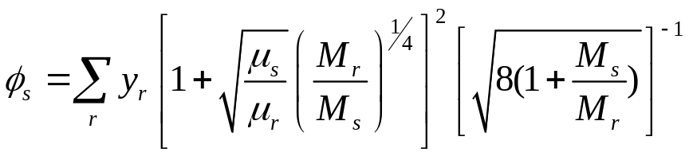
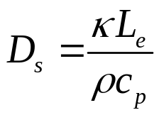

Model for Transport Coefficients
Species coefficients
Species | N2 | O2 | NO | N | O
A_{s} | 0.0268142 | 0.0449290 | 0.0436378 | 0.0115572 | 0.0203144
B_{s} | 0.3177838 | -0.0826158 | -0.0335511 | 0.6031679 | 0.4294404
C_{s} | -11.3155513 | -9.2019475 | -9.5767430 | -12.4327495 | -11.6031403
Mixture coefficients
y_{s} : Mole fraction
M_{r} & M_{s} : Molecular weight
Diffusion coefficients (Lewis number, = 1.4 )

Slide 10
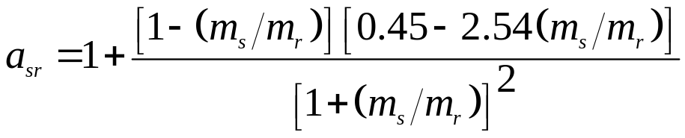
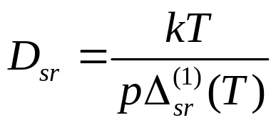
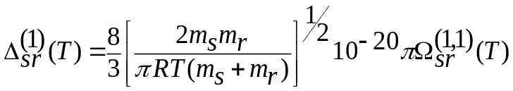
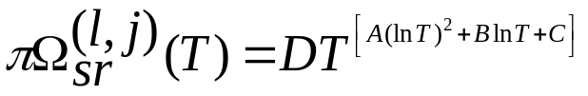
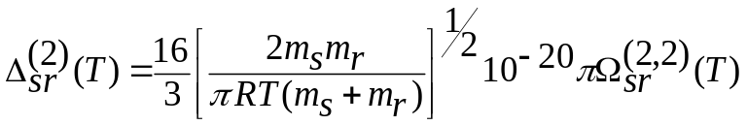
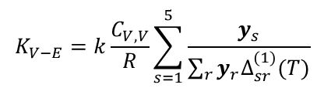
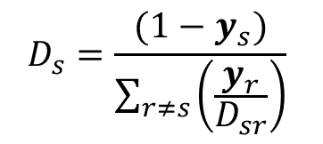
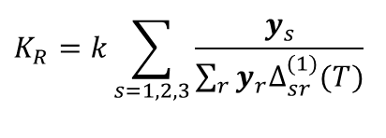
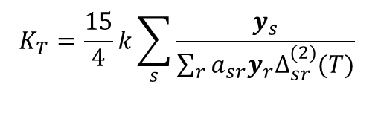
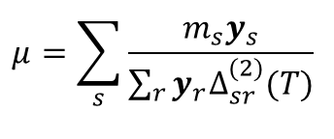
Model for Transport Coefficients
Mixture properties
(Yos mixing rule)
$$μ=\sum_{s}{\frac{m_{s}y_{s}}{\sum_{r}{y_{r}Δ_{sr}^{(2)}(T)}}}$$
$$K_{T}=\frac{15}{4}k\sum_{s}{\frac{y_{s}}{\sum_{r}{a_{sr}y_{r}Δ_{sr}^{(2)}(T)}}}$$
$$K_{R}=k\sum_{s=1,2,3}{\frac{y_{s}}{\sum_{r}{y_{r}Δ_{sr}^{(1)}(T)}}}$$
$$K_{V−E}=k\frac{C_{V,V}}{R}\sum_{s=1}^{5}{\frac{y_{s}}{\sum_{r}{y_{r}Δ_{sr}^{(1)}(T)}}}$$
$$D_{s}=\frac{(1−y_{s})}{\sum_{r≠s}{\left(\frac{y_{r}}{D_{sr}}\right)}}$$
k : Boltzmann constant
D_{sr} : Binary diffusion coefficient
Collision cross sections
A,B,C are the same as before

Slide 11
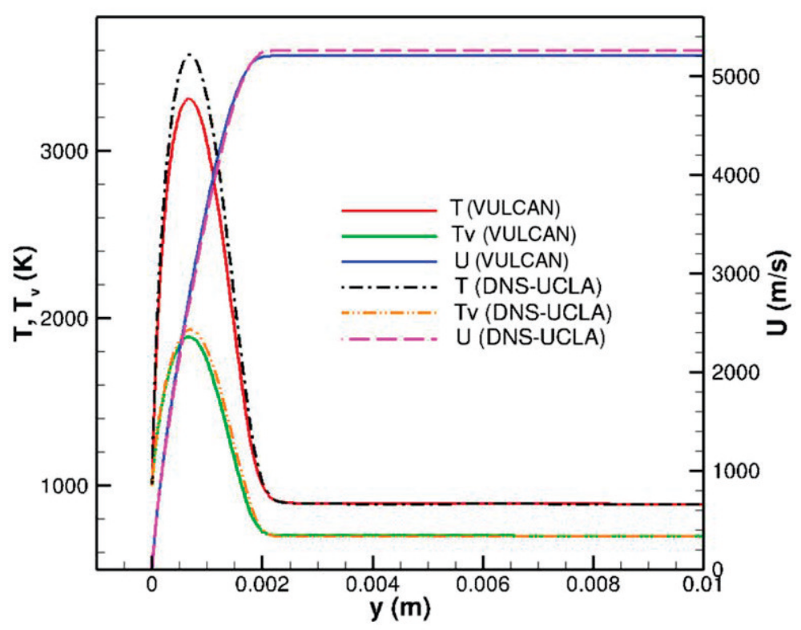
High Temperature Effects on Boundary-Layer Stability
A Mach 10 flow over a 5 deg half-angle cone
The slight discrepancy in the boundary-layer edge velocity is due to the difference in shock treatment.
The differences in peak temperature might be related to the differences on thermochemical models such as internal energy or species diffusion models.
Comparison of mean velocity and two temperatures at x = 0.4 m (DNS-UCLA stands for ShockFIT code)
* C-L Chang, H. Kline, and F. Li, “Wall Cooling Effect on High-Enthalpy Supersonic Modes over a Cone”, AIAA Journal, Vol. 59, No. 10, 2021.

Slide 12
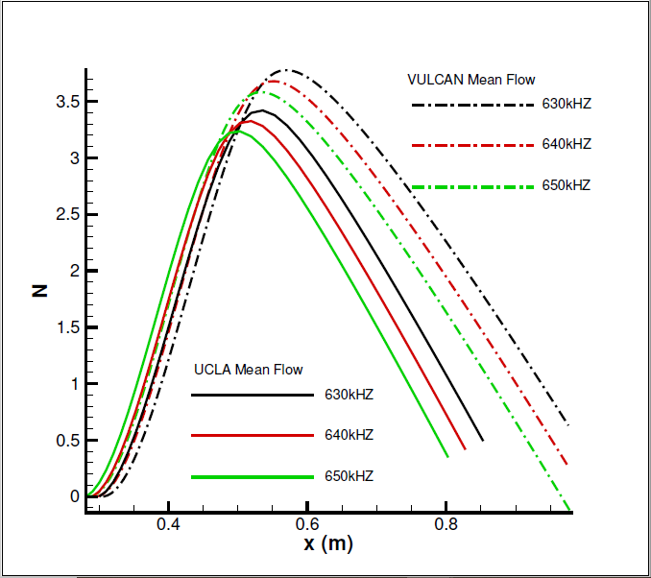
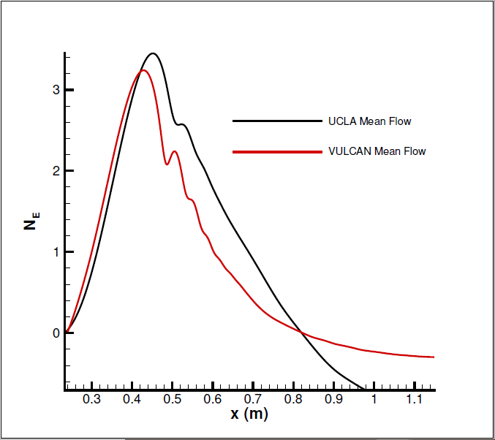
Mean Flow Effects on Stability Analysis
Mean flows based on different thermochemical models have a significant effect on LST and PSE results.
VULCAN-CFD Mean Flow
ShockFIT Mean Flow
VULCAN-CFD Mean Flow
ShockFIT
Mean Flow
N factor at different frequencies from LST using different mean flows
N factor at 700 kHz from linear PSE using different mean flows

Slide 13
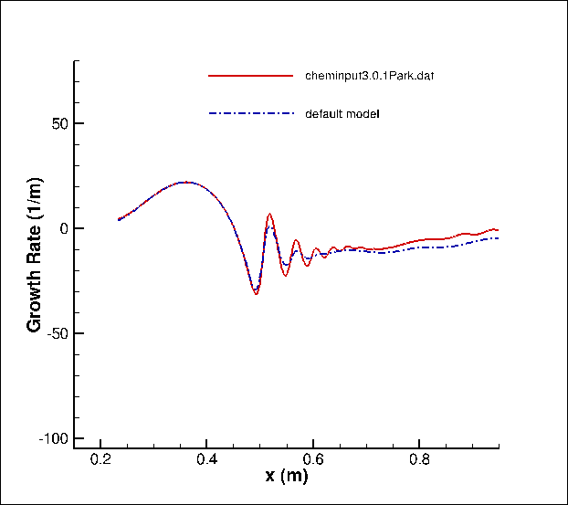
Effect of Using Different Models in LASTRAC
Using different thermochemical models in LASTRAC itself has a minor effect on stability when the same mean flow is used.
Growth rate at 700 kHz using ShockFIT mean flow from linear PSE of different thermochemical models

Slide 14
Summary and Future Work
Mean flows based on different thermochemical models have a significant effect on hypersonic boundary-layer stability
Using different thermochemical models in LASTRAC itself has a minor effect on stability analysis when the same mean flow is used
Further develop LASTRAC code to complete the implementation of nonlinear thermochemical models (Nonlinear PSE)
Investigate the effect of model-dependent mean flows on stability analysis for both linear and nonlinear PSE

Slide 15
Acknowledgement
This work was funded under NASA contract number NNL13A08B, task orders NNL17AA56T and 80LARC18F0084, supported by the Hypersonic Technology Project in the Aeronautics Mission Directorate.

