Slide 1
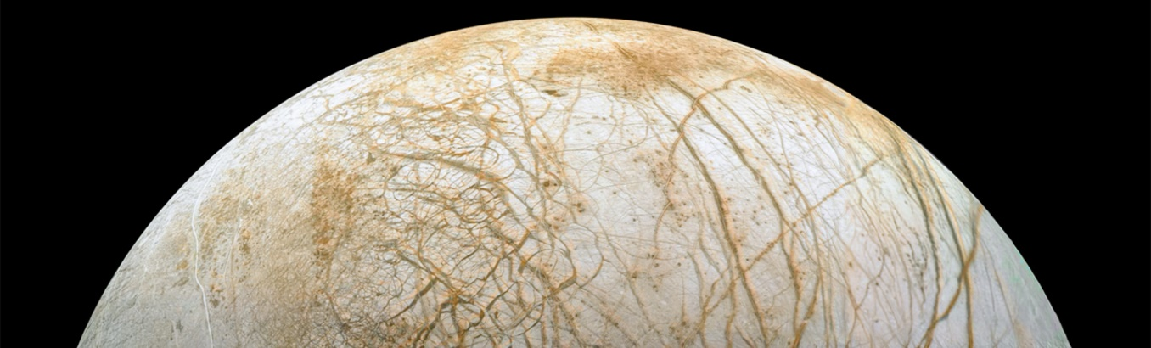
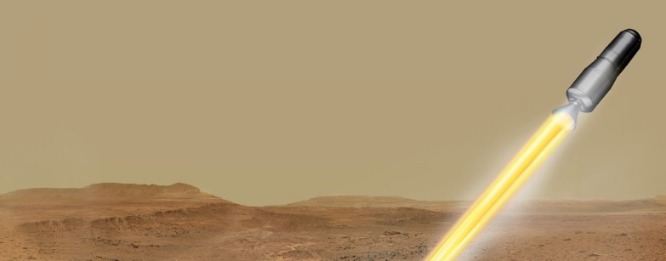

Planetary Protection at Marshall Space Flight Center
Chelsi D. Cassilly, Ph.D.
Jacobs Space Exploration Group/ESSCA
Space Environmental Effects Team
Nonmetallic Materials and Space Environmental Effects Branch
NASA/MSFC/EM41
Chelsi.D.Cassilly@nasa.gov
IHS Astronomy – 2 September 2022
Notes:
Europa Image: NASA (Europa Stunning Surface | NASA Image and Video Library)
MAV Image: NASA (Mars Ascent Vehicle Launching with Samples (Artist's Concept) | NASA Image and Video Library)

Slide 2
Who am I?
Lipscomb University – B.S. in Molecular Biology
  ’08 – ’12
University of Tennessee, Knoxville – Ph.D. in Microbiology
  ’12 – ’17
Harvard Medical School – Postdoctoral Fellow in Chemical Biology
  ’18 – ’21
Jacobs Space Exploration Group – Planetary Protection
  ’21 – present

Slide 3
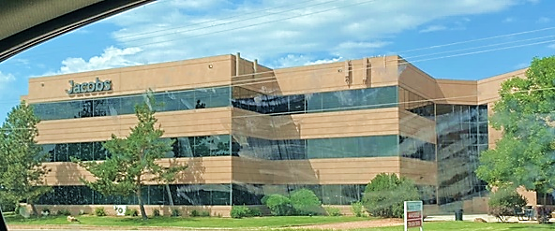
Jacobs Engineering Group Inc. is a technical professional services company
Jacobs Space Exploration Group – subset of Jacobs that supports human spaceflight
  ESSCA contract with NASA MSFC
Notes:
Image: Chelsi Cassilly

Slide 4
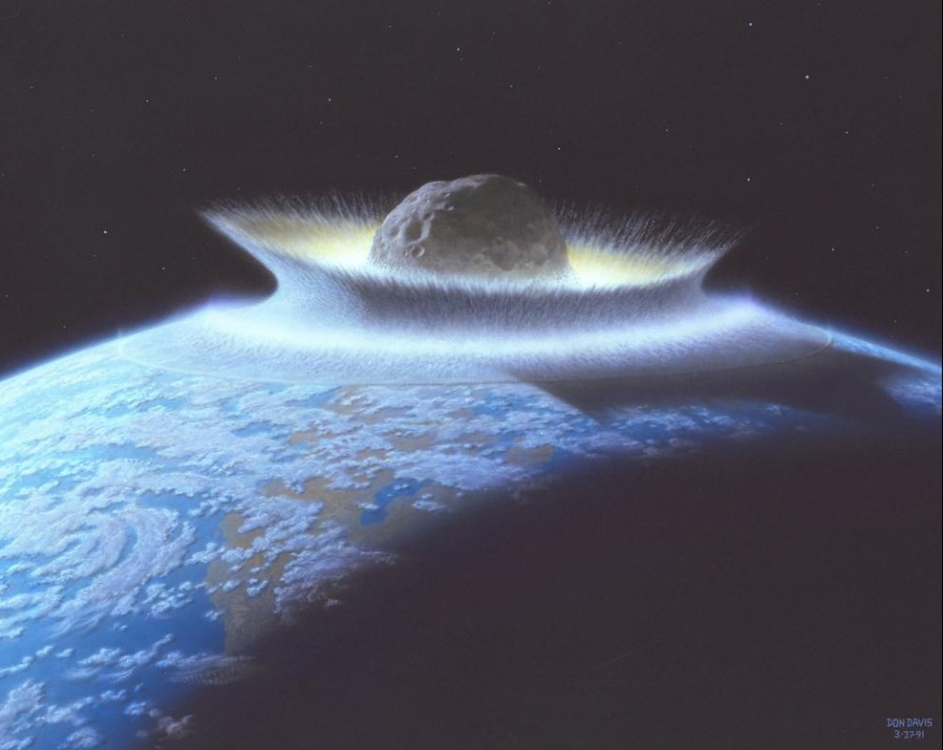
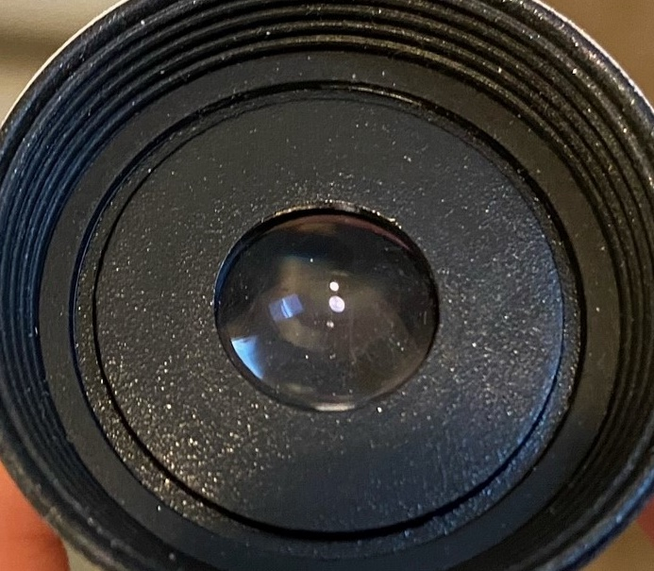
What is Planetary Protection?
It’s NOT:
NASA/ARC
Planetary Defense Contamination Control
Notes:
Asteroid Image: ARC-1991-AC91-0193 | NASA Image and Video Library
Lens: Chelsi Cassilly

Slide 5
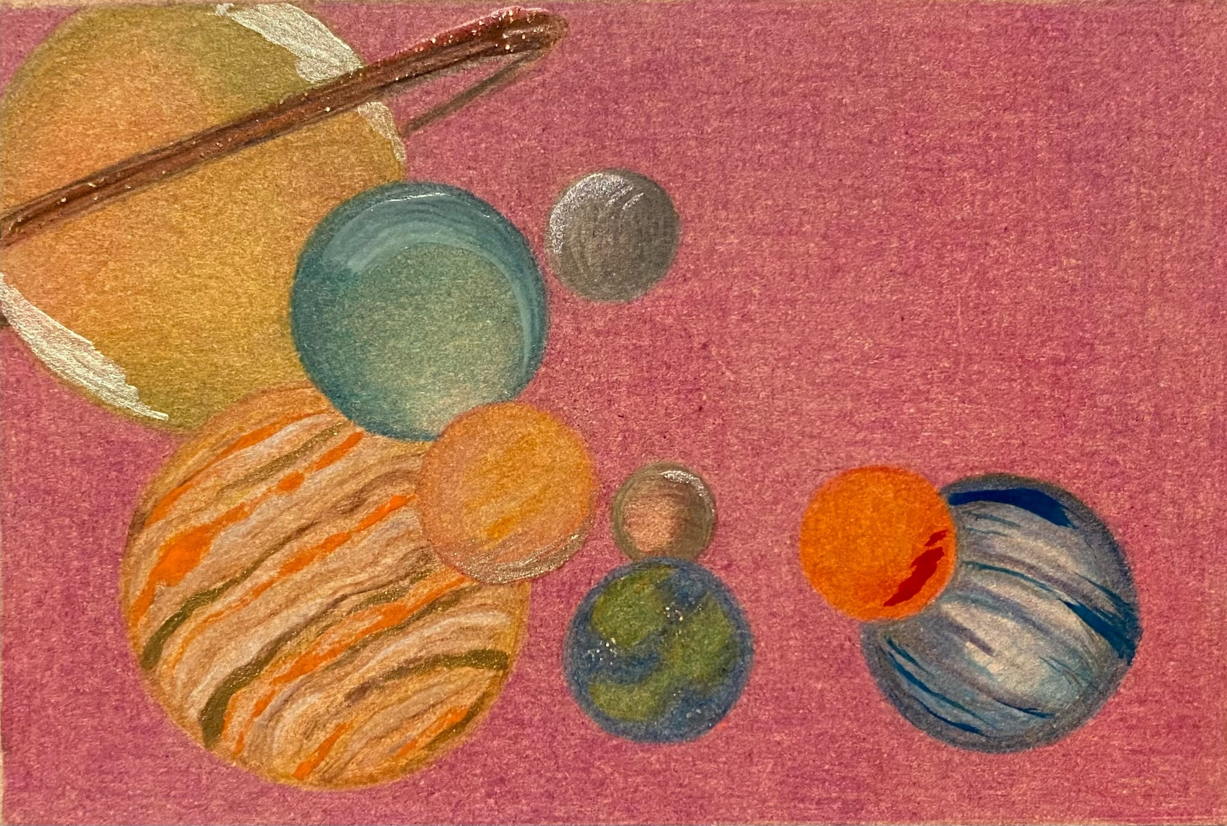
What is Planetary Protection?
Planetary Protection is the practice of protecting solar system bodies from contamination by Earth life and protecting Earth from possible life forms that may be returned from other solar system bodies.

Slide 6
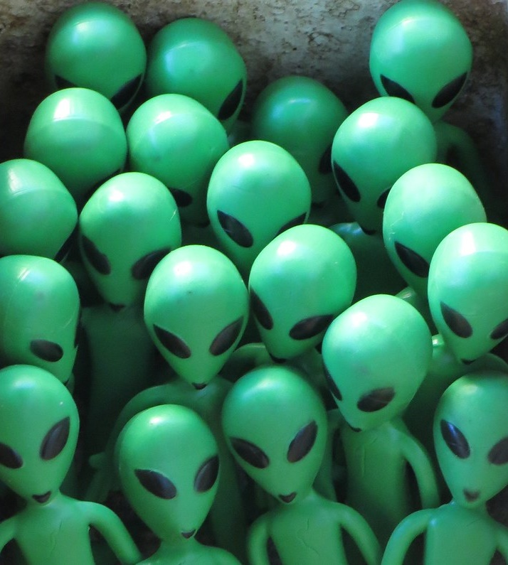
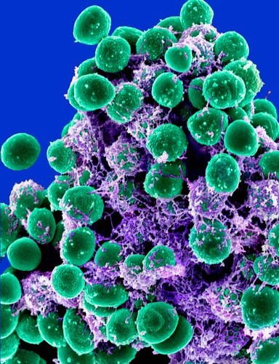
So, what are these “life forms” we care about?
"GroupET10 Aliens" by interdimensionalguardians is licensed under CC BY 2.0
"Staphylococcus epidermidis Bacteria" by NIAID is licensed under CC BY 2.0

Slide 7
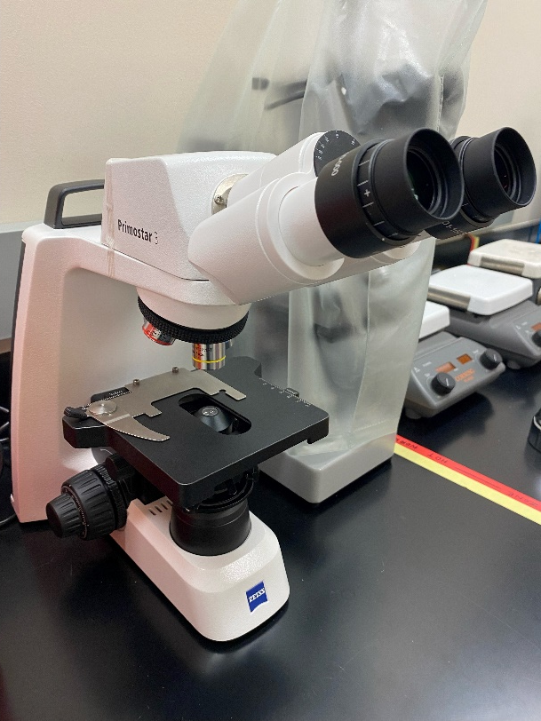
Microbes, Bacteria, and Spores
Microbes are living organisms that are too small to see without the aid of a microscope
Bacteria, viruses, archaea, protozoa, fungi are subsets of microorganisms
Spores are hardy, dormant cells that some bacteria produce in order to survive harsh conditions
Planetary protection is most concerned with endospores, although some bacteria are very resistant to sterilization, and all “bioburden” can be problematic.

Slide 8
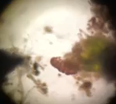
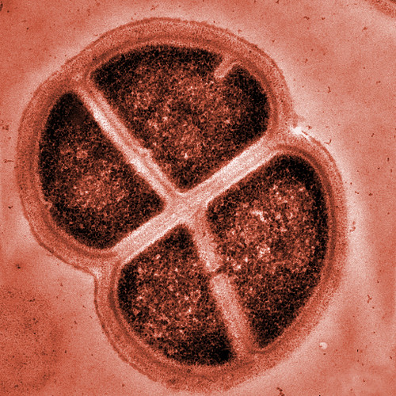
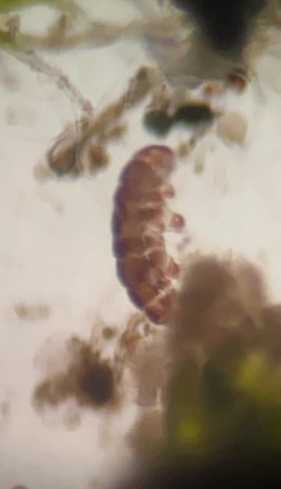
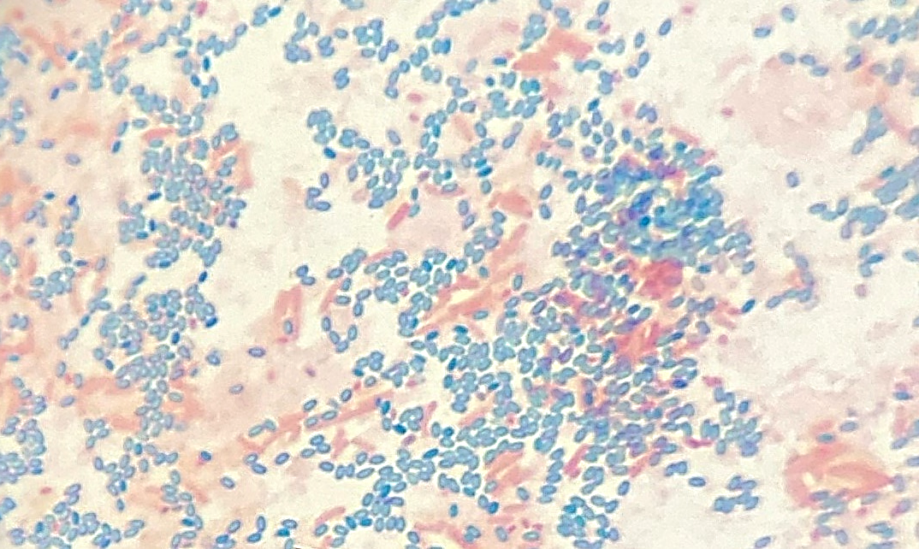
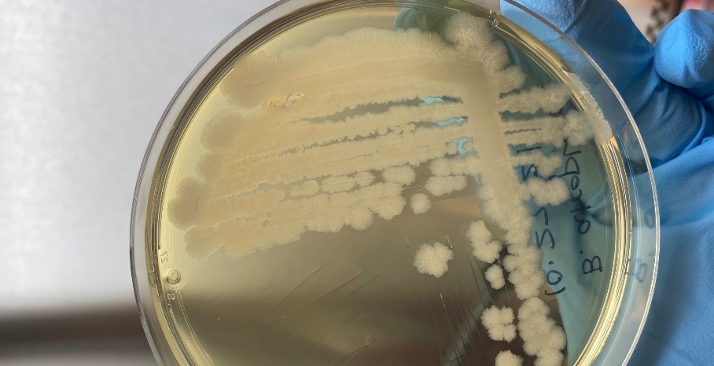
VIDEO
"Deinococcus Radiodurans" by EMSL is licensed under CC BY-NC-SA 2.0
Notes:
Tardigrade Image: jsc2021e019949 | NASA Image and Video Library
Bacillus spores: Chelsi Cassilly

Slide 9
Many microbes can survive one or more of the conditions below:
  Radiation
  Vacuum
  Heat
  Cold
  Dehydration
  Chemicals
  Acid
  Salt
  Impact
  Pressure
  O₂ deprivation
  Starvation
  Time

Slide 10
Why is planetary protection important?
Ethically, to preserve pristine environments and avoid contamination/seeding with Earth microbes

Slide 11

Just as we wish to preserve certain places on Earth...
Notes:
Image: Chelsi Cassilly

Slide 12
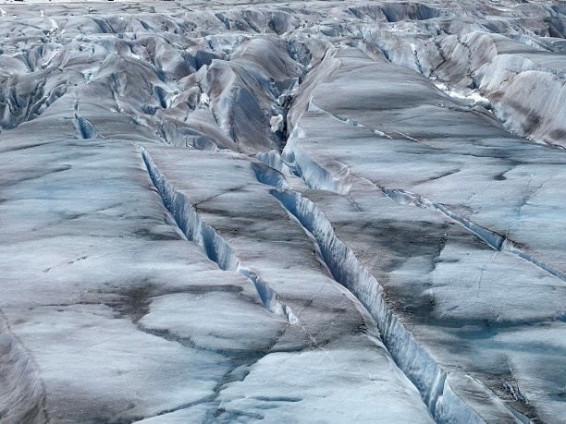
…we also wish to preserve other planetary bodies.
Notes:
Image: Artist Concept of Europa Water Vapor Plume | NASA Image and Video Library

Slide 13
Why is planetary protection important?
Ethically, to preserve pristine environments and avoid contamination/seeding with Earth microbes
To protect Earth from possible microbes or bioactive molecules returning in samples or on spacecraft

Slide 14
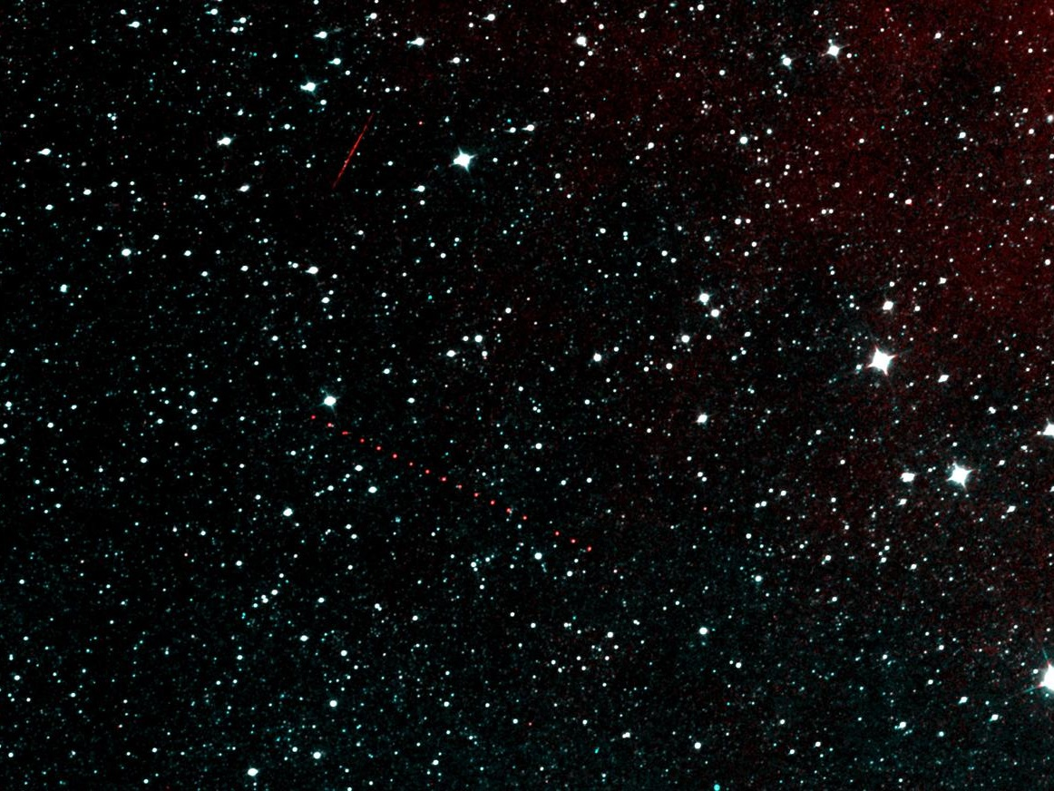

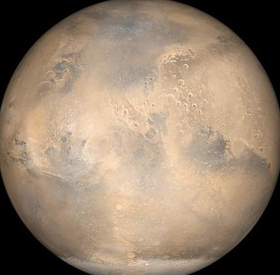
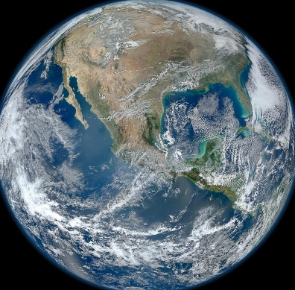
“Backward” Planetary Protection is concerned with protecting Earth
NASA/JPL/MSSS
Notes:
Sky: NEOWISE Next Light | NASA Image and Video Library
Mars: Mars Opposition and Equinox | NASA Image and Video Library
Earth: Earth | NASA Image and Video Library

Slide 15
Why is planetary protection important?
Ethically, to preserve pristine environments and avoid contamination/seeding with Earth microbes
To protect Earth from possible microbes or bioactive molecules returning in samples or on spacecraft
To maintain integrity of science conducted
  Hardware functionality
  Purity of samples collected

Slide 16
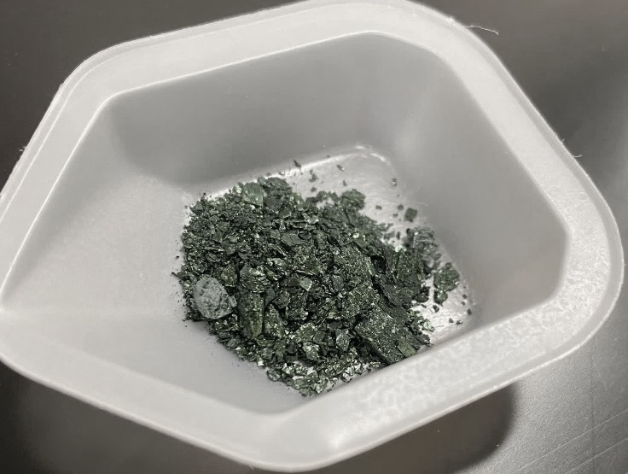
How can we search for life if we bring our own?
Notes:
Image: Chelsi Cassilly
Witness tubes will help scientists tell which materials in the Martian materials may actually be of Earth origin.
Sample tubes are made of titanium, white coating to protect from heating by the sun
Perseverance's sample tubes must isolate and preserve the scientific value of their contents for well over 10 years.

Slide 17
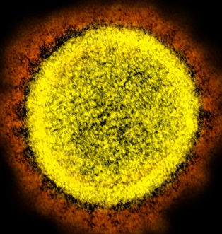
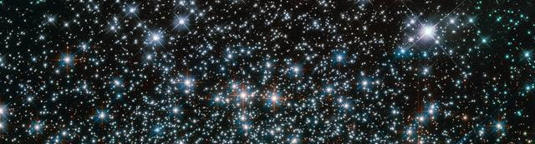
"Novel Coronavirus SARS-CoV-2" by NIAID is licensed under CC BY 2.0
1 × 10³¹ viruses on earth end to end would stretch for 100 million light years
100 million times as many bacteria in the oceans (13 × 10²⁸) as there are stars in the known universe
Microbiology by numbers. Nat Rev Microbiol 9, 628 (2011). https://doi.org/10.1038/nrmicro2644
NASA Goddard
Notes:
Image: Hubble Friday - Heavy Metal Stars | NASA Image and Video Library

Slide 18
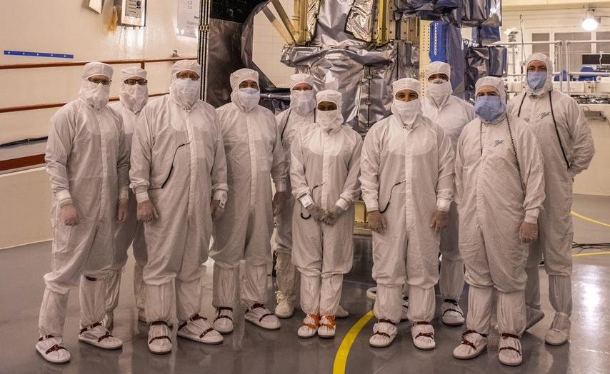
NASA/KSC
Notes:
Image: Landsat 9 Spacecraft (Observatory) Cover Removal | NASA Image and Video Library

Slide 19

We leave a trail of microbes on surfaces and in the air
Humans give off ~1 million biological particles every hour by exhaling, sloughing off skin cells, and radiating hot air from the top of the head
Our Bodies, Our Microbial Clouds. Bloomberg CityLab (2015)

Slide 20
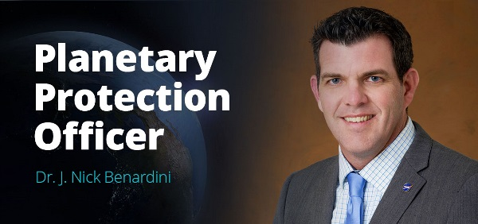
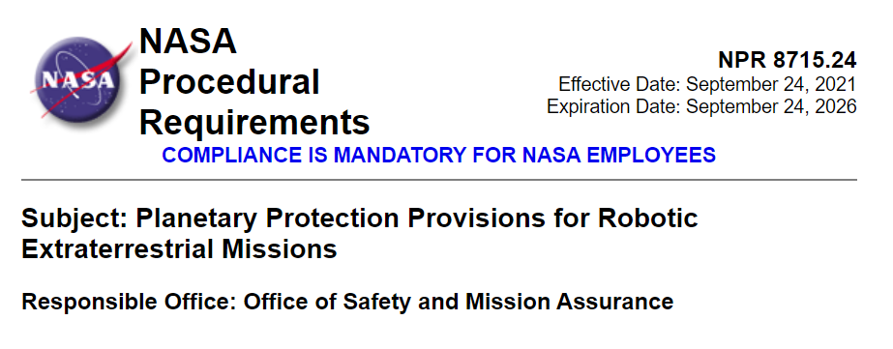
PP Requirements Flow Down from the PPO
Notes:
Image: NASA Announces New Planetary Protection Officer

Slide 21
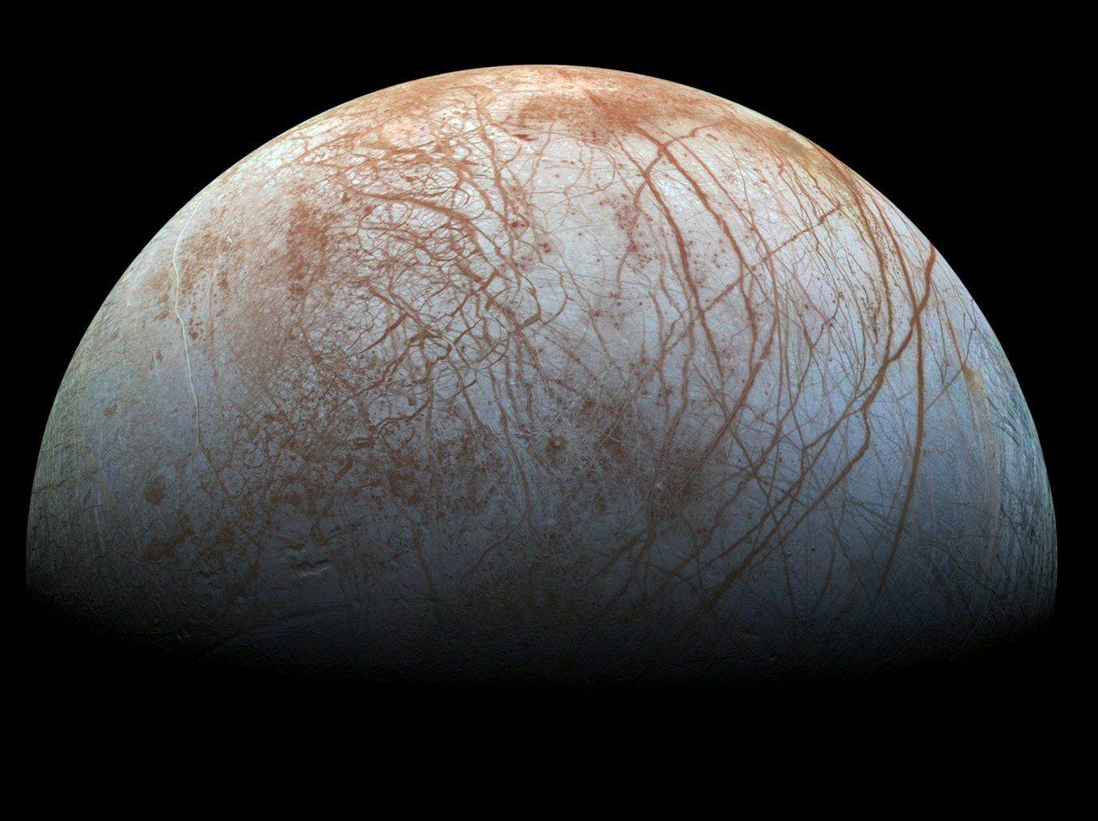
Is there life on EUROPA?
Notes:
Europa Image: NASA (Europa Stunning Surface | NASA Image and Video Library)

Slide 22
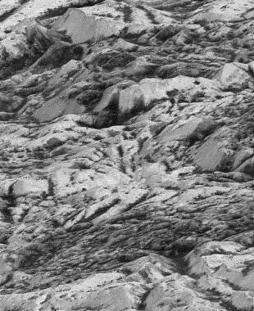
Europa is an Ocean moon of Jupiter
  Possible induced magnetic field
  Thin oxygen atmosphere
  Possible plumes
  Ice shell
  Surface fractures
  Liquid/slushy salt water ocean
  Possible deep surface hydrothermal vents
  Rocky mantel
  Iron-nickel core
NASA/JPL
https://solarsystem.nasa.gov/moons/jupiter-moons/europa/in-depth/
Notes:
Image: Highest Resolution Image of Europa | NASA Image and Video Library
Along Europa's many fractures, and in splotchy patterns across its surface, is a reddish-brown material whose composition is not known for certain, but likely contains salts and sulfur compounds that have been mixed with the water ice and modified by radiation.
The moon’s ice shell is probably 10 to 15 miles (15 to 25 kilometers) thick, beneath which the ocean is estimated to be 40 to 100 miles (60 to 150 kilometers) deep. The Mariana Trench’s Challenger Deep is about 7 miles deep from the surface of the ocean, average ocean depth is 2.3 miles (NOAA).

Slide 23
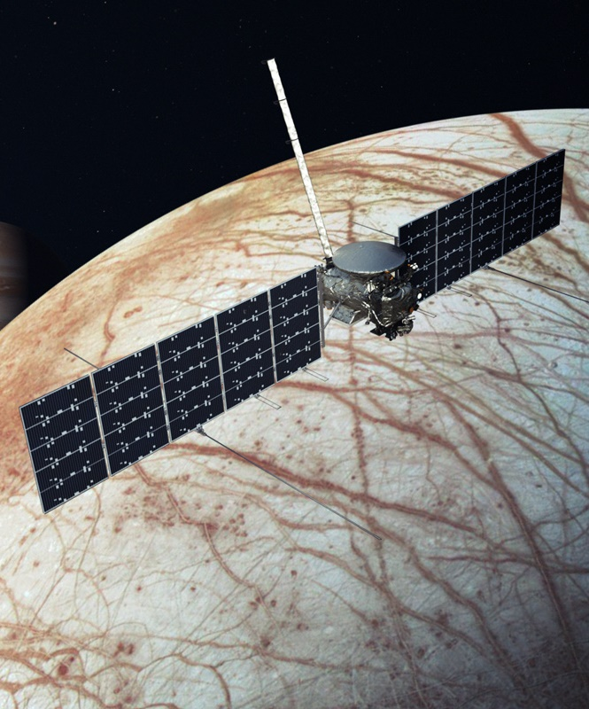
Europa Clipper
NASA/JPL-Caltech
Take measurements to determine if Europa could harbor conditions suitable for life.
40 to 50 close passes over Europa
Expected launch: 2024
Notes:
Image: Europa Clipper Spacecraft (Illustration) | NASA Image and Video Library
Will be in orbit around Jupiter but will pass by Europa

Slide 24
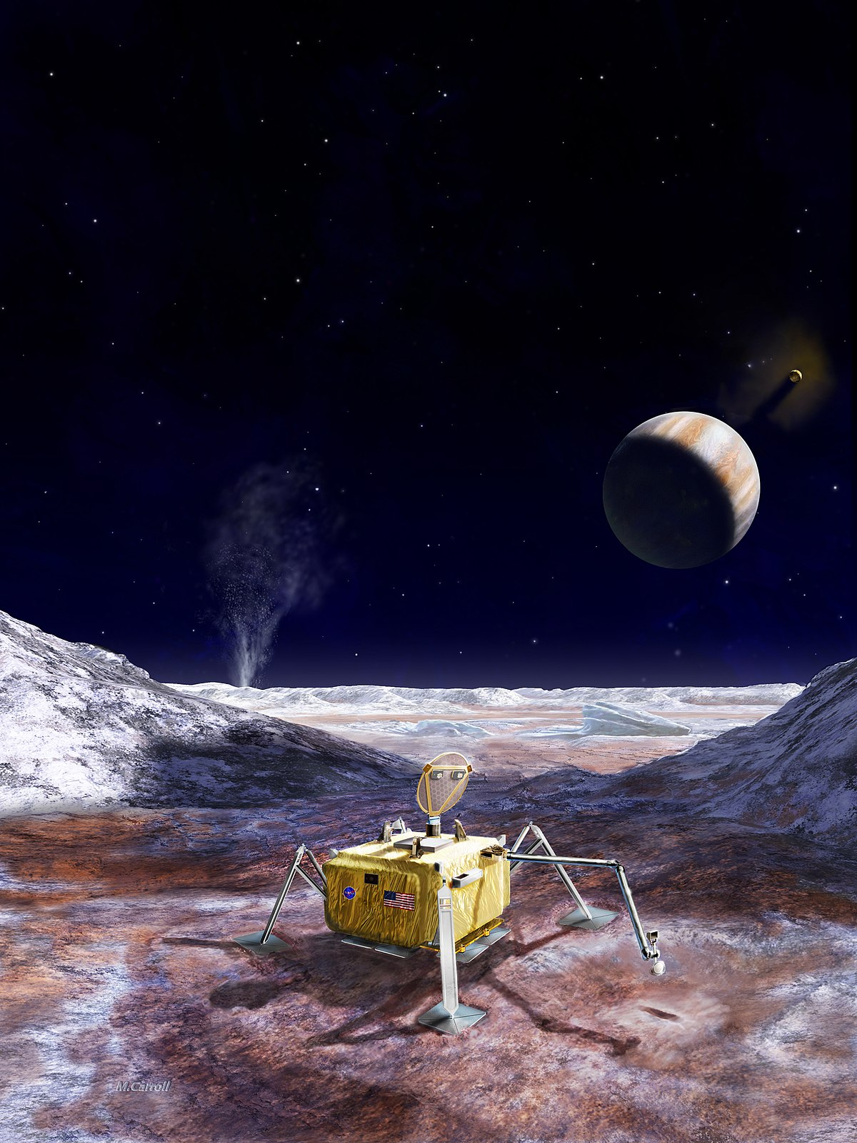
Europa Lander
Image credit: NASA / JPL-Caltech / M. Carroll.
Concept for a potential future mission that would look for signs of life in the icy surface material of Europa.
Collect samples from about 4 inches beneath the surface.
Analyze in miniature laboratory within the robotic lander.
Notes:
Image: Europa Lander Mission Concept (Artist Rendering) | NASA Image and Video Library
390,299,401 miles
Would take about 7 – 10 years to get into orbit around Europa

Slide 25
Europa Lander
Image credit: NASA / JPL-Caltech / M. Carroll.
Search for evidence of biosignatures on Europa.
Assess the habitability of Europa via in situ techniques.
Characterize the surface and subsurface of Europa.
Notes:
Image: Europa Lander Mission Concept (Artist Rendering) | NASA Image and Video Library
390,299,401 miles
Would take about 7 – 10 years to get into orbit around Europa

Slide 26
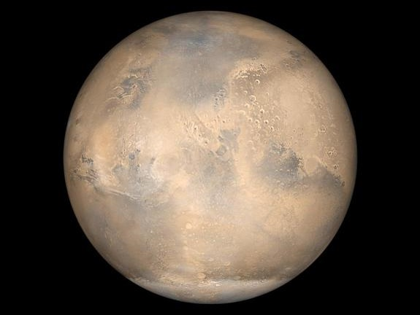
Was there life on Mars?
Notes:
Image: Mars Opposition and Equinox | NASA Image and Video Library

Slide 27
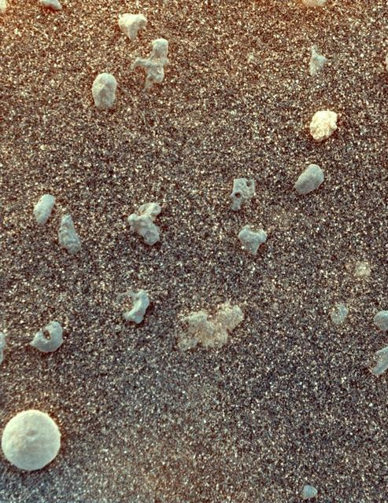
Mars is the fourth planet from the sun
  No structured magnetic field
  Mostly CO₂ atmosphere
  Dust storms
  Terrestrial (soil and rocky surface, rust)
  Polar ice caps of frozen water
  No liquid water
  Volcanoes, craters, mountains, and canyons
  Rocky mantel
  Iron rich core
https://solarsystem.nasa.gov/planets/mars/in-depth/
NASA/JPL/US Geological Survey
Notes:
Mars Image: Mars Under the Microscope stretched | NASA Image and Video Library
Mars is thought to have once had liquid water, may have been too salty or acidic to support life, but some think mars could have once supported life.

Slide 28
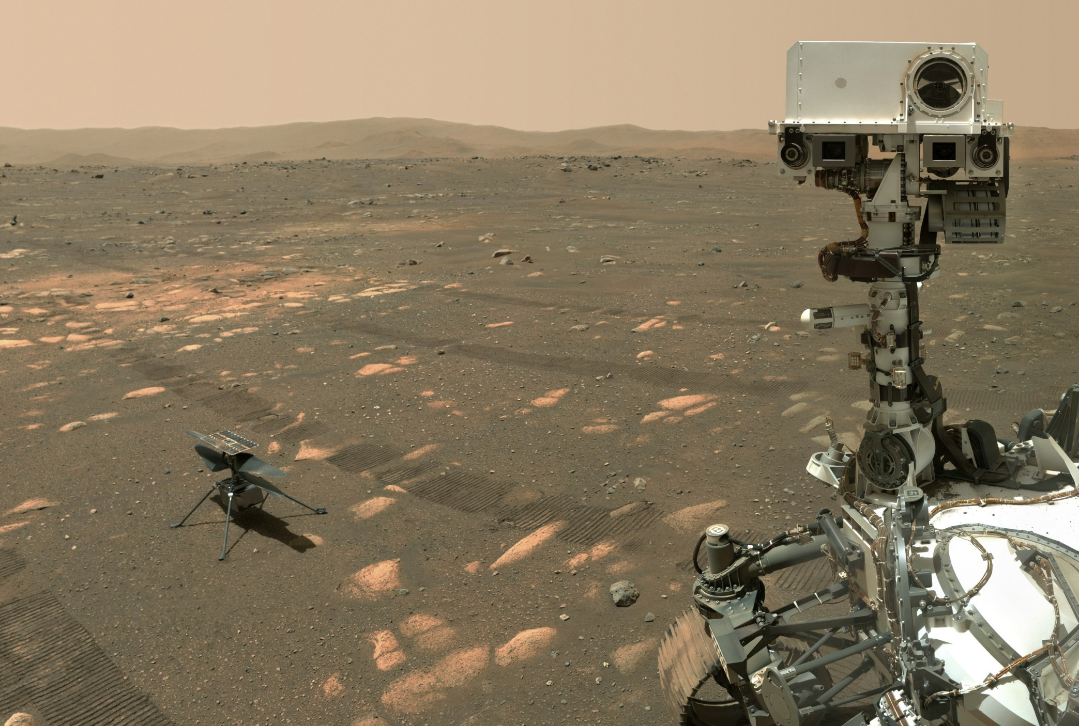
Mars 2020 Mission
Ingenuity
Helicopter
Perseverance
Rover
Image Credit: NASA/JPL-CALTECH/MSSS
Notes:
Image: Perseverance's Selfie with Ingenuity | NASA Image and Video Library

Slide 29
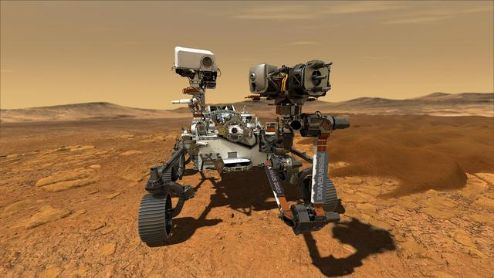
Mars 2020
Investigate Jezero Crater for evidence of past life
Collect samples of soil and rock, and cache them for potential return to Earth
NASA/JPL-Caltech
Notes:
Image: Perseverance on Mars | NASA Image and Video Library

Slide 30
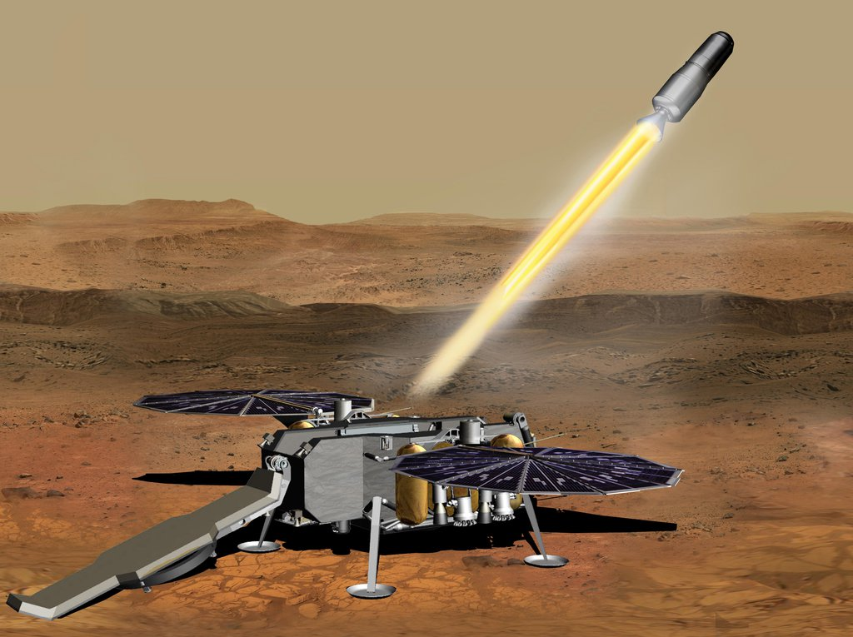
Sample Retrieval Lander
Collects the samples left behind by Perseverance Rover and delivers them to the ascent rocket
Mars ascent vehicle will launch the sample return canister to a low Mars orbit.
NASA/JPL-Catlech
Notes:
Image: Mars Ascent Vehicle Launching with Samples (Artist's Concept) | NASA Image and Video Library

Slide 31
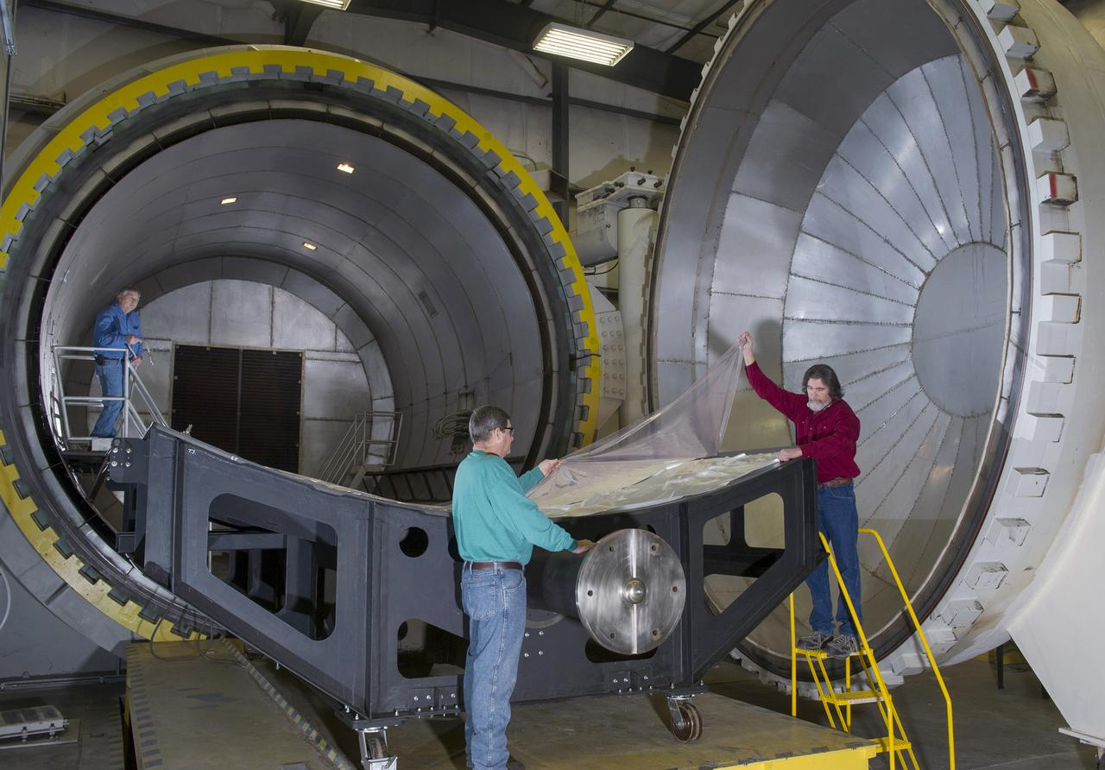
Acceptable Treatment and Cleaning
Heat Microbial Reduction (HMR)
Vapor Hydrogen Peroxide (VHP)
Credit: ESA
NASA/MSFC
Notes:
Image: 18' X 20' AUTOCLAVE | NASA Image and Video Library
NASA PPO has approved use of VHP as a low-temperature sterilization modality, for simple surfaces, with specifications for time, rate, and H₂O₂ concentration levels. Complex geometries (e.g., vented boxes and electronic chassis inside the warm electronics box of a rover), however, require further directions. Thus, an additional study aims to describe the effect of VHP on electronic materials, materials with different configurations, solder joints, etc. Work has also begun for developing a portable VHP system that can be used locally (e.g., at the site of hardware integration in a cleanroom or on the launch pad).

Slide 32
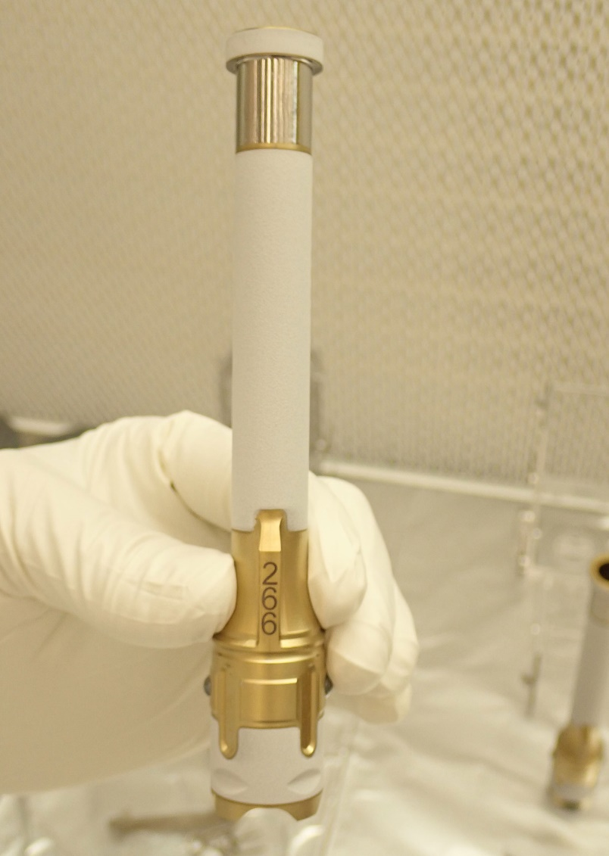
“Clean” is relative
Strict rules limit contaminants from Earth
Sample handling hardware must be very clean
  Sample tubes
  Sample scoops/drills
  Anything contacting samples
Mars 2020 tubes - novel cleaning process
Image Credit: NASA/JPL
Notes:
Tube Image: Perseverance Sample Tube 266 | NASA Image and Video Library

Slide 33
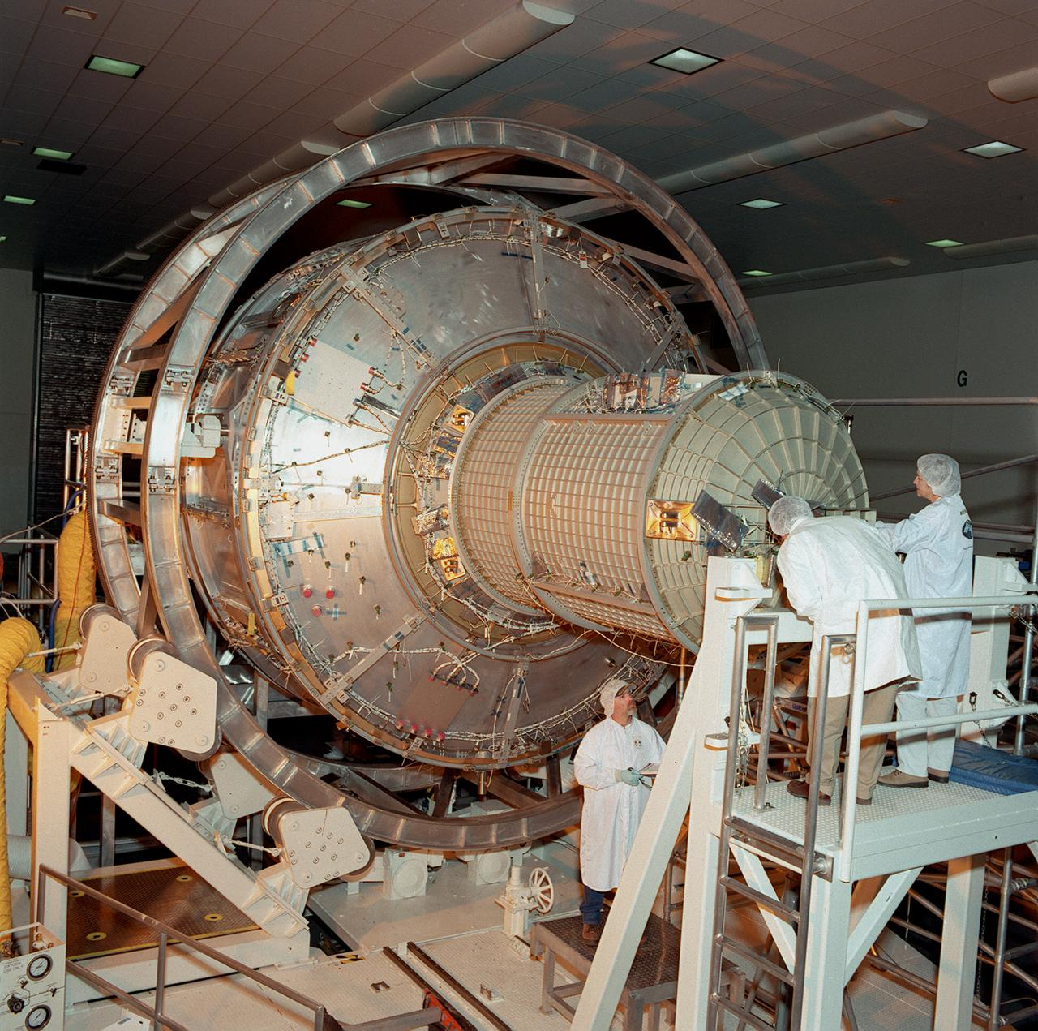
JPL and MSFC – Novel Cleaning Methods
Using new solvents to clean materials
  Vapor hydrogen peroxide
Manufacturing credit
  Can we take credit for reducing bioburden if the hardware goes through curing steps?
NASA/MSFC
Notes:
Image: International Space Station (ISS) | NASA Image and Video Library

Slide 34
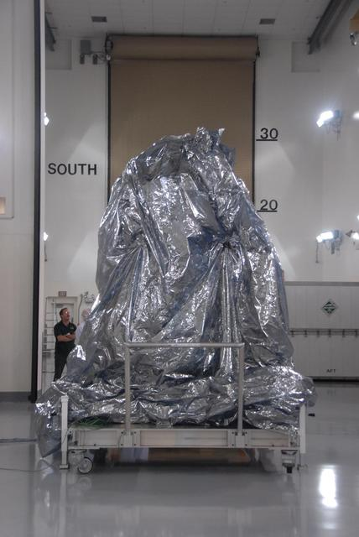
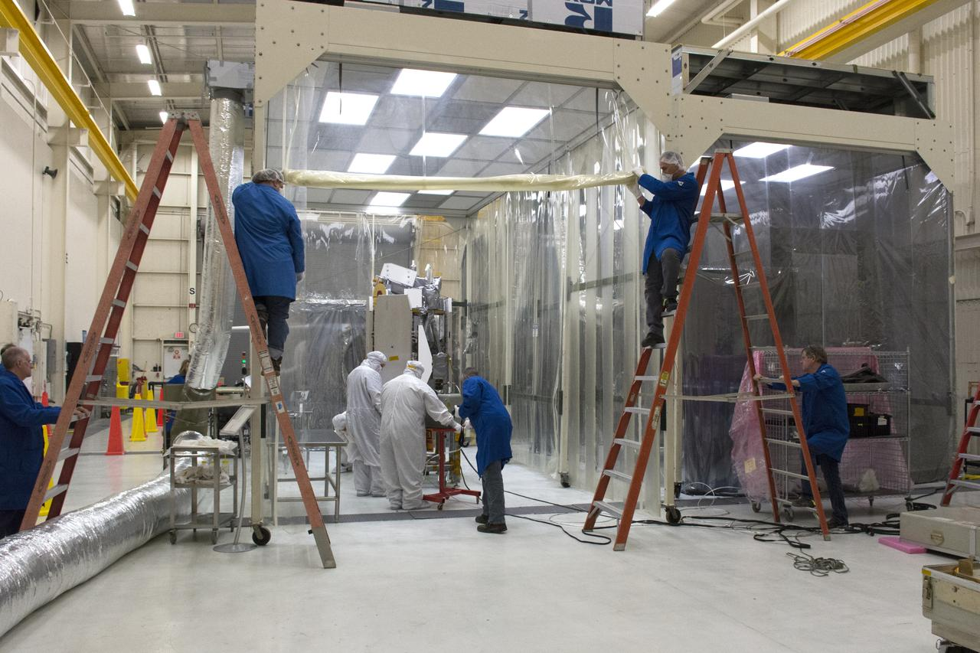
Keep it clean!
Bio-barriers/ bagging
Surface wiping with IPA
HEPA filters
NASA/KSC
NASA/JPL-Caltech
Notes:
Image: NASA WISE Spacecraft in Protective Covering | NASA Image and Video Library
Image: Pegasus ICON Spacecraft Move Into Cleanroom | NASA Image and Video Library

Slide 35
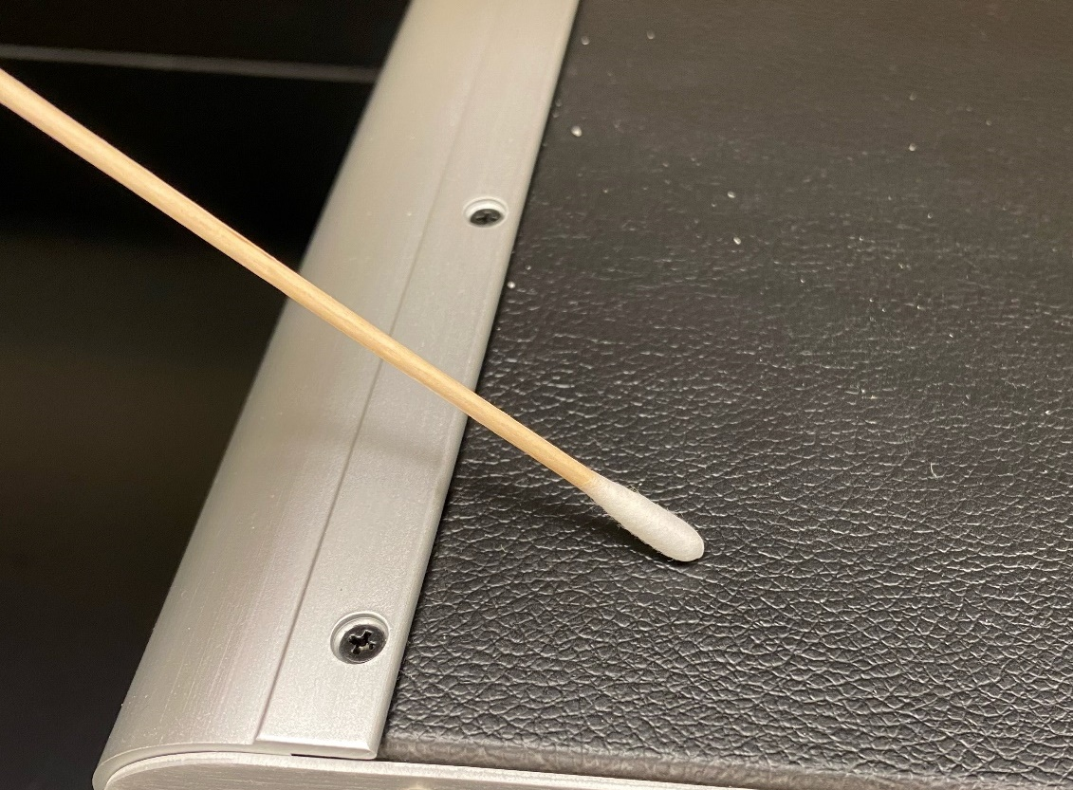
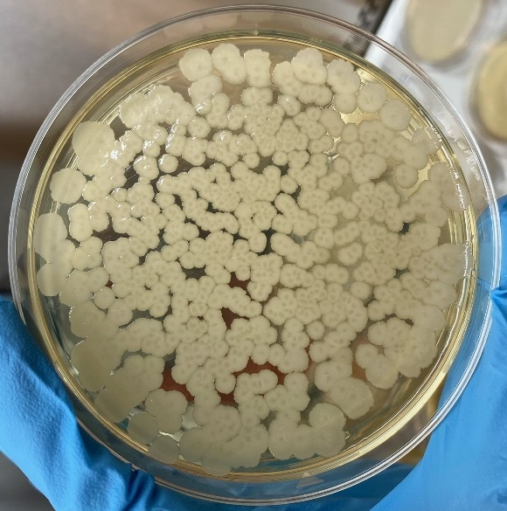
Sampling During Assembly and Integration
To monitor and maintain low bioburden in accordance with NASA requirements
Notes:
Image: Mastcam-Z Final Lens Cleaning | NASA Image and Video Library
Mars is 140 million miles away from Earth

Slide 36
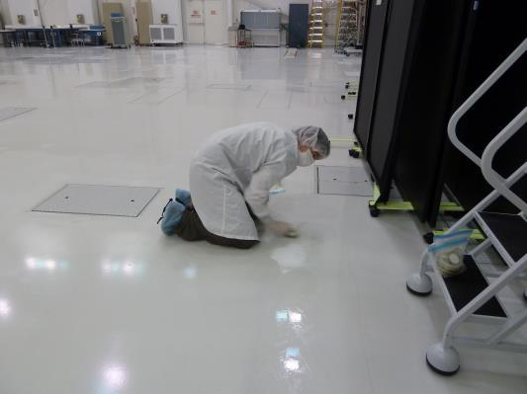
Monitoring cleanroom environment for biological contamination (including air and surfaces)
Image Credit: NASA/JPL-Catlech
Notes:
Image: Looking for Microbes in a Spacecraft Assembly Clean Room | NASA Image and Video Library

Slide 37
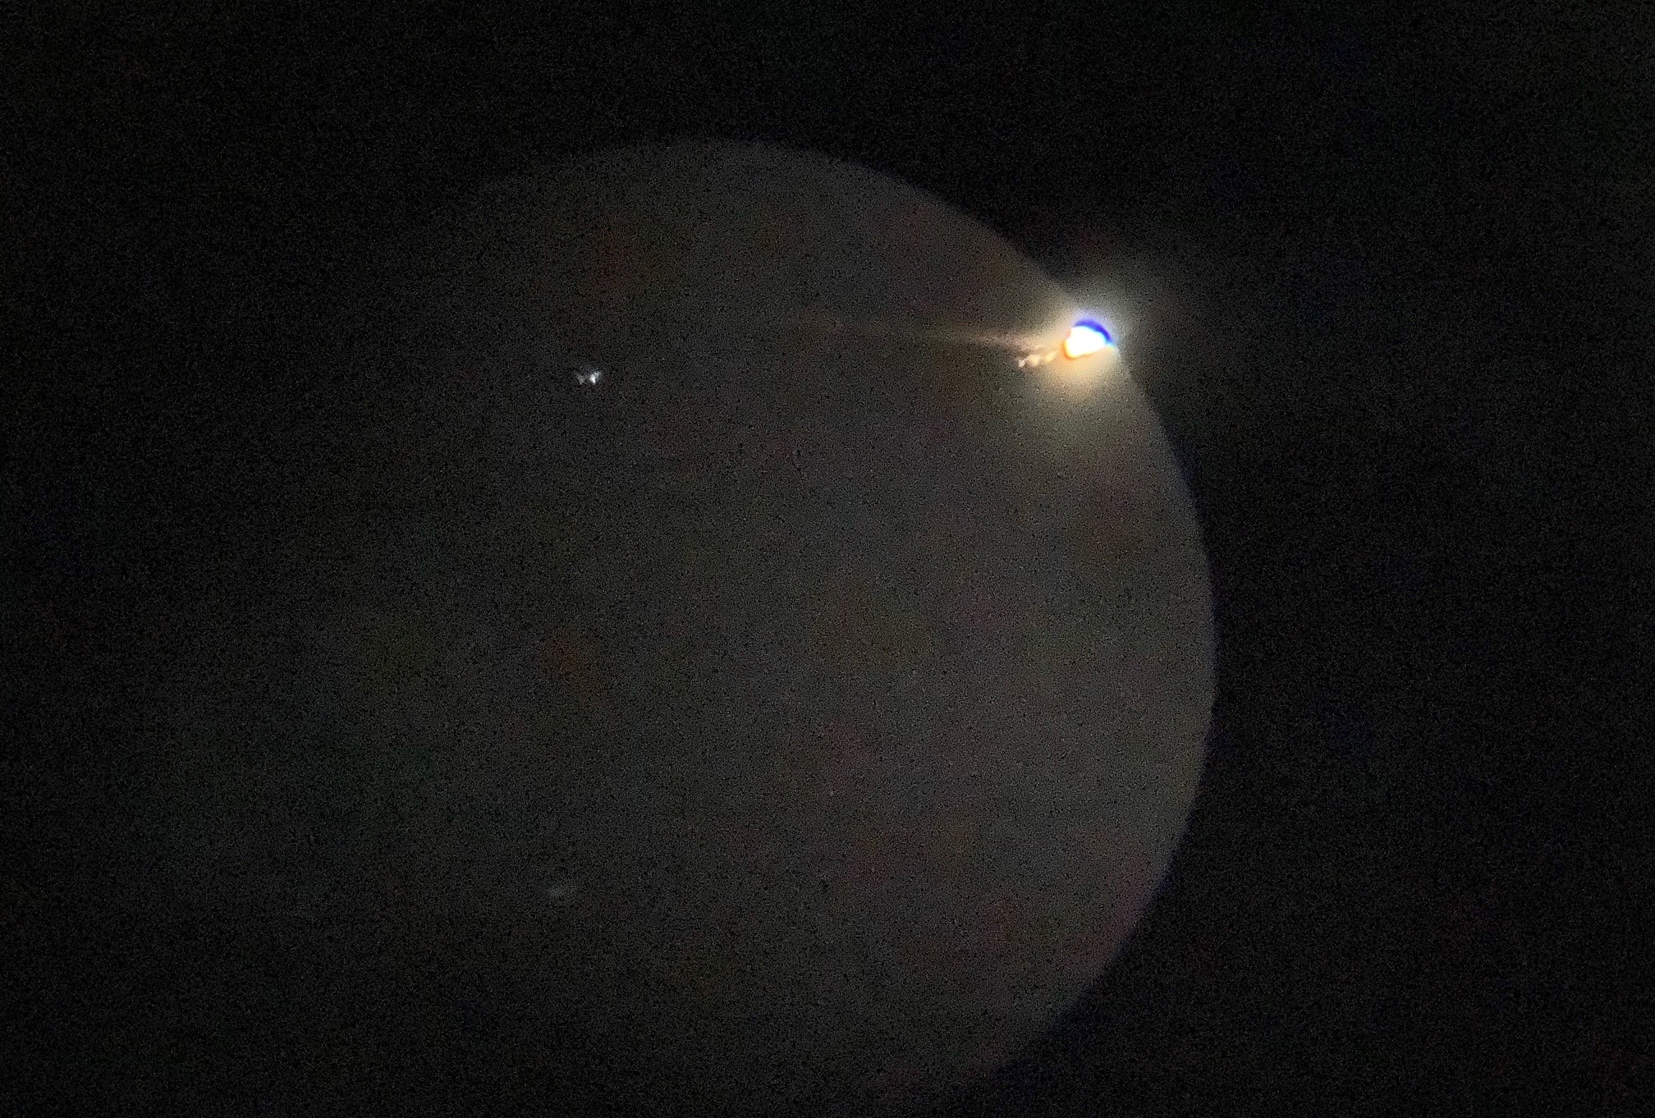
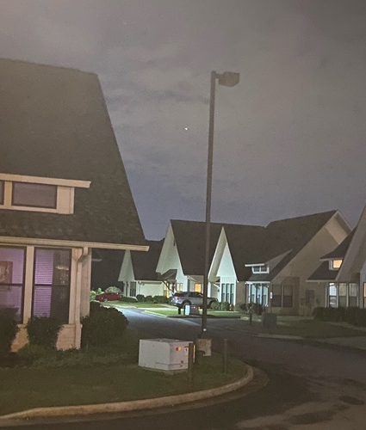
Questions?
Callisto
Jupiter
Ganymede
Europa
9.27.2021

