Slide 1


National Aeronautics and Space Administration
Aerodynamic Technologies to Enable
Future Ultra-Efficient Subsonic Transports
Dr. William E. Milholen II
Aerodynamics Tech Lead, Advanced Air Transport Technology Project
RAeS Applied Aerodynamics Conference, September 25, 2022
www.nasa.gov

Slide 2
Outline
Background
Aerodynamic Technologies
Summary Remarks
    High Aspect Ratio Wings
    Natural Laminar Flow
    Cruise Slotted Wing
    Boundary Layer Ingesting Propulsor
    Active Flow Control
    Advanced Concept Studies

Slide 3
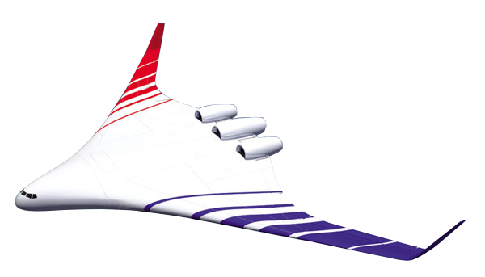
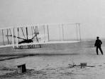

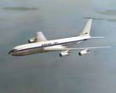
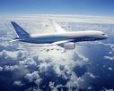
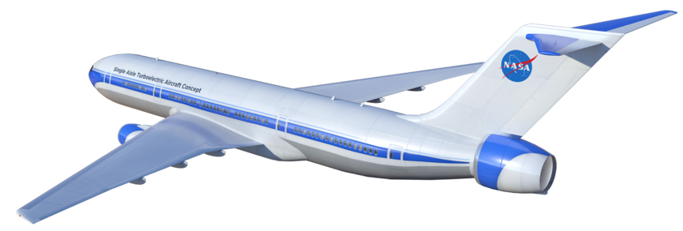
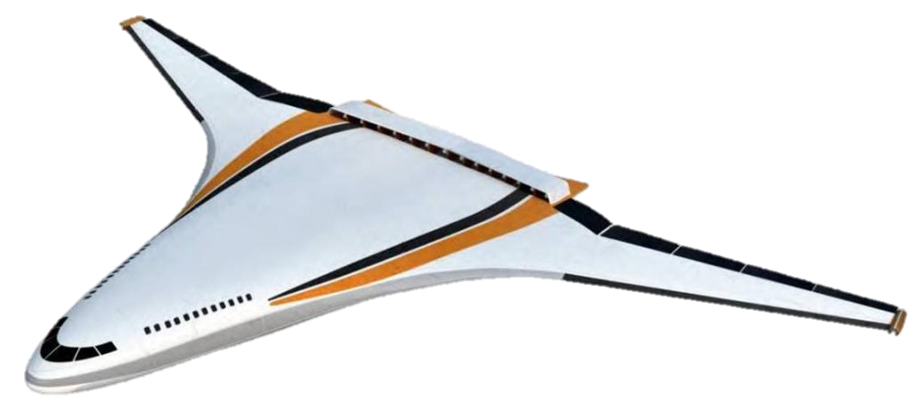
Advanced Air Transport Technology Project
Vision
Enable Aircraft with Dramatically Improved Energy Efficiency, Environmental Compatibility, and Economic Impact for the Nation
  Mission
  Explore and develop viable game-changing concepts, technologies, and tools to improve vehicle and propulsion system energy efficiency and environmental compatibility
Scope
Subsonic fixed-wing commercial transport aircraft
Evolution of Subsonic Transports
DC-3
B-707
B-787
1903
1930s
1950s
2000s

Slide 4









NASA Aeronautics Strategic Thrusts
Safe, Efficient Growth in Global Operations
Achieve safe, scalable, routine, high-tempo airspace access for all users
Innovation in Commercial Supersonic Aircraft
Achieve practical, affordable commercial supersonic air transport
Ultra-Efficient Subsonic Transports
Realize revolutionary improvements in economics and environmental performance for subsonic transports with opportunities to transition to alternative propulsion and energy
Safe, Quiet, and Affordable Vertical Lift Air Vehicles
Realize extensive use of vertical lift vehicles for transportation and services including new missions and markets
In-Time System-Wide Safety Assurance
Predict, detect and mitigate emerging safety risks throughout aviation systems and operations
Assured Autonomy for Aviation Transformation
Safely implement autonomy in aviation applications

Slide 5

Sustainable Flight National Partnership Benefits
Small Core Gas Turbine for 5%-10% fuel burn benefit
(HyTEC Project)
Transonic Truss-Braced Wing for 5%-10% fuel burn benefit
(AATT Project)
Electrified Aircraft Propulsion for ~5% fuel burn and maintenance benefit
(EPFD & AATT Projects)
High-Rate Composites for
4-6x manufacturing rate increase
(HiCAM Project)
Sustainable Aviation Fuels for reduced lifecycle carbon emissions
(AATT Project)
Integrated Trajectory Optimization for 1%-2% reduction in fuel required and minimization of contrail formation
(ATM-X Project)

Slide 6
Aerodynamic Technologies Applicable to Future Transports
High Aspect Ratio Thin Wings
Transonic Truss-Braced Wing (AR=19.5)
Natural Laminar Flow/Drag Reduction
Crossflow Attenuated Natural Laminar Flow (CATNLF) – NLF on highly swept wings
Cruise Slotted Wing – expansion of wing design trade space
Boundary Layer Ingestion
Vehicle-level assessment of tailcone thruster concept
Active Flow Control
Localized blowing for drag reduction, maximum lift enhancement
Advanced Concept Studies (N+4)
Advanced Aircraft Concepts for Environmental Sustainability (AACES) 2050 studies

Slide 7
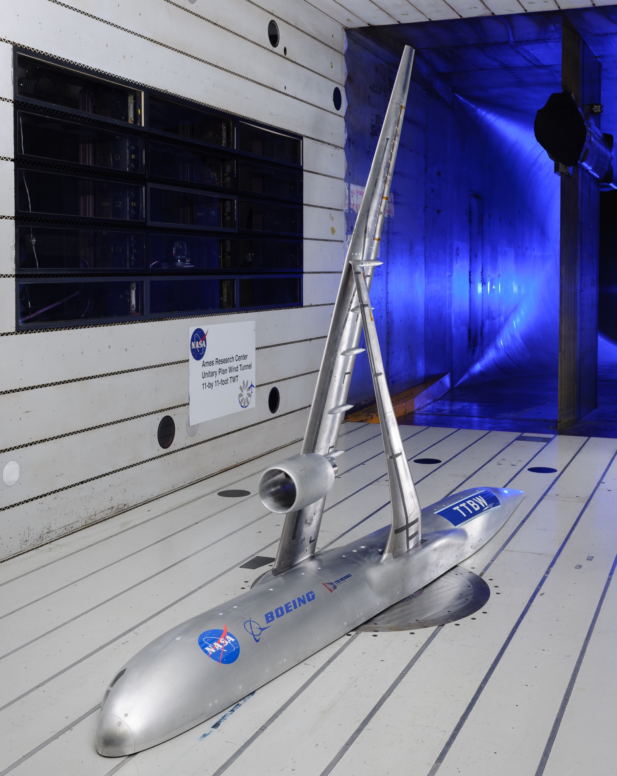
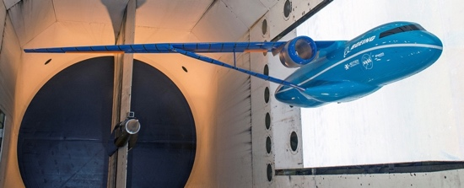
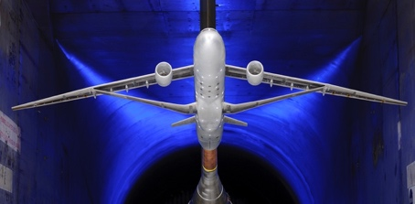
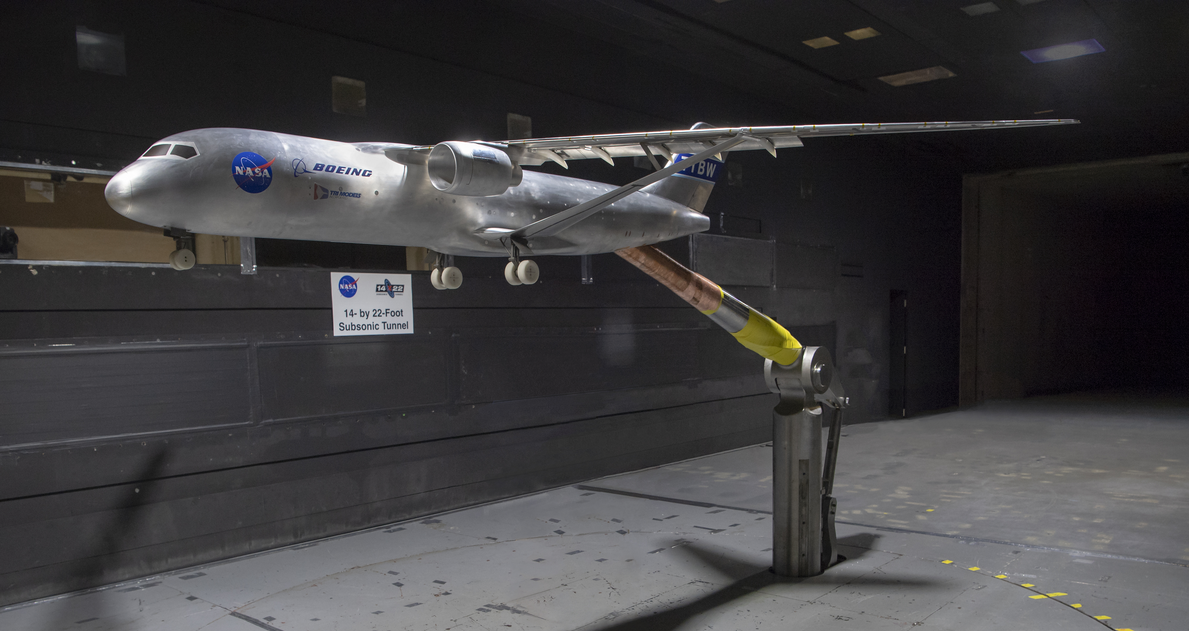
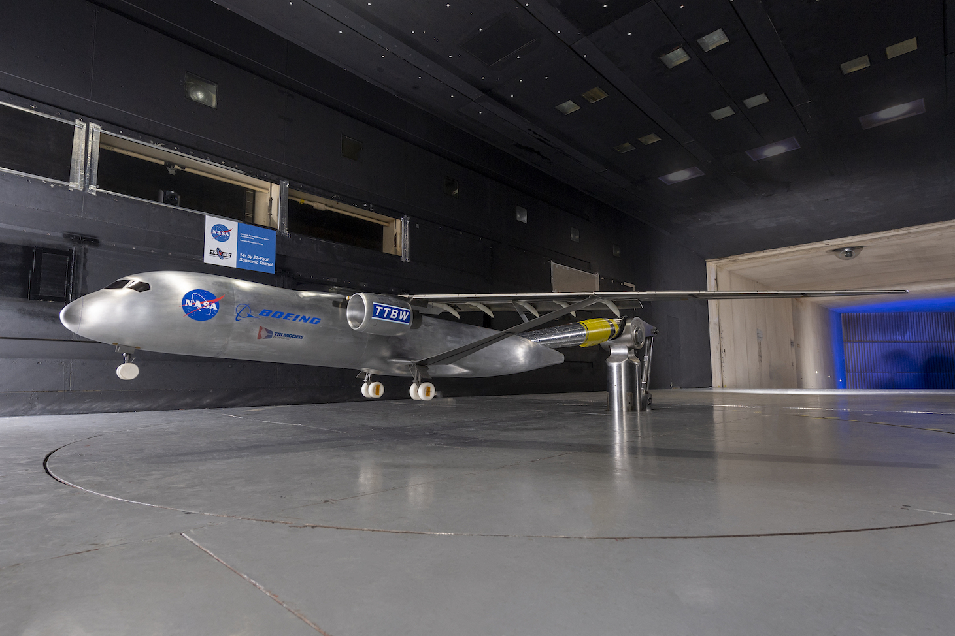
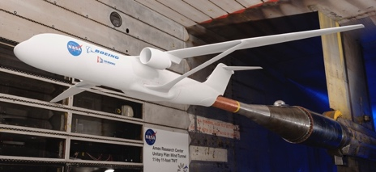
Development Timeline of the Transonic Truss-Braced Wing
2008-14 | 2015 | 2016 | 2017 | 2018 | 2019 | 2020 | 2021 | 2022 | 2023
Phase I-II
Phase III, M=0.745
Phase IV, M=0.80
Phase V, M=0.80
Phase VI
Phase I – Phase II
Conceptual design (TRL 1)
Reduce wing weight uncertainty (TRL 2)
  Validate FEM, flutter modes
Phase IV : M=0.80 Design
More relevant speed
High-speed test
High-Lift test (TRL 3)
Phase V : M=0.80, Envelope Expansion
High-speed buffet boundary (TRL 4)
Expanded high-lift testing
Phase VI : M=0.80, Tech Maturation
Aero
  High-Lift (higher Re)
  Deep Stall
Acoustics
Icing
Structures
Non-linear Aeroelastics Test
High-Speed Test
Phase III , M=0.745
High-speed Design (TRL 2)
First cruise performance test
High-Speed Buffet Test
First High-Lift Test
High-Lift In Ground Effect and
Preliminary Icing Evaluation
First High-Speed Performance Test

Slide 8
Fuel Burn Benefit Estimates for Mach 0.80 TTBW
Subsonic Ultra Green Aircraft Research (SUGAR)
Fuel Burn Benefits Relative to Baseline*
Mission | TTBW Technology | SUGAR Technologies
3500nm | 9.0% | 59.0%
900nm | 7.2% | 55.9%
  TTBW Technology:
  High aspect ratio thin wing design, strut and jury (AR=19.5)
  SUGAR TTBW concept aircraft technologies:
NASA/Boeing 4.5% Scale Transonic Performance Test NASA Ames 11-Foot Transonic Tunnel.
    TTBW
    NLF/HLFC/Riblets
    Advanced Structures
    Unique Structural Joints
    Advanced Engines
    Next Gen. ATM
*Baseline: advanced conventional single-aisle, AR=13, same technologies
NASA/Boeing 8% Scale Low-Speed Performance Test NASA Langley 14- by 22-Foot Subsonic Tunnel.
POC: William Milholen (LaRC)

Slide 9
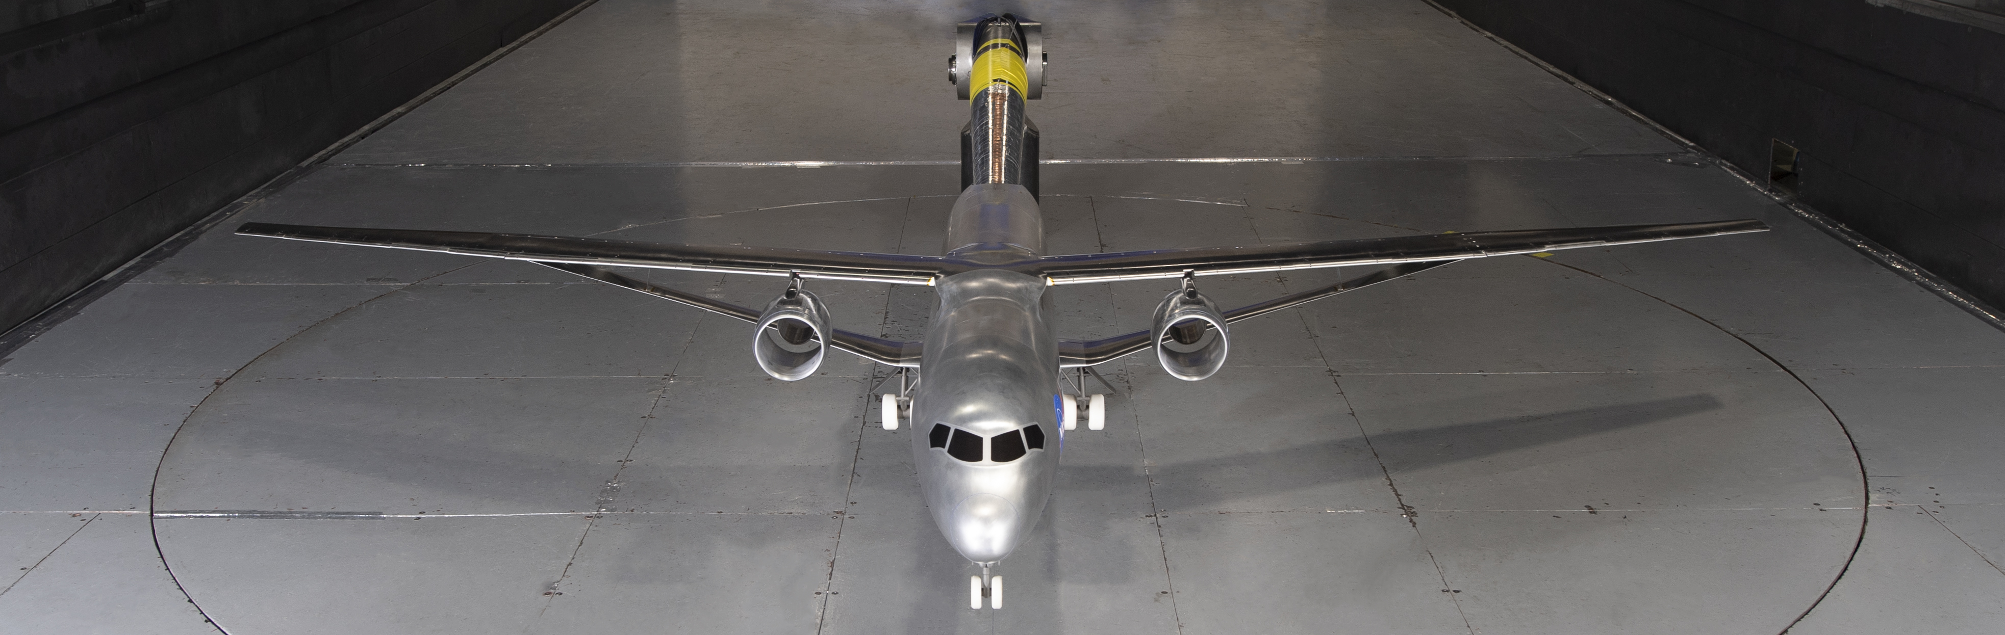
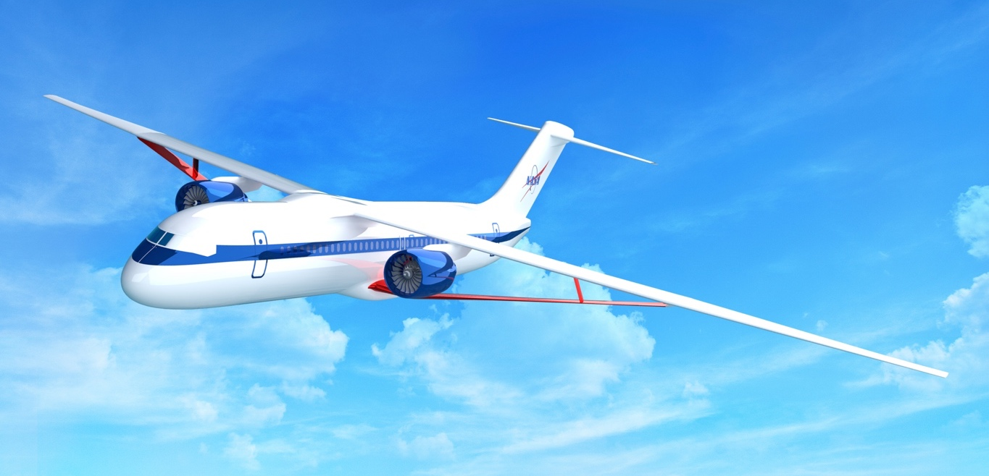
Transonic Truss-Braced Wing Technology Maturation
Increase confidence in technology to be robustly integrated in the aircraft system
Scope
  Mature and reduce risk of Transonic Truss-Braced Wing (TTBW) technology, focused on:
Benefit
  Achieve 5-10% reduction in fuel burn through reduced drag
  Approach
  Concept studies through scale model testing
  Perform high-fidelity prediction, testing and validation to increase confidence in fuel burn benefit
    Buffet boundary prediction
    Stall characteristics
    High-lift system integration
    Acoustic assessment
    Icing impact
    Thin wing structural design
    Unique structural joints
High-Speed Buffet
Unique Noise
Sources
High-Lift Integration
Thin-Wing Design
Icing Protection Challenges
Critical Structural Joints
Design/analysis studies and
wind-tunnel tests are underway.

Slide 10
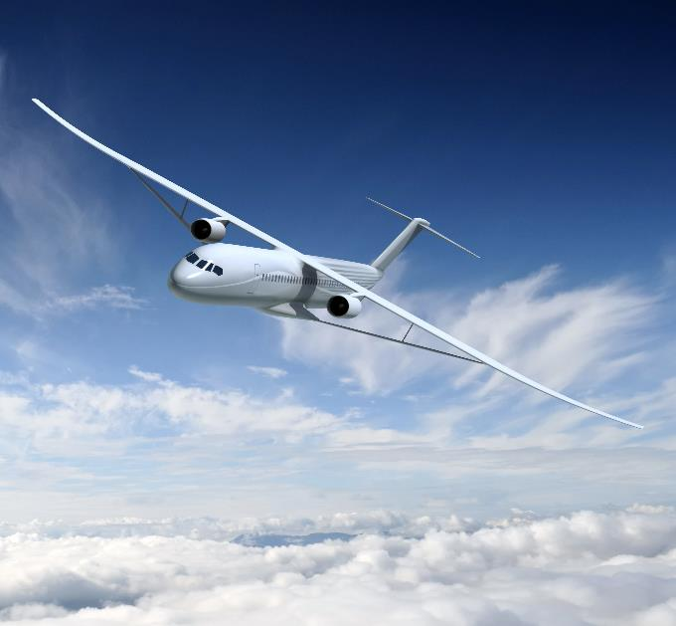
TTBW High-Speed Buffet Prediction: Off-Design Performance
Unique TTBW Buffet Challenges
Buffet by shock induced flow separation on two lifting surfaces
Highly integrated aerostructural design
Truss carries significant lift, outboard flow channeling
Earlier studies indicated truss buffet concern at low C_{L}
Conventional Tube and Wing Buffet Prediction
Buffet by shock induced flow separation on a single lifting surface
Calibrated analytical/empirical buffet prediction techniques
Impacts on aircraft performance/weight predictable
Motivation
Application of classical tube and wing buffet prediction techniques increases risk to TTBW aircraft design
Thin Wing Design
Possible Truss
Buffeting at Low
Lift
Flow Channeling
Unique Buffet Challenges
POC: William Milholen (LaRC)

Slide 11

Overview of TTBW High-Speed Buffet Testing
Test Goals
Determine buffet onset boundary
Collect structural loads
Expand Stability & Control (S&C) database
Testing Information
9% scale semispan, b/2 = 7.65ft
Mach range: 0.20 – 0.92; Re_{c} = 2.0x10⁶ – 6.6x10⁶
~500 static pressure taps, unsteady pressures, accelerometers
Balance data, wing/strut strain gauges
Four-week test, completed February 2022.
Status
Final analysis/report expected late September 2022. Preliminary results indicate good buffet characteristics, multiple buffet prediction methods to be evaluated.
NASA/Boeing 9% Scale TTBW semi-span buffet model installed in the Ames 11- by 11-Foot Transonic Tunnel.
POC: Greg Gatlin (LaRC)

Slide 12
Overview of TTBW Low-Speed High-Lift Testing
Test Goals
First entry (2019):
High-lift performance, rigging studies, S&C
Second entry (2021):
In ground effect testing (IGE), S&C
Preliminary icing evaluation (LEWICE3D shapes)
Testing Information
8% scale model, b = 13.6ft., Mach = 0.20, Re_{c} = 1.0x10⁶
High-lift: variable camber Krueger, single slotted flaps
Removable landing gear, multiple control surfaces
Six component balance, ~500 static pressure taps
Status
High-lift design meets performance goals
IGE trends follow expectations
Critical ice accretion areas identified
NASA/Boeing 8% Scale Low-Speed Performance Test. NASA Langley 14- by 22-Foot Subsonic Tunnel (2019).
Second test entry including ground-effects testing (2021).
POC: Greg Gatlin (LaRC)

Slide 13
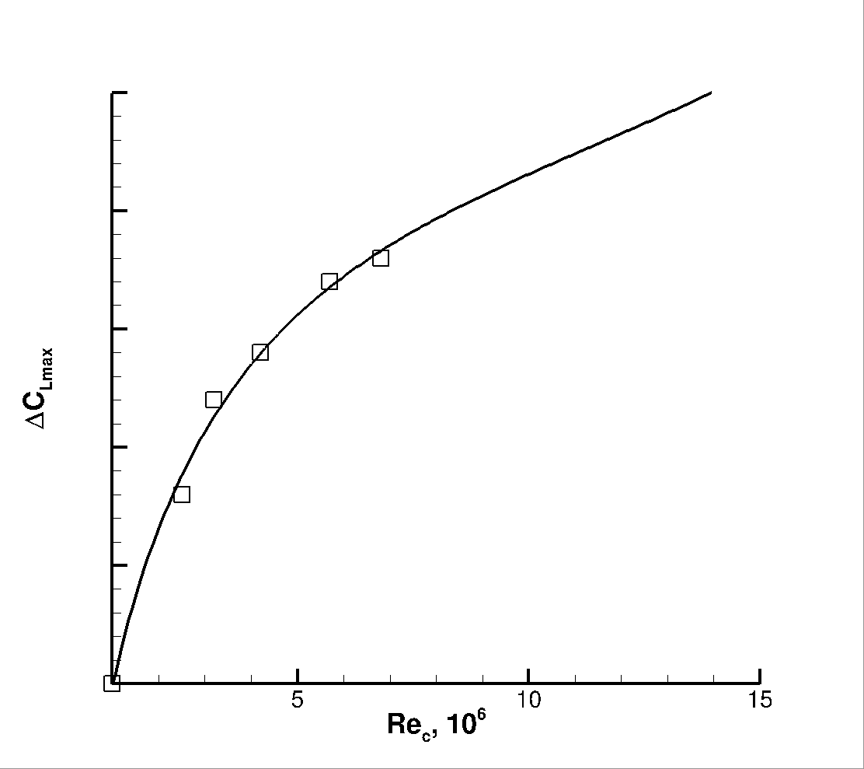
TTBW High-Lift Technology Maturation: Future Testing
Reynolds Number Scaling Sensitivities
High-lift aerodynamics sensitive to Reynolds number
Transition effects, compressibility, model fidelity, aeroelastics,
propulsion effects, many more…….
Adds risk to aircraft development
Does the TTBW present new challenges?
  multiple lifting surfaces, flexible wing, novel high-lift devices
Increasing Re: Future High-Lift Test Planning
Short-term study to consider relevant testing options
Model size, fidelity, instrumentation, facilities
Goal of testing a new model < 2 years
Additional Low-Speed S&C Testing
Third test of existing 8% scale TTBW model
Deep Stall aerodynamics
S&C database expansion
WT Testing
Extrapolate
Flight
ΔC_{L,max}
Scaling WT data to flight:
How much Reynolds number is enough?
POC: William Milholen (LaRC)

Slide 14
Outline
Background
Aerodynamic Technologies
Summary Remarks
    High Aspect Ratio Wings
    Natural Laminar Flow
    Cruise Slotted Wing
    Boundary Layer Ingesting Propulsor
    Active Flow Control
    Advanced Concept Studies

Slide 15
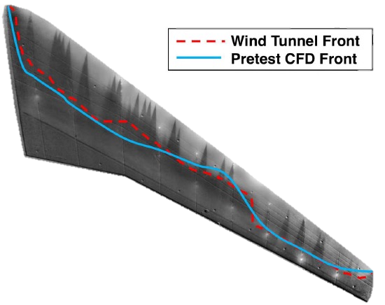
CATNLF Design Method: Wind Tunnel Success to Flight Testing
Crossflow Attenuated Natural Laminar Flow (CATNLF)
Common Research Model with Natural Laminar Flow (CRM-NLF) tested in the National Transonic Facility (NTF) in 2018
  Confirmed computational predictions
  Exceeds historic NLF results
  Focus of 2020 AIAA Transition Modeling Workshop
  Limited results in wind tunnel motivated flight testing
M = 0.86, Re_{MAC} = 15 million
CRM-NLF semispan model in the NTF
Transition images of CRM-NLF wing show regions of laminar flow on model in the NTF
(AIAA 2019-3292)
CRM-NLF exceeds historic experiments, but tunnel environment limits maximum extent of NLF
POC: Michelle Lynde, Richard Campbell (LaRC)

Slide 16
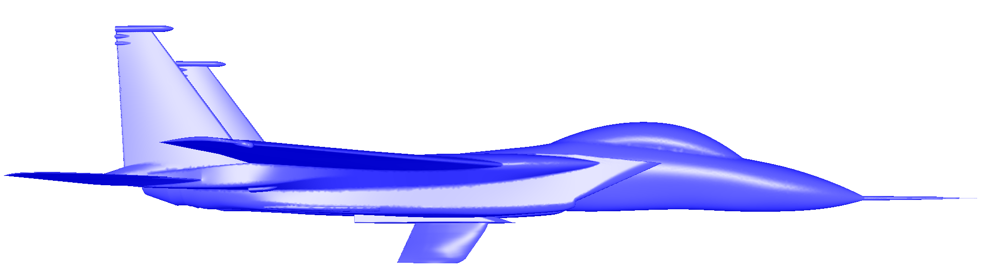
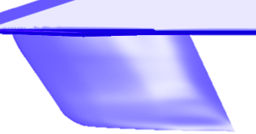
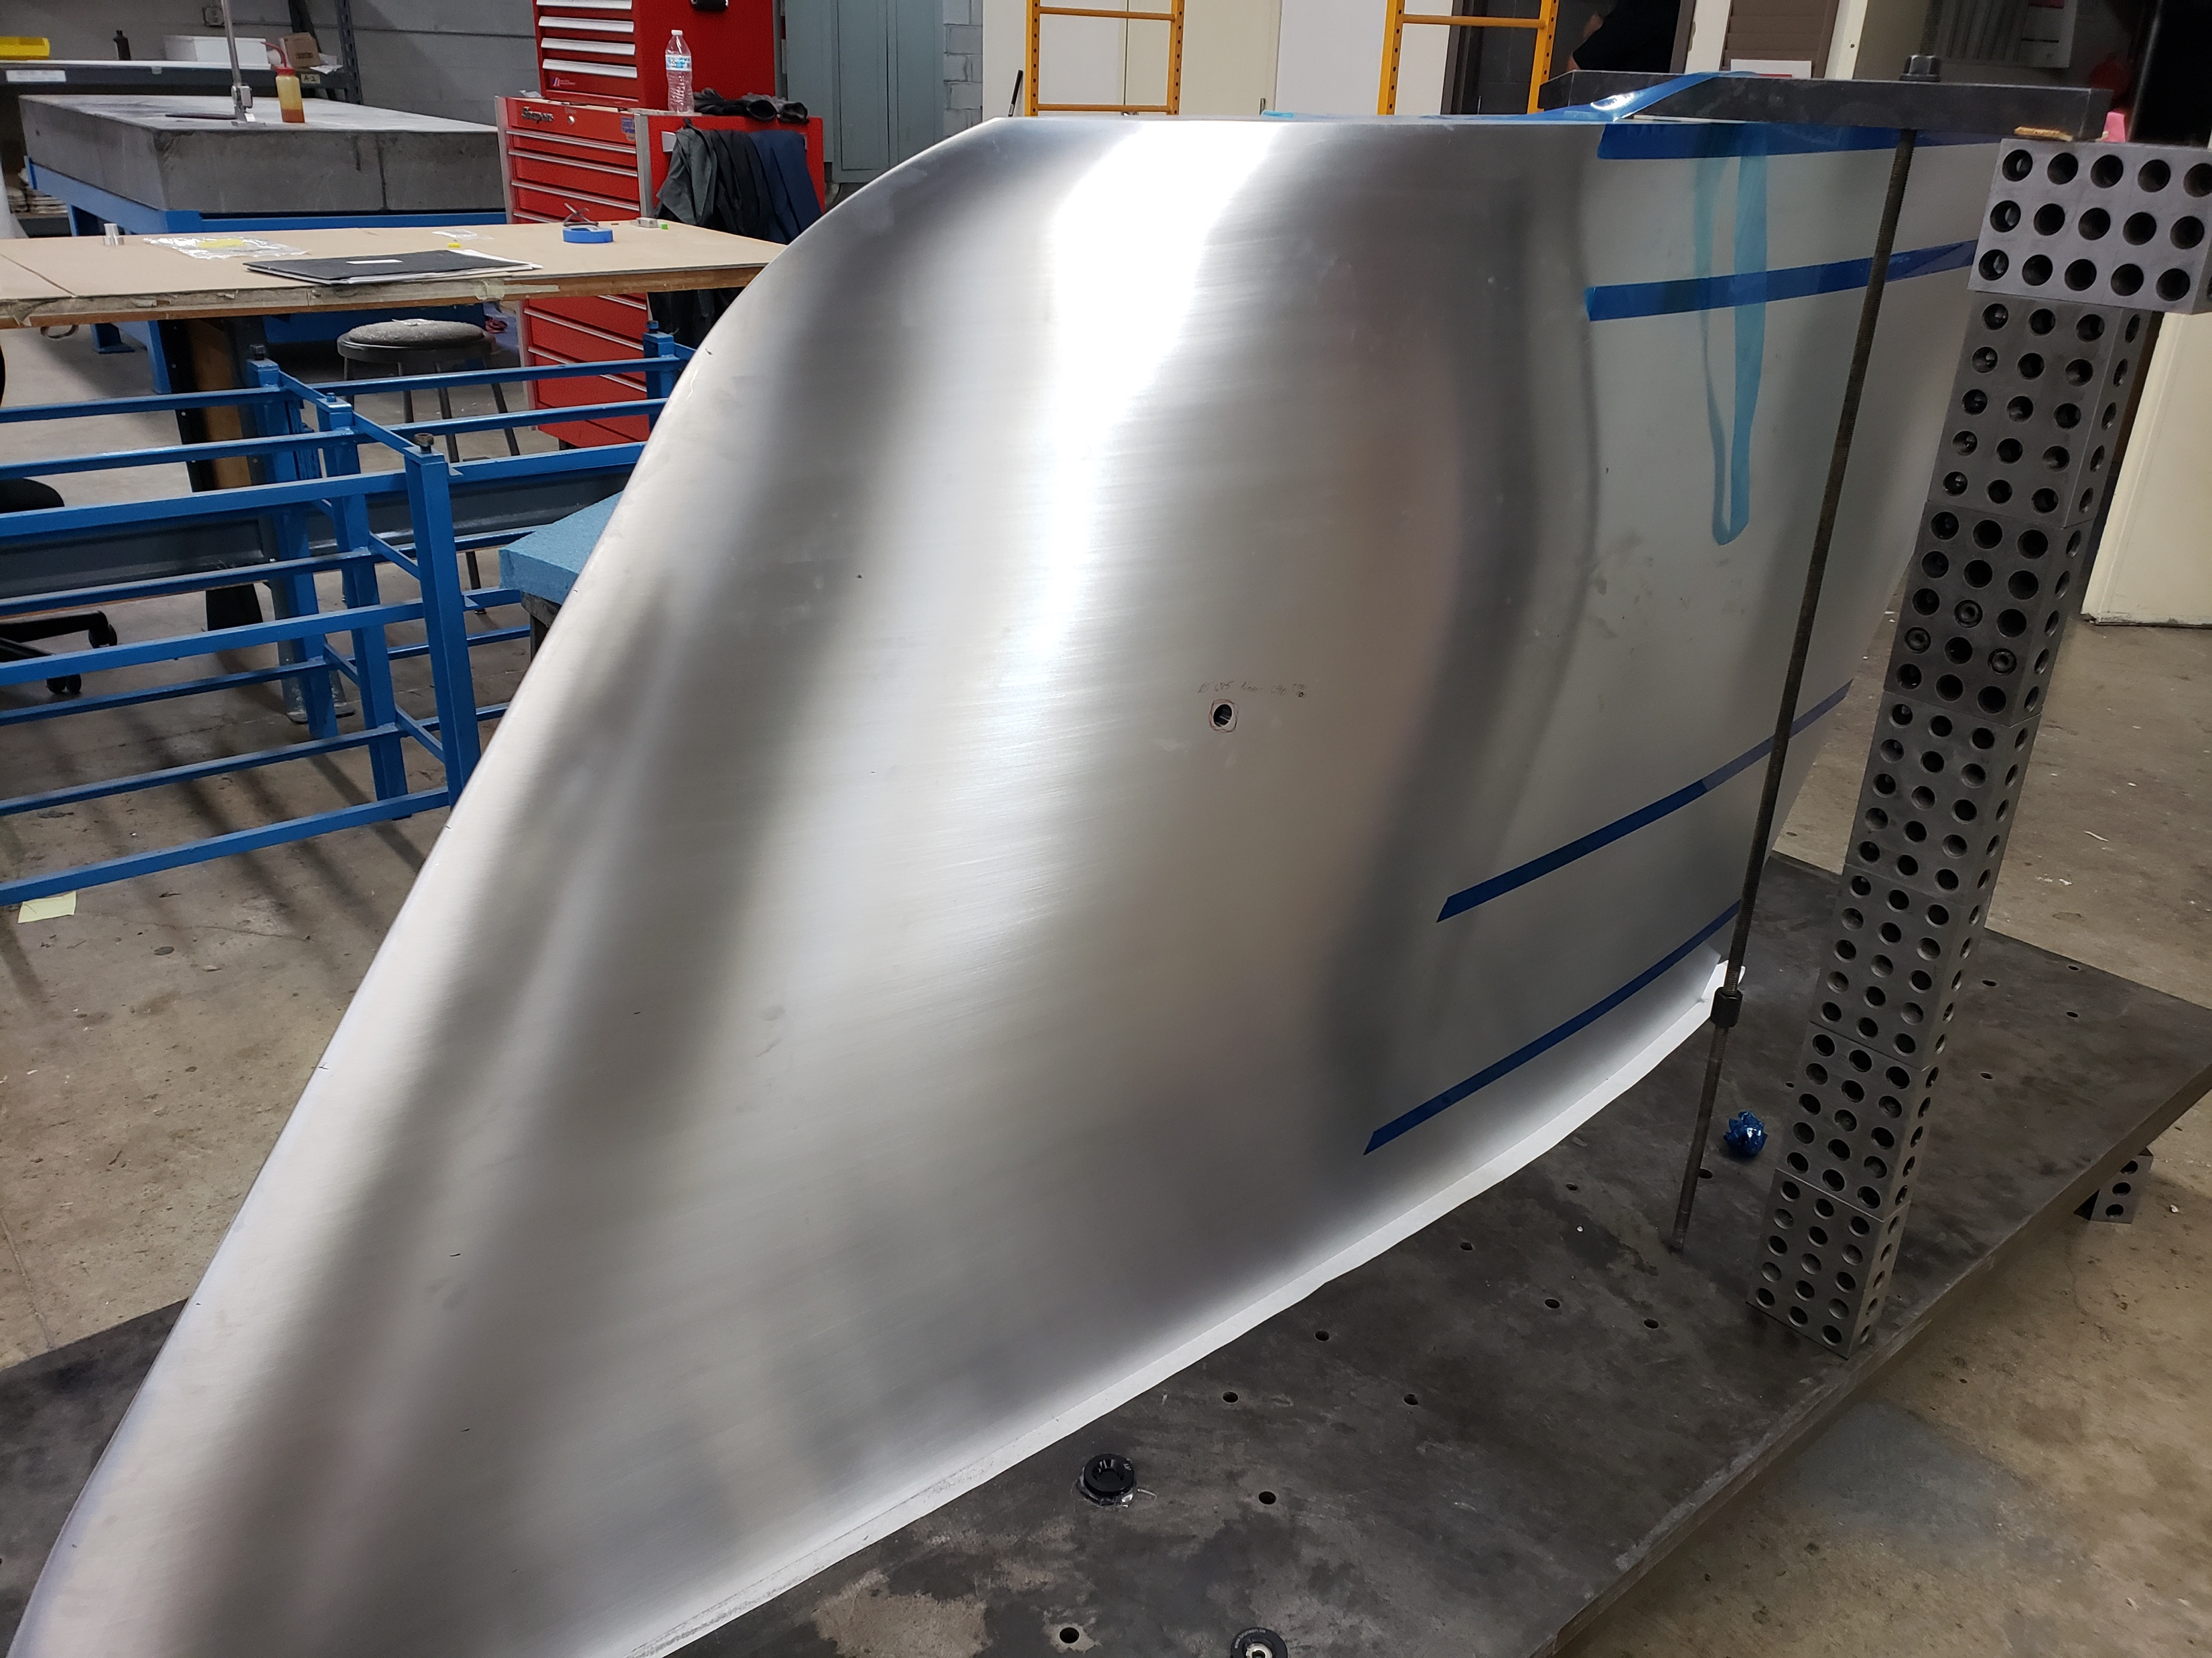
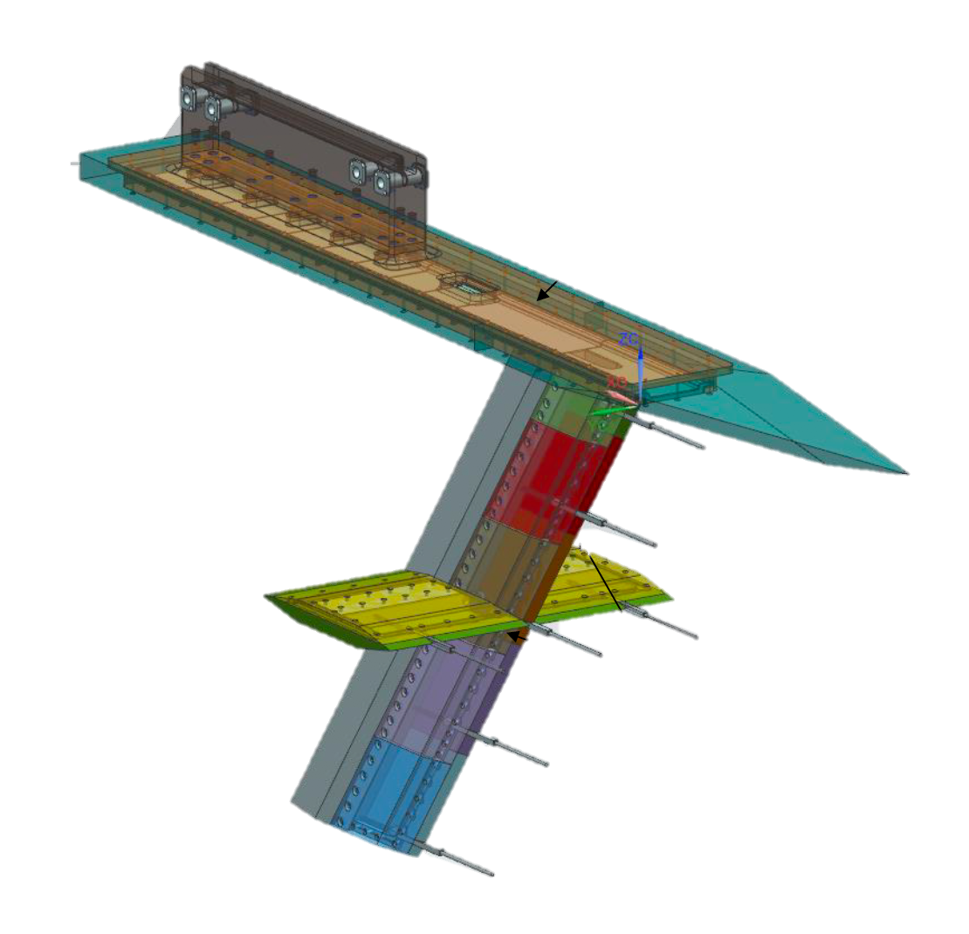
CATNLF Flight Test – Summer 2023
Armstrong Flight Research Center, F-15
6.3 ft.
Laminar
Turbulent
Computational transition front
Test article is a lifting surface representative of a transonic transport wing designed to support 52% laminar flow
Primary Goal: To confirm the effectiveness of the CATNLF method to obtain laminar flow
Secondary Goal: To investigate the surface requirements for laminar flow applications
Support Flight Test Activities:
Enhanced laminar flow detection (2019)
F-15 flow rake survey (Fall 2022)
(AIAA 2021-0173)
Flow Survey Rake
Test article scheduled for delivery September 2022
Proposed Release of Flight Data for Future Workshops
POC: Michelle Lynde, Richard Campbell (LaRC)

Slide 17
Outline
Background
Aerodynamic Technologies
Summary Remarks
    High Aspect Ratio Wings
    Natural Laminar Flow
    Cruise Slotted Wing
    Boundary Layer Ingesting Propulsor
    Active Flow Control
    Advanced Concept Studies

Slide 18

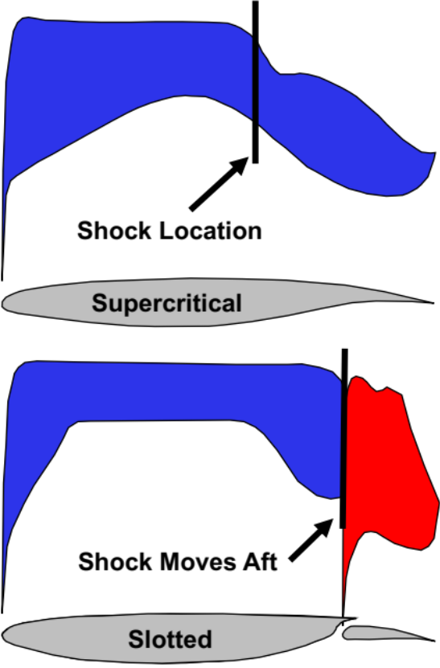

Cruise Slotted Wing (CSW) – Expanding Wing Design Trade Space
Concept
Flow-through slot permits stronger pressure recovery without separation
Enables greater aft loading to weaken shock strength, reduction in wave drag
Design Tradespace
Increase Mach Number
    Improved productivity, more daily city pairs
Increase Wing Thickness
    Lighter wing, greater fuel volume
Decrease Wing Sweep
    Lighter wing, promotes natural laminar flow
Increase Lift Coefficient
    Greater payload limit or cruise altitude
Design Challenge
Skin-friction penalty observed for slotted airfoils
New boundary layer introduced on flap element, lower Reynolds number (Re_{x}) relative to supercritical airfoil
Decrease Drag Coefficient
    Less fuel consumption, increased range
POC: Brett Hiller, Richard Campbell (LaRC)

Slide 19
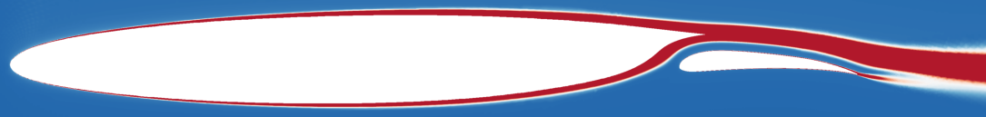
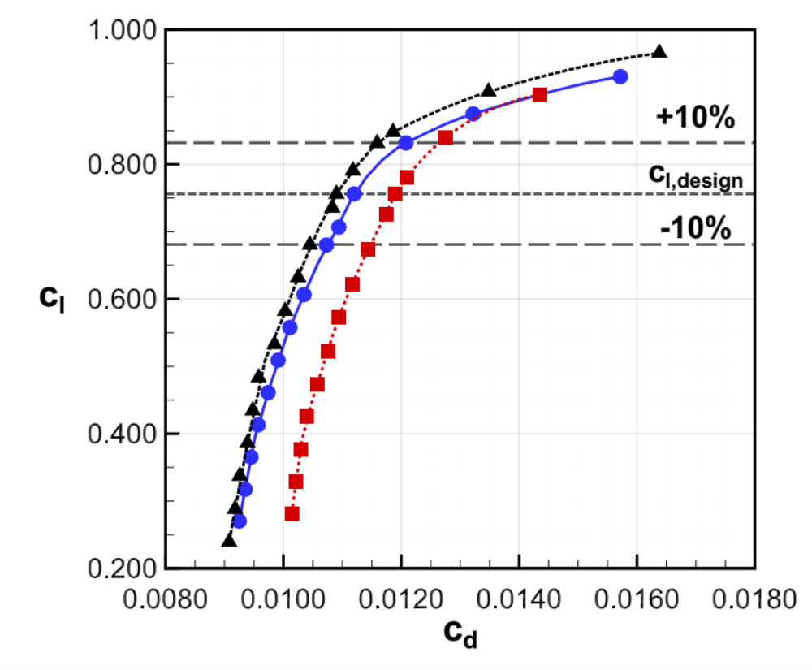
CSW ALMA Concept – Viscous Drag Reduction
CDISC Airfoil Design Studies
NASA Aft Laminar Multi-element Airfoil (ALMA)
Unique Natural Laminar Flow (NLF) Benefits
Laminar aft-element mitigates skin-friction penalty
Crossflow control less challenging: lower local Λ, Re_{x}
NLF on smaller area, reduced concern over “-ilities”
Promising Drag-Saving Technology
CFD predicts ~6% cruise drag reduction vs. supercritical
Robust off-design performance, improved drag divergence
Compatible with conventional LE high-lift devices
M∞ = 0.725, Re_{c} = 14.1x10⁶
Conventional– Turbulent
Slotted – Turbulent
ALMA – Laminar
Single Aisle M=0.80 Wing Design Study Publication, Summer 2023
Drag polar comparison (AIAA 2021-2525)
POC: Brett Hiller, Richard Campbell (LaRC)

Slide 20
Outline
Background
Aerodynamic Technologies
Summary Remarks
    High Aspect Ratio Wings
    Natural Laminar Flow
    Cruise Slotted Wing
    Boundary Layer Ingesting Propulsor
    Active Flow Control
    Advanced Concept Studies

Slide 21
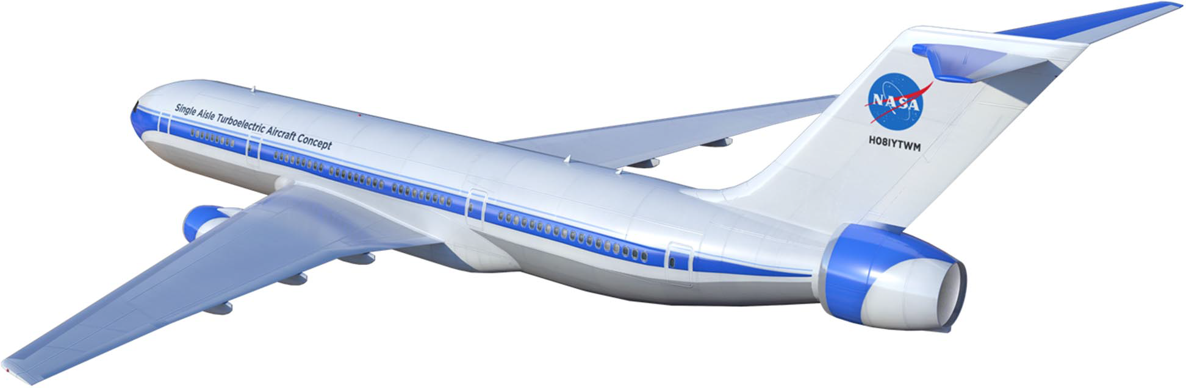
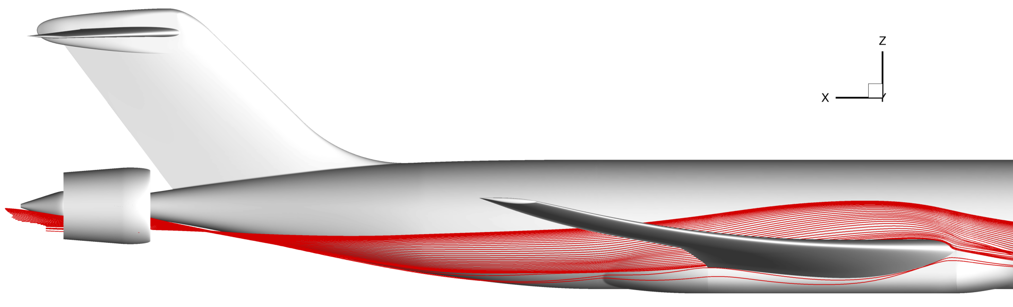
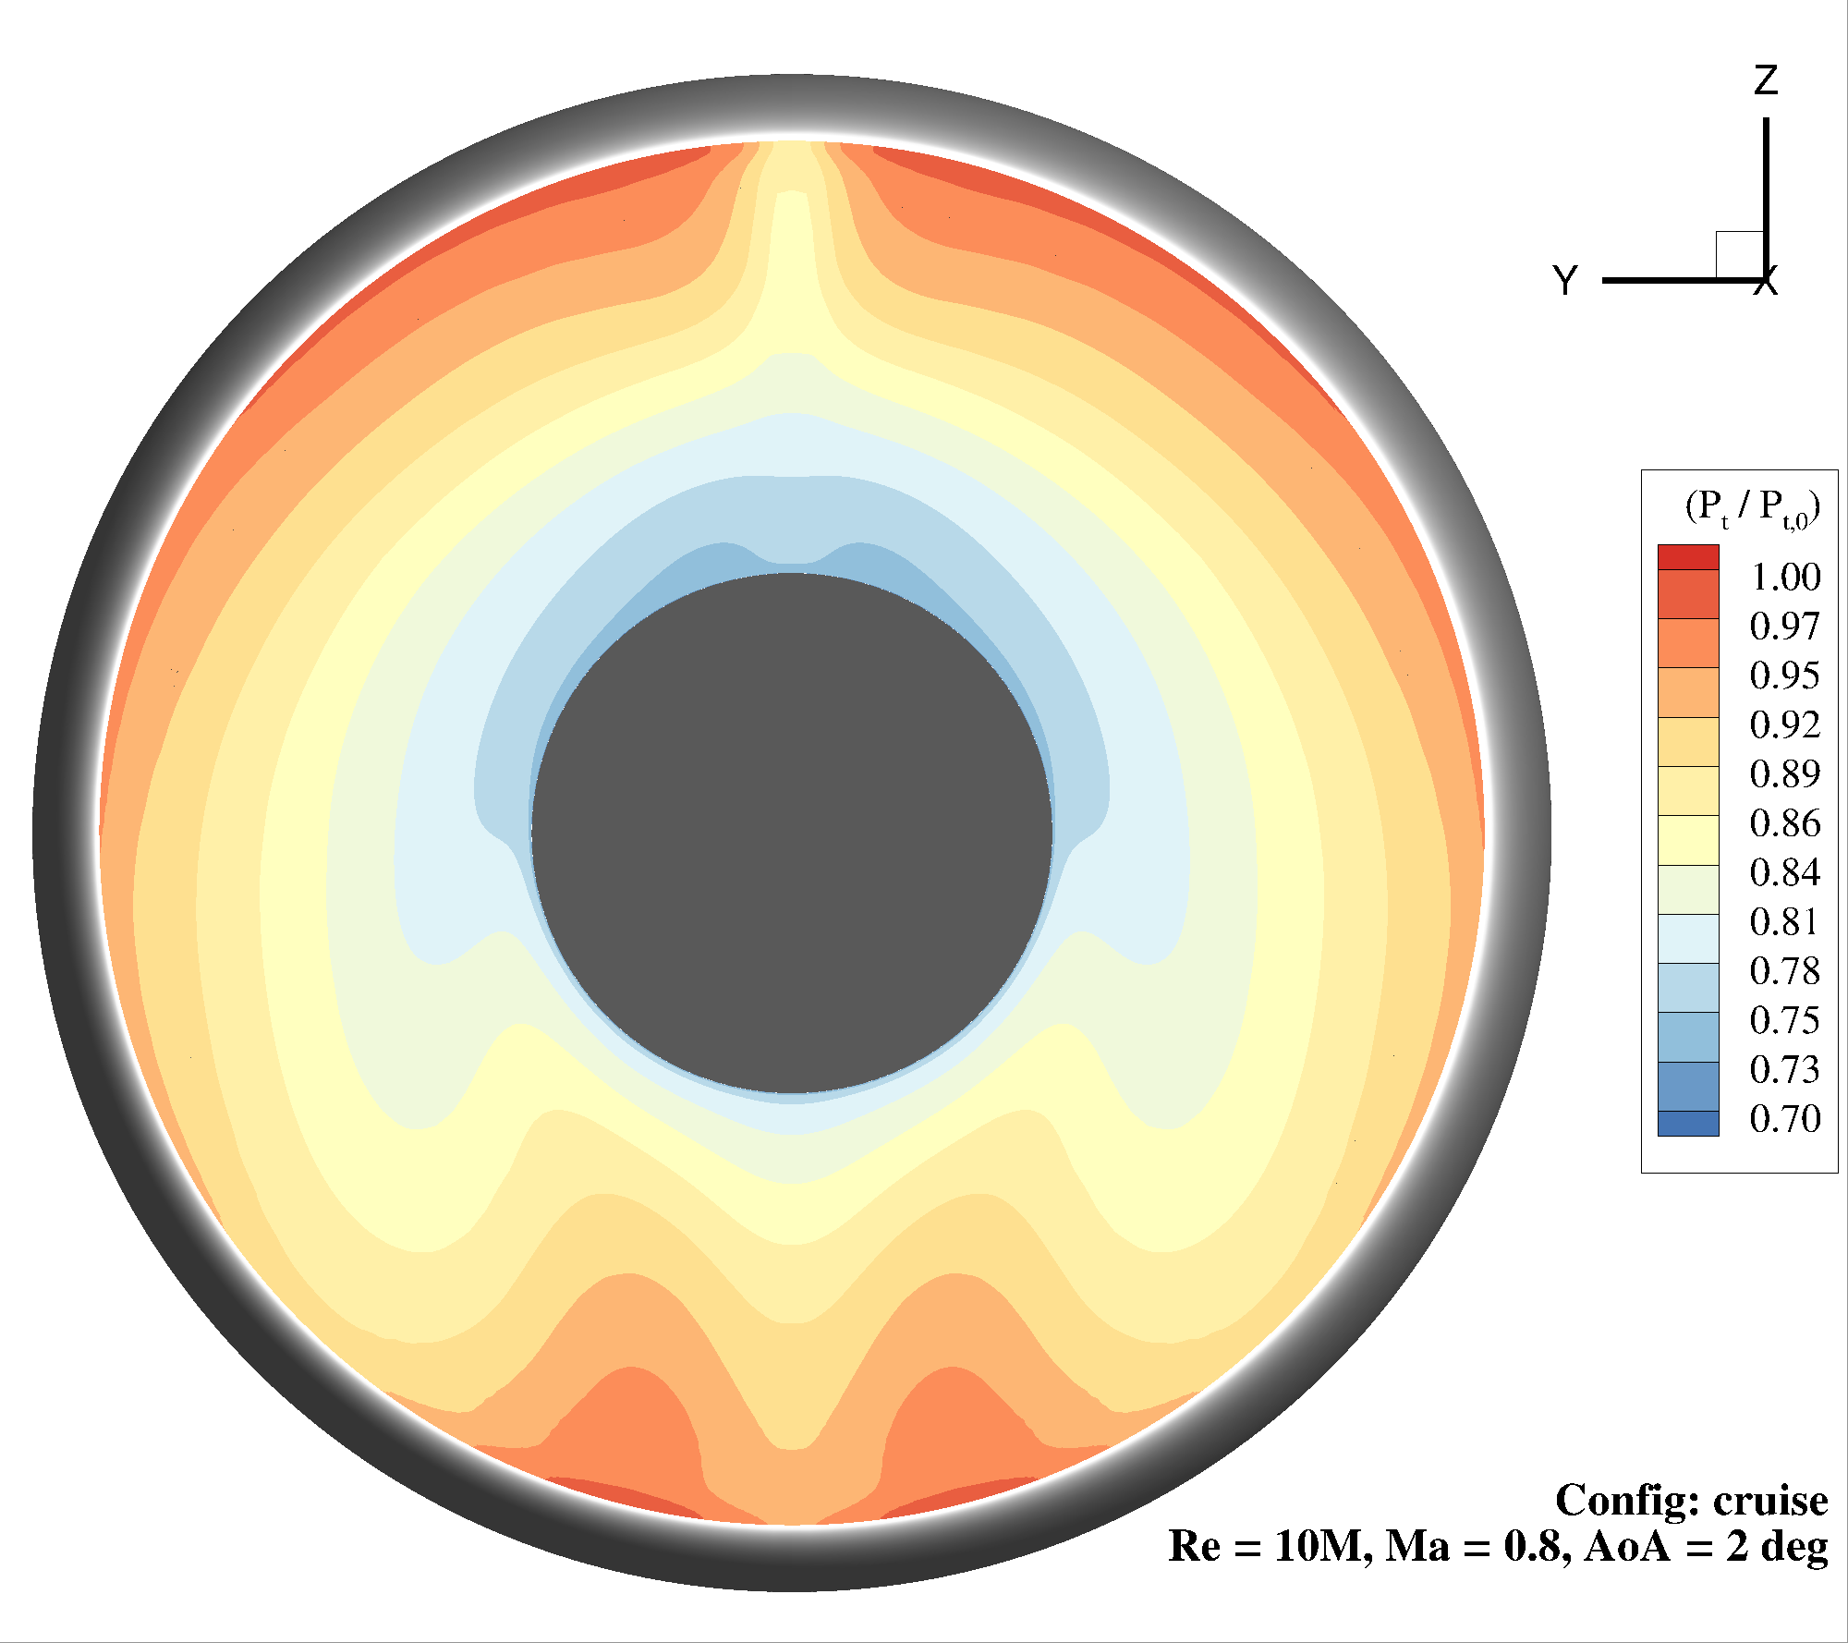
Propulsion Airframe Integration – Boundary Layer Ingestion
Boundary Layer Ingesting Tail-cone System (BLITS)
Objectives
Develop integrated CFD capabilities to enable system-level predictions for BLI configurations
Couple NASA airframe and turbomachinery CFD tools (LAVA + TURBO)
Wind tunnel test to develop validation data
Status
Numerical testing of coupled LAVA/TURBO progressing
CRM-TCT wind tunnel test in NTF (2023)
Flow-thru TCT nacelle to evaluate airframe performance
Characterize inlet flow conditions, distortion mapping
Document influence of TCT on aft body flow
STARC-ABL
Concept
CRM + Tail Cone Thruster
(CRM-TCT)
Influence of wing downwash on tailcone nacelle
Tailcone nacelle inlet distortion total pressure contours
M∞ = 0.80
Re_{c} = 10.0x10⁶
α = 2.0°
CFD simulation of CRM-TCT
using LAVA (AIAA 2022-1171)
POCs: Shishir Pandya (ARC); David Chan, Gregory Jones (LaRC)

Slide 22
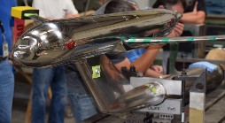
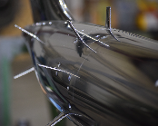
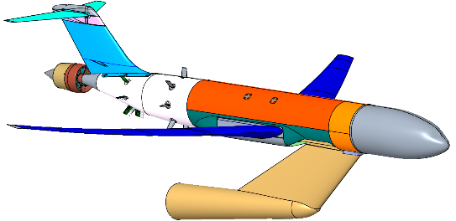



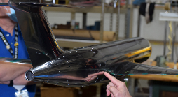
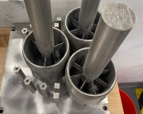
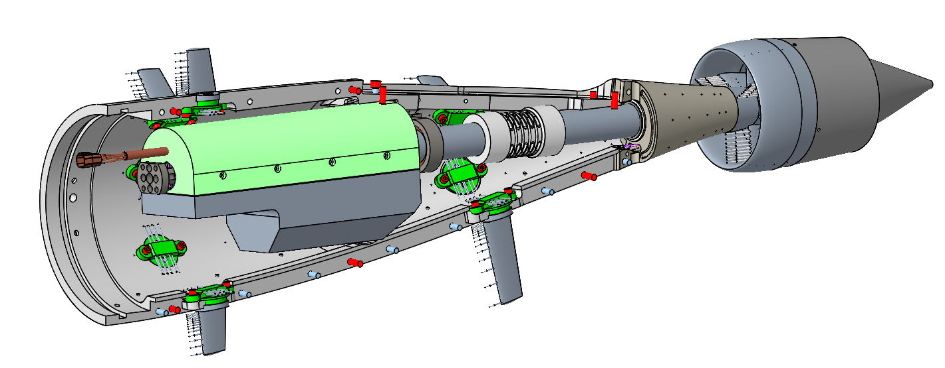
Propulsion Airframe Integration – Boundary Layer Ingestion Flow Physics Test
High Reynolds Number Inlet Distortion Quantification
Common Research Model - Tail Cone Thruster (CRM-TCT) Flow Through Test (NTF, 2023)
  Evaluate tail cone thruster airframe performance
  Simulate propulsor with mass flow plugs, measure inlet conditions at TCT highlight
  Test conditions:
    Mach : 0.75 to 0.85
    Re_{mac} : 5x10⁶ to 20x10⁶
    AOA : -3° to 3°
Fabrication Photos
ARP1420
Rotary
5-hole Probes
BL Rakes
Rotating Mechanism for Nacelles
CRM-TCT Cryogenic Wind Tunnel Model
Determine Propulsor Inlet Conditions and Airframe Effects of TCT Installation for CFD Validation
POCs: Shishir Pandya (ARC); David Chan, Gregory Jones (LaRC)

Slide 23
Outline
Background
Aerodynamic Technologies
Summary Remarks
    High Aspect Ratio Wings
    Natural Laminar Flow
    Cruise Slotted Wing
    Boundary Layer Ingesting Propulsor
    Active Flow Control
    Advanced Concept Studies

Slide 24
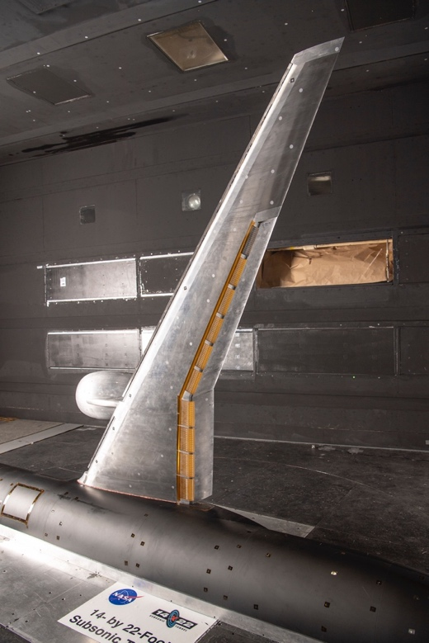
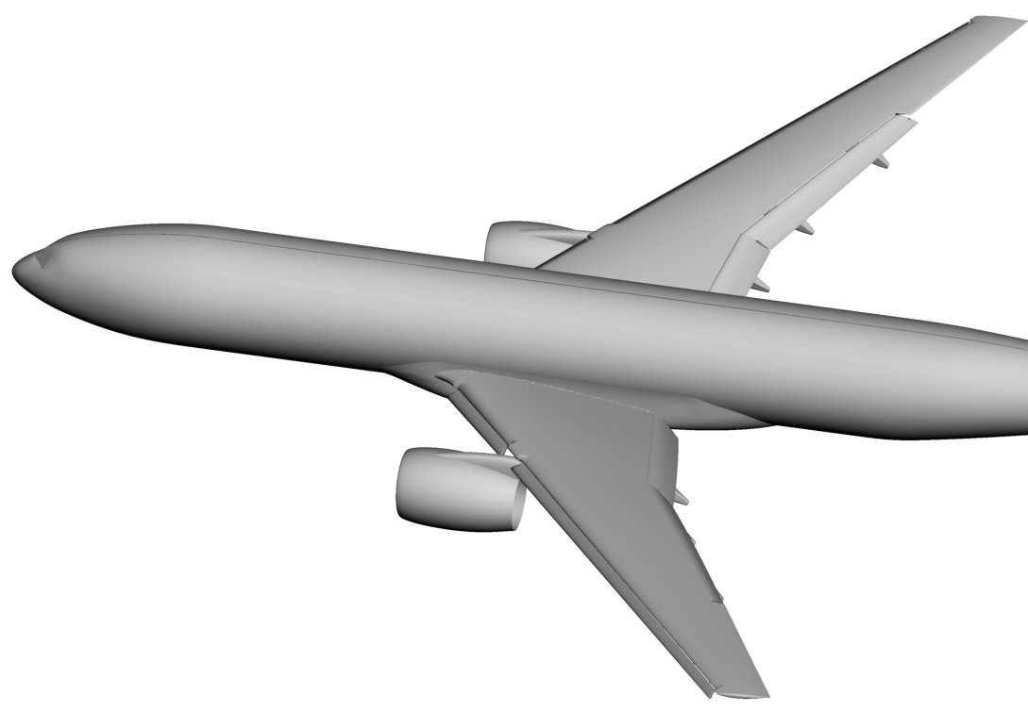
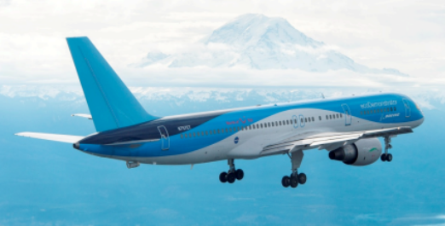
Active Flow Control to Improve High-Lift System Performance
Selective Use of AFC for Enhanced Performance
10% scale CRM-HL in
14- by 22- Foot Subsonic Tunnel
AFC for
Increasing L/D and/or C_{L,max}
AFC
ecoDemonstrator, April 2015
AFC
(Planned)
AFC
AFC-enhanced Vertical Tail
Enables Design Trades:
AFC High Lift
Increase in payload
Increase in range
Reduce engine size
Reduce fuel burn
Large, generic twin engine transport (AIAA 1991-1527):
“1% increase in takeoff L/D is equivalent to 2800 lb increase in payload”
POC: Latunia Melton (LaRC)

Slide 25
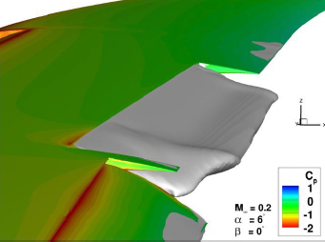
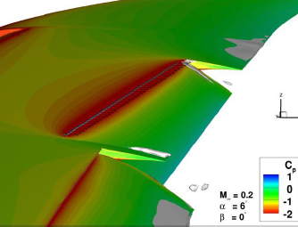
AFC: Localized Drag Reduction
Improvements to L/D Ratio for CRM-HL
25° AFC off
25° AFC on
Objectives
Reduce fuel consumption and emissions by using AFC to reduce drag and increase lift to drag ratio (L/D) during take-off.
Approach:
Study with Boeing to examine potential AFC applications capable of improving L/D that were:
Feasible (minimal architectural impact)
Potentially favorable trade
Possible to test on existing 10% scale CRM-HL model
Drooped aileron AFC application chosen
Predicted L/D improvements up to 5%
Status:
New AFC aileron designed
Wind tunnel test of CRM-HL with AFC aileron in FY23
AIAA SciTech 2023 abstracts submitted on Boeing study
Separated flow
Attached flow
Boeing Drooped Aileron AFC Results (M=0.2, α=6°)
POC: Latunia Melton (LaRC)
NASA Test of AFC on Aileron FY23

Slide 26
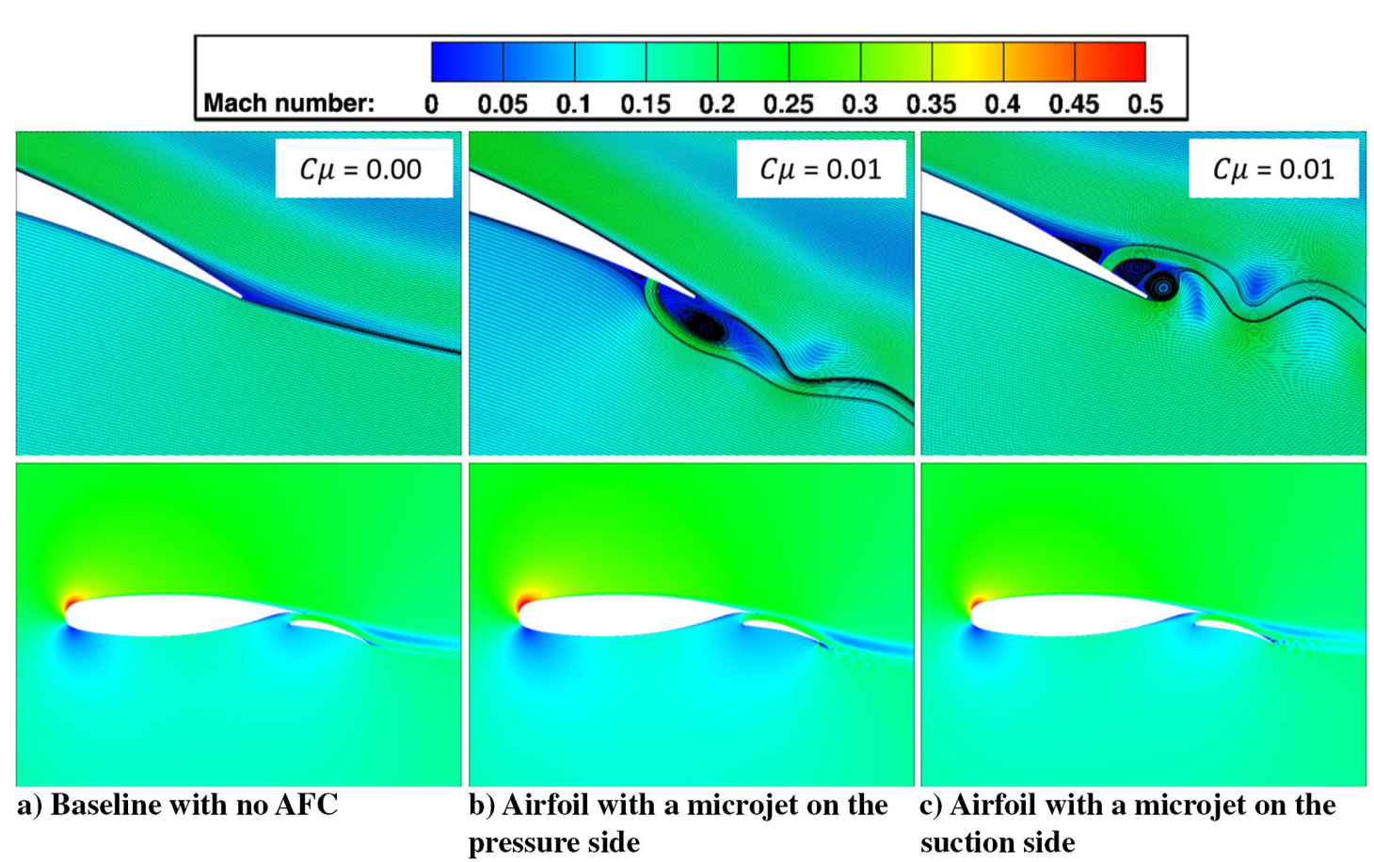
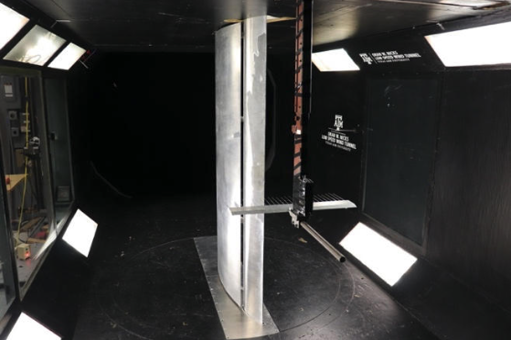
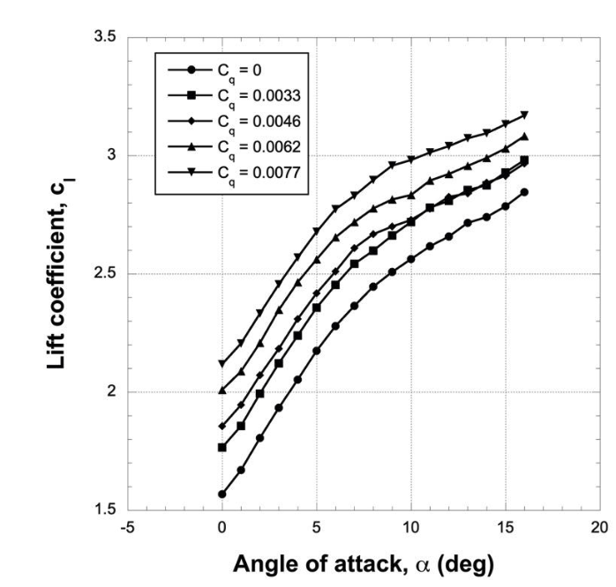
AFC: CFD and Experimental Evaluations of Normal Blowing
Local Application of Normal Blowing (NB) on Flap
Objectives
Increase lift-to-drag ratio (L/D) during takeoff
Demonstrate positive and negative lift increments
Relate jet input to aerodynamic response
Approach
2D CFD and testing of NB on NLR7301 flap
3D CFD simulations of NB on CRM-HL model
Systems study of technology
Status
Microjet chordwise location & angle studies complete
2D experiment at Texas A&M completed
3D CFD simulation on CRM-HL ongoing
Reynolds number study completed (2023 AIAA SciTech)
Hosseini et al., Journal of Aircraft: Vol. 56, No. 4 ; Vol. 58, No. 4
Flap 20°, M∞ = 0.1
POCs: Sheida Hosseini, Shishir Pandya (ARC)
NLR7301 installed in TAMU WT
van Dam et al., AIAA 2022-2535

Slide 27
Outline
Background
Aerodynamic Technologies
Summary Remarks
    High Aspect Ratio Wings
    Natural Laminar Flow
    Cruise Slotted Wing
    Boundary Layer Ingesting Propulsor
    Active Flow Control
    Advanced Concept Studies

Slide 28
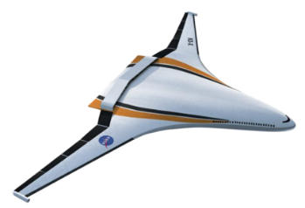
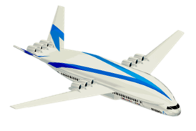
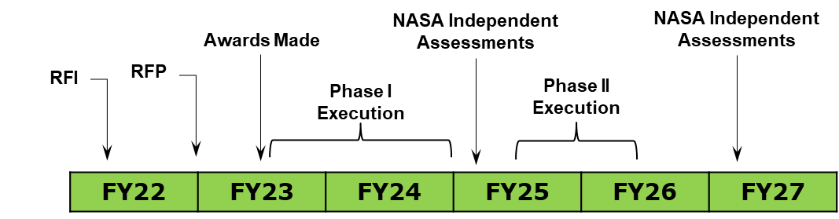


NASA AACES 2050 Studies
Advanced Aircraft Concepts for Environmental Sustainability (AACES)
2008-2019
2020-2029
2030 - 2039
2040 - 2050
FY10-15 ERA N+2 for the 2020s Impact
FY09 N+3 Adv Concept Studies Target 2030-35 Impact
FY23 “N+4” AACES Studies - Explore 2020s, Demo 2030s, Impact 2040s
2040s Marketplace (payload/range/speed), 2050 Environmental Goals
Alternative Energy Scenarios (LH2, LNG, Increased Electrification, 100% SAF)
Advanced Airframes (clean energy compatible, shielding, adaptive, unconventional structures)
Alternative Propulsion (clean energy compatible, BLI, distributed propulsion, hybrid electric)
Tools & Methods for Reduced Lifecycle Cost & Environmental Impact
H₂
Hydrogen
RFI Released 5/19/22, RFP Fall 2022, Awards Early CY23
POC: Eric Hendricks (GRC)

Slide 29
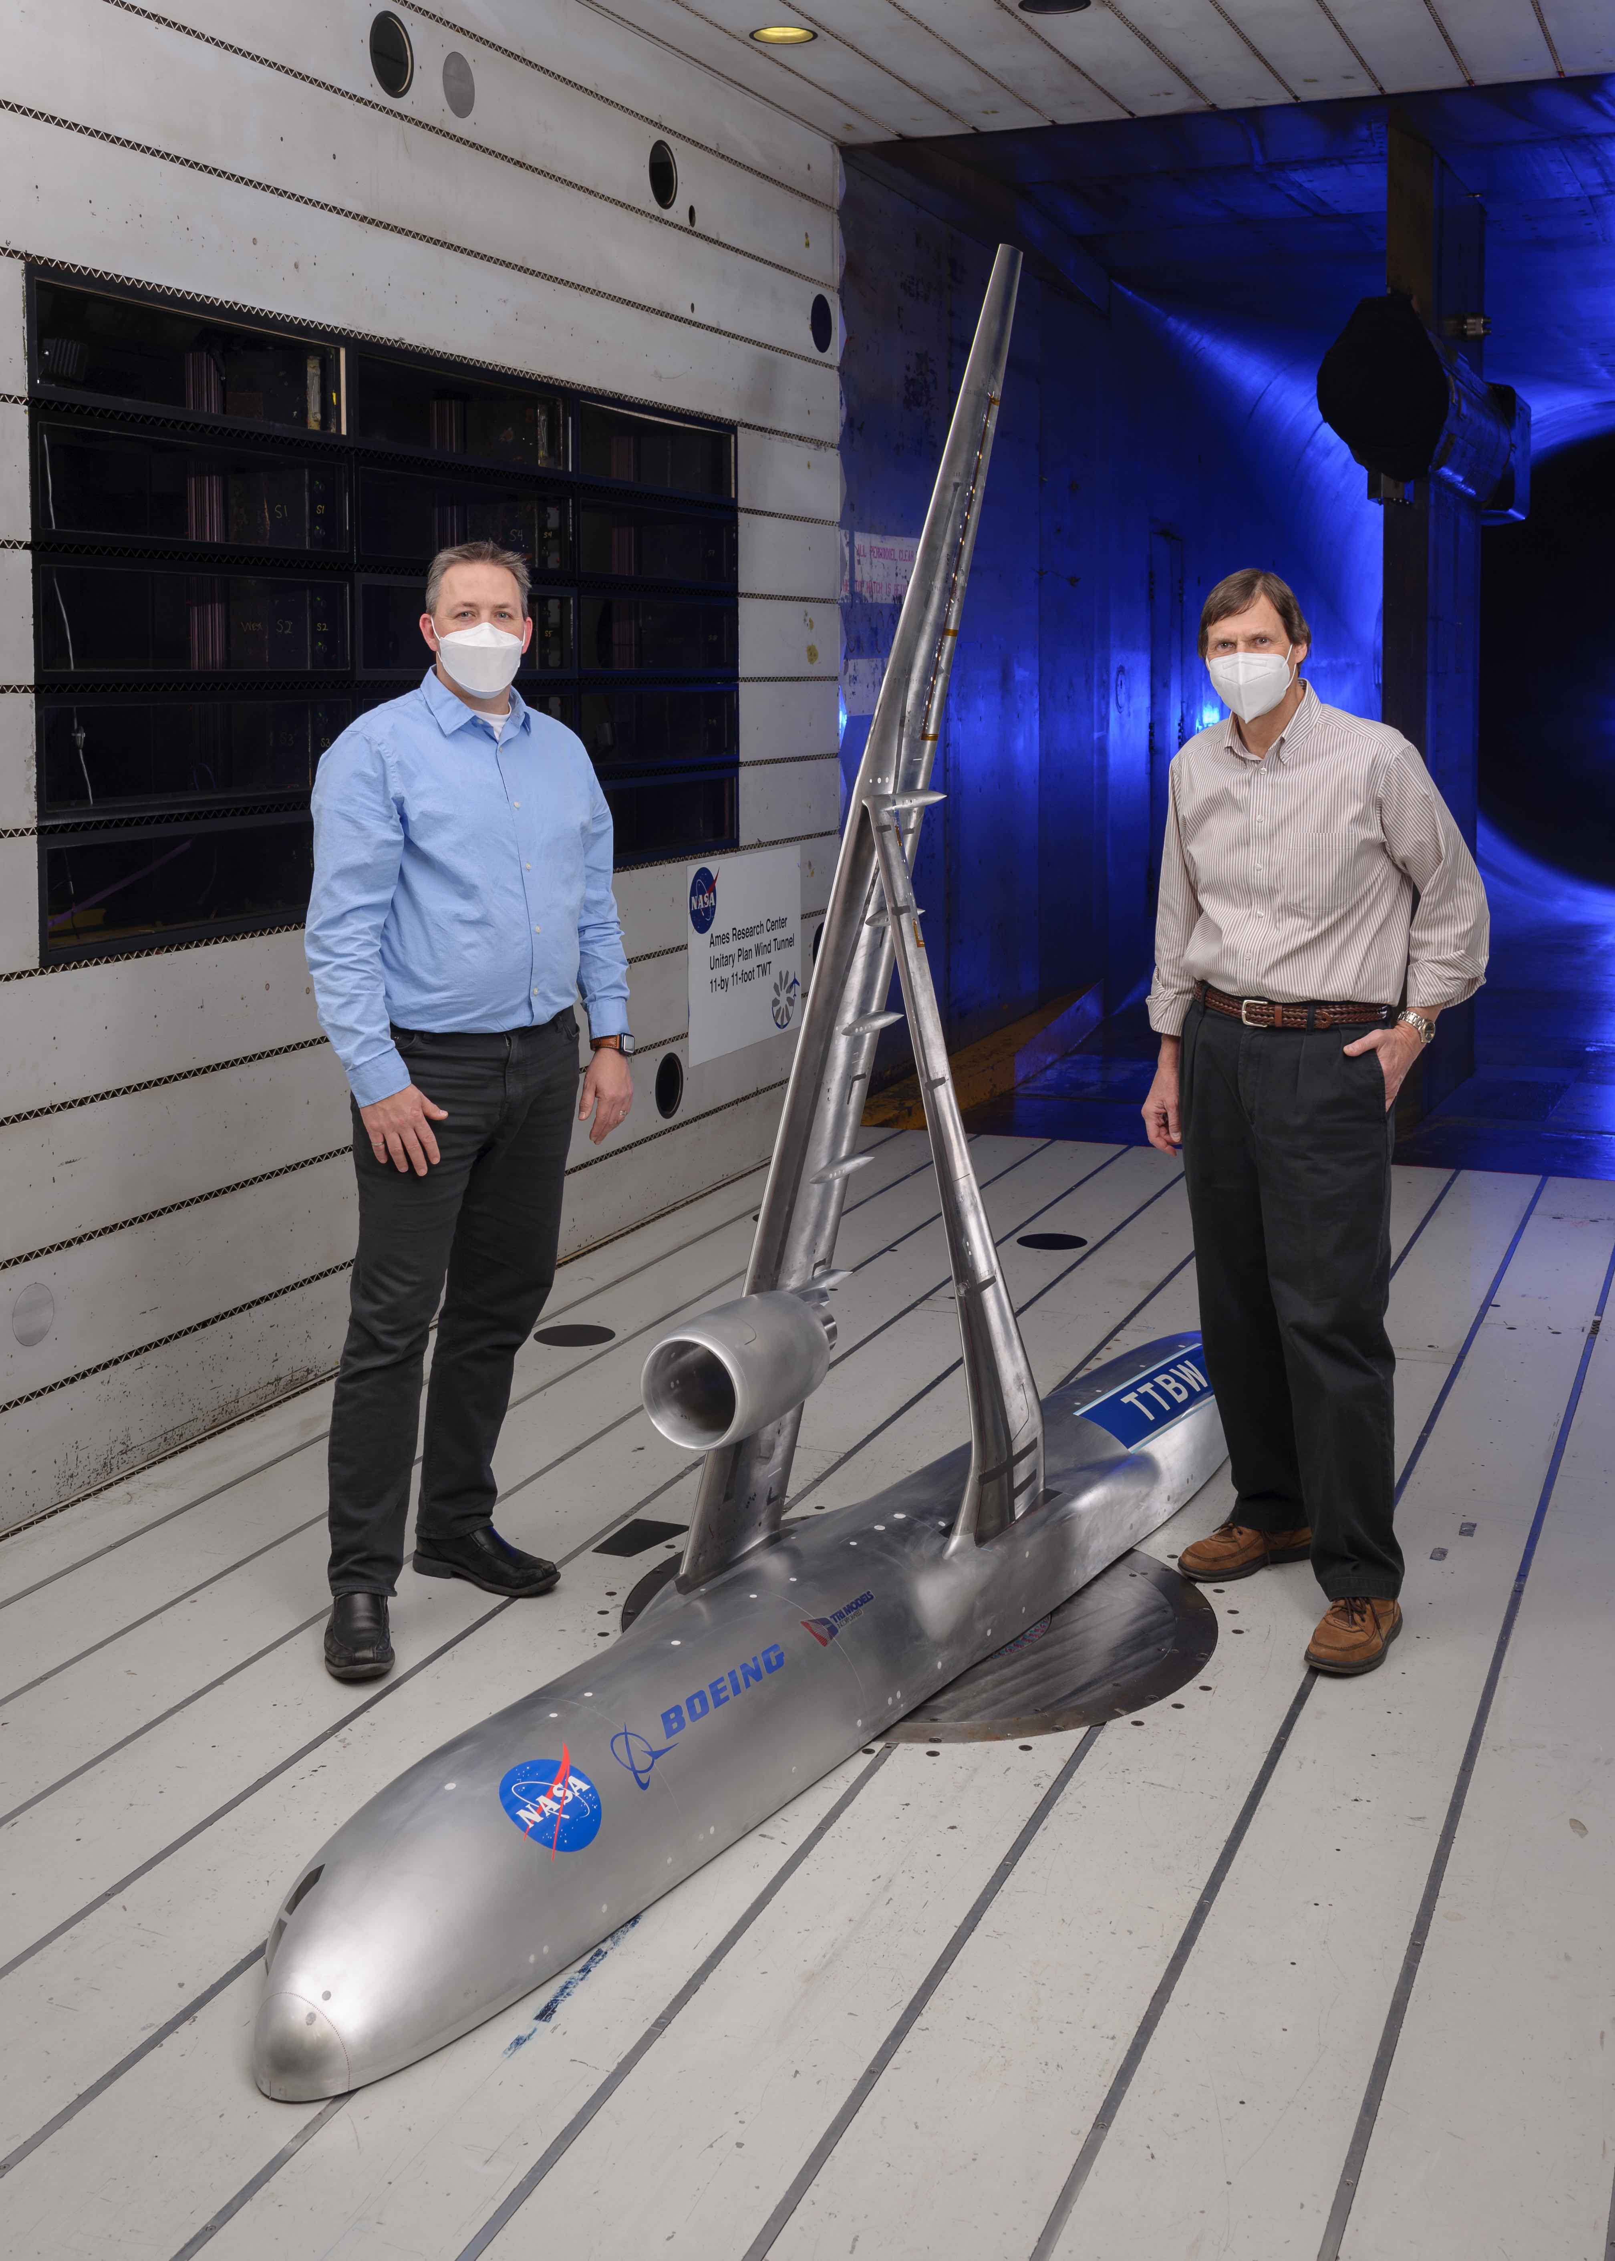
Summary Remarks
NASA is committed to dramatically improve the energy efficiency of subsonic commercial transport aircraft through focused research efforts supporting the goals of the Sustainable Flight National Partnership.
The aerodynamic technologies presented today highlighted a broad range of research efforts that can realistically enable the development of ultra-efficient commercial transports in the 2030 timeframe.
The AACES 2050 studies will foster the development of a generation of subsonic commercial transports to meet the 2050 environmental goals and encompass advanced energy, propulsion, and airframe scenarios.
H₂
Hydrogen

Slide 30


