Slide 1



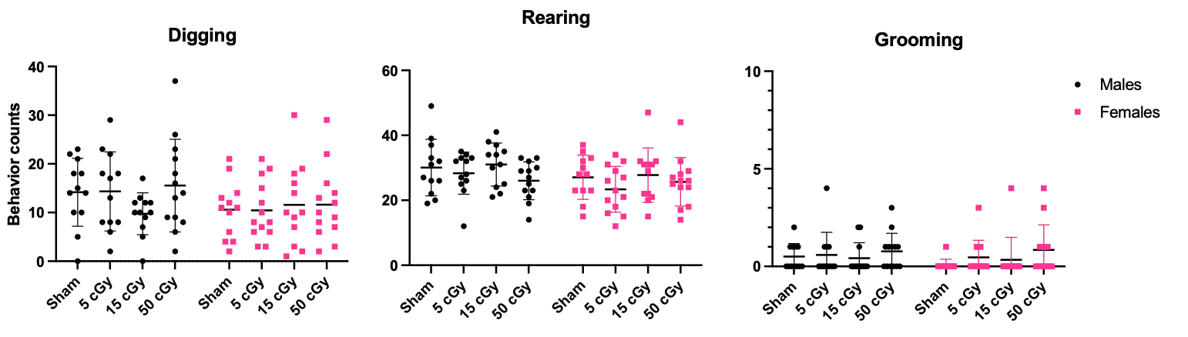


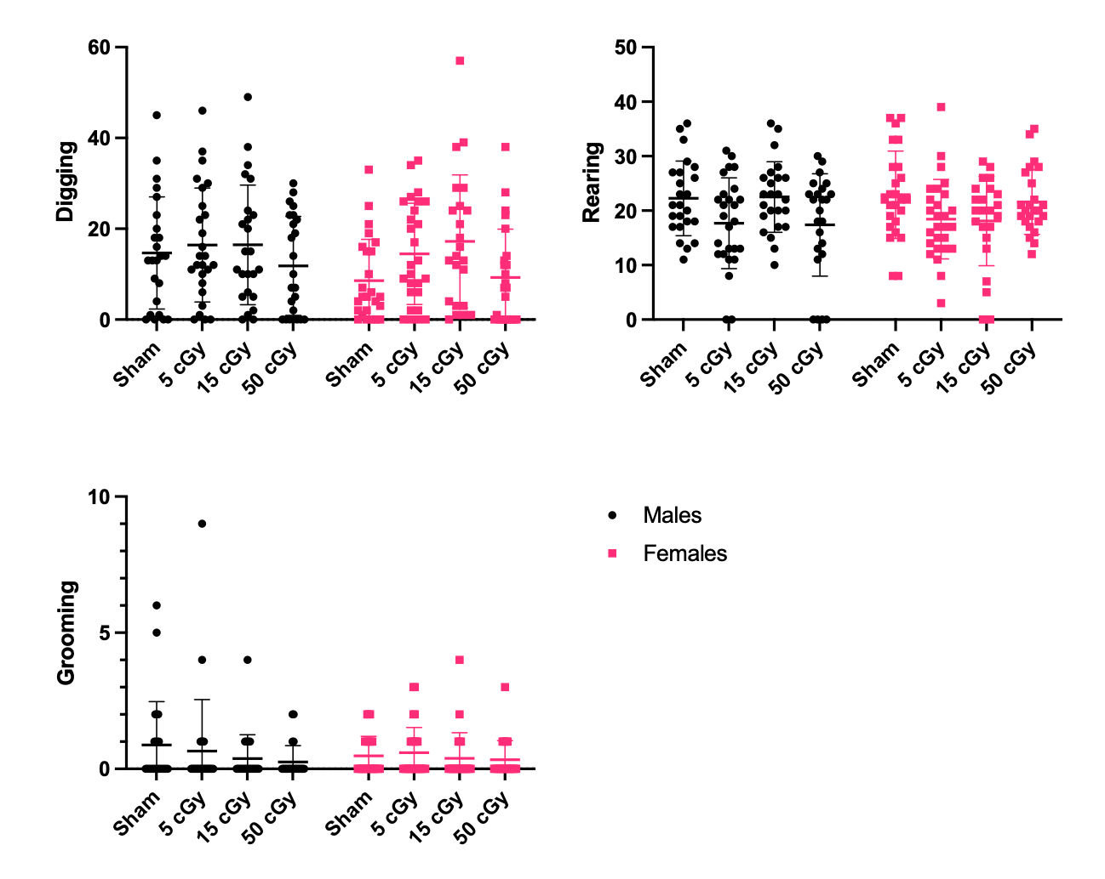
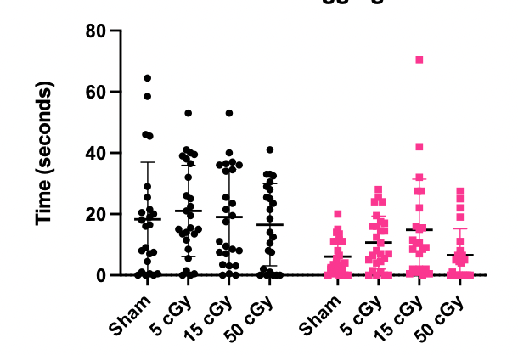
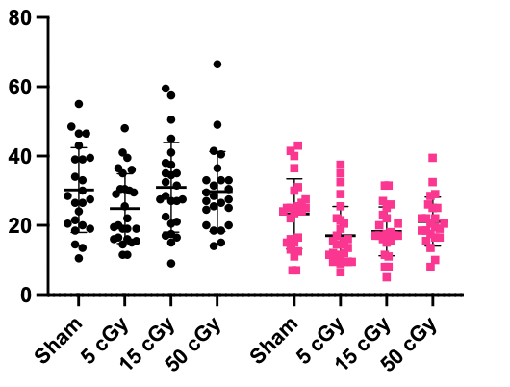
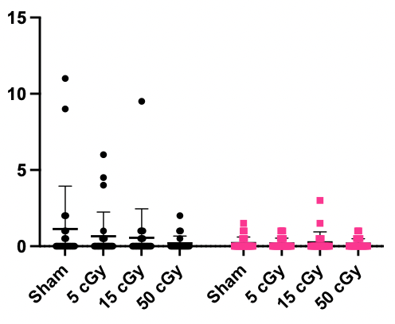
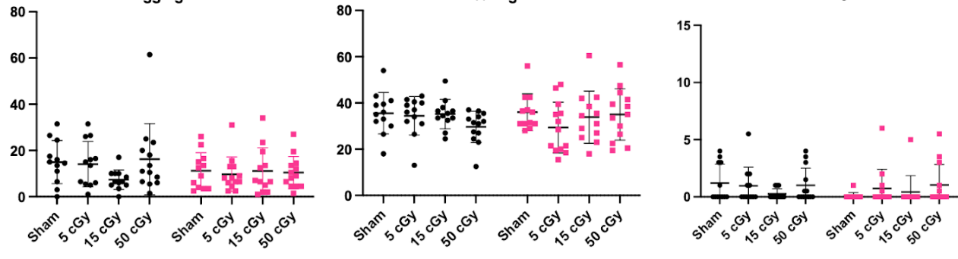
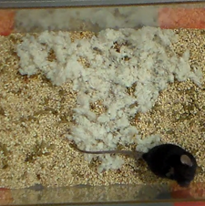
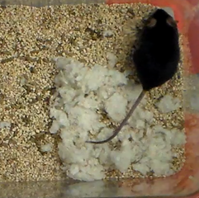
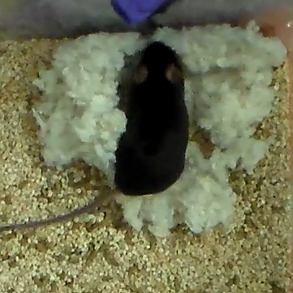
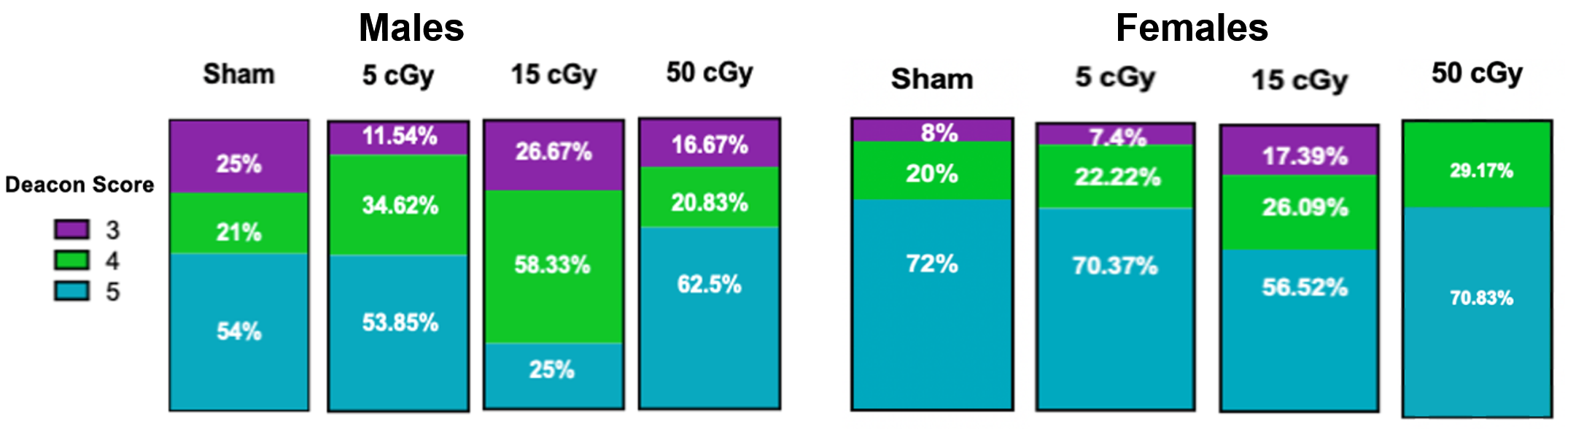
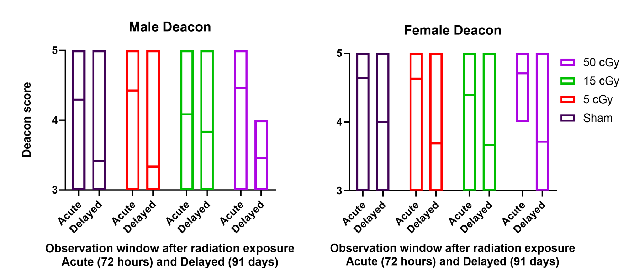
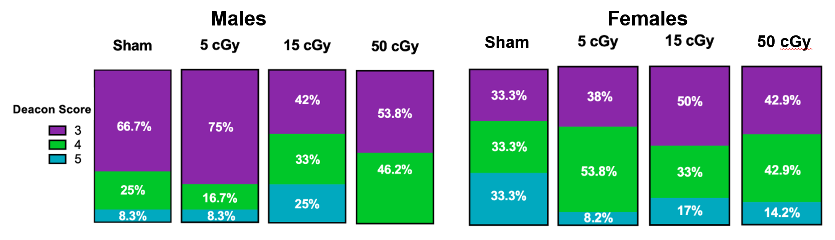
Changes in cognitive performance and behavior induced by space-like environment
O. Siu^{1,2}, S. Puukila^{3,7}, L. Rubinstein^{3,7}, C. G.T. Tahimic^{4,7}, M. Lowe^{5,7}, I. Korosteskij⁴, M. Semel⁴, J. Iyer^{6,7}, S. D. Mhatre^{6,7},
Y. Shirazi-Fard⁷, J. S. Alwood⁷, A. M. Paul^{2,5,7}, and A. E. Ronca⁷
¹Space Life Sciences Training Program, NASA Ames Research Center, Moffett Field, CA; ²Embry-Riddle Aeronautical University, Department of Human Factors and Behavioral Neurobiology, Daytona Beach, FL; ³Universities Space Research Association, Columbia MD; ⁴University of North Florida, Jacksonville FL; ⁵Blue Marble Space Institute of Sciences, Seattle WA; ⁶KBR, Houston, TX; ⁷NASA Ames Research Center, Space Biosciences Division, Moffett Field CA, 94035
Abstract
Results: Behavior Frequency and Duration
Exposure to space radiation is a principal consideration of spaceflight missions as risk is leveraged as time and dose—both expected to increase with future missions to the Moon, Mars, and beyond. Previous mission exposure levels, galactic cosmic radiation (GCR) and solar particle events (SPE), have been characterized as increased compared to those natural to Earth and are predicted to cause robust deficits at higher doses and longer durations. The cognitive health implications of this critical difference are understood as risks to mission and crew operations. We examined potential radiation-induced disruptions on brain health through resting-state in-cage behavior. 23–24-week-old male and female mice were exposed to 0 cGy (Sham), 5 cGy, 15 cGy, and 50 cGy via Five-Ion GCR Simulation (H, Si, He, O, Fe) at the NASA Space Radiation Lab in Brookhaven National Labs. Behavioral and cognitive performance were evaluated via frequency/duration of digging, rearing, and grooming within the 72-hour (acute) and 91-day (delayed) period following irradiation. Additionally, during this time we evaluated nestlet building using a 5-stage Deacon score, rating shredding and shelter assembly of cotton material from untouched (1) to shredded and formed into a crater shape (5). We have observed differences in behavior frequency and duration differences among the 15 cGy subset within the acute observation window. There were no significant differences in behavior frequencies nor duration during the delayed observation period. These experimental design aspects that allot for gender-inclusivity is supportive of the diversification of future space travel mission plans. Investigating gender differences is an element under our main objective of determining radiation dose-response curves. In brief, these studies identified a space-relevant radiation dose of 15 cGy that that can be utilized for future standardized ground studies on the nervous system.
Digging Frequency
Rearing Frequency
Grooming Frequency
Digging Frequency
Rearing Frequency
Grooming Frequency
Figure 1. Behavior frequencies observed 72-hour after exposure. Male and females separated into n≈26 per exposure group. Comparison of behavior frequencies across sexes and all exposure groups (Sham (0 cGy), 5 cGy, 15 cGy, 50 cGy). Error bars indicate mean with upper and lower SD.
Figure 2. Behavior frequencies observed 91 days after exposure. Male and females separated into n≈12 per exposure group. Comparison of behavior frequencies across sexes and all exposure groups (Sham (0 cGy), 5 cGy, 15 cGy, 50 cGy). Error bars indicate mean with upper and lower SD.
Digging Duration
Rearing Duration
Grooming Duration
Digging Duration
Rearing Duration
Grooming Duration
Background and Introduction
The space environment stressors relevant to behavioral health studies are microgravity, radiation, and social isolation. The immune and central nervous system dysfunction that may arise from exposures to these factors are known to be altered circadian rhythmicity, anxiety and degraded cognitive performance (Euston et al., 2012; Parihar et al., 2015, 2018; Raber et al., 2018). Recent studies have understood that, beyond exposure, how the human body responds on a molecular level can result in detrimental cascade effects (Mhatre et al., 2021). As an urgent research need, elucidating the stressor effects on the central nervous system and brain may result in adverse changes to astronaut behavior, mood, and performance of critical tasks. We will later discuss the range of responses and degree of adversity that spaceflight radiation exposure may cause. Brain and behavioral health studies like ours and the ones that precede it meet critical research needs to address neurological risks to both a crew a mission level (HRR Gaps BMed 101-108, SM-104). Comprehension of stressor physiology dynamics is urgently required for future missions and contingencies so that a critical condition or an observable change in cognition is not the earliest call to action.
Ionizing radiation is one of the challenging spaceflight stressors and serious research considerations as such exposure is not easily administered in terrestrial human studies. We use C57BL/6 mice as a model study organism, to which previous brain health studies have found that ionizing radiation alters neuronal morphology and dendritic density (Parihar et al., 2015). Without genetic protective modifications, wild type (WT) mice have a significantly reduced number of dendritic intersections (Parihar et al., 2015). This sign is indicative of less neuronal complexity—a result that is opposite to a developing brain. A complementing study shows an alternate view of the same phenomenon where dendritic spines of neurons decrease in both density and number (Parihar et al., 2015). Additionally, these radiation-induced synaptic changes were accompanied by behavioral deficits such as decreased cognitive flexibility, elevated anxiety, impaired spatial, episodic and recognition memory sometimes lasting up to 1-year post-irradiation (Euston et al., 2012; Parihar et al., 2015, 2018; Raber et al., 2018). Investigating the effects and composition of space radiation, Galactic Cosmic Radiation (GCR) and Solar Particle Events (SPE), multiple simulation studies like the ones referenced have posed the question of if the observed altered anatomy leads to altered behavior. Keeping the hypothesis in mind, that deficits in performance of immune, neural, and cognitive nature will be more robust at greater IR doses, we further predict that males will show more pronounced responses. Krukowski et al. reported behavioral deficits in males subjected to combined GCR; females were protected against these radiation-induced responses (Krukowski et al., 2018). This difference, observed by precedent studies, is expected to be captured by our methods.
Figure 3. Behavior durations (total report per mouse) observed 72 hours after exposure. Male and females separated into n≈26 per exposure group. Comparison of behavior durations across sexes and all exposure groups (Sham (0 cGy), 5 cGy, 15 cGy, 50 cGy). Error bars indicate mean with upper and lower SD.
Figure 4. Behavior durations (total report per mouse) observed 91 days after exposure. Male and females separated into n≈12 per exposure group. Comparison of behavior durations across sexes and all exposure groups (Sham (0 cGy), 5 cGy, 15 cGy, 50 cGy). Error bars indicate mean with upper and lower SD.
Results: Nestlet Building
(i)
(ii)
(iii)
Figure A. Images of nestlets rated by the following Deacon scores from left to right:
Score 3, Cotton material is mostly shredded but no identifiable nest site: less than 50% of the nestlet remains intact, but less than 90% is within a quarter of the cage floor area
Score 4, An identifiable but flat nest: more than 90% of the Nestlet is torn and the material is gathered into a nest within a quarter of the cage floor area
Score 5, More than 90% of the Nestlet is torn and the nest is a crater, with walls higher than mouse body height for more than 50% of its circumference.
Figure C. Nestlet builds scored 72 hours after exposure. Male and females are separated (n≈26). Deacon scores are measured across all exposure groups.
Methods
This project is the first stage in a multi-year study to investigate the multi-variate effect of spaceflight radiation on behavioral health. By determining any significant behavioral deficits, we plan to establish a dose-response curve. This will allow selection of a dose that evokes a mid-range response. A mid-range dose that is low enough to reflect spaceflight exposure, yet high enough to elicit a response. Specifically, we plan to determine the dose dependence of acute Five-Ion GCR for immune, brain and behavioral performance responses. We hypothesize that as IR dose increases, we will observe robust deficits in cognitive and behavioral performance.
My role on this project was primary involvement in the post-IR in-cage behavior studies. Behavioral footage recorded within the 72 hours (acute) and 91 days (delayed) after irradiation was observed for any cognitive changes and compared among different exposure groups for behavioral health. In this blind study, behavior categories of digging, rearing, and grooming are quantified by duration, frequency, and location. The only material available in the cage for the mice to interact with is cotton material for nestlet building. Nestlet development, a WT behavior and construction task that is reflective of cognitive health, is evaluated in stages as determined by the Deacon score (Deacon 2006). The lowest stage (scored as 1) is depicted by largely untouched cotton material and the highest (scored as 5) is depicted by shredded cotton material formed into a crater shape to serve as the mouse’s shelter (Deacon 2006). We organized our results to measure the frequencies of the activities separated by exposure groups. Using GraphPad Prism (version 9.2.0) software, we indicated the behavior frequency mean of each exposure group with upper and lower standard deviation (SD) error bars. The statistical test we used for one sex was a one-way ANOVA with Dunnett’s multiple comparison post hoc test. When comparing the male and female behavior frequencies, the statistical test we used to compare both sexes was two-way ANOVA.
Figure D. Nestlet builds scored 91 days after exposure. Male and females are separated (n≈12). Deacon scores are measured across all exposure groups.
Figure B. Male and female Deacon score averages compared by observation window, separated by exposure level
Conclusions
Future Directions
The summaries for phase 1 tests completed so far of the multi-year plan looking at radiation and behavior as follows: 1) Significant behavior frequency and duration differences were found among the female exposure groups during the acute observation period (72 hours after exposure). 2) No significant behavior frequency nor duration differences among exposure groups nor sexes were observed during the delayed observation period (91 days after exposure). 3) Females were observed to have a higher Deacon score average of nestlet construction both during the 72 hour and 91 day observation periods. The conclusions that we can draw from this study are that males show more pronounced responses to radiation exposure than females, specifically in the cognition skills needed to construct a fully developed nestlet shelter. More research is needed to further contextualize our findings of the delayed period male and female behavior frequencies and durations—of which we found no statistically significant differences among sex nor radiation exposure groups. .
This study focused on the 72-hour and 91-day windows immediately after an acute exposure of radiation, but we must study how biology adapts to the long-term presence of space radiation as missions to the Moon and Mars are planned. These biological adaptations occur on a molecular level before manifesting as a behavior and a prevalent factor in radiation-behavior health adversities is oxidative stress. Space radiation countermeasure studies are currently investigating oxidative stress mitigation on the hippocampus of animal models that are genetically engineered to express increased levels of antioxidants. Neuroimmunology studies and cognition studies like this one must be conducted synergistically because the effect of spaceflight radiation may be studied on both the molecular level and the behavior level
Supported by the NASA Human Research Program (HRP) Human Factors Behavioral Performance Element Grant 80JSC018N0001-FLAGSHIP and the NASA Space Life Sciences Training Program (SLSTP).
POC: (Olivia Siu, osiu@usc.edu))
NASA Space Biosciences SLSTP: https://www.nasa.gov/ames/research/space-life-sciences-training-program
NASA Space Biology Program: https://science.nasa.gov/biological-physical/programs/space-biology

