Slide 2
NASA’s Habitat Outfitting Portfolio
25 October 2022
Technology Development to Support Future Habitation Systems
Presenter: Tracie Prater, Ph.D.
Technical Management, Habitation Systems Development Office, NASA Marshall Space Flight Center
tracie.j.prater@nasa.gov
Paper co-authors: Tiffany Nickens (NASA MSFC), Johnathan Watts (NASA MSFC at time of writing), Jennifer Edmunson (NASA MSFC), Ian Hanson (NASA MSFC), Rachel Bardsley (NASA MSFC), Erin Lanigan (NASA MSFC), Danny Harris (NASA MSFC), Michael Fiske (NASA MSFC – Jacobs ESSCA), Michael Morris (Space Exploration Architecture – SEArch+)
.
Notes:
I’m Tracie Prater…I am in the habitation systems development office at NASA Marshall…today we will be talking about challenges for outfitting of exploration habitats and current activities in the research portfolio

Slide 3

“If we’re going to get to Mars, we’re going to have to clear the maps.”
-Robert Zubrin
Notes:
Exploration habitatation may require new approaches to structural materials and thus new approaches to outfitting that go beyond our previous activities on ISS

Slide 4
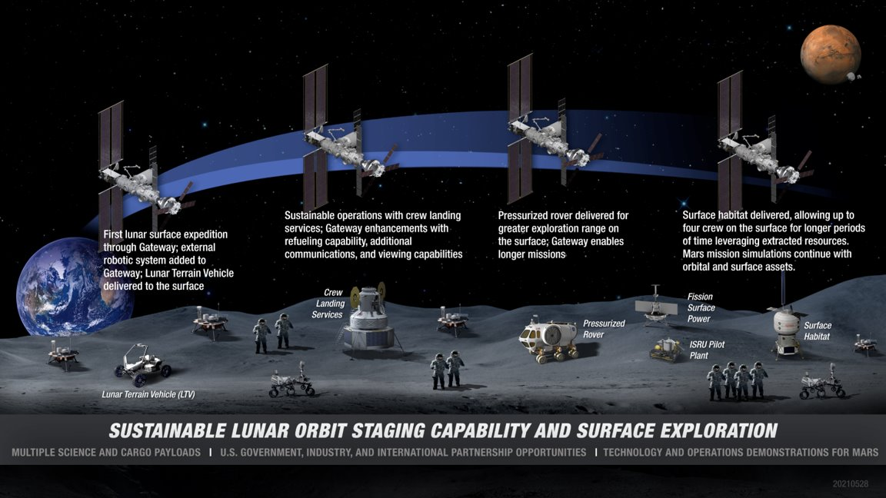
Returning to the Moon Sustainably: NASA’s Artemis Program
Notes:
Longer term Artemis missions will include the Lunar surface habitat, a pressurized rover, and stays at Gateway. Significant outfitting needs are anticipated to support lunar surface operations.

Slide 5
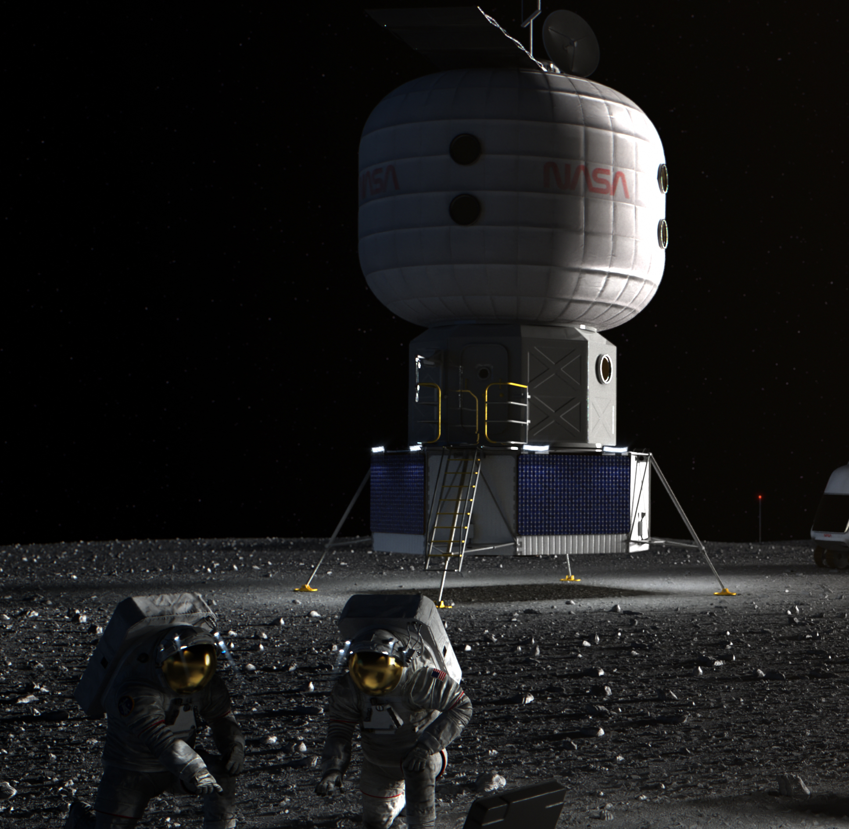
Lunar Surface Habitat
Objective:
A primary asset to achieve a sustained lunar presence and serve as a platform for Mars mission preparations
NASA is working with industry through NextSTEP Habitat (Broad Agency Announcement) to develop conceptual designs for a lunar surface habitat
Capabilities:
Supports 2-4 crew: accommodations for medical, exercise, galley, crew quarters, stowage
30-60 day capable habitat
EVA capable via metallic airlock with suit maintenance capability
Power generation and recharge capability for surface assets
Communications hub for surface assets
Current ground rules and assumptions for lunar surface habitat documented in NASA TM-20220000524
Notes:
Lunar surface habitat…. support crew initially for 30 days (with evolvability to 60 days) and be deployed in the more challenging polar environmen
Under current assumptions, the surface habitat will provide accommodations for nominally 2 crew and 4 crew for short durations, such as during crew swap-outs between SH and a pressurized rover
Primary habitable portion of this in the current reference concept is an inflatable softgoods material system

Slide 6
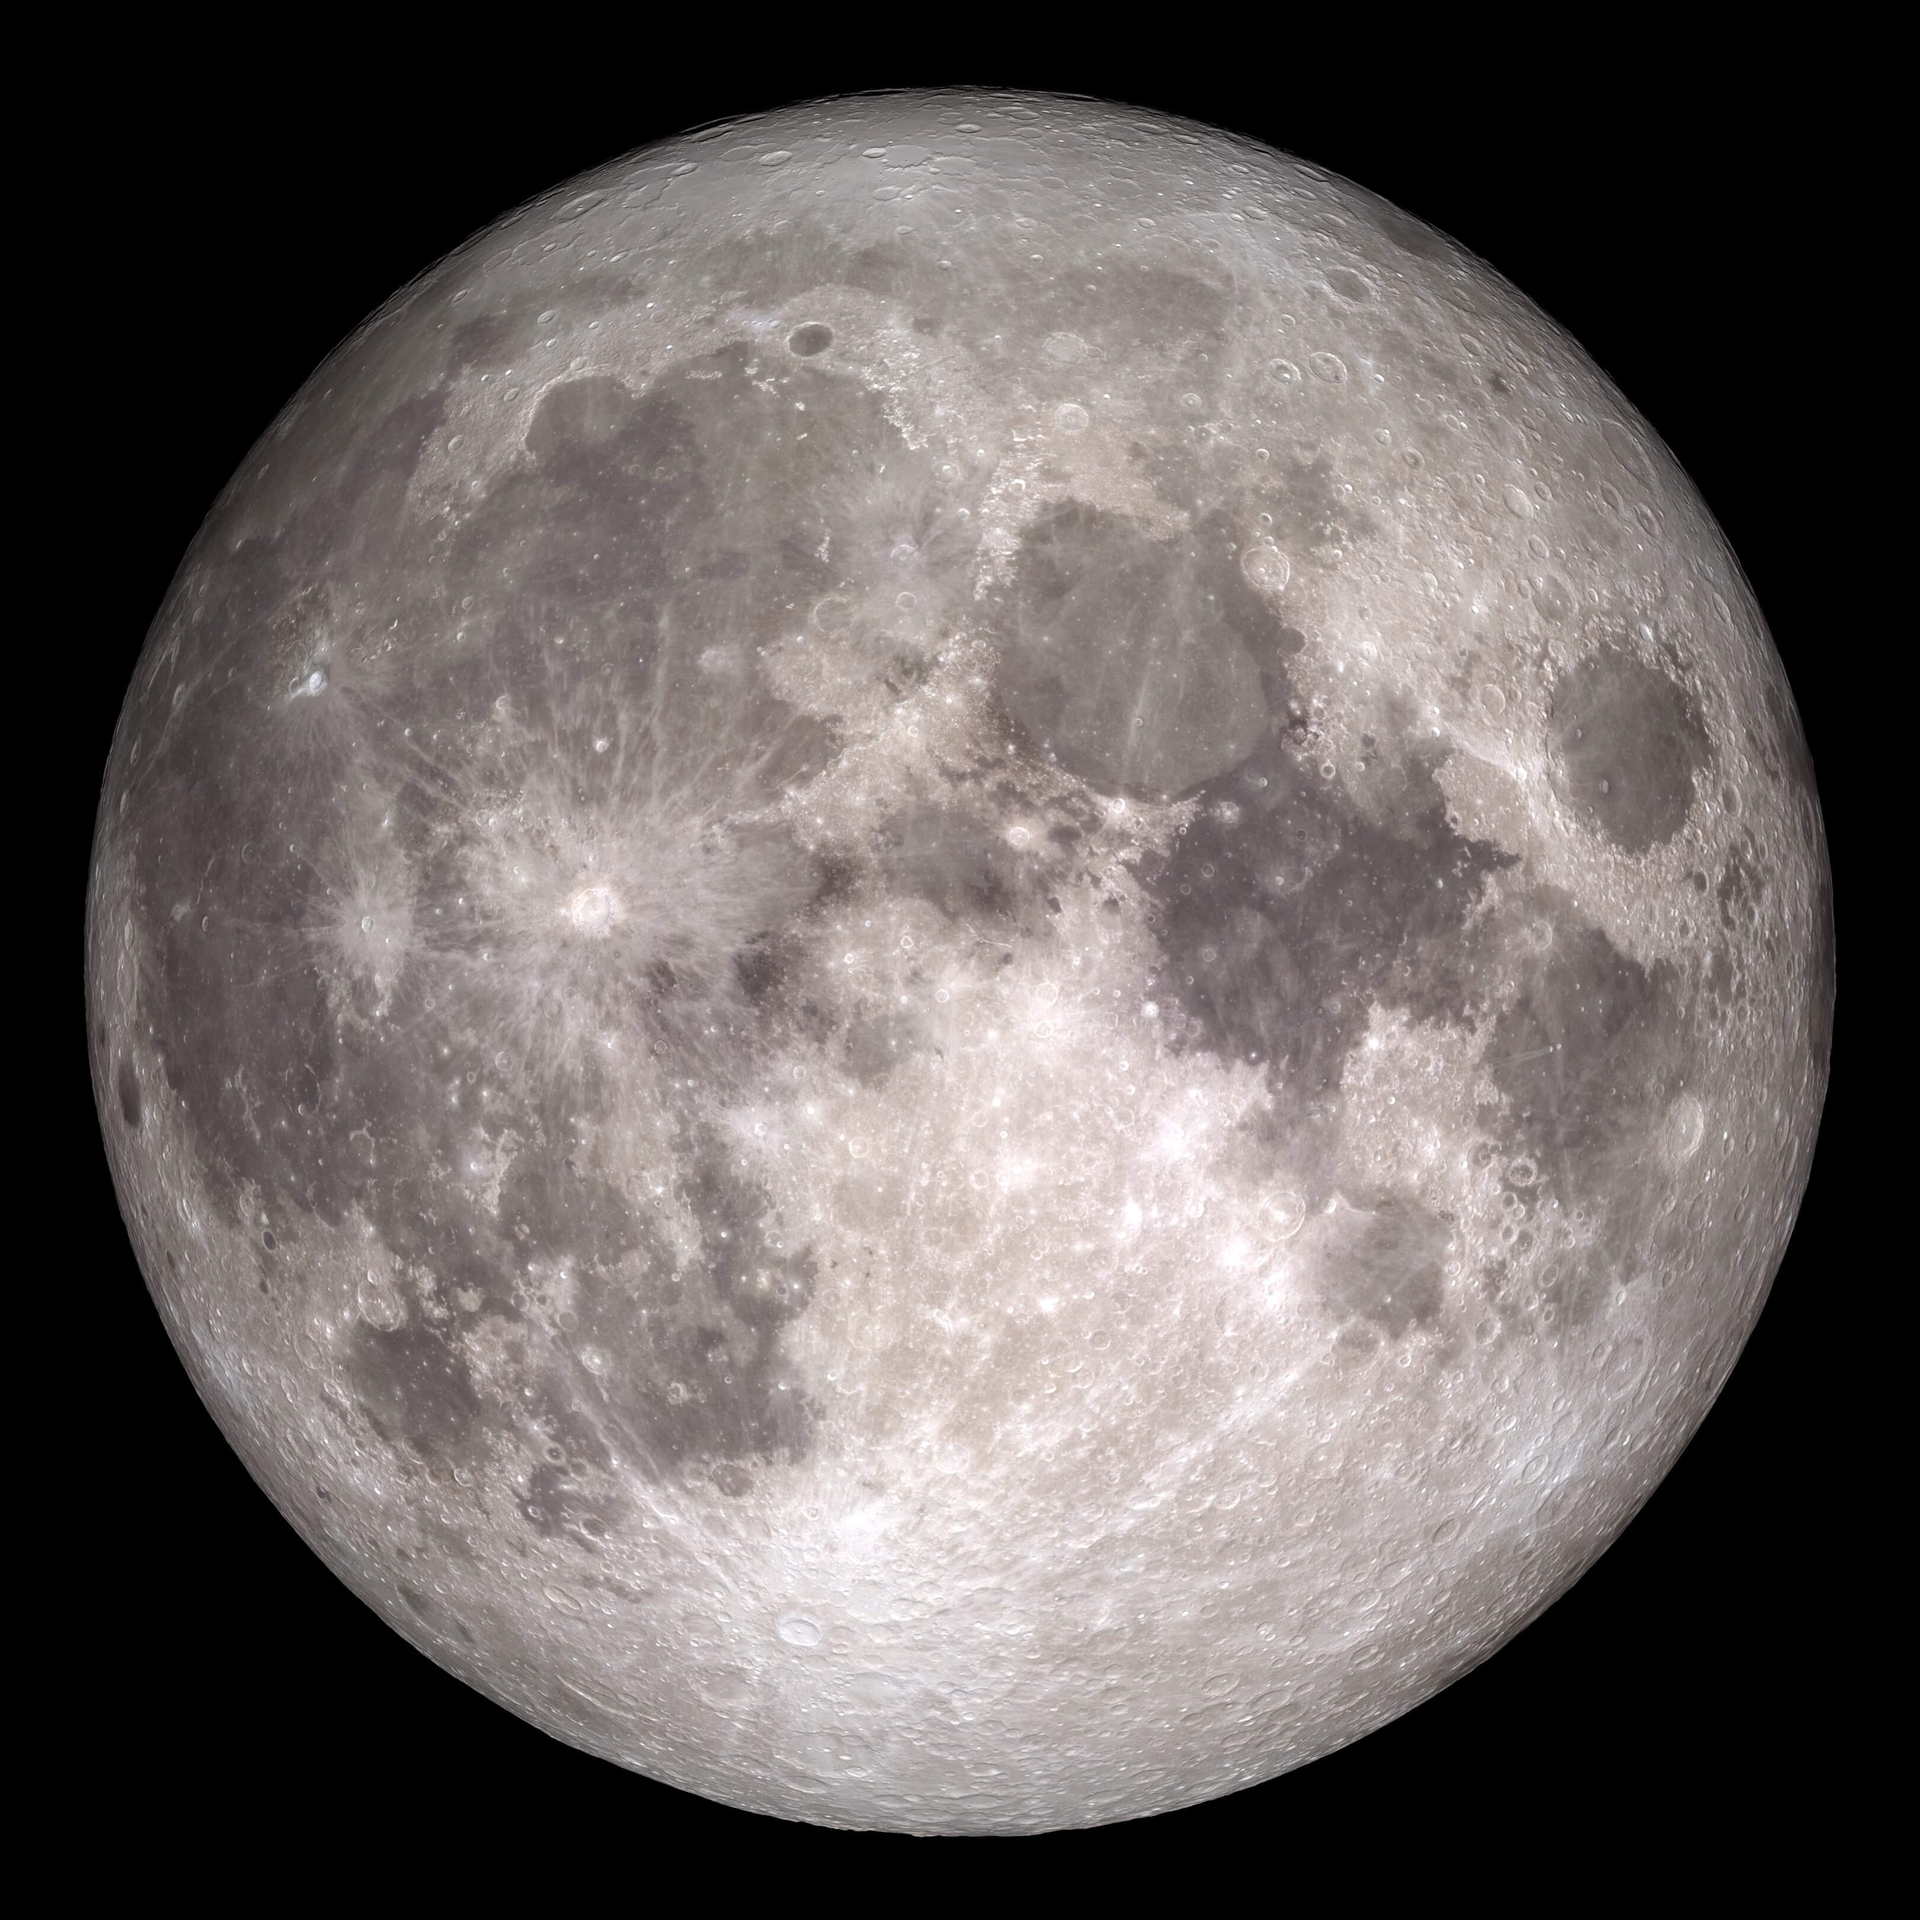
Lunar surface habitat challenges
Delivery mass
Functional volumes
Outfitting
Dust contamination
Dormancy
Survive the night/thermal power
  power conservation
  energy storage solutions with improved energy density
Logistics transfer and loading
Capability to maintain and repair systems
Notes:
There are many challenges to long duration stays on the lunar surface, in particular at regions outside of the equatorial….outfitting the habitat is one of these (outfitting transforms a structure into a usable system)

Slide 7
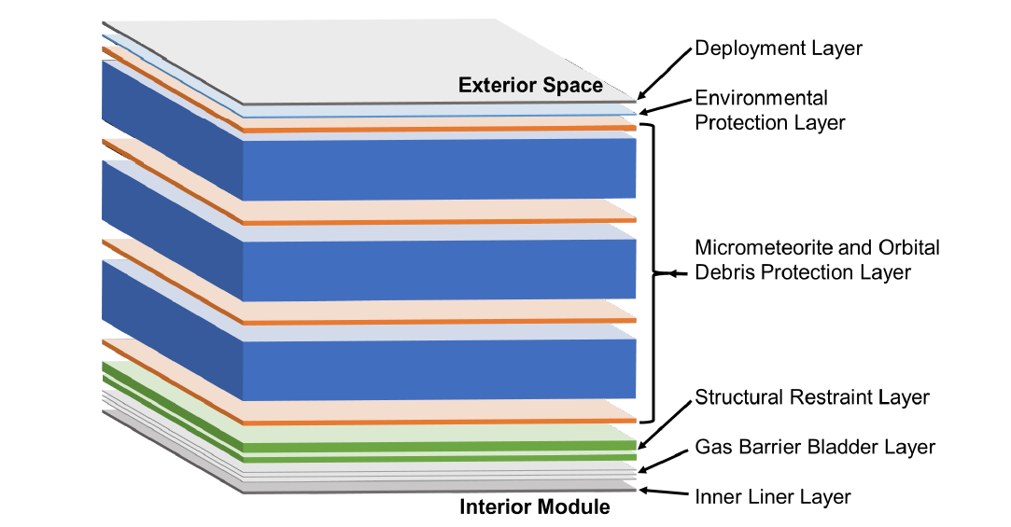
A Different Approach To Habitation: Inflatable Softgoods
In the current lunar surface habitat conceptual design, materials for primary habitable structure are inflatable softgoods.
A typical inflatable layup is shown to the right. There may be additional layers which are architecture specific.
The habitat is stowed for launch and inflated/deployed at the point of use.
Notes:
Mentioned inflatable softgoods material system… multi-layer system is stowed for launch and inflated at point of use…multiple layers that provide environmental protection, strength, and contain the habitat’s atmosphere…advantage is being able to have a potentially much larger volume for the same launch mass as a metal structure…outfitting of inflatable softgoods structures introduces new challenges

Slide 8
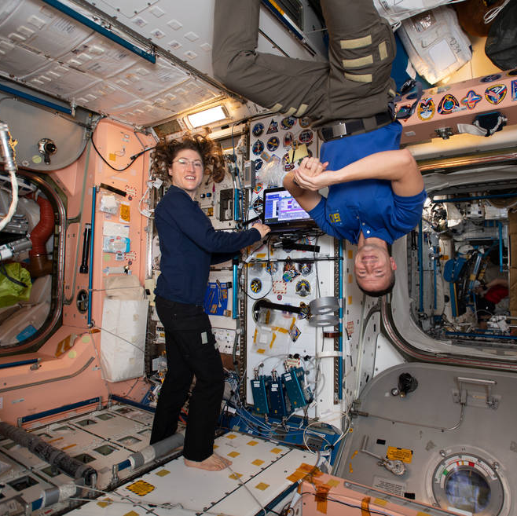
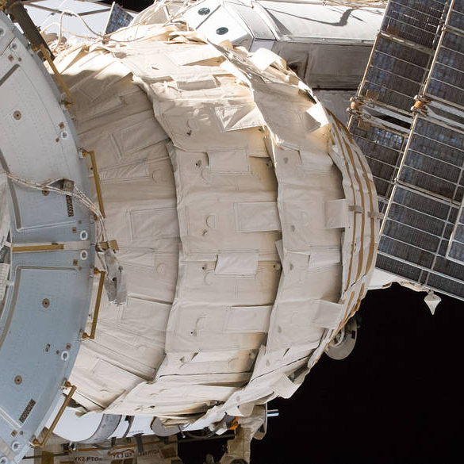
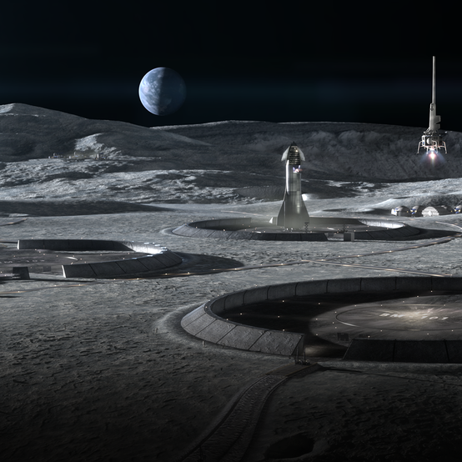
Types of Space Habitats
A class I habitat is a (largely) pre-integrated habitat. A rigid, pressurized metallic structure is an example of a class I habitat (ex. International Space Station).
A class II habitat is a pre-fabricated structure, but is deployed at the point of use. An example is a habitat of inflatable softgoods. BEAM (Bigelow Expandable Activity Module) is pictured.*
A class III habitat is built in situ, potentially using local resources. An example is a 3D printed habitat on the lunar surface. Image from ICON and SEArch+.
*BEAM is a technology demonstration and not a primary habitable structure.
Notes:
3 types of space habitats (class I largely pre-integrated, like ISS); class II would be the inflatable softgoods system or more generally any habitat whose structure is pre-fabricated but assembled in situ; class III is a constructed habitat, usually built using in situ resources…for outfitting, could have elements from earth integrated after arrival or these elements could be built onsite. Taxonomy comes from Kriss Kennedy, space architect at JSC, and Mark Cohen at NASA Ames

Slide 9

What is outfitting?
Habitat outfitting transforms a structure into a usable system.
Outfitting for class I habitats is rooted in ISS experience.
Class II habitats (inflatables) are mass and volume constrained. A majority of subsystems and logistics may need to be delivered separately.
Class III habitats (constructed habitats) require the most outfitting to convert the fabricated structure into a safe, livable environment.
Image from ICON/BIG
Notes:
Outfitting refers to the supplies and equipment (and installation thereof) which provide crew with a livable, safe environment during a mission.
All space habitats require some degree of outfitting.

Slide 10
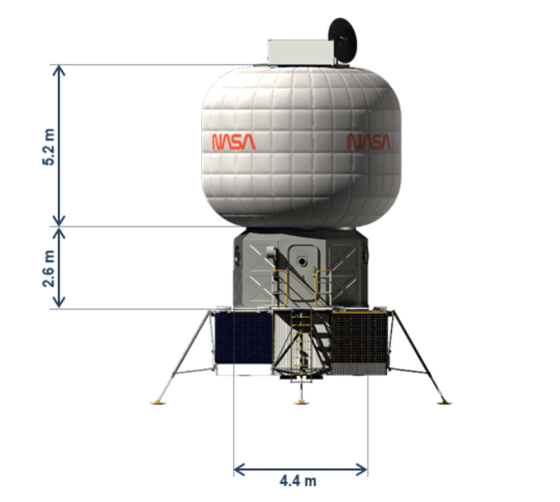
Class II Habitat Outfitting Needs
External outfitting
  -self-leveling
  -deployment of platforms, ladders
  -deployment of external systems (solar arrays,
  radiators, radio frequency antennas)
  -establishment of access pathways for ingress and
  egress
  -waste disposal
b) Internal outfitting
-deployment of flooring, secondary structures, crew
systems
Notes:
Needs we envision for class II habitat outfitting…outfitting is both external and internal….scoped external to also include waste management/disposal and some site preparation

Slide 11
Class II Habitat Outfitting Needs
External Outfitting | Internal Outfitting | Maintenance and repair
Self-leveling | Deployment of flooring | Spares storage and management
Deployment of platforms and ladders | Deployment of secondary structures and crew systems (wall partitions, crew quarters, hygiene stations, waste management, etc.) | Systems to support repair and maintenance
Deployment of external systems (solar arrays, radiators, and radio frequency antennas) | Installation and/or relocation of other support systems (ex. life support systems, racks, utilization and science facilities)
Establishment of access pathways for ingress and egress | Attachment of items to interior structure
Waste disposal pathways and storage | Cabling, lighting, plumbing, and ductwork installation
 | Logistics transfer
* relocation of systems required if they are stored in metallic core for launch and initial location is different from operational location
Notes:
Chart shows the breakdown of what we generated as class II needs in more detail; class II needs also include relocation of any support systems stored in a core structure, to where they will be used in the habitat….deployment of flooring and crew systems; another facet of outfitting in the third column maintenance and repair – includes systems to support maintenance and repair and spares storage and management;

Slide 12
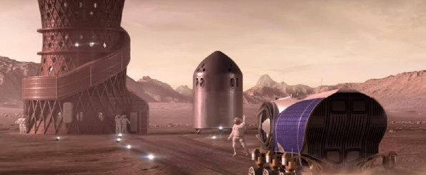
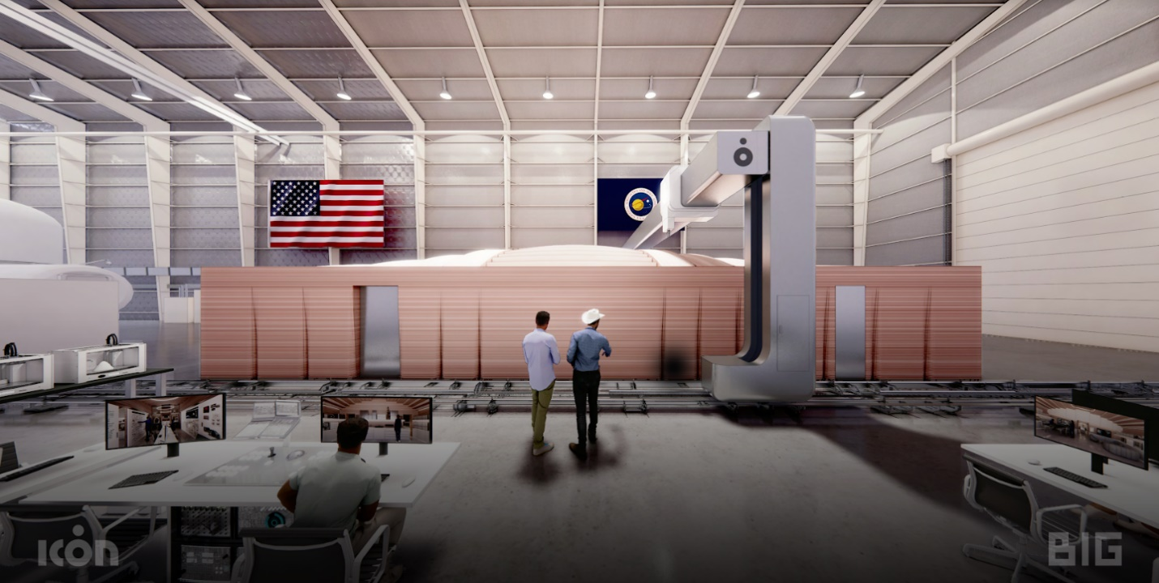
Class III Habitat Outfitting Needs
Example of a class III (constructed) habitat. Image from SEArch+/Apis Cor. Winner of design competition for NASA’s 3D Printed Habitat Challenge, Phase 3.
Example of a constructed habitat: Crew Health and Performance Exploration Analog (CHAPEA) at Johnson Space Center. Image from ICON and BIG.
In situ installation of all subsystems: mechanical, electrical, and plumbing; interior furnishings (workbenches, tables, chairs, etc.); power, lighting, communications; crew/life support/science utilization systems
Known high-priority technology gaps: installation of cabling, conductors and piping/tubing; penetrations*
*penetrations are also a technology gap for inflatable softgoods
Notes:
Class III habitats require the most extensive outfitting because they are really just a structural system to begin with… install all subsystems at point of use, either by manufacturing them there, or launching from earth. On the left -- example of a class III habitat from the architectural design competition in NASA’s Centennial Challenges 3D printed habitat competition –on the right a constructed habitat from ICON that will be used to conduct Mars simulations at Johnson Space Center
Known high priority tech gaps from our perspective on the habitation side: installation of cabling/line management, conductors and piping/tubing, penetrations (also a gap for inflatable softgoods)

Slide 13
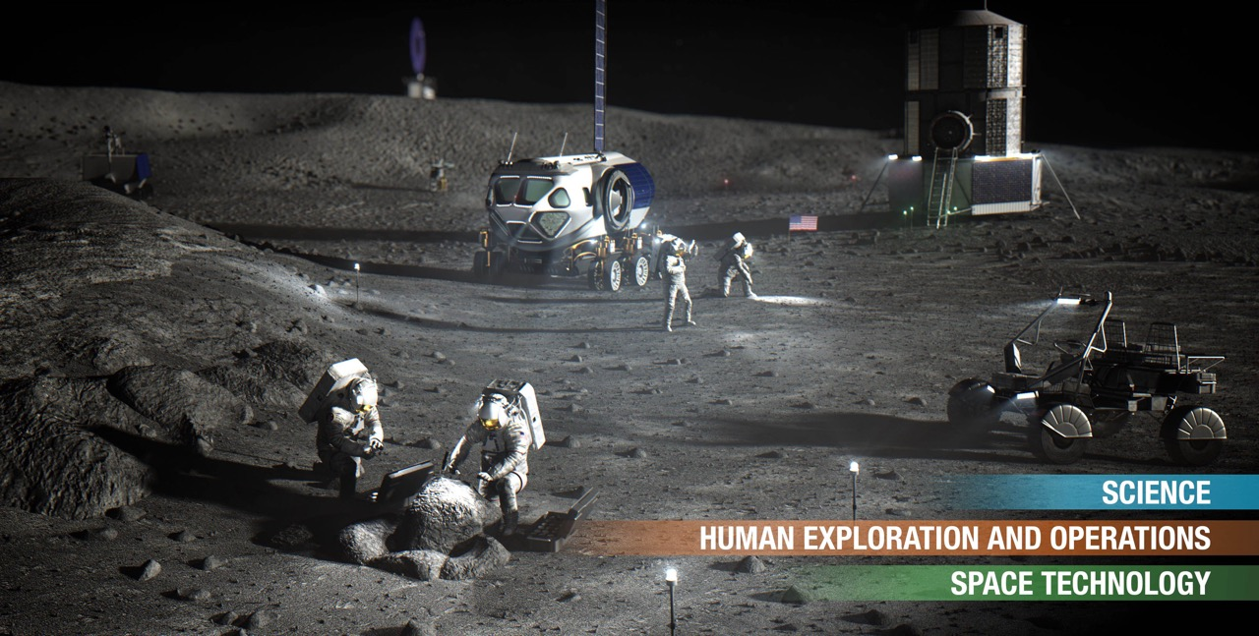
Research questions for outfitting of future habitats
What is the task division for outfitting between crew and robotic systems?
How much crew time is required for outfitting in class II and class III habitats?
What are the differences (and human factors impacts) of outfitting in
partial-gravity environments vs. microgravity?
How do we inspect/monitor class II and III habitats?
What do we bring vs. manufacture on-demand?
How do we optimize manufacturing for exploration environments?
Notes:
With outfitting for future habitats,a number of research questions which guide activities in this portfolio – what is done by crew vs. robotic systems, how much crew time is required, human factors considerations in partial g, inspection of class II and III habitats, how we use in-space manufacturing to assist with outfitting

Slide 14

NASA’s XHab Academic Innovation Challenge (2021-2022)
NASA’s XHab Academic Challenge is designed to develop strategic partnerships and collaborations with universities.
The competition emphasizes design, development, testing, manufacturing, and systems engineering in support of space habitats.
“Make It or Take It: Outfitting an Inflatable Habitat” was a 2022-2023 XHab project which explored approaches to habitat outfitting. Teams considered approaches which rely on delivery and movement of pre-fabricated habitat elements/supplies versus manufacturing these elements/supplies on-demand.
Notes:
XHab is a university program that we have been using to augment our in-house development efforts through university partnerships

Slide 15
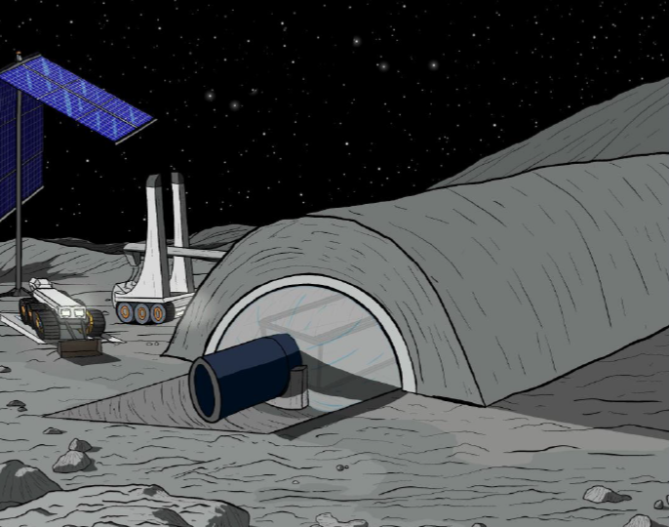
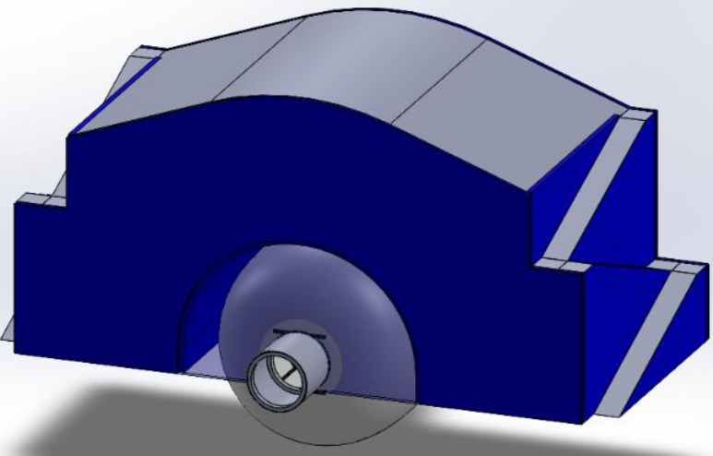
Colorado School of Mines XHab (2021-2022)
Colorado School of Mines developed the Planetary Resource and In Situ Material Habitat Outfitting for Space Exploration (PRISM-HOUSE):
PRISM-HOUSE is an additively manufactured shell structure for environmental protection of an inflatable habitat which can be backfilled with regolith
traded and prototyped components and interior goods using different manufacturing technologies
testing of remote/automated outfitting using robotics
commercial partners: ICON, Branch Technology, Lunar Outpost, Outward Technologies, and Collins Aerospace
Loose regolith
Printed Shell
PRISM-HOUSE concept. Image from Colorado School of Mines.
Inflatable habitat
Notes:
Colorado School of Mines developed PRISM House, which is an additively manufactured shell structure that overhangs an inflatable and is backfilled with regolith to provide additional radiation protection; also looked at interior goods and manufacturing, and automated outfitting/installation of systems with robotics

Slide 16
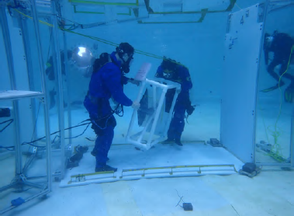
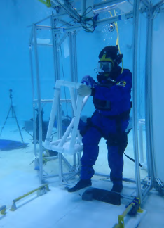
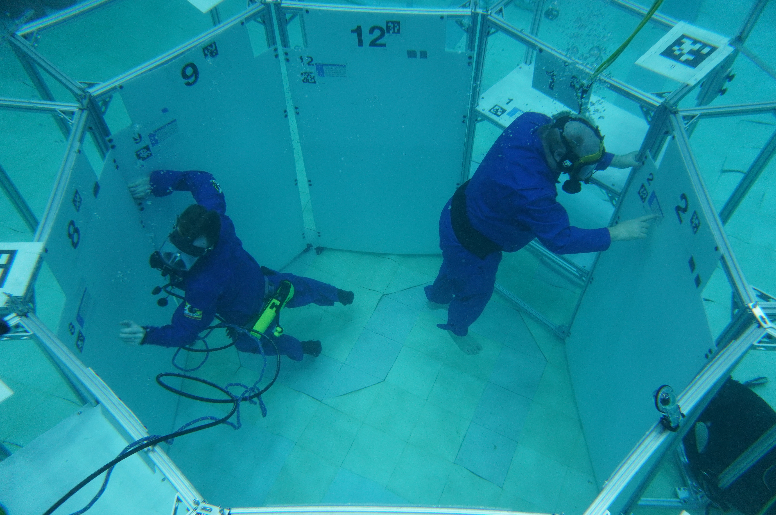
University of Maryland XHab (2021-2022)
“Approaches to Outfitting an Inflatable Habitat”
Generated inflatable habitat designs and layouts starting with NASA’s TransHab concept as a baseline
Developed a three story, novel octagonal core structure with deployable floor panels supported by truss segments
Neutral Buoyancy Research Facility (NBRF) testing evaluated floor deployment
NBRF human factors assessments of moving and installing/securing equipment in simulated habitat space
  divers and hardware weighted to perform tasks at simulated lunar and Mars gravities as well as microgravity conditions
Neutral buoyancy testing from University of Maryland
Notes:
University of Maryland…did extensive human factors testing in their neutral buoyancy facility with divers weighted to simulate Mars and lunar gravity… moving and installing equipment

Slide 17
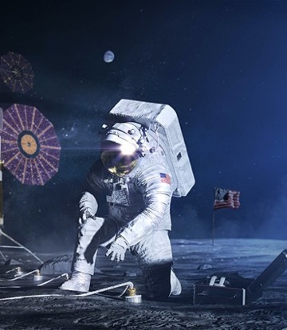
Academic Challenges on Habitation (2022-2023)
2022-2023 XHab project “Moon Supply: Logistics on the Lunar Surface”
Approaches to enable movement and storage of logistics
-within a habitat: ladders, stairs, and elevators
-on a surface: concept of operations for moving logistics between surface assets
2022-2023 RASC-AL (Revolutionary Aerospace Systems Concepts – Academic Linkage) competition themes for:
-Lunar surface transporter vehicle
capability to offload larger elements and logistics
-Homesteading Mars
development of a mission architecture to support seven years of a
crewed presence on the lunar surface, including surface habitation
and operations
Notes:
There is also a new XHab project with University of Maryland this year on how we move logistics within the habitat or on the lunar surface
RASC-AL is another university competition that has competition themes this year on lunar surface transport of logistics and also developing Mars surface habitation concepts

Slide 18
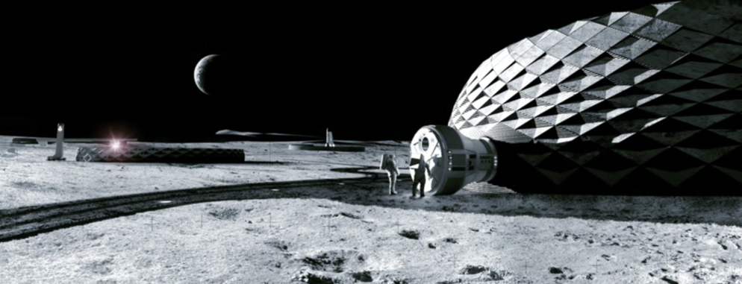
Moon to Mars Planetary Autonomous Construction Project (MMPACT)
MMPACT will demonstrate the use of in situ resource utilization (ISRU)-derived materials, such as lunar regolith, to 3D print large structures on the lunar surface
Technology development and a series of lunar surface demonstrations will eventually enable on-demand capabilities for construction of landing pads, shelters, roadways, blast shields, and habitats (vertical construction)
Led by NASA Marshall, project highly collaborative with participation from other NASA centers, industry partners, and academic institutions
Image from ICON and Bjarke Ingels Group
Notes:
MMPACT project at MSFC is for constructed habitation, which is class III habitats. Technology development on manufacturing for construction using in situ resources and then a plan for a series of demonstrations on the lunar surface to evolve to on-demand capabilities for landing pads, roadways, and eventually habitats

Slide 19
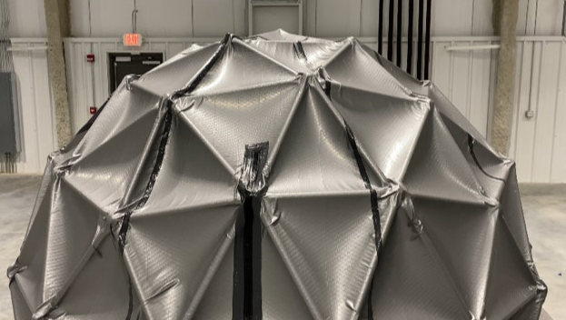
MMPACT and Habitat Outfitting
ICON
-prime contractor for MMPACT
-printed Crew Health and Exploration Analog habitat at NASA Johnson Space Center
Branch Technology
-assessing potential of Cellular Fabrication (C-Fab) technology to support on demand fabrication of outfitting elements
-Foster + Partners designing outfitting elements and developing element taxonomy
-Stanford University developing biopolymer bound soil composite as potential material to support outfitting and surface construction
Drake State Community and Technical College
-manufacturing to support outfitting
Kappler, Inc.
-structure/enclosure for 3D printing on the lunar surface
SEArch+
-specializes in design of habitats and habitat elements
-structural component integration (ex. windows and
airlocks), “light-weighting” engineering/design methods
Enclosure for 3D printing on a planetary surface. Image from Kappler, Inc.
Notes:
MMPACT has a lot of partners – this is just a sampling of those who work specifically on outfitting…ICON on construction with in situ resources, Branch Technology looking at on-demand fabrication of outfitting elements; Foster+Partners is doing design of outfitting elements; Stanford looking at biopolymer bound soil composites as a material option to support outfitting and surface construction; Drake State – manufacturing program for students where they are looking at on-demand manufacturing for outfitting and also training students in those technology areas; Kappler Inc. – structure to enclose a 3D printer on the lunar surface and allow manufacturing at low pressures, which is challenging; Space Exploration Architecture (SEArch+) has focused on design of habitats and habitat elements

Slide 20
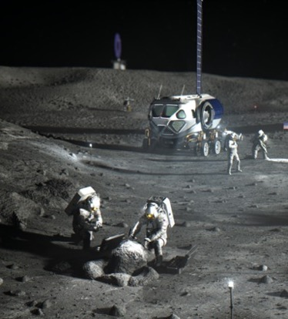
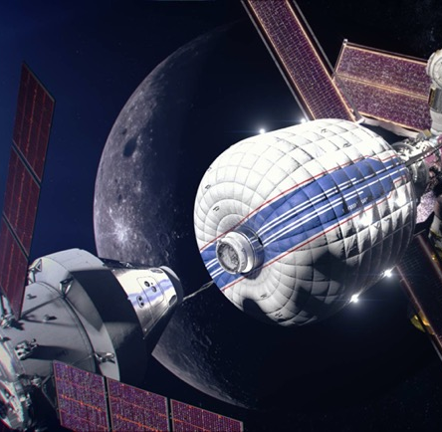
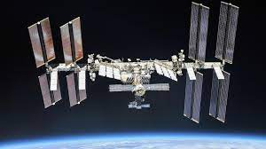
In-Space Manufacturing (ISM) and Habitat Outfitting
ISM project at MSFC examines a wide variety of technologies to enable greater supportability and reduce logistics on space missions
-3D printing of polymers, metals, and electronics
-recycling and reuse
Manufacturing of smaller components is also part of the outfitting ecosystem
Notes:
In-space manufacturing is part of this outfitting ecosystem for on-demand part production to reduce logistics; test and deploy ISM on various platforms to prove out systems and eventually mature them to support outfitting

Slide 21
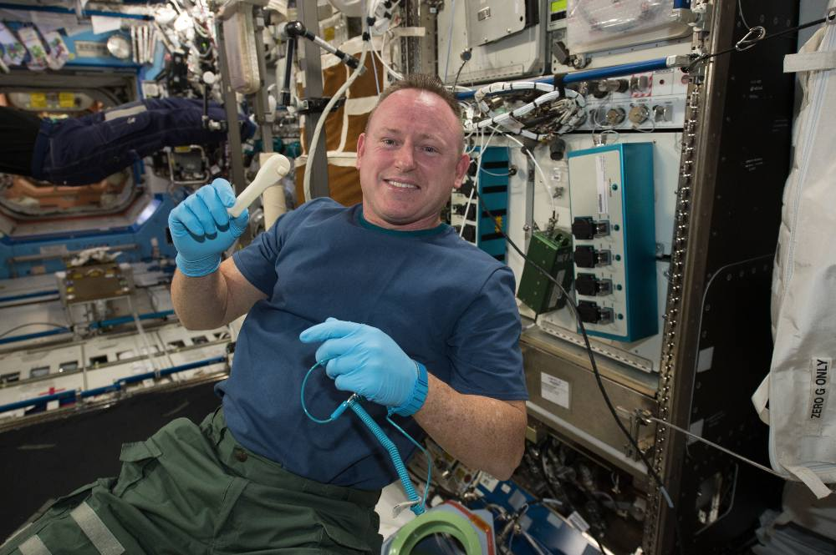
In-space Manufacturing and Analog Missions: A Potential Testbed for Outfitting
ISM in analog mission platforms presents many possibilities for exploring ISM in outfitting:
replacement of parts and components that break or go missing
support of operations
  crew tools, including development of new/custom approaches to solving problems (historical example in NASA’s underwater habitat NEEMO)
possibility for inspection of components using structured light scanning
  understanding of fidelity of scans and crew time/skill sets required
potential positive impacts on crew psychology (in-space “makerspace”, self-reliance)
Notes:
We can in particular use analog missions to explore uses of ISM in outfitting…how ISM could be used to support operations, replace things that break, any potential positive impacts of having manufacturing systems on crew psychology
analog missions can be ground-based or space-based…for example, Comercial low earth orbit platform could be used to simulate exploration calss missions or Mars Transit Habitat docked at Gateway could perform shakedown missions there
Analogs in any location/platform can provide good information on real uses of ISM and associated technologies in a simulated mission scenario

Slide 22
Moon to Mars
Lunar surface habitation development and understanding of outfitting approaches also enables Mars mission elements, including the Mars Transit Habitat.
Shakedown missions and some outfitting at lunar Gateway
Inflatable softgoods habitable structure
Able to support crew of 4 on 1,200 day mission
Can leverage outfitting capabilities developed for lunar surface
Notes:
Ultimately we need to understand outfitting – operations, supporting technologies, and human factors – for an eventual Mars mission….Mars transit habitat will require new approaches to outfitting and so we are trying to really build a portfolio of activities that will position us to bee able to support this…synergy between outfitting between class III habitats and class II habitats that we can utilize to advance the state of the art for both applications

Slide 23
Acknowledgments
Dr. Frank Ledbetter, Dr. Jim Stott - NASA Marshall Space Flight Center
Dr. Dave Akin – University of Maryland
David Goodloe, Platt Boyd – Branch Technology
Devon O’Rouke, Peter Corwin, Michael Forlife, Thao Nguyen, Dr. Christopher Dreyer, Dr. George Sowers – Colorado School of Mines
ICON –Evan Jensen
Orla Punch, Savador Navarro Perez – Foster and Partners
Dr. Mike Lepech - Stanford
Notes:
Acknowledgement of those who had work featured or talked about in this presentation or contributed to the accompanying paper

