Slide 1
Modeling and Simulation for
Space Missions at NASA
2022 SISO SIMposium
September 14, 2022
Presented by Michael Madden
Chief Engineer for Modeling and Simulation
NASA Langley Research Center
Content on Artemis Program created by Edwin “Zack” Crues, Johnson Space Center

Slide 2
Outline
How NASA Uses Modeling and Simulation
ModSim and Apollo
ModSim and Mars
The Artemis Program
  Overview and Program Elements
  Integrated Simulation of Artemis Base Camp
  Key Enablers: HLA and SpaceFOM
Summary

Slide 3
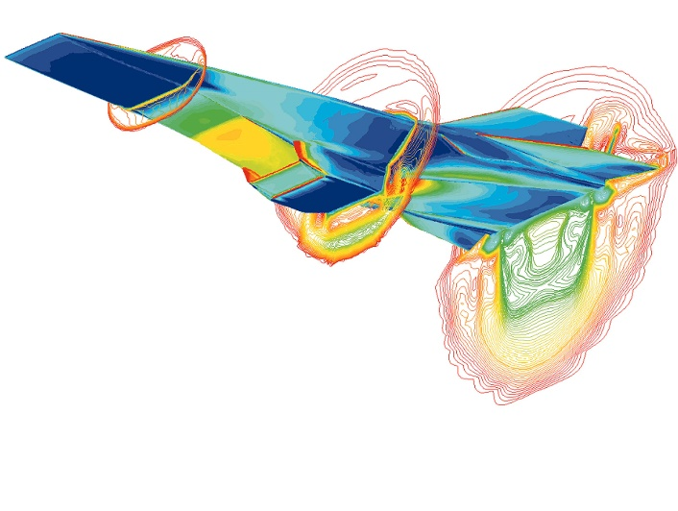
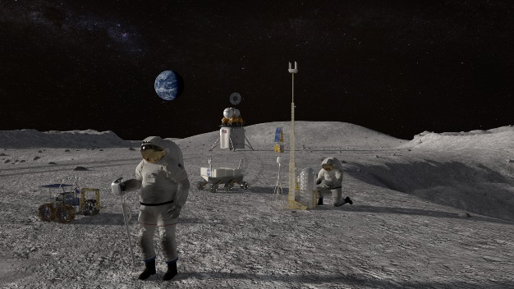
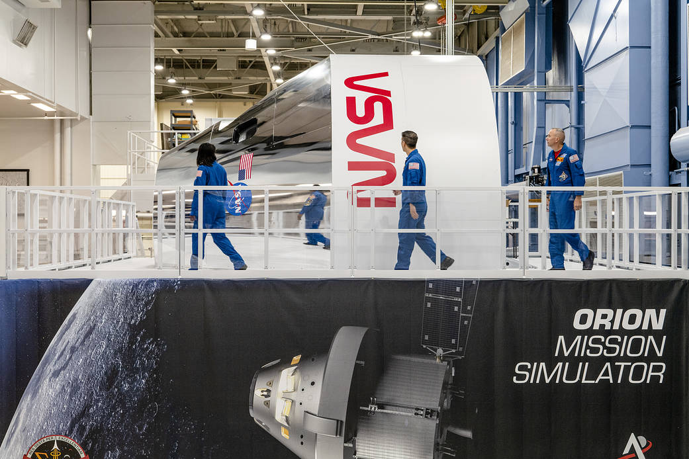
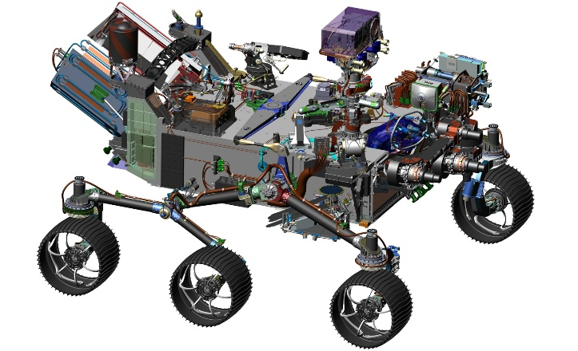
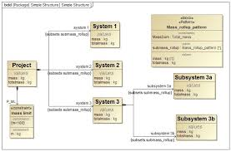
How NASA Uses Modeling and Simulation
Physics-based simulation
Capability driven
Research and Development
Mission/Systems Analysis
Operations
and Training
Fusion of high-fidelity models with real systems
live-virtual-constructive (LVC)
Digital Twins
System-scale simulations
Mixture of parametric, algebraic, and reduced
order physics models
Monte-Carlo capable
Logical modeling of system
  Requirements
  Architecture
  Performance Measures
  Verification & Validation
Fusion of empirical, data-driven, and physics models
Capacity driven
Multi-discipline
Model-Based Systems Engineering (MBSE)
Engineering of Systems
Notes:
Each use category includes a description of the type of ModSim that tends to dominate that use. However, the lines are dashed because ModSim types are not exclusive to a use category. Flight simulators, for example, are often used in Research & Development and Engineering of Systems (e.g., engineering simulator).

Slide 4
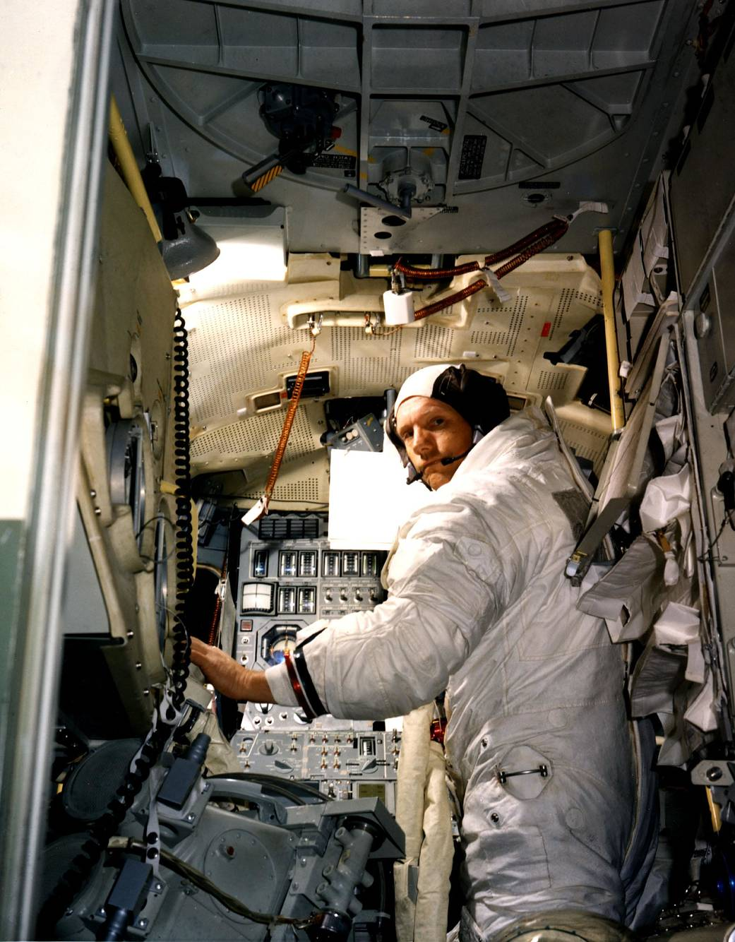
ModSim and Apollo
NASA built simulators to train every aspect of the Apollo mission
  Mission training is essential to reduce failures due to crew mistakes and prepare the crew to respond quickly to any contingency
As one of his duties, Neil Armstrong worked with engineers on both Gemini and Apollo to improve simulator fidelity
“…in the late ‘60s our computer simulations were really quite excellent. They were quite adequate to do most all the things that we were doing.”
– Neil Armstrong
Neil Armstrong in the Lunar Module Simulator
Notes:
Modeling and simulation are critical technologies for accomplishing missions. The Apollo mission and NASA’s Mars missions are among its greatest accomplishments. They would not have succeeded without modeling and simulation.

Slide 5
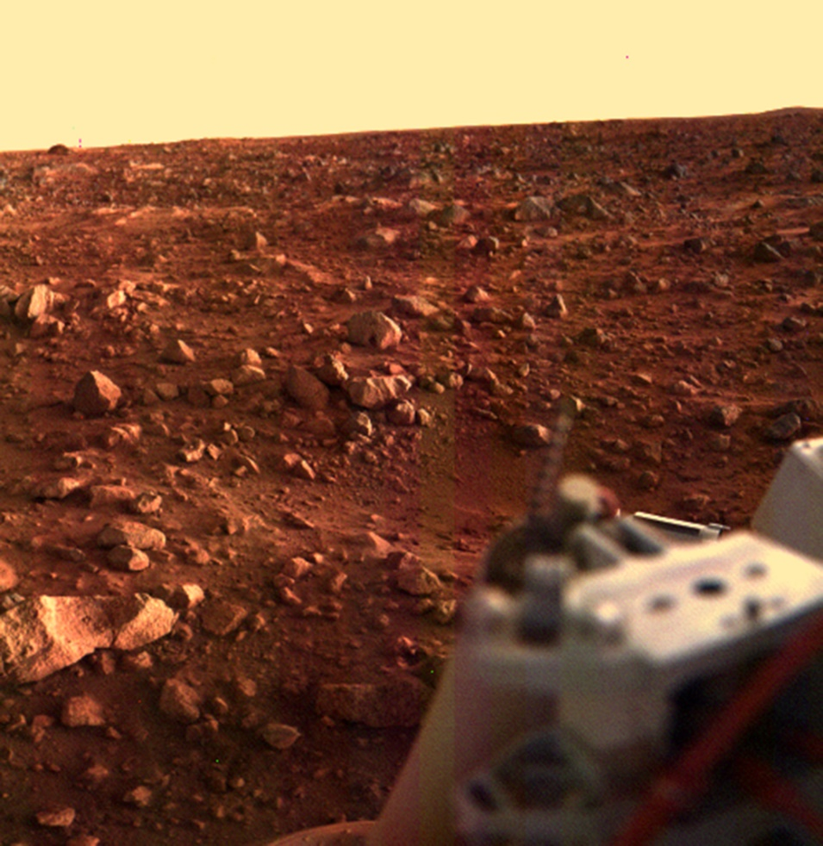
ModSim and Mars (1/2)
July 20, 1976 – America became the first nation to successfully land on Mars with Viking 1
No other nation would succeed for 45 years.
  China became the second nation to land on Mars on May 14, 2021 with the Tianwen-1 spacecraft.
Most missions fail during entry, descent, and landing (EDL)
Engineers refer to Mars EDL as the “seven minutes of terror”
  Because communication time from Mars is five or more minutes, any data sent during EDL won’t be received until the spacecraft has already landed.
End-to-end testing of EDL can’t be done on Earth due to differences in atmosphere and gravity so NASA must simulate the end-to-end test.
Viking 1 image of Martian sunset

Slide 6
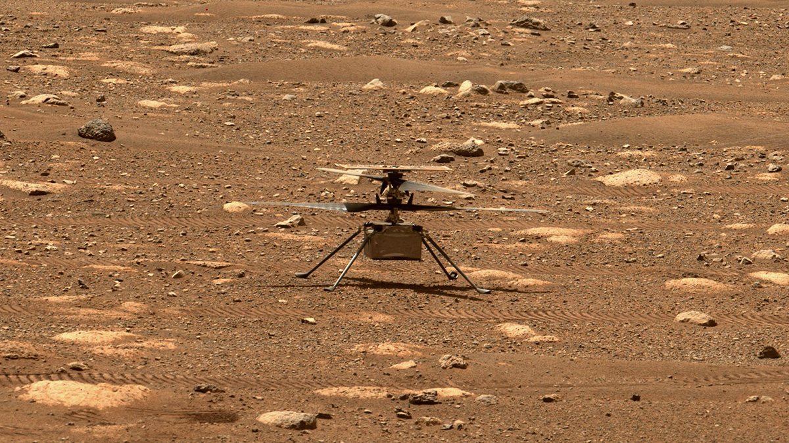
ModSim and Mars (2/2)
Ingenuity helicopter on Mars surface. Image taken by the Perseverance rover.
April 19, 2021, NASA’s Ingenuity helicopter performs the first flight on another planet, Mars.
NASA relied on modeling and simulation to design the rotors and the flight control algorithms.

Slide 7
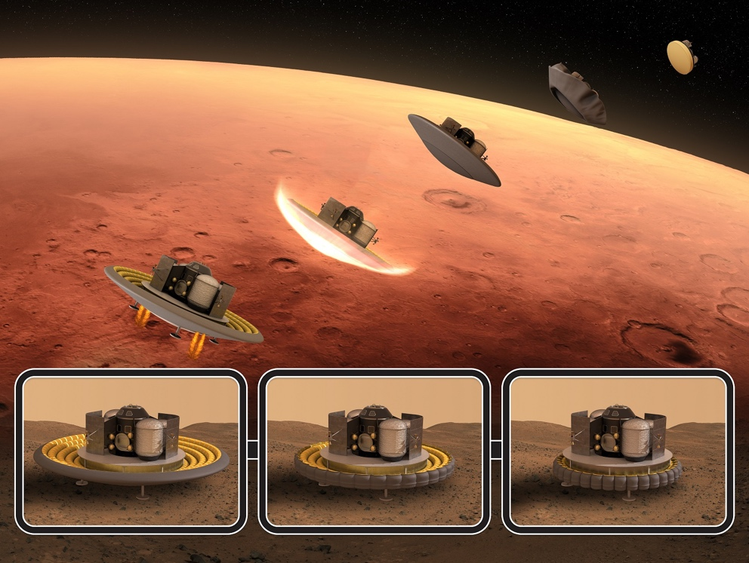
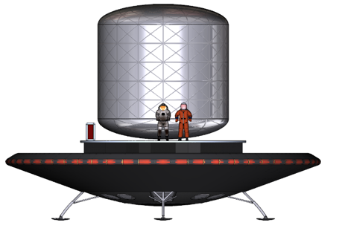
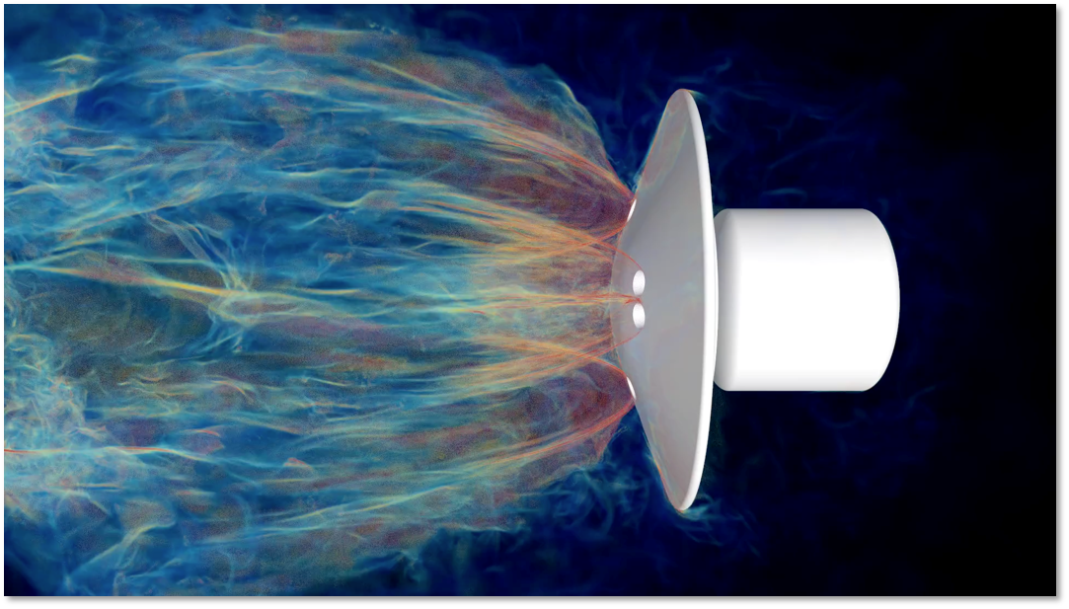





ModSim and Mars: Next Generation Capability
Human-scale Mars landers will require entirely new approaches to safely reach the planet surface
Previous Mars landers have been a few meters in size,
delivering approximately 1 ton of mass to the Martian surface
Human missions will require landers up to 20 meters in size, capable of landing a 20-ton payload
Decelerating such a vehicle will require powerful retropropulsion systems, for which we currently have little experience
NASA is using its FUN3D fluid dynamics solver on Summit to simulate highly complex aero-propulsive phenomena
  Summit is currently the world’s most powerful supercomputer using a hybrid architecture of Intel Central Processing Units (CPU) and Nvidia Graphics Processing Units (GPU)
Conventional computing requires several months to obtain a single result; Summit is able to provide several solutions in a single workweek
Slide courtesy of Eric Nielsen, NASA Langley Research Center

Slide 8
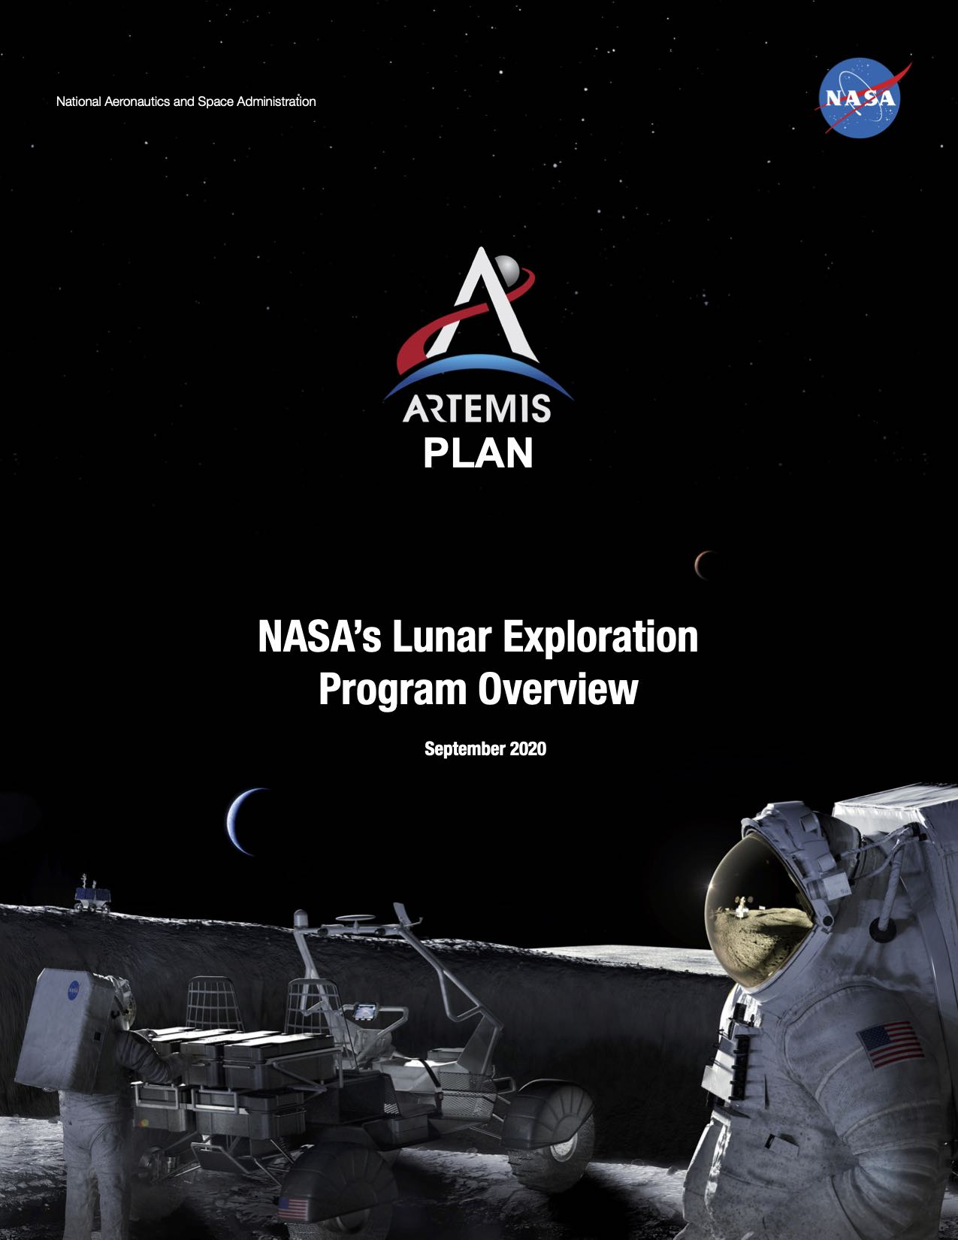
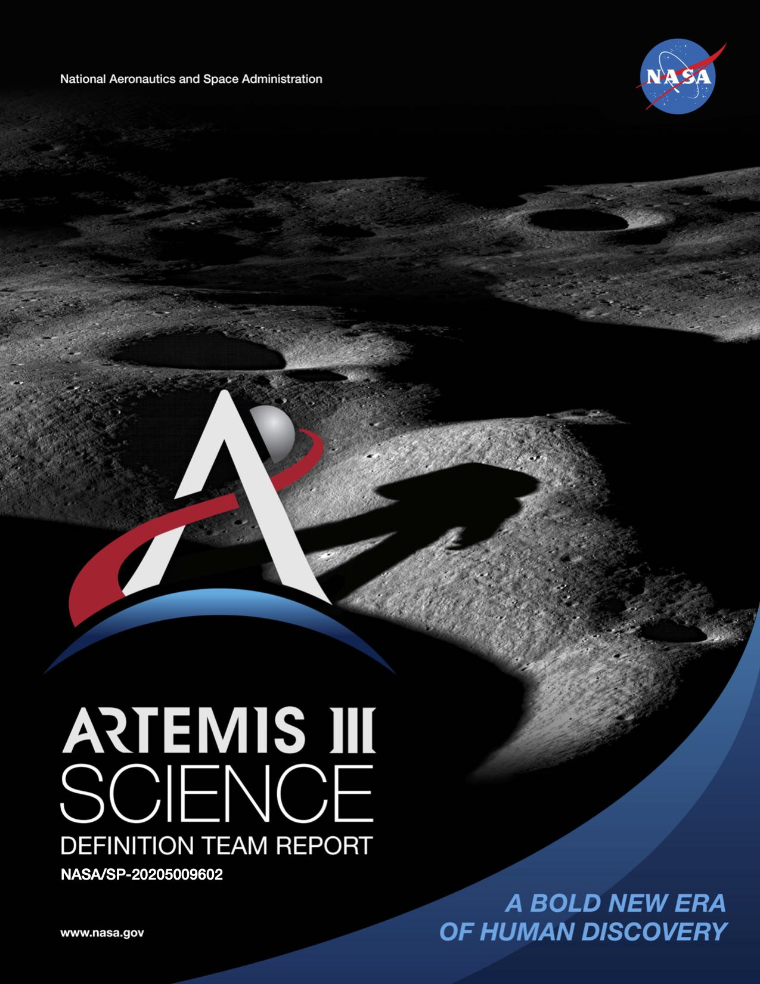
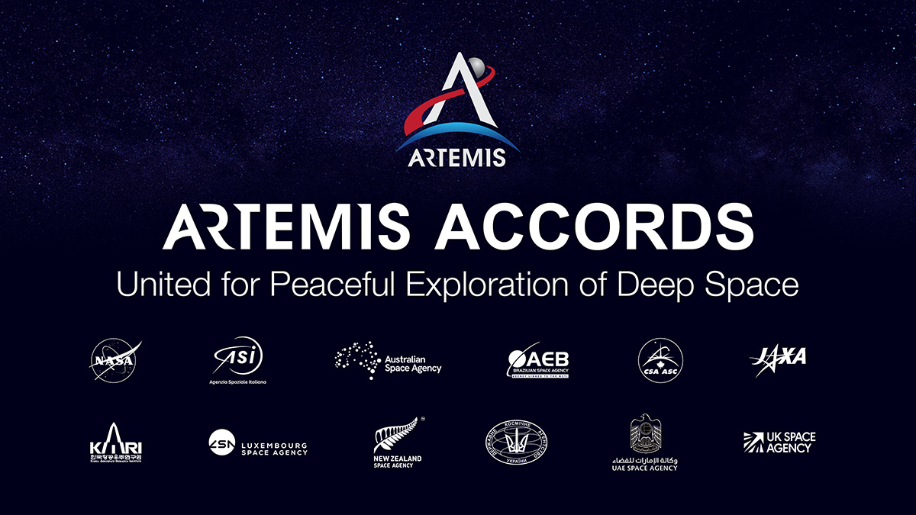
The Artemis Program
Key Objectives: Returning to the Moon to Stay
  Setting Humanity on a Sustainable Course to the Moon
  Landing Human on the Moon in 2024
  Extending Lunar Missions and Preparing for Mars
Key Artemis Documents:
  The Plan: https://www.nasa.gov/sites/default/files/atoms/files/artemis_plan-20200921.pdf
  The Science: https://www.nasa.gov/sites/default/files/atoms/files/artemis-iii-science-definition-report-12042020c.pdf
  The Accords: https://www.nasa.gov/specials/artemis-accords/index.html

Slide 9
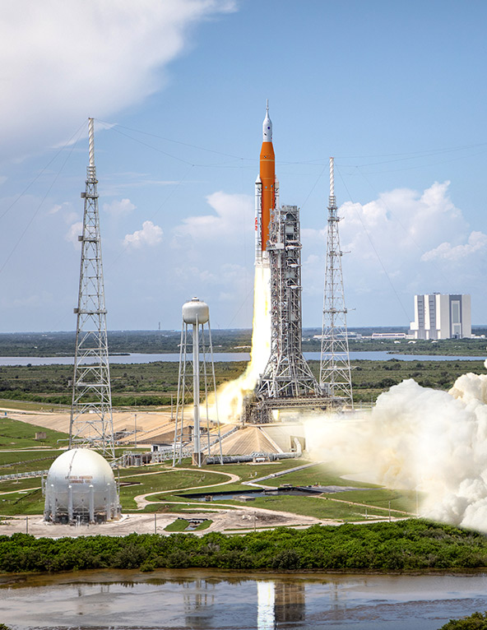
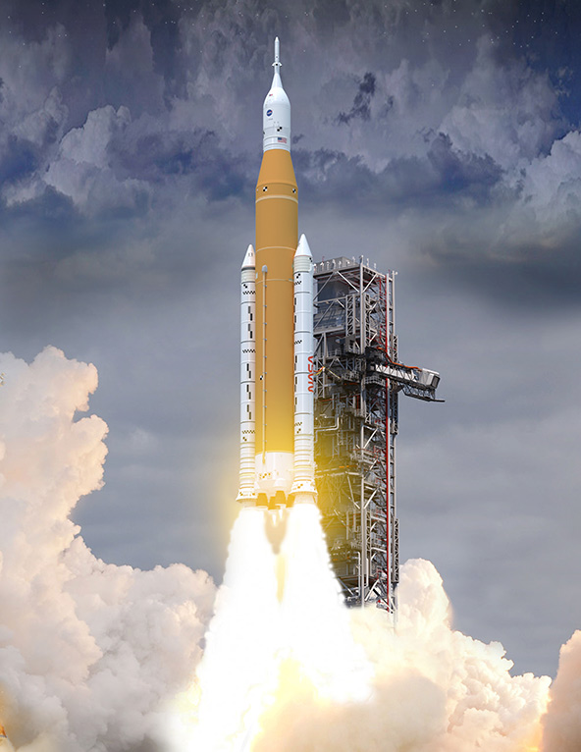
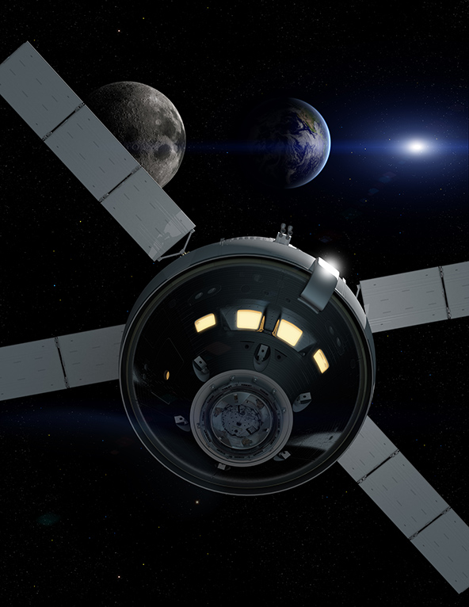
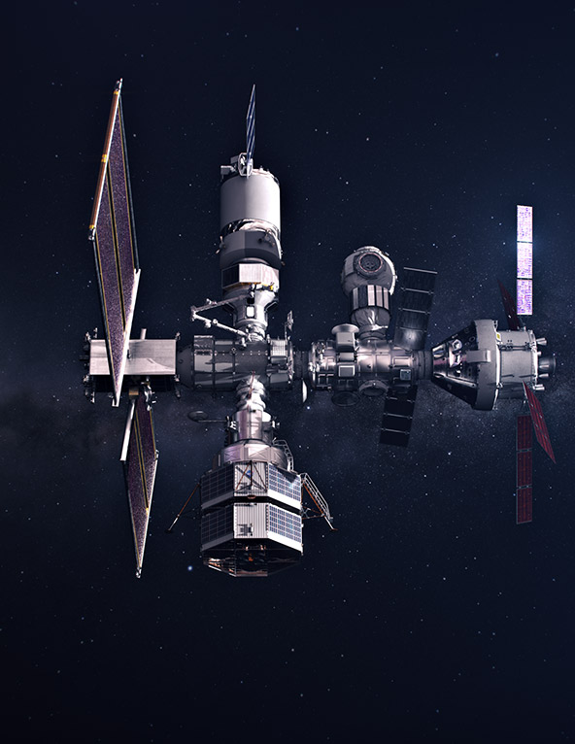
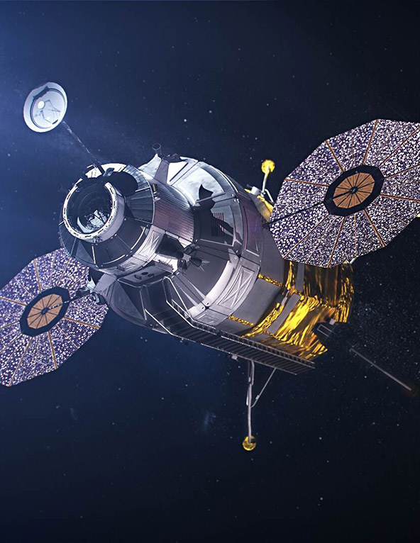
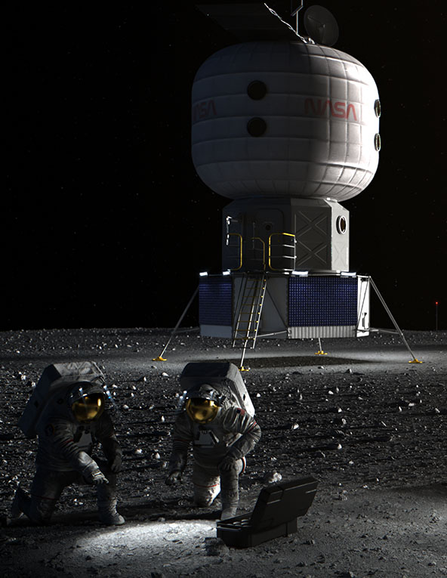
The Artemis Program: Elements
Ground Systems
Space Launch System
Orion Spacecraft
Gateway
Human Landing
System
Artemis Base Camp
The structures on the ground necessary to support launch and recovery of returning astronauts.
The only rocket that can send Orion, astronauts, and cargo to the Moon on a single mission. Upon launch, the SLS will be the most powerful rocket in the world.
The NASA spacecraft that will carry astronauts from Earth to lunar orbit and back.
The spaceship in lunar orbit where astronauts will transfer between Orion and the lander on regular Artemis missions. Gateway will remain in orbit for more than a decade, providing a place to live and work, and supporting long-term science and human exploration on and around the Moon.
Built by American companies, human landing systems are the final mode of transportation that will take astronauts from lunar orbit to the surface and back to orbit.
To give astronauts a place to live and work on the moon, the Artemis Base Camp concept includes a modern lunar cabin, a rover, and a mobile home.

Slide 10
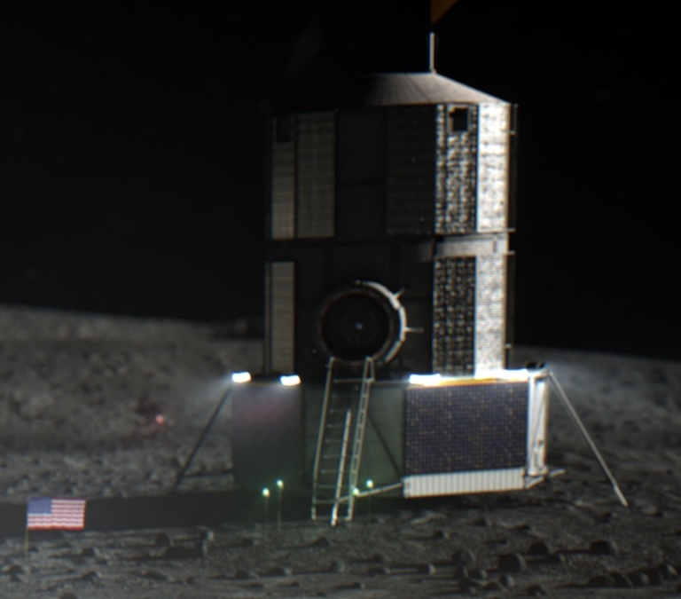
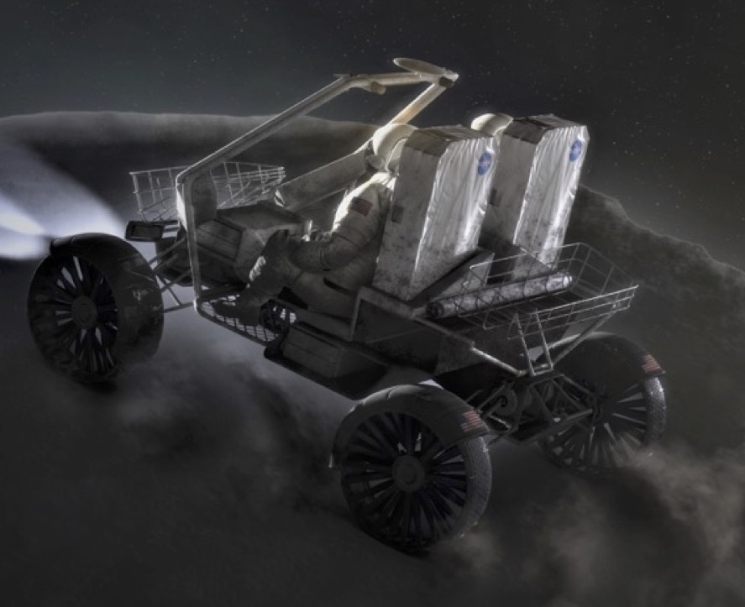
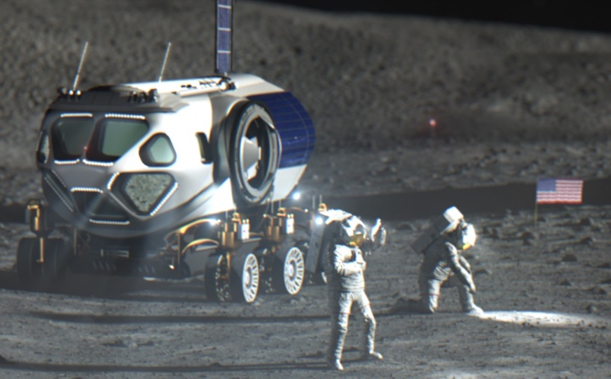
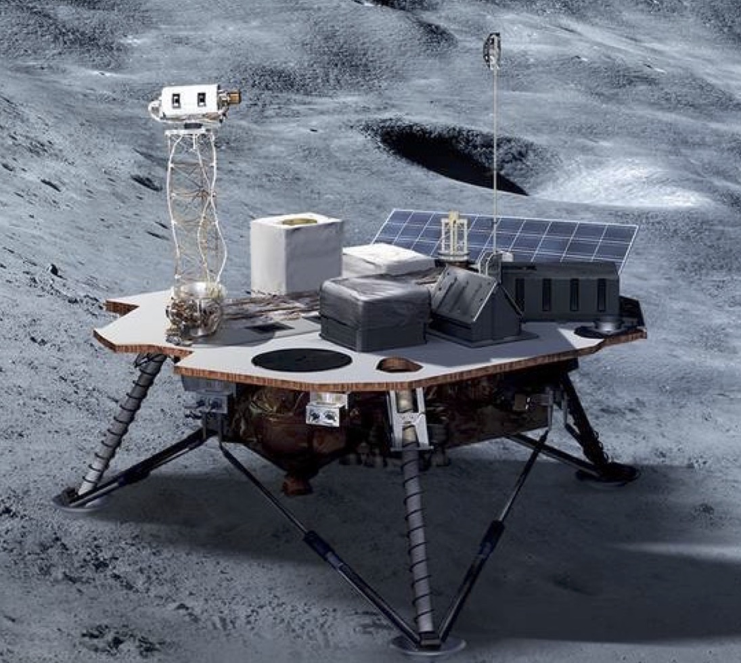
Artemis Base Camp: Elements
A place for Astronauts to live on the Moon
  A modern lunar cabin (Habitat)
  A way to get around (Unpressurized Rover)
  A mobile home (Pressurized Rover)
  Other support elements (Power, Water, Comm, etc.)
Habitat
Unpressurized Rover
Pressurized Rover
Surface Support Elements

Slide 11
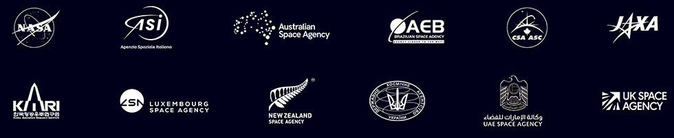
Simulation of Artemis Base Camp (ABC)
The Artemis program has an evolving complex multi-element architecture.
The Artemis program needs the ability to model the integrated performance of this complex system of systems.
The elements will be developed and provided by a variety of international and commercial partners.
These elements will need to interoperate and so will the element simulations.
Element providers are likely to have their own, often proprietary, element simulations.

Slide 12
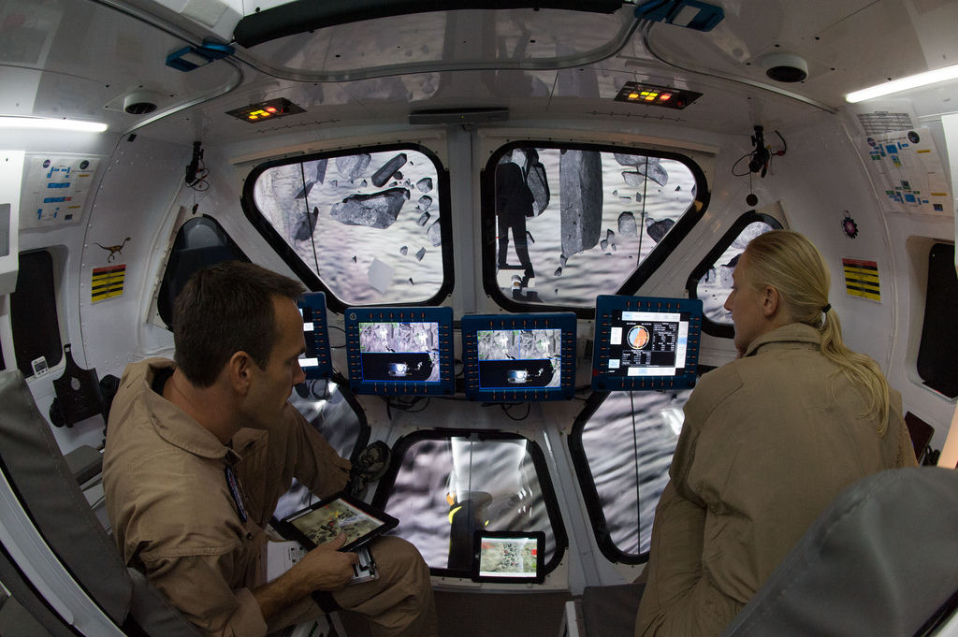
Integrated Mission Simulations
Supports Systems Engineering and Integration (SE&I)
  Captures coupled effects throughout the system lifecycle
  Provides insight into design choices
  Explores handling qualities and human-machine interaction
Supports hardware and software testing in test-as-you-fly (or operate) scenarios
Supports training and operations
Notes:
Modeling and Simulation (M&S) is an enabling discipline for Systems Engineering and Integration (SE&I).
Used to evaluate the coupled effects of the environment, the vehicle configuration, and crew and ground activities as space systems evolve throughout the development process.
Provides insight to project systems engineers and subsystem teams on the integrated effects of design choices.
Supports testing of hardware and software in environments and conditions that are expensive or impossible to recreate on the ground.
Used to train operators on system usage and provide insight into the effects of procedural inputs on the system during operations.

Slide 13
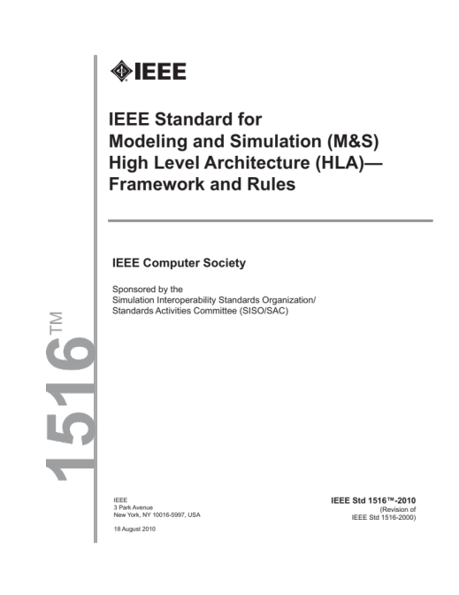
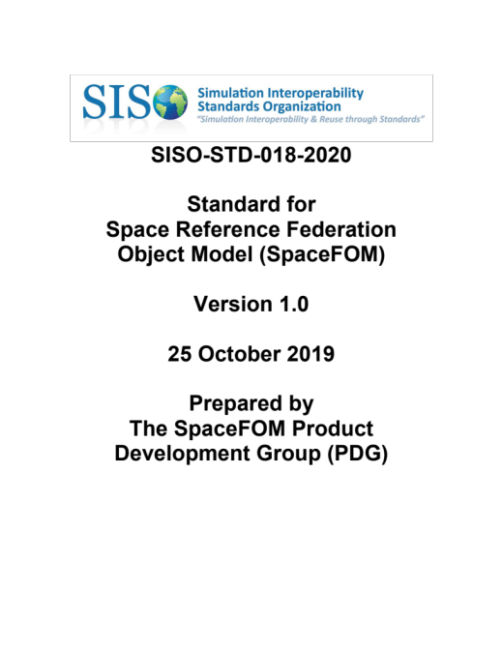
Simulation ABC: Construction
The NASA Exploration Systems Simulations (NExSyS) Team is developing an integrated simulation of the Artemis Base Camp
Current focus on resource flow and integrated architecture performance
Initially using NASA simulations but will transition to partner simulations as available
Using HLA and SpaceFOM as the simulation interoperability standards
  IEEE 1516-2010 - High Level Architecture (HLA)
  SISO-STD-018-2020 - Space Reference Federation Object Model (SpaceFOM)

Slide 14
SpaceFOM: Extension to HLA
HLA relies on a Federation Object Model (FOM) to define interoperable information exchange among simulation participants.
Existing FOMs did not provide adequate support space systems simulations.
The SpaceFOM provides additional specifications for space-based scenarios:
  Roles and responsibilities;
  Common data types;
  Timelines and time standards;
  Time-stepped focused time management;
  Reference frames and references frame trees;
  Reference frame naming convention;
  Common base for space entities: entities and interfaces;
  Well defined execution control definition;
  Rules for assessing SpaceFOM compliance;
  Base set of FOM modules.
Notes:
Handling of specific roles and responsibilities of federates within a federation execution;
Management of common data types useful in the space domain;
Management of common time lines and time scales needed for time homogeneity;
Dealing with specific time-stepped focused time management approaches;
Handling of a flexible positioning system, using reference frames for locating arbitrary bodies in space;
Adopting of a naming convention for operational reference frames;
Offering base object support for physical entities (e.g., space vehicles and astronauts);
Offering base object support for physical interfaces (e.g., docking ports and sensor locations);
Handling a synchronized execution control strategy and framework;
Providing rules for assessing the compliance with the SpaceFOM;
Providing a core base set of FOM modules needed for a SpaceFOM-compliant federation execution.

Slide 15
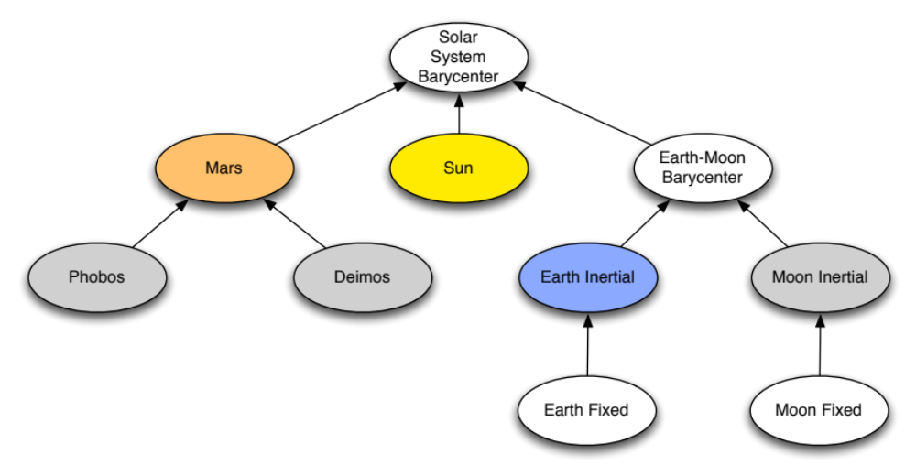
SpaceFOM: Reference Frames and Trees
Defines a reference frame tree.
Supports the computation of a state in one frame with respect to any other frame in the tree.
Is defined based on the needs of the specific federation execution.
Proposes a standardized naming convention for reference frames.
Notes:
This slide and the next essentially are the SpaceFOM defining space and time for space mission simulations.

Slide 16
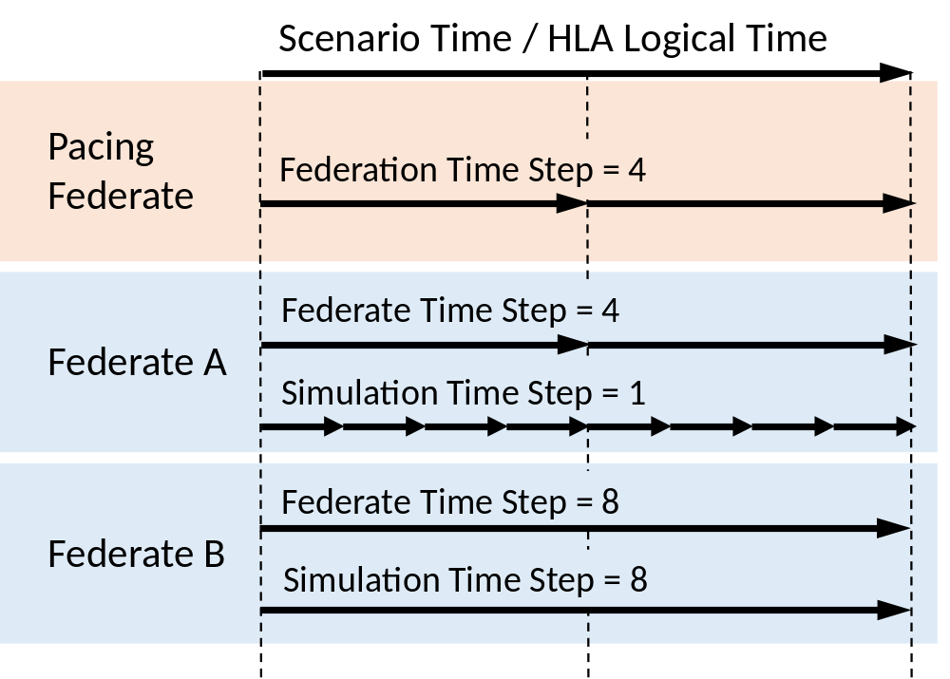
SpaceFOM: Time Standard and Timelines
Defines Terrestrial Time (TT) as the time basis across the federation execution.
  Defines conversions between other time standards.
Defines 6 related timelines to support execution control:
  Physical Time
  Computer Clock Time
  Simulation Elapsed Time
  Simulation Scenario Time
  HLA Logical Time
  Federation Scenario Time
Supports different simulation time steps.
Support non-realtime and realtime execution.
Support Central Timing Equipment (CTE).

Slide 17
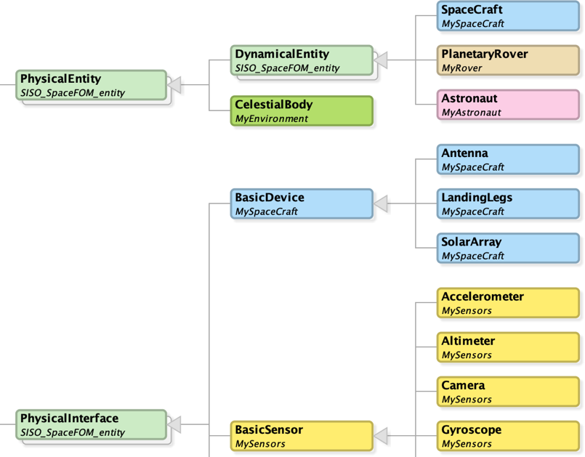
SpaceFOM: Objects and Extension
Builds off of the HLA base objects.
Provides a small set of common object types tailored to space system needs:
  Physical Entity,
  Dynamical Entity,
  Physical Interface.
Other space systems can extend from these.
Provides a set of common unit definitions for object attributes.

Slide 18
SpaceFOM: Rules, Roles, and Execution Control
Rules:
  Specifies 103 rules for compliance
  Additional guidelines
Roles:
  Master Federate
  Pacing Federate
  Root Reference Frame Publisher
Execution Control
  A well-defined executive cycle
  Gated to reduce potential deadlocks
  Supports multi-phase initialization
  Supports controlled mode sequencing
Start
Initialization
Sync
Sync
Run
Freeze
Sync
Shutdown
End

Slide 19
In Summary
Modeling and Simulation (ModSim) have been critical technologies for NASA space missions include Apollo, Mars Missions, and Artemis.
NASA continues to invest in ModSim capabilities to support space missions, especially Moon2Mars.
  For the engineering of human-scale Mars Landers, NASA is rewriting physics simulations for graphical processing units in next-generation, high-performance computers to predict more complex phenomena with shorter runtimes.
  For Artemis, NASA is developing a new generation of integrated simulations that rely on distributed simulation standards including HLA and SpaceFOM.
We are focused on realizing a new age of human space exploration!

Slide 20
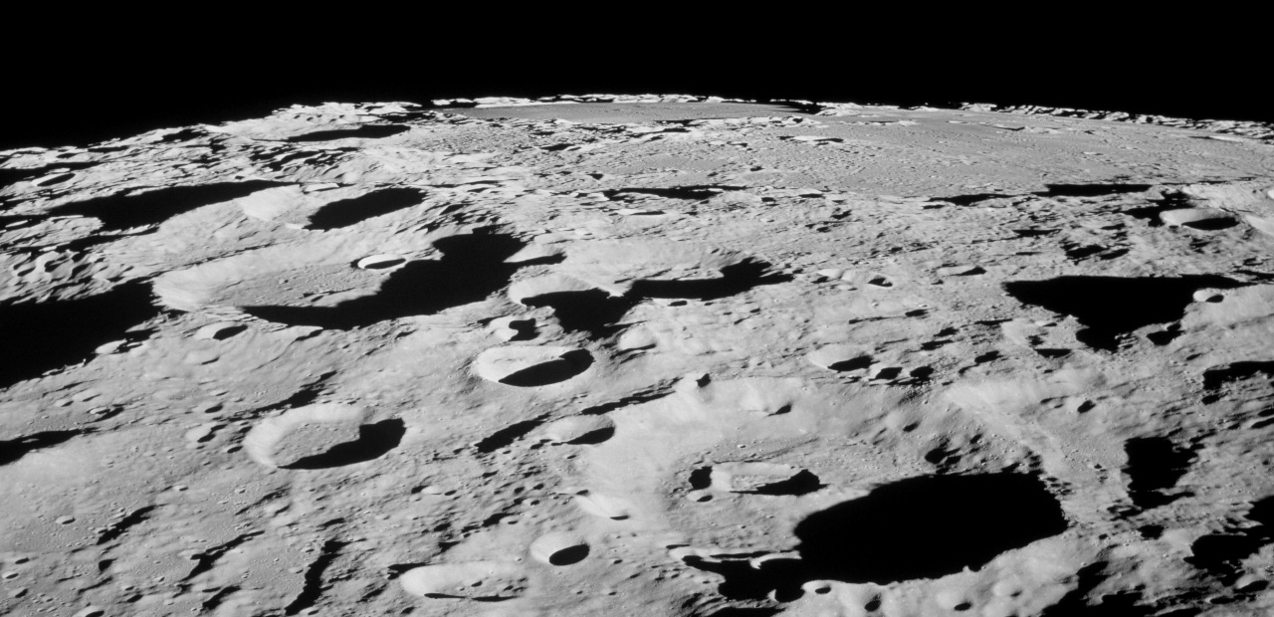
Questions?
NASA Movie - Why The Moon?: https://www.youtube.com/watch?v=bmC-FwibsZg
NASA Movie – We Are Focused: https://www.youtube.com/watch?v=OsIhTw0CK8U

Slide 21
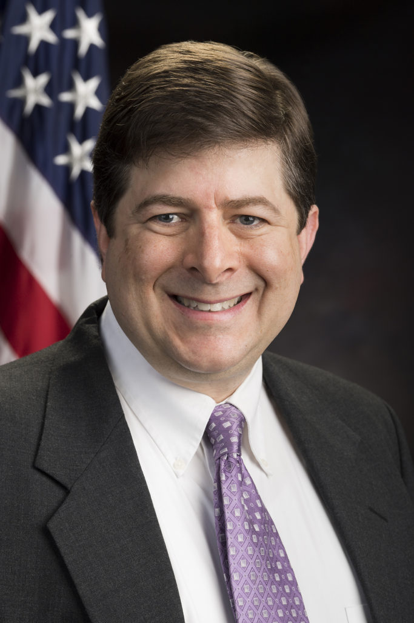
Michael Madden – Chief Engineer for Modeling and Simulation
Arrived at NASA Langley Research Center in 1993
  Software Engineer, Unisys Corp, flight simulation facility (1993-1999)
  In 1999, hired into the Simulation Development and Analysis Branch (SDAB)
    Develops and operates the flight simulation facility
  2008 to 2018 - Chief Scientist for SDAB.
  2018 to Present - Chief Engineer for Modeling and Simulation
Education
  B.S. (1990) and M.S. (1997) in Aerospace Engineering from Virginia Tech
41 Technical Publications on Modeling and Simulation including
  NASA’s standard check cases for vehicle simulations
  Professional society standards for model exchange (AIAA/ANSI S-119), distributed simulation of space missions (SISO-STD-018-00-2020), and simulation use to certify aircraft (AIAA R-154)
Current Roles
  Member, NASA Software Architecture Review Board
  Member, Agency Integrated Model-Based Everything Team
  Member, Engineering Application Program Management Board
  Member, AIAA Modeling and Simulation Technical Committee
  Member, AIAA Digital Engineering Integration Committee
Technical background/passion
Vehicle and environment modeling
Live, virtual, and constructive (LVC) simulation
Software engineering for real-time systems
Model-based methods
Advancing fidelity and validation of modeling and simulation
Collaboration through digital engineering

Slide 22
Additional SpaceFOM Information
B. Möller, E. Z. Crues, D. E. Dexter, A. Garro, A. Skuratovskiy, A. Vankov. A First Look at the Upcoming SISO Space Reference FOM. Proceedings of the SISO 2016 Simulation Innovation Workshop (SIW 2016), Orlando, Florida, USA, September 11-16, 2016.
B. Möller, A. Garro, A. Falcone, E. Z. Crues, D. E. Dexter. Promoting a-priori interoperability of HLA-based Simulations in the Space domain: the SISO Space Reference FOM initiative. Proceedings of the 20th IEEE/ACM International Symposium on Distributed Simulation and Real Time Applications (ACM/IEEE DS-RT 2016), London, UK, September 21-23, 2016, ISBN: 978-150903504-5.
B. Möller, E. Z. Crues, D. E. Dexter, A. Garro, M. Madden, A. Skuratovskiy. Design and Principles Enabling the Space Reference FOM. Proceedings of the SISO 2017 Simulation Innovation Workshop (SIW 2017), Orlando, Florida, USA, September 10-15, 2017.
B. Möller, A. Garro, A. Falcone, E. Z. Crues, D. E. Dexter. On the Execution Control of HLA Federations using the SISO Space Reference FOM. Proceedings of the 21st IEEE/ACM International Symposium on Distributed Simulation and Real Time Applications (ACM/IEEE DS-RT 2017), Rome, Italy, October 18-20, 2017.
B. Möller, A. Falcone, A. Garro, and E. Z. Crues. Experiences in using the SISO Space Reference FOM standard. Proceedings of the 2019 Summer Simulation Conference, SummerSim 2019, Berlin, Germany, July 22-24, 2019, pages 1–12. The Society for Modeling and Simulation International Inc., 2019. url: https://dl.acm.org/citation.cfm?id=3374187.
B. Möller, A. Rydell, E. Z. Crues, D. Dexter, A. Falcone, and A. Garro. SISO Space Reference FOM - Tools and Testing. Proceedings of the 2020 Winter Simulation Innovation Workshop, SIW 2020, Orlando, FL, USA, February 10-14, 2020. Simulation Interoperability Standards Organization, 2020.
E. Z. Crues, D. Dexter, A. Falcone, A. Garro, and B. Möller. SpaceFOM - A Robust Standard for Enabling A-Priori Interoperability of HLA-Based Space Systems Simulations. Journal of Simulation, 2021. issn: 1747-7778. doi: 10.1080/17477778.2021.1945962. url: https://doi.org/10.1080/17477778.2021.1945962.

