Slide 1
Using Macro Fiber Composite (PZT) Sensors for Tank Health Monitoring and Propellant Mass Gauging
Rudy Werlink / KSC - THM MPG PI
Edwin Cortes/KSC
Eric Hurlbert/ JSC EP4
Jacob Nunez Kearny/ JSC EP4
Joe Dziekan/JSC EP6
Tim Sweet/JSC EV2
Jordan Fail/JSC EV2 Hester Yim/JSC EV2
Nathan Wells/JSC EV2
Kevin Crosby/ Carthage College
Joe Gard/ EX Project Manager

Slide 2
Background
In 2020 Rudy Werlink / KSC patented concept based on observation that PZT sensors could detect fluid mass and tank structural health changes
patent No: US 10,562,071 B2
2007 – 2020 on-going Tank Health Monitoring Project funded by AES from 2014 to 2021
In 2018, Orion and AES funded tank tests:
Conducted piggy-back tests on Orion ESM tank, Morpheus tanks and OMS cold tank verification and validation (V&V) Orion testing at the KSC Multi-Payload Processing Facility (MPPF)
Built prototype avionics to demonstrate real-time processing of the frequency response function
In August 2022, Orion funded MPG project to conduct additional tests and avionics development
Higher Flowrate like OMS engine, Tank Tilt, Temperature, Pressure Variation
Continue development of Avionics

Slide 3
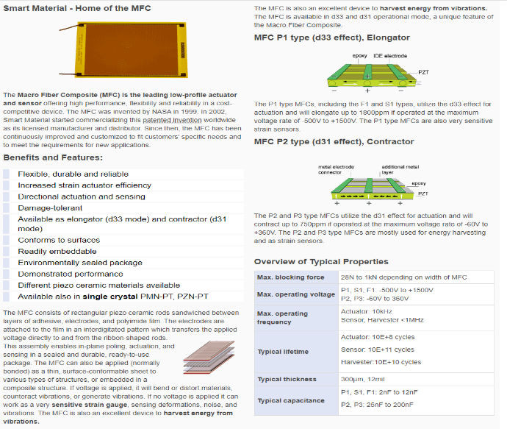
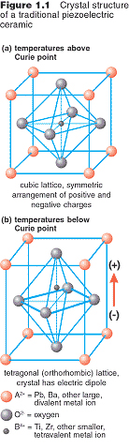
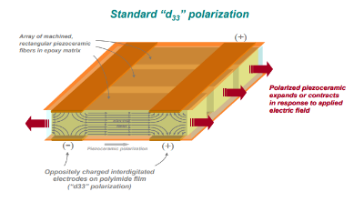
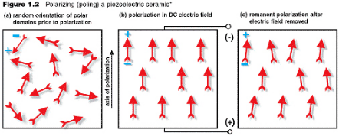
MPG PZT Transducers details (NASA patent manufactured by Smart-material Corp)

Slide 4

Analogy - Tank Structural Health and Mass Gauge
The solution for simple harmonic motion is shown below. The number fn is called the un-damped natural frequency. For the simple mass–spring system, fn is:
Here, k is the spring stiffness and m is the mass of an attached weight. If the mass and stiffness of the system is known, the formula above can determine the frequency at which the system vibrates once set in motion by an initial disturbance. Every vibrating system has one or more natural frequencies that it vibrates at once disturbed. This simple relation can be used to understand in general what happens to a more complex system once we add mass or stiffness.
Changes in stiffness and mass can be detected by comparison to a baseline. By applying the same excitation and maintaining the same stiffness, the frequencies will change only due to the mass changes thus allowing the mass of fluids in tanks to be detected with a non-invasive and accurate method. In Structural Health monitoring, the mass is assumed constant and only the tank stiffness changes affect the frequency shifts. This method may also be used in zero-gravity as the fluid ullage typically settles to the center of the tank volume with the fluid mass on the inner walls (in the equilibrated condition).

Slide 5
Tank Structural Health Monitoring

Slide 6
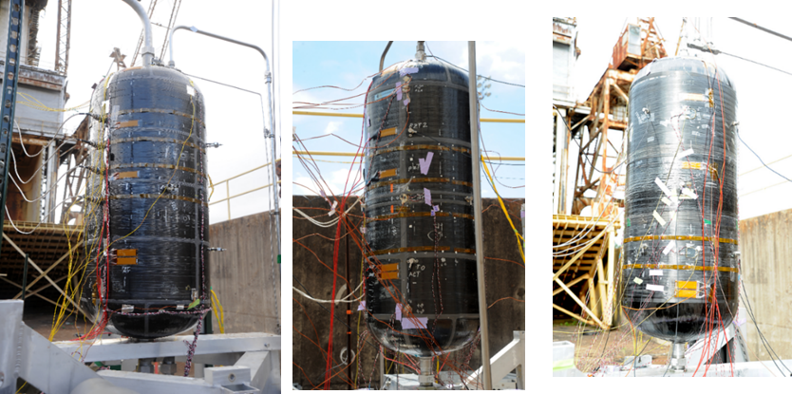
100 gallon composite test tanks prior to test to failure with liquid nitrogen at MSFC:
Summary of Tank Structural Tests to failure using Health Monitoring (THM) including PZT technology
Scorpius all-composite
COPV-2
COPV-1

Slide 7
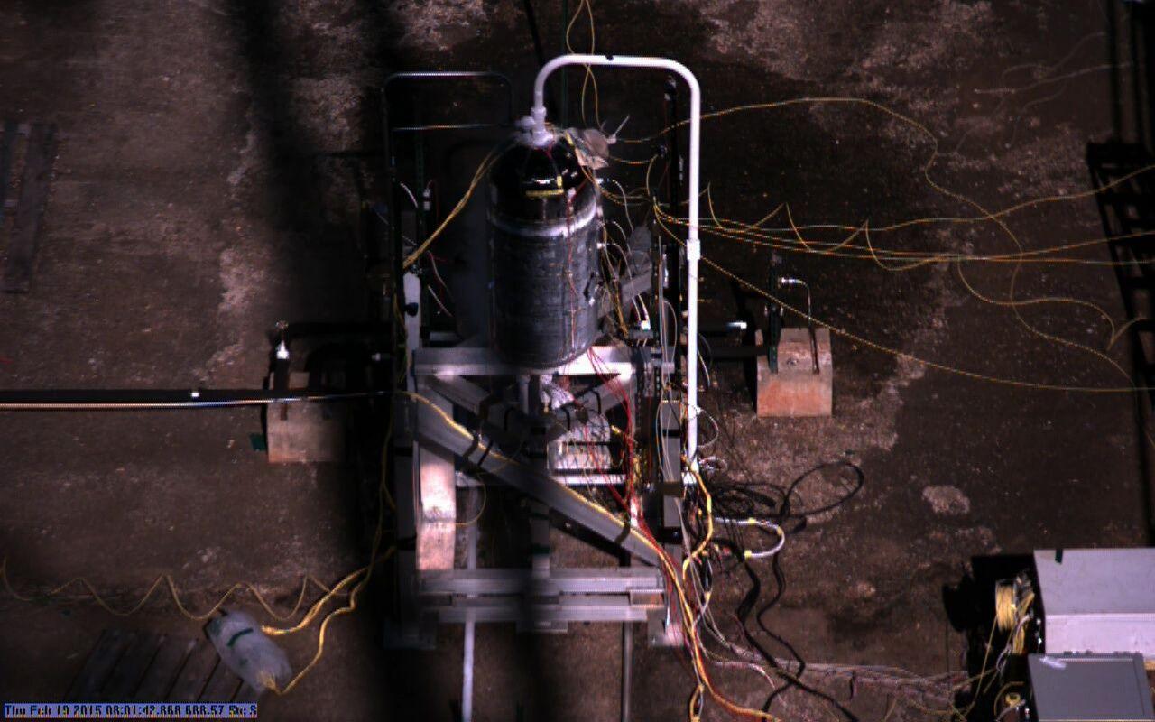
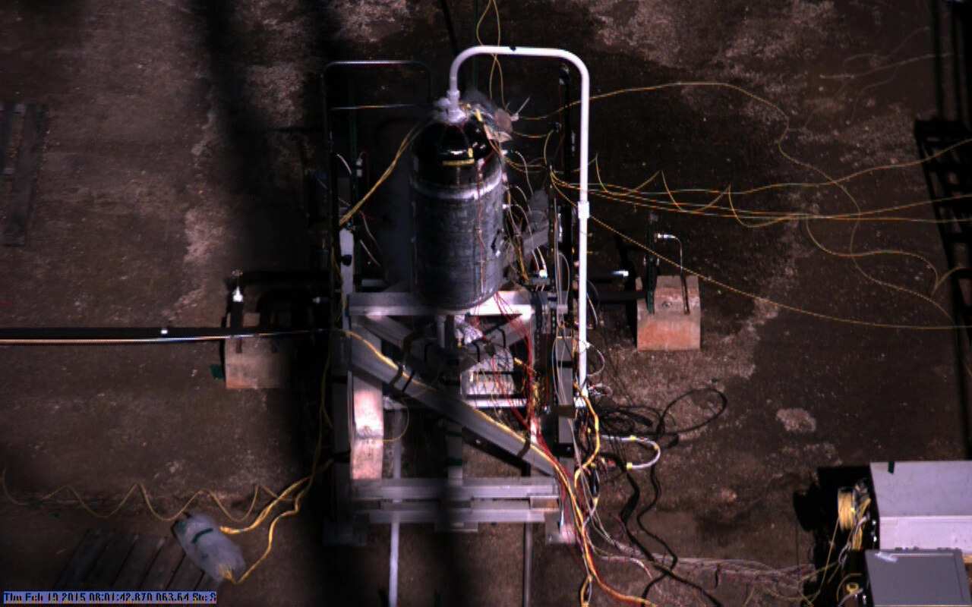
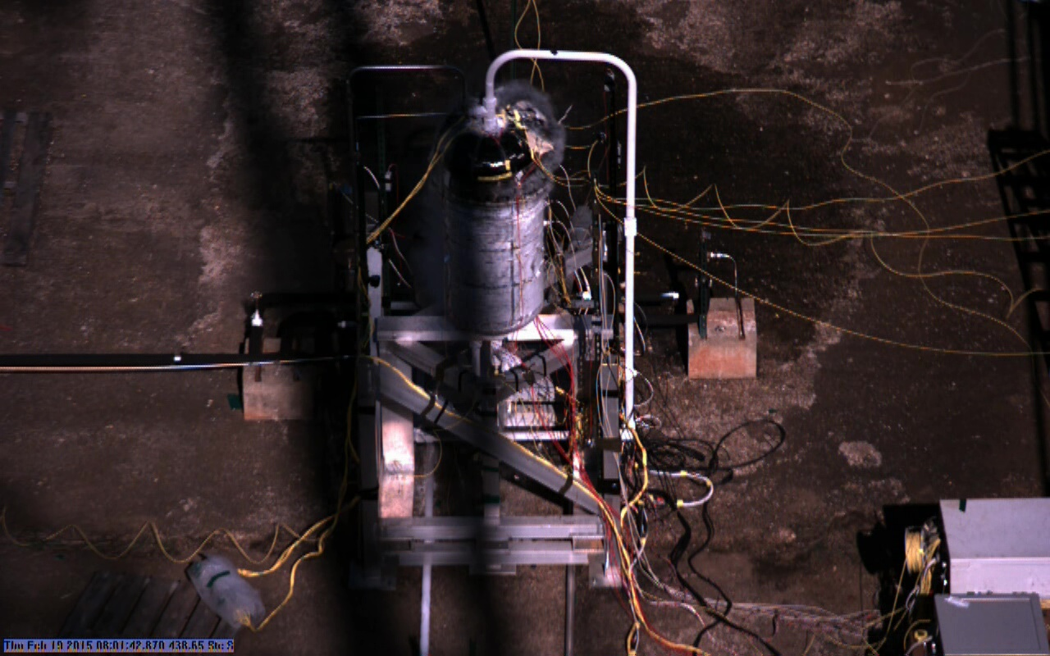
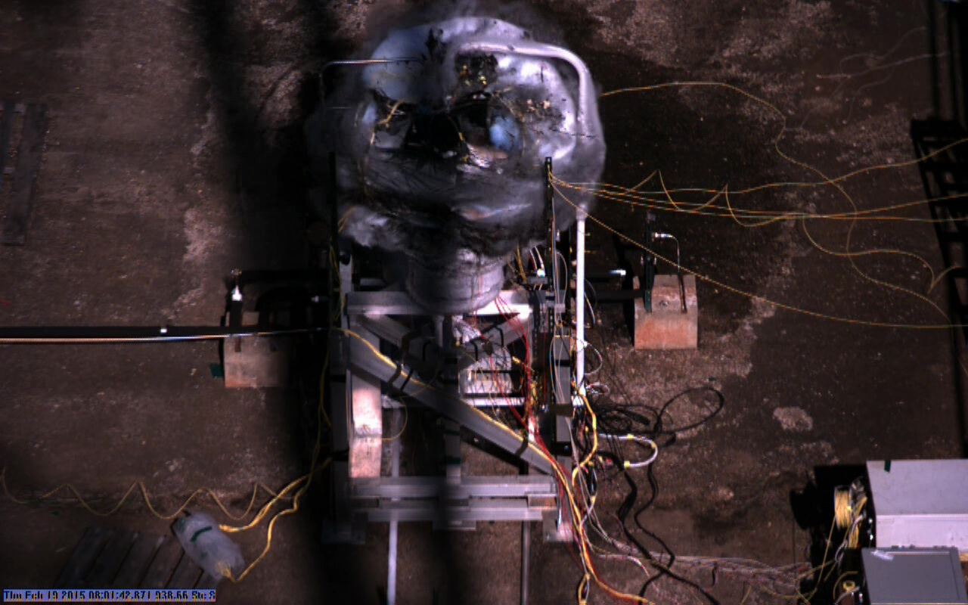
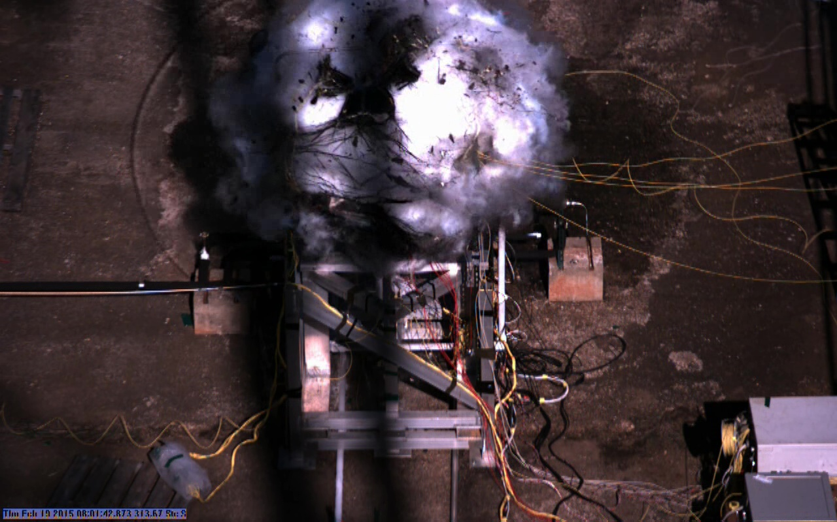
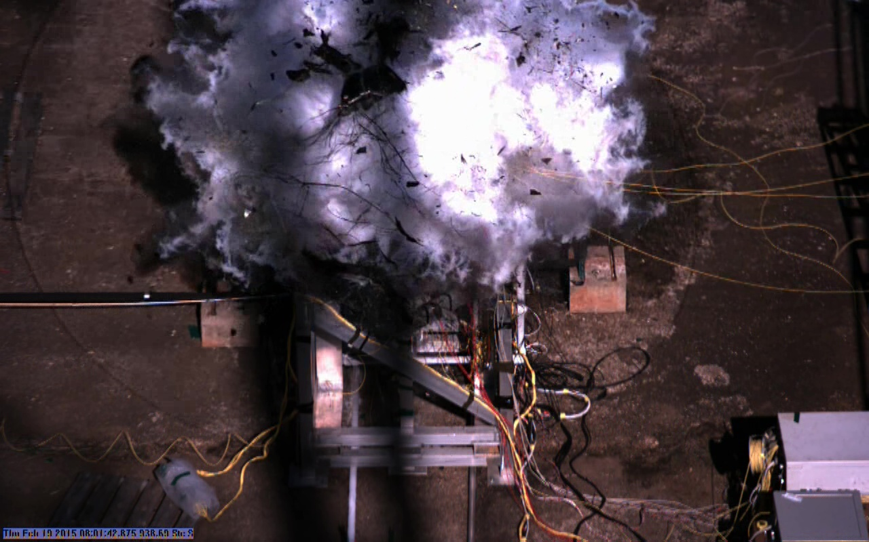
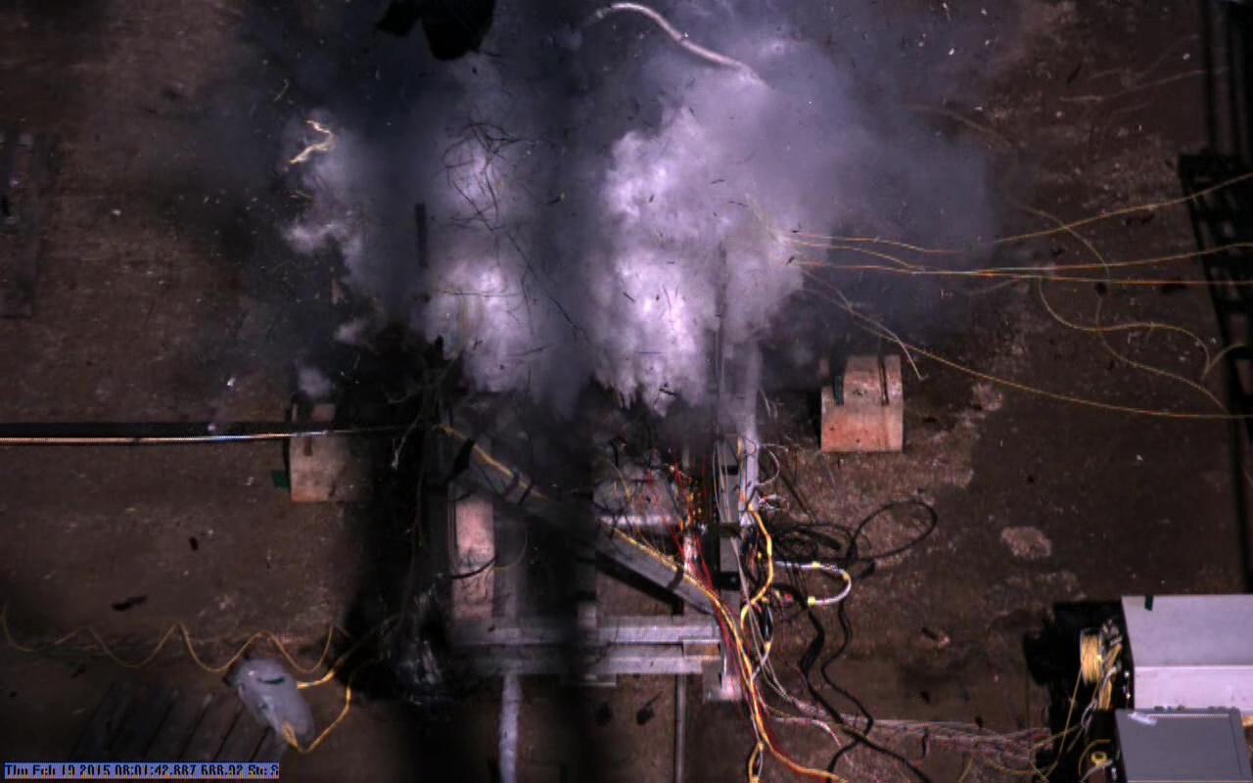
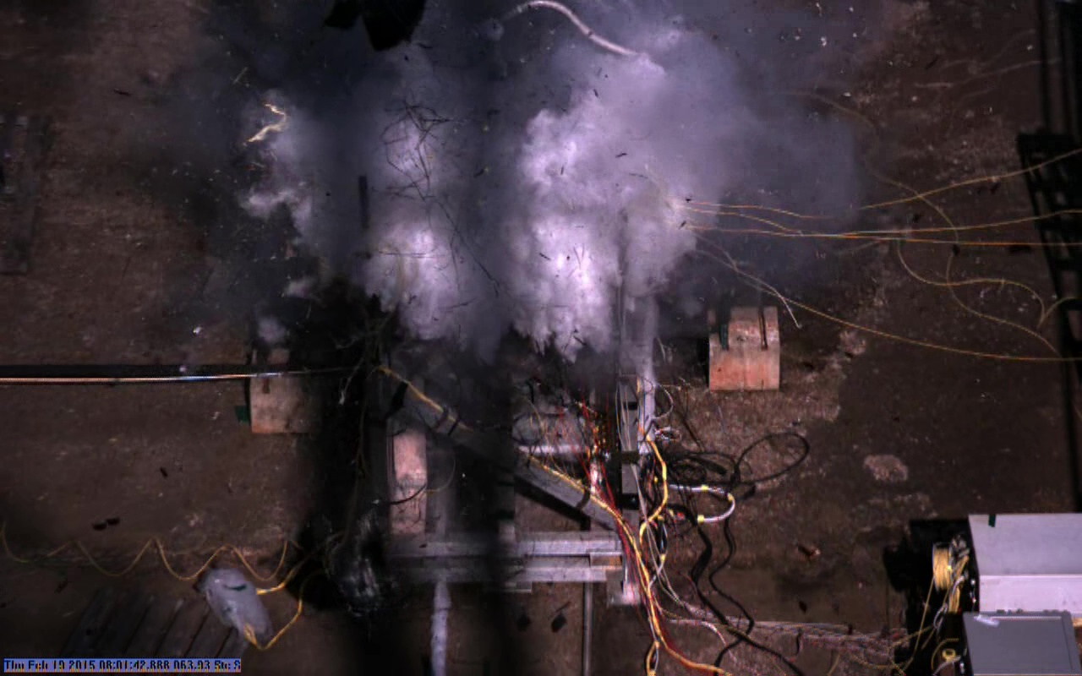
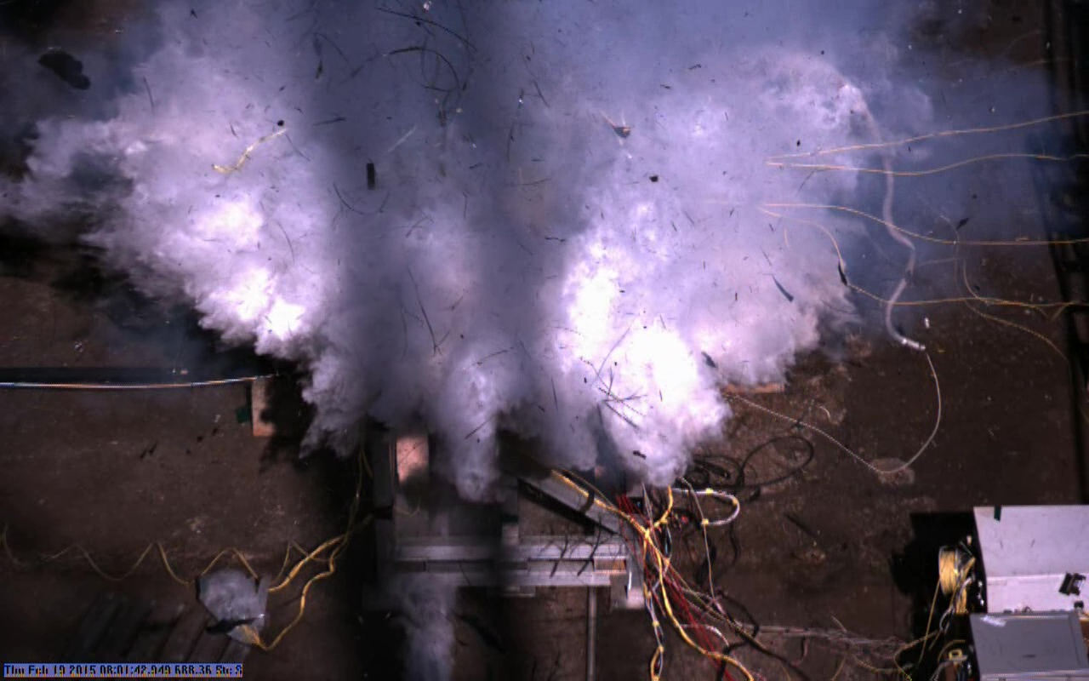
Scorpius 100 gal all composite filled with LN2 at 1230 psig burst showing freeze frames from 4000 frames per sec video.

Slide 8
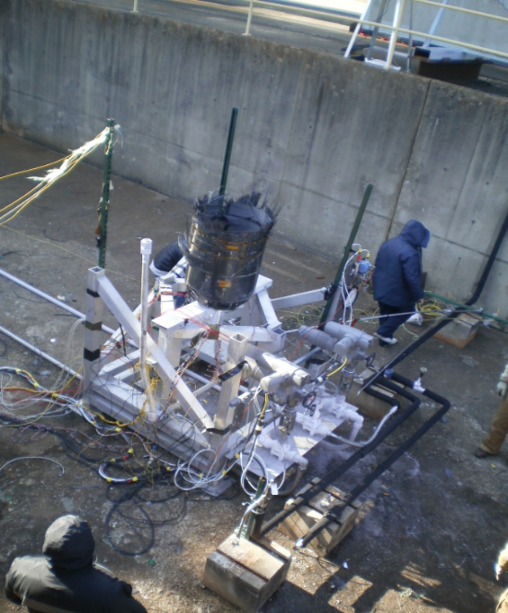
Composite 100 gal tanks LN2 test to failure THM summarized results
Three 100 gallon test tanks tested test to failure filled with liquid nitrogen (Testing conducted at NASA MSFC 2015):
Instrumented with Acoustic Emission Mistras, FBG fiber optics Micron and NASA AFRC fiber optics, NASA PZT active vibration, traditional strain gage systems. The ullage Pressure is increased in steps until failure. PZT data taken also at 0 psig intervals between steps.
Scorpius all composite technologies failed pressure 1230 psi
MSFC manufactured COPV 1 failed pressure 3050 psig
MSFC manufactured COPV 2 failed pressure 3370 psig
Our limited tests indicate:
Acoustic Emission Mistras (good data for locations of cracks but analysis to predict failures complex)
FBG fiber Optics strain Micron and NASA AFRC (cryogenic installation and electronics/software in development) trade off between number of sensors and update rates.
Acellent smart patch (fairly close spacing required, data analysis to predict failures not developed)
The following NASA developed systems are most promising to further develop considering the goals of our activity
FBG fiber optics strain AFRC (NASA design) research system has performance and most developed flight configurations.
PZT active vibration KSC (NASA design) research system shows capability of predicting failures with periodic comparisons of FRF spectrums, not location specific.
Scorpius tank after burst

Slide 9
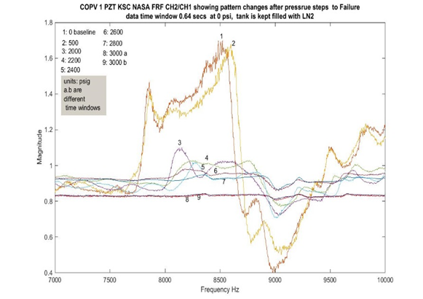
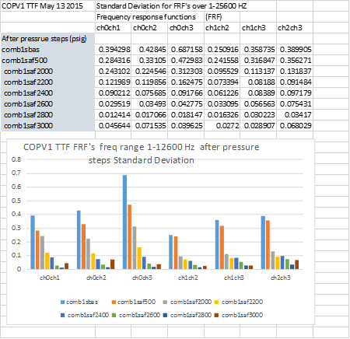
FRF Plots Show Effect of Damage
Figure 22 Figure 22 FRF plots showing the effects of increasing Pressure steps on the modal signatures and Standard deviations plot directly above for COPV 1. and Standard deviations plot directly above for COPV 1.

Slide 10
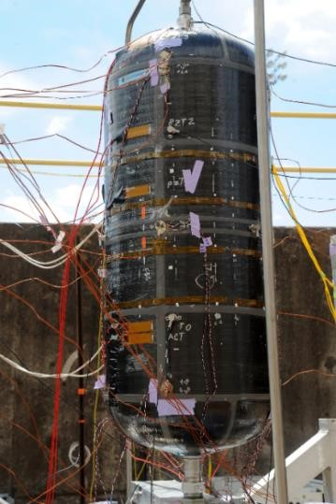
FRF PZT2/PZT1 Plots Show Effect of Damage after step increases in pressure to failure
PZT 2
PZT 1
Actuator
FRF plots showing the effects of increasing Pressure steps (500-3000 psig) on the modal signatures (7000-10,000 Hz)

Slide 11
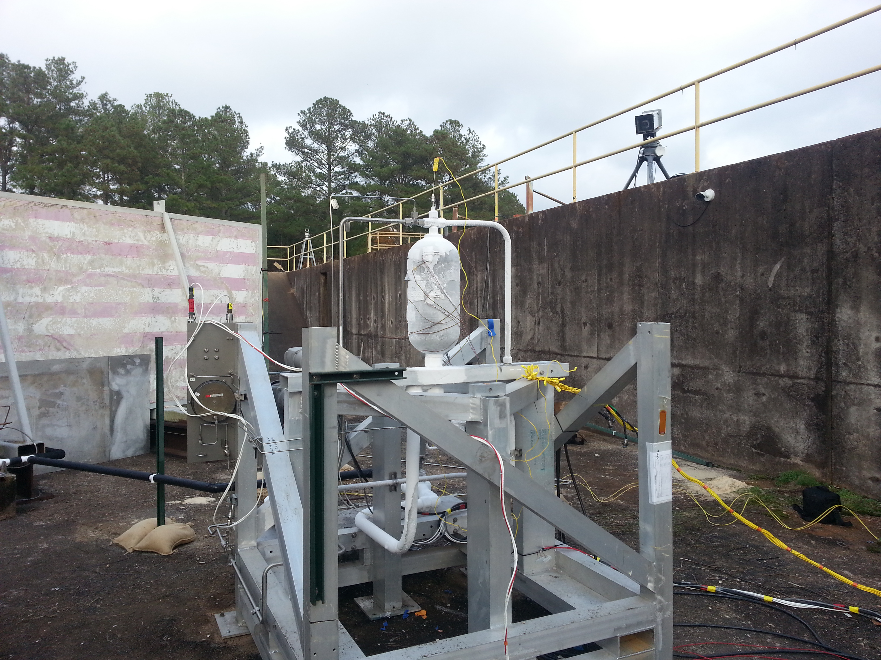
CTD manufactured all composite with inserted flaws at manufacture and selected tanks receiving impact damage tested to failure with LN2, PZT THM active.
CTD manufactured composite test tanks 6 and 100 gallons which have manufactured known flaws to evaluate the Tank Health Monitoring system (developed at KSC NASA which uses active vibration and PZT transducers to monitor tank health). Conducted by filling the composite tanks with liquid nitrogen and applying pressure to the ullage using GN2 until failure occurs.
The KSC developed THM system is active up to failure along with strain gage, temperature pressure and video data. There are three control 6 gallon tanks, nine with various manufactured in flaws and several with external impact damage. The 100 gallon test tanks consist of one control and one with external impact damage.
One of the 6 gallon composite tanks
Following LN2 fill and pressurization to 4600
Psig. Failure mode was cracking-leakage not burst

Slide 12
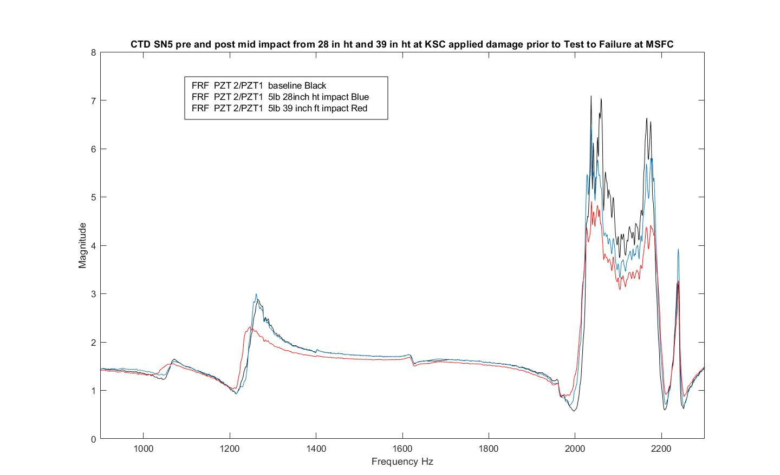
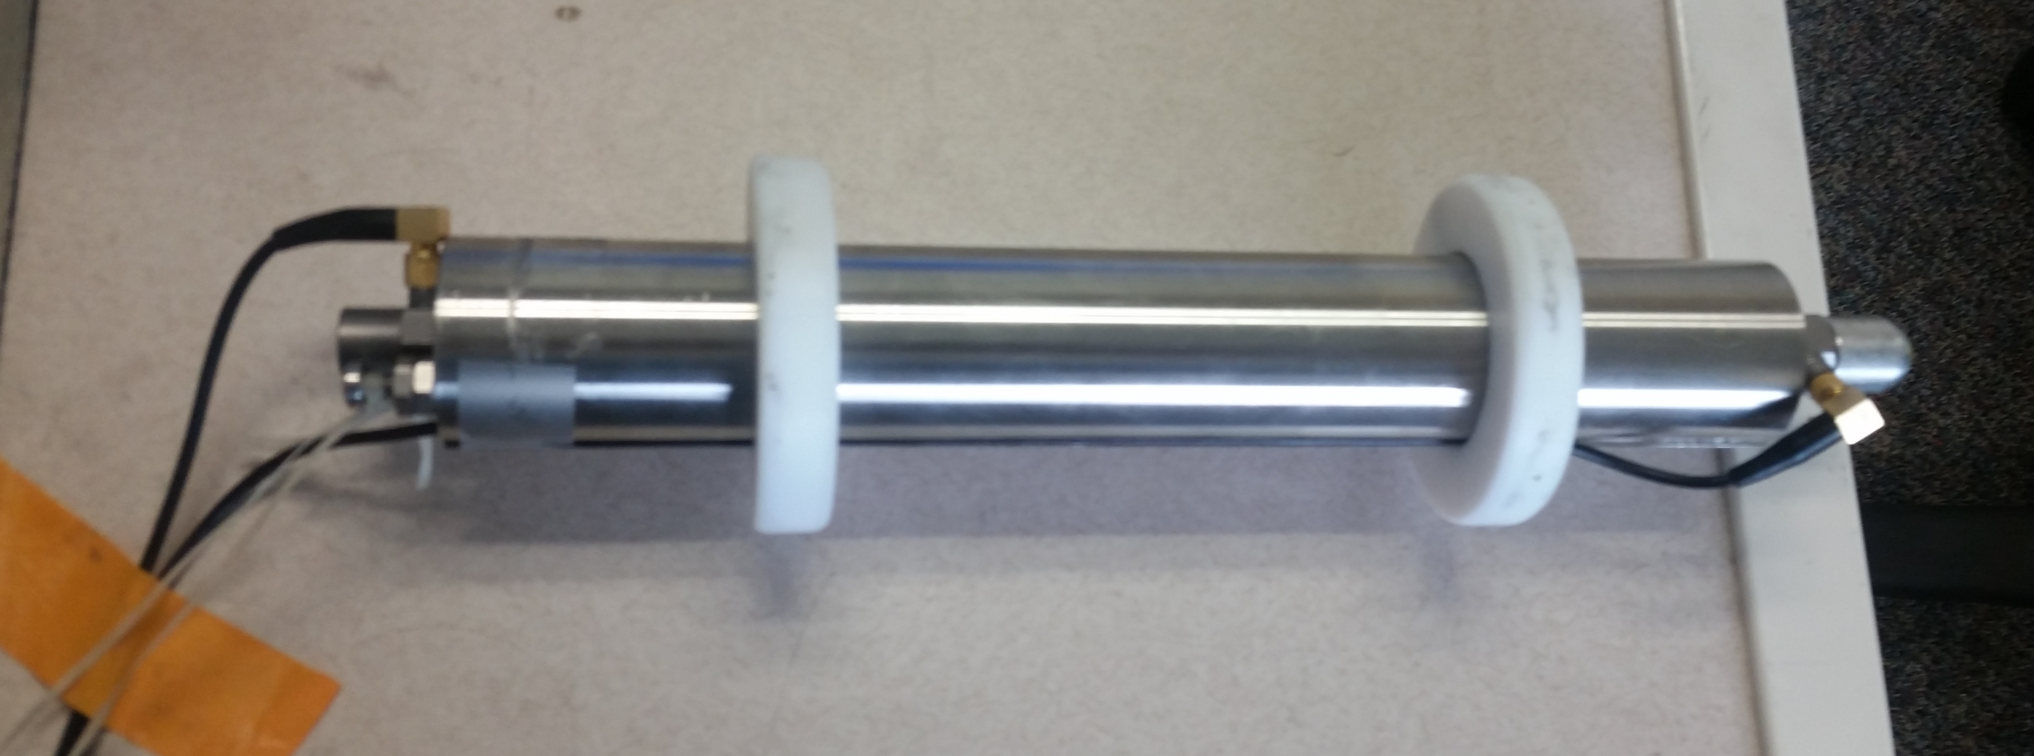
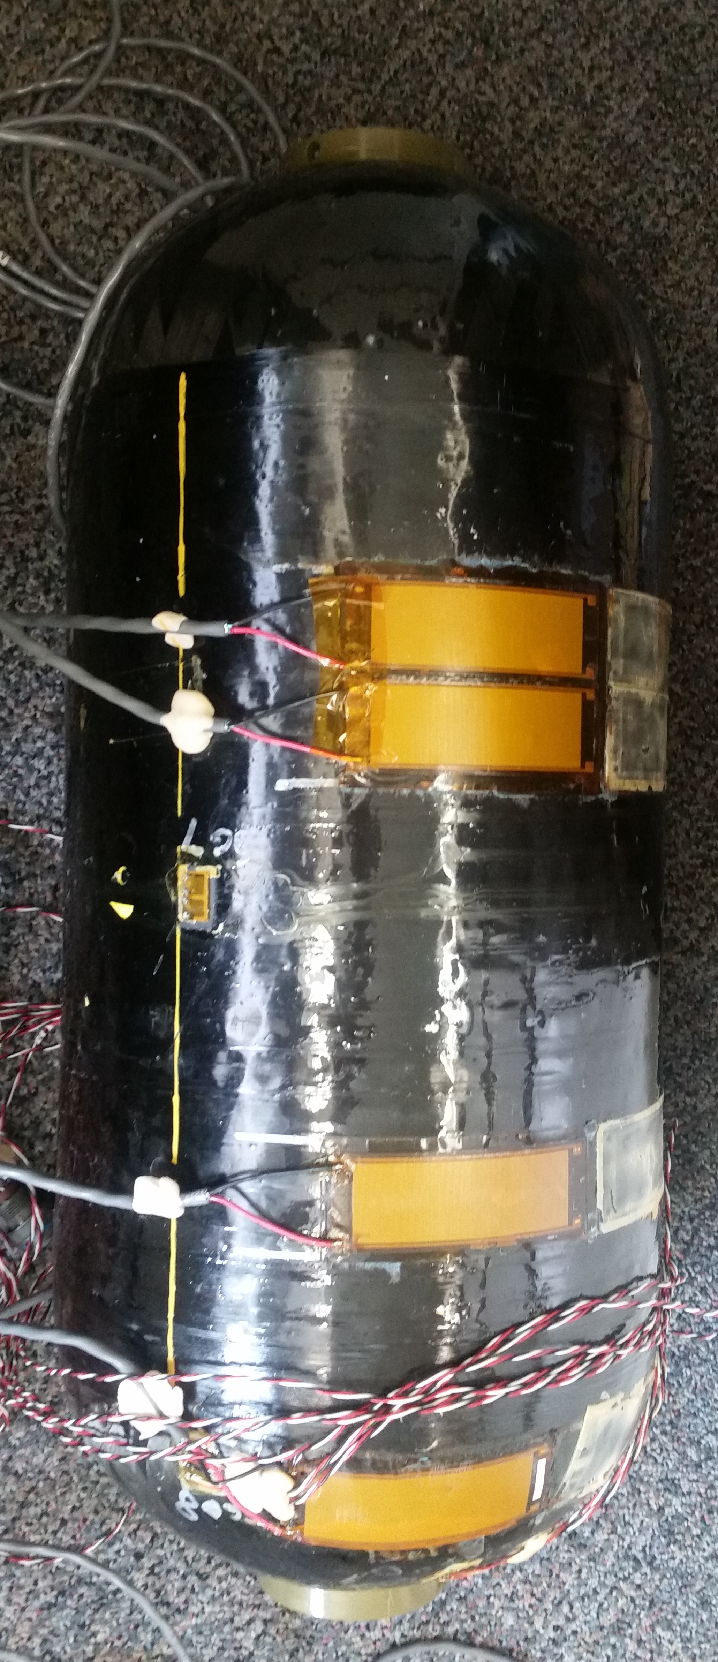
Example of CTD2 MSFC test data showing FRF shift
Typical FRF Shifts shown with applied external slow speed impacts
(CTD SN 2 tank after MSFC testing to failure with LN2)
Drop weight impactor (5.5 lbs.) with force transducers and accelerometers reference: ASTM D7136
PZT Actuator
PZT 0
PZT 1
PZT 2

Slide 13
Modal Propellant Gauging (MPG)

Slide 14
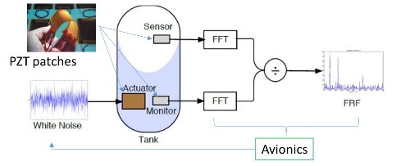
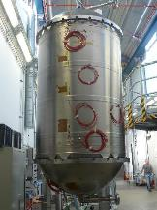
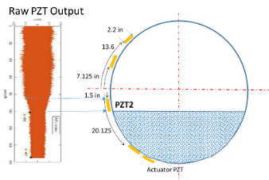
What is Modal Propellant Gauging (MPG)
MPG is Propellant Mass Gauging via measuring structural “fluid-mass-loading” on tank walls
Propellant-agnostic – Broad applicability to HLS and CLPS, Gateway, and Mars
LOx/LCH4 or LH2
MMH/NTO
Natively zero-g and 1-G
Provides Continuous < ~1% fill-level resolution and average point error in settled state
Demonstrated ~0.25% average point error to ref. mass under certain test conditions
Provides Point sensor measurement based on detection of center of PZT
< ~ 1% errors
Non-invasive
Nothing internal to tank
Sensors are easily bonded externally to tank
No leak path added through electrical connectors
Tank-agnostic
Works with metallic or composite and spherical or cylindrical

Slide 15
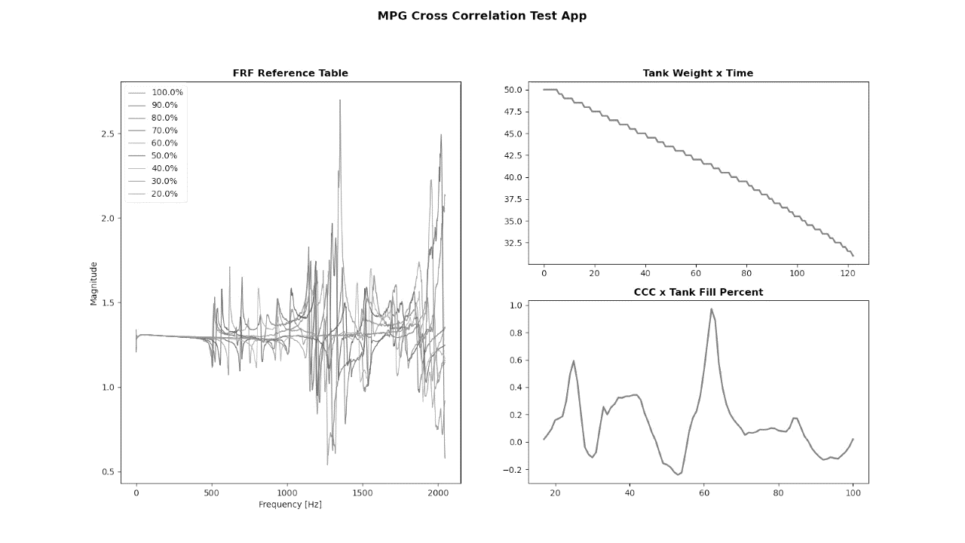
MPG – Cross Correlation Technique

Slide 16
Operational Concept of MPG
Motion, sloshing, no baffles or LAD
+Baffles
MPG Fully Functional
MPG Limitations
MPG Functional in Quiescent Microgravity State
Settled
Engine Burns
Mitigations
Use MPG to detect transient state of some fluid not contacting wall (FRF not stable)
Add LAD and/or Settle with 10-5 g acceleration (depending on fluid) for MPG to work
Mitigations
Develop 0-g calibration over initial flight of the on-orbit stage
Measure propellant usage in 0-g by delta in FRF averaged over time
Inform this thru subscale tank 0-g flights and analytical techniques
Transient accelerations will require wait time to damp fluid motion (ie seconds to minutes)
Point Sensor
& Continuous Modal Gauging
16

Slide 17
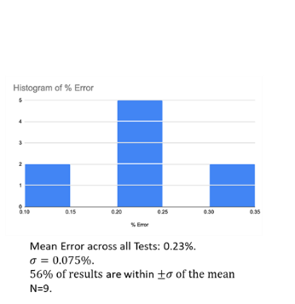
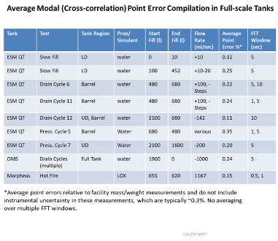
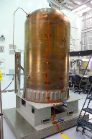
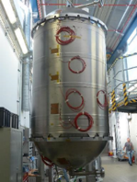
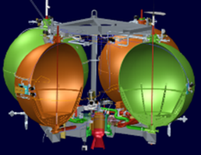
Ground Test of Tanks with complex PMDs in 1-G Completed
Demonstrations of MPG with unique tank geometries and internal hardware to address NESC input from 2017 support activity and some findings from 2020 assessment
Testing has been conducted with Orion tank configurations (ESM qualification tank)
Tank fill and drain test allows MPG mass correlation to be developed.in controlled conditions
Modeling pursued to address sensitivity of MPG to various environments
Sensor patches provide additional loading and mass gauging data when settled in flight
Shuttle OMS Tank
Morpheus – Lox/LCH4
Operation in Plum Brook B2 Chamber with Engine Operation
Orion ESM Tank

Slide 18
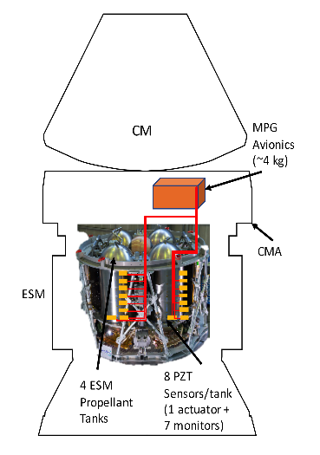
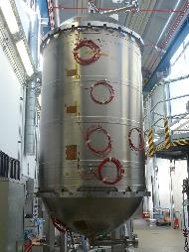
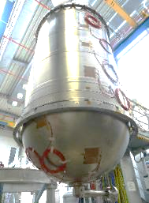
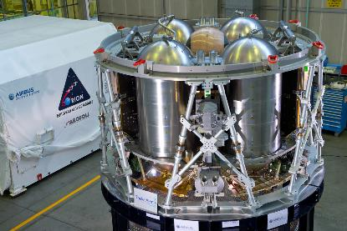
2018 Orion Qualification Tank MPG Testing
Orion ESM Qual. Tank Testing, Summer 2018 ESA/Airbus (6 days)
Pressure Cycles
Fill/Drain Cycles
MPG data collection on a non-interference basis.
MPG data on 8 sensor channels recorded 16,384 samples per second
Notes:
Describe briefly some of the testing on the Orion service module tank, performed over the summer at the Airbus facility here in Bremen.
8 sensors were affixed along the length of the tank as shown in the figure. The proposal is to outfit each of the four tanks with 8 sensors and an avionics box for real-time processing of the modal and point sensor data.

Slide 19
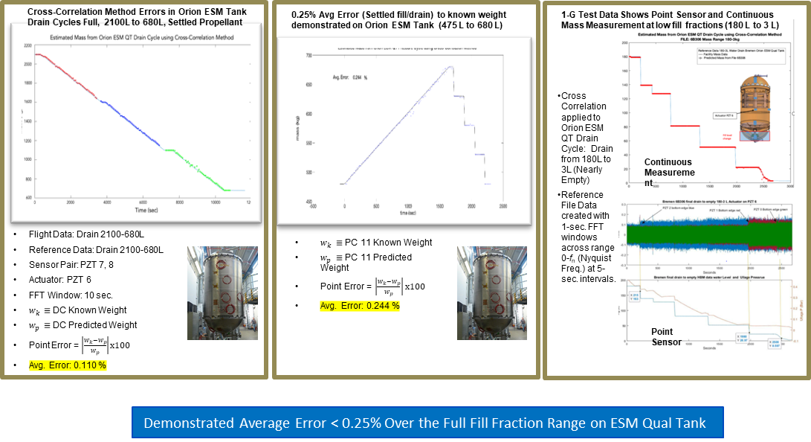
Demonstrated Average Point Errors of 0.1 – 0.25% Settled on ESM Tank
Cross Correlation Algorithm to reference mass with water
Note: Test did not include all sources of error that Orion would see

Slide 20
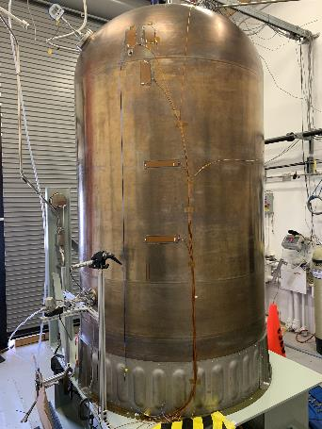
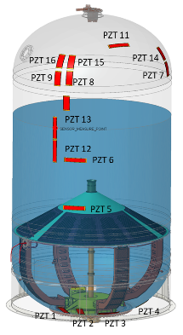
Orion Funded Project Conducted 2022/23 OMS Tank Test Tilt, Pressure, Flowrate Temperature Effects
Purpose
Test Orion PZT geometry
Test possible sources of error on FRF and point sensor performance.
Pressure variations,
Flowrate,
Gimbal angle tilt
temperature
Schedule
Built-up Started
Completed Testing by Feb 2023

Slide 21
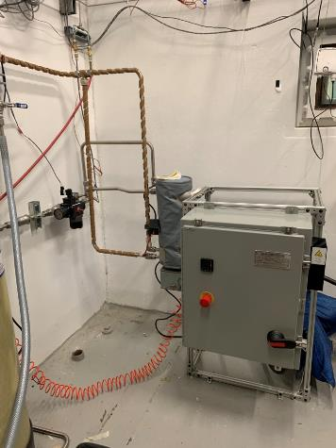
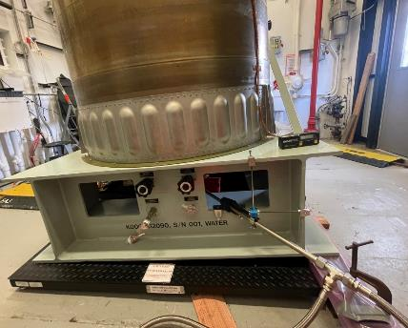
Test Setup Includes Heater and Tilt
Tank Shimmed to 3 deg
External heater for 43C Water Tests

Slide 22
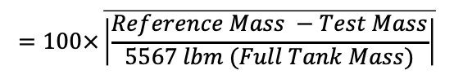
OMS Tank Test (Modal) Errors <1% with Varying Pressure, Temperature, Flowrate, and Tilt
MPG OMS Tank Test Demonstrated Errors from 0.1 to 1% Full Tank over Pressure, Flowrate, 3 deg Tilt, and Temperature Test
Temperature and Pressure data suggest that compensation is possible to further reduce errors
Test Type | Drain Avg. % Error (FT) | Drain % Measured Points within 1.0% | Drain % Measured Points within 0.5% | Drain % Measured Points within 0.25% | Regression Slope (lbm/sec) | 99% Regress + Slope (lbm/sec) | 99% Regress - Slope (lbm/sec) | Facility Mass Slope (lbm/sec) | Avg. % Error after 500 Sec. Drain - Worst Case Regression
GN2; dP=0; Tilt =0 | 0.21 | 98.59 | 92.76 | 79.51 | -9.65 | -9.67 | -9.63 | -9.68 | 0.16
 | 0.12 | 100.00 | 98.52 | 87.25 | -9.51 | -9.52 | -9.51 | -9.51 | 0.10
 | 0.11 | 100.00 | 99.83 | 92.50 | -9.59 | -9.60 | -9.59 | -9.58 | 0.03
GN2; dP=0; Tilt=0; Orion Drain Profile | 0.15 | 98.96 | 98.27 | 83.39 | -9.48 | -9.50 | -9.45 | -9.46 | 0.21
 | 0.10 | 100.00 | 96.03 | 88.10 | -9.24 | -9.30 | -9.18 | -9.31 | 0.10
GN2; dP=0; Tilt=3; Relative Tilt =0; | 0.10 | 100.00 | 99.48 | 96.01 | -9.54 | -9.54 | -9.53 | -9.53 | 0.12
dP=3psi | 0.18 | 100.00 | 94.65 | 74.78 | -9.57 | -9.58 | -9.57 | -9.54 | 0.04
3psi | 0.39 | 98.26 | 72.40 | 31.42 | -9.55 | -9.56 | -9.54 | -9.54 | 0.40
dP=6psi | 0.46 | 92.06 | 63.56 | 38.17 | -9.42 | -9.44 | -9.40 | -9.45 | 0.49
Tilt=3 deg | 0.61 | 87.74 | 40.98 | 14.54 | -9.56 | -9.58 | -9.55 | -9.54 | 0.54
dP=3psi, relative tilt=3 deg | 0.48 | 90.37 | 59.02 | 36.60 | -9.52 | -9.53 | -9.50 | -9.57 | 0.21
thermal | 1.02 | 74.26 | 31.04 | 20.83 | -9.85 | -10.00 | -9.70 | -9.82 | 1.35
GHe Runs | 0.10 | 100.00 | 99.48 | 96.01 | -9.54 | -9.77 | -9.76 | -9.76 | 0.05
dual actuator | 0.29 | 96.70 | 79.17 | 61.46 | -9.53 | -9.54 | -9.52 | -9.50 | 0.35
Drain Avg. % Error
$$=100×\overline{\left|\frac{Reference Mass −Test Mass}{5567 lbm (Full Tank Mass)}\right|}$$
OMS Tank Test Errors from 0.1 % to 1% with Varying Pressure, Temperature, Flowrate, and Tilt

Slide 23
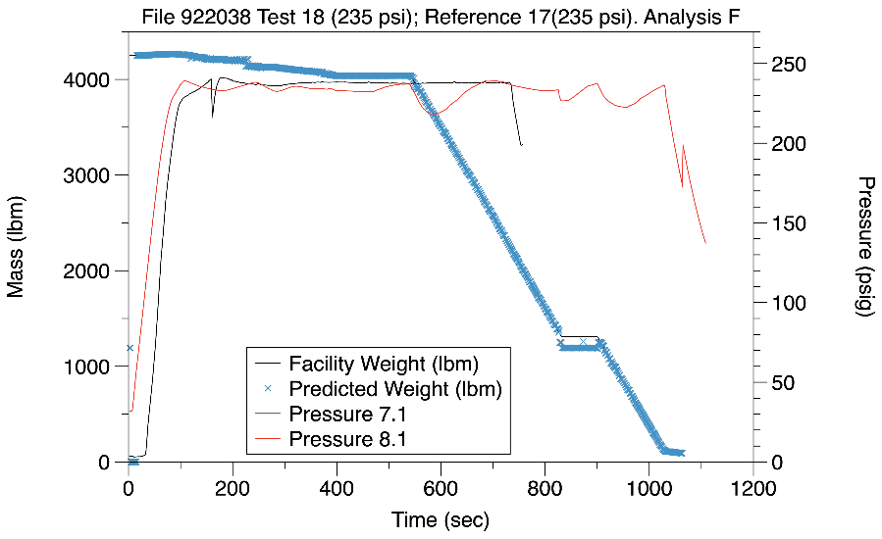
Example MPG Measurements for Orion Upper Tank Burn Profile
7.1 is used as the reference file and 8.1 is the predicted test.
Sensor Config=3; Analysis Parameters F
24 psi dip in reference 7.1 at start of flow.
Dropped Points=0
Full tank continuous drains at 69F, 235 psi GN2
Continuous Drain. Rate: ~9-10 lbm/sec
0⁰ pitch angle
Reference Data Set: Test Matrix Run 9.1-238psi
File: Test9-1Drain1-10-23.mat
Test Data Set: Test Matrix Run 9.2-238psi
File: Test9-2Drain1-10-23.mat

Slide 24
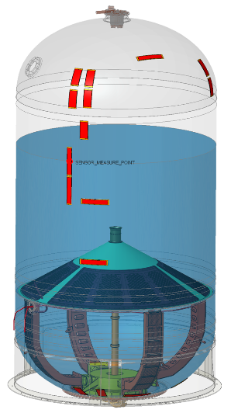
PZT Responds to Liquid Level
Clear Output Signal RMS as liquid passes over PZT
PZT 11
PZT 16
PZT 15
PZT 14
PZT 9
PZT 8
PZT 7
PZT 13
Mass lbms (blue)
PZT 12
PZT 13 Output RMS V (Orange)
PZT 6
Top of PZT
Center of PZT
PZT 5
Bottom of PZT
Time (s)
PZT 1
PZT 4
PZT 2
PZT 3
PZT 1 is the Actuator

Slide 25
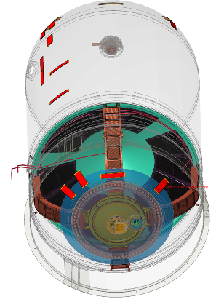
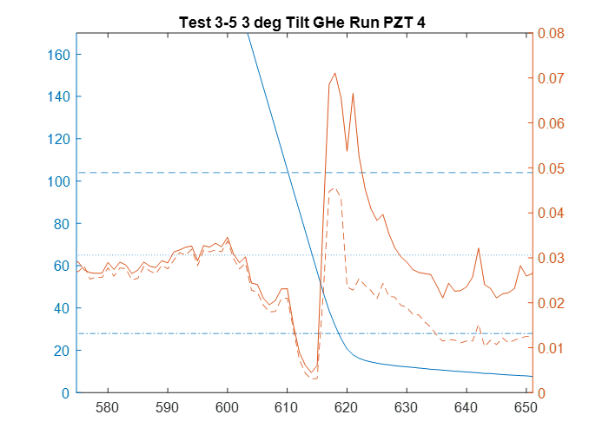
Strong Signal as Tank Nears Empty
Dome Readings are more accurate due to dome curvature
Change in liquid level is a smaller change in mass
There is also strong peak at the time of empty or blow-out conditions that can be measured
Good for serial tank applications like Orion to measure the upper tank
Top of PZT
Mass lbm
RMS V
Center of PZT
PZT4
Bottom of PZT
Time (sec)
2/2/2023
25

Slide 26
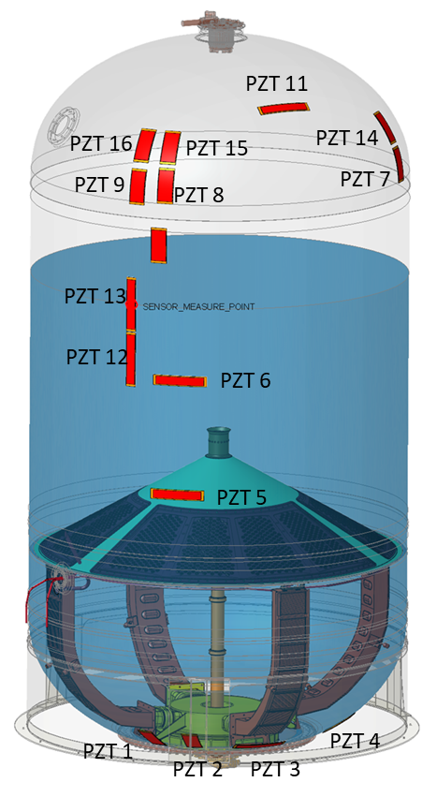
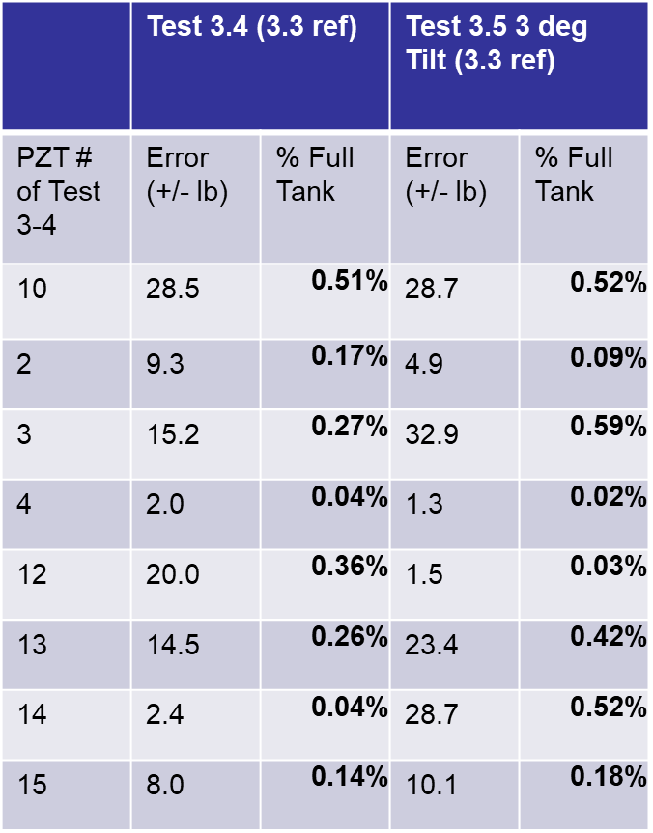
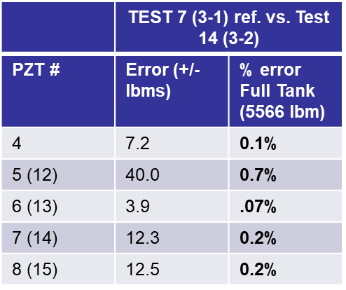
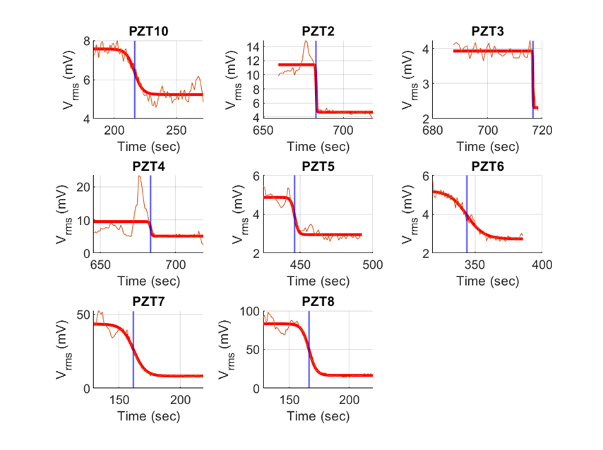
Point Sensor Algorithms and Errors (.02% TO 1 % Full Tank)
Developed and Evaluated Two Algorithms to detect liquid crossing center point of the PZT
Sensor midpoint is identified as the midpoint of the tanh function fit and fill level is associated with the known location of sensor midpoint.
Methods of detection
1) NLT Fit of Tanh Algorithm has advantage in barrel and does not require a reference
2) ref. Signature Algorithm can work better in dome since it includes effects of dome curvature and location relative to actuator
1. NLT Fit TANH Algorithm
Sensor midpoint locations can be estimated with an accuracy of <1% of Full Tank Volume.
Average Point Sensor Error:
Domes: 1.0%
Barrel: 0.87%
2. Ref. Signature Algorithm

Slide 27
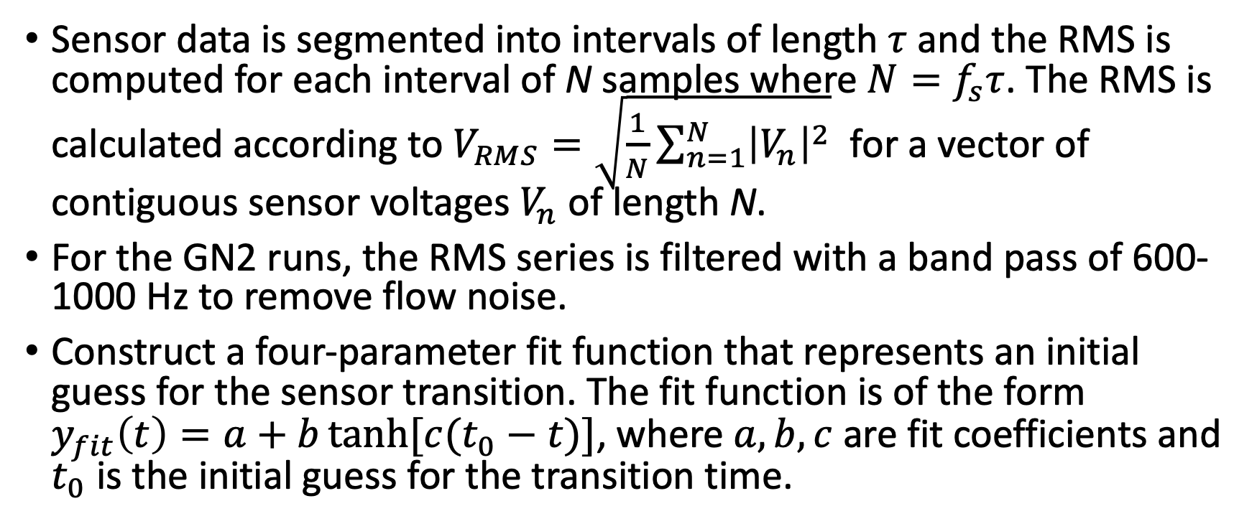
Tanh Function Fit to RMS
Sensor data is segmented into intervals of length $τ$ and the RMS is computed for each interval of N samples where $N=f_{s}τ$. The RMS is calculated according to $V_{RMS}=\sqrt{\frac{1}{N}\sum_{n=1}^{N}{{\left|V_{n}\right|}^{2}}}$ for a vector of contiguous sensor voltages $V_{n}$ of length N.
For the GN2 runs, the RMS series is filtered with a band pass of 600-1000 Hz to remove flow noise.
Construct a four-parameter fit function that represents an initial guess for the sensor transition. The fit function is of the form $y_{fit}\left(t\right)=a+b\tanh{[c(t_{0}−t)}]$, where $a,b,c$ are fit coefficients and $t_{0}$ is the initial guess for the transition time.

Slide 28

Tanh Function Fit to RMS
Sensor midpoint is identified as the midpoint of the tanh function fit and fill level is associated with the known location of sensor midpoint.
Sensor midpoint locations can be estimated with an accuracy of <1% of Full Tank Volume.
Average Point Sensor Error:
Domes: 1.0%
Barrel: 0.87%

Slide 29





MPG and Engine Burn Operation Tested on ICPTA – LOx/LCH4
Integrated Cryogenic Propulsion Test Article (ICPTA )
MPG installed on the Parallel Tanks 4 ft dia, 275 to 325 psia, LO2
Piggy-back Test at Plum Brook B-2 with the ICPTA engine firing under vacuum with provided data to help reduce that risk for the MPG
Parallel Tanks
Test Firing on Feb 14, 2017

Slide 30


MPG Demonstrated During Engine Operation
30 sec Hot-fire Test at 2800 lbf conducted to determine interference between main engine noise and the MPG
Tested Plum Brook thermal vacuum test facility
System uses Two 48” diameter LO2 tanks in parallel feeding 1 engine
Tank L102 (“Tank 2”) was used as the reference tank to predict L101 (Tank 1)
Major Findings
Noise did not interfere with measuring mass during the engine burn
One tank can be used as the reference for another tank as both have similar responses

Slide 31




New Shepard Provides Equilibrated Zero-g Tests
NS10 Mission: January 2019

Slide 32



Suborbital Flight Tests
New Shepard P9: Static Liquid Levels
Three partially filled tanks
Modal data recorded from T+10:T+260 sec.
Video data recorded from T+65:T+340 sec.
Sample Rate: 16384 Samples/sec.
Reported at NSRC 2020: 2% Gauging Accuracy

Slide 33




Suborbital Flight Tests
New Shepard P11: Gauging During Liquid Transfer in 0-g

Slide 34


MPG Tank Modeling Approach
Suborbital Flight Tests
Use High-fidelity Coupled CFD-FE model to predict
Zero-g mode frequencies as a function of fill level.
Multiphysics Model built with Ansys Mechanical, Fluent.
34

Slide 35

CFD-FE Reference Predicts Zero-G Fill Data

Slide 36



Built MPG Avionics Prototype System
Centralized avionics architecture: 4-board MISL bus stack up (from top to bottom)
FPGA board
Analog Sensor Interface board
High Voltage Power/Sensor Actuator board
MISL Power board
Supports 4 Tanks with 8 sensor channels per tank
Perform MPG algorithms
Outputs real time data over an Ethernet interface
Status
Verified FRF real time on avionics in FY19
Moving CCC algorithm over to FPGA in FY20
Need to verify that this is possible

Slide 37

MPG Avionics synergy with Splice & HSRA
Safe & Precision Landing Integrated Capability Evolution (SPLICE) funded by STMD Game Change Project, SMD, HEOMD – multi directorate funded
Human Rated Space Avionics Product Line (HRSA PL) funded by JSC EA (EIF), SPLICE, MPG, AES A&S – to support core functions for multi-projects
MPG Algorithm to run on Xilinx Kintex Ultrascale FPGA with flexibility to fly an industrial or radiation part
MPG Avionics system (1 avionics box) to support 4 tank measurements at 1 HZ
Splice EDU is 6.1 kg
MPG Avionics ~8 kg
22 x 17 x 25 cm
Architecture has Industrial or Rad Tolerant Option using Kintex Ultrascale FPGA

Slide 38
Conclusions
MPG is an external mass gauge system that does not create a leak path
Cross-Correlation and Point Sensor Algorithms successfully demonstrated
Demonstrated <1% average error for full tank
With temperature or pressure compensation a goal of 0.25 % may be achievable
Engine noise did not significantly interfere with mass measurement using Cross-Correlation
Additional engine noise tests will be performed using recent Artemis I data
Tanks of the same part number behave similarly
Can use one tank to develop FRF/mass reference table for all other tanks of the same part number and support system
MPG Point Sensor readings provide another accurate method to establish fluid level in the tank during loading or during a burn
FPGA based avionics and algorithm design provides 1 HZ update on mass measurement
The design being developed provides industrial and Rad Tolerant options for avionics for Deep Space Use

Slide 39

Existing propellant gauging methods comparison
Introduces No leak Path on tanks
Compatible with both MMH/NTO and cryogenics
1G and zero-g capability
Modal Propellant
Gauge (MPG) Has
Advantages
June 20, 2019 - Rev. FNL

Slide 40
Forward Plan
MPG Capabilities are applicable to HLS, Gateway, Orion, Mars
Compatibility with all propellants – no contact with the fluids
No leak path introduced to the tank as needed with internal sensors
Enhance knowledge of propellant loaded on the ground up to 0.25% resolution
Absolute error depends on reference mass knowledge and fidelity of calibration
Provide mass consumed in flight or transferred up to 0.25% resolution
Provides precise mixture ratio monitoring of the engines
Provide data on differential draining of parallel tank configurations typical of landers
Provides Low level propellant indications using point sensor and continuous gaging during burn
Important knowledge during entry descent and landing for hazard avoidance
Forward Plans
Test on flight tank with NTO and MMH for a flight application
Intuitive Machine SAA to fly on NOVA-C lander using Lox/LCH4
Pursuing additional ISS flight experiment
Design subscale tanks to address possible flight tank configuration as best as possible

