Slide 1
STAC Best Practices
WGISS-54
October 4th, 2022
Doug Newman
NASA ESDIS Project, Goddard Space Flight Center
douglas.j.newman@nasa.gov

Slide 2
Summary
A recap of STAC
Top six best practices for WGISS
Discussion
Notes:
STAC - SpatioTemporal Asset Catalogs
WGISS - the Working Group on Information Systems and Services

Slide 3
Recap
STAC overview

Slide 4
What is STAC?
‘The SpatioTemporal Asset Catalog (STAC) family of specifications aim to standardize the way geospatial asset metadata is structured and queried.’
Asset-oriented
Cloud-friendly
A lean standard
Popular

Slide 5
STAC Best Practices
The official location

Slide 6
Official Best Practices
https://github.com/radiantearth/stac-spec/blob/master/best-practices.md
The top 6 with respect to WGISS and the CWIC follow,
Notes:
CWIC - CEOS WGISS Integrated Catalog
CEOS - Committee on Earth Observation Satellites

Slide 7
Organizing your catalog hierarchy
Best Practice 1
Notes:
Here’s where STAC comes in

Slide 8
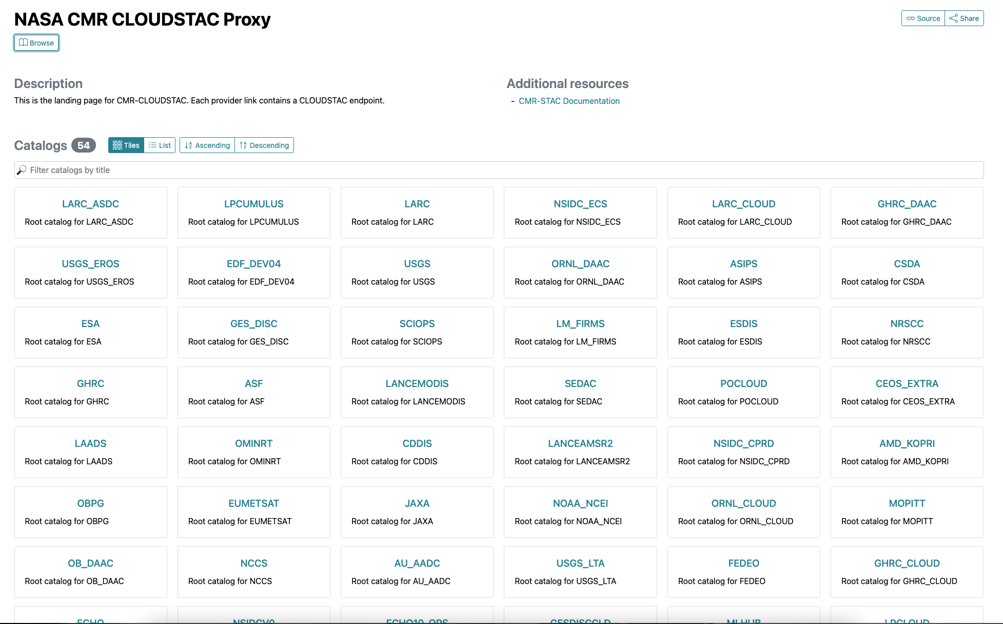
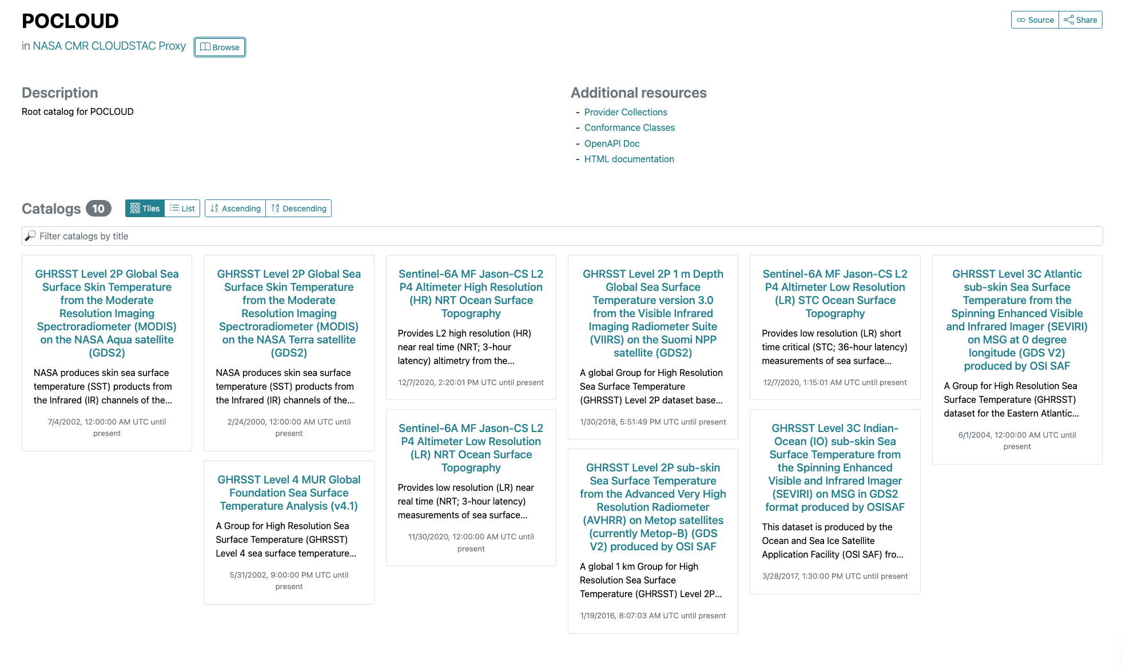
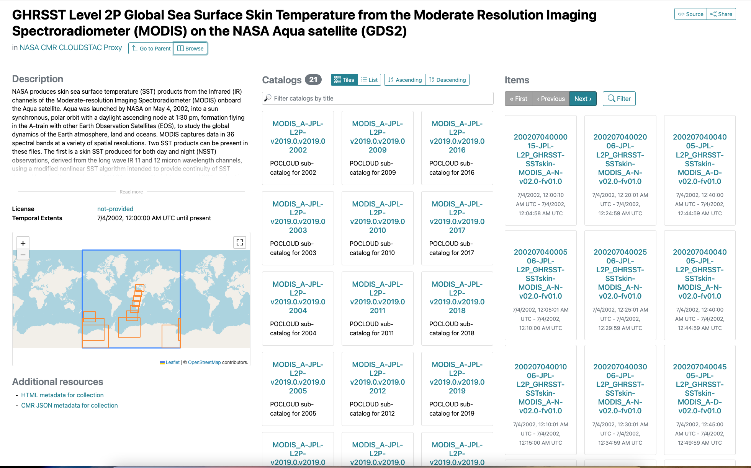
A CMR example
Root : STAC catalog of providers catalogs
  Provider : STAC catalog of collection catalogs
    Collection : catalog of granule items
      Granules - items
Notes:
https://radiantearth.github.io/stac-browser/#/external/cmr.earthdata.nasa.gov/cloudstac/
https://radiantearth.github.io/stac-browser/#/external/cmr.earthdata.nasa.gov/cloudstac/POCLOUD
https://radiantearth.github.io/stac-browser/#/external/cmr.earthdata.nasa.gov/cloudstac/POCLOUD/collections/MODIS_A-JPL-L2P-v2019.0.v2019.0

Slide 9
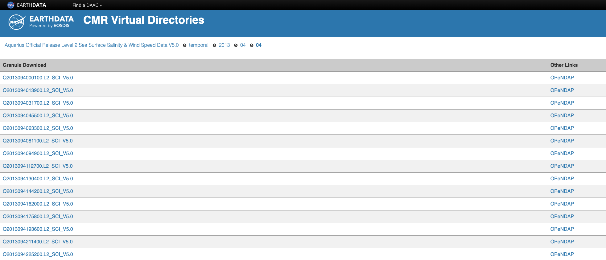
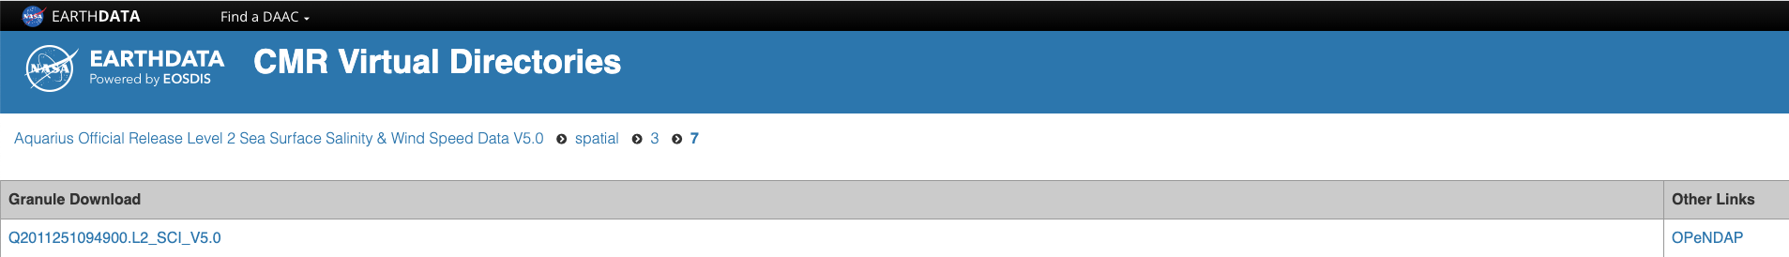
Other examples
You are free to organize your catalog hierarchy as you choose. Perhaps temporally or spatially,
Notes:
https://cmr.earthdata.nasa.gov/virtual-directory/collections/C2036882456-POCLOUD/temporal/2013/04/04
https://cmr.earthdata.nasa.gov/virtual-directory/collections/C2036882456-POCLOUD/spatial/3/7

Slide 10
For federated search
A centralized collection-level catalog (CMR) that directs clients to item catalogs that are federated across CEOS.
CMR
Collection catalog
  Collection 1 ->
    Collection item catalog at ISRO
  Collection 2 ->
    Collection item catalog at INPE
ISRO
Collection catalog
  Collection 1
Notes:
CMR - Common Metadata Repository
ISRO - Indian Space Research Organisation
INPE - National Institute for Space Research, Brazil

Slide 11
Enable CORS
Best Practice 2
Notes:
CORS - Cross-origin resource sharing

Slide 12
If you want to improve accessibility, enable CORS on your resources/services so that diverse online tools can access your data.
This will allow interoperability with things like stacindex.org, stac-browser etc.

Slide 13
Be compatible with STAC browser
Best Practice 3
Notes:
Here’s where STAC comes in

Slide 14
STAC-browser is a great way for users to search your data using STAC conventions.
It also provides a way of testing that your STAC API/Catalog is compliant and usable.
https://github.com/radiantearth/stac-browser
Notes:
API - application programming interface

Slide 15
Asset-oriented catalogs
Best Practice 4
Notes:
Here’s where STAC comes in

Slide 16
Asset roles
Use asset roles to describe how they are to be used.
"assets": {
"analytic": {
"href": "https://storage.foo.com/open-cogs/stac-examples/20201211_223832_CS2_analytic.tif",
"type": "image/tiff; application=geotiff; profile=cloud-optimized",
"title": "4-Band Analytic",
"roles": [
"data"
]
},
Notes:
Assets are the end-game of STAC.

Slide 17
Cloud-native assets
Use s3:// or gs:// URLs where possible.
Consider using the alternate assets extension* to provide cloud-native locations for your assets
Consider using the storage extension** for assisting cloud-native access patterns (bringing compute to the data)
*https://github.com/stac-extensions/alternate-assets
**https://github.com/stac-extensions/storage
Notes:
Assets are the end-game of STAC.
URL - Universal Resource Locator

Slide 18
Catalog decisions
Best Practice 5
Notes:
Here’s where STAC comes in

Slide 19
Catalogs
Static Catalogs
A set of files on a web server that link to one another in
a way that can be crawled.
A simple way to present different sub-catalog views.
Browse not query.
Dynamic Catalogs
An HTTP-based API that can be queried to return STAC
catalogs.
Browse and query.

Slide 20
Relative vs absolute URLs
Be consistent within your catalog. Use solely absolute or relative URLs.
Absolute Published Catalogs
For catalogs that span multiple domains (potentially
CMR) then absolute URLs are essential to differentiate
catalogs at different agencies.
Relative Published Catalogs
For single domain catalogs (a CWIC provider) use
relative URLs with an absolute self link
Self-contained Catalogs
For portable catalogs use relative URLs for all structural links.

Slide 21
Searchable Identifiers
Best Practice 6

Slide 22
STAC aims to be oriented around search.
Aid this goal by…
Providing identifiers that are human-readable but also unique within a catalog.
‘Identifiers should consist of only lowercase characters, numbers, _, and -’
This is intended to minimize the need of aliases in search resolution. E.g. ‘sentinel-1’ as opposed to combinations of ‘sentinel-1’ and ‘Sentinel-1’ and ‘SENTINEL-1’

Slide 23
Discussion

