Slide 1
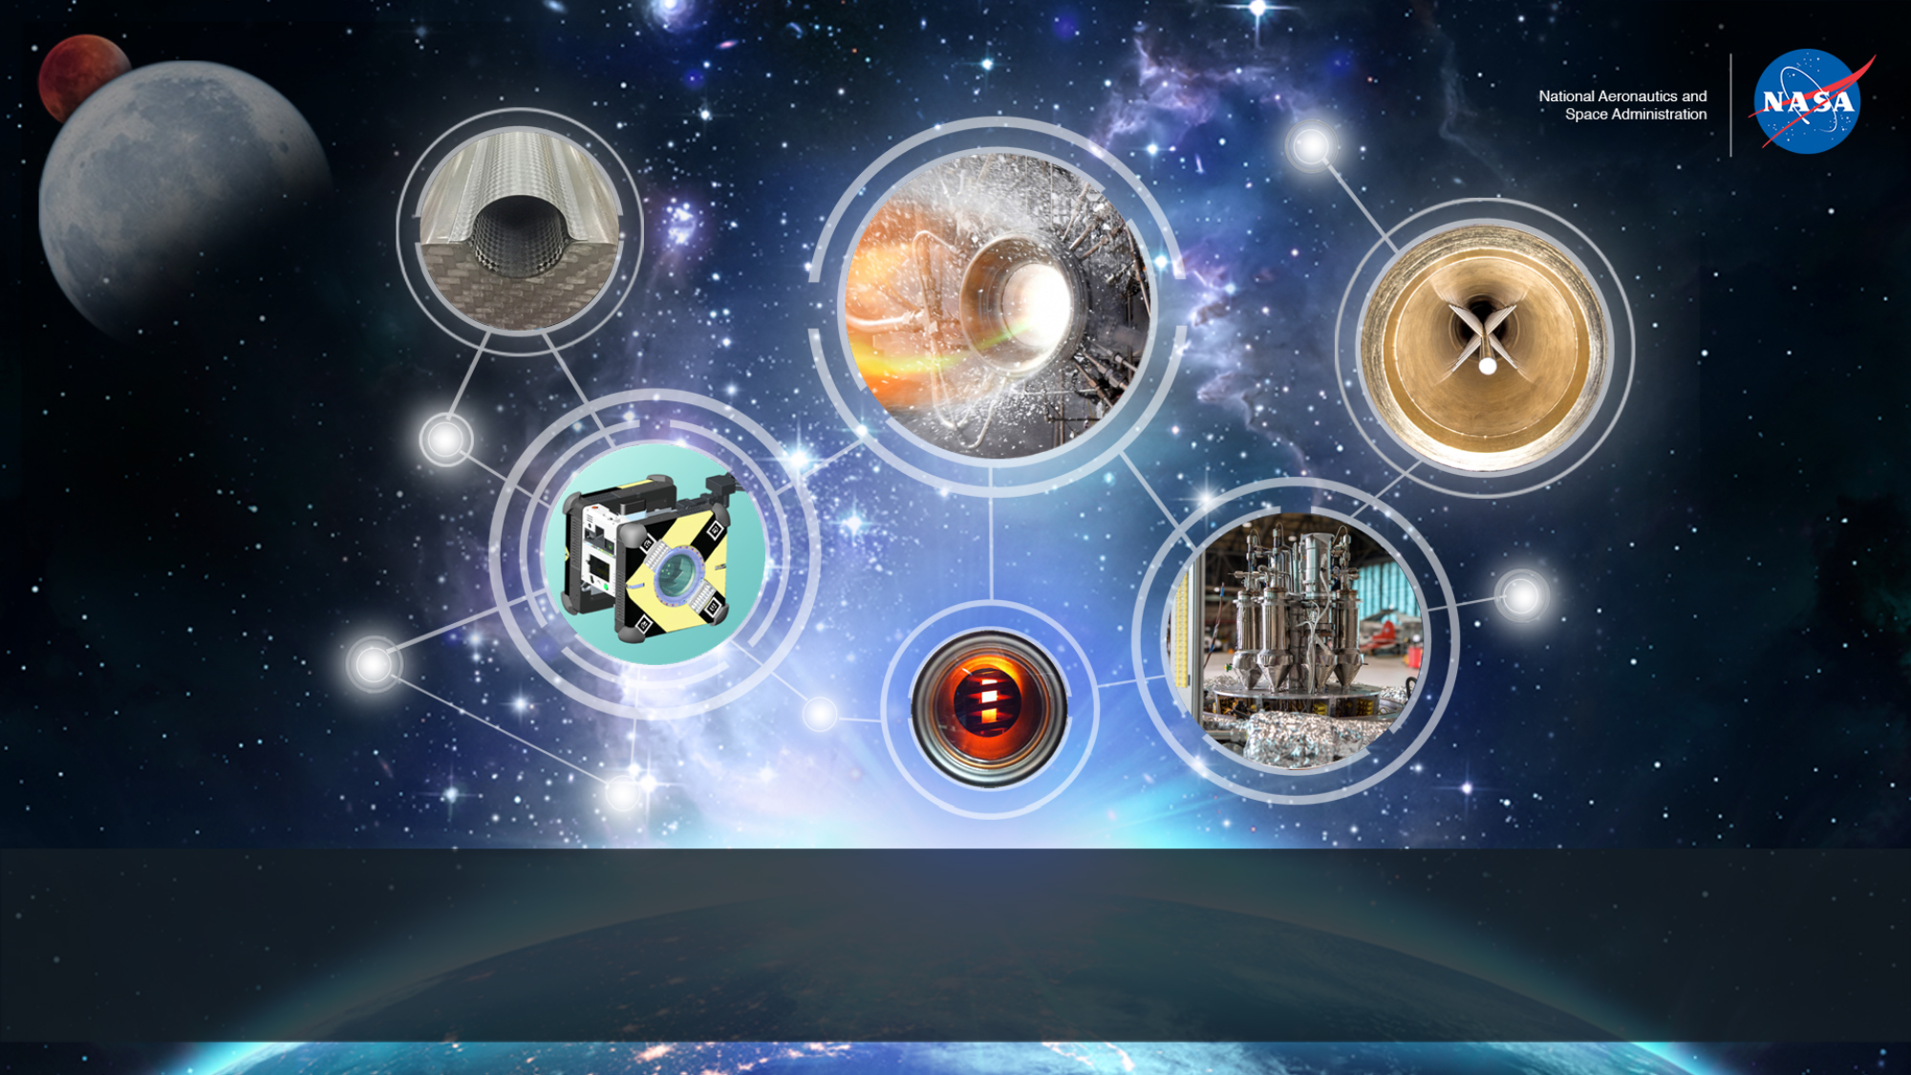
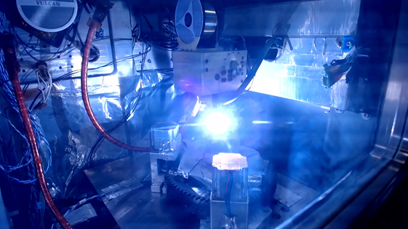
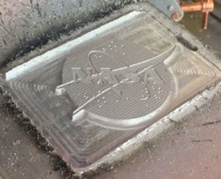
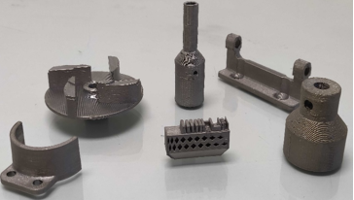
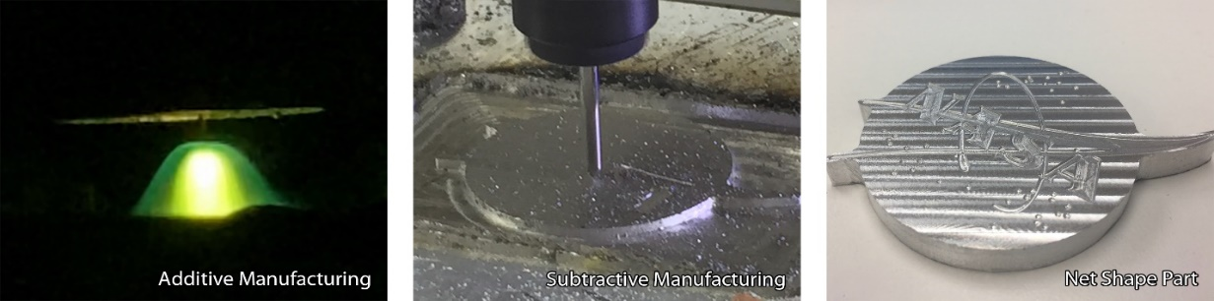
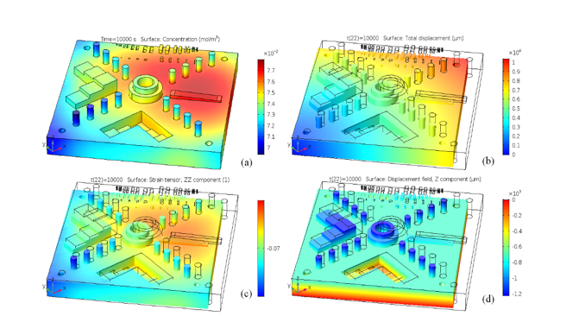
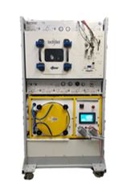
Space Technology Mission Directorate
Game Changing Development Program
Dr. Chris Roberts | Frank Ledbetter | FY22 ODMM Annual Review Presentation | 09.15.2022
Dr. Chris Roberts | christopher.e.roberts@nasa.gov

Slide 2

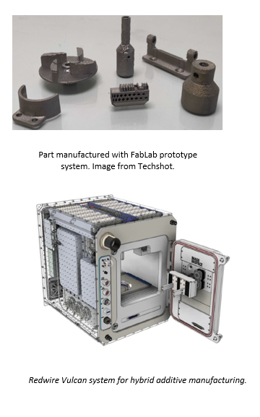
On-Demand Manufacturing of Multi-Materials(ODMM) Overview
Technology Product Capability
Development and demonstration the feasibility of a low-gravity, on-demand manufacturing system for metal parts on the International Space Station.
  R&R Objectives:​ Develop the capability to recycle and reuse materials into useable feedstocks for in-space, on-demand manufacturing.​
  Outfitting Objectives:​ Develop the capability to manufacture on-demand utilities, furnishings, tools, etc. for off-earth habitation including the use of In-Situ Resources.
Technical Capabilities
Develop systems which meet ISS operational constraints (mass, power, volume, safety, limited crew interaction).
Exploration & Science Applicability
Current approach to logistics, which relies on pre-positioned spares, is not sustainable for long duration missions where cargo resupply opportunities are limited.
Once tested on ISS, capabilities developed under ODMM can provide a means to manufacture parts at the point of use on future space missions, reducing the amount of up mass and enhancing crew safety.

Slide 3
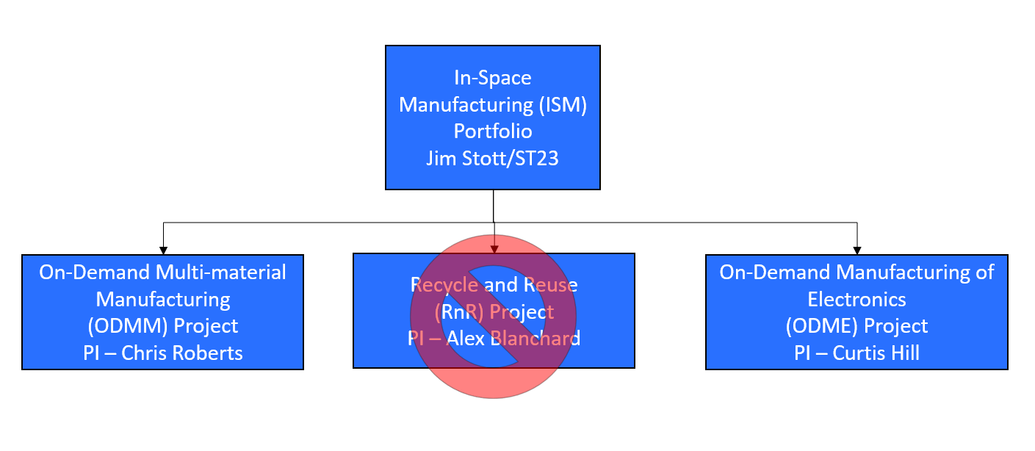
ISM Portfolio
Notes:
If you have submitted a Project Plan, you could utilize the Organizational Chart found in section 8.3 – Management Structure

Slide 4
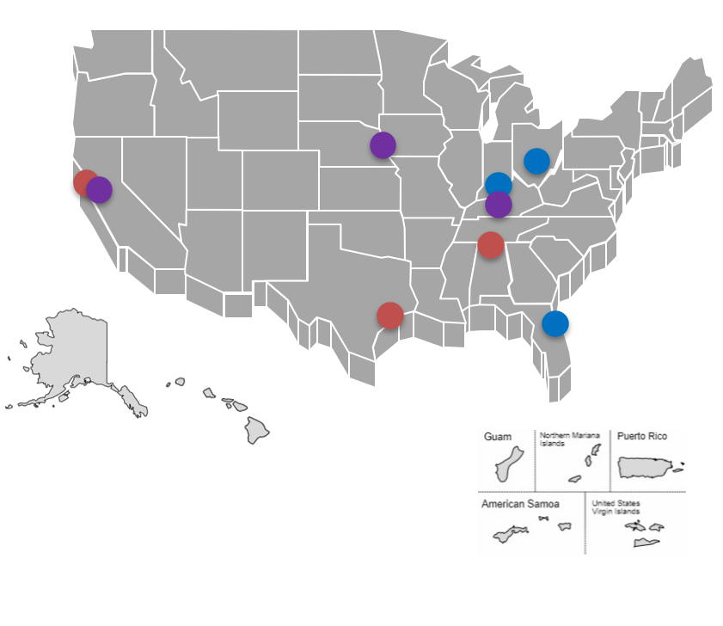


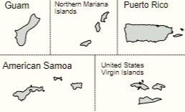
ODMM Collaborations & Partnerships
Contributing Partners and/or Stakeholders
  Techshot, Inc.
  Redwire Space, Inc.
  Cornerstone Research Group*
Contributing Centers
  Marshall Space Flight Center
  Ames Research Center
  Johnson Space Center
Academic Partners
  University of Louisville
  University of California, Berkeley
  University of Nebraska, Omaha
Infusion/Transition Plan
  Technologies will be proven and demonstrating using the ISS as a testbed and then infused into future NASA missions such as Gateway and Lunar Surface Habitats.
  ISS Demonstrations – some complete and more to come
  Lunar Habitat– potential
  Gateway – potential
  Mars Habitat - potential
Notes:
Infusion: An investment reaches a conclusion where a technology is handed off for use by a mission or other need. Infusions can be made to other NASA Mission Directorates, other Government Agencies, Commercial Entities, or International Partner.
Transition: An investment reaches a conclusion where a technology is handed off for further development. Transitions can be made to other STMD programs, other NASA Mission Directorates, academic institution, other Government Agencies, Commercial Entities, or International Partner.

Slide 5
ODMM
Project Goals & Project Objectives
Project Goals
Goal #1 | Develop and demonstrate the feasibility of a low-gravity, on-demand manufacturing system for metal parts on the International Space Station.
Project Objectives
Objective #1 | Design, build, and demonstrate an on-demand manufacturing approach in low gravity for metal parts.
Objective #2 | Develop and demonstrate recycling and reuse technologies that are compatible with manufacturing systems under development.
Objective #3 | Deliver to ISS a flight-certified, on-demand manufacturing system or systems.
Objective #4 | Demonstrate the manufacture of metal parts in a low-gravity environment on ISS.
Objective #5 | Evaluate parts made on ISS against parts produced on the ground.
Objective #6 | Develop physics-based models to predict processing parameters and material outcomes under low-gravity conditions for metals.

Slide 6
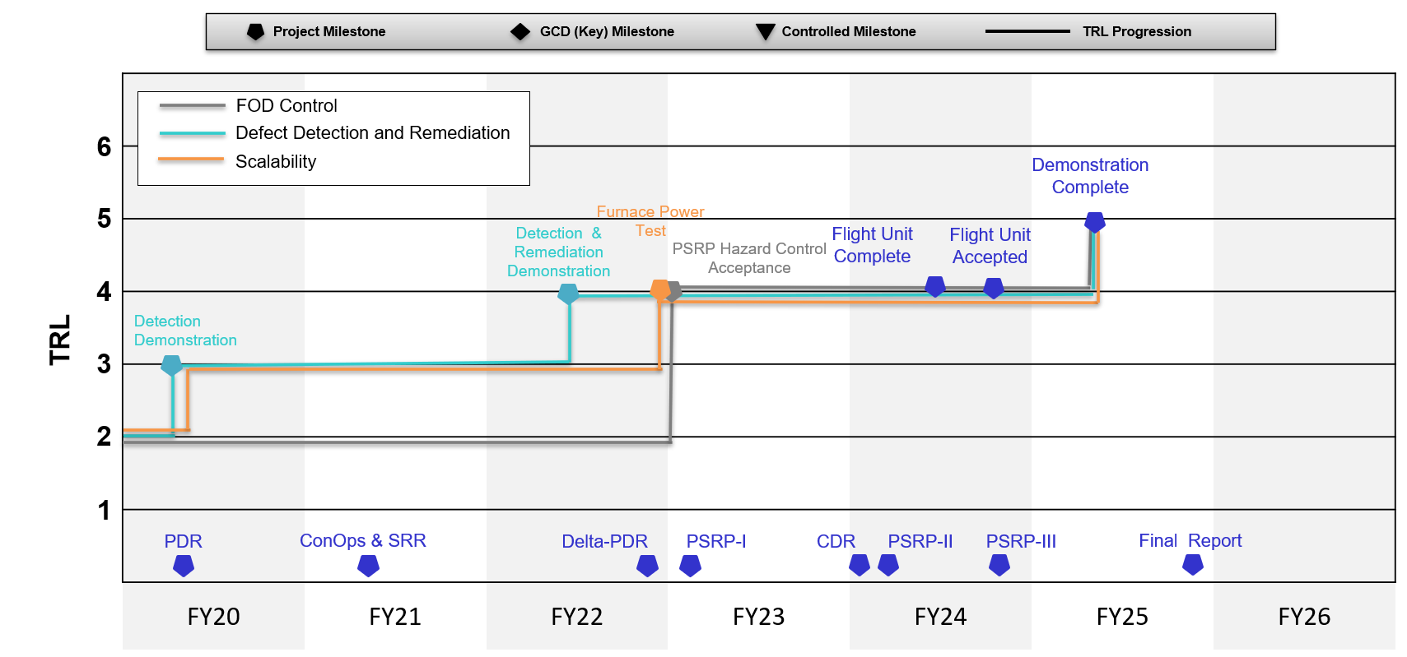
On Demand Manufacturing of Metals
FabLab Technical Assessment Maturation

Slide 7
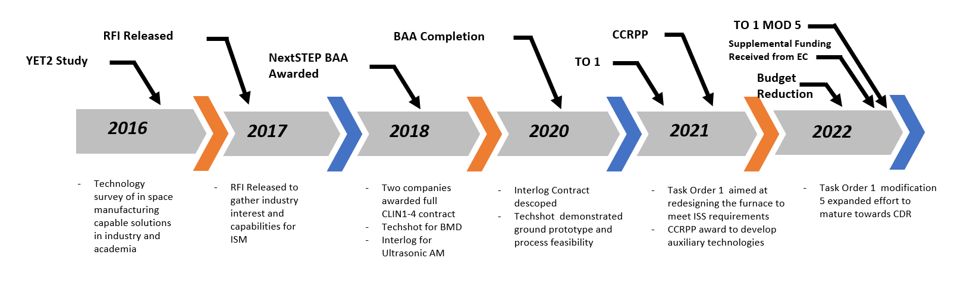
ODMM Accomplishments
  ODMM Project Management Accomplishments:
  Conducted a TAPR on 2/10/2022 to assess the projects progress toward KPPs and inform the board of the need for a downselect.
    FabLab system was recommended as the primary system for future development.
  Secured additional funding from EC to start maturation towards CDR.
    Task Order 1 Modification 5 was awarded.
  Revised project plan submitted for approval.
Notes:
If you have submitted a Project Plan, you could utilize the Organizational Chart found in section 8.3 – Management Structure

Slide 8
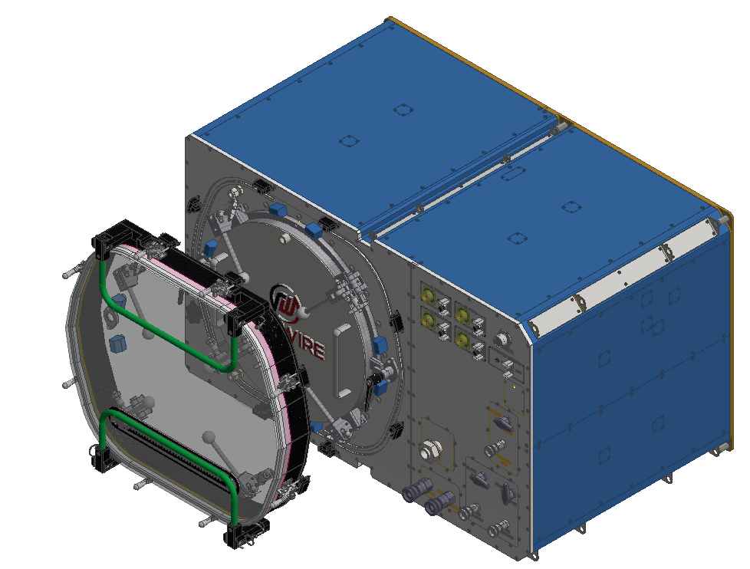
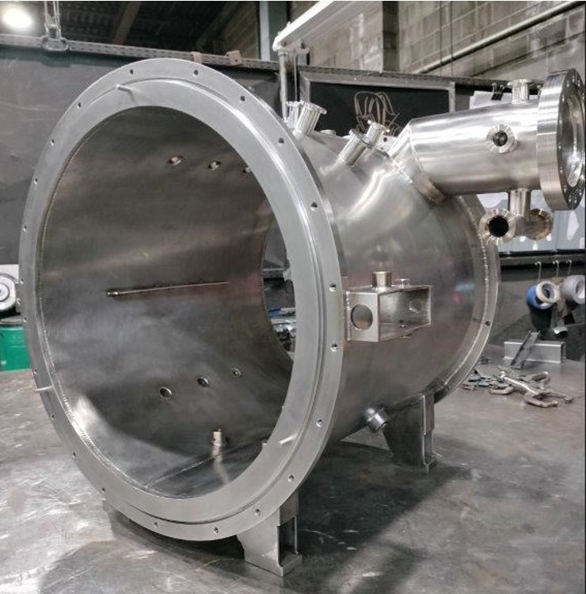
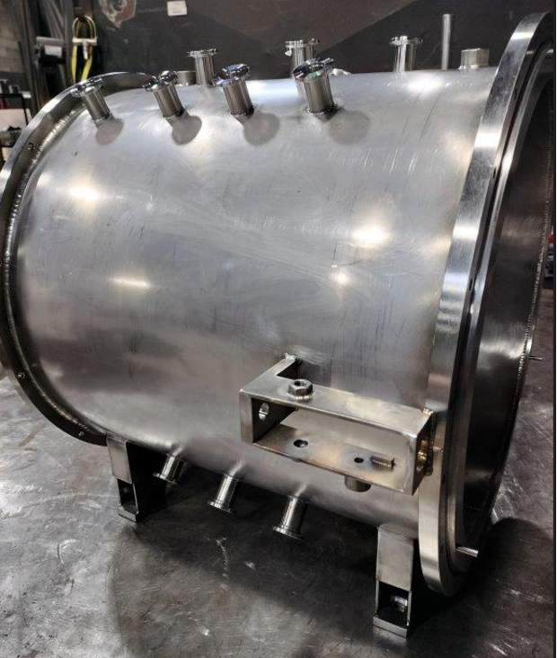
ODMM Accomplishments
  FY22 Furnace Power Reduction:
  Techshot along with subcontractor TM Vacuum Furnaces conducted a trade study of insulation materials and thermal management strategies.
  Techshot performed a preliminary thermal analysis on the revised furnace module showing the design meets margins.
  Coolant loop design changed to accommodate separate loops for MTL fluid and furnace coolant.
  EDQU design finalized and currently undergoing manufacturing.
CAD of Revised furnace module (top). Furnace module hotzone during manufacturing.
Image courtesy of Techshot a Redwire company (bottom).

Slide 9
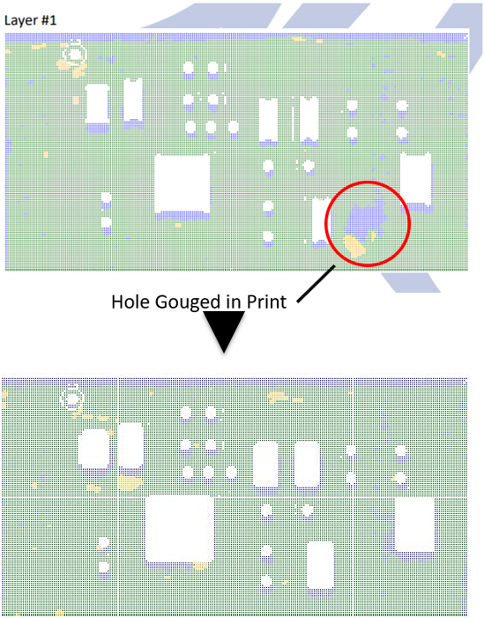
ODMM
Accomplishments
  FabLab FOD Control:
  Glovebag design matured for use on the Techshot FabLab facility.
    Testing study conducted to determine the optimal sealing design (gasket grove vs flange design).
    Clamping design refined.
    Part transfer box designed and manufactured.
    FabLab Defect Detection and Remediation:
    Detection and Remediation algorithms incorporated into control software and demonstrated on an electronics part.
Illustration of inspection and remediation. A forced defect was placed on layer 1 and corrected by layer 5. Image courtesy of Techshot a Redwire company.

Slide 10
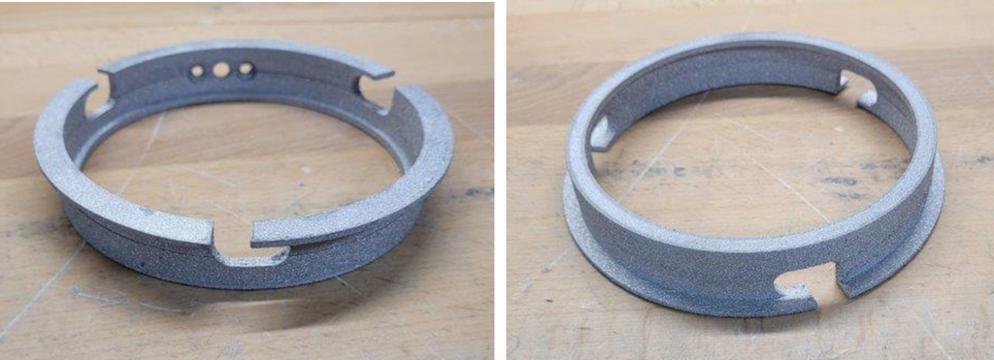
ODMM Accomplishments
  FabLab General Process Development:
  Successfully printed a wrist connection for an extra-vehicular activity (EVA) suit using the FabLab process.
  Reduced temperature sintering studies indicated acceptable properties at lower temperatures than characterized in Phase A.
  Brazing materials development: tensile testing by the contractor of a brazed dog bone to characterize secondary material properties.
  Release coating study ongoing.
Space Suit Wrist Disconnect manufactured by FabLab. Image courtesy of Techshot a Redwire company.

Slide 11
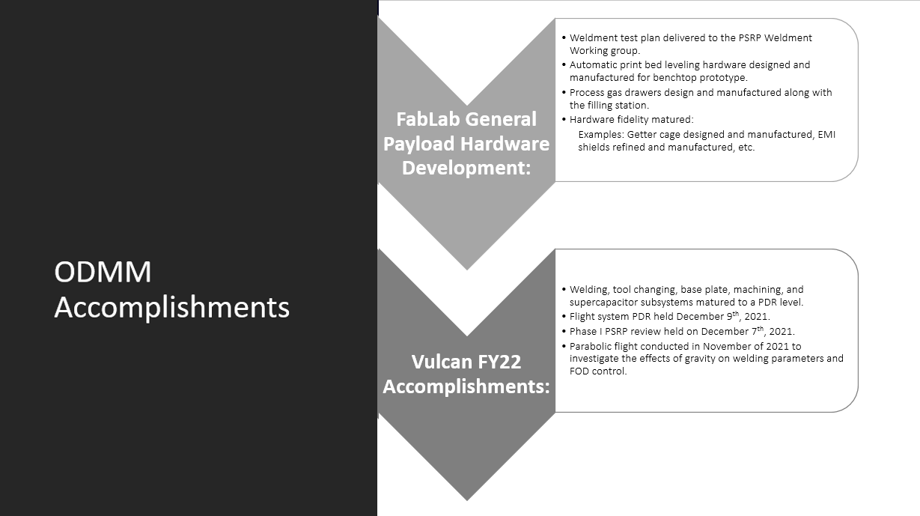

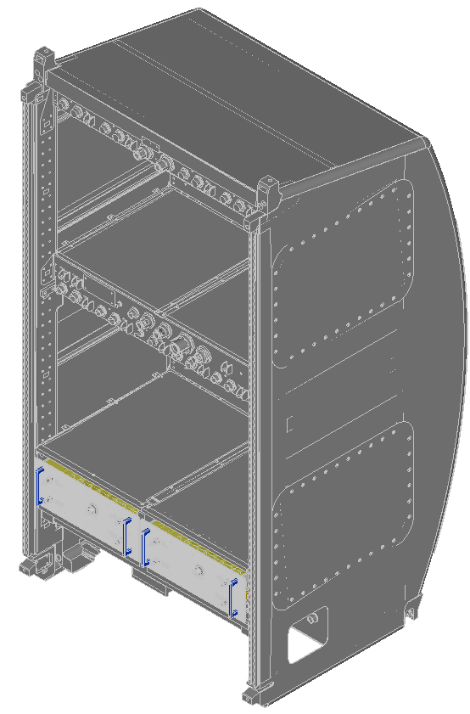
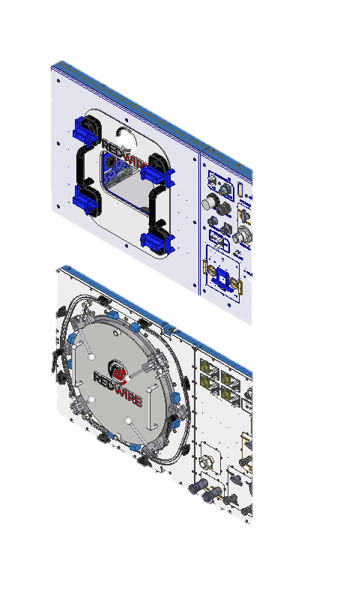

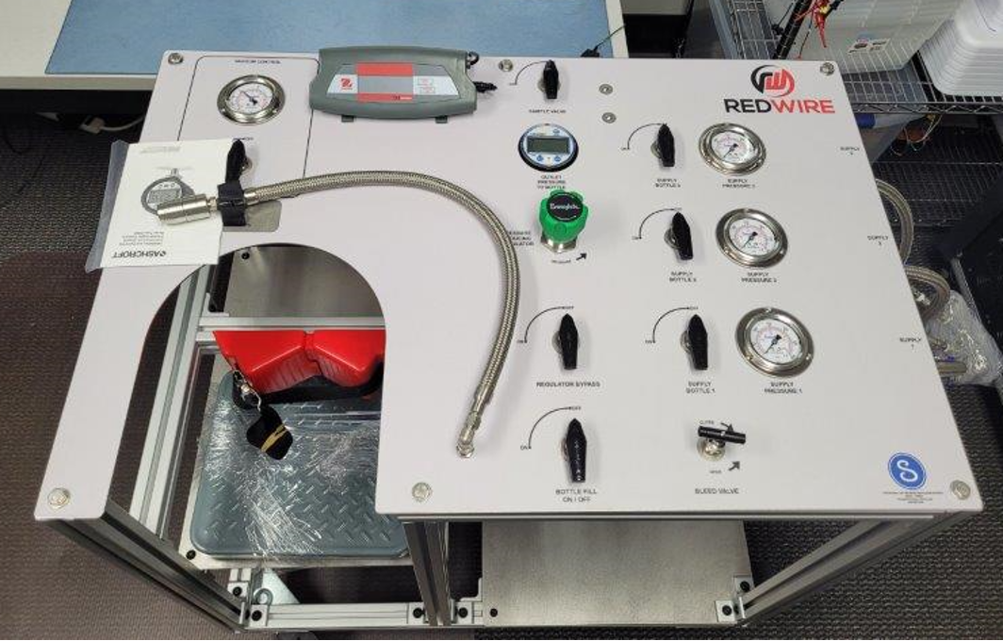
ODMM Accomplishments
ODMM Accomplishments
Weldment test plan delivered to the PSRP Weldment Working group.
Automatic print bed leveling hardware designed and manufactured for benchtop prototype.
Process gas drawers design and manufactured along with the filling station.
Hardware fidelity matured:
  Examples: Getter cage designed and manufactured, EMI shields refined and manufactured, etc.
FabLab General Payload Hardware Development:
Weldment test plan delivered to the PSRP Weldment Working group.
Automatic print bed leveling hardware designed and manufactured for benchtop prototype.
Process gas drawers design and manufactured along with the filling station.
Hardware fidelity matured:
Vulcan FY22 Accomplishments:
Welding, tool changing, base plate, machining, and supercapacitor subsystems matured to a PDR level.
Flight system PDR held December 9th, 2021.
Phase I PSRP review held on December 7th, 2021.
Parabolic flight conducted in November of 2021 to investigate the effects of gravity on welding parameters and FOD control.
Examples: Getter cage designed and manufactured, EMI shields refined and manufactured, etc.
Welding, tool changing, base plate, machining, and supercapacitor subsystems matured to a PDR level.
Flight system PDR held December 9, 2021.
Phase I PSRP review held on December 7, 2021.
Parabolic flight conducted in November of 2021 to investigate the effects of gravity on welding parameters and FOD control.
Vulcan canceled due to GCD budget cuts.
Process gas bottle filling station. Image courtesy of Techshot a Redwire company

Slide 12
ODMM Accomplishments
  Recycling and Reuse (RnR):
  Cornerstone Research Group Reversible Thermosetting polymer (RVT) Development:
    Identified flame retardants and stabilizers compatible with RVT.
    Masterbatched two formulations of the RVT material with 15% flame retardant additives.
    Material characterization of virgin and formulation one of RVT.
  University of Nebraska CAN :
    Manufactured coupons of virgin PLActive (polylactic acid-based biocidal filament) and MDFlex (Thermoplastic polyurethane-based biocidal filament) for mechanical, chemical testing, and microbial testing.
    Successfully completed one recycling iteration of PLActive and MDFlex.
    PLActive showed a minimal decrease in biocidal activity while MDFlex exhibited a slightly larger but acceptable decrease in biocidal activity.
    Outfitting:
    CHAPEA:
      Procured a printer and handheld 3D scanner for the crew habitat.
      Established relationships with the project personnel.

Slide 13
ODMM Accomplishments
  Funding Impacts:
  Follow-on tasking was delay from May to September 2022.
    Task Order 2 was originally intended to be placed on contract in May of 2022.
      Aimed primarily at the maturation of the print module to a CDR level.
    Budget cuts resulted in a delay in tasking while the project secured external funding.
      Budget allocation was received from EC with expiring funds at the beginning of August.
      The delay resulted in a significant reduction in schedule margin and delay in planed activities such as advanced tool plate development, phase I safety review, and manufacturing of test artifacts.
  Projects Not Executed:
  Adidas:
    Study of thermoplastic polyurethane (TPU) degradation after repeated recycling.
  ESPUR (Enabling Sustained Presence Using Recyclables):
    Identifying, designing, synthesizing, and characterizing reusable/recyclable material technologies capable of integrating into additive manufacturing processes.
  Projects Reduced in Scope:
  Cornerstone Research Group RVT SBIR Phase III Options were not executed due to RnR project cancelation.

Slide 14
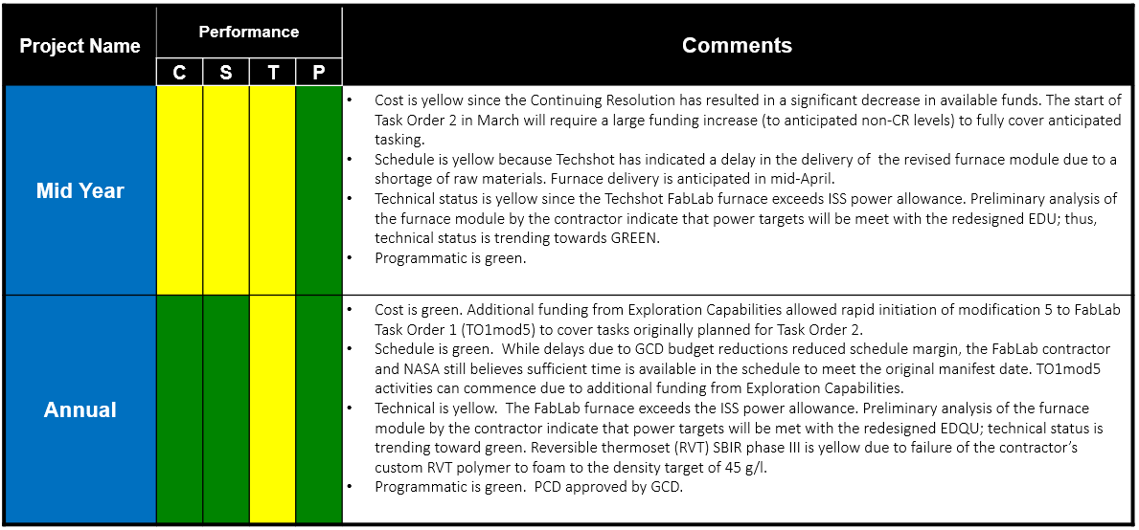
ODMM Project Assessment Summary

Slide 15
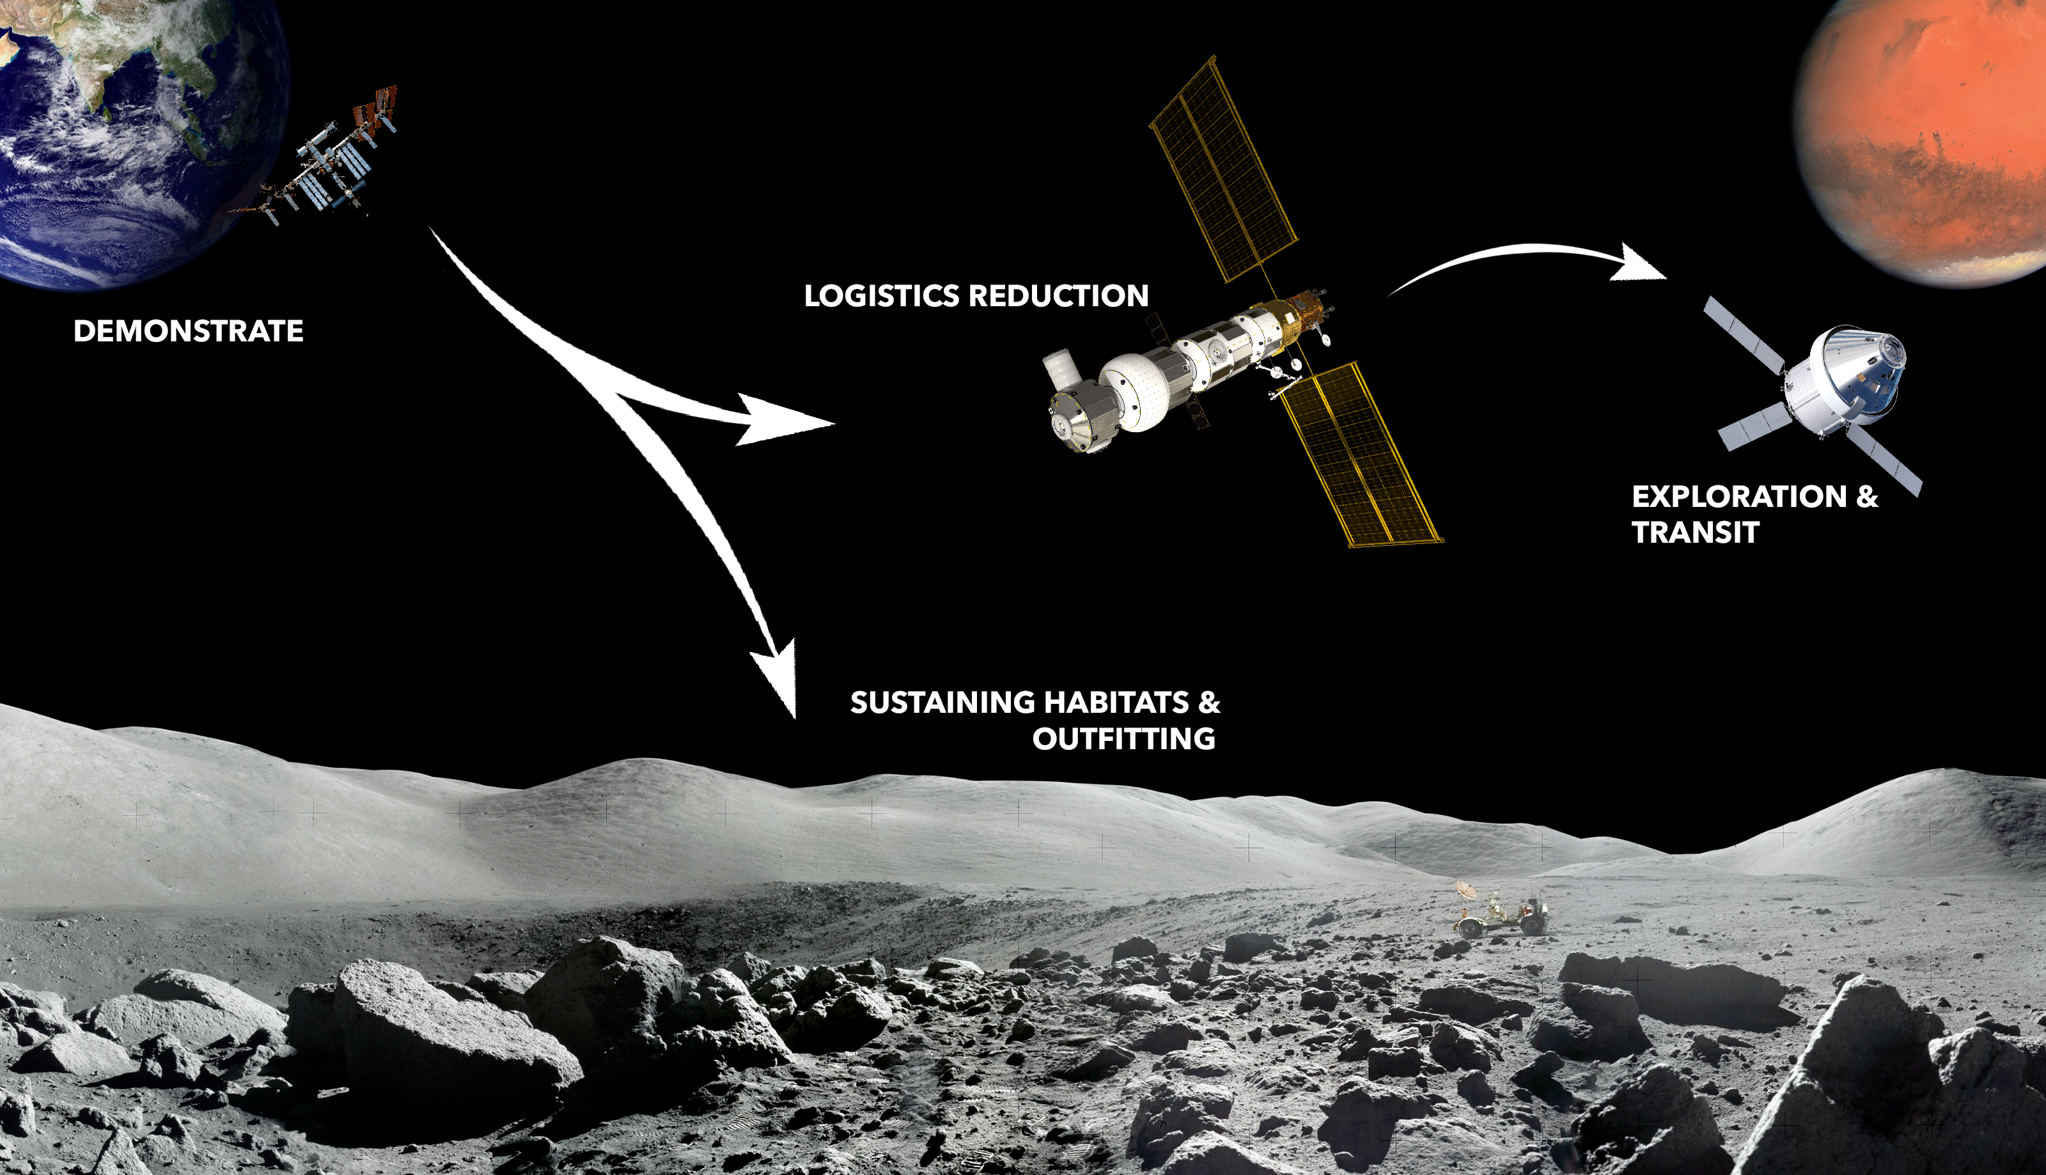
In Space Manufacturing Strategy
& Commercial Manufacturing

Slide 16
ODMM Plans Forward and Transition / Infusion Plan
Infusion/Transition Plan:
Demonstrate: Currently ISS, gateway, and lunar habitats lack the capability to repurpose materials and/or fabricate spare parts, replacement units, and specialty tools in situ. Through FY24 and potentially beyond, ISS serves as the testbed to evaluate technologies to meet these future mission needs.
Commercialize: Several companies are aiming to development of a low earth orbit manufacturing ecosystem. ODMM technologies will remain commercial while aboard the ISS and support development of next generation systems for commercial space stations.
Support: ODMM and other ISM project will continue to support NASA missions through logistics reduction and outfitting.
  The ISM portfolio is expanding to encompass outfitting which may serve as a first use case for manufacturing systems on the lunar surface.
  Once systems have been initially demonstrated on ISS and material coupons and parts from the system have been downmassed to earth and evaluated, results will inform further maturation of the systems to meet mission needs for sparing and repair.
Current strategic assessments are refining infusion plans into commercial industry and flight projects.
Exploration & Science Applicability:
Current approach to logistics, which relies on pre-positioned spares, is not sustainable for long duration missions where cargo resupply opportunities are limited.
Once tested on ISS, capabilities developed under ODMM can provide a means to manufacture parts at the point of use on future space missions, reducing the amount of upmass and enhancing crew safety.
Notes:
Infusion: An investment reaches a conclusion where a technology is handed off for use by a mission or other need. Infusions can be made to other NASA Mission Directorates, other Government Agencies, Commercial Entities, or International Partner.
Transition: An investment reaches a conclusion where a technology is handed off for further development. Transitions can be made to other STMD programs, other NASA Mission Directorates, academic institution, other Government Agencies, Commercial Entities, or International Partner.

Slide 17
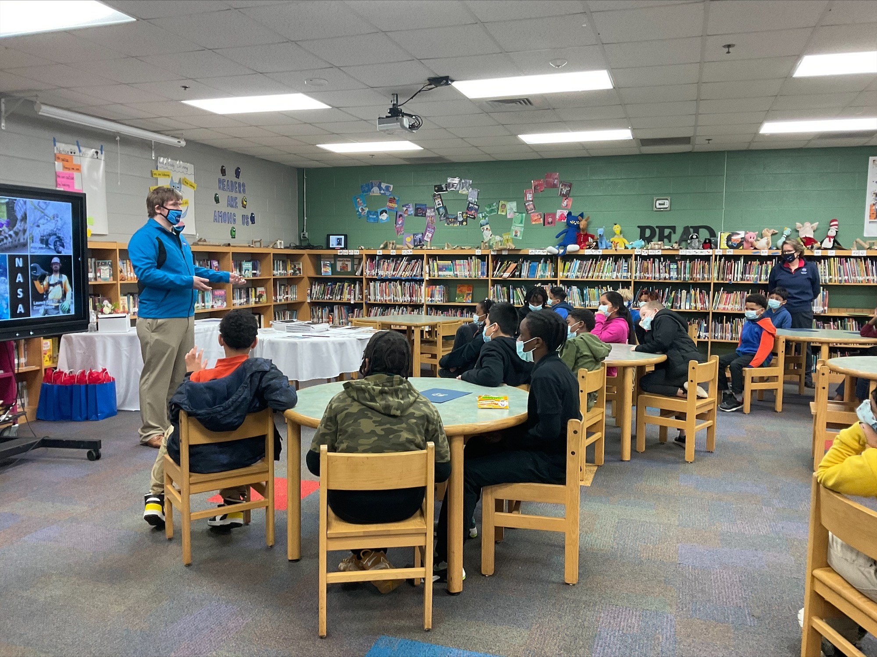
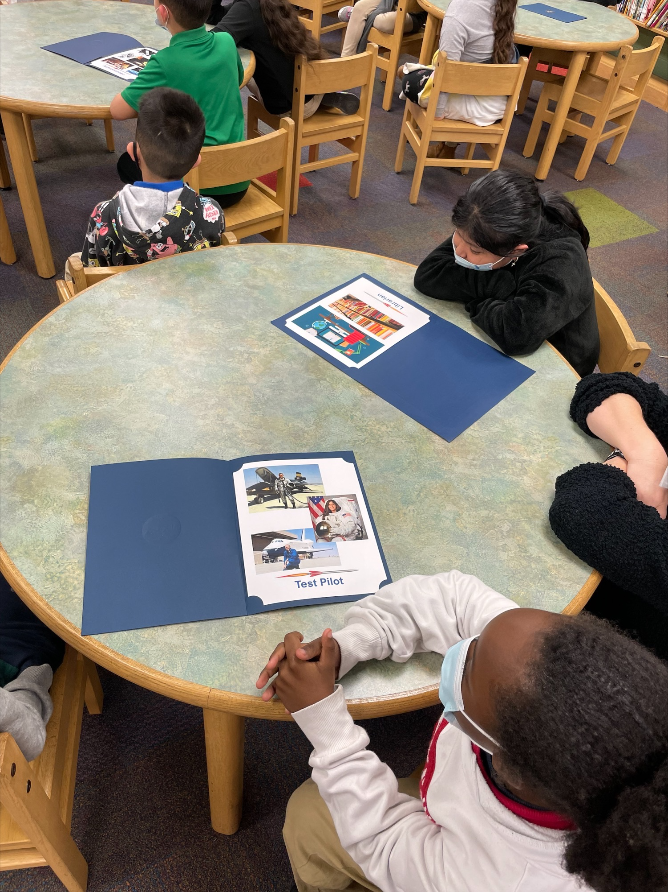
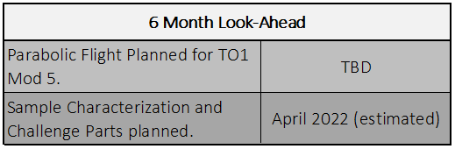
Education/Public Outreach
EPO Involvement
October 2021: On October 28, Christopher Roberts Spoke at the OSAM Technology Transfer Workshop.
November 2021: On November 30, Christopher Roberts briefed the NASA Administrator and Deputy Administrator on the ISM Portfolio.
February 2022: On February 25, Christopher Roberts spoke to 1st and 3rd graders at Amqui Elementary School focusing on ways people can be involved with NASA besides engineering and being an astronaut.
Chris Roberts speaking at Amqui Elementary School
Notes:
Summary of the EPO activities (papers, conferences, outreach events) participated in over the last 6 months and the forward outlook for 6 months

Slide 18
ODMM Project Summary
Accomplishments:
Conducted a TAPR on 2/10/2022 to assess the projects progress toward KPPs and inform the board of the need for a potential downselect.
Determined FabLab design that meets power requirements according to a preliminary thermal analysis which will be verified through hardware testing in September.
Secured funding to ensure the FabLab hardware can be matured through CDR.
Conducted a PDR and Phase I PSRP Review for the Vulcan Payload in December of 2021.
Parabolic flight conducted in 2021 to investigate welding parameters and FOD control for the Vulcan System.
End State Technology Capabilities:
ODMM will design, demonstrate and test additive manufacturing systems for use in micro and reduced gravity environments.
  Current approach to logistics, which relies on pre-positioned spares, is not sustainable for long duration missions where cargo resupply opportunities are limited.
  Once tested on ISS, capabilities developed under ODMM can provide a means to manufacture parts at the point of use on future space missions, reducing the amount of upmass and enhancing crew safety.

