Slide 1
Development of the Principal Component Based Accurate Fast Vector Radiative Transfer Model with Fine Resolution in the UV to NIR Wavelength Range
Qiguang Yang¹, Xu Liu², Ming Zhao¹, Xiaozhen Xiong², and Wan Wu²
¹SSAI INC, Hampton, VA, 23666
²NASA Langley Research Center, Hampton, VA 23681

Slide 2
MOTIVATION
Why Fast Radiative Transfer Model (RTM)?
  To get one spectrum from 200 nm to 2500 nm, the line-by-line model needs more than 2 millions of radiative transfer (RT) calculations to catch the fine gas spectral features. This is a very time-consuming process.
  The Principal Component based Radiative Transfer Model (PCRTM) needs only a few hundreds RT calculations, greatly increases the computation speed of the spectrum.
Why Vector Fast Radiative Transfer Model?
  The scalar assumption introduces error in the simulated radiance
  Only one of the 3 Stokes components will be calculated approximately in the scalar radiative transfer model

Slide 3
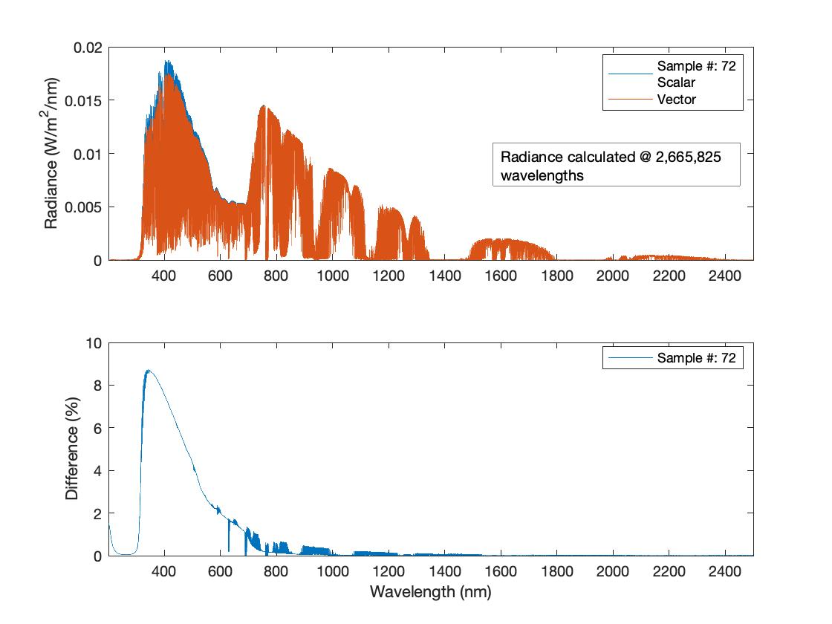
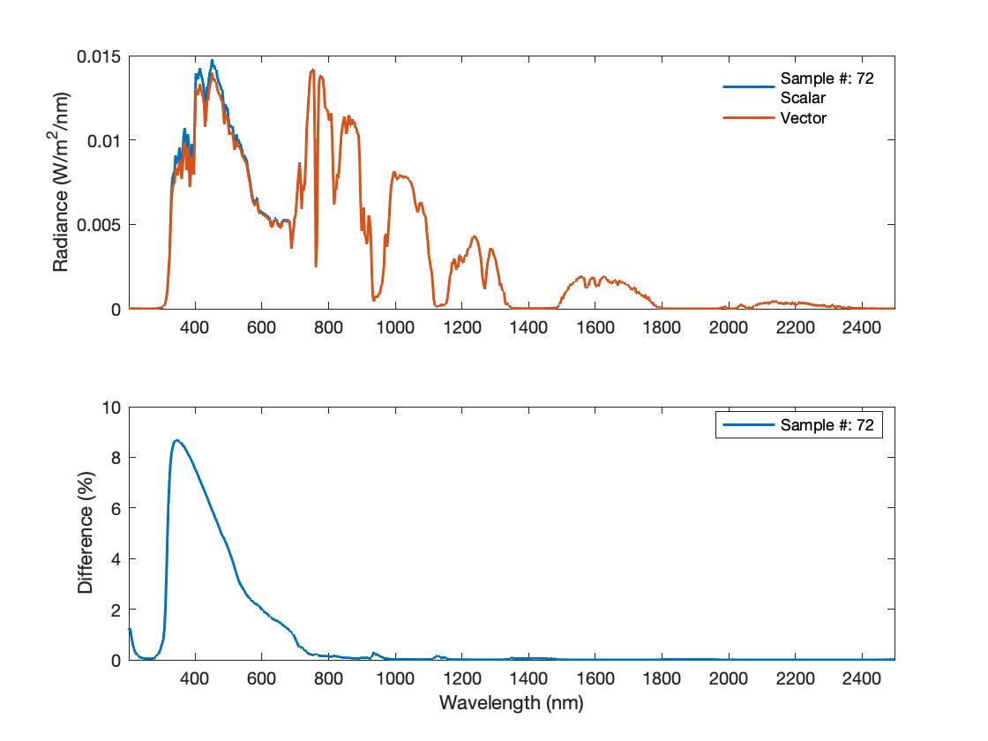
The difference between the I components from scalar and vector RT calculations
The error induced by scalar assumption is systematic and does not cancel out when the spectrum is convolved with the instrument response function to a 6 nm resolution channel radiance spectrum.

Slide 4
Goal of Current Work
Develop a high-resolution vector PCRTM in the wavelength range from 200 nm to 2500 nm.
  Very high spectral resolution (0.01 nm for the whole spectral range, higher resolution in interested shorter wavelength range, such as O₂ A band)
  High accuracy (RMS < 0.1%)
  Very fast (tens to hundreds of times faster than line-by-line model)
Applications:
  It will be used as a fast monochromatic radiance simulator for different satellite/airspace sensors
  Faster vector PCRTM will be developed based on these data and the instrument response function for the sensors. In general, only a few hundreds RT calculations are need for sensor with spectral resolution larger than 0.2 nm.

Slide 5
Methodology in PCRTM
Redundant information in a radiance spectrum
  The spectral features at different wavelength are highly correlated. The whole spectral features can be accurately regenerated with the radiances at few selected wavelengths.
The PCRTM is developed to remove the redundancy and significantly reduce the computation burden.
References:
  Applied Optics, 45, 201-209 (2006);
  Applied Optics, 55, 8236-8247 (2016);
  Optics Express, 24, A1514-A1527 (2016)

Slide 6
Training Data Preparation
As diversity as possible but not physically impossible
  Atmosphere Profiles: the 6 MODTRAN available profiles + many Merra2 profiles;
  Aerosol: various kinds
  Cloud: water; ice (various kinds: different shape, different size etc.)
  Earth surface:
    Land surface: Lambertian, MODIS available BRDF, self-developed hyperspectral BRDF model, BPDF etc
    Ocean surface: Cox-Munk
  Geometry:
    SZA: 0-85; VZA: 0-85; RAA = 0-360

Slide 7
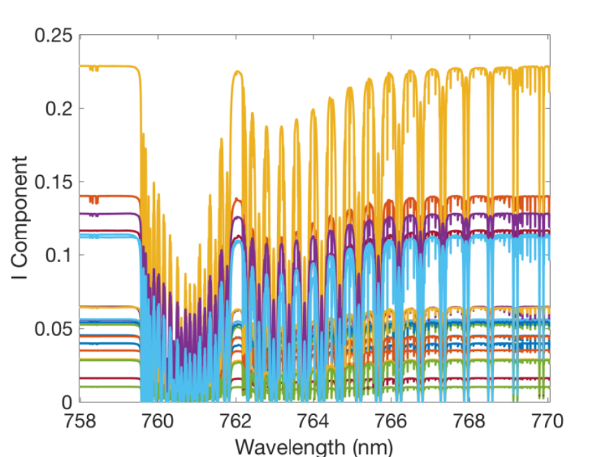
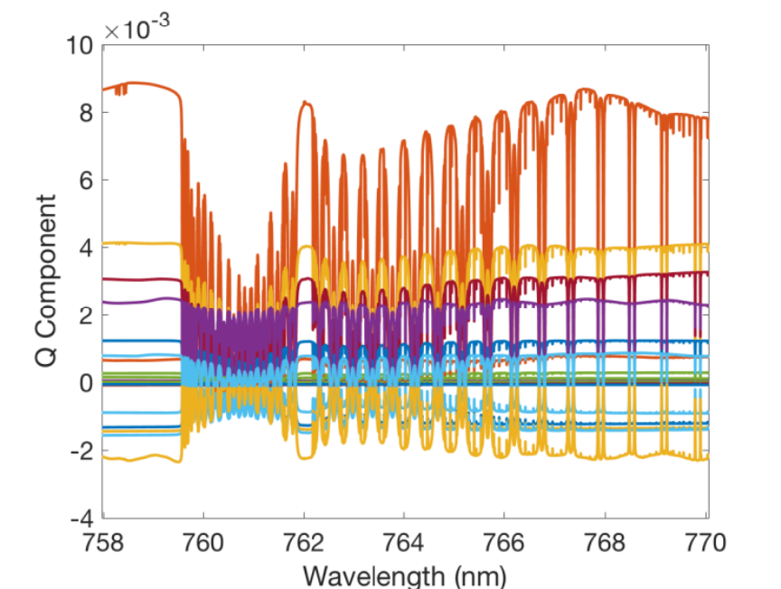
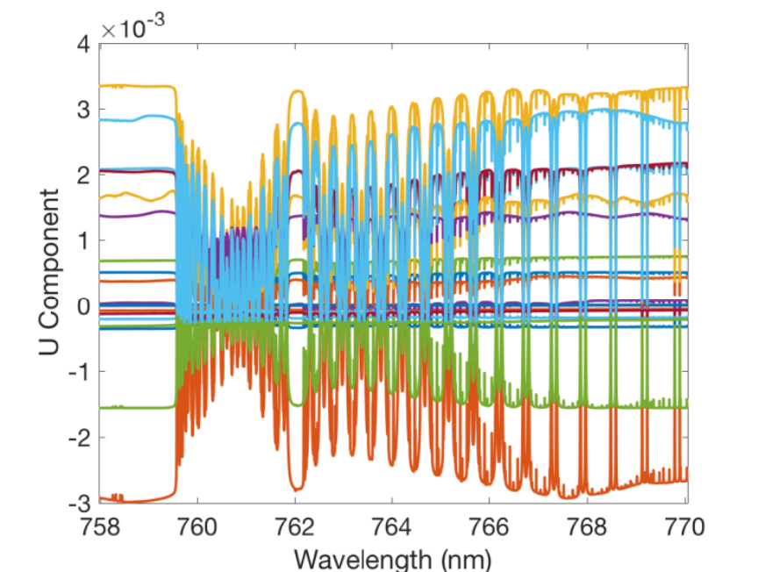

Stokes Components of O₂ A band
$$\left[\begin{aligned}I_{s} \\ Q_{s} \\ U_{s} \\ V_{s}\end{aligned}\right]=\left[\begin{aligned}A_{∥}^{2}+A_{⊥}^{2} \\ A_{∥}^{2}−A_{⊥}^{2} \\ 2A_{∥}A_{⊥}cos⁡(∆∅) \\ 2A_{∥}A_{⊥}sin⁡(∆∅)\end{aligned}\right]$$
8281 wavelengths from 770.0601 nm to 757.9777 nm

Slide 8
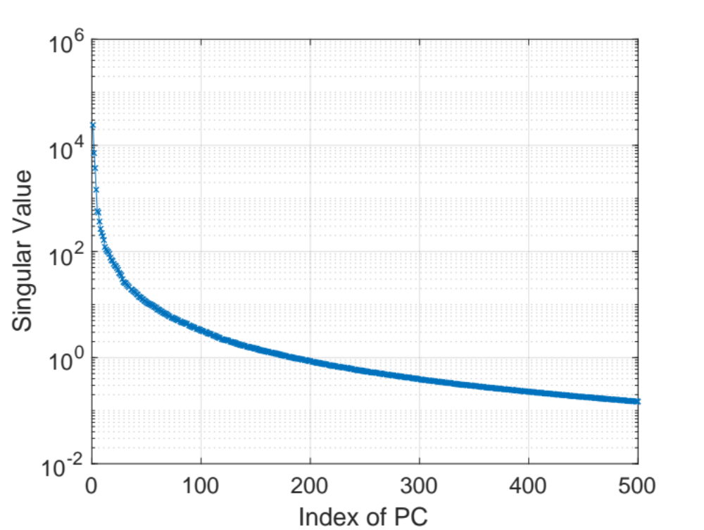
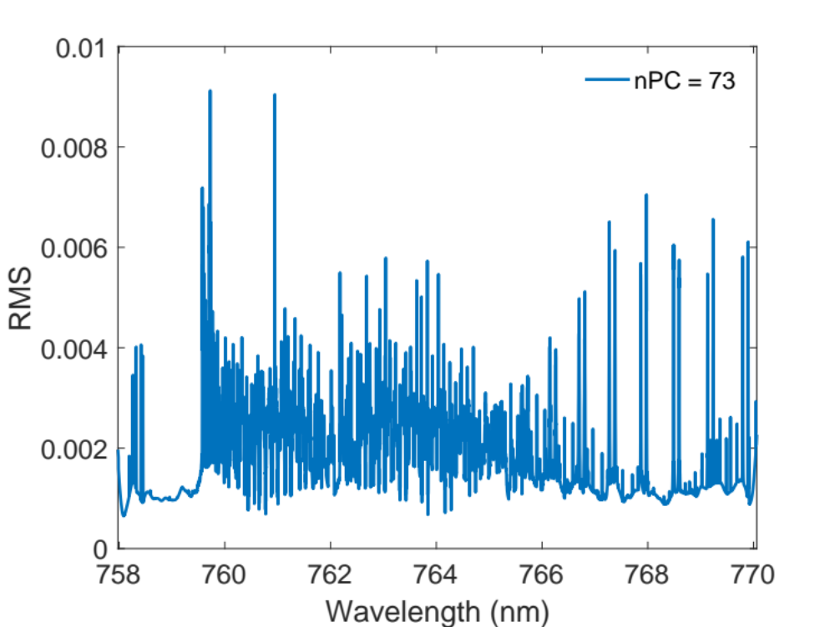
The Principal Component Analysis of the Stokes Components of O₂ A Band

Slide 9
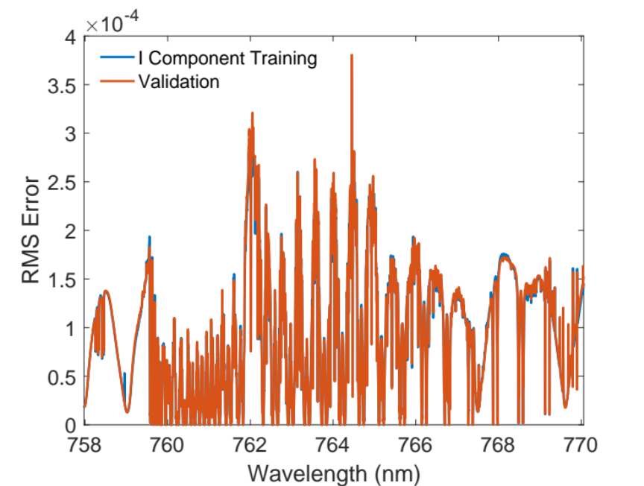
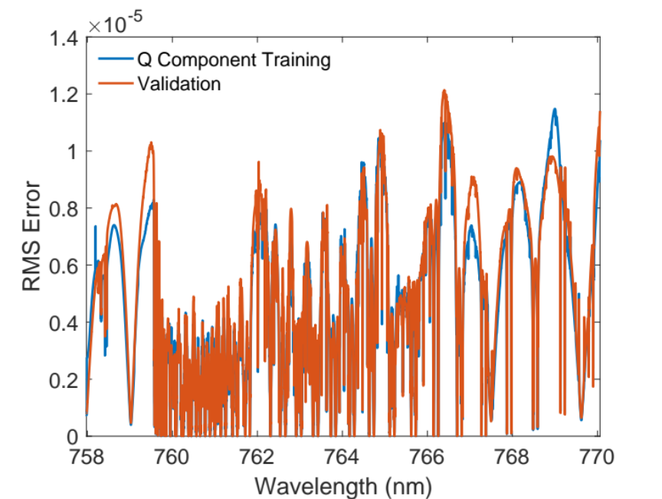
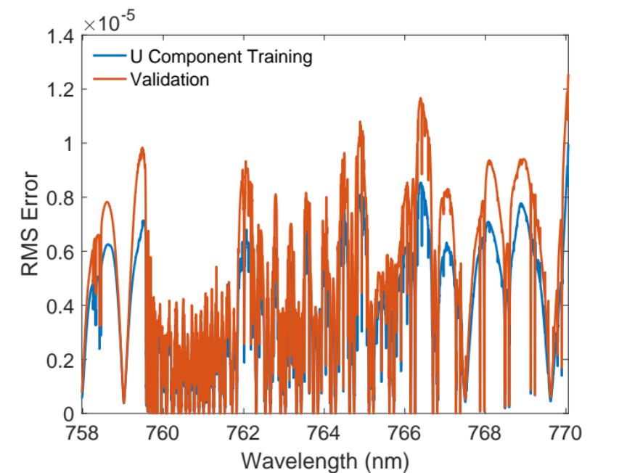
Monochromatic Radiance Selection
We found only 61 monochromatic radiances were needed to regenerate the whole spectrum at the 8281 wavelengths.

Slide 10
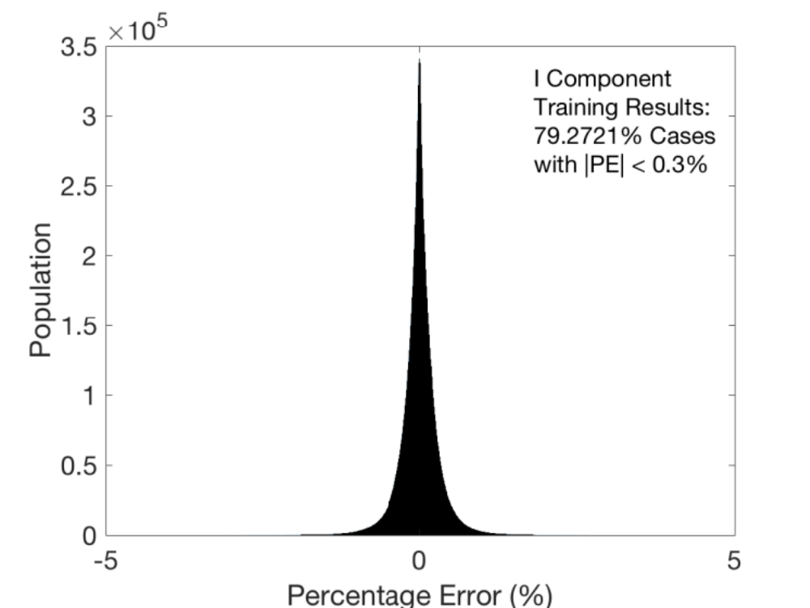

Training and Validation Error
The regenerated radiances using monochromatic radiances at the 61 preselected wavelengths and the preselected 73 PCs were compared to the original data. Among the over 1x10⁸ regenerated radiances, we found 79% of them have a percentage error smaller than 0.3%, which is better than the 1 sigma requirement for CLARREO project. Similar Results are obtained for Q and U components.

Slide 11
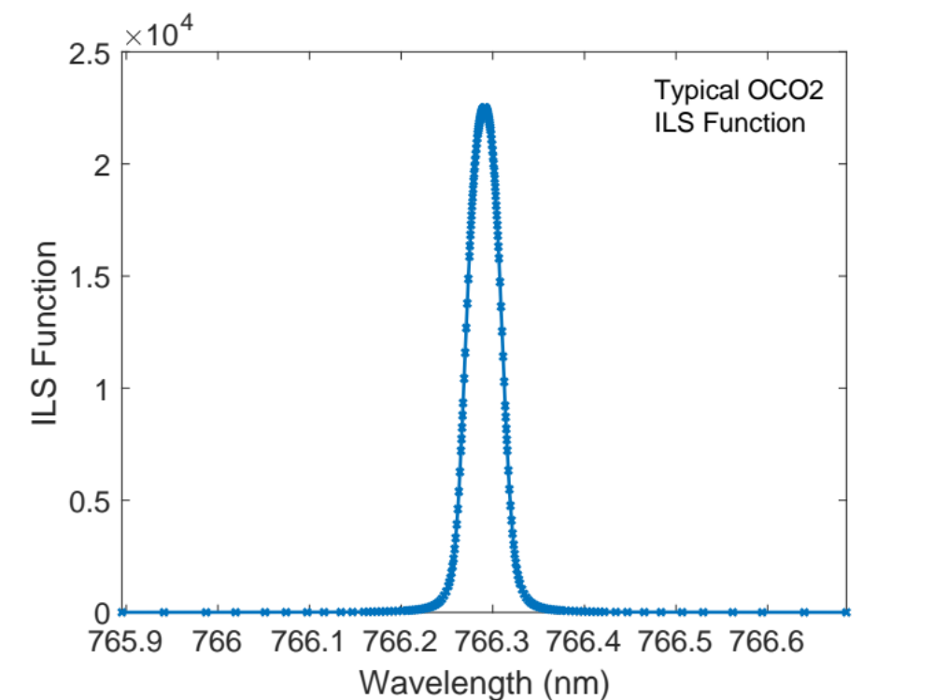
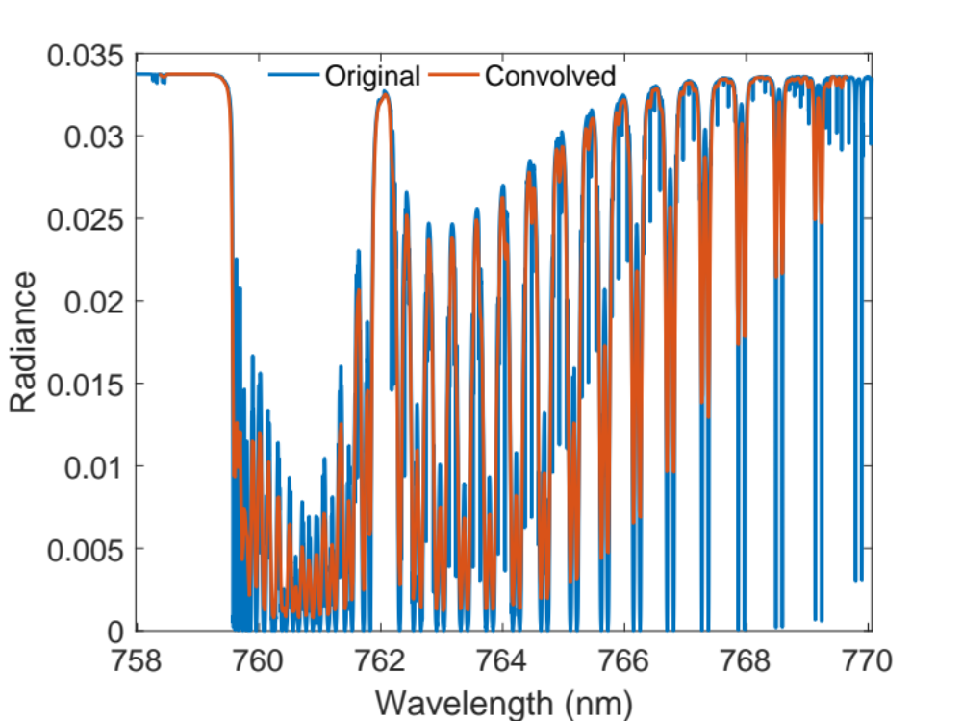
Application Demonstration: Apply to OCO-2 Sensor

Slide 12
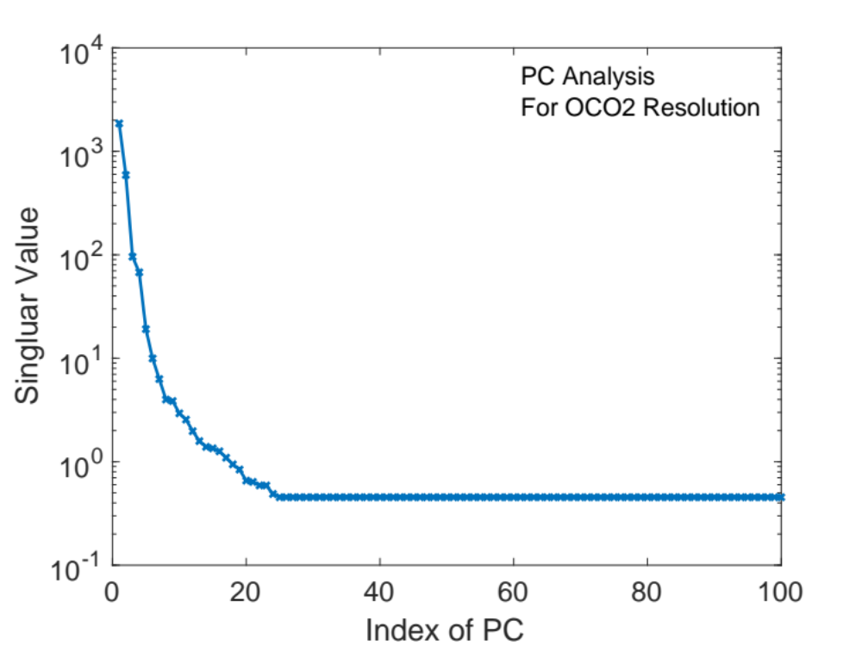
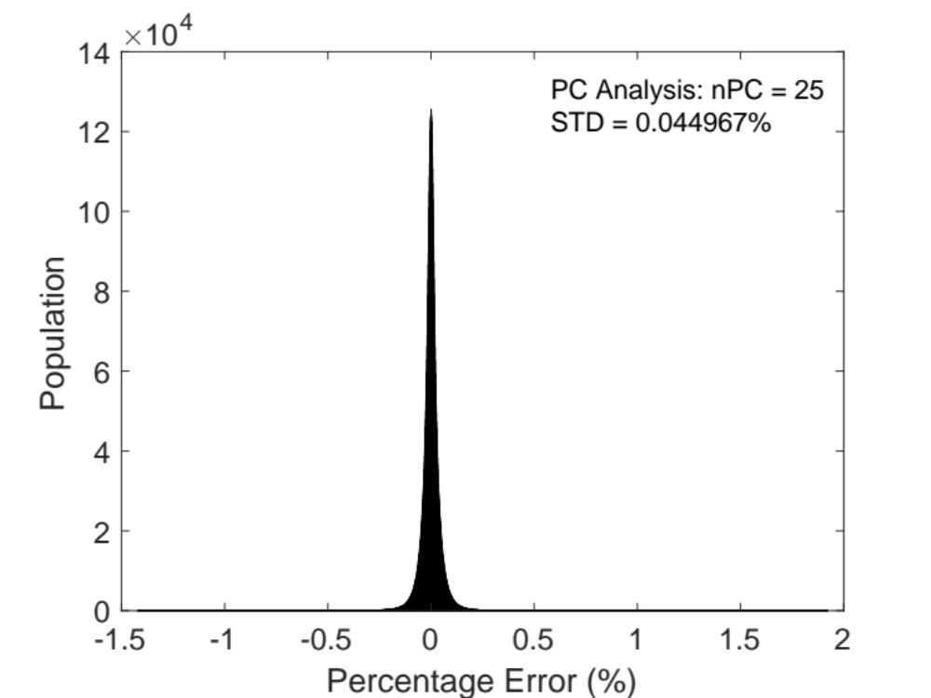
Application Demonstration: PCA of OCO-2

Slide 13
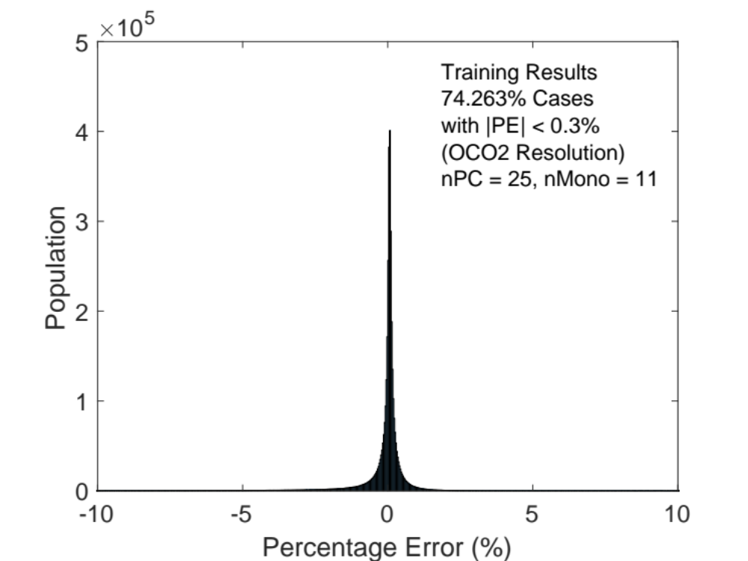
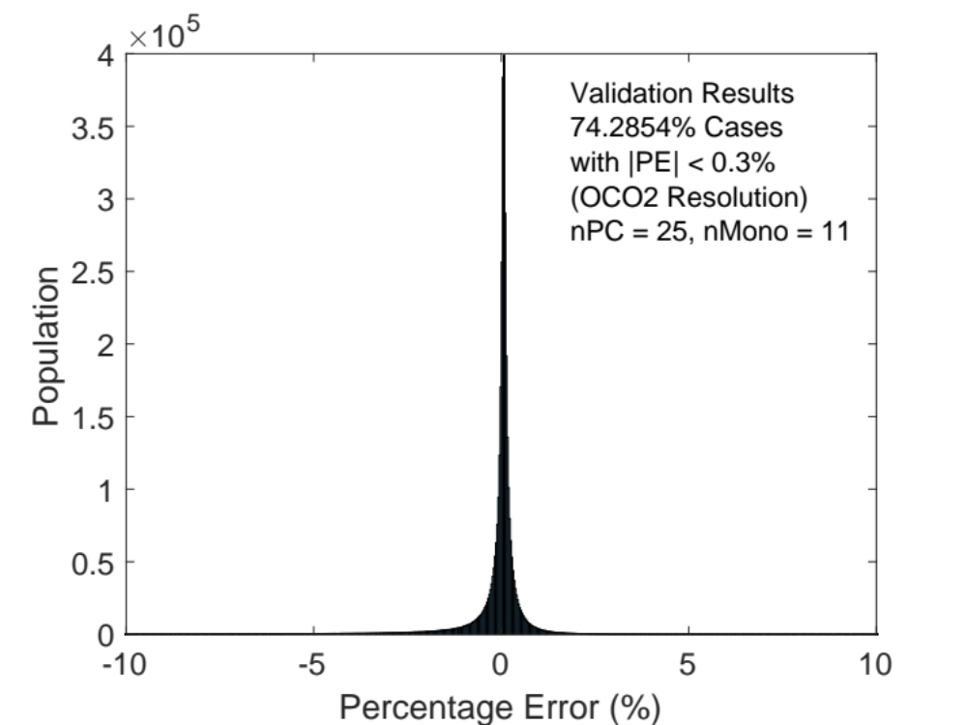
Training and Validation Error for OCO-2 Sensor

Slide 14
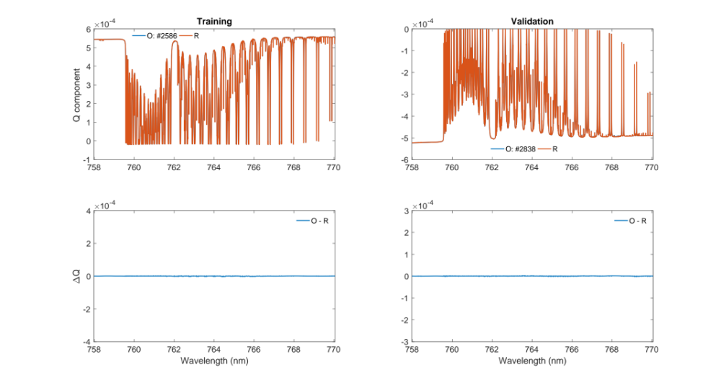
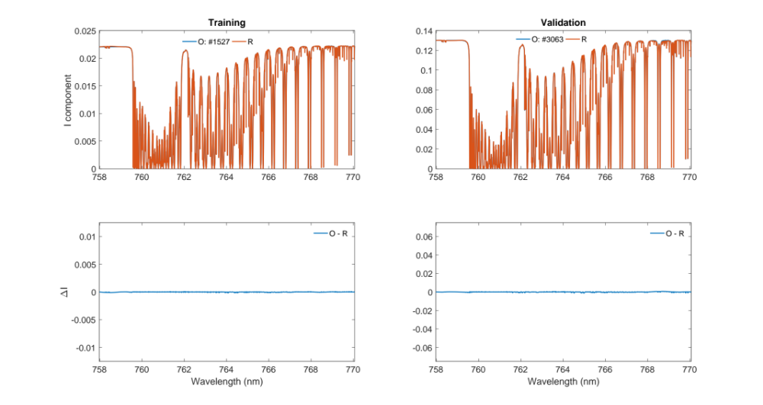
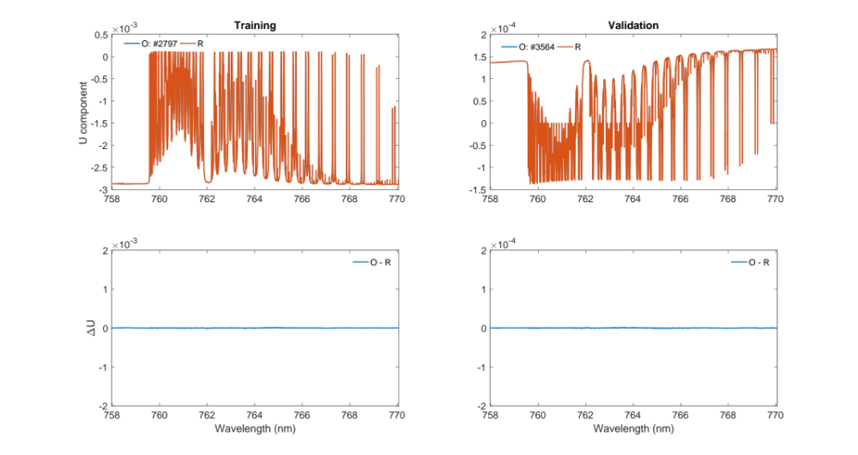
Typical Results

Slide 15
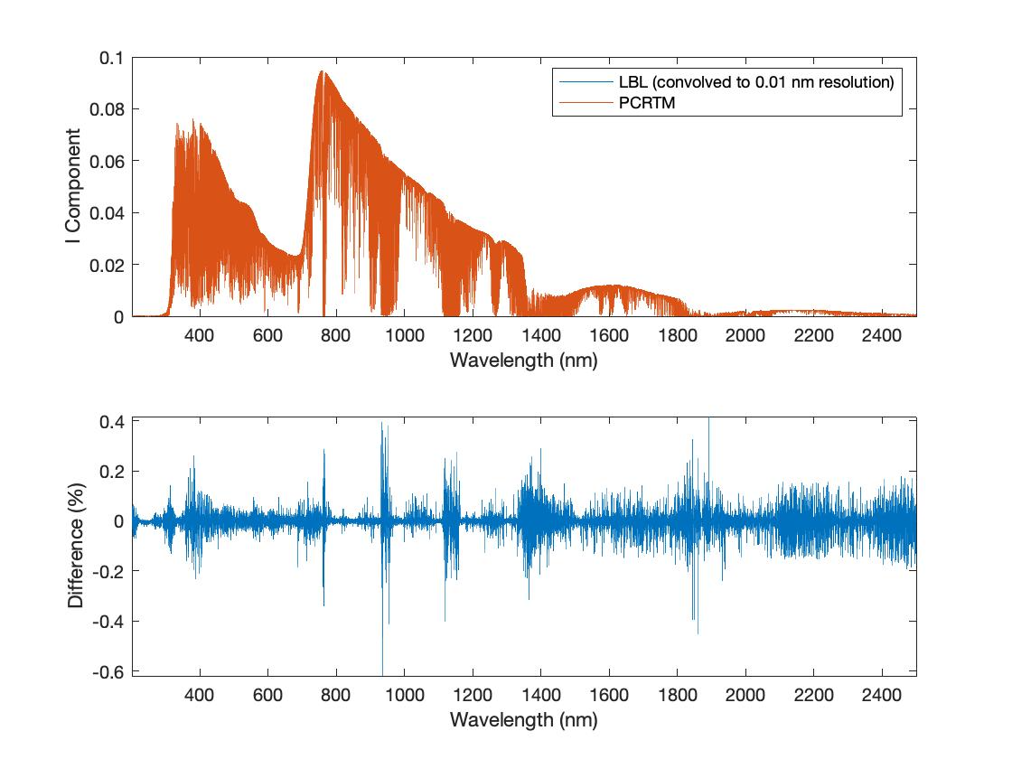
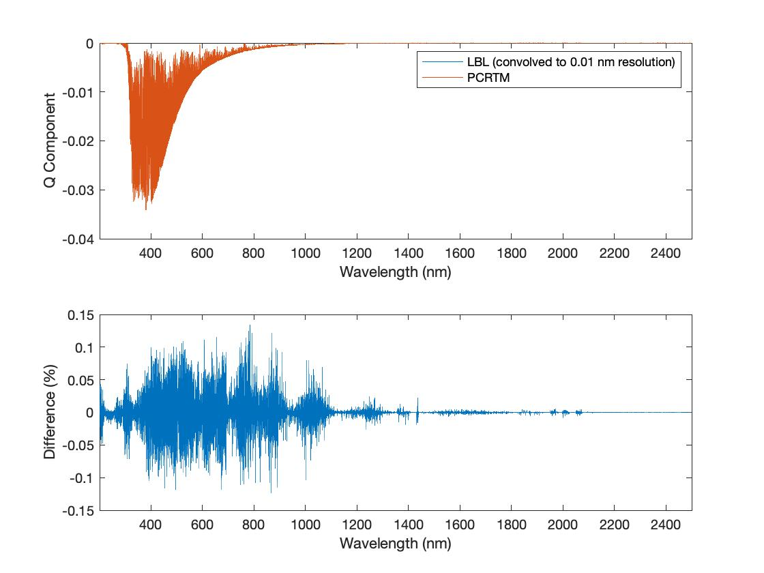
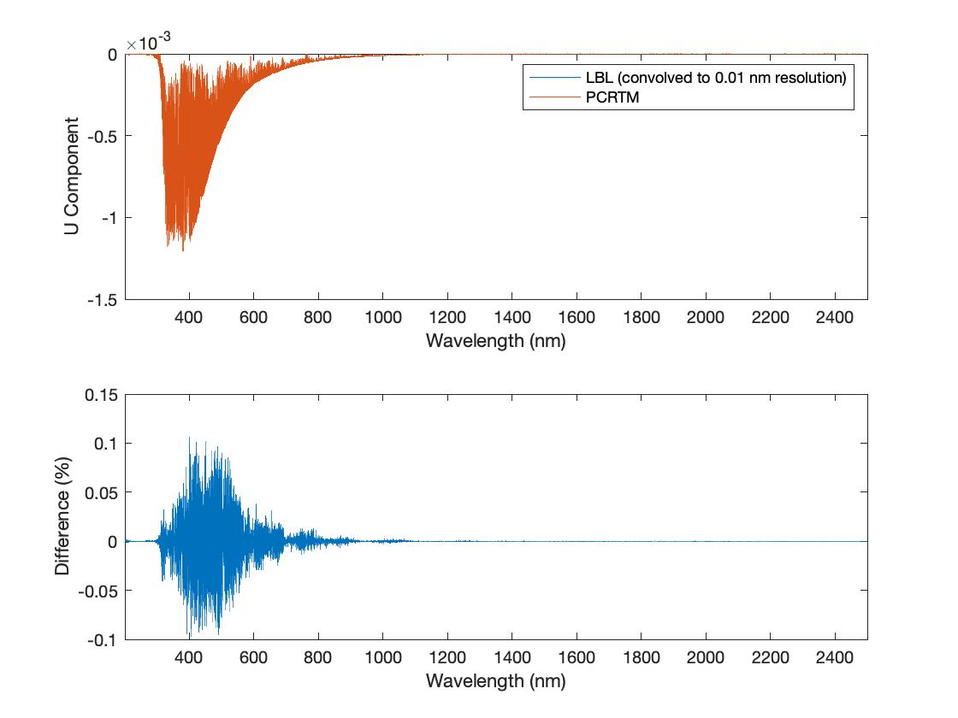
Preliminary Results for the Whole Spectral Range With 0.01 nm Resolution

Slide 16
Conclusion
A fast accurate vectorized PCRTM is developed
  Only 61 RT calculations are need to generate a very high resolution O₂ A band spectrum which has 8281 wavelengths. More than 130 times faster than the line-by-line model
  Only 11 RT calculations are need to construct one OCO-2 spectrum
  The percentage errors in I, Q, U are small. Typically, there are more than 75% of cases has a percentage error smaller than 0.3%, better than the CLARREO project requirement.
The model for the whole spectral range from 200 nm to 2500 nm with RMS error <0.1% will be available soon.

