Slide 1
NASA Lunar Surface Innovation Initiative: Ensuring a Cohesive, Executable Strategy for Technology
International Astronautical Congress
STMD Deputy Associate Administrator: Prasun Desai
September 19, 2022

Slide 2
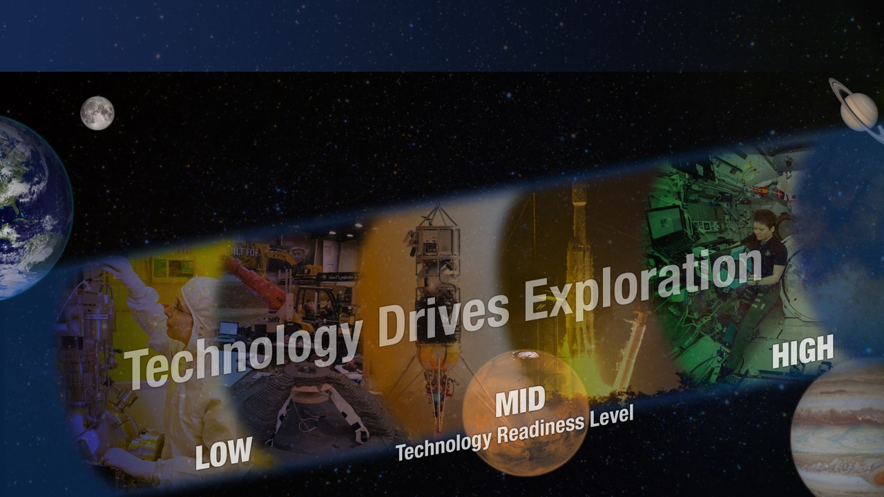
SPACE TECHNOLOGY PORTFOLIO
EARLY STAGE INNOVATION
AND PARTNERSHIPS
Early Stage Innovation
  Space Tech Research Grants
  Center Innovation Fund
  Early Career Initiative
  Prizes, Challenges & Crowdsourcing
  NASA Innovation Advanced Concepts
Technology Transfer
SBIR/STTR PROGRAMS
Small Business Innovation Research
Small Business Technology Transfer
TECHNOLOGY MATURATION
Game Changing Development
Lunar Surface Innovation Initiative
TECHNOLOGY DEMONSTRATION
Technology Demonstration Missions
Small Spacecraft Technology
Flight Opportunities
2

Slide 3
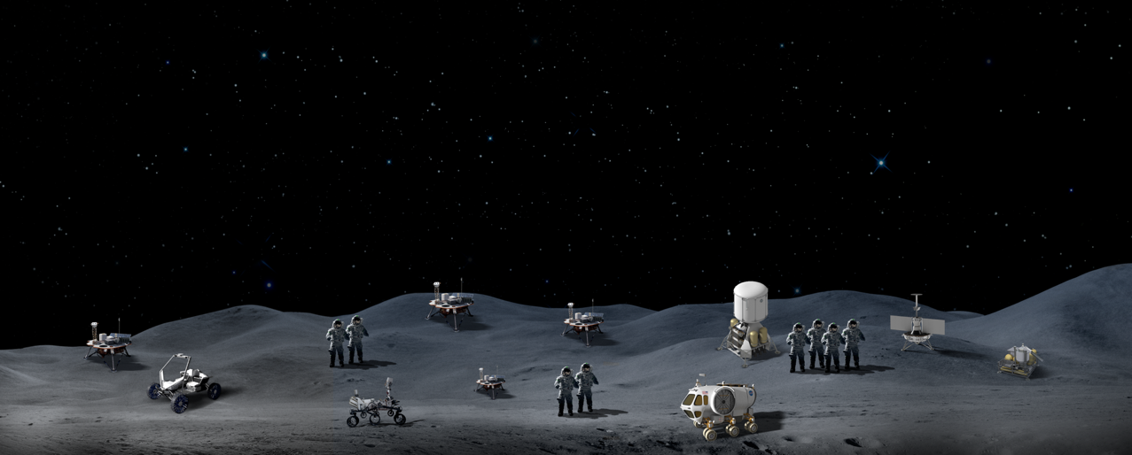



Lunar Surface Innovation Initiative (LSII)
LSII works across industry, academia and government through in-house efforts and partnerships to develop transformative capabilities for lunar surface exploration.
Formulate and integrate technology maturation activities across the TRL pipeline and space technology programs
Leverage innovative partnering and procurement approaches to expedite technology development
Utilize early robotic lunar surface flight opportunities to inform key technology development
Establish the Lunar Surface Innovation Consortium (LSIC)
Surface Excavation
& Construction
Extreme Access
Sustainable Power
Lunar Dust Mitigation
Extreme Environments
In-Situ Resource Utilization
3

Slide 4
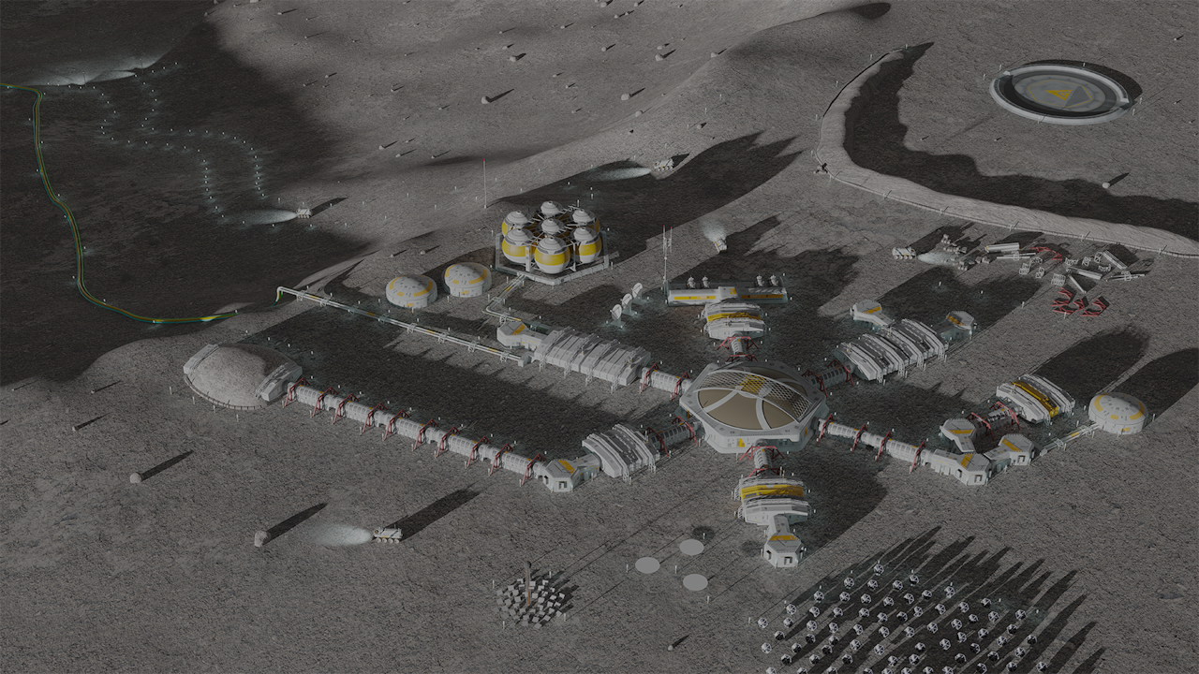

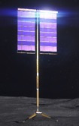



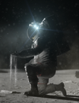
LSII Capability Areas
Six capability areas focused on increasing technology readiness for lunar surface infrastructure
Excavation and
Construction
Surface Power
In-Situ Resource Utilization (ISRU)
Technologies which can provide continuous power throughout the lunar day and night.
Enables autonomous excavation of in-situ materials to be used for construction of structures such as landing pads, habitats, etc.
The collection, processing & use of in-situ materials for production of consumables such as oxygen or propellant.
Lunar Surface Infrastructure
Extreme
Environments
Enables operations across the full range of lunar surface conditions.
Extreme
Access
Dust Mitigation
Enables humans or robotic systems to access, navigate, assess, and explore previously inaccessible locations on the lunar surface.
Active, passive, & operational technologies to remediate lunar dust hazards.

Slide 5

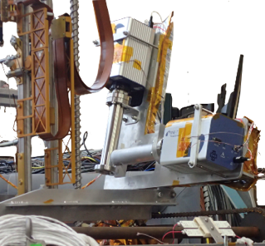
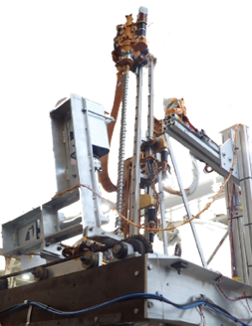
Polar Resources Ice Mining Experiment-1 (PRIME-1)
PRIME-1 will be the first instrument suite to assess the volatiles and drill for ice at a lunar pole tiles.
  Will be integrated on to a commercial lunar lander via NASA’s Commercial Lunar Payload Services (CLPS)
  Consists of two high-TRL instruments – a Mass Spectrometer observing lunar operations (MSolo) and The Regolith and Ice Drill for Exploring New Terrain (TRIDENT)
PRIME will fly to a lunar pole in 2023 and test the common volatile detection and drill technologies used in the Volatiles Investigating Polar Exploration Rover (VIPER) mission.
Industry Participants include Honeybee Robotics (TRIDENT), INFICON (MSolo), and Blue Sun (virtual machine language).
MSolo (Open Ion and Cross-Beam sensor) in test configuration
TRIDENT Drill

Slide 6
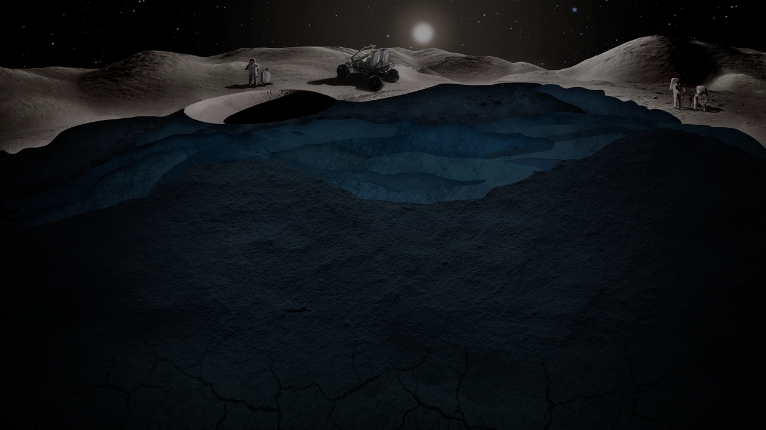

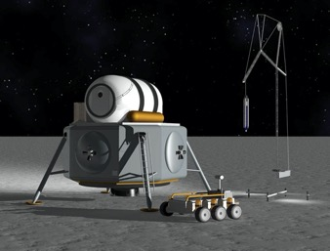
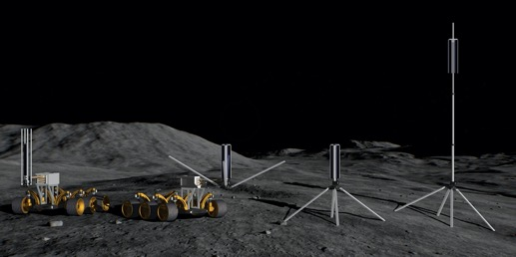
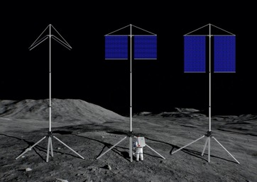
Lunar Vertical Solar Array Technology (VSAT)
Local power will be a critical component for a sustained presence on the lunar surface.
  An autonomous system capable of vertical array deployment of a mast up to 10 m on uneven terrain in order minimize shadowing in order to capture near-continuous sunlight at the lunar South pole.
  Designed for reliable, autonomous retraction and system mobility with minimal mass and packing volume.
Parameters | Goals
Array Power | 10 kW
Terrain Stability | 15 incline with 10m mast
Mass Height | 10 meters
Autonomous Deployment and Retraction | 10 Deployment/Retraction Cycles in lunar gravity
In September 2022, three of these companies (Astrobotic, Honeybee Robotics, and Lockheed Martin) were selected to build prototypes and perform environmental testing.
7

Slide 7
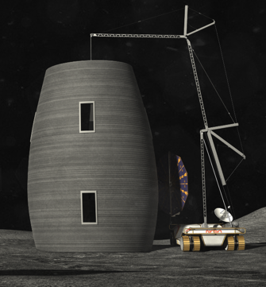
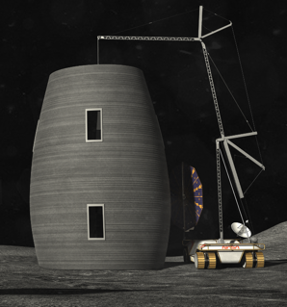
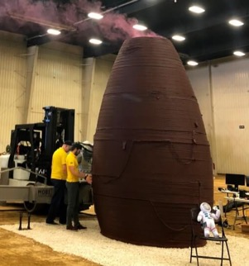
Moon-to Mars Planetary Autonomous Construction Technology (MMPACT)
Structures will be need to provide protection of crew members, hardware and electronics on the surface.
  Develop, deliver, and demonstrate on-demand capabilities to protect crewmembers and hardware, and create infrastructure on the lunar surface via construction of landing pads, habitats, shelters, roadways, berms and blast shields using lunar regolith-based materials.
  Partners: ICON, SEArch+, USAF, Defense Innovation Unit, Texas Air National Guard
17

Slide 8











LSII - Developing capabilities through collaborations
LSII has awarded ~$265M to industry and academia through Space Tech Programs since 2020
Commercial Lunar Payload Services (CLPS) Flight Demonstrations
Tipping Point Partnerships & Collaborative Opportunities
APL LSII Integration and Lunar Surface Innovation Consortium (LSII)
Vertical Solar Array Technology (VSAT) Prototype Solicitation
SBIRs (Ph. I, II, III, CCRPP, Lunar Sequentials)
Collaborations & Partnerships
Breakthrough Innovative Game-changing (BIG) University Challenge
Space Technology Research Grants (New LuSTR, ECF, ESI Grant Opportunities)
NASA Tournament Lab Crowdsourcing (GrabCAD, Yet2, HeroX)
NASA Innovative Advanced Concepts (NIAC)
Centennial Challenges (’Watts on the Moon’ & ‘Break the Ice’ Challenges)
8

Slide 9
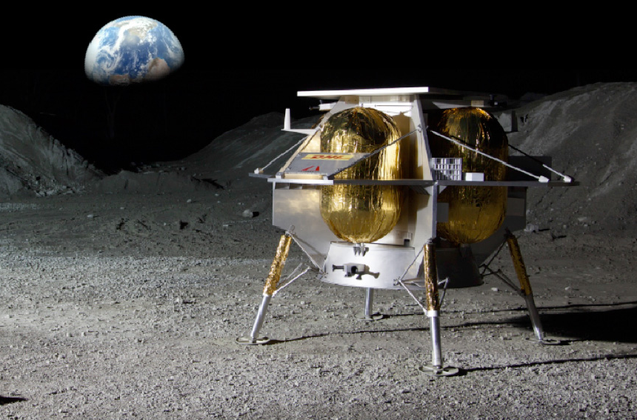
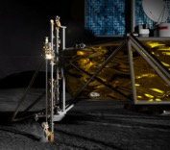
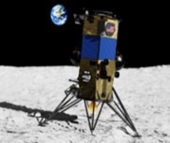
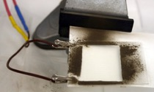
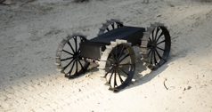
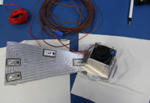
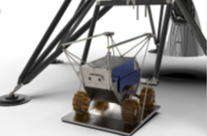
Upcoming Lunar Surface Technology Demonstrations
Lunar surface demonstrations, via the Commercial Lunar Payload Services (CLPS) initiative, are key opportunities to mature the key capabilities required for for NASA and industry.
Astrobotic Peregine-1
(Astrobotic)
CLPS PRIME
(Intuitive Machines-2)
CLPS 19D
(Firefly Aerospace)
CLPS CP-11
(Intuitive Machines-3)
Electrodynamic Dust Shield
Deployable Lunar Hopper (STMD Tipping Point)
Polar Resources Ice-Mining Experiment (PRIME-1)
Cooperative Autonomous
Distributed Robotic Explorers
(CADRE)
Astrobotic Terrain Relative Navigation (ATRN) – Tipping Point
Stereo CAmera for Lunar Plume Surface Studies (SCALPSS 1.1)
Nokia 4G/LTE Proximity Comms (STMD Tipping Point)
9

Slide 10



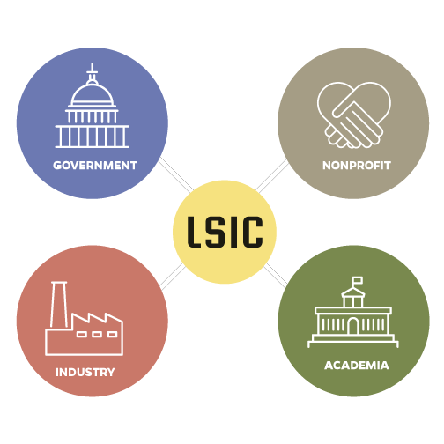
Lunar Surface Innovation Consortium (LSIC)
Nationwide alliance of universities, commercial companies, non-profit research institutions, NASA, and Other Government Agencies with a vested interest in our nation’s campaign to establish a sustained presence on the Moon.
LSIC Objectives include:
Identifying lunar surface technology needs and assessing the readiness of relative systems and components
Making recommendations for a cohesive, executable strategy for development and deployment of the technol­ogies required for successful lunar surface exploration
Providing a central resource for gathering information, analytical integration of lunar surface technology demonstration interfaces, and sharing of results.
Focus Groups (FG) are the primary means for consistent interaction with the LSIC Community. This includes:
Establishing collaborative relationships among members via virtual monthly forums, quarterly virtual workshops, and LSIC member site visits
Building community and developing talent
Compiling member input and reporting outcomes and recommendations
If interested in further information, please visit lsic.jhuapl.edu

Slide 11
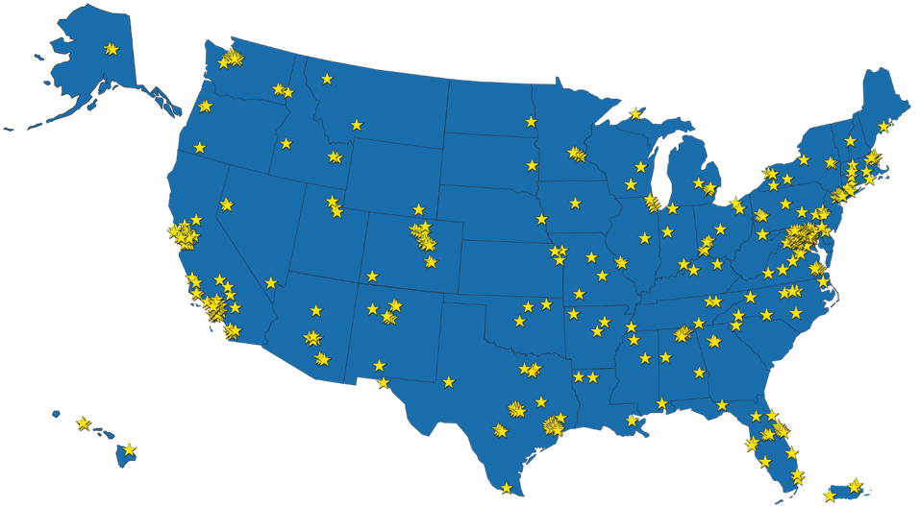
Lunar Surface innovation Consortium Impacts….
LSIC has engaged a network of industry, academia and other government agencies from 50 states, D.C., Guam, Puerto Rico and 46 countries through Bi-annual meetings, Monthly LSII Capability Focus Group meetings and themed workshops.
5
1500
People attended 6 Thematic Workshops
Topics driven by member interest
Key takeaways and recommendations provided in Outcome Report
Bi-annual Meetings
Attended by over 2,000 people
54% at kickoff had not previously worked with NASA Space Tech
6
Focus Groups
Virtual Monthly meetings
Averaging 100 people per meeting
35 Subgroups defined and led by members
Collaboration Space
Provides feedback and recommendations to NASA
678
Organizations working toward one goal
Monthly Newsletter
Technology Assessments Reports
Lunar Simulants Portal
LSIC website
Upcoming Events
Nov 2-3 LSIC Fall Meeting @ University of Texas El Paso
lsic.jhuapl.edu
11
Notes:
Initiated monthly LSIC newsletters to provide valuable updates, upcoming events, meeting summaries, and member spotlights.
Amplifying relative NASA opportunities through the LSIC website, LSIC distribution list, and LSIC Linked In group. The Linked In group provides the opportunity for teaming amongst members. Within the last month, LSIC has shared the LuSTR opportunity, BIG Idea Dust Mitigation Challenge, and ‘Watts on the Moon’ Centennial Challenges Request for Information (RFI) across these platforms.
Established APL Focus Groups leads with NASA counterparts identified. The counterparts work hand-in-hand to ensure that NASA’s key mission objectives and technology priorities are understood in order for APL to effectively facilitate meaningful dialogue amongst the LSIC members and extract key outcomes to better inform the System Integrator efforts.
Each Focus Group has implemented an individual website and listserv distribution list for communication and are currently defining critical challenges and year-one goals. These outcomes will be integrated into a published report.
Conducting multiple thematic workshops

Slide 12
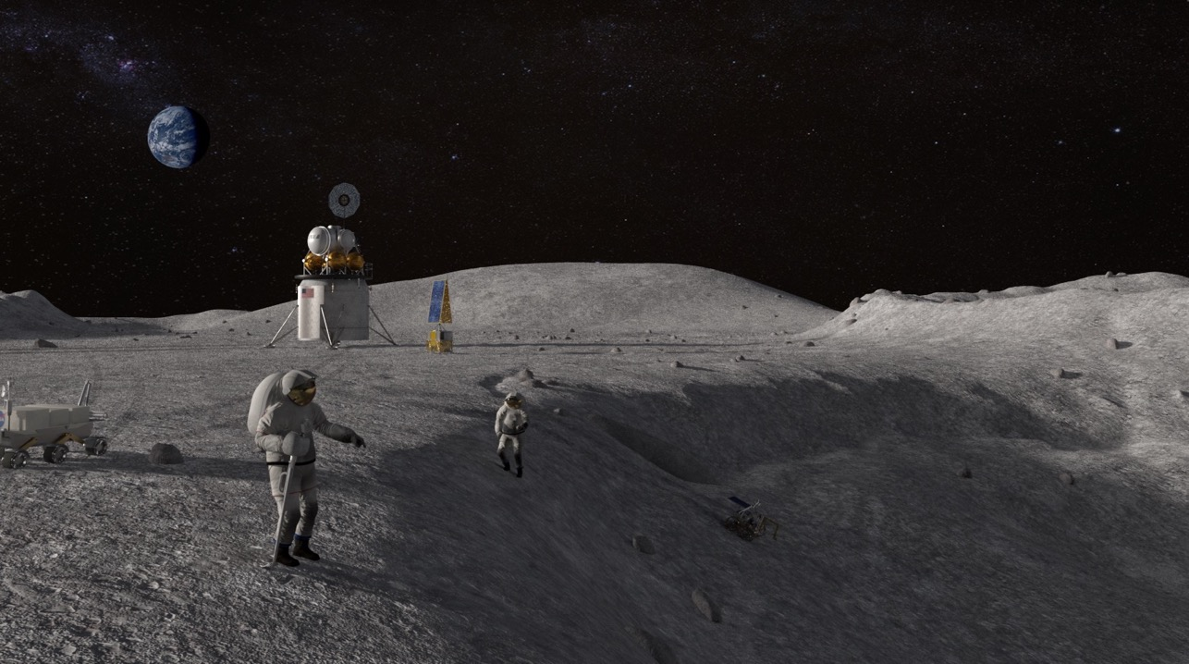

Technology Drives Exploration
12

