Slide 1
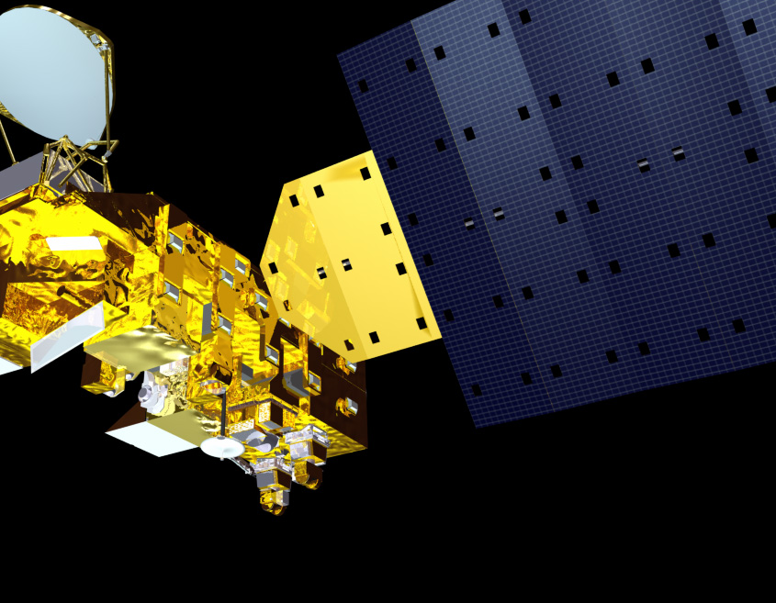
CERES Data Management Team Working group report
Earth radiation budget workshop
Hamburg, Germany - Fall 2022
Kathleen Dejwakh
October 12, 2022

Slide 2
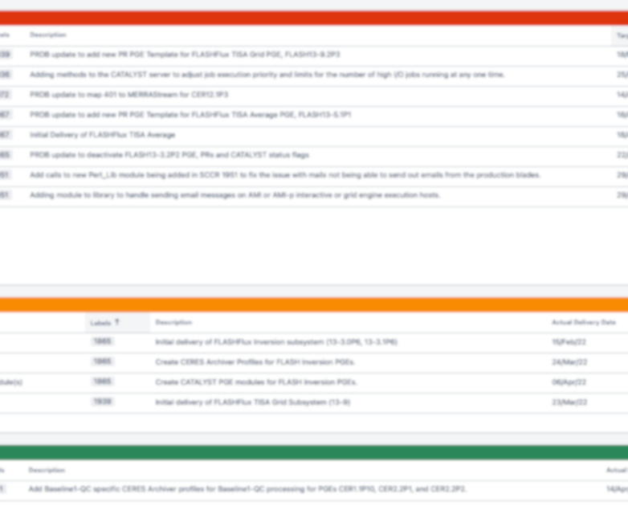
Outline
Team
Highlights
Code Re-architecture
Systems

Slide 3
Data Management Team
Science Algorithms
Production Code
Testing & Config. Mgmt.
Data Products

Slide 4
Data Management Team
Dale Walikainen
Jeremie Lande
Tom Caldwell
Sunny Sun-Mack
Ricky Brown
Steve Kohler
Yan Chen
Elizabeth Heckert
Rita Smith
Walt Miller
SSAI Management:
Walter Miller
Susan Thomas
Victor Sothcott
Igor Antropov
Josh Wilkins
Cathy Nguyen
Ed Kizer
Beau Branch
Denise Cooper
Thomas Grepiotis
Hunter Winecoff
Dianne Snyder
Dale Walikainen
PC Sawaengphokhai
Jay Garg
Hunter Winecoff
Nelson Hillyer
Tammy Ayers
Dennis Keyes
Willinda Evans
Carla Grune
Liz Heckert

Slide 5
HIGHLIGHTS
Team Activities & Code Deliveries

Slide 6
Ed1B NOAA-20
&
Ed2A S-NPP
Data products released April 1, 2022
Notes:
Production started in late Summer/early Fall 2021:
NPP Clouds in late August; Inversion in late September.
NOAA-20 Clouds in late Sep and Inversion in late October.
Earthdata Search, ASDC website, CERES Ordering Tool

Slide 7
Deliveries
Code supporting finalization of new editions:
  Ed2A S-NPP
  Ed1B NOAA-20
CATALYST server automatic restart
Prompt PHP security upgrades
  CERES PR Tool
  CERES Website
Applying Deep Blue aerosols over land to S-NPP SSFs

Slide 8
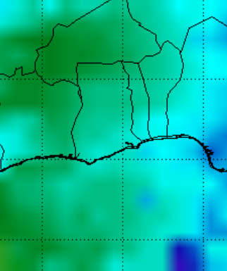

Snow & ice data loss mitigation:
  557th Weather Wing – supplementary data
  snow & ice map, “ice age” value
Production support for upcoming
EBAF 4.2 Surface
Daily albedo coverage fix for FluxByCldTyp
Notes:
No more CLASS Snow & Ice EDR dataset due to DMSP-15 failure
NOGEO SYN1deg processing will be done in early June 2022.
EBAF Surface 4.2 – The reprocessing will likely get to March 2022. Then we would be doing forward processing one month each month, i.e. July for April data August for May and September for June.

Slide 9
Deliveries
MOA: MERRA2 and GEOS-IT accommodation
New ASDC ingest system, Dark Horse:
Forward and backwards compatibility
PIV-M compatibility
FLASHFlux:
  3 out of 7 PGEs running in CATALYST
  MOA, Clouds in production; Inversion delivered

Slide 10
Ed 4 Product Availability
Product | Platform | Processed Thru | Publicly Available?
BDS | Terra, Aqua | May ‘22 | Yes
SSF
SSF1deg-Hour
SSF1deg-Day/-Month
SYN1deg-1Hour/MHour | Terra+Aqua | Jan. ‘22
SYN1deg-Day/-Month

Slide 11
Ed 4 Product Availability
Product | Platform | Processed Thru | Publicly Available?
CldTypHist | Terra+Aqua | June ‘22 | Yes
FluxByCldTyp |  | July ‘21
EBAF |  | Feb. ‘22
EBAF ToA |  | Mar. ‘22

Slide 12
S-NPP Product Availability
Edition | Product | Platform | Processed Thru | Publicly Available?
Ed2A | BDS | S-NPP | May ‘22 | Yes
 | SSF
 | SSF1deg-Hour |  | Sept. ’19*
 | SSF1deg-Day/-Month
Ed1A | SYN1deg-Hour/MHour | Terra+S-NPP | Nov. ’17*
 | SYN1deg-Day/-Month
* L3 processing stopped. Instrument in RAPS mode.
Notes:
Ed1A Terra+S-NPP SYN1deg stopped at November 2017 because:
- Had to prioritize processing Terra-Aqua SYN1deg
- On the path to Edition2A when the reprocessing finished
- And there was no interest in any more data.

Slide 13
Ed 1B NOAA-20 Product Availability
Product | Platform | Processed Thru | Publicly Available?
BDS | NOAA-20 | June ‘22 | Yes
SSF
SSF1deg-Hour
SSF1deg-Day/-Month
Notes:
NOAA-20 will be incorporated into Terra-Aqua-NOAA-20 this Summer.
As Terra and Aqua phase out, NOAA-20 will remain.
Not sure if there will be Terra-NOAA-20 or Aqua-NOAA-20.

Slide 14
Libera Data Mgmt Working Group
Ad hoc meetings: Libera and Radiation Budget Science Project (RBSP)
Libera team discussed high-level plan:
  Science Data Center design
  Science Processing plan
Working Libera-RBSP Interface Control Documents (ICD):
  LASP-ASDC
  RBSP-ASDC
First in-person meeting occurred September 8-9, 2022 at NASA LaRC

Slide 15
CODE RE-ARCHITECTURE
TISA & Clouds

Slide 16
TISA Code re-architecture
Current Codebase
Bloated Redundancies Disjointed Scattered input data sources Tailored routines per source

Slide 17
TISA Code re-architecture
Current Codebase | New Codebase
Bloated Redundancies Disjointed Scattered input data sources Tailored routines per source | Conducive to scientists’ needs Experimentation Extension Similar data stored together Standardized netCDF API Common library functions to reuse Driven out cyclomatic complexity (nested statements)
Notes:
Standardized for
C++ - object oriented
Fortran - object oriented-like

Slide 18
TISA Code re-architecture
Code
re-architecture
Object-Oriented-"like” Interpolation & Averaging
Fortran
Object-Oriented Gridding
C++
Gridding containers, zones, regions
Property containers
JSON property configuration files

Slide 19
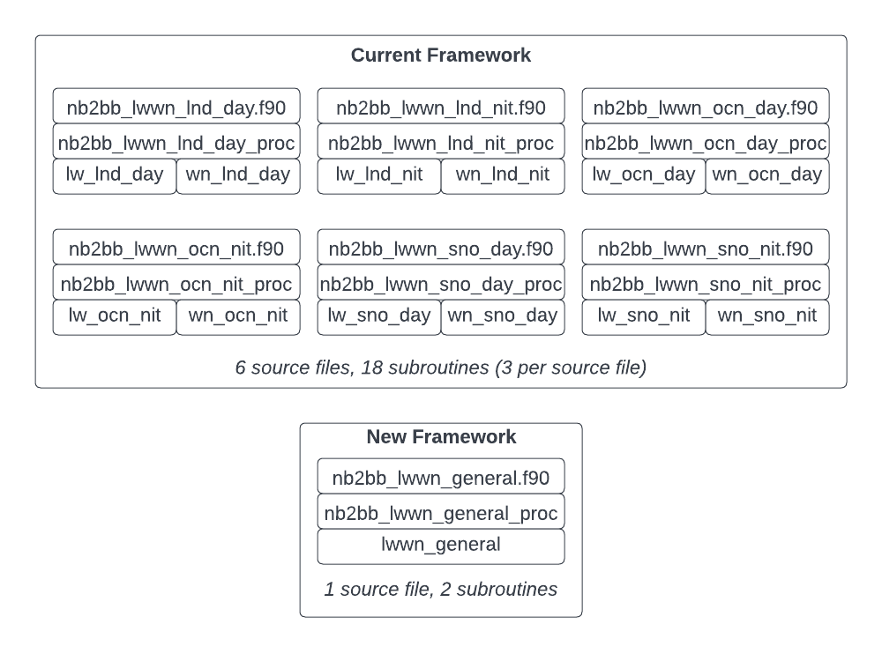
TISA Code re-architecture
X
X
X

Slide 20
TISA Code re-architecture
Software Lines of Code
Original Code |  | Refactored Code
nb2bb_lwwn_lnd_day | 255 | nb2bb_lwwn_general | 156
nb2bb_lwwn_lnd_nit | 253
nb2bb_lwwn_ocn_day | 258
nb2bb_lwwn_ocn_nit | 255
nb2bb_lwwn_sno_day | 256
nb2bb_lwwn_sno_nit | 245
Total | 1522
 | Difference: 1366 lines | Difference
90% code reduction!

Slide 21
Clouds code re-architecture
cloud mask code refactoring

Slide 22
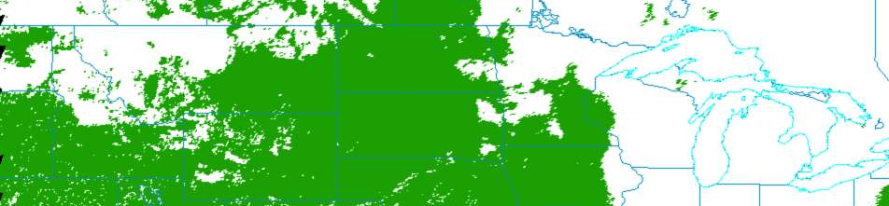
Clouds Code re-architecture
Focus on CERESmask – cloud mask
Powerful code, decision tree
  cloud, no cloud
  other classification types

Slide 23
Clouds Code re-architecture
Maintainability challenges:
  7,121 lines of code
  Direct memory access
  Inputs generated within codebase
New features with refactoring:
  Object-oriented programming
    Parent/child inheritance of methods
    Less code duplication
    Enables unit testing
    Polymorphism: one interface used on multiple data types
  Configuration files – easier to tune repeated values, don’t touch source code
Notes:
Legacy:
All global variables – no encapsulation can lead to hard to trace update anomalies
Multiple possible return points within methods – difficult to trace processing
Intertwined processing for all data types and conditions – little to no compartmentalization of processing with multiple layers of sometimes very complex nested conditional controlling logic
Future:
Encapsulation enables better data integrity between processing endpoints – inherrent protection against update anomalies
Polymorphism encourages compartmentalizing processing with as much code reuse as possible – less to troubleshoot and maintain
Configuration file usage allows tuning without need for continuous integration steps such as rebuilding executables and committing updates to code repository

Slide 24
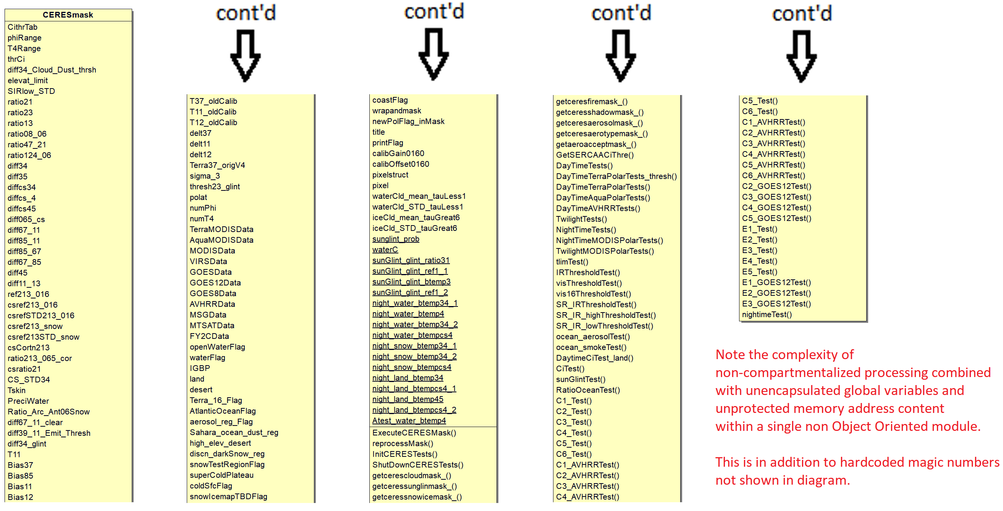
Clouds Code re-architecture
Current listing of variables and functions
Notes:
Note the number of global variables that can be updated anywhere at any time even outside of their intended use – interim variables used as a “scratch pad” are also global and all methods are global as well
Direct memory access provided at execution to legacy app includes greater number of variables than necessary allowing potential for additional still harder to trace update anomalies that would manifest in different processing modules

Slide 25
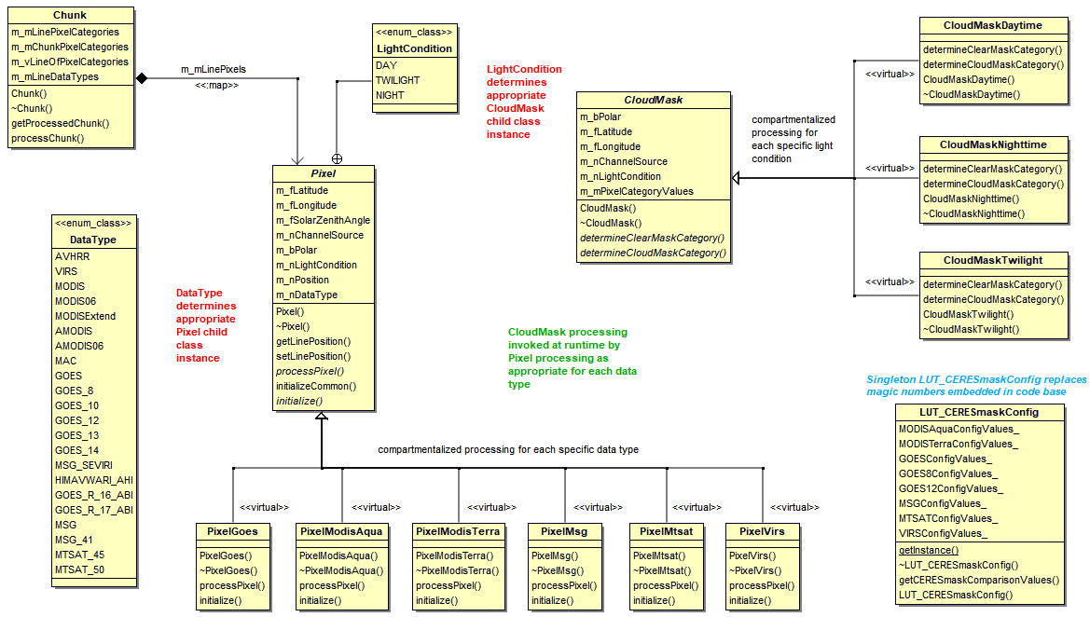
Class structure – refactored mask code
Notes:
Enhanced compartmentalized processing afforded by use of Object-Oriented architecture provides the following benefits:
Child class specific variables can be used as well as local variables for discardable “scratch pad” purposes helping prevent inadvertent updating of higher visibility variables in other modules and methods - excellent scope control
Polymorphic parent/child class inheritance allows reduced conditional complexity to handle the different needs of the various data types and any specific processing requirements
Polymorphism also allows more modularity and for interfaces to use the same method signatures while invoking specialized processing for individual data types

Slide 26
Clouds code re-architecture
Serverless architecture experiment

Slide 27
Clouds Code re-architecture
Goal: Run CURRENT CERES Clouds code in AWS
Motivations:
  Refactoring (new code) – long timeline
  1 week of processing / 1 year of data
  Currently working CERES Edition 5 development – iterate
Build capacity on CERES for running
  In Docker
  On AWS
  With “serverless” architecture – lambdas

Slide 28
AWS lambda: compute service to run code WITHOUT provisioning or managing servers
lean
ephemeral
docs.aws.amazon.com
scalable
Notes:
Modular, clearly delineated inputs and outputs

Slide 29
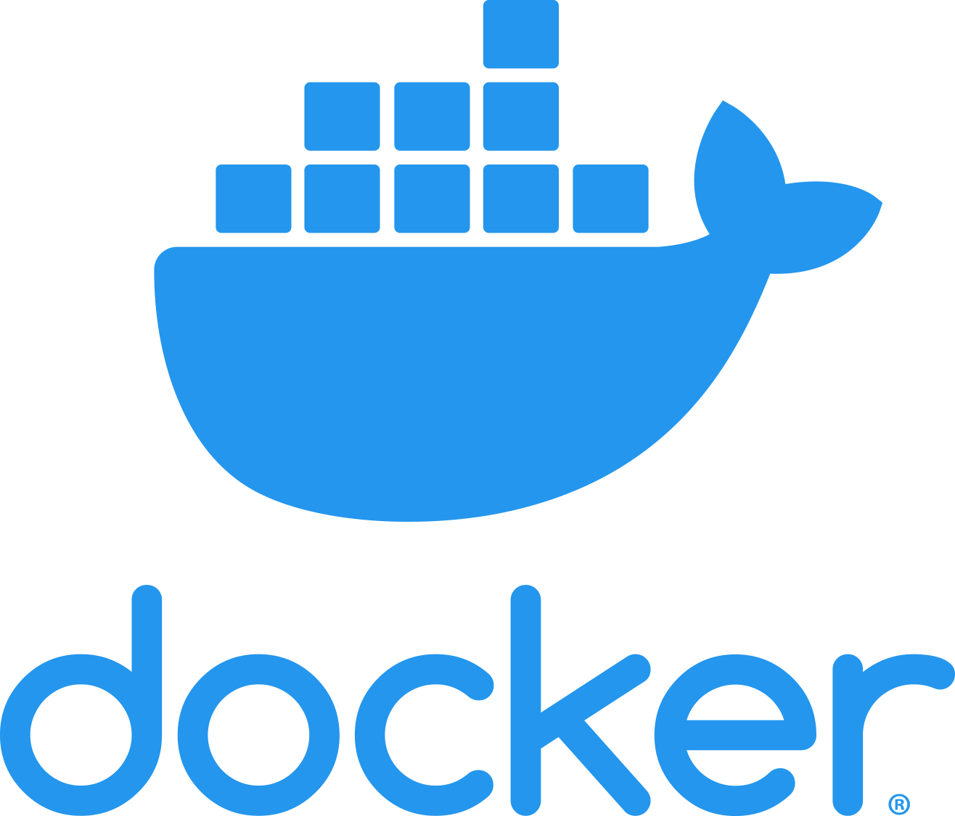
Clouds Code re-architecture
Previous work: “containerizing” Clouds PGEs
  Docker images for 2 product generation executives (PGEs):
    Clouds main – “1P6”
    Clouds clear radiance history (CRH) – “2P5”
  Enabled:
    Building Clouds binaries
    System agnostic execution
Current work: building & running Clouds Docker images in AWS
Code
Libraries

Slide 30
Clouds Code re-architecture
Developer Workstation
CodeBuild Instance
Compute Environment
Pull Source Code
Build Step
AWS Service
CodeCommit
CodeBuild
Build Executables
run unit tests
Build Docker Images
Deploy Docker Images
Elastic Container Registry
Update Lambdas
Lambda Functions

Slide 31
Clouds Code re-architecture
Current design:
  Employ lambda functions for creating PCFs and running PGEs
  Functional: launch-lambda for one PGE: 1P6
  (can also launch via command line)
  STDOUT text going to CloudWatch log streams
  Output data stored in S3 or EFS
Notes:
*retrieval and footprint are actually separated

Slide 32
Clouds Code re-architecture
Simple Storage Service
Elastic Filesystem
1P6 Hourly Retrieval Instance
1P6 Hourly Footprint Instance
1P6 Hourly Retrieval Instance
1P6 Hourly Footprint Instance
Command with run parameters
Launch 1P6
1P6 Hourly Retrieval Instance
1P6 Hourly Footprint Instance
Launch 2P5...
1P6 Hourly Retrieval Instance
1P6 Hourly Footprint Instance
Lambda Instance
Data Storage Service
1P6 Hourly Retrieval Instance
1P6 Hourly Footprint Instance
Notes:
EFS = Elastic File System
Command with run parameters = 48 1P6 hourly instances specified by JSON file config. etc.

Slide 33
Clouds Code re-architecture
Serverless Architecture
Advantages
Caveats
No infrastructure maintenance
Pricing based on compute time
Encourages modular architecture
Automated build/test/deploy
1P6 and 2P5 instances can run in parallel - 1,000 simultaneous lambdas!
Increased vendor lock-in – AWS-specific
Steeper learning curve
Not viable for every computing scenario
15 min. maximum runtime
10 GB memory/512 MB local storage limit
Filesystem read-only (other than /tmp directory)
Notes:
EFS = Elastic File System

Slide 34
SYSTEMS
Ordering Tool & Hardware

Slide 35
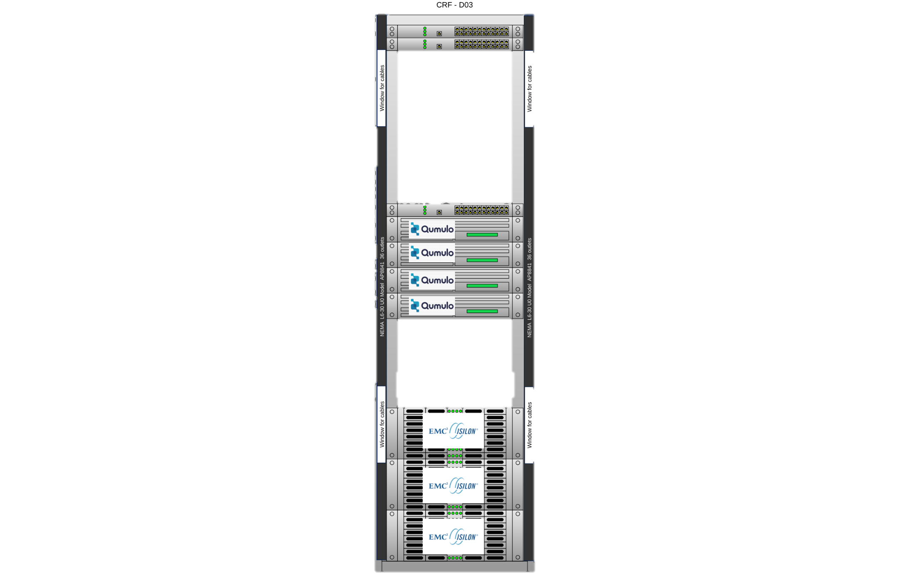
HARDWARE
First HPE w/ Qumulo purchase
  5 nodes in 2020
  1 PB usable space
Second HPE w/ Qumulo purchase
  5 nodes in late Summer 2021
  1 PB usable space
Additional 2 node purchase
  Allows more usable space
  Restriping
Updated total usable space:
~3.2 PB

Slide 36
CERES Ordering tool
Pamela Mlynczak
Churngwei Chu
Babak Samani
Develops and maintains custom, CERES
visualization subsetting and ordering tool
Internal and public versions
Public ordering tool on virtualized hardware

Slide 37
CERES Ordering tool
Converting
QA tool to virtual machines
NOV 2021
Successfully tested subsetting in new physical location - Computational Research Facility (CRF)
DEC 2021
Released new version of CCCM (D1)
Transitioned to PIV-M authentication
APR 2022
Released NOAA-20 Ed1B and NPP Ed2A for ordering and subsetting
UP NEXT
FEB 2022
Quickly mitigated log4j vulnerability

Slide 38
Summary
Ed1B NOAA-20 and Ed2A NPP editions released
Building capacity to run in AWS
  Facilitates Edition 5 development
  Anticipates “SIPS in the Cloud”
New hardware boosts project storage
Actively working with Libera Data
Management Working Group

