Slide 1
Quality practices for highly-constrained projects
GSFC Safety and Mission Assurance
Jesse Leitner, Chief Engineer
Notes:
What do our colors really mean?
Yellow (Warning)
Management awareness/attention needed
Items usually get discussed at Division/Directorate meetings
Red (Critical)
Impact is significant and management awareness/attention needed
Items usually get discussed at Directorate/Center meetings

Slide 2
Outline
  What is a constrained project?
  What is quality and why do we care?
  The two sides of quality
  Quality vs Reliability
  Misguided quality
  Risk
  Risk Classification Guidelines
  Technology vs Classification
  Practical Implementation
  GMIPs

Slide 3
What is a constrained project?
A constrained project is one that doesn’t have the time and/or money to perform all traditional practices
Many constrained projects do not start out as constrained
Most D and below projects are constrained at the start.
Even Class A missions often move into this category late in development

Slide 4
What is quality and why do we care?
Quality is the totality of features and characteristics of a product or service that bear on its ability to satisfy given needs.
  In many cases quality is defined by specifications that do not actually link to performance
  In some cases, such specifications are egregiously more stringent than the application warrants
    We can coin this term misguided quality when the second half of the quality definition does not apply
Quite simply, we need quality as a means to get reliability (or safety) and to assure consistency
  Quality on an individual product tells us that it is a good reproduction of previous working versions and that it is built as designed
  A developer’s quality practices tell us that we can expect future versions to be representative of the previous versions
But remember, no level of quality can make up for a bad design, and thus quality is in no way sufficient to obtain reliability
Furthermore, if we forget that reliability is the end game, we might lose sight on what’s important and top priority

Slide 5
Two sides of quality
Features of the product
  This is the essential element of quality because it represents the system in front of you
  Determined by observation and testing to the extent possible
Paperwork to show it
  Certifications
  Certificates of conformance
  Test data with signatures
  WOAs and travelers
  This provides confidence in internal and ”molecular” aspects that could be the source of various types of latent defects
  This is for the trust part. You can either trust or require paperwork, or a mix of both
  Paperwork itself is never sufficient to guarantee a high level of quality

Slide 6
Quality and Reliability
As mentioned earlier, quality is the totality of features and characteristics of a product or service that bear on its ability to satisfy given needs.
The reliability of a system is its ability to perform (or the probability to successfully perform) the necessary functions within expected life cycle exposure conditions for a required period
  Reliability of a system is established through
    A design that has minimal sensitivity to normal disturbances on the system
    Established past history of the same product
      Similar products may be used as a basis but the translation to the current product may be complex
  We often do not have access to design details for many products, which leads to reliance on
    Knowledge of the developer’s capability to develop reliable products
    Use of a proven design and tight control of variability to establish the reliability basis or claim

Slide 7
Quality and Reliability (cont’d)
Sometimes the original definition for quality of a given commodity or product is no longer meaningful
  Technology and manufacturing have changed
  Evolution of the product design has surpassed the quality definitions
In many cases, manufacturers use the term reliability to represent quality
  This is a practice that is based on past MIL-SPEC definitions.
  One key reason for it is that when there is not sufficient volume to establish reliability, quality is the only tool you are left with
  Often the quality definition for a product loses its meaning over time (due to, e.g., manufacturing changes)
  The conflation of quality and reliability is a major contributor to the retention of outdated practices

Slide 8
Is Quality just reliability on Day 1?
This is a common statement
It can be correct, but not always
The quality requirements would have to be well-aligned with the design, the design itself would have to be proven reliable, and meeting the quality requirements would have to be sufficient on their own to assure that the system functions reliably.

Slide 9
Misguided quality
Imposing stringent and excessive numbers of requirements relative to what is needed to achieve required performance and reliability
Blindly enforcing extensive requirements on manufactured hardware without considering effects of existing assembly vs that of rework
Using flight and/or qualification unit testing requirements that greatly exceed mission requirements, thus providing misleading results or overstressing or reducing the life of flight hardware
Misapplying stringent, but proven, requirements or tests to application areas outside of their original intent and design

Slide 10
What is Risk?
Definition: the combination of
  a) the probability (qualitative or quantitative) that an undesired event will occur, and
  b) the consequence or impact of the undesired event
  c) a factual context or scenario that exists to cause the risk to be present
  In short, risk is an expectation of loss in statistical terms based an existing condition.
Categories of risk (consequences)
  Technical (failure or performance degradation on-orbit)
  Cost ($ it will take to fix the problem)
  Schedule (time to fix the problem)
  Safety (injury, death, or collateral damage)
programmatic
Notes:
It is important to be explicit about what we mean when we say risk. This will be clear when we contrast risk with “possibility”.

Slide 11
Anatomy of a Risk
Context
Impact/Criticality
Concern
Statistics
Uncertainty
Structured risk statement
Likelihood
Consequence

Slide 12
GMIPs are a risk trade
As with most other SMA practices, GMIPs increase risk while buying it down
The key is to have risk buy-down outweigh risk increase
The more constrained the project the more likely GMIPs will result in a net increase in risk
  Most importantly the following should be considered while imposing GMIPs on such a project
    Criticality of the item (is the item itself a single point failure?)
    Past experience with the product
    Past findings on previous versions of the product
    Past experience with the vendor/manufacturer
    The potential to interrupt a development flow
By definition, GMIPs cannot be performed on COTS products. If a GMIP is performed internal to a product, then the product is not COTS.

Slide 13
GMIPS: increasing vs decreasing risk
Decreasing Risk | Increasing Risk
Catch serious* nonconformances at the earliest possible stage | Interrupt development flow
Motivate the assembler to pay close attention to detail | Prompt rework for many nonconformances that do not entail risk
Document stages of development for future problem resolution | Prompt pre-emptive and sometimes undocumented rework
 | Remove time available for completing testing and problem resolution
 | Increase possibilities for pandemic exposure
*serious meaning nonconformances that provide credible elevated risk of failure in testing or operation

Slide 14
Risk Classification Guidelines for Quality in NPR 8705.4A
Plan, document, and implement the quality assurance (QA)plans and quality engineering functions described in NPR 8735.2, including how the critical design, construction, and verification specifications are captured and conveyed to project SMA teams, system developers, and hardware suppliers; how quality data will be managed; supplier risk management; quality management system (QMS) elements and elements of production readiness; product and process QA and product acceptance; and how risks due to nonconformance will be managed.
Detailed guidance by mission class (too lengthy for presentation)

Slide 15
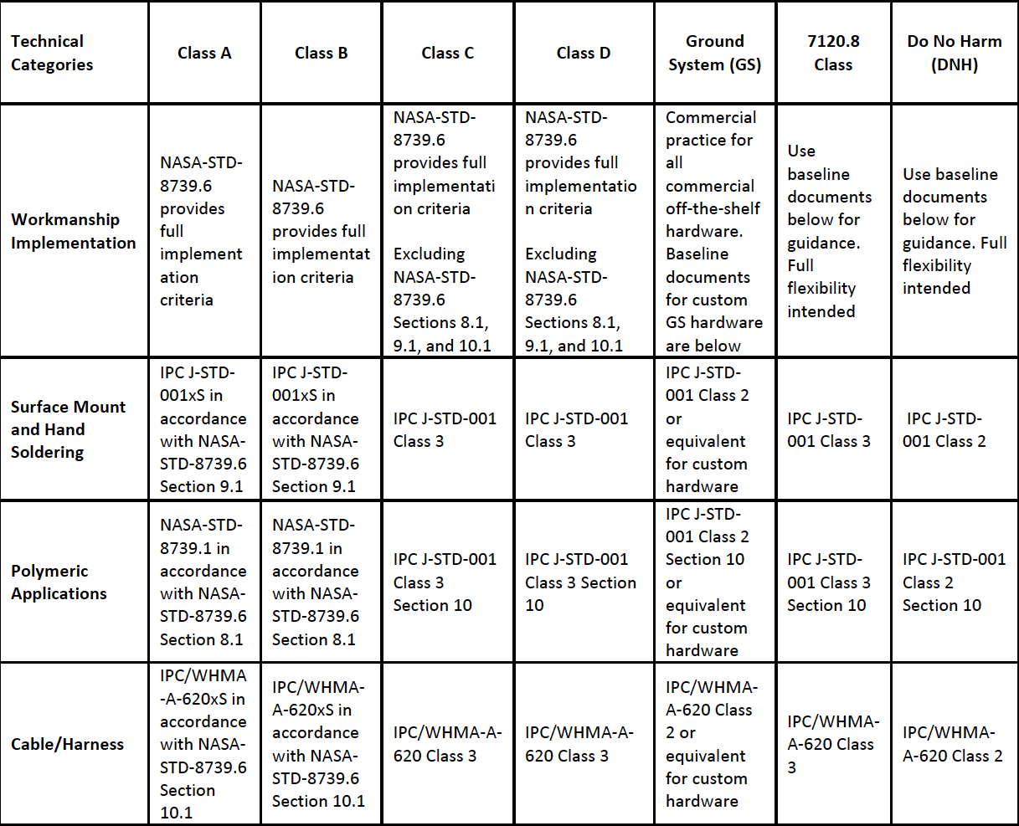
Risk Classification Guidelines in GPR 8705.4A (GSFC-specific)
Representative selection (truncated)

Slide 16
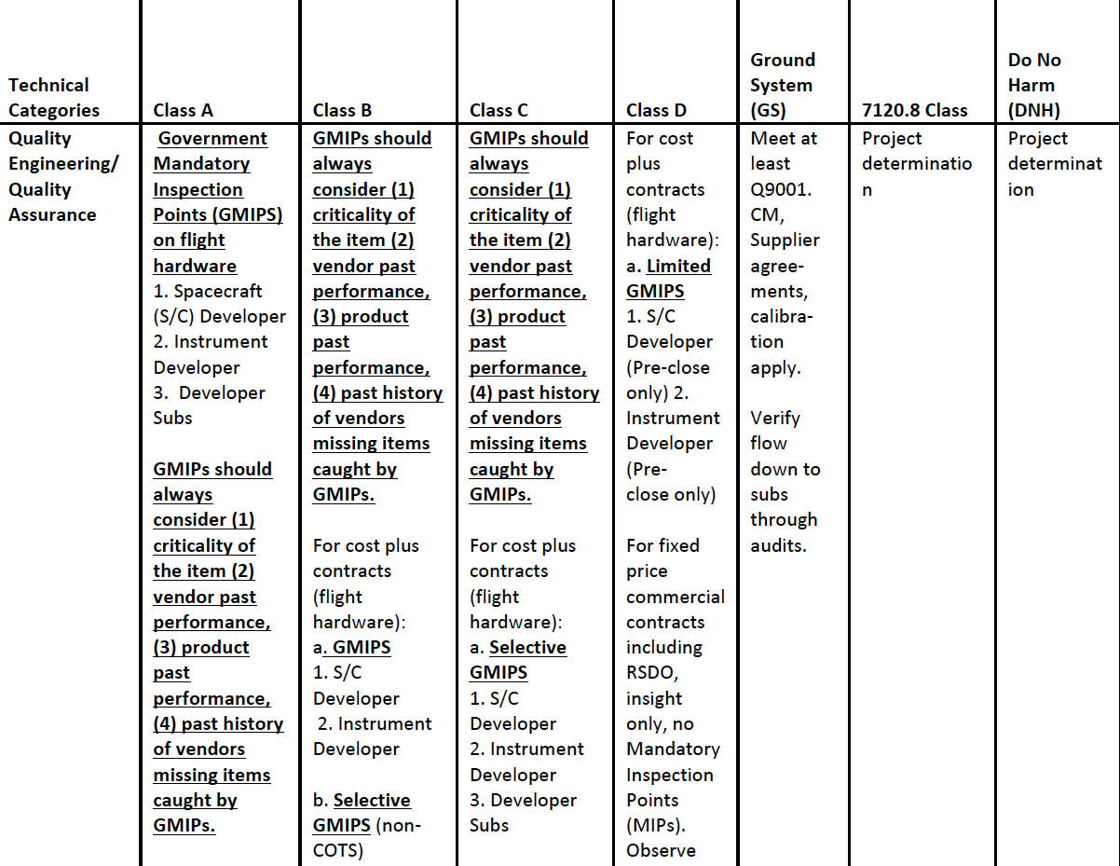
Risk Classification Guidelines in GPR 8705.4A (GSFC-specific) (Cont’d)
Representative selection (truncated)

Slide 17
Implementation of New Guidelines in Practice
Do not change standard practices
  i.e., if you have been using the space addendum for in-house work, continue to use it
  However, allow more flexibility
Evaluate against the specified guidance levels
Allow vendor standard practices for Class D and below
  Note that table is in the form of guidelines only, thus not incompatible with SMD Class D MAR

Slide 18
Quality and Inspection for Standard products
For COTS, only final product can be inspected
For non-COTS standard products, inspections may be negotiated but recognize that inspections disrupt the flow and might significantly increase risk
GMIPs should be considering
  Product history
  Vendor history
  Criticality (SPFs - no fault-tolerance/redundancy, etc)
Notes from previous inspections of same product should be used for reference when available

Slide 19
Quality vs design stability
The more stable a design is, the more effective quality requirements are likely to be
  Quality requirements tend to
    bolster that stability
    ensure the perfect fit is achieved and maintained
    resist changes from the original design
    Assure repeatability for a design that’s been proven reliable
The more a design needs to breathe, mature, and learn from testing (such as in a technology maturation effort or technology demonstration), the more selective the quality requirements should be

Slide 20
Risk Classification Practices vs Technology state of the art and Reliance on Trust and Acceptance of Unproven Items
DNH 7120.8 D C B A
Classification Practices
0
20
Age of Technology (yrs)
0
Reliance on Trust
90%+
0
Acceptance of Unproven Items
90%+

Slide 21
Risk Classification vs Assurance Methodology Focus
Notional view
Note: application of strict workmanship requirements supplants DfM and DfR efforts, and hinders technology maturation.
DNH 7120.8 D C B A
Classification
New technologies, and tech demos should be down here
DfM/DfR
Technology Maturation
Strict workmanship reqmts/verification and extensive screening
Assurance emphasis

Slide 22
Big Picture of Risk-based Quality
Product or Process
Conforming
Non-conforming
Acceptable or no elevated risk
Risk Assessment
Use and log
RCA
C/A
Multiple NCs with no risk suggests requirements problem: requirements change
NC involves risk and vendor quality problem: vendor C/A, rebuild product or correct process as necessary, record result

Slide 23
Look for risks: Pre-2015 vs risk-based
Pre-2015 | Risk-based
Met-cal: check stickers on all “boxes” in a room | Inquire about which measurements have documented accuracy/traceability requirements. Check cal status of instruments used to take those measurements
ESD: Lack of ESD controls based on finding in high-risk area | Determine controls on high-risk area (beyond simply ESD) to find out if there is a clear distinction between where risks can be taken and where they can’t
Ban use of materials beyond date (or no date) | Assess org’s understanding about expiration of materials and risks associated beyond the date
Ban use of standards other than those specified | Determine whether org understands the standard they use and whether they properly negotiate requirements with customer
Strictly enforce sampling rate requirements | Determine whether org makes “quality adjustments” to sampling

Slide 24
Risk-based audit and assessment
Risk-based thinking used to prioritize and scope out overall and individual audit schedules for best bang for the buck
Audit teams include subject matter experts to focus on most substantive concerns
Assessors document nonconformances to requirements and observations of nonstandard practices
Use independent experts to review audit findings to identify trends/systemic issues and guide audit team responses
Make first cut at determining whether credible risk is present due to NCs and observations, or if other areas of risk are identified
Identify findings accordingly to the developer and affected projects
Project and SMA organization assess risk associated with each finding
  in some cases, RCA is required to determine if there is a systemic problem
  Feed back risk assessment results into audit plans
Those that involve elevated risk will prompt RCCA
Common findings across multiple developers with no elevated risk indicates that there is a requirements problem

Slide 25
Summary
Confusion between quality and reliability has long been the source of retaining old and/or ineffective or improperly employed requirements
When establishing quality requirements, it is essential to understand the goal – to establish reliability
When applying quality requirements to highly-constrained projects, the risk trade should be fully assessed to assure that the net effect of selected practices is to reduce overall risk

Slide 26
Concern
Definition: A logical determination that an undesired event may occur or that the protections against such an event may not be sufficiently well understood based on available data
This is the core element upon which a risk is founded
In some sense, it is the risk without the context, likelihood or consequence.
Can come in the same “flavors” (categories) as risks
  Technical
    A part may fail
  Cost
    Cost of an item may grow
  Schedule
    Delivery may be delayed
  Safety
    The spacecraft may fall off the crane

Slide 27
Note on choosing elevated practices
Choosing Assurance levels above the recommended levels for the given classification should be undertaken only with a careful risk-trade analysis as such an approach is not as simple as “paying a bit more for more reliability”.
  Practices that exceed the available resources are likely to drive up programmatic and technical risk by reducing the resources available to complete the most important elements needed for success – finishing the test campaign and thorough resolution of problems encountered in integration and test.
  Furthermore, such practices often involve overtesting or unrealistic testing that may prompt irrelevant failures or actual overstressing of flight hardware.
The practices that involve greater levels of workmanship controls, restrictions on parts and materials, and inspection generally conflict with the technology maturation process (which requires flexibility and responsiveness to testing results and problem resolution).
  Therefore, the importance of a technology demonstration or a mission that involves immature technologies is not an appropriate justification for selecting more stringent assurance activities in most areas.
  In these cases, the assurance emphasis should be placed on design for manufacturability and design for reliability, as opposed to screening, workmanship controls, and inspection.

Slide 28
New features in ISO 9001:2015
Document organization: written under “High Level Structure”
Risk management is at the core
Commitment to quality through strong leadership is strengthened
Better consideration to how organizations evolve to improve
The role of the quality manual is reduced – focus is more on keeping up with technological and societal changes
More emphasis given to the context surrounding the organization
Knowledge is now a resource to manage

