Slide 1

Composite Technology for Exploration (CTE) Project
Infusing Bonded Joint Technology into Space Launch System Block 1b Flight Structures
Ken Segal / NASA Goddard Space Flight Center
ASC 37th Annual Technical Conference
Sept 19-21, 2022
Tucson, Arizona
This material is a work of the U.S. Government and is not subject to copyright protection in the United States.

Slide 2


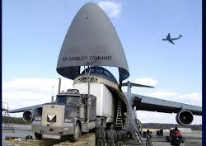


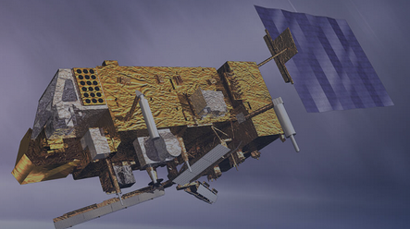
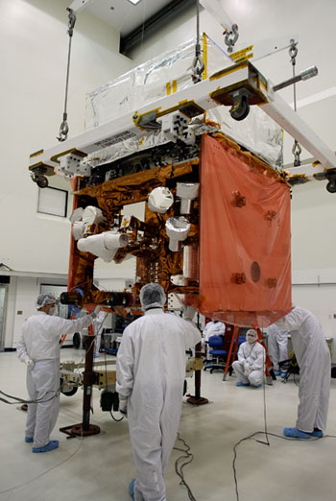
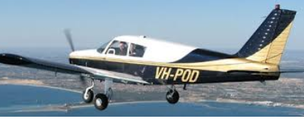
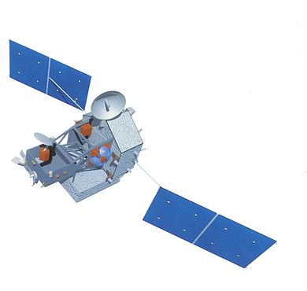


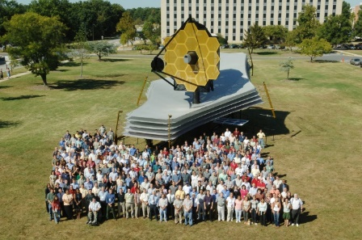
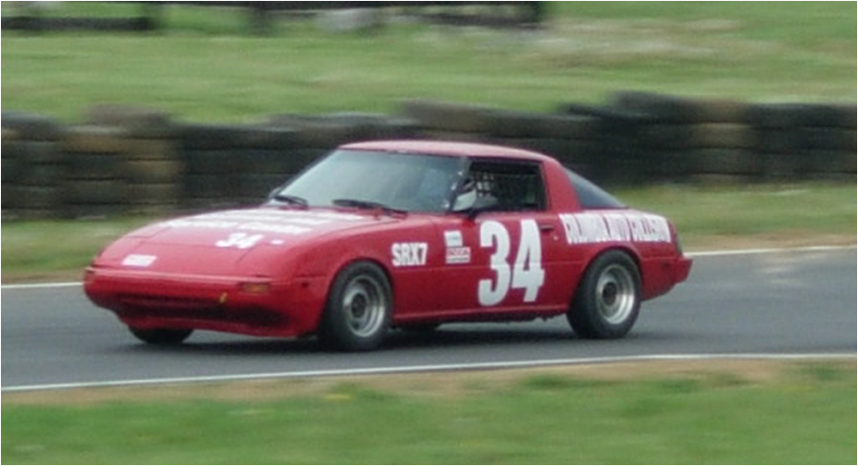
Introduction: Who is Ken Segal ?
Mechanic to Engineer / USAF
UMd / BSME 1988
From Boston
Technology Development: Composites Bonded Joint infusion in SLS
POES
FERMI
TRMM
HST Repair Mission 2a
Pilot Vehicles
JWST

Slide 3
Presentation Intent
Share Longitudinal and Circumferential Joint (L-Joint and C-Joint) Advancements
Identify Joints infused into SLS and other possibilities
Inform you about CTE Motivation, Objectives and Team
Outline Relevant Analytical Tools

Slide 4
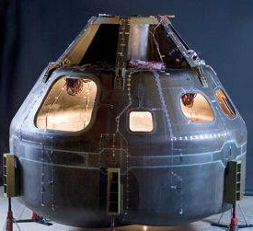
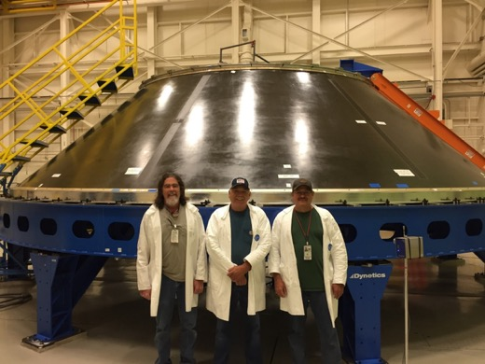
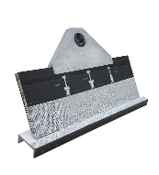
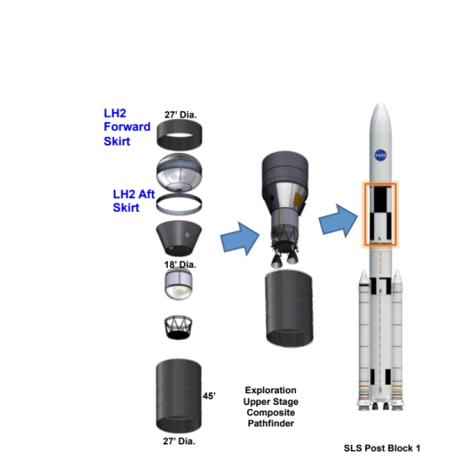
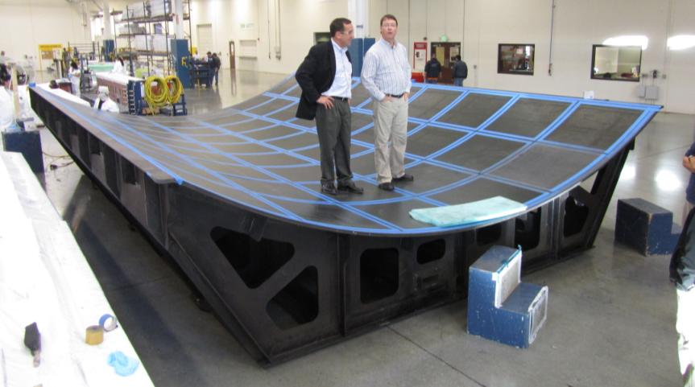
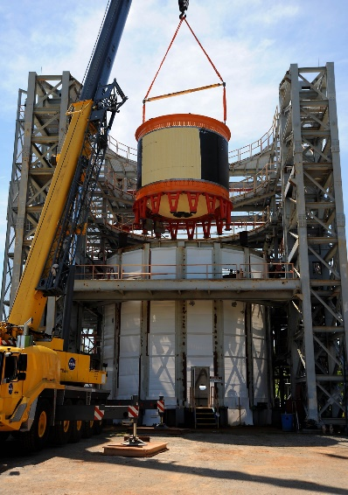
Composites at NASA: Over a decade working on Composites for Launch Vehicle Applications
CCM: Composite Crew Module (2007-2009)
ACT: Advanced Composites Project (2008-2010)
LSSM: Lightweight Spacecraft Structures and Materials (2011-2012)
CoEX: Composites for Exploration (2012-2013)
CCTD: Composite Cryotank Technology Development (2011-2015)
CEUS: Composites for Exploration Upper Stage (2014-2016)
CTE: Composite Technology for Exploration (2017-2021)
RAMPT: Rapid Analysis and Manufacturing Propulsion Technology (2017-2022)
FUTURE : Thermoplastic Development for Exploration Applications (2022-2024)
CCM: Composite Crew Module

Slide 5
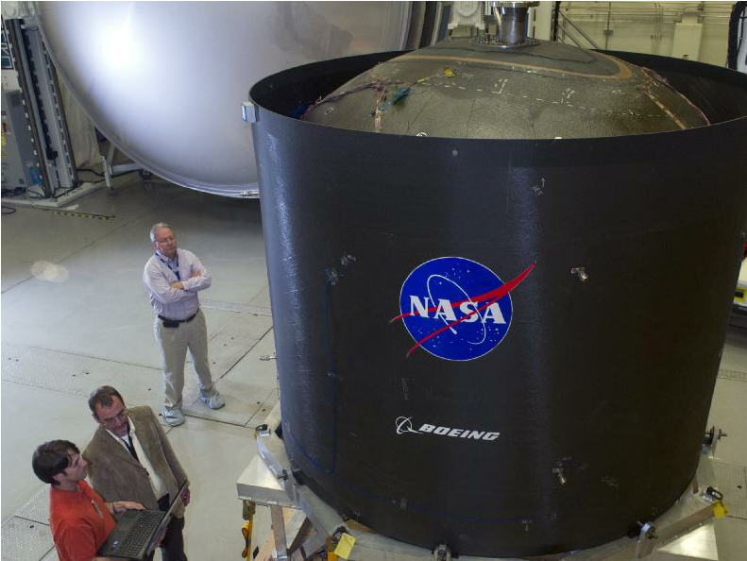
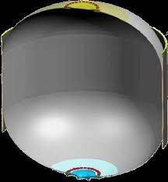
What Is CTE (The Project)
Y-Joint
CTE Grew From the Composite Cryotank Technology Demonstration Program
Analyses of Y-Joint failure mode and load was a significant challenge.
Ref: NASA TM 2015-218967, ‘Test and Analysis Correlation for a Y-Joint Specimen for a Composite Cryotank’; Brian Mason, et al
Notes:
Cracks formed at .2*DLL

Slide 6
CTE Team and Organizational Structure
1.0 Management
J. Fikes - Project Manager
M. Johnston - Deputy Project Manager
MSFC
3.0
Design/Analysis
D. Sleight/LaRC
K. Segal/GSFC
5.0
Manufacturing
W. Guin/MSFC
6.0
Testing/Evaluation
A. Finchum/MSFC
2.0
Materials
S. Miller/GRC
Notes:
Talk about objective to advance joint technology. Acknowledgement verbally to team members.

Slide 7
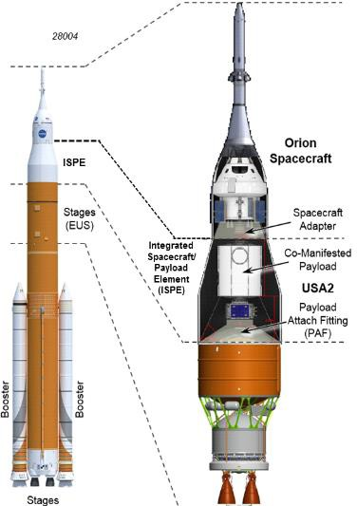
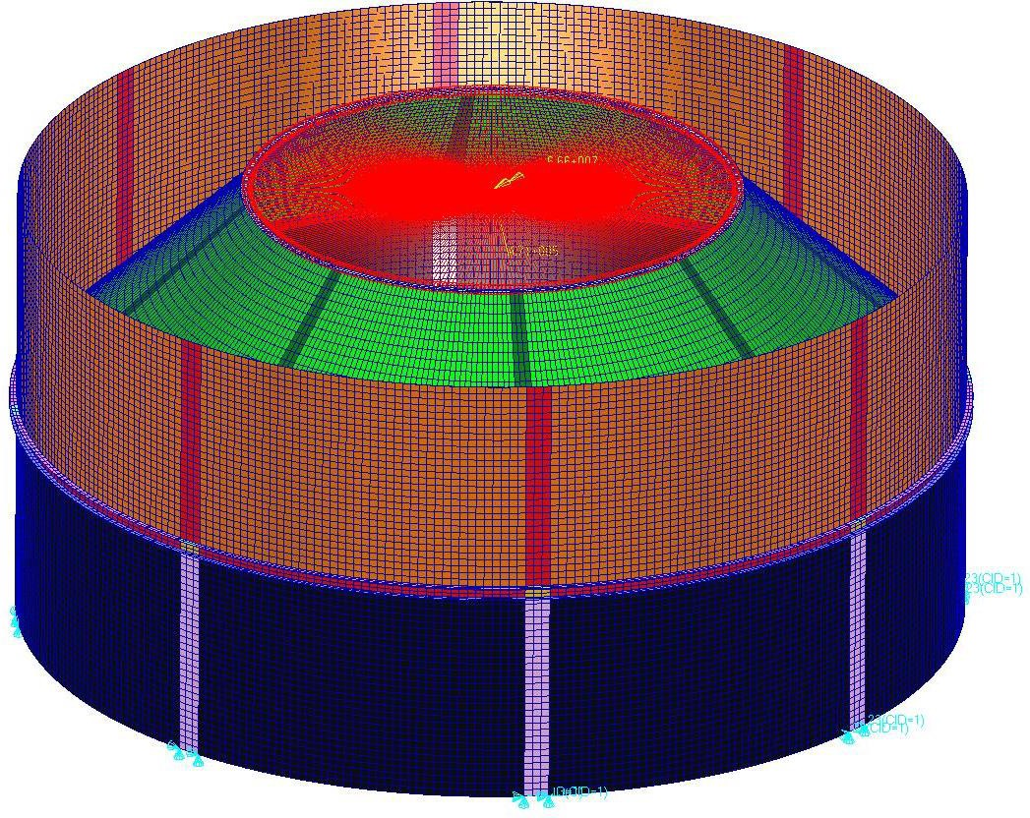
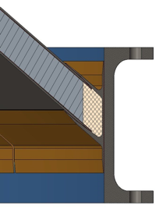
What Is CTE (The Project)
CTE’s goal is fully vetted designs demonstrating the light weight bonded joint technologies enabling flight mission infusions
Joints Advanced
Configuration Studied
Longitudinal Joint
Payload I/F
USA
Payload Attach Fitting (PAF)
Payload
Circumferential Joint
S
r
Universal Stage Adapter (USA)
PAF
USA
PAF
EUS
Payload
Exploration Upper Stage (EUS)
EUS
SLS Block 1b
2

Slide 8
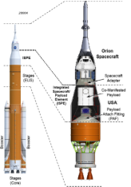
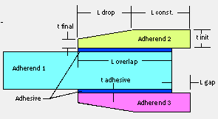
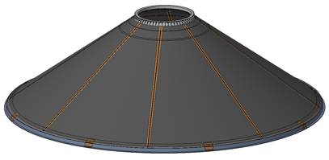
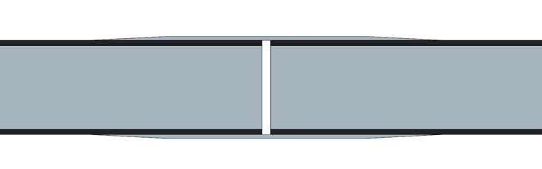
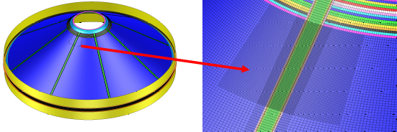
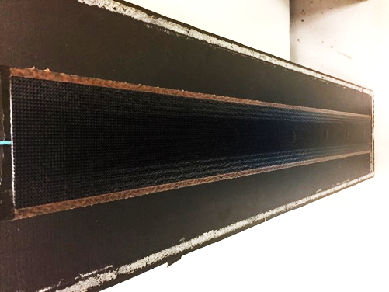
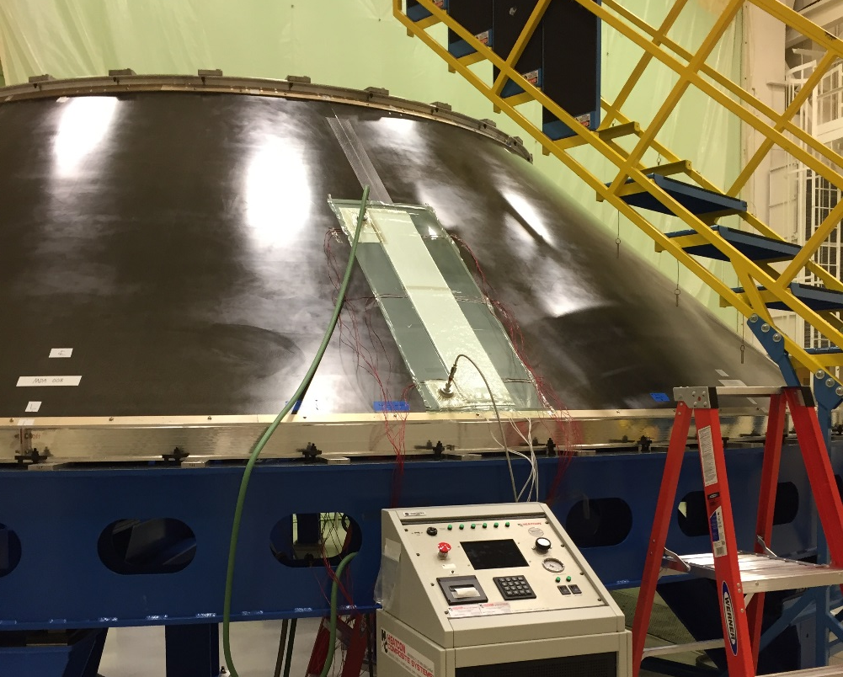
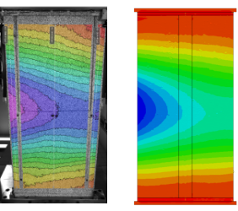
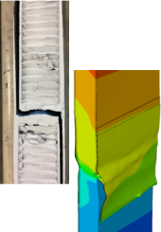
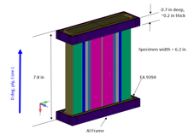

CTE Longitudinal Joint Design Development
CTE Point Design
Material Selection and
Joint Design
Joint Sizing Analyses
Detail Joint Analyses
Joint Manufacturing
Large-Scale Panel Tests and Analysis
Sub-element Tests and Analysis
Sub-Element Test
Design
SLS PLA Infusion
(Manufacturing Demo Shown)
Includes Pristine and damaged verification test analyses

Slide 9
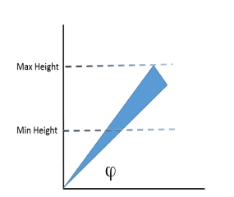
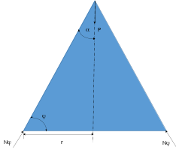
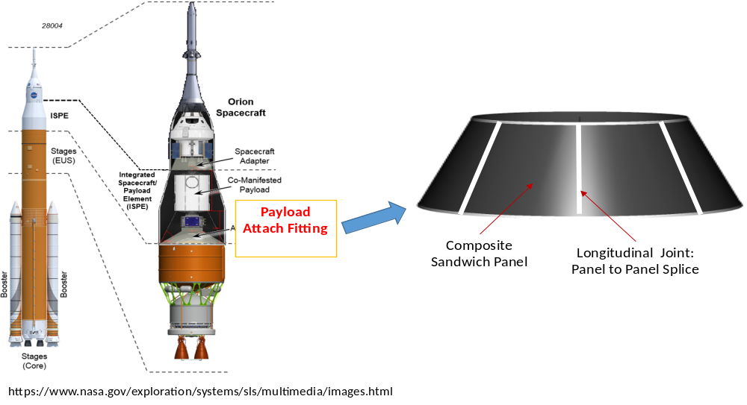

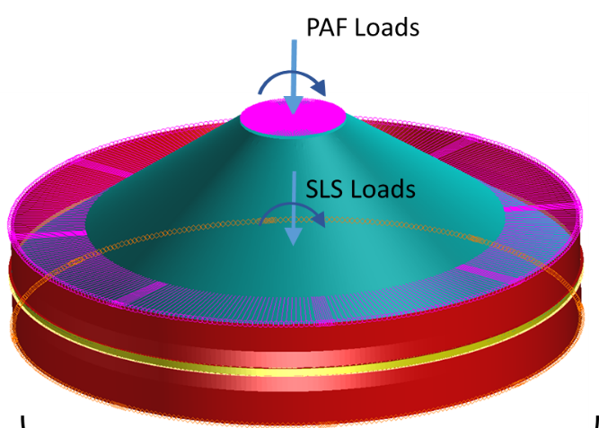
CTE Point Design
Loads
1.58 m Diameter
Based on SpaceX Falcon 9 User guide
Payload 10 metric tons
Based on Delta IV Launch Services User’s Guide
35 degrees conic angle results in highest membrane loads
8.4 m Diameter, Based on SLS Size
Stage / SLS Loads
Based on SLS-SPIE-SPEC-009
Design Basis SLS Block 1b
CTE Point Design is non-flight SLS scale structure design providing conservative joint development requirements
Notes:
Launch Planners Guide

Slide 10
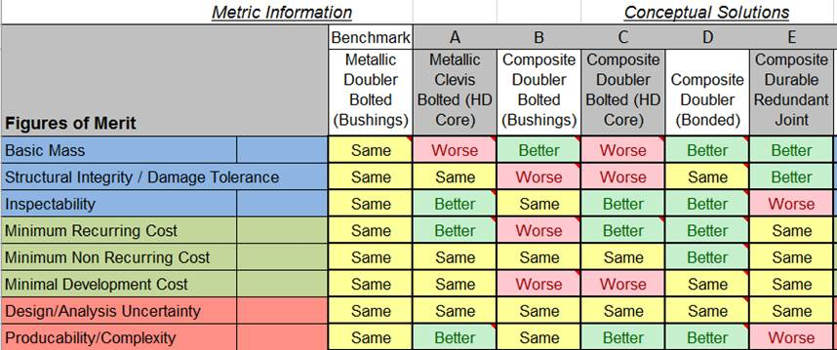
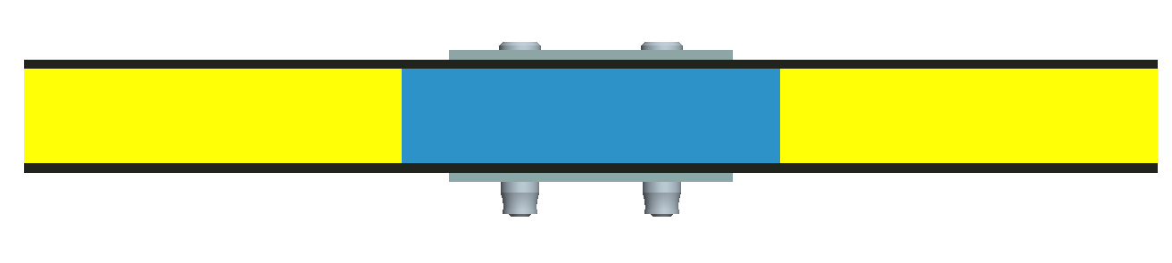
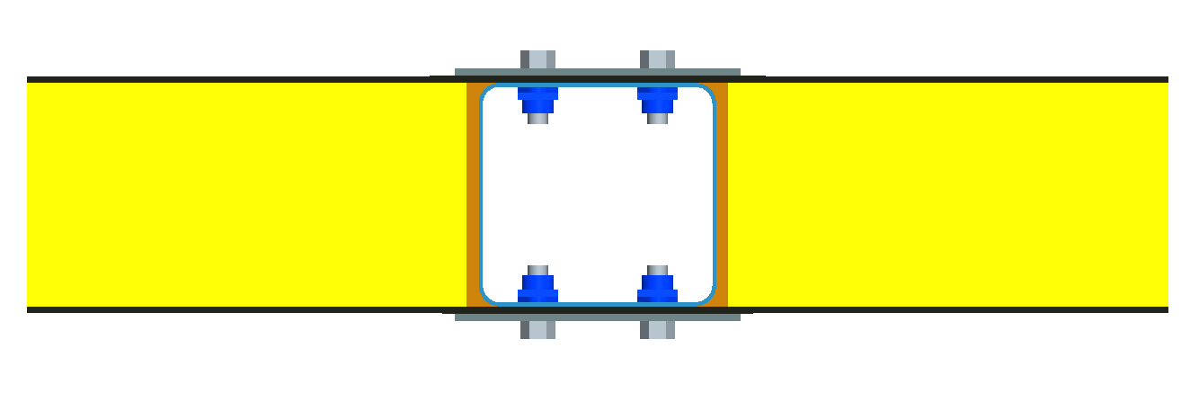
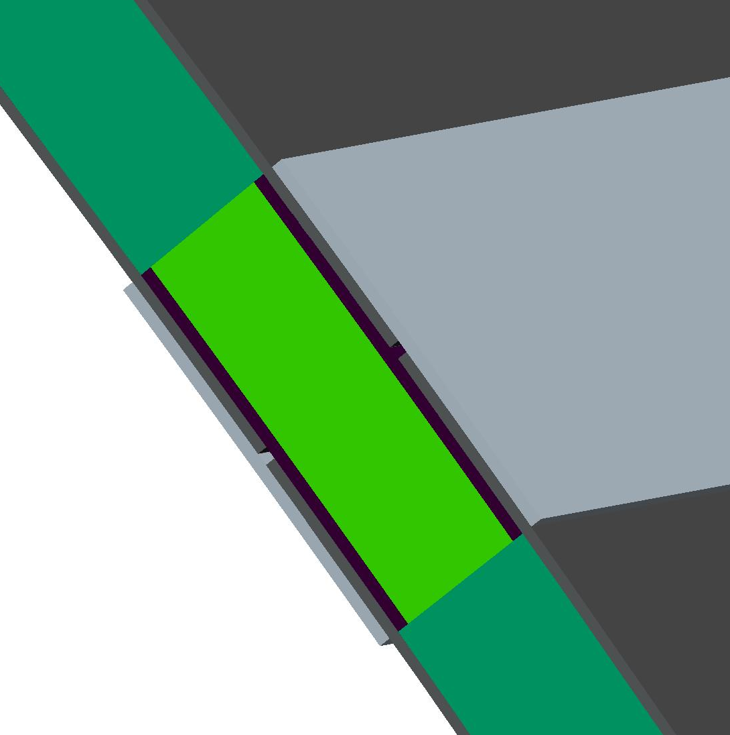
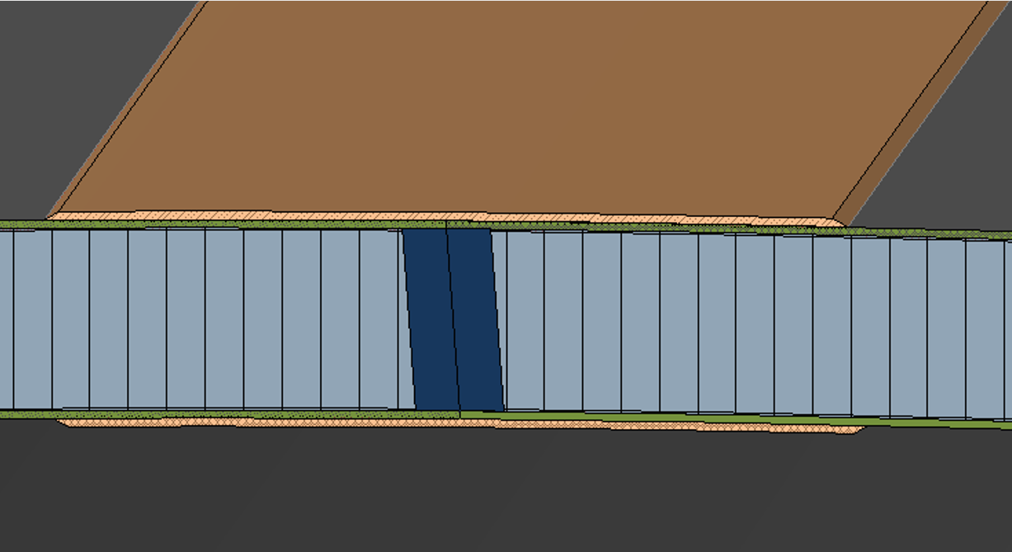
L-Joint Design Down Select
CEUS Studies
CTE Designs
ACT Industry Studies
Densified Core
Metallic Double- Bolted with core densification
Metallic Clevis
ACT Industry studies by Boeing and Northrop- Grumman both concluded the double lap composite bonded joint is a preferred joint to advance:
Ref: Boeing’s ‘Composite Joint Concept Development and Evaluation for an ARES V Vehicle’; Final Report dated June 17,2010
Ref: Northrop’s ‘Lightweight Composite Joint Concept Development and Evaluation for an Ares V Vehicle’ , dated Oct 8 ,2010
Plug
The double lap composite bonded joint was advanced for CTE design advancement and analyses studies due to its simplicity, and the abundance of past studies supporting this design and manufacturing.
Durable Redundant Joint
Bonded Composite Doubler

Slide 11
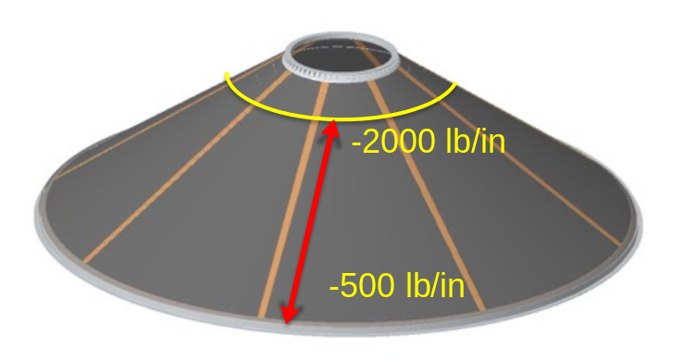
CTE Longitudinal Bonded Joint Design
CTE Longitudinal Bonded Joint Design
Compression is the critical load case
Max. compressive design line load is 2000 lb/in
0.005” FM209-1M adhesive
4-ply T650/5320-1 doubler
CTE L-Joint designed to highest load in acreage area
1” Aluminum sandwich core
8-ply IM7/8552-1 face sheet
EA9396.MD gap filler

Slide 12

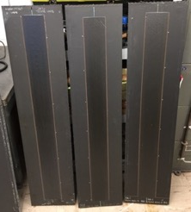
Joint Mass Comparison
Longitudinal Joint Mass and Part Count | Total Mass (lb-f) | # Fasteners | Part Count
Metallic Splice / Bolted with 1 Row of Bolts – Core Densification | 330 | 2100 | 2116
Metallic Splice / Bolted with 1 Row of Bolts – Bushings | 207 | 2100 | 4216
Composite Bolted with 1 Row of Bolts- Core Densified | 290 | 2100 | 2116
Composite Bolted with 1 Row of Bolts- Bushings | 167 | 2100 | 4216
Composite Bolted FailSafe – Core Densified | 234 | 530 | 546
Composite Bolted FailSafe – Bushings | 144 | 530 | 1076
All Bonded | 42 | N/A | 40
CTE Final Design, As Built Data | 27 | 0 | 40
MASS:
‘As modeled’ bonded joint mass 0.38 lb-f / ft
FY18 ‘as built’ mass 0.25 lb-f / ft
2.0 FoS Bonded longitudinal joint : 92% mass reduction and 98% part reduction.

Slide 13
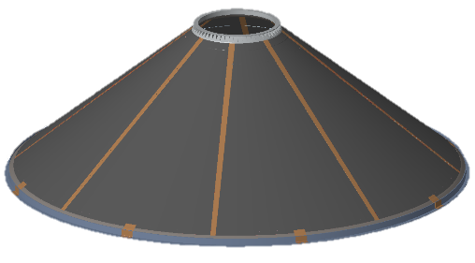
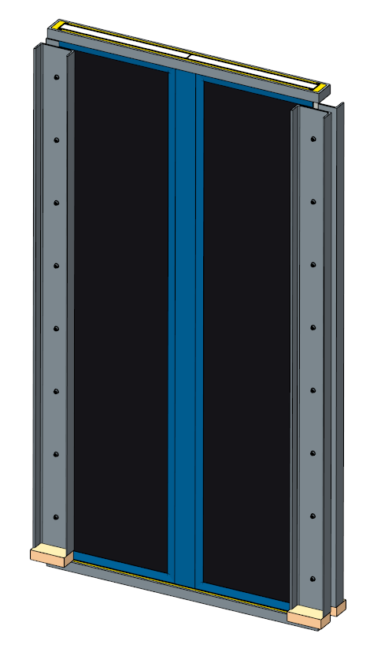
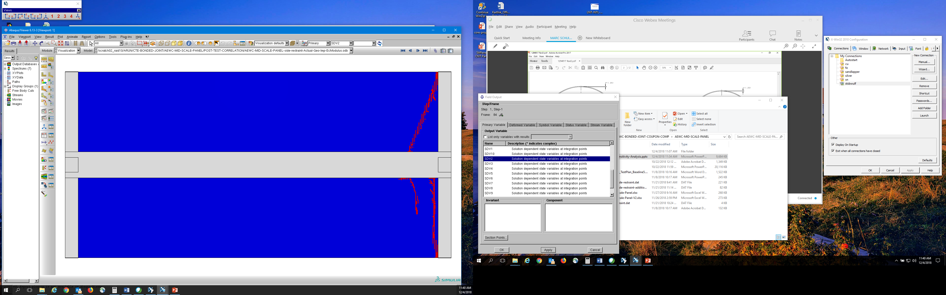
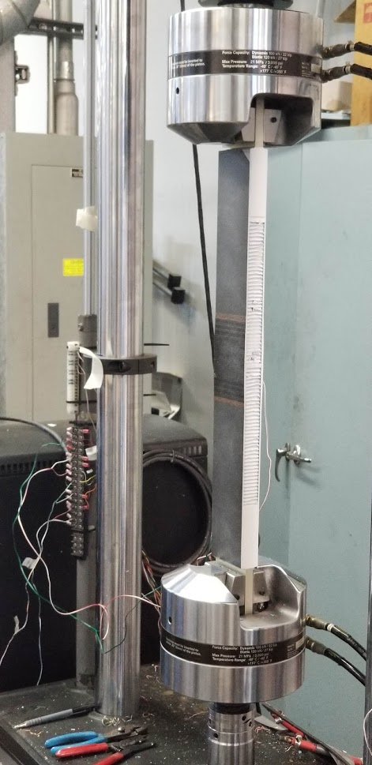
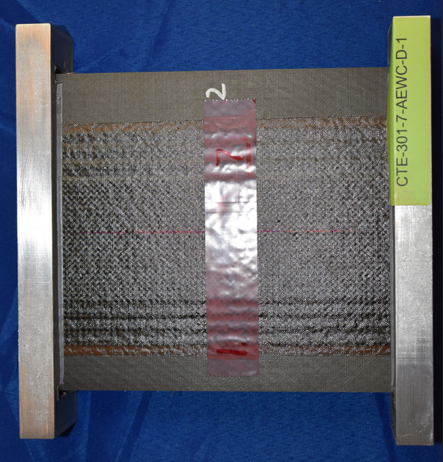
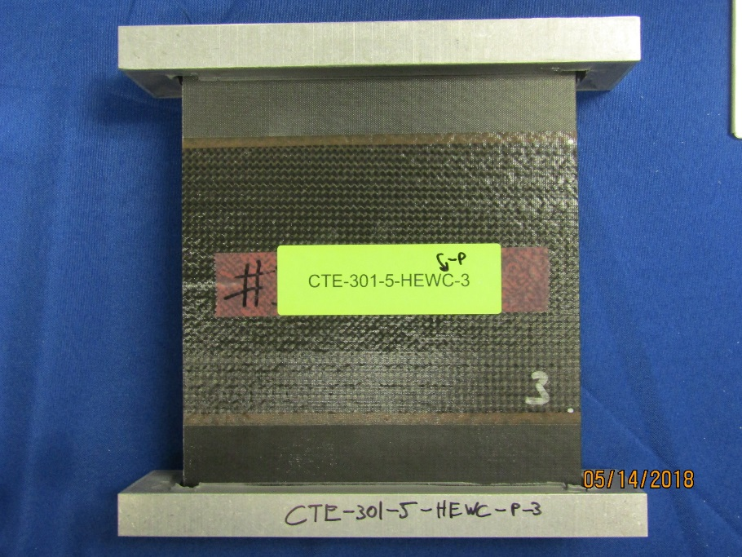
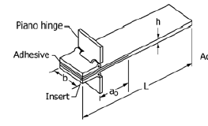
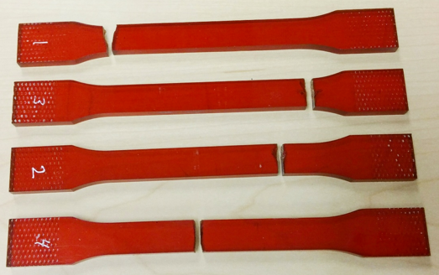
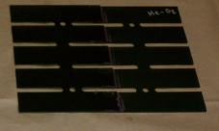
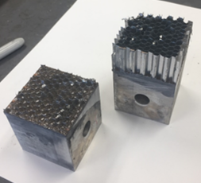
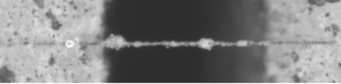
L-Joint Building Block
Component
Number of CTE specimens tested:
Manufacturing Process Development and Scale-up
Subcomponents
2
Design Concepts and Analysis Development
Elements &
Sub-elements
~50
Coupon Testing for Material Properties
Coupons
~350

Slide 14




L- Joint Test Designs
Element test designs
Hoop Tension
24”L x 3” W
Axial and Hoop Edgewise Compression 7”L x 5” W
Sub-component test designs
L-Joint tests verified design and manufacturing, and quantify damage tolerance, and validate bonded joint analytical tools
Axial Strain Contours
L-Joint Buckling Test 62”L x 30” W
Notes:
Transition, done for both pristine and damaged

Slide 15




L-Joint Flawed Joint - Failure Analyses
HEWC: 2 inch flaw
Initial Flaw
2”
Load [kip]
Embedded Teflon insert
Flaw Growth
Displacement [in]
Peak load: 15.1 kip
Delamination growth in axial direction
Disbonded
Bonded
Panel gap

Slide 16




L-Joint HEWC Flawed Test Results
Specimen 1
Specimen 2
Specimen 3
Backside facesheet fractured near top of doubler
Multiple interface delamination
  Average peak load was 19.5 kip with 1.8% coefficient of variation.
  DIC Evidence of damage growth starting above 95% peak load.
    Primary failure mode was delamination near the midplane of the facesheet
    Delamination occurred at multiple interfaces
  The data shows good damage tolerance of the L-Joint / 9% knockdown compared with pristine

Slide 17





CTE L-Joint Flight Infusion
Infusion: SLS Block 1b
Fiber Damage
in Face-sheet
Shown on PAF MDA and on USA (Ruag)
Fiber Damage
in Face-sheet

Slide 18
CTE C- Joint Development
Notes:
Talk about objective to advance joint technology.

Slide 19




CTE C-Joint Design Introduction
End-ring / Circumferential joint (C-Joint ) design
Conic Sandwich Panels
Composite facesheets with aluminum core
3D Woven Pi-preform:
Woven by Bally Ribbon Mills (BRM) with B-stage resin impregnated.
Co-bonded to C-channel and Sandwich Panel
CTE Point Design Structure*
Film Adhesive
3D Woven C-channel: Woven by BRM,
Resin Transfer Molded (RTM) by Cornerstone Research Group (CRG)

Slide 20


FY19 Technical Assessment Periodic Review (TAPR)
C-Channel Fiber and Weave Architecture
Two main 3D weave types
Z-Fiber / Orthogonal weave
Interlocked
weave
Leveraged prior ESA and NASA 3D weave work*: Selected IM7 Fiber and an orthogonal weave for C-channel development
*Jones, J., et al, “Comparative Study of 3-Dimensional Woven Joint Architectures for Composite Spacecraft Structures”

Slide 21
















3D Woven Joints Efforts
Concept
NASA / MSFC and GSFC
BRM (ESA-Sonoca)
Prior Work
BRM
Weave flat panels
Northcoast
RTM panels
NASA/ GRC and NIAR
Properties testing
“Predicted” Elastic Properties
w/ Modeling & Test Correlation
BRM: Design Inputs
NASA/ GSFC & GRC and MSC Software: Modeling Development
TexGen
Illustration
FEA Results
Modeled in
Digimat
NASA/GSFC Joint Assembly
CRG: RTM C-Channel
BRM: End Ring Weaving
NASA/MSFC and NIAR
Joint Verification Testing
CRG: Tool design and Fab

Slide 22








Partners, Collaborators
North Coast Composites
Cornerstone Research Group (CRG)
Bally Ribbon Mills
MSC Software
Extreme Engineering
NASA GSFC
NASA LaRC
National Institute for Aviation Research
NASA GRC
NASA Center
NASA MSFC
Industry
NASA/ GRC | NASA/ GSFC | MSC Software Extreme Engineering | Bally Ribbon Mills | North coast Composites | Cornerstone Research Group (CRG) | NASA/ LaRC | National Institute for Aviation Research (NIAR) | NASA/ MSFC
Cleveland, OH | Greenbelt, MD | Santa Anna, CA | Bally, PA | Cleveland OH | Miamisburg, OH | Hampton, VA | Wichita, KS | Huntsville, AL
Material Modeling, and Testing | Material Modeling | Material Model Support | 3D Weaving | Panel-Resin Transfer Molding | C-Joint -Tooling and RTM | Joint Sizing Analyses | Material Testing | Project Management and Joint Assembly

Slide 23












C-Joint Building Block Effort
CTE Point Design
Component
Number specimens tested:
Manufacturing Process Development and Scale-up
Subcomponent
1
Design Concepts and Analysis Development
Elements &
Sub-elements
~20
Coupon Testing for Material Properties
Coupons
~200

Slide 24







3D Woven Joint Material Modeling
Modeling/ Analysis with DIGIMAT and GRC General Method of Cells
TexGen Model/ BRM
Weave Design
RVE
FE Mesh
FEA Results
Modeling DIGIMAT vs. MSGMC
Pi Preform Weave design and property predictions

Slide 25



3D Weave Progressive Failure Testing
Test Coupon
Flat
Panels
Test Setup
Repeated tension loads shows linear behavior up to ultimate failure
* Details of these tests are W. Jackson, et al "Experimental Observations of Damage States
in Unnotched and Notched 3D Orthogonal Woven Coupons Loaded in Tension," AIAA Scitech 2022

Slide 26


3D Weave Progressive Failure Testing
Matrix Cracking
Failure in CTE-218-10-L. The arrow marks the edge termination of a warp tow. The circles mark the location of the z-tows along the failure surface.
As manufactured
Run 2
30% Failure
Load
Run 4
93% Failure
Load
Matrix Cracks multiply under loading and are attenuated by fiber tows. Ultimate failure is Z- fiber rupture.

Slide 27


3D Weave C-Channel Verification Testing
Web Section
Compression failure
C Channel Compression shows no damage indications until ultimate failure at an average of 8.2x DLL

Slide 28



3D Weave C-Channel Verification Testing
Sub-Element
Test Setup
Flange to Web Junction
Failure is Z fiber rupture
C Channel Tension shows initial indications of damage at 1.5x DLL and with ultimate failure at an average of 5.8x DLL

Slide 29



3D Weave C-Channel / L-Section Testing
Right Edge @ 396 lbs
CTE-413-6: Significant damage at 1584 lbs
Edge damage characterization based on DIC ‘correlation measurement uncertainty’ metric
Test Coupon and setup
Left Edge Initiation DIC (525 lbs)
Right Edge Initiation DIC (396 lbs)
313.6 lbs is DLL
(224 ib/in x 1.4 inch)
C Channel –L Specimen tension tests shows damage indications at 1.3x DLL on one side and 1.6x DLL on the other side. Ultimate failure at 5.0x DLL
* Details in A. Bergan, et al, "Challenges in Scaling Analysis from Coupons to Elements in 3D Woven Composites for a Launch Vehicle End-Ring Structure“, AIAA Scitech 2022

Slide 30




Element Compression Test Results
  3 coupons tested in Compression
    CTE-440 -1, -4 and -5
Reduction in strain in right side region of PI-base indicating Damage at PI-base, confirmed with Xray CT
Linear initial response to 7.4x DLL (12 kips)
The GoPro recorded audible events around the start of the nonlinearity (12 kip)
Smooth non-linearity to first load drop (> 21 kips)
Good repeatability
Ultimate compression strength > 10x DLL

Slide 31

Phase 3 Sub-Element Testing
Objective: Show the C-Joint could withstand 4 lifetimes of loading and sustain performance
3 Cycles load cycles performed with linear load vs displacement responses
Subsequent tests to failure initiation
  Tension -2
    9.28 Kips (10x DLL)
  Tension -9
    8.90 Kips (9.56x DLL)
  Compression -7
    17.84 Kips (11.0x DLL)
  Compression -8
    22.70 Kips (14.0x DLL)
Sub-element coupon tests show that after multiple life cycles C-joint Pi-Preform bond in tension and compression remain robust at loads 9x DLL

Slide 32


Subcomponent Test and Setup
Test team and location: MSFC ET-30 / Bldg. 4655
Instrumentation
  4 Full Field DIC systems
  32 Foil Strain Gages
  10 LVDTs
  5 Go Pros
Sub-
component
C-channel Load
Guided boundary condition
Panel Load
Upper simulator
Sandwich Panel
C-Joint
Lower simulator
Combined Loads Test Cases and Nomenclature
Panel Compression, C-channel Compression (PCCC)
Panel Tension, C-channel Compression (PTCC)
Panel Tension, C-channel Tension (PTCT)
Panel Compression, C-channel Tension (PCCT)

Slide 33



Subcomponent Load Cases
Load Case in order (top down and left to right) | 1.25xDLL | 2.00xDLL | 5.00xDLL
PCCC : Panel Compression C-Chanel Compression |  |  | Stopped Test at 3.7 x DLL
PTCC : Panel Tension C-Chanel Compression |  |  | No tests planned
PTCT : Panel Tension C-Chanel Tension |  | Tension stiffness change
PCCT :Panel Compression C-Chanel Tension | Bolted interface slip | Bolted interface slip
76 Load cases run encompassing the CTE Point Design Structure. Worst case superposition used to be conservative

Slide 34


Test Results – Load vs. Actuator Displacement
PCCC (Panel Compression C-channel Compression)
Actuator Displacement (in.)
Actuator Displacement (in.)
Load (Kips)
Load (Kips)
C-channel
Sandwich Panel
Change in boundary condition
NOTE: Doted line is a reference line measuring the degree of linearity of test results for all charts.
Linear behavior exhibited beyond 2 x DLL
No change in stiffness through testing (3.72 x DLL was last load case run)
During 500 PCCC test a side load actuator boundary condition change led to large deformation of the panel, which triggered a pre-programmed limit and stopped the test automatically.

Slide 35



Test Results – Load vs. Actuator Displacement
PTCT (Panel Tension C-channel Tension)
Load (Kips)
Load (Kips)
C-channel
Sandwich Panel
Actuator Displacement (in.)
Actuator Displacement (in.)
Initially linear behavior becomes nonlinear relatively early – expected based on previous sub-element tests
  C-channel flange stiffness in tension is nonlinear and that affects both the C-channel and Panel displacements
Good repeatability achieved with respect to loading of both C-channel and panel

Slide 36




PTCT (Panel Tension C-Channel Tension)
Indications of Damage via DIC
DIC contour showing permanent displacement after unloading
Re-loads with reduced stiffness 2x DLL
Initial stiffness 1.25x DLL
Virtual extensometers defined in DIC
C-channel flange damage indicated by permanent deformation
  0.006 inch at end of 2x DLL loading
  Some additional recovery may occur due to viscoelasticity
Anticipated based on previous L-section tests
Carried full load, not a structural failure event
Relevant stiffness change may result at this level
Left
Right
Permanent deformation

Slide 37




Test Results – Load vs. Actuator Displacement
PCCT (Panel Compression C-channel Tension)
Good repeatability in initial stiffness
Slippage at the interface of lower C-channel flange and bottom simulator flange observed visually and with DIC in both 1.25 & 2.0 x DLL cases
Slip expected as preload was low to prevent flange damage.
Displacement jump in 2.0 x DLL case as a result of boundary condition change for side actuator
C-channel
Actuator Displacement (in.)
Permanent deformation
Loading
Un-Loading
Load (Kips)
Loading
Load (Kips)
Un-Loading
Slip Range
Permanent deformation
Change in boundary condition
Sandwich Panel
Actuator Displacement (in.)
Different initial stiffness in two loadings noticed.
Small displacement offset noticed at end of unloading cycle
2.0 DLL PCCT Out of Plane Displacement
Lower flange bolt holes inspected- no damage found
Relative Displacement Due to Slip

Slide 38
Final PCCC Test Comparison
Actuator Displacement (in.)
3.72 x DLL CASE
Actuator Displacement (in.)
Load (Kips)
Load (Kips)
Last Test load achieved
PC – 23.58 Kips,
CC – 223.28 Kips
C-channel
Change in boundary condition
Sandwich Panel
Linear displacement behavior exhibited by C-channel to max load and in panel to 2.7 x DLL.
Abrupt change in boundary condition, predicted, at side load actuator and panel load tab intersection point (spherical bearing) led to large deformation of the panel and test stopped automatically.

Slide 39

Panel Rotation at ~3.7xDLL PCCC
Deformed shape exaggerated by 10x
in
+Z Panel Normal
The spherical- spherical bearing ended panel load line was not restrained potentially leading to instability under compressive loading
FEA pre-test shows panel out-of-plane displacement opposite to what observed in test and can be attributed to boundary condition uncertainties
The instability is sensitive to misalignments, C-channel axis roller contact status, etc. and these could have contributed to the direction of rotation (test vs. FEA)

Slide 40
3D Woven Light Weight Joints - Demonstrated
3D Woven joints in a primary load path has been demonstrated
3D Woven Design and analyses tools are proven capable though CTE work
Mass reduction of 100s of pound can be saved in future missions
For more information contact me
Kenneth.N.Segal@nasa.gov / 301-286-2895
or
Ken Segal on Linked in
Deformed shape exaggerated by 10x
in
+Z Panel Normal
Ref, ‘3D Woven Composite End Ring Structure: Design Development and Verification Testing’. SciTech 2022, K. Segal, B.Farrokh, A.Bergan, R. Matarese, D. Sleight, A.Satyanarayana, and D. Myers

