Slide 1

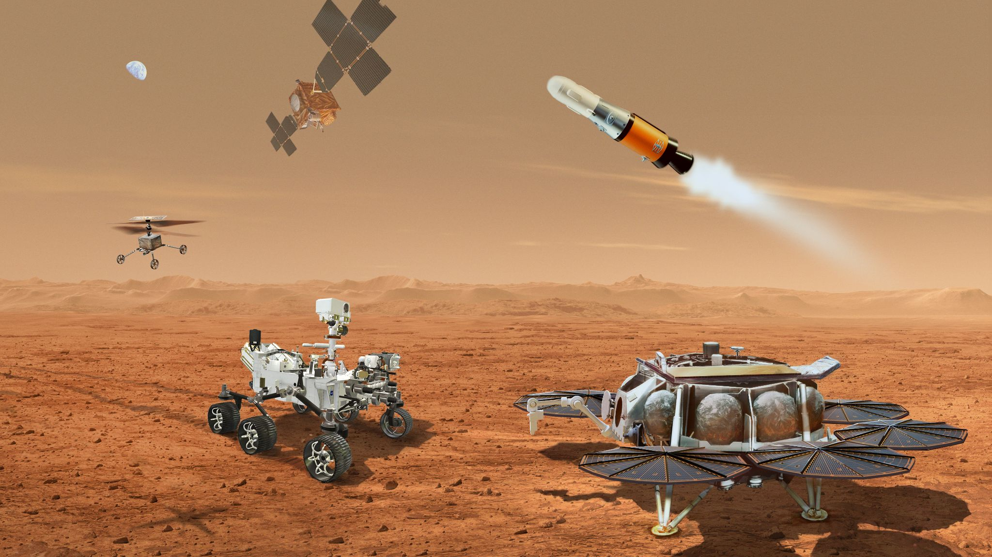

Mars Sample Return (MSR)
Jeff Gramling
Director, Mars Sample Return Program (NASA)
Francois Spoto
Mars Exploration Group Leader (ESA)
Richard Cook
Program Manager, Mars Sample Return Program (NASA/JPL)
IAC, September 2022
The decision to implement Mars Sample Return will not be finalized until NASA’s completion of the National Environmental Policy Act (NEPA) process. This presentation is being made available for information purposes only.

Slide 2

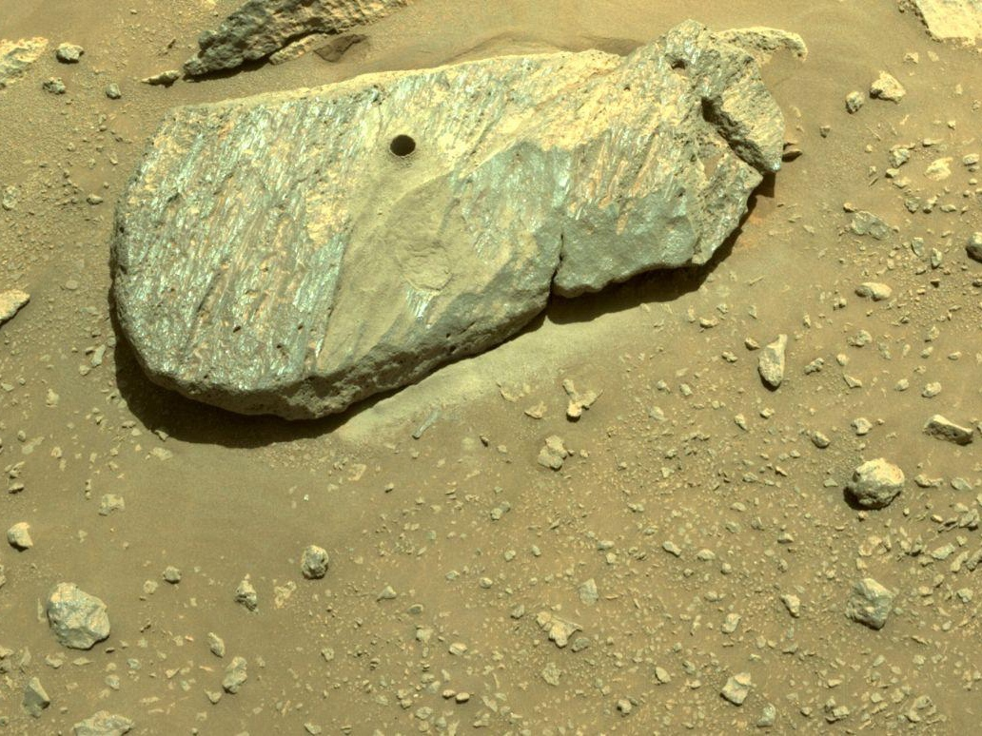
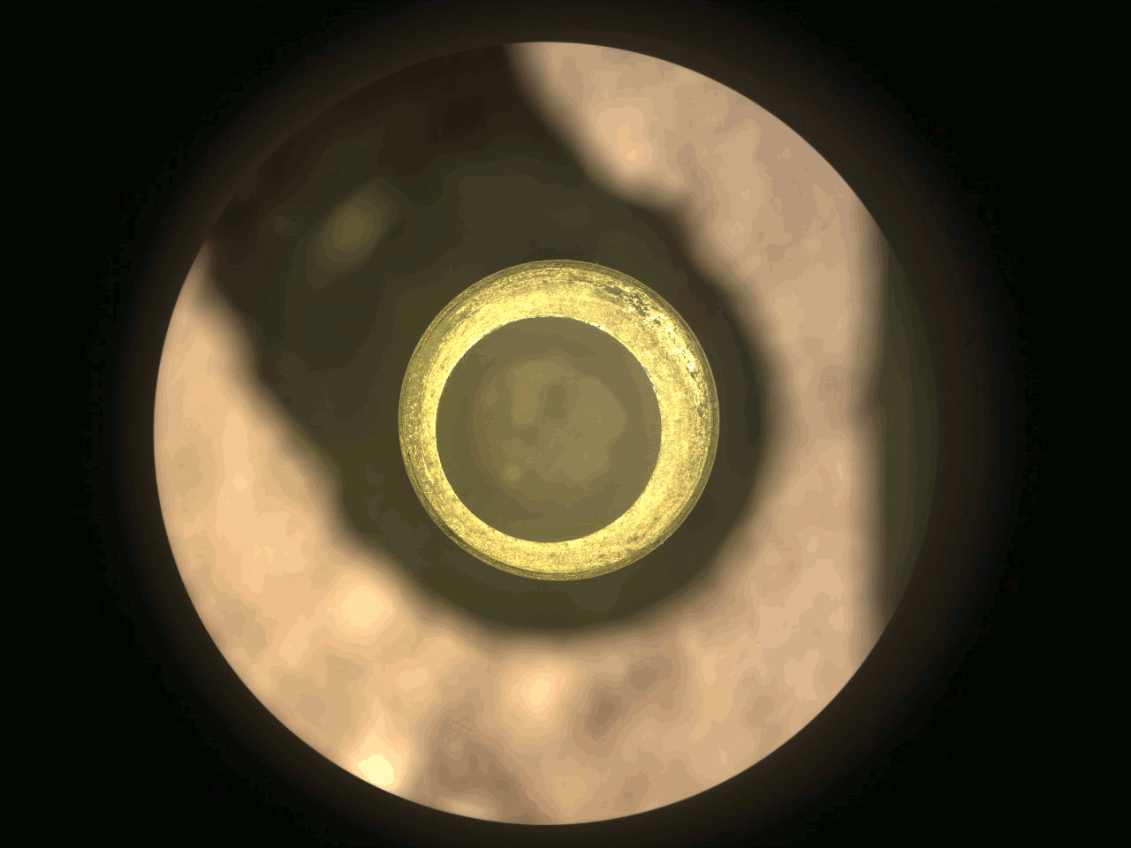
“The highest scientific priority of NASA’s robotic exploration efforts this decade should be completion of Mars Sample Return as soon as is practicably possible with no increase or decrease in its current scope”
Origins, Worlds, and Life- A Decadal Strategy for Planetary Science and Astrobiology 2023-2032

Slide 3
MSR’s architecture is complex and optimized to reduce development risk and safely deliver scientifically-selected Martian samples for analysis on Earth, while ensuring scientific integrity

Slide 4
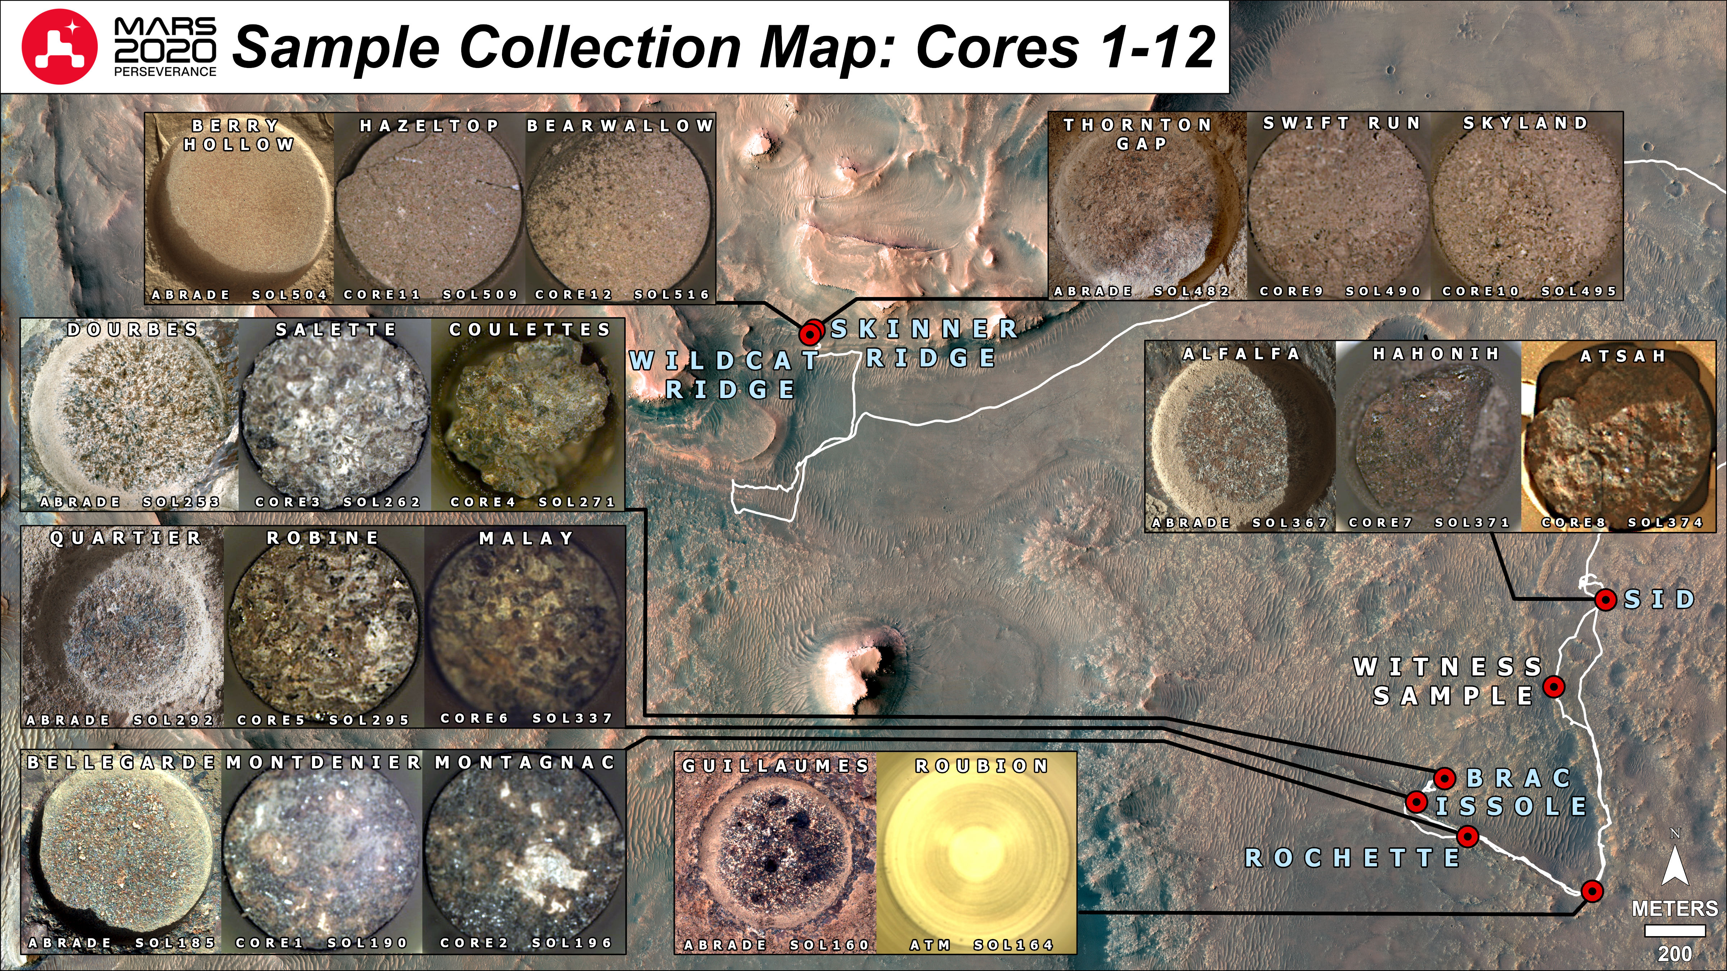
The MSR Campaign is underway with successful landing and collection of 12 scientifically-selected samples

Slide 5
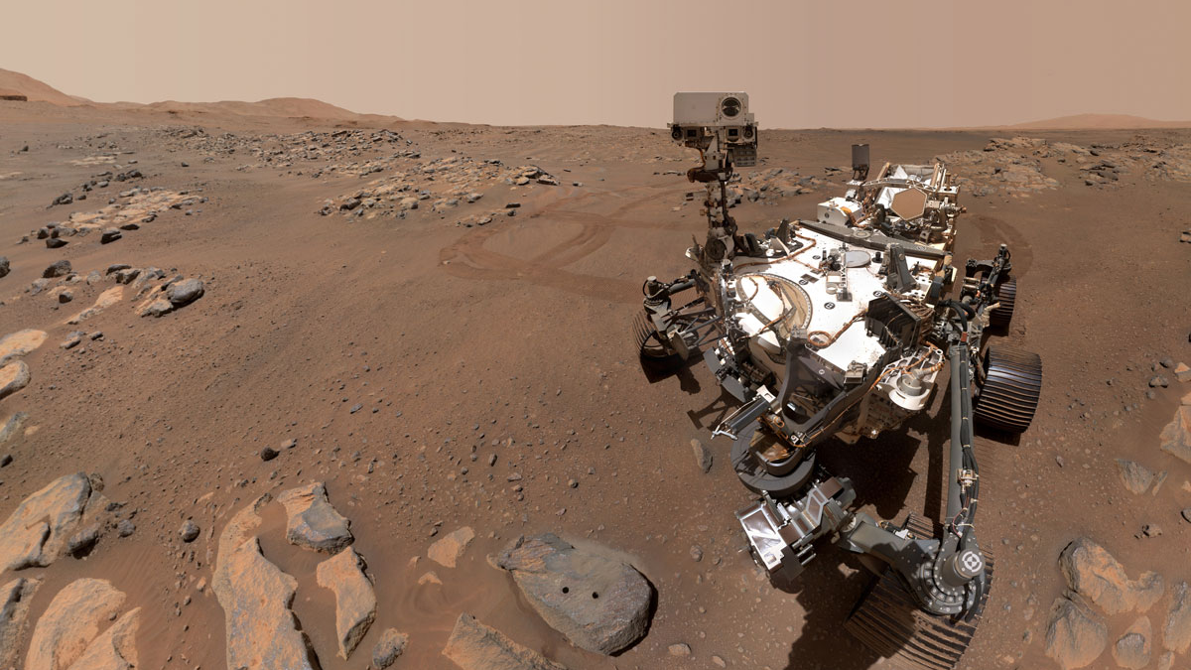
All of the science objectives* for MSR could be addressed by the samples already cached
Examples:
Igneous rocks: absolute ages of units in Jezero crater and anchor the ages of Martian epochs
Detrital sedimentary rocks from the delta front, a target for the search for evidence of life
Evidence of aqueous alteration: insights into the history of water in this region of Mars
Organic compounds: deduce their origins (biogenic vs. abiogenic).
Samples to address major gaps in our knowledge of concern to future human exploration.
*Beaty, et al, 2019, Meteorit Planet Sci 54:S3-S152

Slide 6
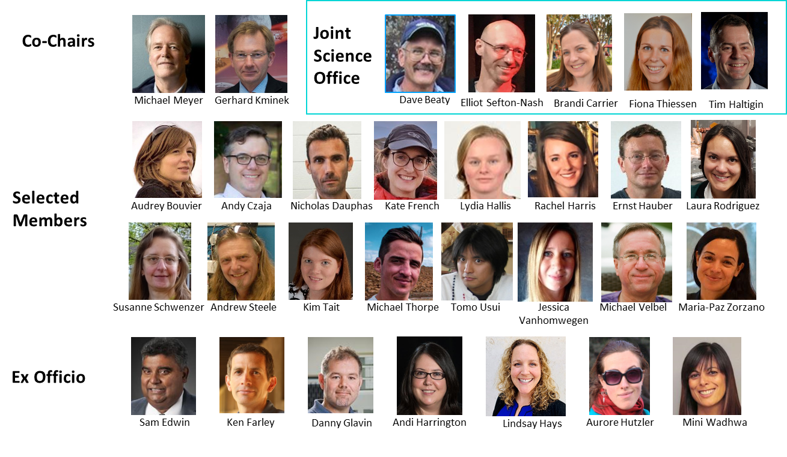
A Joint ESA-NASA Science Team has been established and a Science MOU is in development
The MSR Campaign Science Group was openly competed and jointly selected. They will ensure the science potential of the returned samples will be realized through science community involvement
The Science Memorandum of Understanding (MOU) is an agreement between agencies codifying our intended science collaboration

Slide 7
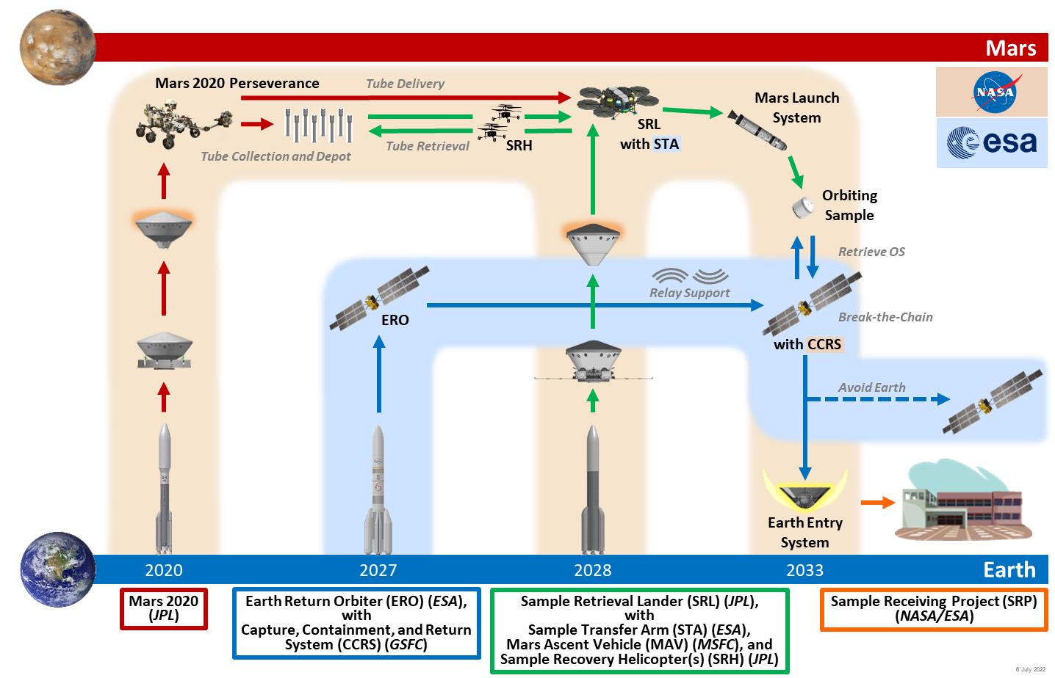
MSR End-to-End Architecture

Slide 8
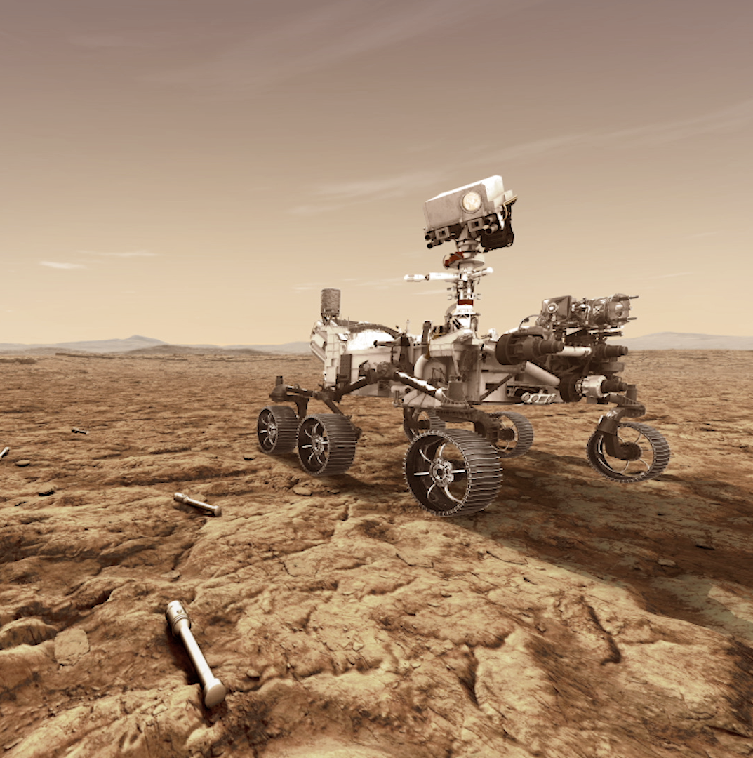
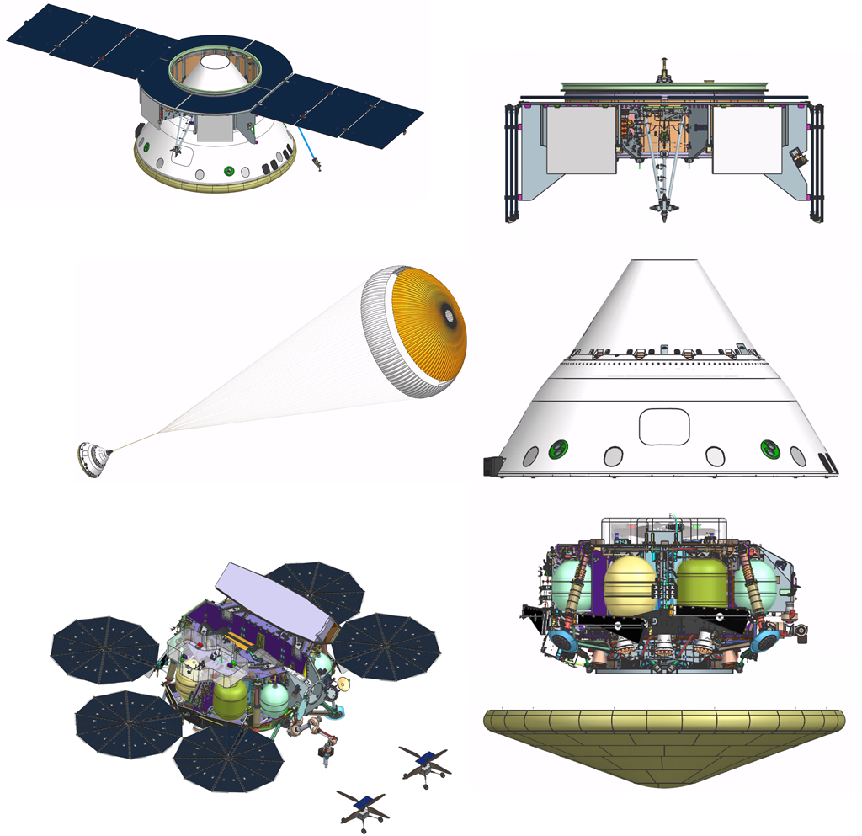
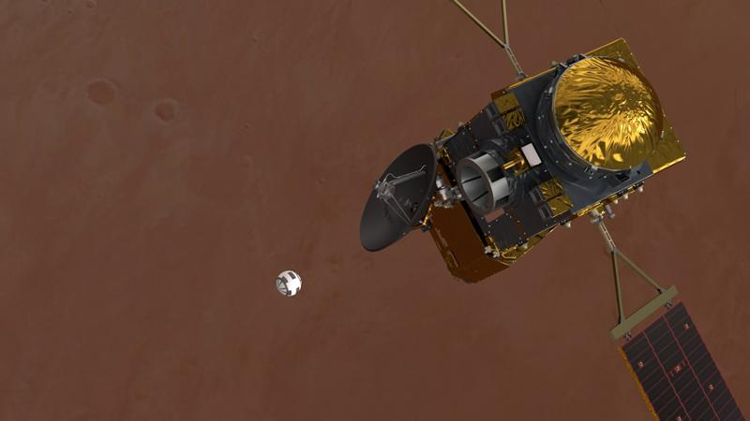
Bringing Mars samples to Earth for future study will require several steps with multiple spacecraft, in a synchronized manner.

Slide 9
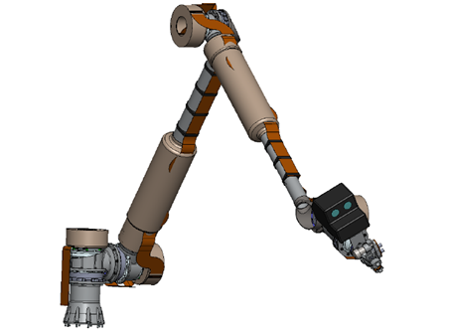
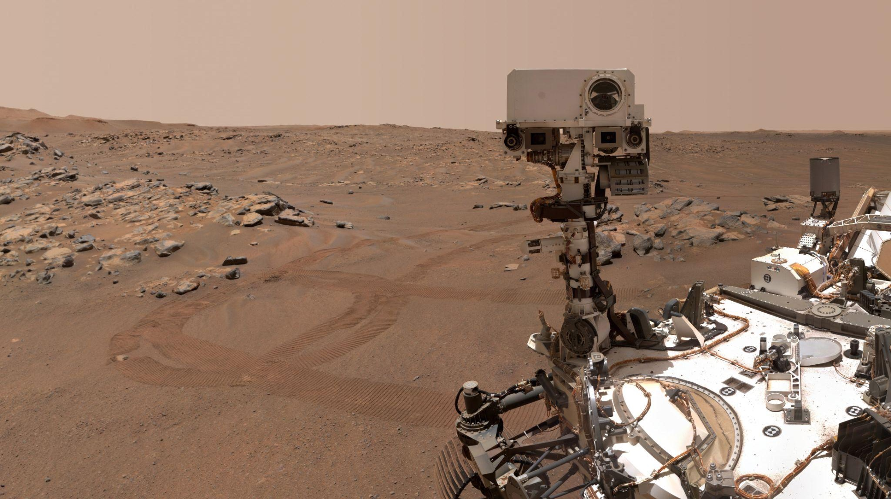
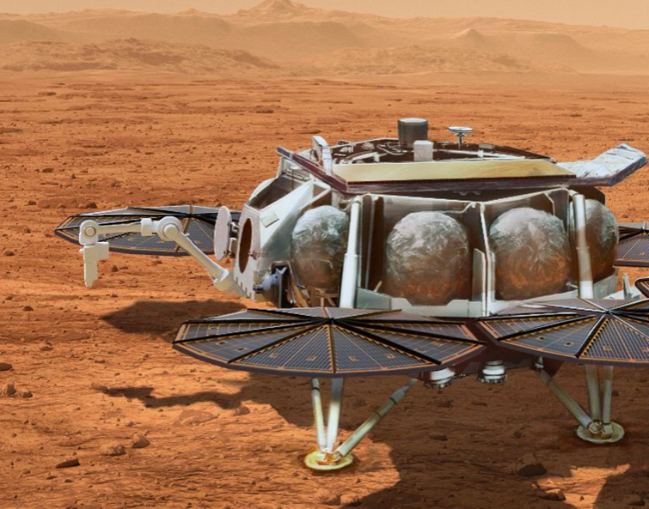
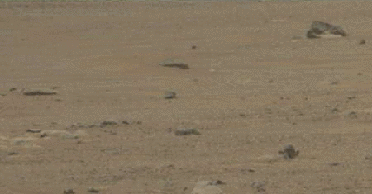
NASA’s Sample Retrieval Lander (SRL) with the
Mars Ascent Vehicle (MAV), two Sample Recovery Helicopters (SRH), and ESA’s Sample Transfer Arm (STA) will join the Perseverance rover near Jezero Crater.
Sample Retrieval Lander
Launch mass: 7.0T
Landed mass: 2.0T

Slide 10
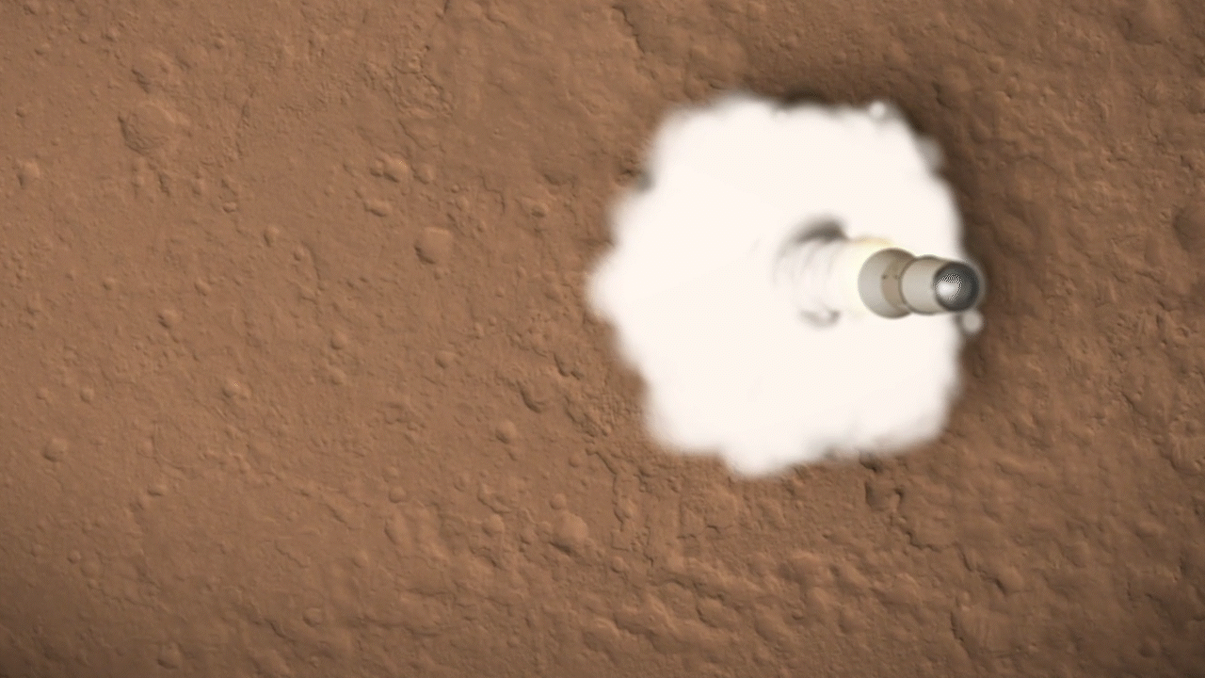
With samples in hand, the MAV would be the first rocket ever to launch from the surface of another planet.

Slide 11
Another spacecraft, the ESA Earth Return Orbiter (ERO) will travel to Mars, carry the Capture, Containment, and Return System (CCRS), provide data relay services during lander descent and surface phase operations through
MAV launch, while waiting in orbit to collect the samples and return them safely to Earth.

Slide 12
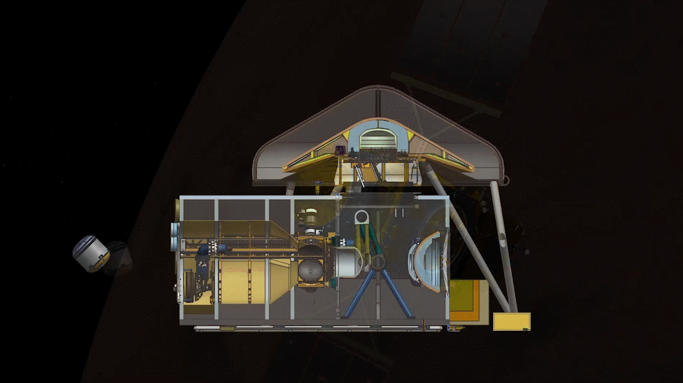
Inside the orbiter would be the NASA-provided CCRS, which would contain the sealed samples, then prepare them for the return to Earth inside the Earth Entry System.

Slide 13
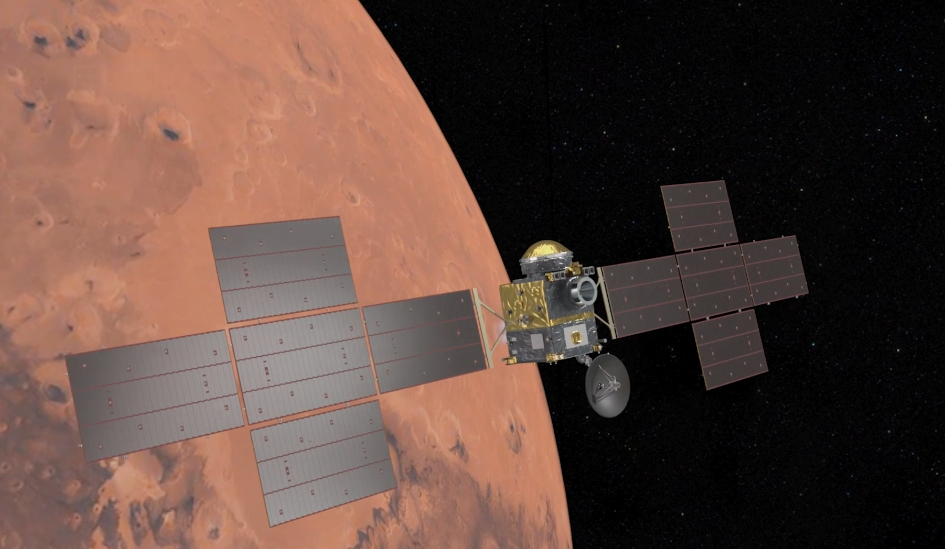
The ERO would use solar electric propulsion to depart Mars orbit, headed for Earth.
Earth Return Orbiter
Launch mass: 7.2T
Departure mass: 3.6T
Return mass: 3.0T

Slide 14
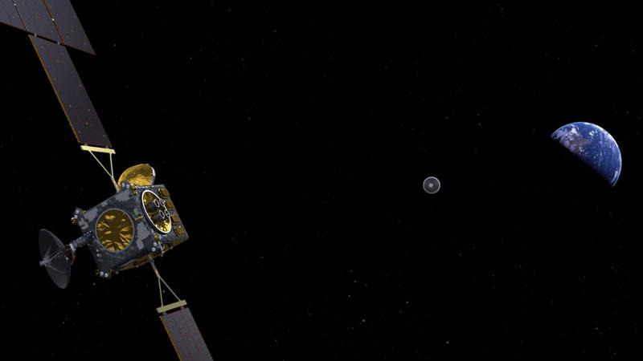
When flying past Earth, the ERO would release the Earth Entry System.

Slide 15
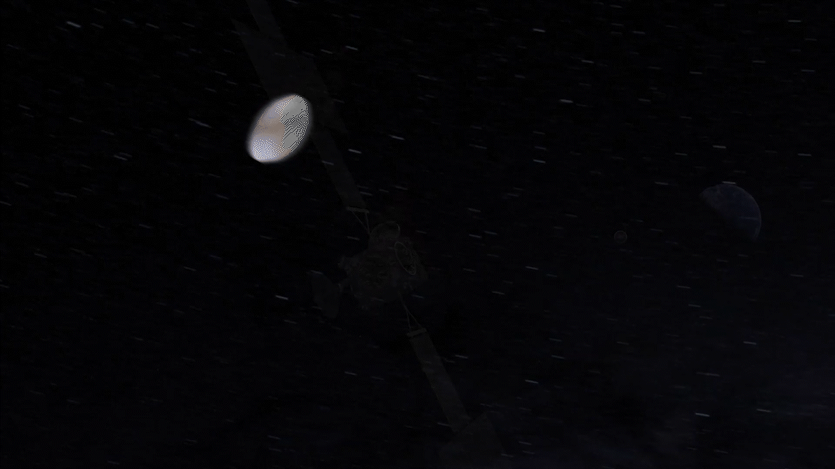
The Earth Entry System would be targeted for a safe place to land.
Its heat shield would protect it during its entry through Earth’s atmosphere.

Slide 16
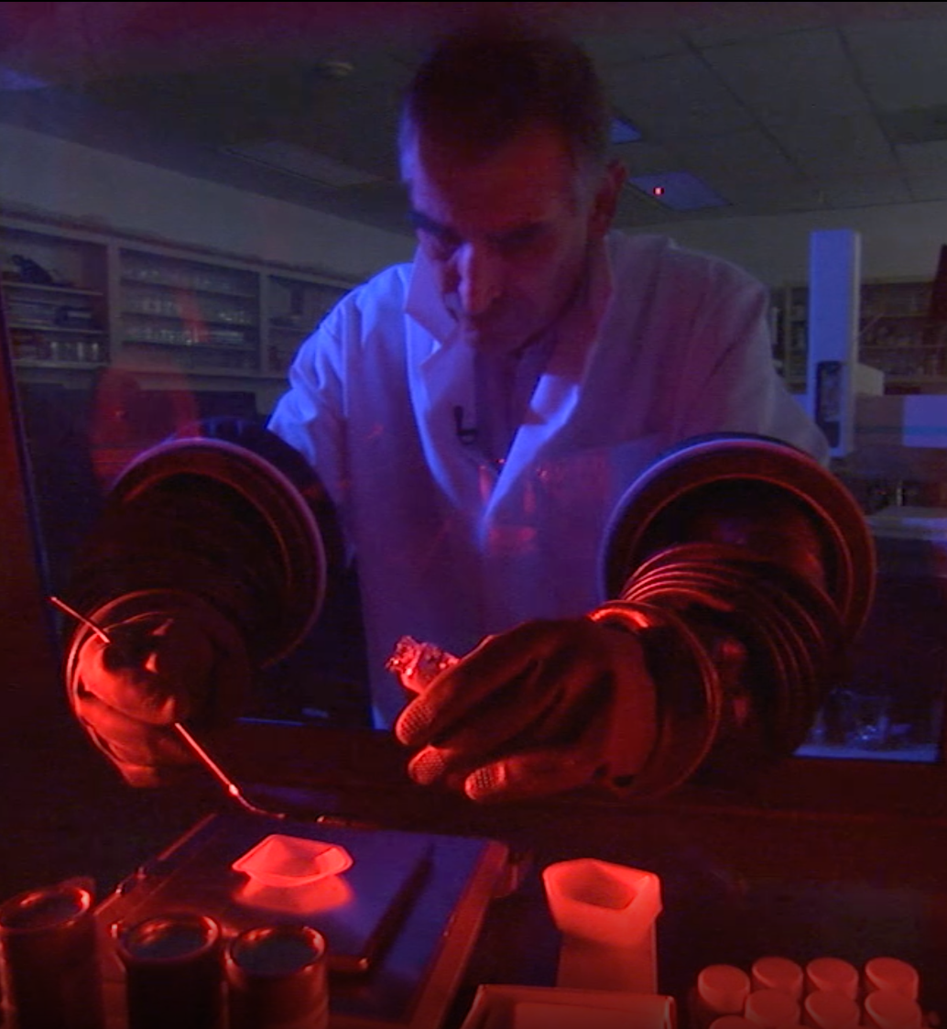
On Earth, we can apply the full breadth of terrestrial science laboratories to study samples, including many instruments too large and complex to send to Mars, and including instruments yet to be invented.

Slide 17
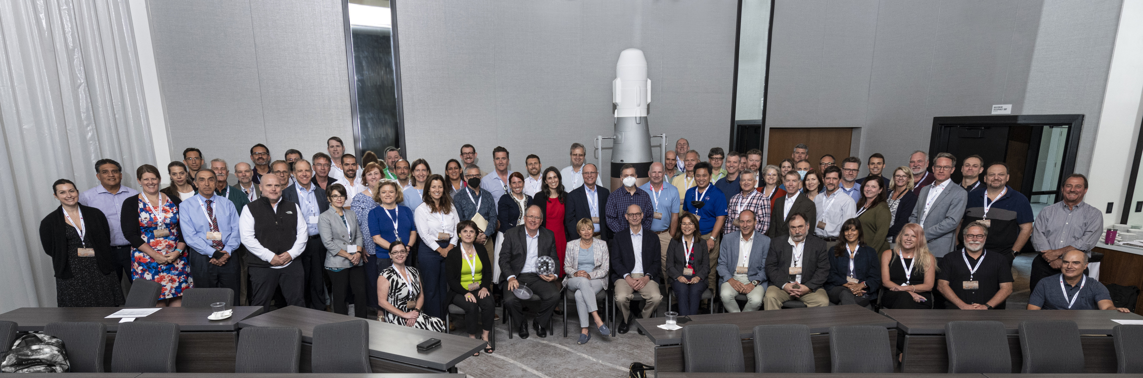
The architecture was externally reviewed by an independent ESA-NASA Review Board at the Mission Definition Review (July 12-15, 2022)
NASA KDP-B Expected By End of September 2022

Slide 18
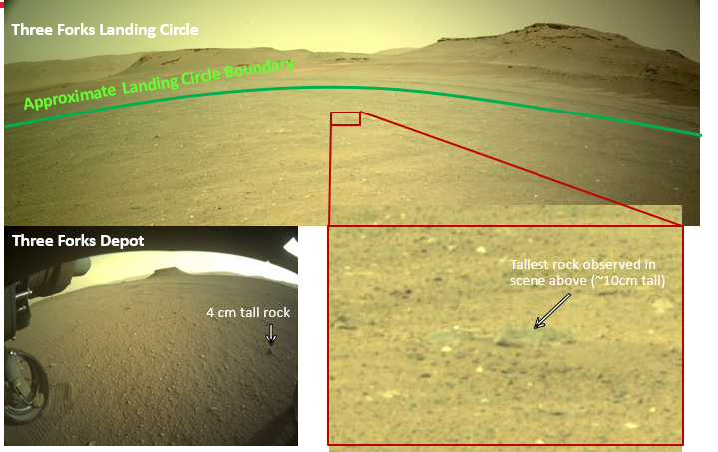
Planning is underway to establish an initial surface depot at Three Forks
Establishment of the initial depot will be preceded by a Science Team workshop to review caching plans.
The open Mars 2020/MSR Sample Depot Science Community Workshop will solicit input from the science community on the potential for the samples in this proposed depot to meet MSR’s
science objectives.
With a depot of scientifically exciting samples on the surface of Mars, and cached on the rover, two pathways to get samples to the lander exist
The Three Forks site, for the envisioned initial depot, is particularly benign for
helicopter operations.

Slide 19
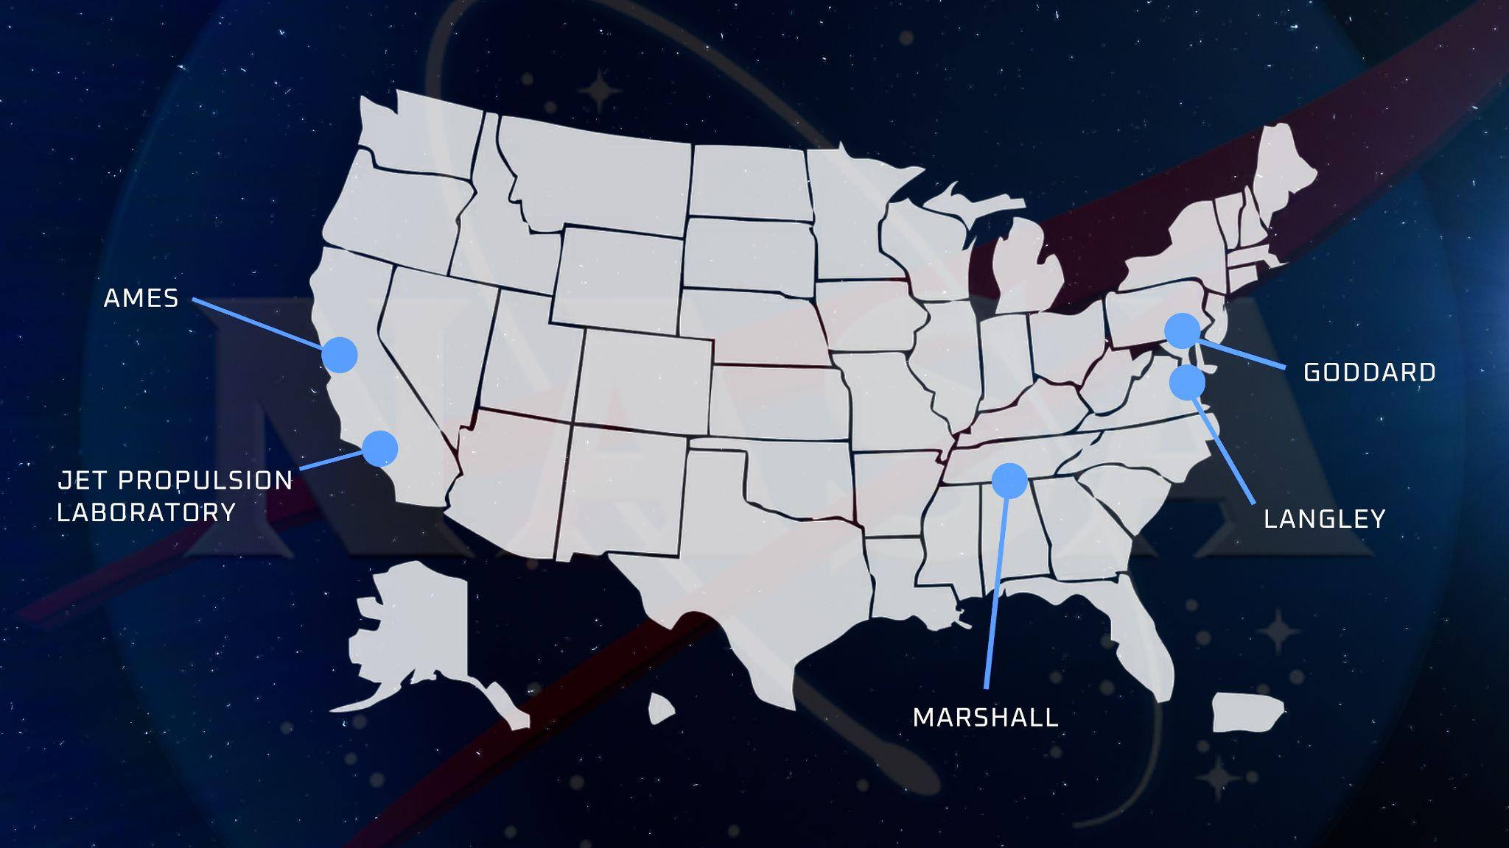
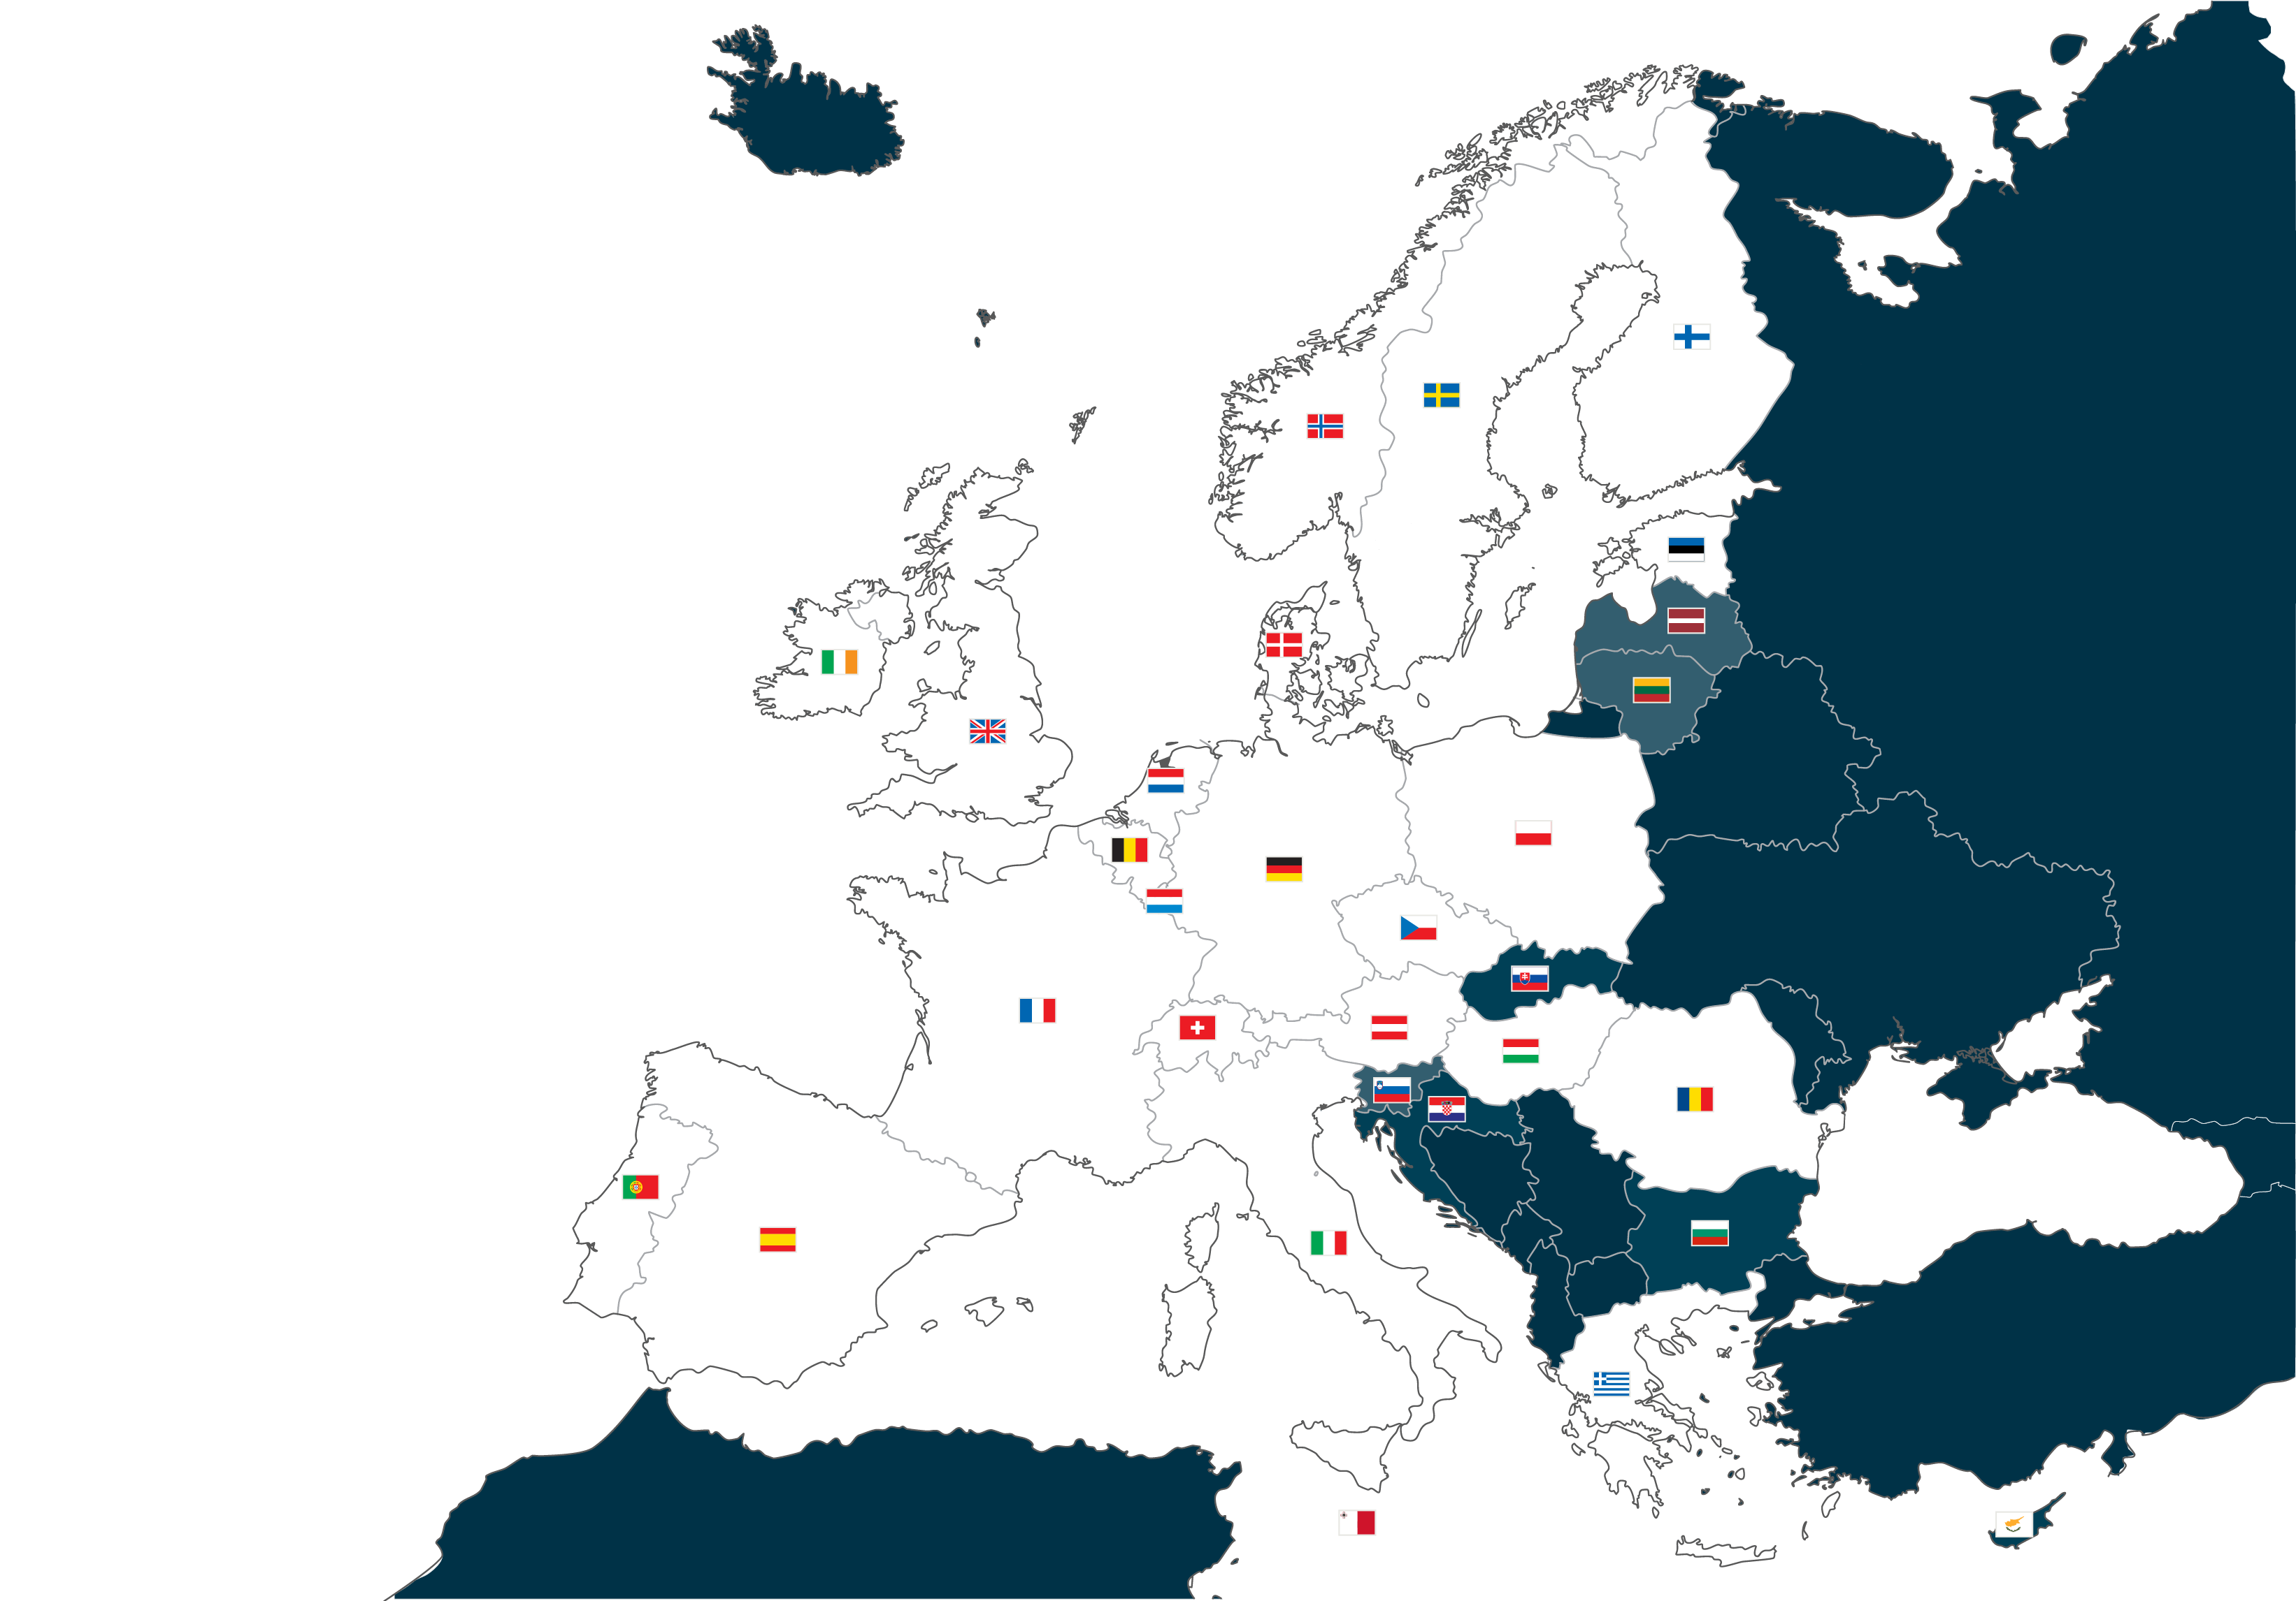


  MSR is an ambitious, international science mission to collect and return rock and sediment samples from the Martian surface
MSR is an ESA-NASA Partnership
  It is only possible today as a result of the substantial investments made through the formulation,
  technology and operational projects of the past decades, being realized through an international partnership
ESTEC
The European Space Research and Technology
Centre, Noordwijk, the Netherlands, is the largest
site and the technical heart of ESA.
ESTEC

Slide 20
MSR’S Responsibilities
Memorandum Of Understanding co-signed 5 October 2020 by NASA and ESA
ESA
Supports MSR campaign activities
Develop/operate the ERO mission
Integrate CCRS onboard ERO
Launch ERO with Ariane-64
Identify/capture the OS around Mars
Return the samples to Earth insertion orbit
Data relay to Mars operations of SRL, Perseverance, SRH, and MAV
Develop STA
NASA
Manages Mars 2020 mission and sample caching/delivery of samples to SRL
MSR campaign manager
SRL mission lead, including the MAV and SRH
Integrate and operate the ESA-delivered STA
Launch SRL
Deliver Orbiting Sample (OS) into Martian orbit
Develop and deliver the to ERO the CCRS and Electra UHF radio payloads
NASA and ESA
Coordinate biological planetary protection
Develop a joint organization to draw maximum science benefit from the mission

Slide 21
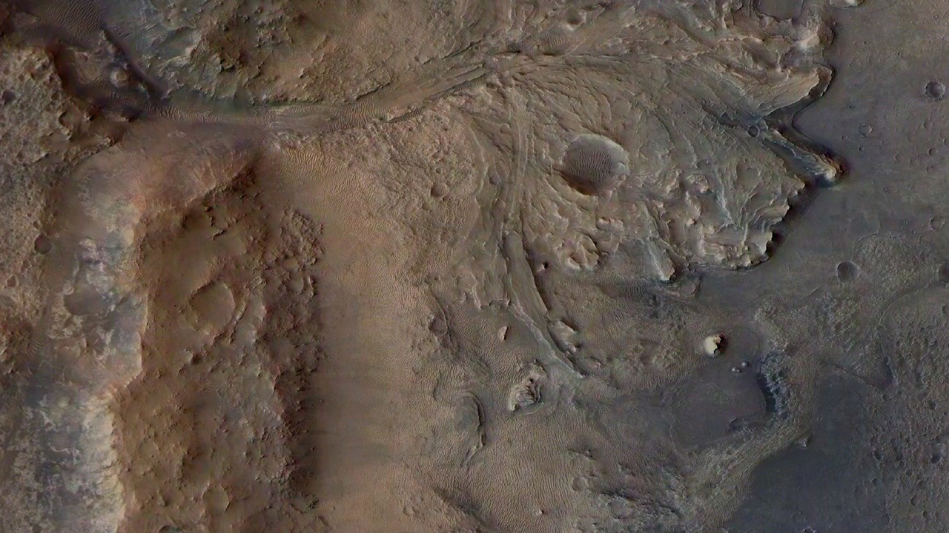
Major developments are ongoing at NASA and ESA
SRL: Managed by JPL with major developments from US
and European industry
        MAV: US consortium led by NASA’s Marshall Space Flight Center
        STA: European consortium led by Leonardo Spa Italy
        SRHs: US consortium led by NASA’s Jet Propulsion Laboratory
      ERO: European consortium led by Airbus Defense and Space France
        CCRS: US consortium led by NASA’s Goddard Space Flight Center
      The development of a Sample Receiving Project is also foreseen to
      recover, curate, and analyze the Martian samples.
          Envisioned to be a US consortium led by NASA’s Johnson Space Center

Slide 22

Now is the Time!
Mars Sample Return has been a priority of the planetary science community for half a century
Now is the time to complete the campaign to return scientifically selected samples for study using advanced instruments in laboratories around the world
Breaking new Ground:
  First precision landing
  First launch from another planet
  First in-orbit rendezvous at Mars
  First round-trip mission to another planet
  First return of samples from another planet
NASA/ESA Partnership is:
  Accomplishing the multi-decadal goal of returning samples from Mars
  Paving the way for future human exploration of Mars

