Slide 1

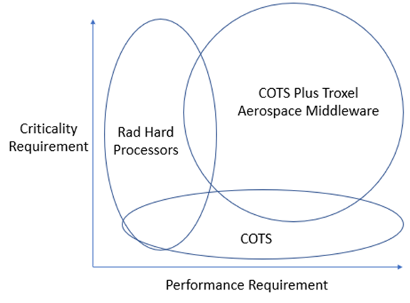
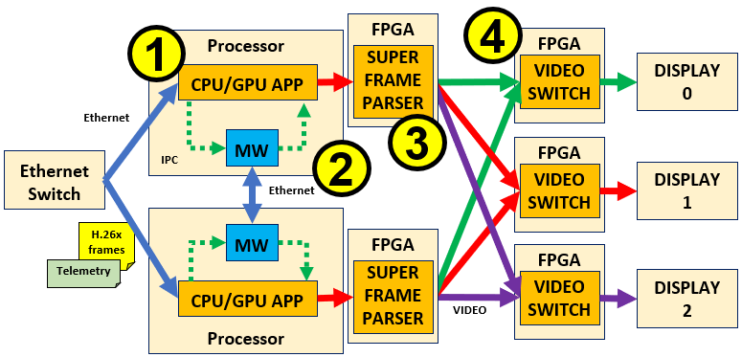
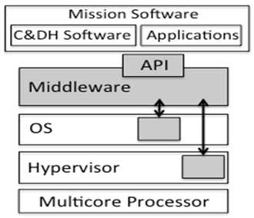
Robust Multicore Middleware (RMuM)
Project Overview
Application agnostic mitigation of some radiation disruption events, allowing for deployment of COTS performance-centric processors with minimal radiation hardening tox further human and autonomous exploration with greater flexibility.
Technical Approach
TRL 6 to 8 maturation, with Class B-certifiable software capable of General-purpose mitigation of SEFIs (Single Event Functional Interrupts).
Contributing Partners and/or Infusion Plans
Moog/NASA Johnson exploration of Lunar Gateway and Lunar Terrain Vehicle (LTV) displays
Jet Propulsion Laboratory Mars Science Helicopter flight software.
Additional Information
Processing Tradeoff Space
Video Display Architecture for JSC Lunar Rover Display
Software Architecture

