Slide 1

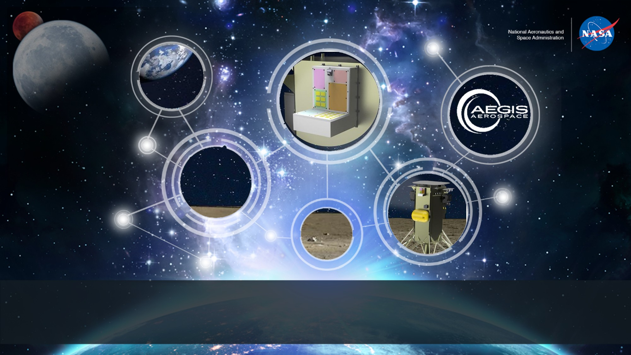
Space Technology Mission Directorate
Game Changing Development Program
Eric A. Jordan | Mark Shumbera | FY22 SSTEF Annual Review Presentation | 09.14.22
Name/Email POC: eric.jordan@aegisaero.com COR: miria.finckenor@nasa.gov

Slide 2
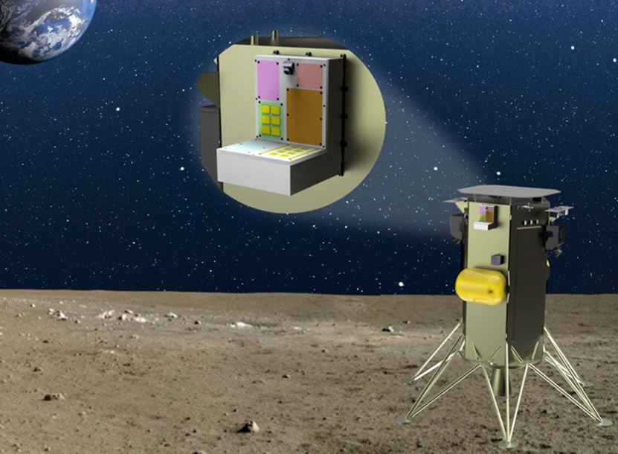
Project Overview
Space Science Technology and Evaluation Facility (SSTEF)
Technology Product Capability
  A general-purpose lunar testbed providing power and data services to individual experiments and payloads for testing at the lunar surface.
Technical Capabilities
  Provides a platform for studying the lunar environment and its effects on materials performance, including interaction with lunar dust.
Exploration & Science Applicability
  Promote commercial technology development
  Stimulate the lunar economy
  Gather data to improve flight hardware and reduce risk for future lunar missions.
Updated SSTEF-1 Conceptual Design
Notes:
Provide an overview of the Project/Task
The slide content is intended to remain static unless significant changes are made to the Project
Pictures are encouraged, please provide new pictures as frequently as possible

Slide 3

Team Members / Project Org Slide
Miria Finckenor
NASA-MSFC
(SSTEF COTR)
Mark Shumbera
Aegis Aerospace
(SSTEF Principal Investigator)
Eric Jordan
Aegis Aerospace
(SSTEF Project Manager)
Notes:
If you have submitted a Project Plan, you could utilize the Organizational Chart found in section 8.3 – Management Structure

Slide 4


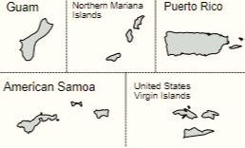
Collaborations & Partnerships
Contributing partners and/or stakeholders
  Aegis Aerospace, Inc.
  L3Harris Technologies, Inc.
  Martin Materials Solutions, Inc.
  Georgia Tech
  Moog, Inc.
  Ozark Integrated Circuits, Inc.
  Northrop Grumman Systems Corp.
  Carbice Corp.
Target applications
  NASA, DoD, international Space Agencies, commercial companies, universities seeking to deploy space science or technology on the lunar surface
Notes:
Infusion: An investment reaches a conclusion where a technology is handed off for use by a mission or other need. Infusions can be made to other NASA Mission Directorates, other Government Agencies, Commercial Entities, or International Partner.
Transition: An investment reaches a conclusion where a technology is handed off for further development. Transitions can be made to other STMD programs, other NASA Mission Directorates, academic institution, other Government Agencies, Commercial Entities, or International Partner.

Slide 5
Project Goals & Project Objectives
Project Goals
Goal #1 | Develop and deploy the first lunar surface test facility and service
Goal #2 | Advance the TRL for partner technology
Goal #3 | Maximize partner experiment data collected
Project Objectives
Objective #1 | Design, qualify, build, test and deploy a lunar surface test facility
Objective #2 | Achieve design certification for robust, reusable platform design

Slide 6
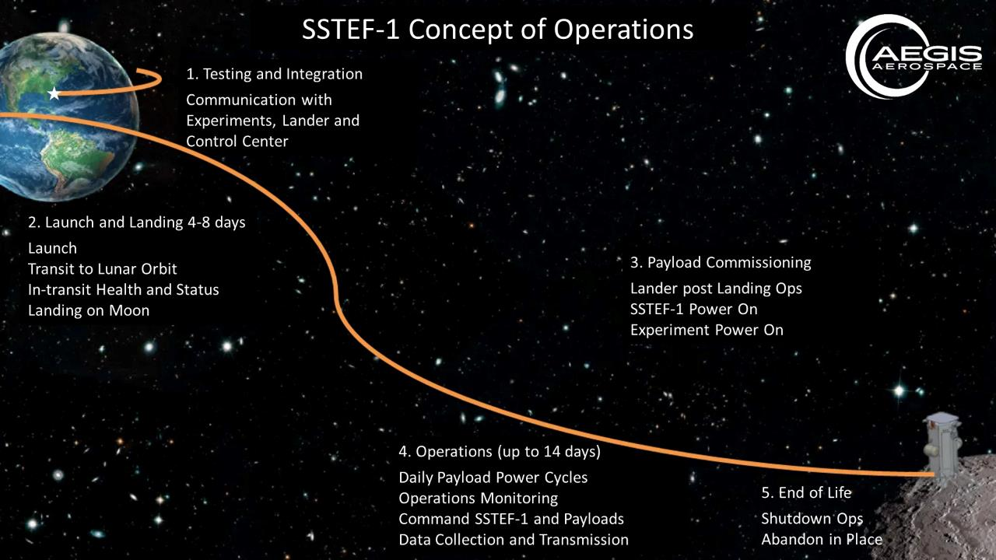

Slide 7
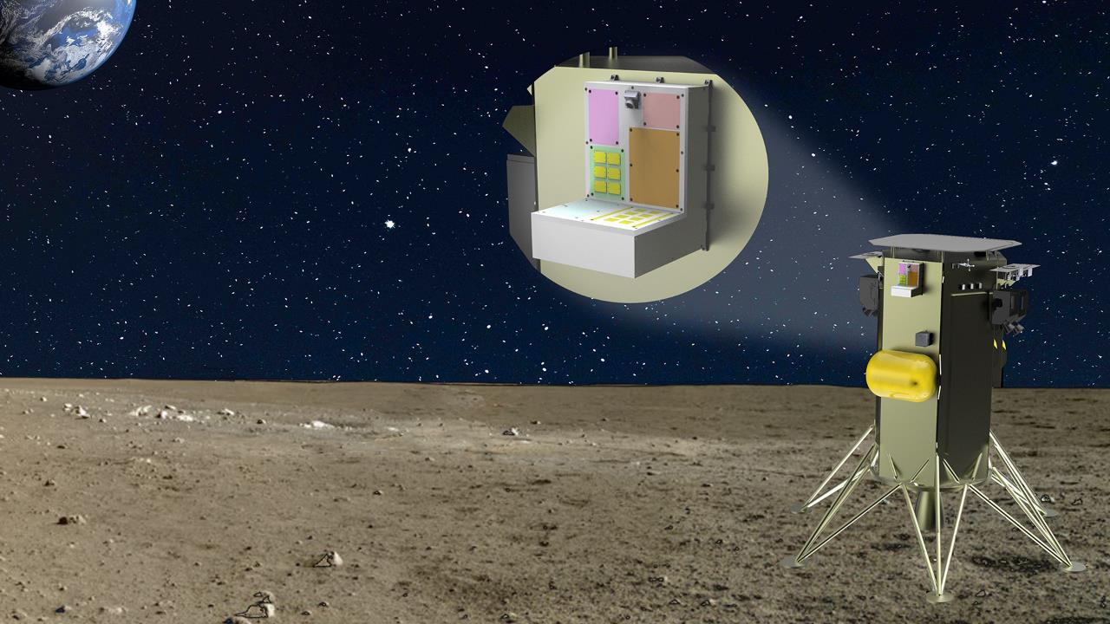

SSTEF-1 Concept
CPU Experiment
Camera
Radiation Shielding Experiment
IR Camera Experiment
Material evaluation Experiment
GPU Experiment
3D printed Antennas Experiment
Solar Cell Test Bed
Nominal Experiment Specifications:
7ea x 500 gram experiments (3.5kg total experiment mass)
Minimal power operation continuous (<1W)
Nominal power operation 1 hour per Earth day (up to 20W)
25kbps average total experiment data via RS-422
SSTEF Specifications:
20W nominal power – high power mode available to experiments
Camera imagery available to lower deck
UV and total irradiance sensor data collection
Redundant comms with lander (Ethernet and RS-422)
Redundant processors
Experiment power monitoring and fault modes
20 W total heater power used during cold phase of mission
Asynchronous commanding from control center

Slide 8
Space Science Technology and Evaluation Facility (SSTEF)
Instructions:
Show the TRL/SRL/MRL advancement over the project lifecycle schedule
Show increases as whole integers
Align readiness level advancements with key/controlled milestones
Project Milestone
GCD (Key) Milestone
Controlled Milestone
TRL/SRL/MRL Progression
FY22 | FY23 | FY24 | FY25
Launch and Ops
9
System
ADP
Lander Integration
Design Certified
8
TRL
7
6
System
SRR
System
PDR
System
CDR
5
Project
Start
Notes:
Chart purpose: show TRL/SRL/MRL advancement over the project lifecycle schedule. Show TRL advancements as whole integer increases. Show how Key and Controlled milestones align with TRL advancement.
TRL/SRL/MRL may not advance at each milestone. Often several milestones are required to produce a step increase in TRL/SRL/MRL.
There can be one, or more, of these charts per project as needed.
For projects with fewer technical elements, the TRL/SRL/MRL data can be combined on one chart.
For more complex projects, the TRL/SRL/MRL progression can separated into multiple charts by project technical area.
Show TRL, SRL, and MRL data for each technical element on the same chart.
Delete TRL/SRL/MRL axis-labels that do not apply – e.g., remove SRL/MRL for projects/technical areas where SRL and MRL do not apply.

Slide 9
Accomplishments
Completed SRR on January 12, 2022
Concept Review completed on March 10, 2022
Preliminary Design Review completed on April 20, 2022
  Preliminary designs for all experiments developed
  Standardized interfaces for experiment mechanical, electrical and communications
  Performed preliminary stress, thermal, modal analyses
Executed subcontract to Intuitive Machines to fly as a payload in 2025
Mechanical, electrical and software design
Thermal interface prototyping
Instrumentation prototyping

Slide 10
Project Assessment Summary
Project Name | Performance |  |  |  | Comments
 | C | S | T | P
Mid Year |  |  |  |  | Technical – None to report Cost – None to report Schedule – None to report Programmatic - None to report
Annual |  |  |  |  | Technical – None to report Cost – None to report Schedule – None to report Programmatic - None to report

Slide 11
Plans Forward and Transition / Infusion Plan
Critical Design Review - Dec 2022
Design certification complete via qualification unit testing - July 2023
Flight Unit production and testing for SSTEF-1 – March 2024
Launch planned for Q1 2025
Actively soliciting customers for SSTEF-2
Notes:
Infusion: An investment reaches a conclusion where a technology is handed off for use by a mission or other need. Infusions can be made to other NASA Mission Directorates, other Government Agencies, Commercial Entities, or International Partner.
Transition: An investment reaches a conclusion where a technology is handed off for further development. Transitions can be made to other STMD programs, other NASA Mission Directorates, academic institution, other Government Agencies, Commercial Entities, or International Partner.

Slide 12
Education/Public Outreach
EPO Involvement
EPO Calendar Outlook (High Priorities):
6 Month Look-Ahead
None to report
Mark Gittleman, CEO of Aegis Aerospace presented “Commercial Space Testing as a Service™ (STaaS)™: From ISS to the Moon and Beyond” at the 2022 ISS Research & Development Conference in Washington, DC.
Top Newsworthy Events:
  Award of subcontract to Intuitive Machines for lander services: Two leading Houston-based commercial space companies formalize an agreement to put a commercial science and testing facility on the Moon
Notes:
Summary of the EPO activities (papers, conferences, outreach events) participated in over the last 6 months and the forward outlook for 6 months

Slide 13
Summary
SSTEF project was awarded to Aegis Aerospace, Inc. in August 2021
All project milestones to date through PDR have been achieved as planned
DDT&E plan will provide mission assurance and optimize Science and Technology returns
Technology from seven industry and academia partners will be integrated into SSTEF platform
Deployment of space technologies to the Lunar surface will:
  Advance the TRL of systems and subcomponents for future missions
  Provide researchers data on developmental technologies
  Collect Lunar environment data to benefit future developments

Slide 14
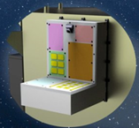
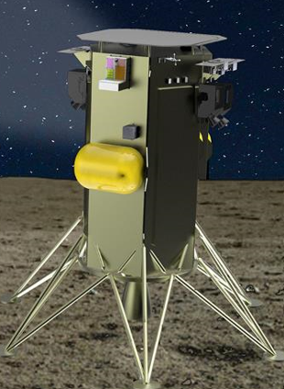
SSTEF– Annotated Cover Pictures
Annotated Cover Slide Images
** Please NO ITAR/SBU Images **
<SSTEF Current Concept>
<SSTEF mounted on NOVA-C Lunar Lander>
<Photo Text Description>
<Photo Text Description>
<Photo Text Description>
<Photo Text Description>

