Slide 1

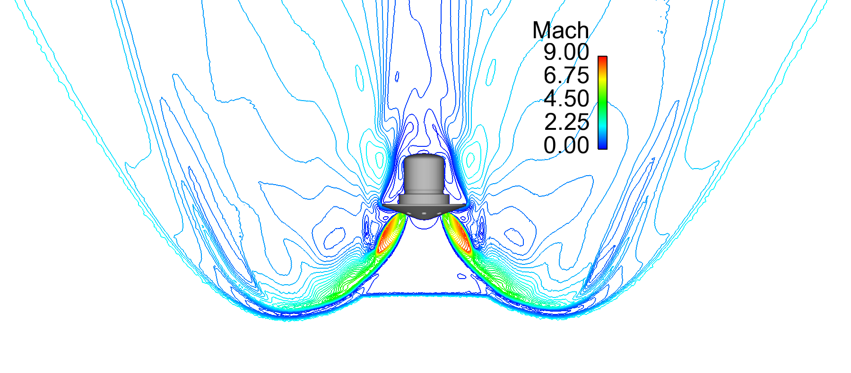
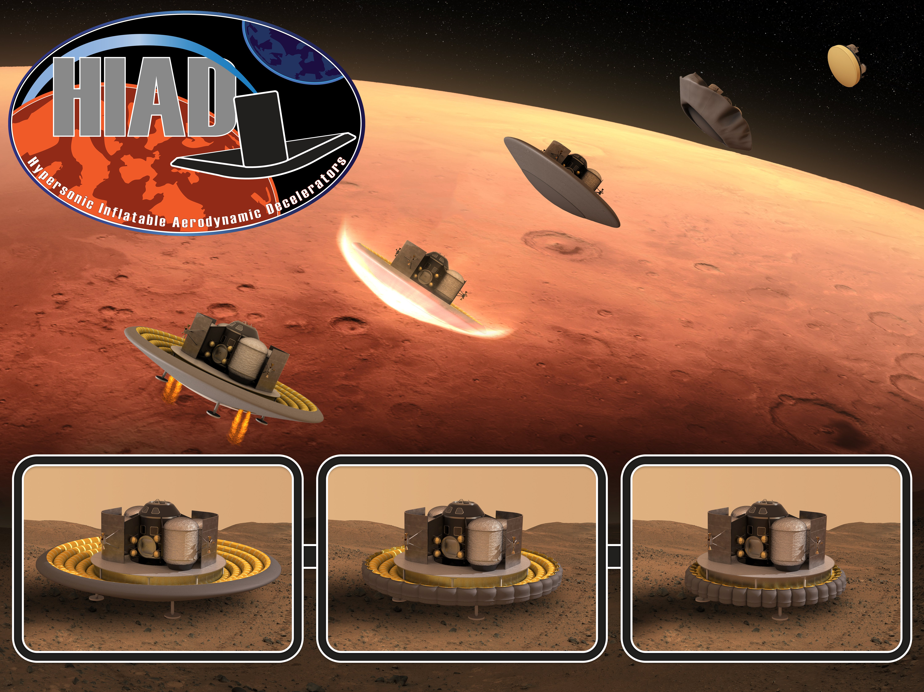
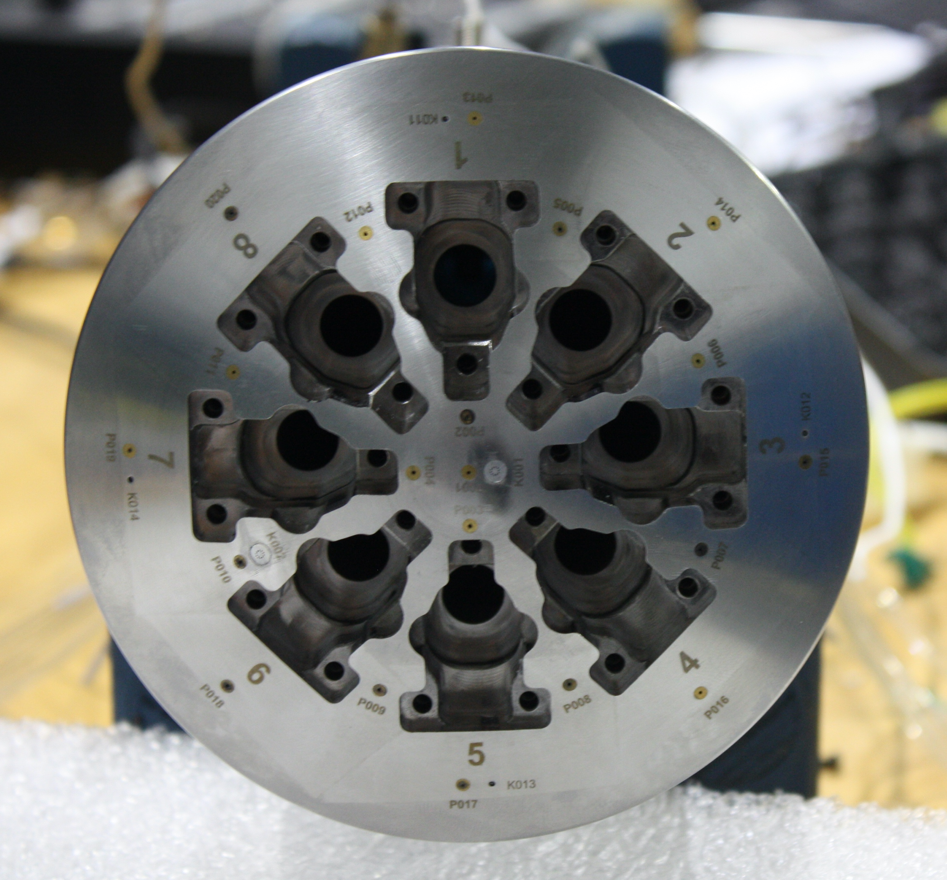
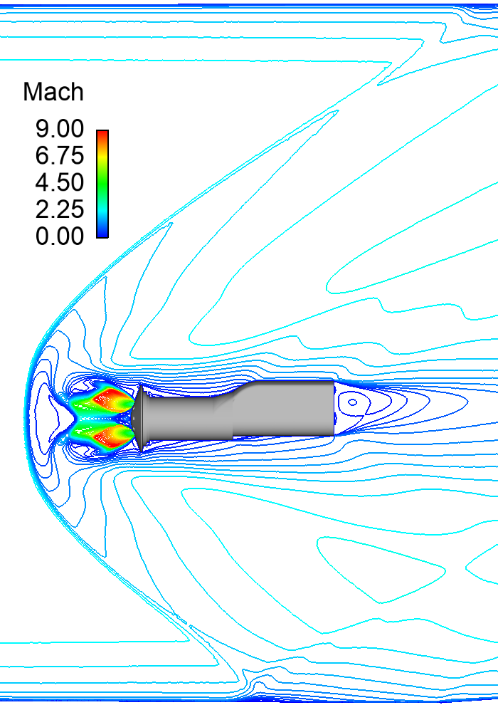
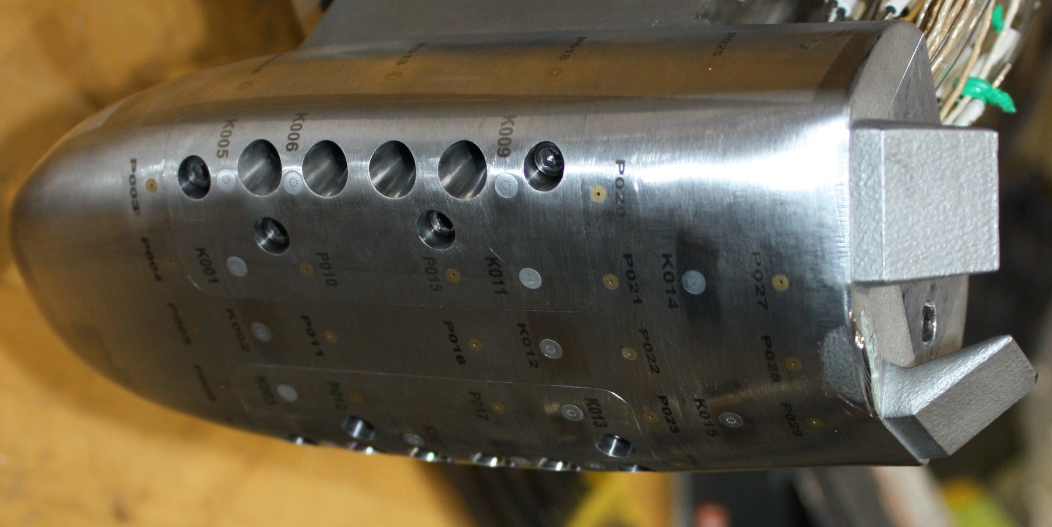
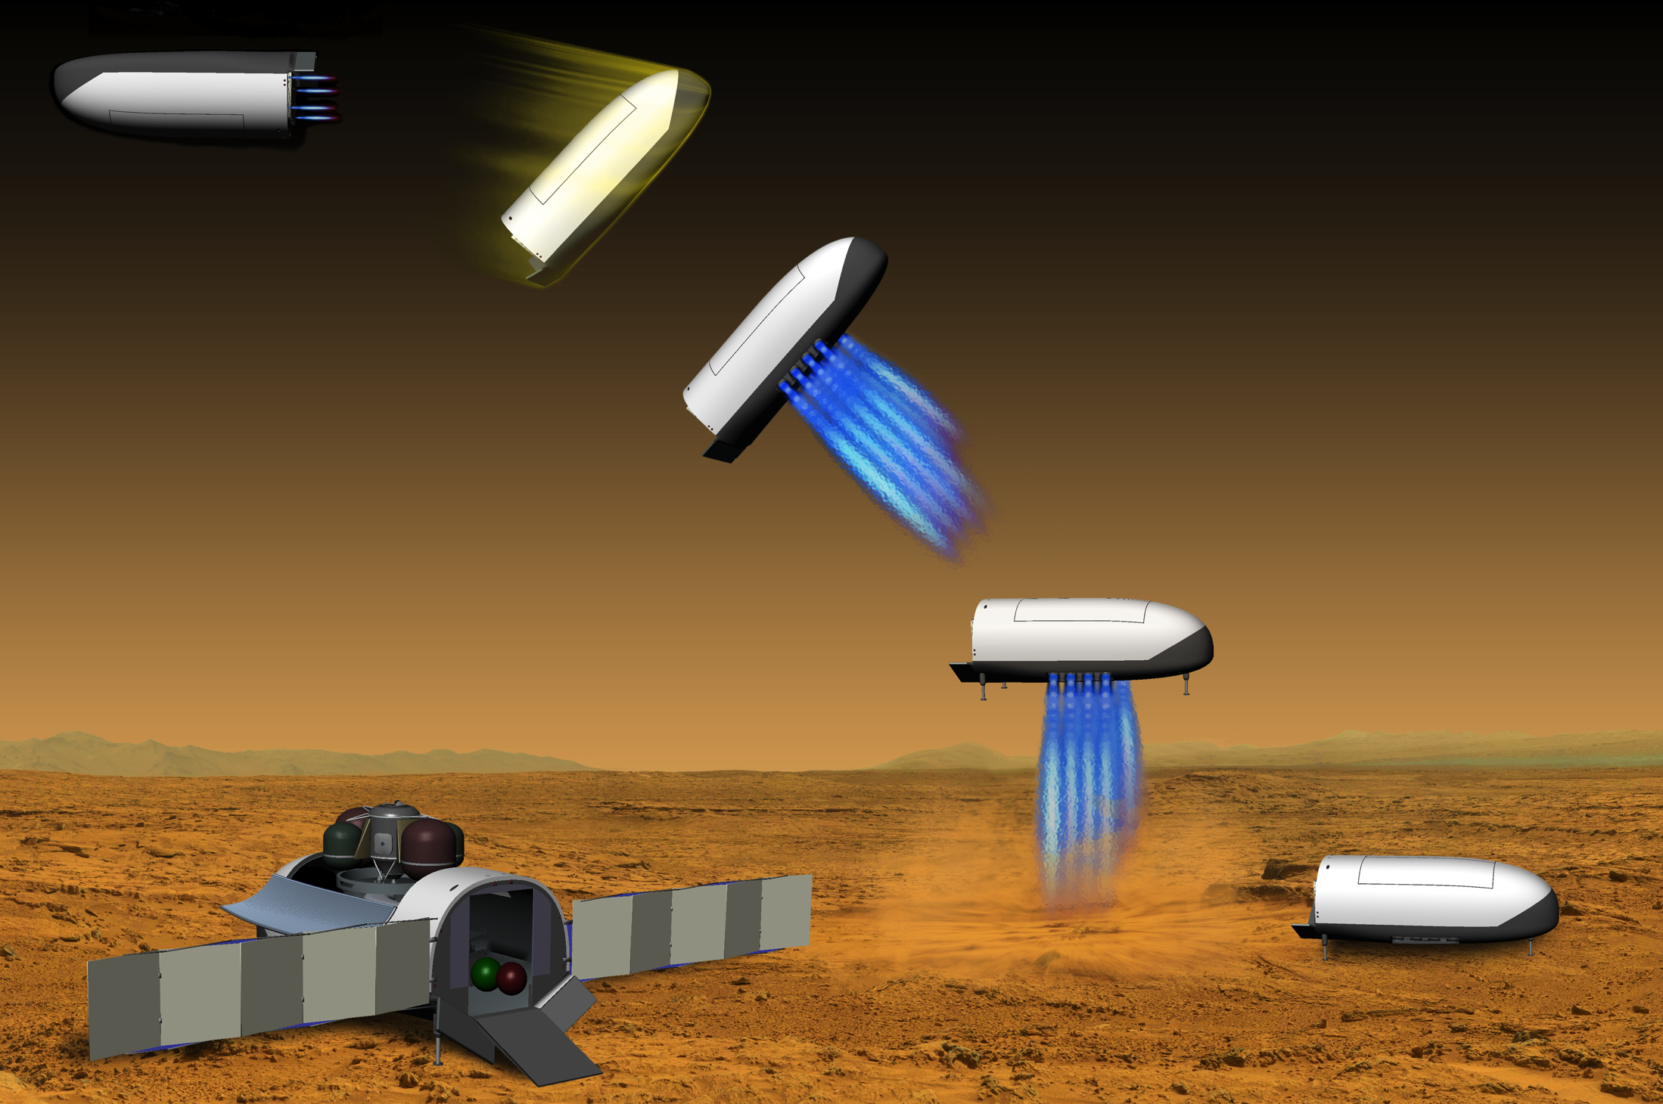
Space Technology Mission Directorate
Game Changing Development Program
Presenter: Karl Edquist | Moderator: Bill Wood | FY22 Descent Systems Study Annual Review Presentation | 09.16.22
karl.t.edquist@nasa.gov

Slide 2

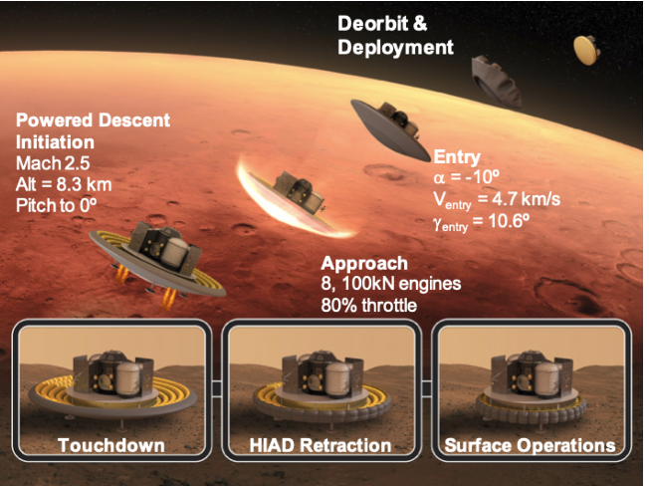
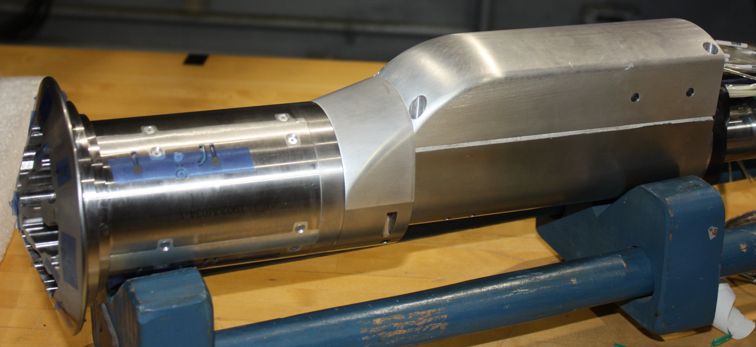
Project Overview
Technology Product Capability
  Propulsive Descent for High-Mass Mars entry vehicles
Technical Capabilities
  Prediction of Propulsive Descent (PD) Aerodynamics using Computational Fluid Dynamics (CFD)
Exploration & Science Applicability
  Human exploration of Mars
CFD Calculation at Partner
Project Test Conditions
High-Mass Mars Entry Concept
CFD Calculation at Flight Conditions
Notes:
Provide an overview of the Project
Pictures are encouraged, please provide new pictures as frequently as possible

Slide 3
Team Members / Project Org Slide
Descent Systems Study
Partner Project
DSS Project Manager
Karl Edquist, NASA Langley
NASA Langley (FUN3D)
Chris Glass
Bil Kleb
Ashley Korzun
Bill Wood
NASA Ames (OVERFLOW)
Robert Childs Joseph Garcia
Logan Halstrom Veronica Hawke
Kristen Matsuno Tom Pulliam
NASA Marshall (Loci-CHEM)
Francisco Canabal
GCD Program Element Manager
Wade May, NASA Langley
GCD Program Manager
CFD Solvers:
FUN3D
OVERFLOW
Loci-CHEM
CFD as Surrogate for High Supersonic Wind Tunnel Testing
PM Jim Ross, Ames
Propulsive Descent Test
PI Karl Edquist, Langley
ARMD Aerosciences Evaluation & Test Capability (AETC) Portfolio Office
Notes:
If you have submitted a Project Plan, you could utilize the Organizational Chart found in section 8.3 – Management Structure

Slide 4
Project Goals & Project Objectives
Technology Goals
Goal #1 | Advance PD predictive analytical modeling capabilities for human Mars EDL
Goal #2 | Quantify the uncertainties in predicting PD aerodynamic interference in a supersonic wind tunnel environment
Goal #3 | Inform future investments to advance human Mars EDL and reduce flight implementation risks
Project Objectives
Objective #1 | Complete high-priority CFD propulsive descent simulations at conditions to be tested in the Langley UPWT
Objective #2 | Compare CFD results to aerodynamic interference test data and quantify the CFD uncertainties at as-tested conditions
Objective #3 | Quantify and compare the resources required to execute the CFD analysis and test campaign
Objective #4 | Identify future investments needed to improve both testing and computational methods

Slide 5
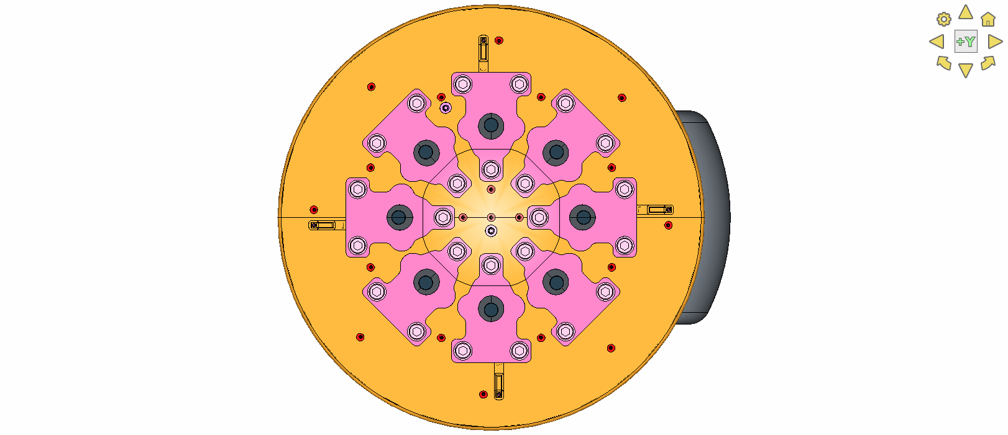
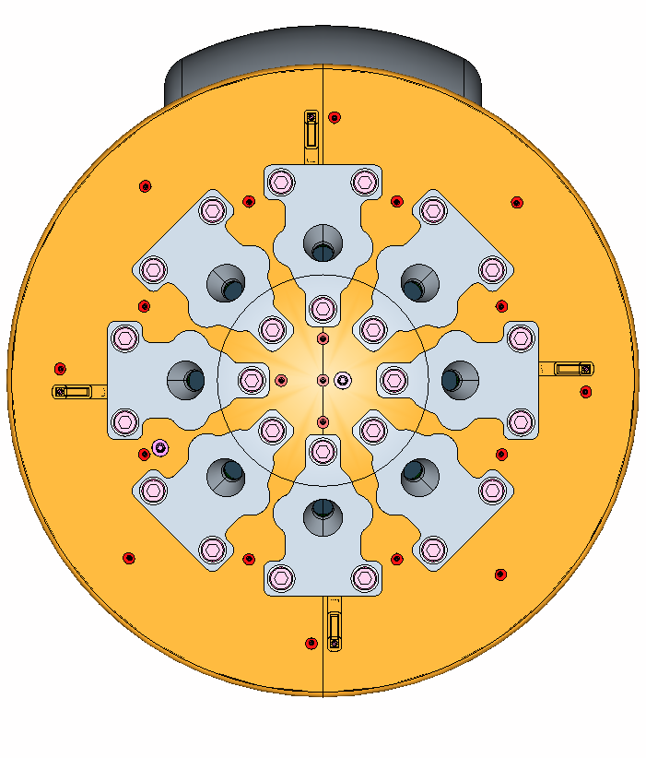
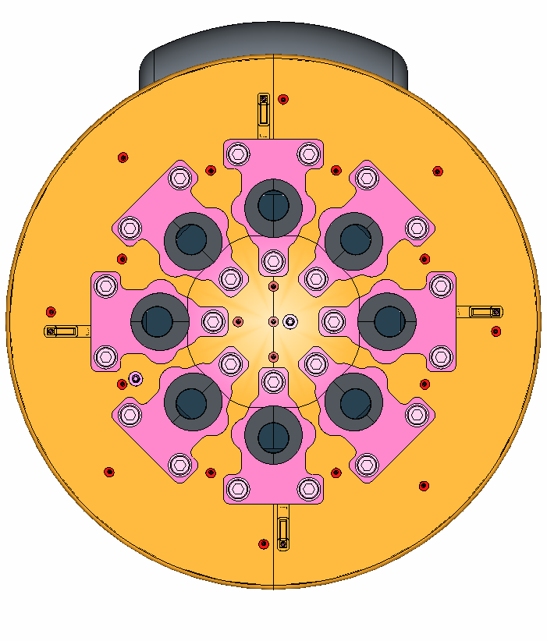

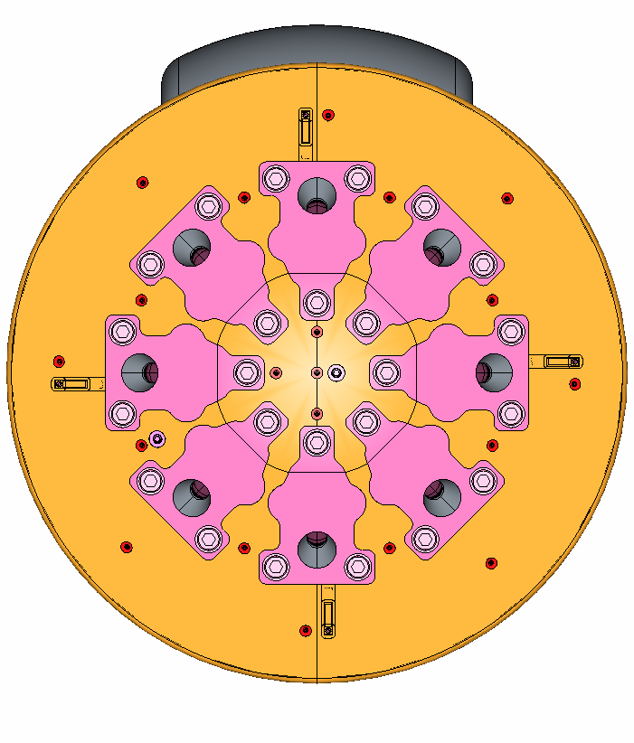
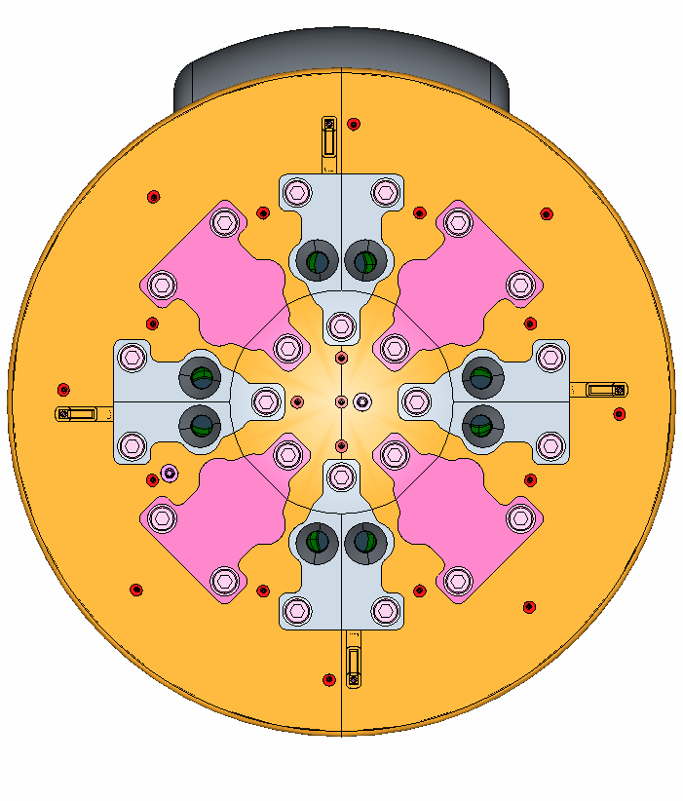
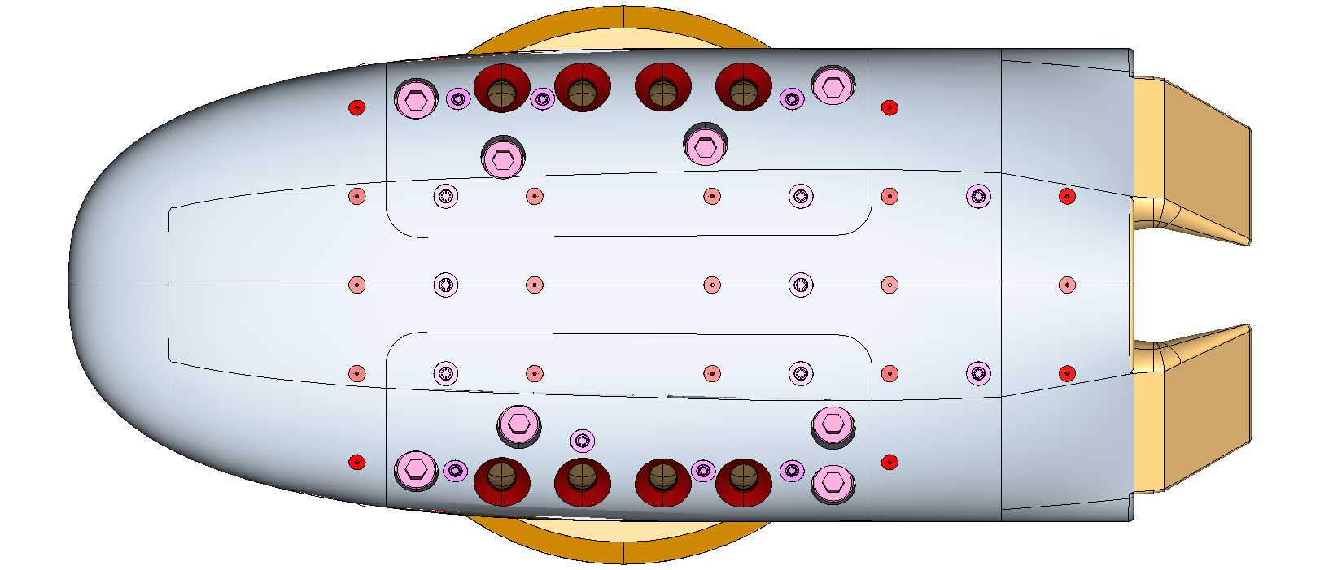
Pre-Test CFD Analysis Matrix
7 models, 3 angles of attack, 4 thrust levels, 3 tunnel Mach numbers, 3 CFD codes = 156 primary cases and 303 bonus cases
To date, have completed 100% of primary cases and 71% of bonus cases
Have used ~4.2M CPU hours in FY22 on the NAS supercomputer, at no cost to project
 |  | Condition #5 (Mach = 2.386, Re = 1e6 / ft) |  |  |  |  |  |  |  |  |  |  |  | Condition #20 (Mach = 3.477, Re = 1e6 / ft) |  |  |  |  |  |  |  |  |  |  |  | Condition #35 (Mach = 4.568, Re = 1.5e6 / ft)
Model | α \ C_{T} | 0.0 | 0.0 | 0.0 | 0.5 | 0.5 | 0.5 | 1.0 | 1.0 | 1.0 | 2.5 | 2.5 | 2.5 | 0.0 | 0.0 | 0.0 | 0.5 | 0.5 | 0.5 | 1.0 | 1.0 | 1.0 | 2.5 | 2.5 | 2.5 | 0.0 | 0.0 | 0.0 | 0.5 | 0.5 | 0.5 | 1.0 | 1.0 | 1.0 | 2.5 | 2.5 | 2.5
 |  | LC | F3D | OF | LC | F3D | OF | LC | F3D | OF | LC | F3D | OF | LC | F3D | OF | LC | F3D | OF | LC | F3D | OF | LC | F3D | OF | LC | F3D | OF | LC | F3D | OF | LC | F3D | OF | LC | F3D | OF
1A | 00 |  |  |  | 1 | 2 |  | 1 | 2 |  | 1 | 2 |  |  |  |  | 0 | 1 |  | 0 | 1 |  | 0 | 1 |  |  |  |  | 0 | 0 |  | 0 | 0 |  | 0 | 0
1A | 05 |  |  |  | 0 | 0 |  | 0 | 0 |  | 0 | 0 |  |  |  |  | 0 | 0 |  | 0 | 0 |  | 0 | 0 |  |  |  |  | 0 | 0 |  | 0 | 0 |  | 0 | 0
1A | 10 |  |  |  | 1 | 2 |  | 1 | 2 |  | 1 | 2 |  |  |  |  | 0 | 1 |  | 0 | 1 |  | 0 | 1 |  |  |  |  | 0 | 0 |  | 0 | 0 |  | 0 | 0
1B | 00 |  |  |  | 1 | 2 |  | 1 | 2 |  | 1 | 3 |  |  |  |  | 0 | 0 |  | 0 | 1 |  | 0 | 0 |  |  |  |  | 0 | 0 |  | 0 | 0 |  | 0 | 0
1B | 05 |  |  |  | 0 | 0 |  | 0 | 0 |  | 0 | 0 |  |  |  |  | 0 | 0 |  | 0 | 1 |  | 0 | 0 |  |  |  |  | 0 | 0 |  | 0 | 0 |  | 0 | 0
1B | 10 |  |  |  | 1 | 2 |  | 1 | 2 |  | 1 | 1 |  |  |  |  | 0 | 0 |  | 0 | 0 |  | 0 | 0 |  |  |  |  | 0 | 0 |  | 0 | 0 |  | 0 | 0
1C | 00 |  |  |  | 0 | 1 |  | 0 | 1 |  | 0 | 1 |  |  |  |  | 0 | 0 |  | 0 | 0 |  | 0 | 0 |  |  |  |  | 0 | 0 |  | 0 | 0 |  | 0 | 0
1C | 05 |  |  |  | 0 | 0 |  | 0 | 0 |  | 0 | 0 |  |  |  |  | 0 | 0 |  | 0 | 0 |  | 0 | 0 |  |  |  |  | 0 | 0 |  | 0 | 0 |  | 0 | 0
1C | 10 |  |  |  | 0 | 1 |  | 0 | 1 |  | 0 | 1 |  |  |  |  | 0 | 0 |  | 0 | 0 |  | 0 | 0 |  |  |  |  | 0 | 0 |  | 0 | 0 |  | 0 | 0
1D | 00 |  |  |  | 0 | 1 |  | 0 | 1 |  | 0 | 1 |  |  |  |  | 0 | 0 |  | 0 | 0 |  | 0 | 0 |  |  |  |  | 0 | 0 |  | 0 | 0 |  | 0 | 0
1D | 05 |  |  |  | 0 | 0 |  | 0 | 0 |  | 0 | 0 |  |  |  |  | 0 | 0 |  | 0 | 0 |  | 0 | 0 |  |  |  |  | 0 | 0 |  | 0 | 0 |  | 0 | 0
1D | 10 |  |  |  | 0 | 1 |  | 0 | 1 |  | 0 | 1 |  |  |  |  | 0 | 0 |  | 0 | 0 |  | 0 | 0 |  |  |  |  | 0 | 0 |  | 0 | 0 |  | 0 | 0
1E | 00 |  |  |  |  | 2 | 0 |  | 2 | 0 |  | 2 | 0 |  |  |  |  | 2 | 0 |  | 2 | 0 |  | 2 | 0 |  |  |  |  | 0 | 0 |  | 0 | 0 |  | 0 | 0
1E | 05 |  |  |  |  | 0 | 0 |  | 0 | 0 |  | 0 | 0 |  |  |  |  | 0 | 0 |  | 0 | 0 |  | 0 | 0 |  |  |  |  | 0 | 0 |  | 0 | 0 |  | 0 | 0
1E | 10 |  |  |  |  | 2 | 0 |  | 2 | 0 |  | 3 | 0 |  |  |  |  | 2 | 0 |  | 2 | 0 |  | 2 | 0 |  |  |  |  | 0 | 0 |  | 0 | 0 |  | 0 | 0
1F | 00 |  |  |  |  | 0 | 0 |  | 0 | 0 |  | 1 | 0 |  |  |  |  | 0 | 0 |  | 0 | 0 |  | 0 | 0 |  |  |  |  | 0 | 0 |  | 0 | 0 |  | 0 | 0
1F | 05 |  |  |  |  | 0 | 0 |  | 0 | 0 |  | 0 | 0 |  |  |  |  | 0 | 0 |  | 0 | 0 |  | 0 | 0 |  |  |  |  | 0 | 0 |  | 0 | 0 |  | 0 | 0
1F | 10 |  |  |  |  | 1 | 0 |  | 0 | 0 |  | 1 | 0 |  |  |  |  | 0 | 0 |  | 0 | 0 |  | 0 | 0 |  |  |  |  | 0 | 0 |  | 0 | 0 |  | 0 | 0
2A | 90 |  |  |  | 0 | 0 | 1 | 0 | 0 | 1 | 0 | 1 | 1 |  |  |  | 0 | 0 | 1 | 0 | 0 | 1 | 0 | 0 | 1 |  |  |  | 0 | 0 | 1 | 0 | 0 | 1 | 0 | 0 | 1
2A | 85 |  |  |  | 0 | 0 | 1 | 0 | 0 | 1 | 0 | 0 | 1 |  |  |  | 0 | 0 | 1 | 0 | 0 | 1 | 0 | 0 | 1 |  |  |  | 0 | 0 | 1 | 0 | 0 | 1 | 0 | 0 | 1
2A | 80 |  |  |  | 0 | 0 | 1 | 0 | 0 | 1 | 0 | 0 | 1 |  |  |  | 0 | 0 | 1 | 0 | 0 | 1 | 0 | 0 | 1 |  |  |  | 0 | 0 | 1 | 0 | 0 | 1 | 0 | 0 | 1
Models

Slide 6
Accomplishments
The main DSS objective for FY22 was to complete computational fluid dynamics (CFD) analysis at expected conditions of the partner project’s Propulsive Descent (PD) test in the Langley Unitary Plan Wind Tunnel test section 2 (Mach 2.3 to 4.6, test still to be completed)
In FY22, completed remaining 22 highest priority CFD cases, for a total of 430 cases in total
Delivered “Milestone K1: Pre-Test CFD Report ” on 18 March 2022
  Document GCDP-02-RPT-22021
  Report summarizes CFD analysis to date in advance of the partner project wind tunnel test no earlier than October 2022
K. Edquist chaired special session “Mars Powered Descent Vehicles I” at 2022 AIAA SciTech, where 3 DSS papers were presented that summarize the CFD results to date
AIAA-2022-0912 | Computational Modeling of Mars Retropropulsion Concepts in the Langley Unitary Plan Wind Tunnel | Karl Edquist
AIAA-2022-0913 | OVERFLOW Analysis of Supersonic Retropropulsion Testing on the CobraMRV Mars Entry Vehicle Concept | Kristen Matsuno (student)
AIAA-2022-0914 | OVERFLOW Analysis of Supersonic Retropropulsion Testing on a Blunt Mars Entry Vehicle Concept | Logan Halstrom

Slide 7
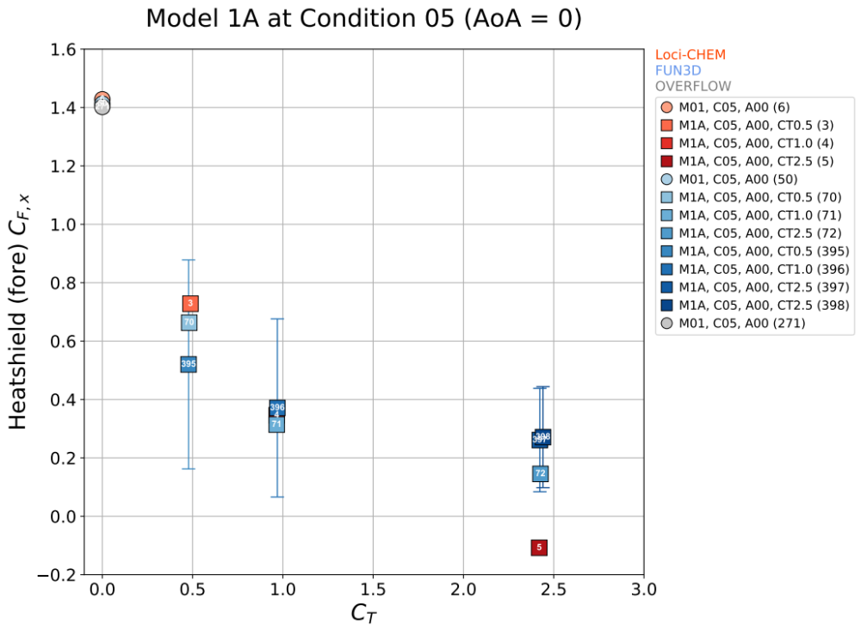
Results: Predicted Effect of Blowing Nozzles for Model 1A
C_{T} = Thrust / (1/2ρV²S_{ref})
AoA = angle of attack
C_{F,x} = aerodynamic axial force coefficient
Tunnel Mach number = 2.4, thrust coefficients (CT) of 0, 0.5, 1, and 2.5
With increasing thrust:
  Shock standoff distance increases
  Heatshield aerodynamic axial force coefficient (CF,x) decreases
Significant scatter between CFD solvers, possibly due to URANS vs. DES, causes will be investigated further
C_{T} = 0
C_{T} = 0.5
C_{T} = 1
C_{T} = 2.5

Slide 8
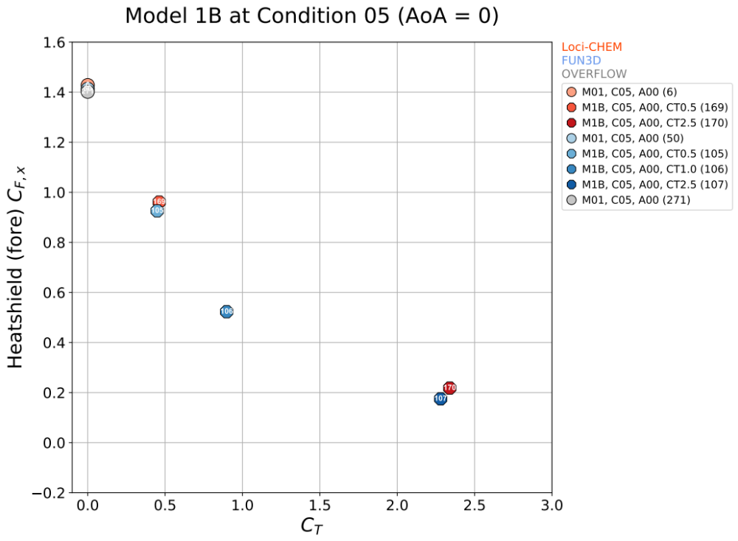
Results: Predicted Effect of Nozzle Cant Angle for Models 1A and 1B
If nozzles have an outward radial component (cant angle = 20-deg) for a given C_{T}:
  Heatshield aerodynamic axial force coefficient increases due to reduced plume blockage inboard of nozzles

Slide 9
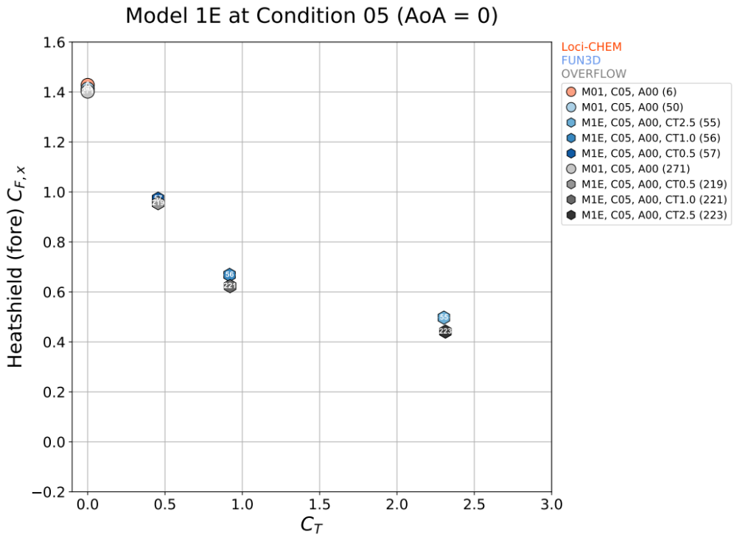
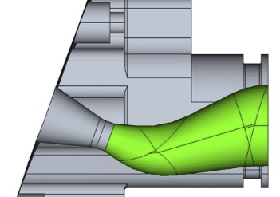
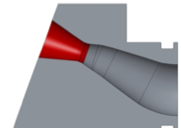
Results: Predicted Effect of Nozzle Radial Location for Models 1B and 1E
If nozzles are placed closer to the heatshield shoulder (model 1E) for C_{T} > 0.5:
  Heatshield aerodynamic axial force coefficient increases due to larger area of high-pressure inboard of nozzles

Slide 10
Project Assessment Summary
Project Name | Performance |  |  |  | Comments
 | C | S | T | P
Mid Year |  |  |  |  | Technical – No issues Cost – Early over-runs in labor costs Schedule – Project has completed all high-priority CFD cases prior to the partner project wind tunnel test Programmatic - Partner project’s test now is scheduled for no earlier than April 2022, 4 months later than expected at the start of FY22, due to COVID-19 and unscheduled facility repairs. A later test start date means that test data will be delivered later than originally expected.
Annual |  |  |  |  | Technical – No issues Cost – Recovered from early over-runs in labor costs Schedule – No issues Programmatic - Partner project’s test now is scheduled for no earlier than October 2022, 10 months later than expected at the start of FY22.

Slide 11
Plans Forward and Transition / Infusion Plan
Propulsive Descent (PD) is an enabling technology for Mars high-mass entry systems (HEOMD)
Improved PD testing methods and quantifying aerodynamics prediction uncertainties will help to inform future investments and overall mission risk
The contribution from DSS is to quantify how well CFD methods predict PD aerodynamics in the wind tunnel environment before using those same tools in the Mars environment
The results from DSS will be used as a starting point for assigning uncertainties for PD aerodynamics in the Mars environment
Notes:
Infusion: An investment reaches a conclusion where a technology is handed off for use by a mission or other need. Infusions can be made to other NASA Mission Directorates, other Government Agencies, Commercial Entities, or International Partner.
Transition: An investment reaches a conclusion where a technology is handed off for further development. Transitions can be made to other STMD programs, other NASA Mission Directorates, academic institution, other Government Agencies, Commercial Entities, or International Partner.

Slide 12
Education/Public Outreach
EPO Involvement
EPO Calendar Outlook (High Priorities):
6 Month Look-Ahead
Three papers presented at the 2022 AIAA SciTech Conference in special session chaired by K. Edquist
  “Computational Modeling of Mars Retropropulsion Concepts Tested in the Langley Unitary Plan Wind Tunnel”
  “OVERFLOW Analysis of Supersonic Retropropulsion Testing on the CobraMRV Mars Entry Vehicle Concept”
  “OVERFLOW Analysis of Supersonic Retropropulsion Testing on a Blunt Mars Entry Vehicle Concept”
Supporting Ames Pathways student ½ time
Notes:
Summary of the EPO activities (papers, conferences, outreach events) participated in over the last 6 months and the forward outlook for 6 months

Slide 13
Summary
In FY22, the Descent Systems Study team has completed all planned CFD analysis at expected supersonic wind tunnel conditions prior to a partner project Propulsive Descent (PD) test in the Langley Unitary Plan Wind Tunnel
The analysis to date suggests that partner project project test measurements will reveal difference in PD aerodynamics due to difference in model geometry, such as nozzle location and cant angle
Once the partner project and post-test DSS CFD analysis are completed by the end of FY23, uncertainties in predicting PD aerodynamics in a supersonic wind tunnel environment will be defined in order to define future investments in PD ground/flight testing

Slide 14
Project Name – Annotated Cover Pictures
CFD calculation of Low-L/D powered
descent vehicle at Mars conditions
Artist depiction of Low-L/D powered
descent vehicle at Mars
AETC Low-L/D wind tunnel model heatshield
CFD calculation of Low-L/D powered
descent model at wind tunnel conditions
AETC Mid-L/D wind tunnel model heatshield
Artist depiction of Mid-L/D powered
descent vehicle at Mars

