Slide 1
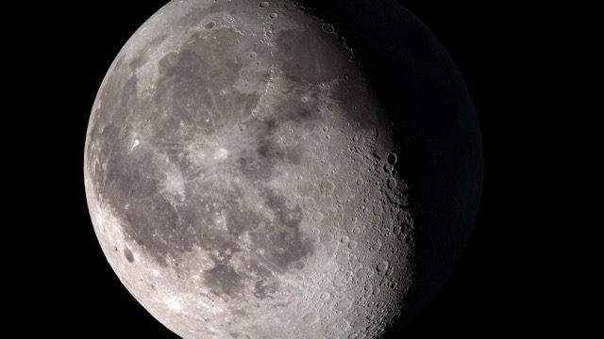
The Lunar Geophysical Network Mission
Clive Neal, University of Notre Dame
Renee Weber, NASA Marshall Space Flight Center
Lunar Reference System Working Group
Aug. 31, 2022

Slide 2
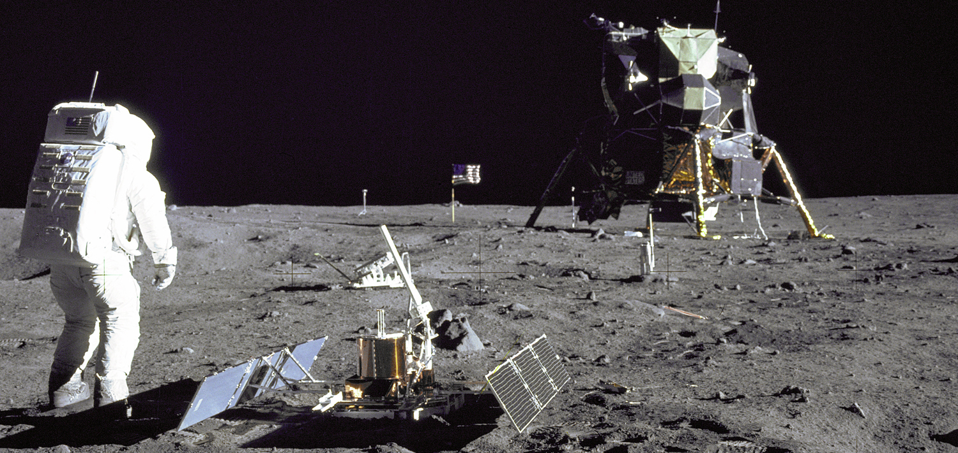
50 Years of Lunar Science: The Legacy of "One Small Step"
Notes:
(Buzz Aldrin with the Apollo 11 seismic experiment. Solar panels have deployed on the left and right and the antenna is pointed at Earth. The laser reflector is beyond the antenna and, in the distance, the TV camera is silhouetted against the black sky.)
At the dawn of the age of planetary exploration, seismology was considered a key technique for understanding a planet and its interior
Seismometers were among the first instruments send to other planets – both to the Moon with Apollo, and Mars with Viking
Pictured is Buzz Aldrin with the seismic experiment on Apollo 11, which laid the groundwork for the first long-lived extra-terrestrial geophysical network. Apollo revolutionized our understanding of the lunar interior, but there are many questions remaining regarding the detailed global structure of the Moon’s deep interior, which has bearing on its thermal, petrological, and rotational history.

Slide 3
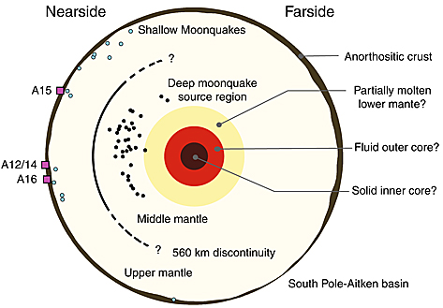
Geophysics: Elucidating planetary interiors
Interior properties provide constraints on formation and evolution models, and possible indicators of an early dynamo for magnetic field generation.
  Layering
  Composition
  Seismic velocity & density
  Presence of partial melt
  Core state
Terrestrial planets all share a common structural framework (crust, mantle, core) which is developed shortly after formation and which determines subsequent evolution.
Wieczorek et al. (2006) Rev. Mineral. Geochem. 60, 221 – 364.
Notes:
Interior properties provide constraints on formation and evolution models, and possible indicators of an early dynamo for magnetic field generation.
Terrestrial planets all share a common structural framework (crust, mantle, core) which is developed very shortly after formation and which determines subsequent evolution.

Slide 4
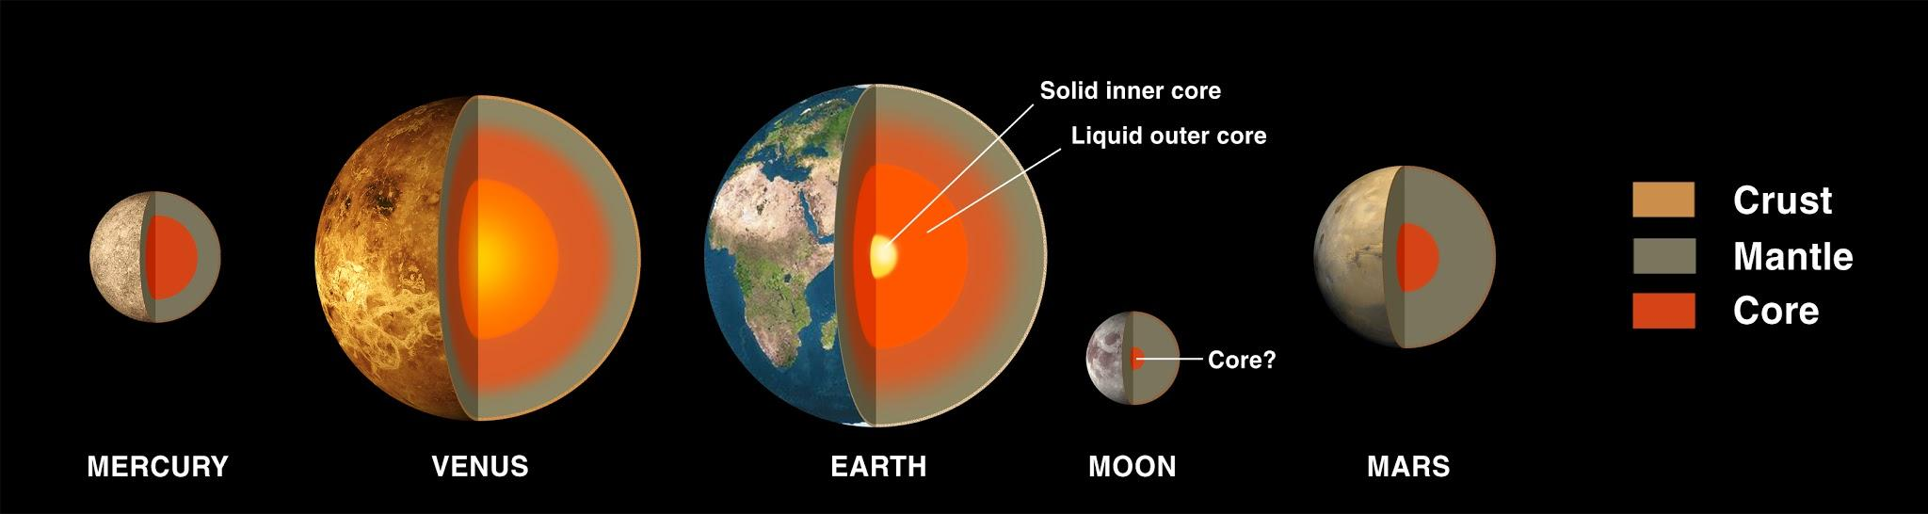
Lunar Science is Solar System Science
While much of Earth’s early structural evidence has been destroyed by plate tectonics, the so-called “ancient” planets retain more information about their early interior structure and are ideal bodies to explore to advance our understanding of all terrestrial planetary formation and evolution.
Constraints on these properties arise from geophysical observations:
  Geodetic parameters
  Lunar laser ranging
  Heat flow
  Seismology
  Gravity field
  Electromagnetic induction
Notes:
While much of Earth’s early structural evidence has been destroyed by plate tectonics, the so-called “ancient” planets, including the Moon, retain more information about their early interior structure, and are ideal bodies to explore to advance our understanding of all terrestrial planetary formation and evolution.
The heat engine that drove differentiation of the Moon waned after the first ~1.5 b.y. of lunar history as the volume of magmatism decreased dramatically. Therefore, the Moon represents an end member in terrestrial planet evolution as it potentially preserves the initial differentiation stage through a magma ocean.
The structure and composition of the lunar interior therefore provides fundamental information on the initial evolution of any differentiated terrestrial planetary body.
My point here being that Lunar Science is Solar System Science

Slide 5

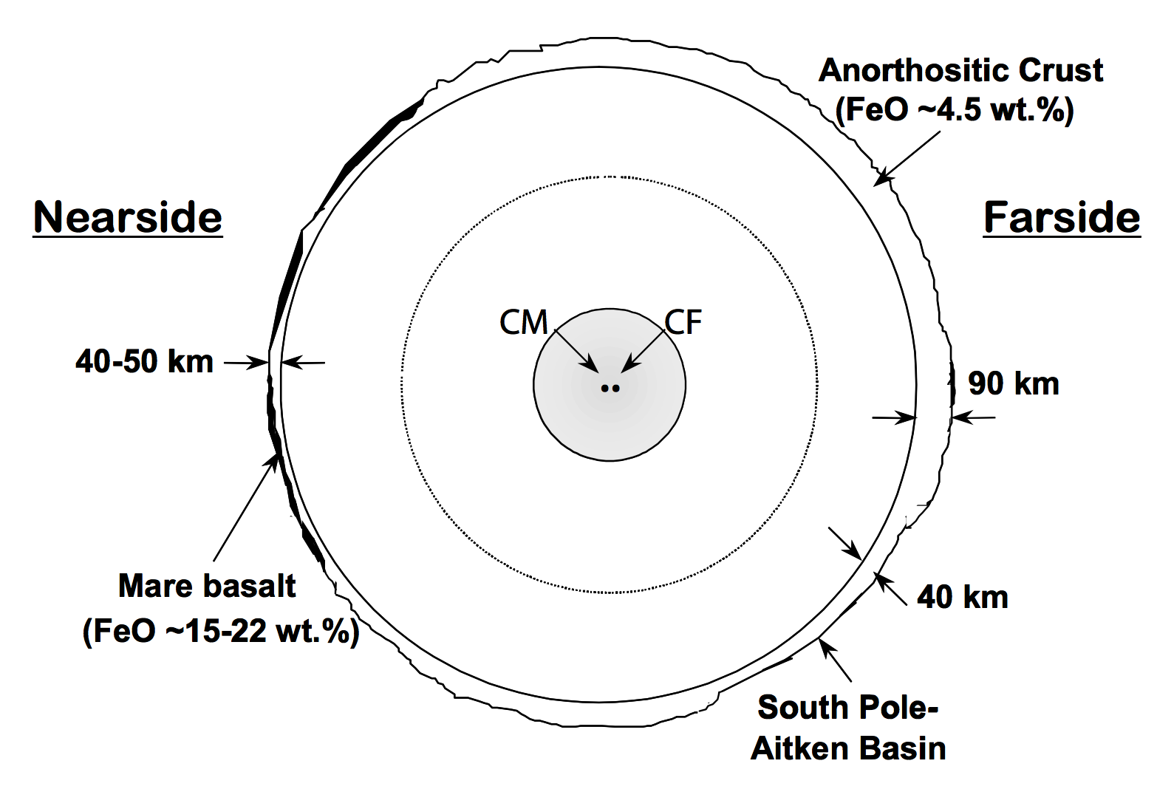
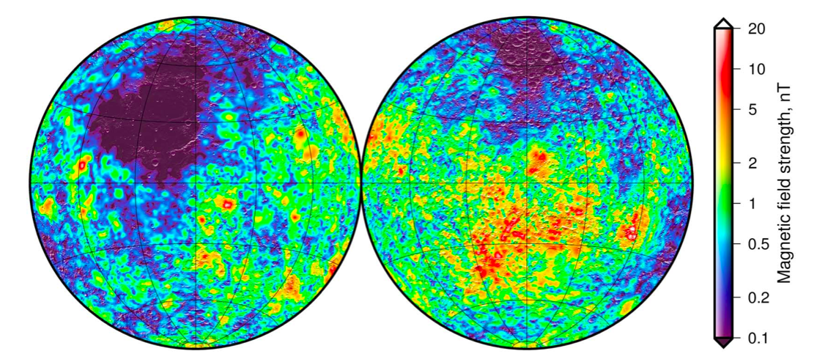
Lunar geodetic parameters
crust
To first order, the
Moon’s moment
of inertia is roughly approximated by homogeneous sphere (I_{solid}/MR² = 0.3930±0.0003)
~0.4
mantle
?
?
?
core
Wieczorek et al. (2006) Rev. Mineral. Geochem. 60, 221 – 364.
Global crustal magnetism – Wieczorek et al. (2017) NVOTM2 #6036
Notes:
To first order, the Moon’s moment of inertia is roughly approximated by homogeneous sphere. If a core is present, it must be small.
The real Moon is of course known to be much more complex, with hemispherical dichotomies in crustal thickness, volcanism, magnetism, and the distribution of heat-producing elements. There is also the question of how these dichotomies propagate into the interior.

Slide 6
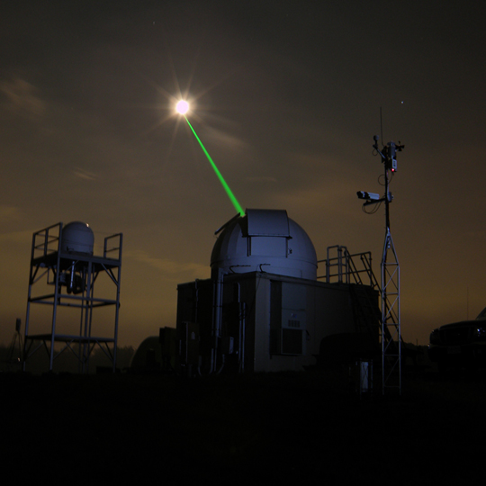
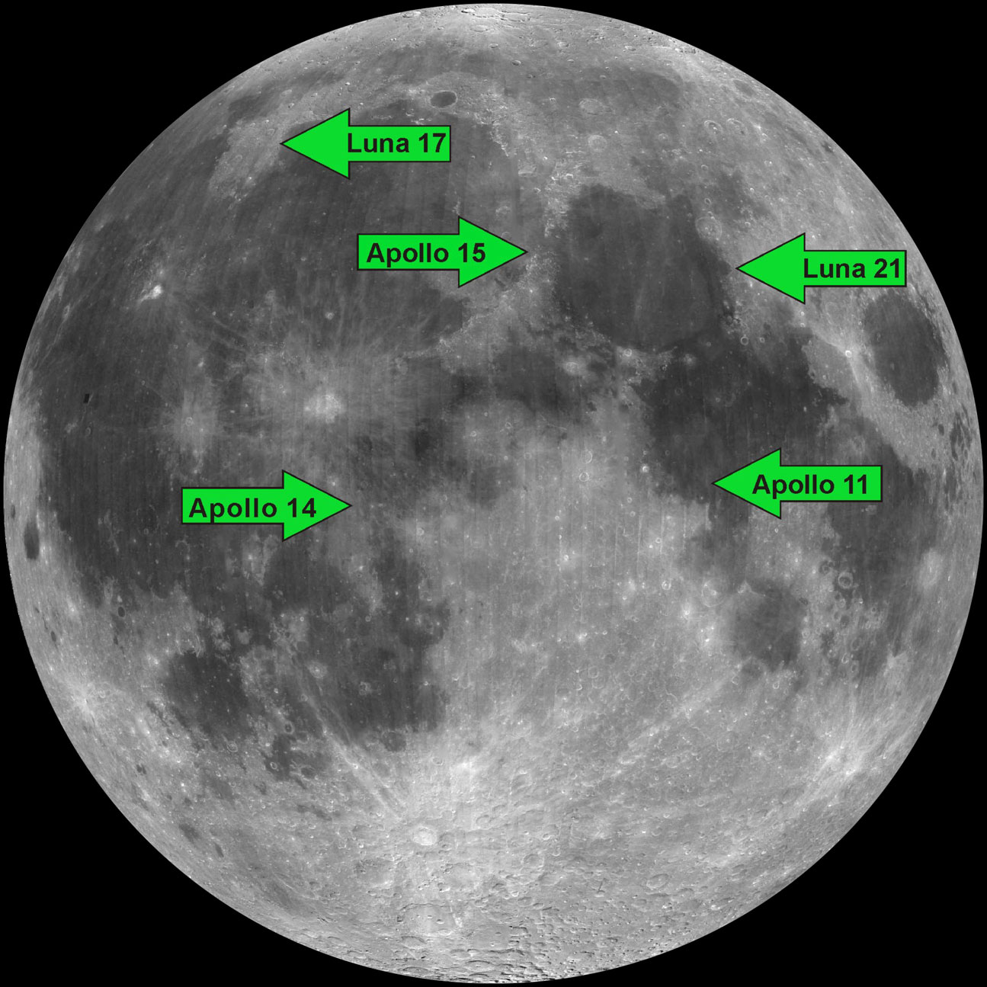
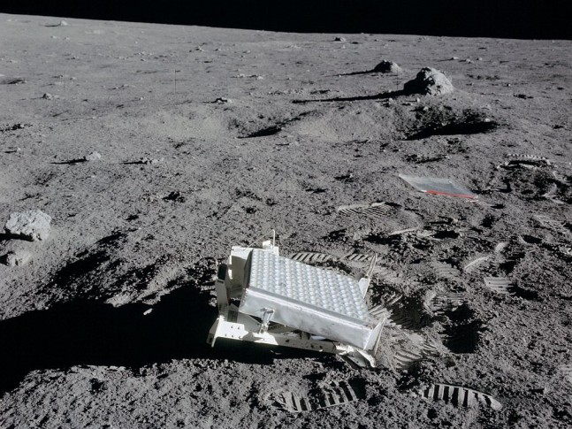
Lunar Laser Ranging (LLR)
LLR has been precisely monitoring the Moon’s geodetic parameters since 1969
Dissipation provided the first LLR evidence for a fluid core
fluid core radius = 352km if iron, or 374km for a Fe-FeS eutectic composition
Notes:
LLR has been precisely monitoring the Moon’s geodetic parameters since 1969, using retroreflector arrays deployed during Apollo and the Russian Luna missions. Luna 17 (Lunokhod 1) was only integrated into the LLR network in 2010 once LROC found the location and gave accurate coordinates.
Changes in the round-trip laser travel time provide information on the rotation of the Moon which can be analyzed to separate lunar orbital motion from geodynamic effects.
LLR also allows for fundamental astrophysics research to be conducted from the Moon (the general theory of relativity, inverse square law, & the Equivalence Principle).
Dissipation provided the first LLR evidence for a fluid core, with a radius dependent upon composition.
But LLR still cannot constrain an inner core, in part because the restricted geographical extent of the existing retroreflector network limits the accuracy of lunar rotation and tide determinations.

Slide 7
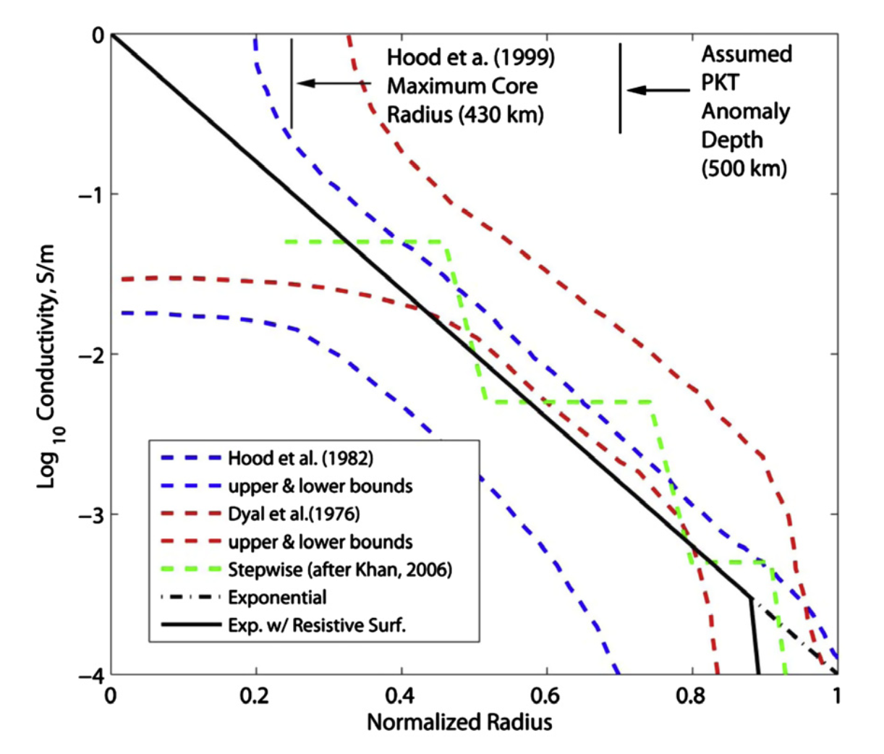
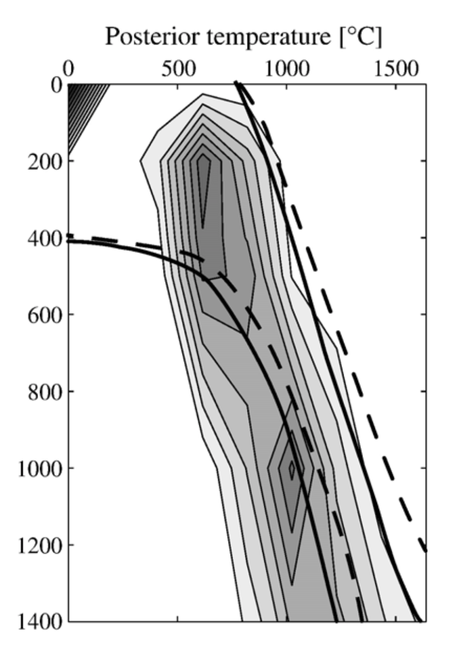
Lunar magnetic induction
EM sounding at Apollo 12 provided broad constraints on core size, mantle composition, and interior temperature (used concurrent orbital reference).
The Lunar Prospector and Kaguya magnetometers detected an induced moment that independently constrained core size.
Apollo 12 site may be anomalous as it is located within the PKT.
depth (km)
Apollo Lunar Surface Magnetometer
Grimm & Delory (2012) ASR 50, 1687–1701
Khan et al. (2006) EPSL 248, 579-598
Notes:
Electromagnetic sounding of the Moon performed during and after the Apollo program provided broad constraints on core size, mantle composition, and interior temperature.
Electrical conductivity and mantle temperatures were constrained at single points at the Apollo stations, using concurrent surface and orbital magnetometer measurements. The observed lateral heterogeneity in electrical conductivity is consistent with the presence of the PKT.
The Lunar Prospector and Kaguya magnetometers also detected an induced moment within the Moon, observed in the Earth's geomagnetic tail. Assuming that the induced field is caused entirely by electrical currents near the surface of a highly electrically conducting metallic core, a preferred core radius was obtained, although not required to fit the observations.

Slide 8
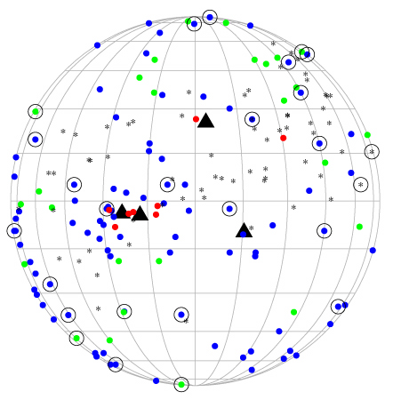
Seismic measurements
Meteorite impact
Artificial impact
Shallow moonquake
*
Deep moonquake
Farside event
Apollo station
Notes:
A passive seismic experiment was deployed on the lunar near side at multiple Apollo sites, and operated continuously from 1969 to 1977.
Many different types of naturally occurring seismicity were recorded, including deep moonquakes, shallow moonquakes, and meteorite impacts.

Slide 9
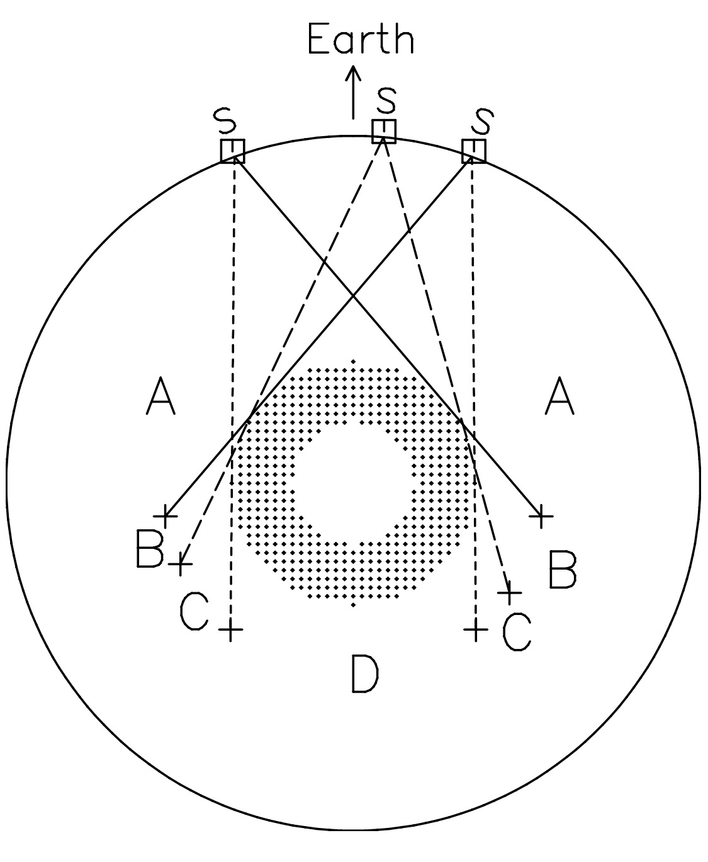
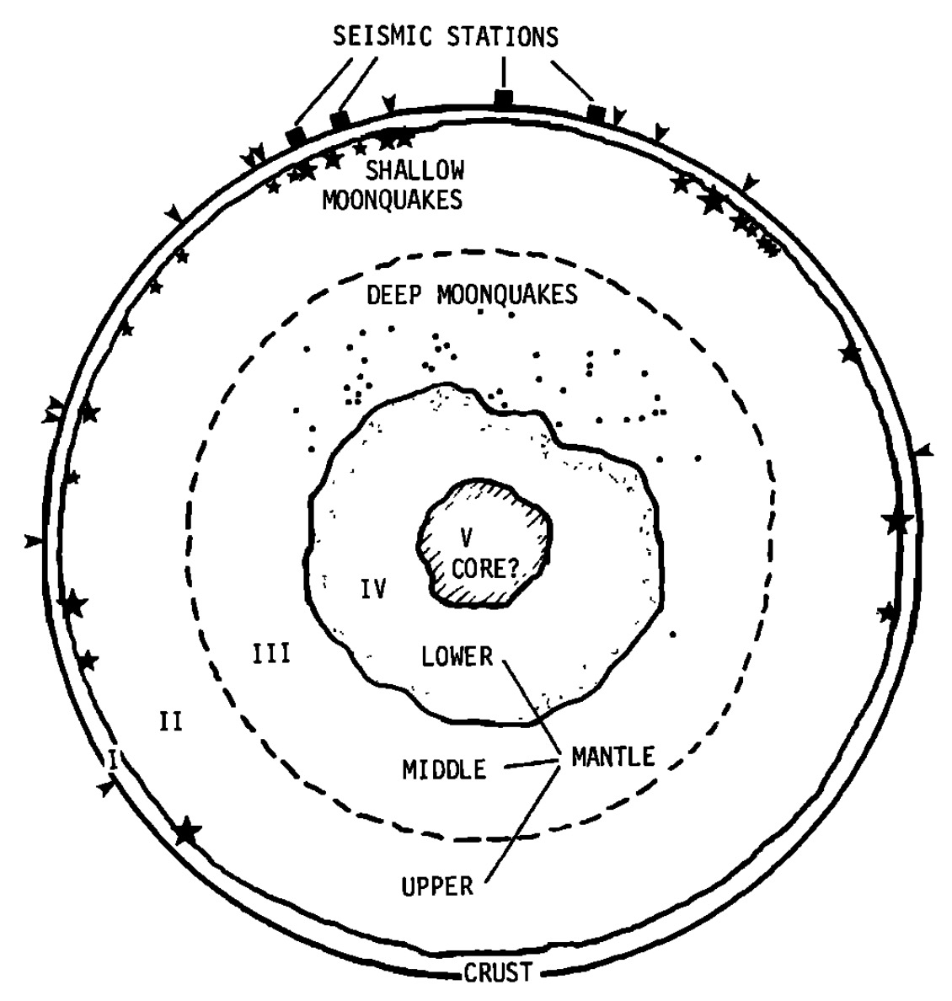
Seismic measurements
No seismic energy originating from far side penetrated the core, so it is likely attenuating
Deepest moonquake source regions ~1200-1400km depth; so core likely 300-500km radius
Nakamura (1983) JGR 88, 677-686
Nakamura (2005) JGR 110
Notes:
No seismic shear-wave energy originating from the far side was observed to penetrate the core, thus it was suggested that the core is likely attenuating.

Slide 10
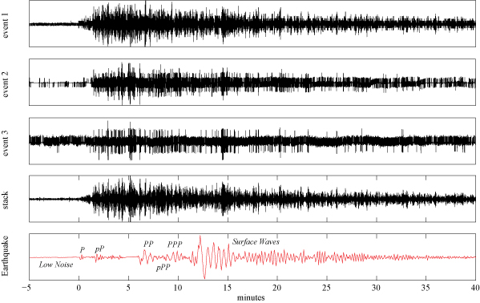
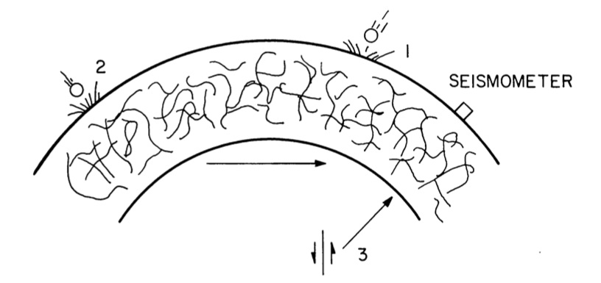
Seismic scattering
lunar
lunar
lunar
Dainty et al. (1974) The Moon 9, 11-29.
lunar
The lunar regolith intensely scatters seismic energy.
Lunar seismograms are of limited quality compared to their modern terrestrial counterparts.
Secondary phases which contain information on deep structure are masked by ringy codas.
Earth
Notes:
The lunar regolith intensely scatters seismic energy. So, lunar seismograms are of limited quality compared to their modern terrestrial counterparts. Secondary phases which contain information on deep structure are masked by ringy codas. These are the reflections of seismic energy from major layer boundaries like the crust-mantle boundary (the Moho) or the core-mantle boundary (CMB)

Slide 11
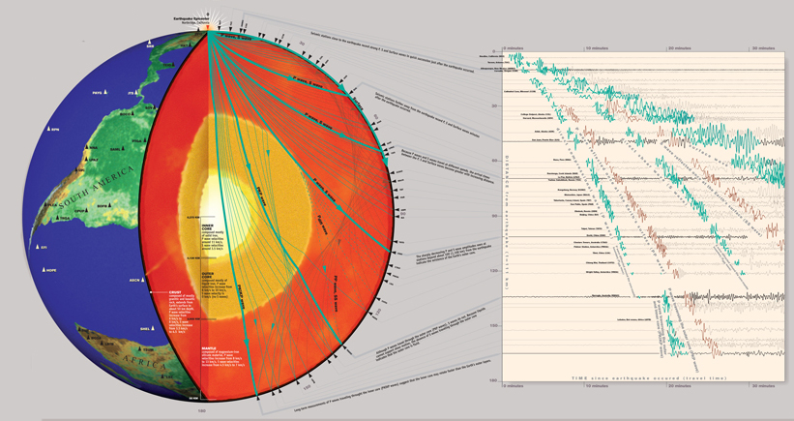
Seismic scattering
lunar
lunar
lunar
Dainty et al. (1974) The Moon 9, 11-29.
lunar
The lunar regolith intensely scatters seismic energy.
Lunar seismograms are of limited quality compared to their modern terrestrial counterparts.
Secondary phases which contain information on deep structure are masked by ringy codas.
Earth
Notes:
The lunar regolith intensely scatters seismic energy. So, lunar seismograms are of limited quality compared to their modern terrestrial counterparts. Secondary phases which contain information on deep structure are masked by ringy codas. These are the reflections of seismic energy from major layer boundaries like the crust-mantle boundary (the Moho) or the core-mantle boundary (CMB)

Slide 12
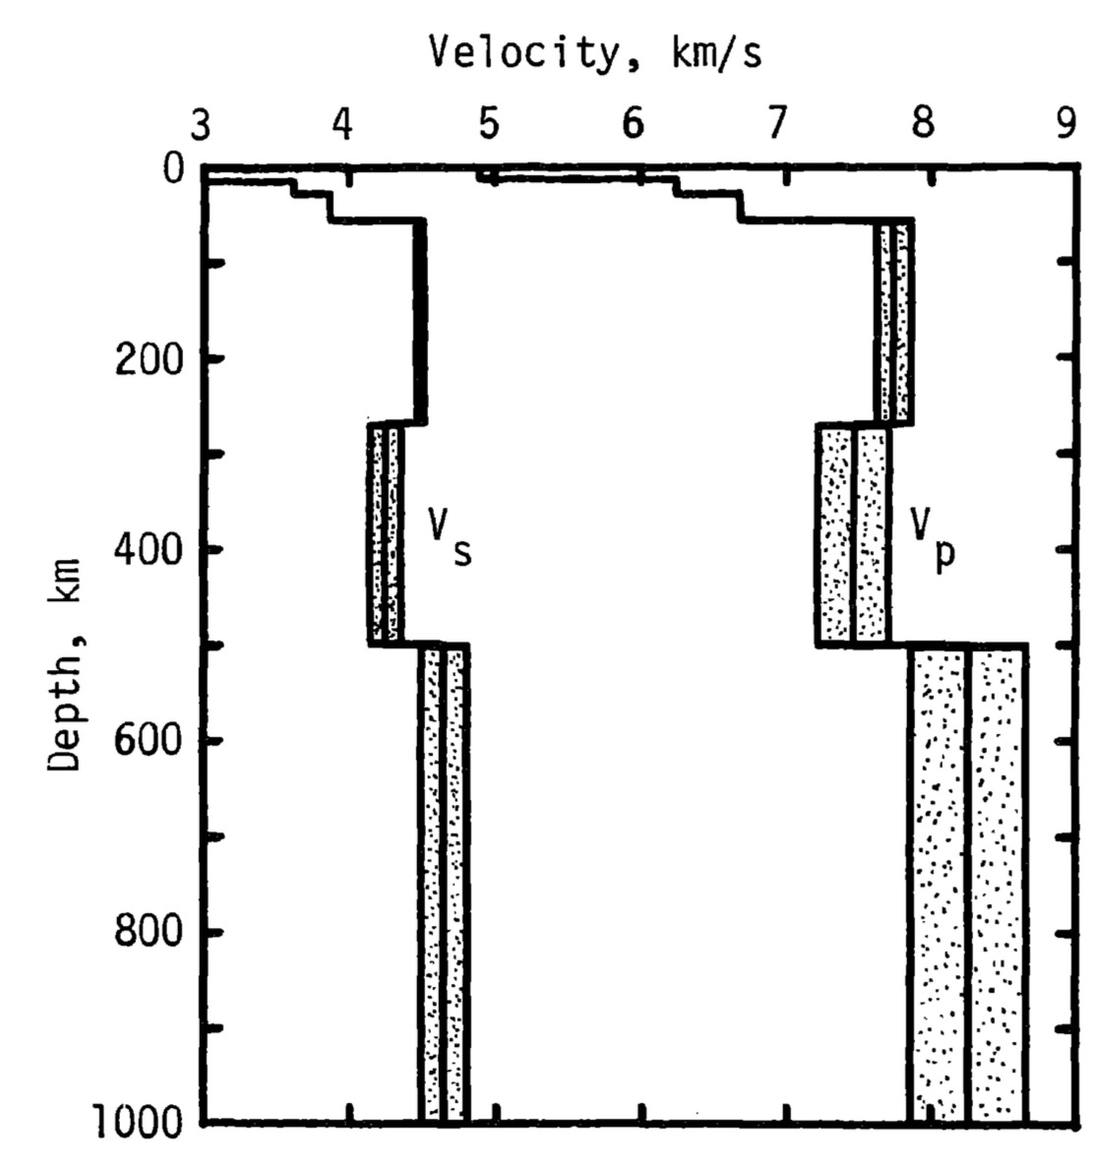
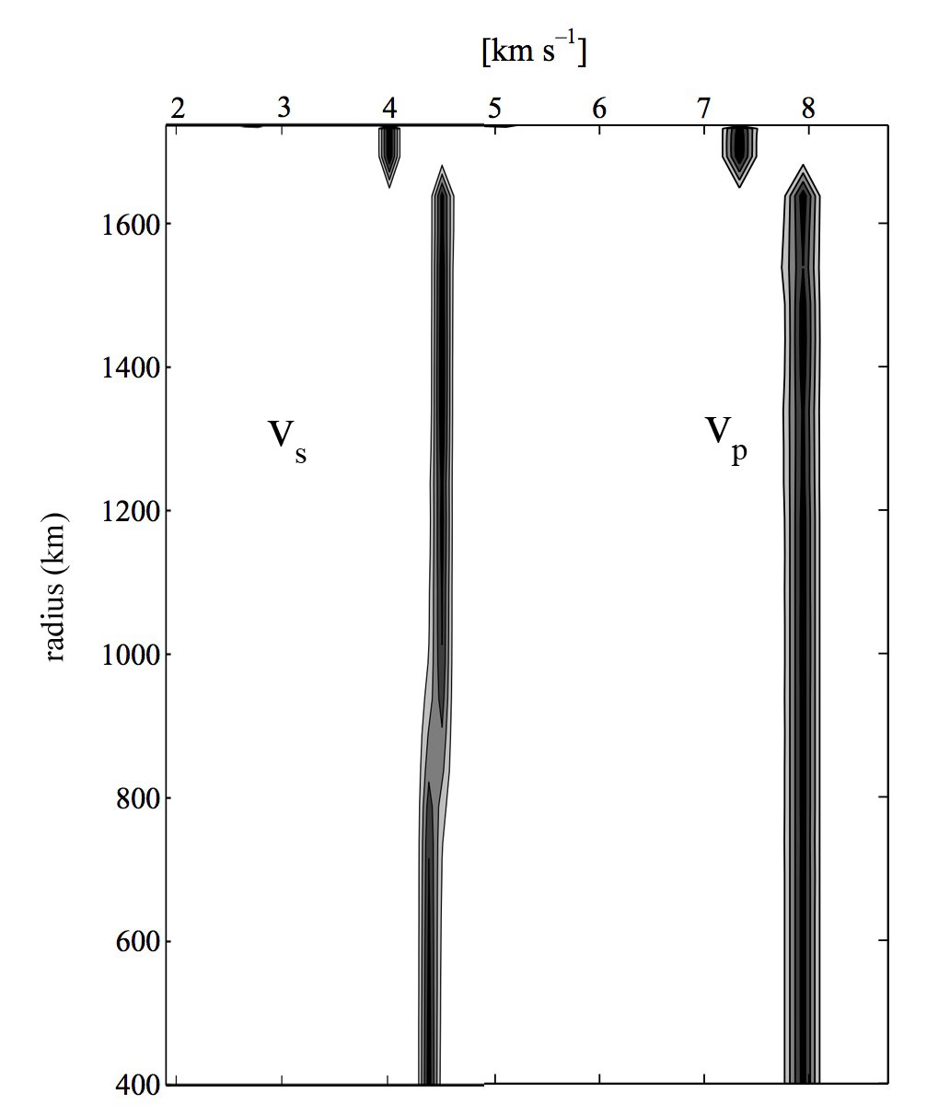
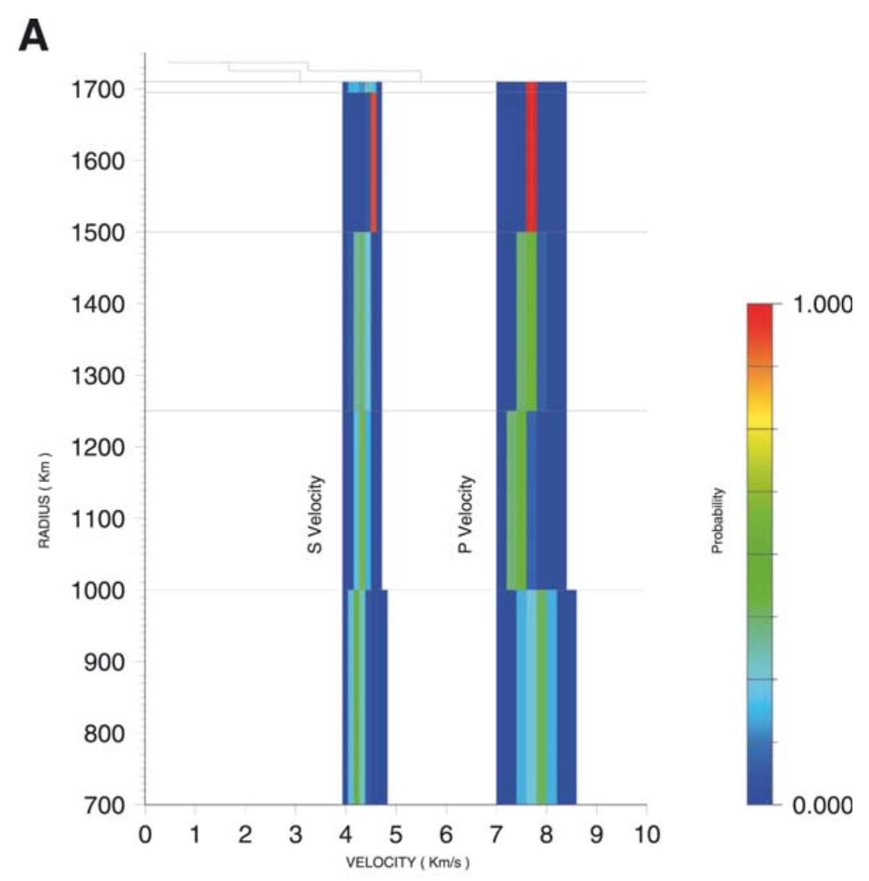
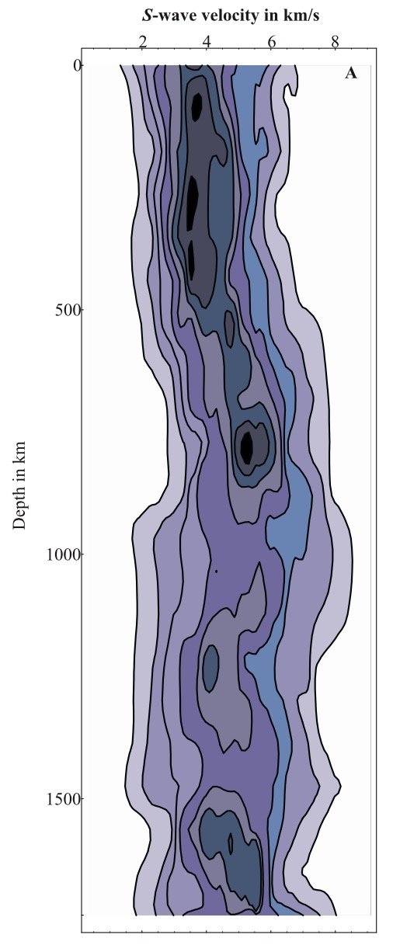
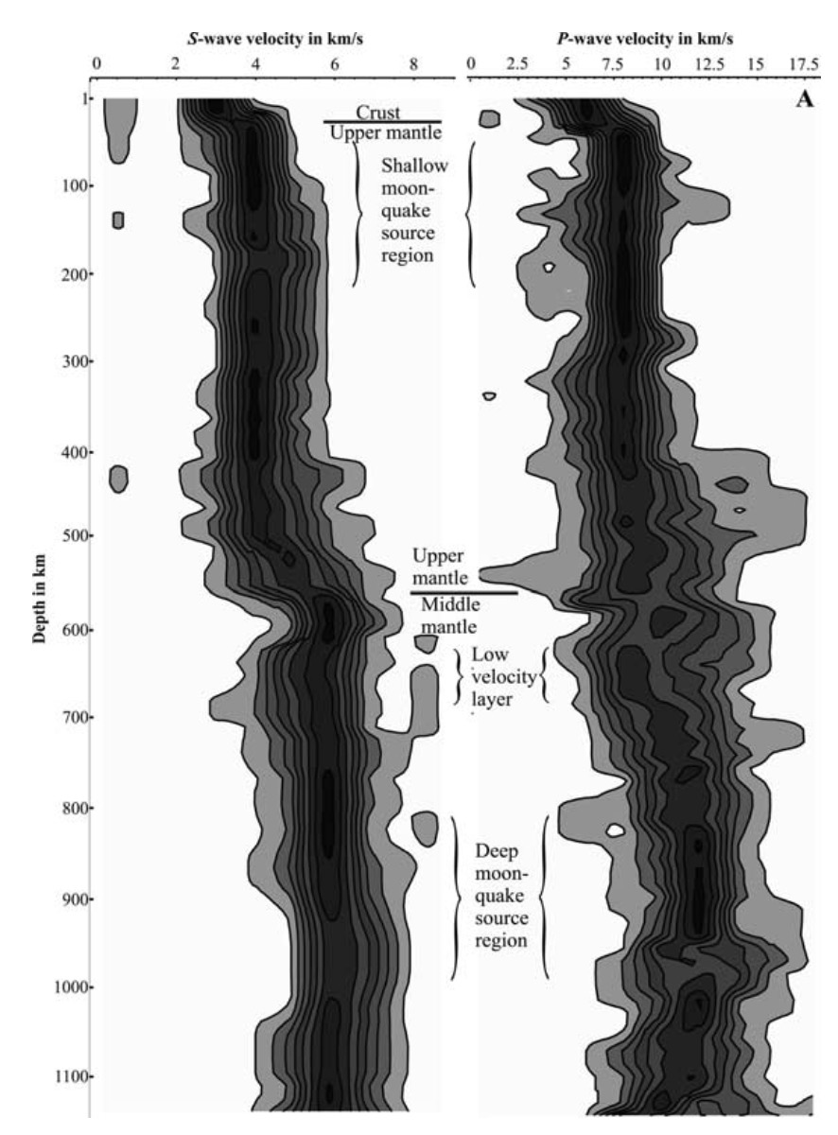
Seismic model uncertainty
Nakamura (1983) JGR 88, 677-686
Lognonné et al. (2003) EPSL 211, 27-44
Khan & Mosegaard (2001) GRL 28, 1791-1794
Khan & Mosegaard (2002) JGR 107
Khan et al. (2007) GJI 168, 243-258
Notes:
Uncertainties are reflected in seismic structure models. Crustal thickness estimates have decreased over the years as newer and more computationally expensive techniques were applied.
Early models based on arrival time inversion alone were supplanted by newer models using maximum likelihood estimates, joint seismic and pre-GRAIL gravity inversion, and free oscillations.
These newer models mostly agree that the only major discernable discontinuity in the lunar interior is the crust-mantle boundary located around 30km deep.
There is no consensus among models regarding the presence of a mid-mantle seismic discontinuity, which has been used in the past to suggest the lower bound of an ancient magma ocean.

Slide 13
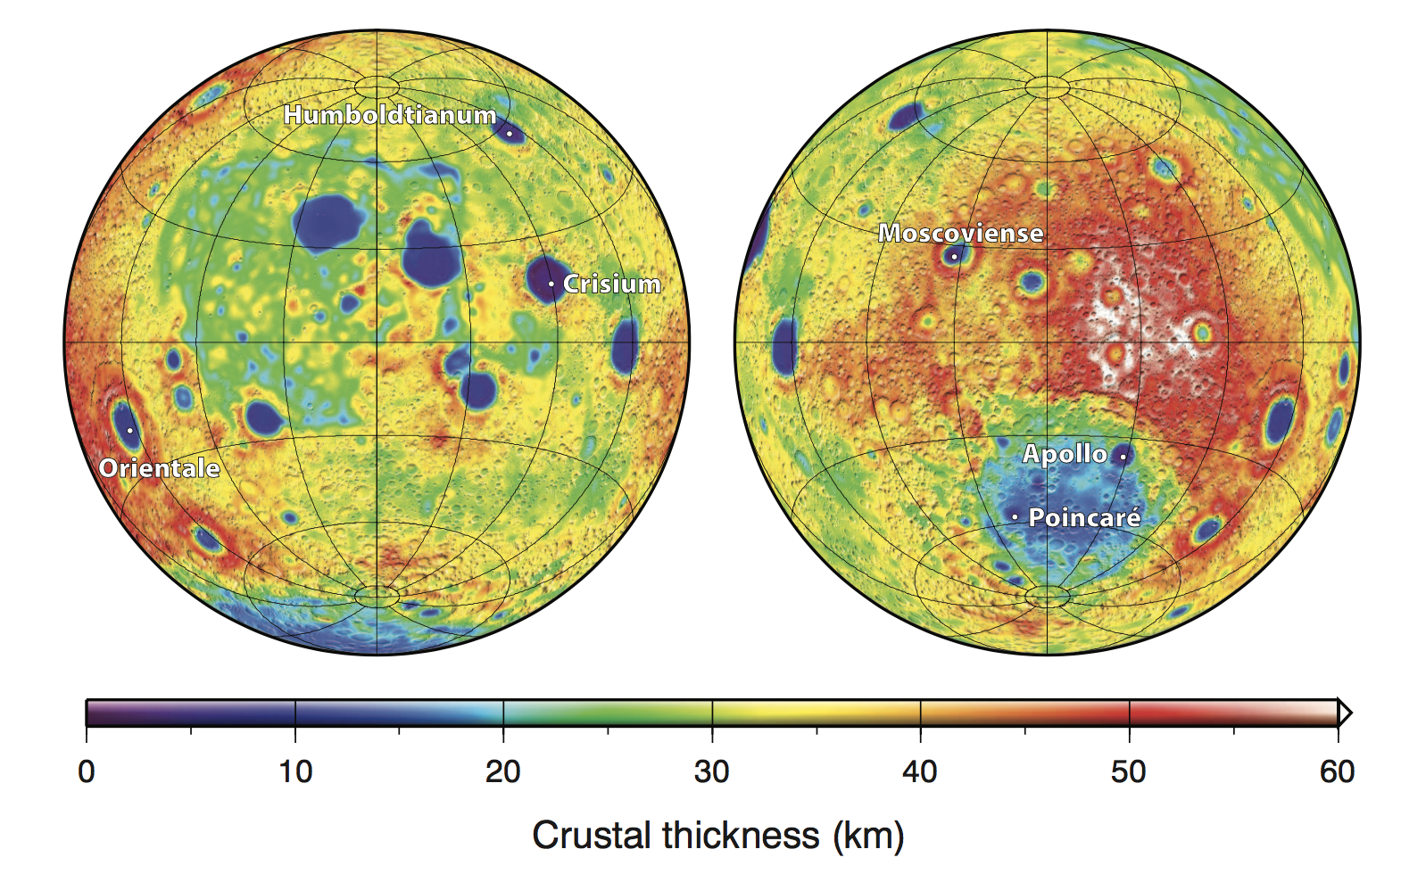
Recent advances in lunar geophysics
GRAIL lunar gravity mission mapped the Moon’s gravity field in extreme detail
Shallow (crustal) structure is tightly constrained, but still tied to (uncertain) ground-truth seismic estimates at the Apollo landing sites
Wieczorek et al. (2013) Science 339, 671-675
Notes:
That brings us to recent advances in lunar geophysics. The GRAIL lunar gravity mission mapped the Moon’s gravity field in extreme detail.
Shallow crustal structure is tightly constrained, but still tied to (uncertain) ground-truth seismic estimates at the Apollo landing sites. This sets up LGN to dramatically enhance one of the highest fidelity planetary datasets returned to date.

Slide 14
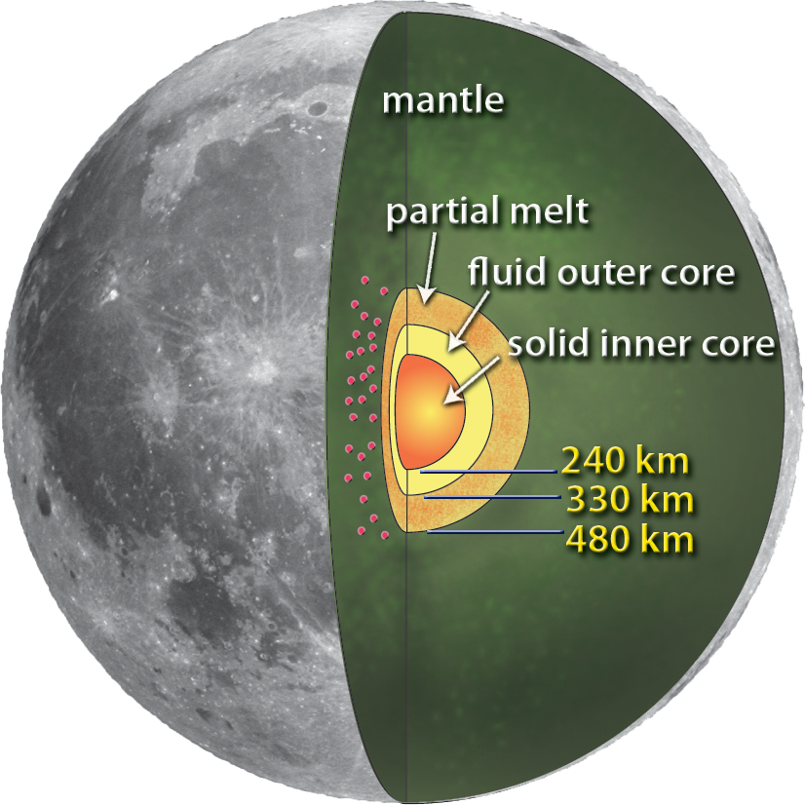
Recent advances in lunar geophysics
Re-analyses of Apollo seismic data found evidence for core reflections, both including (Weber et al., 2011) and not including (Garcia et al., 2011) the presence of a partial melt layer above the liquid outer core.
Differing perspectives on whether a partial melt layer is required to satisfy available constraints (gravity, seismic, geodetic constraints, EM sounding data, phase-equilibrium models, dissipation, volatile content)
Weber et al. (2011) Science 331, 309-312
Notes:
Re-analyses of Apollo seismic data found evidence for core reflections, both including (Weber) and not including (Garcia) the presence of a partial melt layer above the liquid outer core
While the GRAIL mission produced a family of core models consistent with geodetic parameters and seismic constraints, there are differing perspectives on whether a partial melt layer is required to satisfy available constraints.
A melt layer is consistent with inversions of multiple geophysical data in combination with phase-equilibrium computations, but not required in viscoelastic dissipation models based on laboratory deformation of melt-free polycrystalline olivine.
The existence of a partial melt layer would inhibit core cooling…. Which brings us to synergies with geothermal measurements.

Slide 15
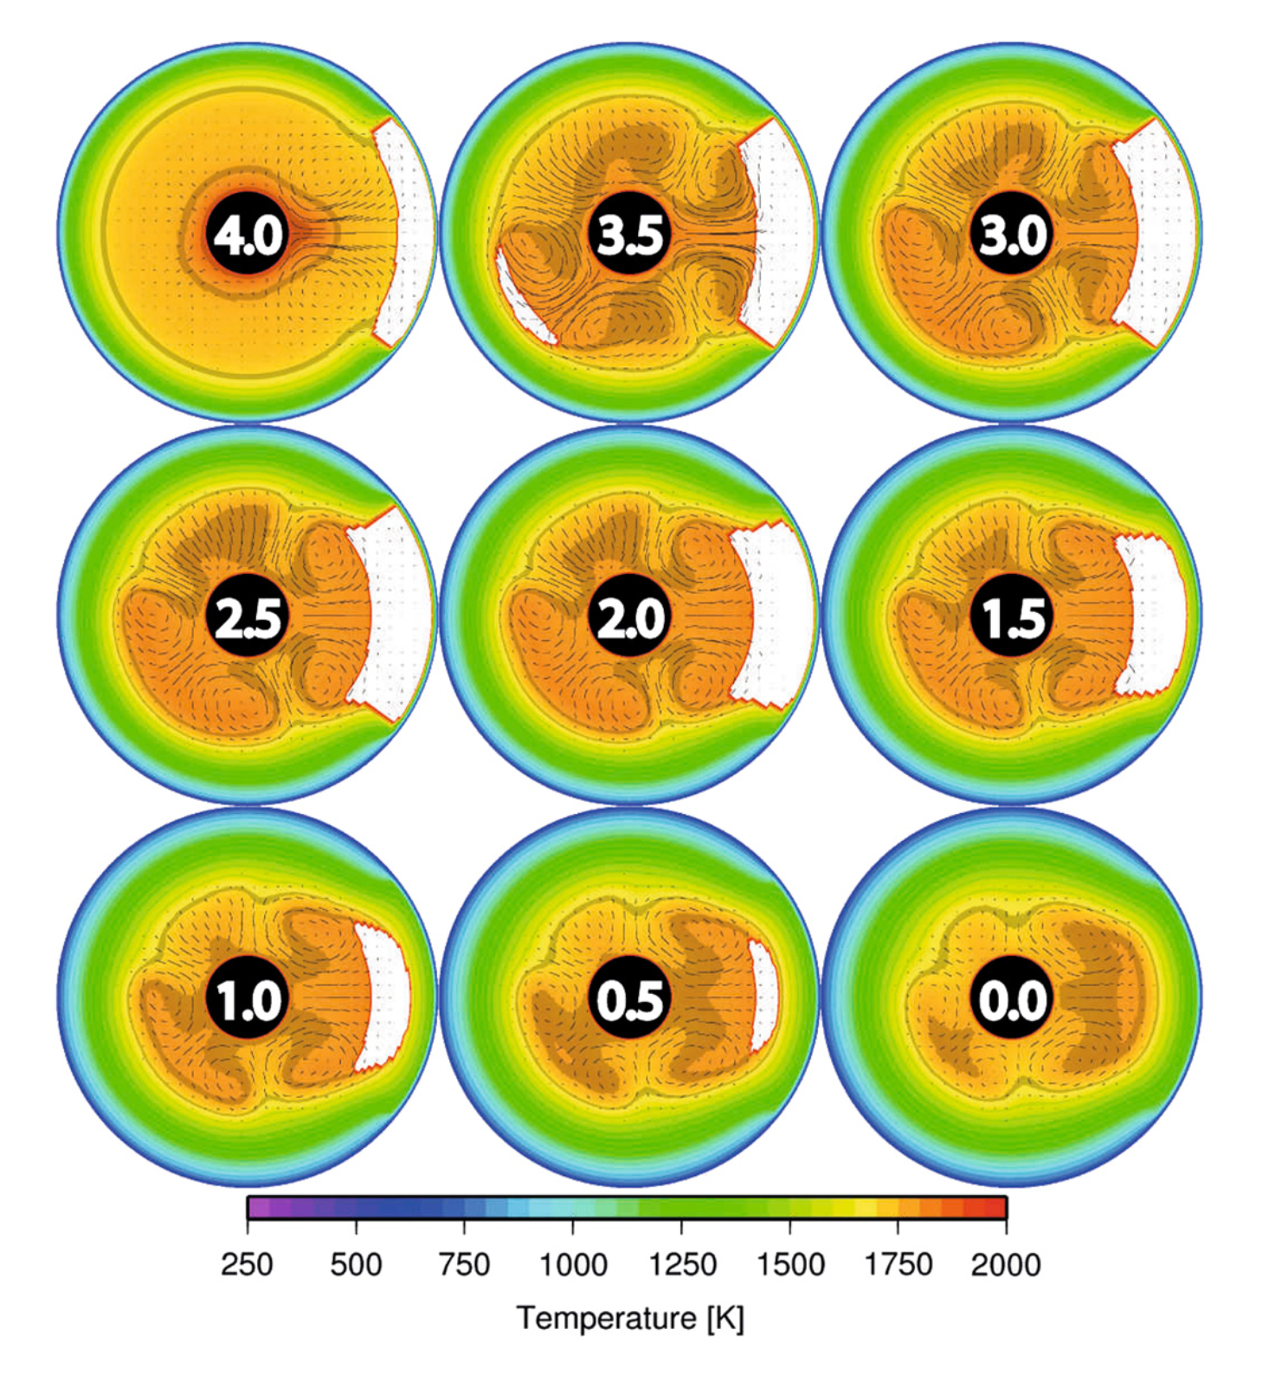
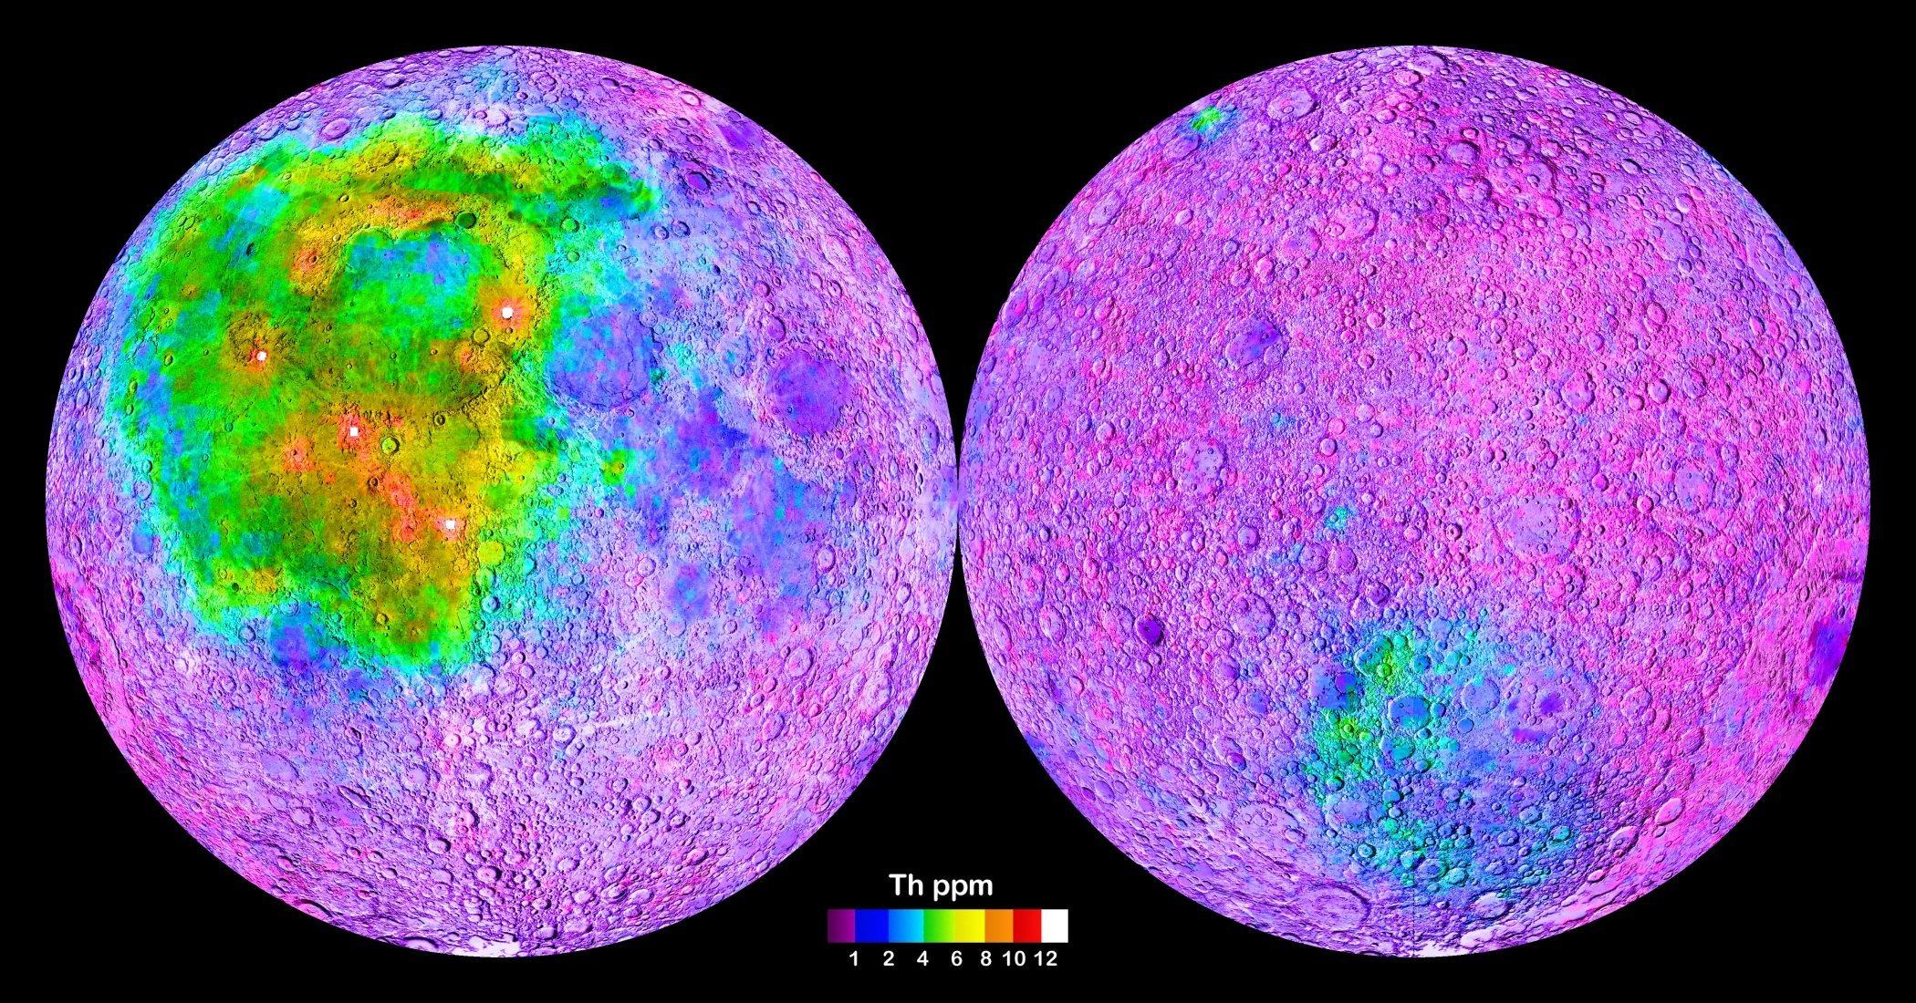
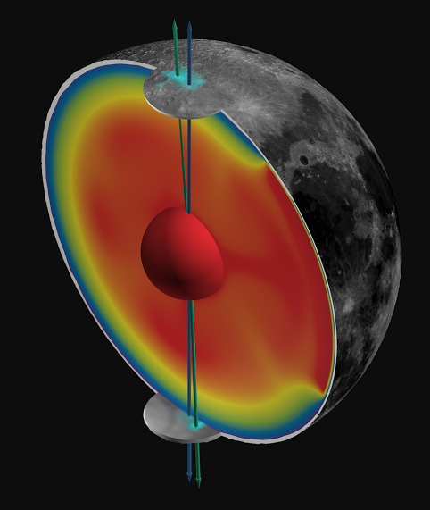
Synergy with geothermal measurements
Geothermal measurements track heat production and interior temperature distribution.
The Apollo Heat Flow Experiments were both within areas dominated by Thorium-rich crust. How the PKT came to exist depends on internal structure.
Determining the physical and thermal structure of the lunar core and deep interior is critical for understanding the Moon's formation. Geophysical data reveal the evolution of the lunar dynamo, by which the Moon may have generated and maintained its own magnetic field. They also provide context for thermal emission and volcanism studies.
Apollo 15
Apollo 17
Laneuville et al. (2014) EPSL 401, 251-260.
Notes:
Which brings us to synergies with geothermal measurements.
Geothermal measurements track heat production and interior temperature distribution.
The Apollo Heat Flow Experiments were both within or near the boundaries of areas dominated by Thorium-rich crust. How the PKT came to exist depends on internal structure.
Geophysical data provide context for thermal emission and volcanism studies. They also reveal the evolution of the lunar dynamo, by which the Moon may have generated and maintained its own magnetic field.

Slide 16
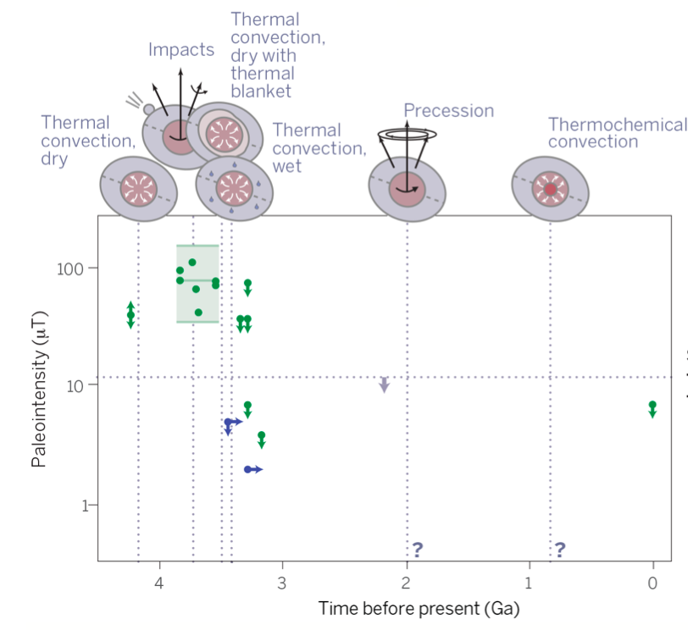
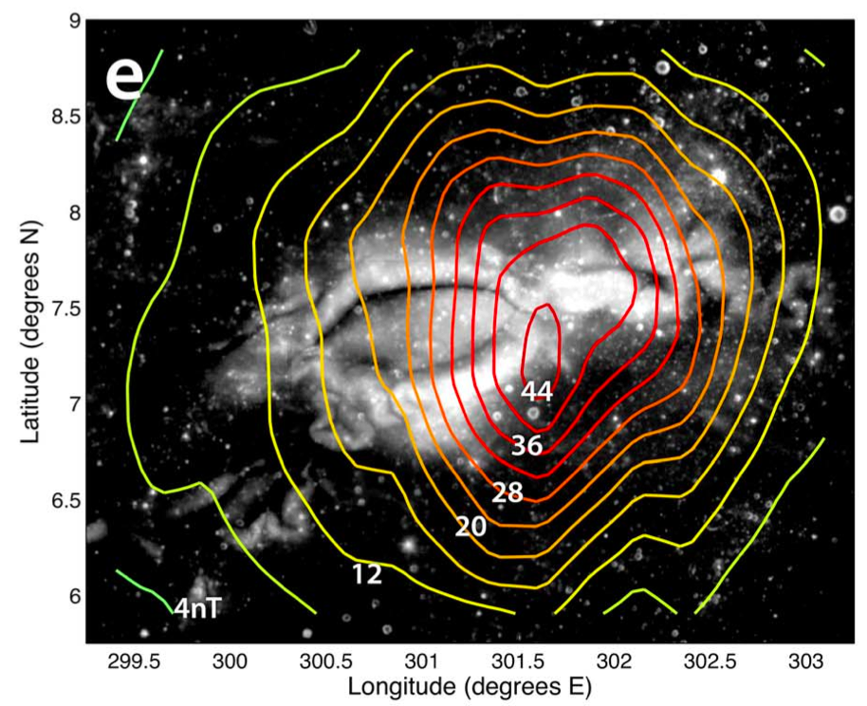
Synergy with paleomagnetic measurements
Magnetism is ubiquitous in the Solar System.
Just beginning to constrain the nature of the extinct lunar dynamo
We don’t know the origin of magnetic anomalies or swirls
???
Weiss & Tikoo (2014) Science 346.
Local crustal magnetism – Hemingway & Garrick-Bethell (2012) JGR 110
Notes:
Magnetism is ubiquitous in the solar system. Both deep structure and magnetism have bearing on the lunar dynamo, which in turn has implications for lunar thermal history and core state.
But we don’t know the full nature of the extinct lunar dynamo, and it’s surprising it even existed on such a small body.
We can constrain dynamo history with paleomagnetism and via crustal magnetism studies, but we also don’t know the exact origin of the Moon’s magnetic anomalies or swirls
Recent modeling shows that dynamo mechanisms using core convection cannot achieve a lunar dynamo for the observed paleo magnitude and duration. It runs out of energy, so perhaps a second dynamo mechanism may be necessary to explain paleointensity observations.

Slide 17
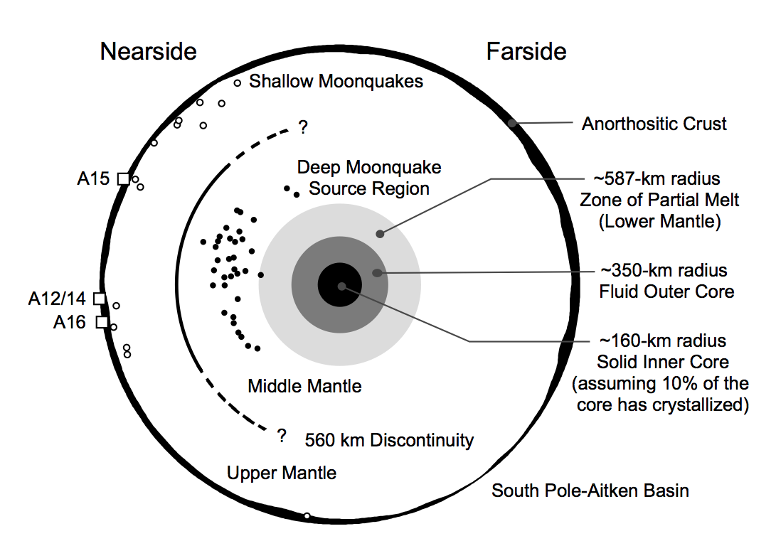
How to develop an internal structure model consistent with all observations?
Complex internal processes drive the distribution of surface observables. If the PKT is indicative of thermal upwelling and mantle overturn, a potential partially molten region could act as a thermochemical blanket preventing the core from cooling.
crust
mantle
?
Wieczorek et al. (2006) Rev. Mineral. Geochem. 60, 221 – 364.
?
?
?
core
Laneuville et al. (2014) EPSL 401, 251-260.
Wieczorek et al. (2017) NVOTM2 #6036
Notes:
So, how can we develop an internal structure model for the Moon that is consistent with all observations and provides logical context for the Moon’s early history?
Complex internal processes drive the distribution of surface observables. If the PKT is indicative of thermal upwelling and mantle overturn, a potential partially molten region could act as a thermochemical blanket preventing the core from cooling.
Cleary in the past 50 years we’ve learned a lot about the Moon, but there are still a lot of open questions which could be addressed by a future Lunar Geophysical Network.

Slide 18
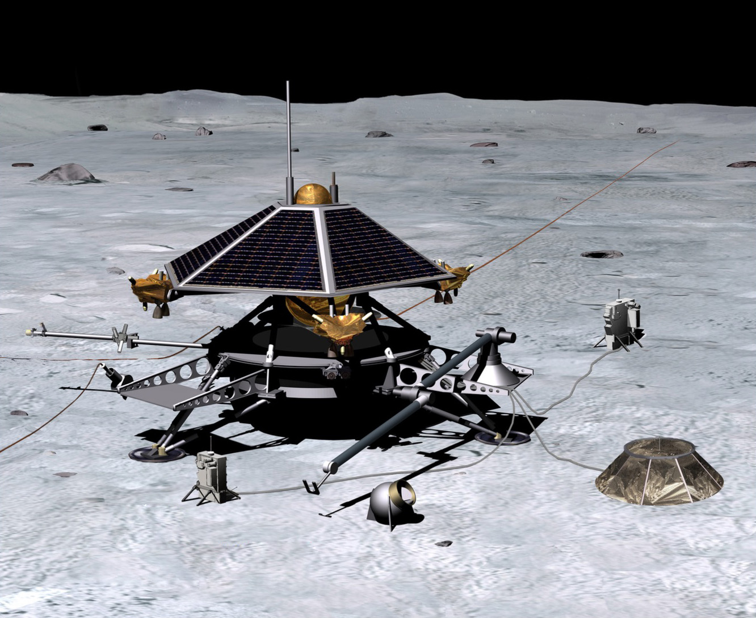
The Lunar Geophysical Network
JPL LUNETTE mission concept
A network of geophysical “nodes” (at least 4) operating continuously for an extended period – at least 2 (ILN), 4 (LUNETTE), or 6 (LGN threshold) years
Science objectives for each node:
Seismometer | Heat flow probe | Retroreflector | Magnetometer
Understand the current seismic state and determine the detailed internal structure of the Moon | Measure the heat flow to characterize the temperature structure of the lunar interior | Constrain the deep mantle environment, fluid core/solid mantle boundary conditions, and the presence/absence of a solid inner core | Determine the electrical conductivity structure of the lunar interior to establish joint constraints on temperature and composition
Notes:
Apollo’s legacy was an evolution in our understanding of the Moon from a cold, dead body to a dynamic, delightful world
To build upon that legacy, the current – and hopefully next - planetary decadal survey recommends a Lunar Geophysical Network as a prioritized mission.
A network of least four nodes (each with a seismometer, heat flow probe, retroreflector, and magnetometer), operating continuously for at least 6 (but preferably) 10 years, would enable progress towards a consistent model of the Moon’s interior from crust to core.
LGN recently completed the ROSES2019 Planetary Mission Concept Study, and is currently in formulation for New Frontiers 5 (I’ll talk about that more in a minute).

Slide 19
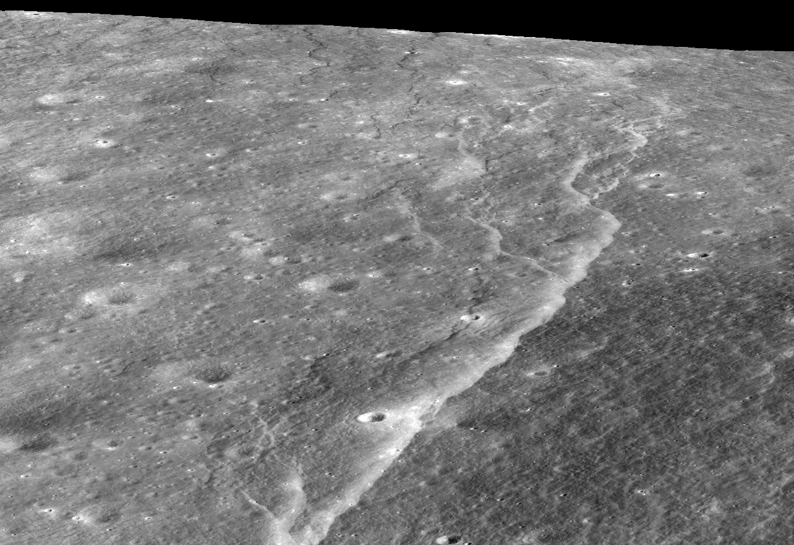
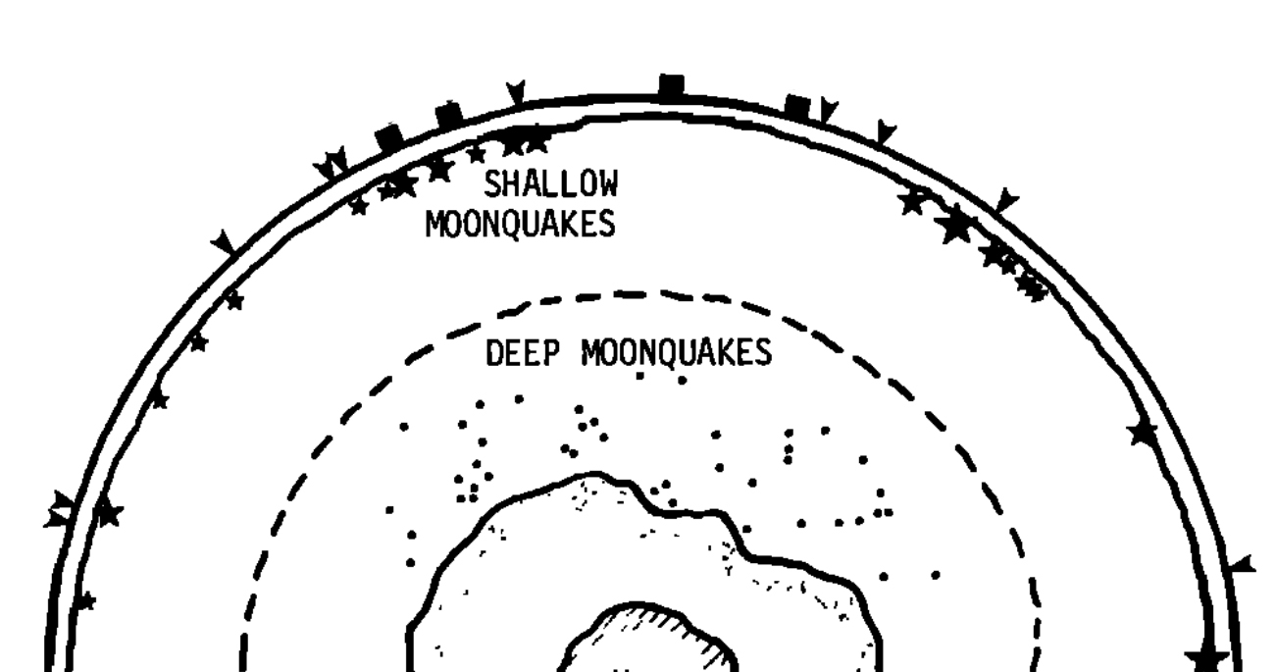
Lunar scientific understanding – outstanding issues
We don’t know the extent or duration of the now extinct lunar dynamo
We don’t know the exact origin of the Moon’s crustal magnetic anomalies/swirls
We don’t have unambiguous observations of a mid-mantle discontinuity (base of the LMO?), a partial melt layer above the outer core, or the nature of the inner core
We don’t know how surface hemispherical observations propagate into the interior
We don’t understand why/how all moonquakes occur
Deep moonquakes: brittle failure in the ductile regime?
Shallow moonquakes: lobate scarp slip?
Notes:
Going back to our outstanding questions in lunar geophysics: (read slide)
… and all of the seismic constrains on the deep interior come from events whose origin we can’t explain!
Deep moonquakes, which are small but frequent, occur at depths below what should be the brittle-ductile transition zone in the Moon. Why do we see brittle failure in the ductile regime? We know they are triggered by tides, but tidal stress is too low to fracture unbroken rock.
Shallow moonquakes, which are large but rare, have had a variety of mechanisms proposed, some stranger than others. Their closest terrestrial counterparts are intra-plate earthquakes, possibly representing failure on ancient fault structures. Recent work suggests they may be related to lobate scarps.

Slide 20
Planetary scientific understanding – outstanding questions
Terrestrial planet hypotheses that can be tested with new geophysical data from the Moon:
How do solar systems form and evolve over time, and when did major solar system events happen?
  What is the tidal relationship between parent bodies and their satellites, and the internal evolution and structure of these systems?
How did the early terrestrial planets form and differentiate?
  The Moon preserves a record of early terrestrial planet differentiation; imaging the core, mantle, crust provides a window into these early processes and how the planets evolve from an initial magma ocean.
What processes shape planetary surfaces and how do these surfaces record solar system history?
  Stagnant lid conduction is assumed to be the norm for smaller bodies, as is global contraction. The thermal evolution of terrestrial objects is tied to their tectonic evolution, and the rate of heat loss is determined by their internal dynamics.
How do worlds become habitable, and how is habitability sustained over time?
  We know the core dynamo is important for magnetic field generation, which is relevant for habitability. At what point did a core dynamo form (if it ever did), and how long was it operational?
What are the hazards of the Solar System for human exploration?
  Seismology can assess risk from shaking, which is needed as we push toward a sustained human presence on the Moon.
Notes:
Stepping further back to the big-picture questions, there are several terrestrial planet hypotheses that can be tested with new geophysical data from the Moon:
(1) We can study this relationship in the Earth/Moon system. The outer Solar System has many satellites, and those worlds are literally shaped by the tidal relationship to their neighbors.
(2) Parts of the Moon preserve remnants of magma ocean crystallization, which presumably took place in the early histories of all terrestrial planets. Following the crystallization of the Magma Ocean, did an overturn event occur? Is the crustal PKT layer the origin of the partial melt layer at the CMB? Crustal thickness, lateral variations in properties, the mantle (and lower mantle) all provide knowledge and insight into these processes.
(3) Better constraining the cooling of the Moon through heat flow measurements will help to test the hypothesis that terrestrial bodies are simple conductive cooling systems, or if it is more complex processes are involved.
Another hypothesis is that terrestrial bodies have been geologically inactive since reaching the stagnant lid regime. We can test that by looking at their current rate of seismicity.
Early crustal evolution and the role of giant impact processes can be examined as a model for seeding the fracture density needed to initiate plate recycling on larger bodies.
(4) The volatile history of the Earth-Moon system is (presumably) preserved on the Moon. Is the lunar interior dry and degassed, or volatile enriched? How did this evolve and why? This can be addressed by magnetotelluric sounding and supporting seismic observations.

Slide 21
Advancements in our scientific understanding of the lunar interior
Key points from the 2018 LEAG Special Action Team: Advancing Science of the Moon
GRAIL data improved lunar gravity field map and revealed features of the lunar crust in unprecedented detail, including fractures and other tectonic structures, mascons, lava tubes and other volcanic landforms, impact basin rings, and the shape and size of complex to peak-ring lunar craters.
  A more nuanced view of the lunar interior drives new questions to be answered by an LGN in concert with GRAIL investment
Applying terrestrial seismic techniques to Apollo data can quantify scattering effects in the shallowest layers of the lunar regolith (meter scale).
  Recent studies have made progress quantifying these effects, feeding instrument design and deployment needs
GRAIL analysis produced a family of core models consistent with geodetic parameters (including constraints from LLR), but gravity data alone have not yet definitively identified the presence of an inner core. Laser ranging data suggest the lunar core is liquid, although combining gravity, topography and laser ranging data to model the deep interior of the Moon produces a solid inner core and total core size akin to the core modeled using Apollo seismic data.
  Additional laser ranging stations would provide significant scientific return
Crustal Th in the PKT would lead to asymmetric mantle temperatures and cause a giant “mantle plume” below the PKT; the influence of ilmenite on mantle overturn may have also permitted a single upwelling plume. GRAIL data revealed a dyke system surrounding the PKT, calling into question the long-standing theory that the PKT is an ancient impact basin. Rather this work suggests it may be a magmatic-tectonic feature overlying the nearside “magma plumbing system” that supplied the mare with their basaltic infills. A thermal asymmetry that extended into the mantle may have produced true polar wander.
  Continued modeling efforts help define new hypotheses for heat-producing element distribution and updated landing site considerations
Paleomagnetic studies of Apollo samples have demonstrated that the Moon had surface magnetic fields of ~30–100 μT between at least 4.2 and 3.56 Ga. The widely accepted theory for the generation of this field is an ancient core dynamo. While large surface impacts can also generate transient magnetic fields, recent analyses of Apollo samples require a slow cooling timescale that excludes impact field origins.
  Sample studies continue to make surprising discoveries about the lunar dynamo, but need the global context of an LGN type mission
Notes:
In the past decade, lunar science has made multiple advancements in our understanding of the Moon’s interior.
Here are the relevant key points from the 2018 LEAG Special Action Team: Advancing Science of the Moon, which was chartered to re-evaluate the 2007 National Academy Of Science report on the Scientific Context For The Exploration Of The Moon.
When taking into account advancements from the GRAIL mission, from improved analysis and modeling techniques, and from paleomagnetic sample analyses, it’s clear that a more nuanced view of the lunar interior drives new questions to be answered by LGN.

Slide 22
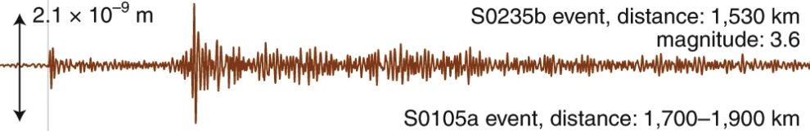
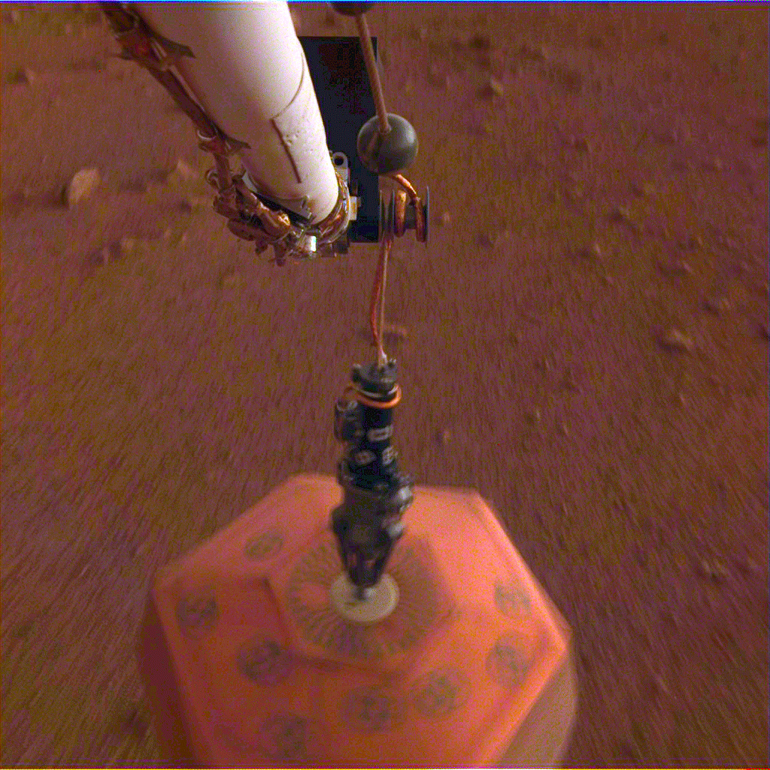
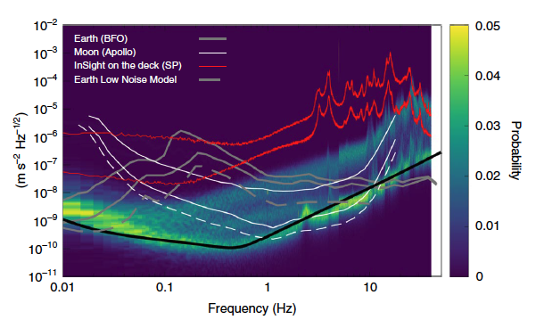
Technologic advancements in geophysical instruments
The first placement of a seismometer on the surface of an extraterrestrial body since the Apollo & Viking era.
The discovery of marsquakes and characterization of the seismicity of Mars
Seismology
Development of the InSight Very Broad Band (VBB) and Short Period (SP) flight seismometers.
Banerdt et al. (2020) Nature
Statistical Comparison of Martian, terrestrial and lunar seismic noise
VBB
VBB
SP
http://seis-insight.eu
http://mars.nasa.gov/insight
Lognonne et al. (2020) Nature
Notes:
Scientific understanding in the field of planetary geophysics has recently been advanced by the Mars InSight mission, particularly through the development of the InSight Very Broad Band (VBB) and Short Period (SP) seismometers.
InSight marked the first placement of a seismometer on the surface of a planetary body since the Apollo & Viking era, revealing the discovery of marsquakes, the characterization of the seismicity of Mars, and the first direct constraints on Mars’ internal structure.

Slide 23
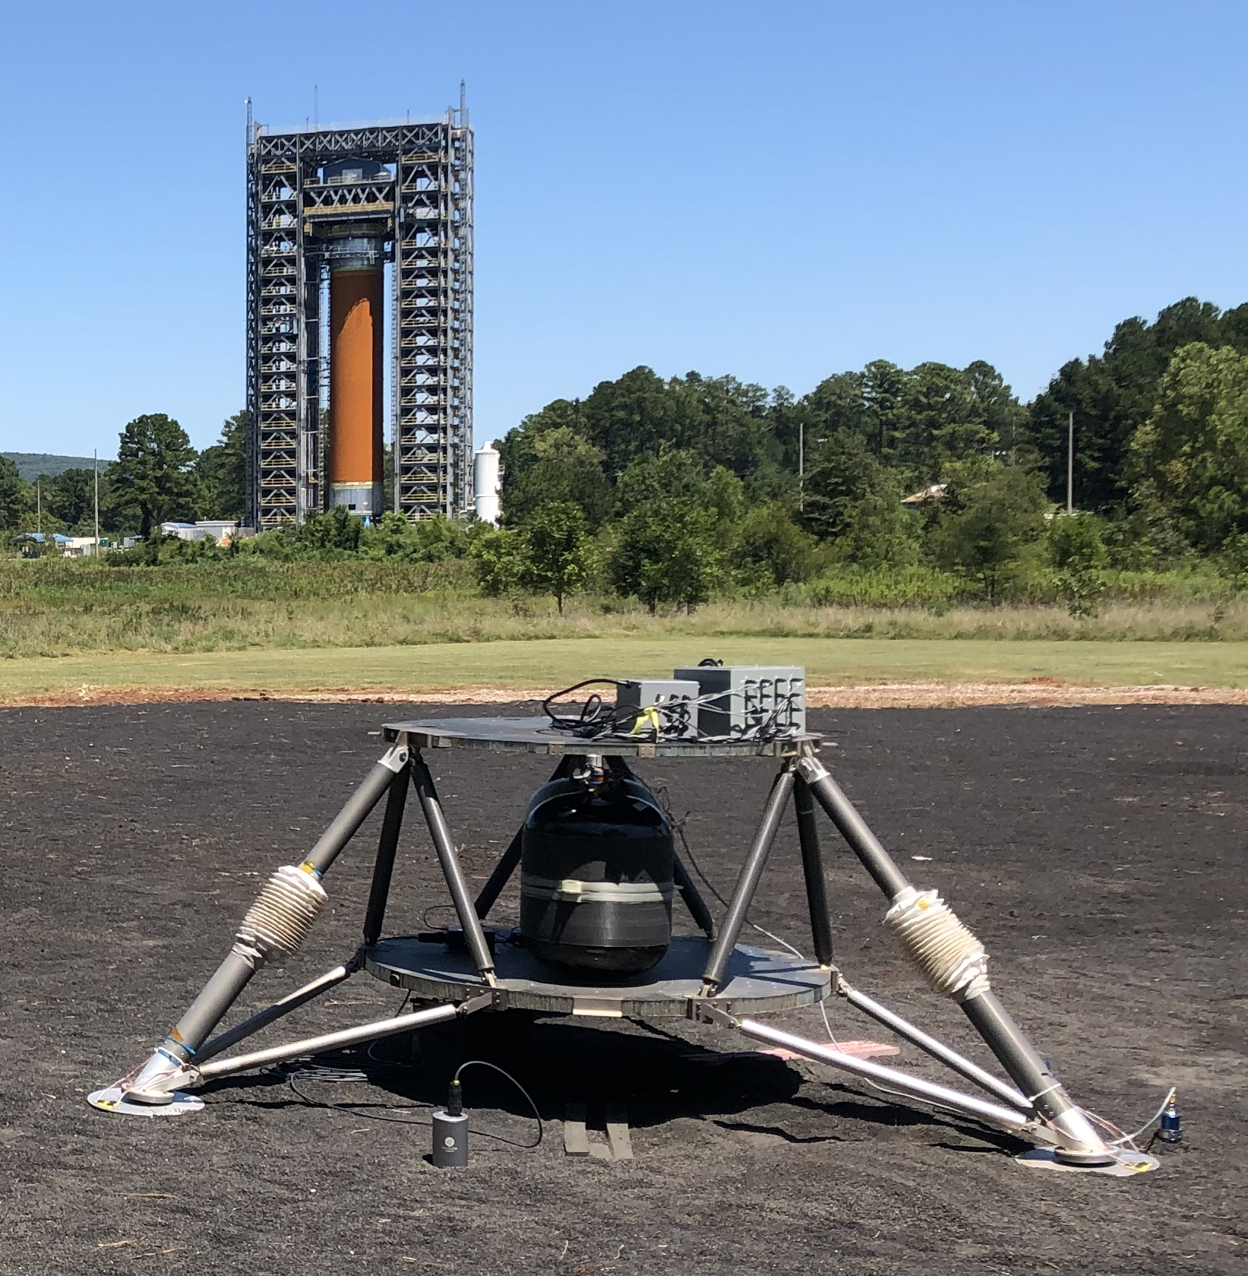
Technologic advancements in geophysical instruments
Seismology
Planetary Broadband Seismometer (PBBS) – JPL
Molecular Electronic Transducer (MET) Seismometer – ASU
Seismometer for Lunar Network (SLN) – University of Arizona
Ultra-low frequency atomic lunar seismometer – JPL
Universal MEMS Seismometer (UMS) – JPL
Notes:
LGN will of course leverage InSight’s advancements in instrumentation and methodology, and there are multiple instrument development efforts underway both for LGN and for CLPS landers.
Here is a list of the US-based seismometers, many of which are currently undergoing lab and field tests

Slide 24
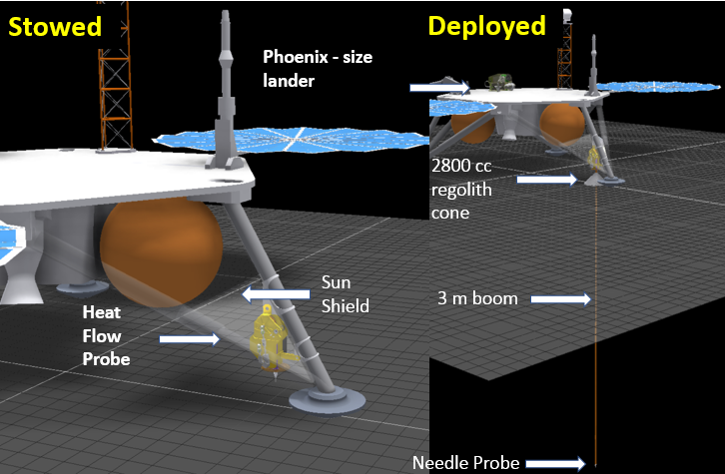
Technologic advancements in geophysical instruments
Heat Flow
We now have a heat flow instrument deployable from a small robotic lander, and it is more robust in its ability to penetrate regolith than the mole-based system used for the InSight mission.
The new heat flow instrument (LISTER) has been selected to fly on a CLPS mission in 2022.
Recent lunar orbital missions (LRO and GRAIL in particular) have global data coverage and the Arecibo Radar has near complete coverage on the near side. These data enable us to select landing sites that would maximize science return.
The Lunar Instrumentation for Subsurface Thermal Exploration with Rapidity (LISTER)
Notes:
Image source: author-generated
We now have a heat flow instrument deployable from a small robotic lander, and it is more robust in its ability to penetrate regolith than the mole-based system used for the InSight mission. It uses a jet of compressed gas to loft regolith out of a borehole that opens as the probe descends.
The new heat flow instrument (LISTER) has been selected to fly on a CLPS mission in 2022 and will reach TRL-9 in time for New Frontiers 5.

Slide 25
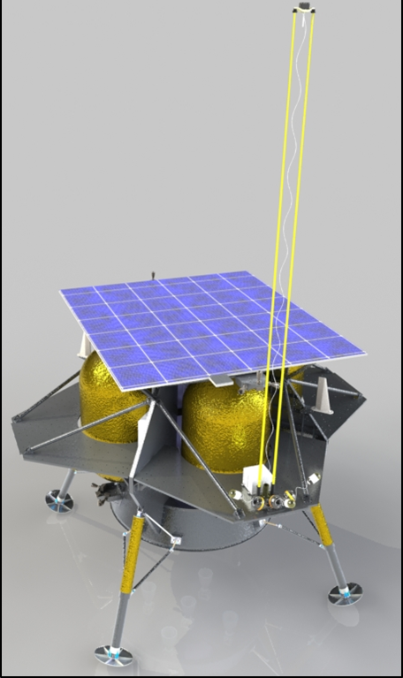
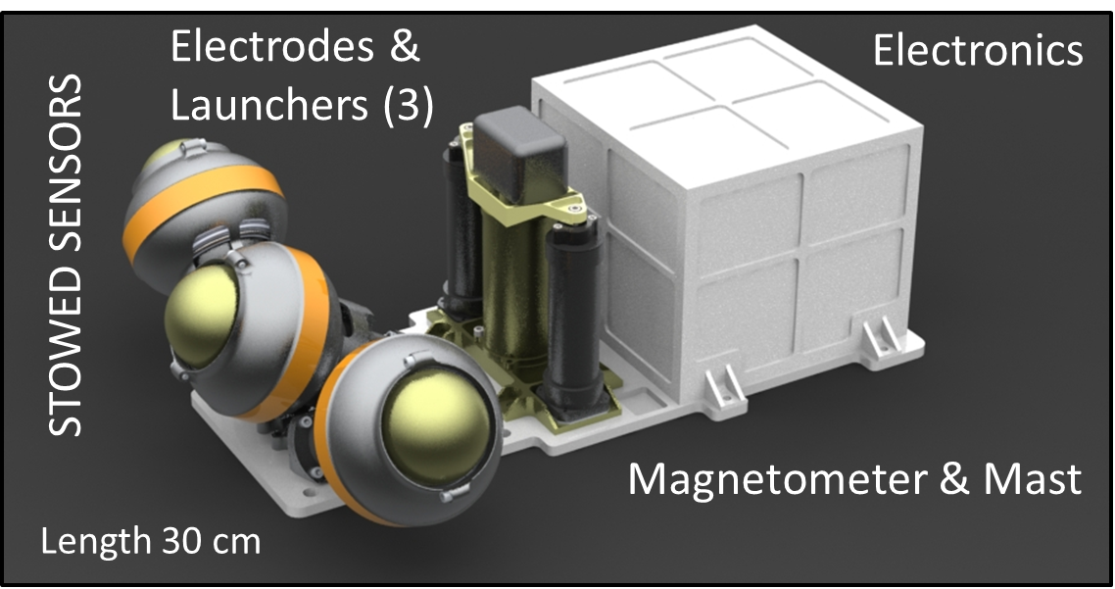
Technologic advancements in geophysical instruments
Electromagnetic Sounding
Surface magnetometer measurement must be supplemented with another constraint in order to perform EM sounding:
  Geometrical information on source field (quasi-DC fields observed by Galileo, Lunar Prospector, Kaguya).
  Direct measurement of AC source field at large distance from target (Apollo-Explorer)
Measurement of the electric field can also be done using the magnetotelluric method (MT).
  MT has been used on Earth for more than 50 years and provides soundings from a single surface station without any knowledge of the source field.
Lunar Magnetotelluric Sounder (LMS)
  Compact instrument combining fluxgate magnetometer with ballistically launched electrodes.
    Electric field determined from voltage drop across electrodes 10-20 m apart.
  Selected for CLPS flight to the Moon in 2022.
Notes:
Magnetotelluric sounding has been used on Earth for more than 50 years and provides soundings from a single surface station without any knowledge of the source field.
Lunar Magnetotelluric Sounder (LMS) is also scheduled to fly on a CLPS lander.

Slide 26
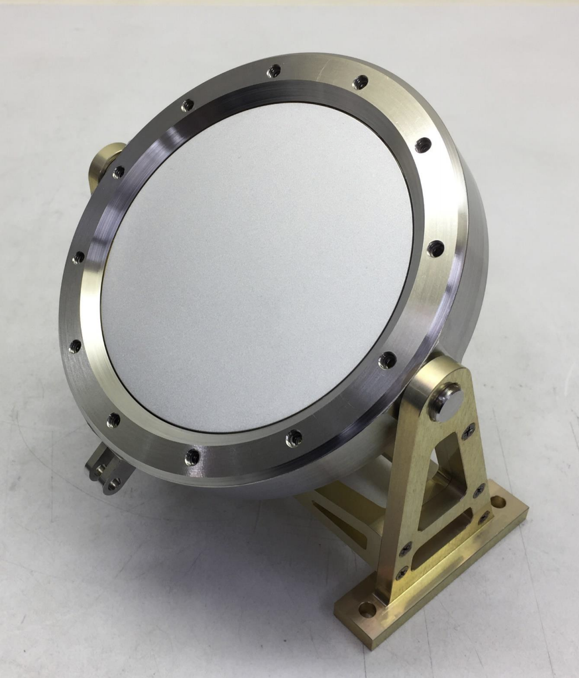
Technologic advancements in geophysical instruments
Lunar Laser Ranging
Technical Advancements
Development of Next Generation Lunar Retroreflector for CLPS lander
Upon deployment in 2022 will support factor of 100 improved range accuracy and science parameter uncertainty
Lunar Scientific Advancements
Strong tidal dissipation from partial melt at bottom 200 km of mantle. Dissipation 1/Q peaks around 3 months period
Improved shape & dissipation of liquid-core/solid-mantle boundary
Collaboration with GRAIL improves principal moments of inertia
Notes:
New laser retroreflectors also scheduled to fly with CLPS landers will support factor of 100 better range accuracy & factor of 100 better science parameter uncertainty

Slide 27
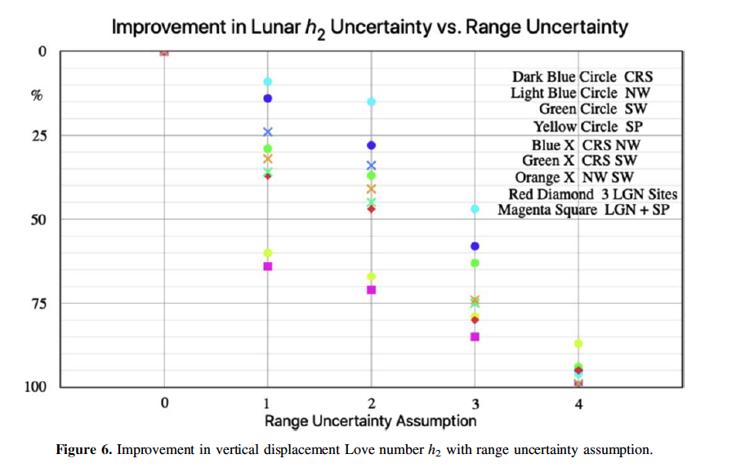
Technologic advancements in geophysical instruments
Lunar Laser Ranging
Love numbers (h, k, and l) are dimensionless parameters that measure the rigidity of a planetary body and the susceptibility of its shape to change in response to a tidal potential.
h and k characterize the overall elastic (displacement) response of the Moon to tides
Williams et al. (2022) PSJ
Notes:
New laser retroreflectors also scheduled to fly with CLPS landers will support factor of 100 better range accuracy & factor of 100 better science parameter uncertainty

Slide 28
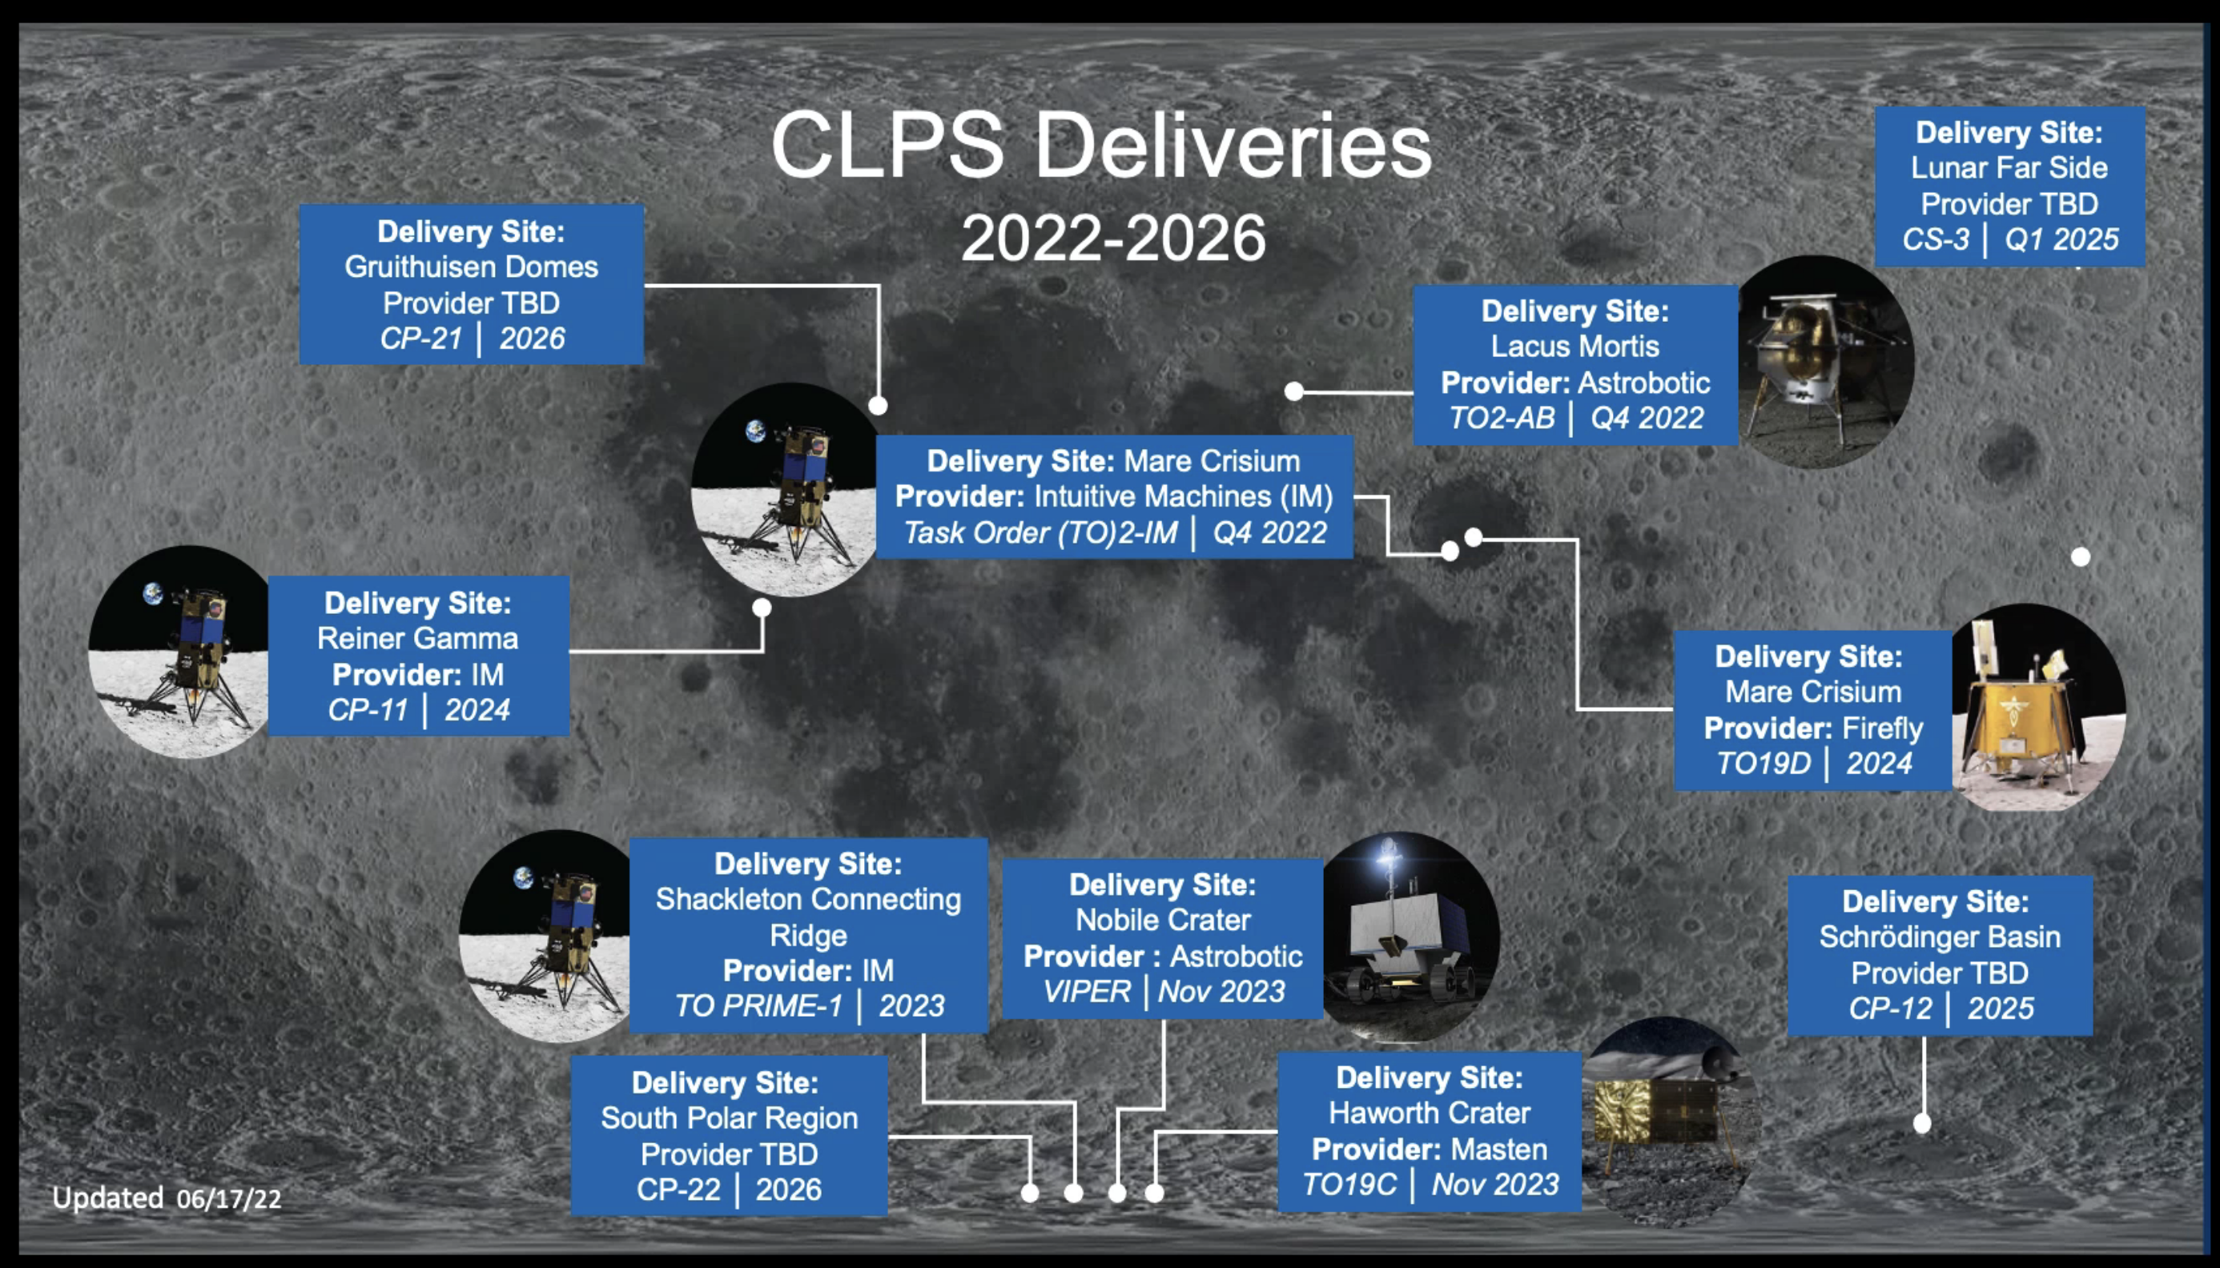
✅
✅
Notes:
Many of these instruments are slated to fly on upcoming CLPS missions

Slide 29
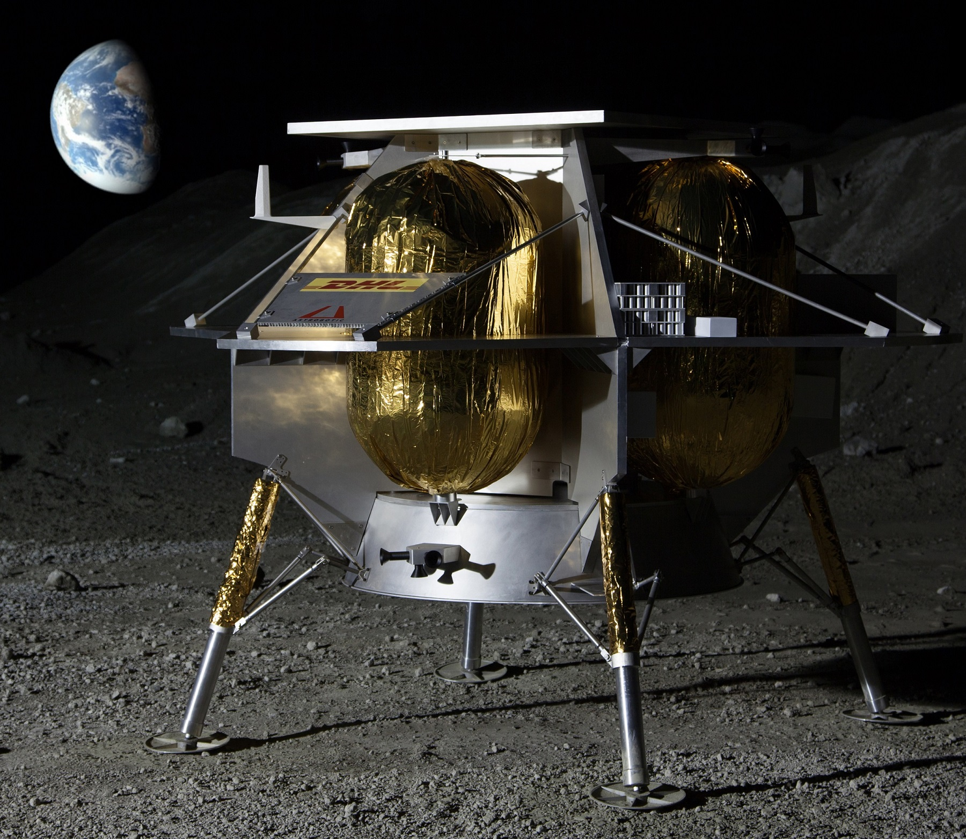
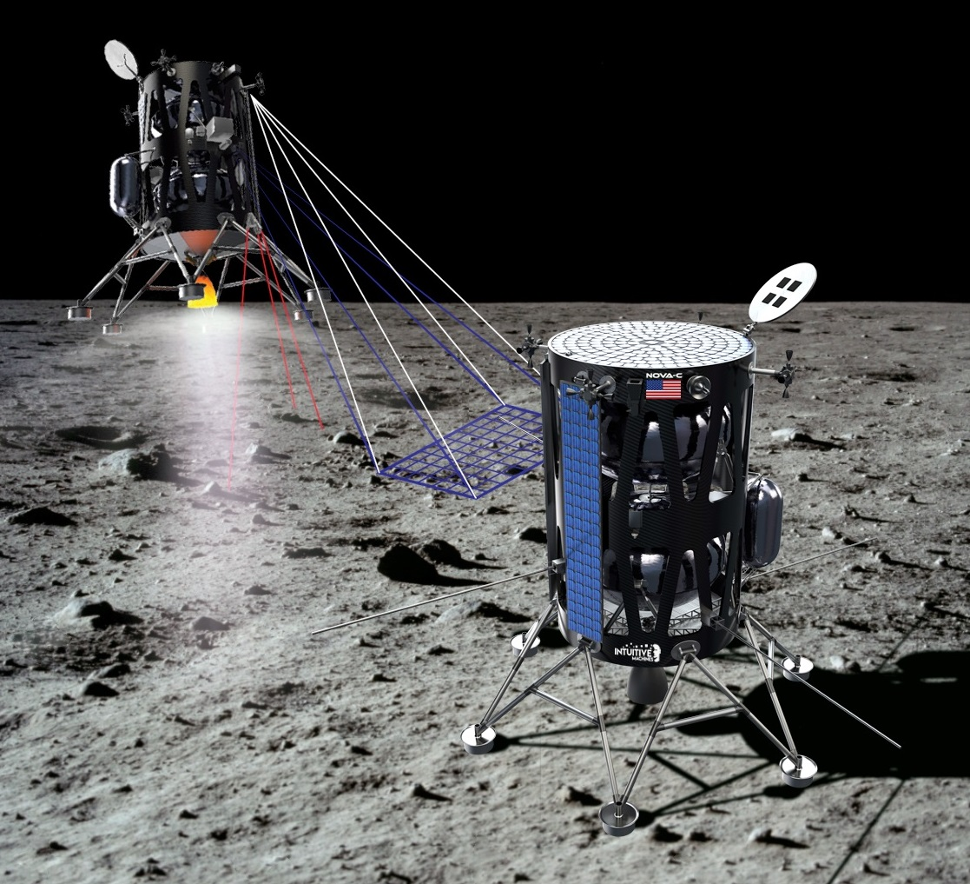
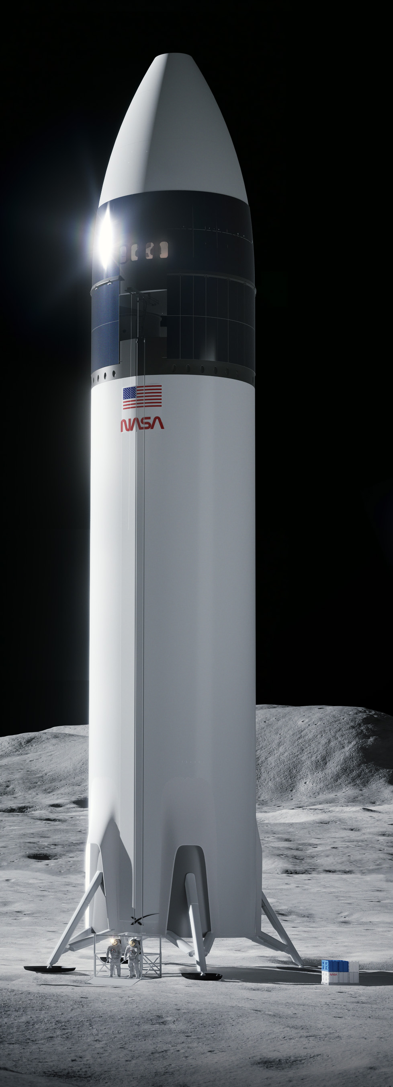
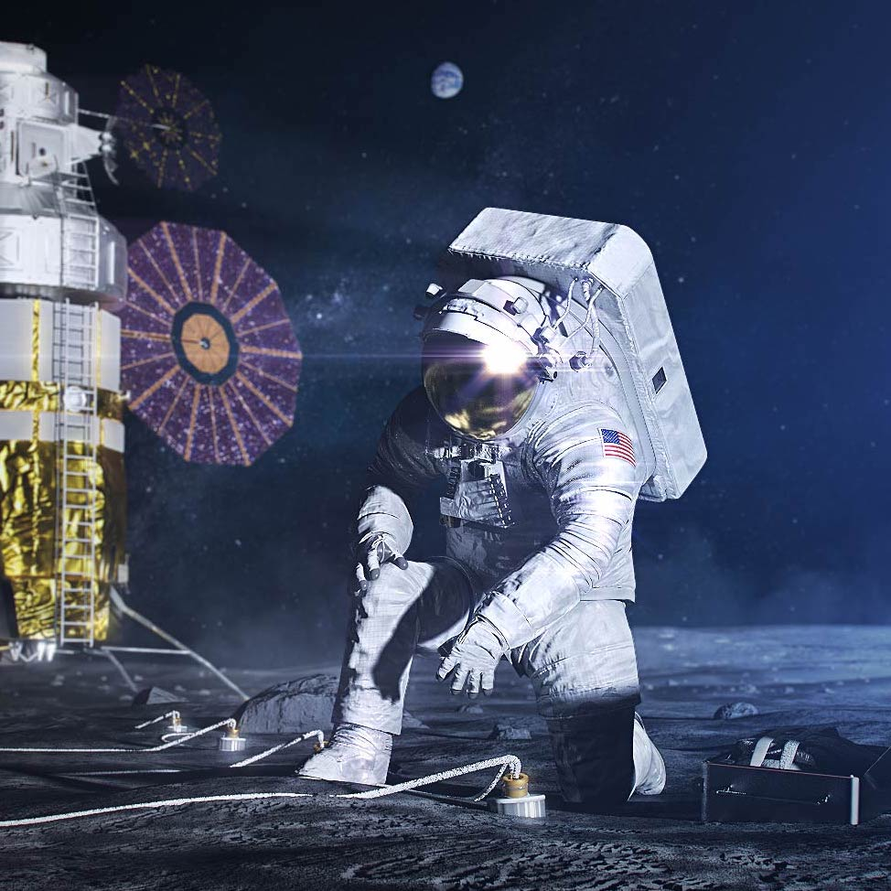
CLPS, Artemis, and LGN
Astrobotic Intuitive Machines
CLPS landers currently carry 30-50 kg of total payload and last 1 lunar day; LGN concept requires a long-lived integrated science mission
CLPS missions can enable LGN by retiring key risks, such as:
  Deployment strategy
  Lander noise characterization
  Thermal and power performance
Multiple new lander providers may eventually enable a mission like LGN to shop around and save on mission bus costs
Human-deployed instruments can further augment LGN network
Notes:
Within HEOMD, the Artemis Program is very focused on human landing on the Moon by 2024
Landing at a single site will not fulfill LGN’s network goal, but if there are opportunities to deploy a long-lived geophysical node at the human landing site, this would be enabling for broader LGN coverage

Slide 30
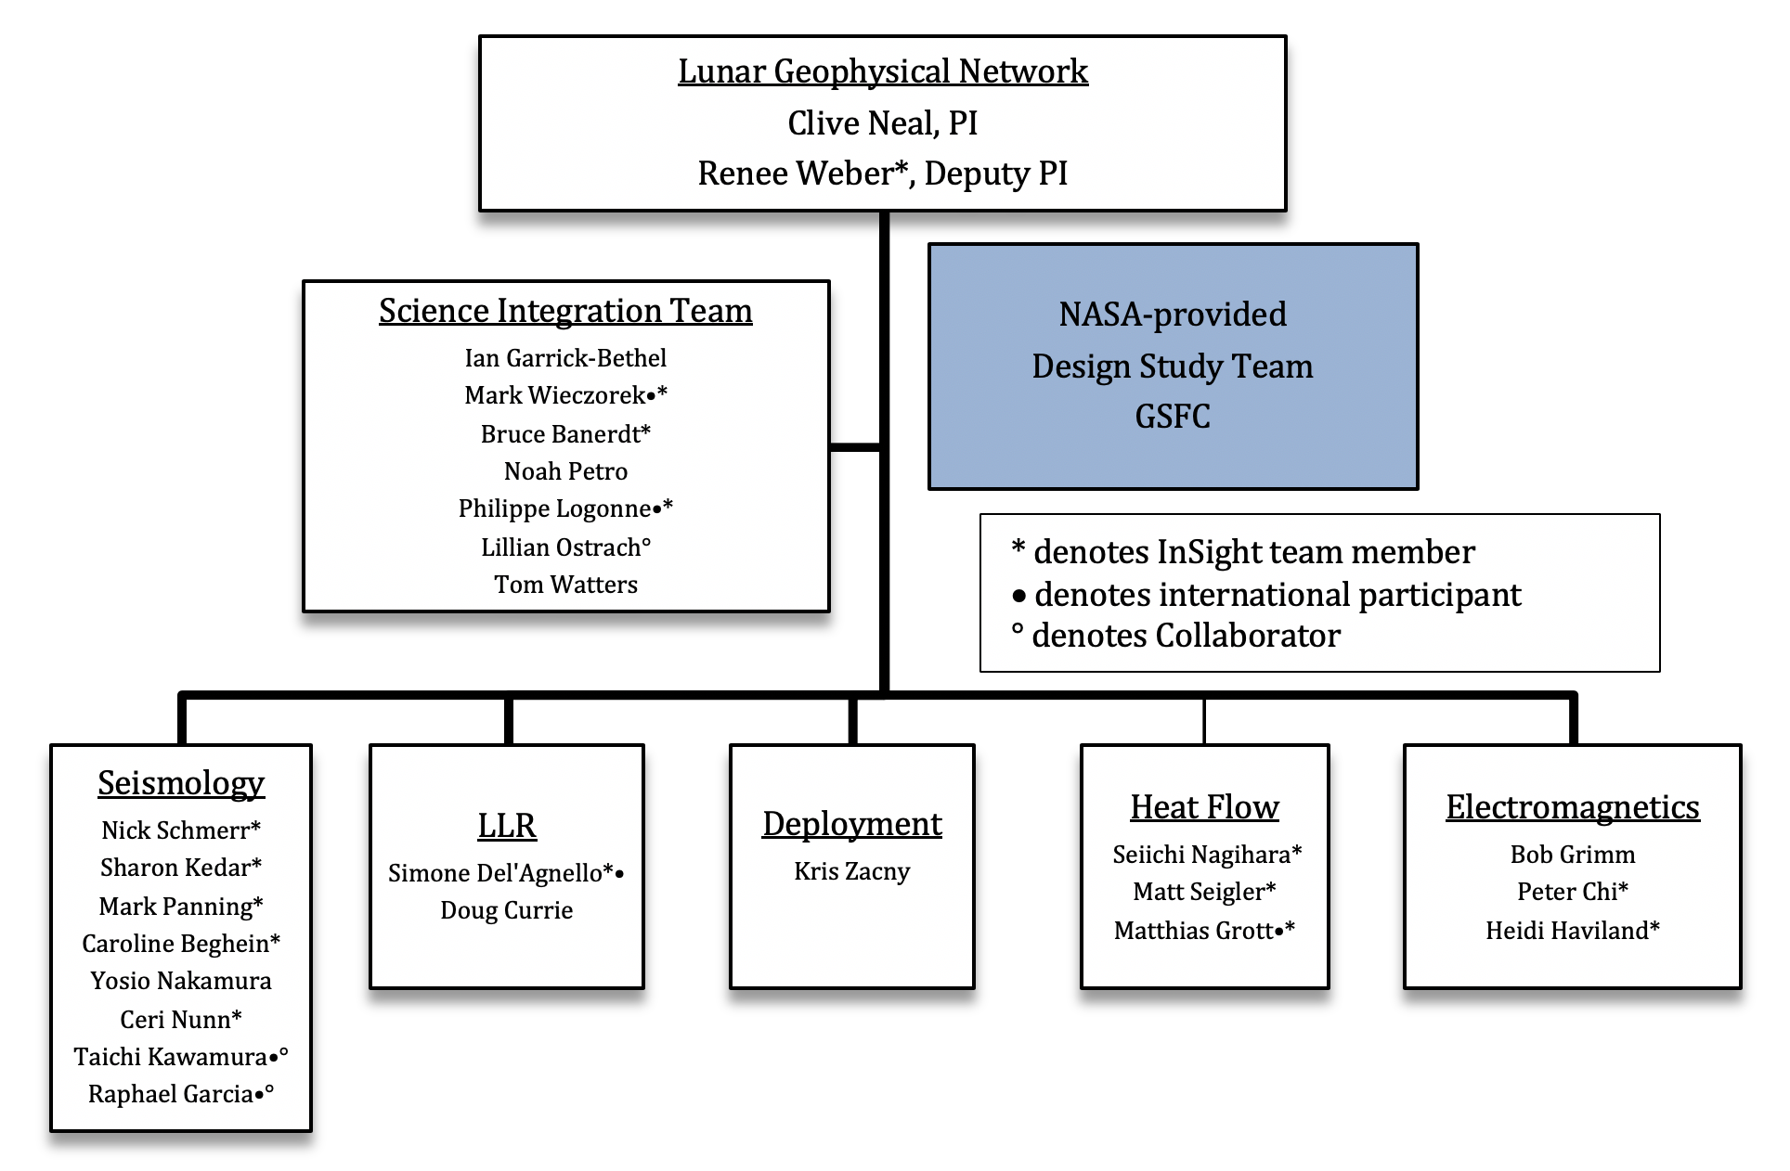
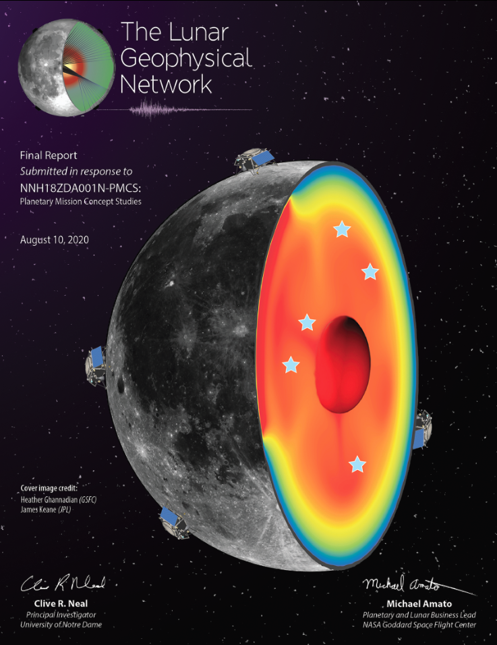
(PMCS)
Electromagnetics
Bob Grimm
Peter Chi*
Heidi Haviland*
Catherine Johnson*
Greg Delory
Jared Espley
https://science.nasa.gov/solar-system/documents
Notes:
Many of these instrument providers are part of the LGN team and contributed material to this presentation.
We recently completed a Planetary Mission Concept Study to investigate outstanding questions in lunar geophysics, which have broad relevance across planetary science
Our team consists of lunar scientists and instrument developers that have been backing LGN for decades, and includes members from both Apollo and InSight

Slide 31
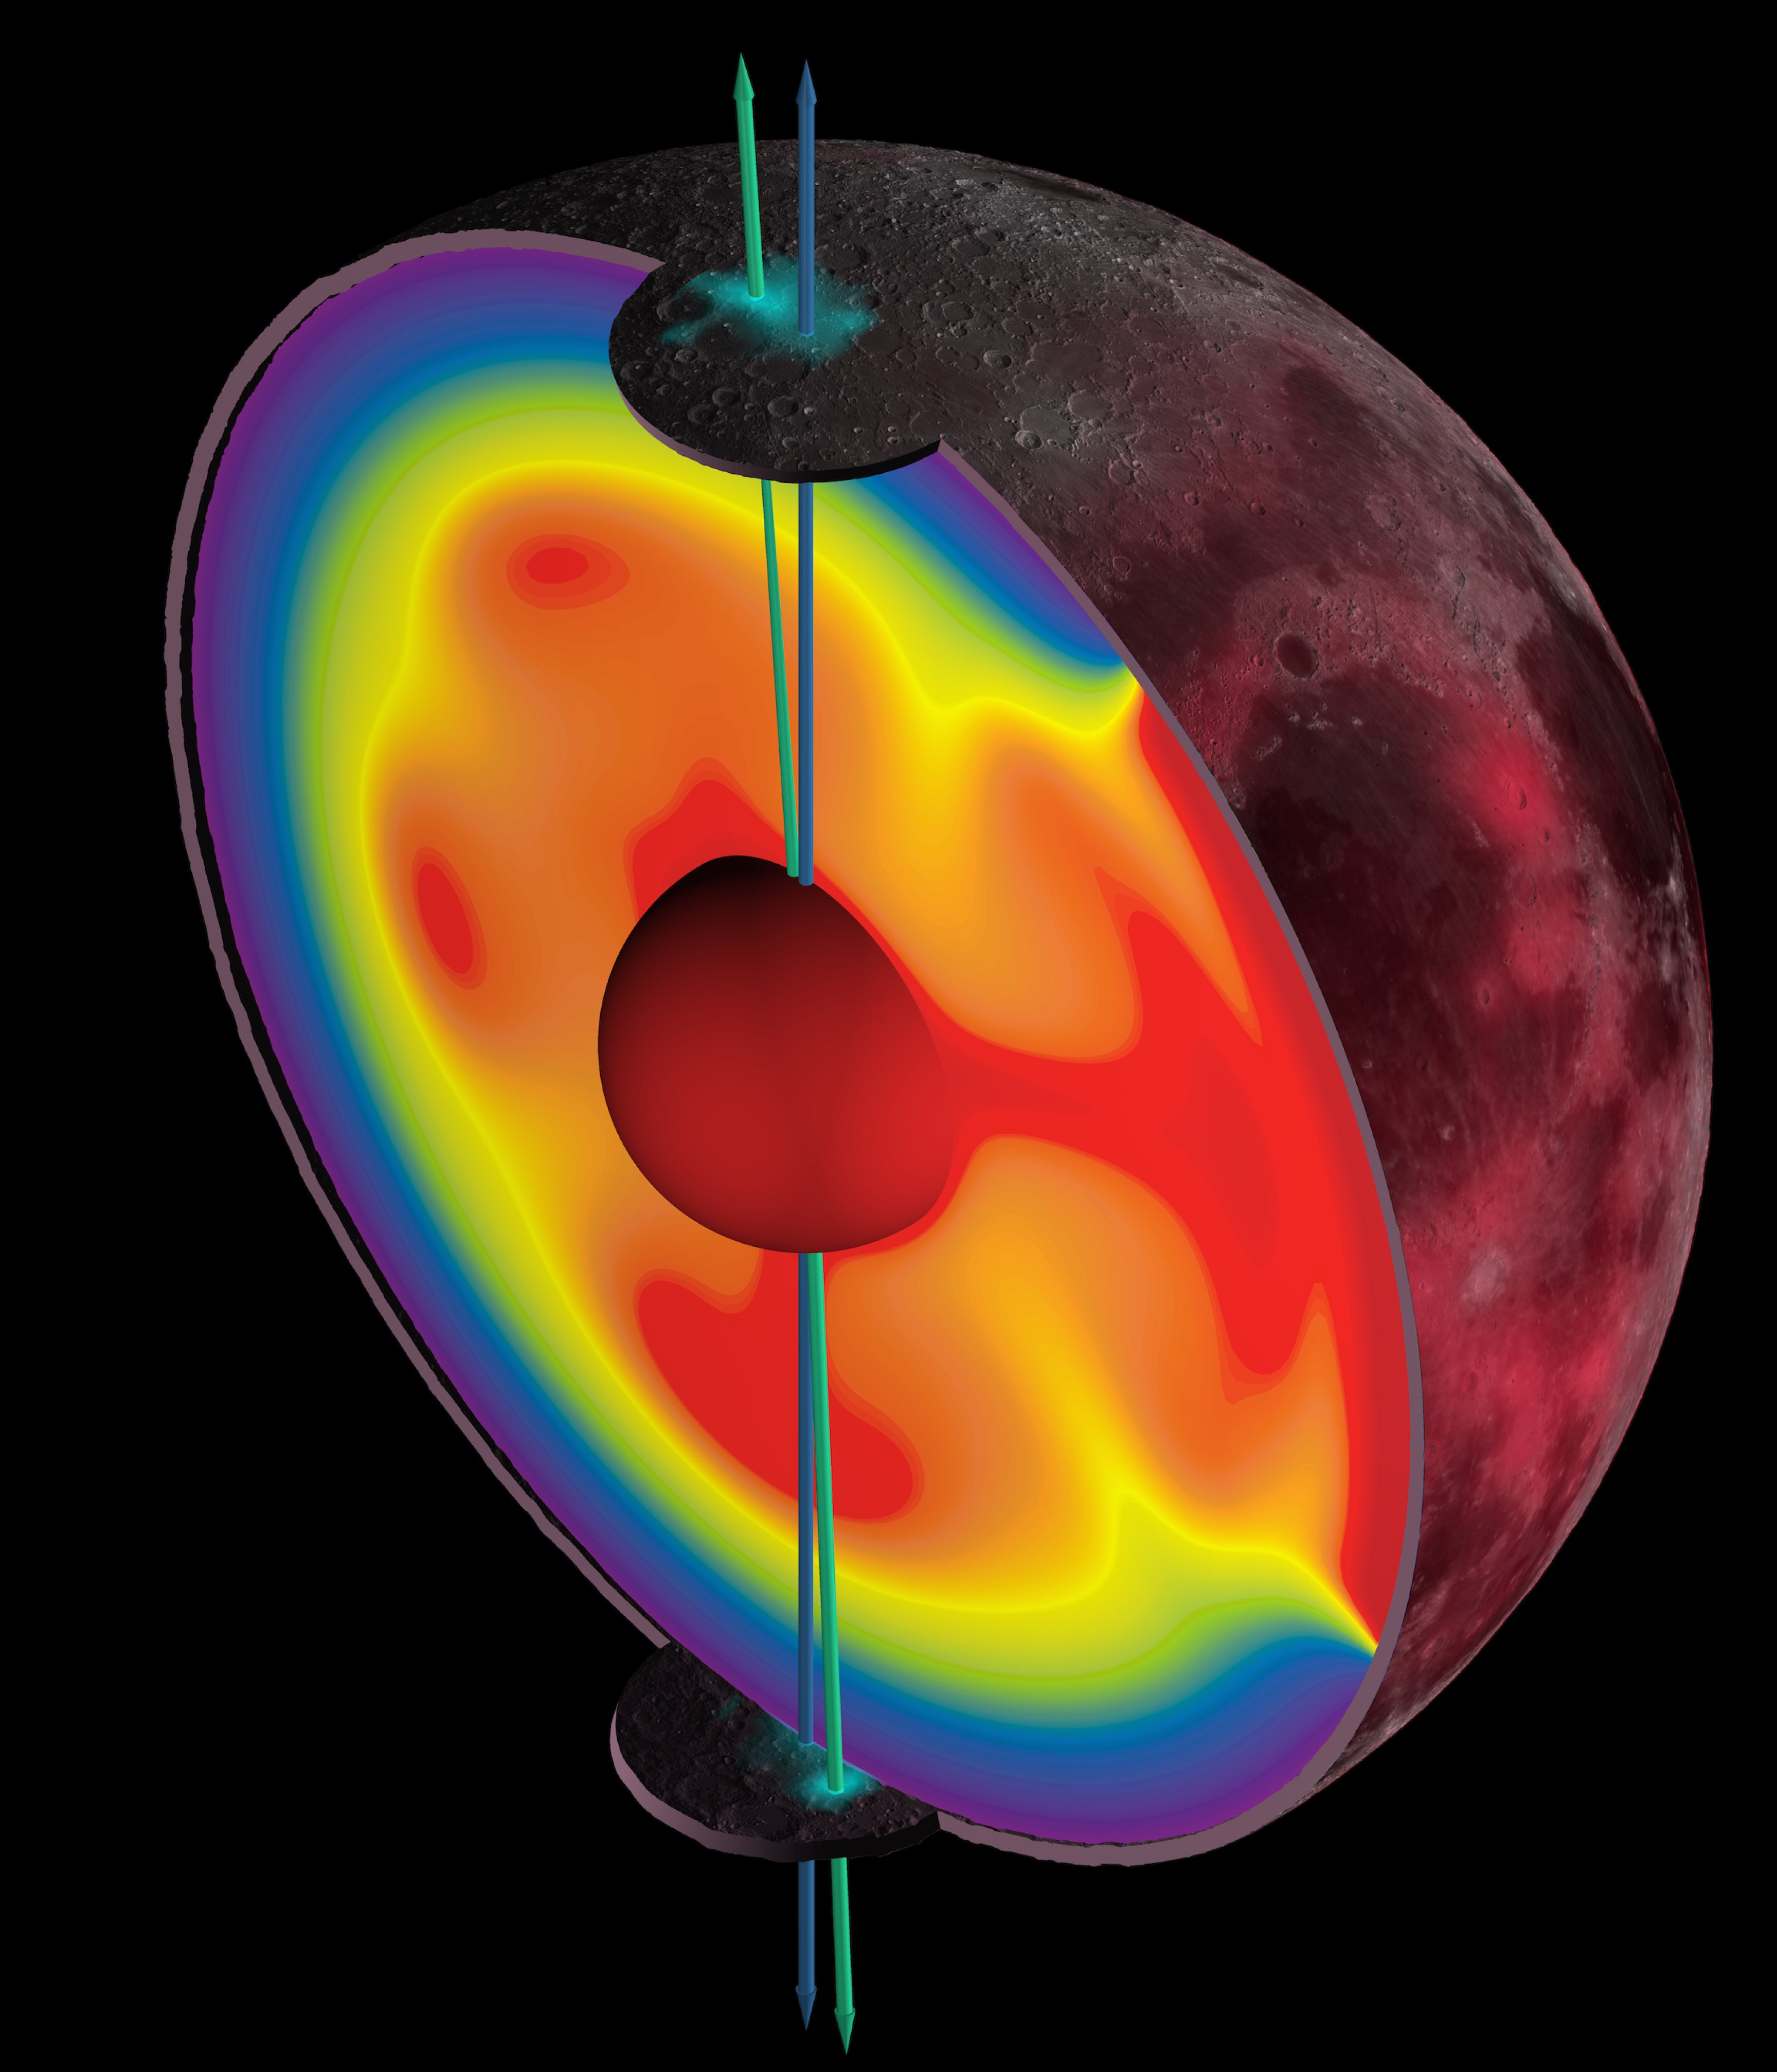

LGN Science Overview
Goal:
To understand the initial stages of terrestrial planet evolution
Objectives:
Define the interior structure of the Moon
Constrain the interior and bulk composition of the Moon
Delineate the vertical and lateral heterogeneities within the interior of the moon as they relate to surface features and terranes
Evaluate the current seismo-tectonic activity of the Moon

Slide 32


Investigations
Determine the size, state, and composition of the lunar core.
Determine the state of as well as the chemical/physical stratification in the lunar mantle.
Determine the thickness of the lunar crust and characterize its vertical and lateral variability.
Determine the thermal state of the lunar interior and elucidate the workings of the planetary heat engine.
Monitor impacts on to the lunar surface as an aid to exploring the lunar interior.
Spera (1992) GCA 56, 2253-2265
Weber et al. (2011) Science 331, 309-312

Slide 33




Secondary Mission Objectives
Secondary Science:
Characterize the present impact flux on the Moon.
Obtain fundamental information about Moon-plasma interactions
Exploration:
Evaluate the seismic hazard to human outposts on the Moon
  Document and locate shallow moonquakes & meteoroid impacts
Earth-based support facilities:
  Laser ranging telescopes;
  Telescopic monitoring of impact flashes during the lunar night.
Nakamura et al. (1974) LPSC 5th, 2883-2890

Slide 34

High-Level Mission Concept
Baseline Mission:
4 identical landers globally deployed around the Moon.
Long-lived: 6-year mission with a goal of 10 years.
Will allow other nodes to be added to strengthen science return (cf. the International Lunar Network).
4 landers launched together, deployed
sequentially.
1
3
4
2
Threshold Mission:
2 identical landers deployed at 1 (young mare basalt P-60) and 2 (Schickard Basin – antipodal to A33).
2 sites distinctly in different terranes.
Sites detect deep moonquakes from farside A33 nest (core and mantle structure).
Expand the LRR network.
Deep EM sounding beneath distinct terranes.
The parent spacecraft = communications relay for all landers.
Each lander will be able to send data direct to Earth, so the communications relay orbiter acts as a back-up for near side landers.

Slide 35





LGN Payload Components
Lander Instrument Suite:
One 4-axis very broad band (VBB) and one 3-axis short period (SP) seismometer beneath each lander.
Heritage: InSight
One 3-axis SP seismometer on the deck of each lander.
Heritage: InSight
1 buried Silicon Audio SP seismometer + 3 MEMS sensors deployed from one of the legs.
Heritage: DALI Program
2 heat flow probes (LISTER) deployed from two lander legs.
Heritage: CLPS (2022)
2 laser retroreflectors (1 on lander deck, 1 on lunar surface).
Heritage: CLPS (2022).
1 Lunar Magnetotelluric Sounder Suite (LMSS): 4 electrodes deployed around lander. Fluxgate and searchcoil magnetometers on booms. Electrostatic analyzer on deck.
Heritage: CLPS (2022).
Cameras: 1 Panoramic Camera and 3 Close-up Imagers
Heritage: Curiosity
LRR
Buried SP
VBB
LISTER
LMSS

Slide 36

Lander concept

Slide 37

Mission Architecture – Falcon 9 Heavy Fairing

Slide 38
Key driving requirements
Class B
6 year mission life, 10 year goal
Threshold mission: No orbiter, 2 landers on near side (P-60 & Schickard sites)
0.5m ground clearance
Communication asset is in orbit
Under-body mounted instruments must be protected from thrusters/plume
Need thermal control for seismometer (shadowed or shielded)
Landing constraints:
  Retroreflectors must be gimbaled and point within 1 degree at Earth
  Fixed cameras can’t be sun blinded
  Avoid 0.5m rocks (orbital resolution is 1m)
  Handle 10% grade (0.5m rock over 5m leg span)
Night/day operations allowed to be different, but data taken 24/7/365(6)

Slide 39

Mission overview
Four landers to permit global distribution (including the far side) and allow for redundancy
Long-lived (6 years with a goal of 10 years) to maximize science and allow other nodes to be added by international/commercial/HEO partners during the lifetime of the mission, thus increasing the fidelity and value of the data obtained.
Landers will be deployed sequentially from a parent spacecraft.
Comm relay will remain in orbit, allowing a lander to be placed on the far side.
Each lander will also be able to send data direct to Earth, so the communications orbiter acts as a back-up for near side landers.
https://science.nasa.gov/solar-system/documents

Slide 40

Landing sites
Notes:
Discrepancies in size (and nature) of the lunar core, mantle, & crust defined by seismic, laser ranging, and GRAIL data reflect lack of fidelity in Apollo seismic & ongoing laser ranging data.
Issues:
Heat flow was only at 2 locations (15/17), both were close to the PKT-FHT terrain boundary, that we now know have different crustal signatures.
Magnetometers deployed at 3 sites (12/15/16) but not networked. Apollo 12 magnetometer and Explorer 35 satellite jointly conducted low-frequency electromagnetic sounding of the mantle. This is in PKT only.
The passive seismometer network had a narrow aperture on the nearside, so global crustal and the deep structure of the Moon has not been resolved.
Retroreflectors were placed on the central nearside and require sites towards the limbs in order to add fidelity to the current data (including inner core constraint).
Far-side unsampled
Landing sites carefully selected to expand Apollo’s footprint and meet measurement requirements for substantial improvement in our understanding of the Moon’s internal structure

Slide 41

In conclusion
Lunar science is Solar System science
The so-called “ancient” planets, including the Moon, retain more information about their early interior structure, and are ideal bodies to explore to advance our understanding of all terrestrial planetary formation and evolution.
Community support for LGN is high
LGN is named as a priority New Frontiers mission in the current planetary decadal survey (2013– 2022)
"The scientific rationale in V&V for the LGN has not changed, and if anything has become more compelling”
- Report Series: Committee on Astrobiology and Planetary Science Options for the Fifth New Frontiers Announcement of Opportunity (2020)
LGN is endorsed by the Lunar Exploration Analysis Group
“NF5 is nominally scheduled to include a lunar geophysical network, and LEAG affirms the importance of such a mission for lunar and Solar System science”
- 2019 LEAG Meeting findings
The Moon is NASA’s current exploration focus
LGN helps constrain seismic risk from moonquakes and impacts

