Slide 1



ISVAR: In-Situ Validation of Augmented Reality
Sarah M. Lehman, PhD
NASA Langley Research Center
DARPA Forward Conference | Sept. 13-14, 2022 | Washington State University

Slide 2
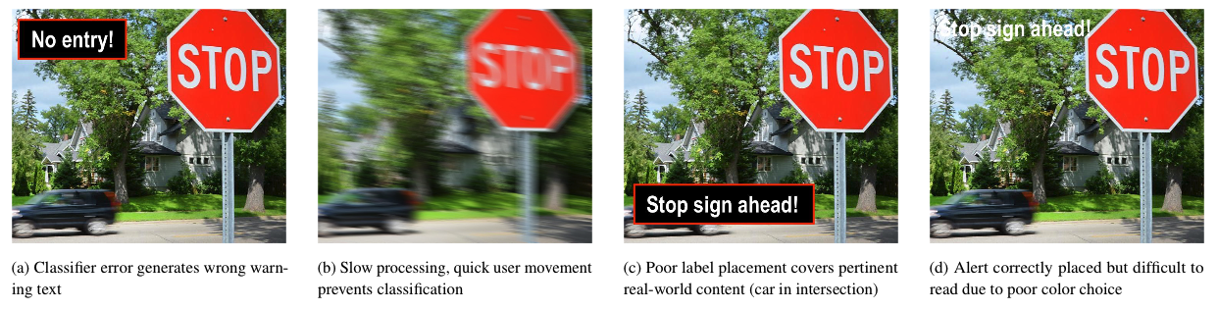
Problem Overview
How to gracefully handle open-ended (and potentially adversary-accessible) use case scenarios for AR systems in the wild?
  AR systems in the wild are exposed to a near-infinite range of conditions
  Need to detect when system is responding to these conditions incorrectly
How to collect, parse forensic data to debug issues (attacks)?
  Something has gone wrong, now we want to fix it
DARPA Forward Conference | Sept. 13-14, 2022 | Washington State University

Slide 3
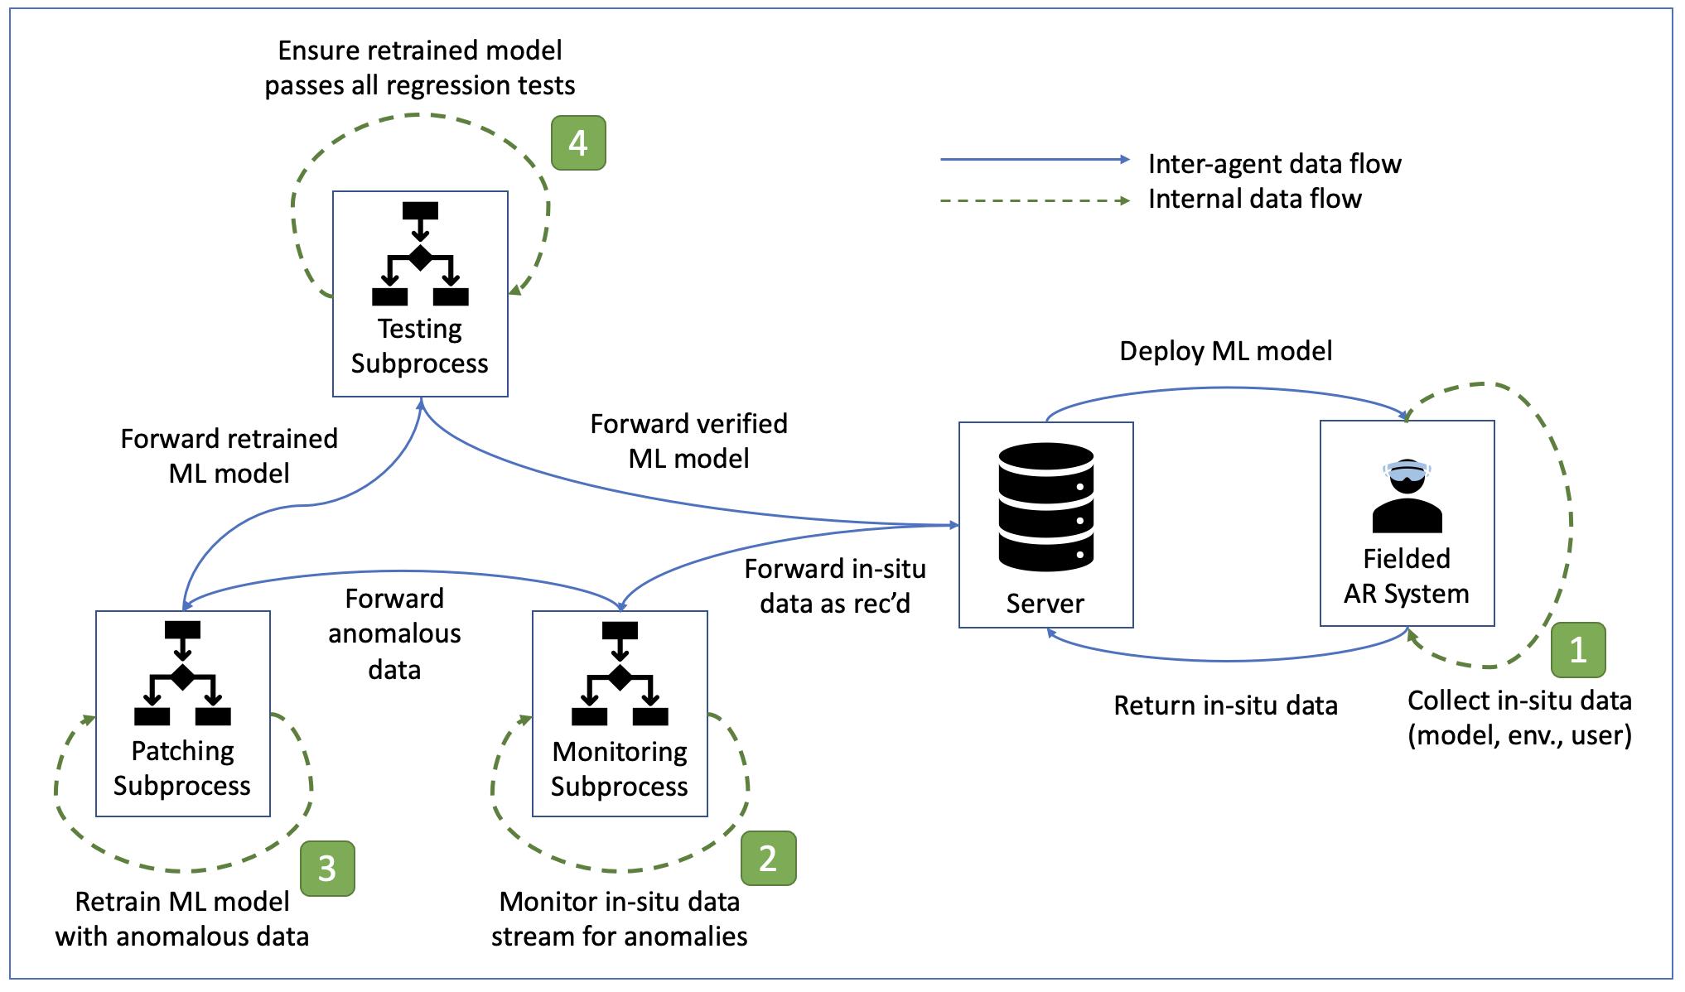
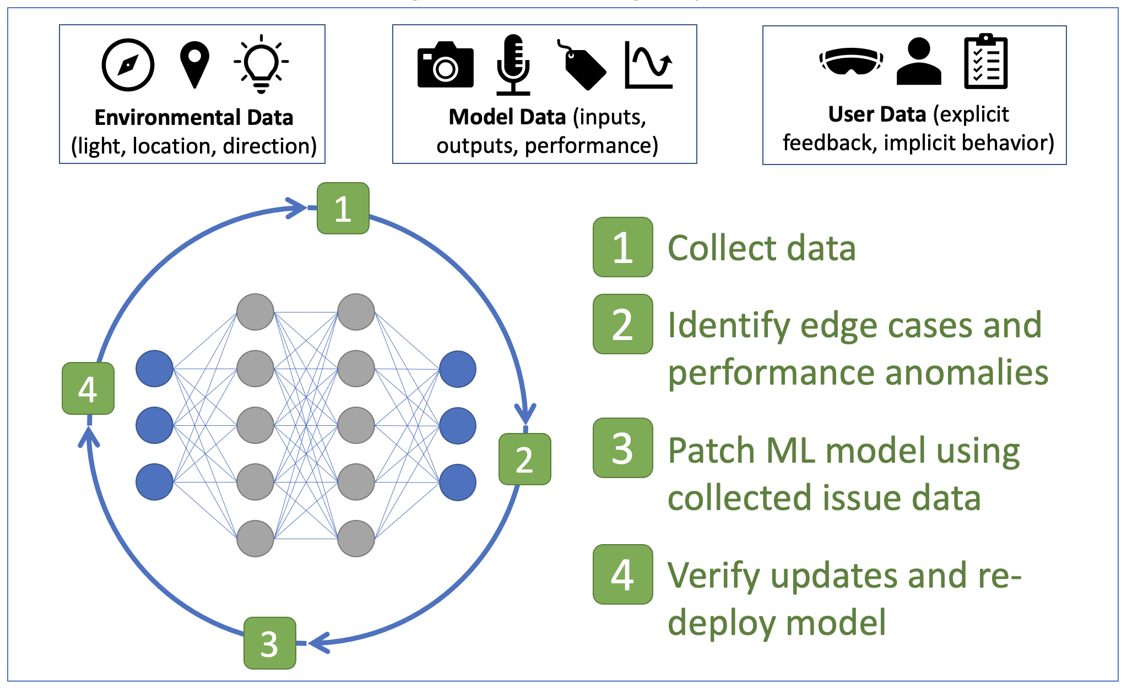
ISVAR
Framework
Collect data
Identify edge cases and runtime anomalies
Patch ML model with issue data
Verify updates and re-deploy model
Conceptually simple but flush with research opportunities!
Phase | Discipline
1 | Human Factors, Optimization, Security
2 | Machine Learning, Software Engineering, Security
3 | Machine Learning
4 | Software Engineering
DARPA Forward Conference | Sept. 13-14, 2022 | Washington State University

Slide 4
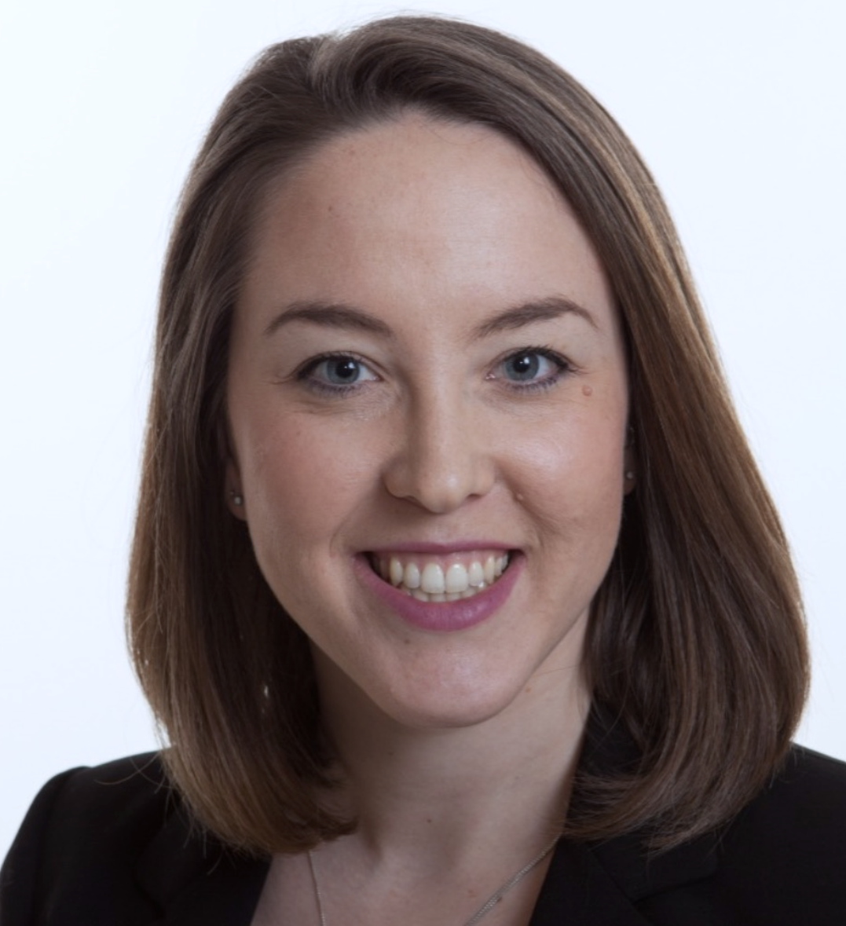
Thank you!
Sarah M. Lehman, PhD
Research Technologist
Safety-Critical Avionics Systems Branch
NASA Langley Research Center
sarah.lehman@nasa.gov
Please reach out if you are interested in ML testing, security, and safety assurance!
DARPA Forward Conference | Sept. 13-14, 2022 | Washington State University

