Slide 1

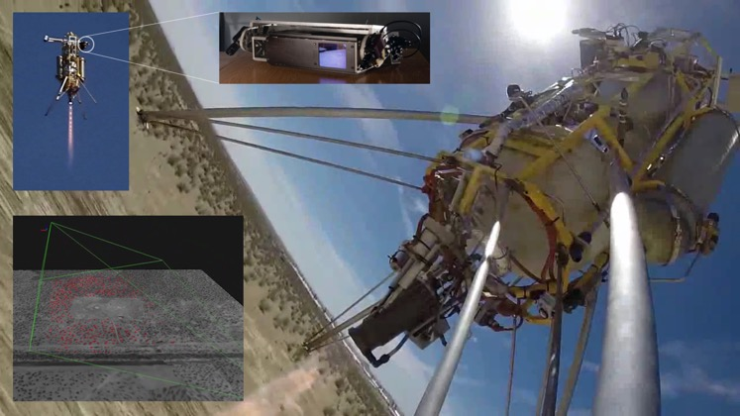
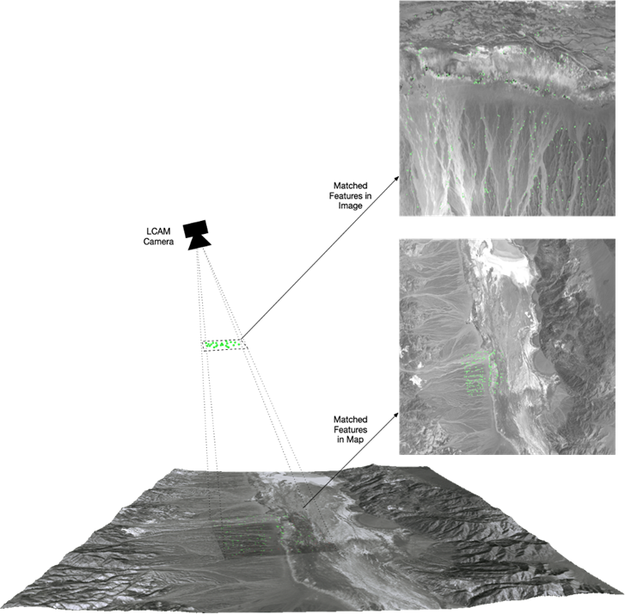
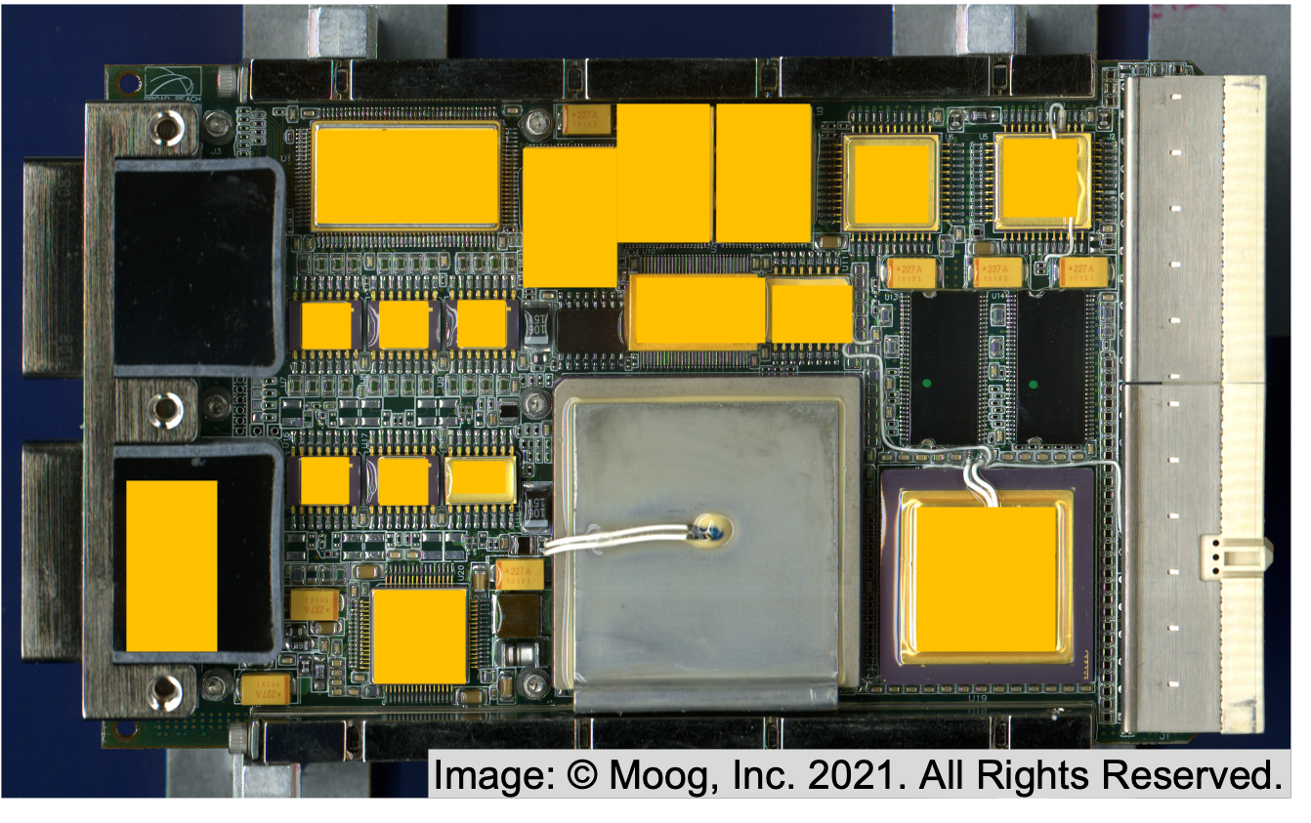
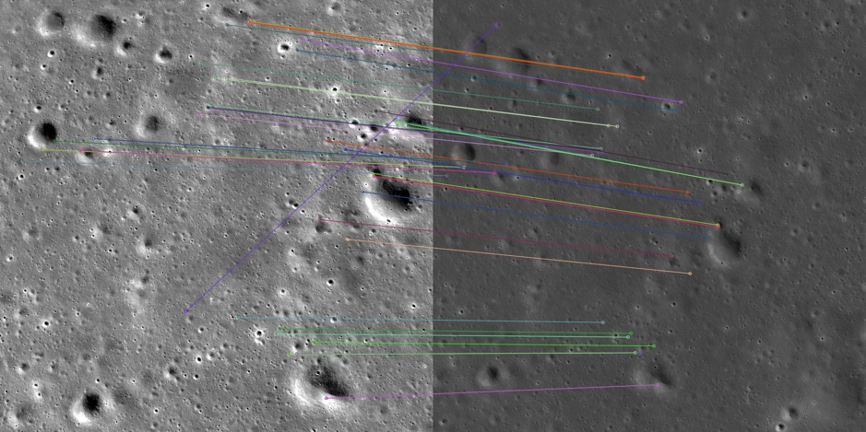
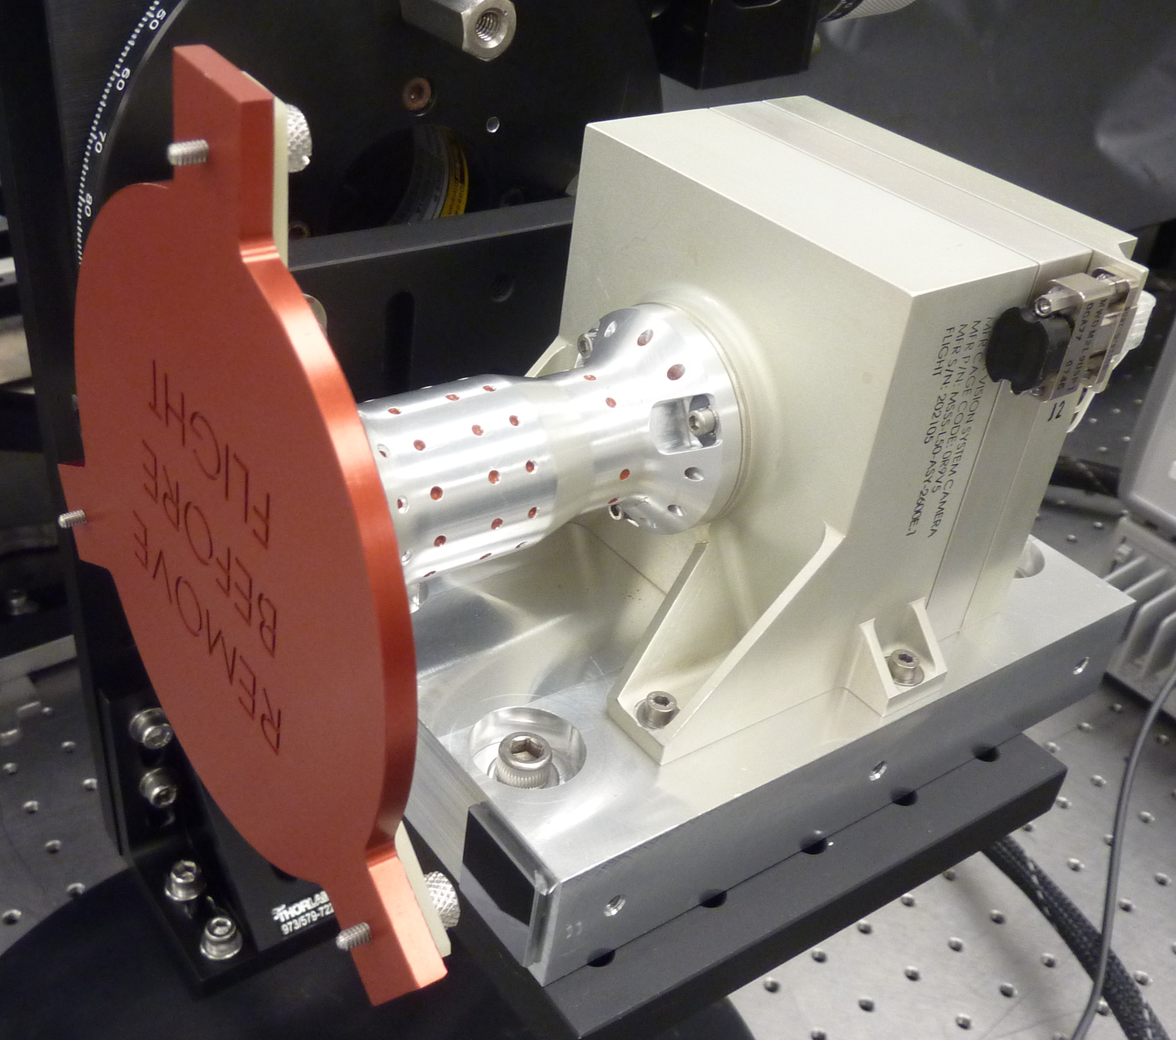
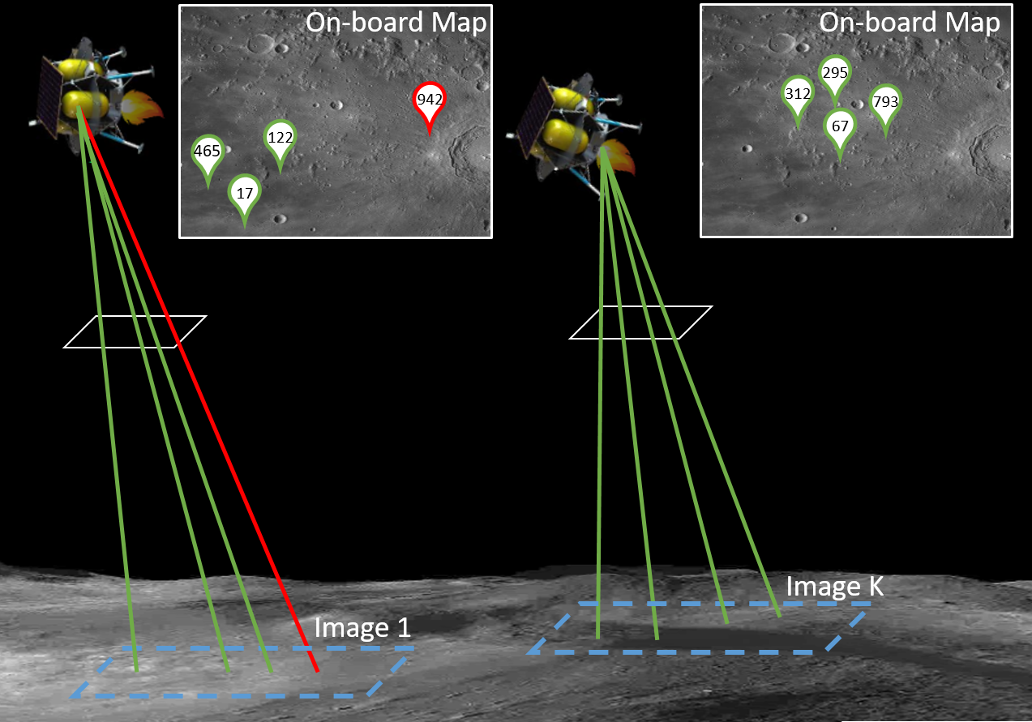
Space Technology Mission Directorate
Game Changing Development Program
Andrew Horchler | Kori Hough | FY22 Astrobotic TRN Annual Review Presentation | 09.16.22
Name/Email POC: andrew.horchler@astrobotic.com

Slide 2
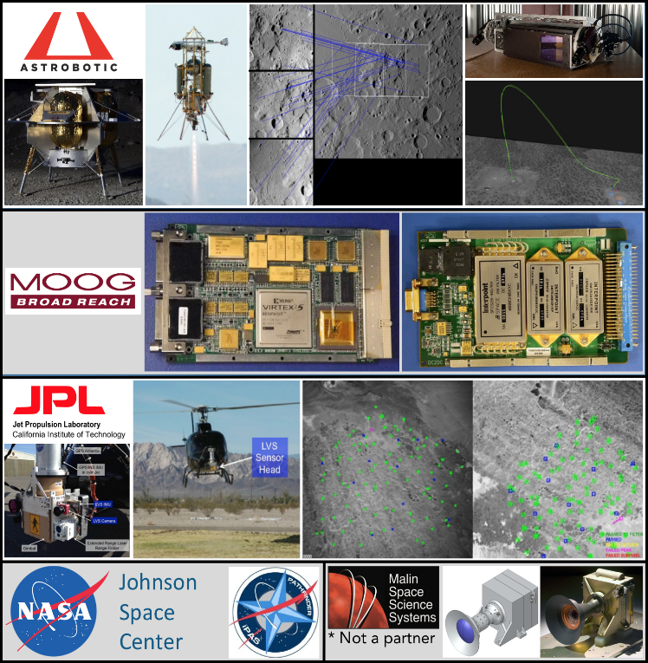
Astrobotic TRN – Project Overview
Technology Product Capability
  Commercial bolt-on Terrain Relative Navigation (TRN) sensor system to enable 100-m precision planetary landing by estimating spacecraft pose relative to an onboard map
  Builds on Astrobotic’s and JPL’s prior TRN systems
Technical Capabilities
  Enables robust 100-m precision planetary landings
  Unique signature-based algorithms facilitate lander integration
  System includes:
    High-performance standalone TRN sensor
    Hardware-accelerated TRN algorithms that work on Moon, Mars, Earth and beyond
    Accurate lunar map generator and tools for TRN analysis
    Fast, high-fidelity lunar simulator for hardware-in-the-loop testing
Exploration & Science Applicability
  Vision-based precision planetary landing technology
  Algorithms demonstrated to work at Moon and Mars
  Enabling capability for science and business objectives
  First Astrobotic TRN sensor will fly on Astrobotic’s Peregrine lunar lander launching in 2022
GCD FY22 Annual Review

Slide 3

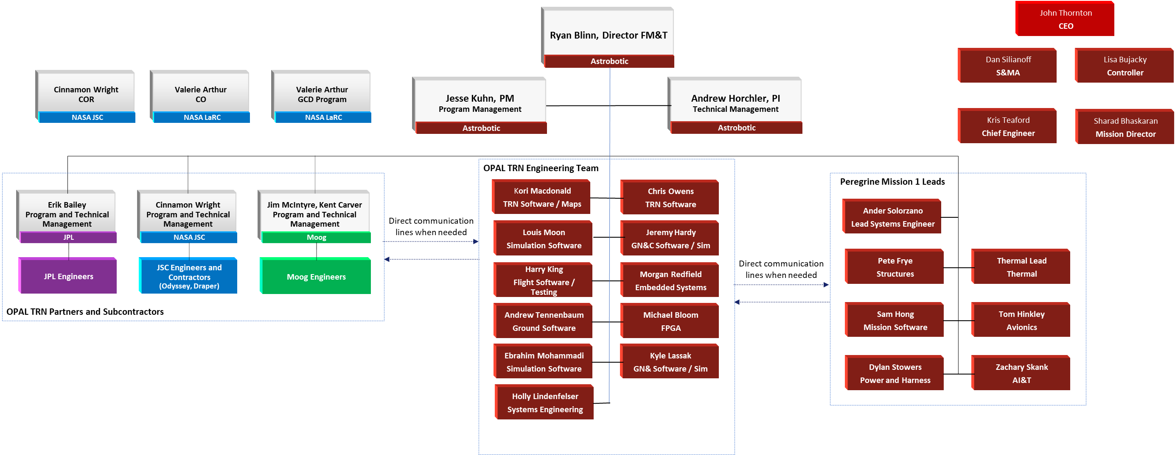
Team Members / Project Org Slide
Wade May
Notes:
If you have submitted a Project Plan, you could utilize the Organizational Chart found in section 8.3 – Management Structure

Slide 4
Collaborations & Partnerships
Contributing Partners and/or Stakeholders
  Astrobotic Technology, Inc.
  Moog, Inc.
  Jet Propulsion Laboratory
  NASA Johnson Space Center
Infusion/Transition Plan
  Goal: Develop a product and a complete toolchain, not just an internal capability
  Leveraging Public-Private Partnerships via Tipping Point to capture prior NASA tech investments
  Transfer Mars 2020 LVS + Feature Descriptor IP Implementation to Industry
  JPL Consulting on software approaches based on Mars 2020 LVS expertise
  Flying TRN Sensor on Astrobotic Peregrine Mission 1, the Griffin-VIPER mission to the South Pole, and on future commercial missions
  OPAL Sensor’s high reliability design suitable for missions beyond the Moon
  Partnering with other companies to provide TRN capabilities
  Pitching to DoD agencies and primes to adapt technology for defense applications
  Internal R&D program supported by Phase II SBIR (GSFC) to port Astrobotic’s TRN software to lower SWaP-C hardware

Slide 5
Standalone Sensor for High Precision Planetary Landing
Technology Goals & Project Objectives
Technology Goals
Goal #1 | Develop a TRN sensor (and supporting systems) and raise it to TRL 9. TRL 9 is interpreted as “flight-proven” through a successful demonstration of the OPAL Sensor in a flight to the Moon.
Goal #2 | Provide the capability to estimate and log absolute spacecraft pose from the initiation of powered descent to the initiation of terminal descent in order to enhance the absolute position knowledge of the spacecraft. The goal is a final touchdown accuracy of 100 m during future closed-loop lunar landings for realistic lunar trajectories (sufficiently lit surface, pointed at surface, spacecraft capable of divert maneuvers, etc.).
Project Objectives – Technology Demonstration Mission
Objective #1 | Integration – The OPAL Sensor shall be integrated with the Peregrine lander (referred to as the spacecraft herein) no later than three months prior to launch.
Objective #2 | Functionality – The OPAL Sensor shall estimate and log absolute spacecraft pose from the initiation of powered descent to the initiation of terminal descent.
Objective #3 | Performance – The OPAL Sensor shall enhance the spacecraft absolute position knowledge.

Slide 6
Astrobotic TRN Sensor (OPAL)
TRL Progression
Project Milestone
GCD (Key) Milestone
Controlled Milestone
TRL/SRL/MRL Progression
FY19 | FY20 | FY21 | FY22 | FY23
Ops
9
8
Terrestrial Flight Test
7
TRL
Launch (TBD)
HWIL IV&V
6
Lander
Integration
5
4
Project
Start
SRR
PDR
PAR
CDR
FRR (TBD)
Final Report
Notes:
Chart purpose: show TRL/SRL/MRL advancement over the project lifecycle schedule. Show TRL advancements as whole integer increases. Show how Key and Controlled milestones align with TRL advancement.
TRL/SRL/MRL may not advance at each milestone. Often several milestones are required to produce a step increase in TRL/SRL/MRL.
There can be one, or more, of these charts per project as needed.
For projects with fewer technical elements, the TRL/SRL/MRL data can be combined on one chart.
For more complex projects, the TRL/SRL/MRL progression can separated into multiple charts by project technical area.
Show TRL, SRL, and MRL data for each technical element on the same chart.
Delete TRL/SRL/MRL axis-labels that do not apply – e.g., remove SRL/MRL for projects/technical areas where SRL and MRL do not apply.

Slide 7
Technical Assessment
Technical Capability Elements | TRL |  |  | TRL Verification
 | Entry | Exit | Current¹
OPAL TRN Compute Element | 8 | 9 | 8 | Hardware has previously flown in GEO. Environmental qualification of FM complete. Lunar Tech Demo Mission (TDM) will raise hardware to TRL 9 for lunar environment.
OPAL TRN Camera | 6 | 9 | 8 | Build-to-print camera performed successfully for Mars 2020 TRN. TDM will raise hardware to TRL 9 for lunar environment.
OPAL TRN Flight Software | 4 | 9 | 7 | Software (and TRL 9 FPGA modules) fully running. IV&V testing raised flight software running on compute element to TRL 6. Terrestrial flight test raised this to TRL 7. Lunar TDM will raise OPAL TRN software/algorithms to TRL 9.
LunaRay Simulation | 4 | 9 | 7 | Map generation and real time scene rendering software fully functional. IV&V testing raised simulation software to TRL 6. Terrestrial flight test raised map generation software to TRL 7. Lunar TDM will raise TRN map generation software to TRL 9
¹Date of last TA was August 1, 2022

Slide 8
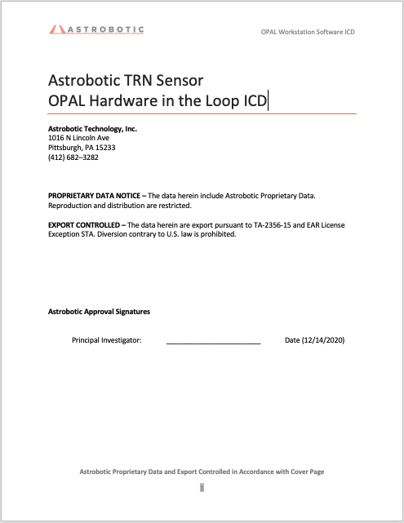
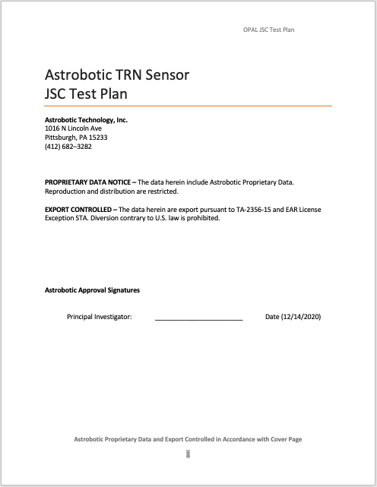
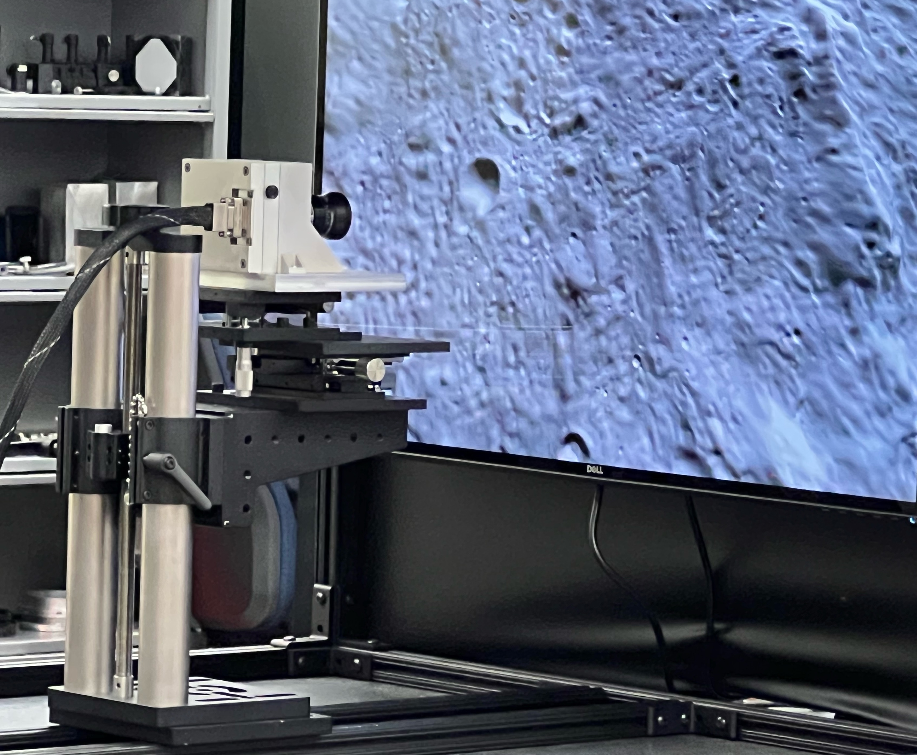
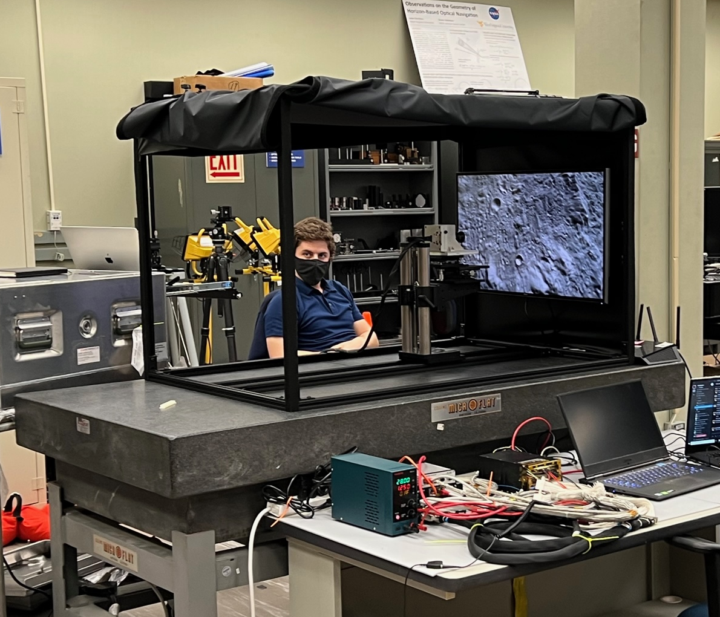
Accomplishments (1 of 4)
TRN Hardware IV&V at JSC in Oct 2021…
ICD and Test Plan for JSC IV&V Test
OPAL TRN Sensor in JSC IV&V optical testbed
The OPAL TRN Sensor underwent five days of open-loop IV&V testing at JSC. The OPAL camera was mounted and aligned in a hardware-in-the-loop testbed and the calibration was verified. JSC’s independent scene generator rendered lunar imagery (from an independent terrain model and trajectory) on a screen. The OPAL camera captured the images and the compute element calculated live TRN pose estimates. A few thousand images were collected under varying conditions. This work helped validate end-to-end functionality as well as Astrobotic’s LunaRay scene generator and and map creation tools.

Slide 9
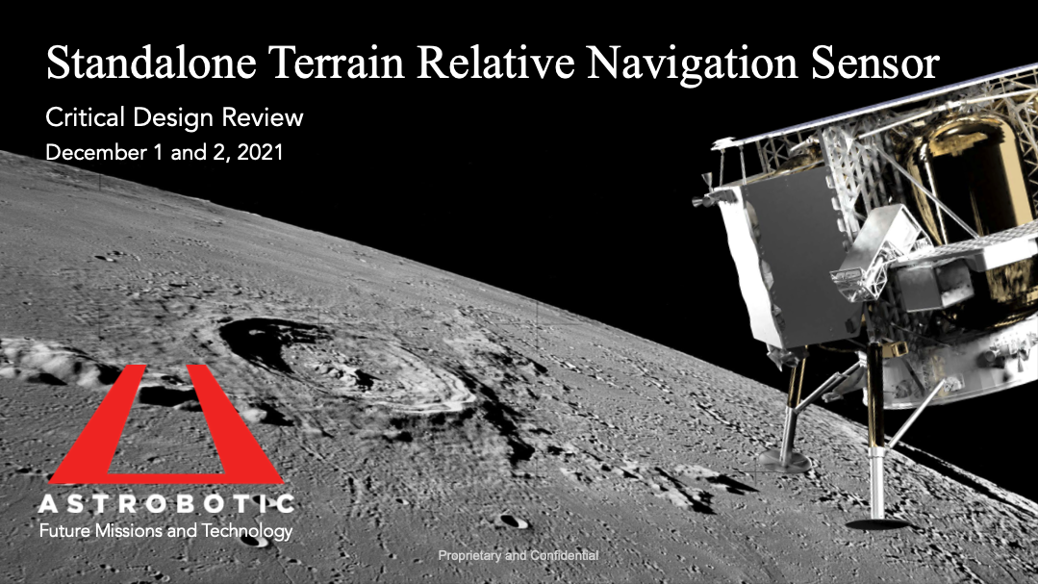
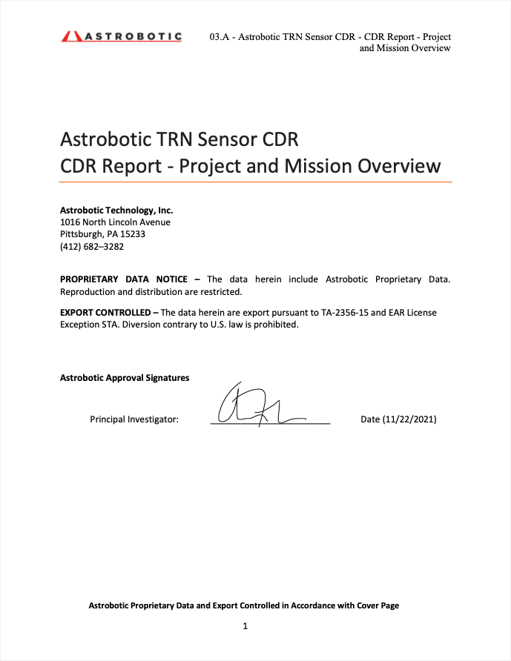
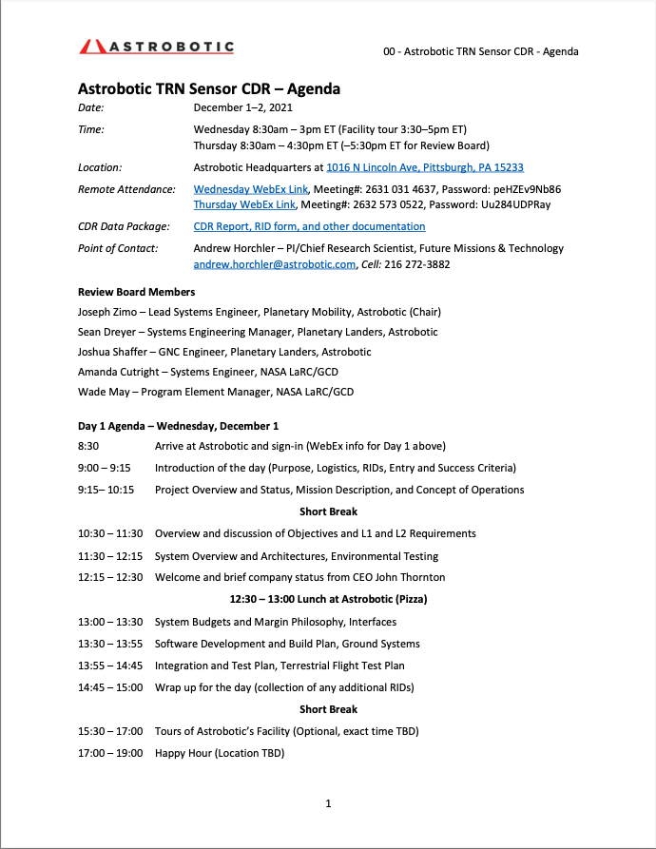
Accomplishments (2 of 4)
Successful CDR in Dec 2021…
An extensive CDR data package delivered, and a two-day CDR was held with external reviewers from NASA LaRC/GCD, NASA JSC, NASA GSFC, NASA MSFC, and JPL.

Slide 10
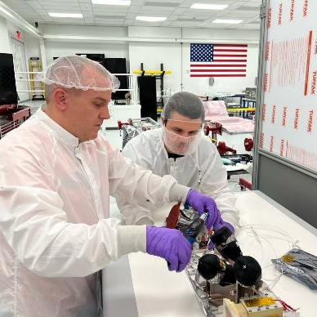
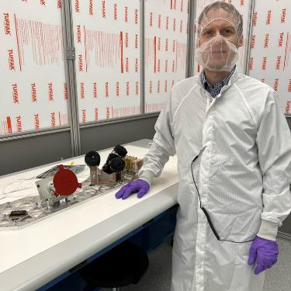
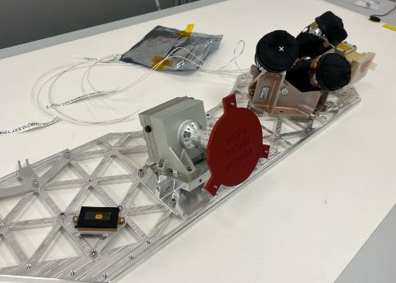
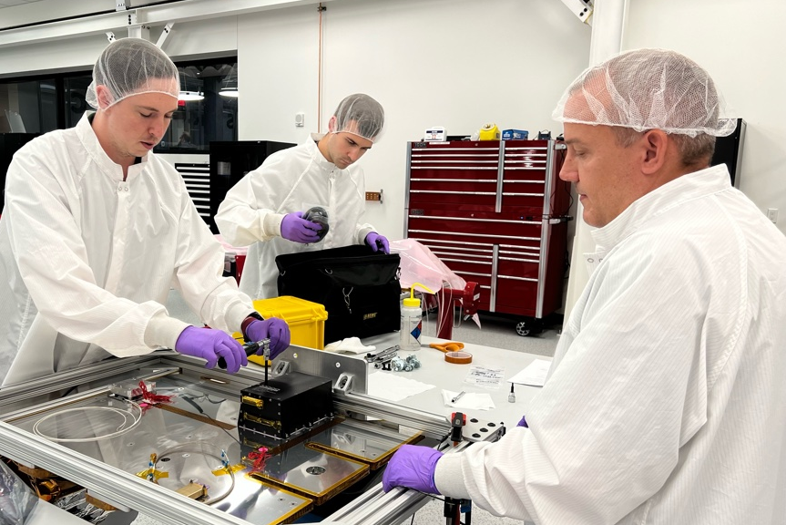
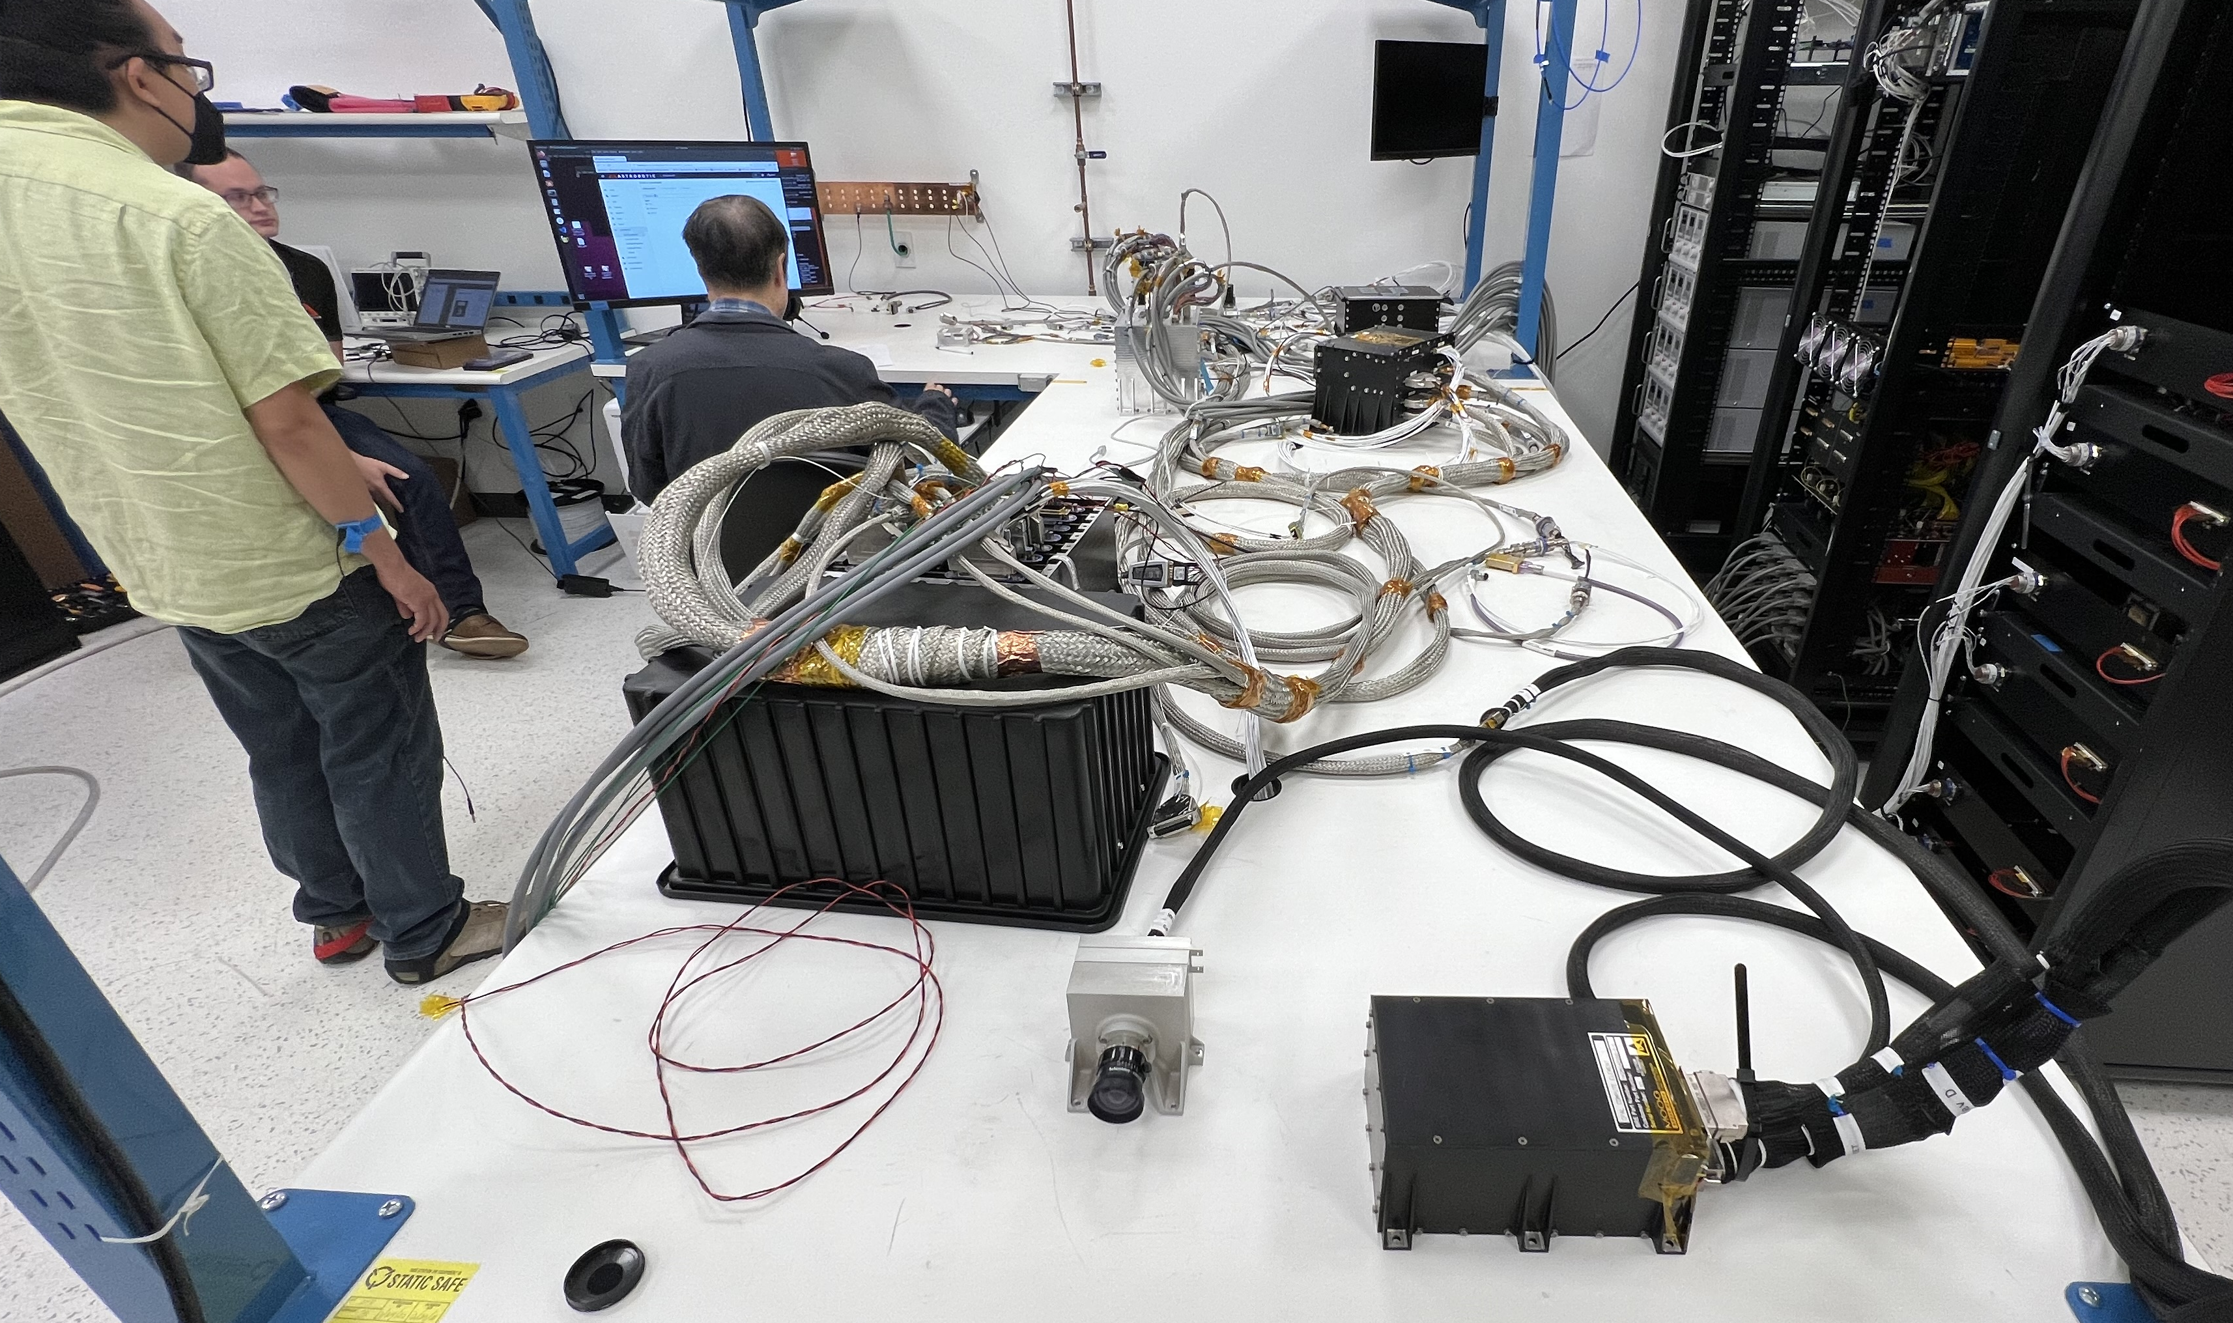
Accomplishments (3 of 4)
Flatsat Testing and Lander Integration of TRN Flight Hardware…
OPAL TRN flight camera integrated onto one of Peregrine’s isogrid decks in Astrobotic’s clean room.
OPAL TRN flight computer integrated onto one of Peregrine’s panels.
OPAL engineering model camera and compute element integrated with Peregrine Production Flatsat

Slide 11
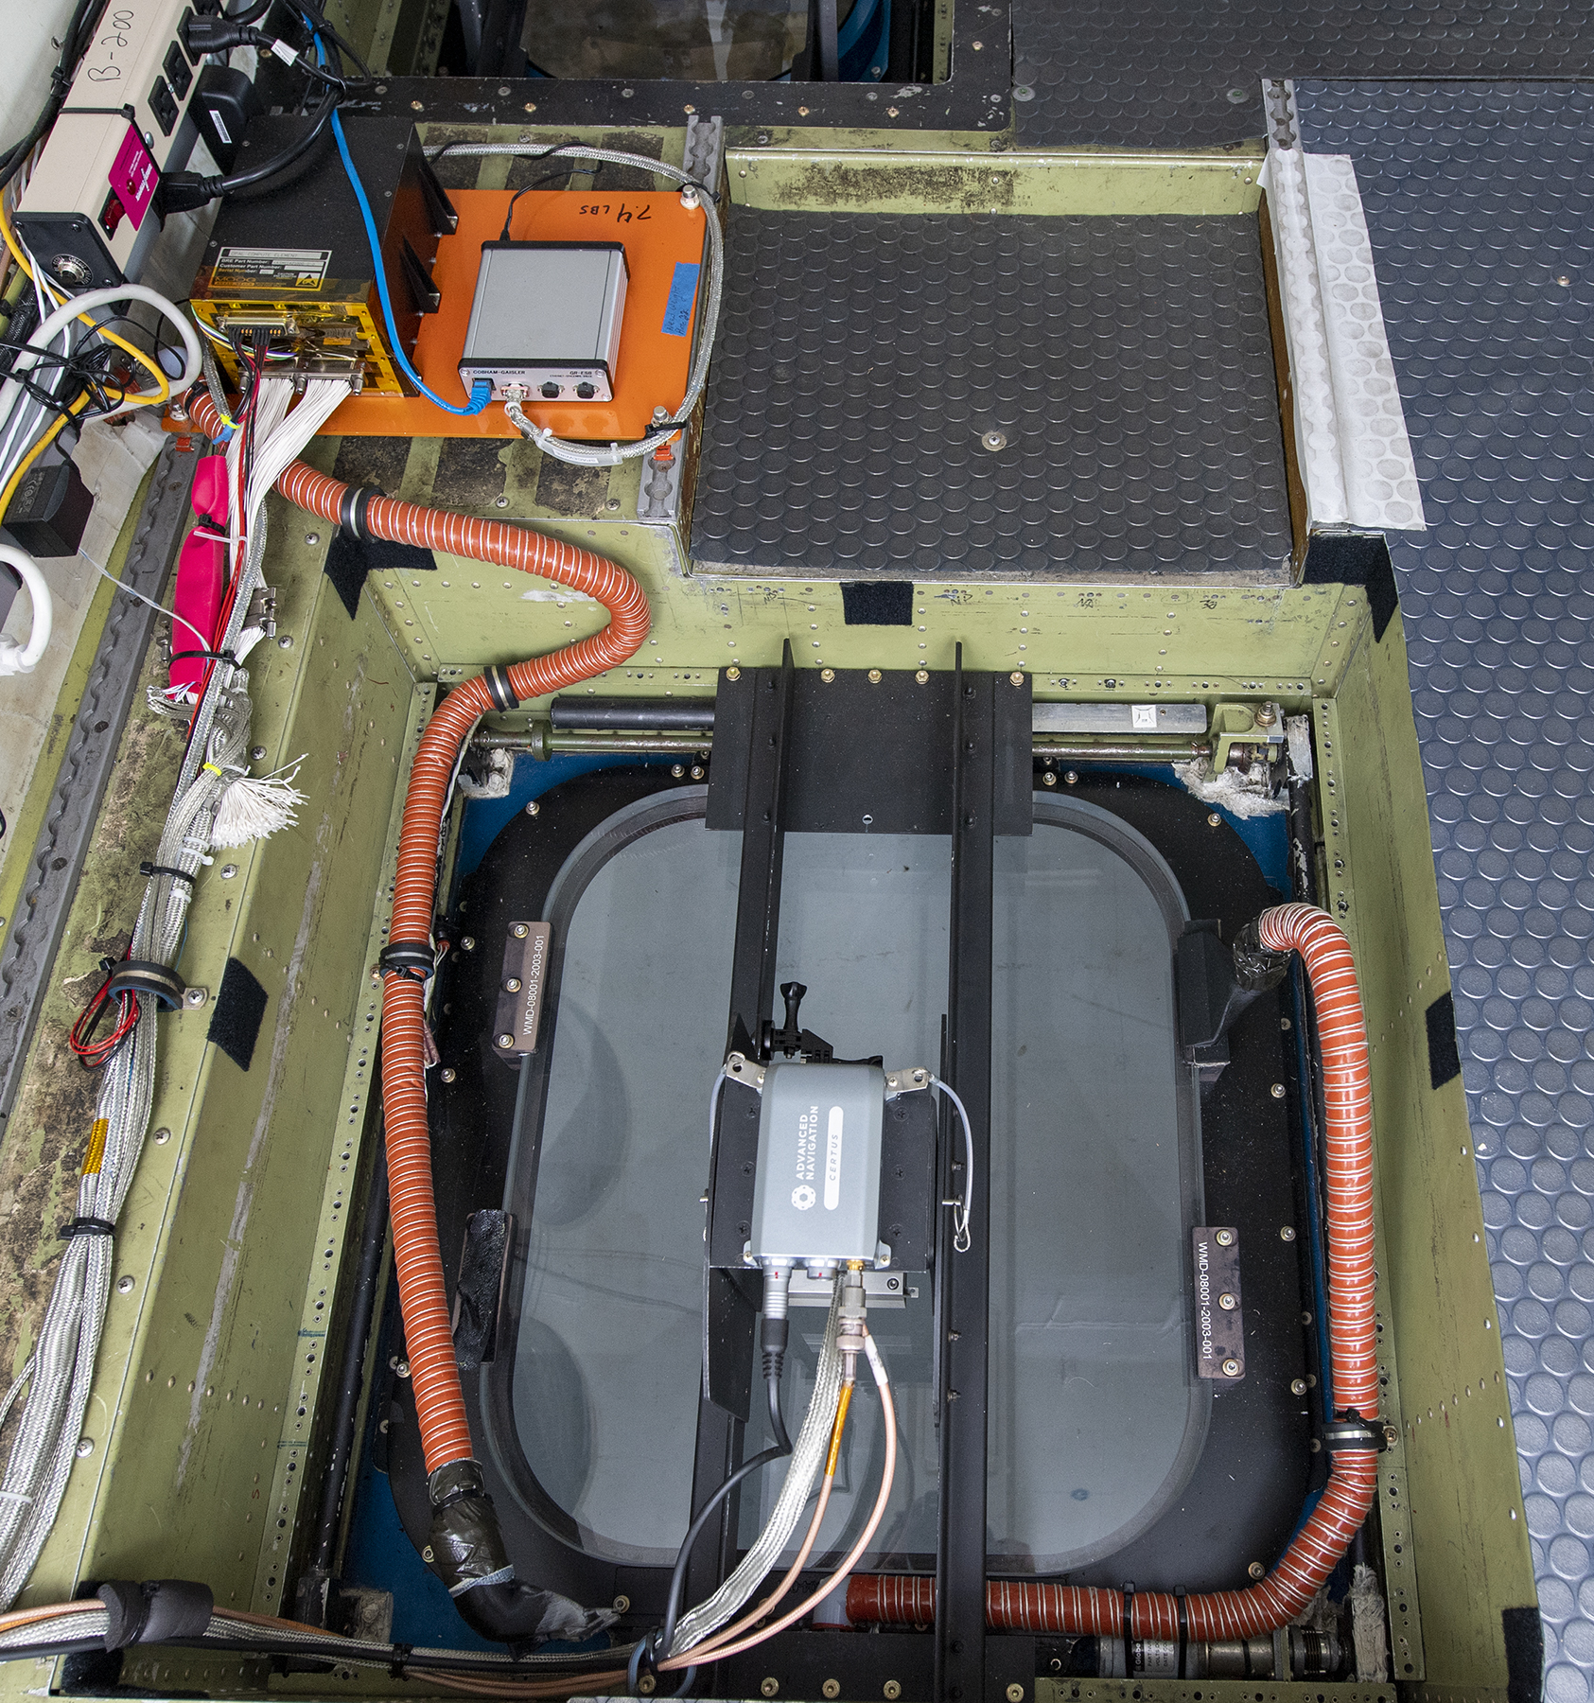

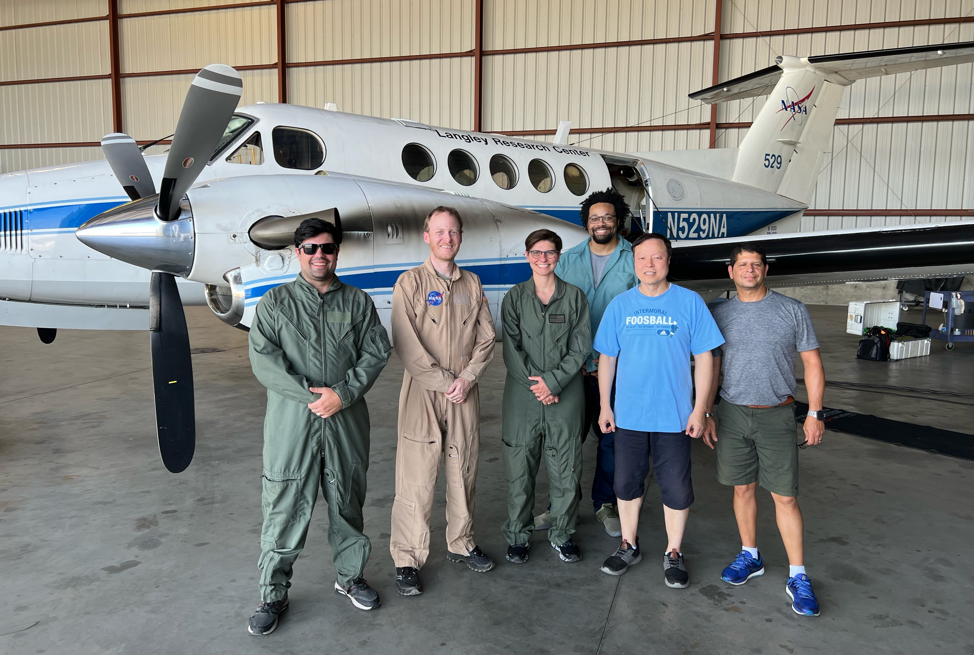
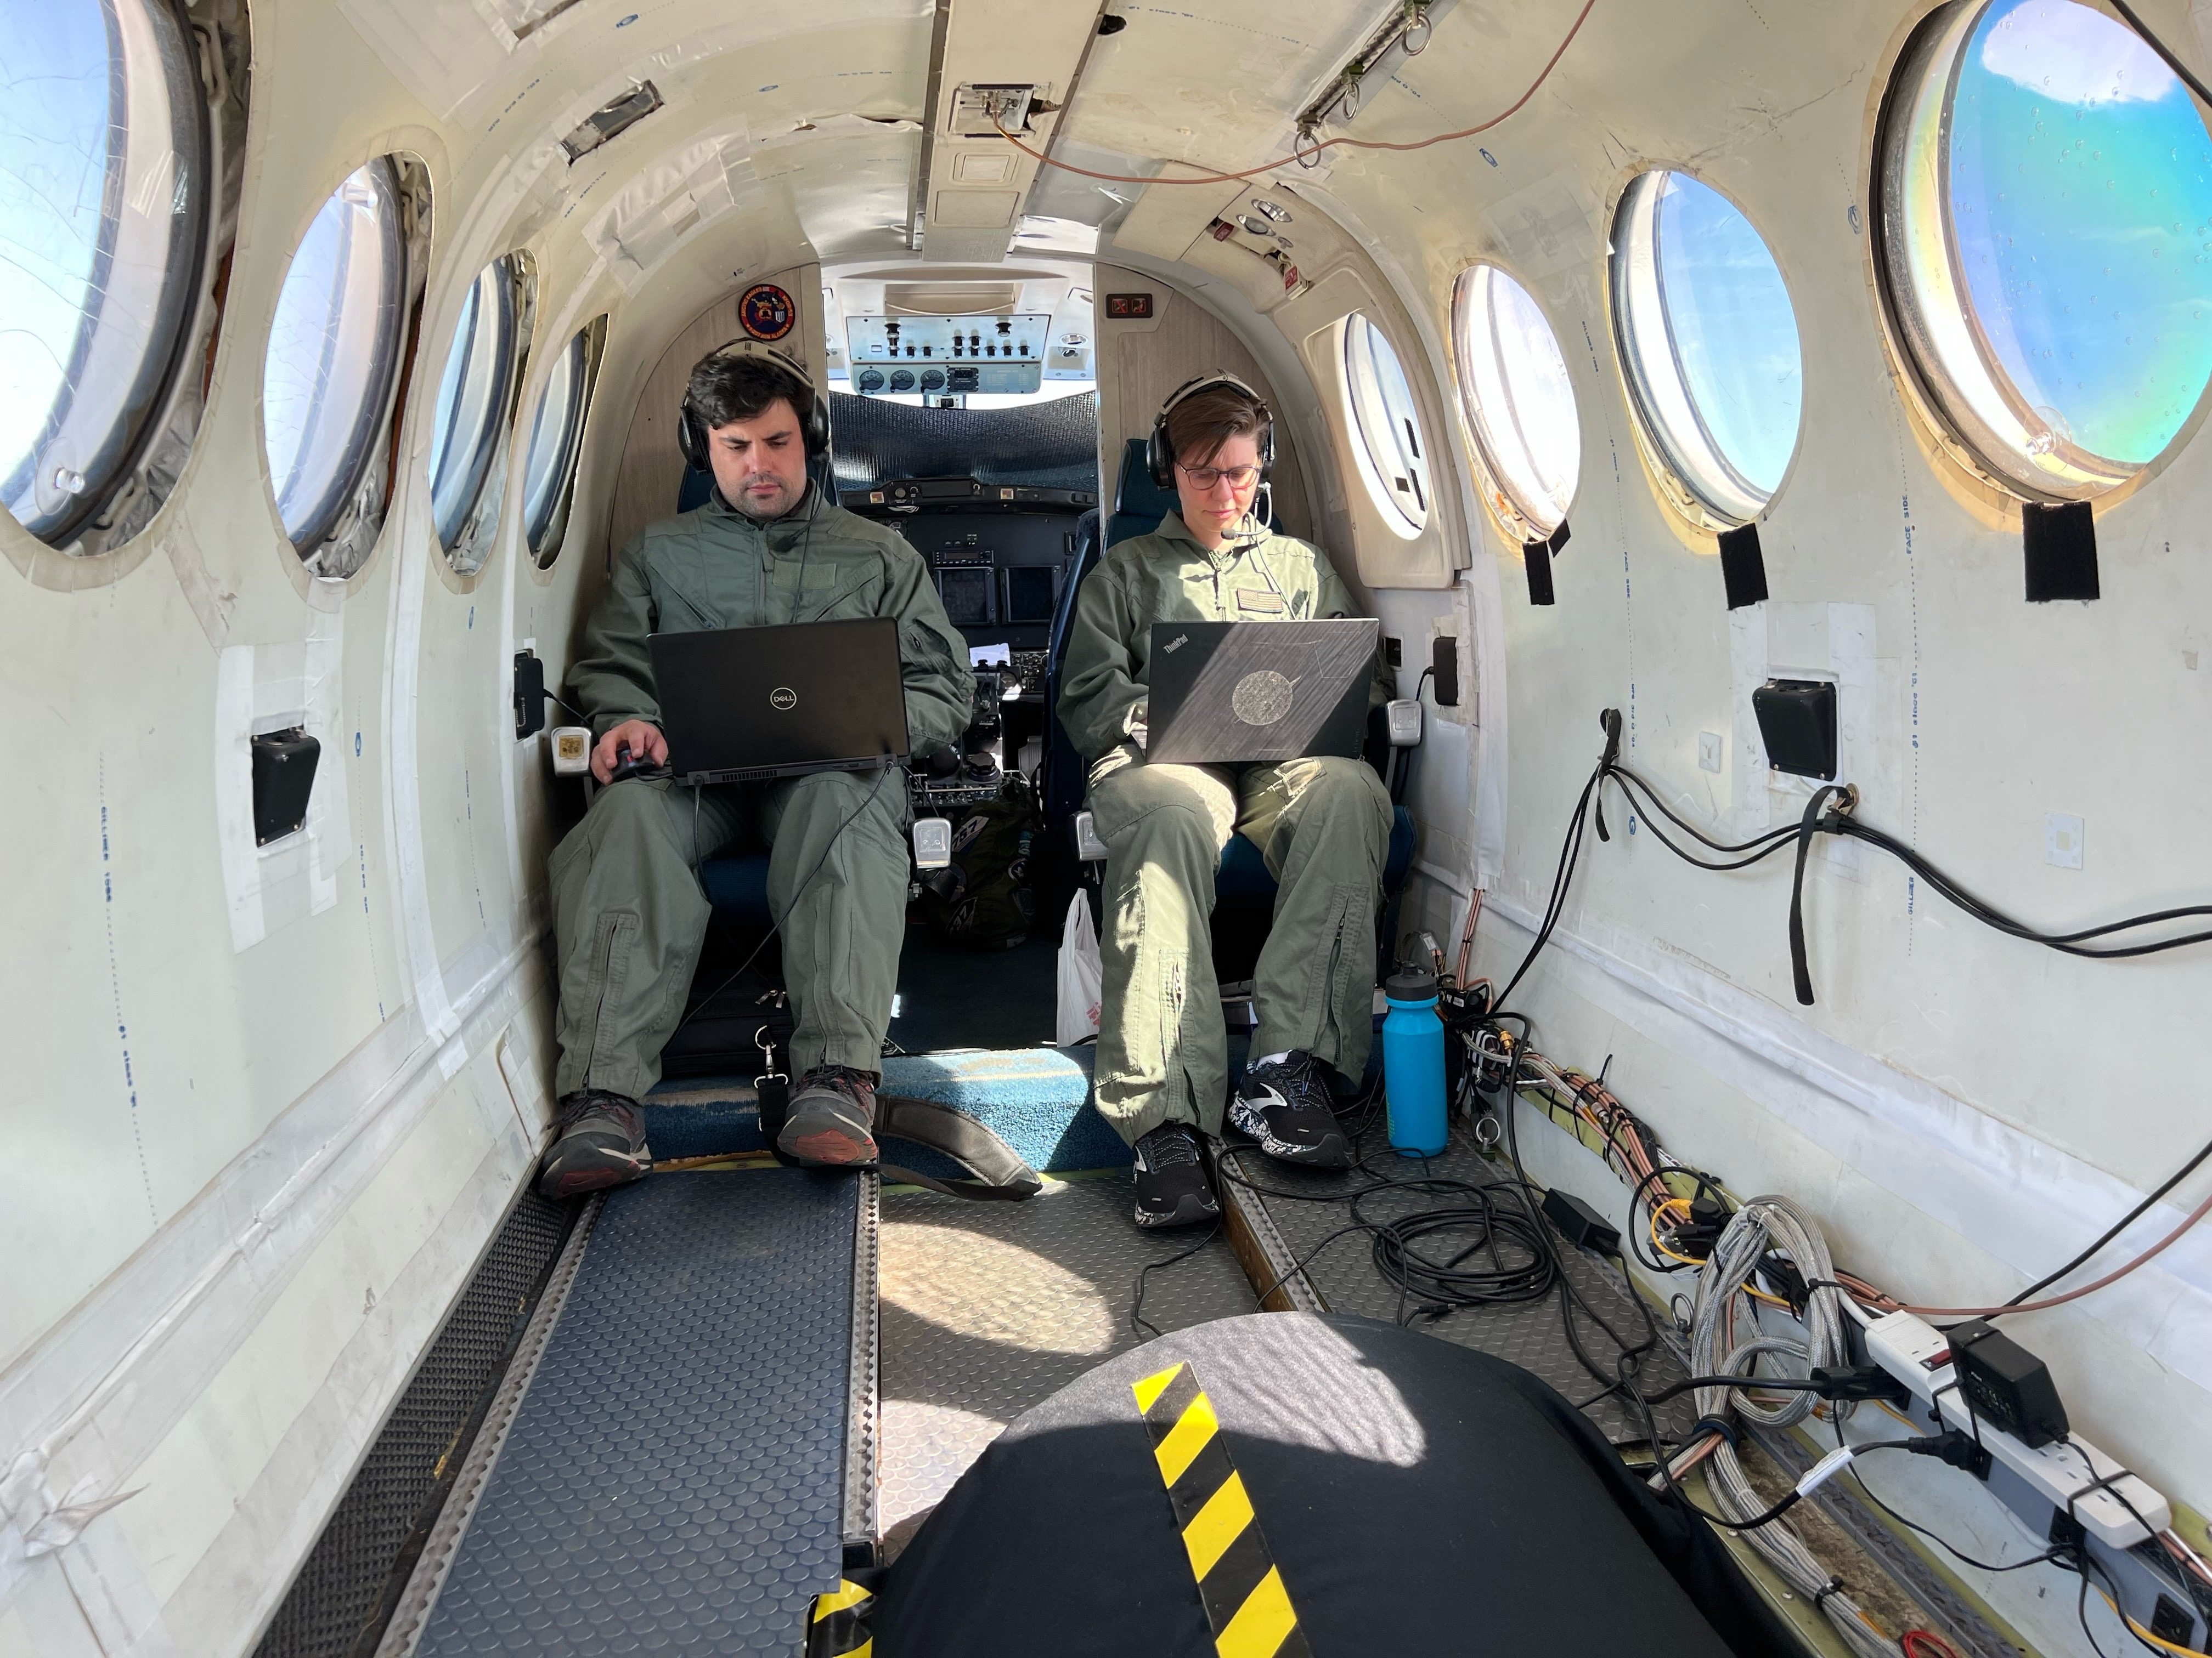
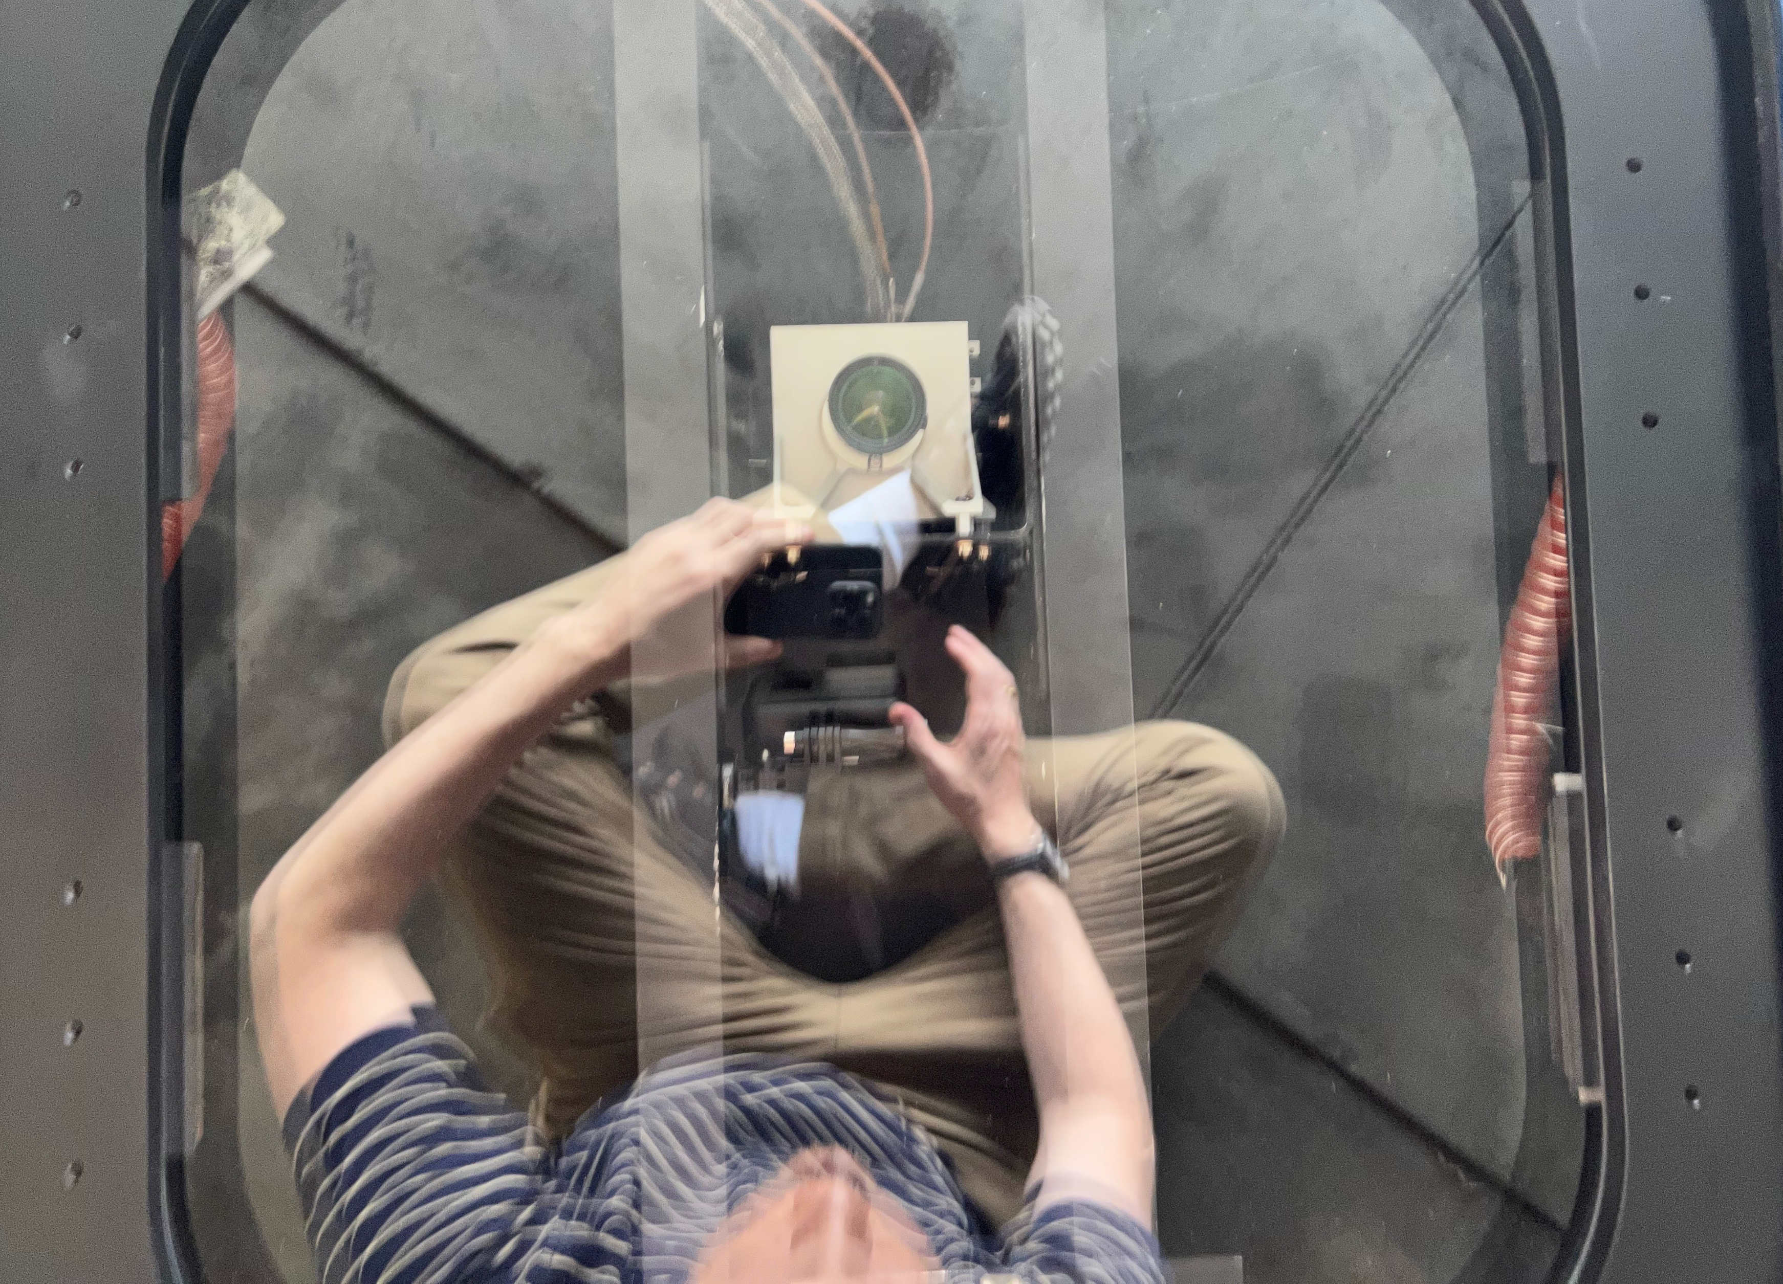
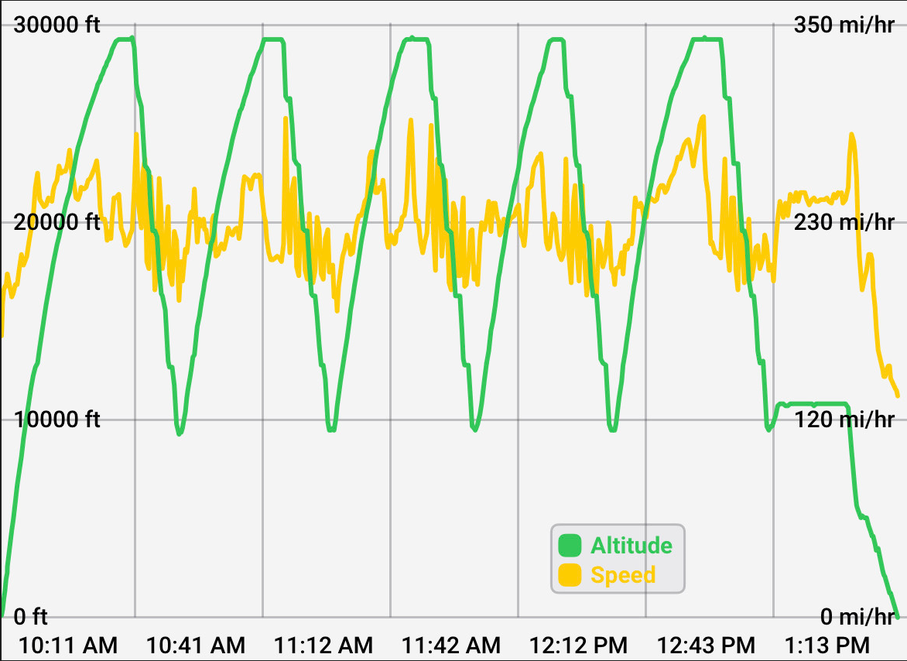
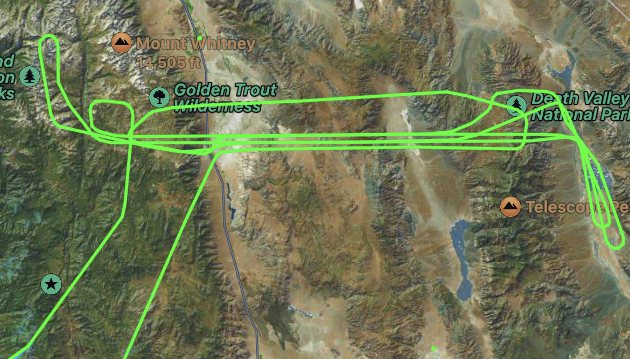
Accomplishments (4 of 4)
Terrestrial TRN Flight Test…
OPAL and ground truth system installed in plane
OPAL flight test crew with King Air B200 from NASA Langley
Astrobotic Technology, Inc. 2022
OPAL camera seen through window in belly under plane
Instrument operators in plane; OPAL under black cover in foreground
Sample descent imagery and flight trajectory over mountains of northern Mojave Desert

Slide 12
Project Assessment Summary
Project Name | Performance |  |  |  | Comments
 | C | S | T | P
Mid Year |  |  |  |  | Technical – Cost – Schedule – Programmatic –
Annual |  |  |  |  | Technical – Cost – Schedule – Programmatic –
* Rationale only required/provided for yellow and red color determinations.

Slide 13
Plans Forward and Infusion Plan
Astrobotic’s TRN system will be demonstrated aboard our Peregrine lunar lander in 2022 as part of this Tipping Point.
The TRN system will be employed to safely and precisely land our Griffin lander and NASA’s VIPER at the lunar South Pole in 2023. The system will undergo further flight testing before launch and is being developed along with a hazard detection sensor.
Astrobotic has sold and is on contract to deliver our lunar TRN system (HW, SW, maps, simulation tools) to another space company. Partnering with others.
In conversations to provide GPS-denied navigation solutions for terrestrial applications.
Under a Phase II NASA SBIR, Astrobotic is developing next generation vision-integrated compute HW to provide lower SWaP-C and higher performance TRN (and other advanced visual navigation applications). The system will be tested at JSC’s STAR Lab.
LunaRay engine being used and marketed for landing site analysis as well as orbital simulation for RPOD/ISAM.

Slide 14
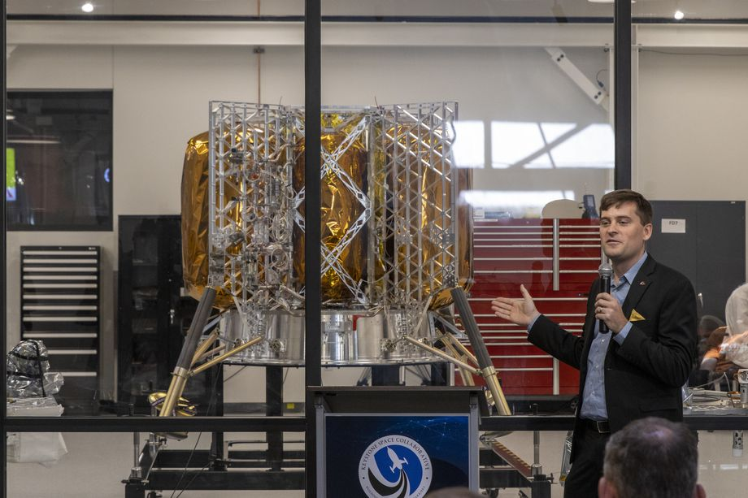
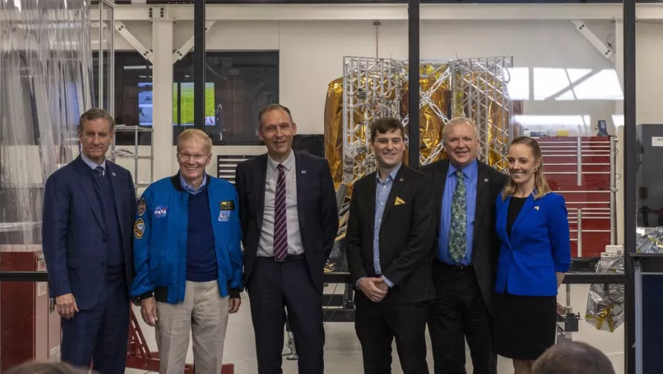
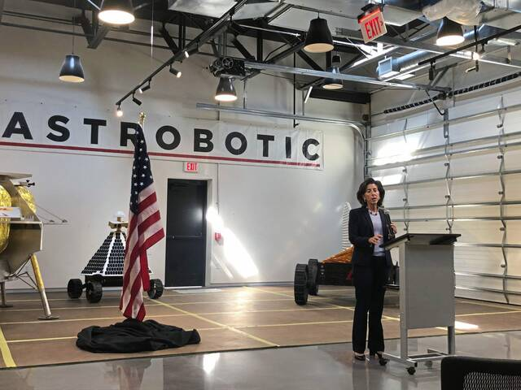
Education/Public Outreach
EPO Involvement
EPO Calendar Outlook (High Priorities):
6 Month Look-Ahead
NASA LaRC/GCD press release on TRN terrestrial flight test | Sep 1, 2022
Moonshot Museum at Astrobotic HQ Grand Opening | Oct 15, 2022
Peregrine Mission 1 Launch | 2022
AIAA SciTech | Jan 23–27, 2023
Sep 30, 2021: U.S. Commerce Secretary, Gina Raimondo, visited Astrobotic’s HQ (article)
April 2022: Numerous NASA and other VIPs and media visited Astrobotic HQ for the unveiling of our Peregrine lunar lander. TRN flight hardware and LunaRay sim was shown off. (video, article)
June 2022: TIME Magazine feature on Astrobotic
Public unveiling of Peregrine lunar lander with NASA Administrator Bill Nelson, NASA Science AA Thomas Zurbuchen, NASA Space Technology AA Jim Reuter, and others in attendance.
US Commerce Secretary, Gina Raimondo, visiting Astrobotic.
Notes:
Summary of the EPO activities (papers, conferences, outreach events) participated in over the last 6 months and the forward outlook for 6 months

Slide 15
Astrobotic TRN – Summary
Accomplishments for the Year-to-Date (Sep 2021–Sep 2022)
  Successful CDR completed
  Open-loop hardware IV&V testing completed at JSC
  FPGA integration of TRN algorithms completed
  Flight hardware integrated on lunar lander successfully
  Terrestrial flight test completed successfully
  Astrobotic’s lunar TRN system successfully commercialized
Summary of TechMat Capability End State for the Scope of the Project
  Complete TRN solution demonstrated in lunar tech demo
  Detailed performance analysis of precision landing capability
  Sophisticated and mission-proven terrain modeling and simulation capability
Forward Work
  Lander integrated acceptance testing
  Finalization of TRN flight software and TRN flight maps
  Lunar Tech Demo and post-mission analysis

