Slide 1

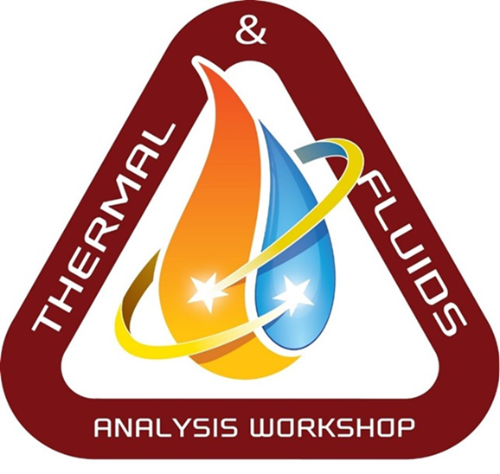
Lunar Thermal Analysis Guidebook (L-TAG):
Thermo-physical and Optical Properties of Lunar Regolith
Carlos Gomez, Brian Hamill, Greg Schunk
NASA/Marshall Space Flight Center
&
Lisa Erickson
NASA/Johnson Space Center
TFAWS Short Course
Presented By
Lisa Erickson
Thermal & Fluids Analysis Workshop
TFAWS 2022
September 6th-9th, 2022
Virtual Conference

Slide 2
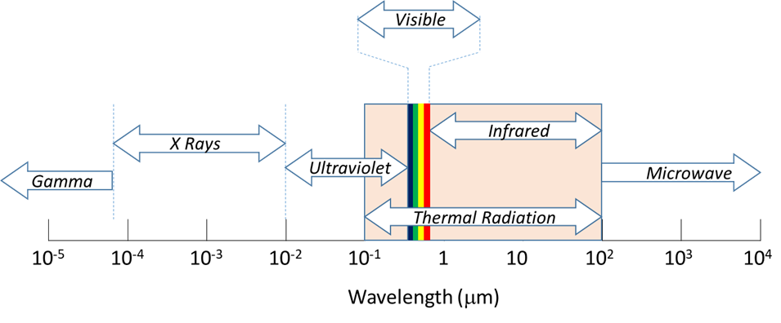
Background
The electromagnetic radiation spectrum is sub-divided into multiple bands based on differences in behavior. Of particular interest in radiation heat transfer is the “Thermal Radiation” band of the electromagnetic spectrum between 0.1 and 100 microns in wavelength.
Outside of the thermal waveband, electromagnetic energy generally passes through objects or has very little heat energy (based on temperature) under practical conditions.
Wavelengths beyond 100 microns may be of interest in measuring extremely low temperatures such as the far side of the Moon or perpetually shadowed craters. An object at a given temperature will emit energy over a spectrum of wavelengths.
Thermal analyses are typically conducted using a two waveband absorptance model which subdivides the thermal energy spectrum into solar (< 3.0 μm) and infrared (>3.0 μm) wavelengths.

Slide 3
Solar Absorptivity/Albedo
Albedo is the fraction of incident light or radiation reflected by a surface and may be defined in several different ways.
Normal albedo is the reflectance of a surface when both viewed and illuminated in the local vertical direction (i.e. normal to the surface).
Directional hemispherical albedo is the reflectance in all directions resulting from direct illumination from a specific direction.
Total hemispherical albedo is the reflectance in all viewing directions integrated over all phase angles.
θ
θ
δ
δ
Normal Albedo
Directional
Hemispherical
Albedo
Total
Hemispherical
Albedo

Slide 4
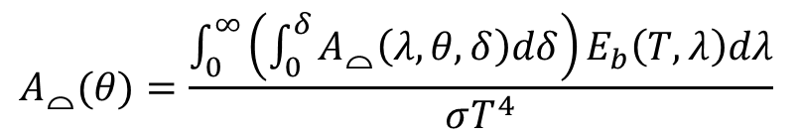
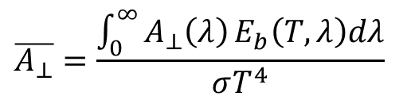
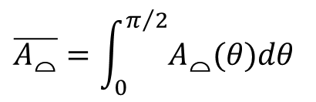
Bolometric Albedo
Bolometric albedos are obtained by integrating the wavelength dependent albedo over the waveband of interest as illustrated below for the lunar surface normal and hemispherical albedos.
A bolometric normal or hemispherical albedo would be averaged against the solar spectrum represented as a black body radiating at 5800K.
The hemispherical bolometric albedo is computed in two steps: first integrated over wavelength for a specific direction and then integrated over all incident directions.
Bolometric Normal Albedo
Bolometric Hemispherical Albedo
$$A_{⌓}(θ)=\frac{\int_{0}^{∞}{\left(\int_{0}^{δ}{A_{⌓}\left(λ,θ,δ\right)dδ}\right)}E_{b}\left(T,λ\right)dλ}{σT^{4}}$$
$$\overline{A_{⊥}}=\frac{\int_{0}^{∞}{A_{⊥}\left(λ\right)}E_{b}\left(T,λ\right)dλ}{σT^{4}}$$
$$\overline{A_{⌓}}=\int_{0}^{π/2}{A_{⌓}(θ)dθ}$$

Slide 5
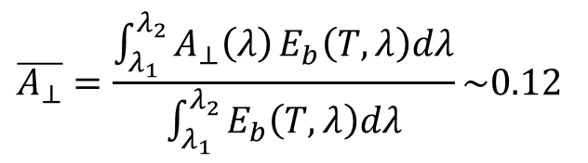

Terrestrial Measurements of Lunar Albedo
Dollfus and Bowell [1] derived the normal albedo from telescopic observations of the near side lunar surface. The measurements were made and averaged for 14 different regions over a wavelength range of 0.327μ to 1.05μ. The following relation was derived to fit the normal albedo to the observations.
Since the observed waveband does not include the entire solar spectrum, the normal wavelength dependent albedo is integrated against the truncated waveband to obtain the bolometric normal albedo as shown below.
The bolometric normal albedo is recommended for orbital calculations involving a radiatively participating lunar surface as described in DSNE 3.3.9.1.2.
$$A_{⊥}\left(λ\right)={10}^{0.83\log\left(λ\right)−0.80}$$
$$\overline{A_{⊥}}=\frac{\int_{λ_{1}}^{λ_{2}}{A_{⊥}\left(λ\right)}E_{b}\left(T,λ\right)dλ}{\int_{λ_{1}}^{λ_{2}}{E_{b}\left(T,λ\right)dλ}}\sim 0.12$$
¹A Dollfus and E. Bowell, “Polarimetric Properties of the Lunar Surface and its Interpretation”, Astronomy and Astrophysics 10, 29-53, 1971.

Slide 6
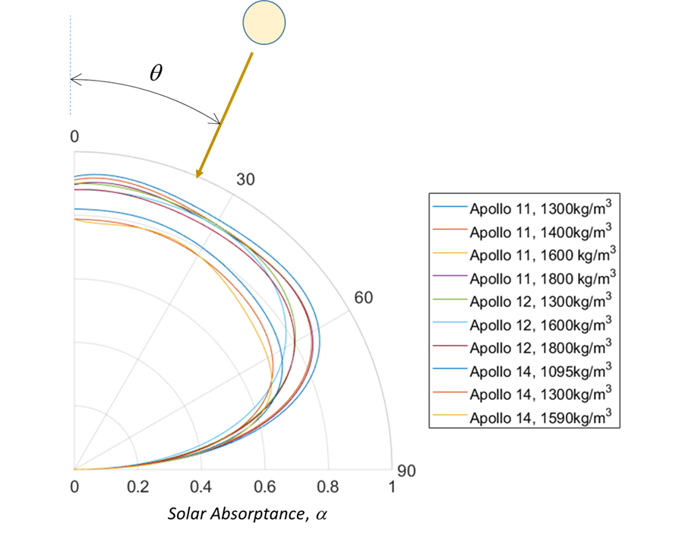
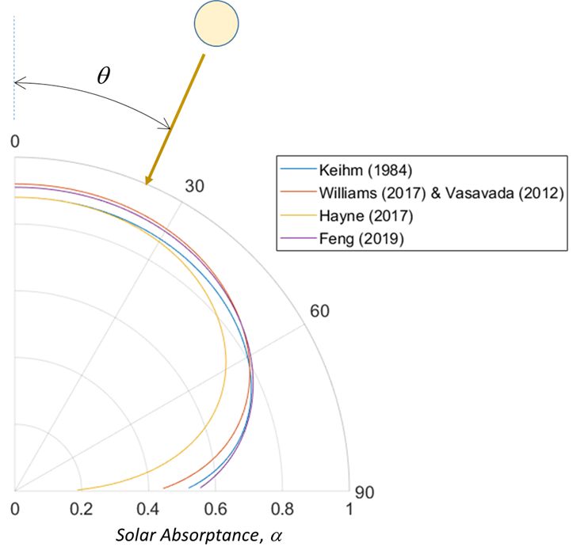
Solar Incident Angle Albedo
For detailed thermal modeling of the lunar surface temperature, a solar incident angle albedo obtained from direct measurement of Apollo Sample Fines or correlations based on lunar surface temperature by a number of authors including Keihm, Williams, Vasvada, Hayne or Feng may be needed.

Slide 7
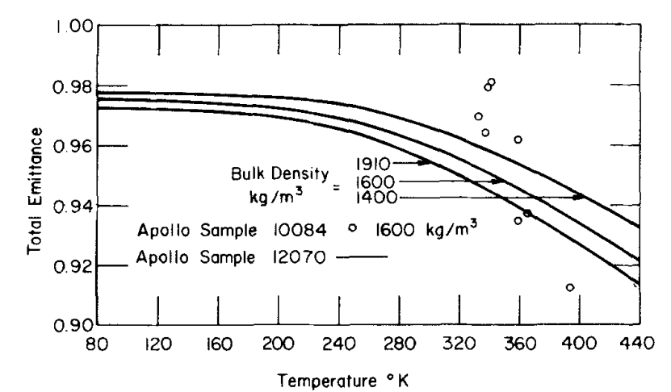
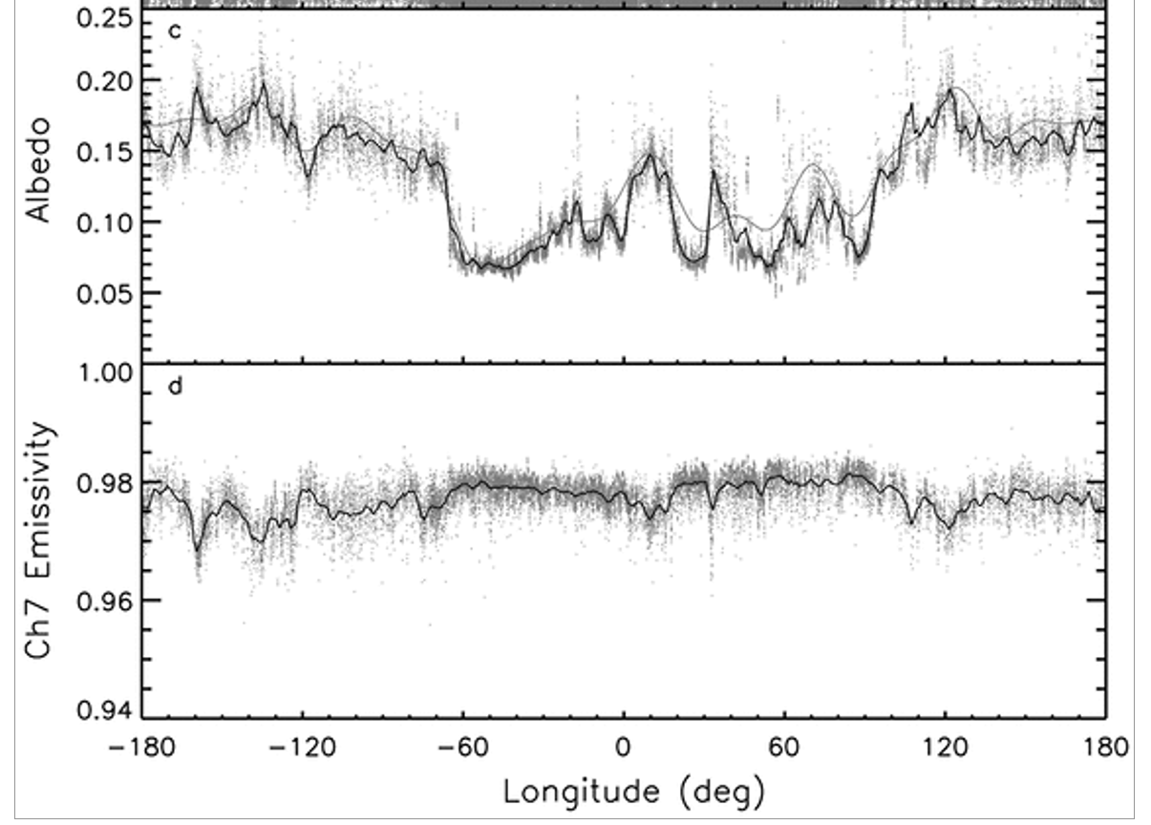
Infrared Emittance
Directional, spectral, and total emittances of Apollo samples have been measured¹
Equatorial emittances has been derived from Ch7 LRO Diviner brightness temperatures, which fairly represents actual kinetic temperatures²
Total Emittance of Apollo 11 and 12 lunar fine samples from Birkebak 1974²
Equatorial Emissivity from Vasavada 2012. Solid line is data smoothed over 3º of longitude every 0.05º (Ch7 is 25–41 μm, this is technically a spectral emittance) ^{.2}
¹ Birkebak, “Thermal Radiation Properties of Lunar Materials from the Apollo Missions,” 1974.
²Vasavada et al., “Lunar equatorial surface temperatures and regolith properties from the Diviner,” 2012.
*Brightness temperatures measure total IR emission from the surface $σT_{BOL}^{4}=ρ\int_{0}^{∞}{ε\left(λ\right)B\left(λ,T_{s}\right)dλ →T_{BOL}={\left(επT_{s}^{4}\right)}^{0.25}}$ For more information see Supporting online Material for Paige et al., “Diviner Lunar Radiometer Observations of Cold Traps in the Moon’s South Polar Region,” 2010, doi: 10.1126/science.1187726

Slide 8
Infrared Emittance
Recommended values from DSNE:¹
Location | Emissivity ε,
Highland mean (0^{O} lat) | 0.95 – 0.98
Mare mean (0^{O} lat) | 0.95 – 0.98
South Pole (84-90^{O}S) nominal | Use Highland equatorial values. (No data available).
¹ Cross-Program Design Specification for Natural Environments (DSNE), Rev G, 2019. Figure 3.4.6.2.1-1. Cremers and Birkeback 1971, Cremers et al. 1972, Cremers 1972, Cremers and Hsia 1974)
Notes:
Note:

Slide 9
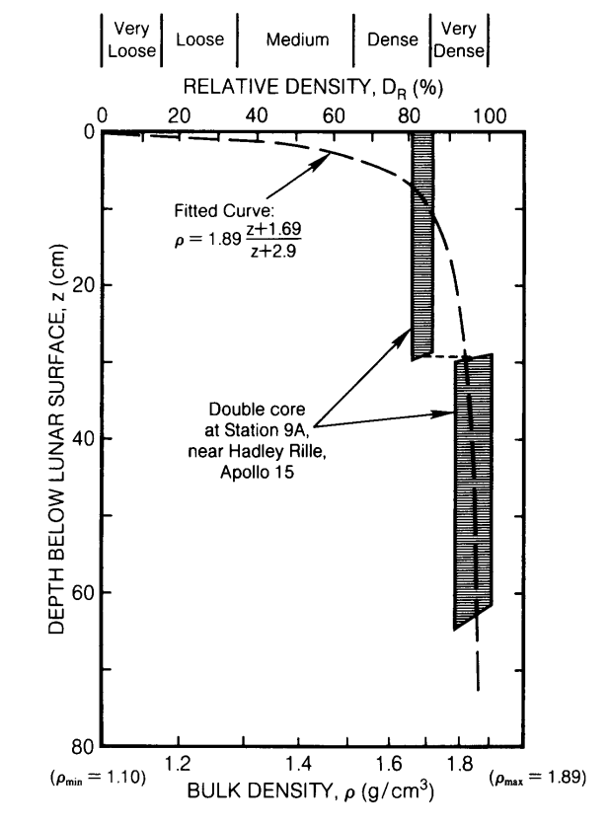
Density, $ρ$
Sample bulk density depends on:
  grain type, size, density
  sample porosity, compression
  ice content¹
On the Lunar Surface, density depends on depth and location
  Global depth vs density models have been developed^{3,4,5}
¹ Reiss et al., "In-Situ Thermal Extraction of Volatiles from Lunar Regolith“ 2018.
²G. Heiken et al., Lunar sourcebook: A user’s guide to the moon. New York: Cambridge, Figure 9.19 p.499.
³ A. Vasavada et al., “Near-Surface Temperatures on Mercury and the Moon and the Stability of Polar Ice Deposits,” 1999.
⁴ Hayne et al., “Global Regolith Thermophysical Properties of the Moon From the Diviner Lunar Radiometer Experiment: Lunar Regolith Thermophysical Properties,” 2017.
⁵ Martinez and Siegler, “A Global Thermal Conductivity Model for Lunar Regolith at Low Temperatures,” 2021.
Bulk density vs depth. Apollo 15 site²

Slide 10

Density, $ρ$
Hayne 2017 – Global Density¹
$ρ_{s}=1100 \left[\frac{kg}{m^{3}}\right]$ surface layer
$ρ_{d}=1800 \left[\frac{kg}{m^{3}}\right]$ deepest layer
$ρ=ρ_{deep layer}−\left(ρ_{deep layer}−ρ_{surface }\right)e^{− \frac{z}{H}} \left[\frac{kg}{m^{3}}\right]$
z = depth (from surface) [m]
H = H-parameter, a location dependent scaling factor.
Determined H for ±70°LAT (typical range: 0 - 0.1 m)
Note: ($ρ_{s},ρ_{d}, k(ρ$,T),$c_{p}(T)$) were assumed constant – they vary locally but their variations manifest as different best fit H parameter values
average H for ±60°LAT is 0.068 m
¹ P. O. Hayne et al., “Global Regolith Thermophysical Properties of the Moon From the Diviner Lunar Radiometer Experiment: Lunar Regolith Thermophysical Properties,” 2017.
Table A1: Standard model parameters and physical constants

Slide 11
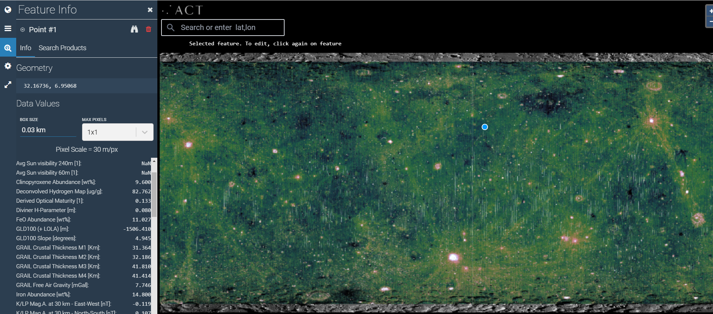
Density: H - Parameter Map
Lunar QuickMap website
https://quickmap.lroc.asu.edu/query?extent=136.6294561%2C71.9324346%2C-177.1800951%2C-76.0361511&proj=16&layerListFilter=&features=209.40000000%2C-89.59200000%7C6.95068337%2C32.16735885%7C-11.40643297%2C-42.98468575%7C43.52367024%2C42.87280373&selected=3&layers=NrBsFYBoAZIRnpEBmZcAsjYIHYFcAbAyAbwF8BdJAdgTpgDoAOAJknyNICIAnAQxwBzAKYAFPgWEAXKcK4AuLgHcAxgHsCeKdC6Uq5KsGSg22RCjgsz9DsQP69QA

Slide 12
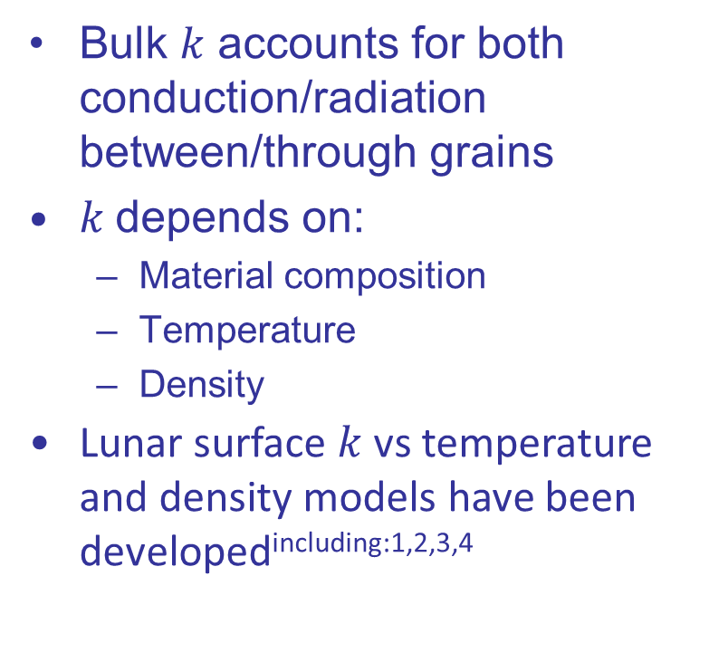
Thermal Conductivity, $k$
Bulk 𝑘 accounts for both conduction/radiation between/through grains
$k$depends on:
  Material composition
  Temperature
  Density
Lunar surface $k$vs temperature and density models have been developed^{including:1,2,3,4}
Thermal conductivity of Apollo samples⁵
¹ A. Vasavada et al., “Near-Surface Temperatures on Mercury and the Moon and the Stability of Polar Ice Deposits,” 1999.
² Hayne et al., “Global Regolith Thermophysical Properties of the Moon From the Diviner Lunar Radiometer Experiment: Lunar Regolith Thermophysical Properties,” 2017.
³ Martinez and Siegler, “A Global Thermal Conductivity Model for Lunar Regolith at Low Temperatures,” 2021.
⁴Woods-Robinson et al., " A model for the Thermophysical Properties of Lunar Regolith at Low Temperatures" 2019.
⁵ Cross-Program Design Specification for Natural Environments (DSNE), Rev G, 2019. Figure 3.4.6.2.1-1. Cremers and Birkeback 1971, Cremers et al. 1972, Cremers 1972, Cremers and Hsia 1974)

Slide 13
Thermal Conductivity, $k$
Suggested models for lunar surface modeling:
  Hayne 2017
  Martinez and Siegler 2019
  See references for full equations
Sufficient in most cases
Improved analytical model fit for low temperatures
Density
Density
¹ Hayne et al., “Global Regolith Thermophysical Properties of the Moon From the Diviner Lunar Radiometer Experiment: Lunar Regolith Thermophysical Properties,” 2017.
² Martinez and Siegler, “A Global Thermal Conductivity Model for Lunar Regolith at Low Temperatures,” 2021.

Slide 14
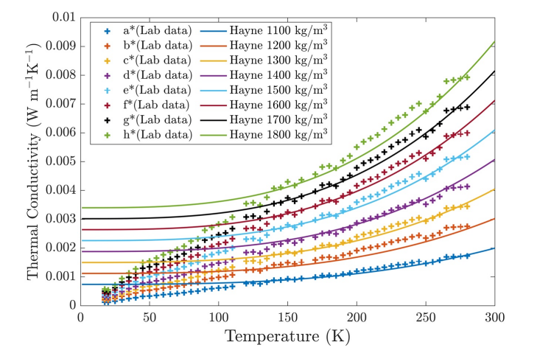
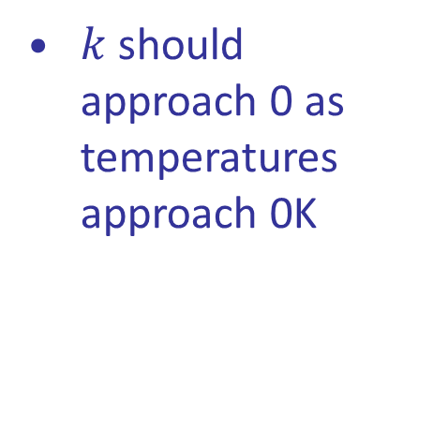
Thermal Conductivity, $k$
Hayne 2017 vs Lab Data for NU-LHT-2²
$k$should approach 0 as temperatures approach 0K
Sufficient in most cases
Improved analytical model fit for low temperatures
Density
Density
¹ Hayne et al., “Global Regolith Thermophysical Properties of the Moon From the Diviner Lunar Radiometer Experiment: Lunar Regolith Thermophysical Properties,” 2017.
² Martinez and Siegler, “A Global Thermal Conductivity Model for Lunar Regolith at Low Temperatures,” 2021.

Slide 15
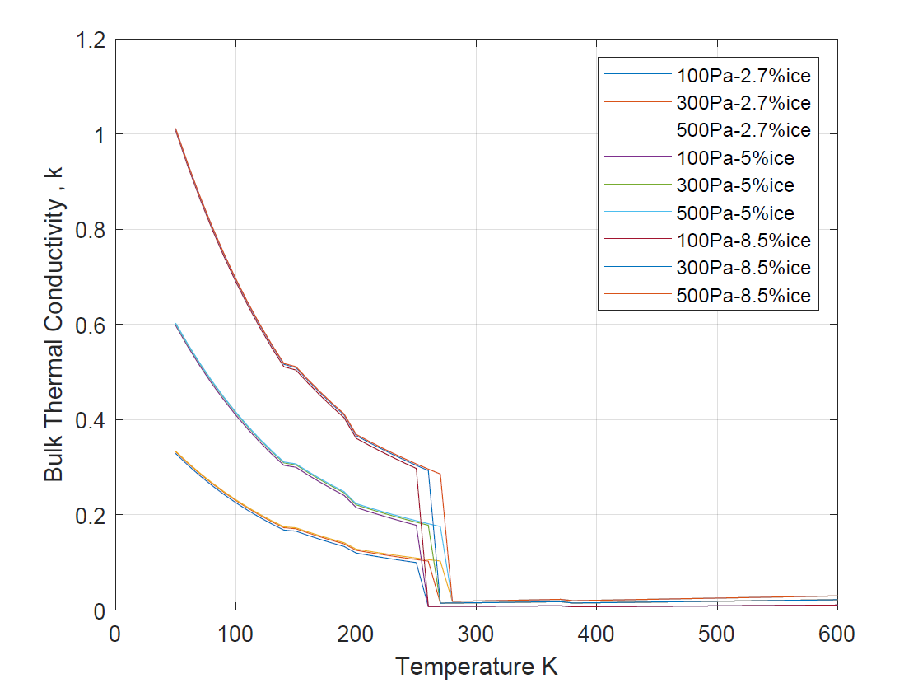
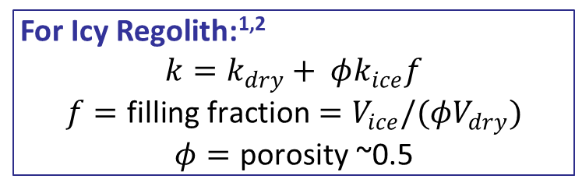
Extra: Extension for Icy Regolith
Reiss 2018 gives a semi-empirical model for thermal conductivity of regolith samples with water vapor between voids + an extension for icy regolith^{1,2}
Available water properties
  (vapor) Polynomial fit provided by D3.1 Table 10, VDI Heat Atlas. 2010.
  (ice) “Revised Release on the Equation of State 2006 for H2O Ice Ih,” IAPWS. 2009.
    https://iapws.readthedocs.io/en/latest/iapws.iapws95.html#iapws.iapws95.IAPWS95
For Icy Regolith:^{1,2}
$$k=k_{dry}+ φk_{ice}f$$
$$f=\text{filling} \text{fraction}=V_{ice}/(φV_{dry})$$
$$φ=\text{porosity}\text{ \sim }\text{0}\text{.}\text{5}$$
Bulk thermal conductivity of regolith with water vapor/ice between voids using predicted with Reiss’s model
¹ Reiss, “In-Situ Thermal Extraction of Volatiles from Lunar Regolith,” 2018.
² Siegler et. al,, “Laboratory Measurements of Thermal Properties of Icy Regolith Analogs,” 2011.
Notes:
May skip this one

Slide 16
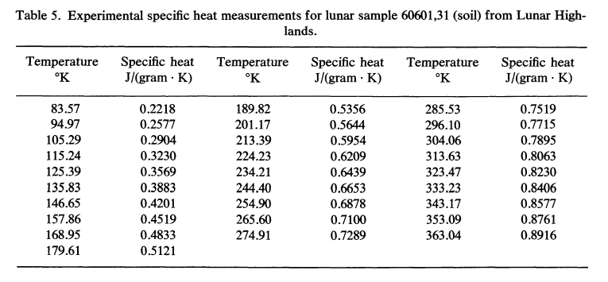
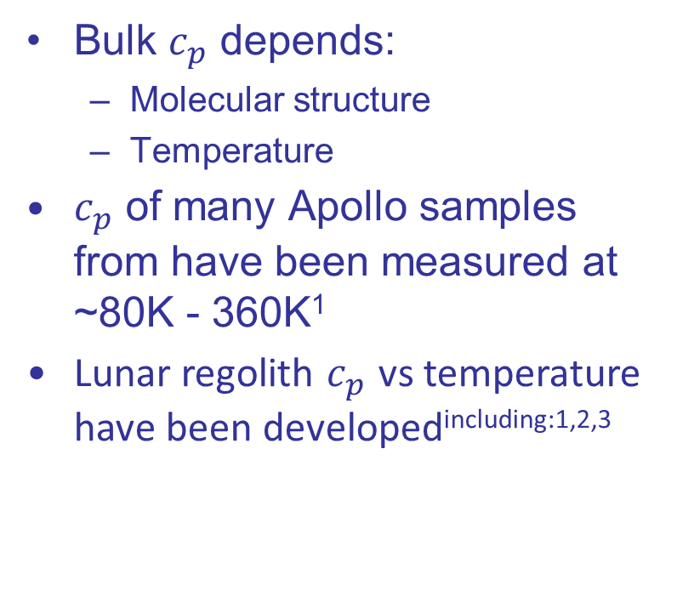
Specific heat, $c_{p}$
Bulk $c_{p}$ depends:
  Molecular structure
  Temperature
$c_{p}$ of many Apollo samples from have been measured at ~80K - 360K¹
Lunar regolith $c_{p}$ vs temperature have been developed^{including:1,2,3}
Specific heat of an Apollo Lunar Highlands sample¹
1 Hemingway et al., “Specific heats of lunar soils, basalt, and breccias from the Apollo 14, 15, and 16 landing sites, between 90 and 350°K,” Proceedings of the Lunar Science Conference, 1973..
² Hayne et al., “Global Regolith Thermophysical Properties of the Moon From the Diviner Lunar Radiometer Experiment: Lunar Regolith Thermophysical Properties,” 2017. (Used data from Ledlow 1992 and Hemingway 1981)
³Woods-Robinson et al., " A model for the Thermophysical Properties of Lunar Regolith at Low Temperatures" 2019.

Slide 17
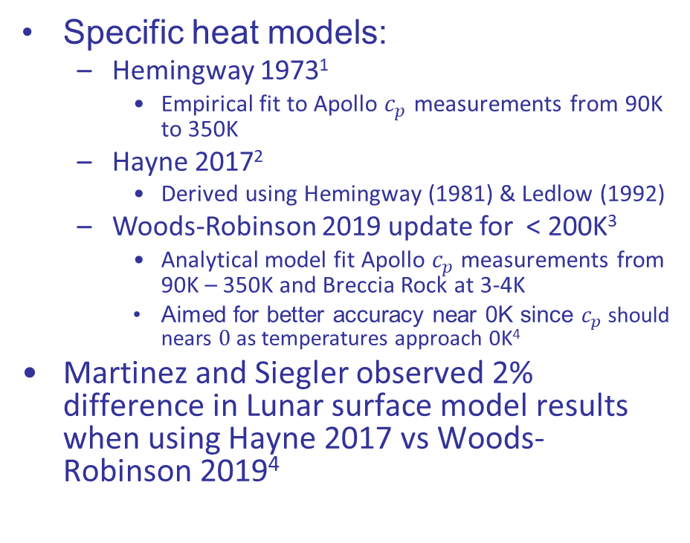
Specific heat, $c_{p}$
Specific heat models:
  Hemingway 1973¹
    Empirical fit to Apollo $c_{p}$ measurements from 90K to 350K
  Hayne 2017²
    Derived using Hemingway (1981) & Ledlow (1992)
  Woods-Robinson 2019 update for < 200K³
    Analytical model fit Apollo $c_{p}$ measurements from 90K – 350K and Breccia Rock at 3-4K
    Aimed for better accuracy near 0K since $c_{p}$ should nears $0$as temperatures approach 0K⁴
Martinez and Siegler observed 2% difference in Lunar surface model results when using Hayne 2017 vs Woods-Robinson 2019⁴
At 10K
24.4 vs 7.05
1 Hemingway et al., “Specific heats of lunar soils, basalt, and breccias from the Apollo 14, 15, and 16 landing sites, between 90 and 350°K,” Proceedings of the Lunar Science Conference, 1973..
² Hayne et al., “Global Regolith Thermophysical Properties of the Moon From the Diviner Lunar Radiometer Experiment: Lunar Regolith Thermophysical Properties,” 2017. (Used data from Ledlow 1992 and Hemingway 1981)
³Woods-Robinson et al.," A model for the Thermophysical Properties of Lunar Regolith at Low Temperatures" 2019.
⁴Martinez and Siegler, “A Global Thermal Conductivity Model for Lunar Regolith at Low Temperatures,” 2021.

Slide 18
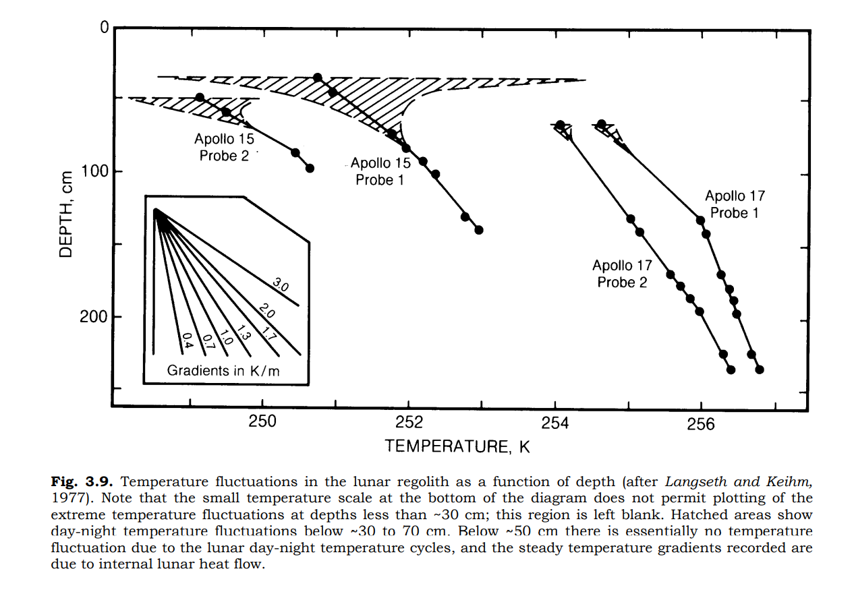
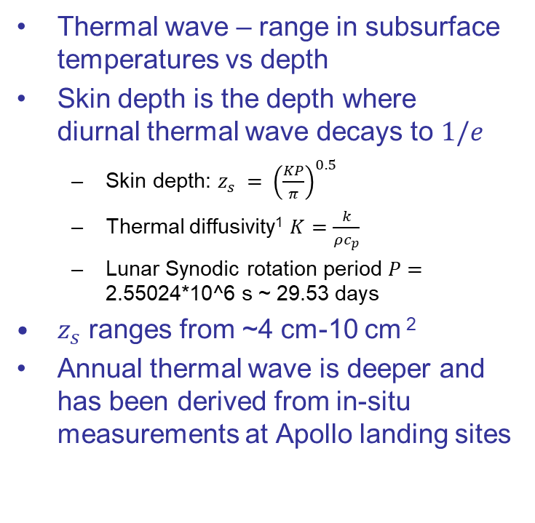
Thermal Wave / Skin Depth
Temperature as a function of depth at the Apollo 15 and 17 landing sites (From Lunar Sourcebook: A User’s Guide to the Moon
Thermal wave – range in subsurface temperatures vs depth
Skin depth is the depth where diurnal thermal wave decays to $1/e$
  Skin depth: $z_{s} = {\left(\frac{KP}{π}\right)}^{0.5}$
  Thermal diffusivity¹ $K=\frac{k}{ρc_{p}}$
  Lunar Synodic rotation period $P=\text{2.55024*10^6 }\text{s}\text{ \sim 29.53 }\text{days}$
$z_{s}$ ranges from ~4 cm-10 cm ²
Annual thermal wave is deeper and has been derived from in-situ measurements at Apollo landing sites
Langseth et al., “Revised lunar heat-flow values.,” 1976.Table 1.
² P. Gläser and D. Gläser, “Modeling near-surface temperatures of airless bodies with application to the Moon,” 2019.

Slide 19
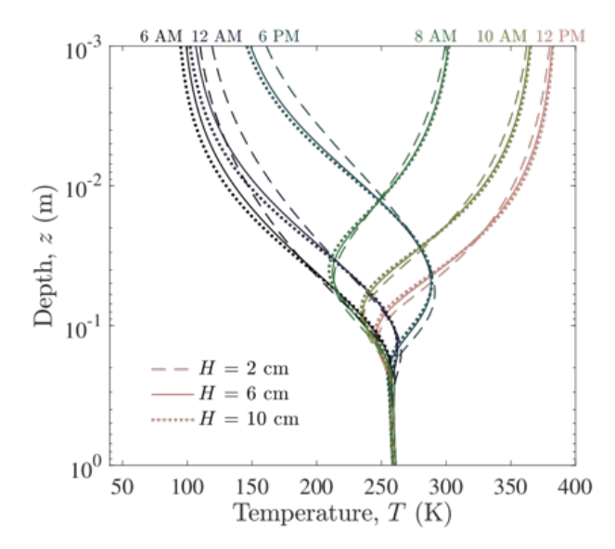
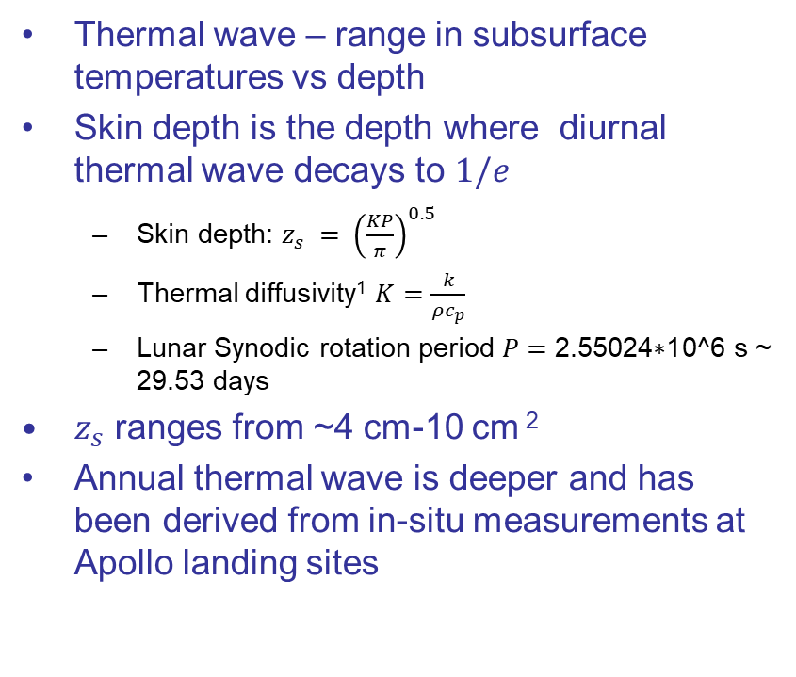
Thermal Wave / Skin Depth
Thermal wave – range in subsurface temperatures vs depth
Skin depth is the depth where diurnal thermal wave decays to $1/e$
  Skin depth: $z_{s} = {\left(\frac{KP}{π}\right)}^{0.5}$
  Thermal diffusivity¹ $K=\frac{k}{ρc_{p}}$
  Lunar Synodic rotation period $P=\text{2.55024∗10^6 }\text{s}\text{ \sim 29.53 }\text{days}$
$z_{s}$ ranges from ~4 cm-10 cm ²
Annual thermal wave is deeper and has been derived from in-situ measurements at Apollo landing sites
Lunar subsurface thermal wave predicted for different H parameters by Hayne 2017 ³
¹ Langseth et al., “Revised lunar heat-flow values.,” 1976.Table 1.
² P. Gläser and D. Gläser, “Modeling near-surface temperatures of airless bodies with application to the Moon,” 2019.
³ Hayne et al., “Global Regolith Thermophysical Properties of the Moon From the Diviner Lunar Radiometer Experiment: Lunar Regolith Thermophysical Properties,” 2017.

Slide 20
Ground Heat Flow
A geothermal heat flux is imposed on the top layer of lunar regolith from radioisotopes in the crust
Apollo heat-flow experiment data were used to calculated ground heat flux at the Apollo 15 and 17 (applied to top ~2m of regolith)
  Not globally applicable due to the ground’s higher thorium content ³
Langseth et al. estimated a global average heat flux, assuming it equaled the heat flux from radioisotopes beneath the surface
Subsurface temperatures in shadowed craters are likely very sensitive to ground heat flux ⁵
Quantifying global subsurface heat fluxes is still an active area of research
Region | Q [W/(m²K)] | Derived from
Hadley Rille | 0.021 | Apollo 15 heat probe data ^{1,2}
Taurus-Littrow | 0.016 | Apollo 17 heat probe data ^{1,2}
Global average | 0.018 | Adjusted from Apollo 15 and 17 values based on estimated concentrations of subsurface K, U, and Tr ^{1,2}
Cabeus & Haworth Crater | 0.0112 | Chang׳E-2 microwave radiometer data ⁴
Shoemaker Crater | 0.0074 | Chang׳E-2 microwave radiometer data ⁴
LCROSS impact site (49.6W, 84.7S) | 0.01 | Chang׳E-2 microwave radiometer data ⁴
Lunar S. Pole | 0.009 | Chang׳E-2 microwave radiometer data and LRO Diviner data ⁶
¹ Langseth et al., “Heat-flow experiment. In Apollo 17 Preliminary Science Report.,” NASA SP-330.
² Langseth et al.,, “Revised lunar heat-flow values.,” Lunar and Planetary Science Conference Proceedings, vol. 3, p. 3143, Apr. 1976.
³ Siegler and Paige, “Lunar Global Heat Flow: Predictions and Constraints,” presented at the Lunar Science for Landed Missions Workshop, NASA Ames, 2018.
⁴ Wei et al, “Thermal behavior of regolith at cold traps on the Moon׳s south pole: Revealed by Chang׳E-2 microwave radiometer data,” 2016.
⁵ Glenar, et. al., “Earthshine as an Illumination Source at the Moon”, 2019.
⁶ Feng et al., “Thermal Gradient Of Regolith In Lunar South Polar Region Inferred From LRO Diviner And CE-2 MRM Data,” 2020.

