Slide 1

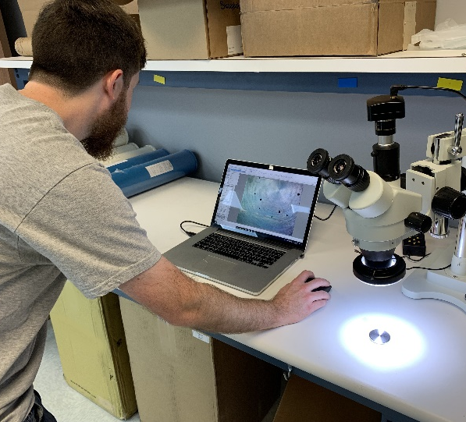
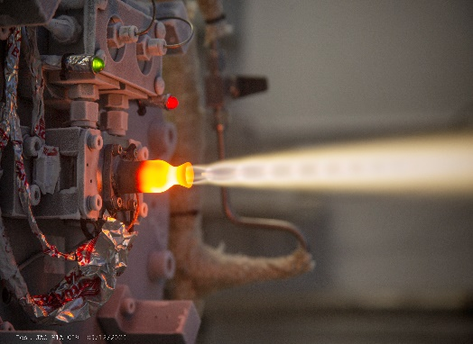
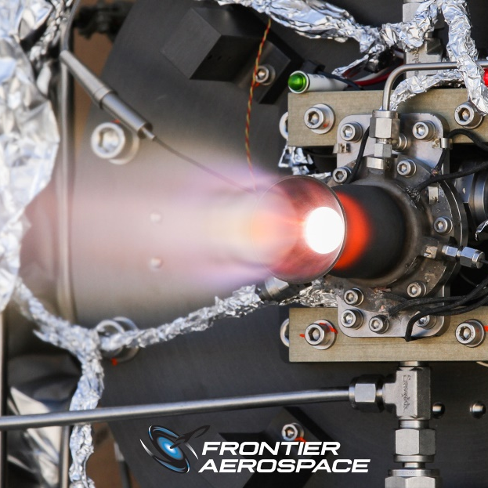
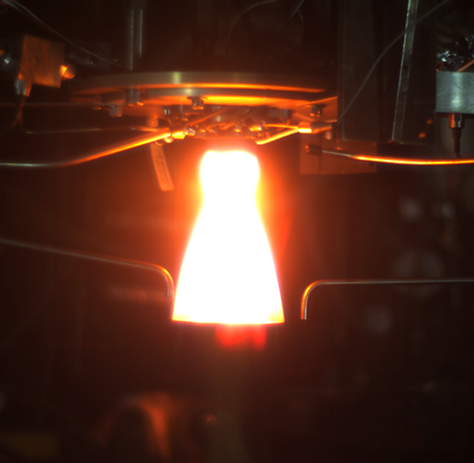
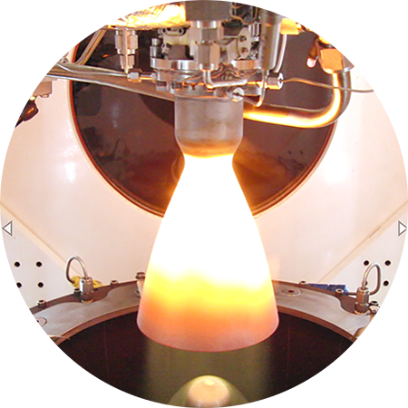
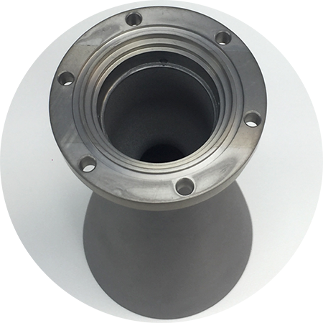
Space Technology Mission Directorate
Game Changing Development Program – TALOS & FACET-TP
Annual Review
Debra Terrell | TALOS/FACET-TP Project Manager | 09.01.2022
Notes:
Please provide pictures specific to your Project for each circle in this coversheet
Please make sure the pictures are Publicly Available and have been cleared by your Center

Slide 2
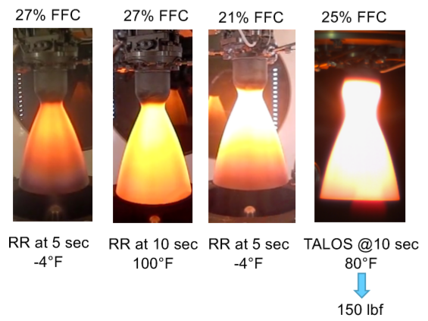
Technology Overview
TALOS/FACET Overview
Technology Goal
  TALOS seeks to develop an Axial (150-lbf) and Attitude Control System
  (10-lbf) thrusters using MON-25 oxidizer. TALOS thrusters are capable of low
  operating temperatures and state of the art pulse-mode operation.
  FACET-TP produces 5 Axial (150-lbf) Flight thrusters, and one spare kit, to be
  flown on Astrobotic Peregrine lunar lander .
Technical Capabilities
  TALOS is a MON-25/MMH Bipropellant thruster
    Lower Operating propellant temperature as compared to the
    state-of-the-art MON engines
      MON-25 is capable of operating between -40°and 80°Fahrenheit
    Pulse-mode operated
      The TALOS engines can pulse roughly three times faster that thrusters of similar size
      Descent engine capability
    Utilization of current valve technology
      Latest in valve technology leveraged from work with Missile Defense Agency (MDA)
      Smaller valve package and consequent reduction in mass
Acoustically stable with acceptable chug margins
TALOS provides a thruster solution that operates at low temperature with a reduced envelope and lower mass than other domestic options

Slide 3

TALOS Overview
Exploration & Science Impact
  Designed to answer an agency need for a domestic, adaptable & extensible thruster for spacecraft main propulsion, attitude control systems, and lander descent/ascent that has pulse-mode capability and low propellant temperature operation
    Applicable to:
      Pulse-mode operated lunar spacecraft
      Deep Space spacecraft for long duration missions
      Planetary landers in extreme environments
  Astrobotic Technology of Pittsburgh and Masten Space Systems of Mojave plan to use the new thrusters aboard their first lunar landers.
Less propellant conditioning = More payload
Lower Thruster Weight = More payload
Faster Minimum Impulse Bit = More control

Slide 4
TALOS Team Members
TALOS-FACET Project Manager
Debra Terrell
Chris Hill, Deputy
Kyle Bankhead, Project Coordinator
Frontier Aerospace Corporation
Andy Ferng, TALOS-FACET Developer/Project Manager
Andy Ferng
Principal Designer/CEO
Jim McKinnon
TALOS-FACET Lead Systems Engineer
Dale Jackson
TALOS-FACET Chief Engineer
George Young
TALOS-FACET Budget Analyst
Lisa Dorsett
TALOS-FACET Propulsion Technical Team Members
GCD Project Element Manager
Fred Elliott
Notes:
If you have submitted a Project Plan, you could utilize the Organizational Chart found in section 8.3 – Management Structure

Slide 5
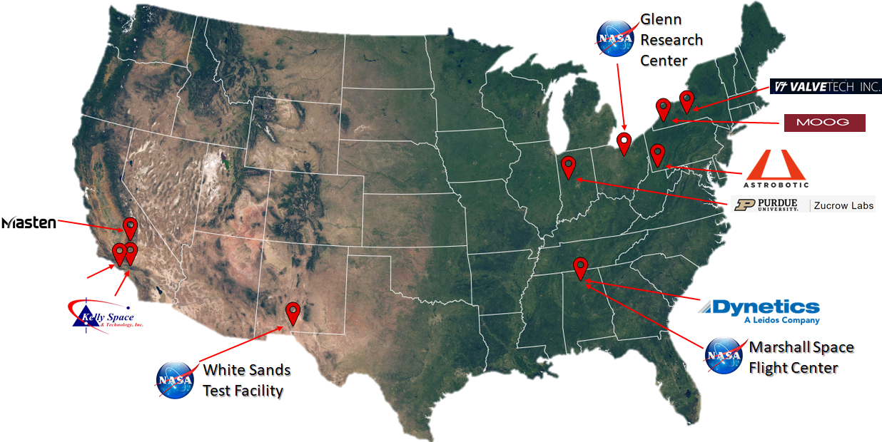
Collaborations & Partnerships
Infusion/transition plan
  TALOS thrusters are baselined for CLPS missions
    Astrobotic Peregrine – first flight on SMD CLPS mission Task Order #2
    TALOS axial thrusters are baselined for Masten Space Systems CLPS mission for Task Order 19C
    Two other companies in the CLPS provider pool have interest in TALOS, if selected for a mission

Slide 6

TALOS Technology Goals & Project Objectives
Technology Goals
Goal #1 | Provide a pulse-mode operated, bipropellant (MON-25/MMH) thruster to the domestic aerospace market with a Technology Readiness Level (TRL) of 6.
Goal #2 | Advance the use of high MON propellants for low propellant temperature applications by demonstrating stable operation in a relevant environment.
Goal #3 | Develop propulsion that will be infused into near-term NASA lunar missions and extensible to future NASA missions into deep space.
Project Objectives
Objective #1 | Design, build, and test MON-25/MMH (150 lbf-class) axial thrusters suitable for lunar or in-space propulsion applications.
Objective #2 | Design, build, and test MON-25/MMH (10 lbf-class) Attitude Control System (ACS) thrusters suitable for spacecraft attitude control.
We are well on our way to meeting these technical goals. Schedule is the biggest challenge.

Slide 7
TALOS Lifecycle Milestone/Maturity Schedule
Axial Qual
ACS Qual
FY19 | FY20 | FY21 | FY22 | FY23
Axial DVT
6
Axial WH
ACS DVT
Axial Flight Units
5
Axial CDR
4
ACS Thruster
TRL
3
Axial Thruster
ACS CDR
2
Complete
1
Project Milestone
GCD (Key) Milestone
Controlled Milestone
TRL/SRL/MRL Progression
Notes:
Chart purpose: show TRL/SRL/MRL advancement over the project lifecycle schedule. Show TRL advancements as whole integer increases. Show how Key and Controlled milestones align with TRL advancement.
TRL/SRL/MRL may not advance at each milestone. Often several milestones are required to produce a step increase in TRL/SRL/MRL.
There can be one, or more, of these charts per project as needed.
For projects with fewer technical elements, the TRL/SRL/MRL data can be combined on one chart.
For more complex projects, the TRL/SRL/MRL progression can separated into multiple charts by project technical area.
Show TRL, SRL, and MRL data for each technical element on the same chart.
Delete TRL/SRL/MRL axis-labels that do not apply – e.g., remove SRL/MRL for projects/technical areas where SRL and MRL do not apply.

Slide 8
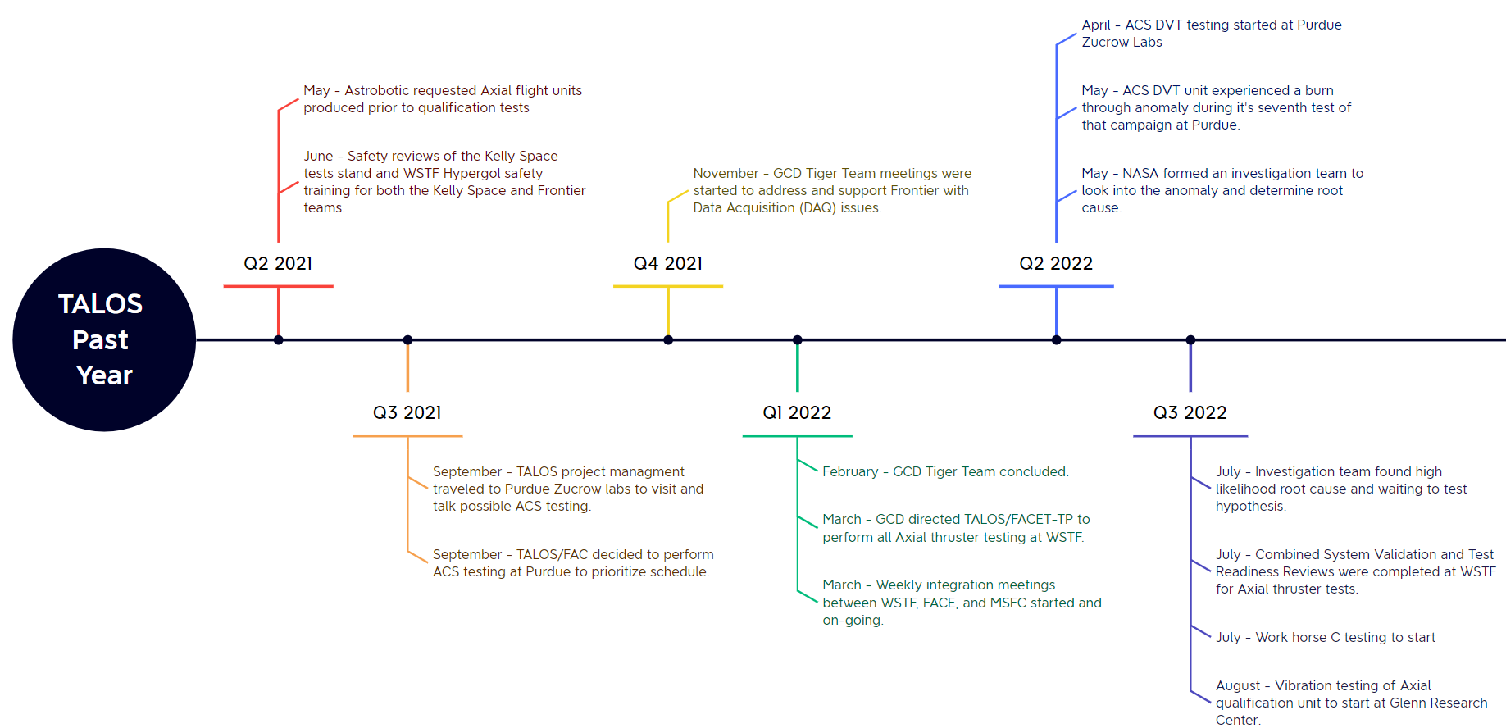
Accomplishments
July-Aug – Workhorse C testing at WSTF

Slide 9
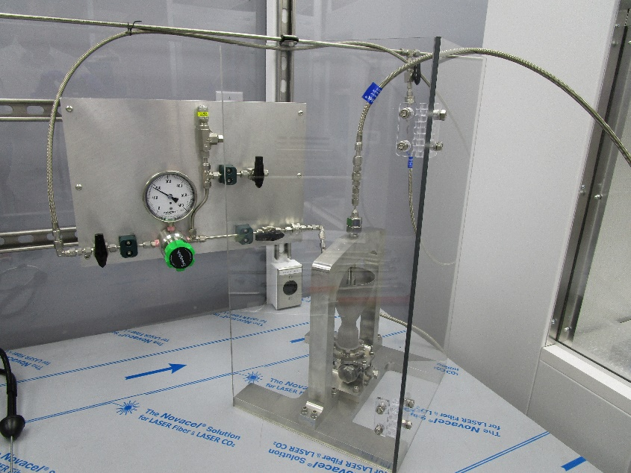
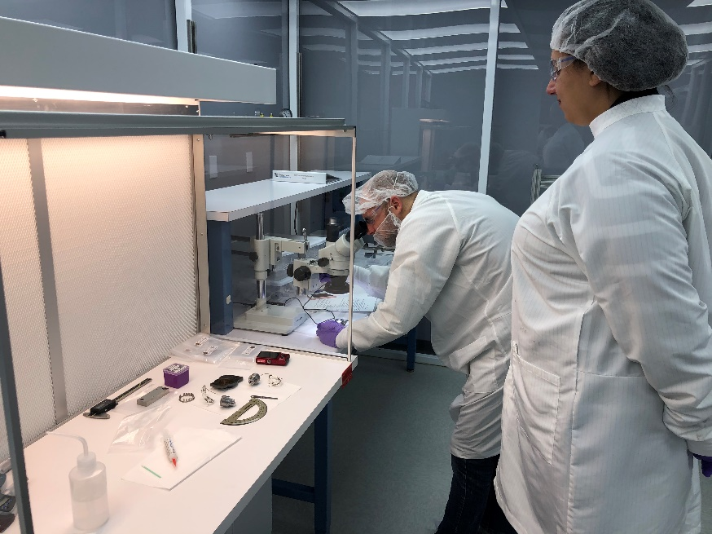
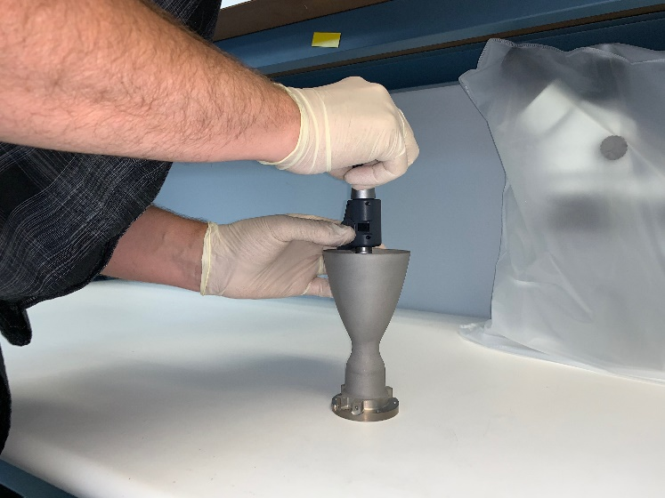
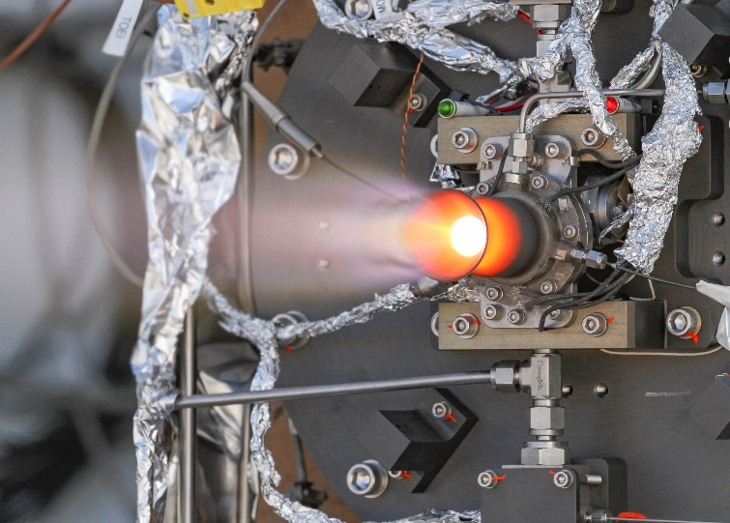
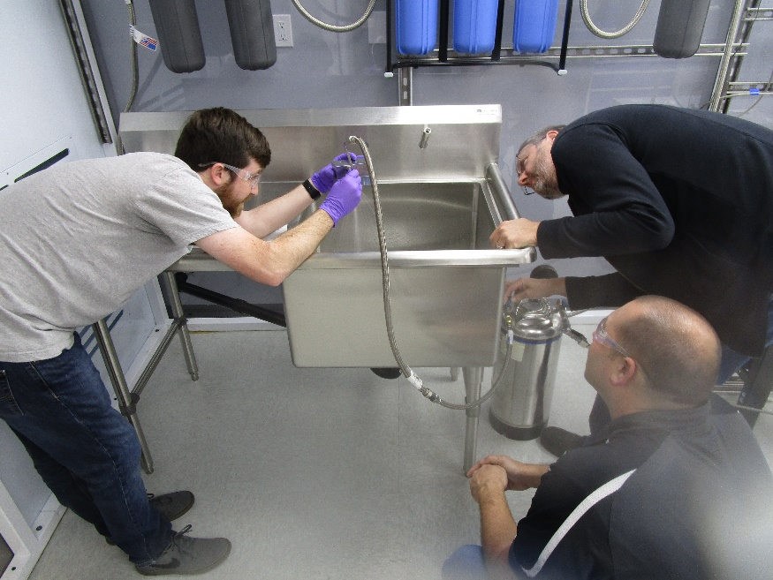
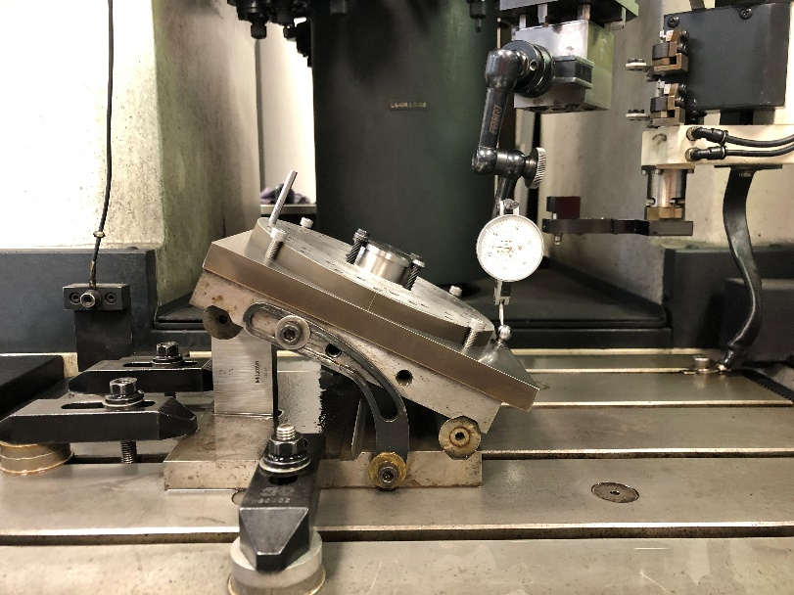
Technical Accomplishments
Technical Accomplishments (YTD)
After an anomaly in Attitude Control System (10 lbf) Design Verification Testing (DVT), an Investigation Team was stood up including NASA, Frontier and Purdue test stand personnel. An investigation plan was devised and implemented. A preliminary report tailored to the needs of the Astrobotic Peregrine mission is nearing completion.
Qualification level Vibration testing of one Axial (150 lbf) qualification thruster was completed in August 2022. This accelerated vibration testing was implemented to buy down some risk for the flight thrusters.
Axial (150 lbf) Work Horse (WH-C) test stand integration and checkout testing has been completed at White Sands Test Facility (WSTF).
FACET (150 lbf) flight thruster acceptance tests are beginning as early as this week (Sept. 13th planned).

Slide 10
Project Assessment Summary
Project Name | Performance |  |  |  | Comments
 | C | S | T | P
Mid Year |  |  |  |  | Technical – ACS DVT preparation progressing at Purdue, Vacuum Compatible Axial DVT unit in production. WSTF available for axial testing. Cost – Need funds for added cost to extend schedule and mod contracts. Schedule – Continues to slip to the right Programmatic – Cost additions and schedule slips
Annual |  |  |  |  | Technical – Test anomaly in ACS DVT, Test uncertainty for Axial Acceptance Cost – FY22 fully funded. FY23 funds are unplanned addition Schedule – Axial DVT and Qual are after planned first flight launch Programmatic – Increased cost and schedule slips

Slide 11
Plans Forward and Infusion Plan
TALOS thrusters are currently contracted for flight on two Commercial Lunar Payload Services (CLPS) missions
  Astrobotic Peregrine Mission 1
    Both Axial and ACS thrusters
    Target launch 2022
  Masten Space Systems Mission 1
    Axial thrusters
    Target launch 2023
  Two other CLPS providers have expressed interest in using TALOS thrusters should they be awarded a mission
TALOS Deep Space Variant (TALOS-DSV) initially planned for FY22 start was cancelled due to TALOS schedule slips and GCD budget constraints.

Slide 12
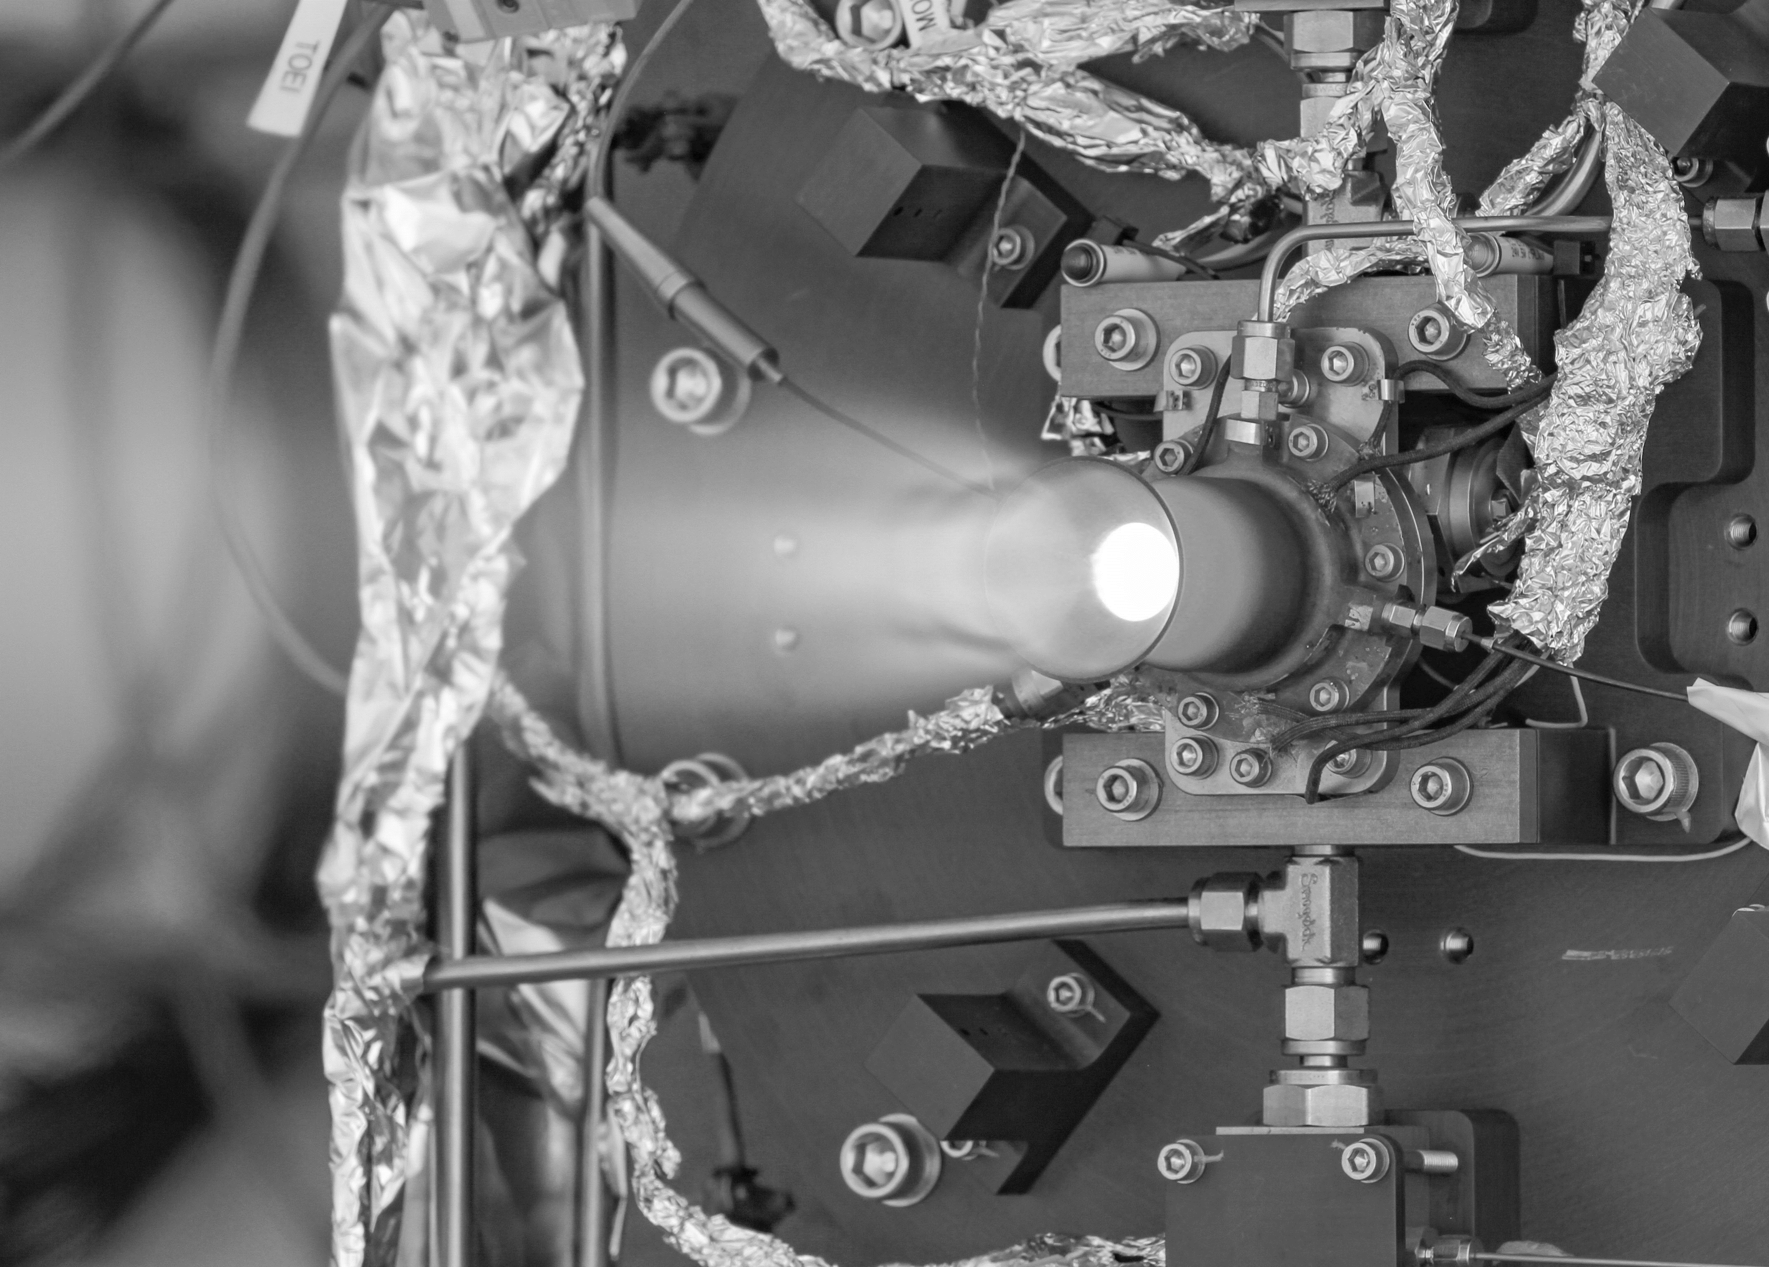

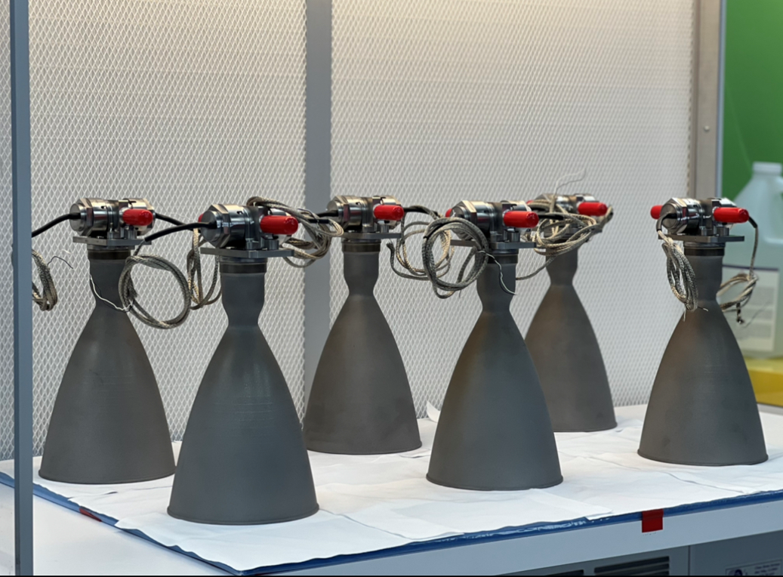
TALOS FACET Project Summary
Qualification level Vibration testing of one Axial (150 lbf) qualification thruster was completed in August 2022. This accelerated vibration testing was implemented to buy down some risk for the flight thrusters.
Axial (150 lbf) Work Horse (WH-C) test stand integration and checkout testing has been completed at White Sands Test Facility (WSTF).
All 5 FACET (150 lbf) flight thrusters are assembled and awaiting test facility availability. FACET flight thruster acceptance tests are beginning as early as this week (Sept. 13th planned).
After an anomaly in Attitude Control System (10 lbf) Design Verification Testing (DVT), an Investigation Team was stood up including NASA, Frontier and Purdue test stand personnel. An investigation plan was devised and implemented. A preliminary report tailored to the needs of the Astrobotic Peregrine mission is nearing completion.
TALOS thruster image courtesy of Frontier Aerospace Corporation

Slide 13
TALOS-FACET Milestones
T – TALOS; F – FACET-TP;
K – key milestone; C – controlled milestone
T | ID | Title | Baseline Date | Current Planned Date | Comments (10/1 schedule update)
F | K1 | Injector Fabrication for Flight Test Units | 5/31/2020 | 1/12/22 | Complete
F | K7 | Procure valves for [axial] flight units | 5/31/2020 | 12/1/2021 | Complete
T | N/A | 2nd Axial DVT delta-TRR |  | 11/9/2021 | Complete – Another Axial DVT at WSTF planned
T | K5 | Axial DVT Testing Complete | 2/28/2020 | 2/20/2023 | Per WSTF schedule 6/22/22
T | N/A | Axial post-DVT Data Review Complete |  | 3/3/2023
T | N/A | ACS DVT TRR |  | 3/4/2022 | Complete
T | K6 | ACS DVT Testing Complete | 3/31/2020 | TBD | Awaiting conclusion of anomaly investigation
T | N/A | ACS post-DVT Data Review Complete |  | TBD
F | K4 | Axial Thruster Flight Units Assembly Complete | 6/30/2020 | 6/16/2022
F | N/A | Axial Thruster Acceptance Test TRR |  | 7/14/2022
F | C2 | [Axial] Thruster Hot-Fire Acceptance Testing Complete | 7/31/2020 | 10/12/2022
F | K5 | Axial Thruster Acceptance Test Data Review & Report Delivered | 8/31/2020 | 10/12/2022 | Thrusters will be shipped serially and test data for each thruster will be included with shipment to Astrobotic
F | C3 | Shipment of Axial Thruster Flight Units Complete | 8/31/2020 | 10/12/2022
N/A | N/A | FAC ACS Thruster Acceptance Testing Complete |  | TBD | Not TALOS or FACET responsibility - First of 14 acceptance tests completed 8/1/2022. Schedule evaluation underway.
T | N/A | ACS Qualification Test TRR |  | TBD | Test article installation complete
T | C6 | ACS Qualification Testing Complete | 6/12/2020 | TBD
T | N/A | ACS Qualification Test Data Review & delta CDR |  | TBD

Slide 14
TALOS-FACET Milestones
T – TALOS; F – FACET-TP;
K – key milestone; C – controlled milestone
T | ID | Title | Baseline Date | Current Planned Date | Comments
T | K7 | Axial Qualification Testing TRR | 3/31/2020 | 3/28/2023
T | C5 | Axial Qualification Testing Complete | 6/12/2020 | 5/11/2023
T | N/A | Axial Qualification Test Data Review |  | 5/29/2023
F | K6 | Support Integration, Flight Operations, & Data Analysis | 3/31/2021 | TBD | Unable to obtain needed dates for these activities from Astrobotic
F | C4 | Deliver Final Report | 5/13/2021 | 6/30/2023
T | C7 | Final Review (Contract and Project) | 6/30/2020 | 6/15/2023

Slide 15
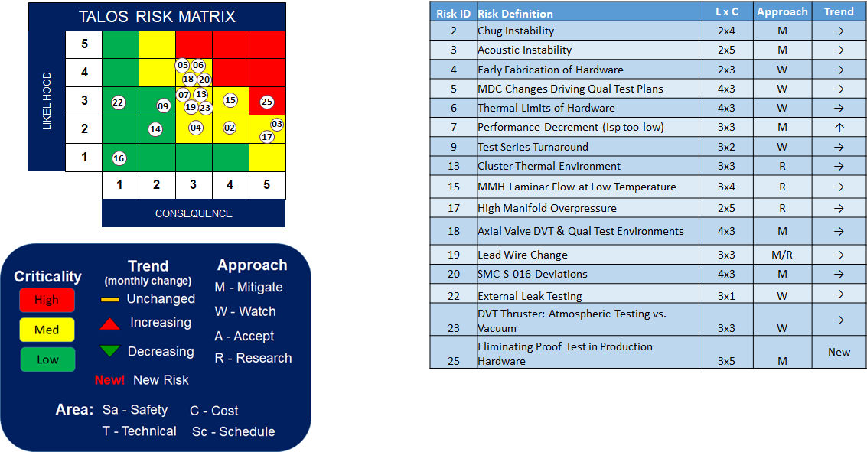
TALOS Risk Summary

Slide 16

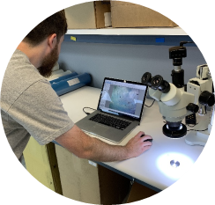
Cover Slide Annotate Images
TALOS Axial Workhorse C
TALOS ACS Workhorse
TALOS Axial Chamber
TALOS Hardware Inspection
TALOS Axial Thermal Stress Test
TALOS Axial Hot-Fire Test
Notes:
MAKE SURE THE PICTURES HAVE BEEN APPROVED BY YOUR CENTER FOR PUBLIC RELEASE
Provide an annotated description of the project images on the front cover slide

