Slide 1


Lunar Thermal Analysis Guidebook (L-TAG):
Lunar Space and Surface Thermal Environments
Carlos Gomez, Brian Hamill, Greg Schunk
NASA/Marshall Space Flight Center
&
Lisa Erickson
NASA/Johnson Space Center
TFAWS Short Course
Presented By
Brian Hamill
Thermal & Fluids Analysis Workshop
TFAWS 2022
September 6th-9th, 2022
Virtual Conference

Slide 2
DSNE Lunar Thermal Environments
Sources
  Design Standard for Natural Environments, Section 3.3.9.1: Thermal Environment for Lunar Orbital Phases,
  Lunar Thermal Analysis Guidebook, Section 4.0: Lunar Space Thermal Environments
Environments in DSNE are inputs for both Orbital and Surface analyses
  Lunar surface Albedo and Planetshine values can be characterized for orbital cases
  Surface is a participatory element in landed cases and a coupled vehicle/surface model is required.
DSNE Environments
  Solar Flux
    Separate range for Lunar Space accounting for additional variation in Lunar-Sun distance should not be confused with Solar Flux range provided for Near Earth mission phases.
      Maximum solar flux: 1,421 W/m²
      Mean solar flux: 1,367 W/m² (Solar Constant)
      Minimum solar flux: 1,315 W/m²
    Values should include an additional 5 W/m² measurement uncertainty when used in analysis

Slide 3
DSNE Lunar Thermal Environments
DSNE Environments
  Albedo:
    Lunar Near Side (Earth-facing)
      Average: 0.12 (164 W/m²)
      High: 0.20 (285 W/m²)
      Low: 0.07 (91 W/m²)
    Lunar Far Side
      Average: 0.15 (205 W/m²)
      High: 0.20 (285 W/m²)
      Low: 0.10 (131 W/m²)
  Emissivity:
    ε = 0.95 – 0.98
Planetshine Derivation
  Absorptivity:
    α = 1 – ā
  Planetshine
    Subsolar point
      εσ(T_{s})⁴ ≈ (1 - ā) S_{o}
    Solar irradiance varies as cos(i), where i is the solar incidence angle (the angle between the Moon-Sun vector and the Moon-satellite vector).
      εσT4 ≈ (1 - ā) S_{o} cos(i)
    Unilluminated Surface temperature
      100K ± 20K

Slide 4
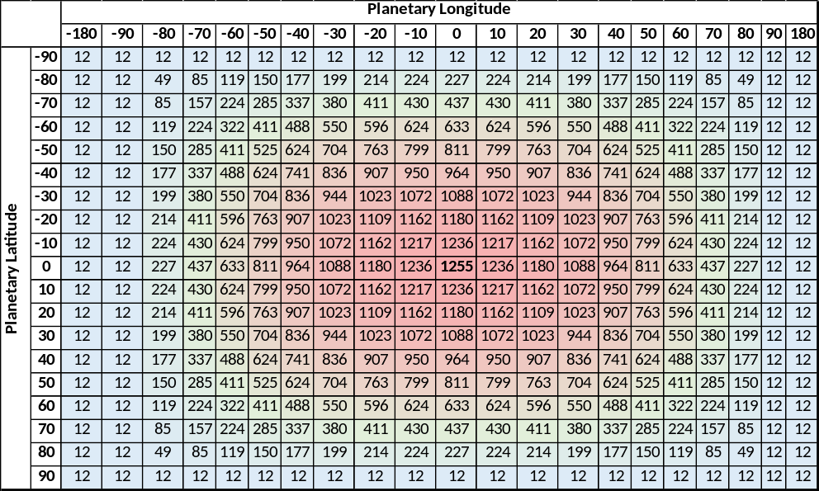
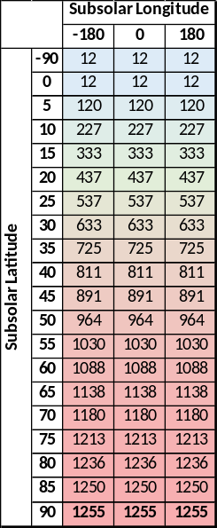


Lunar Orbital Thermal Model Inputs
Example DSNE value combinations for Cold and Hot biased analysis cases
Planetshine calculations
  Includes equation modifications from DSNE to account for unilluminated surface temperatures
  For Planetary Coordinate System:
    If (-90º ≤ (Long_{planetary} - Long_{subsolar}) ≤ 90º) Then
    Else
  For Subsolar Coordinate System:
    If (Latss ≥ 0º) then
    Else
$${\text{Q}}_{\text{IR}}\text{ = }\text{sin}\text{(}{\text{Lat}}_{\text{SS}}\text{) ∙}\left(\left(\text{1 }\text{−} \text{a}\right)\text{ ∙ }{\text{S}}_{\text{0}} \text{−} \text{σ}\text{ ∙ }\text{ε}\text{ ∙} {{\text{T}}_{\text{Dark}}}^{\text{4}}\right)\text{+ }\text{σ}\text{ ∙ }\text{ε}\text{ ∙} {{\text{T}}_{\text{Dark}}}^{\text{4}}$$
Cold Case
Solar | Min Albedo |  | Combined Cold |  | Min OLR |  | Unilluminated Surface
(W/m2) | Albedo | Emissivity | Albedo | Emissivity | Albedo | Emissivity | Temperature (K)
1310 | 0.07 | 0.95 | 0.15 | 0.95 | 0.2 | 0.95 | 80
Hot Case
Solar | Max Albedo |  | Combined Hot |  | Max OLR |  | Unilluminated Surface
(W/m2) | Albedo | Emissivity | Albedo | Emissivity | Albedo | Emissivity | Temperature (K)
1426 | 0.2 | 0.98 | 0.12 | 0.98 | 0.07 | 0.98 | 120
$${\text{Q}}_{\text{IR}}\text{ = }\text{σ}\text{ ∙ }\text{ε}\text{ ∙ }{{\text{T}}_{\text{Dark}}}^{\text{4}}$$
$${\text{Q}}_{\text{IR}}\text{ =}\left(\text{cos}\left({\text{Long}}_{\text{planetary} }\text{−} {\text{Long}}_{\text{subsolar}}\right)\text{∙ }\left({\text{Lat}}_{\text{planetary}}\text{− }{\text{Lat}}_{\text{subsolar}}\right)\right)\text{∙}\left(\left(\text{1}\text{−}\text{a}\right)\text{ ∙ }{\text{S}}_{\text{0}}\text{−} \text{σ}\text{ ∙ }\text{ε}\text{ ∙ }{{\text{T}}_{\text{Dark}}}^{\text{4}}\right)\text{+ }\text{σ}\text{ ∙ }\text{ε}\text{ ∙ }{{\text{T}}_{\text{Dark}}}^{\text{4}}$$
$${\text{Q}}_{\text{IR}}\text{ = }\text{σ}\text{ ∙ }\text{ε}\text{ ∙ }{{\text{T}}_{\text{Dark}}}^{\text{4}}$$

Slide 5
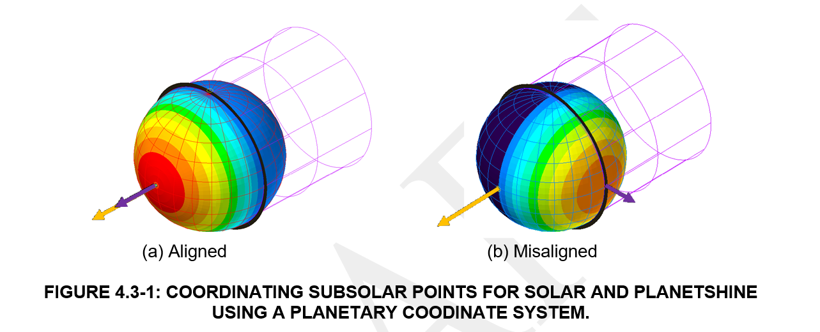
Lunar Thermal Model Inputs
In Thermal Desktop, using the Subsolar coordinate system for orbital cases requires a simpler 2-column planetshine input
Also avoids a simple-to-make solar vector alignment error
  Solar heat rates are calculated during Radk HR task, separate from planetshine table.
  A different Planetshine input table must be generated for each set of orbital parameters (RA Sun, RAAN, etc…) or the Solar Subsolar point and Planetshine subsolar point might not be at the same planetary coordinates.

Slide 6
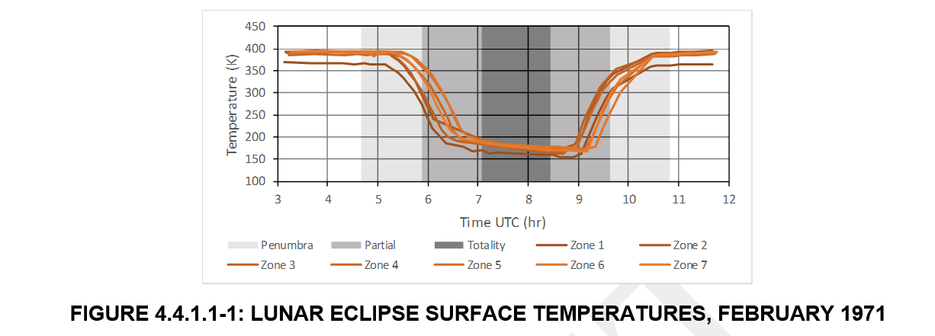
Solar Eclipse Durations
Low Lunar Orbit (LLO)
  Earth Shadow
    Lunar Eclipses for years 1901 – 2100: http://eclipse.gsfc.nasa.gov/lunar.html
    DSNE Table 3.3.9.1.4-1. Projected Worst Case Minimum Solar Flux during Lunar Eclipse, Dated June 26, 2029
    To Model an eclipse event, Solar and Albedo should be set to zero for the duration of partial and total eclipse. Planetshine should be set to unilluminated side values.
  Lunar Shadow
    For orbital mission timelines not inclusive of a lunar eclipse, normal shadowing by the Moon calculated by orbital parameters represents the worst case.
Orbit Altitude | Totality | No Solar Flux (Worst Case)
100 km | 188 minutes | 233 minutes
500 km | 197 minutes | 242 minutes
1,000 km | 177 minutes | 234 minutes

Slide 7
Solar Eclipse Durations
Near Rectilinear Halo Orbit (NRHO)
  Earth Shadow
    For the NASA Gateway NRHO, calculations by Johnson Space Center show that the planned 9:2 Lunar Synodic Resonant NRHO is able to mostly avoid eclipse by Earth shadow from January 2020 to February 2035, with two partial eclipses during the 14th and 15th years. These could also be avoided with orbital modifications by the spacecraft.
  Lunar Shadow
    Eclipses by the Moon would occur several times every year but are always less than 80 minutes. For Solar Eclipses by the Moon in an NRHO (GATEWAY) orbit, the minimum, mean, and maximum eclipse durations are given in Table 5 of the Gateway Integrated Thermal Model Development IAC4r0 document [3] and shown below in Table 4.4.2.2-1
    Depending on the method used to simulate an NRHO orbit, normal shadowing by the Moon calculated by orbital parameters may not represent the worst case and shadow durations from the above table should be used.
Shade | Minimum [minutes] | Mean [minutes] | Maximum [minutes]
Penumbra | 0.9 | 52.5 | 76.1
Umbra | 10.2 | 49.9 | 73.2

Slide 8
Lunar Surface Thermal Environments
Solar Flux
  Use same values as in orbital analysis
Surface Features
  Shadowing is very important for low solar elevation angles.
  DSNE defines typical geometries for craters smaller than 10-15km in diameter
    Can be used to create a simplistic representation in a thermal model
    Larger Craters are not characterized would require use of measured lunar topography
    (covered in another presentation)
  Boulder and other large object distributions defined in DSNE for nearby surface feature effects.

Slide 9
Lunar Surface Thermal Environments
Lunar Surface Temperature
  Landing site optical properties can be assumed to be bounded by min and max albedo and emissivity from DSNE, but detailed surface thermal maps can be used to create a higher fidelity site specific optical property distribution.
    http://luna1.diviner.ucla.edu/~jpierre/diviner/level4_raster_data/diviner_tbol_min.xyz
    Table of minimum bolometric temperatures at 0.5 pixels per degree spatial resolution. Format is ascii: lon, lat, bolometric temperature in K.
    http://luna1.diviner.ucla.edu/~jpierre/diviner/level4_raster_data/diviner_tbol_max.xyz
    Table of maximum bolometric temperatures at 0.5 pixels per degree spatial resolution. Format is ascii: lon, lat, bolometric temperature in K.
    http://luna1.diviner.ucla.edu/~jpierre/diviner/level4_raster_data/diviner_tbol_hour00.xyz
    Table of mean bolometric temperatures ±1 hour around midnight local time, gridded at 0.5 pixels per degree spatial resolution. Format is ascii: lon, lat, bolometric temperature in K.
    http://luna1.diviner.ucla.edu/~jpierre/diviner/level4_raster_data/diviner_tbol_hour12.xyz
    Table of mean bolometric temperatures ±1 hour around noon local time, gridded at 0.5 pixels per degree spatial resolution. Format is ascii: lon, lat, bolometric temperature in K.

Slide 10
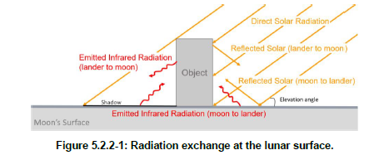
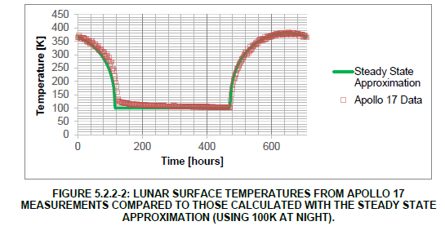
Lunar Surface Thermal Environments
Lunar Surface Temperature - Steady State Approximation
  Lunar surface temperatures are a function of direct incident sunlight, reflected sunlight, with nearby surfaces, conduction to or from objects on the surface, and subsurface heat flow.
  Since the lunar surface has a very low thermal conductivity, surface temperatures are particularly sensitive to shading from vehicles or surface features.
  For equatorial locations, such as the Apollo landing sites, daytime surface temperatures can be approximated by an energy balance across the surface itself using an arithmetic surface.

Slide 11
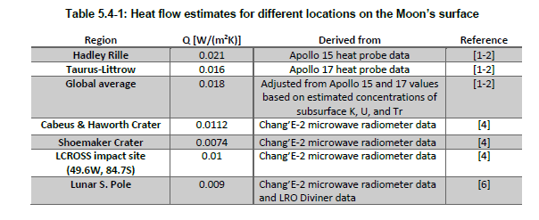
Lunar Surface Thermal Environments
Lunar Surface Temperature – Ground Heat Flow
  Ground heat flow is an important parameter for predicting lunar surface and subsurface temperatures
  For polar regions experience reduce incident solar, these ground heat flows have a larger effect of surface temperature
  Perpetually Shaded Regions (PSRs) of the lunar polar craters may experience non-negligible thermal radiation and reflected solar radiance from the Earth relative to the ground heat flow. Peak broadband earthshine may exceed 150 mW/m² for localized regions

Slide 12
Lunar Thermal Analysis Guidebook (L-TAG):
Using Vector Lists
Carlos Gomez, Brian Hamill, Greg Schunk
NASA/Marshall Space Flight Center
&
Lisa Erickson
NASA/Johnson Space Center
TFAWS Short Course
Presented By
Greg Schunk
Thermal & Fluids Analysis Workshop
TFAWS 2022
September 6th-9th, 2022
Virtual Conference

Slide 13
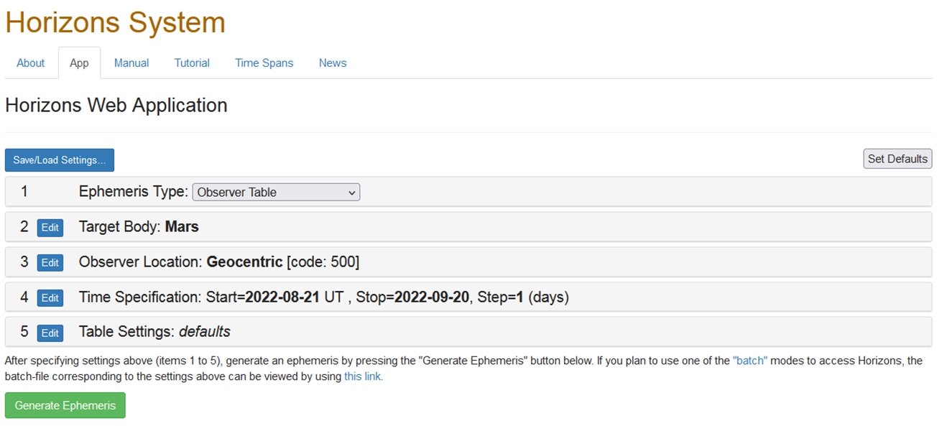
Orbit Vector List for Lunar Surface Modeling
An orbit vector list may be generated from an ephemeris. A web interface is available to provide access to the JPL HORIZONS application which may be used to generate ephemerides for solar system bodies.
Specifically for lunar analyses, the application allows placement of an observer anywhere on or above the surface of the Moon to track a target body (such as the Sun or even the Earth) via user defined parameters.
Elevation angle and azimuth are convenient for conversion into a vector list commonly used by thermal analysis applications such as Thermal Desktop. After accessing the web interface at https://ssd.jpl.nasa.gov/horizons/app.html#/ , the user is presented with the following default settings:

Slide 14
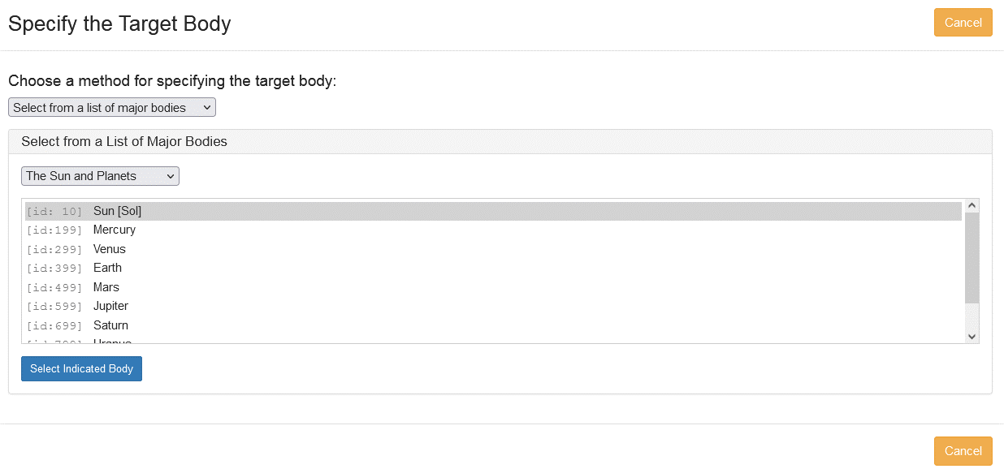
Using HORIZONS
Each setting in the HORIZONS application may be altered through the Edit button. Leave the ephemeris type in Observer Table mode and change the target body to the Sun by choosing Edit and then Select from a list of major bodies from the pull down menu and then select the Sun from the options provided.

Slide 15
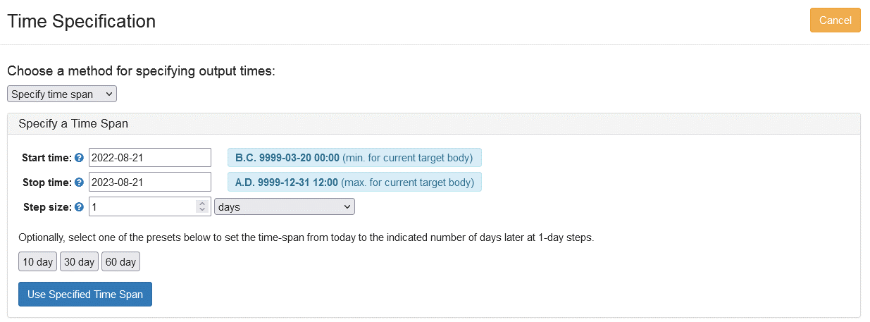
Setting Up the Orbit
Select Edit for the Observer Location and then choose Specify Coordinates from the pull down menu.
Change the Coordinate Body to the Moon by selecting from a pull down list. (The Moon is near the bottom of the list). Enter the desired longitude, latitude and altitude into the displayed dialog. Use negative latitude for the southern hemisphere. The Body ID for the Moon is 301.
Note that the altitude is specified with respect to the IAU reference ellipsoid surface for the Moon. Edit the Time Specification and enter the desired begin and end dates for the ephemeris.

Slide 16
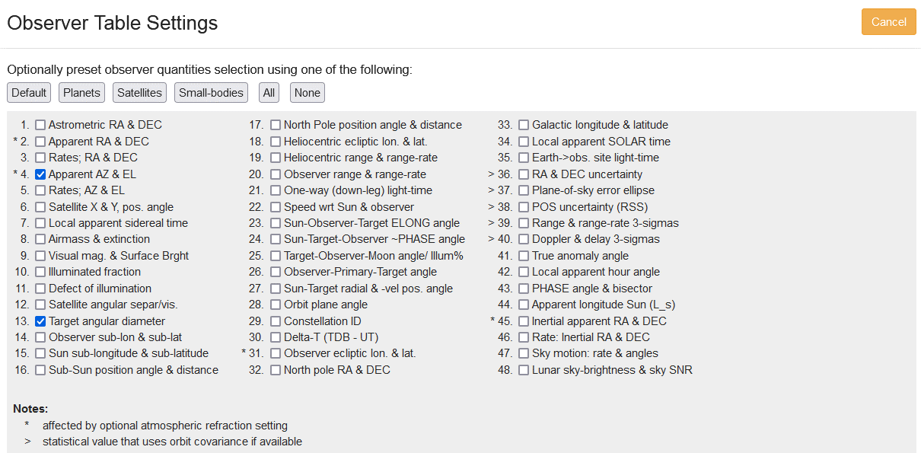
Setting Up the Orbit
Select Edit Table Settings to display the following options. Select #4 Apparent AZ & EL and #13 Target angular diameter and accept to continue. Many options are available.

Slide 17
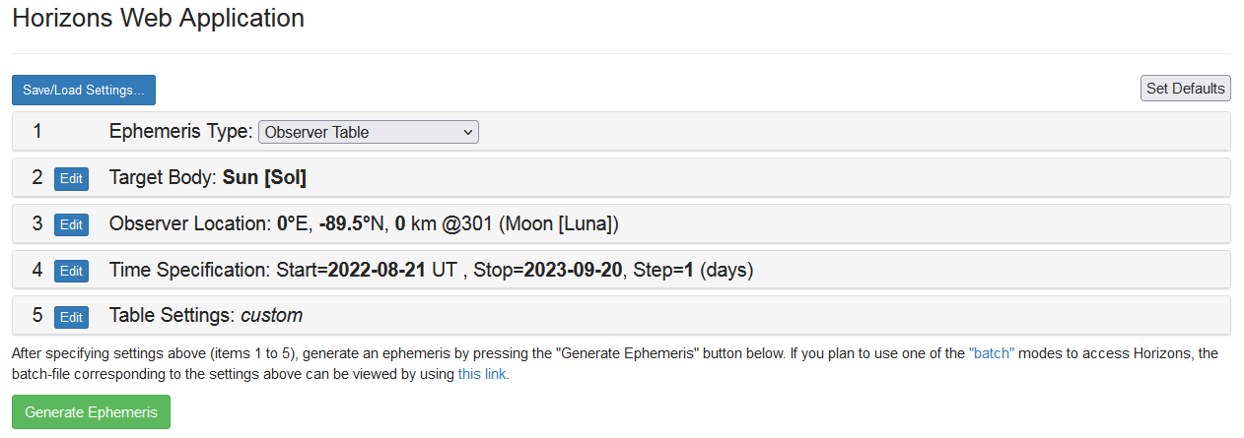
Outputting the Ephemeris
The output form should appear as shown below:
Select Generate Ephemeris and a tabular output will be provided as shown below:
Date__(UT)__HR:MN Azi____(a-app)___Elev Ang-diam
******************************************************
$$SOE
2022-Aug-21 00:00 i 253.939681 -1.668174 1898.670
2022-Aug-22 00:00 i 241.713409 -1.765344 1899.918
2022-Aug-23 00:00 i 229.481626 -1.850880 1901.075
2022-Aug-24 00:00 i 217.245095 -1.920462 1902.114
2022-Aug-25 00:00 i 205.004777 -1.970474 1903.008
2022-Aug-26 00:00 i 192.761821 -1.998205 1903.737

Slide 18
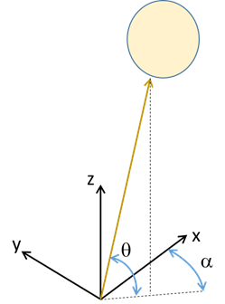


Converting the Ephemeris Output
The first column is the date/time stamp. The * symbol indicates daylight or the solar upper limb is on or above the apparent horizon. Absence of the symbol indicates night time or the Sun has set.
“Azi” and “Elev” are the azimuth and elevation angles relative to the target center. Azimuth is measured clockwise from due north while the elevation angle is respect to the ground plane perpendicular to the local zenith direction.
The final column is the angular diameter of the target (i.e. the Sun) in arc seconds (1 degree=3600 arc seconds). For this application, the angular diameter may be useful for blockage calculations by local terrain or the horizon.
The solar azimuth and elevation angles may be used to derive a unit vector for an orbit description within Thermal Desktop. If the z axis is the local vertical with the x axis pointing to the lunar North Pole, a local coordinate system may be defined as shown. The elevation angle is denoted as θ_{a} and the azimuth angle is denoted as α.
$$\vec{v}$$
$$\vec{v}=\hat{i}\cos{θ_{a}}\cos{α}−\hat{j}\cos{θ_{a}}\sin{α}+\hat{k}\sin{θ_{a}}$$

Slide 19
Vector Orbit Description for a Surface Asset
A table for a vector orbit description is shown below. Time is normalized from the first column of the Ephemeris output. The sun vector is converted from solar elevation and azimuth angles in the Ephemeris output.
Based on the local coordinate system with the z-axis as the local zenith, the planet vector may be defined as (0, 0, -1).
Derive the ratio of distance from planet center to planet radius from the altitude previously entered into the ephemeris. For positions on the Lunar surface, the ratio may only be slightly greater than unity.
$$\vec{v}=\hat{i}\cos{θ_{a}}\cos{α}−\hat{j}\cos{θ_{a}}\sin{α}+\hat{k}\sin{θ_{a}}$$
Thermal Desktop 90ºS
Time | Sun Vector |  |  | Planetary Vector |  |  | Ratio
 | i | j | k | i | j | k
0 | -0.59201 | -0.80548 | 0.02705 | 0 | 0 | -1 | 1.001
1 | -0.74891 | -0.66212 | 0.02716 | 0 | 0 | -1 | 1.001
2 | -0.87199 | -0.48877 | 0.02726 | 0 | 0 | -1 | 1.001
3 | -0.95565 | -0.29325 | 0.02732 | 0 | 0 | -1 | 1.001
4 | -0.99605 | -0.08443 | 0.02735 | 0 | 0 | -1 | 1.001
5 | -0.99137 | 0.12824 | 0.02735 | 0 | 0 | -1 | 1.001
6 | -0.94179 | 0.33509 | 0.02732 | 0 | 0 | -1 | 1.001
7 | -0.84958 | 0.52676 | 0.02725 | 0 | 0 | -1 | 1.001

Slide 20
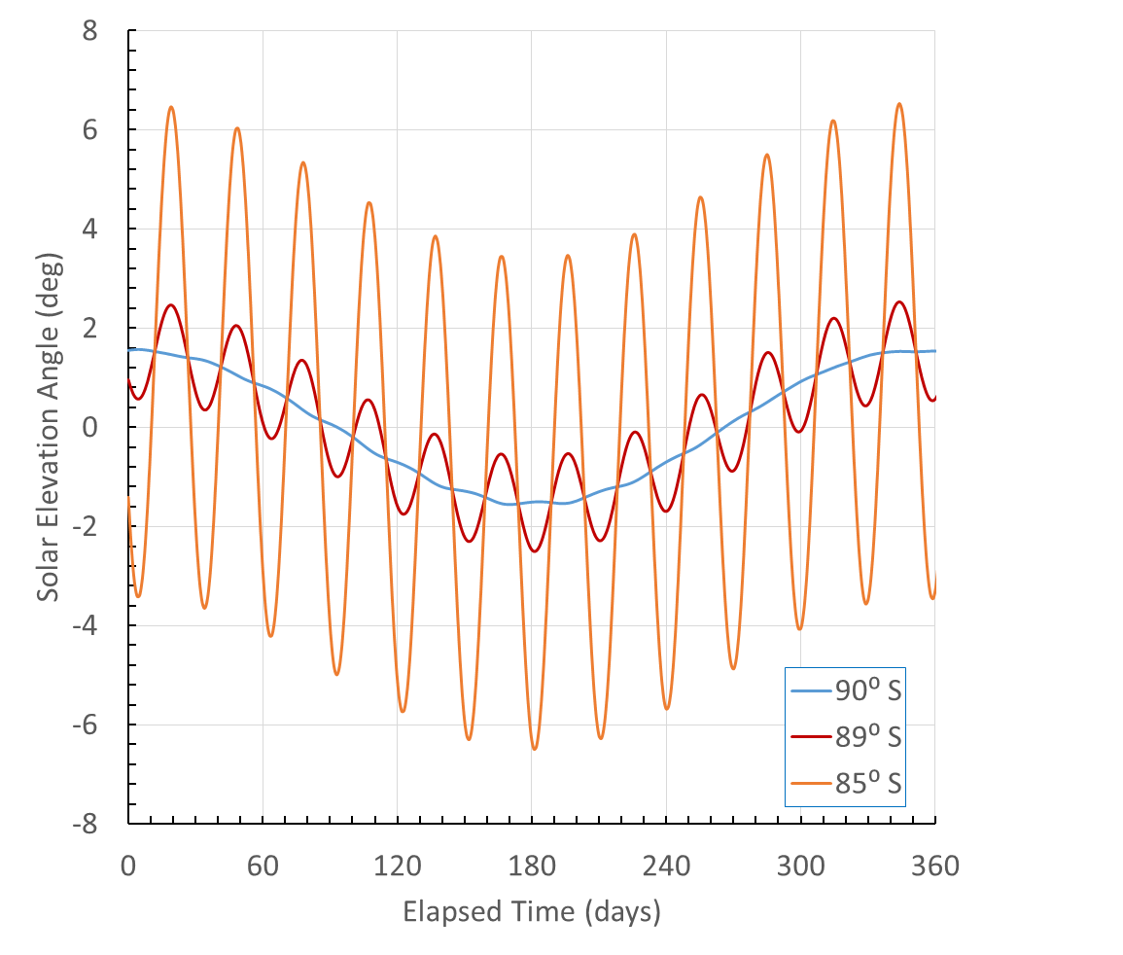



Typical Polar Region Sun Elevation Angle
Day
$$Lunar Synodic Month$$
The yearly variation of the solar elevation angle from an observer located at a range of latitudes near the Lunar South Pole is shown.
Negative elevation angles imply that the Sun is either totally or partially below the horizon. The seasonal variation is quite evident at the pole as the Sun sets below the horizon for approximately half of the calendar year.
The local Sun angle is determined by the Moon’s obliquity relative to the ecliptic plane with a superimposed monthly variation (Synodic period) resulting from variation of the local surface normal due to the difference in latitude from the pole.
At the poles, the monthly variation is zero, resulting in the approximate sinusoidal curve shown.
$$90⁰−Latitude$$
Twilight
$$Lunar Obliquity$$
$$to Ecliptic$$
Night
https://ssd.jpl.nasa.gov/horizons/app.html#/

Slide 21
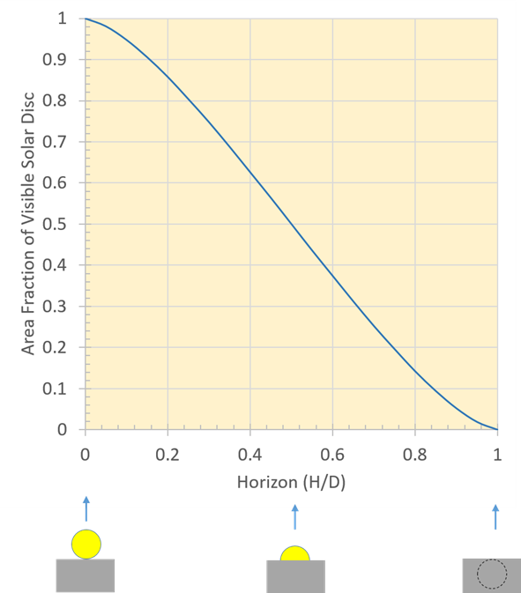
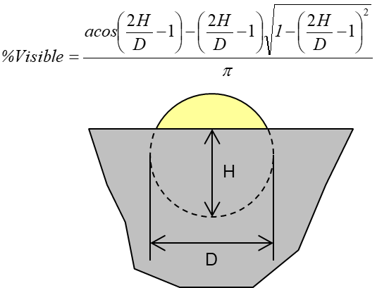
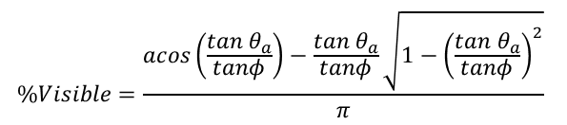

Solar Occultation
The Sun has an apparent angular diameter of approximately 0.53⁰ but the variation in angular diameter is also available through the ephemeris by selecting option #13 Target angular diameter as described previously.
The angular diameter of the Sun may be used to predict simple occultation as the Sun rises or sets above or below the horizon. Solar flux is directly proportional to the areal fraction of the visible Sun disc and may be estimated as shown.
The percent visible may be expressed in a more convenient form (based on the solar elevation angle, θ_{a} and the angular diameter, φ) as shown in the equation below
$$\%Visible=\frac{acos\left(\frac{tan θ_{a}}{tanφ}\right)−\frac{tan θ_{a}}{tanφ}\sqrt{1−{\left(\frac{tan θ_{a}}{tanφ}\right)}^{2}}}{π}$$
$$−φ≤θ_{a}≤φ$$

Slide 22
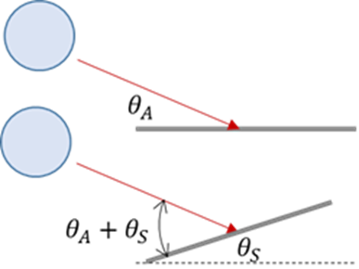
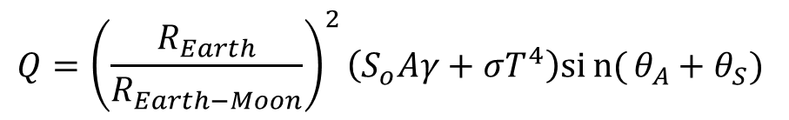
Earthshine Vector List
Perpetually Shaded Regions (PSRs) of the lunar polar craters may experience non-negligible thermal radiation and reflected solar radiance from the Earth (as well as internal ground heat flow). Peak broadband earthshine may exceed 150 mW/m² for localized regions [1].
The hemispherical earthshine at the lunar surface may be approximated by:
Where S_{o} is the solar flux, A is the Earth’s albedo, γ is the fraction of the illuminated Earth disk (100% for peak), T is the black body temperature of the Earth and θ_{A} and θ_{S} are the solar elevation angle and local surface inclination.
Using the JPL ephemeris, it is possible to obtain the Earth elevation angle (unobstructed by local terrain) and the fraction of the Earth’s disk illuminated by the Sun. Set the Target to Earth and specify option #10 Illuminated Fraction in the Observer Table.
$$Q={\left(\frac{R_{Earth}}{R_{Earth−Moon}}\right)}^{2}\left(S_{o}Aγ+σT^{4}\right)sin{(}θ_{A}+θ_{S})$$

Slide 23
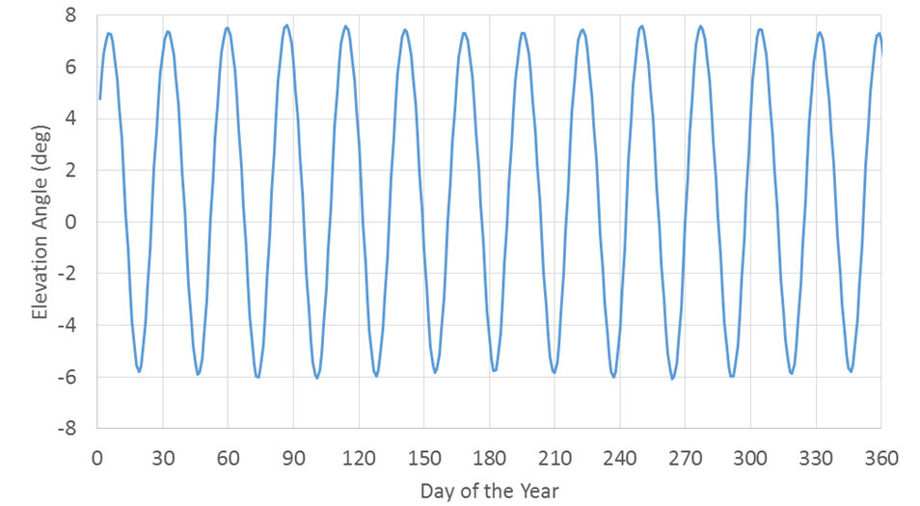
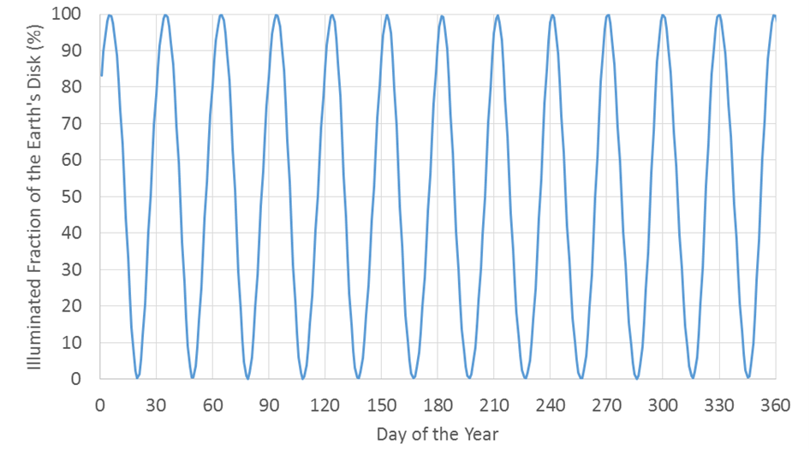
Earthshine Elevation Angle and Illuminated Fraction
The Earth elevation angle (unobstructed by local terrain) and the fraction of the Earth’s disk illuminated by the Sun are shown below.
Much like the Sun, the Earth will set below the horizon as indicated by a negative elevation angle.
The ephemeris calculation of the illuminated fraction of the Earth’s disk does not account for blockage by the observer body (i.e. the Moon). If the Earth is set below the horizon it is not visible on the Moon regardless of the illuminated fraction.
Yearly Variation in Solar Elevation Angle for Location on the Lunar Surface (85°N Latitude)
Illuminated Fraction of the Earth’s Disk for an Observer on Lunar Surface (85°N Latitude)

Slide 24
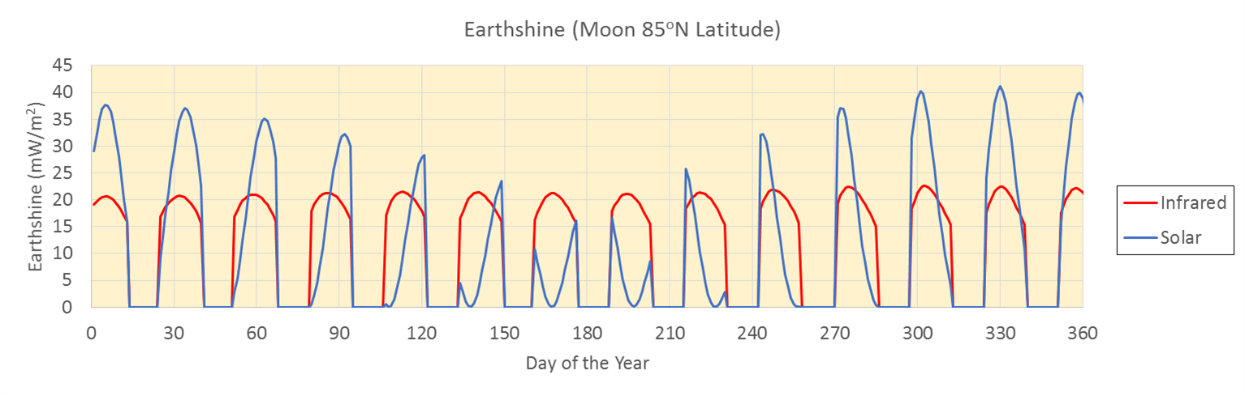
Earthshine Results
A typical yearly variation of Earthshine is shown for a lunar location at 85ºN latitude with a surface tilt of 15º.
The flux is zero for when the Earth sets below the horizon as shown in the figure. The variation and peaks of the reflected solar are greater than the infrared contribution.

Slide 25

Lunar Thermal Analysis Guidebook (L-TAG):
Shadowing and Terrain Effects
Carlos Gomez, Brian Hamill, Greg Schunk
NASA/Marshall Space Flight Center
&
Lisa Erickson
NASA/Johnson Space Center
TFAWS Short Course
Presented By
Greg Schunk
Thermal & Fluids Analysis Workshop
TFAWS 2022
September 6th-9th, 2022
Virtual Conference

Slide 26
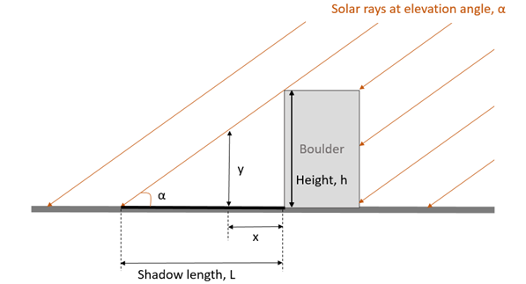
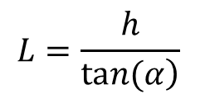
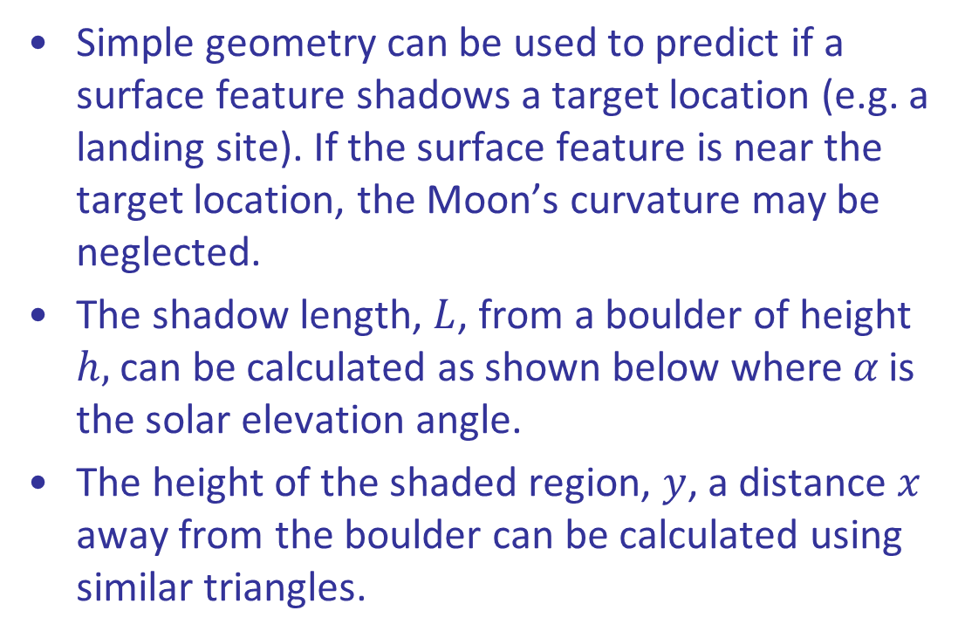
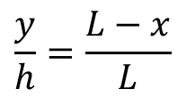
Shadowing by Terrain Features
Simple geometry can be used to predict if a surface feature shadows a target location (e.g. a landing site). If the surface feature is near the target location, the Moon’s curvature may be neglected.
The shadow length, $L$, from a boulder of height $h,$ can be calculated as shown below where $α$ is the solar elevation angle.
The height of the shaded region, $y$, a distance $x$ away from the boulder can be calculated using similar triangles.
$$L=\frac{h}{\left.tan(α\right)}$$
$$\frac{y}{h}=\frac{L−x}{L}$$

Slide 27
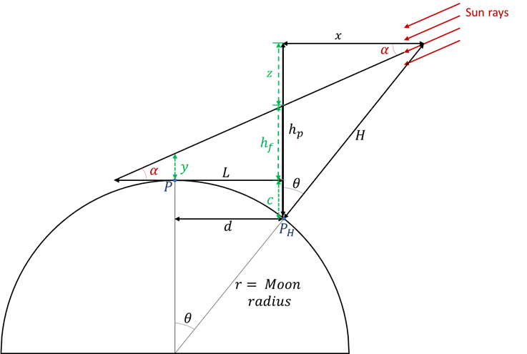
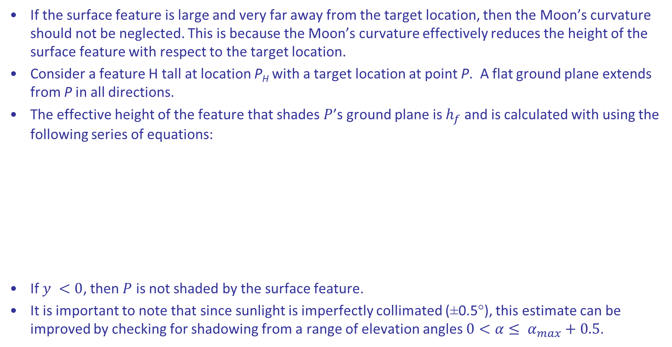
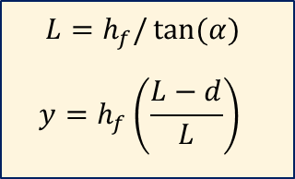
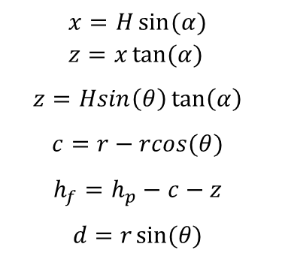
Shadowing by Terrain Features
If the surface feature is large and very far away from the target location, then the Moon’s curvature should not be neglected. This is because the Moon’s curvature effectively reduces the height of the surface feature with respect to the target location.
Consider a feature H tall at location P_{H} with a target location at point P. A flat ground plane extends from P in all directions.
The effective height of the feature that shades $P$’s ground plane is $h_{f}$ and is calculated with using the following series of equations:
If $y <0$, then $P$ is not shaded by the surface feature.
It is important to note that since sunlight is imperfectly collimated (±0.5°), this estimate can be improved by checking for shadowing from a range of elevation angles $0<α≤ α_{max}+0.5$.
$$x=H\sin{(α)} \\ z=x\tan{(α)}$$
$$z=Hsin\left(θ\right)\tan\left(α\right)$$
$$c=r−rcos(θ)$$
$$h_{f}=h_{p}−c−z$$
$$d=r\sin{(θ)}$$
$$L=h_{f}/\tan{(α)}$$
$$y=h_{f}\left(\frac{L−d}{L}\right)$$

Slide 28
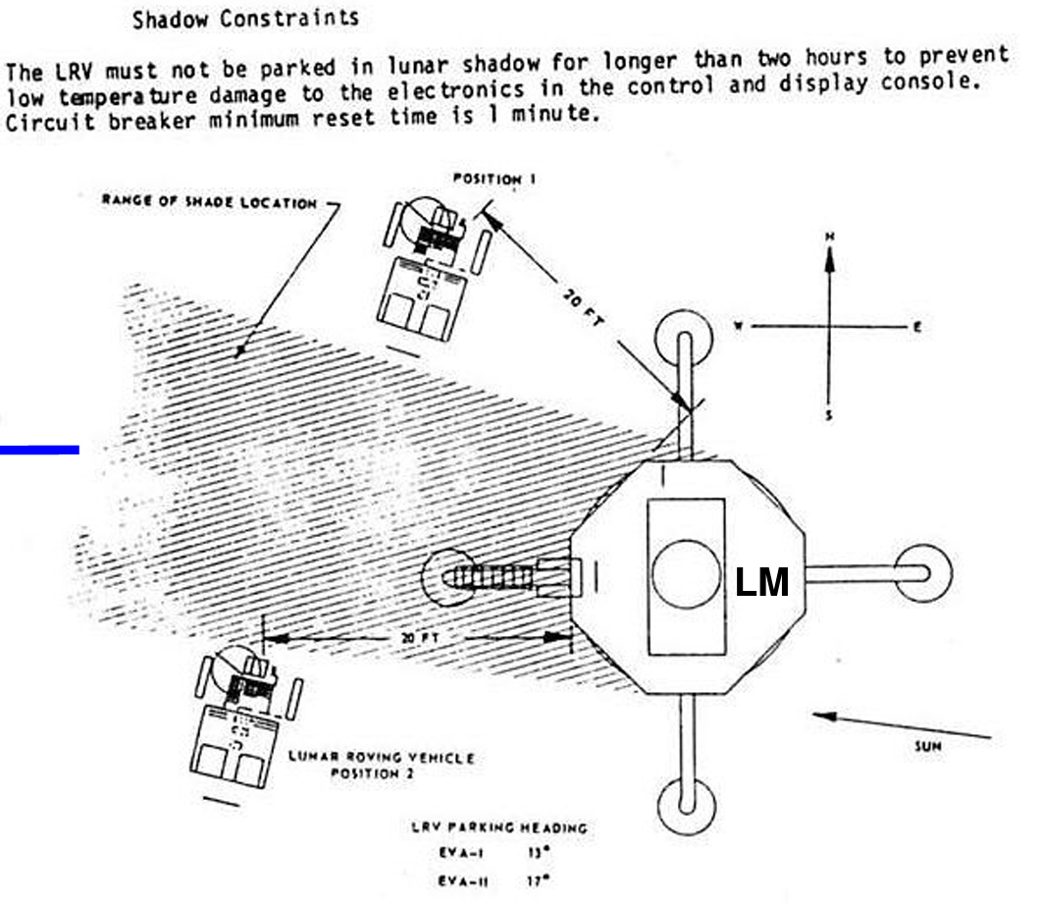
Shading of Equipment around Lunar Surface Assets
Temporal shading of passive equipment located around larger surface assets (such as a lander or habitat) on the lunar surface has presented mission constraints dating back to Apollo with the Lunar Roving Vehicle.

Slide 29
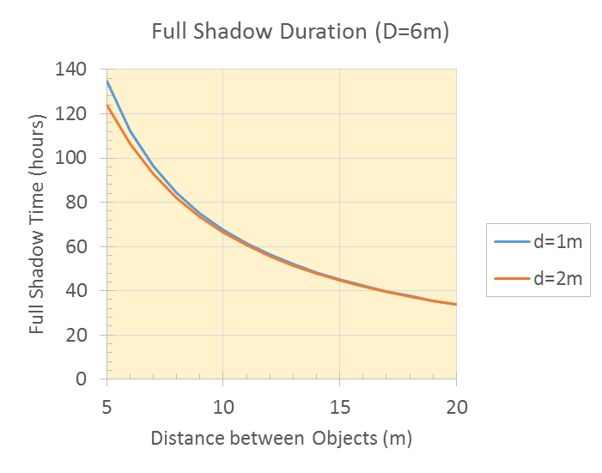
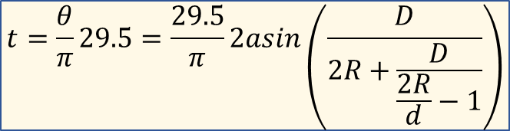
Approximate Full Shading of Passive Equipment
Shadow
A simplified approximation for the duration of full shading of cylindrical objects with a nearly horizontal sun vector (i.e., at the Lunar poles) is provided below.
D is the diameter of the surface asset, d is the diameter of the equipment and R is the distance between the centers of the two objects. The factor 29.5 corresponds to the Synodic Lunar Month in days.
Check length of the shadow per LTAG 9.3.2.
θ
Shadow
Equipment
R
Habitat
Sun
The time in full shadow (in days) is given by:
θ
$$t=\frac{θ}{π}29.5=\frac{29.5}{π}2asin\left(\frac{D}{2R+\frac{D}{\frac{2R}{d}−1}}\right)$$
Sun

Slide 30
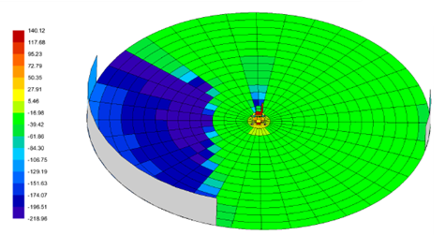
Far Field Terrain Effects
The effects of far field lunar terrain with the potential to shadow or re-radiate onto a site of interest may be included in lunar surface thermal models via a projection technique. The far field terrain may be projected onto boundary elements around the perimeter of the local surface model.
Rana, et al. [1] demonstrated this approach for the Luna 27 lander mission. The landing site was modeled as 30 meter radius disc with the lander positioned at the center.
Concerns that several mountains in the region may shadow or radiate onto the lander led to the approach illustrated below with vertical elements on the perimeter to represent surface features 20-30 kilometers away.
Analysis showed the effect of local mountains to be negligible in this case but the approach may be useful for scenarios where it is not possible to extend a local mesh to account for far field terrain.
[1] H. Rana, V. Laneve, P. Hager, and T. Tirolien, “Thermal Modelling of Luna 27 Landing Site,” p. 10, 2017.

Slide 31
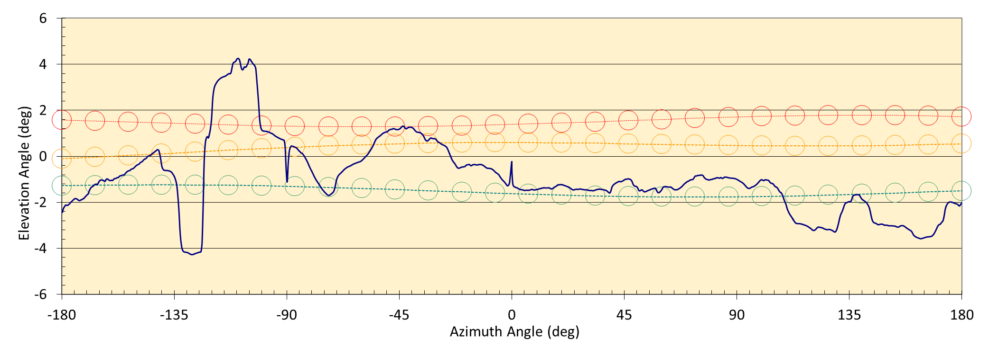
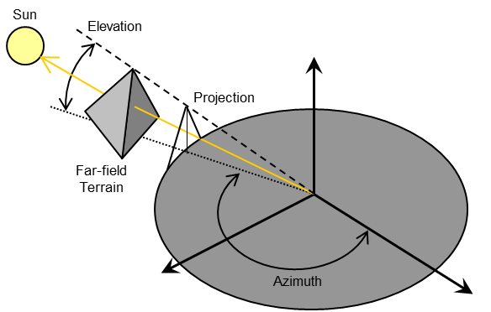
Far Field Terrain Effects
Schunk, et al. [1] employed a similar technique to develop a projection of far-field terrain onto a two dimensional plane for shadowing considerations. Far-field geographical features within large data sets may be reduced to two angles (elevation and azimuth) relative to a specific site of interest on the lunar surface as shown (right).
Typical monthly Sun tracks superimposed on projected lunar terrain are shown (bottom).
The terrain is referenced as an elevation angle relative to the local vertical with a 360⁰ field of view (azimuth). The reference point is the Lunar South Pole at 0 meter elevation relative to the mean lunar radius.
[1] G. Schunk, S. Sutherlin and O. Kornberg, “Constellation Thermal Overview-Altair”, Thermal and Fluid Analysis Workshop (TFAWS), MSFC, 2009.

