Slide 1


EOSDIS Data Archival
CEOS WGISS-54, hosted by JAXA
Tokyo, Japan
October 4-7, 2022
Valerie Dixon
NASA ESDIS Project
Goddard Space Flight Center
valerie.dixon@nasa.gov
Jeanne Behnke
NASA ESDIS Project
Goddard Space Flight Center
jeanne.behnke@nasa.gov
Andrew Mitchell
NASA ESDIS Project
Goddard Space Flight Center
andrew.e.mitchell@nasa.gov
Notes:
CEOS = Committee on Earth Observing Satellites
EOSDIS = Earth Observing System Data and Information System
ESDIS = Earth Science and Information Systems
GSFC = Goddard Space Flight Center
JAXA = Japan Aerospace Exploration Agency
NASA = National Aeronautics and Space Administration
WGISS = Working Group on Information Systems and Services

Slide 2
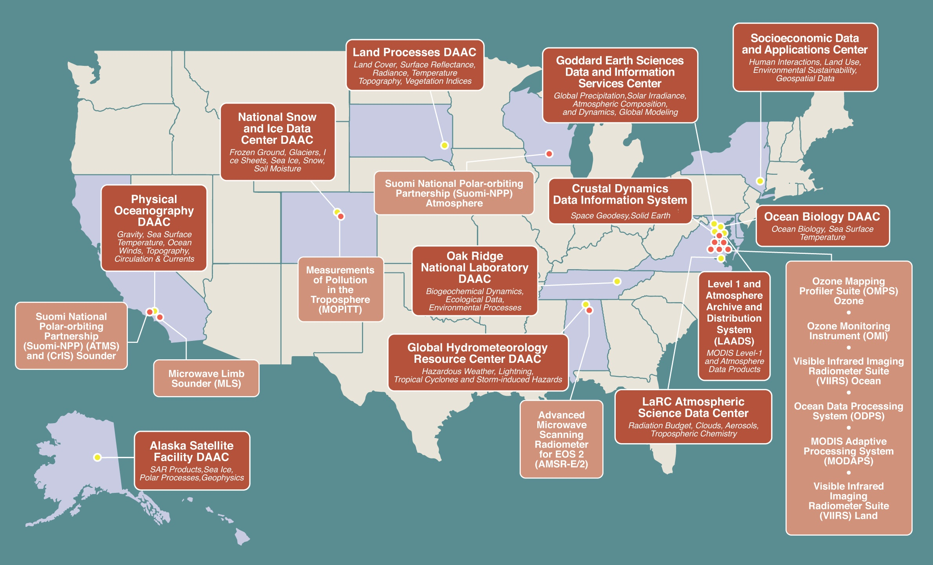
Earth Observing System Data and Information System (EOSDIS) Distributed Active Archive Center (DAACs) and
Science Investigator-led Processing Systems (SIPS)
Notes:
Image from ESDIS Project Office

Slide 3
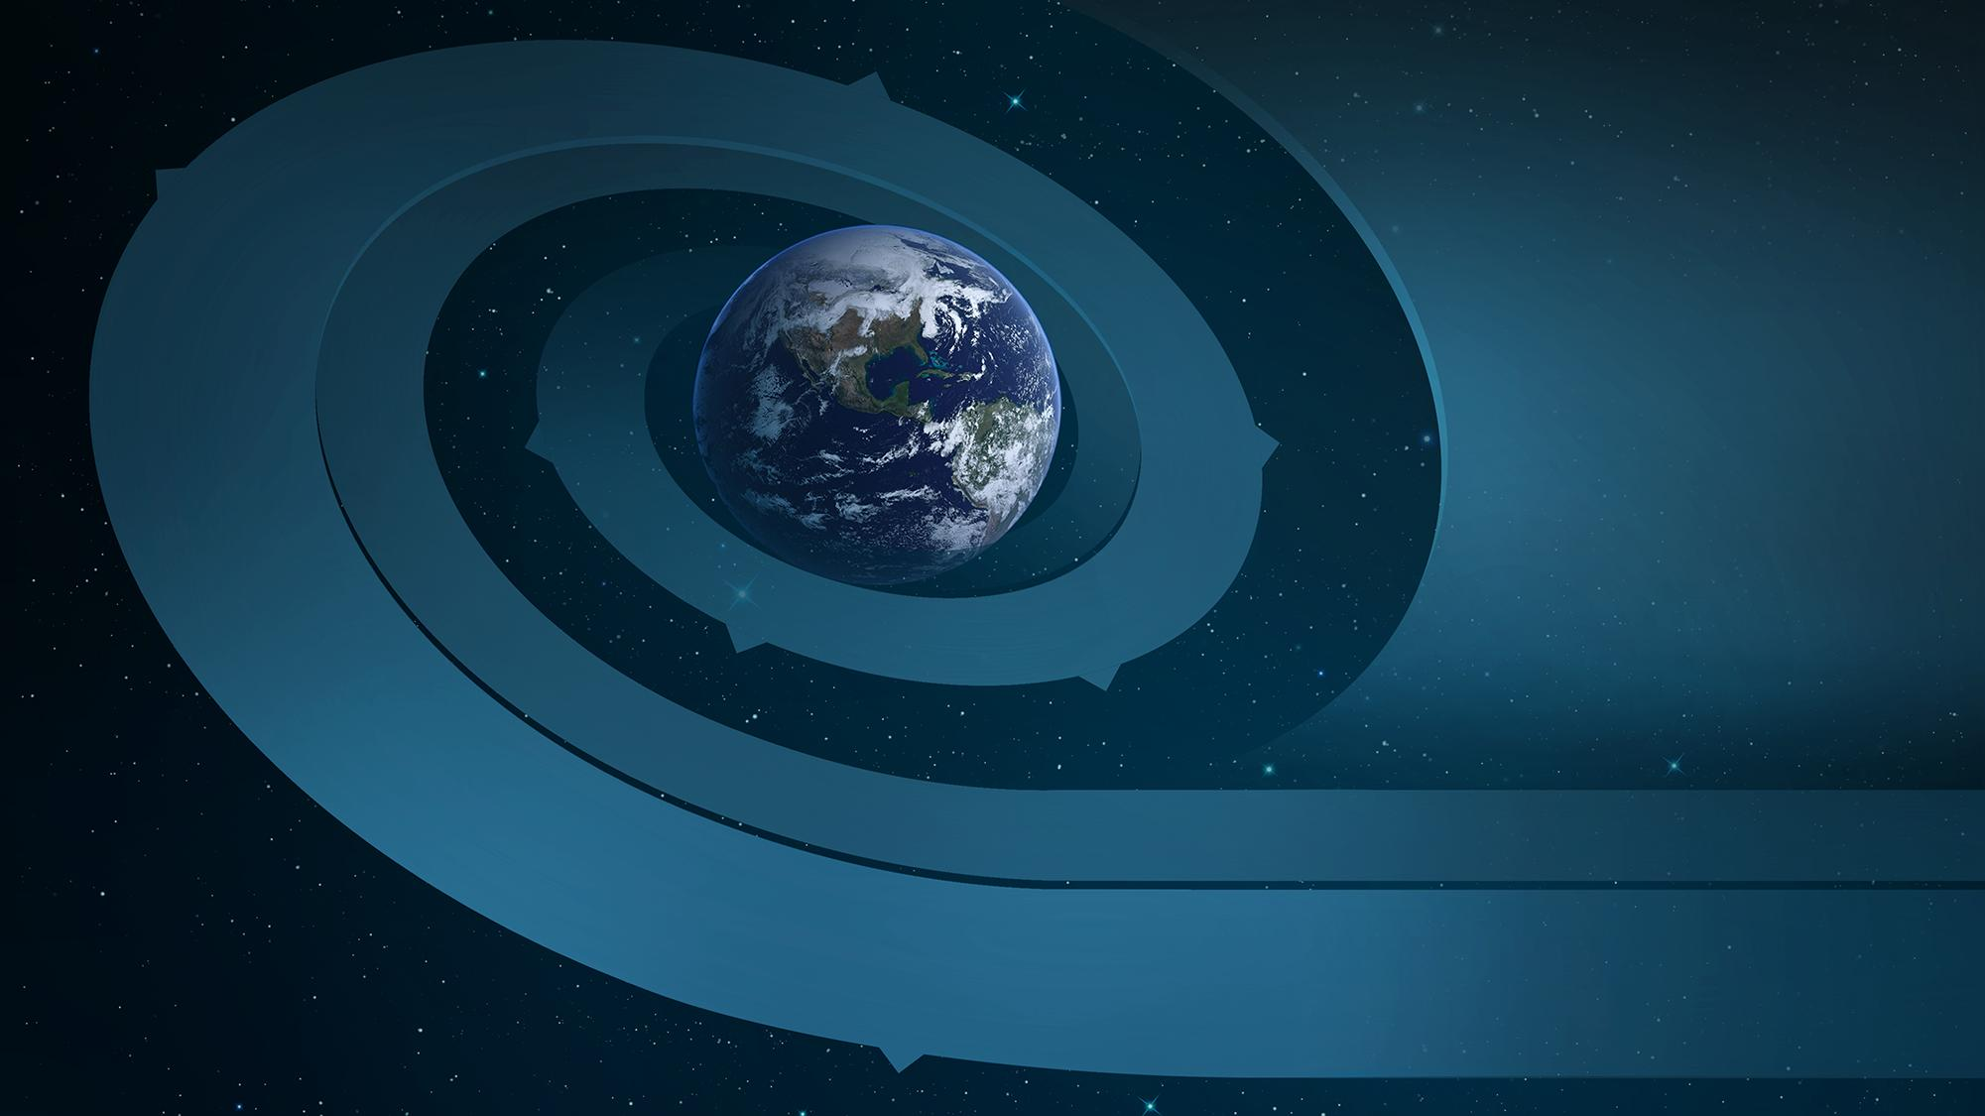




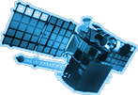












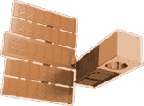




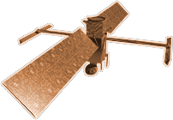






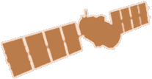

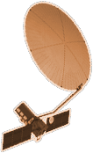

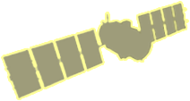
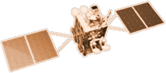


CYGNSS (8)
NISTAR, EPIC
2015
GRACE-FO (2)
SMAP
ICESAT-2
OCO-2
2020
LIS
SAGE III
GPM
SENTINEL-6
MICHAEL FREILICH
TSIS-1
EARTH FLEET
LANDSAT 8
ECOSTRESS
LANDSAT-9
SUOMI NPP
INVEST/CUBESATS
GEDI
CSIM-FD 2023
HARP 2022
CIRIS 2023
CTIM* 2022
HYTI* 2022
SNOOPI* 2022
NACHOS* 2022
NACHOS2* 2022
OCO-3
1995
2010
TROPICS (6)
EMIT
LANDSAT 7
CALIPSO
SWOT
TERRA
CLARREO-PF
AQUA
CLOUDSAT
TEMPO
AURA
2000
JPSS INSTRUMENTS
PREFIRE (2)
2005
OMPS-LIMB 2022
LIBERA 2027
NISAR
MAIA*
ISS INSTRUMENTS
KEY
PACE
INTERNATIONAL PARTNERS
U.S. PARTNER
ISS INSTRUMENT
JPSS INSTRUMENT
CUBESAT
LAUNCH DATE TBD
TSIS-2*
(PRE) FORMULATION
IMPLEMENTATION
OPERATING
EXTENDED
GEOCARB*
SENTINEL-6B
GLIMR*
INCUS*
LANDSAT NEXT*
ESO-1, 2, 3, 4*
MISSIONS
01.20.22
2025
Notes:
Image from ESDIS Project Office

Slide 4





EOSDIS Metrics
24 PB of data (~62 million files) in Earthdata Cloud
3.4 Million files added to the cloud since April
There are more than
72 PETABYTES
of Earth science data in the EOSDIS archive, with an average growth of over 54 TB/day
EOSDIS distributes more than 2 BILLION
data products to over
1.7 MILLION
distinct data users
around the world
Our Land, Atmosphere
Near real-time Capability
for Earth Observing
System (LANCE) has
OVER 820
unique datasets,
distributes more than
125 MILLION FILES
and produces 2.57 Petabytes of data
WITHIN 3 HOURS OF A SATELLITE OBSERVATION
with over
3.56 BILLION
files in the EOSDIS archive

Slide 5
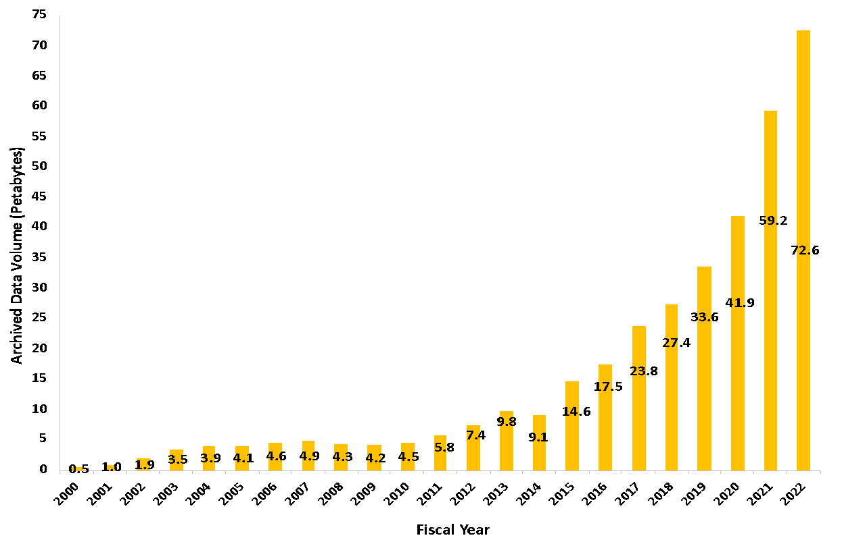
Total EOSDIS Accumulated Data Archive Volume (Petabytes)
Trend: FY2000-FY2022 (at the end of June 2022 )

Slide 6
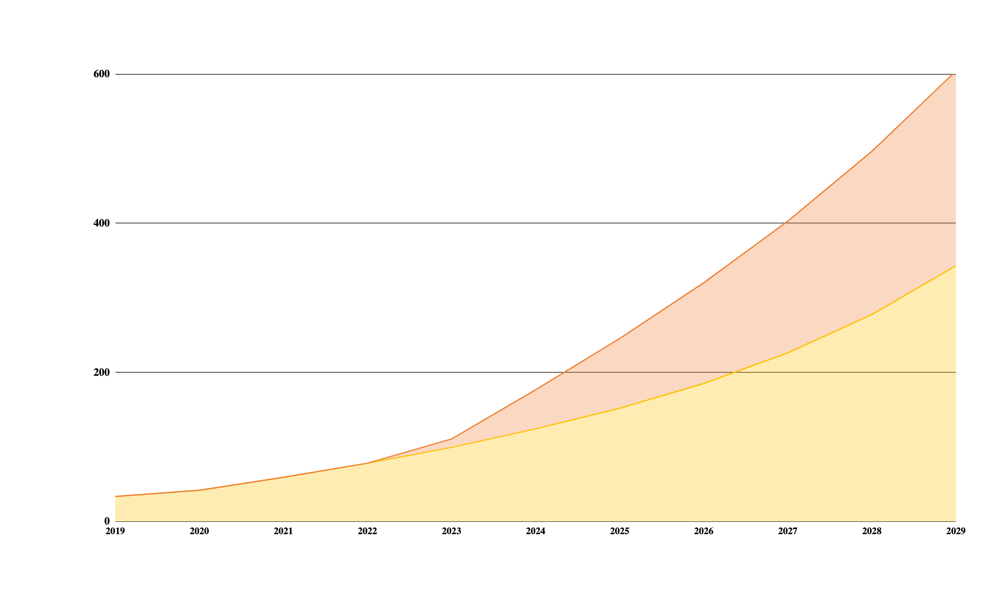
Earth Science Data Archive Growth Projection
EOSDIS
73 Petabytes
today
600 Petabytes
by 2030
Archive Volume
(Petabytes)
13 New Missions
To be added
FY22: 73PB
*
Current Archive Holdings (~95 missions)
Fiscal Year
June 2, 2022

Slide 7







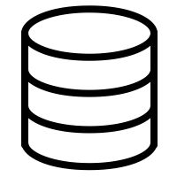

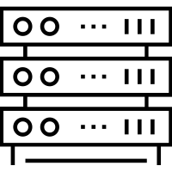

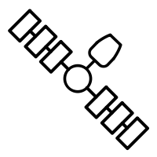


EOSDIS Current Conceptual Architecture
Core EOSDIS Services
Benefits
Optimized for archive, search and distribution
Expert user support
Easily add new data products and producers
Predictable
Challenges
Uneven levels of service and performance
Significant time to coordinate interfaces
Limited on-demand product generation and end-user processing capabilities
Duplication of storage
Duplication of services and software
End-Users
DAACs
SIPS
Varied Data Sources
Notes:
Image from ESDIS Project Office

Slide 8






EOSDIS Conceptual Cloud-Based Architecture
Benefits
Collocated, pay-as you-go processing for anyone
Expert user support
Streamlined product addition
Scalable Data Systems
Reduced duplication of tools and services
Bring the Users and Analysis to the Data
NASA Funded Research
Challenges
Development Coordination
Cost Management
Shifting Labor Needs
Security/Export Compliance
Vendor Lock In
Learning Curve
Cloud Native Access vs. metrics
Cloud-Native
Ingest/Archive/Distribution System
DAAC’s Thematic Stewardship
SIPS
Varied Data Sources
Notes:
Image from ESDIS Project Office

Slide 9
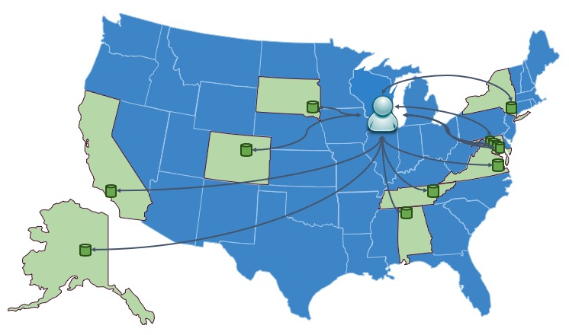
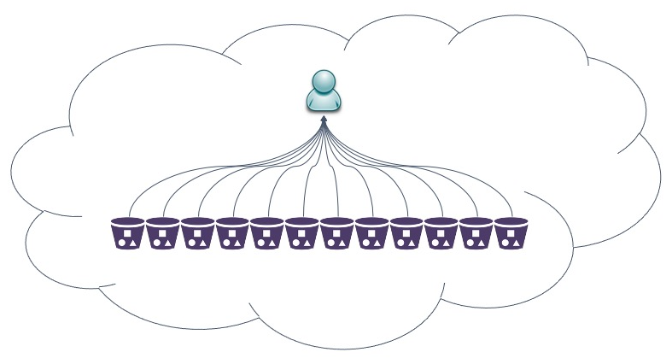
EOSDIS DAAC Transition to Earthdata Cloud
Today users seeking NASA’s data may have to visit several DAACs to fulfill their needs. Moving between data centers and interfaces can be less efficient and time consuming.
As more EOSDIS data is moved into NASA’s Earthdata Cloud, users will be increasingly able to (seamlessly) use data across traditional discipline silos – making the near future look a lot like a ‘Data Lake’.
Notes:
Image from ESDIS Project Office

Slide 10
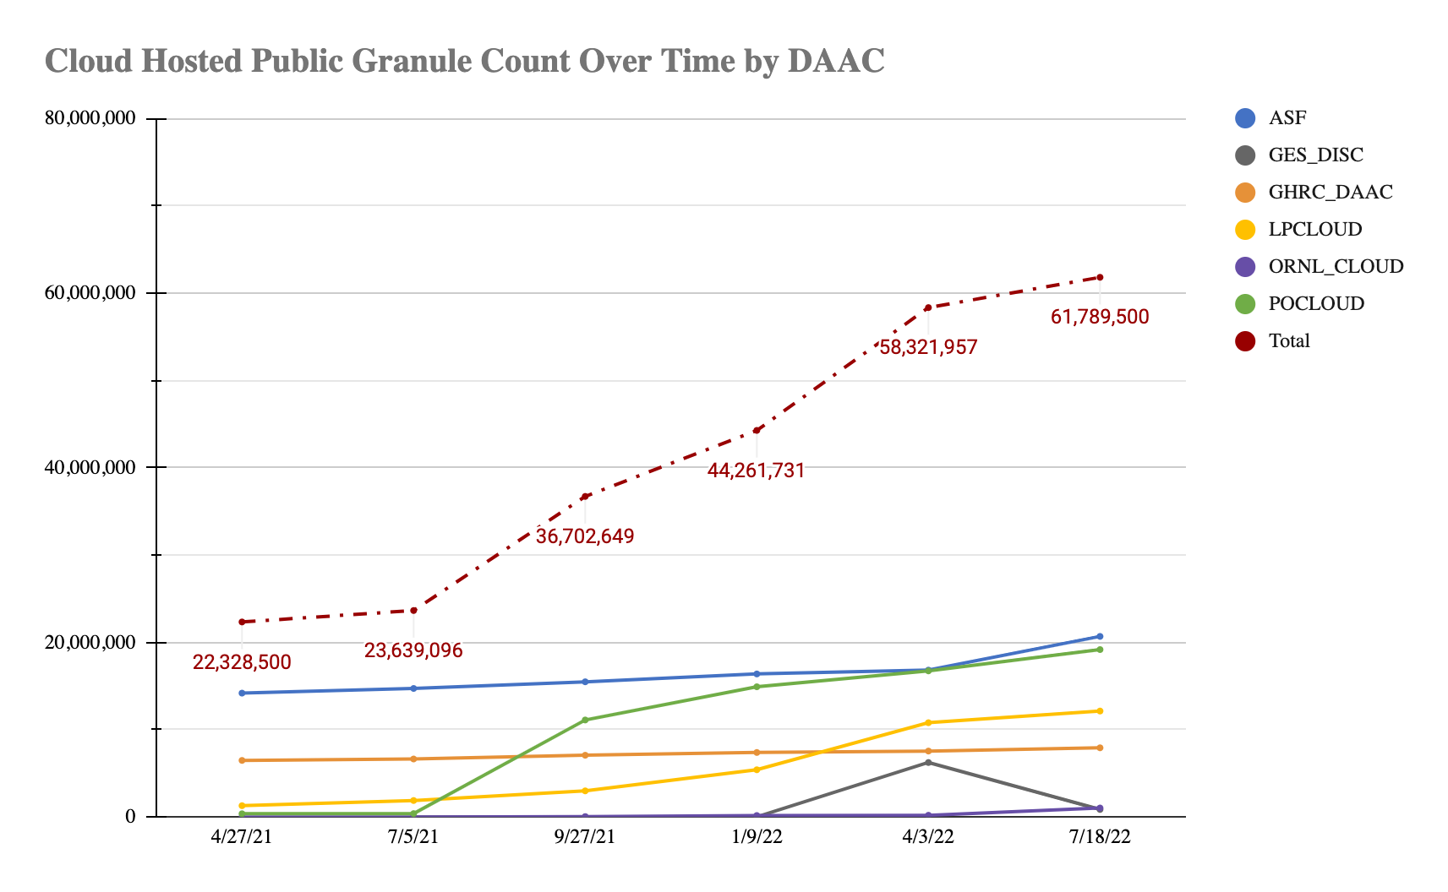
Cloud Holdings Metrics
Data gathered from CMR inventory on 7/18/22.
Total Archive Size in FY21:
1.56Billion granules
112 datasets and 3.4M granules added to EDC’s public offering since April

Slide 11
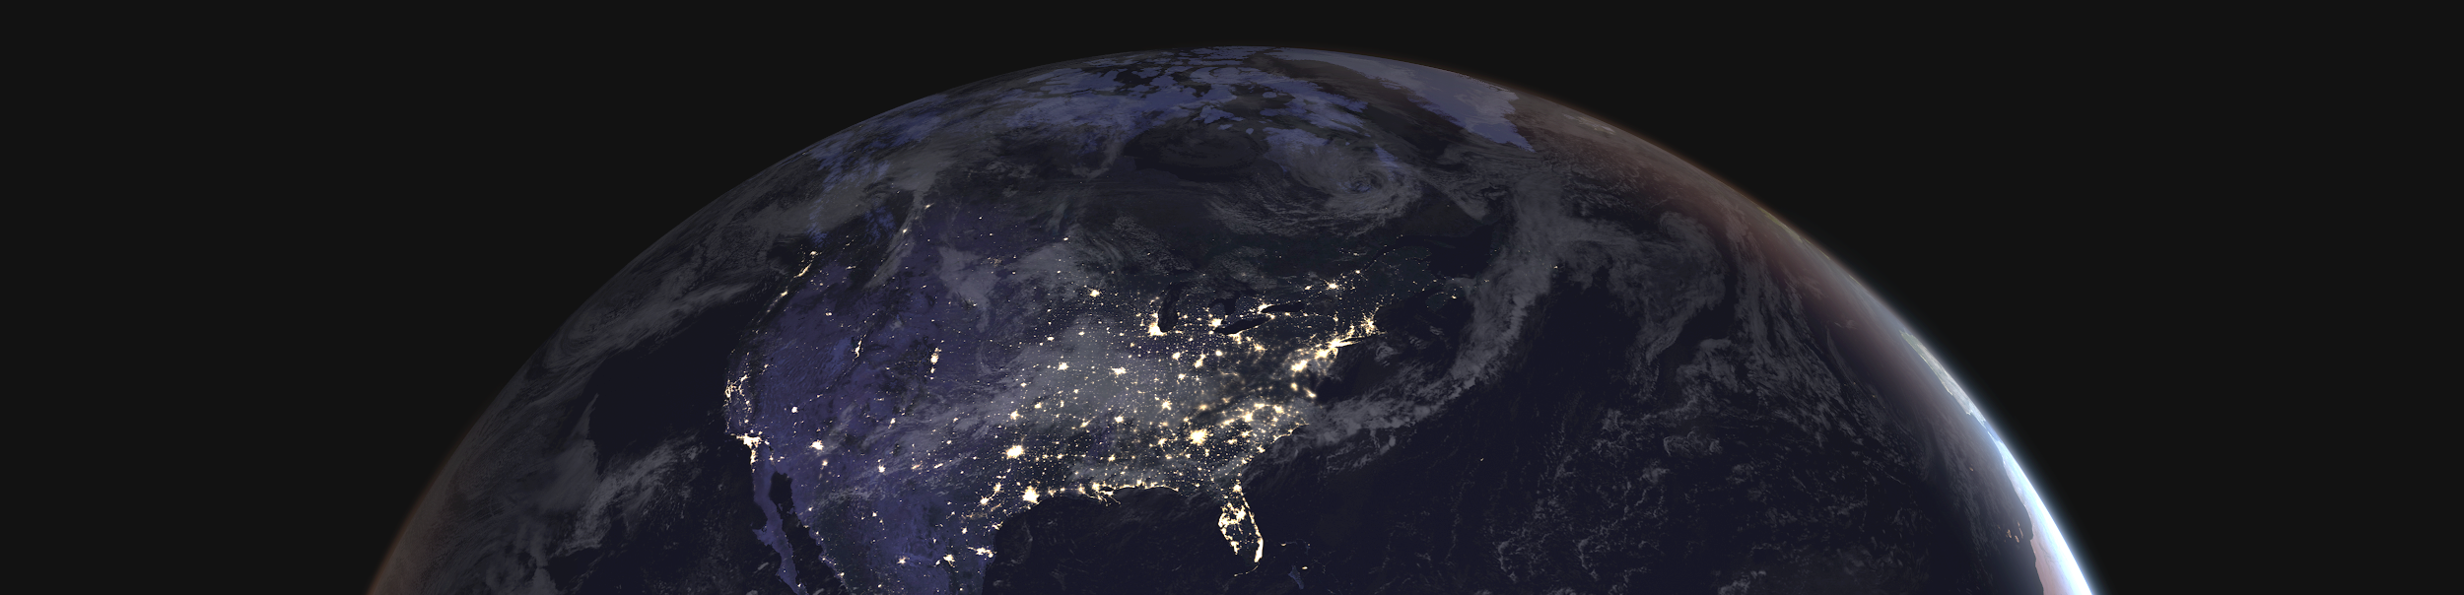
Earthdata Cloud
(EDC)
“Managed” commercial cloud for EOSDIS on Amazon Web Services
Improves the efficiency of NASA’s data systems operations – maintaining free/open data policy
Initially architected for EOSDIS DAACs (applications and mission data ingest, archive, distribution)
Operational July 2019. First in, Common Metadata Repository (CMR) Application, Earthdata Search Application, 6 PB Sentinel-1 mission data.
23 PB of mission data in EDC as of May 2022 with plan to onboard 50/75 top datasets by Q4 CY 2022, establishing initial “data lake”.

Slide 12



What is the Earthdata Cloud Platform?
Earthdata Cloud Platform (NGAP - NASA General Application Platform) is a multi-account, Infrastructure-as-a-Service (IaaS) cloud platform operating on Amazon Web Services (AWS) under a single ESDIS owned top level “payer account”, providing shared cloud services and controls to EOSDIS.
Maximizes Autonomy
Maximizes Flexibility
Shared Services & Controls
Be a platform, not a gate; foster experimentation/innovation and support production needs of application owners
Provide projects the freedom to implement solutions that fit their problem domains
Platform manages common shared services & controls to reduce duplication, system complexity, and cost across EOSDIS
Notes:
Image from ESDIS Project Office

Slide 13
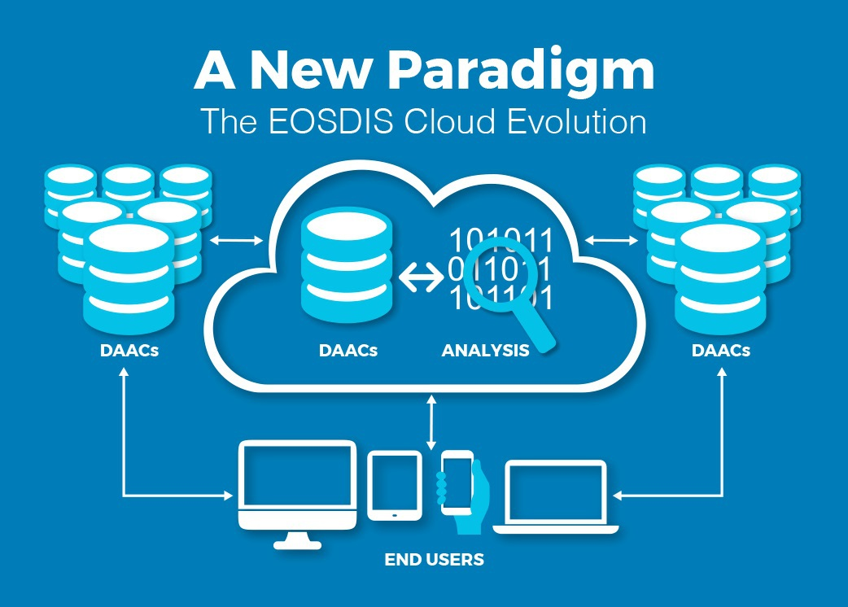
EOSDIS Cumulus Project
Cumulus is a cloud-based framework for:
Data ingest
Data archive
Data distribution
Data management
Cumulus includes Harmony, NASA’s Earthdata Cloud Services System, which allows users to produce analysis-ready data by subsetting, reprojecting, and converting data to a cloud-optimized format.
Shared services reduce redundancy
Notes:
Image from https://www.earthdata.nasa.gov/learn/articles/earth-science-data-cloud-eosdis-cumulus-project

Slide 14

Cumulus Stewardship Features
Backup & recovery
Archive reconciliation
Message retention
Error handling
Monitoring & metrics
CMR Integration
Notes:
Image by vishnu vijayan from Pixabay

Slide 15
Cumulus Archive Management
Cumulus provides archive monitoring and management through the API & dashboard
This includes
  Reingest and bulk operations
  Reconciliation with external systems, like CMR
  Data provenance (visibility into all granule operations)
  Visibility into backups:
    Operational Recovery Cloud Archive (ORCA)
    Level Zero and Repositories Data Store (LZARDS)
Notes:
https://github.com/nasa/cumulus-dashboard

Slide 16
Backup and Recovery - ORCA
In-cloud operational backup system
  Utilizes NGAP approved AWS services and components
  Currently only works for data archived via the Cumulus system
ORCA operators may perform the following functions via the ORCA Operator Dashboard:
  Configure collections and Simple Storage Service (S3) storage classes
  Monitor workflow executions
  Monitor data recovery
  Monitor system metrics
Flexible and adaptable
  DAACs can extend ORCA functionalities to meet unique recovery and archive needs
Notes:
https://nasa.github.io/cumulus-orca/

Slide 17
Backup and Recovery - LZARDS
Tape-based tertiary backup system located at Goddard Space Flight Center (GSFC)
Currently being integrated with Cumulus
Primarily a safe copy for Level 0 data that is born in the Cloud
Notes:
https://nasa.github.io/cumulus/docs/next/workflow_tasks/lzards_backup

Slide 18
Acronyms
API | Application Programming Interface
ATO | Authority To Operate
AWS | Amazon Web Services
CDM | Continuous Diagnostics & Mitigation
CEOS | Committee on Earth Observing Satellites
CICD | Continuous Integration Continuous Delivery
CMR | Common Metadata Repository
DAACs | Distributed Active Archive Center
EDC | EarthData Cloud
EOSDIS | Earth Observing System Data and Information System
ESD | Earth Science Division
ESDIS | Earth Science Data and Information Systems
GSFC | Goddard Space Flight Center
InVEST | In-Space Validation of Earth Science Technologies
IaaS | Infrastructure as a Service
ISS | International Space Station
JAXA | Japan Aerospace Exploration Agency
JPSS | Joint Polar Satellite System
LANCE | Land, Atmosphere Near real-time Capability for Earth
LZARDS | Level Zero and Repositories Data Store
NASA | National Aeronautics and Space Administration
NGAP | NASA General Application Platform
ORCA | Operational Recovery Cloud Archive
OSA | Operations Security Agreement
OSS | Open Source Science
PB | Petabyte
S3 | Simple Storage Service
SaaS | Software as a Service
SIPS | Science Investigator-led Processing Systems
SSP | System Security Plan
TB | Terabyte
WGISS | Working Group on Information Systems and Services

Slide 19
Backup Slides

Slide 20
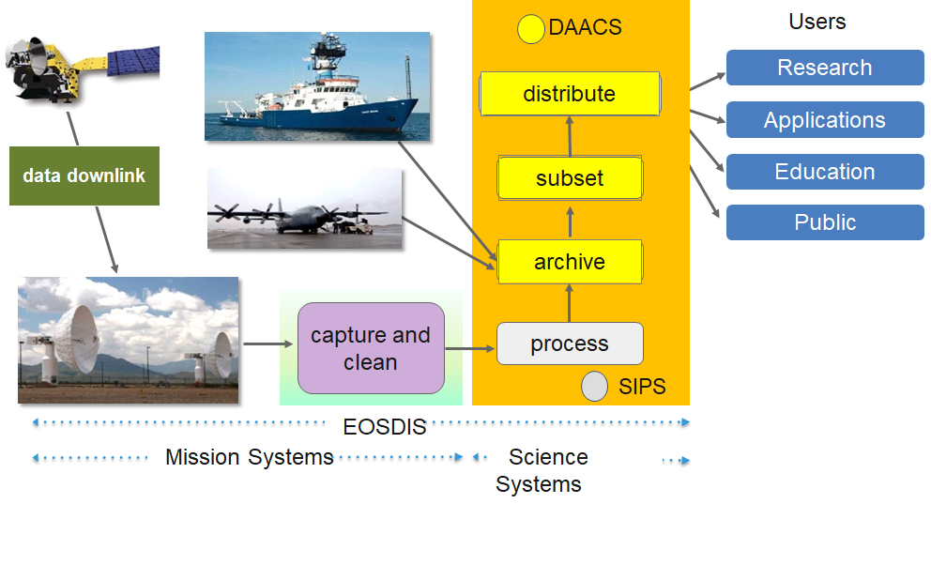
Earth Science Data and Information System (ESDIS)
The ESDIS Project manages the science systems of the Earth Observing System Data and Information System (EOSDIS). EOSDIS is a comprehensive distributed Earth science data and information system designed to support NASA's Earth science missions.
EOSDIS is designed to ingest, archive, distribute, visualize, all types of Earth Science data which include field campaign measurements, airborne data, in situ data, model data, ancillary products used for processing and other related datasets.
The ESDIS Project provides and controls all aspects of the effort including but not limited to requirements, design, acquisition, development, operations, maintenance and decommission.
Operating since 1994, it has been evolving to keep pace with technology and users' requirements.
Notes:
Image from ESDIS Project Office

Slide 21
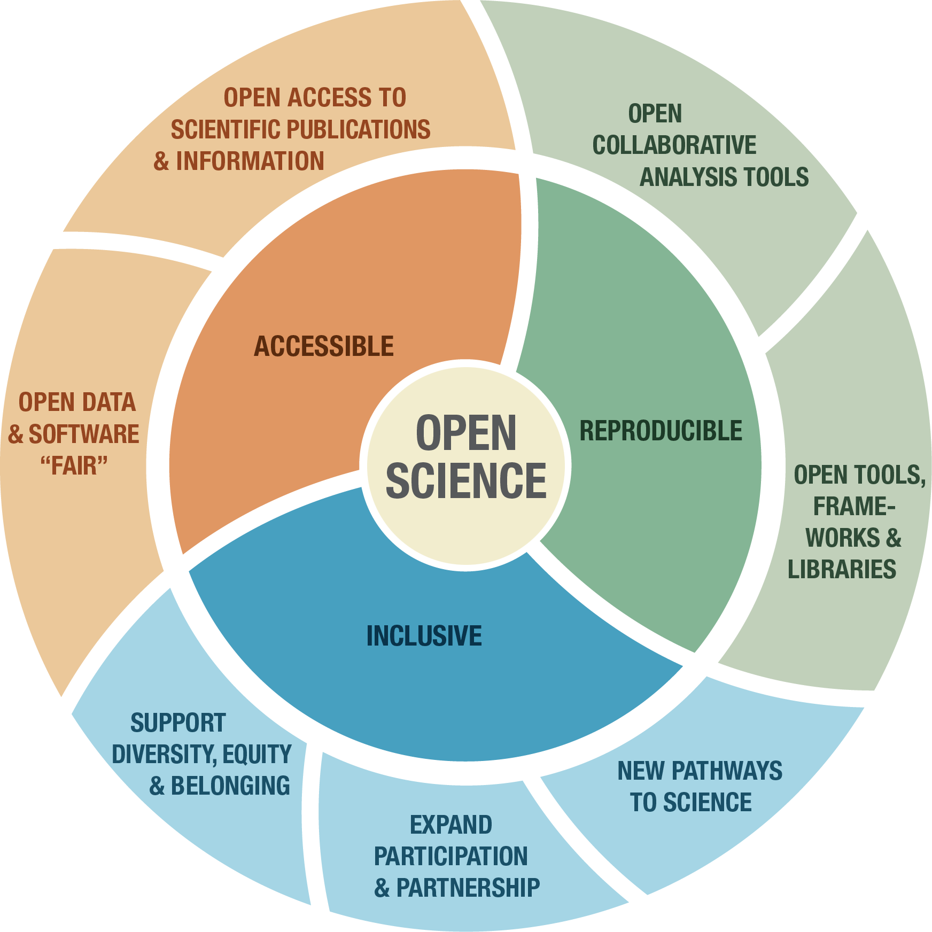
The Earth Science Division Move
into Supporting Open Science
NASA kicked off a 3-year Strategy for Open-Source Science (OSS) Data and Computing Ecosystem:
  DAACs shift to a focus on enabling scientific research and supporting increasingly diverse communities. Data access becomes standardized with common data user interfaces. EOSDIS architecture, infrastructure, services become managed services.
To expand to support enabling science and implement the concepts of OSS, are start with 5 focus areas:
  Data and metadata stewardship
  Information Management
  Open-source software support
  Cross-mission science and modeling
  User support
Notes:
Image from ESDIS Project Office

Slide 22
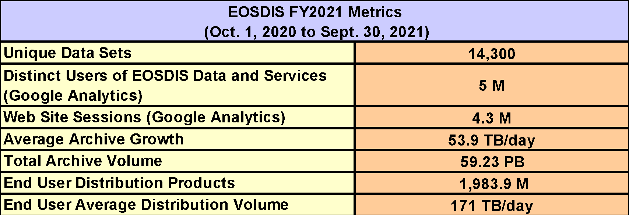
EOSDIS Key Metrics for FY2021
EOSDIS provides:
  A production capability for standard science data products from Earth Observing System (EOS) instruments
  An “active archive” of Earth science data from EOS and other past and present missions
  A distributed information framework (archive centers, SIPS, networks, interoperability, other system elements) with partners supporting EOS investigators and other users in science, government, industry, education, and policy
Web accesses through FY 2019 were recorded by NetInsight, the commercial off-the-shelf software.
NetInsight has been discontinued from Oct 1, 2019 and replaced by Google Analytics.

Slide 23

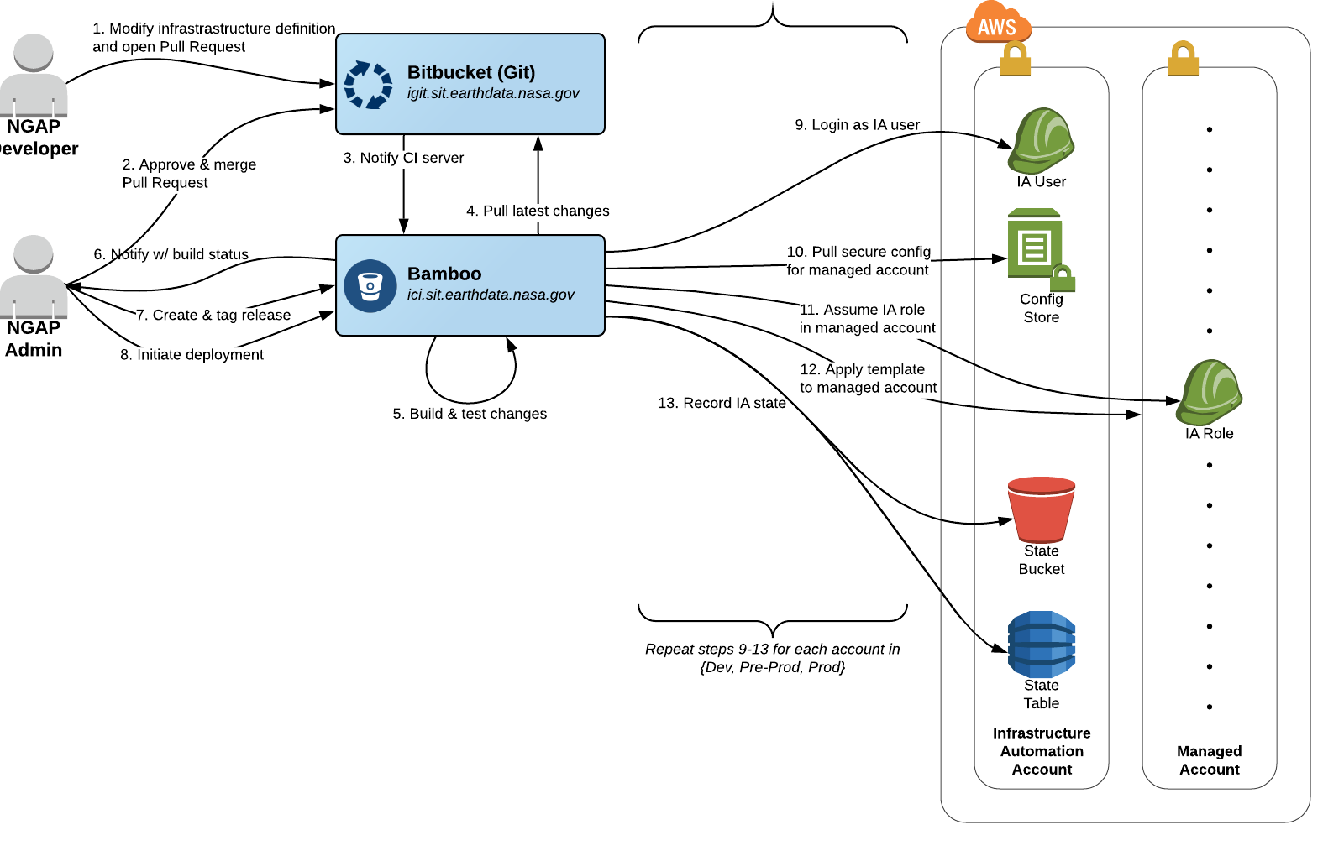

Common Services and Controls
Cloud Platform Infrastructure
Common Services & Controls
NASA-Approved Amazon Services: Vetted AWS and third-party Software as a Service (SAAS) services and process to add new. Focus is on using AWS cloud-native services
Code Deployment Services: DevOps Continuous Delivery Continuous Integration (CICD) Pipeline to security scan, build, and deploy code
Use of Infrastructure as Code: Including re-useable template to define a multi-account ecosystem
Single “LOW” System Security Plan (SSP) and Authority to Operate (ATO)
Single Identity and Access Management Solution (Kion.io):
  Rotate AWS access keys
  Apply session limits
  Provide role-based access control
  two-factor authentication
* While providing most flexibility to EOSDIS organizations

Slide 24
IT Security and Networking Services
Cloud Platform Infrastructure
Security & Networking
“LOW” System Security Plan (SSP) / Certification and Accreditation
  Single ESDIS owned cloud SSP
  Operational Security Agreements (OSA) for EOSDIS organizations.
    Defining application account boundaries and local security operations
Platform Level Operational IT Security Services
  Implement NASA security policies & apply system security architecture principles
  Incident detection & contingency response management, ESOC integration
  Continuous Diagnostics and Mitigation (CDM). NASA CDM tools not updated for cloud so AWS services deployed:
    AWS Simple Systems Manager (asset management)
    AWS Inspector (vulnerabilities)
    AWS Guard Duty (threat detection)
    AWS Config (Configuration Management)
    AWS CloudTrails, CloudWatch, Elastic Search (event management)
System Security Principles
Security Metrics / Security Analytics
NASA (OCIO) Policy
Risk Management
Independent Assessment & Authorization
Incident & Contingency Response
Security Configuration Management

