Slide 1
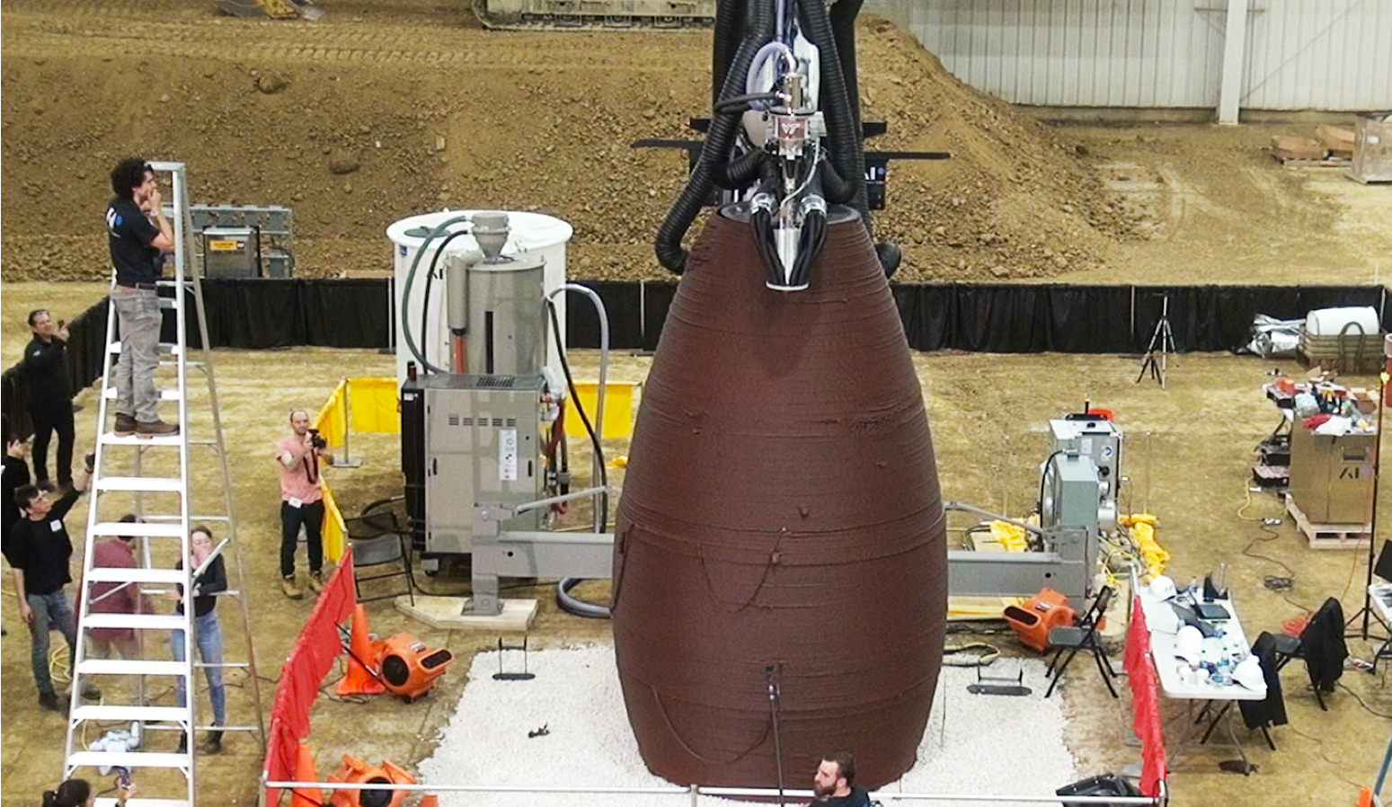
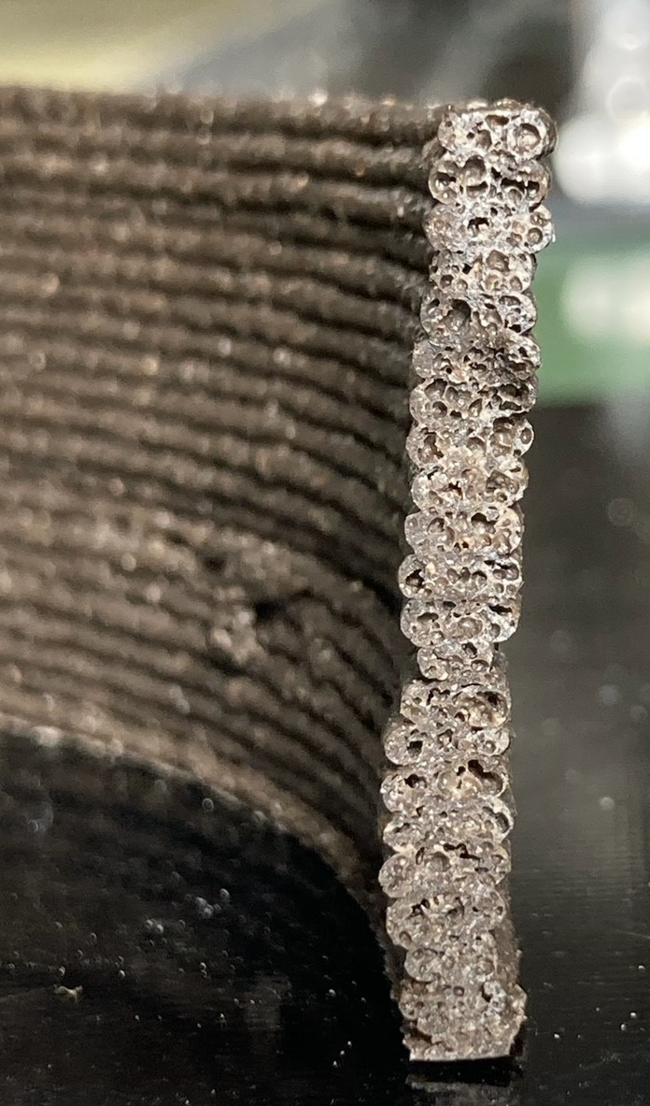
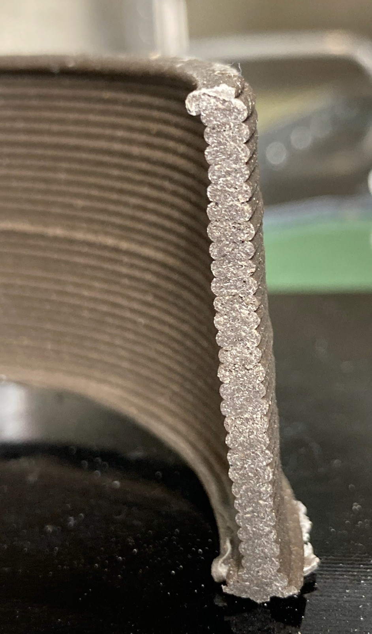
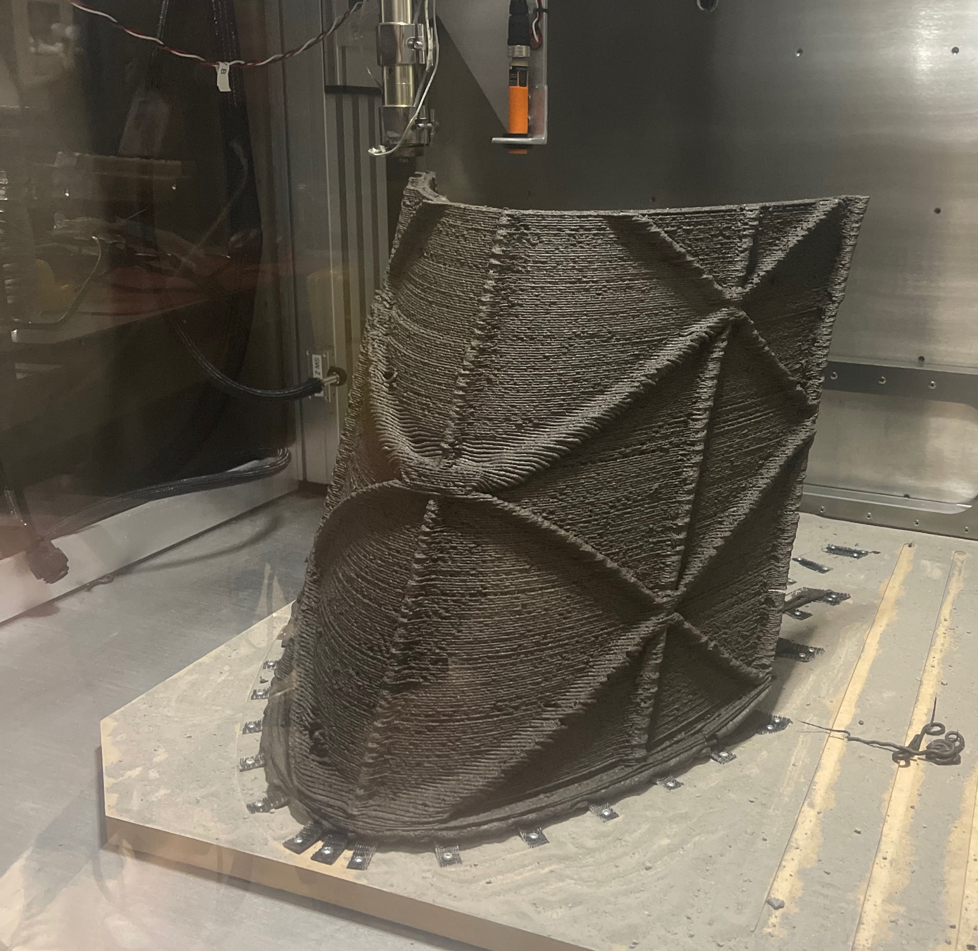
Relevant Environment Additive Construction Technology (REACT)
Project Overview
Advancing the TRL of technologies developed during the NASA 3D Printed Habitat Centennial Challenge. Focused on the design and construction of a lunar unpressurized radiation protection shelter called LINA.
Technical Approach
LINA is designed to protect astronauts and equipment from Galactic Cosmic Radiation, Solar Particle Events, meteorite impacts, moonquakes, thermal extremes and dust.
Polymer regolith composites are being formulated for use in Lunar vacuum/thermal conditions.
Subscale models have been printed on regolith substrate under vacuum.
Contributing Partners and/or Infusion Plans
AI Space Factory and NASA are working towards a scaled CLPS Lunar demonstration.
Additional Information
LINA Lunar construction operations
Significantly reduced pore formation with new formulation
LINA is printed in vacuum (~0.1 torr) on regolith simulant

