Slide 2
Using CALIPSO's
New Ocean Derived
Column Optical Depths
R. Ryan, S. Rodier, M. Vaughan, D. Winker, J. Hair, R. Ferrare, D. Painemal
12 September 2022

Slide 3
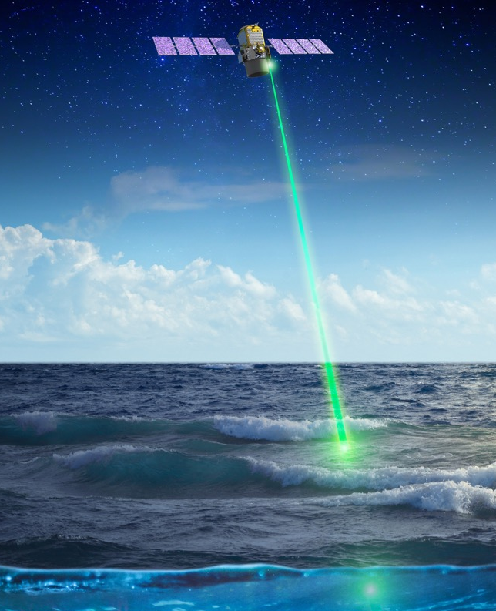
Introduction
Cloud-Aerosol Lidar with Orthogonal Polarization (CALIOP) onboard CALIPSO
  Active direct detection of clouds and aerosols
  Estimation of optical properties
  Small but significant fraction below detection threshold
  Requires CAD, typing, and a priori assumptions
Ocean Derived Column Optical Depths (ODCOD)
  Adaptation of Venkata & Reagan 2016
  Passive style estimate of effective column optical properties from CALIPSO ocean return
  Does not require CAD or aerosol typing
  Mostly independent single instrument estimate of effective total column optical depth
NASA’s Cloud-Aerosol LIdar with Orthogonal Polarization, an instrument aboard the Cloud-Aerosol Lidar and Infrared Pathfinder Satellite Observation satellite launched in 2006
Credits: NASA/Timothy Marvel
Venkata, S.L., Reagan, J.A., Aerosol Retrievals from CALIPSO Lidar Ocean Surface Returns. Remote Sensing 8(12) 1006 (2016). https://doi.org/10.3390/rs8121006

Slide 4
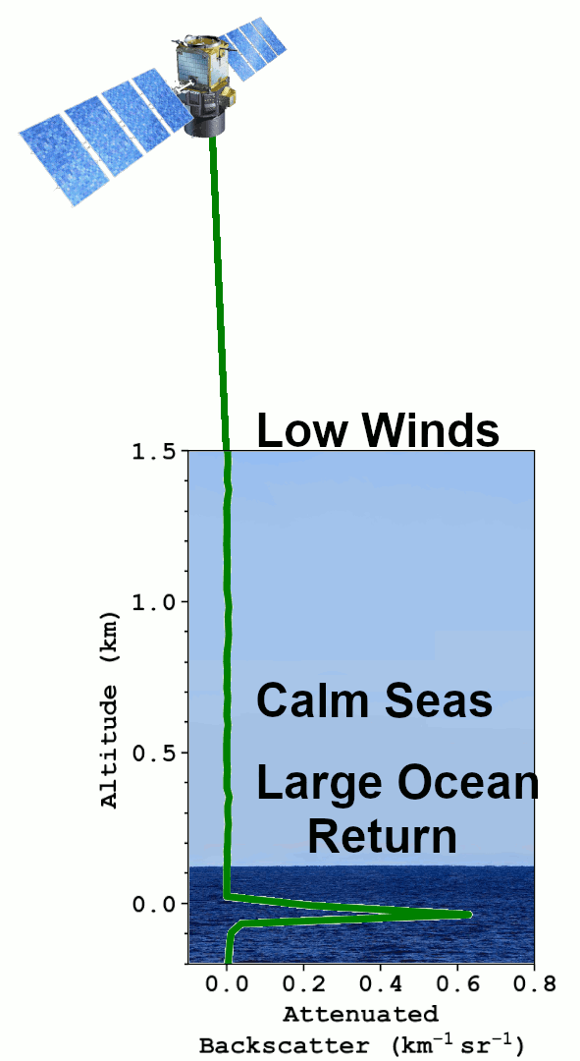
Technique
ODCOD uses the magnitude of CALIPSO's ocean surface return compared to a modeled ideal ocean return to estimate optical depth
The surface points are fit to a model lidar ocean return by an iterative shifting and scaling technique
Only 3 measured points at 532nm make up the surface return
An accurate wind speed estimate is required to calculate a model surface reflectance
Returns with surface saturation or negative surface anomalies are not attempted
Surface depolarization is tested to ensure no sea ice or shallow water sea floor is in the return

Slide 5
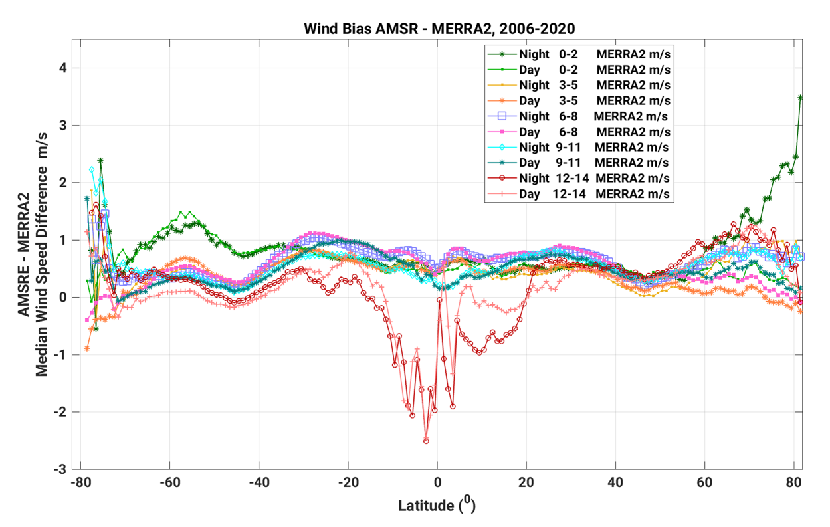
Sensitivity to Wind Speeds
ODCOD uses wind speeds from the MERRA-2 meteorological data used throughout the CALIPSO processing
MERRA-2 winds have a low bias (Carvalho 2019 and CALIPSO Team Investigation)
For ODCOD, -0.5m/s bias would translate to ~0.02 high bias in optical depth
Use AMSR derived lookup tables to apply corrective scaling to MERRA-2 winds
Wind Speeds 3-11m/s
Lots of Samples
High Wind Speeds
Very Few Samples
Carvalho, D. An Assessment of NASA’s GMAO MERRA-2 Reanalysis Surface Winds, Journal of Climate, 32(23), 8261-8281 (2019). https://doi.org/10.1175/JCLI-D-19-0199.1
Notes:
Carvalho (2019) found a median wind speed bias of MERRA-2 being 0.35 m/s low over ocean.

Slide 6
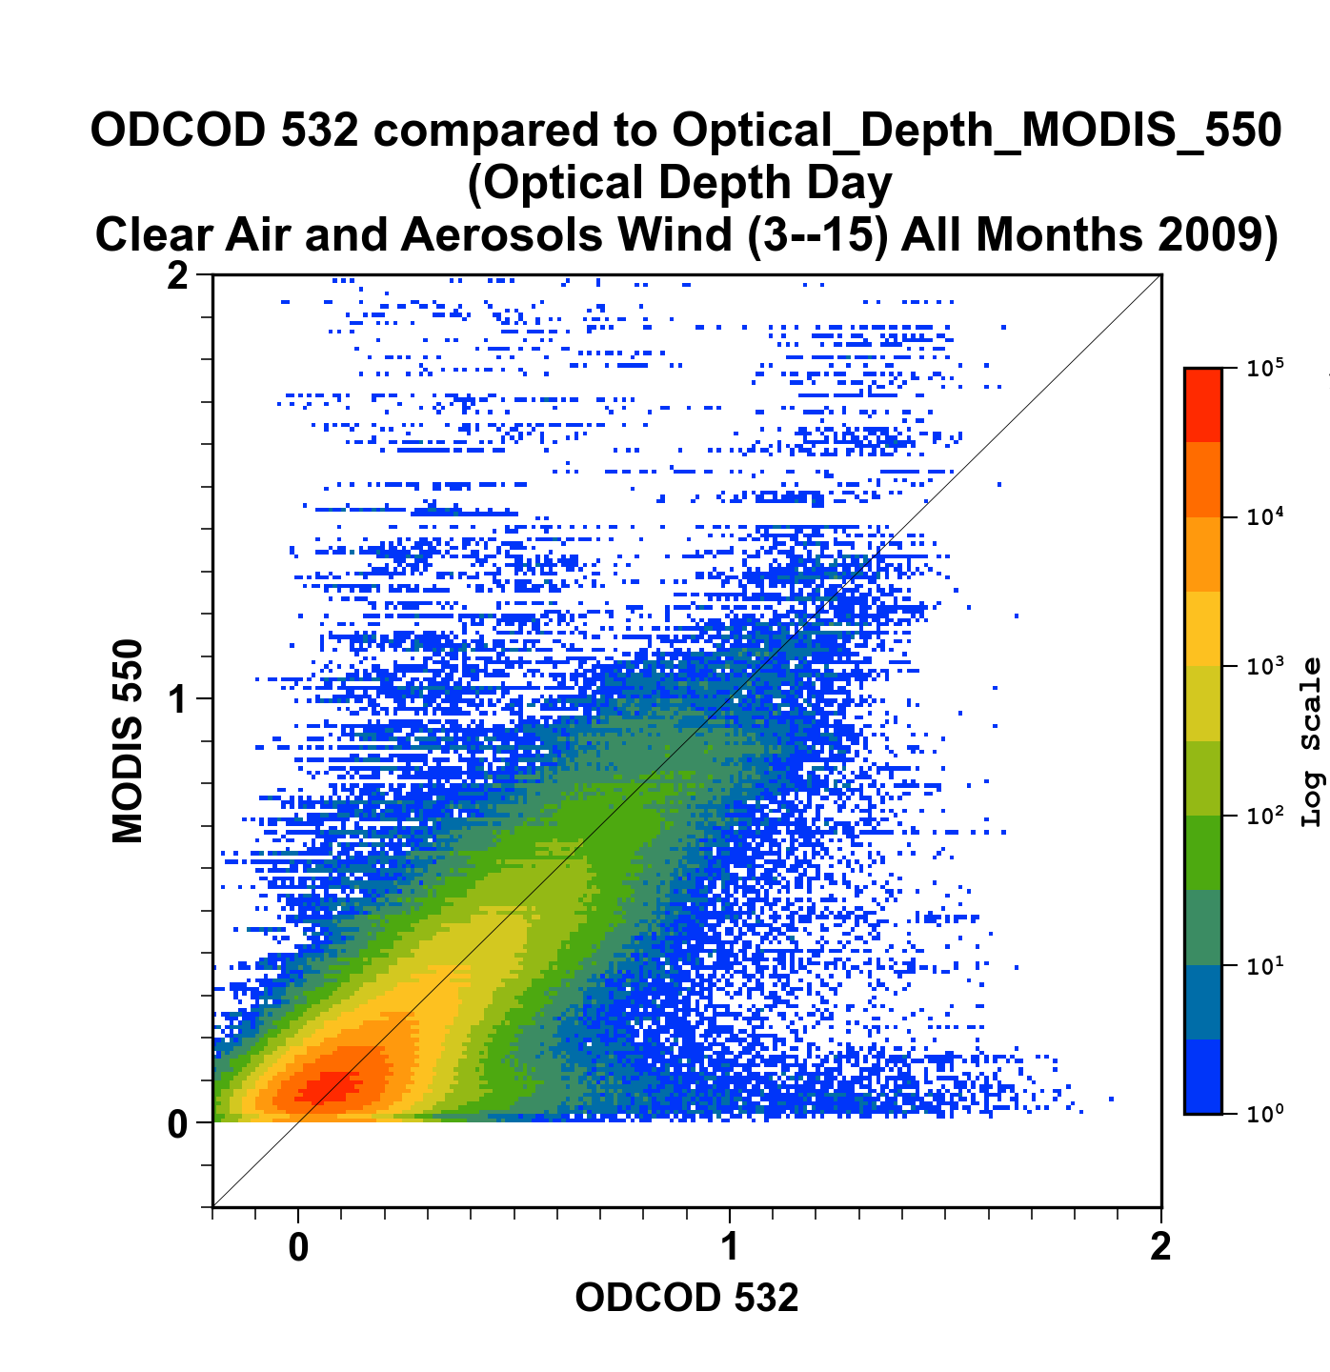
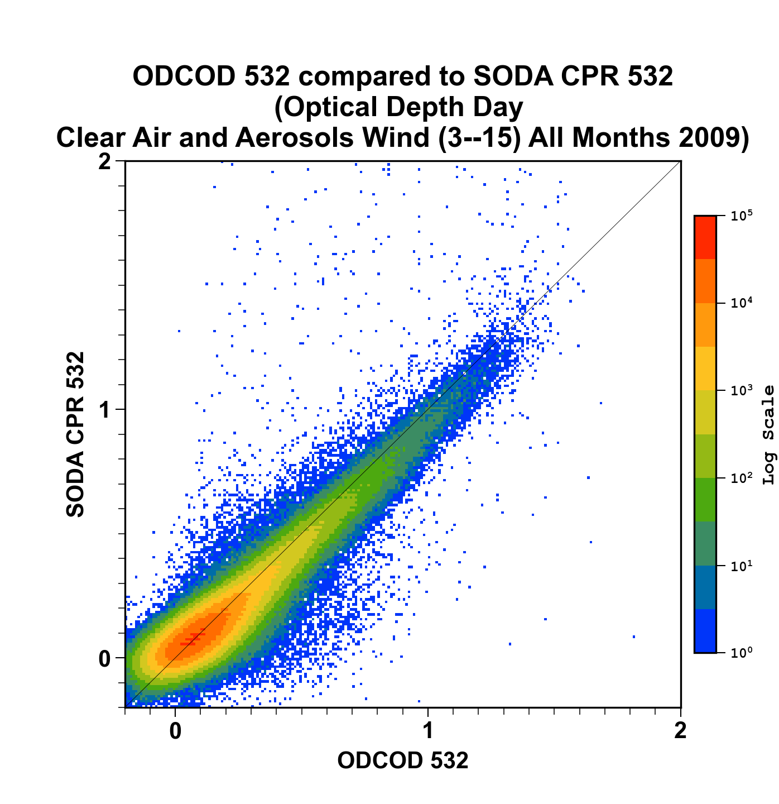
Daytime Comparisons

Slide 7
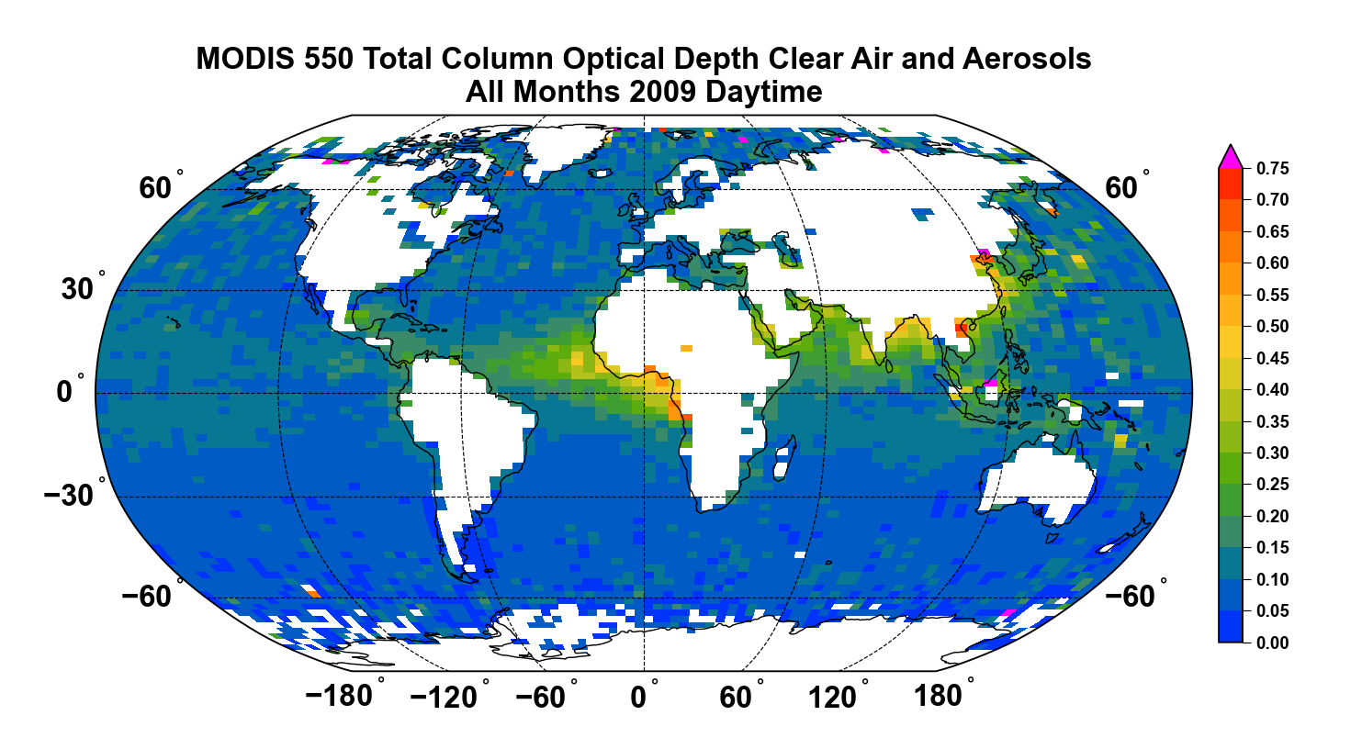
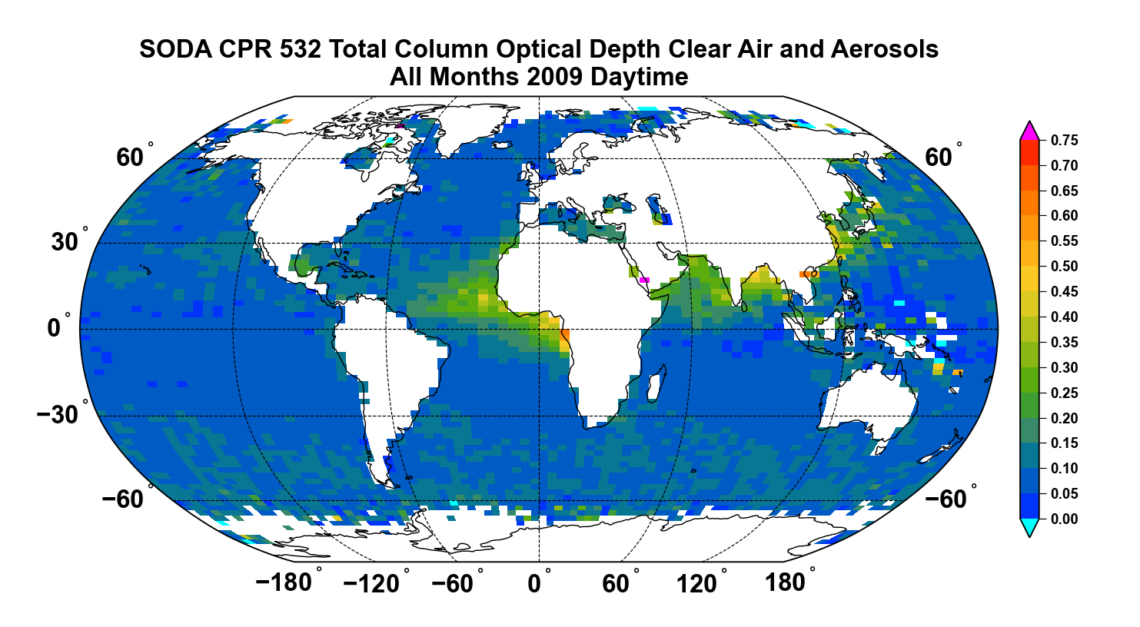
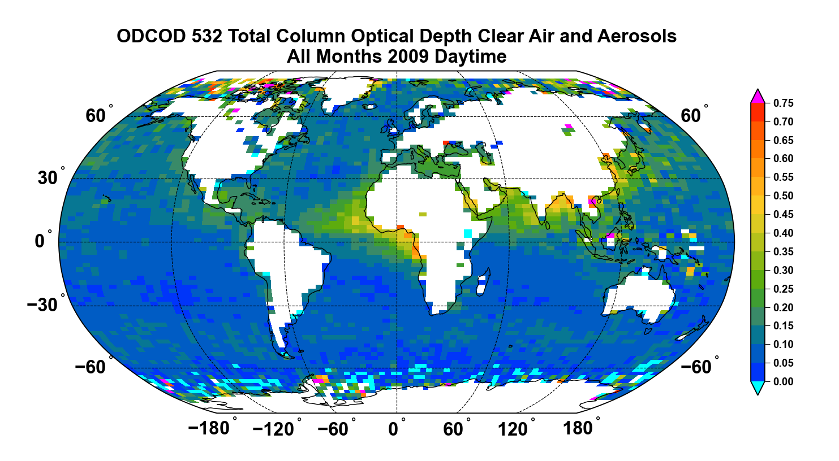
Daytime Comparisons
MODIS is a large grid daytime only product
SODA requires colocation with CloudSat which is not available at night after 2011
ODCOD is available for the entire CALIPSO data record both day and night

Slide 8
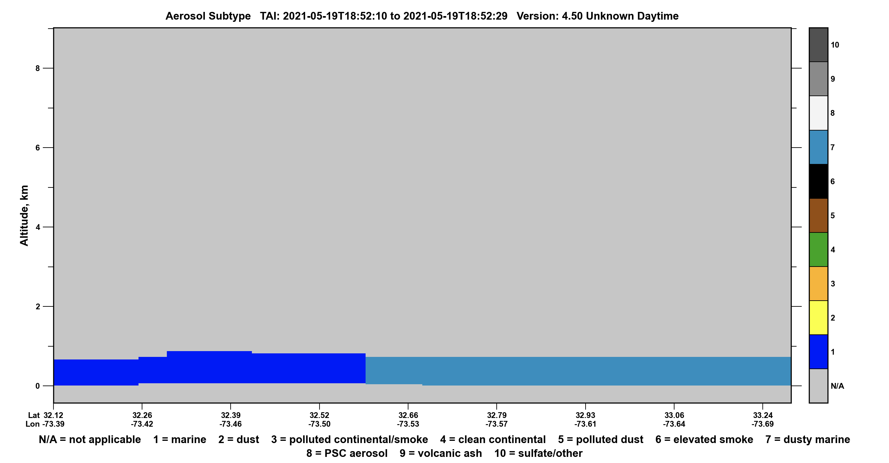
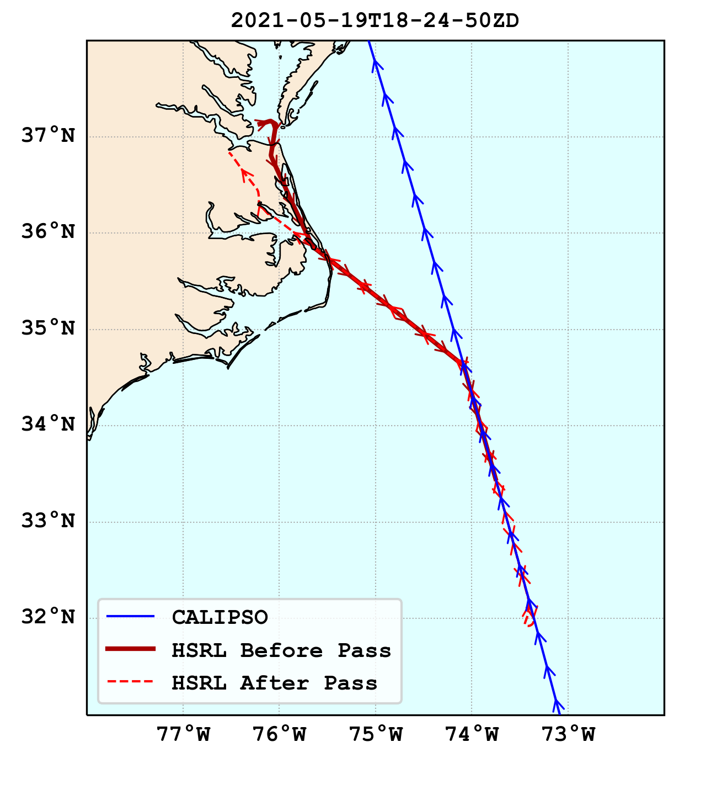
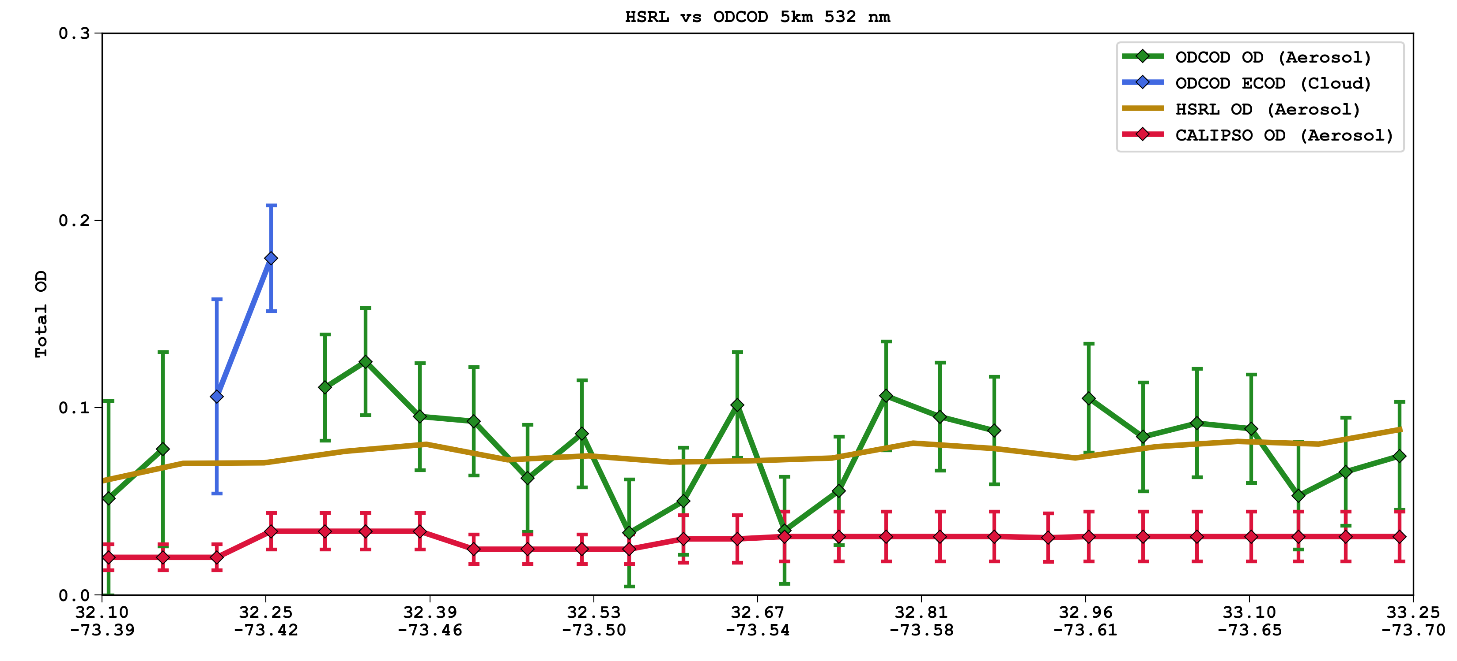
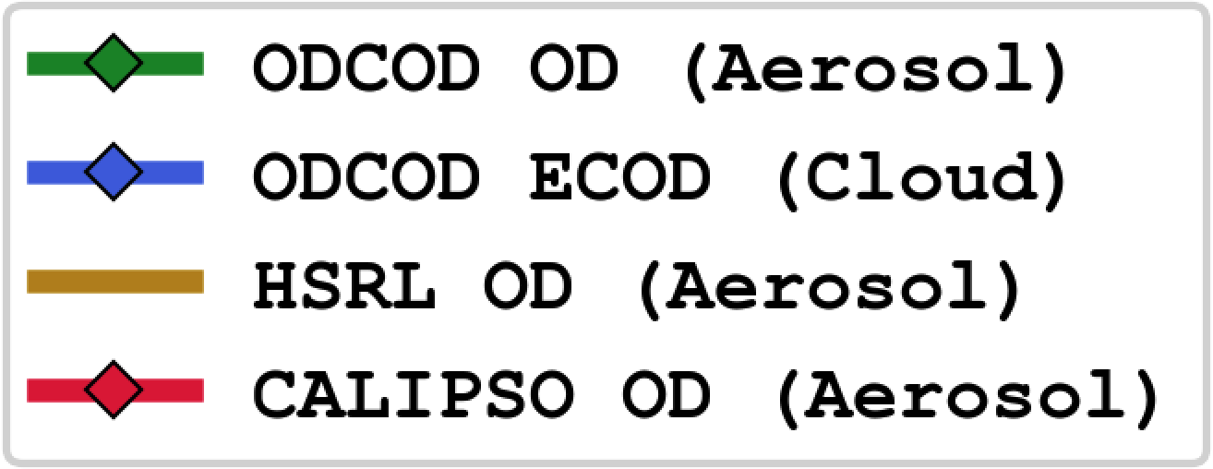
ODCOD Validation
May 19th, 2021
HSRL-2 deployed during ACTIVATE
Off North/South Carolina
Mostly Aerosols Only and single layer scene
Marine and Dusty Marine Aerosols
CALIPSO
Tropospheric + Stratospheric Optical Depth in Red
HSRL-2
Optical Depth in Gold
ODCOD
Aerosol Optical Depth in Green
Cloud Effective Optical Depth in Blue

Slide 9
Data Filtering and Cautions
Basic pre-filtering has already been done
  ODCOD does not attempt a retrieval when any of the following occur
  Undetected Surface, Surface Saturation, Negative Surface Anomaly, Surface Depolarization Ratio below threshold
Wind Speed
  Surface Reflectance model suggestion 3 – 15 m/s
ODCOD QC Flag
  Use values less than 64 (i.e., bits 0-5 are valid, higher bits are failures)
ODCOD Effective Total Column Optical Depth
  “Total Column” includes all particulates within the column, detected and undetected
  "Effective Optical Depths" are not corrected for multiple scattering effects introduced by clouds and aerosols within the column
  ODCOD’s effective optical depths are not generally expected to match the column optical depths also reported in the CALIOP level 2 data products

Slide 10
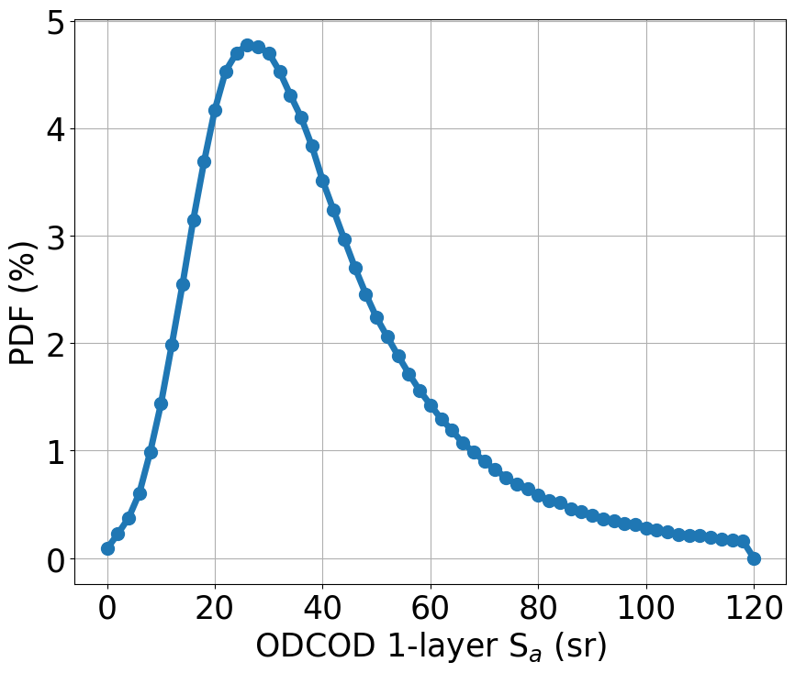
Application: ODCOD-based lidar ratio
Currently, CALIPSO retrieves aerosol extinction coefficient and AOD by solving the lidar equation, simplified via an assumed lidar ratio (S_{a}).
The prescribed lidar ratio is a function of aerosol type.
Ongoing work endeavors to refine the selection of lidar ratios (S_{a}).
We iteratively derive column S_{a} by solving the lidar equation with the use of CALIPSO attenuated backscatter and constrained with ODCOD AOD.
Preliminary results show a reasonable lidar ratio range with values somewhat consistent with other datasets.
Future analysis will exploit the CALIPSO-ODCOD synergy for computing aerosol-specific S_{a}.
One of the primary goals of the ROSES funded project, “Assessing and Improving CALIPSO Aerosol Optical Properties”
Computed daytime lidar ratio over the global ocean for 2017

Slide 11
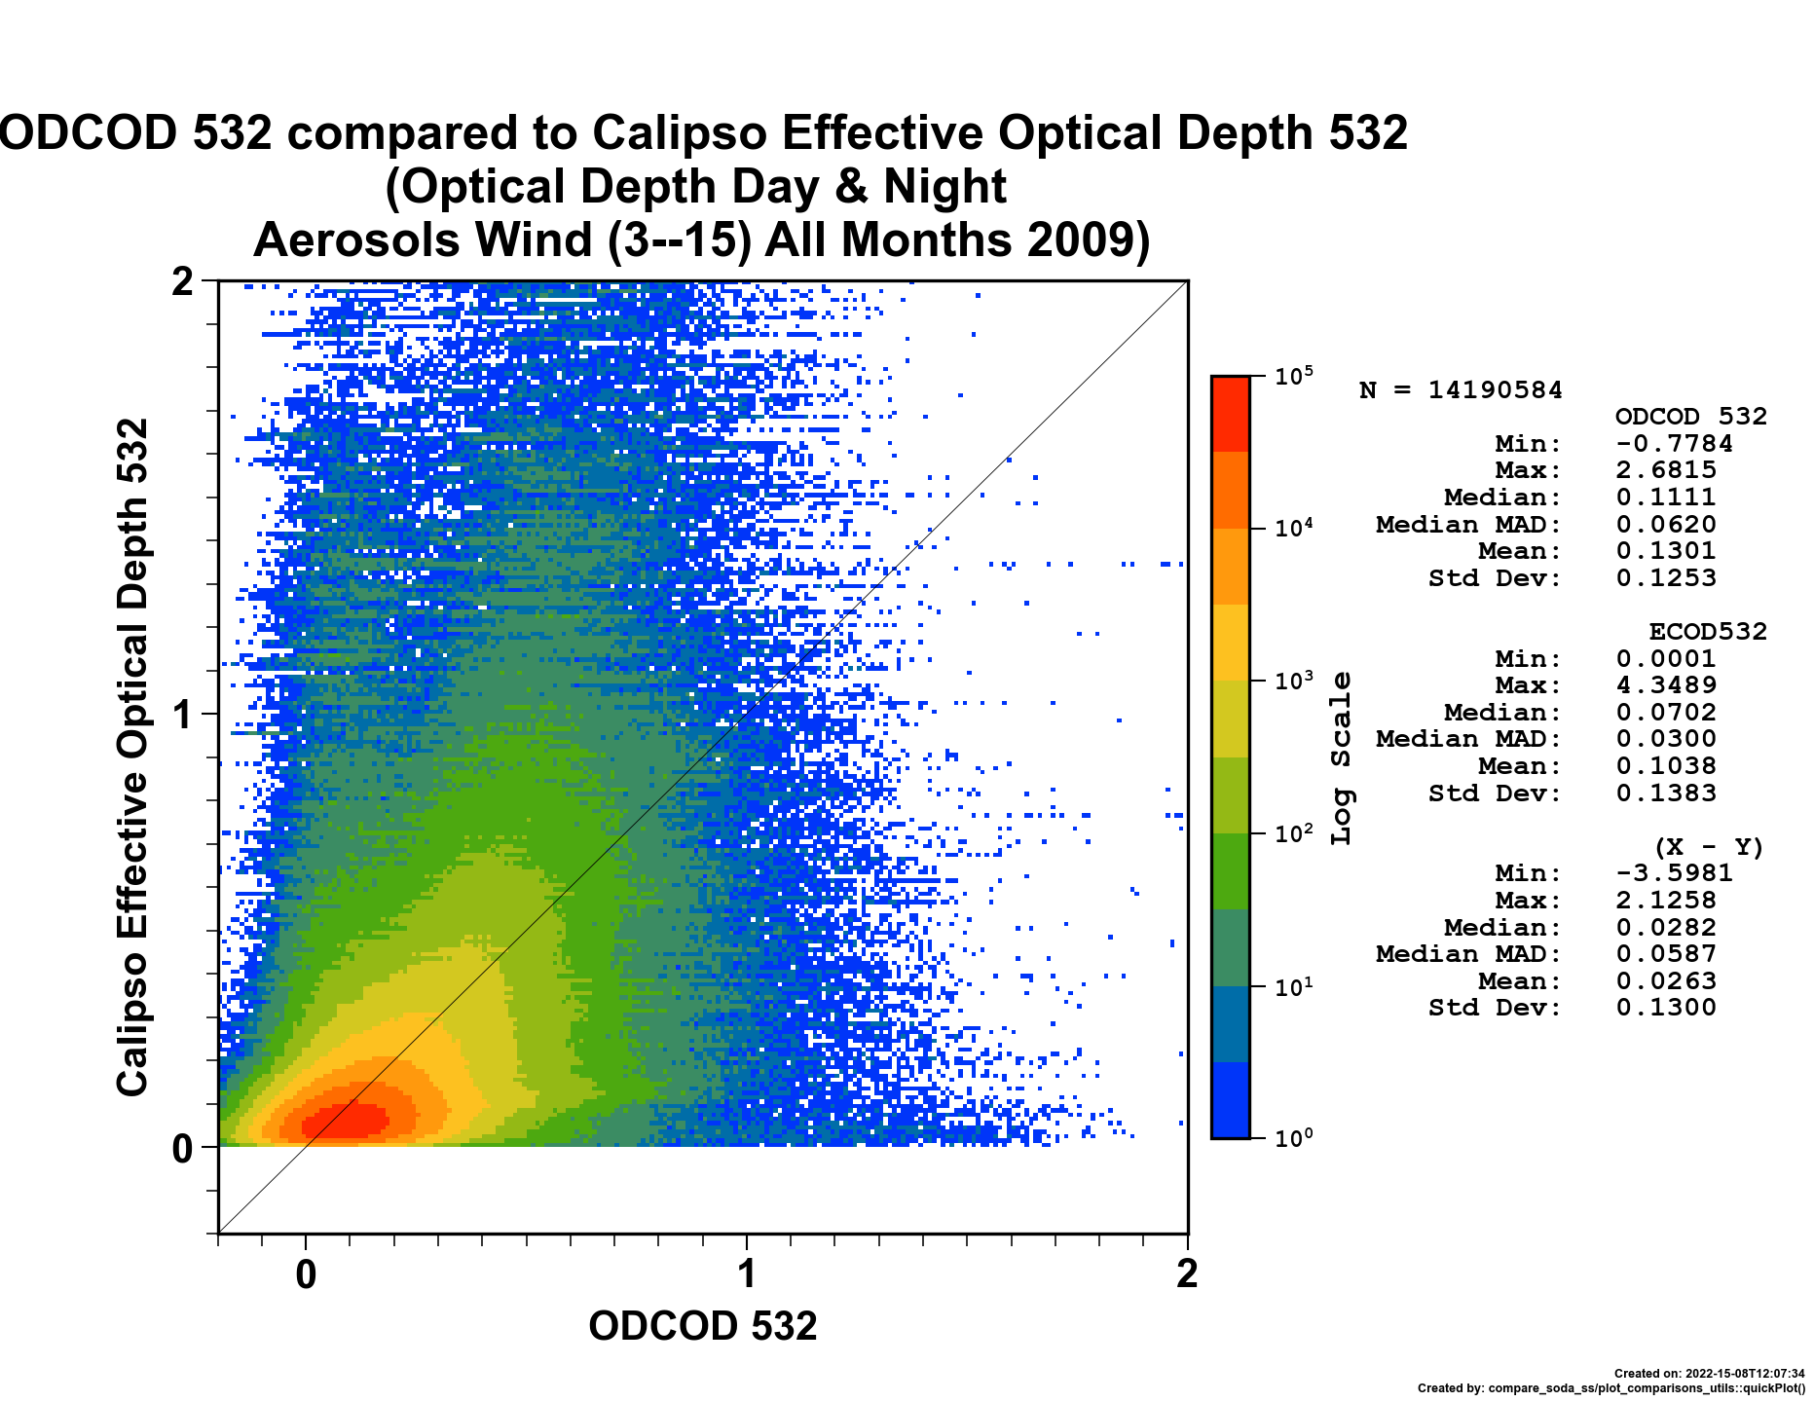

Application: CALIPSO Evaluation
532 nm ODCOD (x-axis) vs CALIOP’s standard aerosol column optical depth retrievals (y-axis)
2009 global, daytime and nighttime,
3 m/s < wind speed < 15 m/s
ODCOD provides a tool for evaluating:
CALIPSO total column optical depth retrievals
cloud-aerosol discrimination
aerosol typing
lidar ratio assignment
And more
CALIPSO Standard Aerosol
Column Optical Depth 532

Slide 12
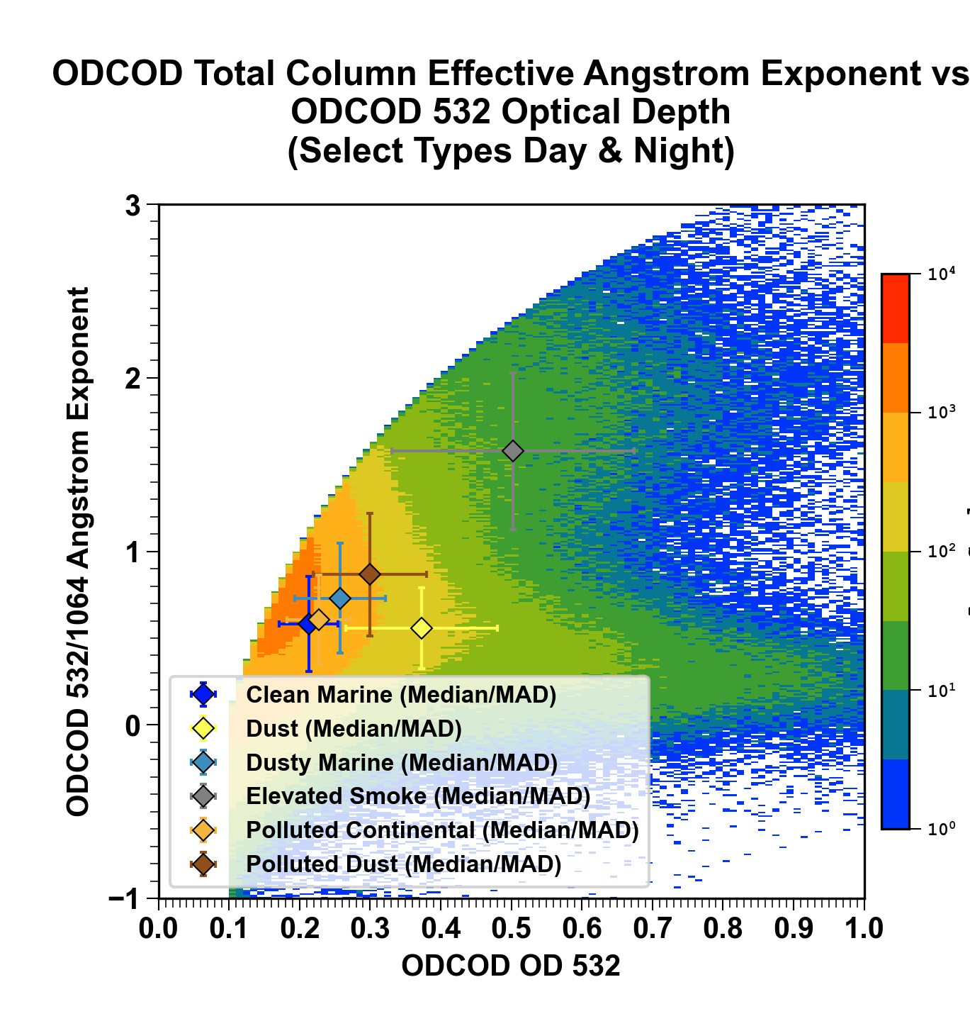
Application: Future Angstrom Exponents
ODCOD at 1064 will not be in Level 2 Version 4.51
However, fully expected to be in Version 5
Will provide estimates of Angstrom Exponents
  Useful in CALIPSO CAD
  Aerosol subtyping

Slide 13
Conclusion
ODCOD at 532 provides a validated and useful estimate of Total Column Effective Optical Depth
ODCOD is available for the entire CALIPSO mission
ODCOD is incredibly useful for evaluating CALIPSO
ODCOD highlights how much untapped potential is still in the CALIPSO data record even after 16 years
Please Check out the Poster, "CALIPSO’s New ODCOD Product
Compared to Langley’s HSRL and HSRL-2"
Contact me with any questions about ODCOD!!
Rob Ryan: robert.a.ryan@nasa.gov

Slide 14
Additional Slides

Slide 15
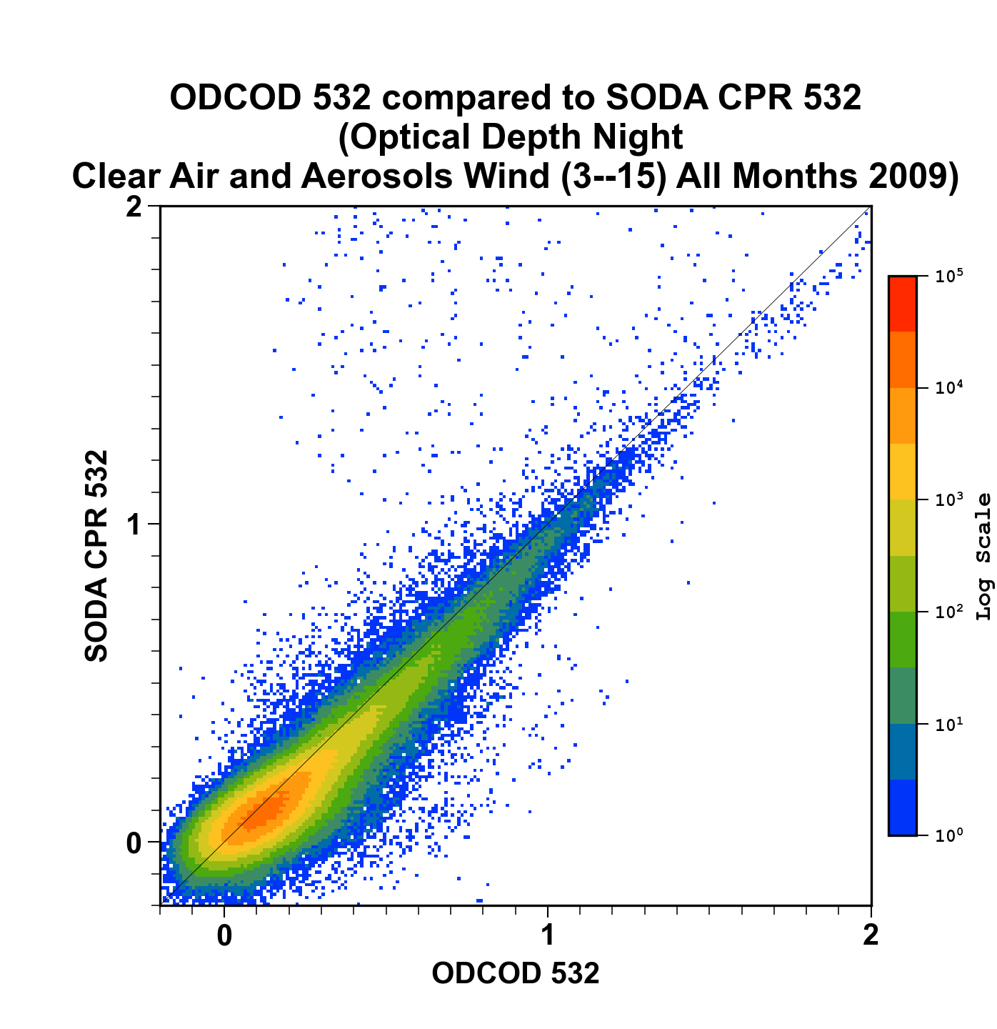
Nighttime Comparisons

Slide 16
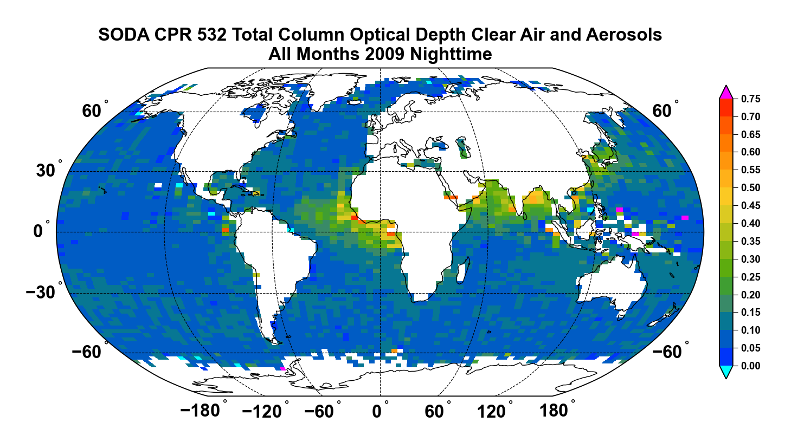
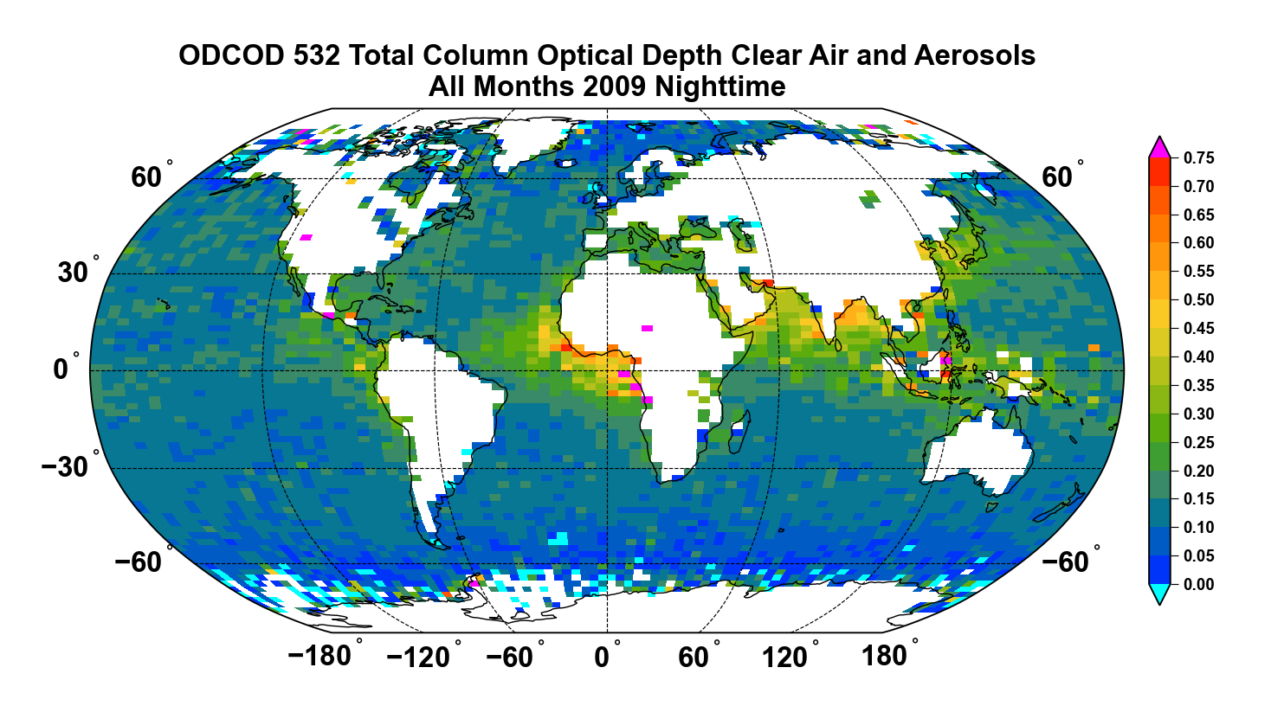
Nighttime Comparisons

