Slide 1

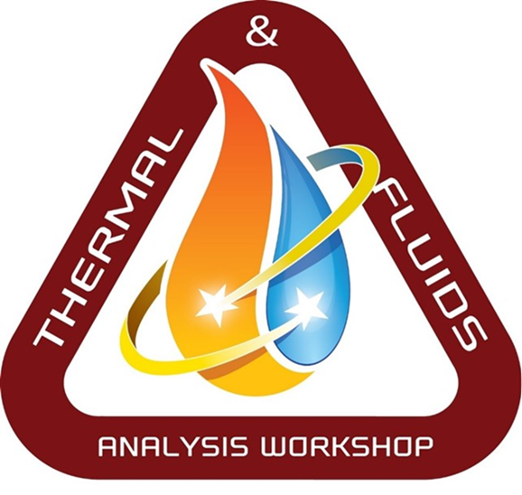
Lunar Thermal Analysis Guidebook (L-TAG):
Introduction
Carlos Gomez, Brian Hamill, Greg Schunk
NASA/Marshall Space Flight Center
&
Lisa Erickson
NASA/Johnson Space Center
TFAWS Short Course
Thermal & Fluids Analysis Workshop
TFAWS 2022
September 6th-9th, 2022
Virtual Conference

Slide 2
Lunar Thermal Analysis Guidebook (L-TAG)
What is L-TAG?
  L-TAG is a document developed by the Lunar Thermal Environments Task Team (L-TETT) in 2020 - 2021 to provide guidance to the thermal community regarding thermal analysis assessments of the Lunar natural environments.
  L-TAG was the first User’s Guide produced under the Human Landing System (HLS) Program.
    Document number = HLS-UG-001
  L-TAG is publicly available at the link below.
    human landing system lunar thermal analysis guidebook - NASA Technical Reports Server (NTRS)

Slide 3
Lunar Thermal Environments Task Team (L-TETT)
What is L-TETT?
  The Lunar Thermal Environments Task Team (L-TETT) was chartered by HLS to support MSFC/EV44 in formulating Sections 3.3.9.1 and 3.4.6 of the Cross-Program Design Specification of Natural Environments (DSNE).
  The L-TETT also developed and documented thermal analysis methodologies for orbital and surface missions. This companion document to DSNE will aid thermal analysts in appropriate application of Lunar thermal environments.
  L-TETT is led by MSFC/EV34 with support from a NASA agency-wide team of thermal and environment experts.
    The following NASA centers provide L-TETT membership support:
      Marshall Space Flight Center (MSFC)
      Johnson Space Center (JSC)
      Glenn Research Center (GRC)
      Jet Propulsion Laboratory (JPL)

Slide 4
Design Specification for Natural Environments (DSNE)
What is DSNE?
  DSNE is a document developed by the Marshall Space Flight Center/EV44, Natural Environments Team.
    Cross-Program Design Specification for Natural Environments (DSNE)
  DSNE includes the following types of environments:
    Terrestrial environments at launch, abort, and normal landing sites (winds, temperatures, pressures, surface roughness, sea conditions, etc.).
    Space environments (ionizing radiation, orbital debris, meteoroids, thermosphere density, plasma, solar, Earth, and lunar-emitted thermal radiation, etc.)
      Destination environments (Lunar surface and orbital, Mars atmosphere and surface, near Earth asteroids, etc.).
  DSNE was originally developed under the Constellation Program and was modified to represent updated Design Reference Missions (DRMs) for NASA Exploration Systems Development (ESD) Programs. This would capture all natural environments for the Artemis Program and HLS Program.
    Document number = SLS-SPEC-159
  DSNE is publicly available at the link below.
    cross-program design specification for natural environments (dsne) - NASA Technical Reports Server (NTRS)

Slide 5
Short Course Agenda
Presenters
  MSFC/Carlos Gomez (L-TETT Chairman and Moderator for this course)
  MSFC/Greg Schunk (L-TETT member, contributor to L-TAG)
  MSFC/Brian Hamill (L-TETT member, contributor to L-TAG)
  JSC/Lisa Erickson (L-TETT member, contributor to L-TAG)
Short Course
  Four hours (two before lunch, two after lunch)
  Combination of technical presentations, analysis demonstrations, and question/answer session
Agenda
  The Earth’s Moon
  Lunar Space & Surface Thermal Environments
  Thermo-physical and Optical Properties of Lunar Regolith
  Modeling Lunar Orbits
  Lunar Surface Ground Plane Modeling Approaches
  Detailed Lunar Terrain Modeling
  Special Topics

Slide 6
Lunar Thermal Analysis Guidebook (L-TAG):
The Earth’s Moon
Carlos Gomez, Brian Hamill, Greg Schunk
NASA/Marshall Space Flight Center
&
Lisa Erickson
NASA/Johnson Space Center
TFAWS Short Course
Presented By
Greg Schunk
Thermal & Fluids Analysis Workshop
TFAWS 2022
September 6th-9th, 2022
Virtual Conference

Slide 7
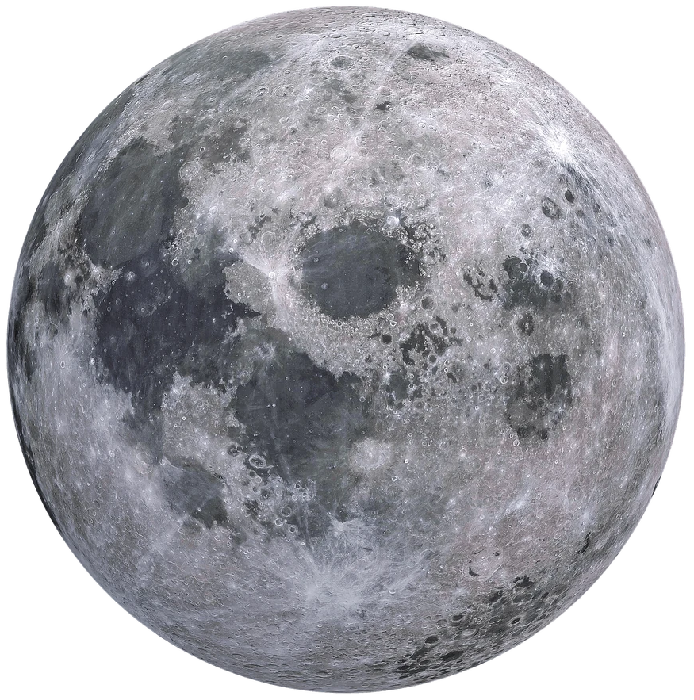
The Earth’s Moon
As observed from the Earth, the Moon’s surface is characterized by large dark regions known as maria.
The lighter surfaces on the lunar surface are referred to as highlands.
Owing to a greater iron oxide composition, the maria are not as reflective as the lunar highlands and were so named by ancient astronomers who mistakenly interpreted the maria as oceans.
The lunar surface is characterized by a layer of regolith of variable thickness depending upon location as described in DSNE 3.4.2.1 with the general composition provided below.
 | Maria | Highlands
 | (wt%) | (wt%)
SiO₂ | 45.4% | 45.5%
Al₂O₃ | 14.9% | 24.0%
CaO | 11.8% | 15.9%
FeO | 14.1% | 5.9%
MgO | 9.2% | 7.5%
TiO₂ | 3.9% | 0.6%
Na₂O | 0.6% | 0.6%

Slide 8
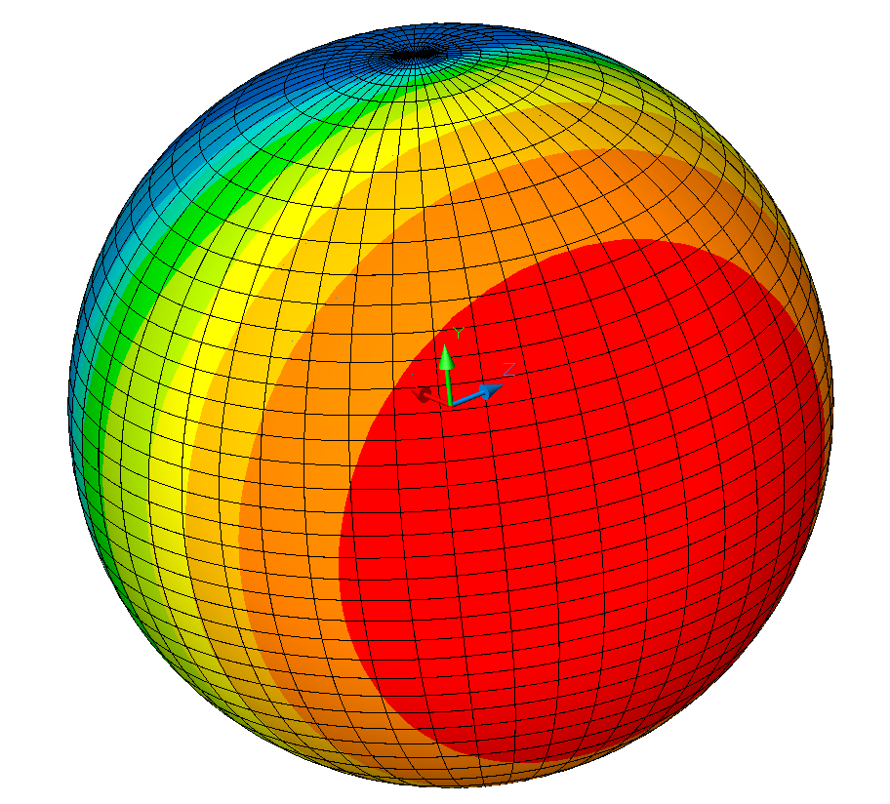
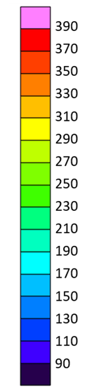
Lunar Surface Temperature
Lunar Surface
Temperature (K)
Due to the rotational period of the Moon, the thermo-physical properties of lunar regolith and the absence of an atmosphere, the Moon’s surface thermal environment is much more severe than that of the Earth in both magnitude and variation.
Surface temperatures on the sun-lit side of the Moon can exceed 390 K (242ºF) at the sub-solar point while dark side temperatures may plunge well below 90 K (-298ºF).
The performance of conventional spacecraft thermal control systems may be compromised or even rendered non-functional in such environments.
Spacecraft in low lunar orbits passing directly above or near the lunar sub-solar point (i.e. Sun directly overhead) must account for the impacts of infrared flux emitted from the surface upon thermal radiators.

Slide 9
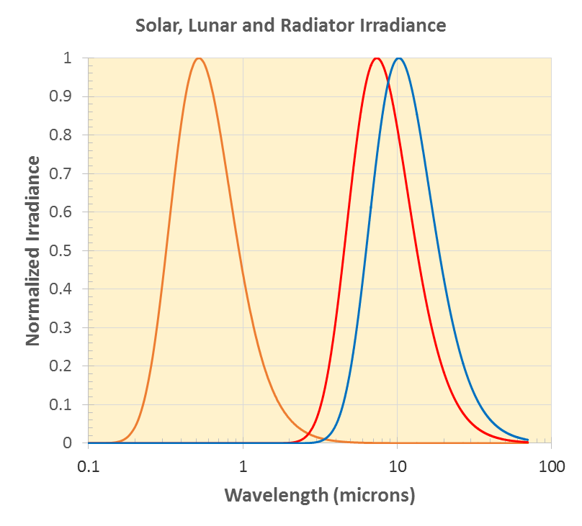
Heat Rejection on the Lunar Surface
With Lunar equatorial temperatures possibly exceeding 250⁰F, high infrared background radiation from lunar terrain and the surface can seriously compromise the performance of conventional thermal radiators.
The solar spectrum is well separated from the radiator emission but the lunar background radiation (red) will greatly reduce the energy a thermal radiator (blue) can emit due to the overlapping wavebands.
The Apollo missions were severely constrained by the lunar thermal environment resulting in restrictions in both duration and landing time of day. Lunar Roving Vehicle (LRV) battery overheating was an issue on both Apollo 16 and 17 due to the local thermal environment and lunar dust accumulation on the LRV radiator.
Solar
Equatorial
Radiator

Slide 10
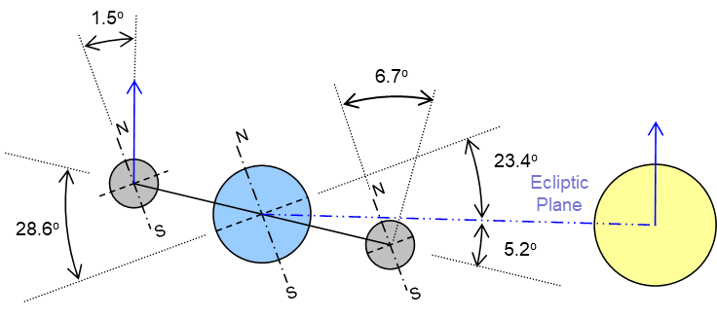
The Moon’s Orbit about the Earth
The orbital relationship between the Earth, Moon and Sun is illustrated below. Like many planetary satellites in the Solar System, the Moon is tidally locked to its partner so that the rotational period is the same as its orbital period about the Earth and, aside from small deviations due to libration, one side of the Moon always faces the Earth.
The Moon’s axis of rotation is tilted 1.542⁰ relative to the ecliptic plane while the lunar orbit plane is inclined 5.145⁰ relative to the ecliptic plane. The lunar obliquity (inclination to the orbit plane) is the sum of the two angles (6.68⁰).
The maximum sun elevation angle at the poles is related to the tilt.
Locations at the lunar poles (of sufficient altitude) may experience near continuous sunlight.
Lunar Orbit Parameters
Parameter | Value
Semi-major axis (km) | 384400
Perigee (km) | 363300
Apogee (km) | 405500
Sidereal rotation period (days) | 27.322
Synodic period (days) | 29.530
Inclination to ecliptic (deg) | 5.145
Inclination to Earth equator (deg) | 18.28 - 28.58
Lunar Obliquity to Ecliptic (deg) | 1.542
Orbit eccentricity | 0.0549
Obliquity to orbit (deg) | 6.68

Slide 11
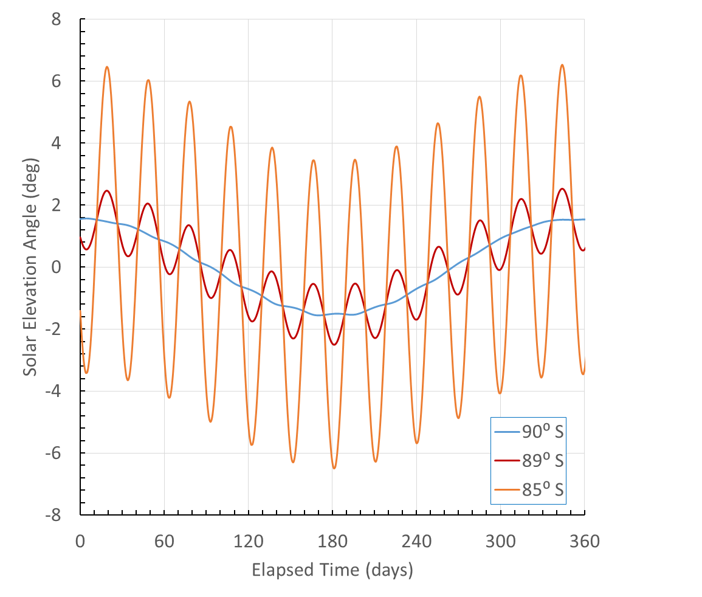



Solar Elevation Angle for South Pole Region
N
Day
$$Lunar Synodic Month$$
$$90⁰−Latitude$$
Horizon
S
Elevation
Angle
$$Lunar Obliquity$$
$$to Ecliptic$$
Twilight
N
Horizon
S
Angular
Diameter
Night
The angular diameter of the sun is approximately 0.53º as viewed from the lunar surface.
https://ssd.jpl.nasa.gov/horizons/app.html#/

Slide 12
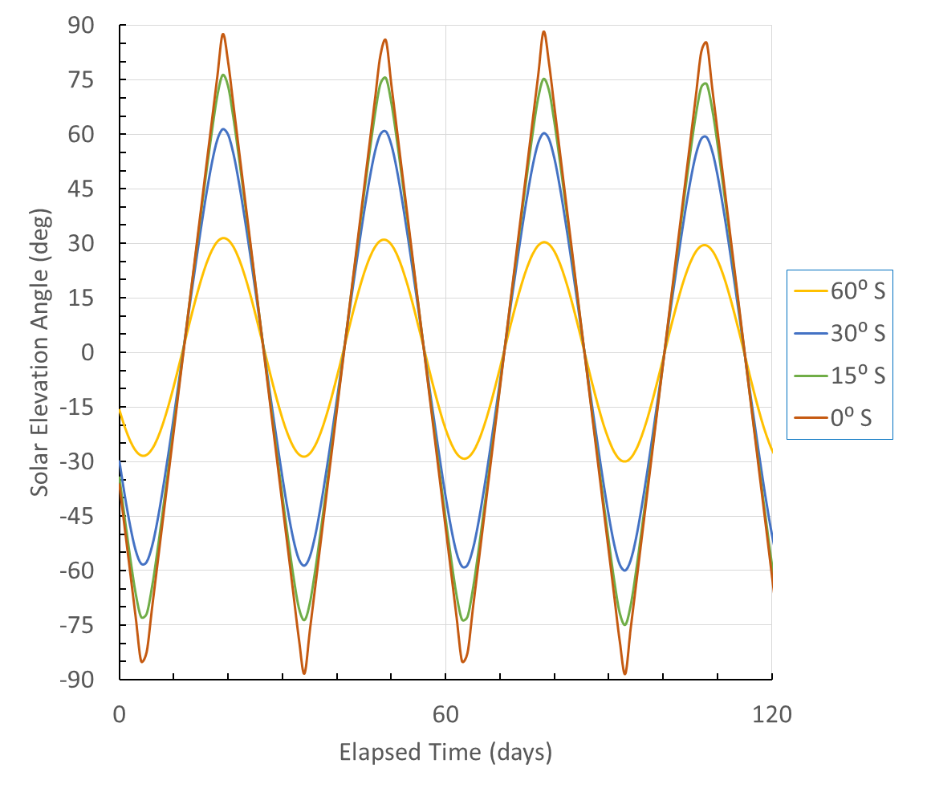
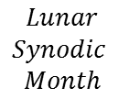
Solar Elevation Angle for Southern Hemisphere
Day
N
Horizon
$$Lunar$$
$$Synodic$$
$$Month$$
Elevation
Angle
S
N
Horizon
Angular
Diameter
S
Night
The angular diameter of the sun is approximately 0.53º as viewed from the lunar surface.

Slide 13
Lunar Orbital Period
The rotational (and orbital) period of the Moon can be characterized relative to both a fixed point in space (Sidereal) and to the Sun (Synodic).
The Sidereal period is on the order of 27.3 days while the Synodic period is on the order of 29.5 days.
The Synodic period of 29.5 days represents sunrise to sunrise for a reference point on the surface of the Moon (as well as a New Moon to New Moon as viewed from the Earth).
For an asset on the lunar surface, the Sun angle is periodic over the Synodic period and may be more pertinent for thermal assessments.
Synodic
~29.5 days
Sidereal
27.3 days
New Moon

Slide 14
A Note on Solar Elevation Angle
The JPL Horizons Ephemeris computes local solar elevation angles on the lunar surface relative to the center of the Sun.
For a perfectly collimated beam, the maximum elevation angle at the poles would be equal to the Lunar Obliquity relative to the Ecliptic. But the peak elevation angles computed by the Ephemeris are slightly different (on the order of 1.54⁰ +/- 0.014⁰).
The small difference is suspected due to the Sun centered calculation and the Lunar Orbit Inclination but is not be of consequence thermally.
N
Sun Center
N
Perfectly
Collimated
Perfectly
Collimated
Sun Center
1.54º
1.54º
1.54-0.014º
1.54+0.014º
S
S
https://ssd.jpl.nasa.gov/horizons/app.html#/

Slide 15
Lunar Seasons
South Pole Winter
1.5º
N
At sufficient altitude, locations at either pole may experience near continuous illumination.
N
Sun
Polar Axis of Rotation
S
Sun Vector
South Pole Summer
1.5º
N
Portions of polar craters may remain perpetually shadowed, possibly containing frozen water
Sun
Sun Vector
S

Slide 16
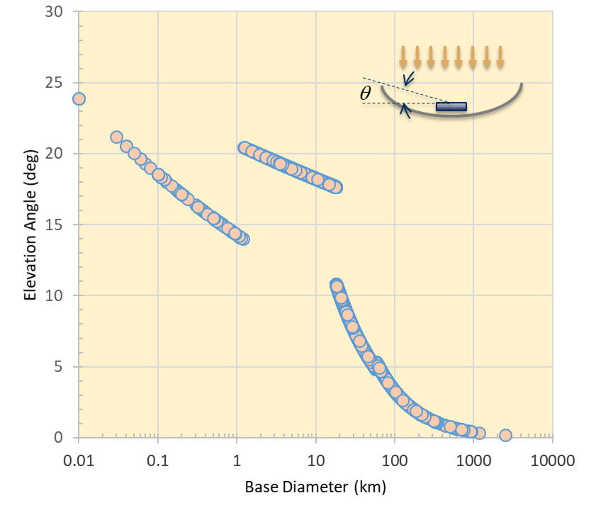
Lunar Crater Size Distribution/Topology
Lunar Crater Elevation Angle
DSNE 3.4.1.1 provides a description of the crater size-frequency distribution and DSNE 3.4.1.2 describes the topography (depth to diameter ratios) for lunar craters.
Details for craters near a specified landing site may be found in the Lunar Impact Crater Database available at https://www.lpi.usra.edu/lunar/surface/
Over 8700 craters are cataloged in the database with up to 80 parameters (including depth, diameter, location, etc.) identified for each crater.
A summary plot of the elevation angle (derived from crater depth over radius) versus crater diameter for each crater in the database is shown.
Teemu Öhman, “Lunar Impact Crater Database”, Lunar and Planetary Institute & Arctic Planetary Science Institute, May 2011 and September 2015.

Slide 17
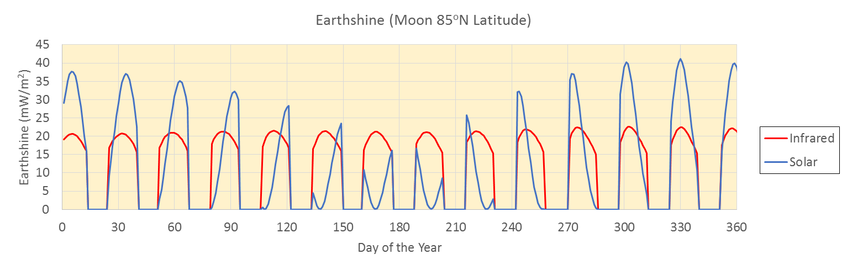
Earthshine
Perpetually Shaded Regions (PSRs) of the lunar polar craters may experience non-negligible thermal radiation and reflected solar radiance from the Earth (as well as internal ground heat flow). Peak broadband earthshine may exceed 150 mW/m² for localized regions [1]
A typical yearly variation of Earthshine is shown for a lunar location at 85ºN latitude with a surface tilt of 15º.
The flux is zero for when the Earth sets below the horizon as shown in the figure. The variation and peaks of the reflected solar are greater than the infrared contribution.
¹David A. Glenar, et. al., “Earthshine as an Illumination Source at the Moon”, Icarus, Volume 321, p. 841-856, March 2019.

Slide 18
Perpetually Shaded Regions
Detailed thermal analysis combining thermo-physical properties of the Lunar surface and subsurface with the ground heat flow result in surface temperature predictions approaching -428⁰ F (18 K) for regions considered to be “permanently shaded” [1].
The floor of craters near the Lunar poles can experience reflected solar flux from the crater walls which can increase the surface temperature to approximately -370⁰ F (50 K) without direct solar flux impingement. Contributions from Earth albedo and re-radiation may also be a factor.
Most surface assets are non-cryogenic and the primary mode of heat transfer with the surface is radiative. Therefore, for such cases, it is a conservative thermal modeling approach to treat the surface temperature as a boundary condition within this temperature range -428 to -370⁰ F (18 to 50 K).
The Lunar surface temperatures will typically increase near the surface asset analyzed. Maintaining the surface temperature at the lower boundary conditions may avoid the analytical overhead needed to accurately calculate surface temperatures on a detailed grid.
¹D. A. Paige and M. A. Siegler, “New Constraints on Lunar Heat Flow Rates from LRO Diviner Lunar Radiometer Experiment Polar Observations,” vol. 47, p. 2753, Mar. 2016.

Slide 19
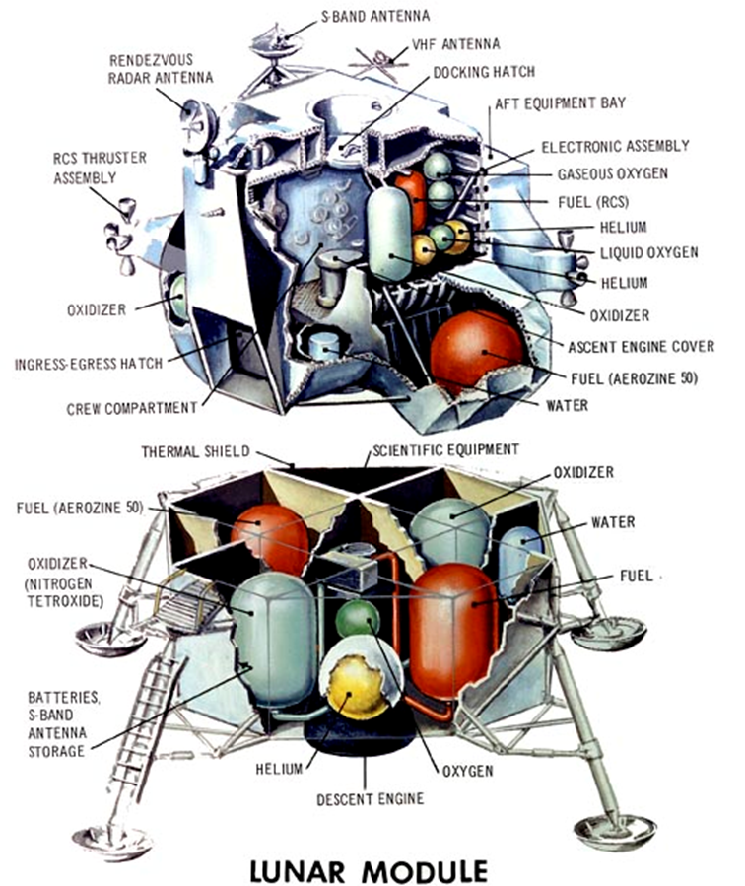
Apollo Lunar Module Thermal Control System
Waste heat rejection achieved via water evaporation or sublimation from on-board water stores.
The onboard water supply consisted of one 367 pound tank in the descent stage and two 47.5 pound tanks in the ascent stage.
The cooling water was consumed for drinking as well.
This resulted in severe restrictions on mission duration as well as constraints on the landing time and location.

Slide 20
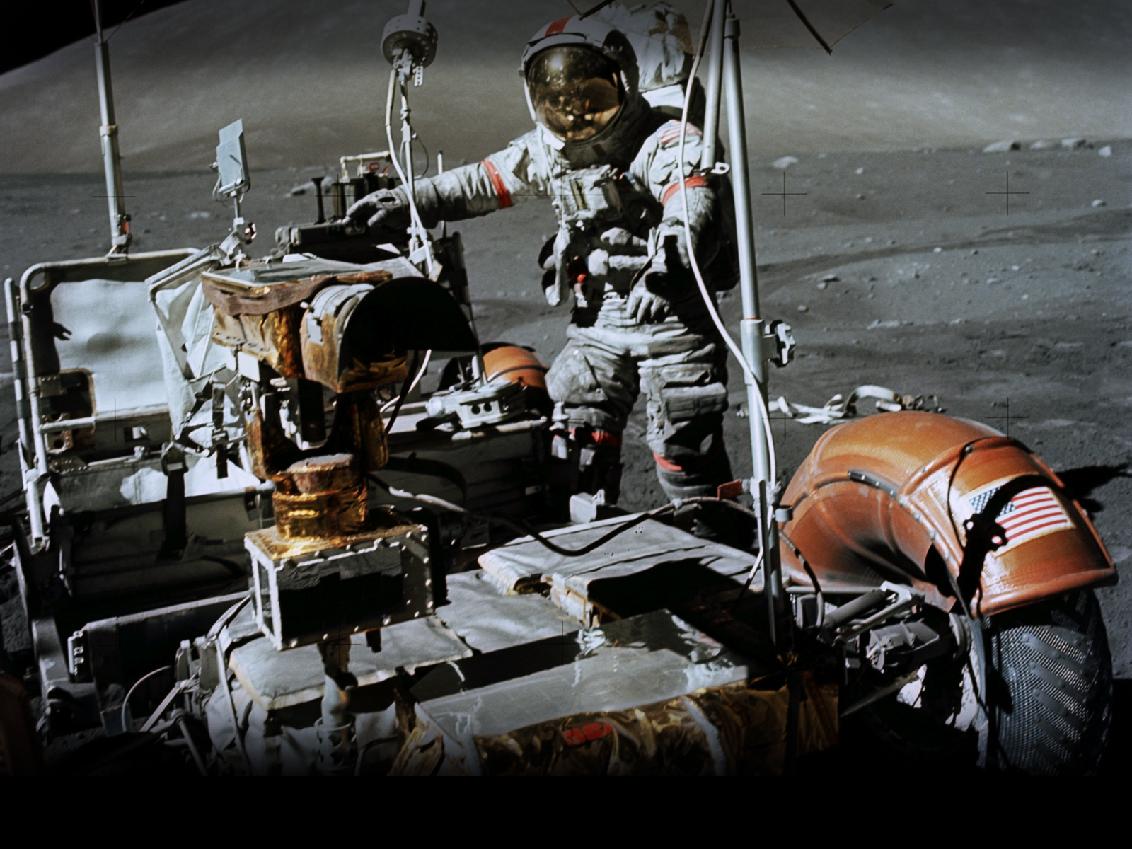
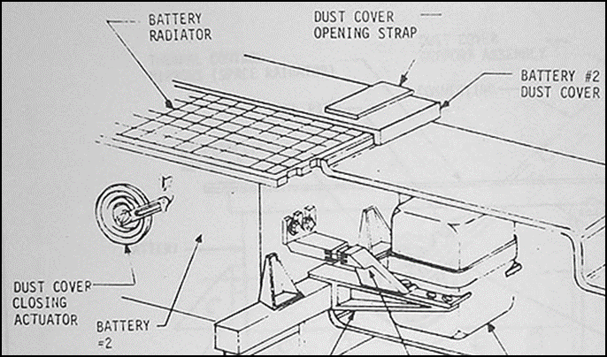
Apollo Lunar Rover Thermal Management
Each wheel of the lunar rover was powered by a ¼ horsepower electric motor. With an estimated top speed of 8 miles per hour.
“Thermal control systems consist of special surface finishes, multi-layer insulation, space radiators, second surface mirrors, thermal straps, and fusible mass heat sinks” [1].
It was discovered that lunar dust was readily disturbed during normal operations in and around the rover.
With a solar absorptance > 0.90, accumulated lunar dust greatly hindered radiator surfaces.
On Apollo 16 and 17 the LRV batteries experienced problems with overheating due to dust accumulation on the radiators. The astronauts attempted to remove the dust manually without much success.
John Young remarked that “Dust is the number one concern in returning to the moon.”
[1] Lunar Rover Operations Handbook, Boeing Company Doc. LS006-002-2H LRV Systems Engineering, Huntsville, April 19, 1971

Slide 21
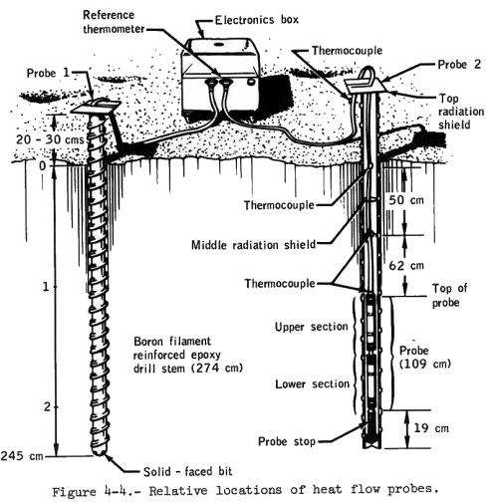
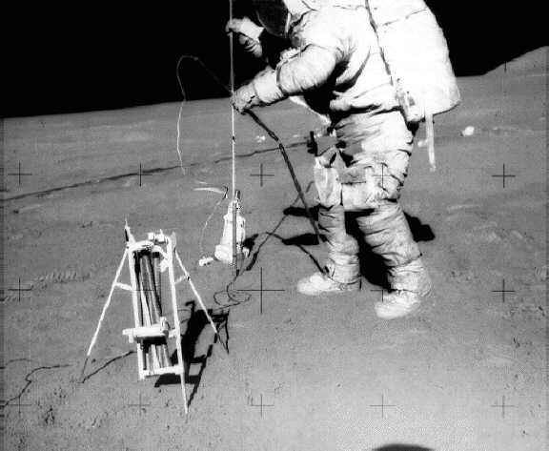
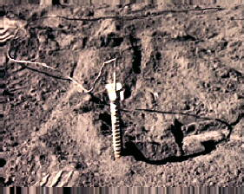
Apollo Lunar Surface Experiment Package (ALSEP)
Heat Flow Experiment (HFE)
“The interior of the Moon is warm compared to the surface, therefore heat flows from the interior to the surface where it is lost into space by radiation.”[1]
“The HFE found that the surface layer temperature during the night was 76K (-197°C) rising to a maximum of 358K (+85°C) during the day. The temperature at 1.5 meters under the surface was a constant 253K (-20°C), indicating the regolith is an excellent thermal insulator.”[1]
“The results of these measurements indicate a heat flow of 21 milliwatts per square meter at the Apollo 15 landing site and of 16 milliwatts per square meter at the Apollo 17 landing site.”[1]
[1]
https://www.honeysucklecreek.net/msfn_missions/ALSEP/hl_alsep.html

Slide 22
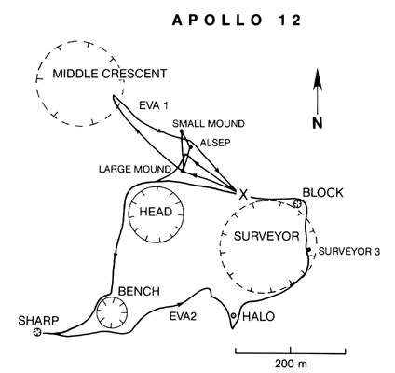
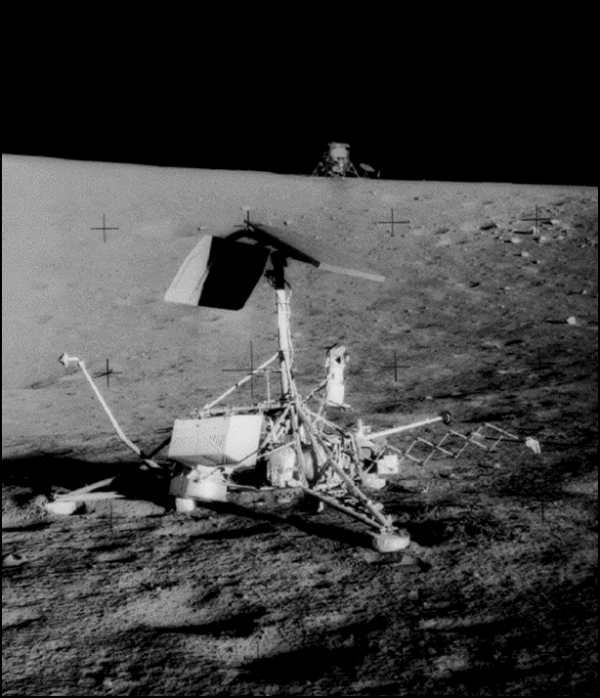
The Apollo 12 Mission and Surveyor 3
Surveyor 3 was launched in 1967 and remained exposed to the lunar environment for 31 months prior to the arrival of Apollo 12, which landed approximately 160 meters from Surveyor’s location.
Several artifacts from Surveyor were recovered and returned to Earth. One interesting discovery was the appearance of a number of microscopic craters.
Some were on the side facing the Lunar Module and it is speculated that the craters resulted from lunar dust kicked up by the exhaust plume during landing.

Slide 23
Lunar Thermal Analysis Guidebook (L-TAG):
Keplerian Representation of an NRHO
Carlos Gomez, Brian Hamill, Greg Schunk
NASA/Marshall Space Flight Center
&
Lisa Erickson
NASA/Johnson Space Center
TFAWS Short Course
Presented By
Brian Hamill
Thermal & Fluids Analysis Workshop
TFAWS 2022
September 6th-9th, 2022
Virtual Conference

Slide 24
Simplifying Orbital Vectors to 2-body Problem
The Motion of a spacecraft is governed by an infinite network of attractions to all celestial bodies.
  Rigorous analysis if this network is impossible
Fortunately, the motion of a space craft in the Solar System is dominated by one central body at time.
  This led to the very useful two body assumptions. (Used in a Keplerian orbit)
    Motion of a spacecraft is governed by attraction to a single body
    The mass of a spacecraft is negligible compared to that of the central body
    The bodies are spherically symmetric with the masses at the centers
    No forces act on the bodies except gravitational forces and centrifugal forces along the line of centers
But what about an orbit about a Lagrange point orbit where the gravitational forces of two bodies are equal? (such as an NRHO)
  This is not a 2-body problem (Earth – Moon – Vehicle)
Do we have to use complex Vector lists?

Slide 25
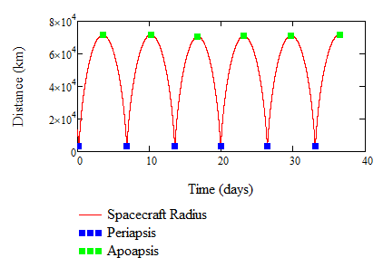
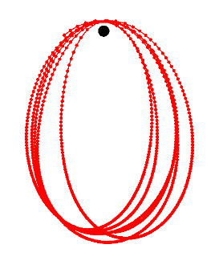
Vector List from EV40
Here is an EV40 NRHO vector list orbit
  Since an NRHO is unstable, there are perturbations to the orbital parameters as the spacecraft orbits. These must be corrected or the spacecraft will not maintain its orbit.
  As the orbit is not Keplerian, a vector list is the only way to represent the complete orbit in Thermal Desktop
  The orbital averages for this orbit are:
    Periapsis radius: 3,354 km
    Apoapsis radius: 71,283 km
    Orbital Period: 6.58 days
    The orbital period was estimated
    by taking the average time
    between periapsis or
    apoapsis

Slide 26
Simplification of Vector List input
Why would the vector list need to be simplified?
  This particular vector list contained over 52,000 positions
    Not every position is needed.
    Positions spaced evenly, but would be more useful concentrated around the Moon
Ways to simplify
  Sample the Data, say every 1000th point. Or even removing all points beyond a distance where the moon is relevant to a thermal analysis
However, a vector list is an “as flown” trajectory. It does not necessarily envelope the hottest or coldest thermal mission relevant environments.
  Seasonal variations or off-pointing cases
Using Keplerian orbits, the orbital parameters can be tuned to envelope those environments
  How to emulate an NRHO with a Keplerian?

Slide 27
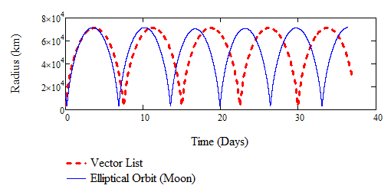

Thermal Desktop Orbital parameters
For Thermal Desktop calculations:
    Periapsis altitude: 3,354 km – 1737km = 1617km
    Apoapsis radius: 71,283 km – 1737km = 69546km
Using those parameters, Thermal Desktop gives:
  Orbital period: 646,942 seconds or 7.48 days
  Eccentricity: 0.910096
  This does not match the period taken from the NRHO vector list. (6.58 days)
This is because the spacecraft is not just orbiting about the Moon. It is orbiting about a Lagrange point in the Earth/Moon system.
  Assume the orbits can be described by conic sections. (ellipse)
  What governs the orbital period?
    The semi-major axis, a
    Gravitational Mass, μ
    Changing the moons mass causes a few problems such as spacecraft speed at periapsis and time spent in proximity to the Moon

Slide 28
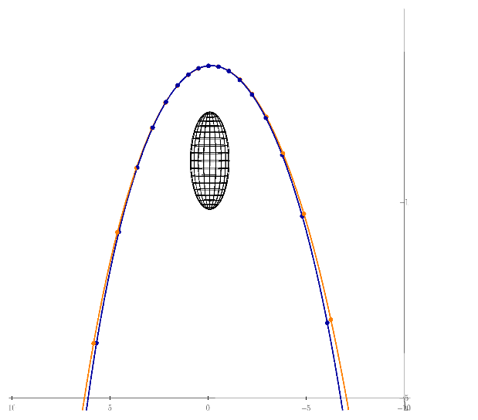
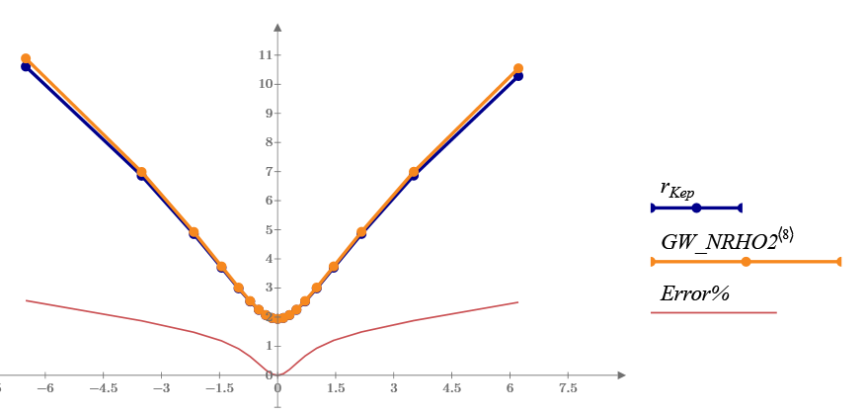
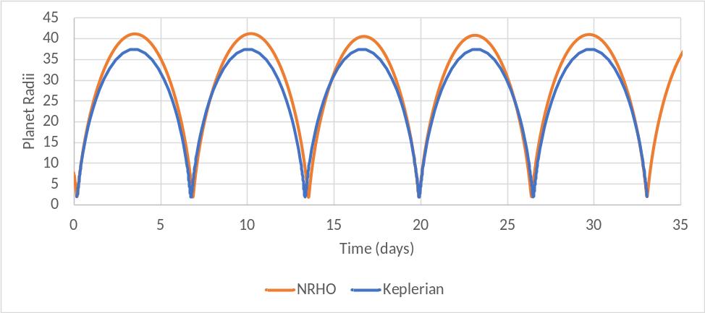
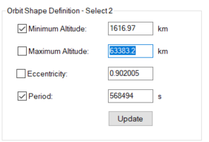
Keplerian Approximation of NRHO
Changing the Apoapsis (or max altitude) keeps the distance and true anomaly vs time close to the NRHO vector list while matching orbital period
Defining the Keplerian with min altitude and
period to match the NRHO calculates a max
altitude of 63383 km (NRHO was 69546 km)

Slide 29

Lunar Thermal Analysis Guidebook (L-TAG):
Ground Plane Setup
Carlos Gomez, Brian Hamill, Greg Schunk
NASA/Marshall Space Flight Center
&
Lisa Erickson
NASA/Johnson Space Center
TFAWS Short Course
Presented By
Brian Hamill
Thermal & Fluids Analysis Workshop
TFAWS 2022
September 6th-9th, 2022
Virtual Conference

Slide 30
Analytical Environments and Ground Plane Setup
In Thermal Desktop, 2 type of Radiation Tasks
  Radks
    Thermal exchange between model surfaces
    Heat rejection to Radiation Sink Node: “Space”
      Could also represent: Room Ambient, TVAC Cold Walls, etc…
    Modeled as energy exchange: Q_{space-i} = k_{i-space}*(T_{space}⁴ – T_{i}⁴)
  Heat Rates
    Directional and diffuse heat loads applied to Model
    Typically defined using “Orbits” defined by the Orbit manager.
    Modeled as incident fluxes: Q_{env-i} = Q_{solar} + Q_{albedo} + etc…
  These are calculated and applied independently, but will result in:
    Q_{net} = Q_{solar} + Q_{albedo} + Q_{planetshine} + etc… + k_{i-space}*(T_{space}⁴ – T_{i}⁴)

Slide 31
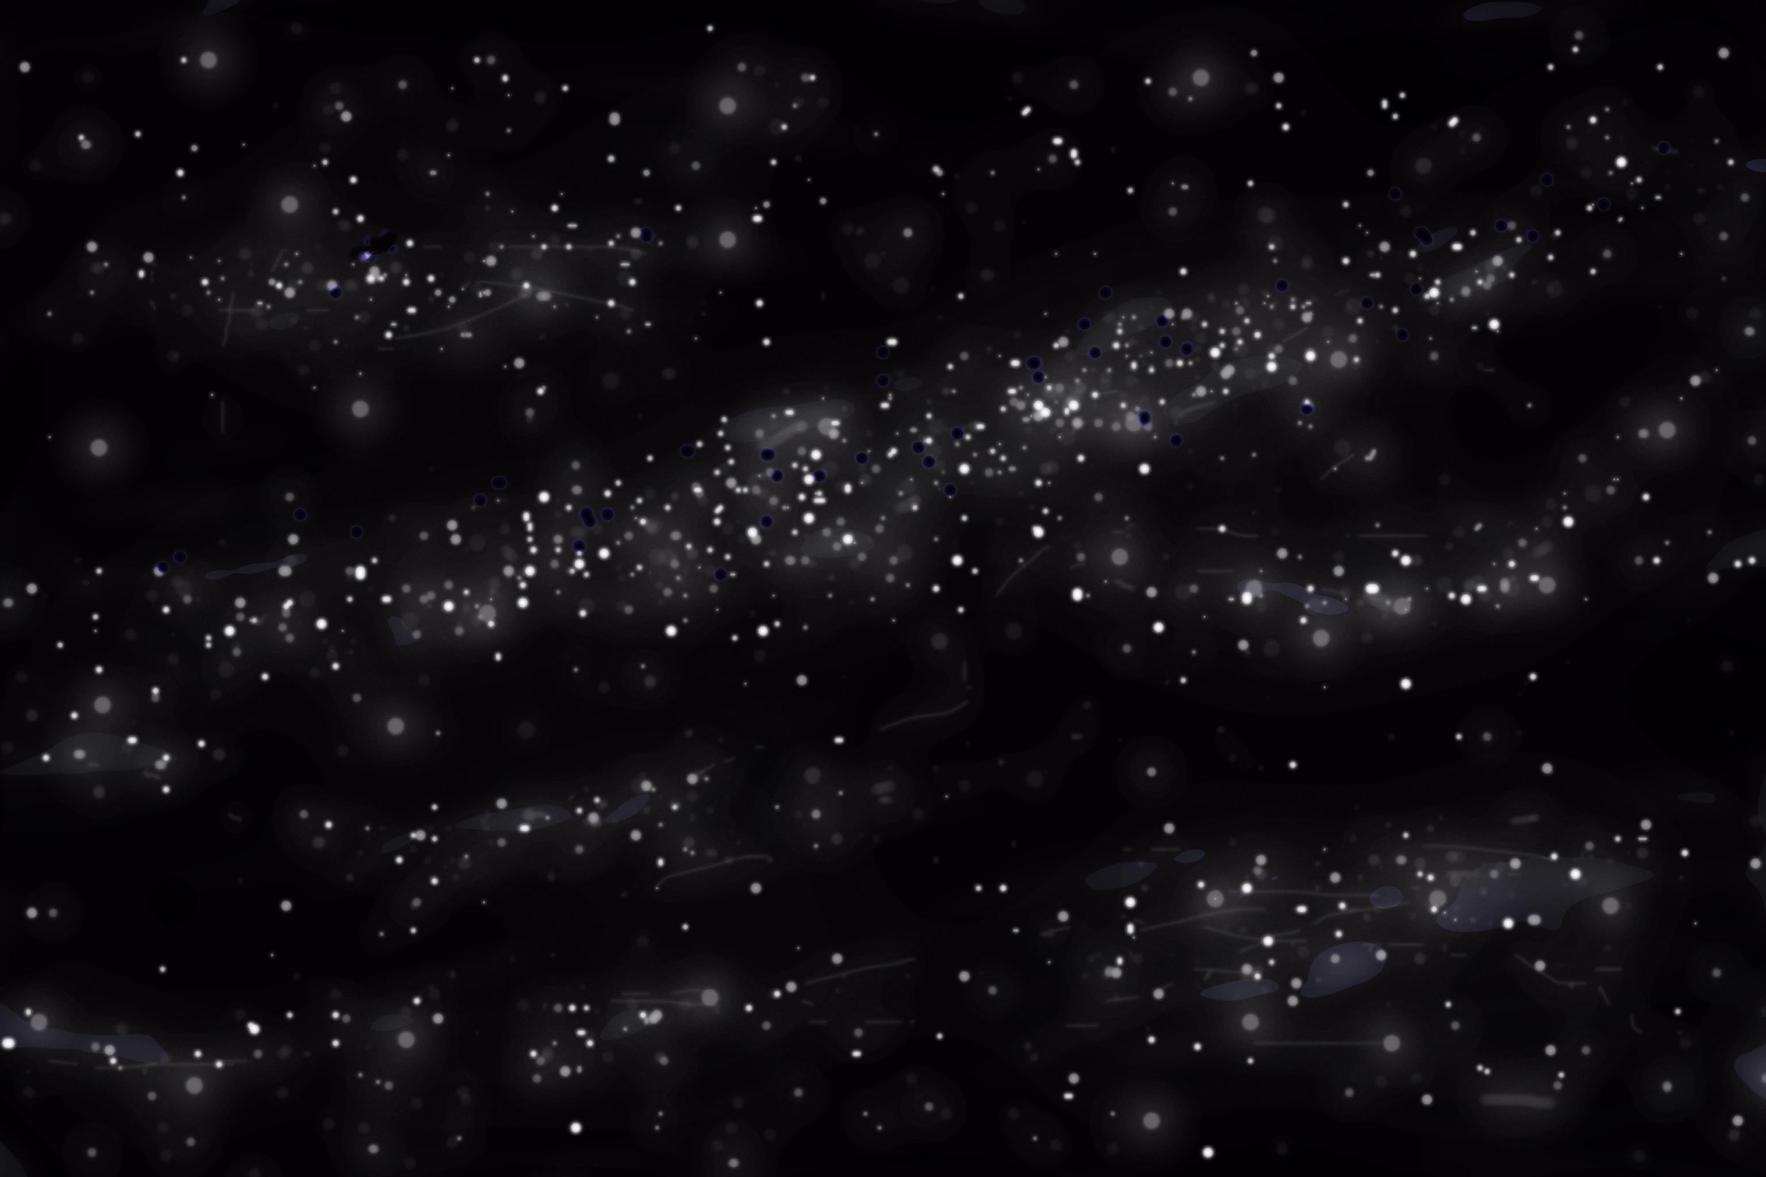
Radiation Exchange (RadKs)
Look at RadKs First.
  The SPACE node sets the
  radiation sink temperature
  When applied to the spacecraft:
    Defines the energy exchange as:
    Q_{space-i} = k_{space-i}*(T_{space}⁴ – T_{i}⁴)
    k_{space-i} is the grey-body form factor to space for a node: k_{space-i} = 1 – k_{spacecraft-i}
    For a single node k_{space-i} = 1
    Can also be represented as:
    Q_{space-i} = k_{space-i}*(T_{space}⁴) – k_{space-i}*(T_{i}⁴)
Q_{space-i} = k_{i-space}*(T_{space}⁴ – T_{i}⁴)
Q_{space-i} = k_{space-1}*( T_{space}⁴)
Q_{i-space} = k_{i-space}*( T_{i}⁴)

Slide 32
Heating Rates (Fluxes)
Now look at Heating Rates (HRs)
  These are calculated as incident fluxes applied to the spacecraft
  Terrestrial Lat/Long Orbit
    Idealized Planet (Below Horizon)
    Sky (Above Horizon)
  Solar
    Direct Solar
    Albedo
    Diffuse Solar
    Diffuse Sky Albedo
  IR
    Planetshine
    Diffuse SkyIR
Q_{HR(incident)} = Q_{Solar} + Q_{Albedo} + Q_{Diffuse Solar} + Q_{Diffuse Sky Albedo} + Q_{Planetshine} + Q_{diffuse SkyIR}

Slide 33
Planets with Atmosphere (or without)
Combining RadK and HR terms gives: Q_{net} = Q_{HR} + Q_{radK}
RadK and Hr are separate calculations
    RadK doesn’t see idealized planet surface
Considering IR wavelengths
  Diffuse Sky IR represents above horizon
  GroundIR/Planetshine is below horizon
Q_{IR} = Q_{Planetshine} + Q_{diffuse SkyIR} + Q_{space}
Q_{IR} = Q_{Planetshine} + Q_{diffuse SkyIR} + k_{space-i}*(T_{space}⁴ – T_{i}⁴)
Q_{planetshine} and Q_{diffuse_SkyIR} represent all incident IR.
The term k_{space-i}*(T_{space}⁴) should equal 0 for energy balance.
Q_{Net} = Q_{Solar} + Q_{Albedo} + Q_{Diffuse Solar} + Q_{Diffuse Sky Albedo} + Q_{Planetshine} + Q_{Diffuse SkyIR} + k_{space-i}*(T_{space}⁴) – k_{space-i}*(T_{i}⁴)

Slide 34
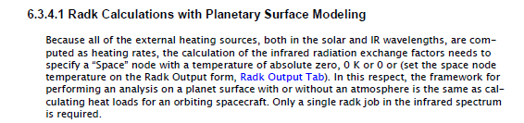
Planets with no Atmosphere
For Lunar analysis, is may be confusing to include a DiffuseSkyIR term in the HR rate as there is no atmosphere.
Space should only be visible above horizon
  DiffuseSkyIR represents above horizon and Sky temp is set to 2.73K
  Diffuse Solar and Diffuse Sky Albedo should be 0
Setting the “SPACE.1” node to 2.73K creates a flux from space above and below horizon regardless of idealized planet surface presence.
A large modeled ground plane can block enough of the space flux below the horizon to be accurate.
  If SPACE.1 node is set to 2.73K:
    A large modeled ground plane is required
    Diffuse Sky should remain unchecked
Q_{HR(incident)} = Q_{Solar} + Q_{Albedo} + Q_{Diffuse Solar} + Q_{Diffuse Sky Albedo} + Q_{Planetshine} + Q_{diffuse SkyIR}
Q_{HR(incident)} = Q_{Solar} + Q_{Albedo} + Q_{Diffuse Solar} + Q_{Diffuse Sky Albedo} + Q_{Planetshine} + Q_{diffuse SkyIR}

Slide 35
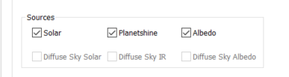
Other Considerations
Solar occultation will be discussed later, but…
  In cases with low solar incidence angles, planetary orbits may not be the best choice.
  Vector list orbits (which can be taken from planetary orbits hra files) can allow for partial solar illumination.
    When calculating heat rates with a vector orbit, SkyIR is not an option
    In this case, care should be used to either use a larger ground plane or understand the effect (usually small) that the space node flux is having on the model.

Slide 36
Sizing the Ground Plane
The Lunar surface temperature is dependent on shadowing by surface assets
  A participatory ground plane (not just an idealized planet surface) needs to be included in thermal models
The Lunar Thermal Analysis Guidebook breaks ground plane sizes in two groups.
  Large enough to capture the vehicle’s effect on the surface.
  Large enough to capture the surface effect on the vehicle.
Thermal analysis tools, like thermal Desktop, can provide an idealized ground plane to account for the ground effect on a vehicle.
  Allows for a smaller modeled ground plane that only captures vehicle effect on surface
  Less computationally demanding.

Slide 37
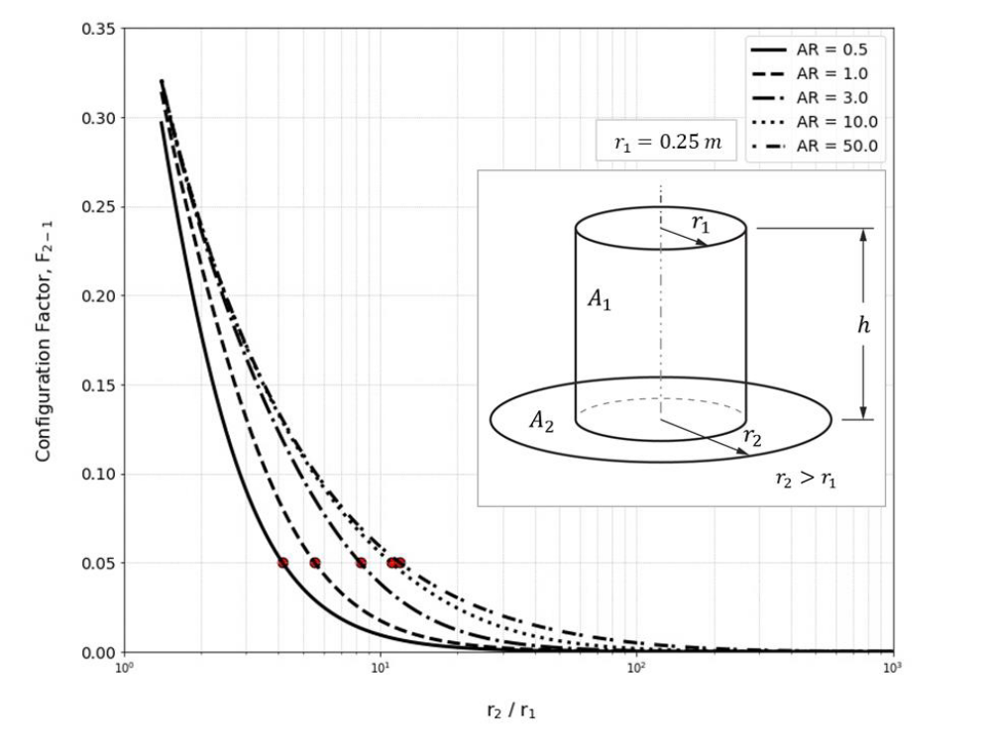
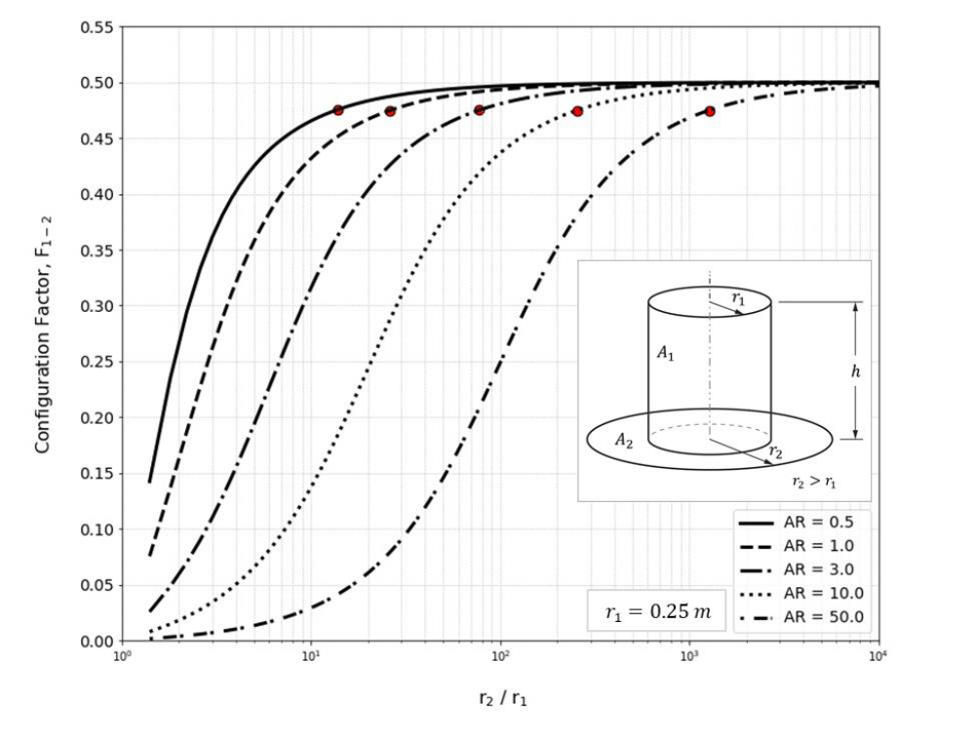
Sizing the Ground Plane
LTAG Section 9.3
Vehicle Effect on Surface
Surface Effect on Vehicle
((𝑟1/𝑟2)_{𝐹2−1=0.05}≅1.77𝑙𝑛(𝐴𝑅)+5.85
(𝑟2/𝑟1) _{𝐹1−2=0.05} ≅12.63(𝐴𝑅)+0.943

Slide 38
Sizing the Ground Plane
Vehicle Effect on Surface
Surface Effect on Vehicle
AR = 5
  Vehicle Radius = 7m
  Ground Radius = ~61m
AR = 5
  Vehicle Radius = 7m
  Ground Radius = ~450m
((𝑟1/𝑟2)_{𝐹2−1=0.05}≅1.77𝑙𝑛(𝐴𝑅)+5.85
(𝑟2/𝑟1) _{𝐹1−2=0.05} ≅12.63(𝐴𝑅)+0.943
Much smaller modeled surface required if idealized planet surface used
  Some analyses may not be able to take advantage

