Slide 1

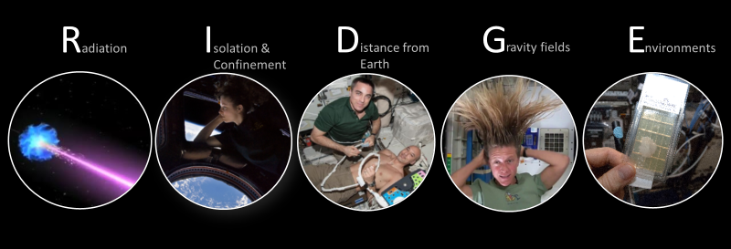
Focus on Human Health & Performance Risks
  Research to Reduce Risk through Better Knowledge, Standards and Technologies
Notes:
Applied Res Program and 5 main hazards for future space exploration: radiation, isolation and confinement, distance from Earth, altered gravity, hostile closed environs. Operational focus.

Slide 2
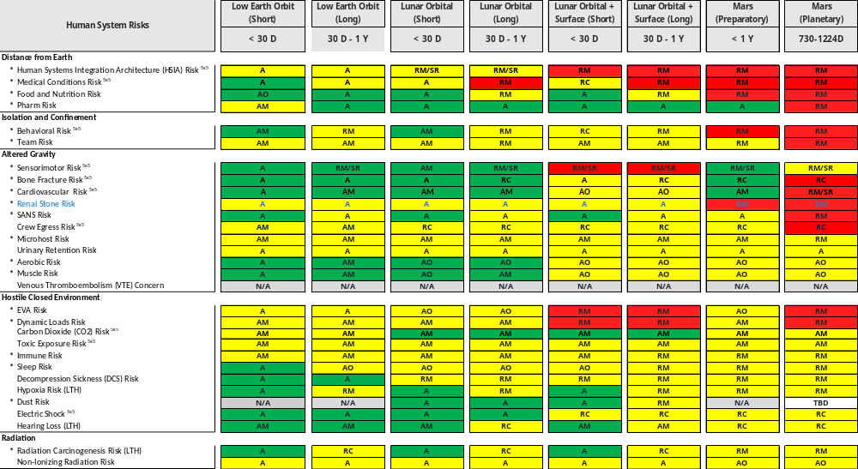
Human System Risks due to Spaceflight Hazards as per Mission Scenario
Risk colors:
High LxC
Mid LxC
Low LxC
Risk dispositions:
A Accepted
AM Accepted with monitoring
AO Accepted with optimization
RC Requires characterization
RM Requires mitigation
RM/SR Requires Mitigation/ Standards refinement

Slide 3
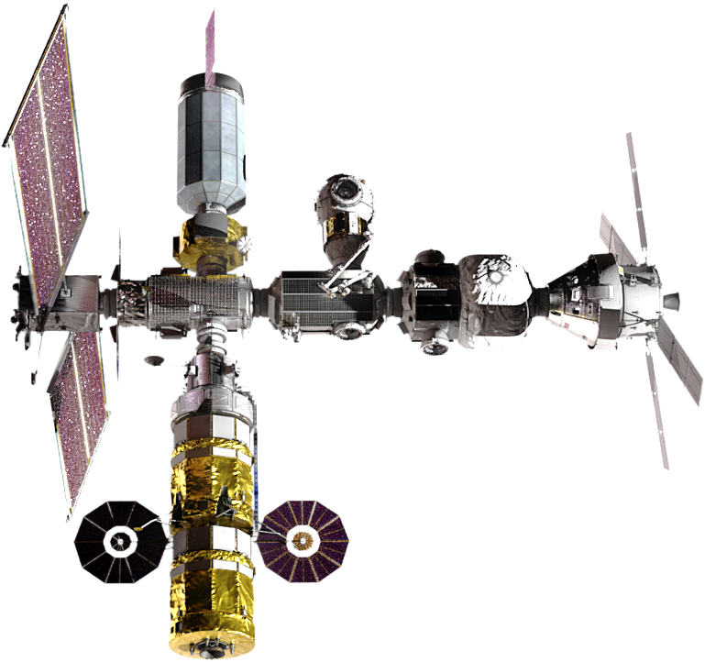

Notional Physiological Effects of Varied Gravity
microgravity
partial-gravity
microgravity
1
?
?
ISS Knowledge
?
System 1
System 3
Affect on the Body
System 2
System 4
On the surface
0
100
200
300
400
600
500
Days in Space

