Slide 1

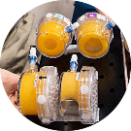
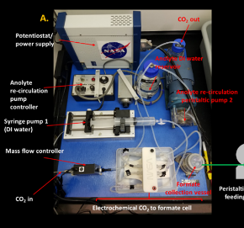
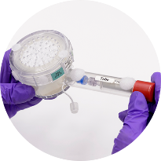
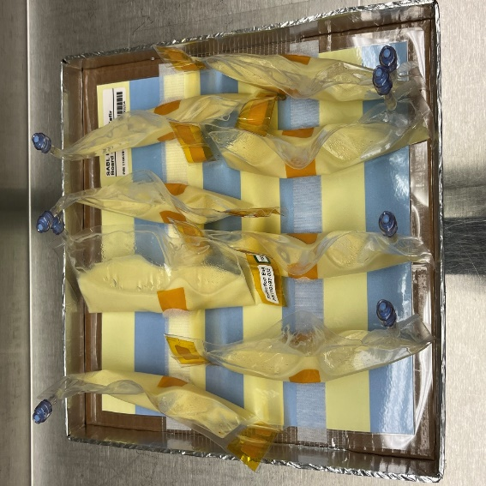
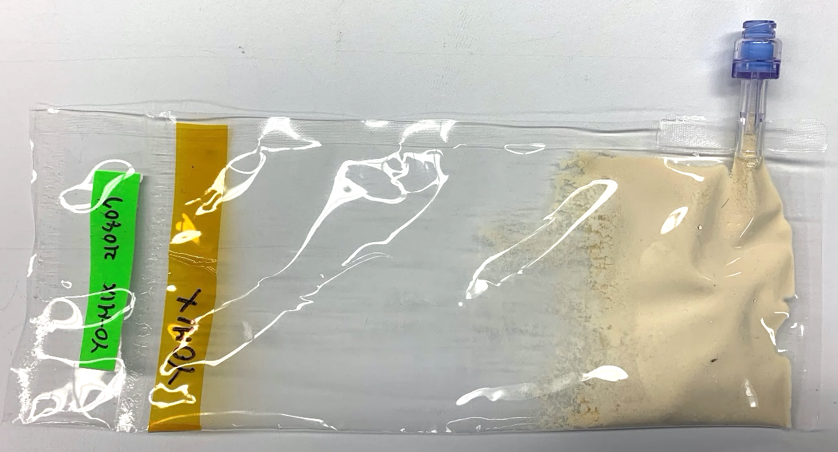
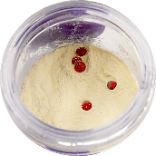
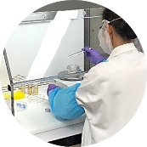
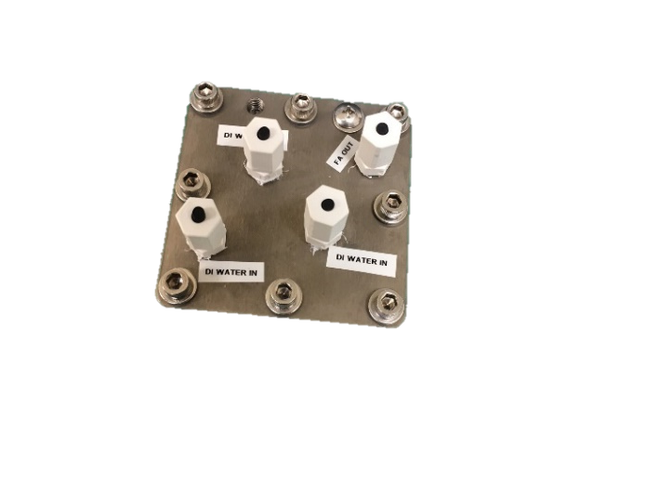
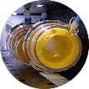
Space Technology Mission Directorate
Game Changing Development Program
Frances Donovan| Mark Settles | FY22 Synthetic Biology Project Annual Review Presentation | 09.15.22
Name/Email POC: Frances.M.Donovan@NASA.gov

Slide 2

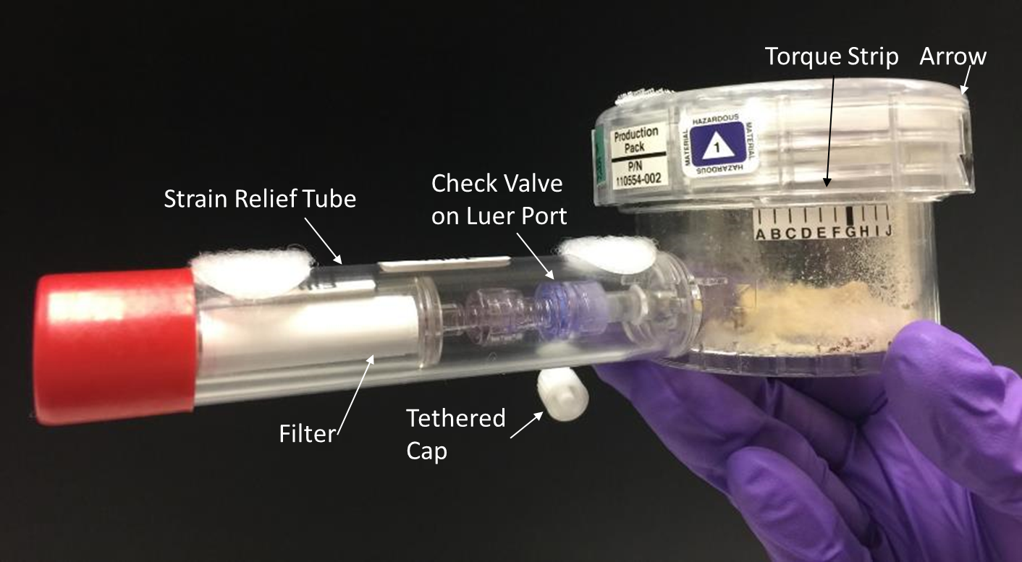
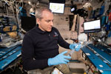
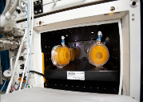
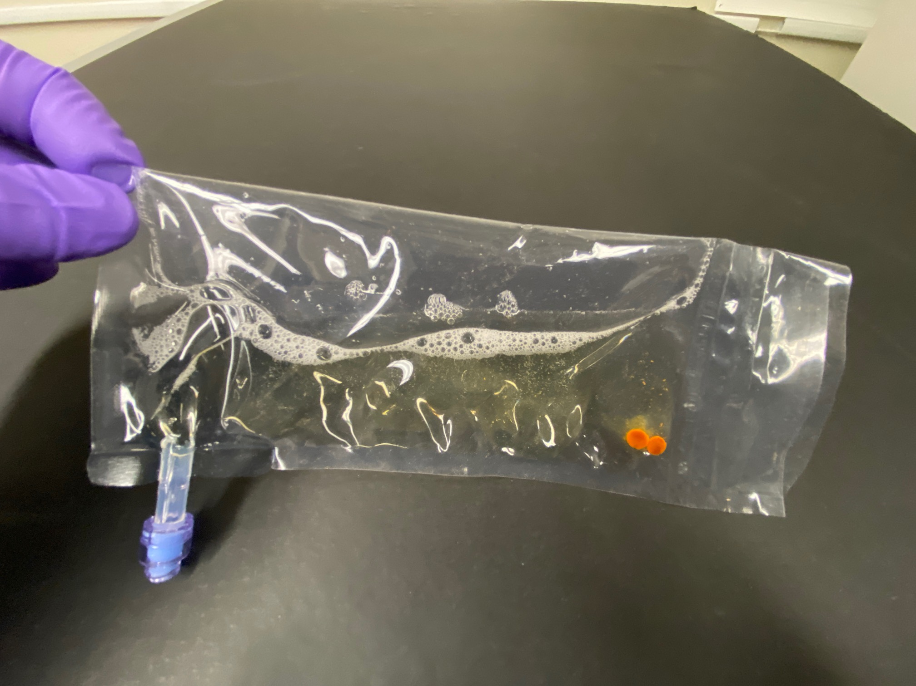
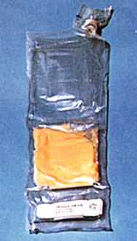
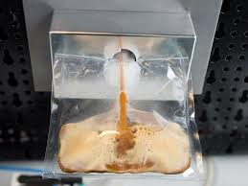


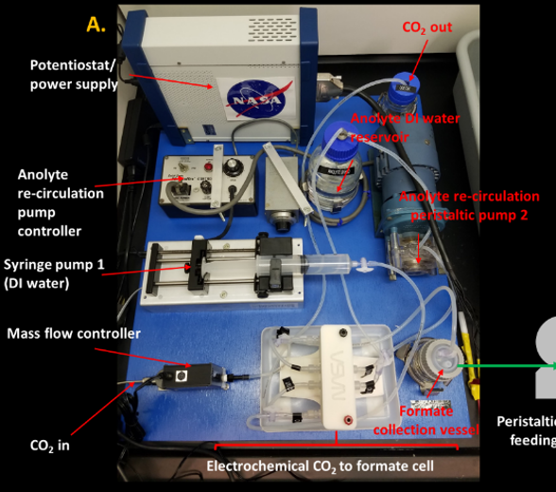
Project Overview
BioNutrients -1 Flight Production Pack for on-orbit testing
Technology Product Capability
  Develop and demonstrate an on-demand nutrient production system for long-duration missions to mitigate demonstrated nutrient degradation in stored foods. Develop an evolvable platform for future surface missions – capable of producing other compounds (e.g., Medicines) requiring minimal resources. Perform an ISS time-course hydration, incubation, freezing and return for analysis over 5 year period.
  Develop and demonstrate a prototype system that enables microbial manufacturing via abiotic CO₂ conversion to products that drive biomanufacturing for future long-duration missions.
Technical Capabilities
  Reduced gravity compatible bioreactor development
  Long-duration ambient storage of microorganisms
  Methods for ensuring quality and safety of biomanufactured products
  Development of ISRU based growth media
  Space-relevant biomanufacturing system development
  Space qualified organisms for biomanufacturing
BioNutrients -2, Gen-1 Flight Production Pack
Future Implementation Concept
Hybrid CO₂-Based Biomanufacturing Concept
Exploration & Science Applicability
  Cross-cutting: Supports crew health, enhanced logistics, mission sustainability and risk reduction for extended duration habitation missions on the moon (Artemis) and Mars and space-based outposts.
Notes:
Provide an overview of the Project/Task
The slide content is intended to remain static unless significant changes are made to the Project
Pictures are encouraged, please provide new pictures as frequently as possible

Slide 3

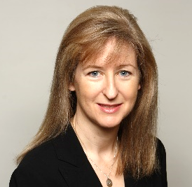
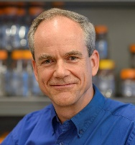


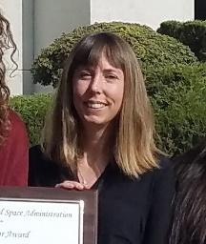
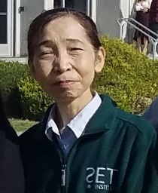
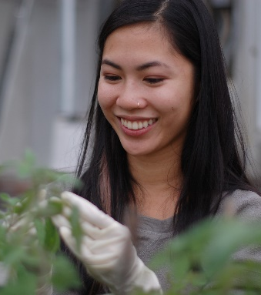
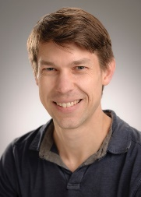
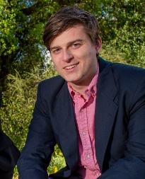

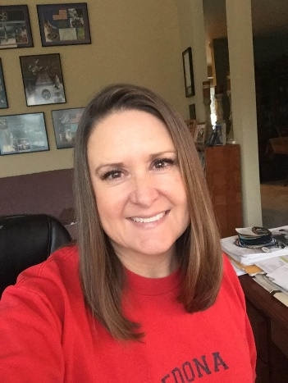


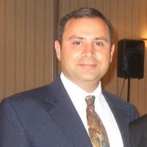
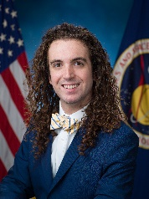



Team Members / Project Org Slide
Synthetic Biology GDC project Elements
Project Management
Frances Donovan, Ph.D. Project Manager, co-Investigator
John Hogan, Ph.D. Principal Investigator
Marilyn Murakami Resource Manager
A. Mark Settles, Ph.D. Co-Investigator
BioNutrients
CO₂ based manufacturing
Science
Engineering and Operations
Natalie Ball
Hiromi Kagawa, Ph.D.
Sandra Vu
Jon Galazka, Ph.D.
Matthew Paddock
Mathangi Soundararajan
Lisa Anderson
Julie Levri, Payload Liaison
Oscar Roque
Sean Sharif
Kevin Sims, Payload Manager
Alyssa Villanueva
Harry Jones, Ph.D.
Systems Engineer
Safety: Daniel Varnum-Lowry
Q/A: Paul Milazzo/Leonard Lee
Logistics at KSC: Satro Narayan

Slide 4
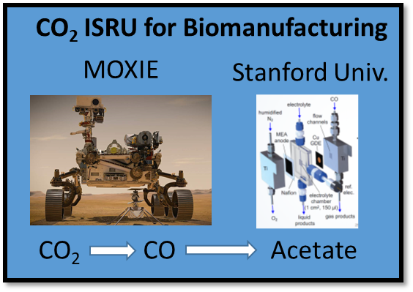
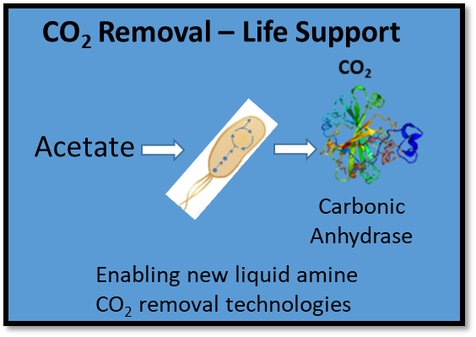


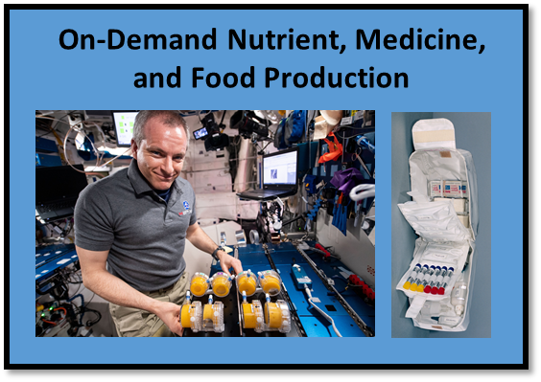
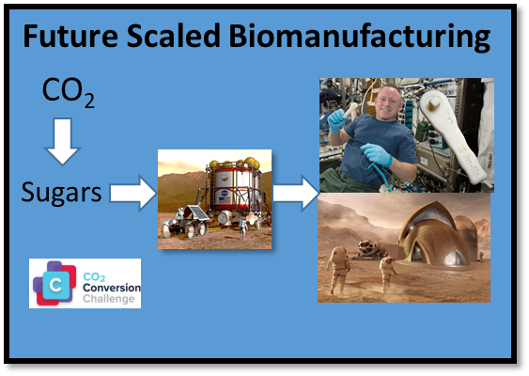


Collaborations & Partnerships
NASA C
EC
HRP
NASA Centennial CO₂ Conversion Challenge
ARCn Challenge
Academic
Stanford University cooperative agreement Kanan Lab
OGA
DARPA/DOD/Space Force
Biofoundries Program
BioMade
SBIR/STTR
Nature’s Fynd
Mango Materials
NSTRI
CUBES
UC Berkeley
UC Davis
Stanford U
Utah State U
U of Florida
Commercial Vendors​
ATUM​
Claremont BioSolutions​
ThermoFisher​
Cytiva
Instant Systems
Leveraging technologies, data, and expertise developed for earth based biomanufacturing
Notes:
For OGA: not in actual partnership yet but we benefit from advances made by DARPA/DOD/Space Force
Biofoundries Program
In-Space Biomanufacturing
BRICS
Living Structural Materials
and the new BIOMADE consortium
Cooperative agreement with Dr. Matthew Kanan at Stanford University – Developing electrochemical CO₂ conversion technology to produce microbial substrates – obtaining record efficiencies.
Space Technology Research Institute CUBES – Center for the Utilization of Biological Engineering for Space – Developing ISRU-based biomanufacturing systems for Mars surface missions.
NASA CO₂ Conversion Challenge – Contestants challenged to convert CO₂ to preferred sugars using novel non-biological technologies to generate organic substrates to “feed” microbial biomanufacturing. Now complete.
Commercial Vendors – Using external services to conduct preliminary work and equipment testing during laboratory shut-down. Includes ATUM (secretion chassis engineering), Claremont BioSolutions (cell lysis); ThermoFisher (centrifuge); Cytiva (biomass concentration).

Slide 5

BioNutrients Element
Technology Goals & Project Objectives
Technology Goals
Goal #1 | Develop a platform technology for safe, on-demand microbial production of nutrients during missions.
Goal #2 | Demonstrate hardware & microbes in space and use results to guide this technology development effort.
Goal #3 | Develop in-space implementation requirements and methods for initial deployment.
Project Objectives
Objective #1 | Conduct 5-year test to verify concept and create space-adapted hosts for future tests.
Objective #2 | Develop space-ready low mass/volume storage and growth system
Objective #3 | Develop and verify a food safety plan for implementation.

Slide 6
CO₂-Based Manufacturing Goals & Objectives
Mark Settles
CO₂-Based Manufacturing Goals
Goal #1 | Develop microbiological techniques using ISRU to widely broaden In Space Manufacturing capabilities.
Goal #2 | Provide technology tests and trade studies demonstrating the technology’s potential impact on lunar and Mars surface missions.
CO₂-Based Manufacturing Objectives
Objective #1 | Perform an initial integration of the developed CO2 conversion, bioreactor, engineered organism and purification systems to both demonstrate the validity of the concept, and to identify needs/challenges for prototype development.
Objective #2 | Develop “space-ready” engineered microorganism(s) capable of making a targeted mission product (carbonic anhydrase), and test with an improved production and product harvesting system.
Objective #3 | Develop use case scenarios for this overall approach, identify needed future areas of research and development, and provide recommendations for forward work.

Slide 7
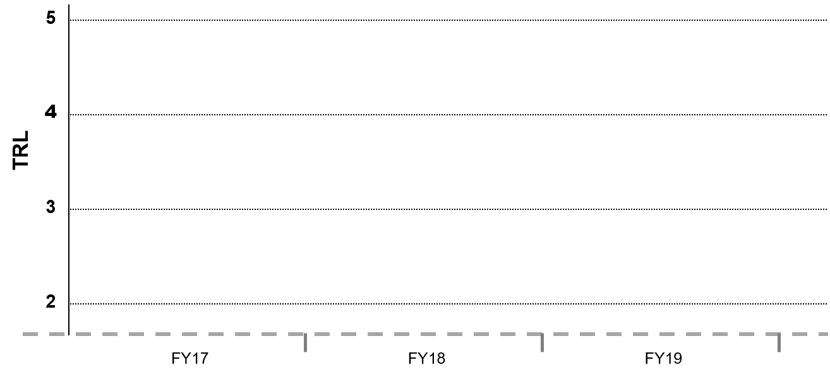
BioNutrients/CO₂-Based Manufacturing
Lifecycle Milestone/Maturity Schedule
Frances Donovan
Project Milestone
GCD (Key) Milestone
Controlled Milestone
TRL Progression
BioNutrients Gen 1 ISS Test
BN-3 Gen 2 Test
HACCP validation
HACCP review
BN-3 Gen 2 FRR
Final Report on Flight Results and Development Needs
Analyses of first returned samples
BN-2 Gen1 Design review
BN-2 ground test
BN-2 Flight Readiness Review
CO₂ Prototype Gen 2 Test
CO2-based manufacturing close out report
Bioreactor Design review
Platform fab complete
CO₂ Prototype Gen 1 Test
Production strain ground test
Bioreactor materials test
BioNutrients Launch to ISS
CO₂ Prototype Assembly
FY19
FY20
FY21
FY22
FY23
FY24 +

Slide 8
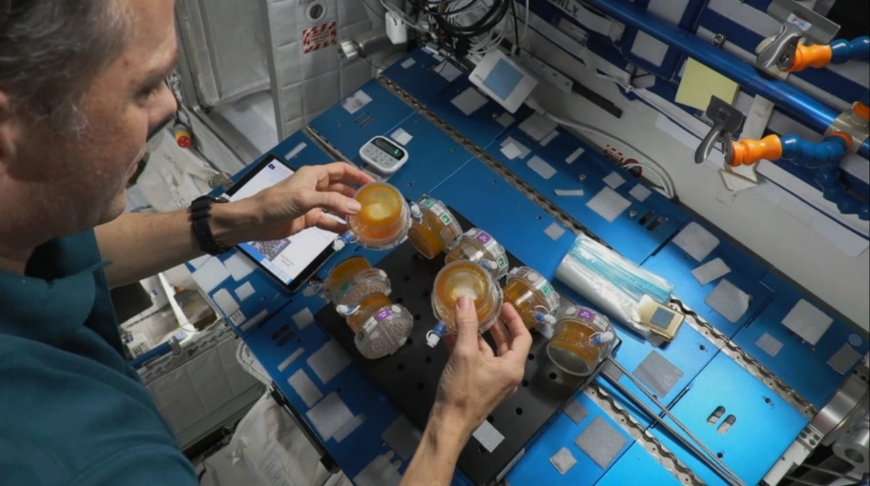
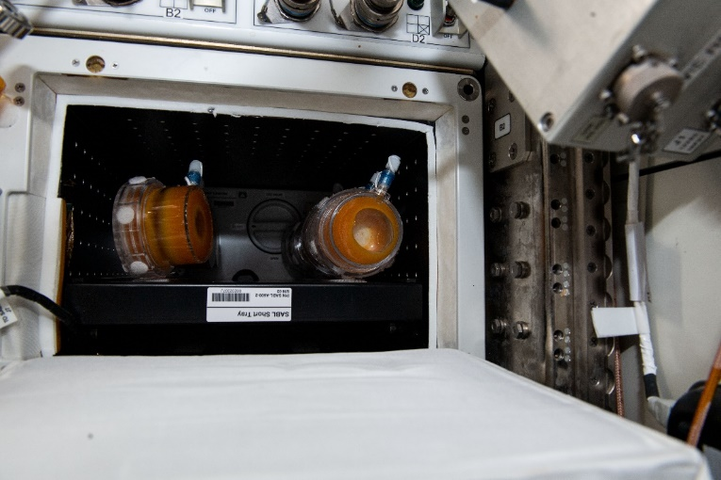
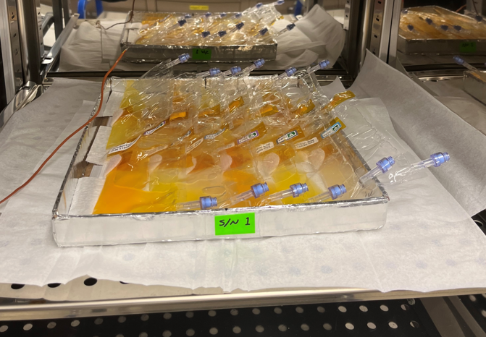
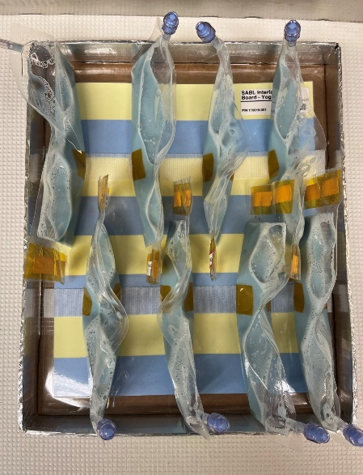

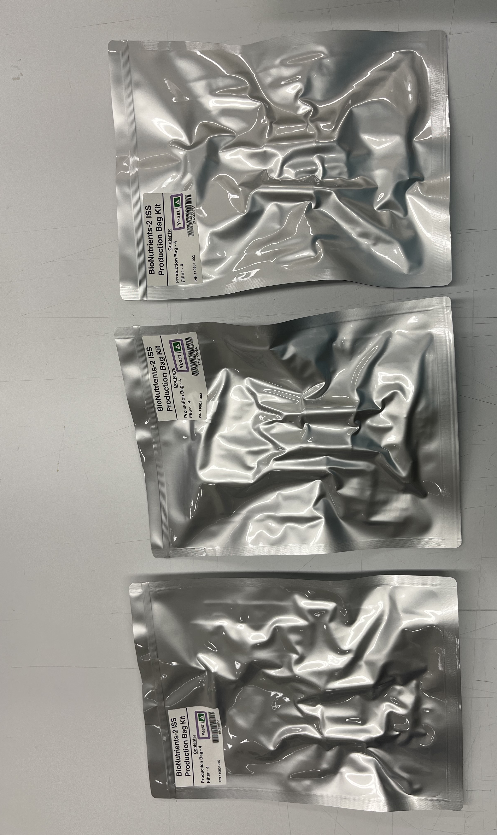
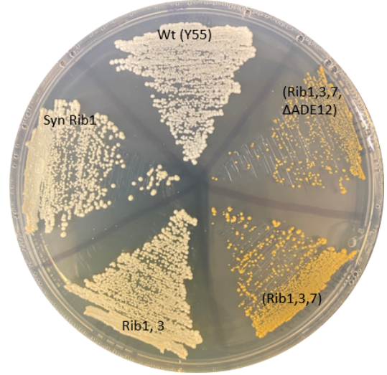
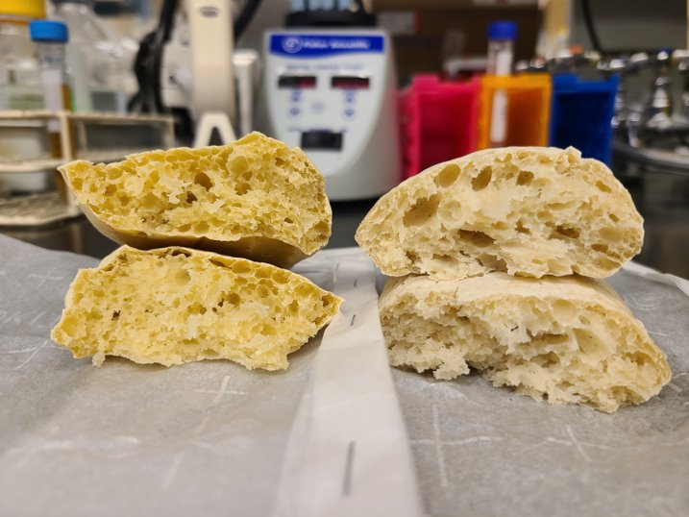
Accomplishments – BioNutrients
BioNutrients-1
  Fourth successful on-orbit run, 2.8 years of ambient storage, viability and successful operation on ISS.
  No contamination detected in run 1,2 and 3 (run four sample results are pending due to late August return), no leaks, no anomalies.
  Growth on ISS exceeds ground controls.
BioNutrients-2
  Producing Nutrients (carotenoids), a protein therapeutic follistatin, and new food delivery system – yogurt and kefir.
  Phase 2 Safety Review passed.
  All ground testing successfully completed with gen-1 bioreactor.
  Flight Readiness Review passed 08/25/2022 (open work pending).
  Hardware is built and ready for launch on SPX-26.
BioNutrients-3
  Additional nutrient product development is underway
    Additional Nutrients to be co-expressed with carotenoids to deliver a multi-nutrient pack.
  Food Safety development testing
    Enriched bread and in-mission heat kill (aka baking).
    Examining use of E-nose to detect contaminated cultures.
BN-1 run four production packs in SABL incubator on the ISS, February 2022. Astronaut Tom Marshburn agitating the cultures at the 6-hour timepoint.
BN-2 Experiment Verification Test and flight build (A) yeast strains producing carotenoids and follistatin in 3 mil FEP bag reactors, (B and C) yogurt cultures in 5 mil FEP, blue pH indicator dye turns to yellow as the culture grows and becomes the yogurt product. D. flight Build with four vacuum sealed reactors per packet.
A
B
C
D
BN-3: (E) Yeast colonies engineered to express the B vitamin riboflavin (yellow color = increased expression). (F) Baking for food safety. Carotenoid expressing yeast left vs commercial yeast starter baking was 3hr at 85 degrees C.
E
F

Slide 9
BN-2: Reduced Mass Hardware
117 g Gen-0 Bioreactor
10 g Gen-1 Bioreactor
Gen-1: Changed to a gas-permeable Fluorinated Ethylene Propylene (FEP) bag bioreactor.
9

Slide 10
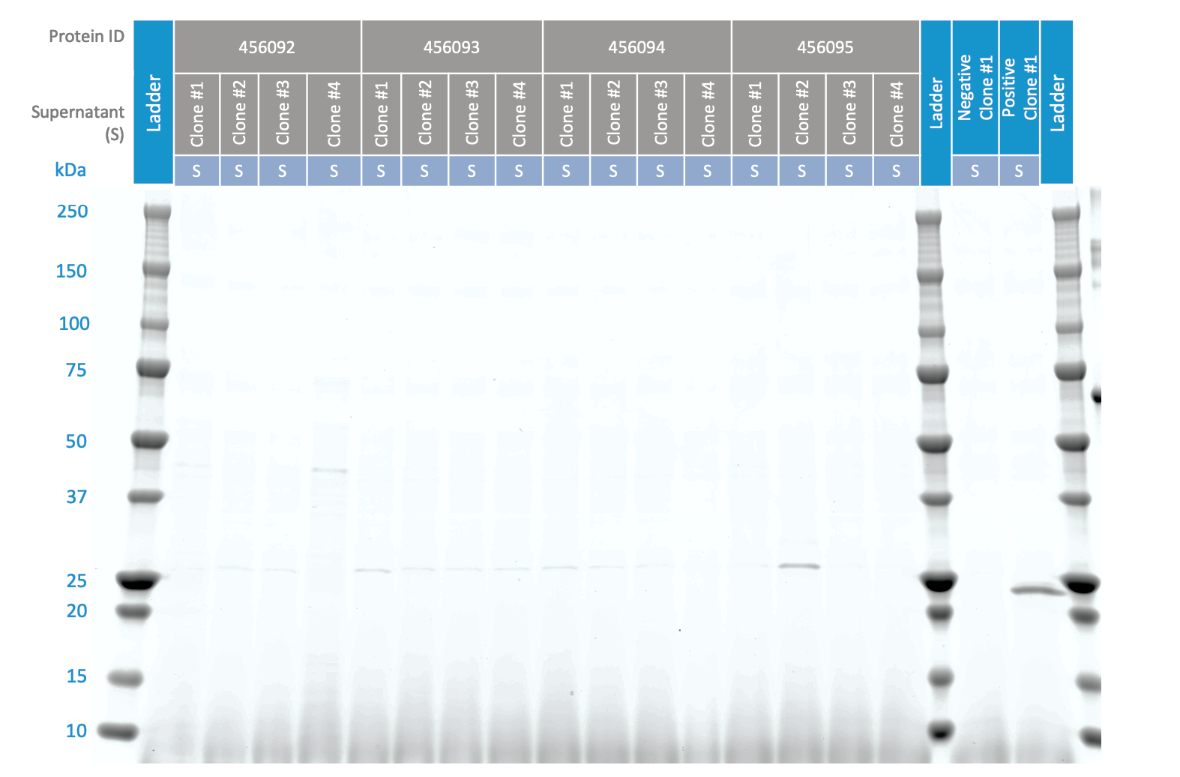
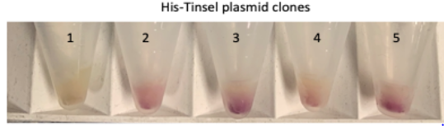
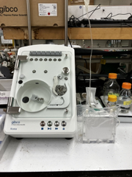
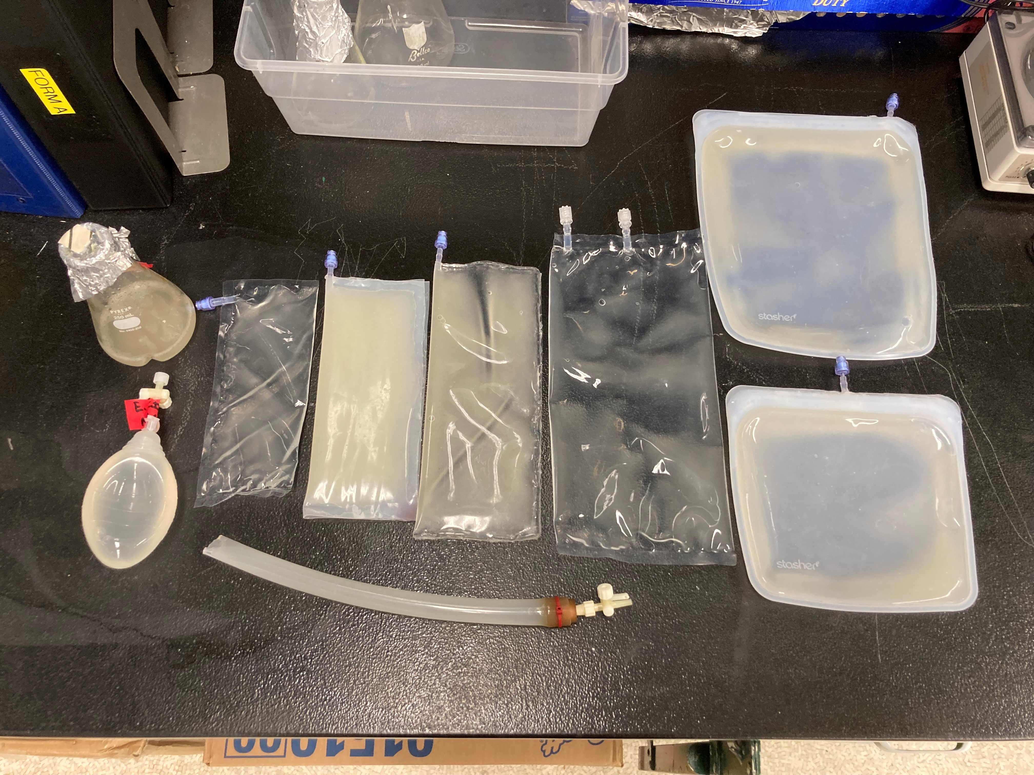
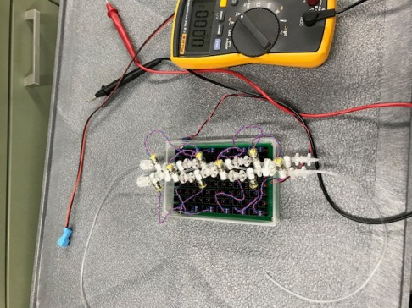
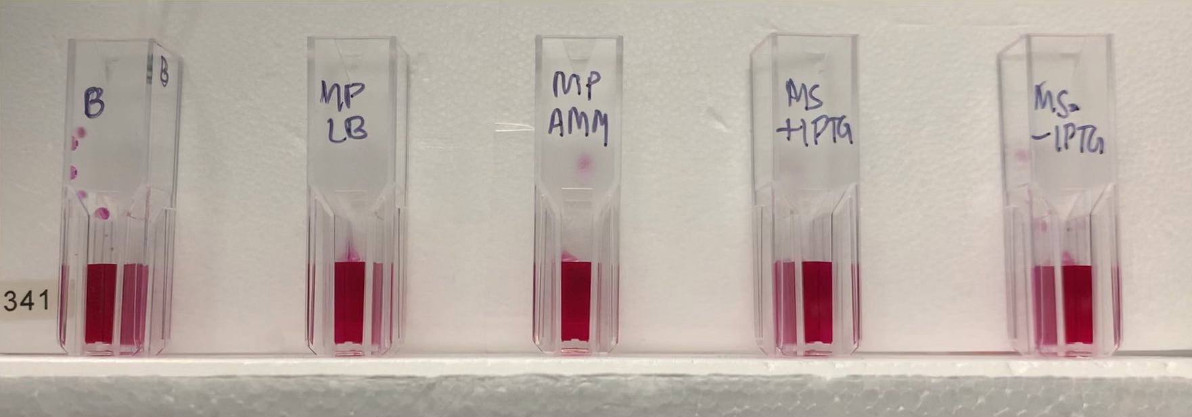
Accomplishments
CO₂-based Manufacturing
Modeling and survey efforts: commercial technologies and subsystem options were modeled to assist in development of the higher fidelity platform. Equivalent system mass (ESM, the system complexity metric (SCM), technology readiness level (TRL), and degree of crew assistance were used to identify a simpler, less costly, and easier to operate design for semi-automated biomass dewatering, cell lysis, and protein affinity purification.
KPP advances made with defined growth media –Raising % mass of media components that can be sourced ISRU to 46% (KPP5, target is 50%).
Genetic engineering results: Developed new Carbonic Anhydrase producing strain capable of secreting the product into the liquid media surrounding the cells, leading to potential for simpler product purification.
Bioreactor testing
  Materials and commercial products
  Mixing
current product Carbonic Anhydrase
A
D
E
Moving from initial prototype to higher capability, higher fidelity subsystem testing
secretion clone isolated
Product purification
  De-watering commercial options
  Custom cell lysis designed and tested
  Activity assay developed
C

Slide 11
Project Assessment Summary
Project Name | Performance |  |  |  | Comments
 | C | S | T | P
Mid Year |  |  |  |  | Technical – Cost – Budget was lower than planned due to CR, impacting progress timeline Schedule – Budget limitations, staffing shortages, procurement delays, and Covid restrictions impacted schedule. Uncertainty in budget limited forecasting of deliverables. Programmatic -
Annual |  |  |  |  | Technical – Cost – Schedule – green. Change request for updated milestones schedule approved 08/14/2022 to fit within forecasted budget. Programmatic -

Slide 12
Plans Forward and Transition Plan
BioNutrients looks for transition into Advanced Food Systems/HRP and Exploration Capabilities
  Through discussion with HRP Advanced Food Systems, the BioNutrients mission and microbial, fungal, algal based food products are now represented part of the Food Roadmap/Integrated Research Plan. The goal is to be transitioned into their program.
  Continue to be engaged with STTR partner developing an alternate organism platform for support of nutrition via biomanufacturing.
CO₂-based Manufacturing: first product targets Exploration Capabilities, platform targets ISRU
  Demonstration product is carbonic anhydrase (CA), a catalytic enzyme that facilitates the liquid amine-based CO₂ air revitalization technology. AES acted as a partner and supported a directed evolution project to produce an optimized CA enzyme. AES will ultimately determine the air revitalization technology for exploration missions and the specific need for CA will be determined based on this decision.
  CO₂-based conversion technologies are still nascent. Plan to leverage CO₂ Conversion Centennial Challenge to investigate the product’s ability to support a biomanufacturing system.
  Cooperative Agreement with academic partners to further develop CO₂ conversion capabilities.
Synthetic Biology plans to leverage advancements made by the external community: new products, new systems, to meet the evolving needs of sustainable exploration.
  The Center for the Utilization of Biological Engineering in Space (CUBES) and the external research community have demonstrated numerous new products and conversion systems that highlight the potential for synthetic biology and biomanufacturing to support exploration. Potential products include adhesives/additives for construction, materials, food products, fuel, media resupply components, recycling capabilities, medicines and nutrients.
  OGA/& GOV/Industry private partnerships: BioMade -Building a sustainable, domestic end-to-end bioindustrial manufacturing ecosystem- looks to solve issues of scalability. DARPA/DOD/Space Force -Biofoundries Program.

Slide 13
Education/Public Outreach
EPO Involvement
EPO Calendar Outlook (High Priorities):
BioNutrients-1 fourth on-orbit run featured in Space Station Science Highlights: Week of January 31, 2022.
NASA-ARC PAO Image Feature under development to highlight ground operations for BioNutrients-1 run 4.
GCD highlight video reel submitted for APR.
List Top 3 Newsworthy Events:
  BN-2 launch (November 2022)
  BN-1 and BN-2 on orbit operations this December-January time frame
  CO2-based manufacturing platform breadboard test (July 2023)
6 Month Look-Ahead
American Society for Gravitational and Space Research (ASGSR) | 11/09/-11/12/2022
BN-2 launch SPX-26 and on orbit operations | NET November 2022 (likely a Dec – March time frame)
BN-1 and BN-2 sample return on SPX-26 return | NET December 2022
Human Research Program Investigator Workshop | NET January 15, 2023
Notes:
Summary of the EPO activities (papers, conferences, outreach events) participated in over the last 6 months and the forward outlook for 6 months

Slide 14
Summary
BioNutrients-1 passes midpoint of 5-year ISS shelf-life study, no contamination, viable production.
BioNutrients-2 is ready for launch on SPX26, producing nutrients and a protein therapeutic, yogurt and kefir.
BioNutrients-3 progressing towards multi-nutrient pack development and food safety through HACCP and heat kill.
CO₂-based Manufacturing has completed ESM analysis of potential subsystems, manuscript is in internal review.
CO₂-based Manufacturing subsystem testing in lab have identified bioreactor materials and growth conditions, demonstrated production and activity assay of target product Carbonic Anhydrase. On track for PDR at TAPR and CDR in February.
KPP for % ISRU media components by mass has increased to 46% (target is 50%).
Infusion/Transition success story – the BN-1 carotenoid expressing yeast to be used in LEIA
( Lunar Explorer Instrument for Space Biology Applications) award.
Tech Maturity and TRL at end state
  BioNutrients element expects to have demonstrated the 5-year shelf life of biomanufacturing organisms, media, and bioreactors, demonstrated production of multiple nutrients, multiple food types, and a therapeutic in a ready to consume format. Approvals for actual consumption to be obtained by adopters. TRL 5
  CO₂-Based Manufacturing will demonstrate a small-scale CO₂-based biomanufacturing platform with acetate-based media, organism engineered to survive on this media and producing a relevant product, product purified to relevant purity, with assessment of recycling and ESM comparison of options. TRL 4

