Slide 1
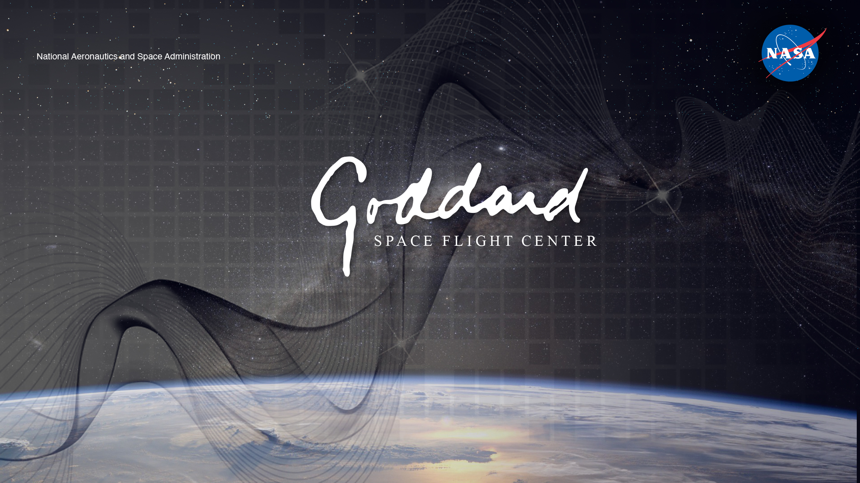
NASA’s Goddard Space Flight Center’s Distributed Systems Missions (DSM) Architecture
Presentation to: International Astronautical Congress, Session B4, 7
Cheryl Gramling
Gary Crum, Matthew Dosberg, Evana Gizzi, Christopher Green, JoAnn Hill, Michael Johnson, Kendall Mauldin, Robert Morgenstern, Christopher Roberts, Conrad Schiff
21 September, 2022

Slide 2
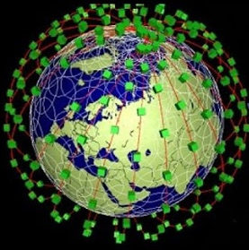
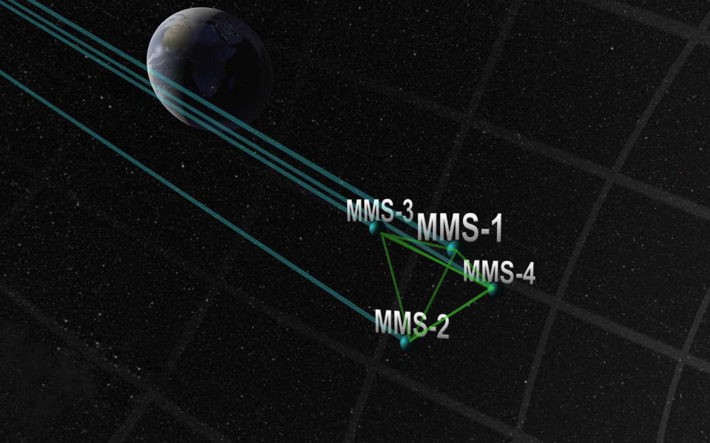
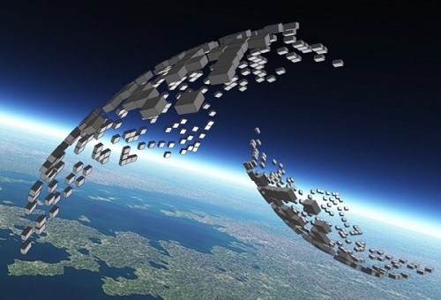
Agenda
Motivation
Vision
Approach
Transforming Science and Operations
Constellation
Web
Formation
Swarm
Spacecraft in separate orbital boxes making passive observations
Larger constellation performing active, cooperative tasks
A specific geometrical shape to passively observe in response to targets of interest
All spacecraft actively respond to targets of interest; precision alignment

Slide 3
Motivation
Science Mission Directorate Divisions
Academia
Industry
National Academies Decadal Surveys
Use Cases
Multi-Point Observations
Enabling
Technologies
Autonomous Event-Driven Operations
Data Resampling & Fusion
Plug and Play
Architecture
DSMs provide a whole that is greater than the sum of the parts.

Slide 4
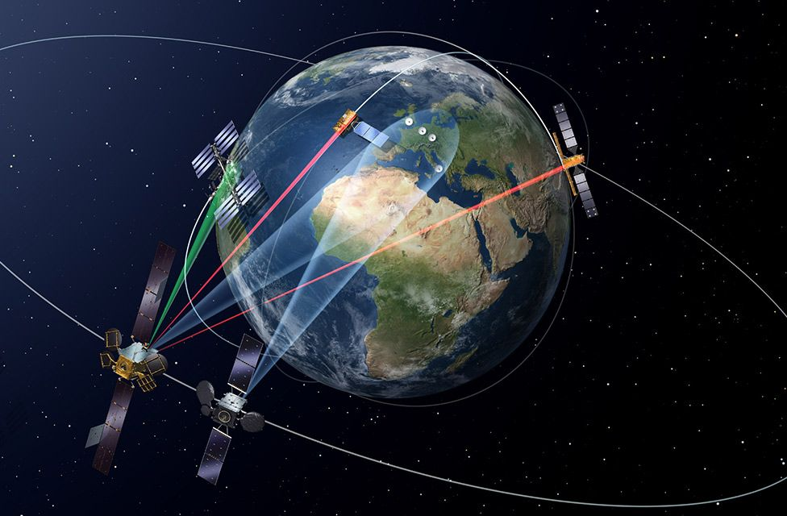
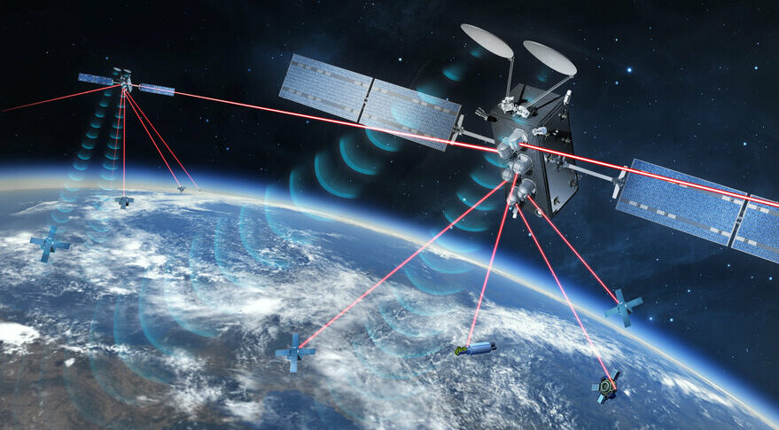
GSFC’s Distributed Systems Missions (DSM) Vision
Credit: ESA, EDRS
  Establish Goddard as a Center of Excellence and catalyst for DSM implementation by defining open architectures that create new opportunities for transformational science and exploration advancement for the entire NASA ecosystem.
  Influence and execute the technology and capability advancements that enable transformational DSM concepts, through partnerships with industry, academia, and other NASA centers and government agencies.
  To enable dynamically-networked space- and surface-based sensors—systems of systems
Credit: SpaceLink https://www.eosspacelink.com/
Constellation Capabilities
  Enable currently unfeasible multi-point observations

Slide 5
Approach
Design
Reference
Missions
Use Cases
Use Cases
Use Cases
Use Cases
Unifying Specific Capabilities
Enabling Capabilities
Agile Development
Approach Philosophy:
Develop and openly share the catalytic framework and capabilities for DSMs.

Slide 6
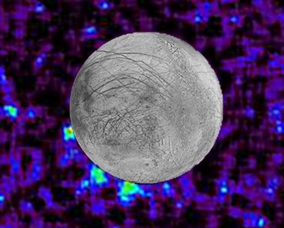
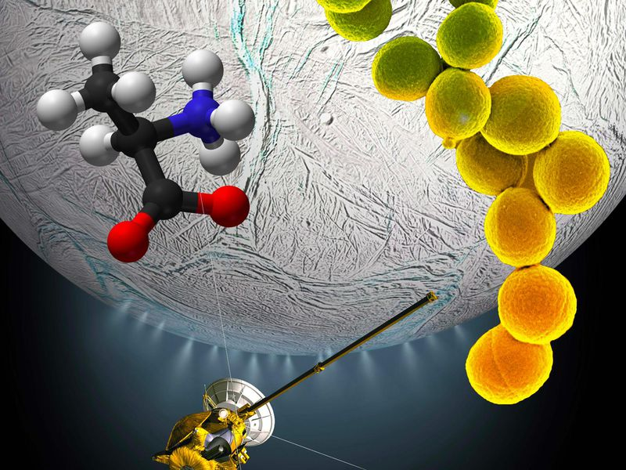
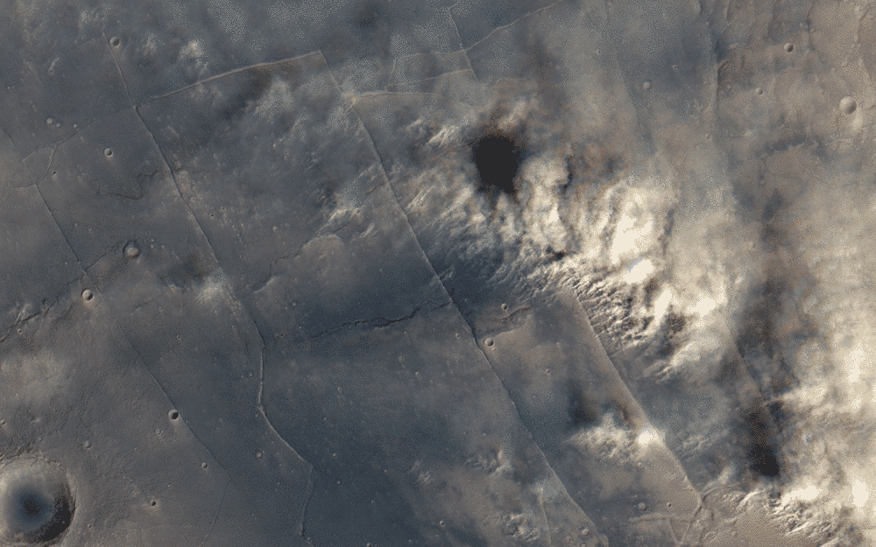
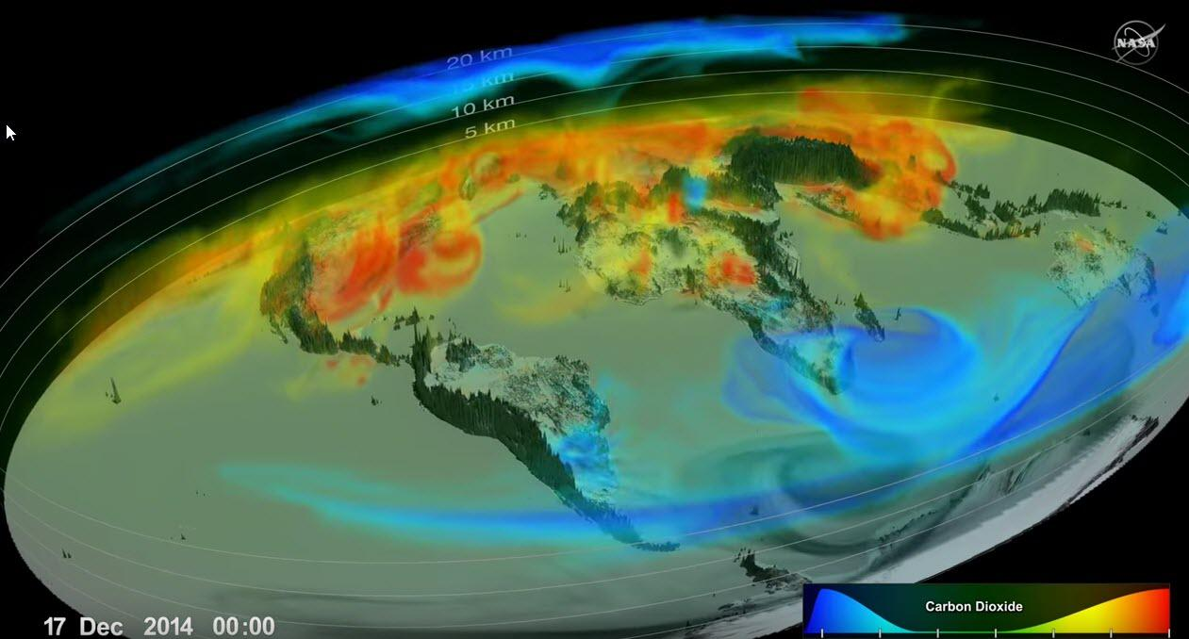

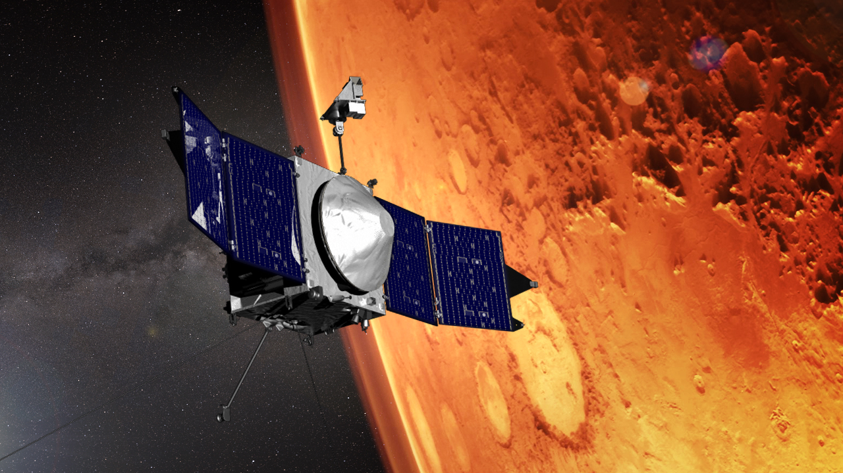
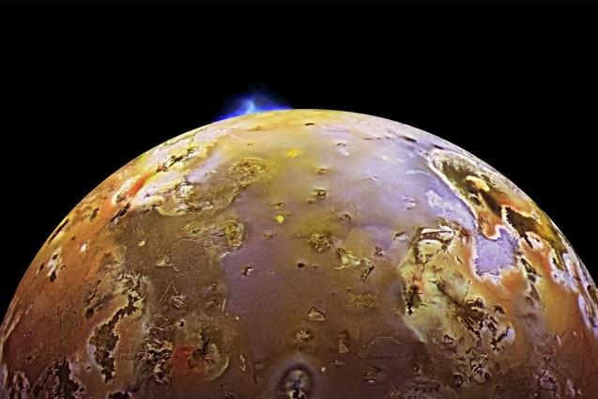
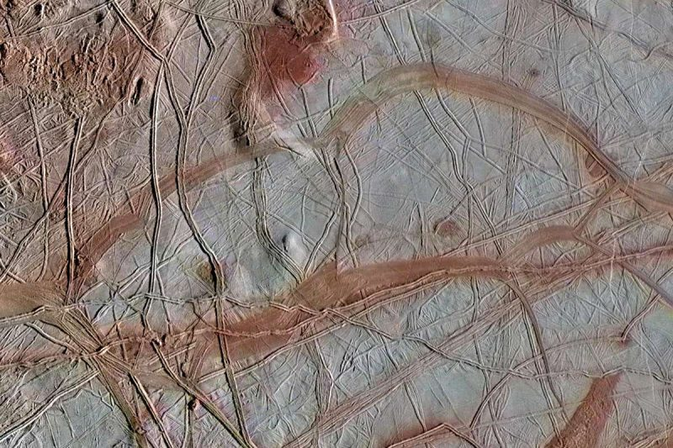
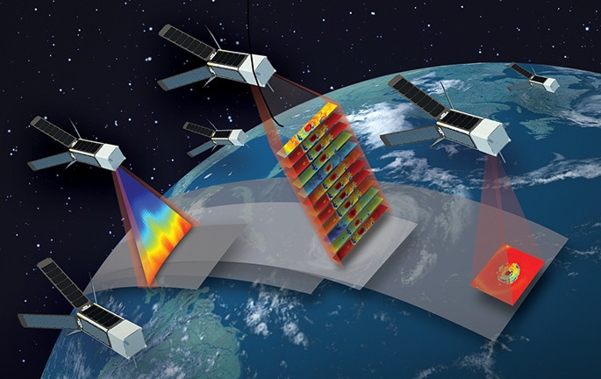
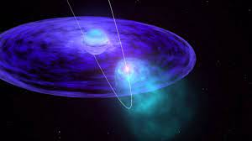
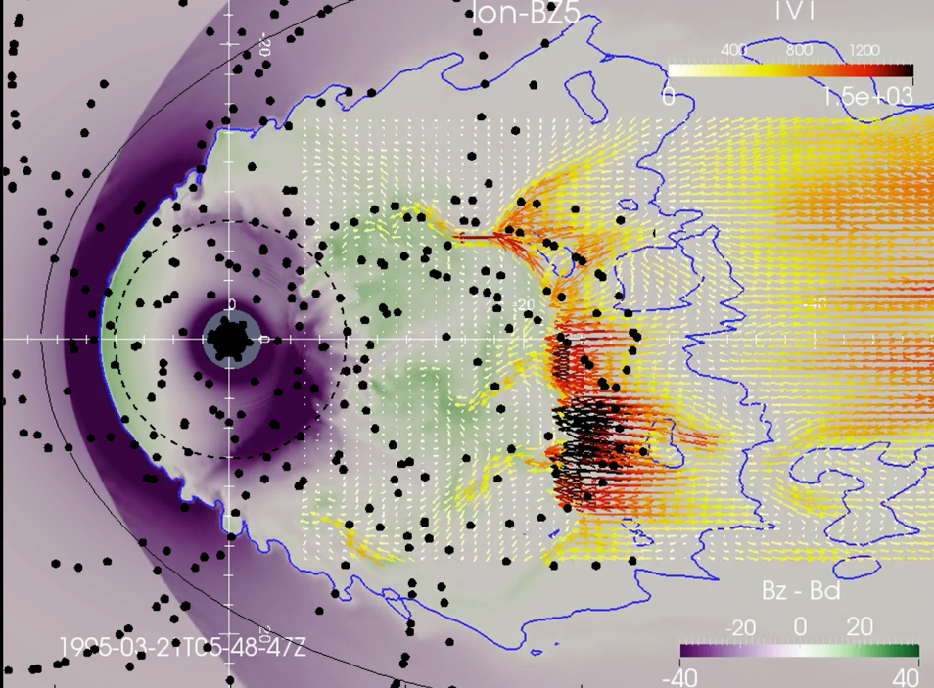
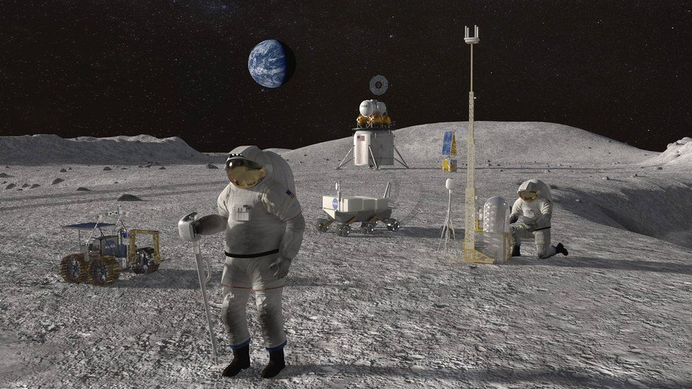
DSM w/ Autonomous Science Agent & Adaptive Learning Transform Science Return
Identify novel Events
More detailed Measurements
Real-time Response
High resolution Predictions
Plume detection
Habitability and Biosignature Detection
Planetary and Space Weather
Atmospheres and Volatiles
Volcanic eruptions
Active Tectonism
Terrestrial Phenomena
Spacecraft acting collaboratively adapt to new information.
Cosmic Activity
Magnetic Activity
Opportunistic Science and Advanced Exploration

Slide 7
NASA’s Goddard Space Flight Center’s Distributed Systems Missions (DSM) Architecture
If interested in learning more or exploring collaboration activities, please email us at
GSFC-DSM@mail.nasa.gov
Imagery Credit:
Plume Detection: NASA, ESA, W. Sparks (STScI)
Volcanic Eruptions: NASA/JPL-Caltech
Cosmic Activity: NASA-GSFC
Habitability and Biosignature: NASA/JPL-Caltech/Space Science Institute
Active Tectonism: NASA/JPL-Caltech/University of Arizona/SETI Institute
Magnetic Activity: NASA-GSFC
Planetary and Space Weather: ESA/DLR/FU Berlin (G. Neukum) / Justin Cowart
Terrestrial Phenomenon: MIT/LL, NASA
Atmospheres and Volatiles: NASA-GSFC
Opportunistic Science/Advanced Exploration: NASA

