Slide 1
MARS 2020 Backshell Radiative Heating Measurement and Shock Tube Verification
Brett A. Cruden⁽¹⁾, Ruth A. Miller⁽²⁾, Aaron M. Brandis⁽²⁾, Augustin C. Tibere-Inglesse⁽³⁾, Christopher C. Jelloian⁽⁴⁾, Mitchell Spearrin⁽⁴⁾, Thomas K. West⁽⁵⁾, Christopher O. Johnston⁽⁵⁾, Dinesh K. Prabhu⁽¹⁾, Joshua Monk⁽²⁾, Justin Clarke⁽⁶⁾, Luca Di Mare⁽⁶⁾, Matthew McGilvray⁽⁶⁾
Radiation in High Temperature Gases Workshop
Santa Maria, Portugal, Sep. 2022
⁽¹⁾AMA Inc, NASA Ames Research Center
⁽²⁾ NASA Ames Research Center
⁽³⁾ORAU, NASA Ames Research Center
⁽⁴⁾University of California, Los Angeles
⁽⁵⁾ NASA Langley Research Center
⁽⁶⁾ Oxford University

Slide 2
Outline
MEDLI2 flight measurements
Shock Tube Informed Bias Methodology
EAST Test results
  Emission Spectroscopy
  Tunable Diode Laser Absorption Spectroscopy
  Resolution of Measurement Artifacts

Slide 3
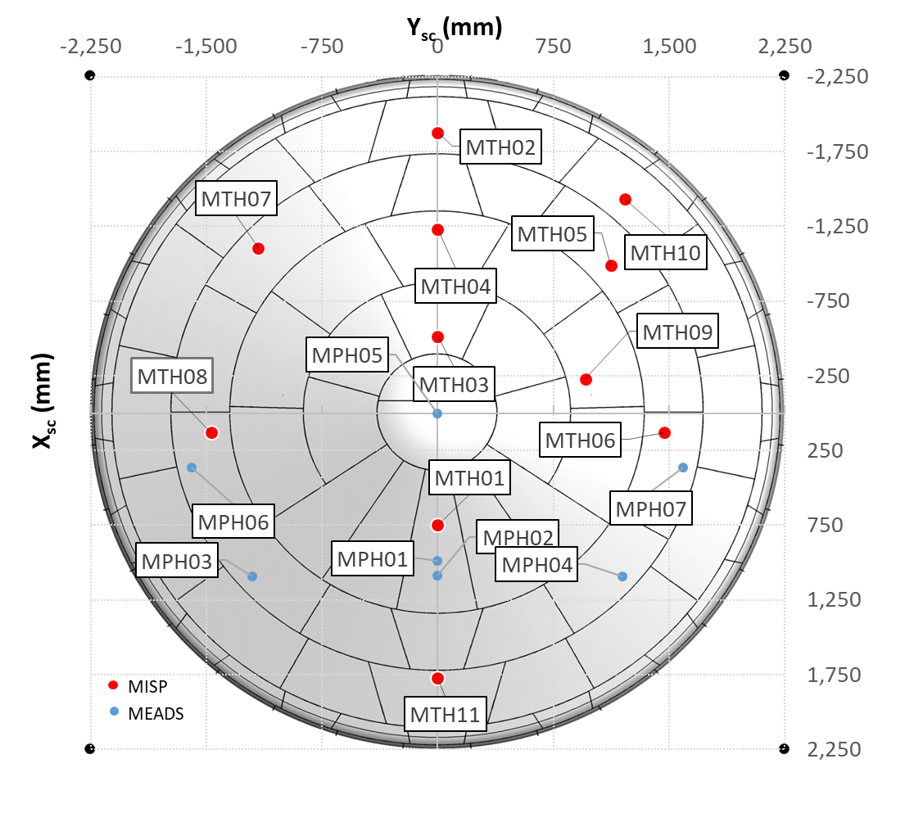
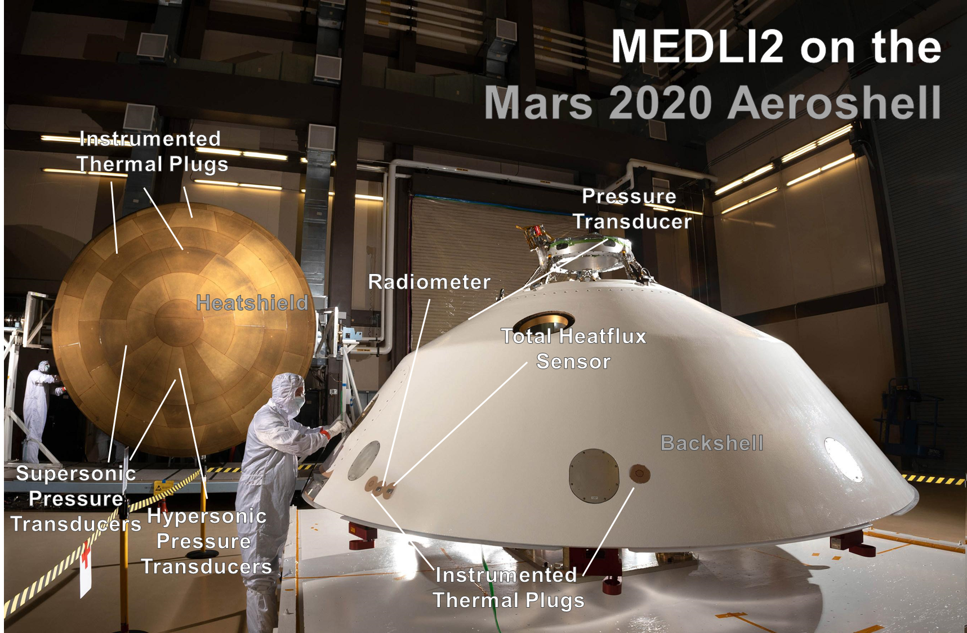
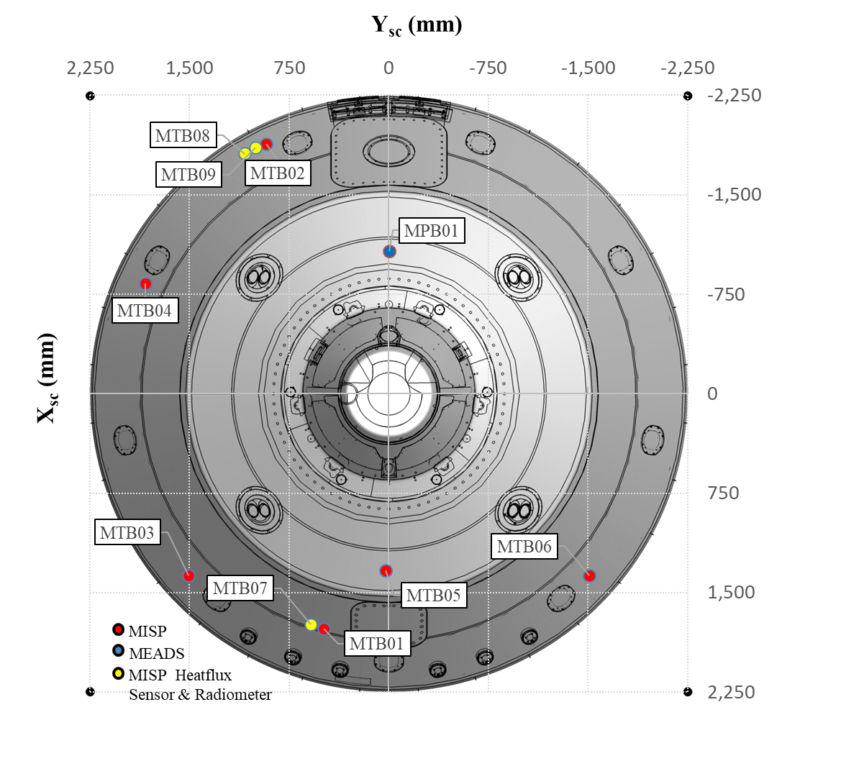
Mars2020 Entry Descent and Landing Instrumentation 2
Aftbody
Forebody
Mars 2020 brought the Perseverance rover to the surface of Mars
MEDLI2 measured aerothermal environments during Mars 2020 entry

Slide 4
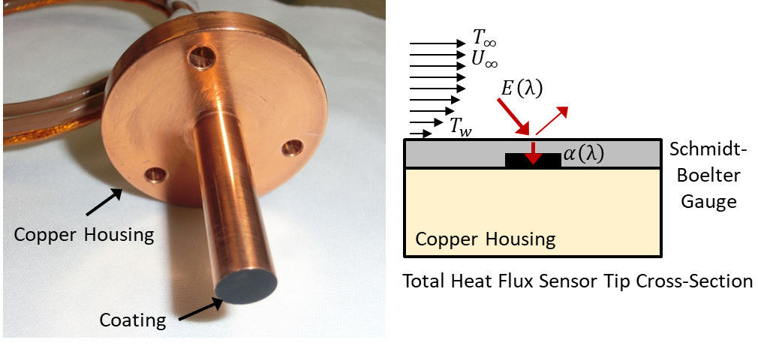
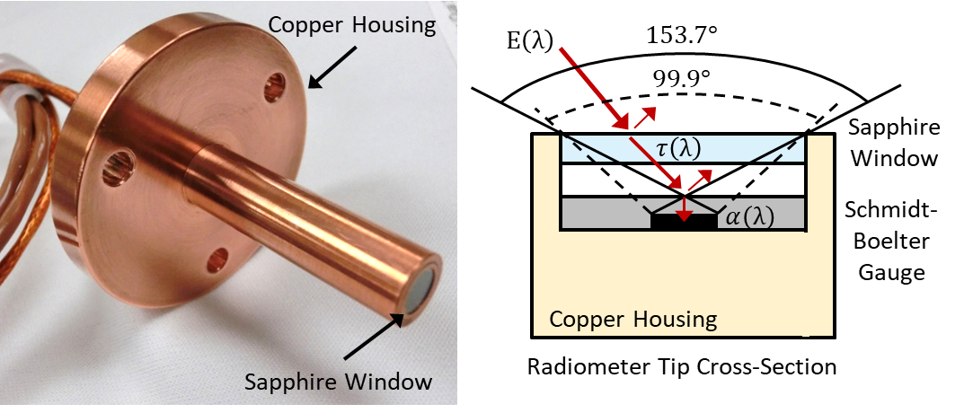
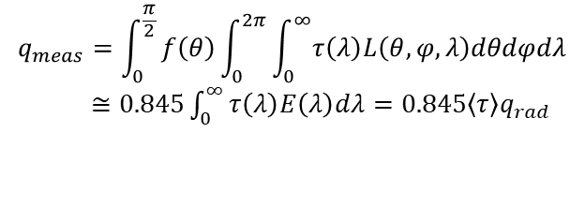
Backshell instrumentation
Heatflux Gauge
    q_{total} = q_{convective} + αq_{radiative}
MTB08/09
Radiometer
$$q_{meas}=\int_{0}^{\frac{π}{2}}{f\left(θ\right)\int_{0}^{2π}{\int_{0}^{∞}{τ\left(λ\right)L\left(θ,φ,λ\right)dθdφdλ}}}$$
$≅0.845\int_{0}^{∞}{τ\left(λ\right)E\left(λ\right)dλ}=0.845\left\langle τ\right\rangle q_{rad}$
MTB07
Sensors on Mars2020 Backshell detected heat fluxes and radiation during entry
Heatflux gauge measures convective heating (cold wall) and radiation (absorbed)
Radiometer measures radiation that passes through its view factor and spectral range

Slide 5
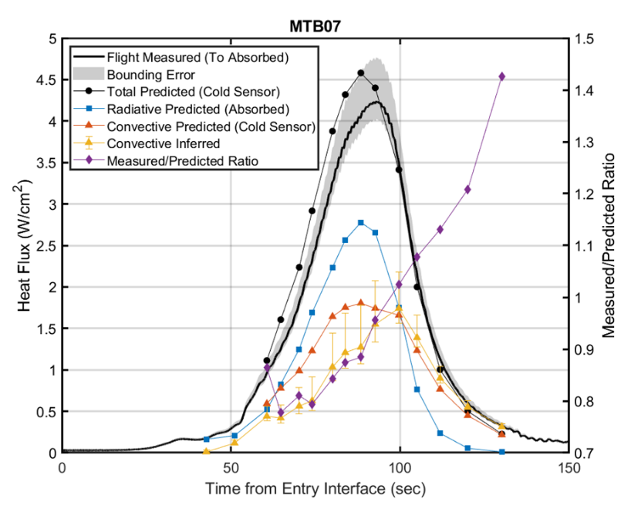
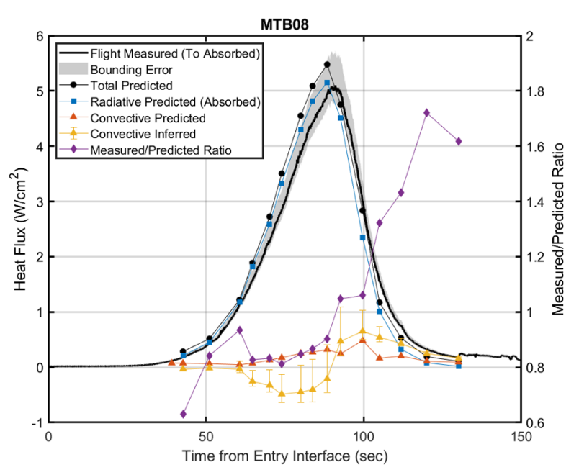
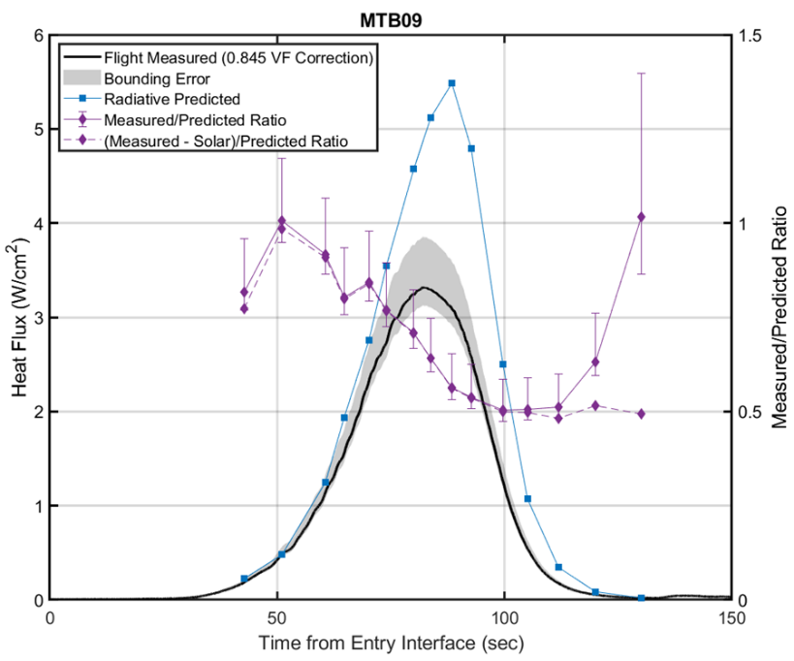
MEDLI2 Results – Initial Analysis
Heat Flux Sensors
  Reasonable agreement of predicted vs. measured total heat flux
  An inferred convective heating is deduced based on (measurement – predicted radiation)
    Agreement to predicted convective heating is reasonable (wall temperature must be considered)
  Leeside gauge is dominated by radiation
Radiometer
  Shows initial agreement to prediction, drops to 0.5x predicted radiation
  Believed to be due to coating of window by ablation products
MTB08/09
MTB07

Slide 6
Revised MEDLI2 Analysis
Correction factors for temperature dependence of sensor increased measured heat flux by ~10%
Following entry, revised trajectory data became available
  OD58 – Orbital Determination 58 : based on entry state predicted while spacecraft in cruise
  MEADS – Trajectory Reconstruction using the MEADS (pressure) sensors on vehicle
  BET8 – ver. 8 of the Best Estimated Trajectory – updated atmospheric model
Sensitivity to flowfield inputs also observed
  “Cruden” model predicts higher heatflux with earlier peak than the “Johnston” model
Convective heat flux needs to be re-evaluated as cold wall
q_{inferred}=q_{measured}-αq_{rad}

Slide 7



CO2 Chemistry (Simplified)
CO
$${CO}_{2}+O→CO+O_{2}$$
CO
= Johnston/Cruden
= Park
CO₂
O₂
CO₂
O
$${CO}_{2}+M→CO+O+M$$
$$O_{2}+M→O+O+M$$
= “Johnston”
= “Cruden”
= Johnston

Slide 8
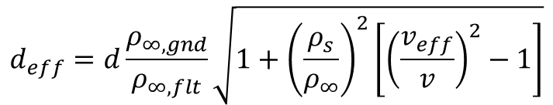

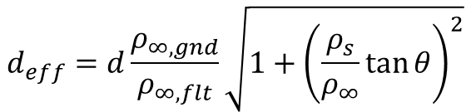
Shock Tube Informed Bias (Johnston 2019)
MTB07
How can compressive shock measurements be used to validate predictions on oblique streamlines and the wake?
  The normal velocity of the oblique shock has similarity to the velocity of an incident shock in particle time
  Binary Scaling – for 2nd order collision processes, ρ_{∞,1}d₁ is similar to ρ_{∞,2}d₂
    A larger initial density will correspond to longer distances behind the shock
$$v_{eff}=v/cosθ$$
$$d_{eff}=d\frac{ρ_{∞,gnd}}{ρ_{∞,flt}}\sqrt{1+{\left(\frac{ρ_{s}}{ρ_{∞}}\tan{θ}\right)}^{2}}$$
$$d_{eff}=d\frac{ρ_{∞,gnd}}{ρ_{∞,flt}}\sqrt{1+{\left(\frac{ρ_{s}}{ρ_{∞}}\right)}^{2}\left[{\left(\frac{v_{eff}}{v}\right)}^{2}−1\right]}$$

Slide 9
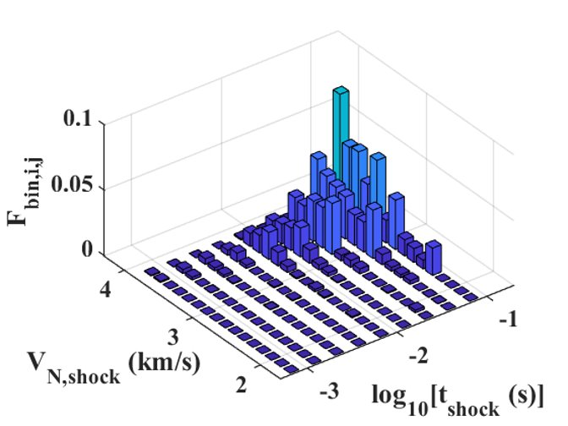
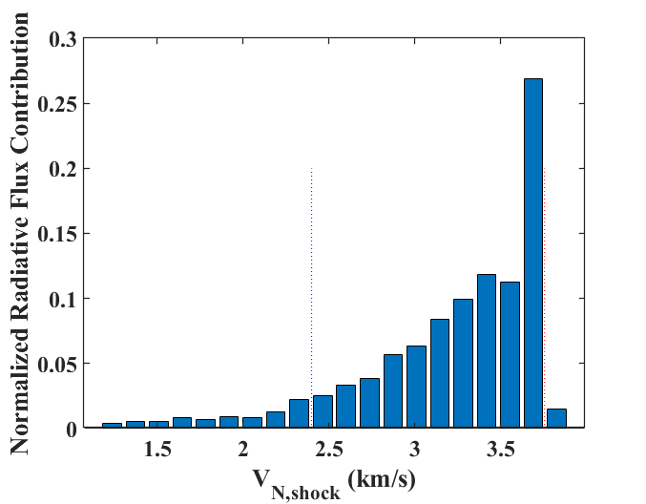

Selecting STI conditions for MEDLI2
v_{eff} $cosθ$
d_{eff}
10% Lower Bound
90% Lower Bound
Every point in the flowfield can be translated to a corresponding v_{eff} and d_{eff}
The contribution of the flowfield point to the radiative heat flux can then be evaluated
This maps the contributions of different velocities and particle times to the total radiative heat flux, at one point in time and one vehicle location
This was evaluated at 9 time points and 2 vehicle locations (MTB07, MTB08)

Slide 10
EAST Test 64A Conditions
Densities were chosen corresponding to near peak heating, ½ of peak heating and at end of heat pulse
The velocity range is swept to cover most of the histogram
A follow up test in the low density EAST tube (64B) will study earlier time points

Slide 11
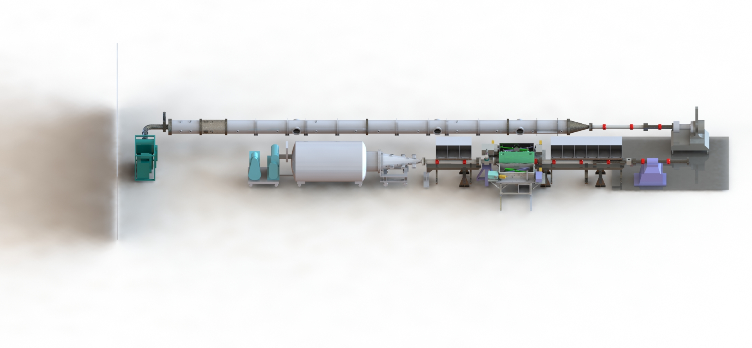
EAST Facility
Low Density Shock Tube
Driver
Expansion Cone
High Velocity Tube
Vacuum Spectrometers

Slide 12
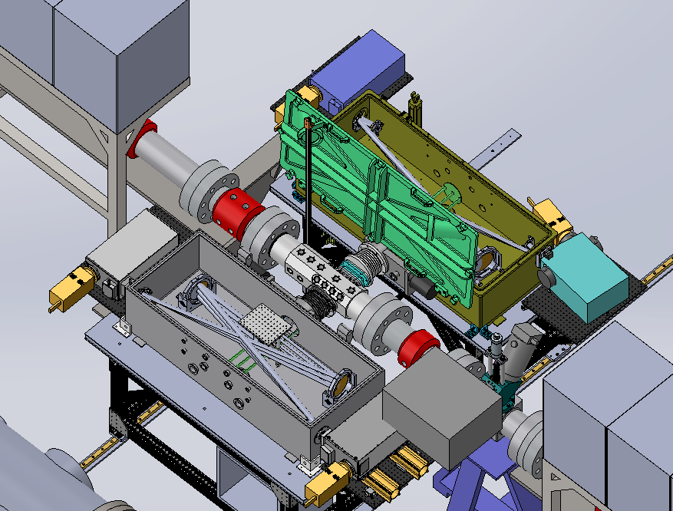
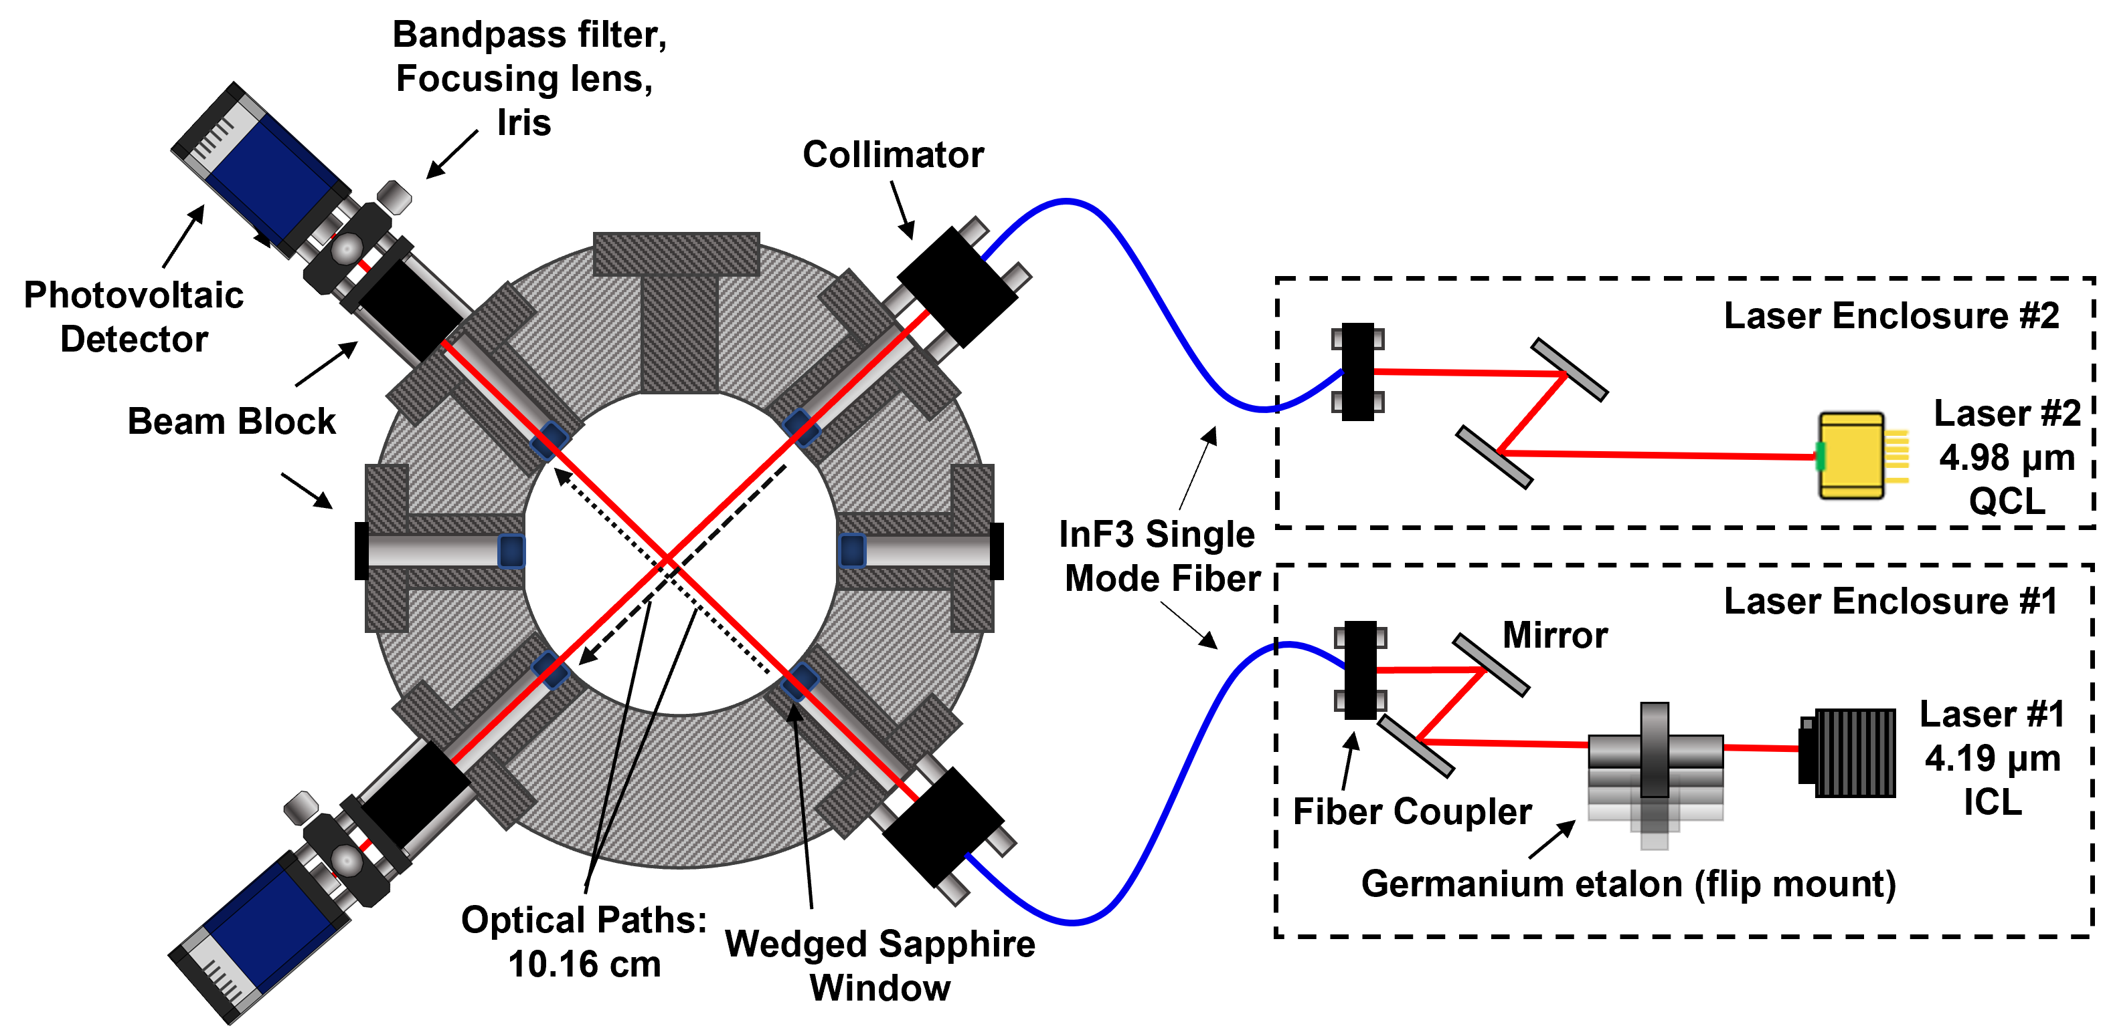
EAST Set Up
UV Spectrometer
Mid IR Spectrometer
EAST Facility Test Section Equipped with
  3 Tunable Diode Lasers
    Measure CO and CO₂ absorption
    Obtain number densities, temperature(s)
  Mid-infrared spectrometer
    Measure CO₂ radiation
    Two bands must be measured separate shots
  UV absorption and radiation measurements attempted, but nothing interesting observed
Absorption
Spectrometer
Light Source

Slide 13
Tests Completed
59 Shots completed
3 Pressure conditions
  Approx. 1 km/s sweep of velocity
2 Wavelength ranges in emission
  ν₃ fundamental (4.3 μm, ΔP=3)
  ν₃+2ν₂ and ν₃+ν₁ combination bands (2.7 μm, ΔP=5)
  2 high resolution shots
TDLAS utilized 4 lasers (3 simultaneous)
  ICL – CO₂ v₂”=0,1, J”=58/103-143 at 4.19 μm
  ICL – CO₂ ground state, J”=110-134 at 4.17 μm
  QCL – CO at 4.98 μm, v”=0,2-3, J”=14-31
  ECQCL – CO₂ at 4.24 μm (single line only)
Fun stuff
  Filling in some gaps in the previous sweeps
  High Pressure (9 Torr) shots – try to induce chemistry
  Low P & V (0.5 Torr, 1.5-2 km/s) – measure v-T relax
  Higher Velocity (3.3-4.7 km/s) – higher T chemistry
1.1 Torr
2.5-3.3 km/s
(Peak Heating)
1.5 Torr
1.9-3.0 km/s
(Mid Point)
2.0 Torr
1.3-2.1 km/s
(Close out)
Fun stuff

Slide 14
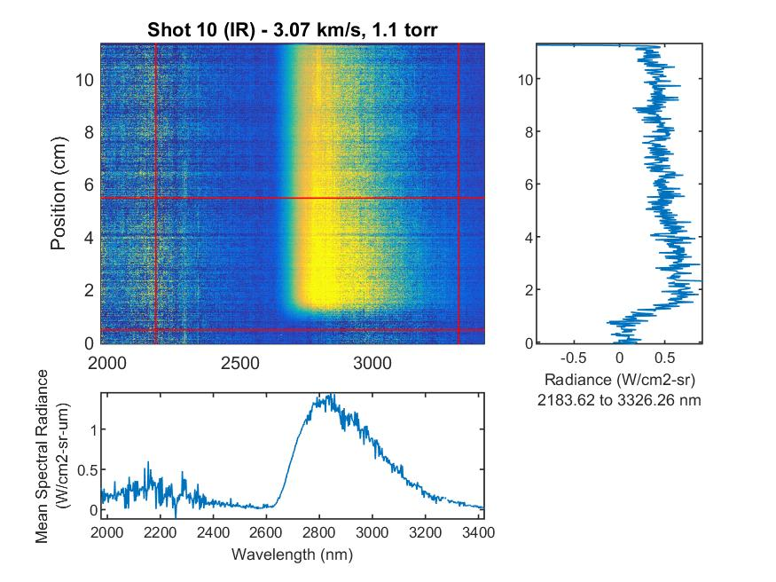
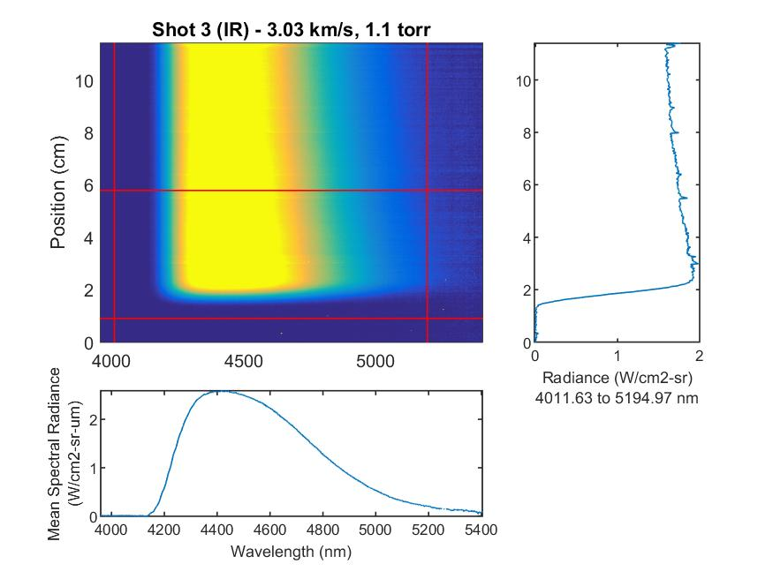
Emission Data
2.7 μm
4.3 μm
V
V
Spectral data obtained in horizontal cross-section
Spatial dependence in vertical direction
d_{test}~10 cm => t_{lab} ~ 30-50 μs t_{part} ~ 0.4-0.5 ms, d_{eff}~0.1 m

Slide 15
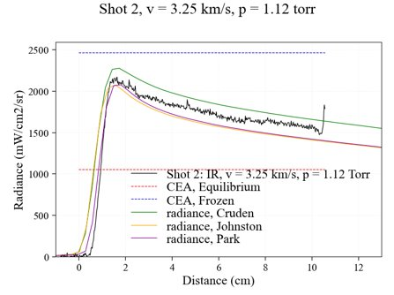
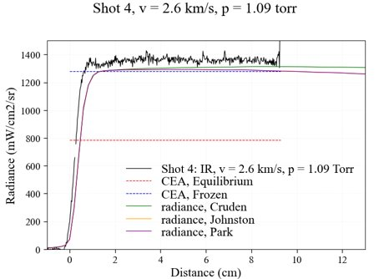
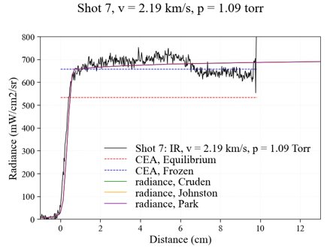
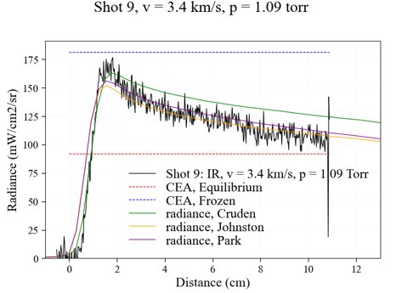
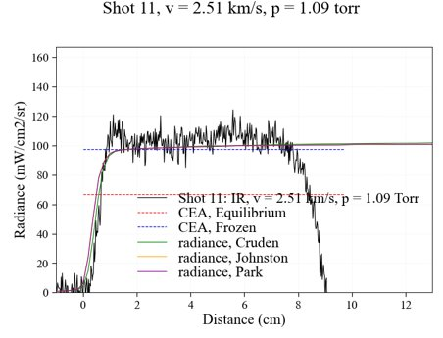
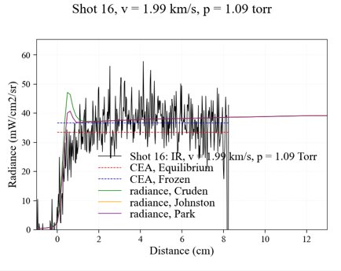
Radiance vs. Distance
4.3 um
2.7 um

Slide 16
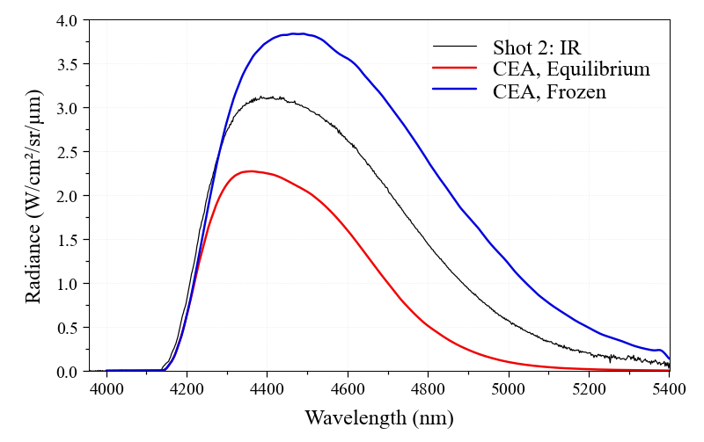
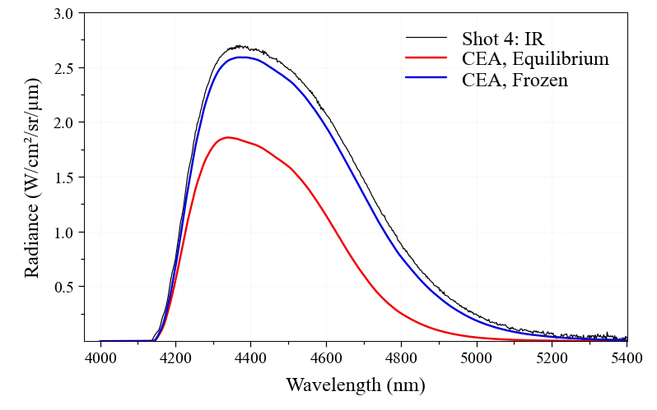
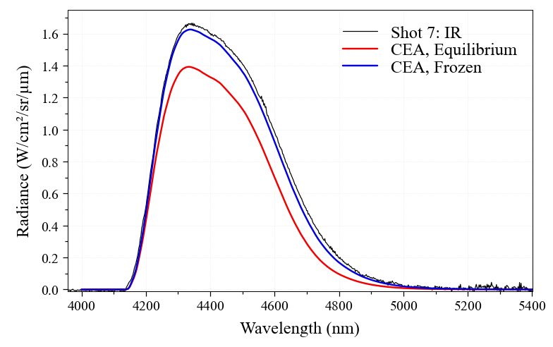
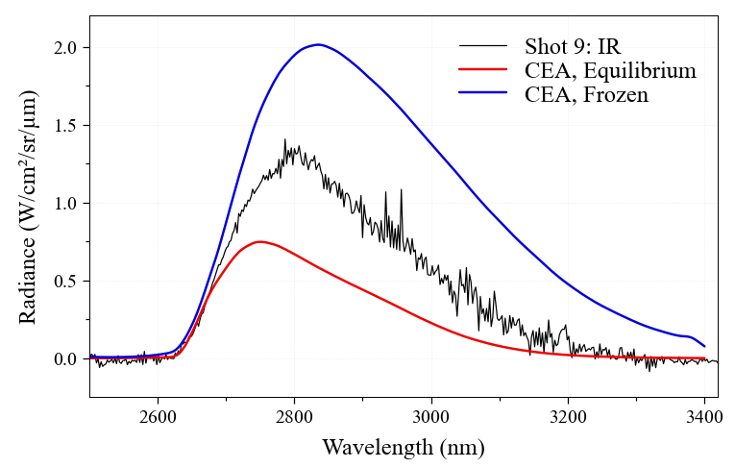
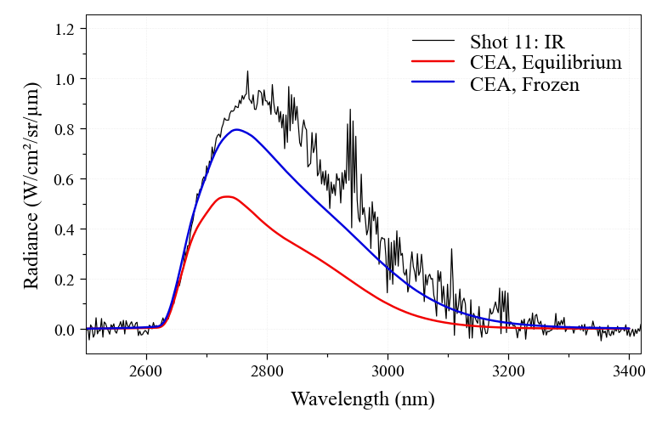
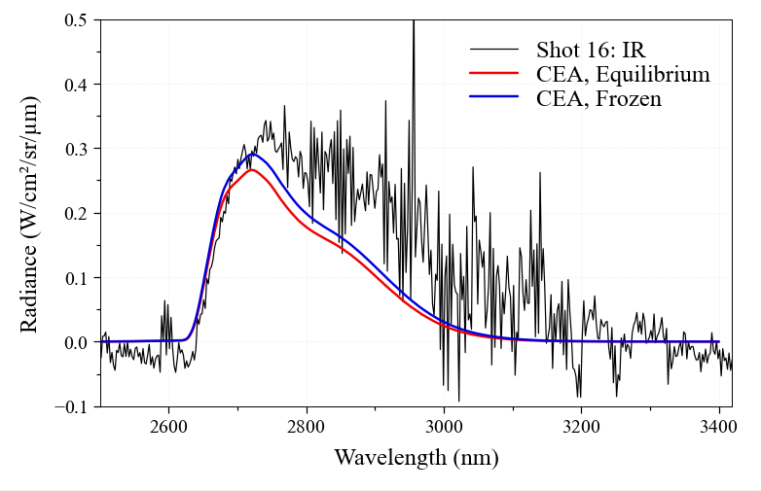
Mid-infrared Spectra
3.2-3.4 km/s
2.5-2.6 km/s
2.0-2.2 km/s
4.3 μm
2.7 μm
~ 2 cm behind shock front

Slide 17
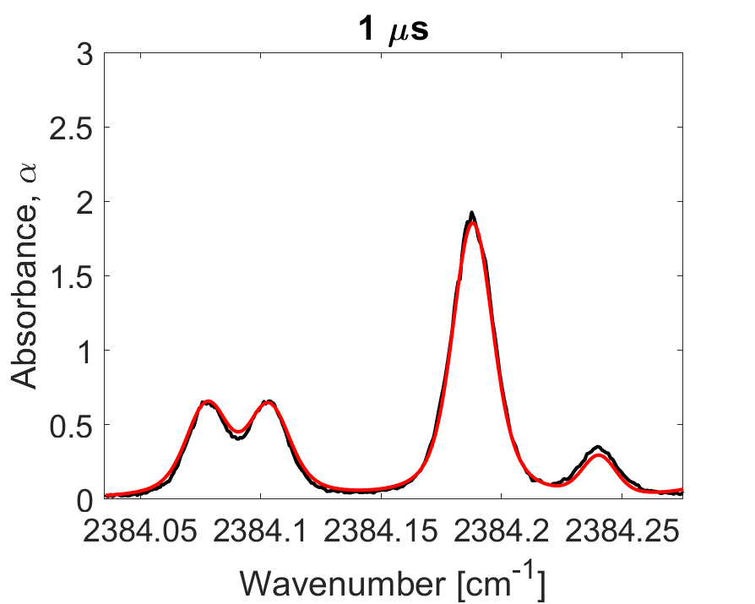
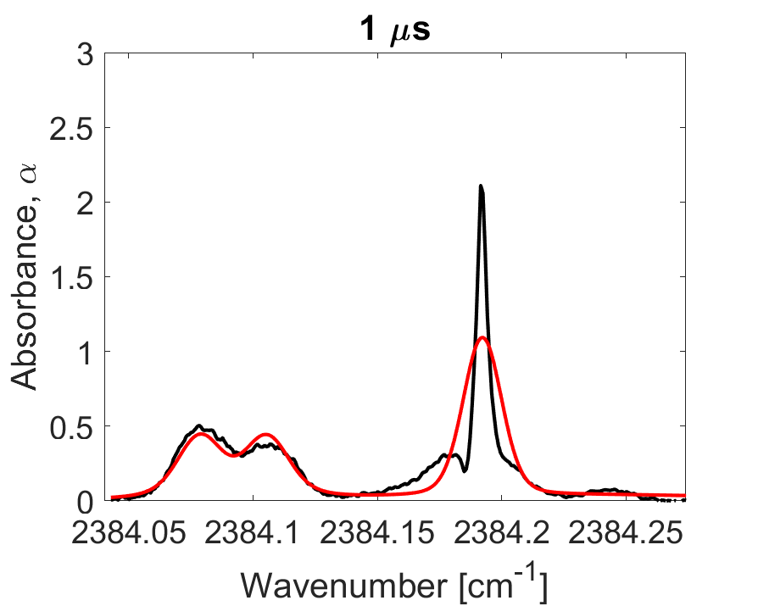
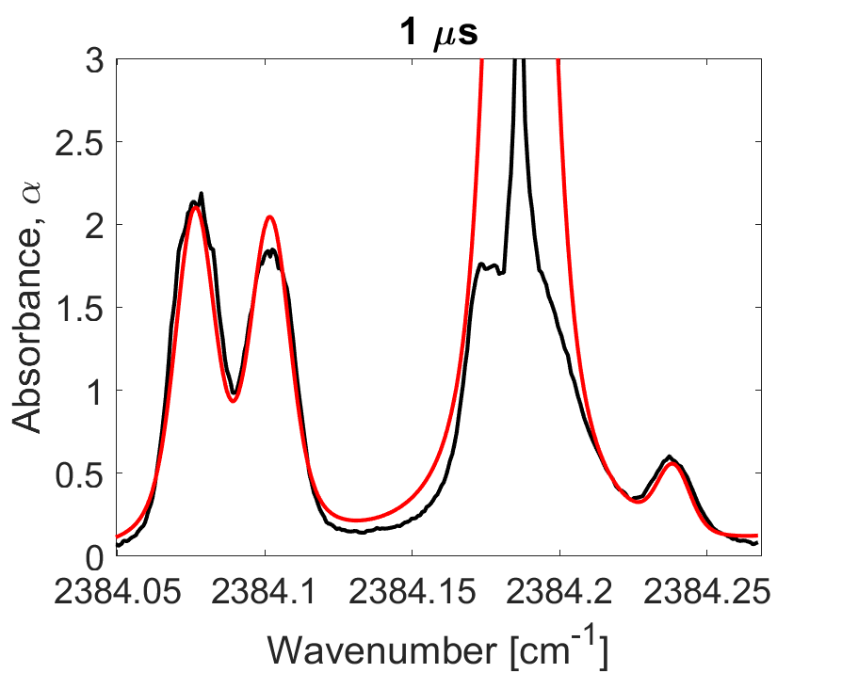
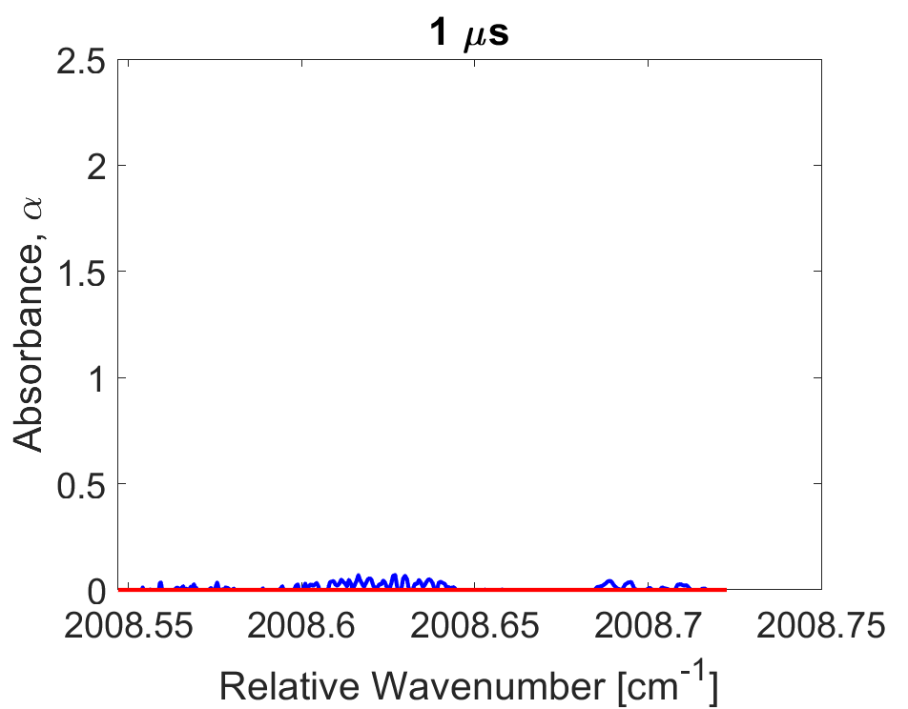
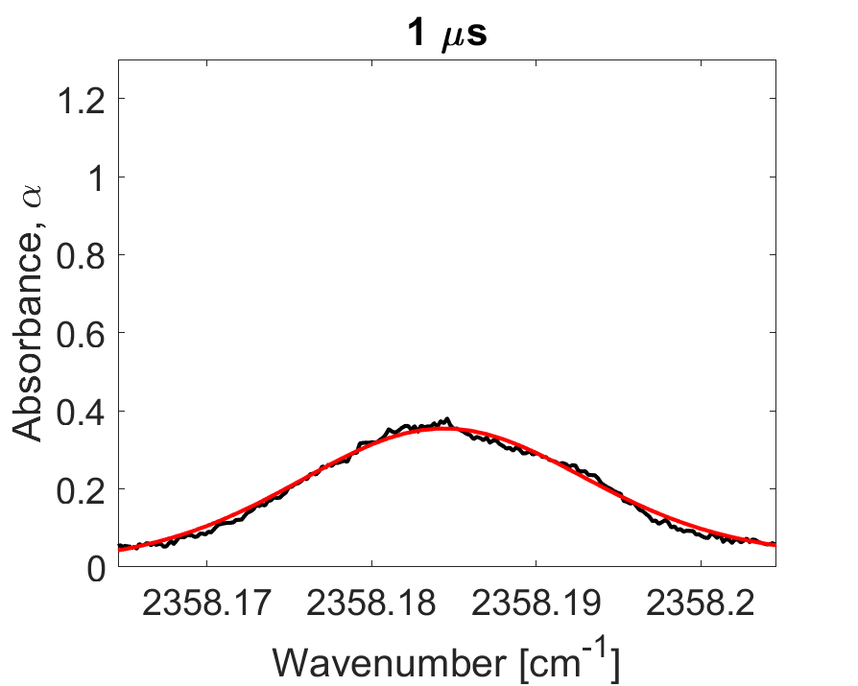
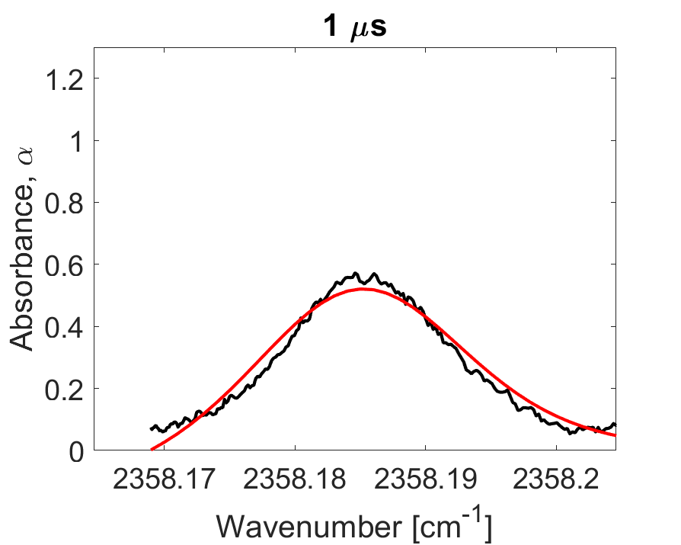
Tunable Diode Laser Absorption Spectroscopy
Shot # 10 U_{is} = 3.07 km/s
Shot # 11 U_{is} = 2.51 km/s
Shot # 16 U_{is} = 1.99 km/s
Absorption lines measured vs. time from shock front
Fits obtain temperature and number density data
CO absorption not measured below ~2.7 km/s
4.19 μm
CO₂
4.19 μm
CO₂
4.19 μm
CO₂
4.98 μm
CO
4.24 μm
CO₂
4.24 μm
CO₂
17

Slide 18
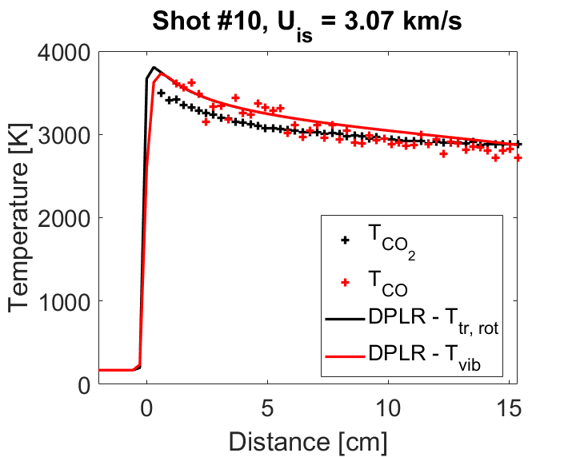
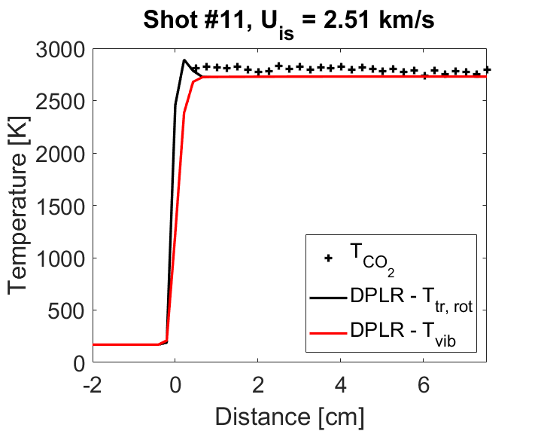
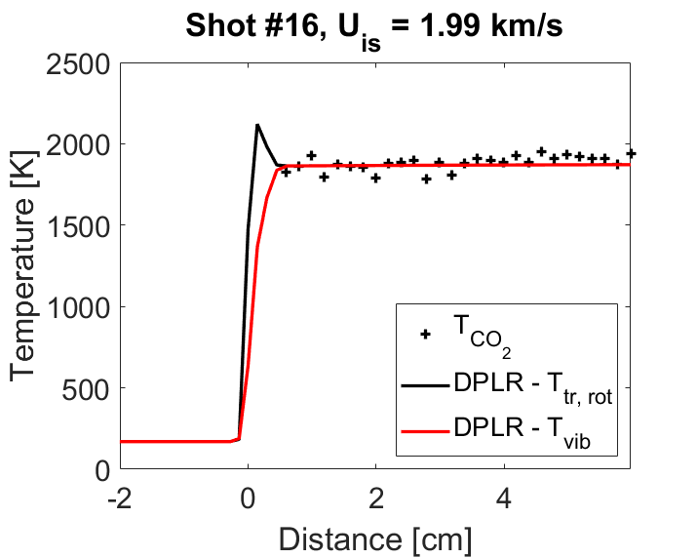
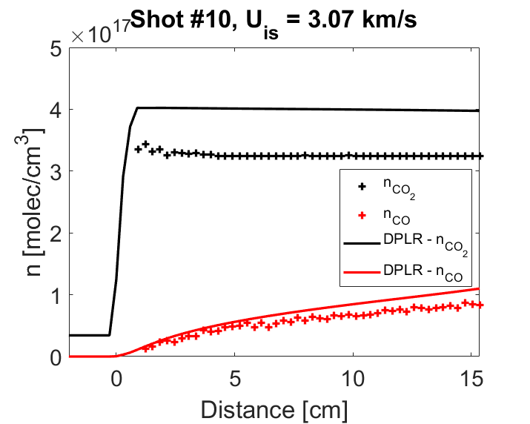
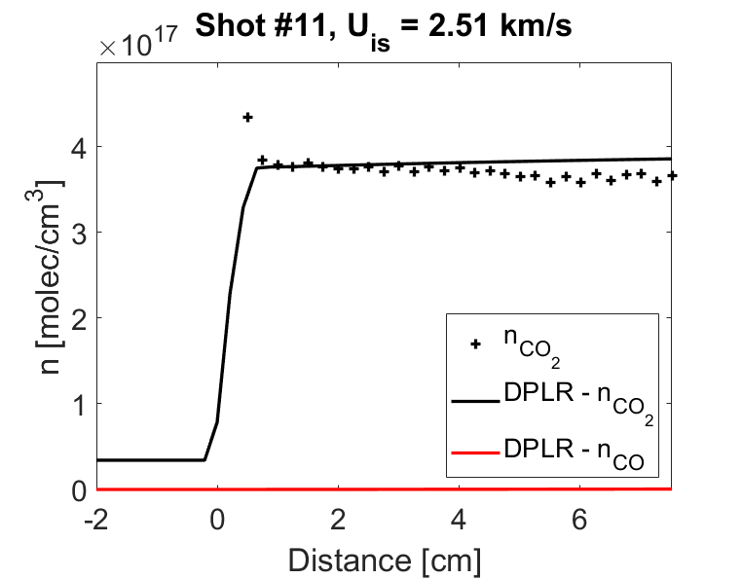
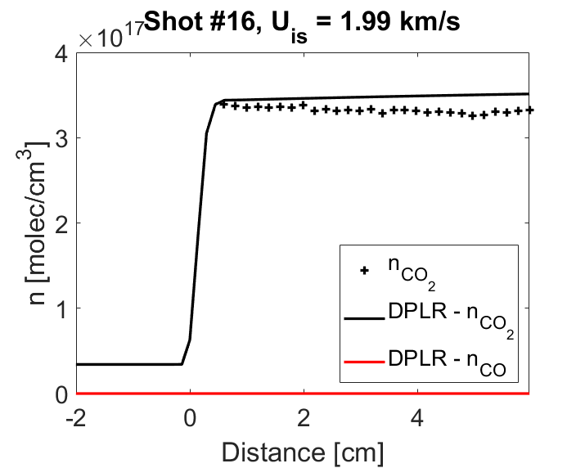
TDLAS Analysis vs. Distance
Temperatures are reasonably close to CFD prediction vs. distance
Densities of CO₂ tend to be low
No chemistry observed below 2.7 km/s
CO density well predicted when dissociation occurs
Preliminary
Preliminary
Preliminary
Preliminary
Preliminary
Preliminary
Preliminary
Preliminary
Preliminary
18

Slide 19
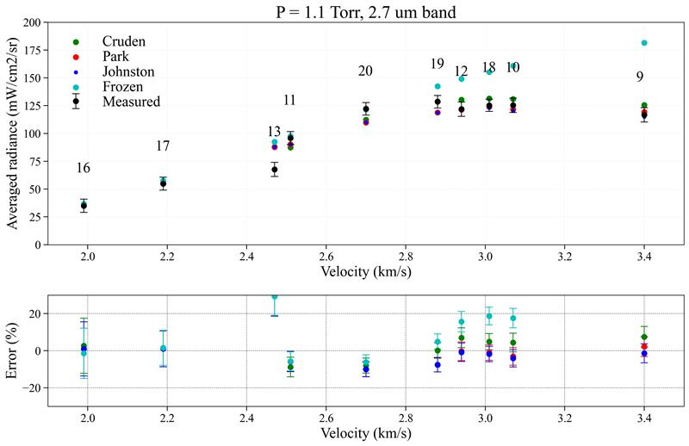
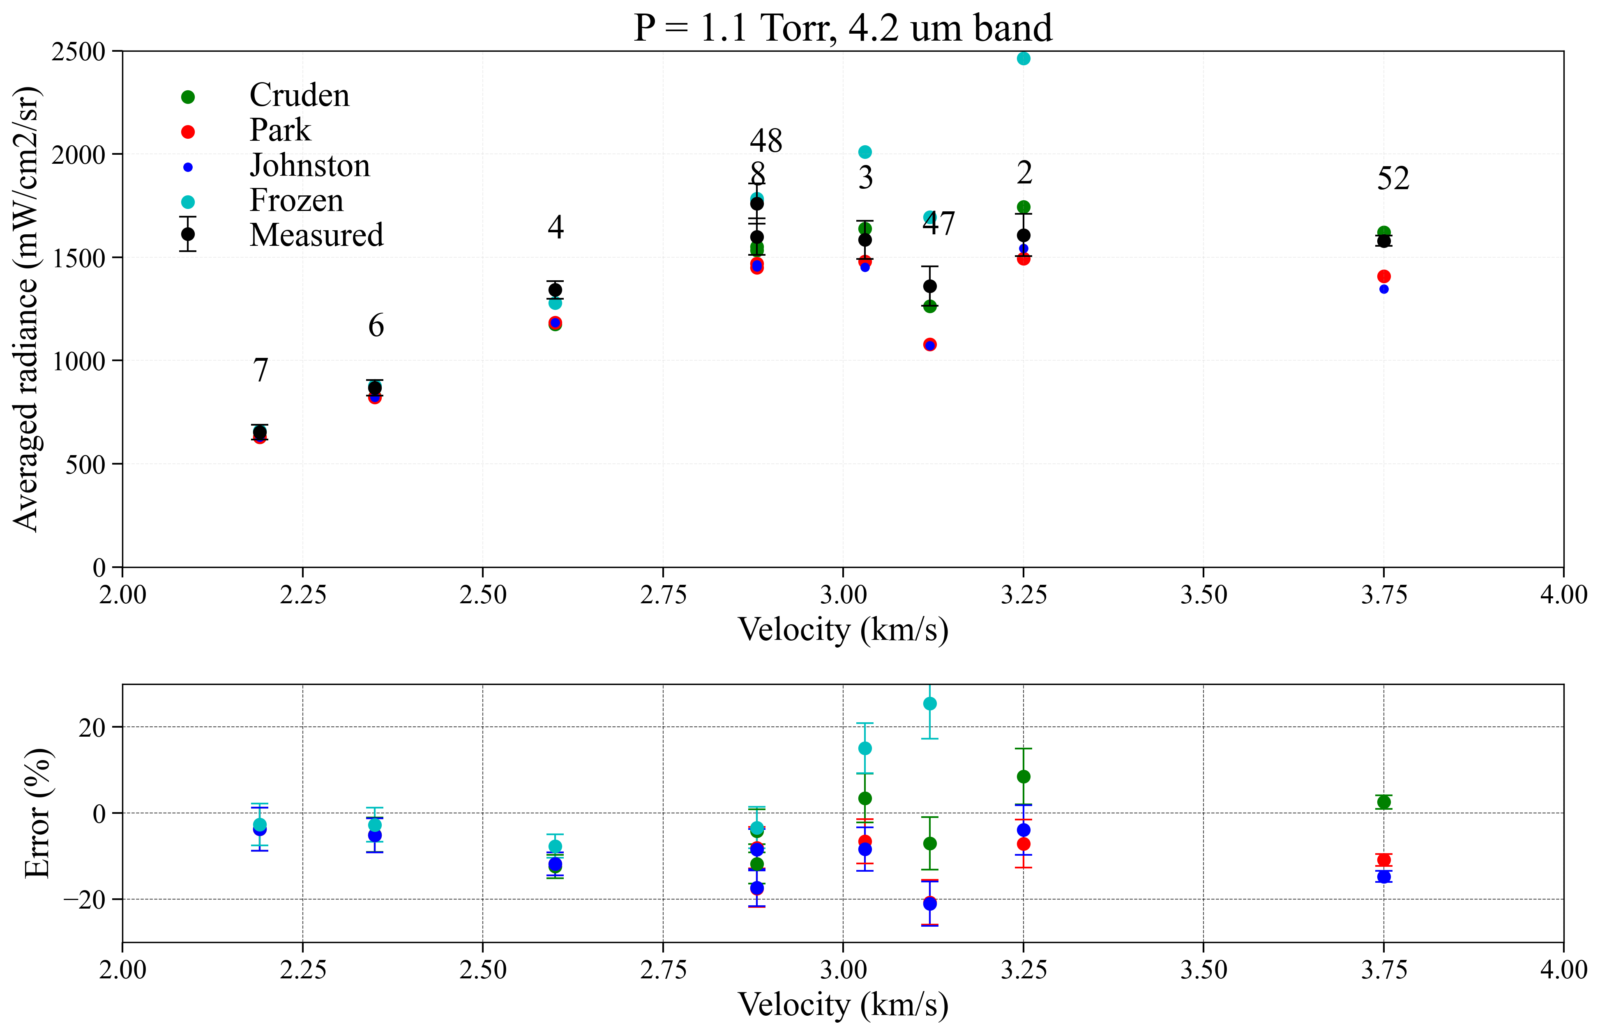
Emission Summary at 1.1 Torr
Shock appears frozen < 2.7 km/s – radiance exceeds frozen by up to 10%
At higher velocities is between two rate models

Slide 20
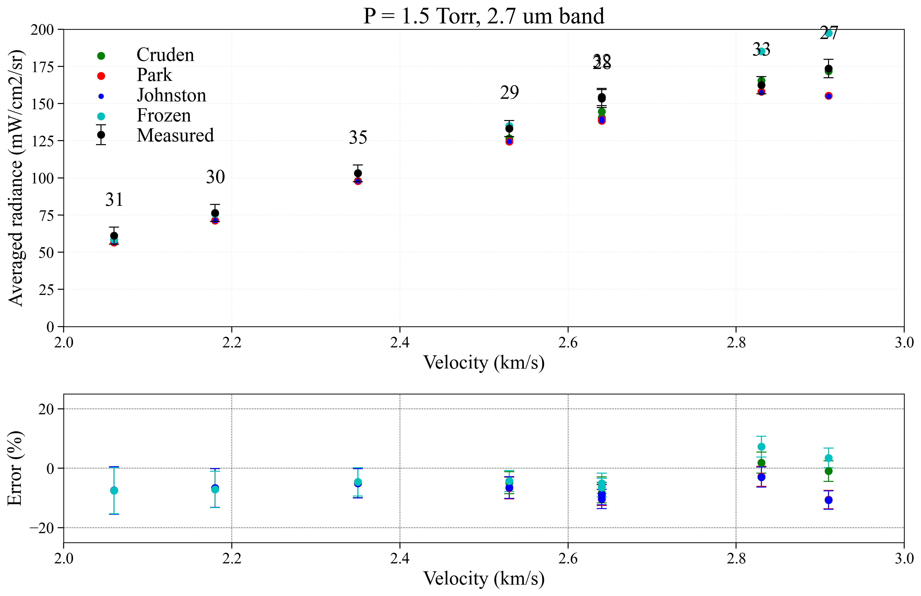
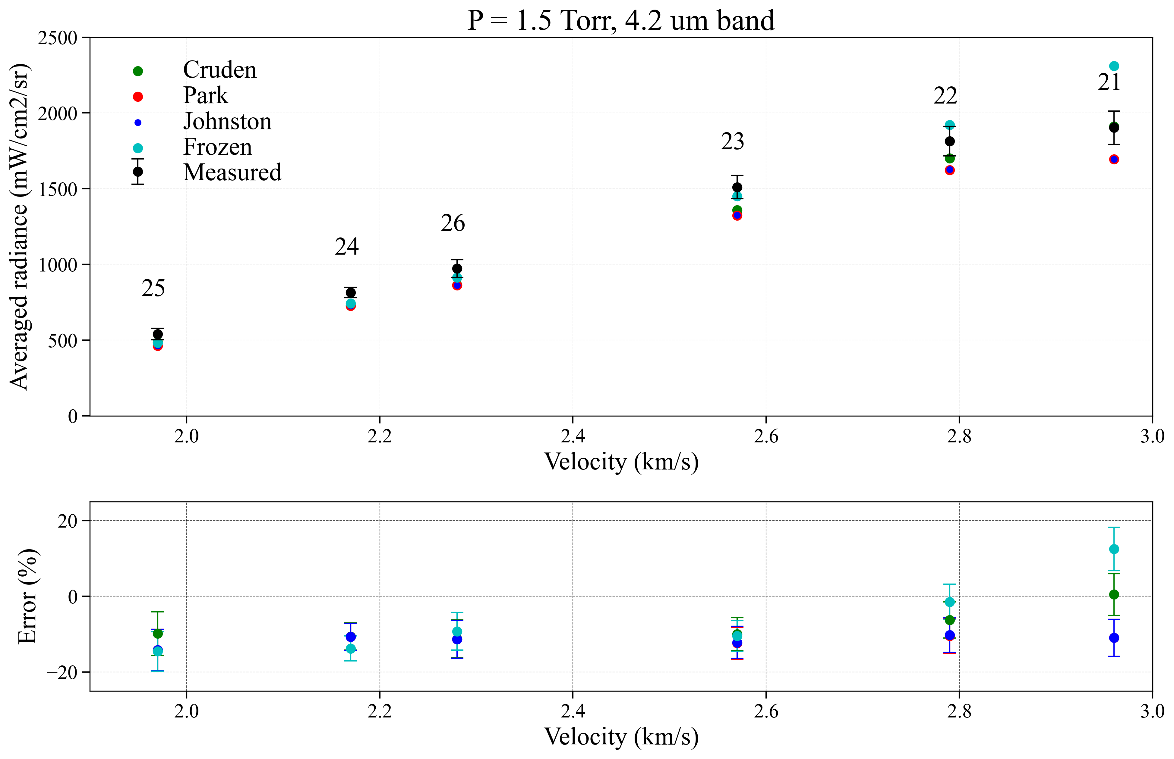
Emission Summary at 1.5 Torr
Radiance exceeds frozen levels by ~10% below 2.7 km/s
Reaction rate mostly agrees better with Ebrahim above 2.8 km/s

Slide 21
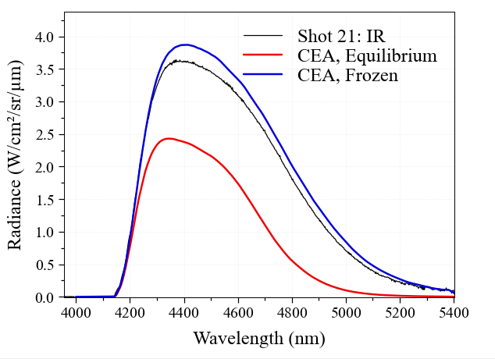
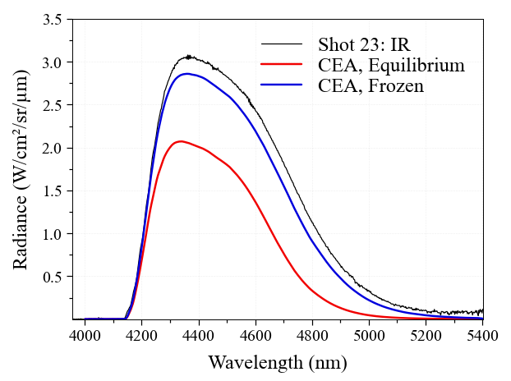
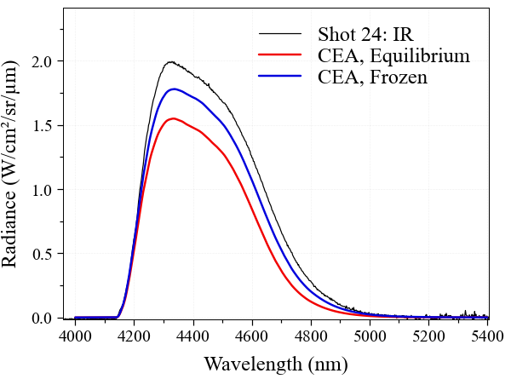
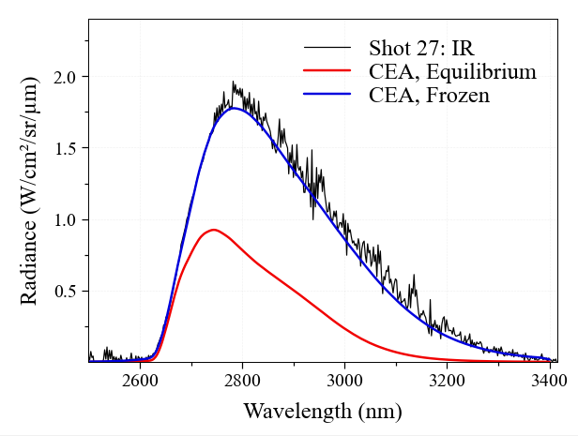


1.5 Torr Spectra (~2 cm from shock front)
Higher velocity (~ 3 km/s)
v≈ 2.5 km/s
Lower velocity (< 2.2 km/s)
4.3 um
2.7 um

Slide 22






Emission vs Distance from Shock (1.5 Torr)
4.3 um
2.7 um

Slide 23






TDLAS Analysis vs. Distance at 1.5 torr condition
Temperatures are reasonably close to CFD prediction vs. distance
Densities of CO₂ tend to be low
No chemistry observed below 2.7 km/s
CO density well predicted when dissociation occurs
Preliminary
Preliminary
Preliminary
Preliminary
Preliminary
Preliminary
Preliminary
Preliminary
Preliminary

Slide 24


TDLAS Summary
Temperatures measured by TDLAS within 5% of predictions
CO₂ number densities deviate at higher velocity, tend low by ~10-20%
  Deviation at 2 Torr due to optical thickness

Slide 25



CO Formation Data from TDLAS
CO formation rate at 1.1 Torr from TDLAS Measurements
The yield at 10 μs matches Park rate at low velocity, between two models at higher v
Characteristic formation time (exponential fit) is between the models

Slide 26



2 Torr Data
EAST Emission data vs. MEDLI2 backshell data
(note densities and relaxation distances are not same)
4.3 μm
2.7 μm
2 Torr data (below 2 km/s) appears chemically frozen
Radiance Magnitude exceeds frozen condition by as much as 20%
Comparison to measured radiation pulse close-out is reasonable (similarity not met)

Slide 27
Understanding Measurement Artifacts

Slide 28


Shock History Artifacts
As shock wave decelerates, flight similarity assumption breaks down
  Positions further behind the shock were “created” at higher initial enthalpies upstream
Oxford’s LASTA code predicts the deceleration impact given a measured velocity vs. position in the tube
Different post-shock states are obtained versus distance behind the shock front
Post-shock state can be evaluated as either (chemical) equilibrium or frozen
A 0-D reactor is simulated starting from the frozen condition to get the post-shock state
Use similarity in Lagrangian time
$Δt_{particle}=\frac{Δx}{v_{2}}$
Distance particle moved
Flow velocity
in the lab frame
Reacting LASTA Sim
n_{CO2}
Δt
T
n_{CO}
Δx

Slide 29


Emission prediction corrected for shock history
(Frozen)
(Reacting)
Using LASTA frozen predictions matches the radiance measured at 2.3 km/s
LASTA correction does not substantially alter reacting case
Impact on TDLAS?

Slide 30





Boundary Layer Impact on Absorption
LOS
Cold CO₂ in the boundary layer may contribute to absorption signal
Boundary layer profile is calculated using similarity solution from Mirel’s theory.
Numerically solve in shock fixed coordinates
Including boundary layer did not alter emission data
Core
Shock Location
(x = 0)
Sum simulated absorbance along each x
Boundary
Layer
Shot #14
The R(58) line of CO₂ is primarily affected by the cooler boundary layer
u₂
$$δ_{99}$$

Slide 31


Frozen Case, Both Corrections
Fit of emission data yields temperature and density consistent with TDLAS and LASTA code
LASTA number density is within the uncertainty of TDLAS measurement

Slide 32


Reacting Case, Both Corrections
Temperature from emission, TDLAS and LASTA are all consistent with DPLR (Ebrahim rate)
Density decreasing behind shock front observed in Emission and TDLAS, predicted by LASTA
Absorption density is increased with boundary layer correction, agrees within error
Corrections still need to be demonstrated on larger dataset

Slide 33
Conclusions and Observations
MEDLI2 returned full data set of backshell and forebody heating
  Radiometer was blocked with ablation products but the lee-side heat flux gauge is a good indicator of radiation
  Predictions show sensitivity to chemistry, entry trajectory
Reconstruction of MEDLI2 backshell is attempted in EAST 4” (10 cm) Tube from 1.1-3.5 km/s
  Higher pressures (1.1-2.0 Torr) are representative of time after peak heating (92-140s)
  Particle time in EAST is ~0.5 ms, equivalent distance of 0.1 m is lower than flight scales for backshell radiation
Chemically frozen on experimental timescale < 2.7 km/s
  Emission data tends to exceed frozen result at shock front
  TDLAS agrees well with frozen temperature and number density
Reactions observed >2.7 km/s
  Emission lies between the two reaction models, but trends toward “Cruden” model at higher velocity and pressure
  TDLAS temperature/CO density agrees well with Johnston model initially, then falls between the two CO₂ reaction models
  TDLAS CO₂ number density lower than simulation in reacting regime
Measurement artifacts
  Emission underprediction may be explained by including deceleration in shock tube (LASTA code)
  Underestimate of core flow CO₂ density in TDLAS is explained by boundary layer absorption
  Considering boundary layer absorption and shock deceleration together brings measurements into agreement
Data supports need for refinement of CO₂ reaction model

Slide 34
Backup

Slide 35



High Pressure Tests
Shots at 9 Torr attempt to induce chemistry on experimental time scale
  Not accomplished at 2.3 km/s: Radiance increasing (probably deceleration effect)
  Not accomplished at 2.5 km/s: Radiance exceeds frozen by ~10%
  Chemistry observed at 2.7 km/s: Agrees with Ebrahim
TDLAS was optically thick, not useful for analysis

Slide 36



High(er) Velocity Test
High(er) Velocity emission data appears consistent with Ebrahim/Cruden rate
High Velocity TDLAS temperature agrees wtith Park/Johnston
Two measurements show conflicting results

Slide 37


Bonus Test #1 Low V/P
Tests to observe V-T relaxtion (<2 km/s, 0.5 Torr)
TDLAS shows reasonable agreement to Park v-T
  Note this is T_{v} of ν₂ (bending)
Emission still shows offset (higher intensity) than frozen or TDLAS data
  Emission depends on T_{v} of ν₃ (asymm. stretch)
*
High resolution emission measurement
* Number density was fixed to get good 2T fit

Slide 38




Attempts to measure CO₂ “Continuum”
Shot #9, U_{is} = 3.4 km/s
CO absorption
Shot #11, U_{is} = 2.51 km/s
Vibrationally hot CO₂
absorption
TDLAS measurement at frozen condition shows good agreement to CDSD prediction
High-resolution emission detects something but mostly below detection limit

