Slide 1



October 25, 2022
Heat Pipe Heat Exchanger for Nuclear Electric Propulsion Power Conversion System
Dennis Nikitaev, Corey D. Smith, Matthew Duchek, Christopher Harnack, William Machemer
Notes:
Hello, my name is Dennis Nikitaev, I’m an aerospace systems engineer at AMA, and today I’ll be talking about the Heat Pipe Heat Exchanger for Nuclear Electric Propulsion Power Conversion System.

Slide 2


Acknowledgements
This work was supported by NASA’s Space Technology Mission Directorate (STMD) through the Space Nuclear Propulsion (SNP) Project
Contract No. 80LARC17C0003
Task No. 10.020.000
A special thanks to DV Rao from LANL for his input and guidance.
Notes:
This work was supported by NASA’s STMD through the SNP project. A special thanks goes to DV Rao from LANL for his input and guidance.

Slide 3
Agenda
Heat Pipe Reactor NEP PCS Overview
Heat Pipe Modeling
Reactor Modeling
Heat Exchanger Modeling
Reactor/Heat Pipe/Heat Exchanger Subsystem Solution Method
Results
Conclusion/Future Work
Notes:
The agenda for today is to:
Provide an overview of the NEP power conversion system
Look at how we can model the heat pipes
Then move on to reactor and heat exchanger modeling
Go through the integrated reactor-heat pipe-heat exchanger subsystem solution method
Present some results
And close out with conclusions and future work

Slide 4
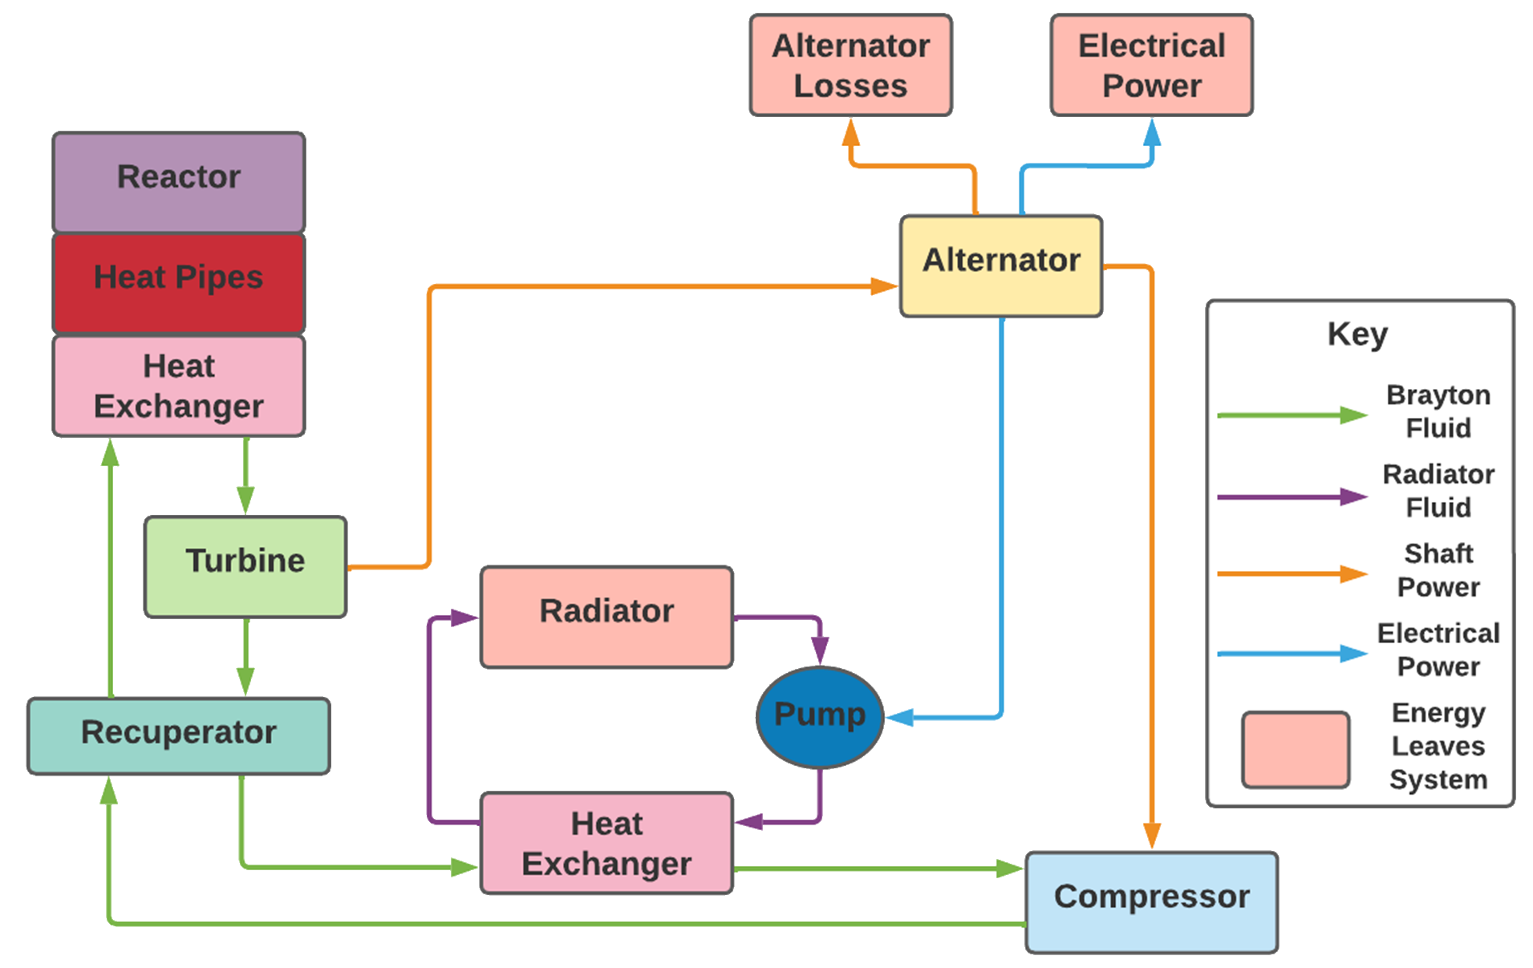
Heat Pipe Reactor NEP PCS Overview
Heat flows from the reactor through the heat pipes to the heat exchanger.
Notes:
The Heat Pipe reactor power conversion cycle diagram is presented on this slide. The reactor produces heat which travels via heat pipes to the reactor heat exchanger thus heating the Brayton working fluid.
This fluid travels to the turbine and releases enthalpy thus providing power to the alternator and compressor.
The fluid exits the turbine and is precooled in the recuperator before entering the radiator heat exchanger. Here, liquid eutectic NaK circulates between the radiator and heat exchanger thus enabling heat rejection.
The Brayton working fluid leaves the radiator heat exchanger and travels to the compressor from which it leaves at the maximum system pressure and travels back to the recuperator to get preheated before re-entering the reactor heat exchanger.

Slide 5
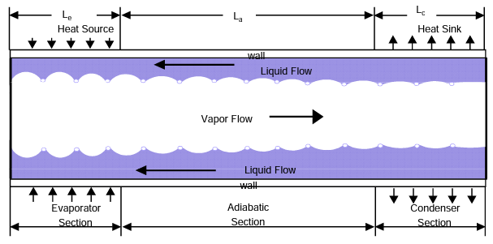
General Heat Pipe Operation [1]
The liquid inside the heat pipe is stored inside a wicking structure with surface tension holding it in place.
The liquid absorbs heat in the evaporator section and turns into a vapor thereby transporting heat via increased enthalpy to the condenser section.
The vapor releases heat in the condenser section and turns back into a liquid.
Notes:
This slide shows the schematic of the heat pipe.
The fluid inside the heat pipe is in a saturated state with the liquid kept in place in the outer walls by a wicking structure and the vapor flowing in the middle.
The heat is provided in the evaporator section which converts the liquid into vapor.
The vapor flows through the entire length of the heat pipe through the adiabatic section to the condenser section where heat is released and the vapor condenses back to a liquid. The liquid then flows back to the evaporator section and the process is repeated.

Slide 6
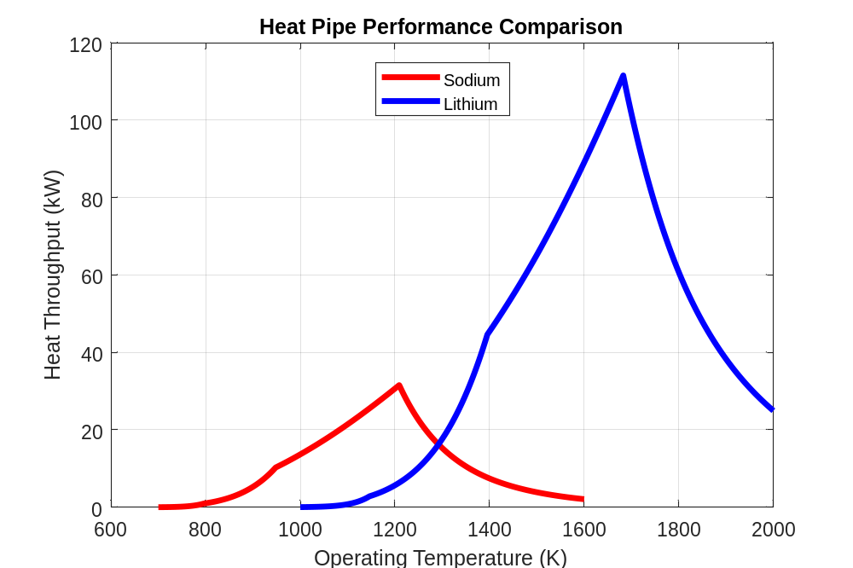
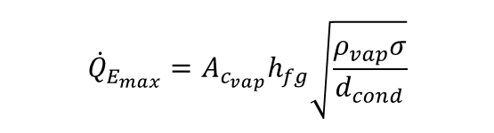
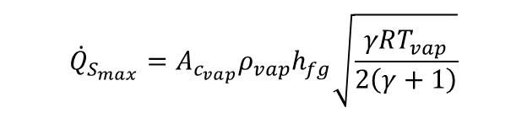
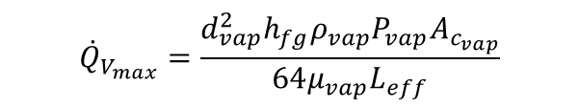
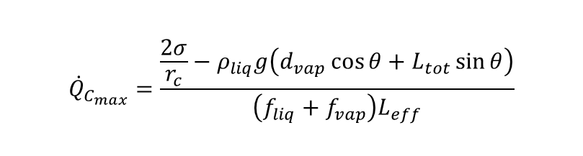


Heat Pipe Limits Model
Heat pipes are governed by operability limits which dictate the maximum heat transferred from the heat source [2-9].
$${\dot{Q}}_{V_{max}}=\frac{d_{vap}^{2}h_{fg}ρ_{vap}P_{vap}A_{c_{vap}}}{64μ_{vap}L_{eff}}$$
$${\dot{Q}}_{S_{max}}=A_{c_{vap}}ρ_{vap}h_{fg}\sqrt{\frac{γRT_{vap}}{2\left(γ+1\right)}}$$
$${\dot{Q}}_{E_{max}}=A_{c_{vap}}h_{fg}\sqrt{\frac{ρ_{vap}σ}{d_{cond}}}$$
$${\dot{Q}}_{C_{max}}=\frac{\frac{2σ}{r_{c}}−ρ_{liq}g\left(d_{vap}\cos{θ}+L_{tot}\sin{θ}\right)}{\left(f_{liq}+f_{vap}\right)L_{eff}}$$
$${\dot{Q}}_{B_{max}}=\frac{\frac{2βσ}{r_{n}}}{1+\frac{βL_{eff}μ_{liq}}{Kh_{fg}A_{c_{wick}}ρ_{liq}}}$$
$$β=\frac{2πL_{evap}k_{{wick}_{eq}}T_{vap}}{h_{fg}ρ_{vap}\ln{\frac{d_{HP−in}}{d_{vap}}}}$$
Notes:
The heat pipe model used in this work is based on the heat pipe limits which include:
Viscous limit that is dictated by the viscosity of the vapor which is usually encountered during start up.
Sonic limit which states that the vapor cannot flow beyond its sonic velocity.
Entrainment limit which is based on the surface tension of the liquid which must keep the liquid contained inside the wick.
Capillary limit which balances the pressure losses of the liquid and vapor.
And the boiling limit at which dry out occurs in the evaporator section which could damage the heat pipe.
Both sodium, and lithium were considered for this study due to their high temperature operating regimes and a constant proprietary heat pipe geometry from LANL.
Here, we see that lithium can transport up to 5 times the heat of sodium, but at temperature 500 K above that of sodium.

Slide 7
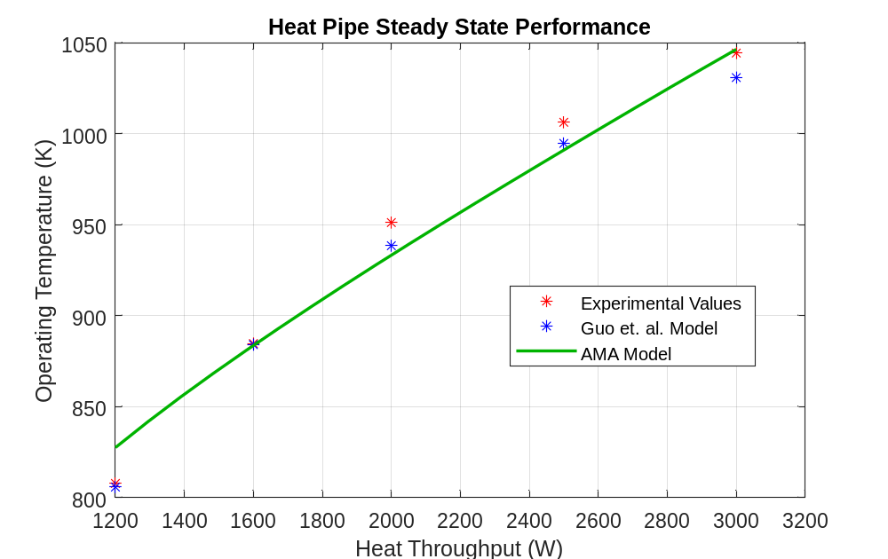
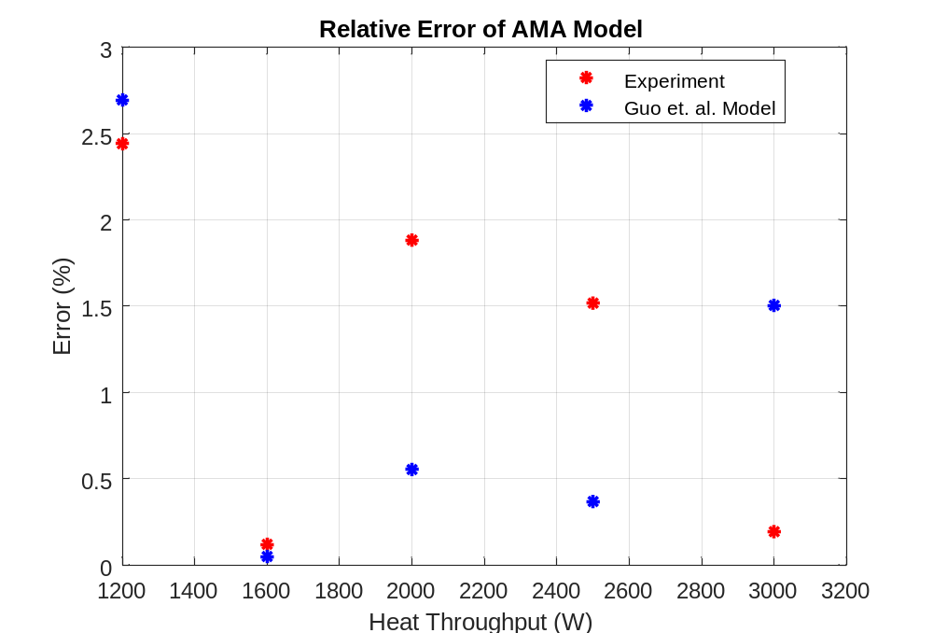
Heat Pipe Limits Model Validation
A study on sodium heat pipes and their application to KRUSTY was conducted resulting in both experimental and numerical results [10].
When compared against these results, the AMA limits model is in good agreement with errors less than 3% [13].
Notes:
A study done on the KRUSTY heat pipes resulted in both experimental and numerical results which were used to compare with the AMA heat pipe model.
The AMA model is shown to be in good agreement with the results from this study.
The graph on the left shows the heat throughput and operating temperature while the graph on the right shows the error. Here, the red points are experimental values while the blue points are numerical values.
The resulting errors are less than 3%.

Slide 8
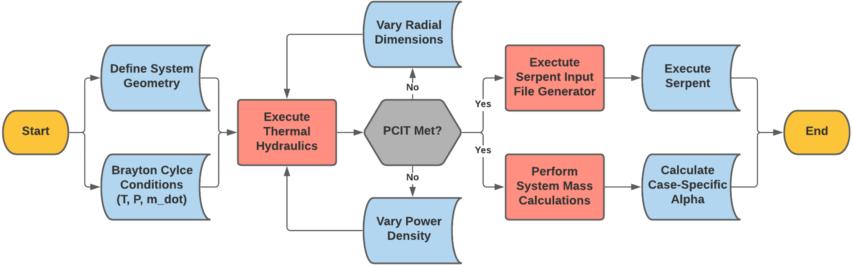
Reactor Sizing Model
Reactor thermal hydraulics (T/H), mass calculations, and neutronics are coupled into a single methodology to account for the physics of entire reactor loop
  Thermohydraulics (T/H): Performs reactor sizing by varying mass flow rate, number of unit cells, and thermal power density until a desired reactor exit temperature is reached
  Neutronics: Serpent and OpenMC input files are generated per case based on T/H converged dimensions
  Mass:
    Physics-based sizing - Core unit cells, axial/radial reflectors, external shields, pressure vessel
    RSMASS-D [10] - Various subcomponents (I&C, structural support, etc.)
Bounding conditions from the Brayton model (temperature, pressure, flow rate) are used as inputs and convergence criteria for the reactor T/H sequence.
Notes:
To parametrically assess the reactor performance space, a detailed physics-based code suite was generated to analyze the trades between various reactor working fluid options and operability regimes. This code suite includes a first-order thermal hydraulic solver based on user-input geometry and boundary conditions provided by the power conversion system, such as temperatures, mass flow rate, and pressure. The code will converge on the required number of unit cells by varying the thermal power density and mass flow rate per unit cell. Following T/H convergence, a case-specific neutronics script can be generated in either SERPENT or OpenMC to analyze the reactor physics on the specified core geometry. The code sequence finalizes with a mass estimate by applying volume/density calculations on the converged dimensions and subcomponent mass empirical correlations from the SP-100 project to inform system alpha models.

Slide 9
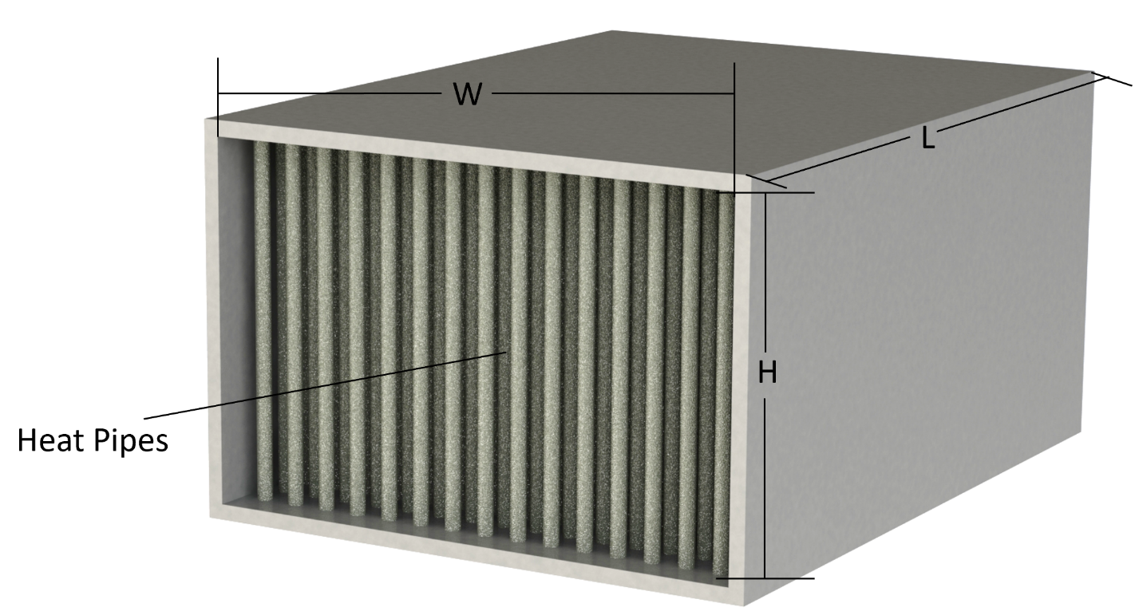
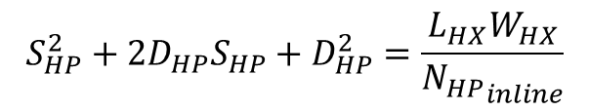
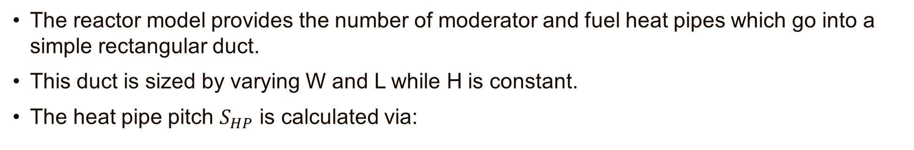
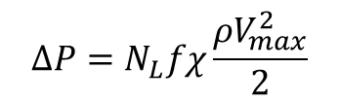
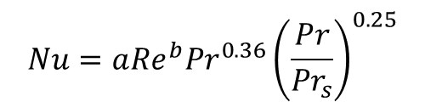

Tube Bank Heat Exchanger Model
The reactor model provides the number of moderator and fuel heat pipes which go into a simple rectangular duct.
This duct is sized by varying W and L while H is constant.
The heat pipe pitch $S_{HP}$ is calculated via:
$$S_{HP}^{2}+2D_{HP}S_{HP}+D_{HP}^{2}=\frac{L_{HX}W_{HX}}{{N_{HP}}_{inline}}$$
$$\frac{L_{HX}}{D_{HP}+S_{HP}}\left(\frac{W_{HX}}{D_{HP}+S_{HP}}−\frac{1}{2}\right)={N_{HP}}_{stag}$$
The total heat transferred, pressure losses, and power conversion inlet temperature (PCIT) are calculated using Zukauskas correlations [11].
$$Nu=a{Re}^{b}{Pr}^{0.36}{\left(\frac{Pr}{{Pr}_{s}}\right)}^{0.25}$$
$$∆P=N_{L}fχ\frac{ρV_{max}^{2}}{2}$$
Heat exchanger sizing is limited by heat pipe geometry and reactor sizing.
Notes:
For the simplification of analysis, the heat exchanger is assumed to be a duct with a rectangular flow area with a constant height taken from the length of the condenser section of the heat pipes with the heat exchanger length and width parameters are varied.
The total number of heat pipes is provided by the reactor model and their pitch is determined by these equations depending on their arrangement.
The convective heat transfer coefficient, pressure losses, and resulting power conversion inlet temperature are calculated by using the Zukauskas correlations.
The result of this modeling approach is that the heat exchanger sizing is limited by the heat pipe geometry and reactor sizing.

Slide 10
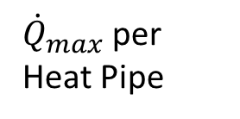
Tube Bank Heat Exchanger Model
Reactor is sized based on required power to heat Brayton fluid
Masses are calculated based on 1st principles using total material volume and density
Heat pipe surface temperature is altered by a non-linear solver.
Process is repeated until a minimum mass is found which also adheres to the specified outlet temperature and pressure loss.
Heat Pipe Limits Model
Heat Pipe Surface Temperature
${\dot{Q}}_{max}$ per Heat Pipe
Inlet Conditions
Reactor Sizing Model
# of Heat Pipes
Reactor + shield mass
Inlet Conditions
L,W
Heat Exchanger Model
Outlet Conditions
HX Mass
Iteration and Logic
Subsystem sizing solution is iterative.
Notes:
The solution method for the heat pipe-reactor-heat exchanger subsystem begins with an assumed heat pipe surface temperature.
The heat pipes are assumed to be an isothermal heat source.
Based on the heat pipe limits model, the heat throughput per heat pipe is fed into the reactor sizing model along with the inlet conditions.
The reactor sizing model determines the number of heat pipes required to yield a PCIT.
The number of heat pipes is then fed into the heat exchanger model which yields the outlet conditions for a given length and width.
The heat exchanger outlet conditions and subsystem component masses are analyzed, and the heat exchanger size and heat pipe surface temperature are varied by a non-linear solver to eventually yield the desired outlet temperature with minimized pressure losses and minimized total subsystem mass.
The subsystem sizing solution is iterative.

Slide 11
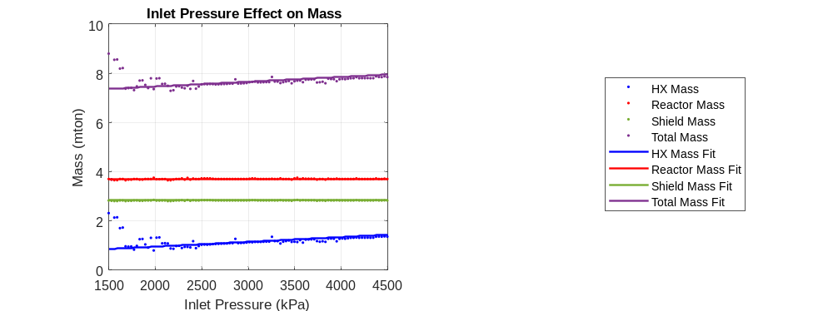
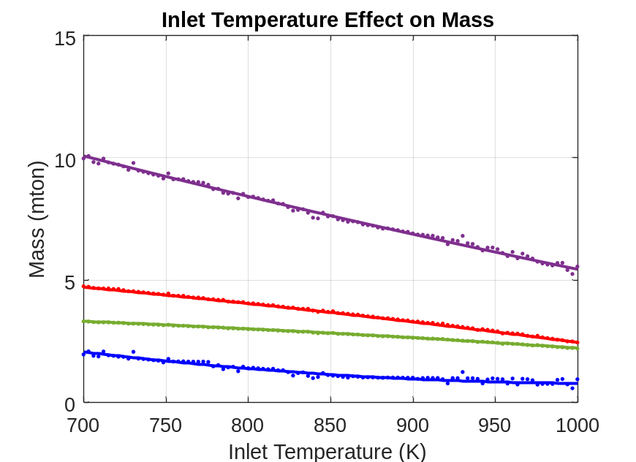
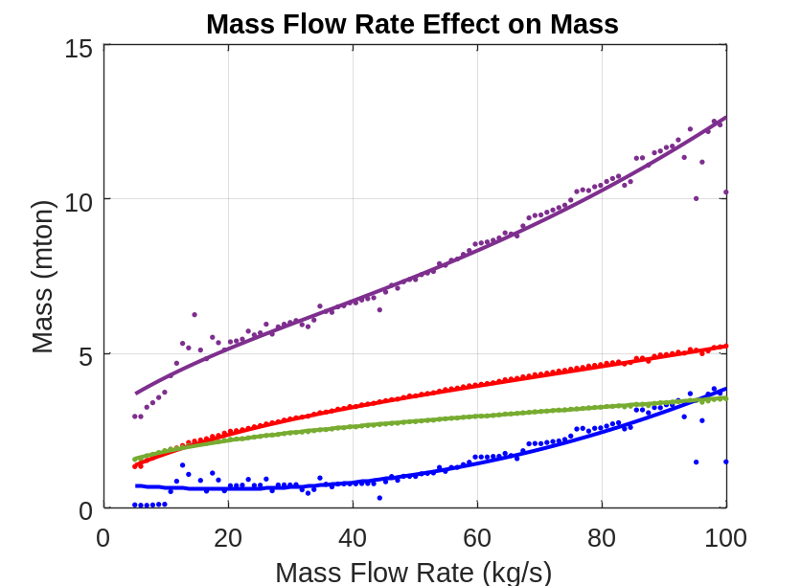
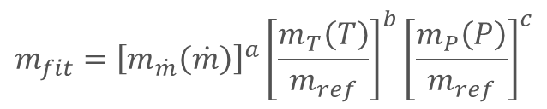
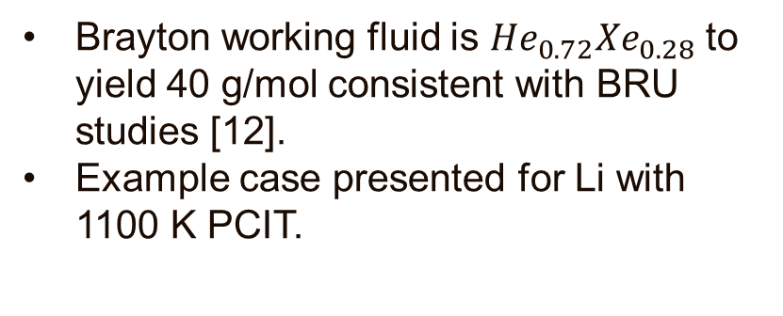
Heat Pipe Limits Model Validation
Sweeps of inlet conditions performed to estimate subsystem mass.
Used for thermodynamic optimization.
Inputs | Input Parameter Range | Units
Mass Flow Rate | 5 to 100 | kg/s
Inlet Temperature | 700 to (PCIT – 100) | K
Outlet Temperature (PCIT) | 1100 – 1400 | K
Inlet Gas Pressure | 0.5 to 4 | MPa
Heat Pipe Fluids | Na & Li | -
Brayton working fluid is ${He}_{0.72}{Xe}_{0.28}$ to yield 40 g/mol consistent with BRU studies [12].
Example case presented for Li with 1100 K PCIT.
$$m_{fit}={\left[m_{\dot{m}}\left(\dot{m}\right)\right]}^{a}{\left[\frac{m_{T}\left(T\right)}{m_{ref}}\right]}^{b}{\left[\frac{m_{P}\left(P\right)}{m_{ref}}\right]}^{c}$$
Notes:
The heat pipe-reactor-heat exchanger subsystem inlet conditions were swept and curve fits were implemented.
The range of the swept parameters are shown in this table and the fit itself consists of a dimensional fit of the component mass based on the mass flow rate along with dimensionless fits based on the inlet temperature and pressure.
Different curve fits exist for different heat pipe fluids and desired PCIT values.
The working fluid used is Helium-Xenon to yield 40 g/mol consistent with BRU studies.
An example case is presented here for lithium with a 1100 K PCIT.
Here, the system mass decreases with rising inlet temperature which is consistent with the decreasing required heat through put.
Since the heat throughput remains relatively constant with changing pressure, the reactor and shield masses remain the same while the heat exchanger mass increases due to increased volumetric flow rate.
With increasing mass flow rate, the heat exchanger mass increases exponentially while the reactor and shield mass increase logarithmically.

Slide 12
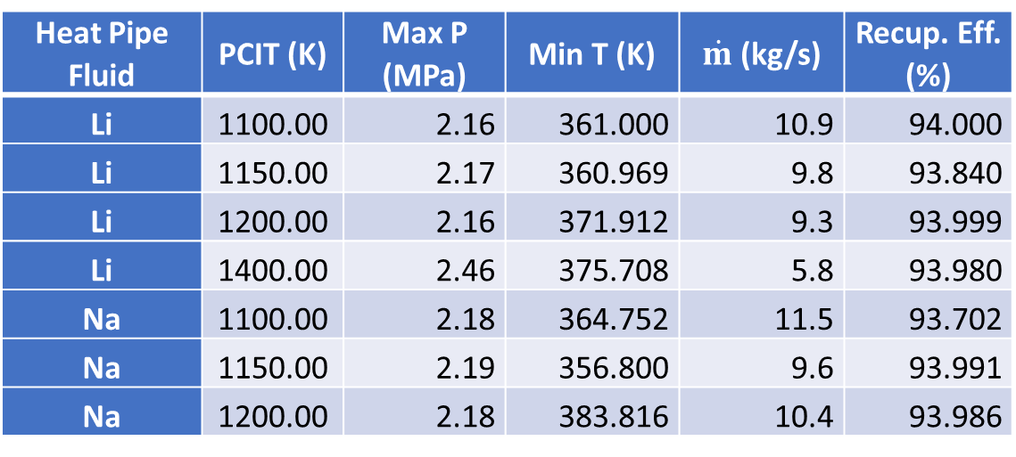
Thermodynamic Optimization
A thermodynamic optimization model was executed to optimize the system mass.
Optimization cases evaluated:
  Sodium:
    1100 K PCIT
    1150 K PCIT
    1200 K PCIT
  Lithium:
    1100 K PCIT
    1150 K PCIT
    1200 K PCIT
    1400 K PCIT
Heat Pipe Fluid | PCIT (K) | Max P (MPa) | Min T (K) | $\dot{m}$ (kg/s) | Recup. Eff. (%)
Li | 1100.00 | 2.16 | 361.000 | 10.9 | 94.000
Li | 1150.00 | 2.17 | 360.969 | 9.8 | 93.840
Li | 1200.00 | 2.16 | 371.912 | 9.3 | 93.999
Li | 1400.00 | 2.46 | 375.708 | 5.8 | 93.980
Na | 1100.00 | 2.18 | 364.752 | 11.5 | 93.702
Na | 1150.00 | 2.19 | 356.800 | 9.6 | 93.991
Na | 1200.00 | 2.18 | 383.816 | 10.4 | 93.986
Optimization parameters include:
  Maximum system pressure
  Turbine pressure ratio
  Mass flow rate
Notes:
Based on the mass curve fits from the previous slide, a Power conversion System thermodynamic model was evaluated to optimize the system mass.
These cases have been evaluated for both lithium and sodium. Due to the higher operating temperature of lithium, 1400 K PCIT was included.
The optimization parameters included the maximum system pressure, turbine pressure ratio, and the mass flow rate.
This table summarizes some of the resulting parameters for each considered case.

Slide 13
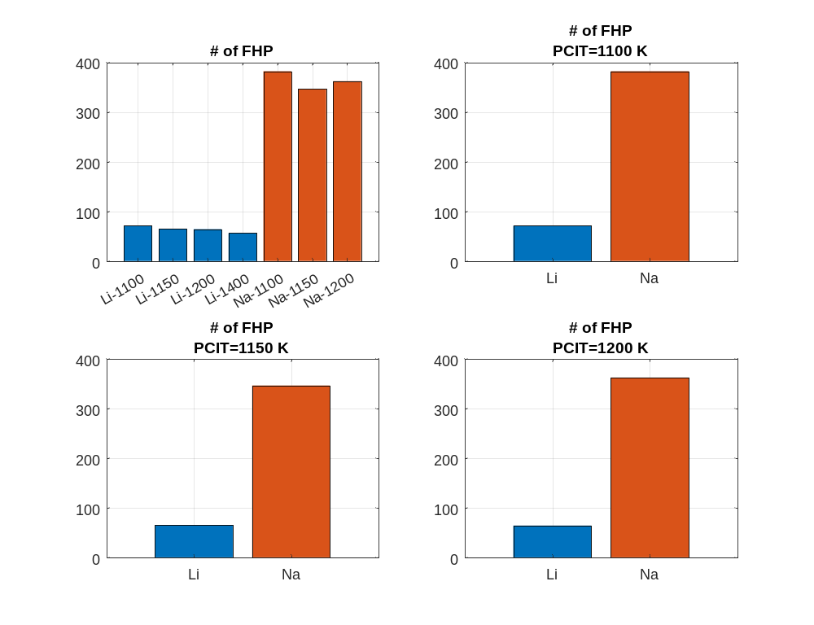
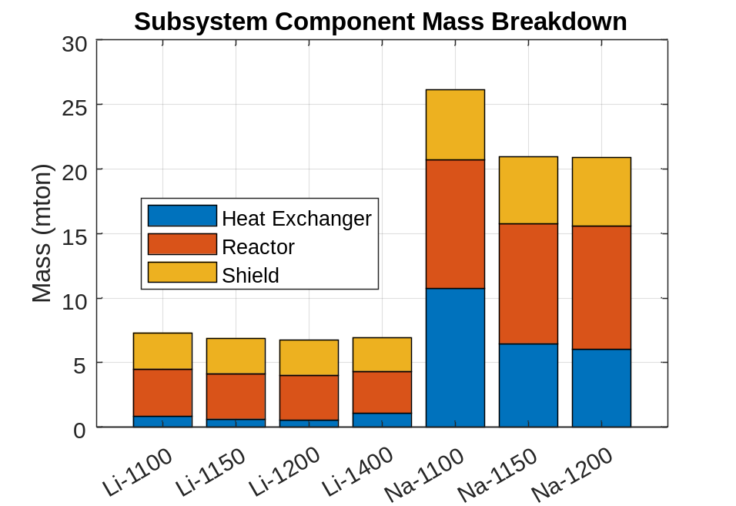
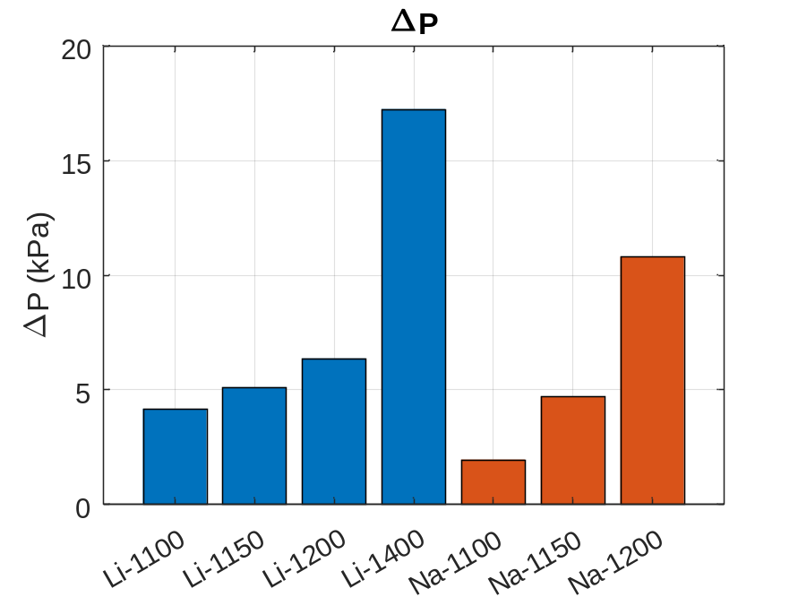
Detailed Component Level Results
A detailed component level model evaluated the cycle given thermodynamic optimization results.
The electrical power level produced is 2 MWe at a maximum system pressure of 2.2 MPa.
Na subsystems result in 5X the heat pipes of Li subsystems.
This results in 3X the mass of Li subsystems.
Low PCIT Na subsystems pressure losses are lower than Li subsystems.
Higher PCIT increase pressure losses due to increased volumetric flow rates.
Notes:
Sodium and lithium were evaluated as different fluids inside the heat pipes as well as different PCITs with the pairs shown on the x-axes.
A detailed component level model evaluated the cycle given the optimum thermodynamic operation and producing a net power of 2 MWe with an average maximum system pressure of 2.2 MPa.
The outcome is that sodium results in 5 times more heat pipes than lithium which yields 3 times the mass of lithium systems.
The low temperature sodium case results in pressure losses that are lower than the lithium case at the same temperature while the higher temperature case results in higher pressure losses due to the increased volumetric flow rates. Following this, the 1400 K lithium case results in the highest pressure losses of all evaluated cases.

Slide 14
Conclusions/Future Work
Conclusions
  Na heat pipes yield to high mass subsystems due to increased number of heat pipes over Li subsystems.
  Higher PCIT yield to higher pressure losses.
  Low PCIT Na-based subsystems result in low pressure losses.
Future Work
  Experiment to better understand noble gas mixture heat transfer through tube banks
  Explore variable heat pipe geometries
Notes:
This work concludes that sodium heat pipes result in high mass heat pipe-reactor-heat exchanger subsystems due to the increased number of heat pipes over lithium.
Higher power conversion inlet temperatures result in higher pressure losses while lower temperatures result in lower pressure losses due to lower volumetric flow rates.
Future work should include an experiment to better understand noble gas mixture heat transfer through tube banks and explore variable heat pipe geometries.

Slide 15
References
[1] MyHeatSinks. Standard Heat Pipes. MyHeatSinks, Inc., , 2022.
[2] Zohuri, B. Heat Pipe Design and Technology: Modern Applications for Practical Thermal Management. Springer International Publishing : Imprint: Springer, Cham, 2016.
[3] Levy, E. K. “Theoretical Investigation of Heat Pipes Operating at Low Vapor Pressures.” Journal of Engineering for Industry, Vol. 90, No. 4, 1968, pp. 547–552. https://doi.org/10.1115/1.3604687.
[4] Deverall, J. E., Kemme, J. E., and Florschuetz, L. W. Sonic Limitations and Startup Problems of Heat Pipes. Publication LA4518. Los Alamos Scientific Laboratory, Los Alamos, NM, 1970.
[5] Tien, C. L., and Chung, K. S. “Entrainment Limits in Heat Pipes.” AIAA Journal, Vol. 17, No. 6, 1979, pp. 643–646. https://doi.org/10.2514/3.61190.
[6] Churchill, S. W. “Friction-Factor Equation Spans All Fluid-Flow Regimes.” Journal of Chemical Engineering, Vol. 84, No. 24, 1977, pp. 91–92.
[7] Nikitaev, Dennis, Smith, Corey D., and Palomares, Kelsa. Summary of the Comparison of Convective Heat Transfer Correlations. Presented at the Nuclear Emerging Technologies for Space, Cleveland, OH, 2022.
[8] Busse, C. A. “Theory of the Ultimate Heat Transfer Limit of Cylindrical Heat Pipes.” International Journal of Heat and Mass Transfer, Vol. 16, No. 1, 1973, pp. 169–186. https://doi.org/10.1016/0017-9310(73)90260-3.
[9] El-Genk, M. S., and Tournier, J.-M. P. “USES OF LIQUID-METAL AND WATER HEAT PIPES IN SPACE REACTOR POWER SYSTEMS.” Frontiers in Heat Pipes, Vol. 2, No. 1, 2011. https://doi.org/10.5098/fhp.v2.1.3002.
[10] King, D. B., and Marshall, A. C. RSMASS-D Nuclear Thermal Propulsion and Bimodal System Mass Models. Presented at the AIP Conference Proceedings Volume 387, Albuquerque, New Mexico (USA), 1997.
[11] Zukauskas, A. and Ulinskas, R. Heat Transfer in Tube Banks in Crossflow. United States, 1988.
[12] El-Genk, M., and Gallo, B. High Performance Brayton Rotating Unit (UNM-BRU-3) for Space Reactor Power Systems. Presented at the 7th International Energy Conversion Engineering Conference, Denver, Colorado, 2009.
[13] Mayorca, M. A. Numerical Methods for Turbomachinery Aeromechanical Predictions. Dissertation. Royal Institute of Technology, Stockholm, Sweden, 2011.

Slide 16

Thank you for Watching!!!
Contact Information:
Dennis Nikitaev
dennis.d.nikitaev@ama-inc.com
www.ascend.events

