Slide 1
CFD For Capsule Design
Dinesh K. Prabhu
AMA, Inc. at NASA Ames Research Center
Thermal and Fluids Analysis Workshop (TFAWS 2022)
September 6-9, 2022

Slide 2
CFD for Aerothermal Design of Capsules for Atmospheric Entries at the Ice Giants
Dinesh K. Prabhu
AMA, Inc. at NASA Ames Research Center
Thermal and Fluids Analysis Workshop (TFAWS 2022)
September 6-9, 2022

Slide 3
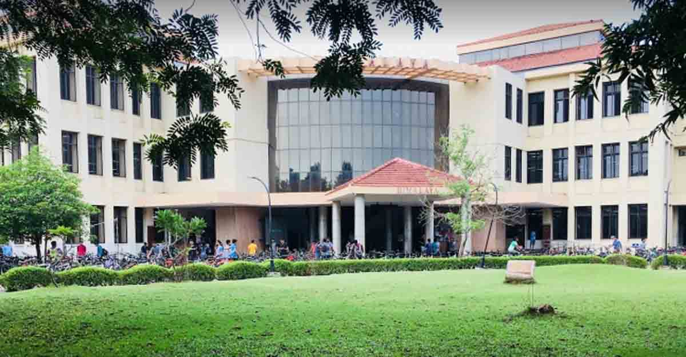

Speaker Bio
B. Tech. (Aero. E.): Indian Institute of Technology, Madras, India
M. S. & Ph. D. (Aero. E.): Iowa State University, Ames, Iowa
  Dissertation: A new parabolized Navier-Stokes code for chemically reacting flow fields
  Advisors: Prof. John Tannehill (ISU), (late) John Rakich (NASA ARC), and Joseph Marvin (NASA ARC)
Worked at NASA Ames Research Center, California and at National Aerospace Laboratories, India
Projects: X-33 (SSTO), X-37 (Wing Leading Edge), Space Shuttle Orbiter (High AoA aerodynamics and Return-To-Flight), TSTO, Entry System Architecture Study, CEV/MPCV/Orion, ADEPT, SIAD, MSL, Mars2020, MSR-SRL, Arc jet & Ground Test, and numerous other projects (several canceled ☹) & proposals (some wins ☺)

Slide 4
Need Knowledge Of…
Destination
  Estimate of entry kinetic energy and comparison with chemical bond energies
Entry vehicle geometry
  Shape (aerodynamic drag) and size (drag area), which along with mass => ballistic coefficient
Trajectory (or trajectories)
  Dispersions – either due to entry state or atmospheric uncertainties and/or aerodynamics
Computing tools
  Code for flow fields (and radiation fields, if applicable)
  Materials thermal response codes
Examples
Scaling laws
  Pressure
  Convective heat flux

Slide 5
Exploration of the Outer Planets
Destination | Comments
Jupiter | Pioneer 10 (NASA/1973) Pioneer 11 (NASA/1974) Voyager 1 & 2 (NASA/1979) Galileo (NASA/1995) - in situ measurements of the atmosphere Juno (NASA/2016)
Saturn | Pioneer 11 (NASA/1979) Voyager 1 (NASA/1980) Voyager 2 (NASA/1981) Cassini (NASA/2004-17)
Uranus | Voyager 2 (NASA/1986)
Neptune | Voyager 2 (NASA/1989)
Jupiter also studied in missions using gravity assists (e.g., Cassini 2000)
Cassini de-orbited and entered Saturn atmosphere, but no atmospheric measurements
Juno will be de-orbited for entry into Jupiter

Slide 6
Some Characteristic of the Outer Planets
Destination | Esc. Vel. km.s⁻¹ | Rot. Vel. km.s⁻¹ | Ent. Vel. km.s⁻¹ | Rel. Vel. km.s⁻¹ | Ref. KE MJ.kg⁻¹ | Composition (by vol.) | BDE MJ.kg⁻¹ | Ion. potential MJ.kg⁻¹
Jupiter | 60.2 | 12.29 | 59.89 | 47.6 | 1133 | 90:10 (H₂:He) | H₂: 31.1 CH₄: 25.9 | He: 592.7 H₂: 738.4 H: 1302
Saturn | 36.09 | 9.54 | 37.54 | 28 | 392 | 95:5 (H₂:He)
Uranus | 21.38 | -2.57 | 22.57 | 20.0 | 200 | 85:15 (H₂:He)
Neptune | 23.56 | 2.67 | 27.67 | 25.0 | 313 | 80:20 (H₂:He)
Entering a planet’s atmosphere in the direction of its spin, i.e., prograde entries, is beneficial – reduced aerothermal environments due to reduced velocity (atmosphere relative)
Max. benefit of planet rotation is at the equator – benefit drops off as cosΛ (Λ is the latitude)
Retrograde entry at Saturn ≈ Prograde entry at Jupiter!!!
Retrograde entry at Neptune ≈ Prograde entry at Saturn
For Ice Giants, entry kinetic energy insufficient to ionize any gas species – convective heating dominates & no radiative heating until entry velocities > 27 km/s

Slide 7
Atmospheric Structure
Julianne I. Moses, L. N. Fletcher, T. K. Greathouse, G. S. Orton, V. Hue, Icarus, 307, 2018, Pages 124-145.
G. A. Allen, Jr., M. J. Wright, and P. Gage, NASA TM-2004-212847, 2005.
Agrawal, et al., “Atmospheric entry studies for Uranus,” IEEE Aerospace Conference, 2014
URANUS
NEPTUNE
Reference altitude of Z = 0 km is pegged at 1 bar (1000 mbar) pressure
Tropopause at either planet is ≈0.1 bar (100 mbar) [Robinson, T., Catling, D. Nature Geosci 7, 12–15 (2014). https://doi.org/10.1038/ngeo2020]
Mission Science (descent probe) is from 0.1 bar to 10 bar (RF transmission decreases with increasing pressure)

Slide 8
Atmospheric Composition
Julianne I. Moses, L. N. Fletcher, T. K. Greathouse, G. S. Orton, V. Hue, Icarus, 307, 2018, Pages 124-145.
URANUS
NEPTUNE
Chemical modeling of the atmospheres shows no CH₄ at Uranus and 0.0015 mole of CH₄ at Neptune
“Unmixing” of the Uranian atmosphere occurs much deeper than expected – He mole fraction varies with altitude
For initial analysis purposes, we can assume $X_{H_{2}}:X_{He}$= 0.85:15 (Uranus) and$X_{H_{2}}:X_{He}$ = 0.82:0.18 (Neptune)

Slide 9
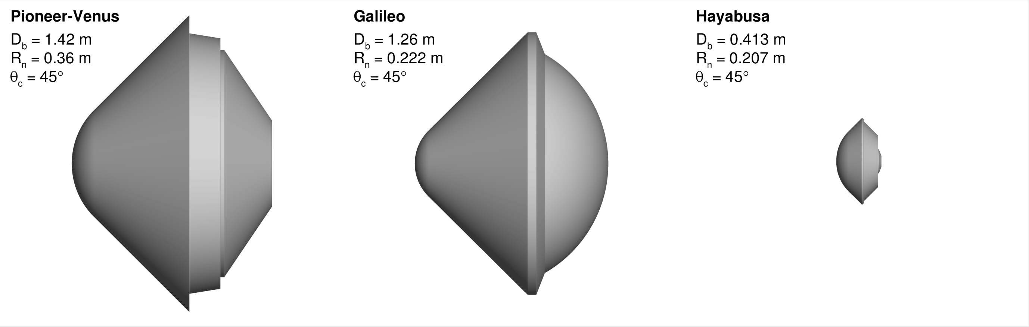
Capsule Geometries
NASA, “Planetary Mission Entry Vehicles: Quick Reference Guide, v4.0,” NASA SP-20220010761, 2022.
A 45° blunted cone is the configuration of choice for exploration of planetary atmospheres whose ambient densities provide sufficient resistance to the entry capsule
  A 45° sphere-cone has good dynamic stability characteristics
The DeepSpace2 probe (on Mars Polar Lander) was also a 45° sphere-cone
Galileo probe the only one with flight heritage for Outer Solar System planet entries
The ratio R_{n}:R_{b} is not necessarily 0.5, which is often assumed
  A sharper nose is preferred if shock-layer radiation is the dominant heating mechanism – q_{Rad} ≈ √R_{n}
  A blunter nose is preferred if convective heating is the dominant mechanism – q_{Conv} ≈ 1/√R_{n}

Slide 10
Trajectories (1/3): General Ideas
Entries (direct or from orbit) for Gas/Ice Giants are almost always ballistic (no lift => α = 0° for axisymmetric geometries)
Simple view: atmospheric density reduces the velocity magnitude & gravity turns the velocity vector
For the restrictive case of no change in flight path angle and an isothermal atmosphere:
  The product $ρ_{∞}^{a}V_{∞}^{b}$ reaches a maximum when $V_{∞}=V_{E}\exp\left(−\frac{a}{b}\right)$
    Peak convective heating ($∝ρ_{∞}^{0.5}V_{∞}^{3}$) occurs when $V_{∞}=V_{E}\exp\left(−\frac{1}{6}\right)≅0.85V_{E}$
    Peak stagnation pressure ($∝ρ_{∞}V_{∞}^{2}$) occurs when $V_{∞}=V_{E}\exp\left(−\frac{1}{2}\right)≅0.61V_{E}$
For a single flight trajectory time histories of relevant physical quantities rather easy to compute
  Discretize the heat pulse and stagnation pressure times histories for flow computations (continuum or other)
For multiple trajectories (including atmospheric dispersions, aerodynamic uncertainties, uncertainties in entry state, …) need to delink trajectories from environments
  Tacit assumption: there isn’t substantial shape change (due to material recession) – certainly not true for Jupiter entries, but useful assumption for Ice Giant entries

Slide 11
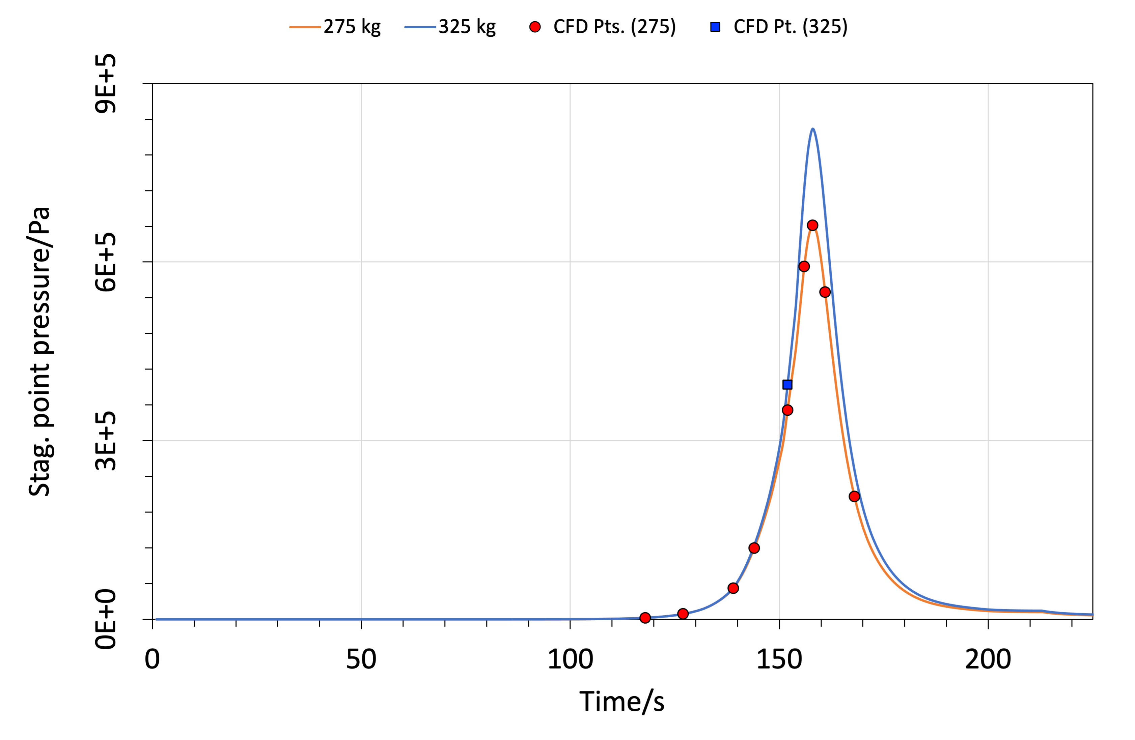
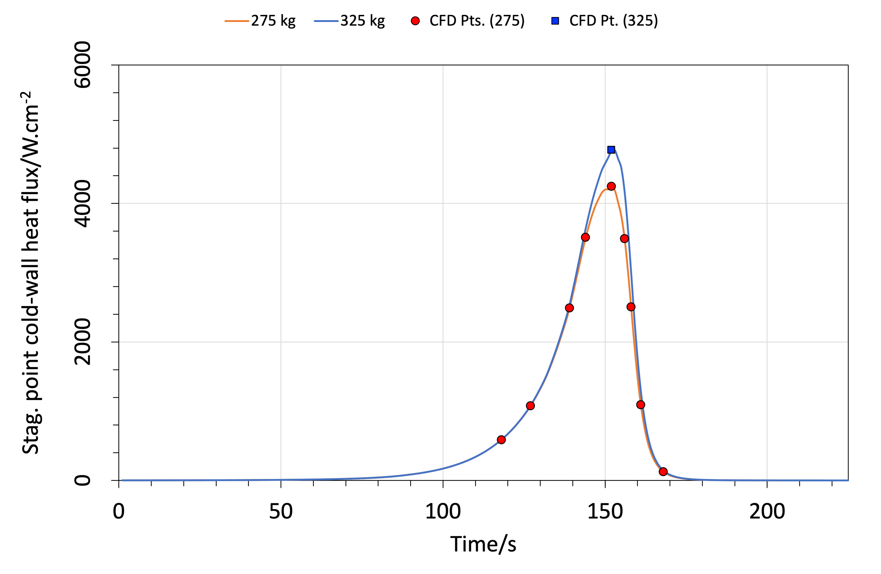
Trajectories (2/3): Single Trajectory Example
PRESSURE PULSE
HEAT PULSE
$$q_{stag}(t)=K_{1}\frac{\sqrt{ρ_{∞}\left(t\right)}}{\sqrt{R_{n}}}V_{∞}^{3}(t)$$
$$p_{stag}(t)=ρ_{∞}(t)V_{∞}^{2}(t)$$
Newtonian impact theory
Strictly for first-order boundary layer

Slide 12
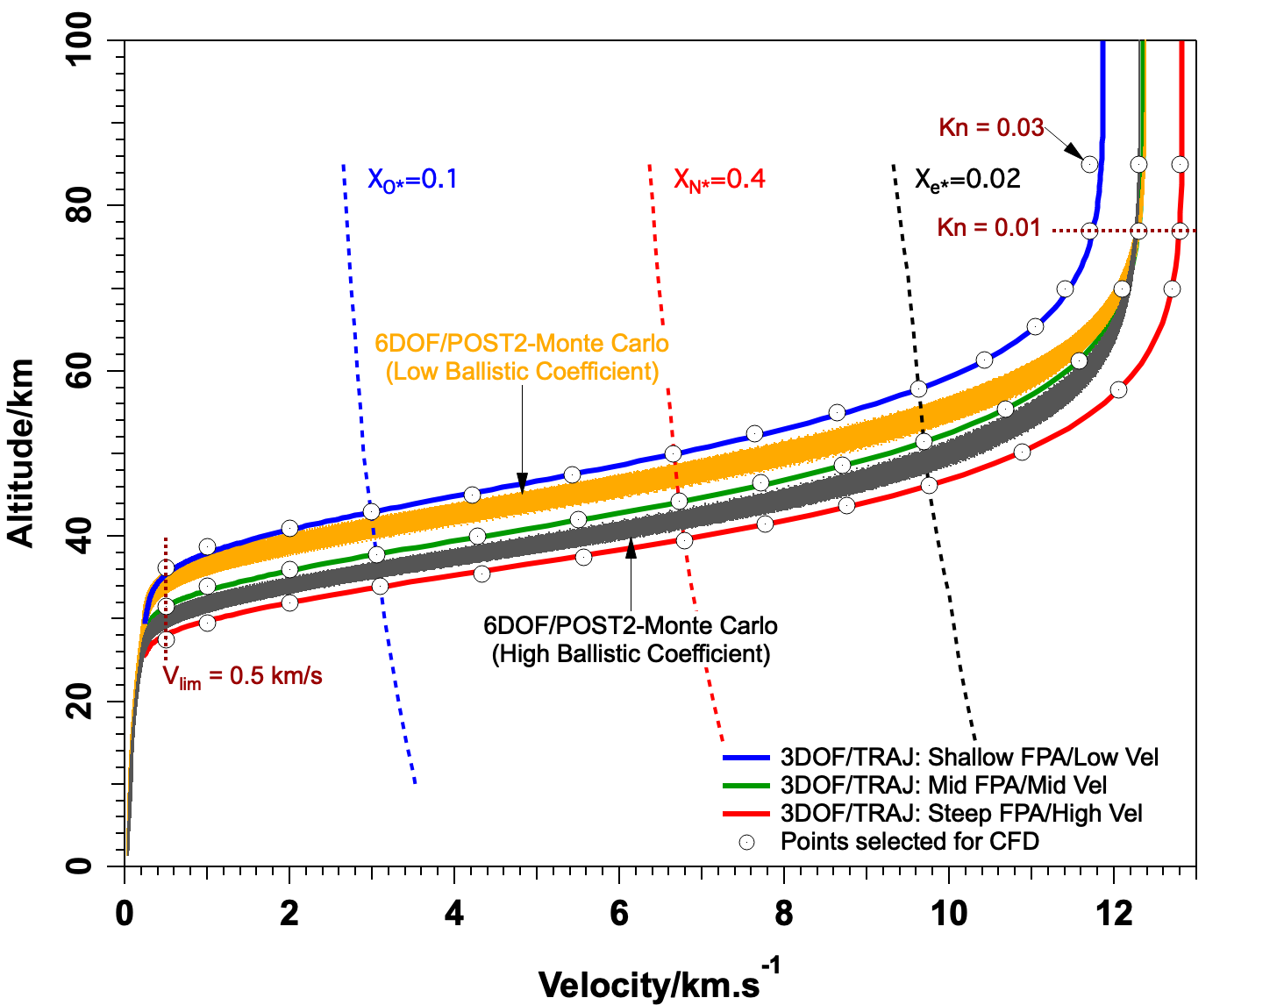
Trajectories (3/3): Design Space Example
Discretize the density (equiv. altitude)-velocity space as desired for flow computations
  For lifting entries, each point in the $ρ_{∞}$-$V_{∞}$ space could have several angles of attack!
Impose upper and lower limits $ρ_{∞}$-$V_{∞}$ space
  Upper limit – Knudsen number cutoff
    $Kn=λ/{R_{n}}≤0.01$
    $λ$ is the mean free path & $R_{n}$ is a characteristic length (=nose radius)
    Limit value of 0.01 is subjective, but represents a limit up to which the continuum approximation holds
  Lower limit – Mach number cutoff ($M_{∞}$ > 1?)
    $M_{∞}>1$ is also subjective and depends on the choice of flow solver [how best to handle diminishing compressibility of flow medium]
Additional guides provided by equilibrium estimates of post-shock chemical composition

Slide 13
Flow Modeling: General Ideas
Continuum vs. Non-continuum
  Use ${Kn}_{∞}={λ_{∞}}/{R_{n}}<0.003$ as a rough limit for continuum flow [${Kn}_{∞}$ is the freestream Knudsen number,$λ_{∞}$= $\left(\frac{μ_{∞}}{ρ_{∞}}\right)\sqrt{\frac{π}{2RT_{∞}}}$is the mean free path , and $R_{n}$is the nose radius]
List of species (H₂, H, He, & CH₄ and its dissociation products, if needed)
Chemistry mechanism and reaction rates (chemical kinetics)
Thermodynamic properties of species and mixture
Laminar and Turbulent transport properties/models of species and mixture
Wall boundary conditions
  Cold vs. Hot
  Recombinative efficiency or “catalytic” efficiency vs. equilibrium
  Surface roughness

Slide 14
Some General Ideas
The entry problem is all about transformation of energy between thermal, chemical, radiative, and kinetic energies and energy management (thermal protection)
Total enthalpy ($H$) of the gas is the “energy” that is referred to above
$$H=\overset{Thermal}{\overbrace{\sum_{s=1}^{n_{s}}{Y_{s}h_{s}(T)}}}+\overset{Chemical}{\overbrace{\sum_{s=1}^{n_{s}}{Y_{s}∆_{f}^{o}H_{s}}}}+\overset{Kinetic}{\overbrace{\frac{1}{2}u∙u}} \left\{\begin{matrix}Y_{s} & mass fraction of s \\ ∆_{f}^{o}H_{s} & enthalpy of formation of s at STP \\ h_{s} & thermal enthalpy of s \\ T & temperature \\ u & velocity vector\end{matrix}\right.$$
Notes:
  Usually, thermal enthalpy content in the ambient gas is negligibly small compared to the kinetic energy and chemical energy except for the case of CO₂ atmospheres (Venus and Mars) – CO₂ has $∆_{f}^{o}H_{s}≅−9$ MJ/kg
  Atmospheric entry – ambient gas is (bow) shock heated, high KE in the freestream is reduced post-shock & chemical and thermal energy is increased; chemical energy is recovered at the surface
  Arc jet testing – low KE ambient gas is arc heated; dissociated gas acquires KE in a convergent-divergent nozzle, but reduces thermal energy due to expansion; KE reduced again behind bow shock around the test article
September 8, 2022
TFAWS 2022
14

Slide 15
Mass Conservation
Wright, M. J., unpublished work (based partly on work of Stallcop et al., JTHT, 12(4), 1998)
Mass conservation equation of species s for a steady flow
$$∇∙\left(ρuY_{s}\right)=∇∙\sum_{s=1}^{n_{s}}{ρ𝒟∇Y_{s}}+{\dot{ω}}_{s}$$
$$\begin{matrix}ρ & mixture mass density \\ u & velocity vector \\ Y_{s} & mass fraction of species s \\ n_{s} & number of species in the mixture \\ 𝒟 & mass diffusion coefficient \\ {\dot{ω}}_{s} & mass production rate of species s\end{matrix}$$
Need models for $𝒟$ and ${\dot{ω}}_{s}$
  Mixture is at best binary – H₂, He – or at worst ternary – H₂, H, He. Using a constant Schmidt number ($Sc =\frac{μ}{ρ𝒟}$, $μ$is the coefficient of viscosity of the mixture ) is okay in initial computations, or collision integral $Ω^{(1,1)}$
  Need chemistry mechanism & kinetics to develop production rate of species s.
September 8, 2022
TFAWS 2022
15

Slide 16
Chemistry Mechanism and Kinetics
Leibowitz, L.P., Physics of Fluids, 16(1), 1973, pp. 59-68
Leibowitz, L.P. and Kuo, T.J., AIAA Journal, 14(9), 1976, pp. 1324-1329
Currently rely on mechanism and rates developed by Leibowitz
$$\begin{matrix}H_{2}+M & ⇌ & H+H+M & dissociation \\ H+H & ⇌ & H^{+}+e^{−}+H & associative ionization \\ H+He & ⇌ & H^{+}+e^{−}+He & associative ionization \\ H+e^{−} & ⇌ & H^{+}+e^{−}+e^{−} & direct ionization \\ H+e^{−} & ⇌ & H^{+}+e^{−}+e^{−} & two−step ionization \\ He+e^{−} & ⇌ & {He}^{+}+e^{−}+e^{−} & direct ionization \\ He+e^{−} & ⇌ & {He}^{+}+e^{−}+e^{−} & two−step ionization\end{matrix}$$
Reactions are written in the endothermic direction (energy supply direction)
Reaction rates are in modified Arrhenius form
$$k_{f}\left(T\right)=AT^{n}\exp\left(−\frac{T_{a}}{T}\right)$$
  Activation temperature from heats of reaction (assuming no thermal barriers)
September 8, 2022
TFAWS 2022
16

Slide 17
Momentum Conservation
Svehla, R. A., NASA TR R-132, 1962, and NASA TM 4647, 1995
Wright, M. J., unpublished work (based partly on work of Stallcop et al., JTHT, 12(4), 1998)
Momentum conservation equation for a steady flow
$$∇∙\left(ρuu\right)=−∇p+∇∙T$$
$$\begin{matrix}p=\frac{ρℜT}{ℳ} & pressure \\ T=μ\left[∇u+{\left(∇u\right)}^{t}\right] & stress tensor\end{matrix}$$
$$\begin{matrix}ℜ & molar gas constant=8.3144\frac{J}{mol.K} \\ ℳ & mixture molar mass \\ μ & mixture coefficient of viscosity\end{matrix}$$
Viscosity of each species from collision integrals $Ω^{(2,2)}$ - classical approach is to use Lennard-Jones 6-12 potential
Viscosity of the mixture from mixing rule – either Wilke or Gupta-Yos
September 8, 2022
TFAWS 2022
17

Slide 18
Energy Conservation
Gordon, S. & McBride, B., NASA RP-1311, June 1996
Bruno, D. et al., Phys. Plasmas 17, 112315 (2010)
Colonna, G. et al., Int. J. Hydrogen Energy 37, 9656-9668 (2012)
Energy conservation equation for a steady flow
$$∇∙\left(ρuH\right)=\overset{Diffusive}{\overbrace{∇∙\overset{Thermal}{\overbrace{\left[κ∇T\right]}}+∇∙\overset{Chemical}{\overbrace{\left(\sum_{s=1}^{n_{s}}{\left[h_{s}\left(T\right)+∆_{f}^{o}H_{s}\right]ρ𝒟∇Y_{s}}\right)}}}}$$
  A constant amount of enthalpy can be added or subtracted from above equation without changing the balance
    Useful idea if $∆_{f}^{o}H_{s}$ of dominant species is negative, e.g., CO₂ has $∆_{f}^{o}H_{s}≅−9$ MJ/kg
  IF viscous terms are small (high Reynolds number), then
$$∇∙\left(ρuH\right)=0 ⟹ ρu∙∇H=0$$
    Total enthalpy is a constant – a result that is useful in defining the boundary layer edge
  Species enthalpy is from curve fits
    NASA Lewis fits have 200 K lower limit on temperature – linear extrapolation of enthalpy at low temperature end
    Bruno et al. fits have 50 K lower limit on temperature – preferred fits for Ice Giant entries

Slide 19
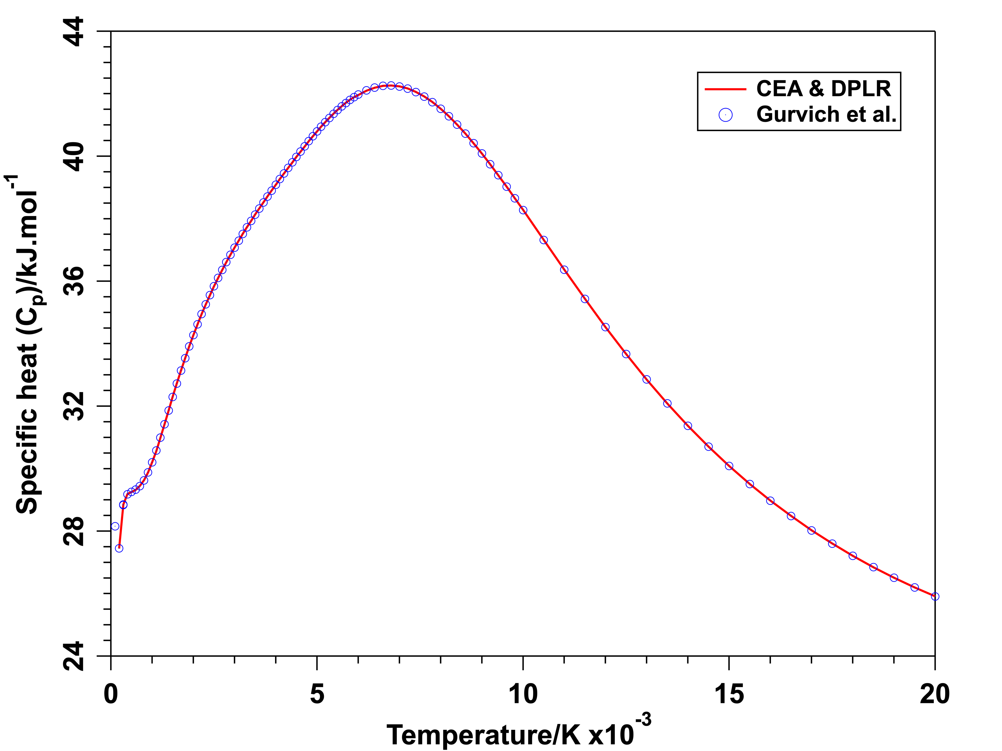
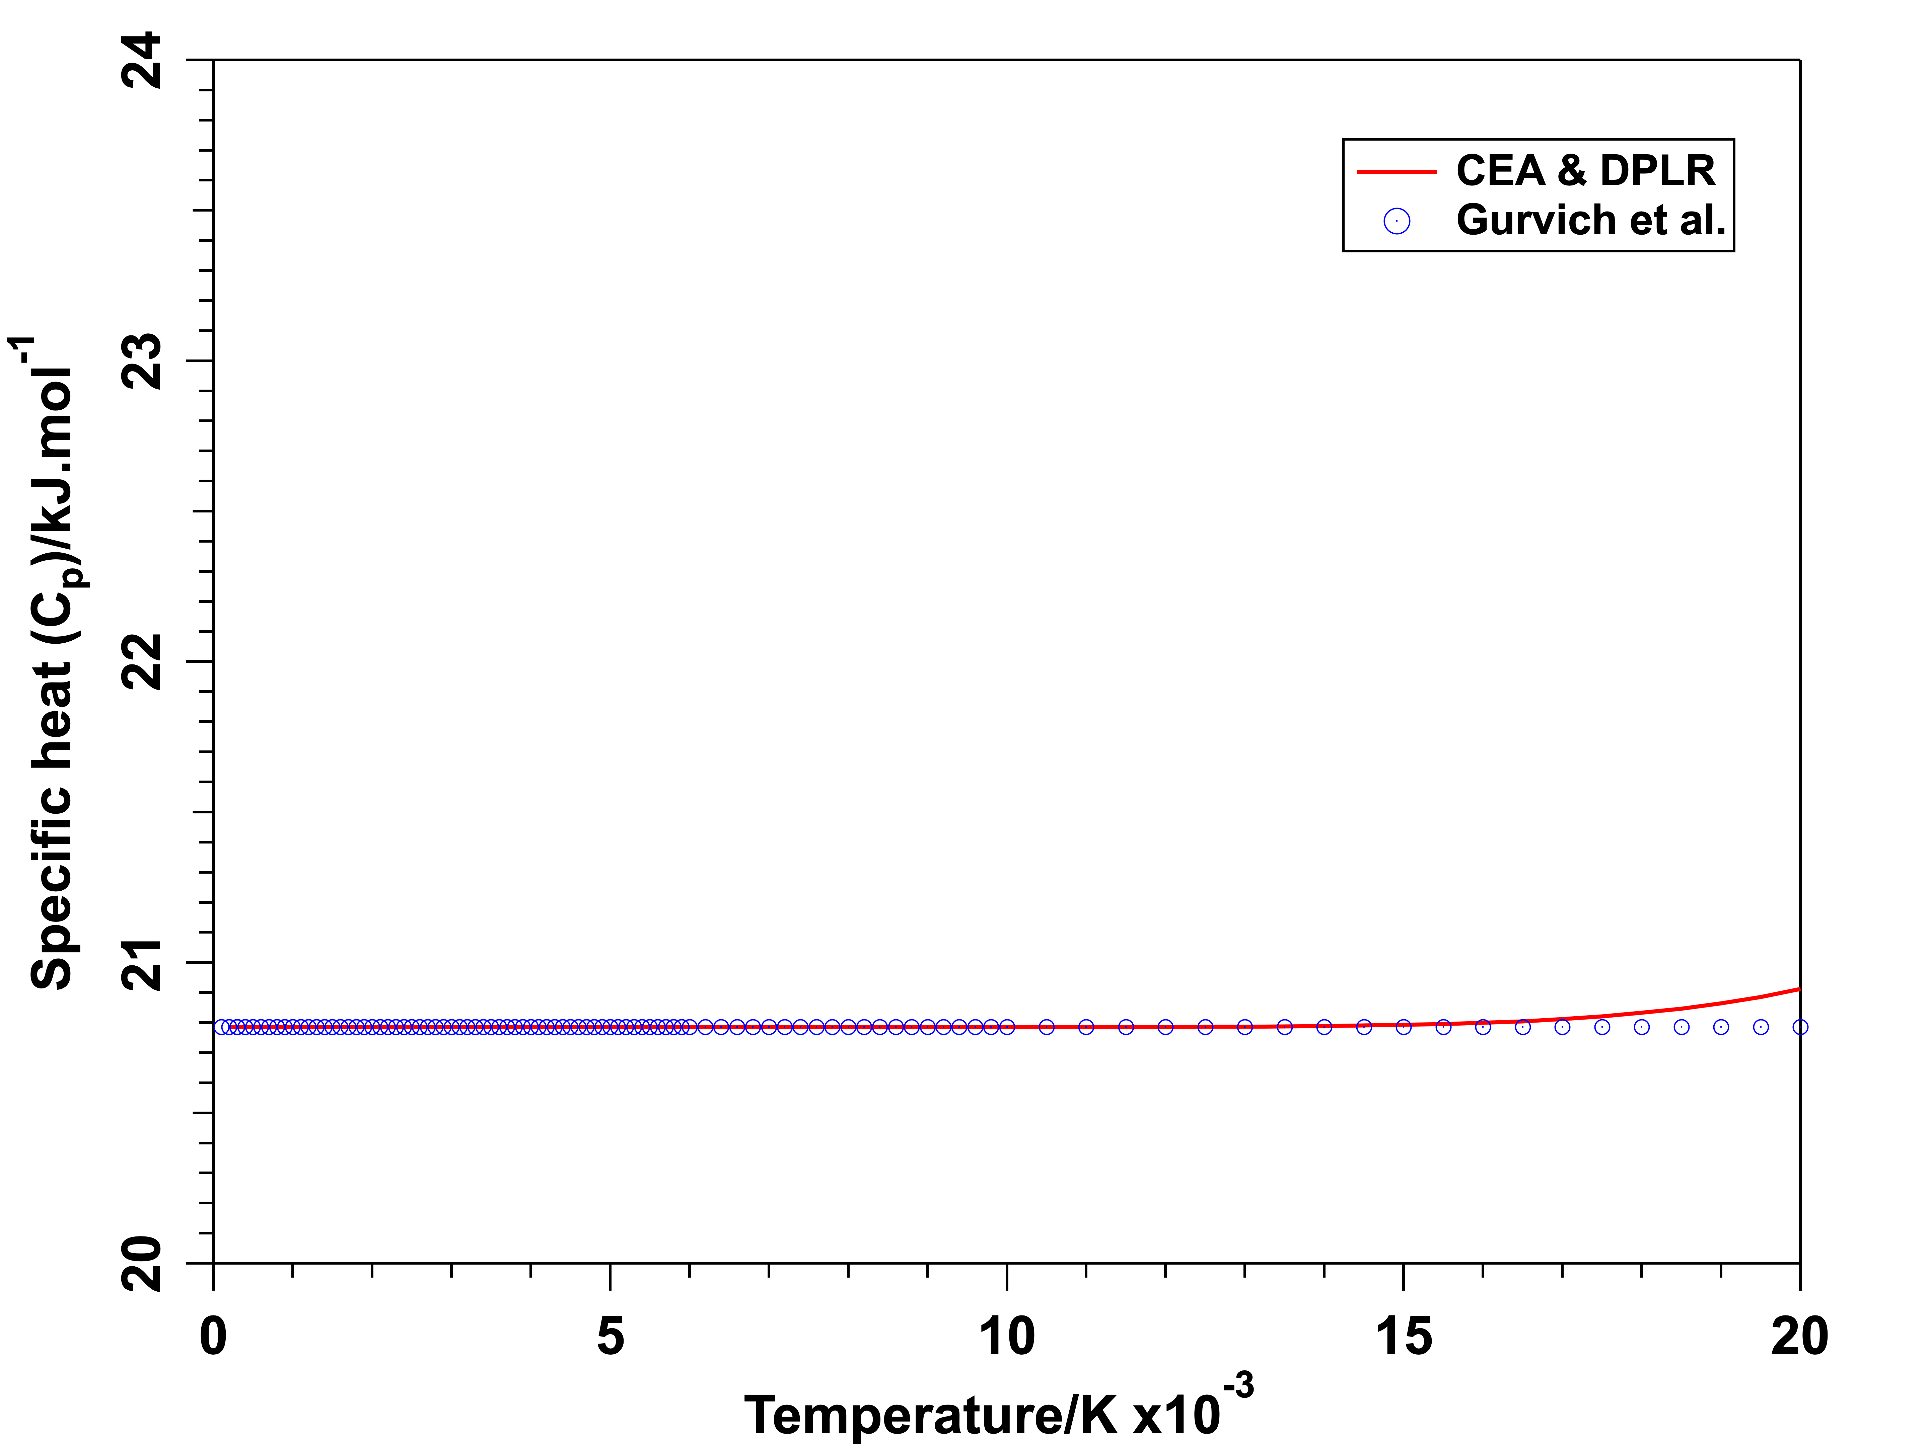
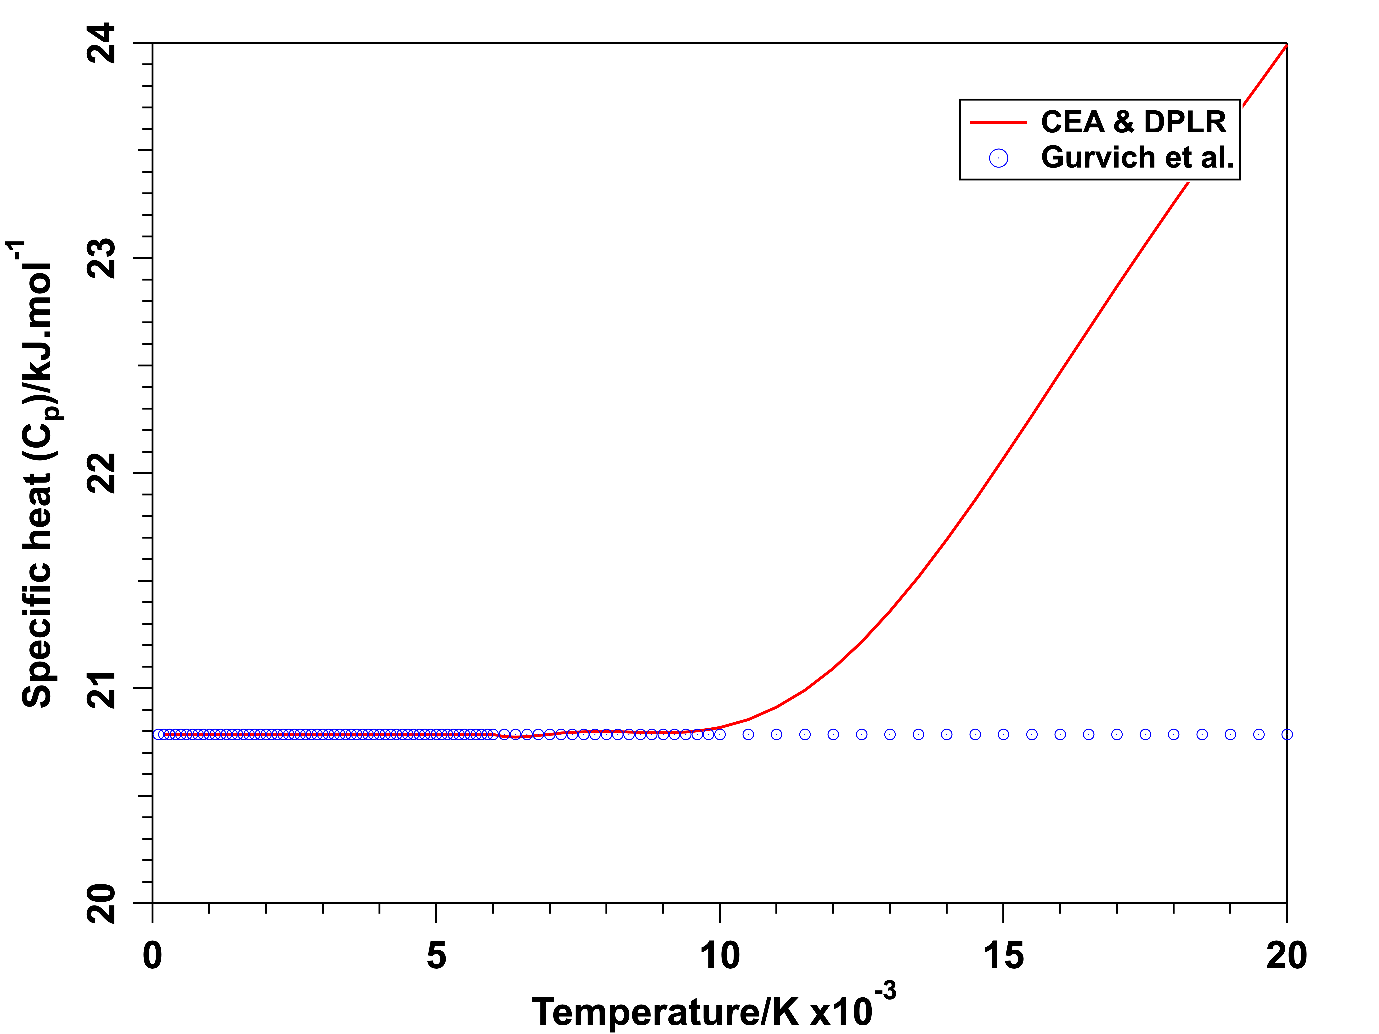
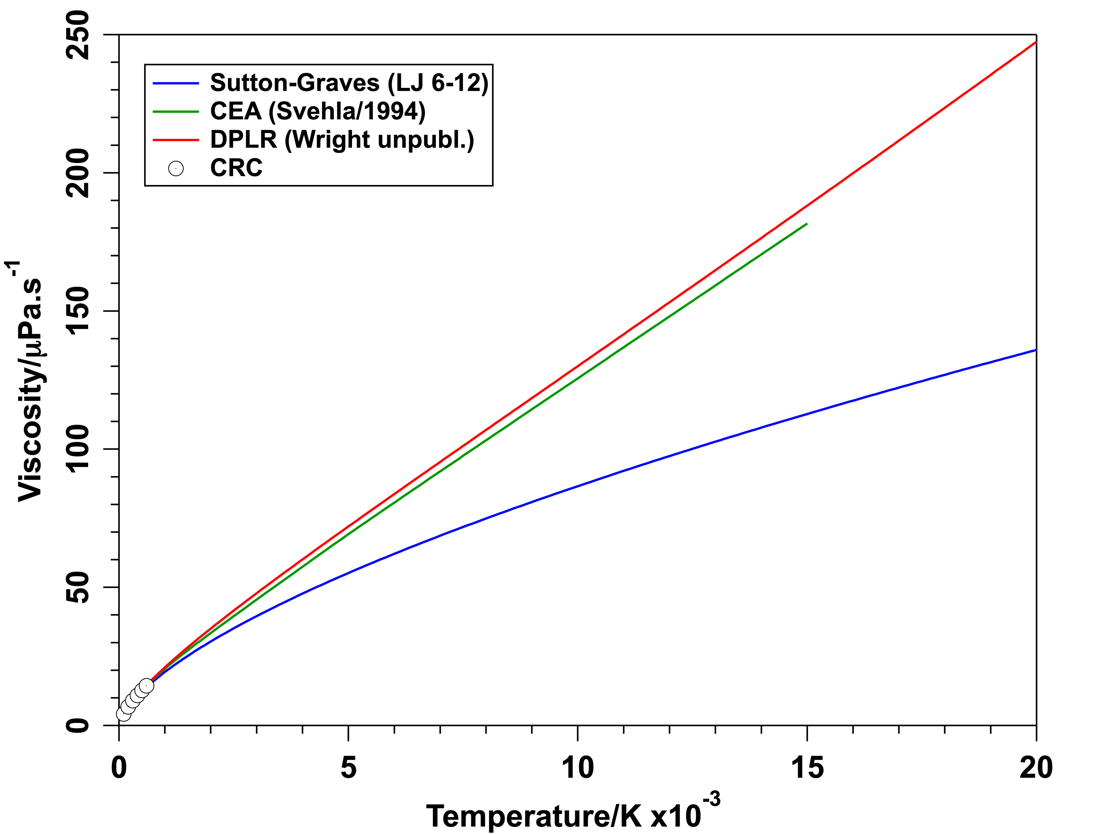
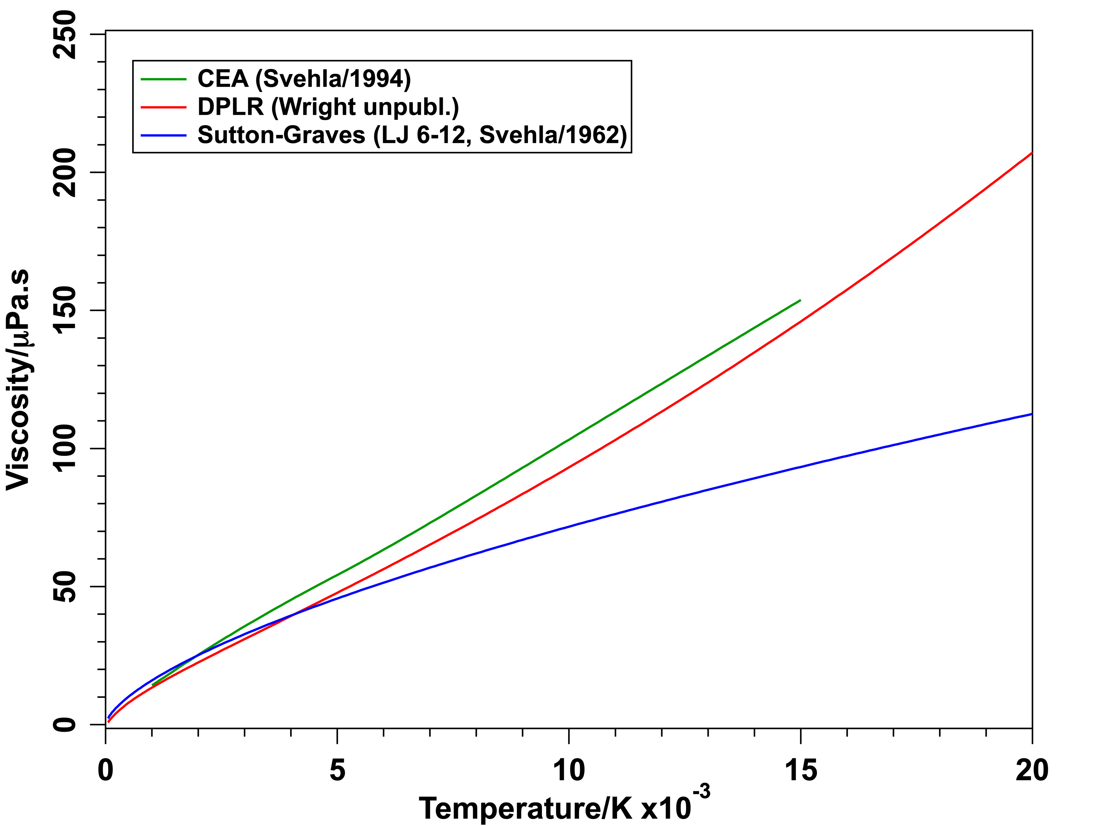
Thermodynamics and Transport Properties
Gurvich et al., Thermodynamic Properties of Individual Substances, Vol. 1/Part 2, Hemisphere Publishing, 1986
Svehla, R. A., NASA TR R-132, 1962, and NASA TM 4647, 1995
Wright, M. J., unpublished work (based partly on work of Stallcop et al., JTHT, 12(4), 1998)
CRC Handbook of Chemistry and Physics, 84th ed., 2003-2004, p. 6-184.
Thermodynamic Properties – Specific Heat [$C_{p}$]
H₂
He
H
Transport Properties – Viscosity [$κ=μC_{p}/Pr$]

Slide 20
Wall Boundary Conditions
Three types of walls
  Cold wall – wall temperature fixed at 298 K (usually), but species chemistry allowed to float
    The efficiencies could be temperature dependent and would be different for different materials
  Hot wall – wall temperature AND species chemistry allowed to float, usually conduction into the material is ignored
    $q_{thermal}+q_{chemical}=ε_{w}σ\left(T_{wall}^{4}−T_{sink}^{4}\right)$ where $ε_{w}=ε(T)$ is the emissivity and $σ$ is the Stefan-Boltzmann constant
  What is the wall composition ($Y_{s,w}$)?
    Atoms are allowed to recombine (with consequent heat release), but gradients of mass of molecular species are set to zero
      $H_{2}←H+H$ $[{∆H}_{r}^{o}=−436\frac{kJ}{mol}]$
      $\frac{∂}{∂n}He=0$
  For either kind of wall, atom recombination reactions are modeled as 1st-order gas-phase reactions, usually without being tempered by the corresponding equilibrium constant
    Percentage completion of recombination reaction is controlled by the efficiency parameter γ; γ = 1 is a fully “catalytic” wall and γ = 0 is a “noncatalytic wall”
    The efficiencies could be temperature dependent and would be different for different materials
  Equilibrium wall – wall composition is determined by $p_{wall}$ and $T_{wall}$ (fixed or floating)
    Works well in most cases except for CO₂ flow over a cold wall – CO + O has a significant thermal barrier

Slide 21
“Catalysis”
In principle, there is no thermal barrier to the reaction $H_{2}←H+H$
No issue with this recombination for a cold wall – all recombination heat of reaction is recovered at the wall
There could be a problem with the hot-wall boundary condition, esp. if no conduction into the wall material is considered
The flux of H atoms recombining at the surface is
$$j_{H,w}=ρ_{H,w}γ_{H}\sqrt{\frac{ℜT_{w}}{2πℳ_{H}}}$$
$0≤γ_{H}≤1$ is the recombination efficiency (or “catalytic” efficiency)
  Depends on the material
  Could also be temperature dependent
Recombination is in the gas phase, but reaction is not tempered by the equilibrium constant
  Predicted wall temperatures could be higher than the sublimation temperature of carbon

Slide 22
Transition & Roughness
Saunders, D. A., and Prabhu, D. K., BLAYER User Guide, NASA TM 2018 – 219749, 2018
Aerothermal design databases are usually constructed assuming fully turbulent flow – conservative approach
Could some of that conservatism be reduced through considering flow transition?
Two considerations:
  Smooth wall – transition due to instability of the wall-bounded shear layer
    Reynolds number based on momentum thickness is one criterion
    $${Re}_{θ}(r;t)=\frac{ρ_{e}(r;t)u_{e}(r;t)θ(r;t)}{μ_{e}(r;t)}>250$$
  Rough wall – sandgrain roughness-based criterion
  $${Re}_{kk}(r;t)=\frac{ρ_{k}(r;t)u_{k}(r;t)k}{μ_{w}(r;t)}>200$$
    Viscosity is evaluated at the wall because roughness is part of the wall. Criterion is based on smooth-wall CFD
    Roughness develops in time, but usually assumed constant over the entire flight
Use BLAYER code to determine edge, and boundary-layer parameters (thicknesses)

Slide 23
Definition or Problem Statement
Aerothermal environments mean temporal & spatial distributions of physical quantities that are required for selection, sizing, testing/qualification of materials that make up the thermal protection system around the atmospheric entry vehicle/capsule
The required physical quantities, for widely used materials response code, e.g., FIAT, are:
  Pressure ($p$)
  Convective film coefficient ($C_{H}$)
    Laminar, transitional, or turbulent
    Hot wall or cold wall
    Catalycity
    Smooth wall or rough wall
  Radiative heat flux ($q_{Rad}$)
  Recovery enthalpy ($H_{rec}$)
Optional physical quantity of interest is:
  Surface shear ($τ$)
$$C_{H}=\frac{q_{Conv}}{H_{rec}−h_{w}}$$
$$H_{rec}=H_{e}+\frac{r−1}{2}u_{e}^{2} r={Pr}^{ς}$$
$$ς=\left\{\begin{matrix}1/2 & laminar \\ 1/3 & turbulent\end{matrix}\right.$$
September 8, 2022
TFAWS 2022
23

Slide 24
Computing Tools
Volume grid generation software (usually commercial)
  Pointwise, Link3D, GridPro, …
  For simple geometries (with rotational symmetry), CAPSULE_GRID developed by D. Saunders (Ames) is sufficient
    An initial flow field solution is computed on the grid and the grid is progressively tailored so that the outer boundary conforms to the bow shock
High-temperature flow field computations
  DPLR, LAURA, FUN3D, US3D, …
  BLAYER to extract boundary-layer data from computed flow field
Radiation field computations
  NEQAIR, HARA, …
Materials thermal response computations
  FIAT, TITAN, PATO, …
The tools could be used standalone, or coupled together loosely
If there is substantial mass loss due to ablation, then trajectory codes (POST2, TRAJ, …) would have to be coupled too – Jovian entry would be a case in point

Slide 25
Features of High-Temperature Flow Field Codes
Chemistry
  Reaction mechanism & rates
Thermodynamic properties – curve fits or analytical expressions
  Atomic species and their ions (if necessary) – Translational energy (continuous) & electronic energy (discrete/quantal)
  Molecular species and their ions (if necessary) – Translational energy (continuous), rotational, vibrational, & electronic energy (discrete/quantal)
  Free electrons (if necessary)
Transport properties – curve fits or analytical expressions
  Coefficients of mass diffusion, viscosity, and thermal conductivity – collision integrals of pairs of species
Mixing rules for mixture properties
Models for turbulent transport of mass, momentum, and energy, perhaps including surface roughness
  Baldwin-Lomax, SST, or Spalart-Allmaras, …
Gas-Surface Interaction – “catalysis”
Blowing boundary conditions to consider injection of pyrolysis products from TPS material
September 8, 2022
TFAWS 2022
25

Slide 26
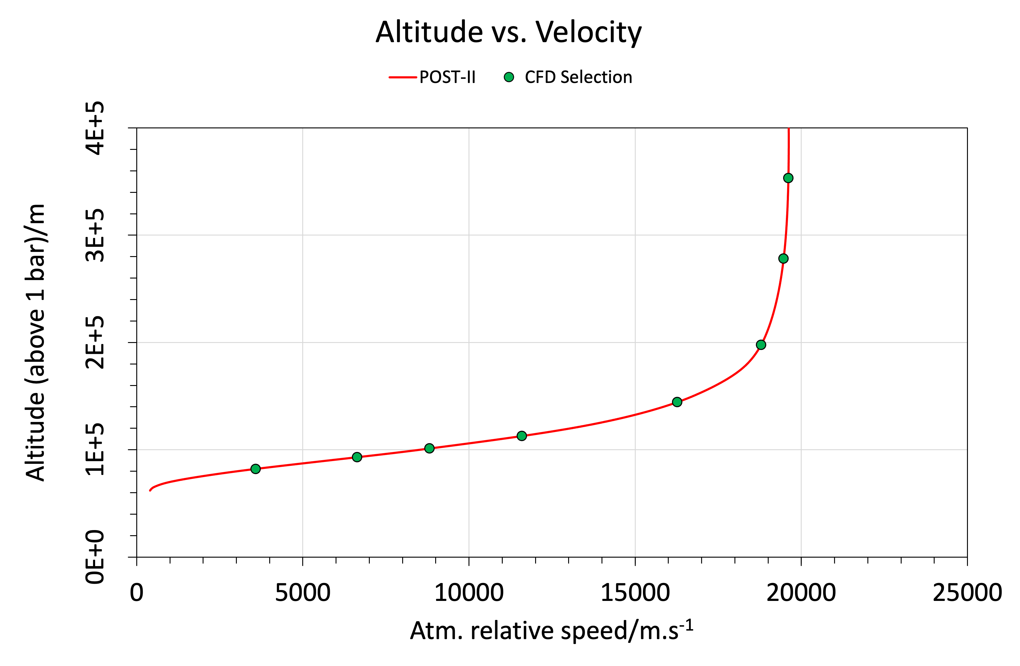
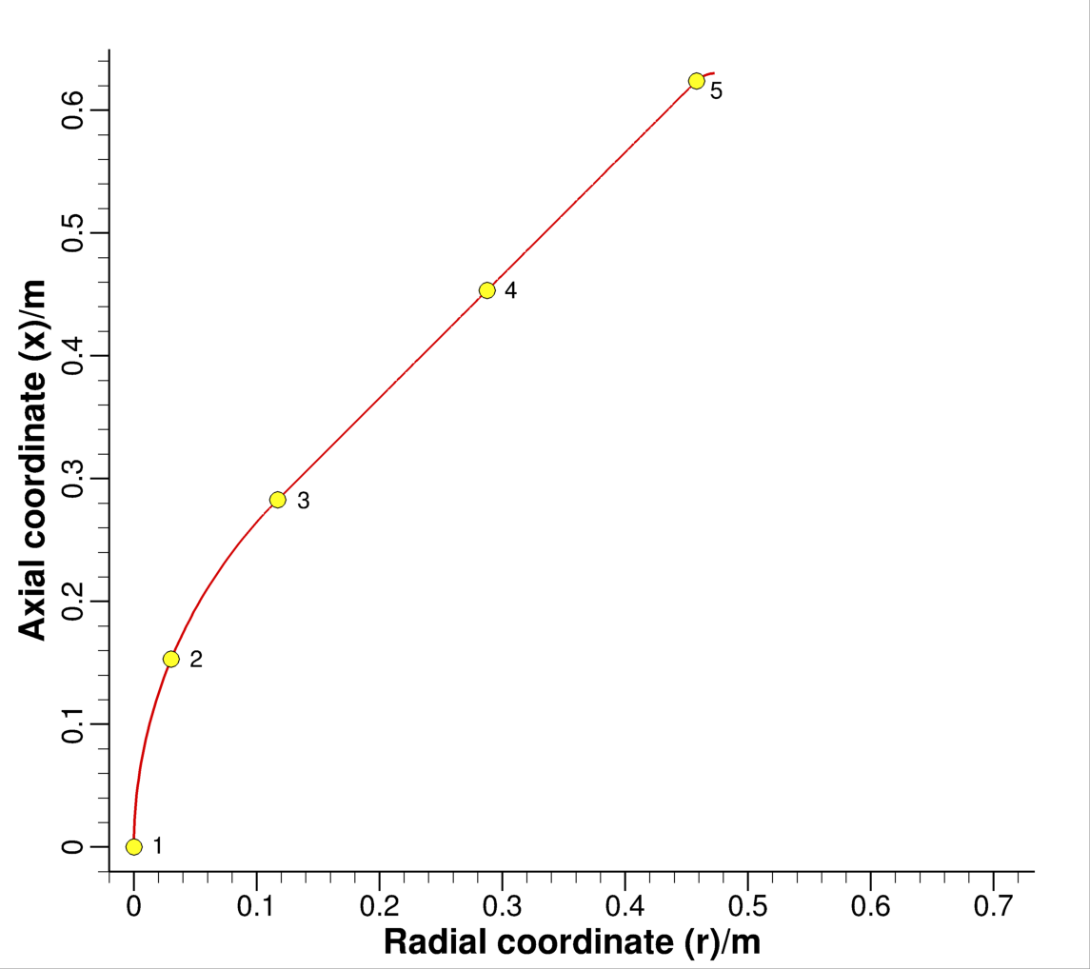

Example: Ice Giant Entry Probe
($Db$ = 1.26 m, $Rn$ = 0.35 m, $θc$ = 45°)
Probe Geometry
For initial design purposes 3DOF trajectories are sufficient, i.e., no capsule dynamics are involved
Design trajectory is usually the max. heat load trajectory – heat load is the time integral of the heat flux
Heat flux time history is usually referenced to the stagnation point

Slide 27
DPLR Predictions for Selected Time Points (1/2)
Temperature profiles along stagnation line are shown for each time point along the flight trajectory
  Near-wall magnification shows non-physical profiles for the fully catalytic wall case – wall temperatures > sublimation temperature of C
  Equilibrium wall profiles are better behaved – equilibrium is enforceable for cases with surface pressures greater than 1 bar
Turbulent flow unlikely at early time points – roughness enhancement has peculiarities (rough wall environments are lower than smooth wall!)
Best to use turbulent rough wall results for sizing – conservative thickness estimates

Slide 28
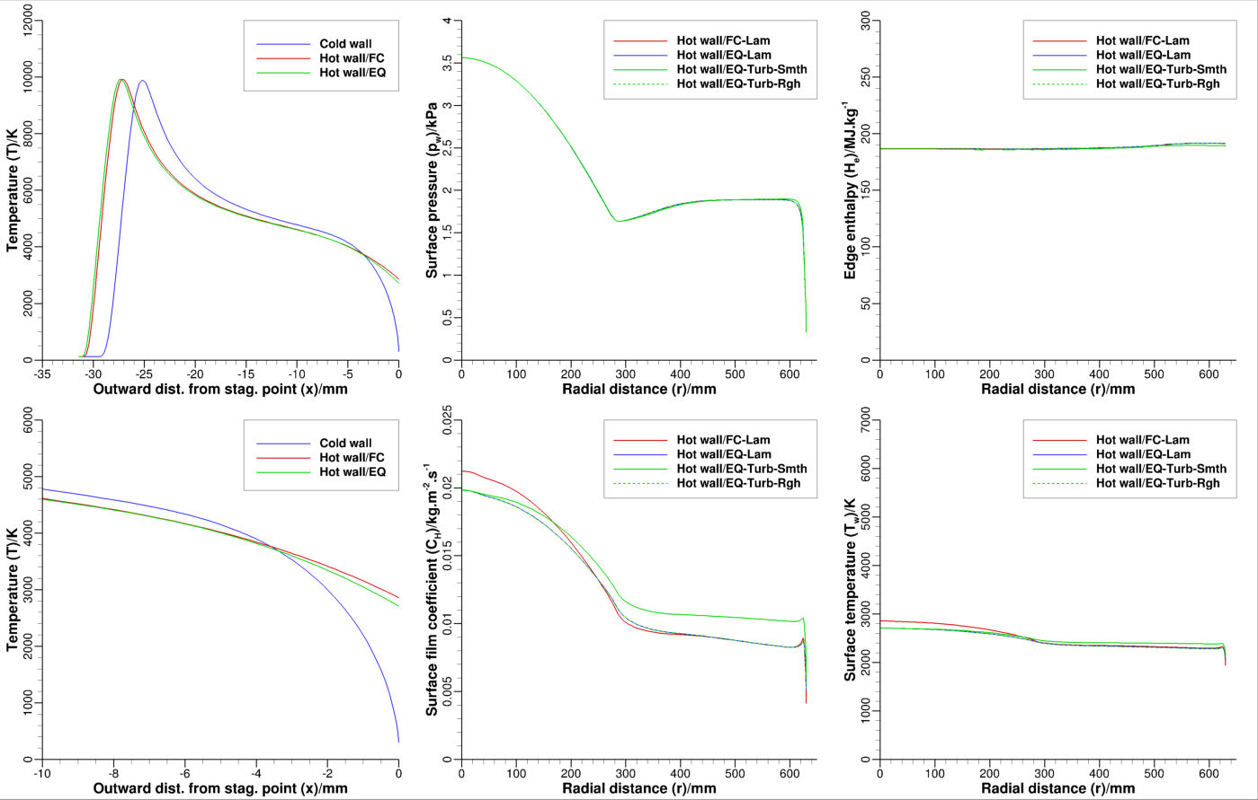
t = 177.6 s
Stag. line profile of T
Surface distributions of FIAT-relevant quantities
Turbulent rough wall calculation results are indistinguishable from laminar (counterintuitive, given turbulent smooth wall results are higher)
September 8, 2022
TFAWS 2022

Slide 29
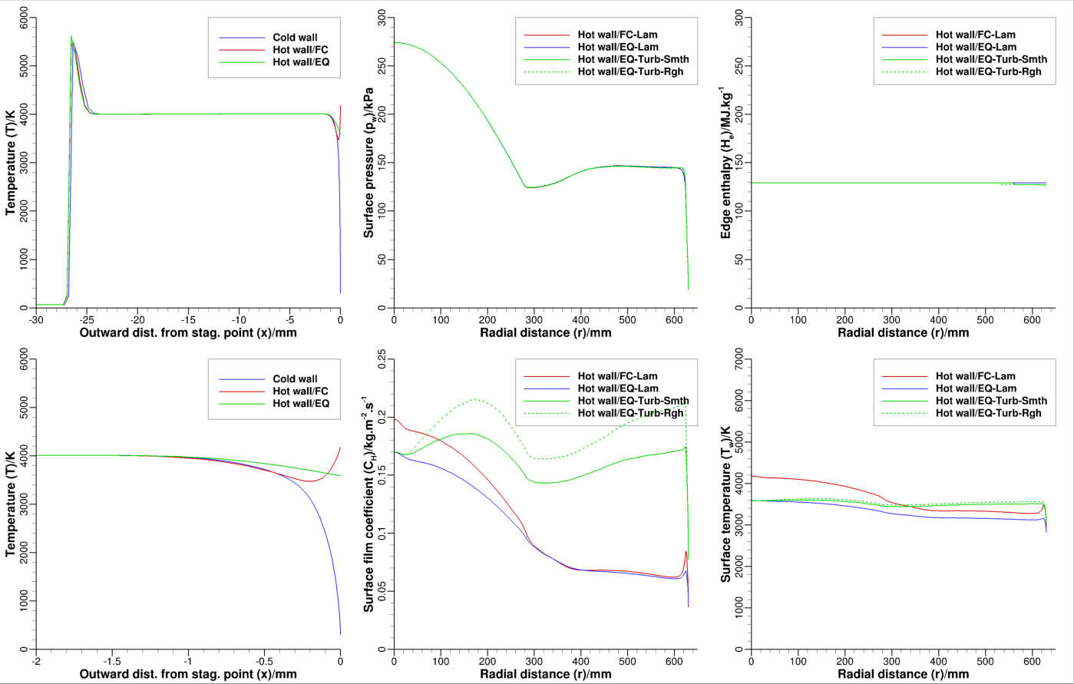
t = 202.6 s (Peak Heating Point)
Stag. line profile of T
Surface distributions of FIAT-relevant quantities
Temperature profile shows negative gradient at the wall – wall temperature > sublimation temperature of carbon
Turbulent rough wall calculation results are now clearly distinguishable from turbulent smooth wall results] – environments are turbulent – pressures are in excess of 1 bar (100 kPa) over wetted surface
September 8, 2022
TFAWS 2022

Slide 30
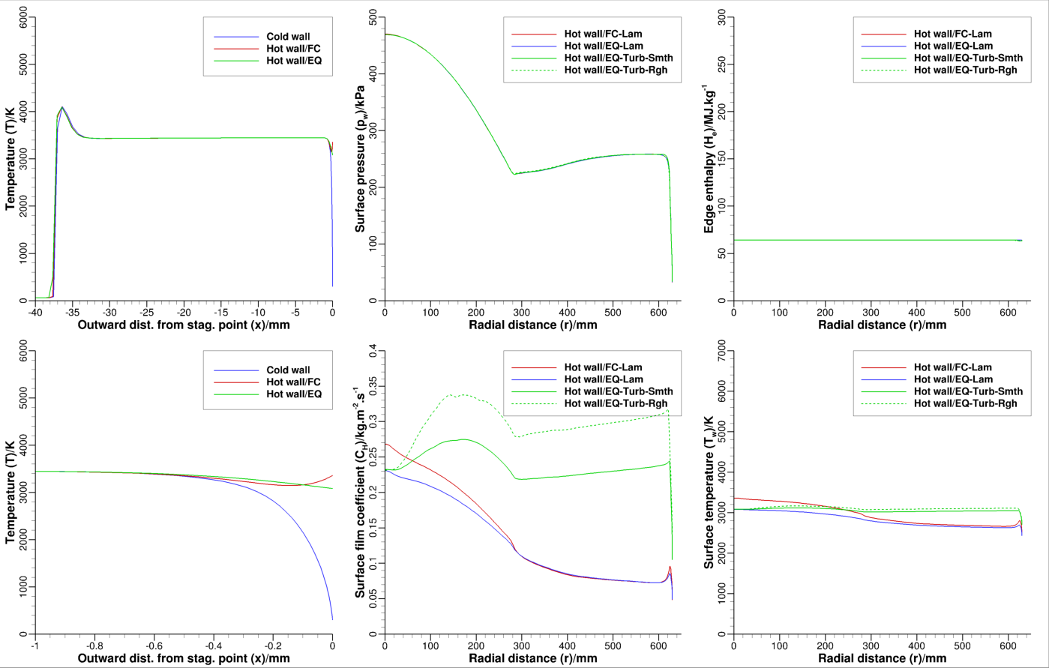
t = 207.7 s (Peak Dynamic Pressure Point)
Stag. line profile of T
Surface distributions of FIAT-relevant quantities
Temperature profile still shows negative gradient at the wall
Turbulent rough wall calculation results are now clearly distinguishable from turbulent smooth wall results] – environments are turbulent – pressures are in excess of 1 bar (100 kPa) over wetted area
September 8, 2022
TFAWS 2022

Slide 31
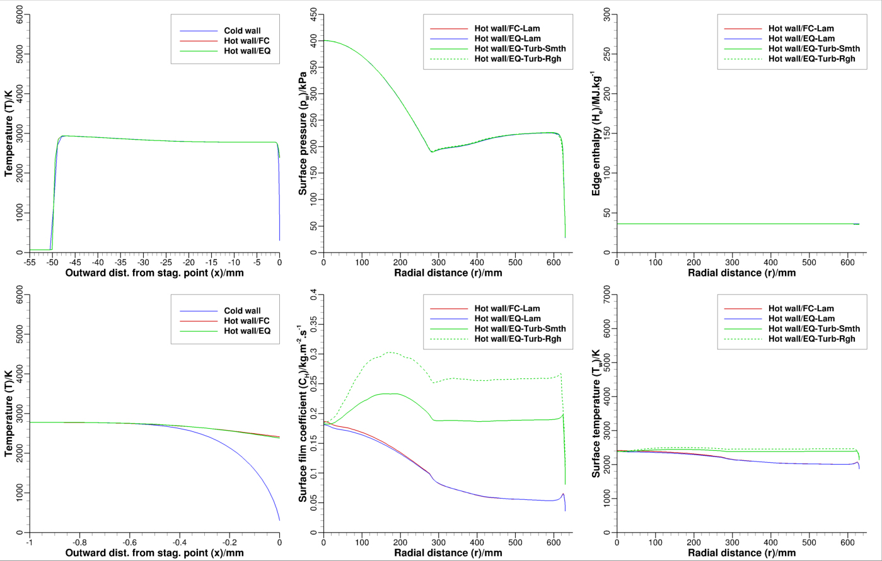
t = 210.3 s
Stag. line profile of T
Surface distributions of FIAT-relevant quantities
Temperature profiles for hot wall cases are now similar for equilibrium and fully-catalytic wall
Turbulent rough wall calculation results are now clearly distinguishable from turbulent smooth wall results] – environments are turbulent – pressures are in excess of 1 bar over wetted area
September 8, 2022
TFAWS 2022

Slide 32
DPLR Predictions for Selected Time Points (2/2)
Surface distributions of heat flux, shear stress, and Re_{kk} are shown
Cold-wall heat flux does not exceed 2200 W/cm²
Hot-wall shear does not exceed 2 kPa
Re_{kk} (k = 0.4 mm) exceeds 200 after t > 203 s
September 8, 2022
TFAWS 2022
32

Slide 33
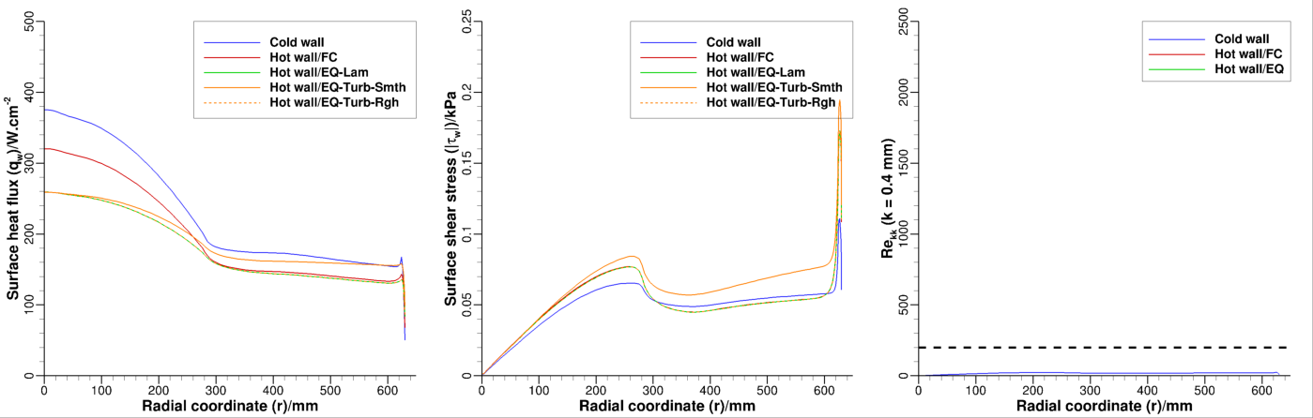
t = 177.6 s
Re_{kk} < 200 for entire wetted surface – flow laminar
Turbulent rough wall calculation results are indistinguishable from laminar (counterintuitive, given turbulent smooth wall results are higher)
September 8, 2022
TFAWS 2022

Slide 34
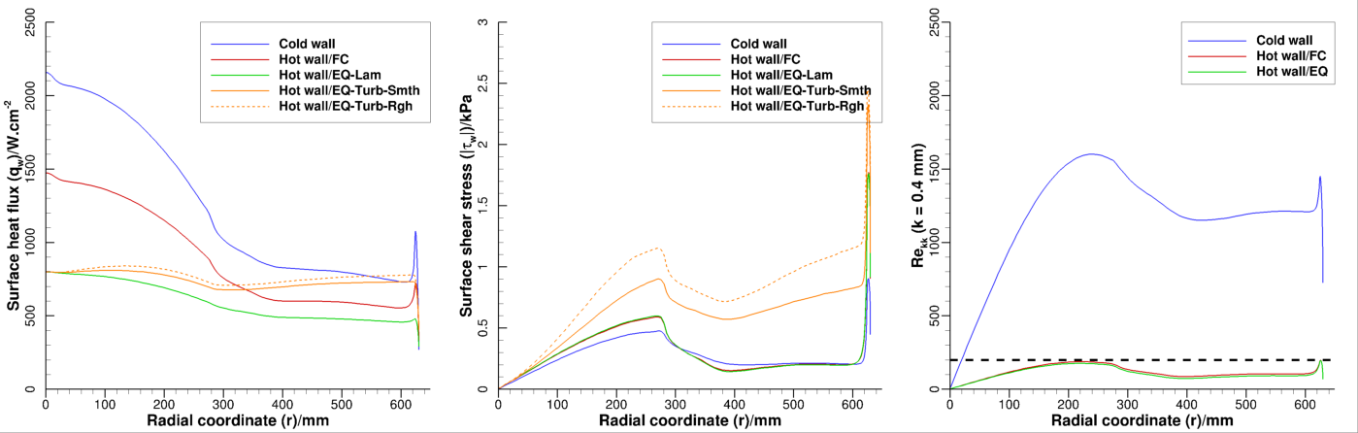
t = 202.6 s
Re_{kk} > 200 for nearly entire wetted surface cold-wall cases
Re_{kk} of 200 nearly reached at nose-cone junction for hot wall cases – flow likely transitions to turbulent
Turbulent rough wall calculation results are now clearly distinguishable from turbulent smooth wall results]
September 8, 2022
TFAWS 2022

Slide 35
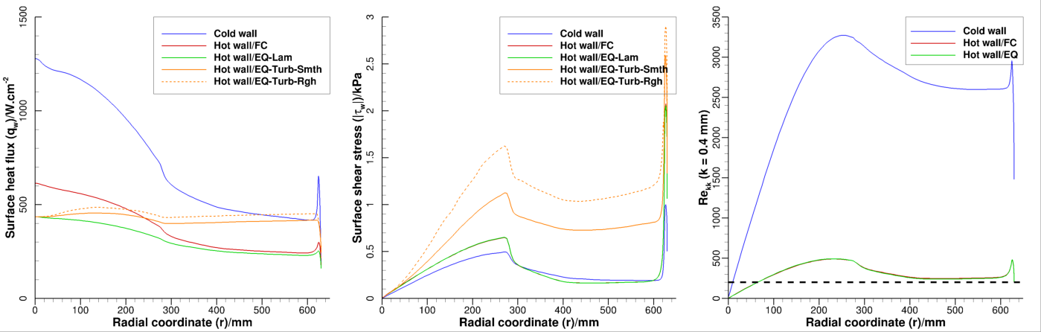
t = 207.7 s
Re_{kk} > 200 for all cases (hot or cold wall) – flow turbulent
Turbulent rough wall calculation results are now clearly distinguishable from turbulent smooth wall results]
September 8, 2022
TFAWS 2022

Slide 36
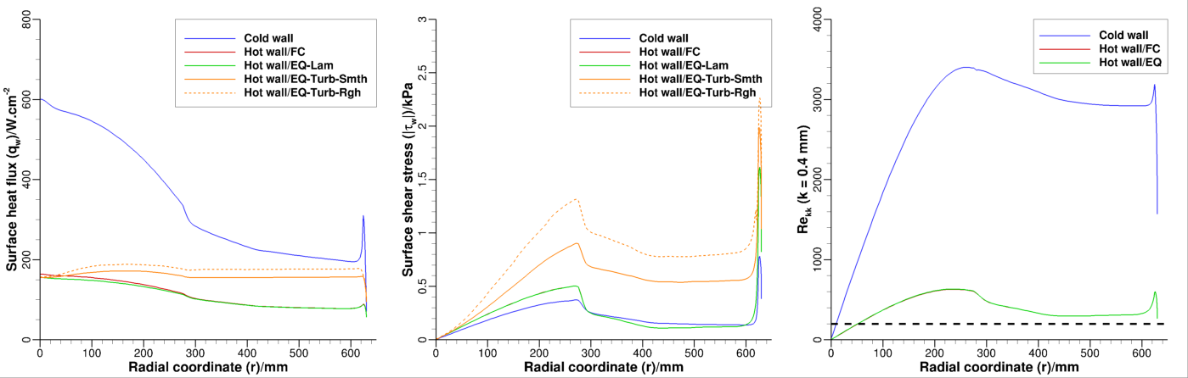
t = 210.3 s
Re_{kk} > 200 for all cases (hot or cold wall) – flow turbulent
Turbulent rough wall calculation results are now clearly distinguishable from turbulent smooth wall results]
September 8, 2022
TFAWS 2022

Slide 37
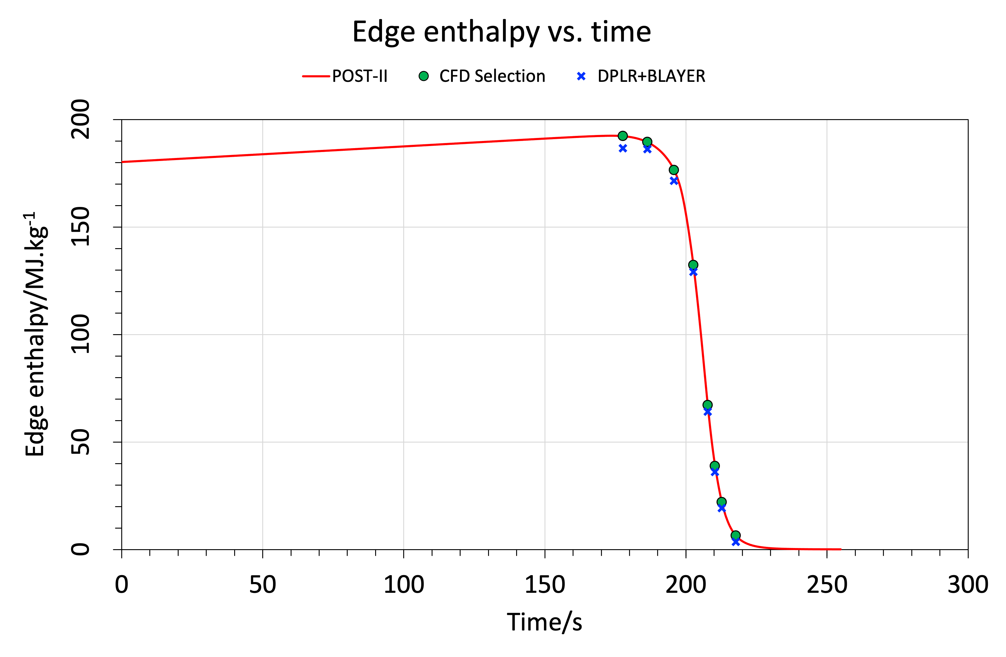
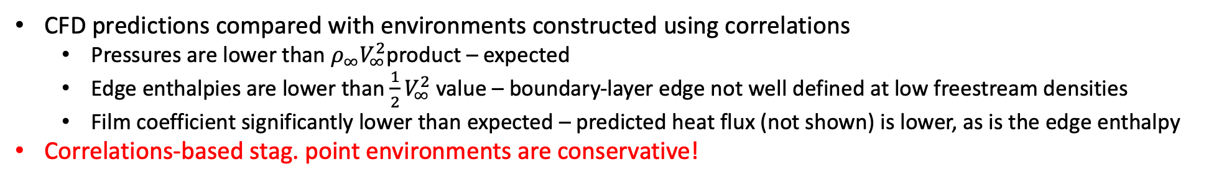
Stagnation Point Environments
Correlations vs. Predictions
CFD predictions compared with environments constructed using correlations
  Pressures are lower than $ρ_{∞}V_{∞}^{2}$product – expected
  Edge enthalpies are lower than $\frac{1}{2}V_{∞}^{2}$ value – boundary-layer edge not well defined at low freestream densities
  Film coefficient significantly lower than expected – predicted heat flux (not shown) is lower, as is the edge enthalpy
Correlations-based stag. point environments are conservative!

Slide 38
Uncertainties
Uncertainties are handled as multipliers on CFD predictions
Pressure: Uncertainty < 10% => Multiplier (max.) = 1.1
Laminar heat flux: Uncertainty < 20% => Multiplier (max.) = 1.20
Turbulent heat flux: Uncertainty < 35% => Multiplier (max.) = 1.35
Heat flux augmentation due to roughness is roughly 30%

Slide 39
Using CFD results in early System Studies
Early system studies and study of conceptual shapes usually focus on the stagnation point
Correlations can be developed from CFD data help speed up early system studies
Correlations are usually for the stagnation point
Correlations can be added to trajectory codes
Trajectory codes can be coupled with 1D material response solvers to size the heatshield material
  1D stagnation point sizing result would mean uniform material thickness – useful in obtaining initial mass estimates

Slide 40
Stagnation Point Scaling Laws
Simply functional relations between physical quantities, such as pressure, heat flux, … and ambient atmospheric properties, vehicle speed, and size, i.e., power laws of the type
$R_{aerothermal}^{a}ρ_{∞}^{b}$ $V_{∞}^{c}$
  $R_{aerothermal}$ is a characteristic length scale/aerothermal radius/effective radius
  $ρ_{∞}$ is ambient atmospheric density
  $V_{∞}$ is flight speed
Require these for pressure, convective heat flux, radiative heat flux, and enthalpy
Focus on the stagnation point because there is good theoretical considerations for this
September 8, 2022
TFAWS 2022
40

Slide 41
Stagnation Point Environments: Pressure
Scaling law for pressure at the stagnation point
$$p_{stag}=fρ_{∞}V_{∞}^{2} 0.9<f<1$$
Modified Newtonian impact theory is the basis for this scaling law
  Newtonian impact theory is strictly for $M_{∞}→∞$ and $γ→1$, which gives a max pressure coefficient of 2
  Modification to impact theory is necessary for finite $M_{∞}$ and $γ>1$
There is no geometric scale in this law and holds for a blunt body of any shape or size
September 8, 2022
TFAWS 2022
41

Slide 42
Stagnation Point Environments: Conv. Ht. Flux
Scaling law for convective heat flux
$$q_{stag}=K\frac{\sqrt{p_{stag}}}{\sqrt{R_{aerothermal}}}\left(H_{edge}−h_{wall}\right)$$
Simplified version of the Fay-Riddell correlation
  Assumes 1st-order boundary-layer theory, i.e., thin shear layer attached to the wall is driven by the inviscid streamwise pressure gradient
  Fay-Riddell correlation developed from boundary-layer computations with either frozen flow or equilibrium flow AND Sutherland’s law for viscosity
  Correlation revisited by Zoby, Deiwert-Marvin, and Sutton-Graves in the 1960s-1970s – still in use today!
There IS a geometric scale in this law
Requires estimate of the enthalpy difference that drives heating
$K$ is constant, but value depends on the gas mixture AND is dependent on the choice of transport property model
September 8, 2022
TFAWS 2022
42

Slide 43
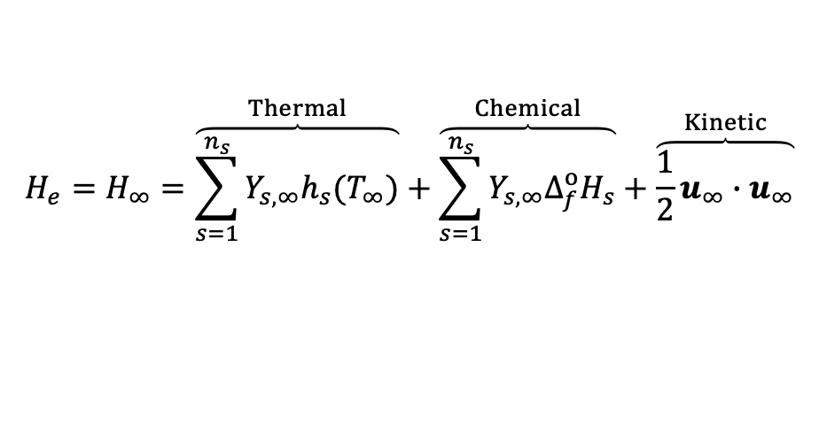
Stagnation Point Environments: Conv. Ht. Flux
Scaling law for convective film coefficient is then
$$C_{H}=\frac{q_{stag}}{\left(H_{edge}−h_{wall}\right)}=K\frac{\sqrt{p_{stag}}}{\sqrt{R_{aerothermal}}}$$
In the 1st approximation, film coefficient is independent of wall type – cold vs. hot – and depends solely on stagnation pressure and the aerothermal length scale
Convective film coefficient peaks when stagnation pressure peaks
The edge enthalpy required by the materials response solver is simply the freestream total enthalpy
  Assumption valid if boundary-layer thickness is significantly smaller than the shock-layer thickness
  At the stagnation point there is no distinction between edge enthalpy and recovery enthalpy
$$H_{e}=H_{∞}=\overset{Thermal}{\overbrace{\sum_{s=1}^{n_{s}}{Y_{s,∞}h_{s}(T_{∞})}}}+\overset{Chemical}{\overbrace{\sum_{s=1}^{n_{s}}{Y_{s,∞}∆_{f}^{o}H_{s}}}}+\overset{Kinetic}{\overbrace{\frac{1}{2}u_{∞}∙u_{∞}}}$$

Slide 44
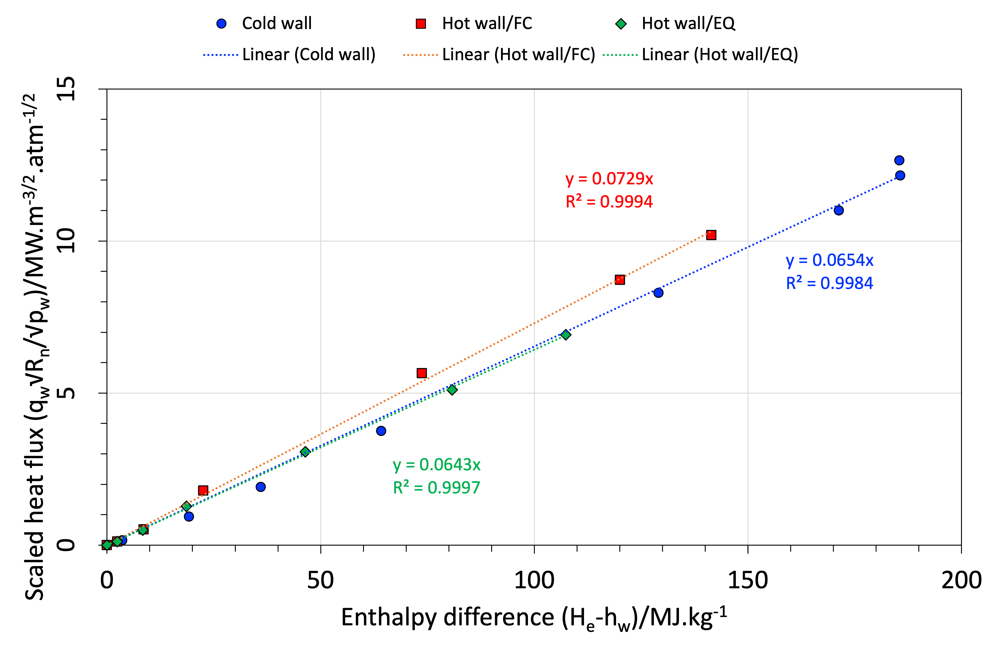
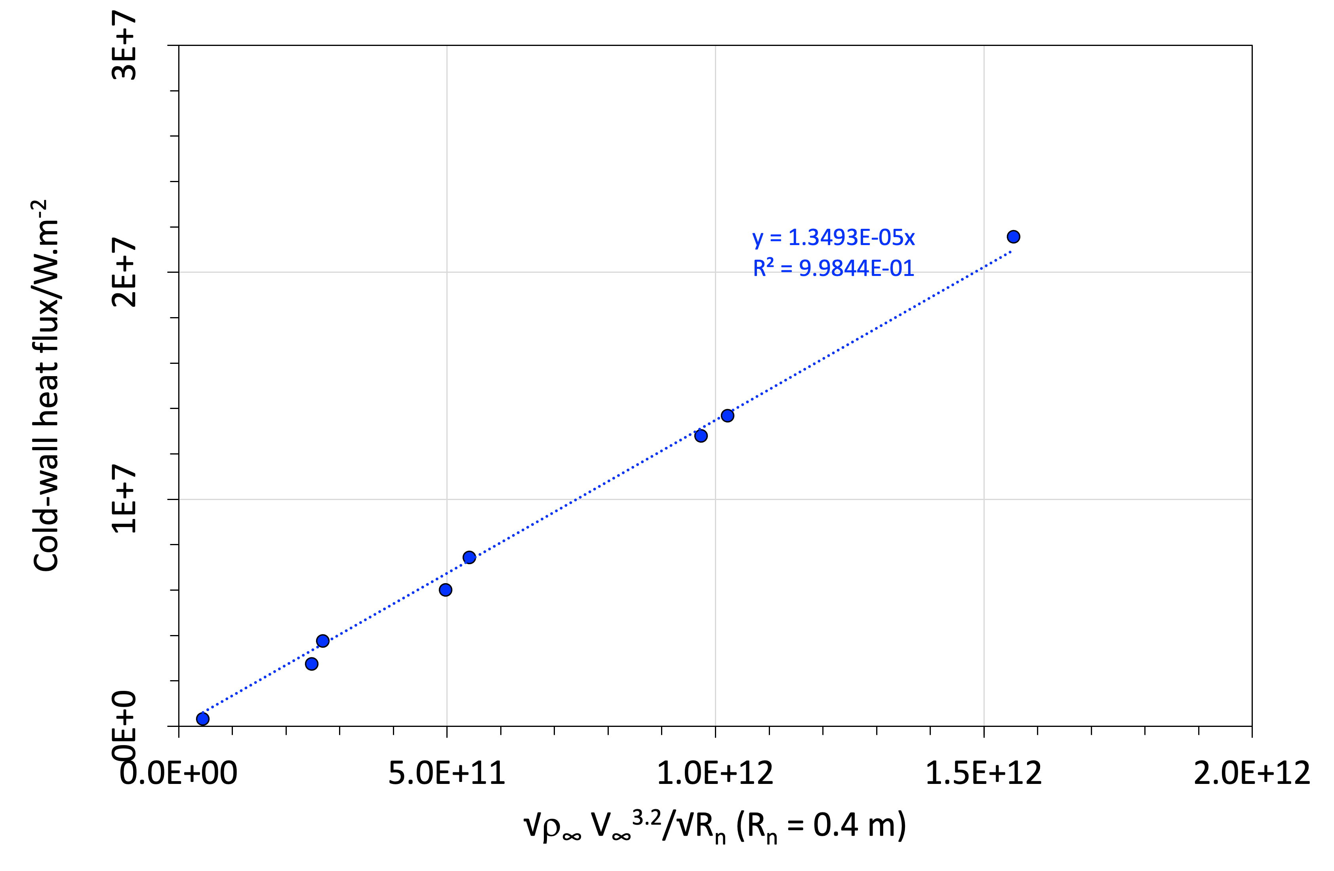
Stagnation Point Environments: Conv. Ht. Flux
Sutton, K. and Graves, R. A., NASA TR T-376, November 1971.
$$q_{stag}\frac{\sqrt{R_{n}}}{\sqrt{p_{stag}}}=K_{1}\left(H_{e}−h_{w}\right)$$
$q_{stag}=K_{2}$ $\frac{1}{\sqrt{R_{n}}}\sqrt{ρ_{∞}}$ $V_{∞}^{3.2}$
Sutton-Graves type correlation: heat flux driven by enthalpy difference & agnostic to wall type – cold or hot
  Cold wall (fully catalytic) and hot wall (equilibrium) $K_{1}$ values are in good agreement (< 2% difference)
  Hot wall (equilibrium) $K_{1}$ of 0.0643 is about 9% different from previous value of 0.0594 – within aerothermal uncertainty of 25%
  Hot wall (fully catalytic) $K_{1}$ of 0.073 is greater than cold wall (or eq. wall) value by 23% or more
TRAJ type correlation: cold-wall heat flux driven by freestream density and velocity
  Cold wall (fully catalytic) $K_{2}$ value of 1.3493 x10⁻⁵ (for heat flux in W/m²) compares very well with current value of 1.343 x10⁻⁵ coded in TRAJ (< 0.5% different)
September 8, 2022
TFAWS 2022
44

Slide 45
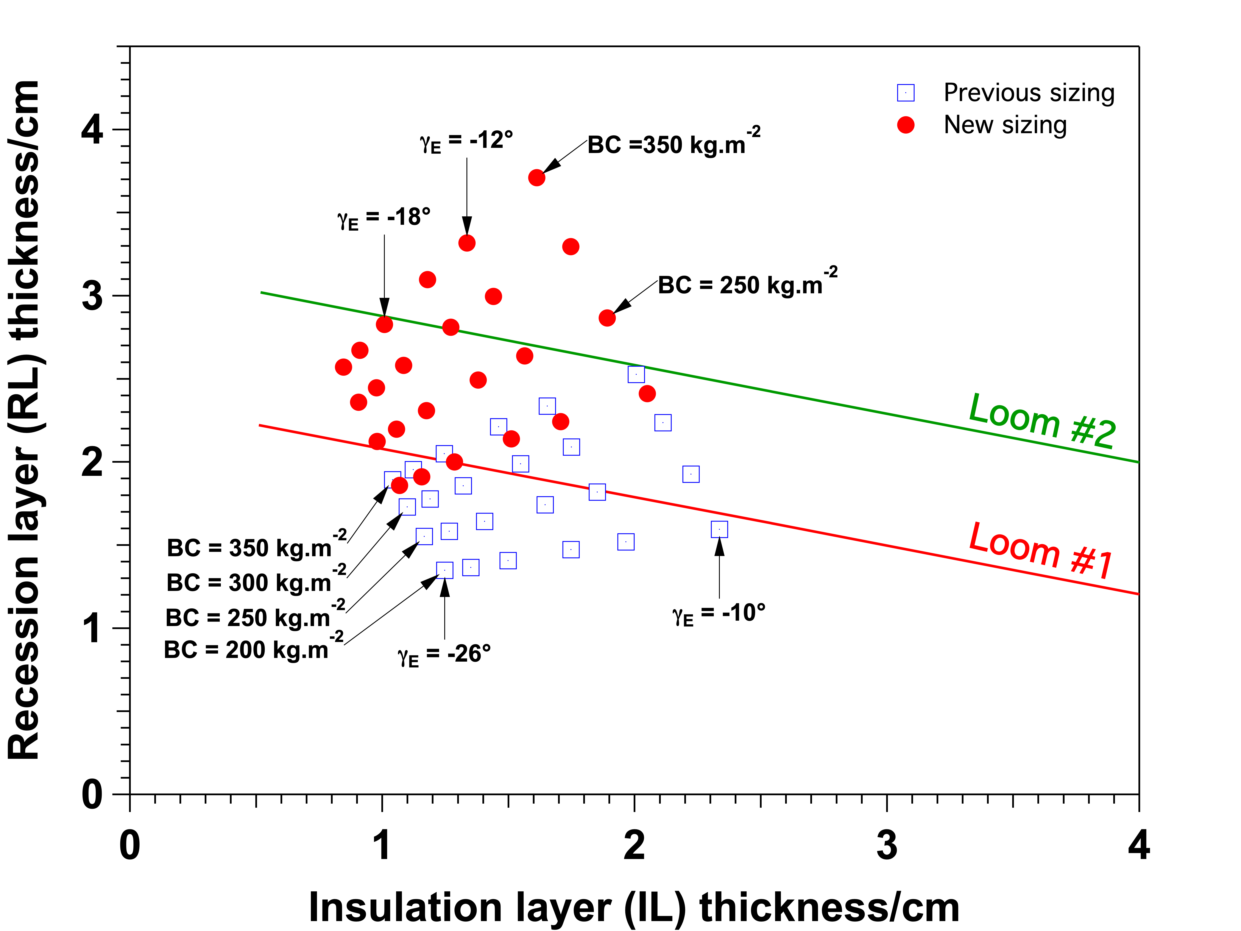
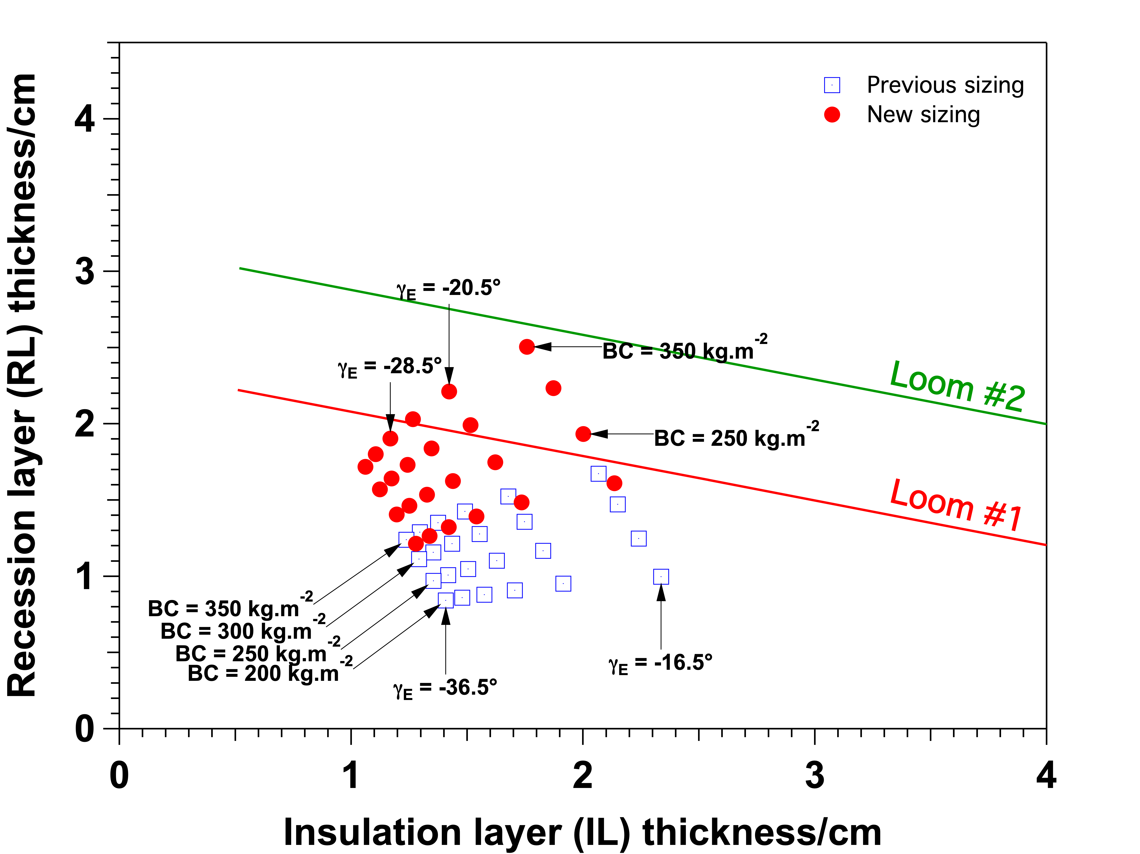
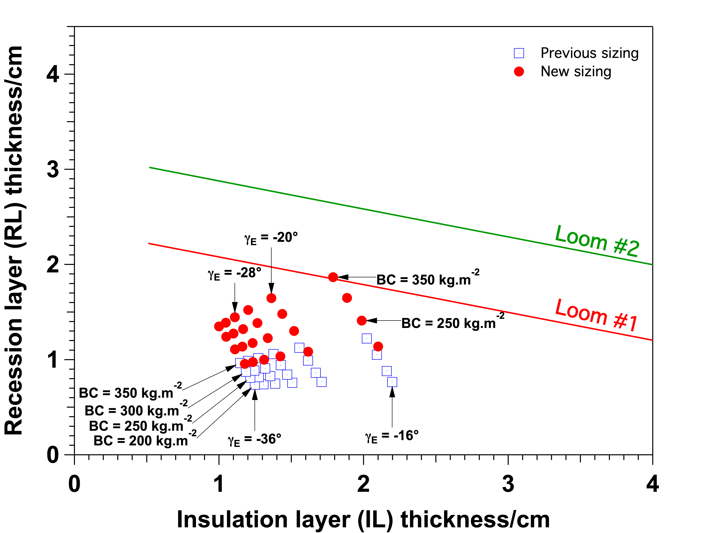
Application of Correlation-Based Methodology
Prabhu, D. K., “Exploration of Atmospheric Entries at Saturn, Uranus & Neptune with HEEET as Heatshield TPS,” FAR 2019, Torre Cintola, Italy.
SATURN
Velocity = 35.66 km/s (Inertial)
Latitude = 0°, Azimuth = 67.05°
URANUS
Velocity = 22.34 km/s (Inertial)
Latitude = 0°, Azimuth = 37.7°
NEPTUNE
Velocity = 24.73 km/s (Inertial)
Latitude = -10°, Azimuth = 76.9°
2-Layer (insulation and recession) carbon-based ablator considered in the study
Trajectory code, TRAJ, coupled with the material response code, FIAT
Uncertainties in aerothermal environments (stag. point only), materials properties considered
Manufacturing margins added to material sizing predictions
Result assessed against the loom capability to weave predicted thickness

Slide 46
Closing Remarks
CFD for Ice Giant atmospheric entries is straightforward
Attention needs to be paid to:
  Thermodynamic properties, which need extension down to 50 K – problem gets complicated due to ortho- & para- forms of H2
  Transport properties show inflections in temperature variation – science behind those need to be examined
  CH₄ kinetics – might be important for Neptune entries even if the mole fraction is low
  Gas-surface interaction of atomic H with hot carbon would need to be addressed
Other open issues (ongoing work)
  Transition/Turbulence and influence of surface roughness
  Fluid dynamics & chemistry of wall blowing
  Backshell environments

Slide 47
Questions?

