Slide 1
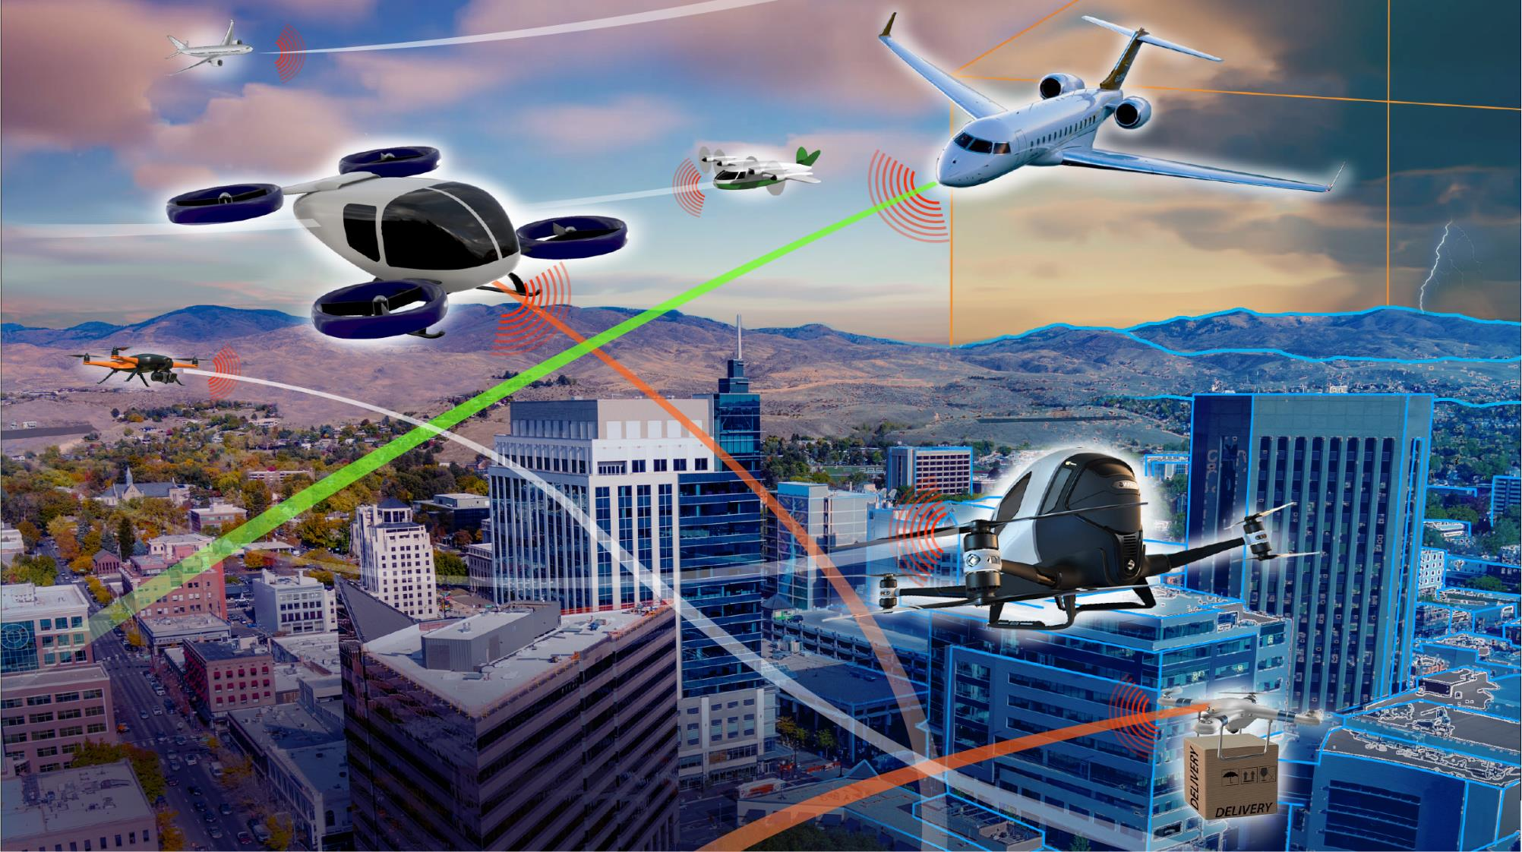

Digital Flight
A New Cooperative Operating Mode to Complement VFR and IFR
September 2022
Release approval 20220013666
Notes:
Approved for release: STRIVES 20220013666

Slide 2
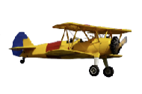


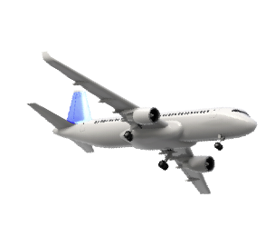
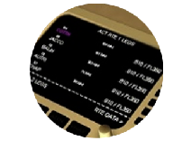
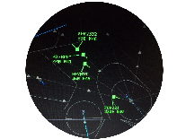
20th Century Evolution of Operating Modes
Origins of Visual Flight Rules (VFR)
Origins of Instrument Flight Rules (IFR)
Flexibility
Access
See and
Avoid
“Airways”
Increased
Collision Risk
Visual Separation
“Airway”
Traffic
Control
(ATC)
Radio
Navigation
Flexibility
Access
Procedural Separation
CAUTION!
The Future of
Aviation Mobility is:
Radar
Surveillance
Voice Communications
Radar
Separation
Capacity
Flexibility
Access
Global
Precision Navigation
Advanced
Avionics
Traffic
Management Automation
Capacity
Flexibility
Access
Data
Communications
Initial Trajectory-Based Operations

Slide 3
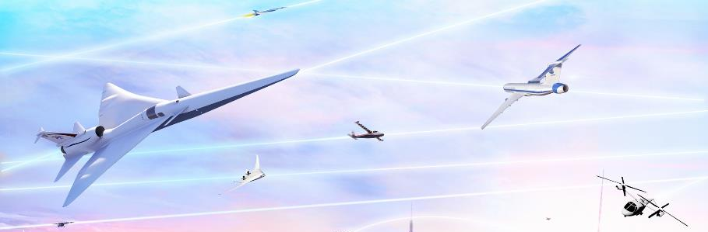
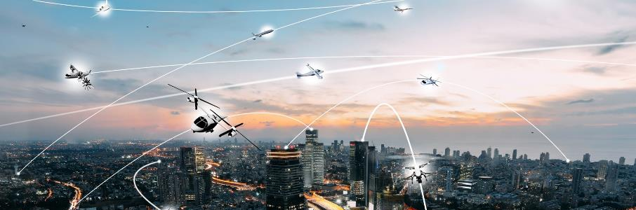
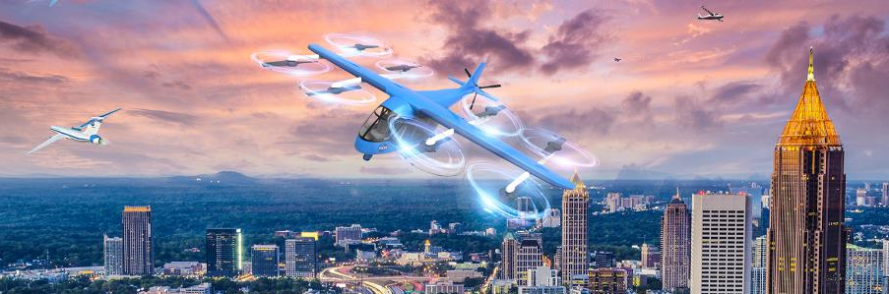
Limitations of Current Operating Modes
VFR and IFR:
Not adaptable to greater flight diversity
Not scalable to high tempos & density
Not suited to self-piloted aircraft
Not ensuring operational predictability
Not conducive to regional growth
“New and adapted flight rules and procedures will be required to efficiently manage these increasingly dynamic operations of differing priority and types.”
Airbus and Boeing, 2020
Notes:
IFR Instrument Flight Rules
VFR Visual Flight Rules

Slide 4
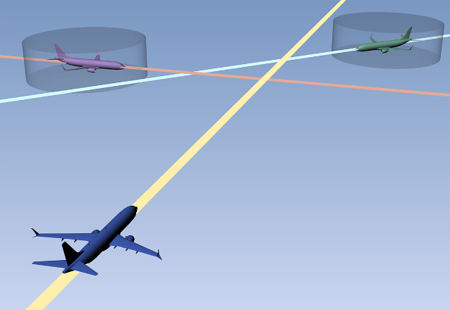
Introducing “Digital Flight”
Digital Flight (DF):
A proposed cooperative operating mode
  in which flight operations are conducted by reference to digital elements, with the operator ensuring flight-path safety through cooperative practices and self-separation enabled by digital technologies and automated information exchange
Digital Flight Rules (DFR):
Regulations governing sustained Digital Flight operations
as an alternate means of separation in VMC and IMC, in lieu of employing visual procedures (VFR) or receiving ATC separation services (IFR)
Applicable to all airspace user categories (i.e., new entrants and incumbent operators) and accepted in all airspace classes without the need for segregation
Compatible with the emerging concepts of UTM, UAM, and ETM. Could serve as the mature-state operating mode in each of these concepts and other similar derivatives (xTM).

Slide 5
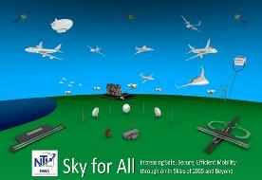

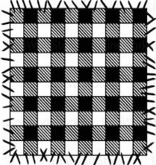
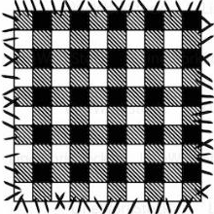
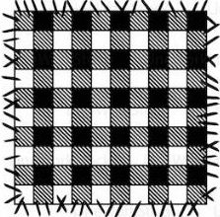
Resolving Emerging Patchwork of Operating Modes
Approach: Common New Operating Mode
IFR
Harmonization through Digital Flight
Common operating mode
Serving unique market needs
IFR + DFR
UML 4+ w/ DFR
Airline / Bus. Aviation
“Reduced operating costs”
UML 4+
UML 4+
Sky for All
Mid-21st Century Vision
Achieve Scalable Secure Digital Aviation System
Assure Safety as Operations Diversify & Grow
Design for Sustainability & Resiliency
Enable Equitable Access for Diverse Ops
Enhance Quality of Life
Promote and Empower Operator Mobility
Transform Existing Aviation Ecosystem
ETM w/ DFR
Urban Air Mobility
“Dense / complex urban ops”
ETM
VFR / IFR
High Altitude Ops
“Cooperative separation”
VFR + IFR + DFR
Emergency Air Svcs
“All Weather Safe Response”
IFR + DFR
IFR
Larger UAS
“Seamless integration in the NAS”
VFR / IFR
VFR + IFR + DFR
Digital Flight Rules (DFR) & Digital Information Ecosystem
VFR + IFR + DFR
Regional Air Mobility
“Community-friendly regional travel”
VFR / IFR
UTM
General Aviation
“Simplified Vehicle Operations”
UTM w/ DFR
Small UAS
“Beyond visual line of sight”
Transformation Accumulation
Evolution of proven capability
Maturity to serve needs & risk targets
UAS: Unmanned Aircraft System
UTM: UAS Traffic Management
ETM: Upper Class E Traffic Management
UML: UAM Maturity Level
Notes:
ETM – Upper Class E Traffic Management
UAS – Unmanned Aircraft Systems
UML – Urban Air Mobility
UTM – UAS Traffic Management

Slide 6







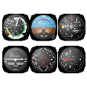


A Third Operating Mode
Flight by Visual Reference
Visual Flight
Flexible
Scalable
Pilot sees and avoids
Distributed decision-making
No centralized coordination
No required intent sharing
Cooperative procedures and rules
Limited to no dependence on technology or ATC
Pilot
Flight by Reference to Digital Information
Proposed: Digital Flight
Operator is the separator
Distributed decision-making
No centralized coordination
Required intent sharing
Encoded cooperative practices
Technology-dependent separation
Cooperative with Air Traffic Management
Flexible
Scalable
Predictable
Accessible
Decision-Maker
Operator
Automation
Operating
Environment
Flight by Reference to Instruments
Instrument Flight
ATC is the separator
Federated/centralized decision-making
Centralized coordination via ATC approval
Intent sharing with ATC
Limited dependence on technology
Predictable
Accessible
Pilot
ATC
Notes:
ATC – Air Traffic Control

Slide 7







Digital Flight Elements and Architecture
Essential Elements
Architectural Flexibility
Cooperative Practices
Spectrum
Digital Flight
    Self-Provision
    Services Provision
Digital Information Connectivity
& Services
Shared Traffic
Awareness
Separation Automation
    Location of automation
    and decision-making

Slide 8








Digital Flight Principal Capabilities
Operator Self-Separation
Cooperative Conflict Management
Adaptive Pairwise Separation
Right-of-Way / Burden Electronically Determined
Time-Critical Maneuvers Coordinated
Computed Resolution
Coordination Rules
Higher 4D Nav. Performance Shared
DFR
Smaller
Separation Criteria
Higher 4D Nav. Performance Shared
DFR
DFR
Larger
Separation Criteria
Detected Conflict
Coordination Rules
Has Right-of-Way
Lower 4D Nav. Performance
Shared or Assumed
Conflict Prevention
Hazard Avoidance
VFR
IFR
DFR
Current
DFR
Current
Burdened
Lateral Performance
Vertical Performance
Along Path Performance
Predicted
Predicted
DFR
Collaborative Utilization of Constrained Resources
Self-Organization & Sequencing
Self-Regulation of Density & Operational Complexity
Lower Density
Terminal
Airspace
Flow management assigns RTA to #3
#1
IFR
Shared
destination
and ETA
#2
IFR
DFR
#3
Optimized route with self-separation producing dependable future state (actual time of arrival = RTA)
Current
All DFR
No Central Coordinator
Predicted
All DFR
Higher Density

Slide 9

Digital Flight Cooperative Practices
Share and Update Intent
Navigate with Intended Precision
Take
Timely
Action
Respect Established Operating Procedures
To Be Determined
Ensuring harmonized use of the airspace
Apply Pair-Appropriate Separation
Coordinate
with ATC in Controlled Airspace
Join in Appropriate Flow Management
To Be Determined
Respect
VFR and IFR Aircraft
Text
Respect
Intent When Changing Intent
Respect
Right-of-Way Among DF Aircraft
Coordinate Maneuvering Among DF Aircraft
Avoid Hot
Protected Airspace
To Be Determined

Slide 10
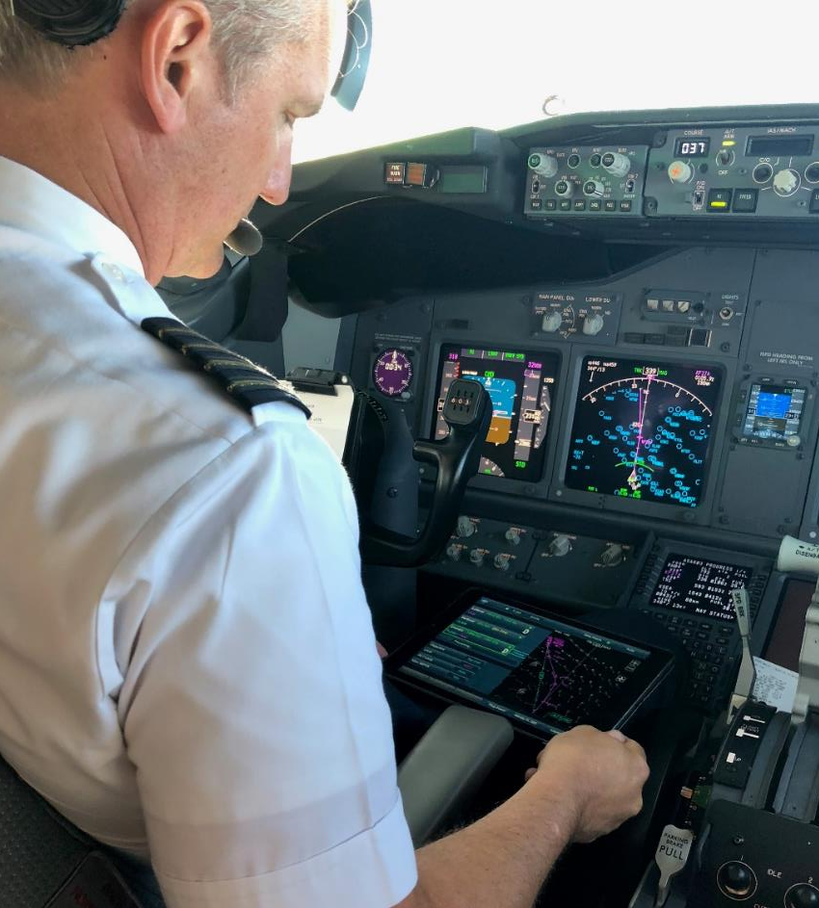
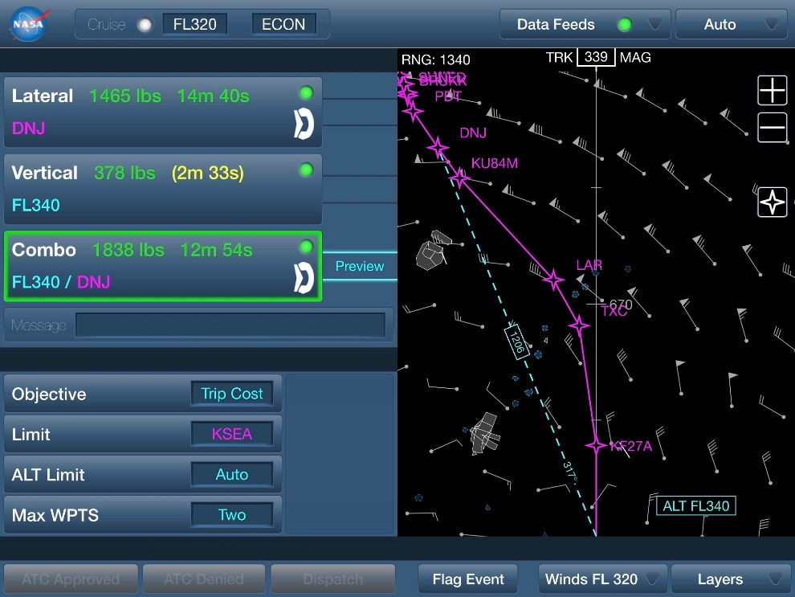

NASA Tech is Already Building Toward Digital Flight
TASAR: Traffic Aware Strategic Aircrew Requests
NASA technology for flight optimization
Validated in airline operations
Now commercially available
DF

Slide 11






Digital Flight Community Engagement
NASA Convergent Aeronautics Solutions (CAS) Project
Industry Workshops Identified Critical Barriers…
… and Paths Forward / “Chisels”
Safety & Certification of Autonomous Systems
Concept Communication
    Describe the DF concept in greater detail to reduce identified uncertainties
Stakeholder Engagement
    Engage with key stakeholders to communicate concept and get input on desired DF policy
Modelling, Simulation, and Analysis
    Conduct studies to quantify performance and
    safety impacts resulting from DF
Technology Demonstration
    Define and conduct real-world demonstrations of DF capabilities
Integration
with VFR and IFR
Regulation Lead Time and Complexity
Unambiguous Responsibilities
Technology and Data Link Maturity
Avoiding Impact on Non-DF Cost and Operations
Viable Implementation Path
Business Case Viability

Slide 12
Digital Flight: A Path Forward
DFR
Continuing Innovation
Launching the S-Curve
of Digital Flight
Accelerated Adoption
Services Expansion
Increasing Complexity
DFR Regulations Development
Benign Applications
Standards Development
Compliance Development
DF
Operational
Credit
Applications under IFR
Performance R&D
Critical Infrastructure
Capability Maturation
Applications under VFR
DF Community Building
Early Applications
Information Services

Slide 13





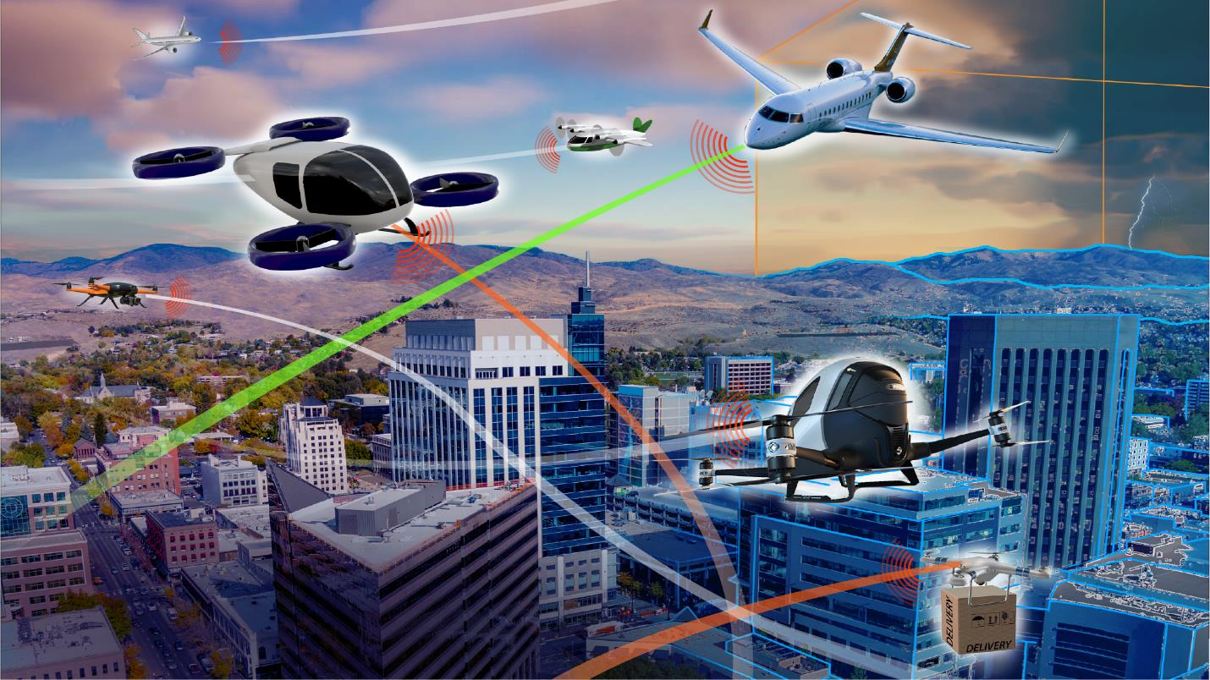
Digital Flight: A Moonshot for Aviation
“We set sail on this new sea…
for the progress of all people.”
John F. Kennedy
Sept. 12, 1962
Thank You!
David.Wing@nasa.gov
Wes.Ryan@nasa.gov

