Slide 1
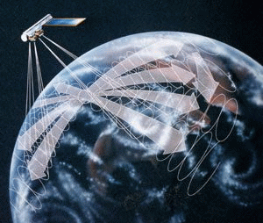

CERES Angular Distribution Model Working Group Report
Wenying Su
Wenying.Su-1@nasa.gov
NASA LaRC, Hampton VA
Zachary Eitzen Lusheng Liang Sergio Sejas
SSAI, Hampton VA

Slide 2
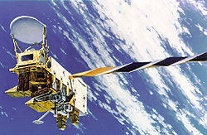
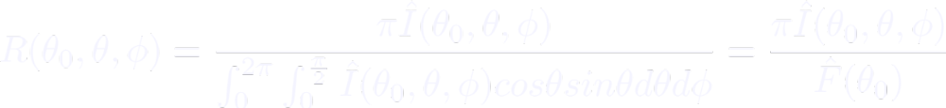

From radiance to flux: angular distribution models
Sort observed radiances into angular bins over different scene types;
Integrate radiance over all θ and ϕ to estimate the anisotropic factor for each scene type:
For each radiance measurement, first determine the scene type, then apply scene type dependent anisotropic factor to observed radiance to derive TOA flux:
θ
θ₀
ϕ
rotating azimuth plane
Notes:
First I'd like to give you a brief overview of what is ADM. CERES instrument measures the radiance. What we need is flux. To derive flux from the radiance measurements, we need to understand the relationship between radiance and flux, this is the goal of ADMs.
To facilitate the development of the ADMs, CERES instrument has a special scan mode, rotating azimuth plane scan. In this mode, the CERES instrument can rotate in azimuth as it scans in elevation, thus maximize the angular coverage. During the early years of Terra/Aqua, one of the CERES instruments was always in RAP mode to collect data for ADM development.
The general strategy of building an ADM is to sort measured radiances into angular bins over difference scene types, denote as I hat. Over a certain scene type, if we have sufficient angular coverage, we can integrate over all upwelling direction to estimate the flux (denote as F hat), and therefore estimate the AF for each scene type. Scene type is defined using many variable, including cld properties, surface type, and snow/ice fraction, among other variables.
Then TOA flux is determined from the observed radiance as shown in this equation.

Slide 3
Partly cloudy fresh snow ADMs
Ed4: ADMs are derived for discrete intervals of cloud fraction and snow fraction.
Proposed Ed5:
  Using imager-based fresh snow fraction, and assuming snow coverage under clouds is the same as cloud-free portion of the footprint
  Adding dependency on surface type when fresh snow fraction equals 100%
  Adding dependency on cloud thickness when cloud fraction greater than 50%
New ADMs increase flux consistency by ~3.5% for partly cloudy fresh snow scenes.
Notes:
Proposed cloudy fresh-snow ADMs adding surface type and cloud properties for scene classification increase flux consistency by 3.5% for partly cloudy sky and by 1.7% for overcast sky.

Slide 4
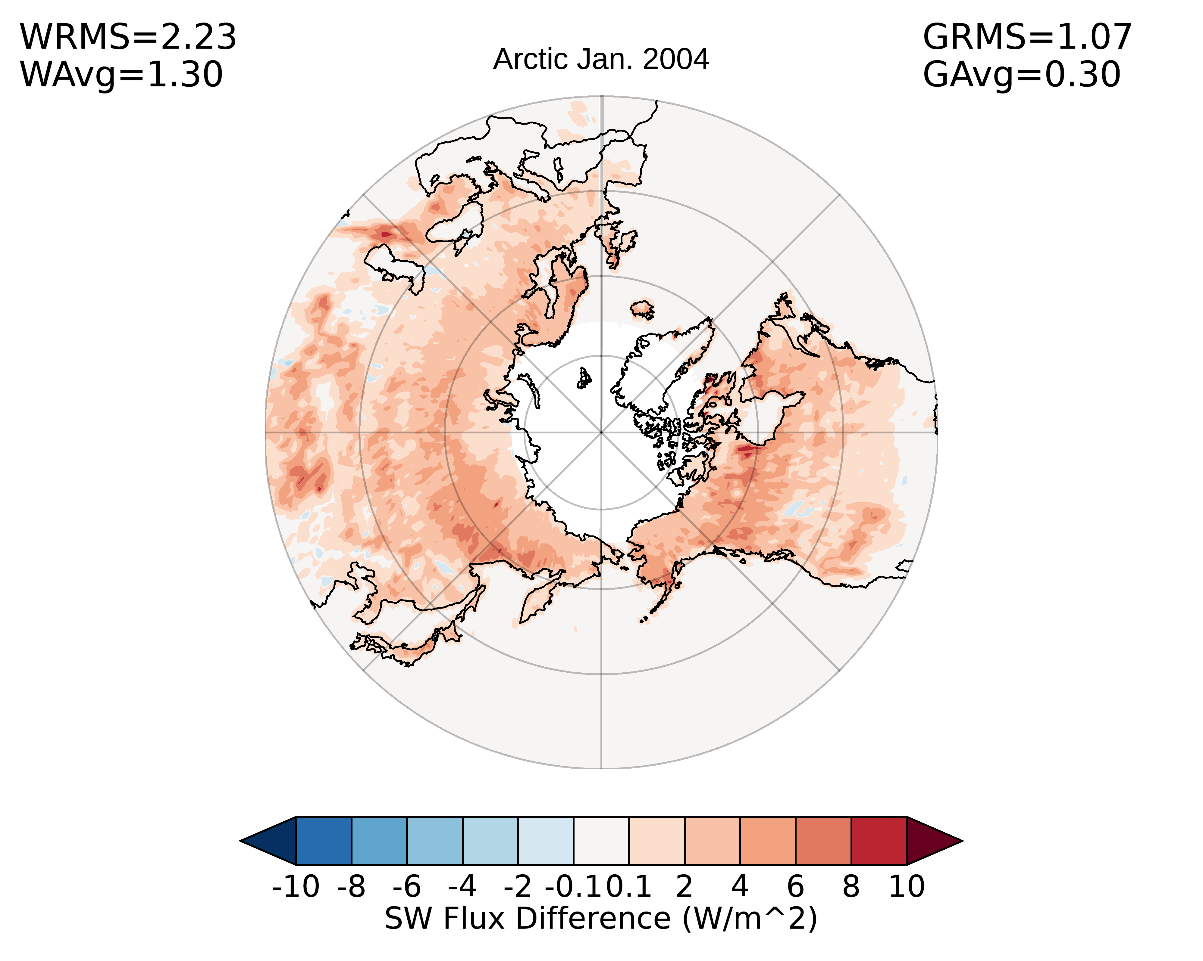
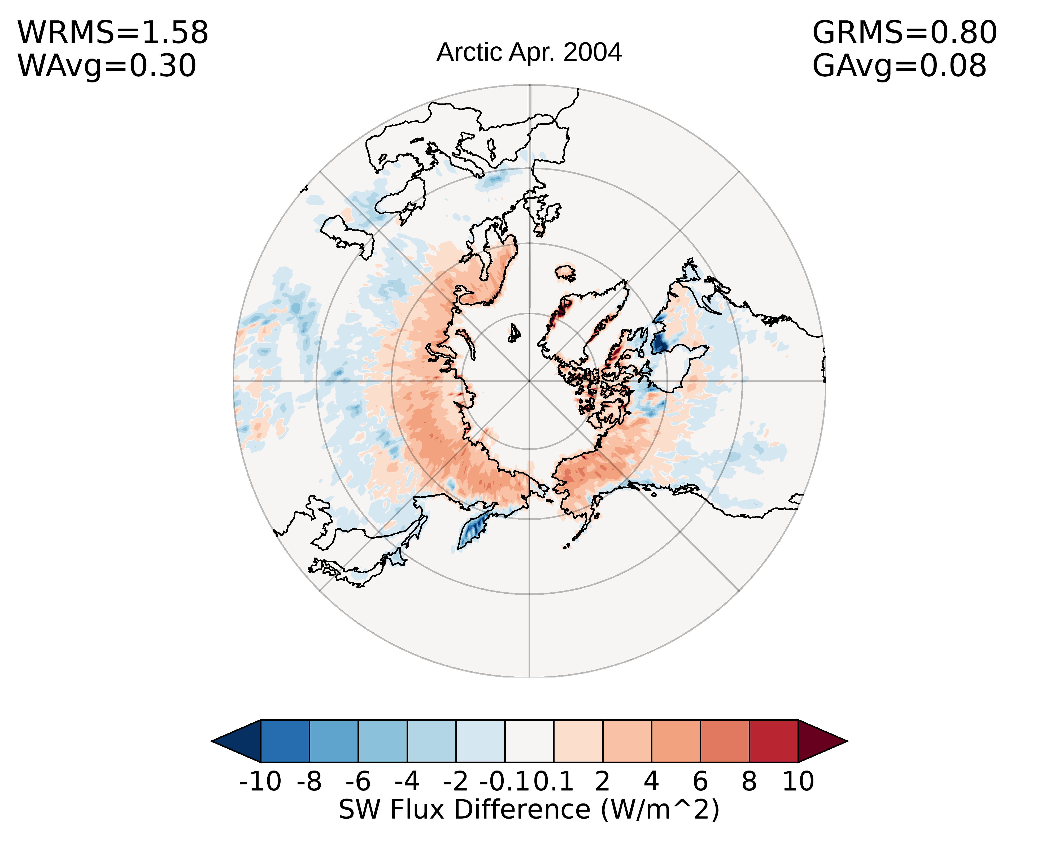
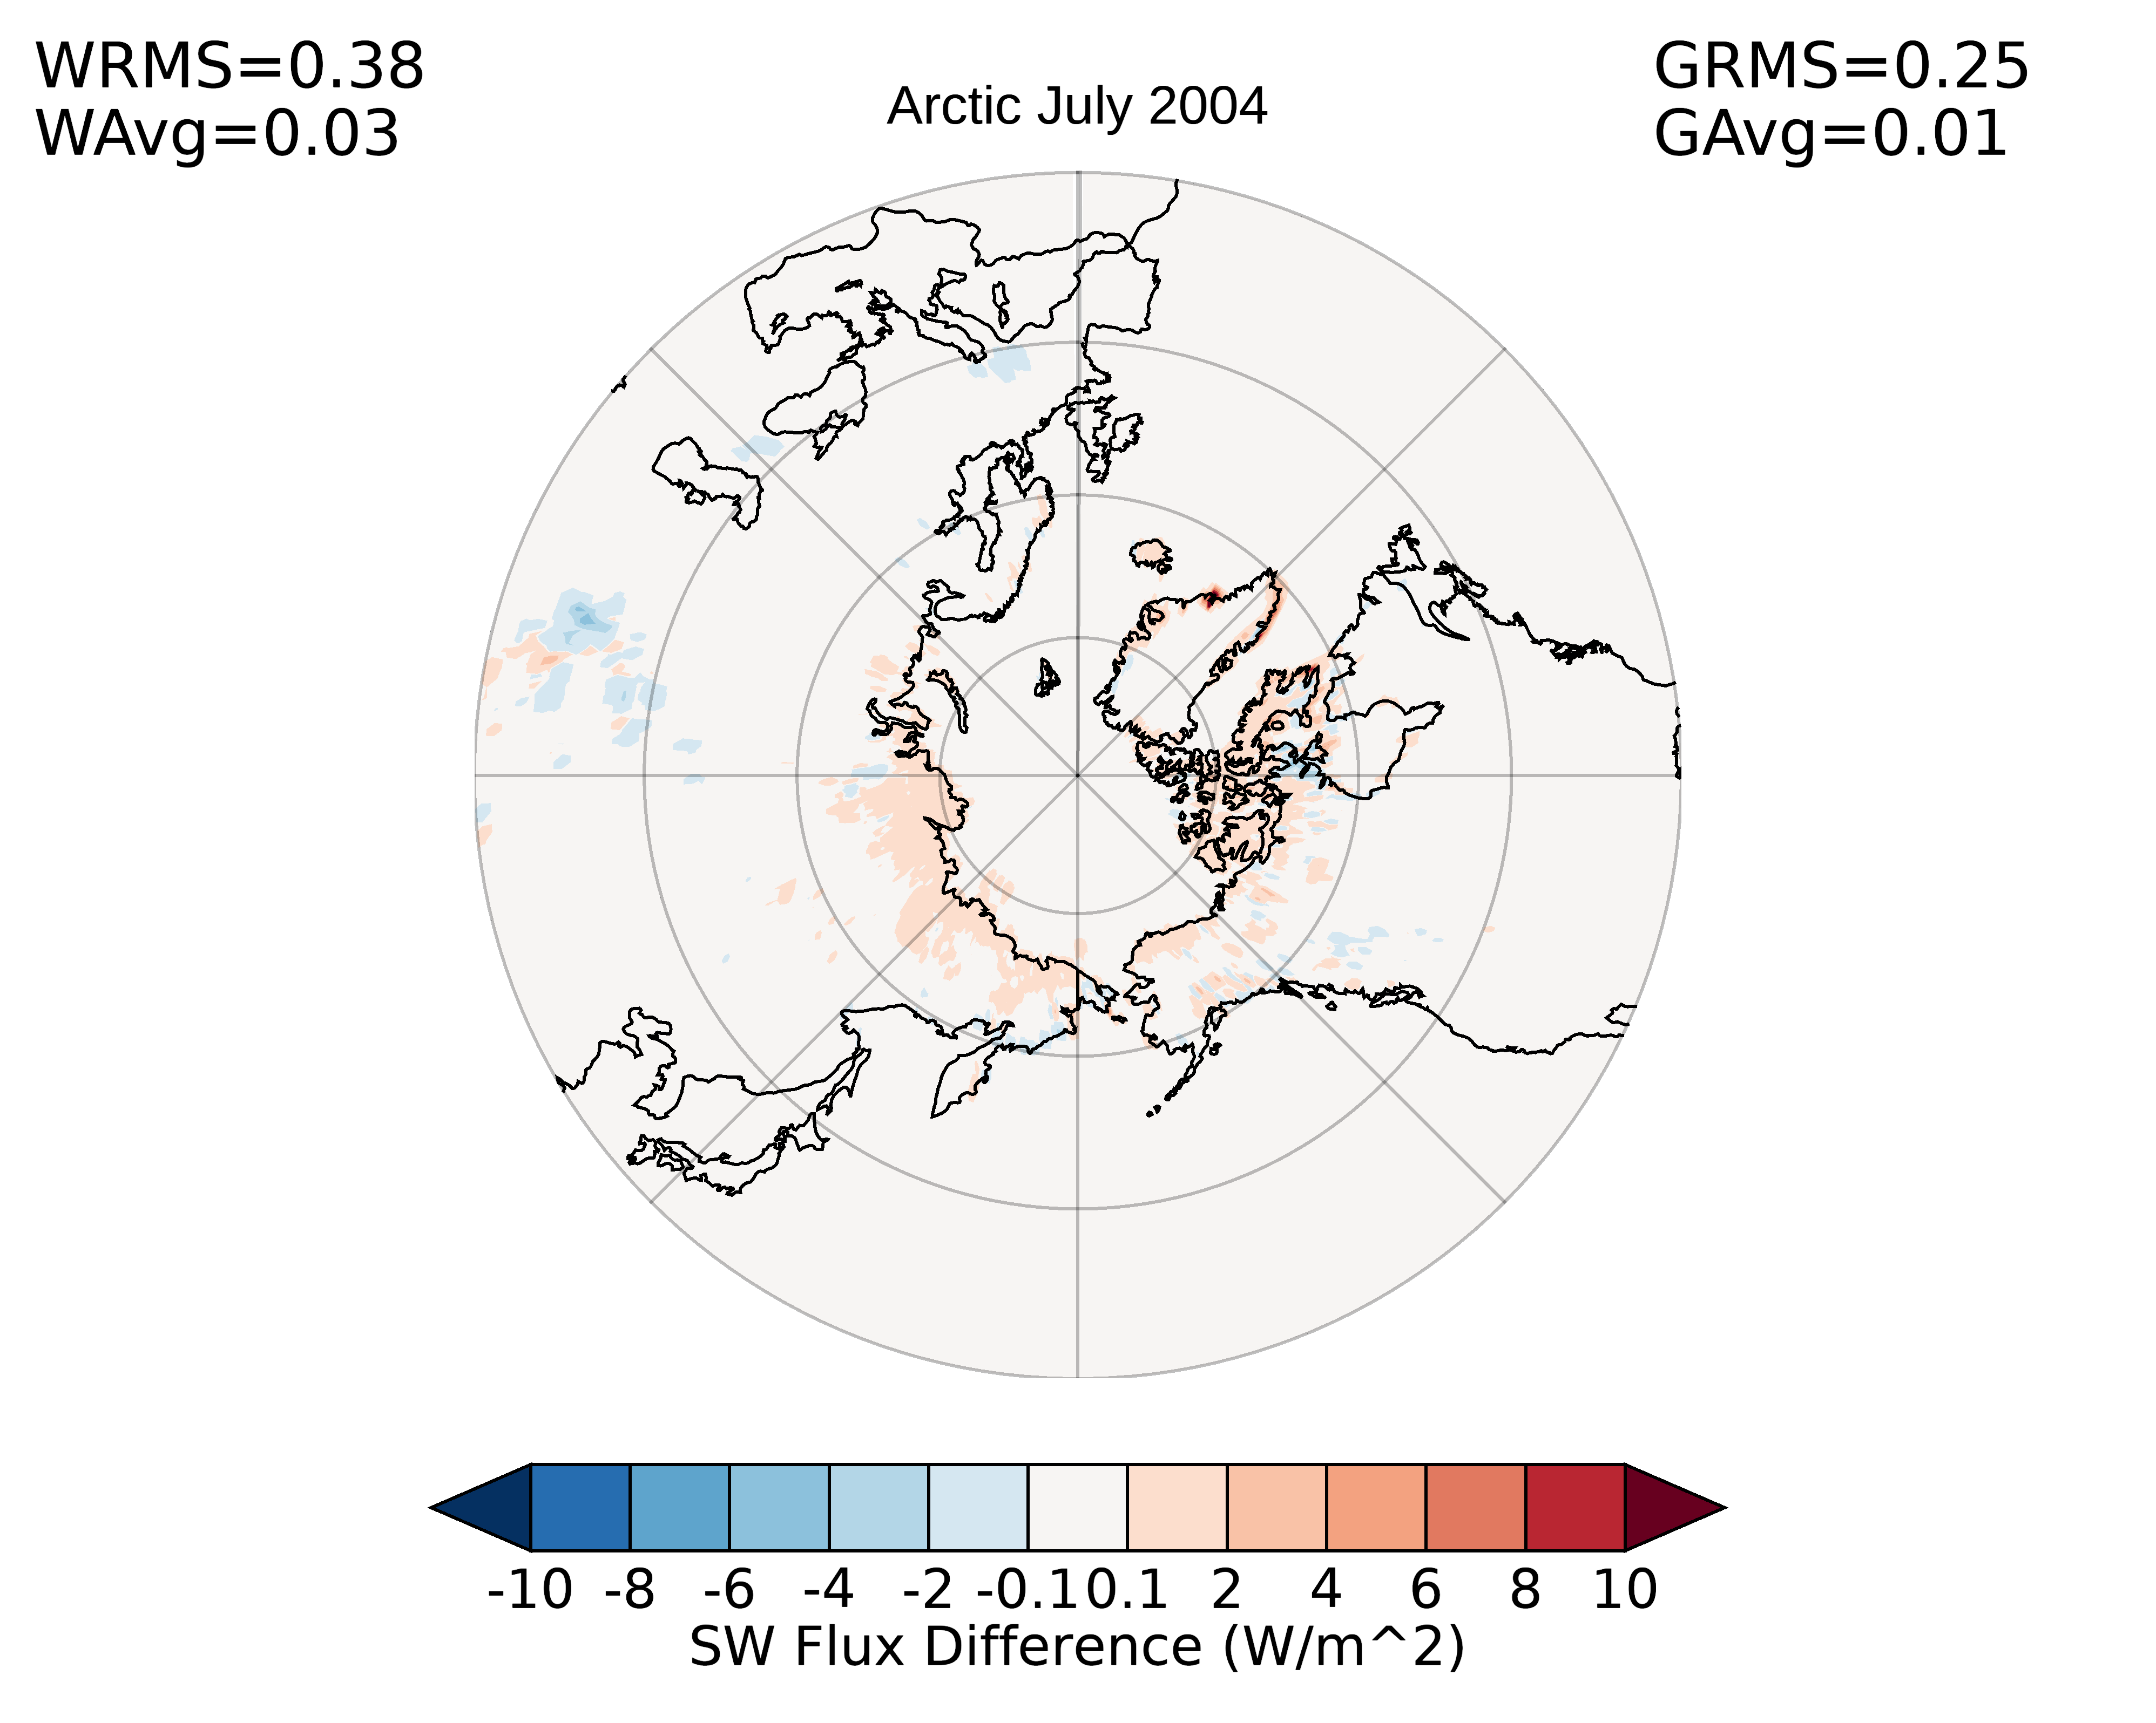
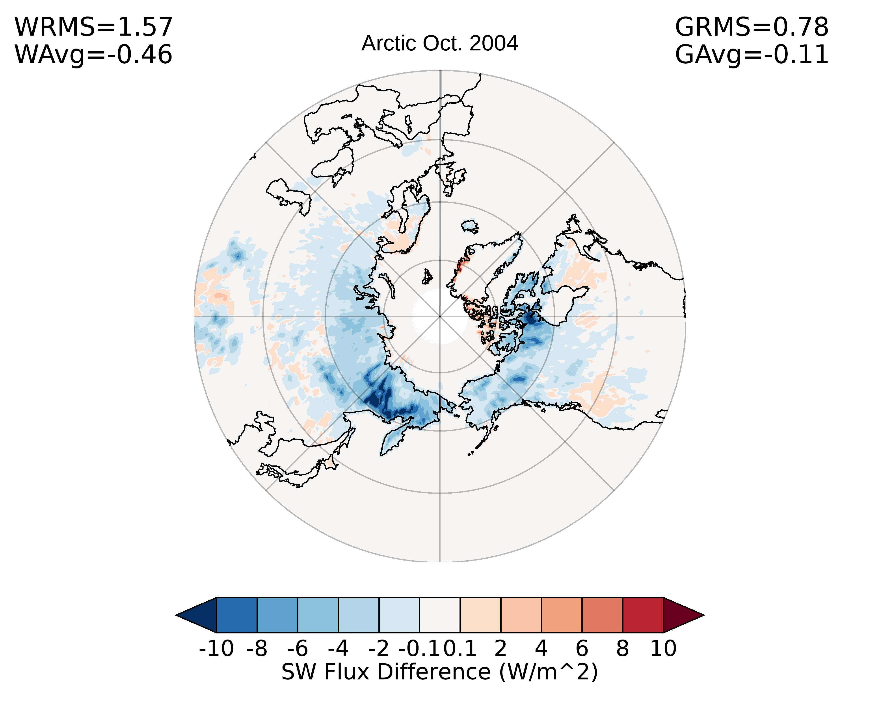
Impact of partly cloudy fresh-snow ADM change on fluxes

Slide 5
Overcast fresh snow ADMs
Ed4: Overcast ADMs are derived separately for bright and dark surfaces and for thin (tau<10) and think (tau>10) clouds.
Proposed Ed5 ADMs are constructed for:
  4 surface type categories: low-to-mod tree shrub, mod-to-high tree shrub, dark desert, bright desert
  6 log(tau) bins
  2 cloud phase
New ADMs increase flux consistency by ~1.7% for overcast fresh snow scenes.

Slide 6
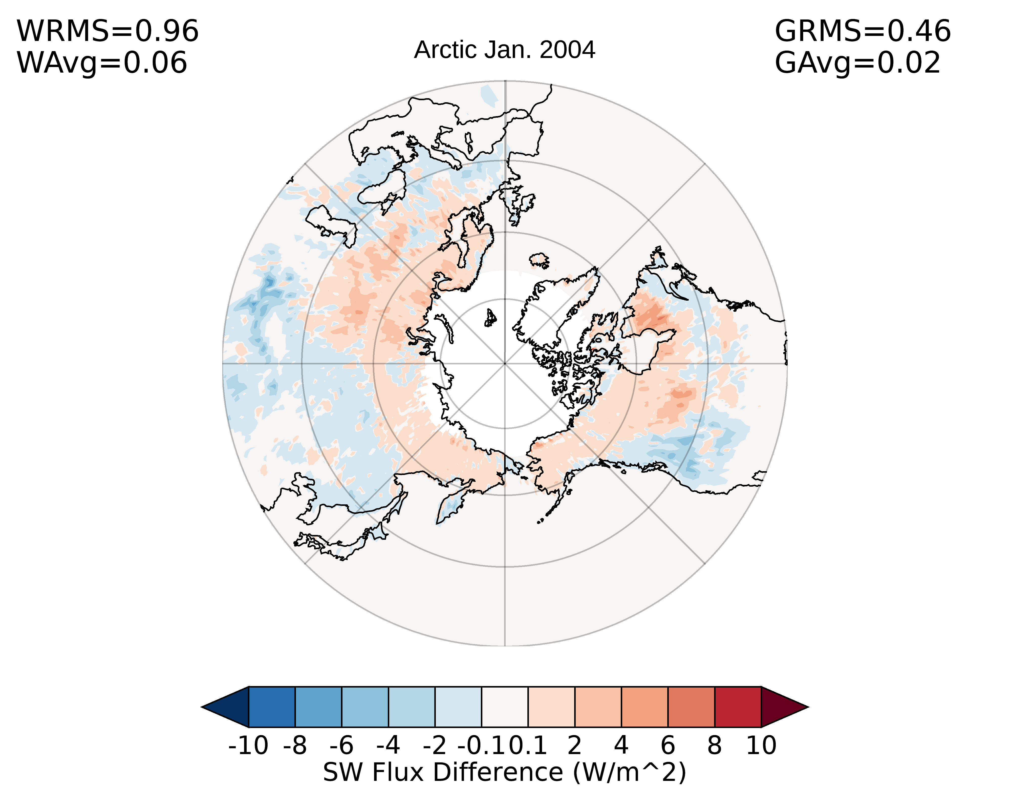
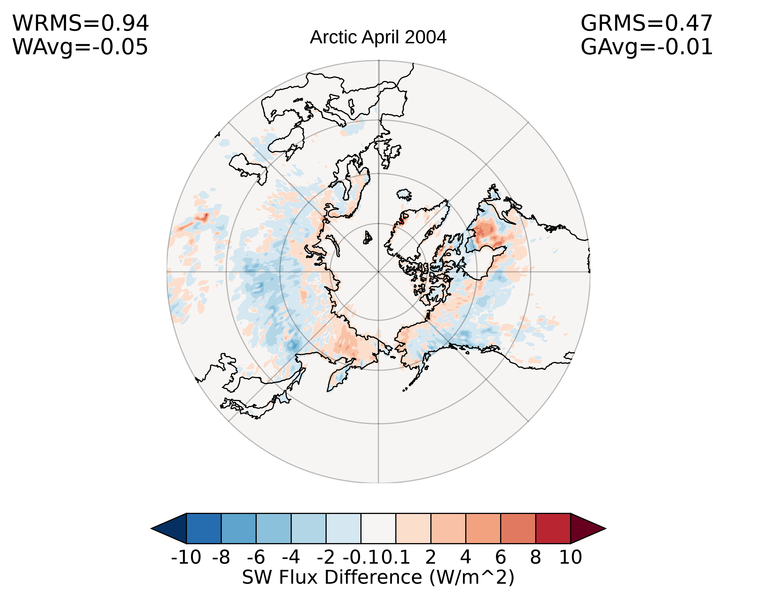
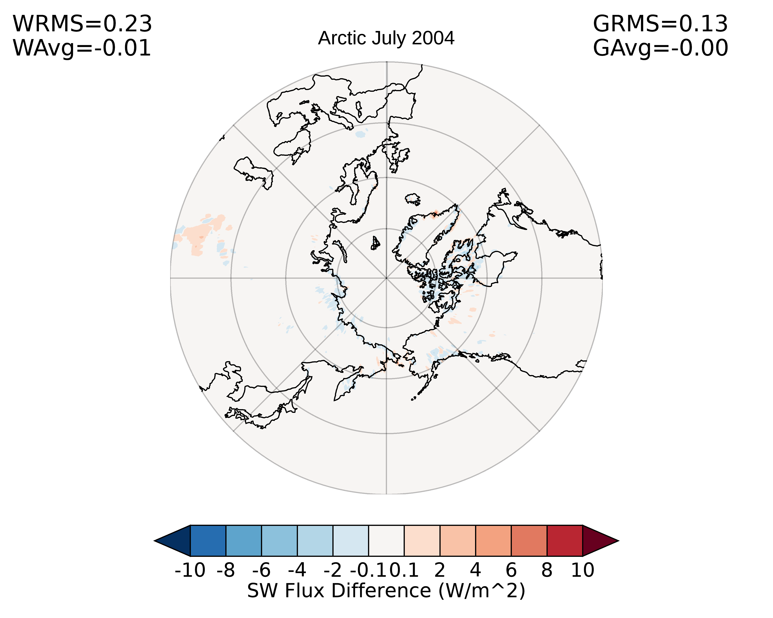
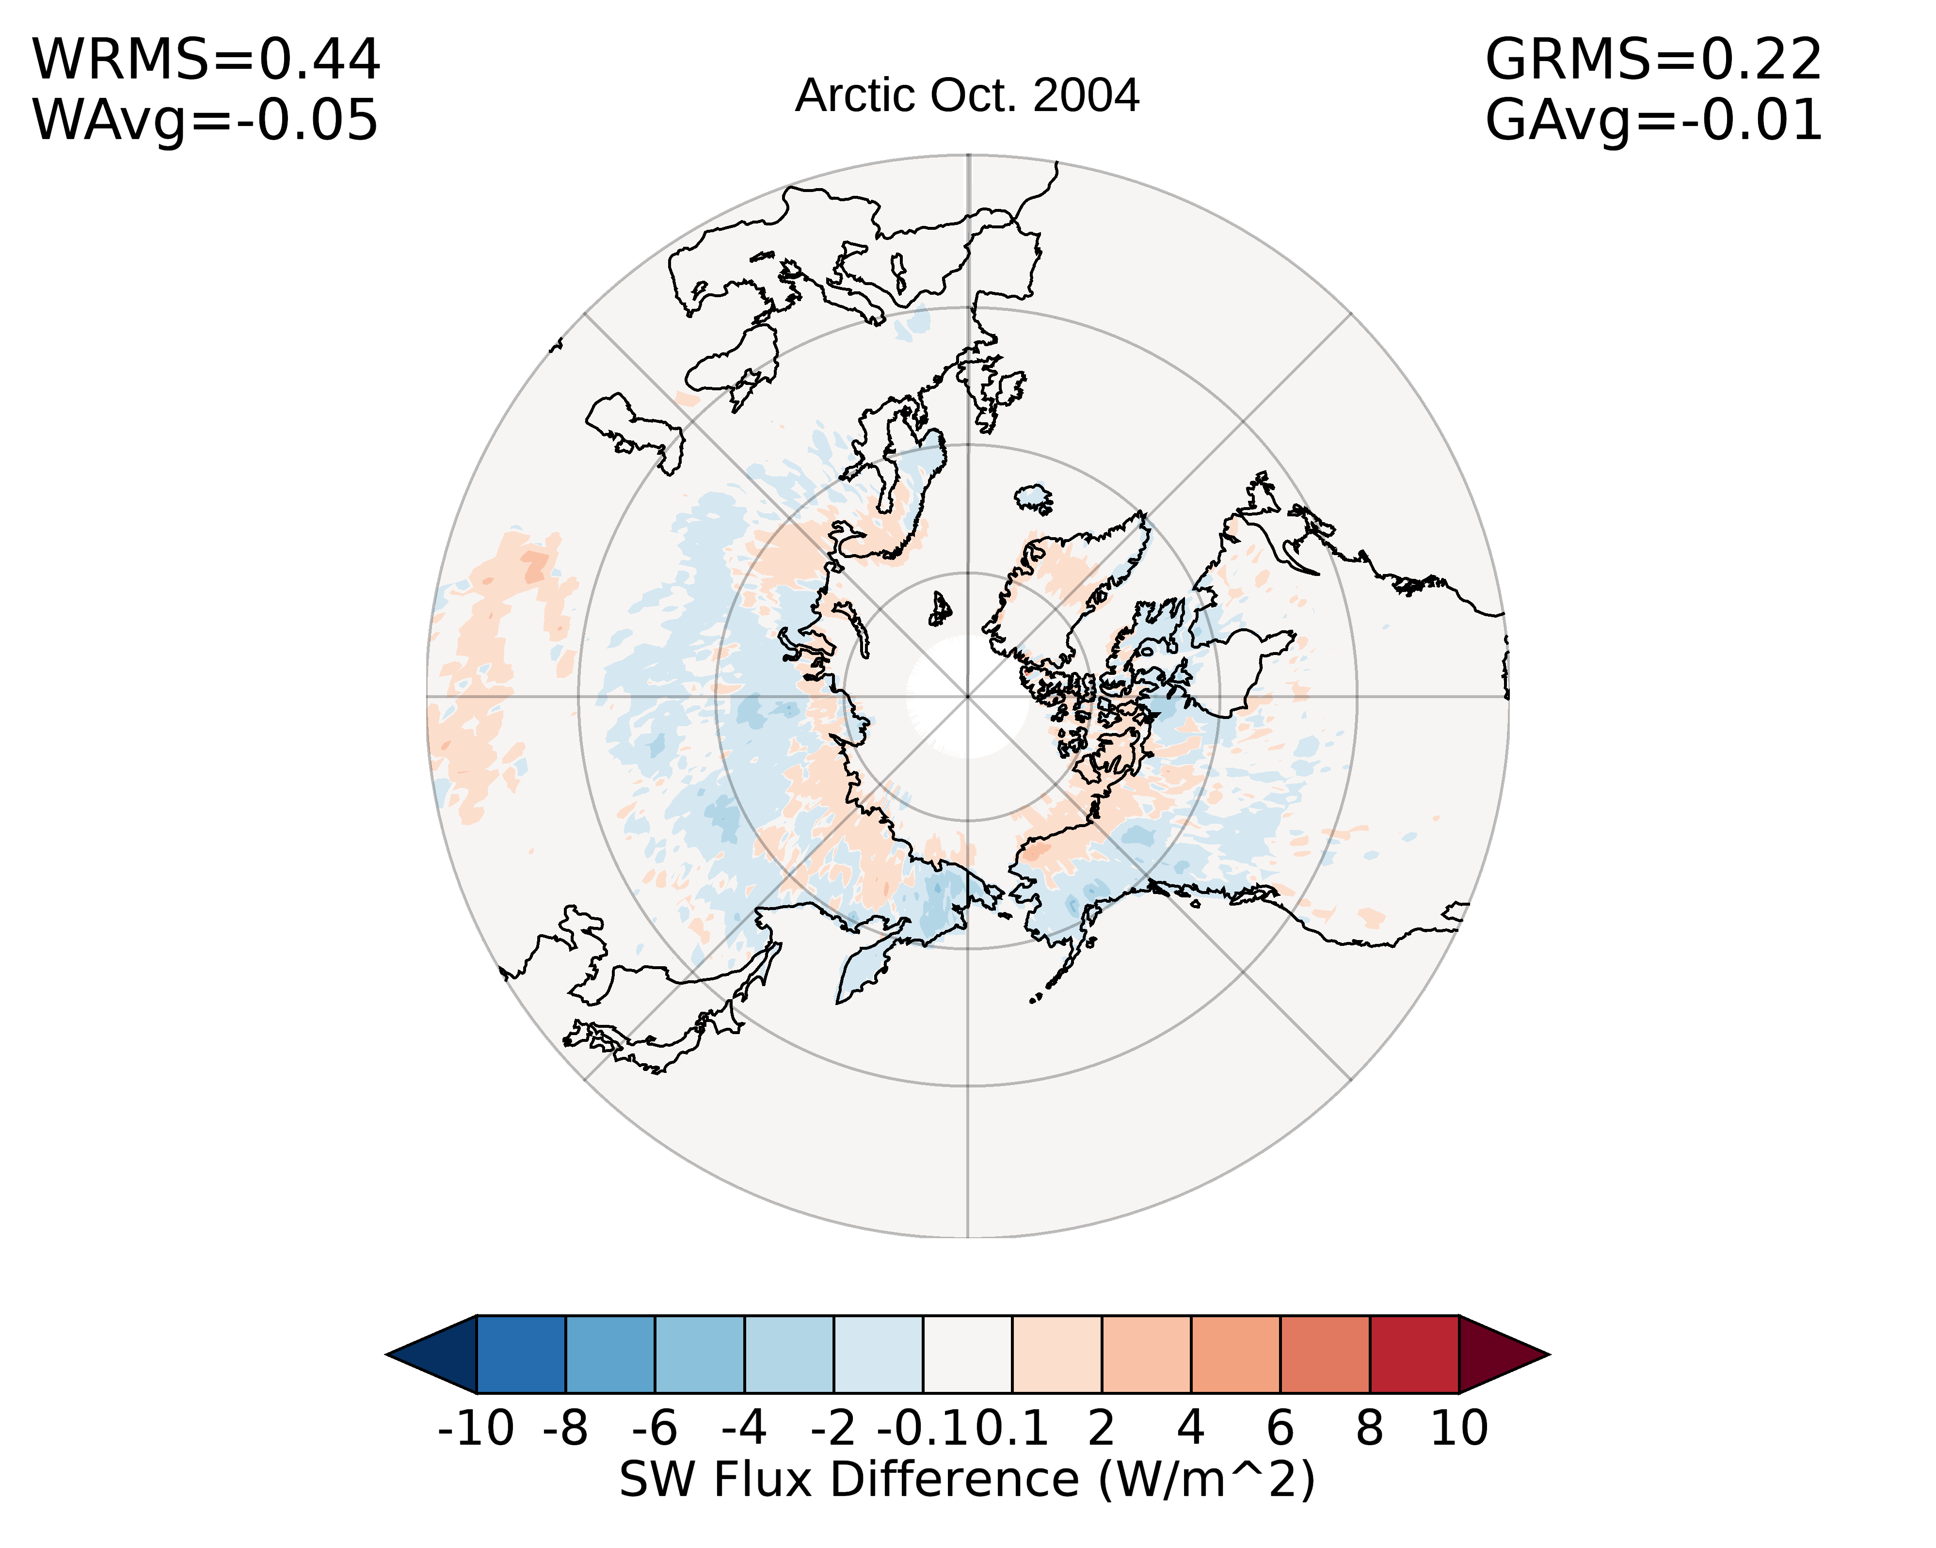
Impact of overcast fresh-snow ADM change on fluxes

Slide 7
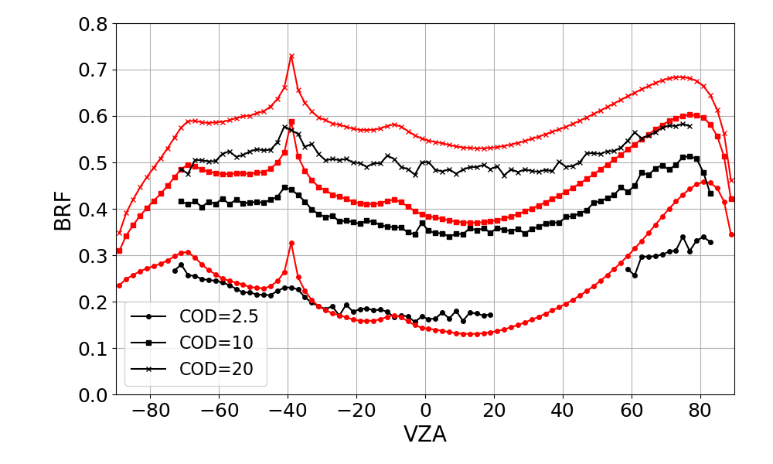
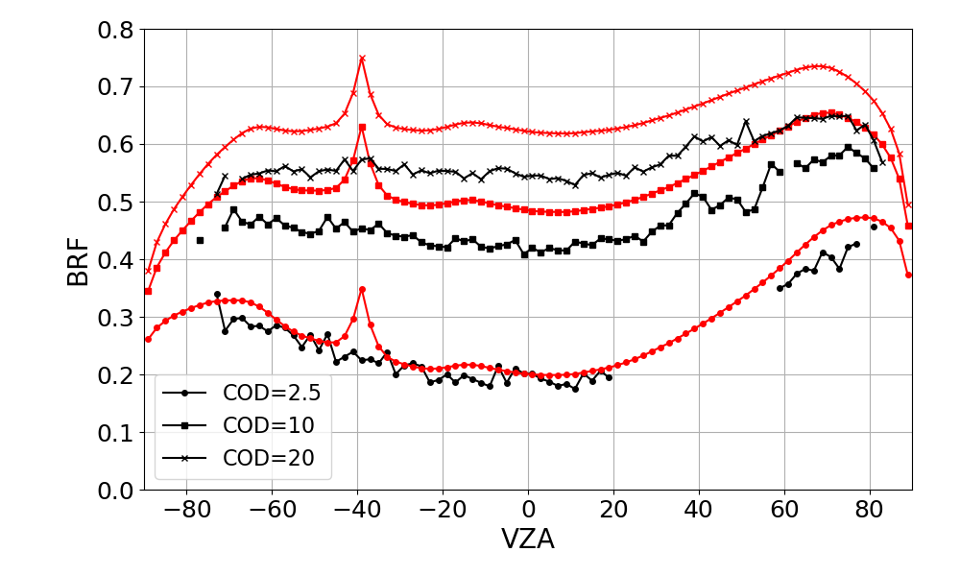
Cloud simulations used to fill the missing bin have large deviation from observation
water
Ice

Slide 8
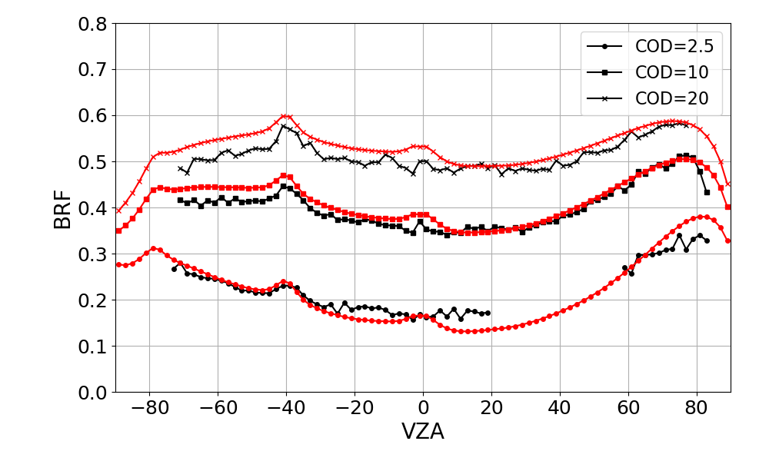
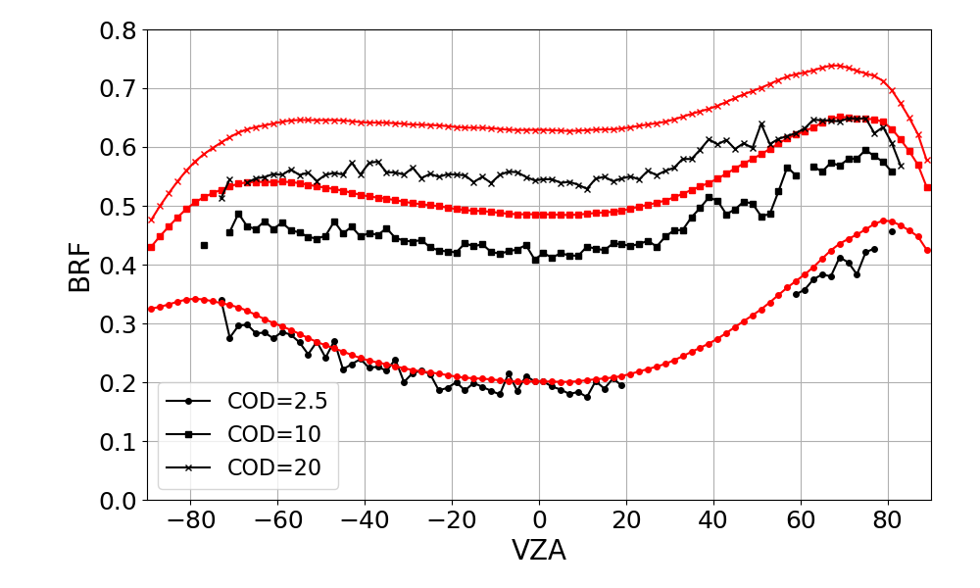
Calculation from DISORT with cloud optics from Ping Yang agrees better with observations
water
Ice
Clouds placed at 500 to 1000 m with an effective diameter of 20um
Clouds placed at 7000 to 9000 m with an effective diameter of 46.34um (single habit model, PY, July 2016)
Notes:
16s streams for water and 32 streams for ice. Cox-Munk ocean surface model with wind speed of 7 m/s

Slide 9
How resilient are ADMs to climate variability and change
As climate change and the mean climate state shifts, can the ADMs constructed using data taking in the early 2000s be used for flux inversion now and in the coming decades?
Using data taken during different phase of ENSO to test LW ADM sensitivity to climate variability:
  Used the NOAA Physical Sciences Laboratory Multivariate ENSO Index v2 to characterize ENSO phase.
  Used 36 cool (MEI < 0) cross-track months and the 12 coolest (MEI < 0.14) RAPS months to construct clear- and cloudy-sky LW ADMs, called “Cool Aqua”.
Attempted to construct LW ADMs with only cross-track data, but it was impossible for clear-sky ADMs, and the cloudy-sky ADMs only worked for a minority of cloudy scenes, with most cloudy scenes going to neural networks.
The Ed4 inversion code was run with these Cool Aqua ADMs and the fluxes were compared with those on the SSF.
Note that most of the RAPS period was in warm ENSO conditions, so if ENSO has a large impact, it should show up here.

Slide 10
Daytime LW fluxes (Cool Aqua - SSF)
Global average differences
 | All-sky bias (W m⁻², %) | All-sky RMS | Clear-sky bias | Clear-sky RMS
201801 | -0.02 (-0.01%) | 0.97 (0.40%) | 0.05 (0.02%) | 0.40 (0.15%)
201804 | -0.01 (-0.01%) | 1.01 (0.41%) | 0.09 (0.03%) | 0.36 (0.13%)
201807 | 0.01 (<0.01%) | 1.01 (0.40%) | 0.13 (0.04%) | 0.40 (0.14%)
201810 | -0.02 (-0.01%) | 0.97 (0.39%) | 0.08 (0.03%) | 0.37 (0.14%)
Biases and RMS Differences are calculated by averaging all flux differences within each grid cell when both the SSF and Cool Aqua fluxes are valid and not produced by neural networks, and then area-weighting grid cells with valid differences. Both clear-sky and all-sky fluxes are very close on average, and the RMS differences are within roughly 1 W m⁻². Note that 2018 went from cool ENSO conditions (Jan and Apr) to roughly neutral conditions (Jul) to warm conditions (October).

Slide 11
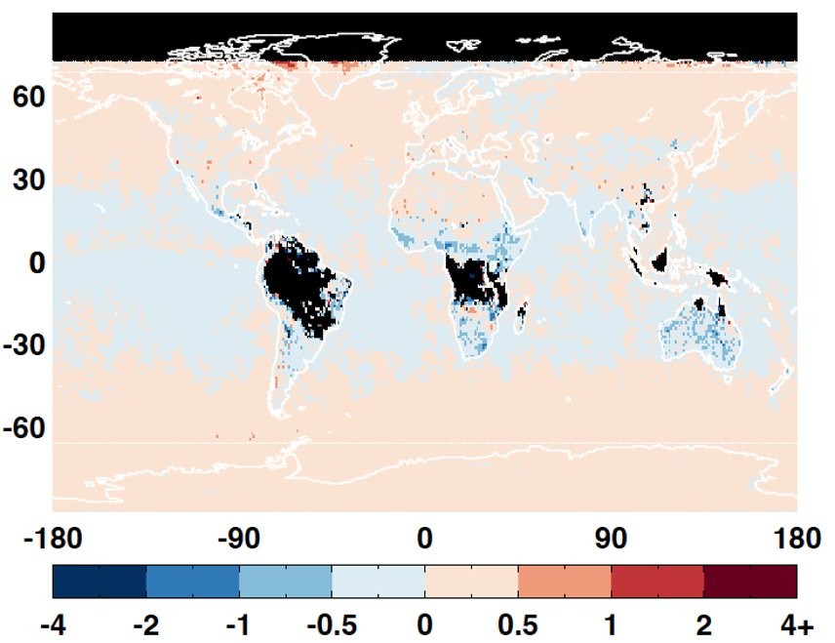
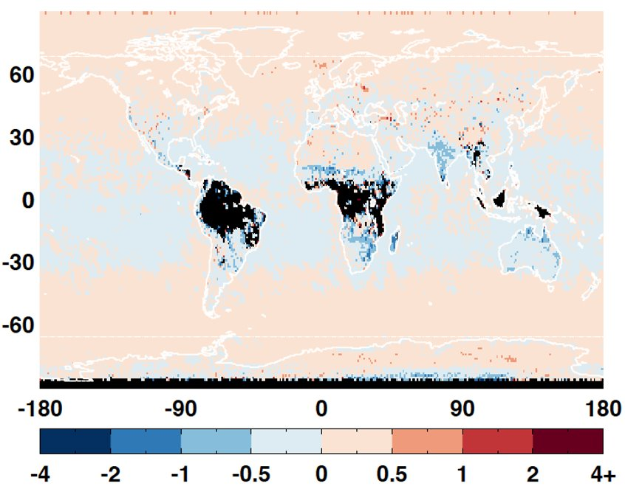
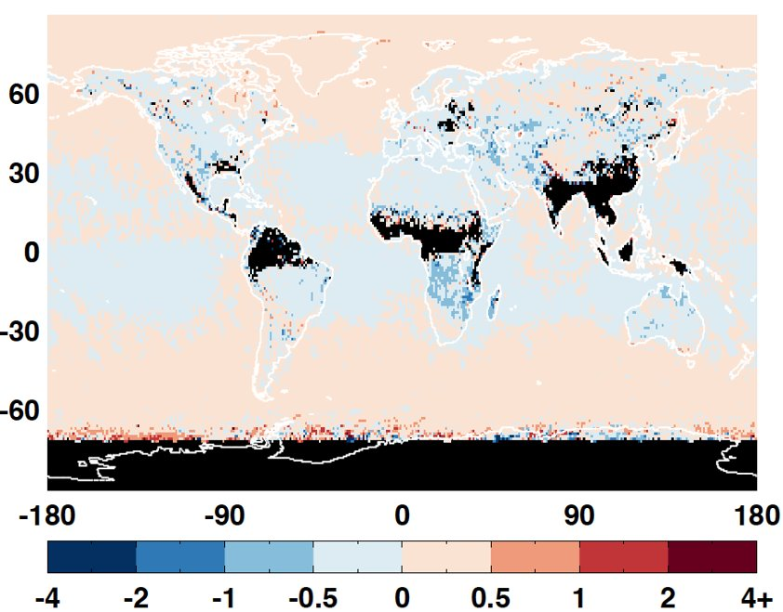
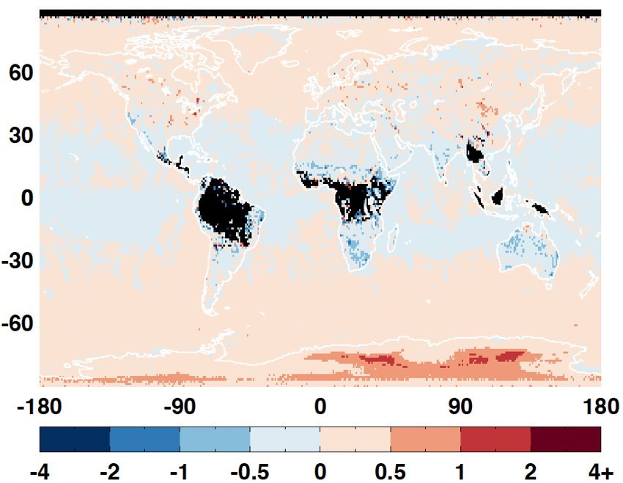
Daytime LW flux difference (Cool Aqua – SSF)
Use footprints that both sets of ADMs produce non-ANN-based fluxes
201801 201804
201807 201810

Slide 12
Daytime LW fluxes (Cool Aqua - SSF)
Global average differences including ANN fluxes from both sets of ADMs
 | All-sky bias (W m⁻², %) | All-sky RMS | Clear-sky bias | Clear-sky RMS
201801 | -0.03 (-0.01%) | 1.20 (0.50%) | 0.01 (~0.00%) | 0.45 (0.16%)
201804 | 0.01 (~0.00%) | 1.30 (0.54%) | 0.08 (0.03%) | 0.39 (0.14%)
201807 | -0.01 (~0.00%) | 1.38 (0.55%) | 0.08 (0.03%) | 0.44 (0.15%)
201810 | -0.03 (-0.01%) | 1.30 (0.53%) | 0.04 (0.01%) | 0.43 (0.16%)

Slide 13
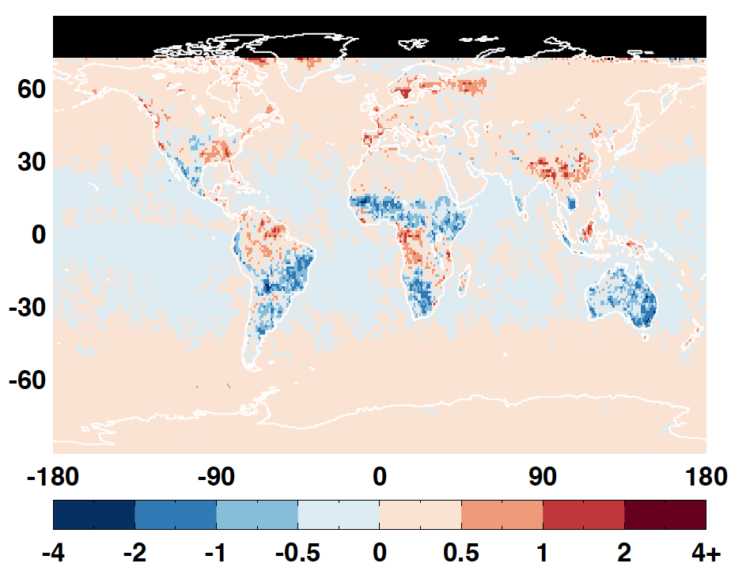
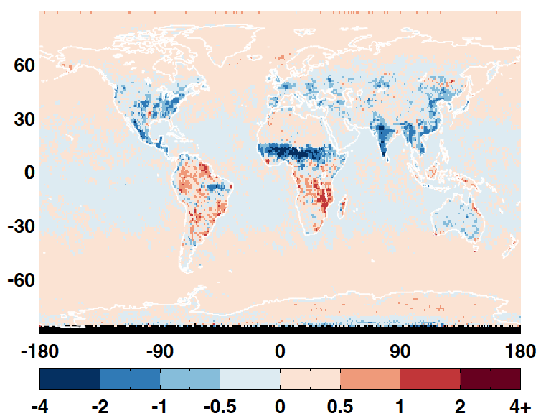
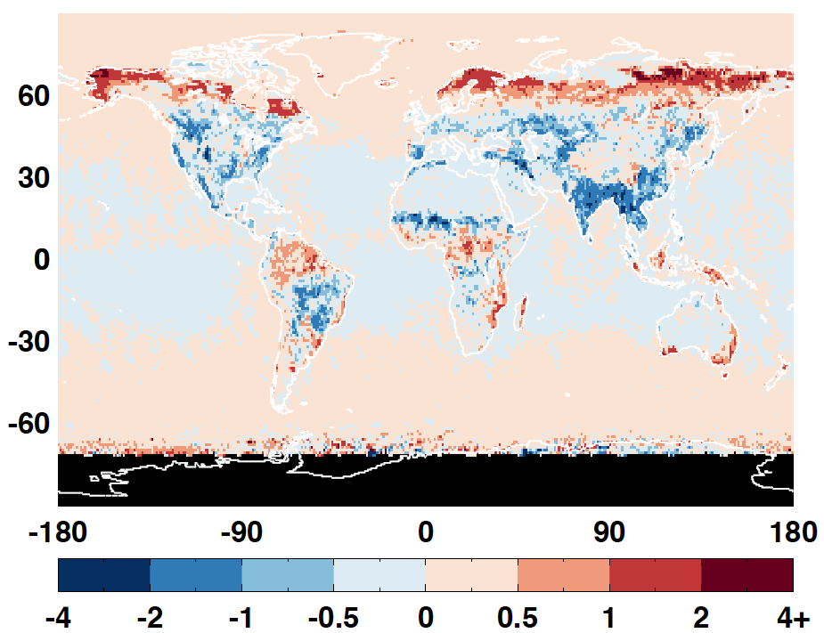
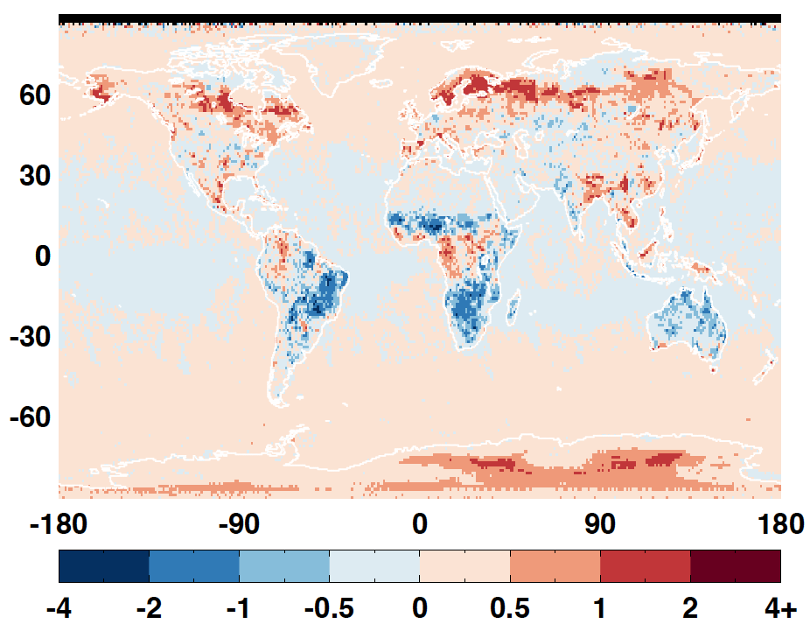
Daytime LW flux difference (Cool Aqua – SSF)
Use footprints that both sets of ADMs produce valid fluxes including using ANN ADMs
201801 201804
201807 201810

Slide 14
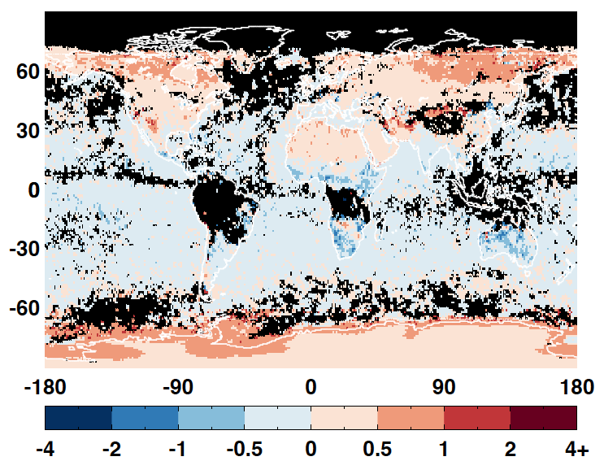
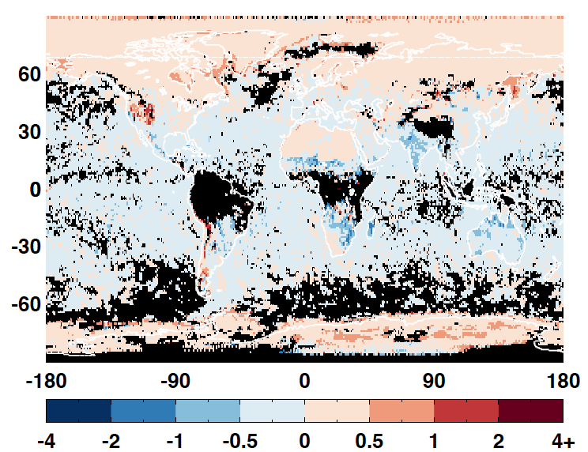
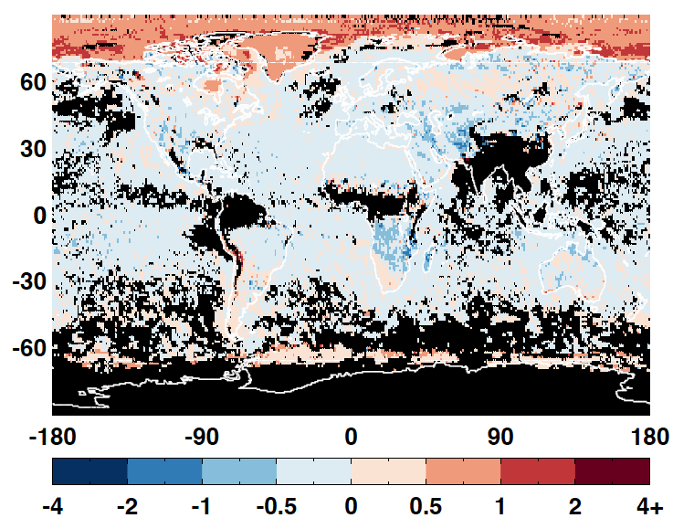
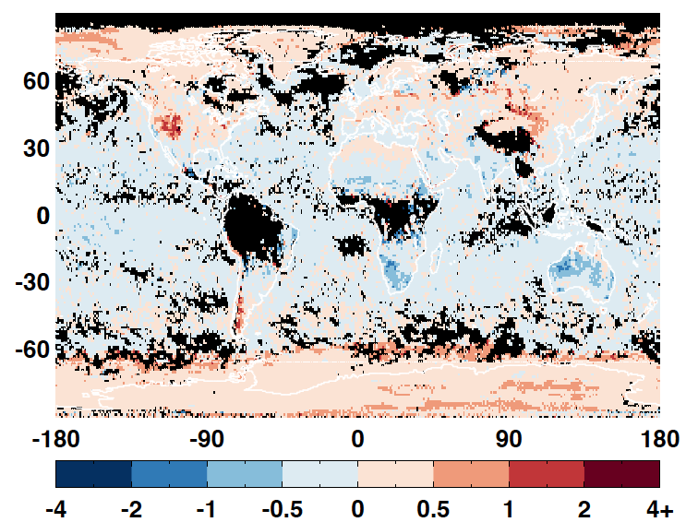
Daytime clear-sky LW fluxes difference (cool Aqua –SSF)
201801 201804
201807 201810
Notes:
No ANN FOV for both cool Aqua and SSF

Slide 15
Surface emissivity
The LW emissivity is an input for the cloudy-sky LW ADMs, which are most scenes.
For Edition 4 and earlier editions, a single value of emissivity was assigned to each IGBP type for both the LW and WN channels.
With Edition 5, we will use 10-year climatology of surface emissivity based on IASI hyperspectral data (Zhou et al. 2011, 2013), which will allow for the emissivity to change with season and vary within each IGBP type. This is especially important for arid and semi-arid land areas.

Slide 16
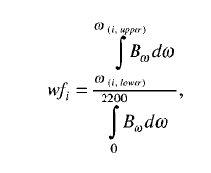
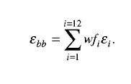
Surface emissivity
The Zhou 10-year climatology of surface emissivity based on IASI hyperspectral data gives monthly 0.25° x 0.25° values of emissivity at 0.25 cm⁻¹ resolution from 645 cm⁻¹ to 2760 cm⁻¹. This was converted to LW channel emissivity by first calculating average emissivity over the 12 Fu-Liou bands, and then averaging the band averages over the LW, using a weighting factor:

Slide 17
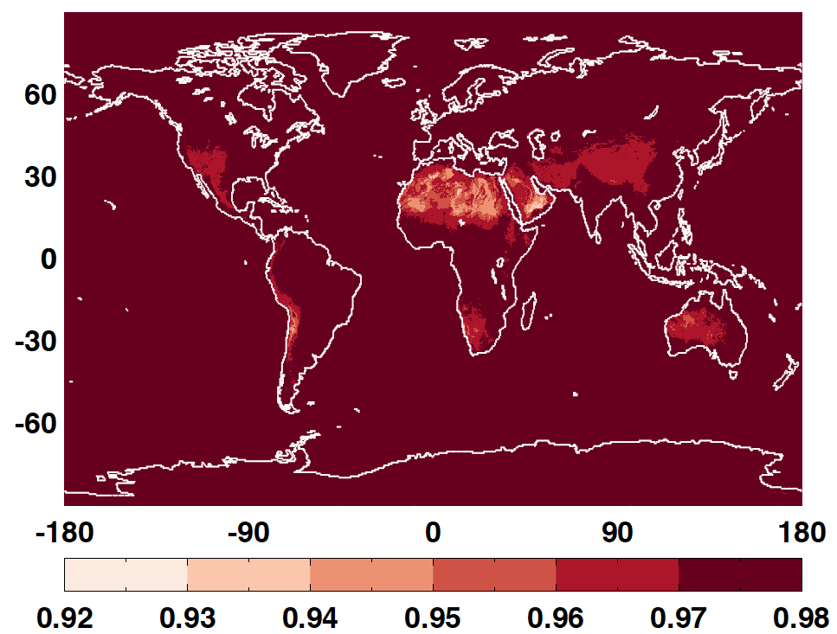
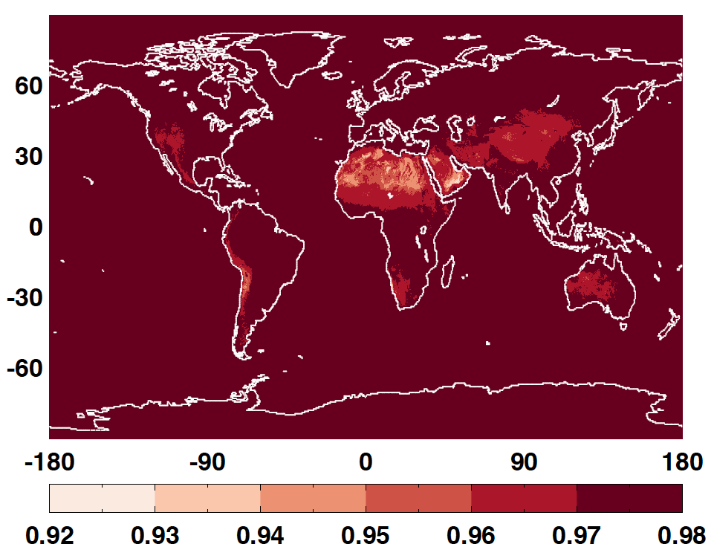
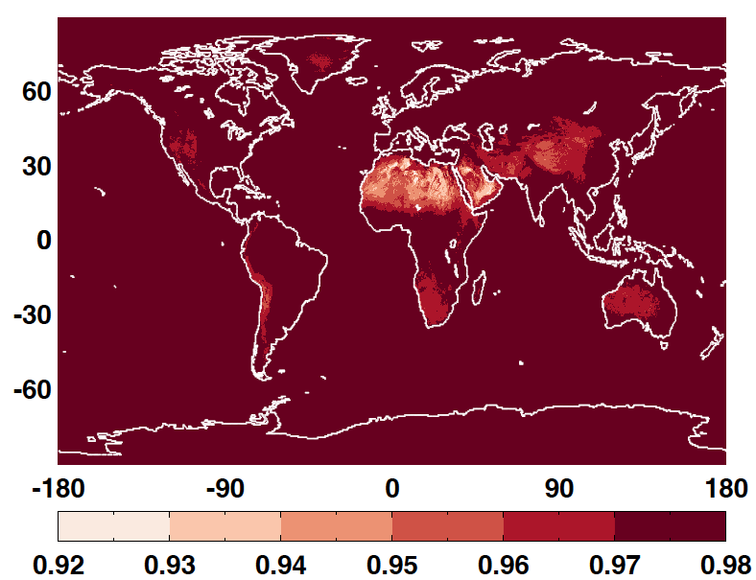

LW emissivity from IASI
Jan Apr
July Oct

Slide 18
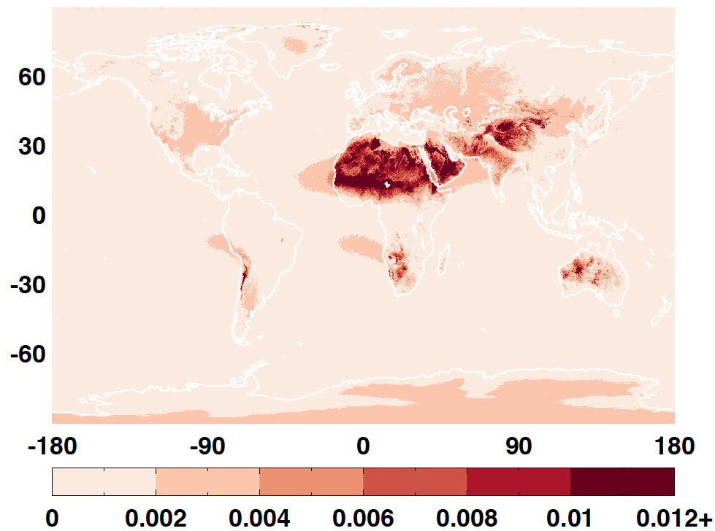
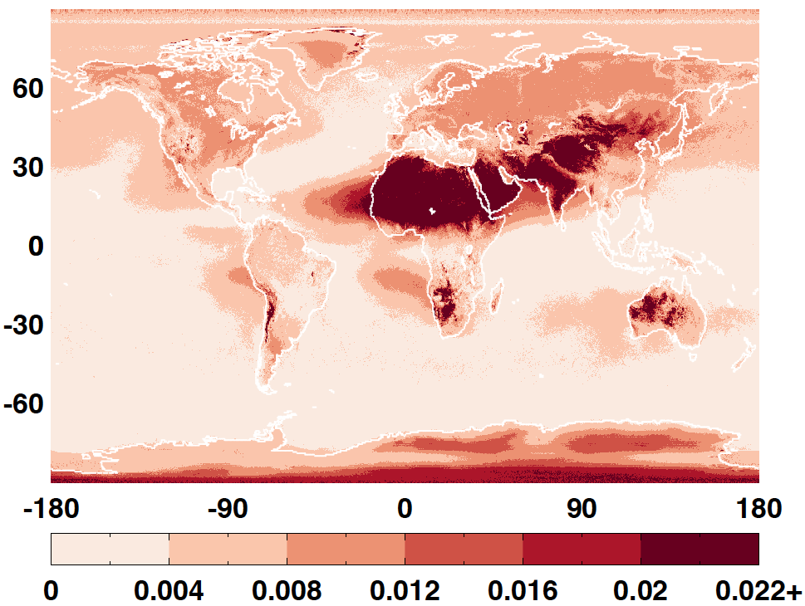
Maximum seasonal difference in LW and WN emissivity
LW WN

Slide 19
Summary
Proposed cloudy fresh-snow ADMs adding surface type and cloud properties for scene classification increase flux consistency by 3.5% for partly cloudy sky and by 1.7% for overcast sky.
Radiances calculated from DISORT with cloud optics from Ping Yang agrees better with observations than those currently used to fill the missing bins.
RMS error of LW flux using ADMs developed with data taken during La Nina and El Nino phase is equivalent to LW ADM uncertainty, indicating small sensitivity of LW ADMs to climate variability.
Developed monthly surface LW and WN emissivity based on IASI spectral emissivity. Large seasonable variability are observed over arid and semi-arid regions. Impact on LW flux will be tested.

